Slide 1
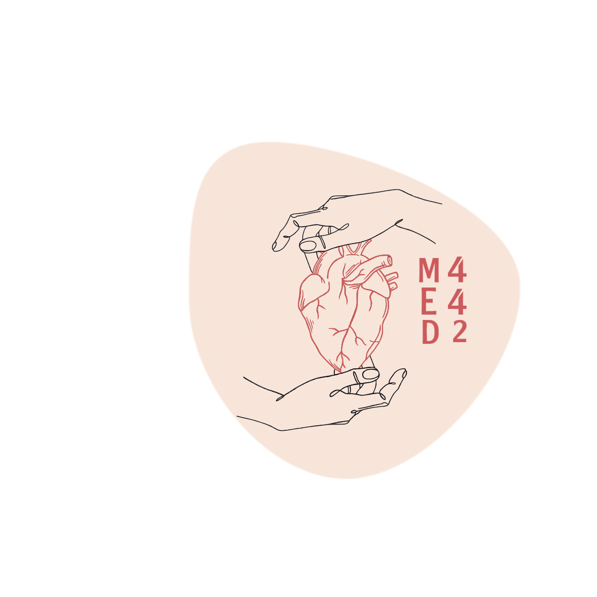
Immunology of Bronchial Asthma
Color index : Main text Important Dr’s notes Females slides only Males slides only Extra info

Slide 2
To know the difference between extrinsic and intrinsic asthma
To be familiar with types of allergens and their rules in the allergic sensitisation
To understand the inflammatory processes operating in allergic asthma
To know about airway remodelling
Objectives:

Slide 3
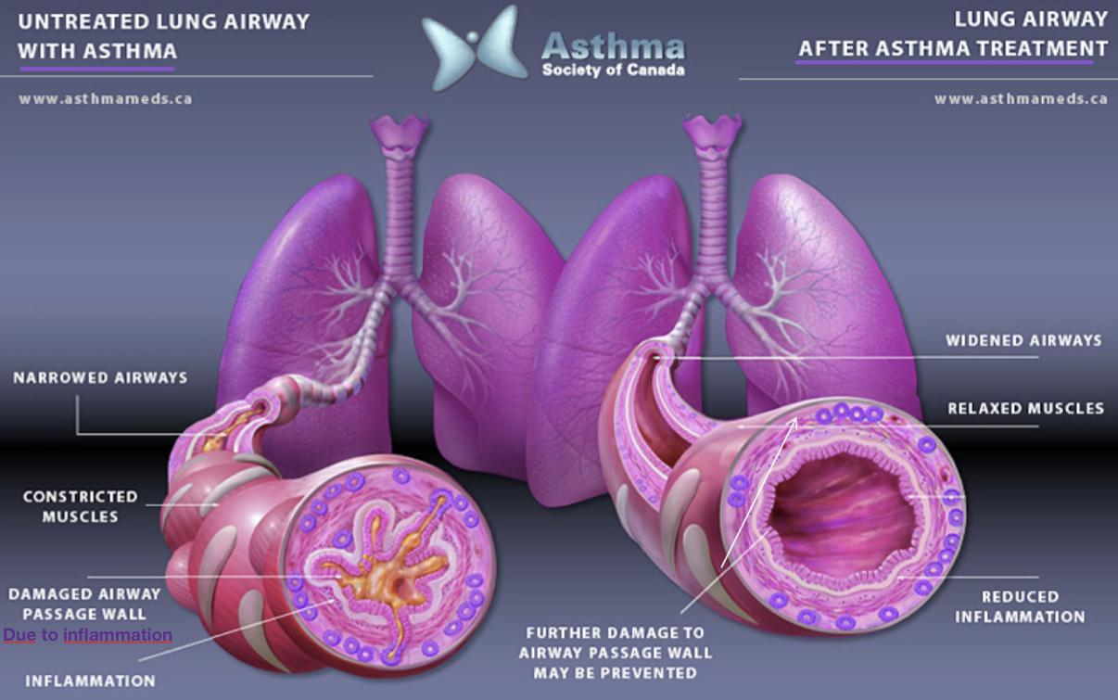
Helpful video
Asthma: Are chronic inflammatory disorder of the airways that causes recurrent episodes of wheezing (صفير) , breathlessness, chest tightness and cough.
Special characteristics.
Episodes of Reversible airway obstruction.
Airway obstruction= يعني انسداد مجرى الهواء
Reversible: يعني أن العلاج يخفف من أعراض الربو
Increased bronchial reactivity. يعني ان الرئة تكون حساسة بزيادة، اي شيء يجيها على طول انفلاميشن يتبعه Bronchoconstriction due to histamine release
Airway inflammation
Symptoms.
breathlessness (difficulty in breathing)
wheezing
persistent cough
chest tightness
هو انفلاميشن يصيب مجرى الهواء ويخليهم ضيقة وسبب الانفلاميشن هذا هو مواد تحسس منها الجسم بشكل خاطئ وسبب رد فعل مناعية بحيث الخلايا تهاجم الرئة وتسبب التهاب
Asthma is a chronic disorder of the conducting airways, usually caused by an immunological reaction which is marked by episodic bronchoconstriction due to increased airway sensitivity to a variety of stimuli

Slide 4
Classification of asthma
Important slide
Classification | Non-atopic (Intrinsic): Not allergic asthma which doesn't affect the immune system Symptoms are triggered by respiratory infections due to viruses, exposure to cold and even exercise مو من البيئة | Atopic (extrinsic): Allergic asthma which affect the immune system symptoms are triggered by an allergen (such as dust). The immune system over reacts, producing too much of IgEتجي المرضى نوبة ربو بسبب غبار او زرع وغيره من البيئة
severity | More severe | Less severe
Prevalence | Older patient, (10-33% of asthmatics), less common | 60-90% children 50% adults
History of allergy | Not needed | Needed
serum IgE | Normal | High
skin test (skin prick test) | Negative | Positive (in 75%-85%)
Family history | Non | may have
Atopy: genetic tendency to develop allergy
Atopy is a problem with your immune system that makes you more likely to develop allergic diseases. Your genes cause this problem.

Slide 5
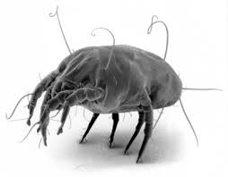
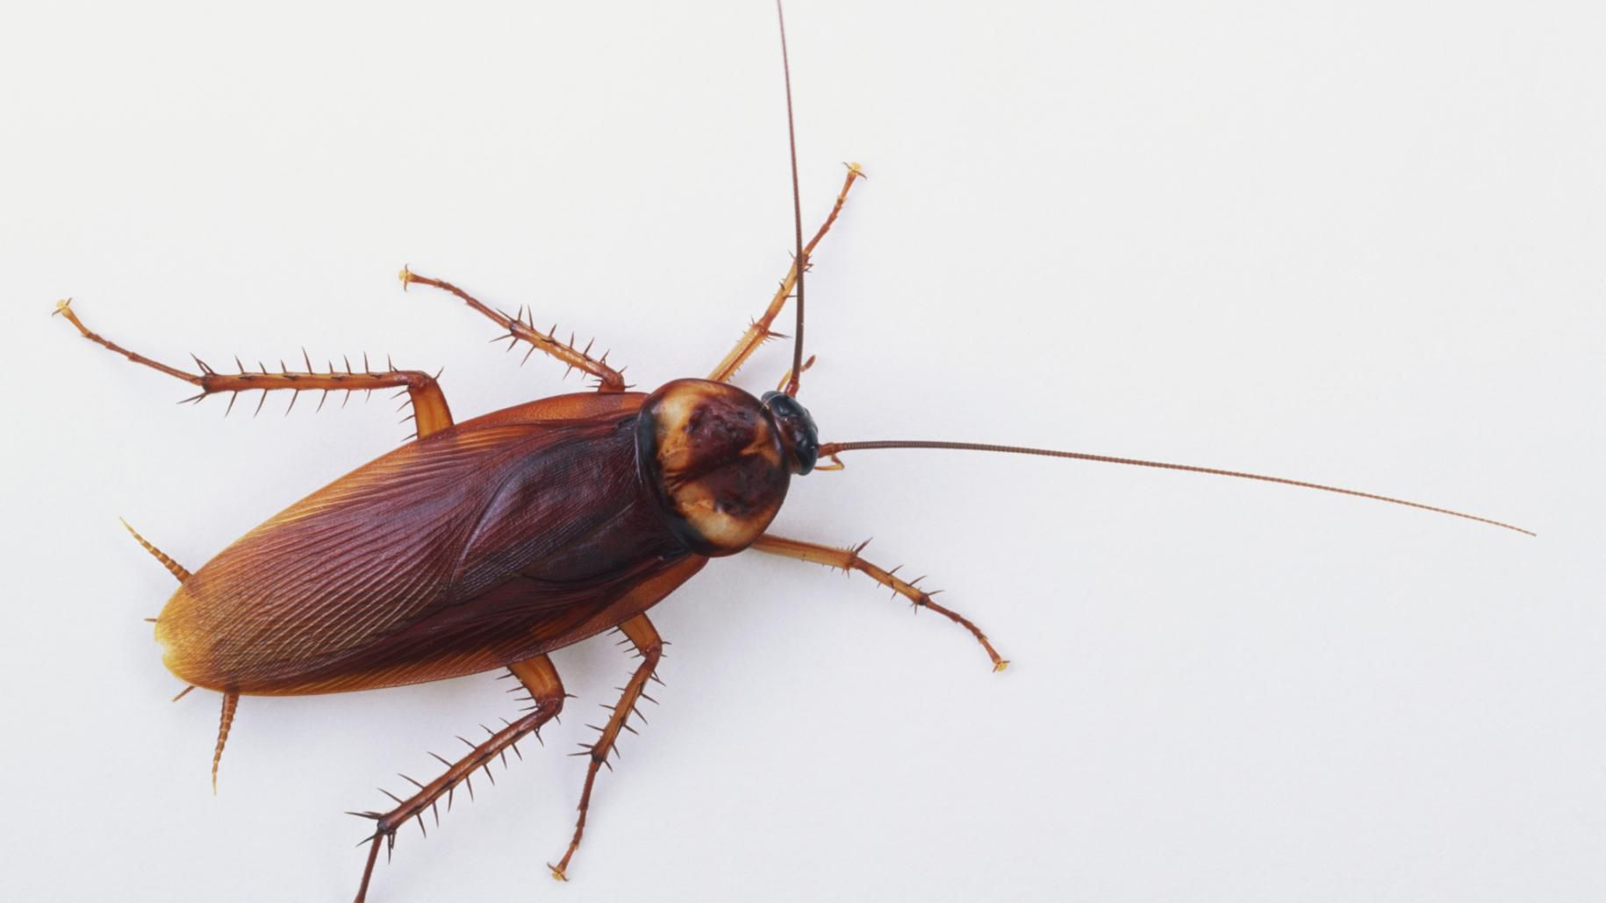
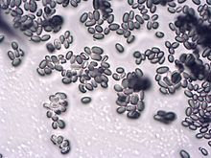
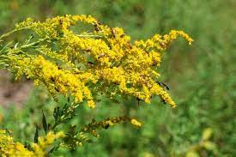
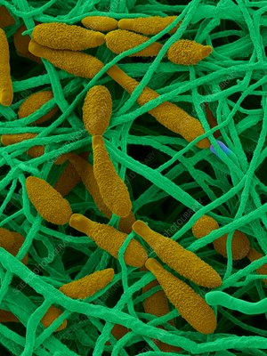
Rule of allergens in asthma (extrinsic asthma)
Allergens sensitization is linked
to the risk of developing asthma
Types of Allergens
Indoor Allergens
house dust mites غث الغبار | domestics pets (cat fur & dander) وبر/فراء | cockroaches (insects) | molds (Fungal spores)
Outdoor Allergens
grass, tree & weed pollens | tree pollens لقاح الشجر | weed pollens | fungal spores (e.g. Alternaria)
Allergen: an antigen that triggers an allergic reaction that are mostly proteins. t’s the main cause of hypersensitivity type 1.
Fungal spores can be considered as
indoor and outdoor allergens Grass
Allergens sensitization
هذي اخذناها بالفاونديشن كانوا مرحلتين الاولى هي
sensitization
وهي اللي ما تظهر الاعراض زي مثلا شخص اكل تفاحه، اول مره ياكلها بحياته ما تظهر اعراض الحساسية ولكن الجسم يسوي اجسام مضادة ضدها والمرحلة اللي بعدها هي
challenging phase
وهي اللي تظهر اعراض الحساسية وهنا قصدهم ان المصابين بالربو، المرة الاولى بحياتهم لما شمو الغبار ما جتهم نوبة ربو ولكن المرة اللي بعدها جتهم

Slide 6
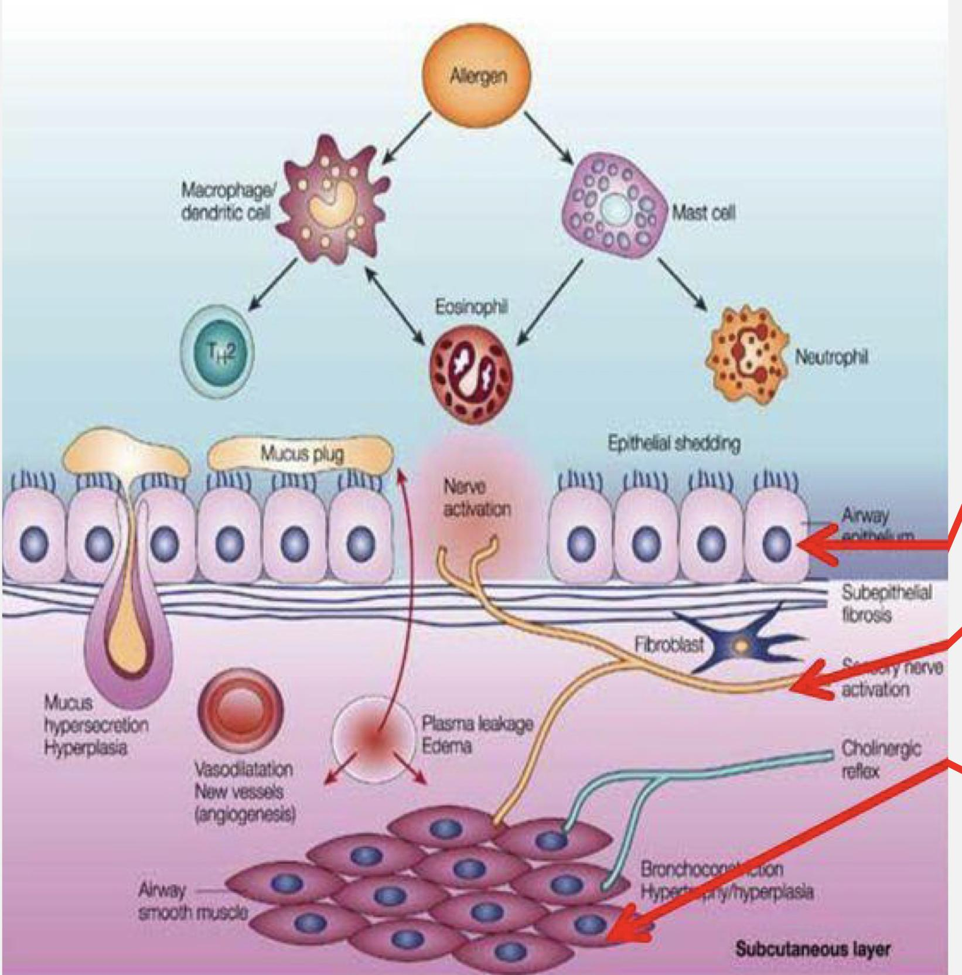
Antigen presenting cells (APCs) and allergic response
Myeloid DCs (mDCs)
Help in the development of asthma symptoms
Asthma results from Complex interactions among the inflammatory cells that involve:
Subsets of dendritic cells (DCs) in the lung
Dendritic cell is a type of APCs it will take the allergen (antigen) inside it (dendritic cell) And it has two types
Airway epithelium
Plasmacytoid DCs (pDCs)
Aid in the respiratory tolerance to allergens
Nervous system
Bronchial smooth muscles
(constriction)
what is immunological tolerance?
unresponsiveness to specific antigens in an effort to prevent destructive over-reactivity of the immune system. It is important for normal physiology
يعني قدرة الجهاز المناعي على معرفة اذا الانتجن حقه (ما يهاجمه) واذا مو حقه يهاجمه
مهم عشان الجسم ما يهاجم نفسه فإذا صار فيه مشكلة يسبب مرض مناعي

Slide 7
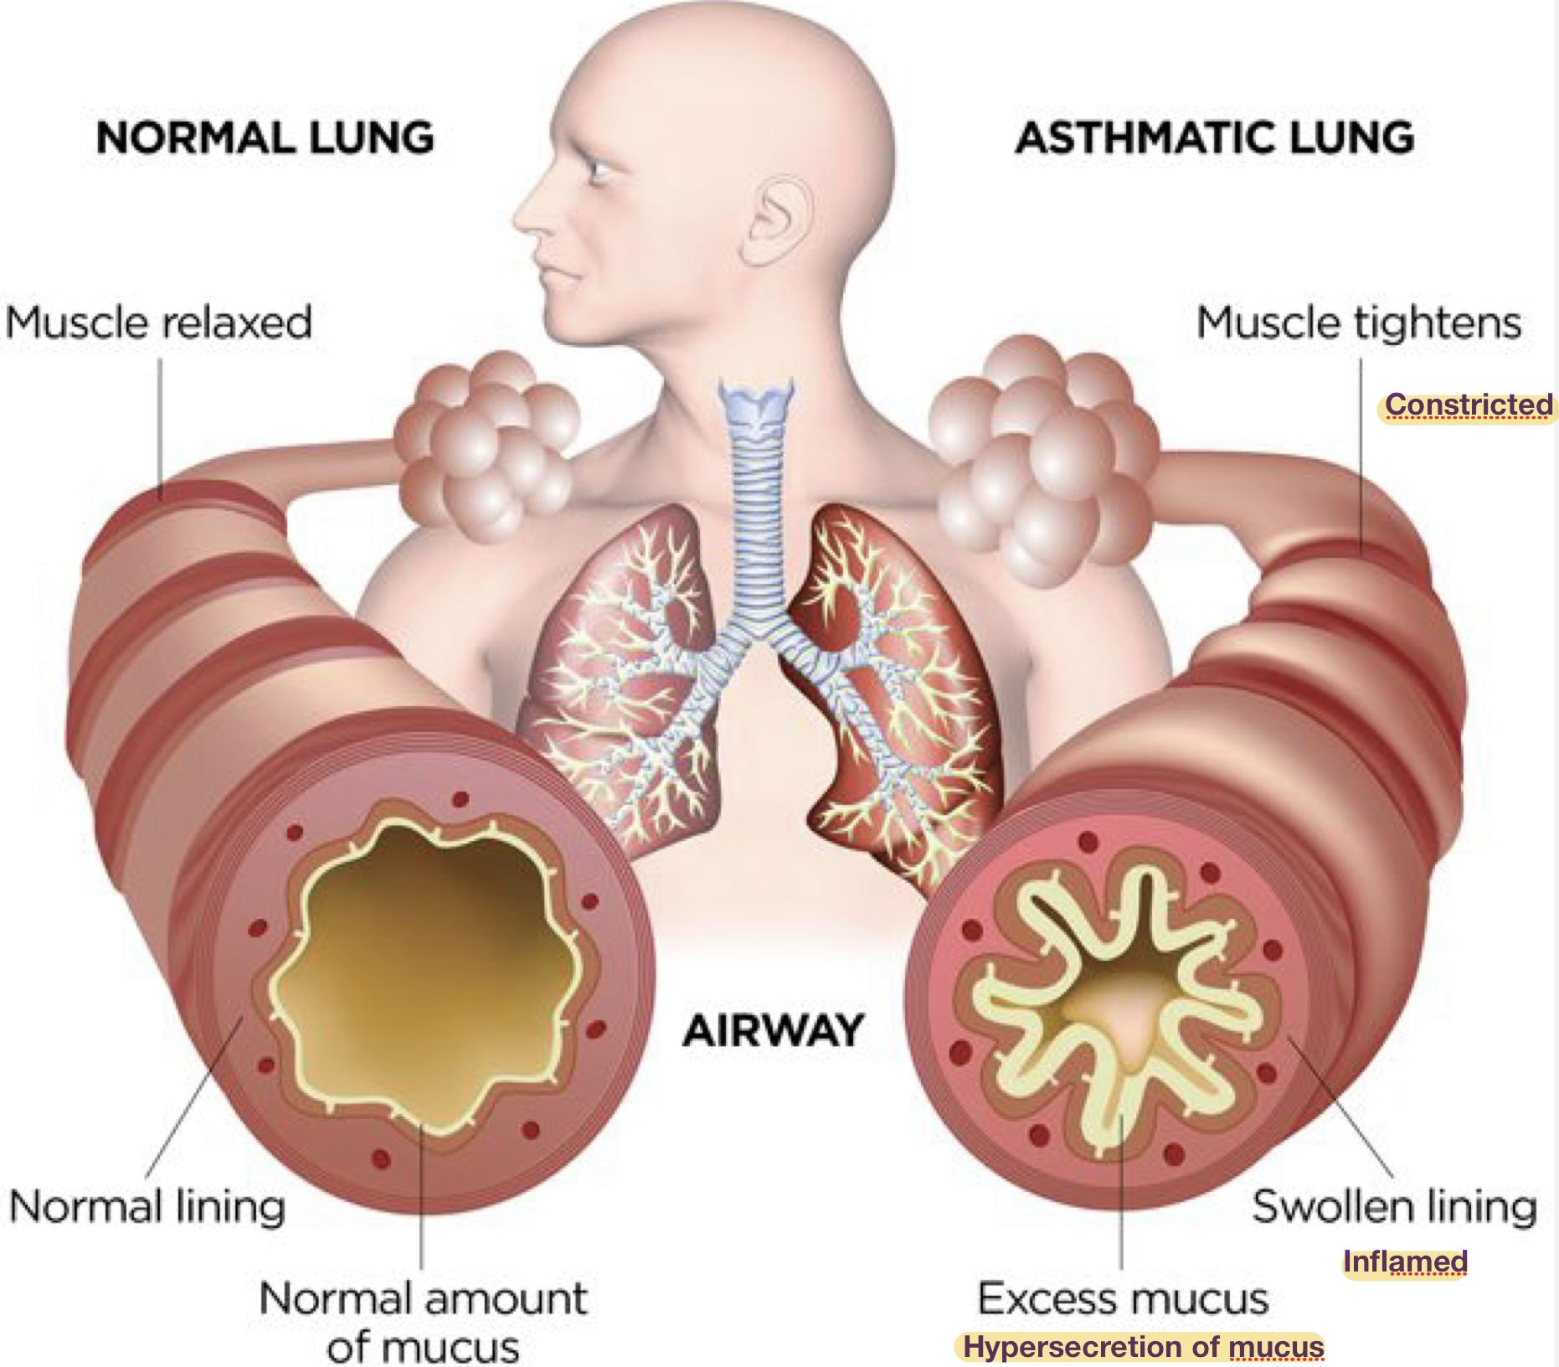
Allergic response
Factor contributing to airflow obstruction leading to difficulty in breathing include:
Constricted smooth muscles of bronchioles
Inflamed epithelial wall (thickened/narrowed)
Hypersecretion of mucus from mucus glad

Slide 8
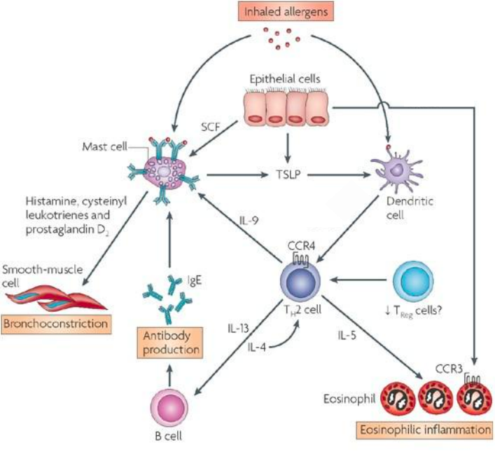
Watch this video
min 9:20
1- In susceptible individuals (vulnerable to allergen) first encounter with allergens activate B-cells to produce IgE. (Sensitization Phase)
Be careful, the main cytokines responsible for the constriction are IL-4 and 13. IL-5 has an indirect effect. It’s main function is explained later.
#Team39
Allergic Response
2- Subsequently, Inhaled allergens activate submucosal mast cells in the lower airways, resulting in release of mediators within seconds causing:
1. Bronchoconstriction
2. Influx of eosinophils & other inflammatory cells

Slide 9
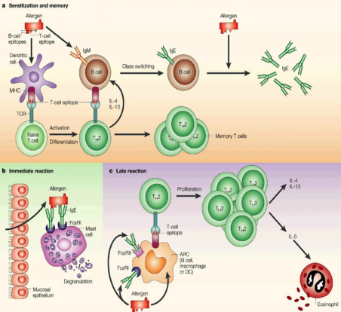
Sensitization Phase | 1) When the allergen enters the body, it’s then recognized by the dendritic cells 2) This process activates a naive T cell to become Th2 lymphocyte 3) Th2 cells release multiple cytokines (IL-4-5-9-13). 4) One of these cytokines (IL-4) activates B cells, causing a class switch (a process of converting IgM to IgE) 5) None of the symptoms will manifest in this phase because the mast cell will not release any mediators
Immediate/Early Reaction (within minutes) | 1) IgE will then bind to the Antigen and set on the mast cell via the Fc receptor 2) This stimulates the mast cells to release certain cytokines and mediators 3) This shows some clinical features such as: bronchial construction, airway edema, mucus plugging 4) This stage is reversible and responds to bronchodilators
Late Reaction (4-10 hours later) | 1) Results from infiltration by inflammatory cells. 2) Activation of lymphocytes & eosinophils (Activated Th2 release IL-5 that stimulate the production and release of eosinophils) 2) Which will release granules and mediators that are toxic to epithelial cells (causing mucosal damage, edema, spasm of the small muscles fibers) 3) This stage responds to steroids (Anti-inflammatory drugs)

Slide 10
Allergens drive T-cells towards Th2 type:
Th2 secrete the cytokines (IL-4, IL-5, IL-9 & IL-13) which promote :
Production of IgE by B cells
Airway inflammation
Eosinophil attraction and infiltration
Increased bronchial reactivity

Slide 11
T helper 2 (TH2) cells & Role of cytokines in allergic asthma (IMPORTANT)
 | Role in allergic asthma
Interleukin-4 (IL4) (during the initial priming of TH2) | Regulates isotype switching in B cells from IgM to IgE. Induces MHC II on Antigen-Presenting Cells (e.g. dendritic cells, mast cells) Induces adhesion molecules expression. Activate mast cells & eosinophils.
Interleukin-5 (IL5) | Induces an increase in eosinophil production in the bone marrow. (IL5 for production while IL4 for activation of eosinophils) Release of eosinophils from the bone marrow into circulation.
Interleukin-13 (IL13) | Induces inflammation. Stimulates mucus hypersecretion. Induces subepithelial fibrosis. (Which if not controlled, may lead to scarring and damage)
Eosinophils | Initiate asthmatic symptoms by causing tissue damage in the airways of the lungs. Production of eosinophils is inhibited by IL-10 (anti-inflammatory cytokine) (If IL-10 levels decrease, eosinophils accumulate and cause more damage)
Regulatory T-cells (T-reg) | Suppress the effector mechanisms that induce asthmatic symptoms. Asthmatics may lack functional regulatory T cells that can inhibit an asthmatic response.

Slide 12
Airway inflammation
What is fibrosis?
Watch this video
Airway remodeling
(structural changes of the airways)
Increased bronchial reactivity
Airway reactivity is a term used to describe a set of symptoms that indicate a person is having a bronchial spasm, which happens when the bronchial tubes (airway) are irritated by something. So it’s used when asthma is suspected, but not yet confirmed
Airway smooth muscle cells hyperplasia (Make more of them) and hypertrophy (Become bigger)
( due to repeated exposure of constriction that increases demand on cells
Lung fibroblast activation hyperplasia (leads to fibrosis)
(Lung fibroblasts play a role in airway inflammation and airway remodeling)
Mucous gland hyperplasia
Collagen deposition
Chronic Inflammation
Airway remodeling can ultimately lead to fibrosis and irreversible airway obstruction in some patients (if not effectively treated)
They’re more likely to develop an asthma attack on exposure to non-specific irritants:
Chemical irritants
Smoke and strong perfumes
Sulphur dioxide and air pollutants
Viral and bacterial respiratory infections

Slide 13
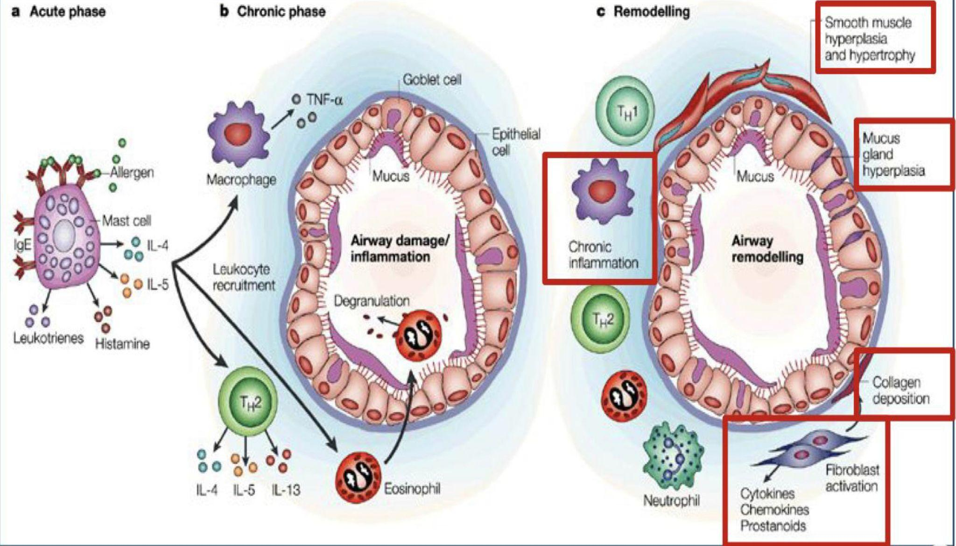
Airway inflammation Cont..
Airway remodeling
(structural changes of the airways)
Airway reactivity
Airway reactivity is a term used to describe a set of symptoms that indicate a person is having a bronchial spasm, which happens when the bronchial tubes (airway) are irritated by something. So it’s used when asthma is suspected, but not yet confirmed
A patient with bronchial hyperreactivity should avoid exposure to nonspecific irritants to prevent developing asthma attacks.
Allergens are specific because they will be recognized by the APCs which then will be presented to the naive T cell.
Whereas non-specific irritants only cause asthma attacks to patients who have bronchial hyperreactivity such as asthmatics. #Team39
Activation of inflammatory cells (mast cells and eosinophils) is a major inducer of airway inflammation, which is a hallmark in asthmatic lung that leads to increased bronchial reactivity .

Slide 14
Take home messages
1- Asthma is characterized by episodic reversible airway obstruction
2- There are 2 types of asthma: extrinsic and intrinsic
3- In the extrinsic type allergens drive T-cells into TH2 pattern
4- Airway inflammation is a hallmark finding in the asthmatic lung
5- Inflammatory cells lead to increased bronchial reaction & airway remodelling which is not reversible

Slide 15
MCQs:
For more MCQs click here
Q1: Which of the following is a characteristic of asthma ?
Malaise | B) Reversible obstruction | C) Lung collapse | D) No dyspnae
Q2: Which of the following is Factor contributing to airflow obstruction leading to difficulty in brerathing?
Infections | B) Wheezing | C) Persistent cough | D) Inflamed epithelial wall
Q3: Which Regulates isotype switching in B cells from IgM to IgE?
IL3 | B) IL4 | C) IL13 | D) IL5
Q4: What stage is reversible and respond to bronchodilators?
Sensitization Phase | B) Late reaction | C) early reaction | D) both a and b
Q5:What does Induce inflammation?
IL13 | B) IL3 | C) IL2 | D) IL1
1-B 2-D 3-B 4-C 5-A

Slide 16
Team leaders :
Fay aldossari
Qusai alsultan
Team members :
Shatha Alshabani
Razan Alnufaie
Layan Alburikan
Shahad almarshad
Abdullah Alqarni
Rayan khaled
Turki Saleh
Immunologymed442@gmail.com

