Slide 1
Bacterial Upper Respiratory Tract Infections
Editing File

Slide 2
Discuss epidemiology & various clinical presentations of URTIs
Identify the most important etiological agents causing different URTIs, and discuss their virulence factors, laboratory diagnosis and potential preventative strategies.
Determine the antibiotic of choice for the different URTIs
Discuss complications of GAS and C.diphtheriae infections
From 439 microbiology teamwork, big thanks for them
Extra Information
Bacteria (in this lecture)
Gram Positive
Gram Negative
(GAS) Strept. Pyogenes
Streptococcus pneumoniae
Haemophilus influenzae
Bordetella pertussis
Corynebacterium diphtheria
Moraxella Catarrhalis
Take it as a rule
There is no chance to staphylococcus bacteria to be one of the cause of the respiratory infections,
In the other hand, Streptococcus bacteria might be especially the group A of it (pyogenes).

Slide 3
Lecture Outline
Dr note: most upper respiratory tract infections are caused by viral infections, it will be followed by bacterial infection
Epiglottitis
Haemophilus type B
Pharyngitis
GAS
Diphtheria
Bacterial Upper Respiratory Tract Infections
Pertussis
Bordetella Pertussis
Otitis Media
Sinusitis
Deep neck space infections
From 439 microbiology teamwork, big thanks for them

Slide 4
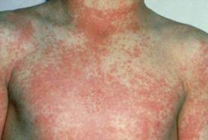
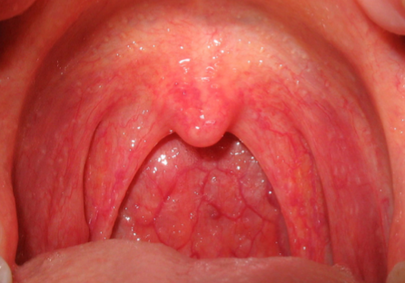
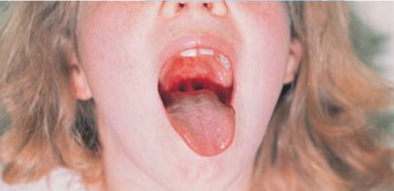
Pharyngitis
Video
Pharyngitis: related to pharynx, where the infection occurs
Epidemiology | Late fall, winter, early spring 5 - 15 years
Etiology | Respiratory Viruses: (70-80% in children, 80-90% in adults) Most common cause Bacteria causes: (20-30% in children, 10-20% in adults) Streptococcus pyogenes (Group A streptococcus/GAS): most important. Corynebacterium diphtheriae Important but not common anymore, because of the vaccinations Fusobacterium Necrophorum: anaerobic -causes Lemierre's syndrome Neisseria gonorrhoeae Homosexual people are the most likely to be infected by this bacteria.
Sign and Symptoms | Common symptoms: Sore throat Pharyngeal erythema and edema Fever
 | More consistent with viral: All of them begin with C Coryza (running nose) Cough Conjunctivitis (احمرار العين)
 | More consistent with bacterial (GAS): Tonsillar exudates (pus production on tonsils) Tender and enlarged (>1 cm) lymph nodes Fever 38.4 to 39.4 C GAS pharyngitis may present with scarlatiniform rash, described as sandpaper-like
Rash is more common in GAS due to production of toxins
There is normal flora
There is no normal flora

Slide 5
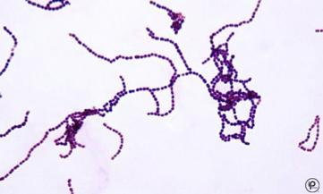
A- GAS Pharyngitis
(Group A Streptococcus, pyogenes)
1. Pharyngitis
Video
Morphology | Gram positive cocci in chains Cocci in chains → streptococci → catalase negative Facultative anaerobe Beta haemolytic
Virulence Factors | Capsule (protection from phagocytosis) M protein in cell wall (help in attachment) Help GAS to adhere to epithelial cells of nasopharynx + resist phagocytosis. How? domains of the molecule bind to serum factor H → diminished availability of alternative pathway-generated complement system. Streptolysin O & S (toxic to cells) Streptococcal Pyrogenic Exotoxins (SPE)
Causes | Respiratory infections | Pharyngitis - Otitis - Sinusitis
 | Other | Skin and soft tissue infections.
Diagnosis | Throat swab Rapid Bacterial antigen detection Specific but not always sensitive - 3 mins. Culture on blood agar Gold standard but takes time - 18 hrs. Antistreptolysin O Determines whether a patient had a recent infection with GAS (patient is having an infection prior to 5 days & not expecting to find it anymore).
Treatment | Penicillin for 10 days (drug of choice) If the patient is allergic to penicillin: Clindamycin or macrolide (e.g.clarithromycin).
Complications (good treatment prevents further complications) | Suppurative: (pus forming, related to infection itself) Peritonsillar abscess. Parapharyngeal space abscess.
 | Non suppurative: (more serious, related to the immune system) Occurs 1-6 weeks after acute S.pyogenes infection Rheumatic fever Inflammation of heart (pancarditis), joints, blood vessels, & SC tissue. After the infection of respiratory tract only. Cause: cross reactivity of anti-M protein Ab and the human heart tissue. Acute Glomerulonephritis After infection of the skin or respiratory tract. Symptoms: edema - hypertension - hematuria - proteinuria. Cause: Ag-Ab complexes on the glomerular basement membrane.

Slide 6
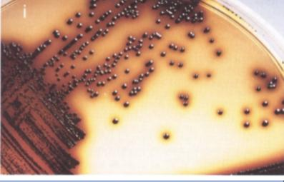
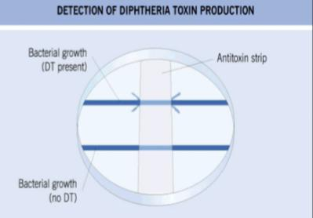
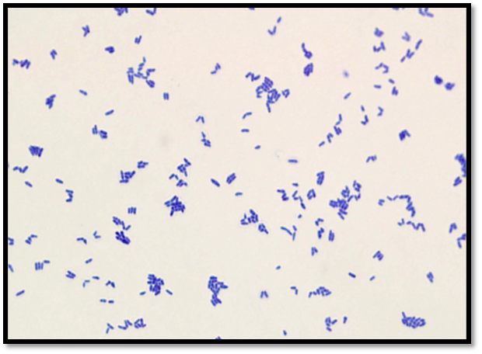
B- Diphtheria Pharyngitis
(Corynebacterium diphtheriae)
1. Pharyngitis
Video
(childhood disease)
Morphology | Gram positive bacilli
Overview | Rare in developed countries, because it is prevented by vaccine. Mainly Presented as Upper respiratory tract infection. Characterized by: formation of bleeding pseudomembranes in pharynx/throat. (grey thick membranes) Diphtheria usually manifests as pharyngitis (can be severe → breath difficulties).
Virulence | Diphtheria toxin
Diagnosis | Throat swab Culture on special media (e.g Tinsdale media) ElEK's test to confirm the toxin production
Treatment | Antitoxin (more important) and antibiotics (Penicillin or erythromycin).
Complications | If the patient is not vaccinated: Myocarditis Neuritis It might cause mortality because of heart failure
Prevention | Vaccination with diphtheria toxoid (inactivated toxin) containing vaccine.

Slide 7
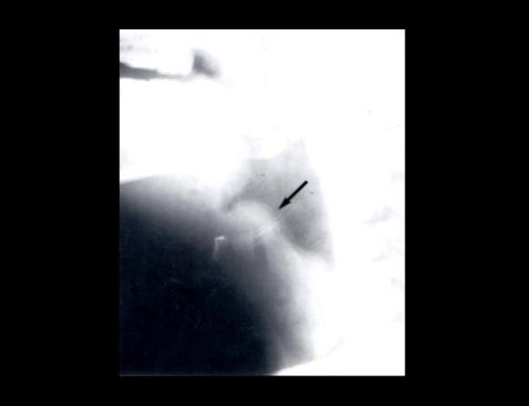
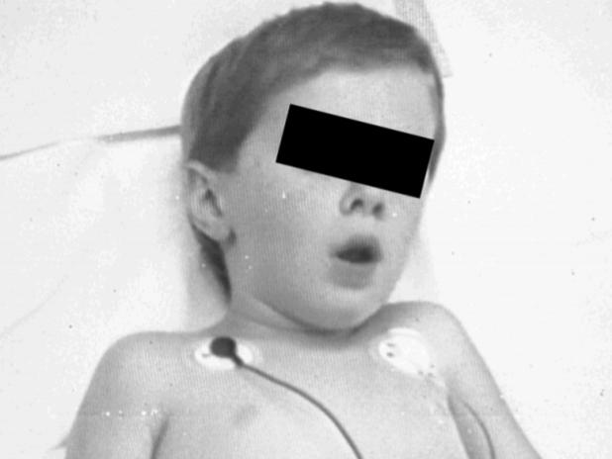
Epiglottitis
2. Epiglottitis
Video
Overview | Usually affect young unimmunized children. Affecting breathing, sometimes a medical emergency.
Etiology | Haemophilus Influenzae Type B (most common) S. pneumoniae S. aureus Beta hemolytic streptococci.
Signs and symptoms | Dysphagia (Swallowing difficulties,pain). Drooling (drop saliva uncontrollably from the mouth) Respiratory distress (+ difficulty in breathing) - hypoxia - cyanosis.
Diagnosis | Blood culture Culture of epiglottic surface (under controlled setting) Swab is usually not taken, unless there is airway support Lateral X-ray
Treatment | Maintenance of airway, throat examination is contraindicated Empiric treatment Ceftriaxone + Vancomycin
Prevention | HiB vaccination

Slide 8
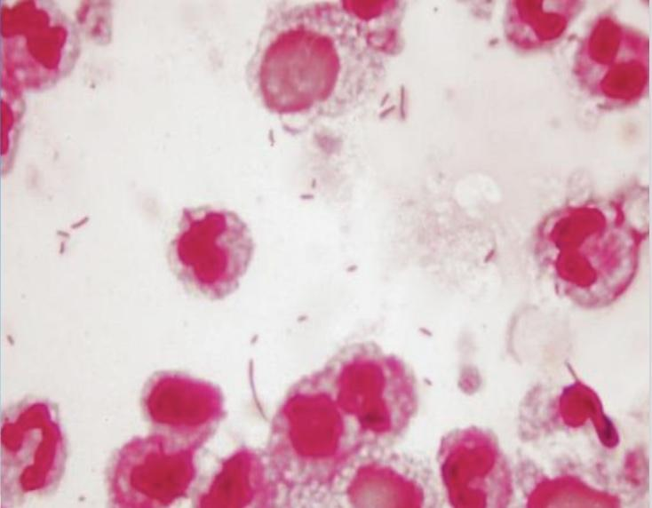
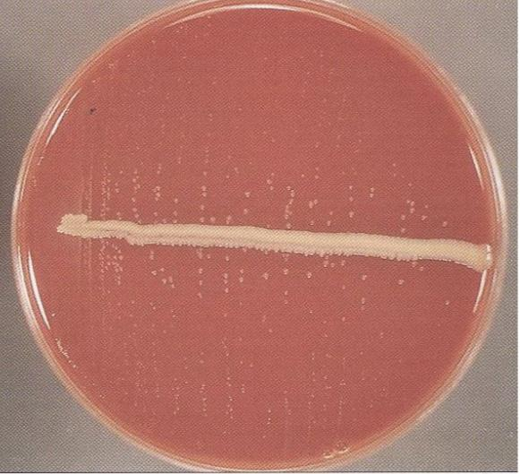
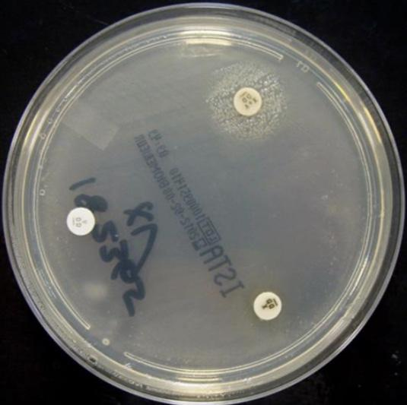
Haemophilus Influenzae
2. Epiglottitis
Video
Morphology | Gram negative pleomorphic, coccoid to rod-shaped cells (coccobacilli), fastidious Oxidase and catalase positive Requires X (heme) and V (NAD) factors for growth Used to confirm ID (grows in X and V together. presence of X alone or V alone will not be enough for the growth of the pathogen.) Grows on chocolate agar, not in regular agars. H. Influenza affects children < 5 years old.
Types ✭ | Encapsulated (typable) strains Most important is Type B | Nonencapsulated (nontypable) strains (causes simple infections)
Causes | Causes invasive diseases (Type B) (epiglottis - meningitis) | Causes local infections (sinusitis - otitis - pneumonia (Rarely) in elderly)
Virulence | Capsule (main virulence factor) The typeable strains (A-F) Type B is more virulent that types A, C,...F , because of the composition of its capsule. | (Capsule: anti-phagocytosis and specific attachments to specific tissues)
Prevention | Prevention of Type B through vaccination | –
Treatment | Amoxicillin-Clavulanate 2nd or 3rd generation Cephalosporin
.
This is the Bacteria

Slide 9
Pertussis (whooping cough)
(Bordetella pertussis)
3. Pertussis
Video
(السعال الديكي)
Morphology | Bordetella pertussis: gram negative bacilli
Virulence Factors | Pertussis toxin Filamentous hemagglutinin Pertactin
Stages | Incubation period 1 to 3 weeks Catarrhal stage 1-2 weeks (sneezing, runny nose) Paroxysmal stage 2-4 weeks (continuous cough) (very serious stage it leads to respiratory failure, and if the child was 6 months or younger they might die) Convalescent stage 1-2 weeks (least serious stage)
Diagnosis | Sample: nasopharyngeal (NP) swabs Special media needed: (selective media to culture the organism) Charcoal blood (Regan-Lowe) Bordet-Gengou
Treatment | Macrolide (erythromycin)
Prevention | Prevention by vaccination (acellular pertussis-containing vaccine)

Slide 10
Acute Otitis Media
(the most common cause are viruses)
4. Otitis Media
Overview | Fluid + inflammation of the mucosal lining of the middle ear More common in children
Etiology | S. Pneumoniae (n) (gram + diplococci) H. Influenzae (non typable) (gram - coccobacilli) S. Aureus Moraxella catarrhalis (gram - diplococci) GAS Viral (alone or with bacteria)
Diagnosis | Mainly clinical diagnosis Tympanocentesis sometimes needed (a procedure that involves a small gauge needle to aspirate fluid from the middle ear cleft) Sample: middle ear fluid Sent for culture
Treatment | Amoxicillin or Amoxicillin-Clavulanic acid

Slide 11
Moraxella Catarrhalis
5. Sinusitis
Morphology | Gram negative diplococci Catalase and oxidase positive
Causes | Otitis Sinusitis Pneumonia
Treatment | Amoxicillin-Clavulanic acid
Acute Bacterial Sinusitis
Overview | More common in children Occurs with viral URTI Patient mostly presented with headache and fever
Etiology | S. Pneumoniae H. Influenzae (non typable) Moraxella .catarrhalis Anaerobes Viral (most common)
Diagnosis | Mainly clinical diagnosis Imaging (CT/MRI) when there is suspension of complications
Treatment | Amoxicillin-Clavulanic acid for 1-2 weeks

Slide 12
Deep Neck Space Infections
5. Deep Neck Space Infections
Overview | Rare but serious. Could be a complication of GAS. Lateral pharyngeal, retropharyngeal or prevertebral space.
Signs and symptoms | Patient is very sick and toxic. Neck stiffness can occur with retropharyngeal space infection/abscess.
Etiology | Usually polymicrobial. Mainly streptococci + oral anaerobes.
Complications | Retropharyngeal (danger space) infection may extend to mediastinum and present as mediastinitis.
Management | Surgery Antibiotics: meropenem - piperacillin - clindamycin Duration: 2-3 weeks

Slide 13
Summary

Slide 14
Infection | Symptoms |  | Diagnosis | Treatment | Complications
Viral Pharyngitis | Sore throat Pharyngeal erythema and edema Fever | Coryza (running nose) Cough Conjunctivitis (احمرار العين) | - | - | -
Bacterial Pharyngitis |  | Tonsillar exudates Tender & enlarged (>1 cm) lymph nodes | Mentioned above (according to pathogen) | Mentioned above (according to pathogen) | GAS: Rheumatic fever Acute Glomerulonephritis
 |  |  |  |  | Diphtheriae: Myocarditis Neuritis
Epiglottitis | Dysphagia Drooling of saliva Respiratory distress Difficulty in breathing Hypoxia Cyanosis |  | Blood culture Culture of epiglottic surface Lateral X-ray | Maintenance of airway Empiric: Ceftriaxone + Vancomycin
Pertussis |  |  | Mentioned above (according to pathogen) | Macrolide (erythromycin)
Acute Otitis Media |  |  | Clinical diagnosis Tympanocentesis Middle ear fluid for culture | Amoxicillin or Amoxicillin-Clavulanic acid
Acute Bacterial Sinusitis |  |  | Clinical diagnosis Imaging (CT/MRI) | Amoxicillin-Clavulanic acid for 1-2 weeks
Deep Neck Space Infections | Sick and toxic. Neck stiffness |  |  | Surgery Antibiotic for 2-3 weeks Meropenem Piperacillin Clindamycin | Mediastinitis

Slide 15
Cases/SAQ
Questions from the doctor
Q1: A mother brings her 5 year old unvaccinated son to the emergency department, where he presents with acute dysphagia, respiratory distress & fever. A blood culture was grown on a chocolate agar and showed gram negative coccobacilli.
a) What is the most likely diagnosis
b) organism
c) is it preventable?
Q2: A 5 year old unvaccinated patient that has recently arrived from India has pharyngitis, and formation of pharyngeal pseudomembranes. .
a) What is the most likely diagnosis
b) organism
c) is it preventable?
D) What are 2 potential complications?
Q3: A 3-year-old boy is brought to the hospital because he has been coughing for the past 2 week start with runny nose then. His mother states that cough seems to come in bouts(phases). The coughing is sometimes severe enough to cause him to vomit.
a) What is the most likely diagnosis
b) organism
c) what is the virulence factor
D) is it preventable?
Q4: A 10 year old patient comes to the office complaining from acute pain in his ear. Upon examination a bulging tympanic membrane was found. Gram stain from the middle ear fluid if showed:
A- gram - diplococci
B- gram + diplococci
C- gram - coccobacilli(fastidious)
What is the organism of each one?
Q5: A teenager comes to the hospital with a fever and sore throat. A throat swab showed a Beta hemolytic colony.
a) What is the most likely diagnosis
b) organism
C) name 4 potential complications?
Answers Key
Q1:
epiglottitis
H.influenzae Type B
yes, by vaccination.
Q3);
Pertussis (whooping cough)
Bordetella pertussis
pertussis toxin (mainly) and maybe filamentous hemagglutinin
yes by vaccination.
Q4:
Moraxella catarrhalis
strept.pneumoniae
Haemophilus influenzae
Q5):
A) Pharyngitis
B) S.pyogenes
C) Rheumatic fever, Glomerulonephritis, Peritonsillar abscess, Parapharyngeal abscess.
Q2:
Diphtheriae
corynebacterium diphtheria
yes by vaccination.
Myocarditis, Neuritis.

Slide 16
MCQs
1- C
2- D
3- A
4- B
5- C
6- D
1- The most common cause of pharyngitis is
A-Bacterial | B-Fungal | C- Viral | D- Immunological
2- Non supportive complication of GAS occurs after infection of respiratory tract only
A- Peritonsillar abscess | B-Parapharyngeal space abscess | C-Acute glomerulonephritis | D-Rheumatic fever
3- What is the bacterial infection that characterized by formation of pharynx/throat pseudomembranes
A-Diphtheria | B- TB | c- Pertussis | D- Epiglottitis
4- Bacterial infection, the unimmunized child presented with dysphagia, drooling, respiratory distress
A-Pharyngitis | B- Epiglottitis | C- Pertussis | D- Otitis media
5- Type of bacteria that cannot grow in regular aggars, it needs specific growth factors ( it is fastidious)
A- GAS | B- Strept. Pneumonia | C-Haemophilus influenzae | D- Staph aureus
6- a way To help determine whether a patient had a recent strep infection with GAS
A- Blood agar | B- Bacterial Antigen Detection | C- Throat swab | D-Antistreptolysin O
For more questions click here!

Slide 17
Microbiology Team⁴⁴²
Leaders
Shaden Albassam | Mohammed Alghamdi
Co-Leader Ahmad Bahmaid Members
Raghad Alnadeef | Yazeed Hussein
Ghada Binslmah | Talal Alharbi
Tharaa Alhowaish | Meshari Alshathri
Amani Alotaibi | Emad Almutairi
Nouf Alsaigh | Abdulrahman Al-Douir
Razan Almanjomi | Abdulrahman Binbakhit
Shahed Bukhari | Abdullah Alshahri
 | Abdulaziz Alnasser
 | Luay Almutair
 | Ali Dhafer Jabaan
 | Abdulaziz Alotaibi
Special Thanks to Microbiology Team⁴⁴¹
Thanks to the amazing Sara Alhamlan for the great theme!
Microbiology442@gmail.com

