Slide 1
Community Acquired Pneumonia
Editing File

Slide 2
Objectives
Discuss the epidemiology and pathophysiology of pneumonia and CAP.
Explain the different classifications of pneumonia.
Recognize clinical presentations associated with CAP.
Discuss the diagnosis and treatment of CAP.
Identify common etiological agents causing CAP and discuss their laboratory work up.
Discuss virulence factor and prevention of Streptococcus pneumoniae.

Slide 3
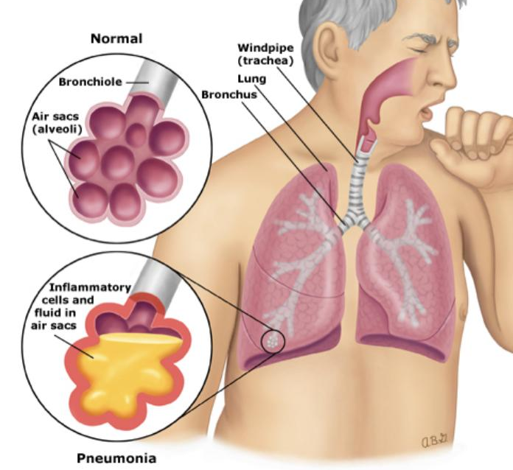
Pneumonia
(infection of the lung)
Video.
Definition | Pneumonia is an infection that leads to inflammation of the parenchyma of the lung (the alveoli) (consolidation (عتمة) and exudation).
properties | It may present as acute, fulminant clinical disease or as a chronic disease with a more prolonged course.
Epidemiology | -Overall the rate of CAP 5-6 cases per 1000 persons per year. -Mortality 23% (higher than URTI) (High, especially in old people). -Almost 1 million annual episodes of CAP in adults >=65 yrs in the US. Pneumonia in this age is atypical (the symptoms aren’t clear)
Etiological agents | Infectious: - Bacterial - Fungal - Viral - Parasitic Non-infectious: - Chemical - Allergen related
Pathogenesis Two factors involved in the formation of pneumonia | 1- Pathogens 2- Host defenses

Slide 4
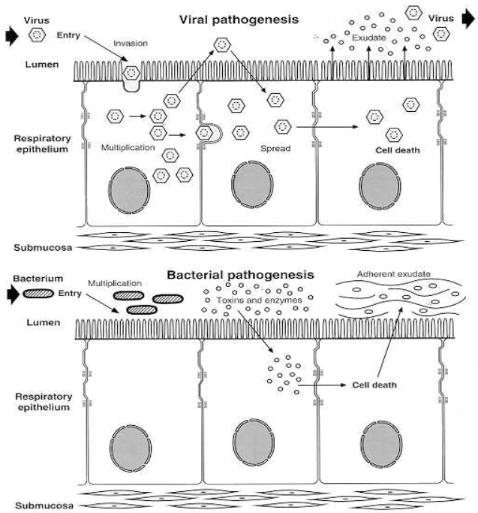
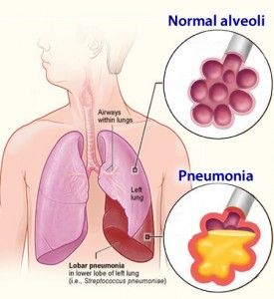
Risk Factors
Age extremities (younger than 2 years, older than 65 years)
Immunosuppression
Asthma and COPD
Prior influenza
Alcoholism
HIV
Smoking
Institutionalization
Aspiration
Dementia
Recent hotel : Legionella
Travel, Pets (especially birds and parrots), occupational exposures - birds (C. Psittaci)
Defense mechanism of respiratory tract
Filtration and deposition of environmental pathogens in the upper airways
Cough reflux
Mucociliary clearance
Alveolar macrophages particularly against streptococcus pneumonia
Humoral and cellular immunity
Oxidative metabolism of neutrophils
Pathophysiology
1- Inhalation or aspiration of pulmonary pathogenic organisms into a lung segment or lobe. 2- Results from secondary bacteraemia from a distant source, such as Escherichia coli urinary tract infection and/or bacteraemia (less commonly). Infection in other organ / place such as urinary tract leads to bacteremia then infects the lung. 3- Aspiration of oropharyngeal contents (multiple pathogens).
4- pneumonia can be caused by tuberculosis

Slide 5
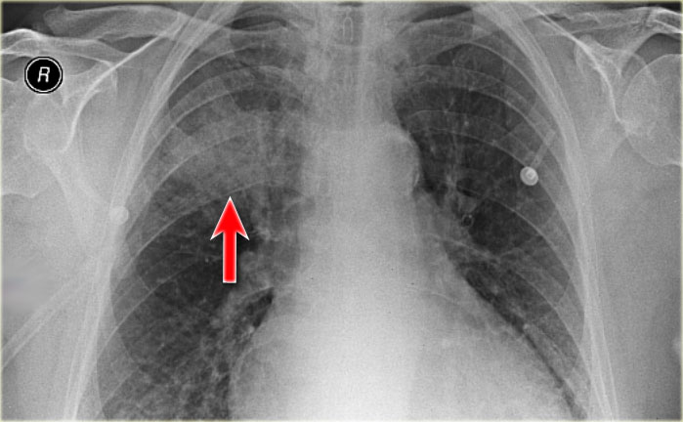
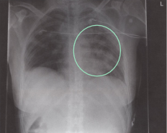
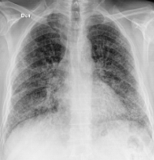
Pathogen
Classification Of Pneumonia
Anatomy
Acquired Environment
Classification by Acquired Pathogen | Bacterial (The most common cause in adults) | Typical. (Caused by a typical organism(staph aureus or streptococcus pneumonia)). Typical presentation of pneumonia, fever, productive cough, leukocytosis, chest pain, low oxygenation etc..
 |  | Atypical. Less sick than typical, also called walking pneumonia, dry cough, less dangerous. (The patient won’t present you with typical symptoms)
 | Viral (the most common cause in children)
 | Fungal
 | Parasite
Classification by Anatomy | Lobar= streptococcus pneumonia | Entire lobe St. pneumoniae (usually)
 | Lobular | Bronchopneumonia Around alveoli and bronchi. Most common in viral infection St. pneumoniae (usually)
 | Interstitial | Around the lung interstitium. Usually caused by: Atypical or Viruses
Classification by Acquired Environment | Community acquired pneumonia (CAP)
 | Hospital acquired pneumonia (HAP)
 | Nursing home acquired pneumonia (NHAP)

Slide 6
Community acquired Pneumonia
CAP: is a pneumonia acquired outside of hospitals or extended care facilities
Fever, productive cough, infiltrate (we see it in x-ray)
Prevalence of Community acquired Pneumonia (CAP)
Strep. Pneumoniae- 48% most common Viral- 23% Atypical orgs (MP,LG,CP)- 22% Haemophilus influenzae 7% Moraxella catarrhalis 2% Staph. aureus 1.5% Gram negative organisms 1.4% Anaerobes
Community Acquired Pneumonia Classification
Typical | Atypical
Detected by gram stain. | Atypical: not detectable on gram stain (because they have no cell wall); won’t grow on standard media. Some don’t have cell wall; will not respond to β lactams.
Strep. Pneumoniae - lobar pneumonia (capsulated) Haemophilus influenzae (capsulated) Moraxella catarrhalis Staph. Aureus Gram-negative organisms | Mycoplasma pneumoniae Chlamydia pneumoniae (Mild) Legionella pneumoniae (Severe infection→ ICU) Psittacosis, Bird owners (Chlamydia psittaci) Q fever, Farmers (Coxiella burnetti)

Slide 7
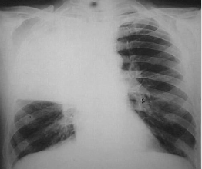
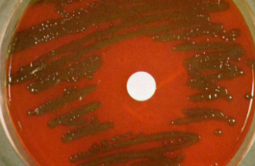
Typical pneumonia
(Clinical Manifestation)
Overview | The onset is acute Prior viral upper respiratory infection (3-4 days after viral infection, patient develops pneumonia)
Respiratory Symptoms | Fever Shaking chills Cough with sputum production (rusty-sputum) Chest pain- or pleurisy (chest pain when inspiration ) Shortness of breath
Diagnosis | Clinical | -History(fever, cough, chest pain) and Physical examination(Decreased air entry & dullness on percussion)
 | Radiological | X-ray examination (used to confirm the diagnosis,pneumonia, and to determine the type,lobar/interstitial/lobular) - X-ray of typical is usually lobar or lobular
 | Laboratory | - CBC (shows Leukocytosis) - Sputum • Gram stain 15% • Culture - Blood culture 5-14% - Pleural effusion gram + culture

Slide 8
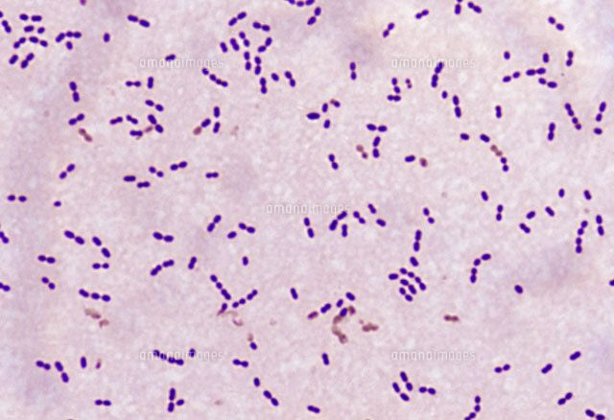
These 2 methods are used to differentiate
between S.viridans & S.pneumoniae
باختصار تقتل نفسھا بالـAutolysin عشان تطلع الـPneumlysin وتضر الھوست
Streptococcus Pneumoniae (Causes Typical)
Overview | Normal flora of upper respiratory tract in 20-40% of people. might cause pneumonia with the risk factors
Organism (Same morphology as S. viridans) | Gram positive diplococci Alpha hemolytic Catalase negative
Other Features | Sensitive to Optochin Lysed by bile (bile soluble) (Remember S.viridans is normal flora in the GIT so it can survive in bile unlike S.pneumoniae which can’t )
Virulence factors | Capsule (Most important factor) -More than 90 capsular types Pneumolysin (Pore forming toxin that destroys host cells resulting hemolysis) Autolysin (Hydrolyzes its own cell wall to release the pneumolysin) Neuraminidase(Used for attachment to host cell)
Prevention | Vaccination recommended for old ages (>50)
Used to differentiate between S.viridans and S.pneumoniae
Causes | Respiratory infections | Pneumonia, Sinusitis, Otitis
 | Non-Respiratory infections | Bacteremia, Meningitis

Slide 9
Atypical pneumonia
Overview | Approximately 15% of all cases of community acquired pneumonia Not detectable on gram stain & won’t grow on standard media Some don’t have a bacterial cell wall, don’t respond to B-lactams
Symptoms | Mild to severe (legionella is the most severe) insidious onset (Gradual) Headache, Malaise, Fever Dry cough Arthralgia / myalgia
Signs | Minimal Low grade fever Few crackles Rhonchi (continuous sound produced in the lungs due to an obstruction)
Diagnosis | X-ray (Usually interstitial) CBC (Mild elevation WBC) U&Es (urea & electrolytes), Low serum Na (Legionella (water born infection)) LFTs (liver function tests) increase in ALT (alanine aminotransferase) & Alk Phos Sputum Culture on special media (BCYE) for Legionella Urine antigen for Legionella Serology for detecting antibodies DNA detection
Treatment | Macrolide (Protein synthesis), Quinolones (DNA), and Tetracycline (We can use one, or a combination of these in case of resistance) B lactams have no activity Treat for 10-14 days

Slide 10
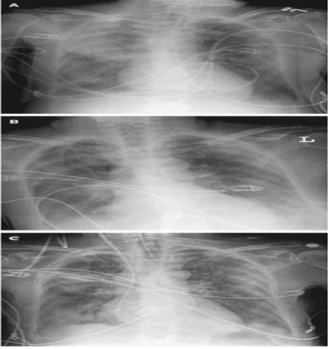
Mycoplasma Pneumoniae
(Causes Atypical)
Eaton’s agent (1944)
No cell wall. (so antibiotics that affect the cell wall won’t work, e.g β lactams)
Common.
Rare in children and in patients older than 65.
people younger than 40 (middle aged).
Can cause URT symptoms. e.g. cough, sore throat, nasal congestion, headache, fever...
Usually mild and responds well to antibiotics.
Can be very serious.
Transmits well in crowded places like schools, homeless shelters, prisons.
X-ray and Serology
Diagnosis
NAAT (Molecular testing)
(nucleic acid amplification testing)
Culture requires special media with slow growth (weeks)
Extrapulmonary findings | Myocarditis, Skin rash, Encephalitis, Hemolysis, Pancreatitis
Mild disease 5-10% of community acquired pneumonia Obligate intracellular organism 50% of adults Sero-positive Subclinical infections common
Diagnosis | Serology & NAAT ( molecular test )
Chlamydia Pneumonia (less common)

Slide 11
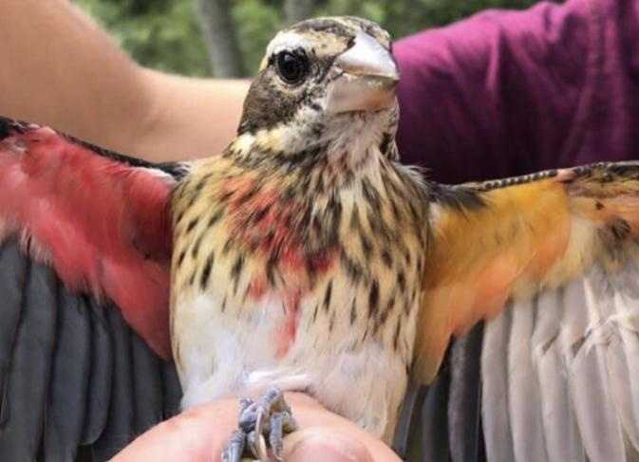
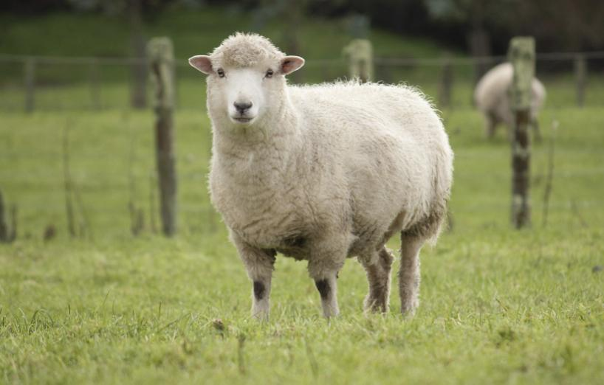
Psittacosis
Organism | Chlamydia psittaci
Cause of infection | Exposure to birds
Usual patient | Bird owners, pet shop employees, vets.
Carriers | Parrots, Pigeons, and poultry. (Birds are often asymptomatic)
Q Fever
Organism | Coxiella burnetii
Cause of infection | Exposure to farm animals mainly sheep (Spread by inhalation of infected animal birth products). Pneumonia is acute form of infection تفرز وقت الولادة في الحیوانات بعدین یجي احد یستنشقھا
Complications | Acute Q fever could cause Atypical Pneumonia
Diagnosis | Serology
You can get infected with Q fever by:
Breathing in the bacteria that is in the air or dust while:
birthing, slaughtering or butchering infected animals.
handling infected animals, infected animal tissues, fluids or excretion or animal products or materials that have been infected including wool, hides, straw, manure fertiliser and clothes (e.g. washing clothes worn when birthing, butchering or slaughtering animals).
herding, shearing or transporting animals.
mowing grass contaminated by infected animal excretions.
visiting, living or working in/near a high-risk industry.
direct contact with infected animal tissue or fluids on broken skin (e.g. cuts or needlestick injuries when working with infected animals).
drinking unpasteurised milk from infected cows, sheep and goats.

Slide 12
Legionella Pneumophila
الأشد بينهم
Causes Legionnaires disease (serious disease)
Serious outbreaks linked to exposure to cooling (water) towers
Can be very severe and lead to ICU admission
Can be any form of consolidation (interstitial, lobar, lobular).
Can Cause | Hyponatraemia (common) Decrease in serum sodium concentration <130 mMol
 | Bradycardia
 | WBC < 15,000
 | Abnormal LFTs (liver function test) > affect muscles
 | Raised CPK (creatinine phosphokinase)
 | Acute Renal failure
Diagnosis | Specimen: sputum | Culture on specialized media (BCYE-Buffered charcoal yeast extract)
 |  | DFA (low sensitivity) Direct fluorescent antibody test (Direct immunofluorescence)
 |  | NAAT (most commonly PCR)
 | Urine antigen testing
Pontiac fever | Non pneumonic Influenza like illness Self limiting Related to exposure to environmental aerosols containing Legionella (potentially a reaction to bacterial endotoxins)

Slide 13
Antibiotic Treatment of CAP
Factors to consider in selection of antibiotics:
Comorbidities (Other Diseases They Have)
Previous antibiotic exposure in the last 3 months
Severity. (maybe resistant)
Outpatient management vs requiring inpatient admission vs requiring ICU.
Type of Patient | Microorganism | Macrolide | Doxycycline | Levofloxacin | ꞵ-lactam & macrolide | ꞵ-lactam & Levo
Outpatient, Healthy ,no exposure to antibiotics in last 3 months | -S.pneumoniae - Atypical pathogens - Viral
Outpatient, with comorbidity,or exposed to antibiotics in last 3 months | - All of the above + - Anaerobes - S. aureus Gram+
Inpatient: Not ICU | - All of the above + - Coliforms gram-
Inpatient ICU - | - All of the above + -Pseudomonas

Slide 14
Organism | Disease | Gram stain | Diagnosis | Treatment
Haemophilus Influenzae | Typical CAP | Gram Negative Bacilli Fastidius Oxidase and catalase positive | 1-Blood Culture 2-Lateral X-ray | -Amoxicillin-Clavulanate -2nd or 3rd Generation Cephalosporin
Streptococcus pneumoniae Alpha haemolytic | Community acquired pneumoniae (CAP) typical lobar pneumoniae | Gram positive cocci in chains Aerobic/Facilitated anaerobe Catalase negative | - | -
Moraxella catarrhalis | Typical CAP | Gram negative diplococci Catalase and oxidase positive | - | Amoxicillin-Clavulanic acid
Staph Aureus | Typical CAP | Gram Positive in clusters Coccus Aerobic Catalase And Coagulase (+) | - | -
Chlamydia psittaci | Psittacosis | - | - | -
Coxiella burnetii | Q Fever | - | Serology | -
Mycoplasma pneumoniae Chlamydia pneumoniae Legionella pneumoniae Coxiella burnetii Chlamydia psittaci | Atypical CAP | not detectable on gram stain Some don’t have cell wall; will not respond to β lactams. | Chlamydia Pneumoniae: Serology & NAAT (Molecular Test) Legionella Pneumoniae -Septum: Culture on specialized media (BCYE) DFA NAAT Urine Antigen Test | -

Slide 15
Cases/SAQ
Questions from the doctor
1- a 60year-old diabetic patient with copd came to the emergency department complaining from fever and productive cough. examination revealed decreased air entry over the left lower lobe . an x-ray showed lobar consolidation . a gram stain showed gram + diplococci or gram - Or gram+ in clusters
1)what is the diagnosis ?
2) What is the most likely causative agent?
3)What is the most important virulence factor?
2- a 60 year-old man came to the emergency with fever , dry cough and feeling unwell .an x-ray showed interstitial infiltrates
1)what is the diagnosis?
2) What is the most likely causative agent?
Answers Key
1A:
1 -typical (lobar) pneumonia
2- S.pneumoniae if - moraxella if + with clusters it’s staphylococcus aureus
3-Capsule, pneumolysin ,autolysin
2A:
1-atypical (interstitial ) pneumonia
2- Mycoplasma pneumoniae

Slide 16
MCQs
1-D
2-C
3-A
4-D
5-D
6-C
1- All of the following are the characteristics of Streptococcus pneumoniae, EXCEPT?
a-It is present as normal flora in healthy individuals | b-The colonies are diplococcus and encapsulated | c-Alpha hemolytic colonies appear in blood culture media | d-It grows well in a high concentration of glucose media
2-A person with Legionella pneumophila can be best treated with:
a-Vancomycin | b-linezolid | c-erythromycin | d-ceftazidime
3-What are symptoms of pneumonia?
a-Cough, fever, and chills | b-Rash, painful joints, and itching skin | c-Jaundice and peeling skin | d-all of them
4-Typical bacterial pneumonia is caused by:
a-Mycoplasmal pneumonia | b-Legionnaires pneumonia. | c-Pneumocystis carinii. | d-Staphylococcus aureus.
5-Pneumonia risk factors:
a-smoking | b-alcohol | c-asthma | d-all of them
6-All of the following can be used to diagnose atypical CAP EXCEPT?
a-x-ray | b-serology | c-gram stain | d-culture
For more questions click here!

Slide 17
Microbiology Team⁴⁴²
Leaders
Shaden Albassam | Mohammed Alghamdi
Co-Leader Ahmad Bahmaid Members
Raghad Alnadeef | Yazeed Hussein
Ghada Binslmah | Talal Alharbi
Tharaa Alhowaish | Meshari Alshathri
Amani Alotaibi | Emad Almutairi
Nouf Alsaigh | Abdulrahman Al-Douir
Razan Almanjomi | Abdulrahman Binbakhit
Shahed Bukhari | Abdullah Alshahri
 | Abdulaziz Alnasser
 | Luay Almutair
 | Ali Dhafer Jabaan
 | Abdulaziz Alotaibi
Special Thanks to Microbiology Team⁴⁴¹
Thanks to the amazing Sara Alhamlan for the great theme!
Microbiology442@gmail.com

