Slide 1
Hospital Acquired Pneumonia
Editing File

Slide 2
Define the terms, pneumonia, community acquired pneumonia, health care associated pneumonia (HCAP) and ventilator associated pneumonia (VAP).
Describe the pathogenesis of the health care associated pneumonia (hospital associated pneumonia ) and VAP.
Classify HCAP according to the time of onset .
Name the different causative bacterial agents
Classify and describe types of VAP.
Recognize the ways by which VAP is prevented.
Describe the different chemotherapeutic anti-microbial agents used for the treatment of health care associated pneumonia.
Evaluate response to treatment and recognize reasons for failure of treatment.

Slide 3
pneumonia
(Infection of the pulmonary parenchyma)
Health care associated pneumonia (HAP)
التهاب رئوي مكتسب من المستشفى
Acquired 48-72 hours after admission to health care institutions eg. pneumonia caused by organisms in hospital which are usually resistant to antibiotics
eg. Pseudomonas aeruginosa
We can also call it nosocomial pneumonia
Community acquired pneumonia(CAP)
Acquired in the community, by community acquired organisms. e.g .Streptococcus pneumoniae
It is usually susceptible to antibiotics.
Types of pneumonia
المريض يجيه المرض برا المستشفى
تجي العدوى للمريض بعد دخوله للمستشفى
Introduction to HAP
Definition of Nosocomial Pneumonia | Hospital associated pneumonia (HAP) or health care associated pneumonia (HCAP)
When does it occur? | At least 48 hours after admission without being intubated at the time of hospitalization (put on a ventilator).
How severe? | -Nosocomial pneumonia (HAP) is the 2nd most common hospital-acquired infections after urinary tract infection. Accounting for 31 % of all nosocomial infections -Nosocomial pneumonia is the leading cause of death from hospital-acquired infections. -The incidence of nosocomial pneumonia is highest in ICU (intensive care unit) patients.*

Slide 4
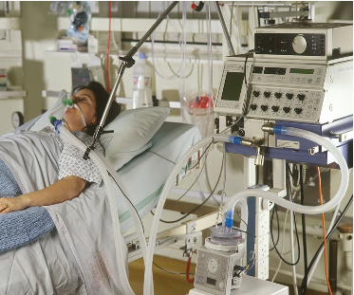
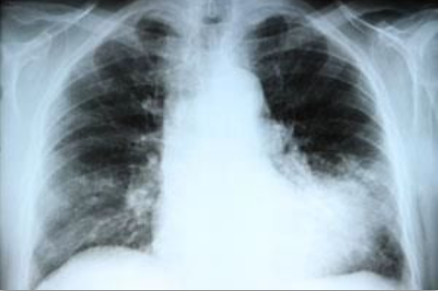
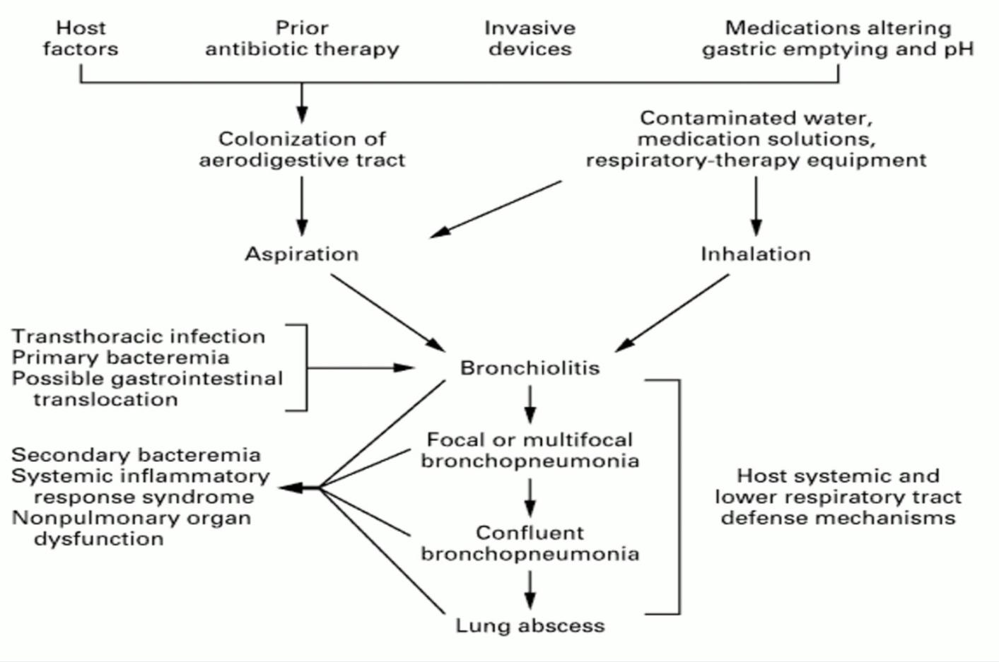
Intensive care unit (ICU)
The incidence of nosocomial pneumonia in ventilated patients is 10-fold higher than non-ventilated patients
The reported crude mortality for HAP is 30% to greater than 70%.
Pathogenesis of HAP (important)
Significant impairment of host defenses
Introduction of a sufficient-size inoculum to overwhelm the host's lower respiratory tract defenses
The introduction of highly virulent organisms into the lower respiratory tract
مناعة المريض تكون ضعيفه
افرازات جاية من normal flora يستنشقها وتدخل للرئة تسوي infection
يكون المريض عنده كمية كبيرة من البكتيريا في جهازه التنفسي
تكون العدوي قوية وشديدة
Most common way of transmission
by microaspiration of oropharyngeal secretions colonized with pathogenic bacteria.
Microaspiration: saliva goes to the lung.
It is rarely inhaled as large droplets
Symptoms of HAP might be, dyspnea (shortness of breath) , cough, fever.
The oropharyngeal secretions that contains high number of bacteria goes to patient’s lung.
مو مطلوبة بس للفائدة

Slide 5
Classification of HAP according to onset
 | Early-onset Nosocomial Pneumonia | Late-onset Nosocomial Pneumonia
Time | Occurs during the first 4 days of admission | Occurs after more than 4 days of admission
Overview | Usually similar to CAP | Includes more Gram -ve bacteria & more resistant bacteria, multi drug resistant, hospital infection.
Causative Organisms important | Usually is due to S.Pneumonia | More commonly by Gram -ve organisms, especially: P.aeruginosa, Acinetobacter
 | MSSA | MRSA تكون more resistant
 | H.Influenza & Anaerobes | Enterobacteriaceae (enteric bacteria e.g Klebsiella, Enterobacter, serratia)
MRSA : Methicillin Resistant Staph Aureus
MSSA : Methicillin Sensitive Staph Aureus
Methicillin = oxacillin = cloxacillin and all of them can not deal with MRSA
Pneumonia
Health care associated Nosocomial
Community Acquired
According to Association
According to onset
Atypical
Typical
Early onset
Ventilator associated
Hospital Acquired
Late onset

Slide 6
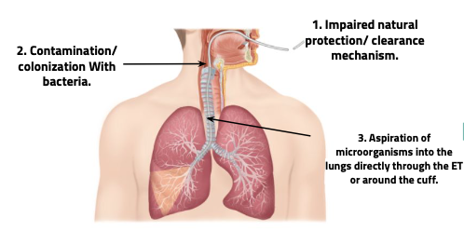
Causative Agents
Pseudomonas aeruginosa gram negative oxidase +ve | Common causes of late-onset pneumonia, Particularly in ventilated patients
Acinetobacter gram negative oxidase -ve
Enterobacteria Enteric Gram negative bacilli e.g. (Escherichia, Enterobacter, Serratia) | Isolated most frequently particularly in patients with : (1)late-onset disease and in patients with serious underlying disease often (2)already on broad-spectrum antibiotics (fourth generation cephalosporin). (Prior use of broad-spectrum antibiotics and an immunocompromised state make resistant Gram-negative organisms more likely.)
Staph. Aureus Gram +ve لازم اعرف ال history حق المريض في البداية رح تكون MSSA بعدين يكتسب المريض MRSA | Isolated in about 20~40% of cases and is particularly common in: 1. Ventilated patients after head trauma, neurosurgery, and wound infection 2. In patients who had received prior antibiotics or Prolonged care in ICU
 | MRSA (Methicillin Resistant Staph Aureus) is seen more commonly in patients who: - Received corticosteroids as they suppress the immune system - Undergone mechanical ventilation for more than 5 days (The longer the incubation period, the higher the risk of getting more resistant organisms) - Presented with chronic lung disease - Had prior antibiotics therapy
Anaerobes | - Common in patients predisposed to aspiration. (VAP) - (especially) VAP with anaerobes occurred more often with oropharyngeal intubation than nasopharyngeal intubation. لأن الoropharynx تكون مليانه anaerobes
اعرف إن فيه مشكلة
Ventilation
إذا لاحظت إن المريض يحتاج زيادة
Note: If the patient needs increased ventilation support (e.g. increased tidal volume) then this is a clear sign of VAP and we need x-ray to confirm it (infiltrate)

Slide 7
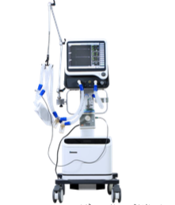
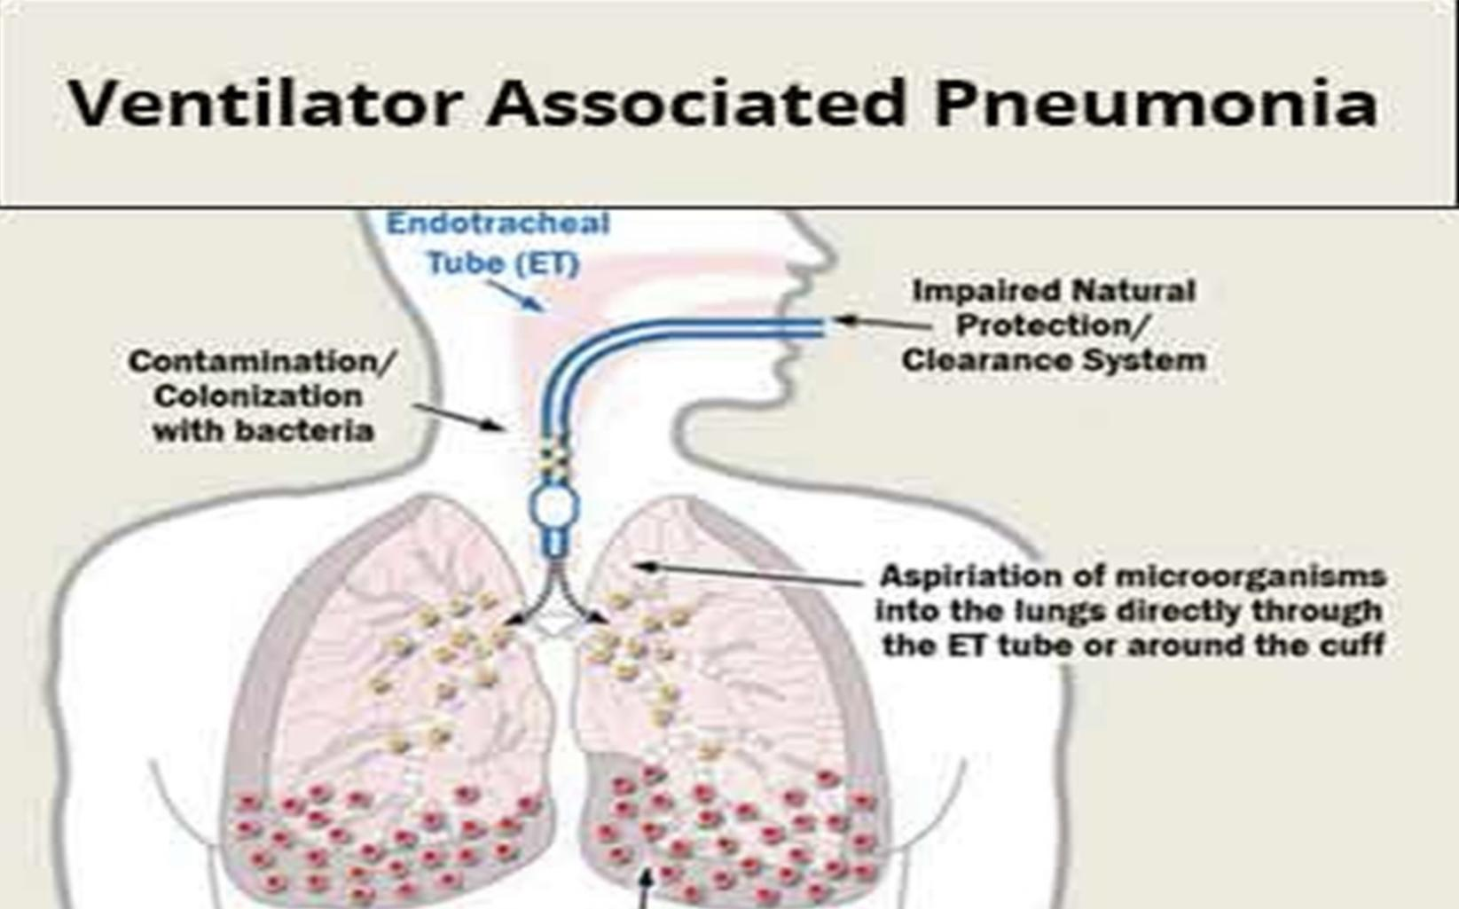
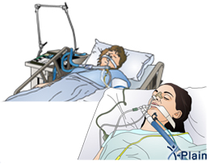
Ventilator Associated Pneumonia VAP
Type of Nosocomial pneumonia that has developed in patient who are receiving mechanical ventilation. (Ventilation is Tracheal intubation : tube through the trachea) which complicates the intubation process)
Classification of VAP
 | Early-onset | Late-onset
Time | Within 48-72 hrs after tracheal intubation | After 72 hrs of tracheal intubation
Overview | We start counting the days of The onset of the disease from the tracheal intubation, not from the admission to the hospital.
Causative Organism | Same as HAP.
Pathogenesis of VAP(important)
Mechanical ventilation prevents mechanical clearance by cough and the mucociliary escalator.
Bacterial colonization of the aerodigestive tract
Aspiration of contaminated secretion into the Lower airway (Microaspiration)
البكتيريا تتكاثر ورح يصير استعمار للبكتيريا
المريض رح يشفط الافرازات ويتنفسها وتنتقل لجهازه التنفسي
المريض مايقدر يتنفس طبيعي فما يقدر يكح (عامل الدفاع) فما يقدر يطرد البكتيريا

Slide 8
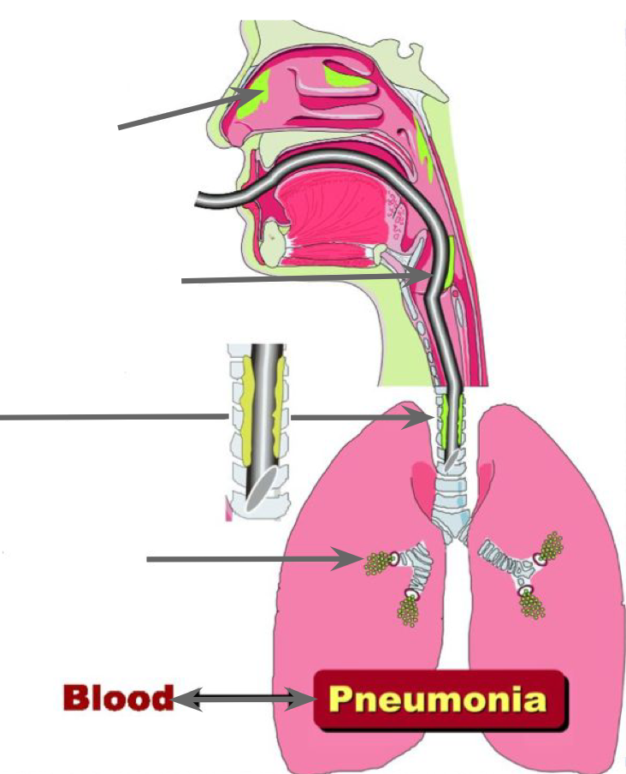
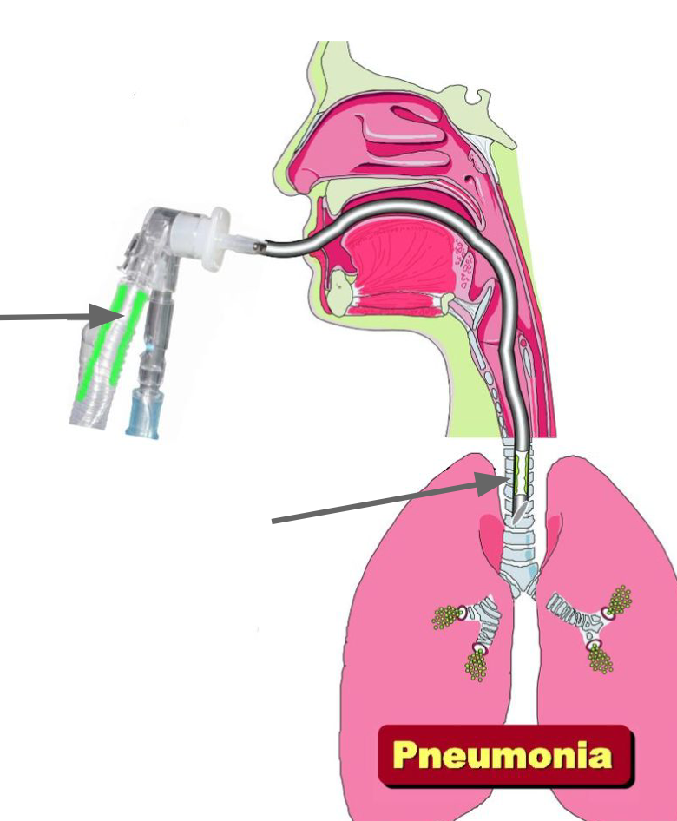
Source of infection: endogenous or exogenous
1
Endogenous: يكون من المريض نفسه
A
C
B
D
E
Source of microorganisms:
(A) Impaired natural protection/ clearance system allows increased colonization of nasopharynx.
(B) Colonized oropharynx and gastric fluid pool along tube in neonates.
(C)Colonized tracheal secretions.
Mechanism of Pneumonia:
(D) Aspiration of colonized fluids any of the above sources Into the lungs can result in pneumonia.
(E) A hematogenous sources seeding the lungs may rarely cause pneumonia. يكون الدم مصدر البكتيريا
2
Exogenous: من المستشفى أو الكادر الطبي
A
B
Source of microorganisms:
Hands of health care worker.
(A)Ventilator circuit.
(دائرة الجهاز تكون ملوثة)
(B)Biofilm of endotracheal tube.
Mechanism of Pneumonia:
Pneumonia occurs when colonized secretions are inhaled into the lungs through the endotracheal tube.
Biofilm : Thin layer from the secretion of the organism will cover the tube so it will be colonized with a lot of bacteria and aspirated, this protects Biofilm the bacteria from antibiotics & the immune system.

Slide 9
Prevention for VAP
تقلل حدوثها لكن ما تمنعها تماما
●Effective hand washing and use of protective gowns and gloves.
●Semi Recumbent positioning.
45°degree(يكون المريض نصف جالس)
●Avoidance of large gastric volume (تكون الوجبات صغيرة)
●Oral (non-nasal) intubation. (colonization يمنع ال )
●Continuous subglottic suctioning.(شفط الإفرازات لمنع التراكم)
●Humidification with heat and moisture exchanger.(ترطيب الجو )
●Posture change (تغيير وضعية المريض باستمرار )
Non-Pharmacologic Strategies
●Avoiding stress-ulcer prophylaxi.(Patients in ICU are in risk of ulcer they can be given prophylaxis to reduce stomach pH but the problem is that this would increase the risk of infection med439
●Prophylactic antibiotic therapy.(Oral or systematic)
●Vaccines
●(Influenza vaccine Or strept coccus pneumonia vaccine )
●Chlorhexidine (oral rinse) (antiseptic) Disinfects the oral secretion from Gram +ve mainly staphylococcus aureus. (med439)
●Prophylactic treatment of neutropenic patients. المريض رح يكون عنده نقص في نيتروفلز فاعطيه الدواء عشان امنع العدوى
Pharmacologic Strategies
Topical Gentamicin, Colistin, Vancomycin cream (given every 6h for 3 weeks) treating oropharyngeal colonization could prevent VAP (ventilator associated pneumonia.)
Oral Regimen

Slide 10
Treatment
Most initial therapy is empiricتجريبي because no pathogen is identified or results are not available when antimicrobial decisions are made in most patients.
اخذ عينة من المريض
Initially be treated with a broad- spectrum antibiotic regimen aimed at covering all likely bacterial pathogens
خلال انتظار نتيجة الفحص نبدا بال empiric antibiotic اللي يغطي gram +ve and -ve
This regimen should subsequently be narrowed, according to the result of culture.
لما تطلع نتيجه الفحص نبدا نعطيه antibiotic بناء ع النتيجة
The pathogen may be influenced by :
coexisting illnesses, prior treatment, and length of hospitalization.
The frequency of ICU-acquired P. aeruginosa carriage or colonization/infection was 23.4% at 7 days and 57.8% at 14 days. للقراءة
كل ما زادت عدد الايام اللي يكون تزيد احتمالية إصابته بال
The mortality can be reduced with early appropriate empiric therapy.(Form 30 % with appropriate therapy to more than 90% with inappropriate therapy) .
p.aeruginosa
Levofloxacin
Meropenem
A broad spectrum antibiotic of the fluoroquinolone drug class.
A broad-spectrum carbapenem antibiotic.
5
1
4
DRUGS
4
Piperacillin-tazobactam
Vancomycin gram +ve
2
3
3
A combination of the antibiotic piperacillin, and the β-lactamase inhibitor tazobactam.لازم مع بعض
Used when there is a risk of MRSA or more severe infections.
(Used with above drugs)
Cefepime
A fourth-generation cephalosporin, has a broad spectrum

Slide 11
Response to therapy
If no clinical response is noted or deterioration occurs, we need to consider:
Infectious causes:
Resistant pathogen
Superinfection عدوى إضافية
Unusual pathogens.
مو من القائمة البكتيريا اللي انا غطيتها .ex:legionella
Lung abscess.
Extrapulmonary infection.
Non infectious events:
Heart: congestive heart failure (CHF).
Lung: fibroproliferative acute respiratory distress syndrome (ARDS), pulmonary emboli, Atelectasis.

Slide 12
Summary
Early Onset | S. Pneumonaie , MSSA , H. Influenza & Anaerobes
Late Onset | P.Aeruginosa , Acinetobacter , MRSA, Enterobacteriaceae
Signs | Fever , Cough , Infiltrate … Increased Ventilation Support
Pathogenesis | 1-Impairment of host Defenses (Immune system) 2-Introduction of a Sufficient-Size inoculum 3-Introduction of Highly virulent organisms
Transmission | Microaspiration of oropharyngeal Secretions colonized with Pathogenic Bacteria
Treatment | Initially by treated with a Broad-Spectrum Antibiotic regimen aimed at covering all likely bacterial pathogens
HAP
VAP
First 4 Days of Admission
Within 48-72 Hours after Tracheal Intubation
More than 4 Days of Admission
After 72 Hours of Tracheal intubation
1-Poor mechanical clearance because of the ventilator
2- Bacterial Colonization
3-Aspiration of Contaminated secretion

Slide 13
SAQ
Q1: A 56-year-old woman is brought to the emergency department for seizures that began 10 minutes prior to presentation with no clear precipitating cause. On physical exam, the patient is having a generalized tonic-clonic seizure. She is administered lorazepam and a second intravenous line is obtained for fosphenytoin, but the seizures do not abort. The patient is intubated, given propofol, and is admitted to the medical intensive care unit. On hospital day 4, the patient is difficult to wean from anticonvulsants and remains intubated. Her temperature is 101°F (38.9°C), blood pressure is 138/99 mmHg, pulse is 101/min, and respirations are 19/min with an oxygen saturation of 89% on room air. Physical examination is notable for crackles on the right anterior chest and a chest radiograph demonstrates a right lung lobar consolidation. Blood and sputum cultures were sent to the microbiology lab and came positive for a Gram-negative, rod shaped,oxidase -ve.
A) What is the most probable diagnosis?
B) Describe the onset?
C) Most likely causative agent?
D) While waiting lab results, what should have you done?
Q2: A 47 years old patient is admitted to the hospital. 6 days later he developed cough, fever & shortness of breath. An chest radiograph showed chest infiltrates. A culture shows gram +ve cocci in clusters.
A) What is the most probable diagnosis?
B) Describe the onset?
C) Most likely causative agent?
Q3: After head truma a patient was sent to the ICU and put on mechanical ventilation. A week later he developed a fever & x ray showed infiltrates. The patient also required increased ventilation. A sputum culture showed gram +ve, coccus, coaglase +ve.
A) What is the most probable diagnosis?
B) Describe the onset?
C) Most likely causative agent?
Answers Key
A1:
(A) Ventilator Associated Pneumonia
(B) Late onset
(C) Acentobacter
(D) started on empiric antibiotic treatment, vancomycin and piperacillin-tazobactam
A2:
(A) Hospital acquired Pneumonia
(B) latent-onset
(C) MRSA
A3:
(A) Ventilator Associated Pneumonia
(B) Late onset
(C) Staph Aureus

Slide 14
MCQs
1.A
2.A
3.C
4.A
5.D
6.B
1-A patient with anaerobe infection results from intubation . What is the most likely kind of intubation he had?
A-Oropharynx intubation | B-Laryngopharynx intubation | C-Nasopharynx intubation | D-A&C
2-Common CAP bacterial infection
A-Streptococcus pneumonia | B-Pseudomonas aeruginosa | C-Staph Aureus | D-B&C
3-One of the Most common way of transmission in HAP
A-Ears secretions | B-Blood transfusion | C-Oropharyngeal secretion | D-Tears
4-Effective hand washing consider
A- Non-Pharmacologic Strategies | B-Pharmacologic Strategies | C-Oral regimen | D-A&C
5-The susceptibility of p.aeruginosa infection is highest with any condition of these?
A.-Ventilated for 3 days | B-Ventilated for 6 days | C-Ventilated for 72 hour | D-Ventilated for 14 days
6-What is of these might be the cause of weak response for therapy
A-lung fibrosis | B-lung abscess | C-Pharyngitis | D-Laryngitis
For more questions click here!

Slide 15
Microbiology Team⁴⁴²
Leaders
Shaden Albassam | Mohammed Alghamdi
Co-Leader Ahmad Bahmaid Members
Raghad Alnadeef | Yazeed Hussein
Ghada Binslmah | Talal Alharbi
Tharaa Alhowaish | Meshari Alshathri
Amani Alotaibi | Emad Almutairi
Nouf Alsaigh | Abdulrahman Al-Douir
Razan Almanjomi | Abdulrahman Binbakhit
Shahed Bukhari | Abdullah Alshahri
 | Abdulaziz Alnasser
 | Luay Almutair
 | Ali Dhafer Jabaan
 | Abdulaziz Alotaibi
Special Thanks to Microbiology Team⁴⁴¹
Thanks to the amazing Sara Alhamlan for the great theme!
Microbiology442@gmail.com

