Slide 1
Respiratory Viral Infections (1)
Editing File

Slide 2
Introduction to respiratory viral infections.
Characteristics of respiratory viruses (Orthomyxoviridae, Paramyxoviridae).
Mode of transmission.
Clinical features.
Lab diagnosis.
Treatment & prevention.

Slide 3
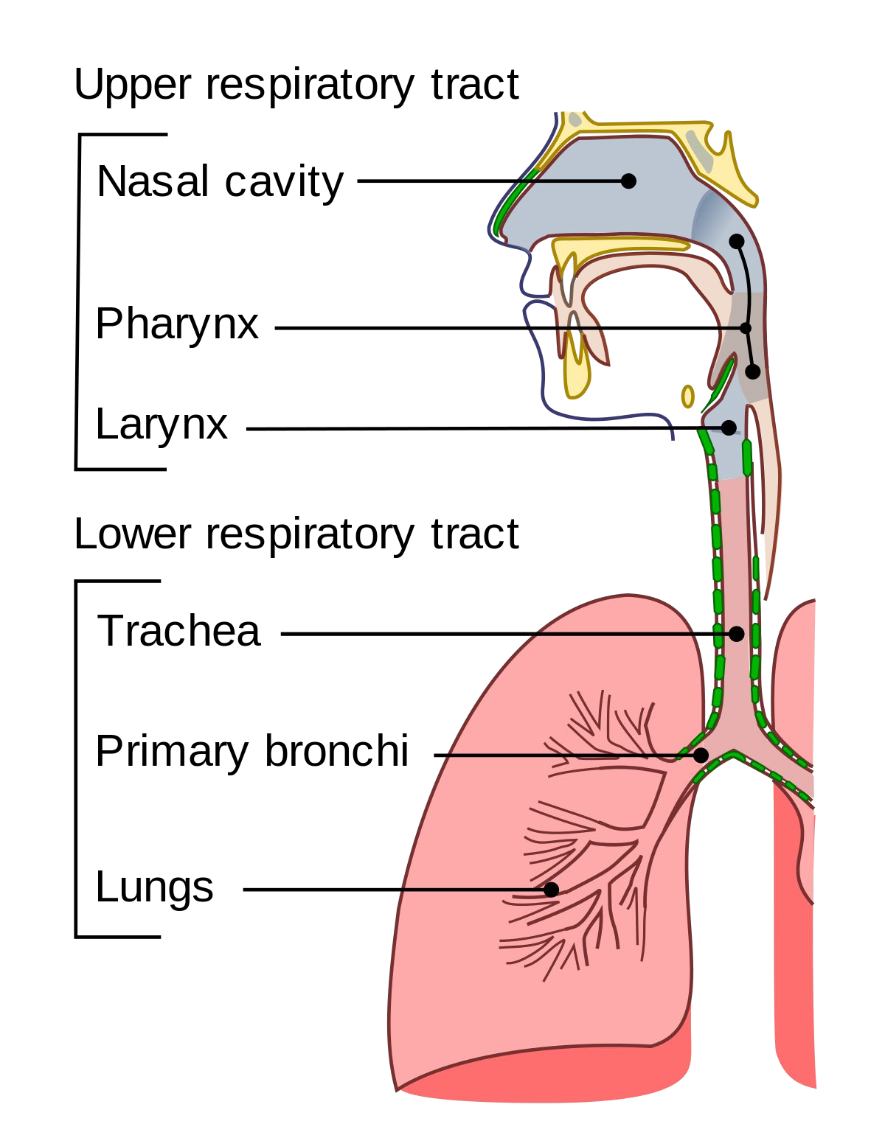
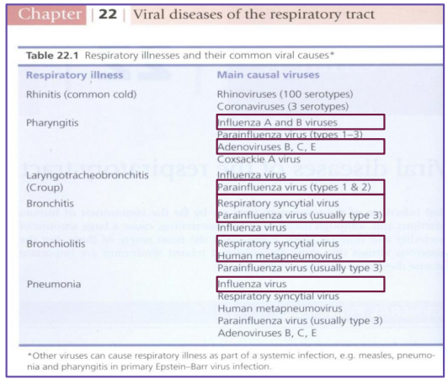
Respiratory Tract Infections
Are the commonest of human infections and cause a large amount of morbidity and loss of time at work (sick leave).
Are common in both children and adults.
Mostly caused by viruses.
Mostly are mild and confined to the upper respiratory tract (URT).
Mostly are self-limiting disease.
Only influenza virus and RSV can be treated
URT-infection may spread to other organs causing more severe infection and death.
Clinical Manifestations:
Common in upper respiratory tract:
Common cold (rhinitis).
Pharyngitis.
Tonsillitis.
Sinusitis & otitis media.
Common in lower respiratory tract:
Croup (acute laryngotracheobronchitis).
Acute bronchitis.
Acute bronchiolitis.
Viral pneumonia.
When the infection spreads to the
lung, it’s called pneumonia

Slide 4
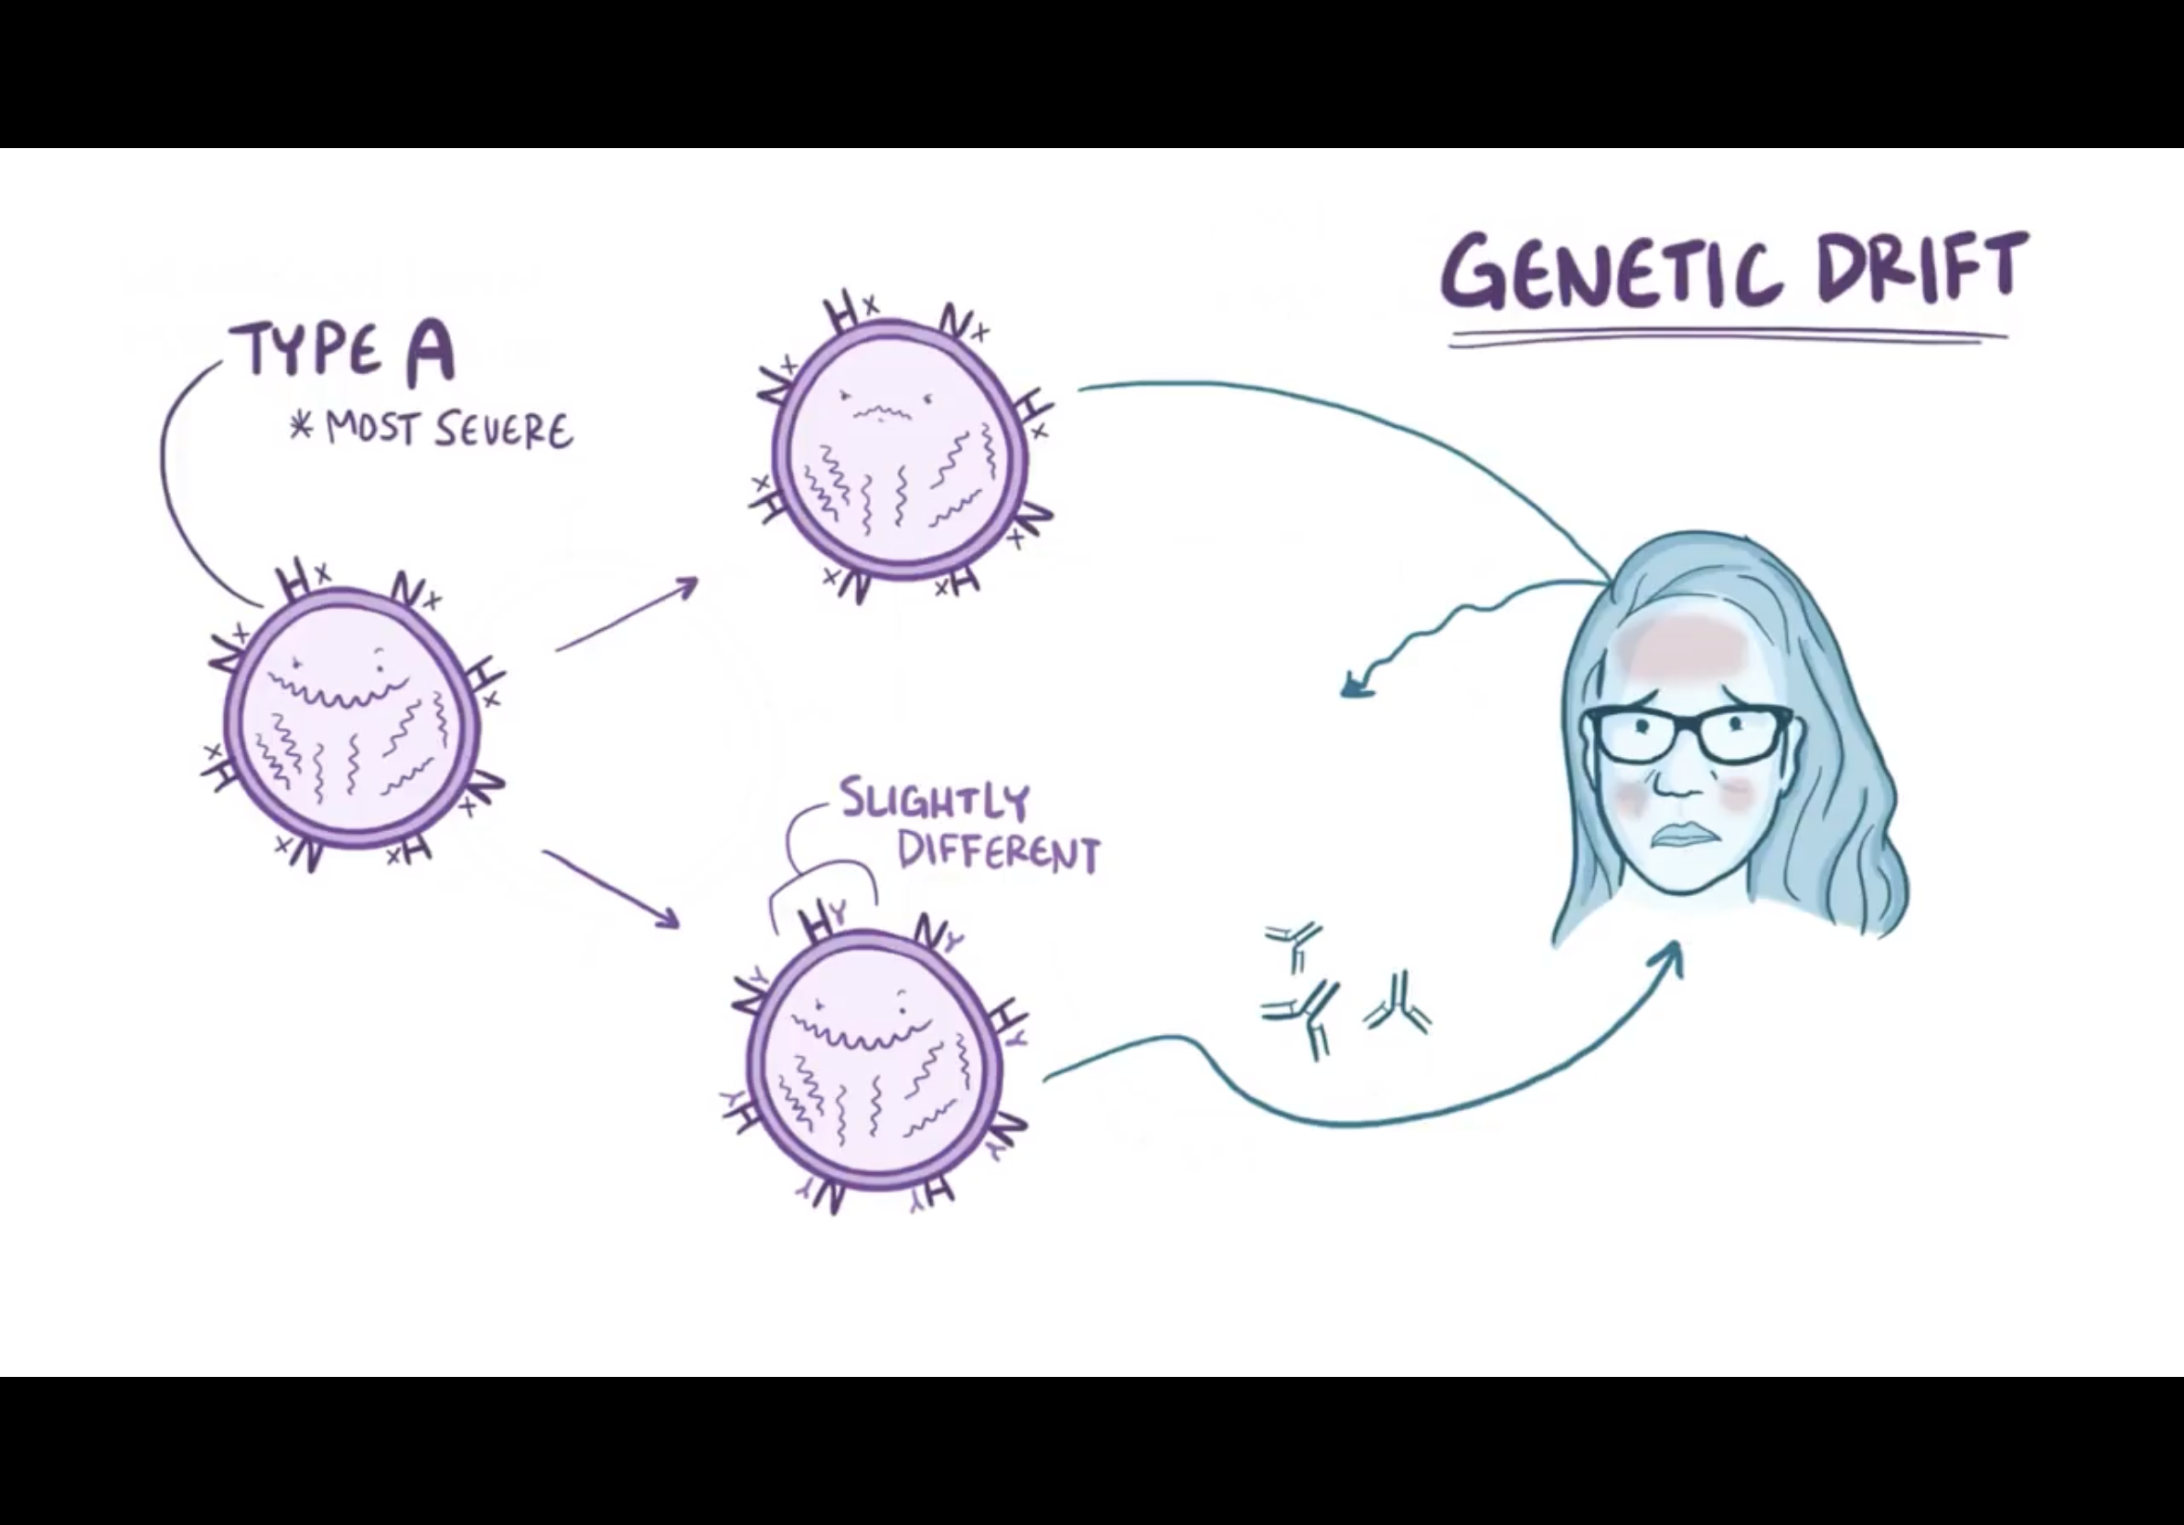
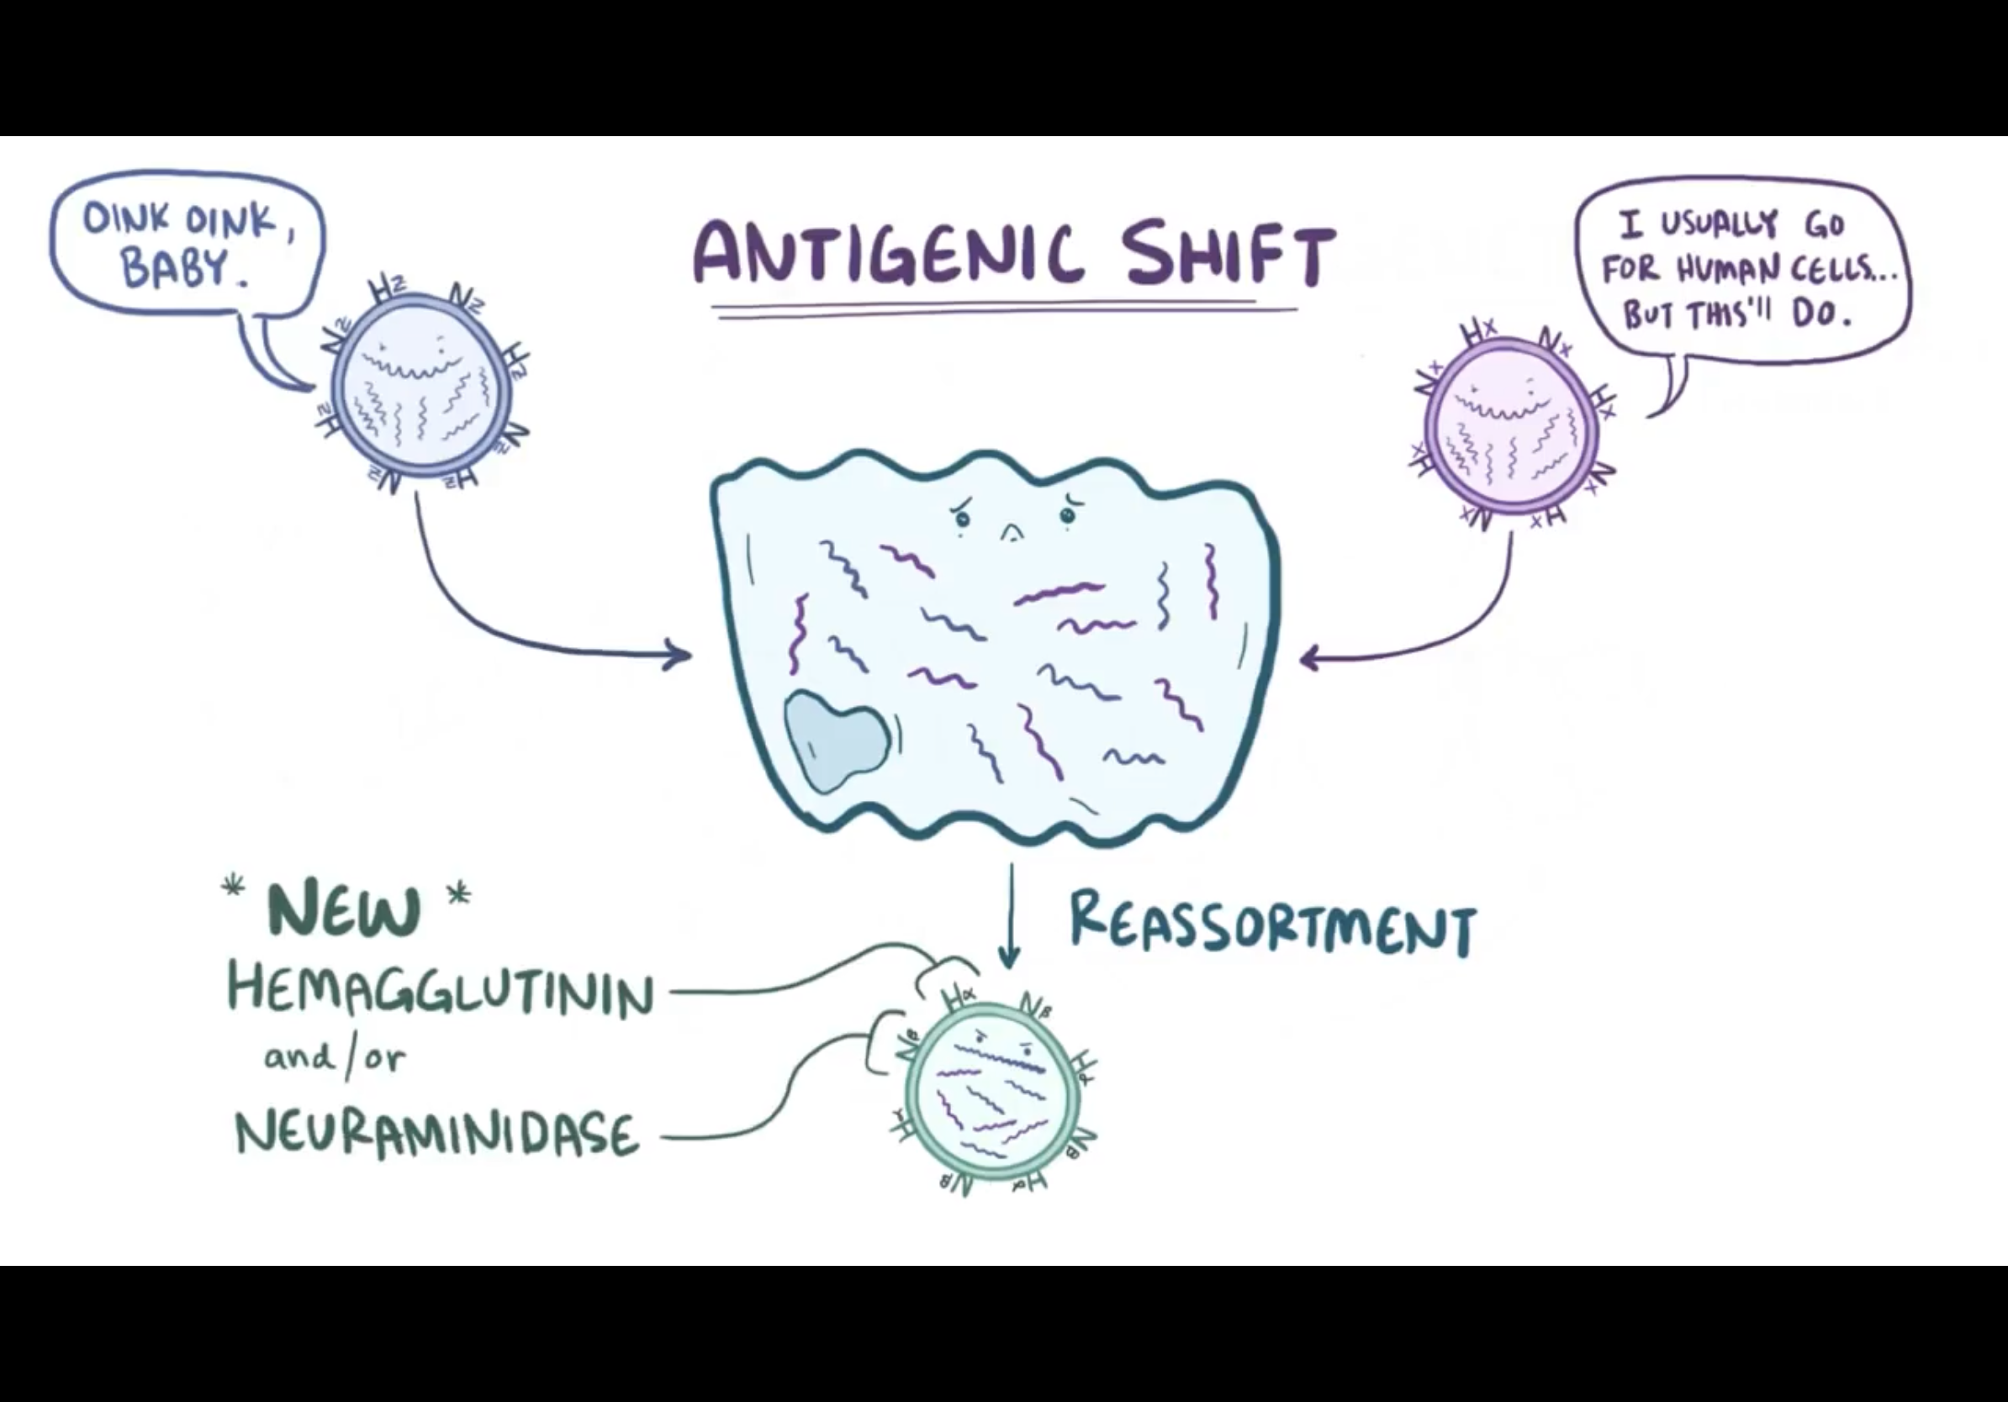
Types of influenza virus
A
B
C
• Infects human only
• Causes mild illness
A
B
C
• Infects human and Animal
• Causes epidemic & pandemic
• Causes epizootic in animal
• Antigenic drift= minor change
• Antigenic shift= major change= Reassortment= rearrangement
• Infects human only
• Causes outbreak
• Antigenic drift only
• Infects human only
• Causes mild illness
• Infects human only
• Causes outbreak
• Antigenic drift only
Antigenic shift and drift
• Infects human only
• Causes mild illness
Antigenic drift: the accumulation of a series of minor (small) genetic mutation.
غالبا یكون فیروس واحد صار له طفرة أكثر من مره ومع الزمن وكثرة الطفرات صار كأنه فیروس جدید مثلا تغیر مكان أو ترتیب الرسبترز مو أكثر من كذا
DRIFT / MUTATIONS HAPPEN WITH BOTH TYPE A & B
Antigenic shift: mixing of genes from influenza viruses from different species.
بالصورة الـ hemagglutinin والـ neuraminidase عند الانسان زي ما تشوفون شكله دائري ، وعند الطيور شكله مثلث ، هذا يعني أن حتى لو عندي طيور مصابة بانفلونزا ماراح تجيني عدوى لأن ماعندي رسبتر للمثلثات والعكس بالنسبة للطيور ماراح اعديها لأن ماعندها رسبتر للدوائر . اللي صار بعدين أن فيه خنزير اصابته العدوى من الإنسان والطيور برضو لأنه مخلوق عنده كل أنواع الرسبترز ، فصار عنده دوائر ومثلثات ، وحصل جوا جسمه reassortment للجينات والنتيجة طلع لنا فايروس جديد فيه دوائر ومثلثات ، وبيقدر يعدي الانسان والحيوان كلهم ، يعني نتج لي ، Influenza type A
SHIFT / REASSORTMENT ONLY HAPPENS WITH TYPE A

Slide 5
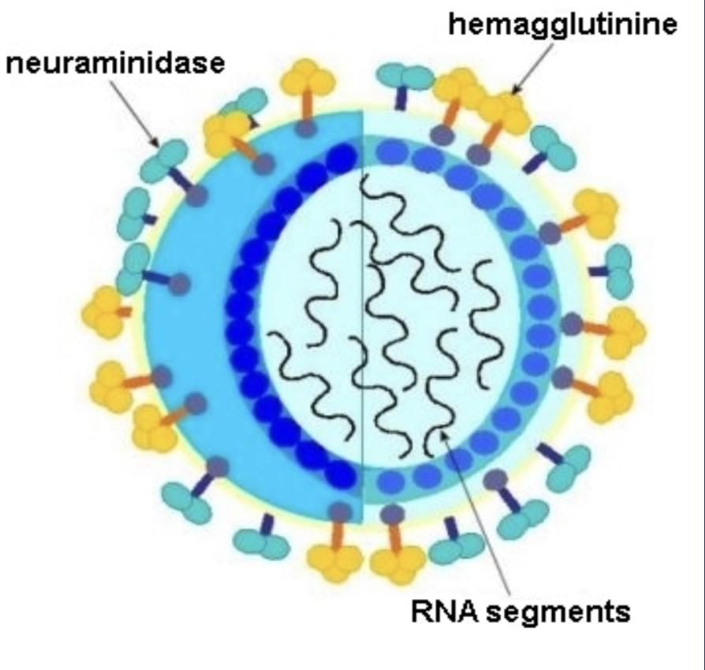
Influenza Virus
Family | Orthomyxoviridae. A family of RNA viruses
Structural features | Enveloped virus with 2 projecting glycoprotein spikes: 1- Haemagglutinin (H) 2- Neuraminidase (N)
Genome | 8 segmented negative (-ve) polarity single stranded RNA (ssRNA) This virus is highly susceptible to mutations and rearrangements within the infected host.
Pathogenesis | The virus infects the epithelial cells of the nose, throat, and bronchi. And occasionally it infects the lungs.
Transmission | Inhalation of infectious aerosol droplets.
I.P. | From 1-4 days. Incubation period is is the time elapsed between exposure to a pathogenic organism, and when symptoms and signs are first apparent.
Symptoms | Fever, malaise, headache, cough, chills, sore throat, and generalized pain.
Prognosis | Usually self-limiting disease. resolves spontaneously with or without specific treatment.
Complications | - Primary influenza pneumonia - 2nd bacterial pneumonia - Reye’s syndrome [fatty degeneration of CNS and Liver (Aspirin)] (people with influenza virus should not use aspirin)
Lab diagnosis | Routine testing by: Direct detection of Influenza A or B virus from sputum, nasopharyngeal swab, aspirate (NPA) or respiratory secretion by direct immunofluorescent assay (IFA). Other detection methods: Cell culture (we don’t use it anymore, because it takes 3-4 days), and PCR. RT-PCR: detection of the nucleic acid of RNA viruses PCR: detection of the nucleic acid of DNA viruses.
Treatment | Influenza A virus only: amantadine and Rimantadine. Both influenza A&B viruses: Oseltamivir (Tamiflu) or Zanamivir (Relenza). (They can be used as treatment and prophylaxis).
Will be discussed in slide 6
The RNA of this virus is segmented to 8 segments which makes it more prone to mutations and therefore we have to take a vaccine each year
Most of the viral infections are self-limiting( don’t need a medication) but we give these drugs to people with severe infections.

Slide 6
Influenza Virus, cont.
Prevention | Influenza vaccine:
 | The flu shot vaccine (★the annual trivalent flu vaccine): Inactivated (killed vaccine). | The nasal spray flu vaccine (Flu mist): Live attenuated vaccine.
 | Given to people older than 6-months, including healthy people and those with chronic medical conditions. | Approved for use in healthy people between 5-49 years of age.
 | Both vaccines contain two strains of the current circulating influenza A&B virus
 | Vaccine should be given in October or November, before the influenza season begins.
Influenza Viral Proteins
Haemagglutinin (H) | Neuraminidase (N)
Responsible for Attachment to the cell surface receptors. | Responsible for release of the progeny viral particles from the infected cell.
16 haemagglutinin antigenic type, H1 – H16. | 9 neuraminidase antigenic type, N1 – N9.
Antibodies to the HA is responsible for immunity. | -
Human associated H antigen type are H1,H2,H3 | Human associated N antigen are N1,N2
Neuraminidase: يسمح للفيروس انه يطلع من الخلية المصابة ويروح يعدي خلايا أخرى مجاورة
Type A influenzavirus : Divided into subtypes based on the hemagglutinin and neuraminidase proteins.
The currently circulating strains are: H1N1 & H3N2.

Slide 7
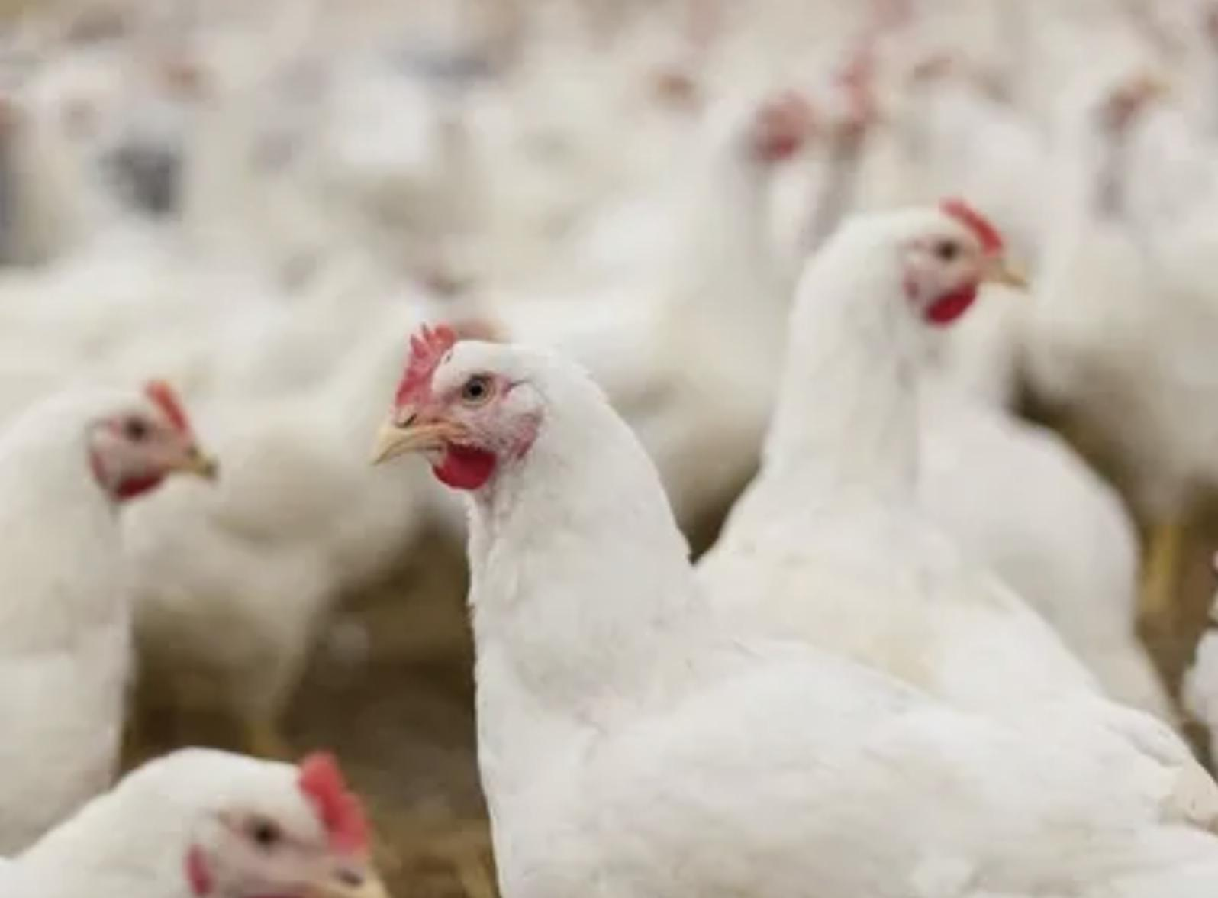
Avian Flu
(انفلونزا الطيور)
Family | Typical orthomyxovirus.
Viral etiology | Avian influenza type A virus (H5N1).
Epidemiology | Wild birds are the natural reservoir for the virus. They shed the virus in saliva, nasal secretion and feces. All domestic poultry are susceptible to infection. They become infected, when they eat food contaminated with secretion or excretion from infected bird. Avian influenza viruses do not usually infect human easily . High risk group includes those who working in poultry farms (مزارع الدواجن) and those who are in close contact with poultry.
Symptoms | Ranges from typical flu to severe acute lower respiratory disease. Diarrhea, abdominal pain and bleeding from the nose have been reported.
Treatment | Should be initiated within 48 hours. Oseltamivir and Zanamivir are used.
Lab diagnosis | PCR, detection of the viral RNA in throat swap, and nasopharyngeal aspirate (NPA).
Avian influenza type A virus (H5N1).
 | the presence of a certain type of viral receptor throughout the mucosa of the bird respiratory tract | in contrast ,human have this receptor only in alveoli, not in the upper respiratory tract.
The ability of H5N1 strain to infect birds more effectively than human is due to:
This explains why human are rarely infected with H5N1 but if human become infected will have severe lower respiratory tract infection and pneumonia.

Slide 8
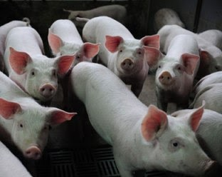
Swine Flu
Female slides only
(انفلونزا الخنازير)
Epidemiology | from 2009 to 2010 H1N1 influenza pandemic - In March 2009, an outbreak of respiratory illnesses was first noted in Mexico, which was eventually identified as being related to a novel H1N1 influenza A virus. The outbreak spread rapidly to the United States, Canada, and throughout the world as a result of airline travel In June 2009, the World Health Organization (WHO) raised its pandemic alert level to the highest level, phase 6
Etiology | The pandemic was caused by an H1N1 influenza A virus that represented a reassortment of two strains, one human strain, and one avian strain
Increased rates of severe complications, hospitalization, and death were observed among infected pregnant women compared with the general population, particularly during the second and third trimesters and after delivery.
Most deaths were related to respiratory failure resulting from severe pneumonia with multifocal infiltrates on lung . Although the majority of reported deaths occurred in individuals with underlying health problems ,up to one-third of hospitalized patients had no underlying chronic illness

Slide 9
Parainfluenza Virus
Dr: If croup / acute laryngotracheobronchitis are is suspected, YOU NEVER TAKE A THROAT SWAB!!! Go for NPA
More common in infant and young children. In adult is just a common cold
★ Clinical Syndromes
Family | Paramyxoviridae
Structural features | Enveloped virus Negative polarity, single stranded RNA genome Has 5 serotypes.
Transmission | Inhalation of infectious aerosol droplets mainly in winter
★ Clinical Syndromes
★ Infants & Young Children | Young Children | Adults
★Croup or Acute laryngotracheobronchitis Inflammation of vocal cords PIV Type-I, II. Fever, harsh (barking) cough, difficult inspiration (Can lead to airway obstruction which may require hospitalization and tracheostomy). Croup can either be Viral or Bacterial. Viral is Parainfluenza type I and II. Bacterial is H. influenza. How can we differentiate? We do CPC and if there is a) high number of Lymphocyte → viral croup b) high number of Polymorph → bacterial croup | Bronchiolitis and Pneumonia PIV Type-III | Common cold No fever
Lab diagnosis | Routine testing by: Direct detection of the virus from sputum, Nasopharyngeal swab, aspirate (NPA) or respiratory secretion by direct immunofluorescence assay (IFA). Other detection methods: tissue culture, PCR.
Treatment & prevention | Supportive treatment (reassurance), No specific treatment or vaccine available.
Treatment and prevention:
Routine testing by Direct detection of the virus from sputum, Nasopharyngeal swab, aspirate (NPA) or respiratory secretion by direct immunofluorescence assay (IFA).
tissue culture, PCR.
Supportive treatment (reassurance), No specific treatment or vaccine available.
Lab diagnosis:
Other detection methods:

Slide 10
Respiratory Syncytial Virus
(RSV & Human metapneumovirus)
Syncytial= fused cells
More common in infant
Family | Paramyxoviridae
Structural features | Enveloped virus Negative polarity, single stranded RNA genome.
Transmission | Inhalation of infectious aerosol droplets mainly in winter.
★ Clinical Syndromes
infants especially under 6 month | infants | Adults
★ Bronchiolitis Life-threatening disease with respiratory distress and cyanosis can be fatal and can lead to chronic lung disease in later life if not treated. | Pneumonia Can be fatal | Common cold No fever
Lab diagnosis | Routine testing by: Direct detection of the virus from sputum, Nasopharyngeal swab, aspirate (NPA) or respiratory secretion by direct immunofluorescence assay (IFA). Other detection methods: Isolation of virus by cell culture from N.P.A with multinucleated giant cell or syncytia as cytopathic effect (C.P.E); PCR .
Treatment & prevention | ★ Ribavirin administered by inhalation for infants with severe condition. ● No vaccine available, but passive immunization immunoglobulin can be given for infected premature infants.
(influenza(A&B),parainfluenza, and RSV viruses): have direct respiratory tract infection
Lab diagnosis:
Other detection methods:

Slide 11
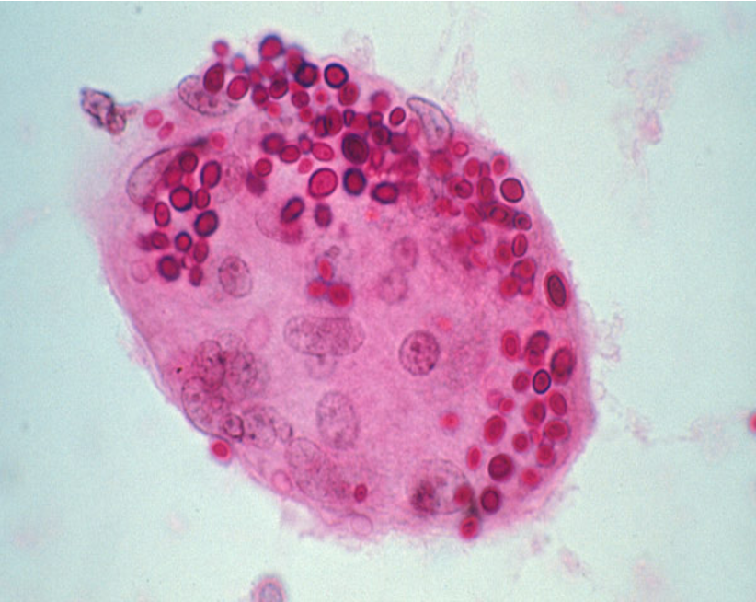
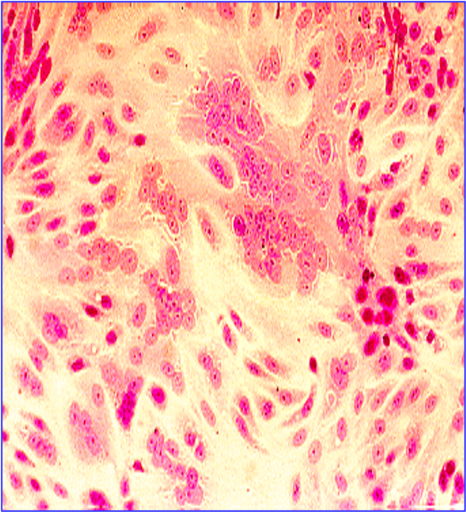
Respiratory syncytial virus
Female slides only
Multinucleated giant cells called syncytia
Usually these syncytia are the result of expression of a viral fusion protein at the host cell membrane during viral replication.
Viruses such as RSV are known to induce the formation of syncytia.

Slide 12
Measles Virus
(الحصبة)
Family | Paramyxoviridae
Structural features | Enveloped virus Negative polarity single stranded RNA genome.
Transmission | Inhalation of infectious aerosol droplets.
Epidemiology | Measles virus infects human only. So we can eradicate it (easy to control) Most cases in preschool children, very infectious. Infection occurs mainly in winter and spring.
Pathogenesis | 1- The virus infects first epithetical cells of upper respiratory tract. (It is not really a respiratory infection, but its transmission is throuh URT) 2- Then the virus spreads to the blood causing viremia Viremia = Fever 3- Then it infect the endothelial cells of blood vessels. 4- Then the virus reaches the lymphoid tissue where it replicates further and disseminates to the skin causing maculopapular rash.
I.P | Incubation period is 7- 14 days. (Influenza was 1-4 days, Measles & mumps have a longer IP because they cause a systemic infection)

Slide 13
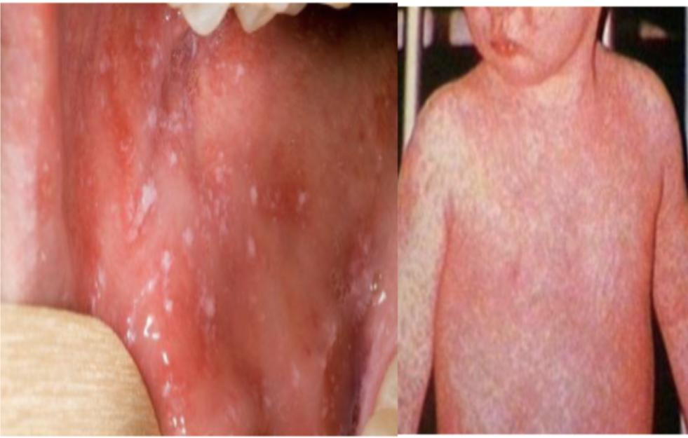
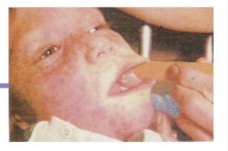
Measles Virus
Measles Maculopapular
Koplik’s spot
Clinical Features | Prodromal symptom: Fever, Cough, conjunctivitis(pink eye) and running nose. ★ Koplik’s spot: Small red papules with white central dots appear mostly in buccal mucosa. (buccal mucosa is the lining of the cheeks and the back of the lips, and inside the mouth). ★ Rash: Maculopapular rash first on face, trunk, extremities. The rash is red, become confluent, last for 4 or 5 days, then disappears leaving brownish discoloration of the skin and final desquamation. Recovery complete in normal children with life long sold immunity
Complications | ★ Encephalitis: Acute or subacute sclerosing panencephalitis (SSPE). (VERY RARE) Giant cell pneumonia: rare in immunocompromised children due to direct invasion of measles virus to the lung tissue.
Lab diagnosis | Serology by detection of IgM Ab using ELISA and in case of Subacute sclerosing panencephalitis (SSPE) detection of measles antibodies in CSF or detection of viral RNA using PCR.
Treatment & prevention | No specific treatment. prevention by giving the live attenuated vaccine ( MMR ) for Measles, Mumps, & Rubella(الحصبة الألمانية) ( to all children 15 months age and booster dose at school entry ), it give excellent long last protection.

Slide 14
Mumps Virus
Definition | ★ An acute benign viral parotitis. Parotitis: a painful inflammation & swelling of salivary gland, mainly parotid glands. A disease of children (5-15 years) Also can be seen in young adult, but with more complicated features.
Family | Paramyxoviridae
Structure features | Enveloped virus with Negative polarity, single stranded RNA genome. The viral envelope is covered with two glycoprotein spikes, hemagglutinin and neuraminidase.
Transmission | Inhalation of infectious aerosol droplets during sneezing and coughing, or direct contact with saliva.
Epidemiology | ★ Mumps virus infects human only (It’s easy to control, so we can eradicate it) Highly infectious, peak in winter. Long incubation period 18-21 days.
Pathogenesis | 1- Infection started in the epithelial cells of upper respiratory tract. 2- Then virus spread by viremia to parotid gland mainly. 3- Also might spread to other organs such as: testes, ovaries, pancreas and CNS.
Clinical Features | Classic mumps starts with moderate fever, malaise, pain on chewing or swallowing, particularly acidic liquids. Sudden onset of fever and painful swelling of parotid gland (parotitis) Self-limiting disease resolve within one week. Solid and long life immunity developed.

Slide 15
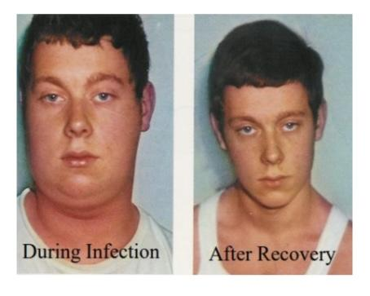
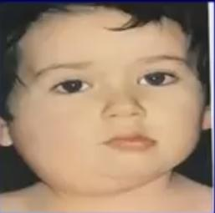
Mumps Virus
Very infectious
(More severe in adults)
Complications | Aseptic meningitis,Encephalitis, Pancreatitis Thyroiditis After puberty: Orchitis: inflammation of one or both testicles (inflammation of the testis). usually unilateral, rarely leads to sterility. Oophoritis: inflammation of ovaries.
Lab diagnosis | ★ Serology by detection of IgM specific Abs using ELISA cell culture and isolation of the virus from saliva or detection of viral RNA using PCR.
Treatment & prevention | No specific antiviral treatment Prevention by giving the live attenuated vaccine (MMR) for Measles, Mumps and Rubella, MMR is live attenuated vaccine given to all children 15 months old & a booster dose at school entry Give excellent long last protection.
Thank you Najla
هو نفسه الفايروس الي جاهم interesting صح?

Slide 16
Summary
 | Influenza virus | Avian flu | Parainfluenza virus | RSV | Measles | Mumps
Family | Orthomyxoviridae |  | Paramyxoviridae
Structural features | -Enveloped virus -Negative polarity,Single stranded RNA genome.(ssRNA) | - | -Enveloped virus -Negative polarity,Single stranded RNA genome.(ssRNA)
Transmission | Inhalation of infectious aerosol droplets. | Contact with infected poultry | Inhalation of infectious aerosol droplets. Mumps also could be transmitted by direct contact with saliva.
Manifestations | Fever, malaise, headache, cough, chills, sore throat, and generalized pain. | -Ranges from typical flu to severe acute respiratory disease. -Diarrhea, abdominal pain and bleeding from the nose | ★ Infants & Young Children Croup or Acute laryngotracheobronchitis Fever, harsh (barking) cough, difficult inspiration PIV Type-I, II. Young Children Bronchiolitis and Pneumonia PIV Type-III | infants especially under 6 month: Bronchiolitis infants: Pneumonia | -Koplik’s spot -Maculopapular rash -Fever, Cough, conjunctivitis and running nose | -Parotitis - moderate fever, malaise, pain on chewing or swallowing, particularly acidic liquids. -Sudden onset of fever and painful swelling of parotid gland (parotitis)
Complications | - Primary influenza pneumonia - 2nd bacterial pneumonia - Reye’s syndrome [fatty degeneration of CNS and Liver (Aspirin)] (people with influenza virus should not use aspirin) | - | - | - | -★ Encephalitis: Acute or subacute sclerosing panencephalitis (SSPE). -Giant cell pneumonia. | Aseptic meningitis, Encephalitis, Pancreatitis, Thyroiditis. After puberty: -Orchitis -Oophoritis.
Lab diagnosis | -Nasopharyngeal swab, aspirate (NPA) -direct immunofluorescent assay (IFA). -PCR | -Nasopharyngeal swab, aspirate (NPA) -PCR | -Nasopharyngeal swab, aspirate (NPA) -direct immunofluorescent assay (IFA). -PCR |  | -ELISA (Serology) (detection of IgM specific antibodies) -PCR
Prevention | The flu shot vaccine: for Healthy people The nasal spray flu vaccine: including healthy people and those with chronic medical conditions. | - | No specific treatment or vaccine available. | No vaccine but passive immunization immunoglobulin can be given for infected premature infants. | (MMR) for Measles, Mumps and Rubella
Treatment | influenza A virus only: amantadine & Rimatidine Both A&B: -Oseltamivir (Tamiflu) -Zanamivir (Relenza) | -Oseltamivir -Zanamivir |  | ★ Ribavirin administered by inhalation for infants with severe condition. | No specific treatment | No specific treatment

Slide 17
Questions from the doctor
SAQ
Q1: A 2-year-old child presents to the pediatrician’s office for a rash. Her mother is against vaccines, so the child had not received any childhood vaccines. On physical exam, she has a high fever as well as a confluent maculopapular rash. She also has blue-white spots on her buccal mucosa.
A) What do you think is the virus?
B) How will you diagnose it?
C) Treatment or prevention?
D) What are possible complications?
Q2: 5-month-old girl was admitted to the emergency department of a secondary hospital for recurrent episodes of shortness of breath. She had been referred to the hospital by the general practitioner after 3 days of gradually worsening symptoms of difficult breathing, cough and expiratory wheeze. No medication had been given. Physical examination on admission showed a well-developed, well- nourished infant. There were no congenital abnormalities. The patient had a normal weight and length. Temperature: 38, BP: 90/65 mmHg Heart rate: 140/min Respiratory rate: 65/minute with nasal flaring and intercostal retractions, Pulse oximetry: 95% on room temperature.
A) What is your diagnosis?
B) What virus could this be a complication of?
C) How will you confirm it in the lab?
D) Your choice of treatment?
E) Is there a vaccine for the causative virus?
Q3: 1-year-old boy who was brought to the clinic in January because he
developed fever, chest congestion, rhinorrhea, decreased oral intake and a "barking" cough 3 days previously. His medical history was significant only for recurrent otitis media. On examination, his temperature was 38.40C. He was in acute distress and had audible obstructive upper airway sounds. His throat was erythematous. On lung examination, upper airway sounds were prominent and there was wheezing and subcostal retractions.
A) What is your diagnosis?
B) What lab diagnostic method should be asked for?
C) What are other complications that this virus may cause?
D) What is your choice of treatment?
Answers Key
A1:
(A)Measles
(B) Serology IgM, ELISA
(C) No treatment, but MMR vaccine
(D) Encephalitis & Giant cell pneumonia
A2:
(A) Bronchiolitis
(B) RSV infection
(C) Nasopharyngeal swab + IFA
(D) Ribavirin
(E) Nope
A3:
(A) Croup Aka. Acute laryngotracheobronchitis
(B) Nasopharyngeal swab, aspirate (NPA) + IFA
(C) Bronchiolitis and Pneumonia
(D) Supportive treatment

Slide 18
MCQs
1-A 2-B 3-B 4-B 5-A 6-C
1- 6-month-old boy was hospitalized for having fever, Harsh (barking) cough, difficulty in breathing, which worsen and led to airway obstruction. NPA was taken and an enveloped ssRNA virus was detected. What is the most likely diagnosis?
A-laryngotracheobronchitis (croup) | B-Bronchiolitis | C-Pneumonia | D-لا تختار ذا الجواب
2-In the previous question what is the most likely organism?
A-RSV | B-Parainfluenza virus | C-Measles | D-Mumps
3-What is the function of the Neuraminidase viral protein?
A-Attaches to the cell surface receptor. | B-Responsible for release of the progeny viral particles from the infected cell. | C-Phagocytosis. | D-Division.
4-Mumps virus infects?
A-Infants only | B-Human only | C-Human & animal | D-Animal only
5-Ribavirin is an antiviral drug effective against?
A-Respiratory syncytial virus | B-Influenza virus | C- Mumps virus | D- Measles virus
6-Koplik’s spot is a clinical feature of ?
A-Mumps virus | B-Influenza virus | C-Measles virus | D-Parainfluenza virus
For more questions click here!

Slide 19
Microbiology Team⁴⁴²
Leaders
Shaden Albassam | Mohammed Alghamdi
Co-Leader Ahmad Bahmaid Members
Raghad Alnadeef | Yazeed Hussein
Ghada Binslmah | Talal Alharbi
Tharaa Alhowaish | Meshari Alshathri
Amani Alotaibi | Emad Almutairi
Nouf Alsaigh | Abdulrahman Al-Douir
Razan Almanjomi | Abdulrahman Binbakhit
Shahed Bukhari | Abdullah Alshahri
 | Abdulaziz Alnasser
 | Luay Almutair
 | Ali Dhafer Jabaan
 | Abdulaziz Alotaibi
Special Thanks to Microbiology Team⁴⁴¹
Thanks to the amazing Sara Alhamlan for the great theme!
Microbiology442@gmail.com

