Slide 1
Respiratory Viral Infections (2)
Editing File

Slide 2
Objectives
The students should be able to recognize:
Characteristics of SARS-COV-2,MERS-CoV, Rhinovirus,
Coxsackieviruses & other Picronaviruses, Adenovirus, Epstein
– Barr virus.
Mode of transmission.
Clinical features.
Lab diagnosis.
Treatment & prevention.

Slide 3
Extra slide
Overview
Epstein-Barr Virus
Adenovirus
Herpesviridae
Adenoviridae
Viruses
Picornaviridae
Coronaviridae
Rhinovirus
SARS-CoV
Coxsackieviruses
MERS-CoV
SARS-CoV 2

Slide 4
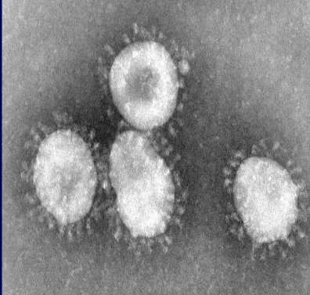
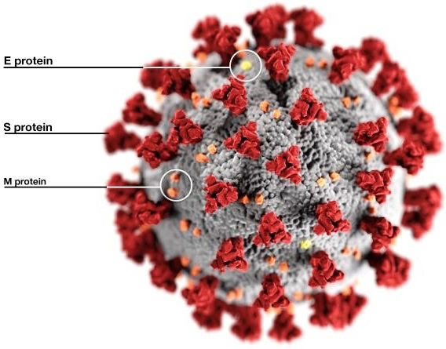
Coronavirus
Family | Coronaviridae
Structural features | Enveloped virus with positive polarity ss-RNA genome.
Transmission | Inhalation of infectious aerosol droplets.
Clinical symptoms | ★The 2nd cause of common cold.
Epidemiology | causes zoonotic disease (infects humans and animals including birds, camels, pigs and others). The infection becomes uncontrollable when it became zoonotic,because we can’t control animals.
Corona prefix comes from the Latin word crown
named for the “crown-like” appearance of virus (The appearance of the S spike structures)
SARS-CoV
Severe Acute Respiratory Syndrome (SARS)
Overview | In winter of 2002, a new respiratory disease known as (SARS) emerged in China after a new mutation of coronavirus. The disease spread worldwide due to travelling.
Reservoir | The animal reservoir may be rats or cats
Clinical symptoms | SARS starts with high fever followed by cough with difficulty breathing ★(atypical pneumonia). Associated with high mortality due to respiratory failure.

Slide 5
MERS-Cov
Middle East Respiratory Syndrome (MERS)
Overview | In September 2012, a case of novel coronavirus infection was reported involving a man in Saudi Arabia who was admitted to a hospital with pneumonia and acute kidney failure. This virus has been named Middle East Respiratory Syndrome (MERS), it caused by coronavirus
Source | -Mutation in bats or camels
Epidemiology | So far, all the cases have been linked to countries in and near the Arabian Peninsula. • Highly infectious • Incubation period 2-14 days.
Infection caused | MERS-CoV infected several human cells , including lower, but NOT upper Respiratory track .kidney.intestinal and liver cell
Transmission | • from ill people to others through close contact. • no evidence of sustained spreading in community settings. • Evidence suggest that the virus can be acquired from direct close contact with animals.
Clinical Symptoms | • fever, cough, and shortness of breath. • Some had gastrointestinal symptoms including diarrhea and nausea/vomiting. • Some had mild cold like symptoms and others had no symptoms and recovered. • Most people with comorbidities developed severe acute respiratory illness.
Risk groups | • Individuals with weakened immune systems • People with pre-existing medical conditions (or comorbidities) such as diabetes, cancer, and chronic lung, heart, and kidney disease.
Complications | • ★Severe complications include pneumonia and kidney failure. About 30% of people infected with MERS died.
Lab diagnosis | •Detection of the viral nucleic acid (NA,nasopharyngeal) by PCR. •Other methods: Isolation of the virus from NPA by cell culture. not for diagnosis only for scientific research
Treatment | No specific antiviral treatment. For severe cases, current treatment includes care to support vital organ functions.
Prevention | • Wash hands often with water and soap or use an alcohol-based hand sanitizer. • Cover nose and mouth with a tissue when cough or sneeze. • Avoid touching eyes, nose and mouth with unwashed hands. • Avoid personal contact with sick people. • Clean and disinfect frequently touched surfaces such as toys and doorknobs.
Reason of not having a vaccine : this disease was not pandemic

Slide 6
SARS-CoV-2
Severe Acute Respiratory Syndrome (SARS)
Overview | In 2019, a new coronavirus emerge in Wuhan, Chania and cause a respiratory disease known as COVID19.
Epidemiology | Highly infectious and cause pandemic infection. • Incubation period 2-14 days.
Transmission | Animal to human and human to human through inhalation of infectious aerosol droplets and close contact.
Risk groups | • individuals with weakened immune system. • people with pre-existing medical conditions or comorbidities like diabetes, cancer, obesity, chronic heart, lung and kidney disease. • smokers.
Clinical Symptoms | The symptoms vary from asymptomatic to mild or severe conditions, the main symptoms include: fever, headache, sore throat, myalgia, progressive dry cough, diarrhea, loss of taste and smell, vomiting, short of breathing, pneumonia.
Complications | Difficulty in breathing, severe pneumonia and death.
Lab diagnosis | •Detection of the viral nucleic acid (NA) by RT-PCR. •Other methods : Isolation of the virus from NPA by cell culture . culturing NPA sample requires level 3 lab.
Treatment | No specific antiviral therapy, Some patients got benefit from dexamethasone treatment.
Prevention | People are advised to protect themselves by taking preventive actions: • wash hands •use sanitizer •wear a face mask • social distancing.
vaccines | approved by saudi FDA: 1- pfizer an mRNA vaccine. 2- AstraZeneca a harmless viral vector vaccine. 3-Moderna vaccine

Slide 7
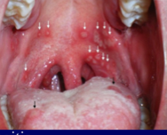
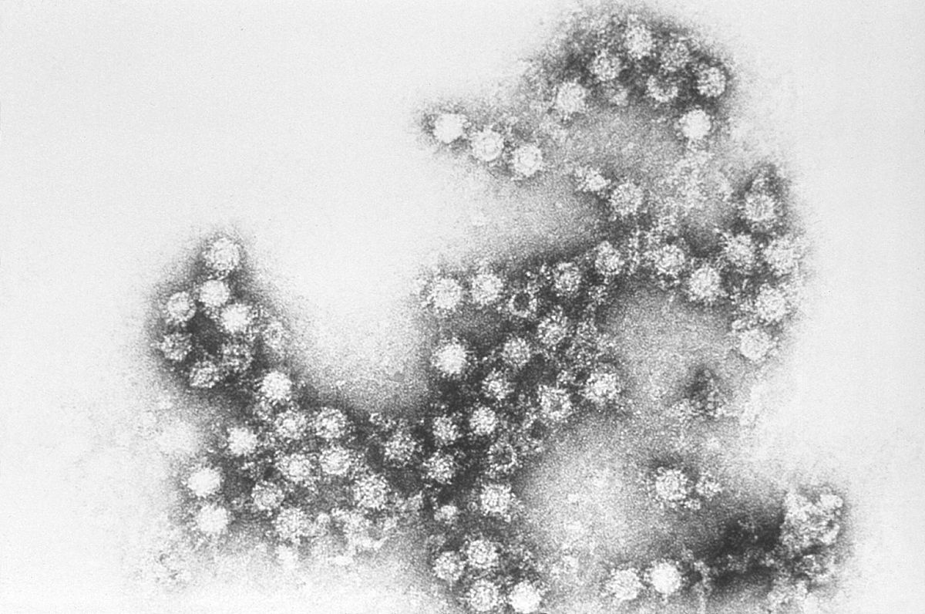
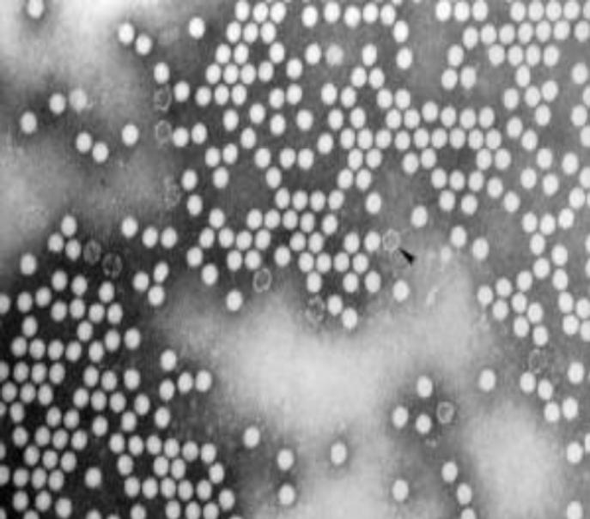
Rhinovirus,Coxsackieviruses & other Picronaviruses
 | Coxsackieviruses & Other Picronaviruses | Rhinovirus
Family | Picornaviridae
Structural Features | Non-enveloped virus with positive polarity ssRNA genome
Transmission | ★Inhalation of infectious aerosol droplets . Droplet transmission occurs when a person is in in close contact (within 1 m) with someone who has respiratory symptoms
Clinical Symptoms | •Coxsackieviruses cause ★herpangina and pharyngitis Echovirus & other Enteroviruses cause respiratory symptoms. Herpangina: small blister like ulcer appear on tongue and roof if oral cavity | •★The 1st cause of common cold. Dr:مابدياكم تعرفو اكثر من هيك •The main symptoms of common cold are sneezing, clear watery nasal discharge with mild sore throat, and cough
Lab diagnosis | routine testing by detection of the viral NA from NPA using RT-PCR.
Treatment and prevention | Usually self-limiting disease, no specific treatment, and no vaccine available.
Notes | Other Picroviruses would be • Coxsackieviruses group A & B • Echovirus, Enteroviruses. | More than 100 serotypes available.
Picture
Coxsackieviruses and Rhinovirus are the same , however they differ in their phenotypic characteristics .
Rhinovirus mainly affects the respiratory tract ,while coxsaclieviruses
mainly affects respiratory tract AND GIT (distal small bowl)

Slide 8
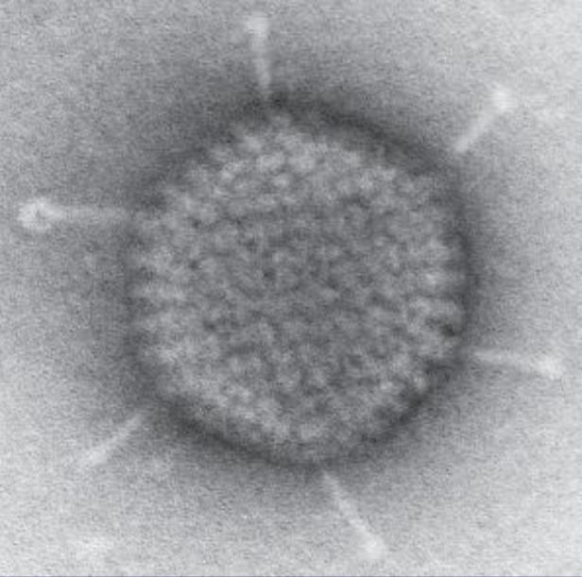
Adenovirus
Family | Adenoviridae: DNA
Structural features | Non-enveloped virus with ds-DNA genome.
★Pathogenesis | It infects epithelial cell lining respiratory tract, conjunctiva, urinary tract ,gastrointestinal tract genital tract.
Clinical syndrome | 1-Pharyngitis and tonsillitis 2-Pharyngoconjunctivitis 3-Conjunctivitis One of the most dangerous adenovirus causes red eye where the whole conjunctiva becomes red and it’s highly transmitted to other patients 4-Pneumonia: in preschool children 5-gastroenteritis 6-Acute hemorrhagic cystitis 7-UTI (Cervicitis and urethritis) Does everything other than meningitis and encephalitis (IMPORTANT)
Lab Diagnosis | -Routine testing by direct detection of the Ag from NPA by direct IFA -Other Method : Tissue culture,PCR
Treatment and prevention | No specific treatment or vaccine

Slide 9
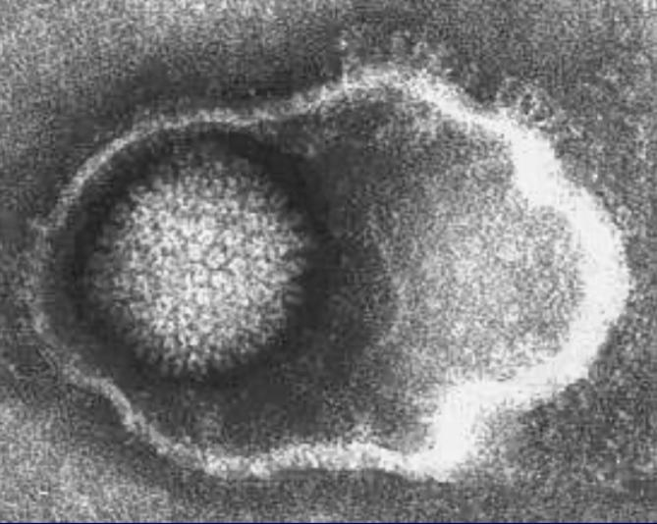
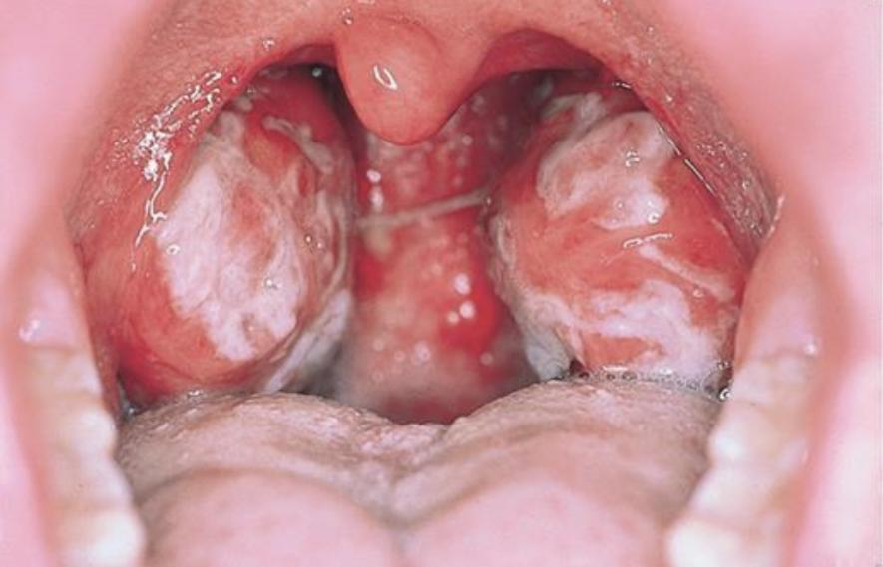
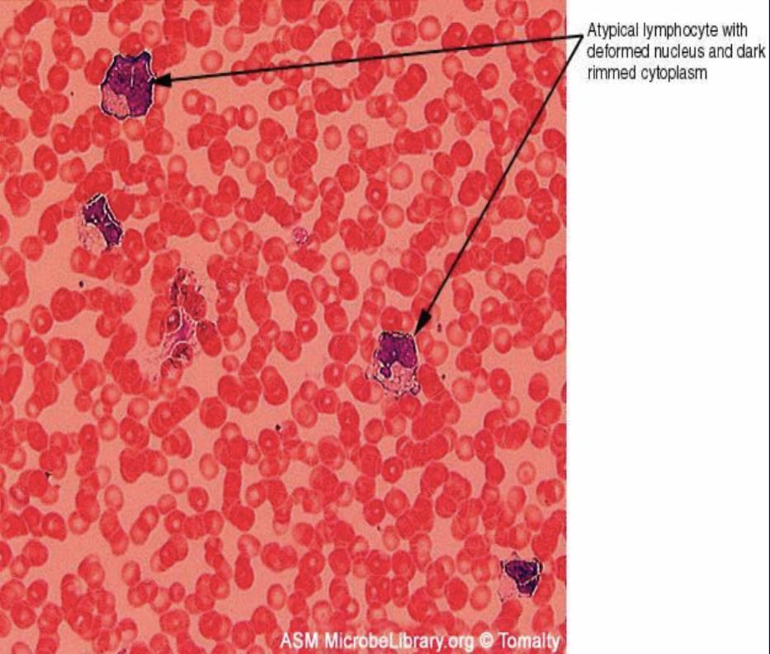
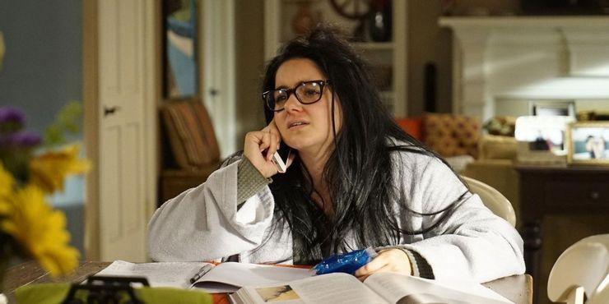
Epstein-Barr Virus
(EBV)
(Infectious mononucleosis)
Family | Herpesviridae
Structural features | Enveloped , icosahedral dsDNA virus
Pathogenesis | -Lymphotrophic Causes lymphocytosis that produce atypical lymphocytes (especially B cells) which results in production of non-specific antibodies (Heterophile antibodies). Lymphotropic = Likes to go to the lymphatic system. Lymphocytosis =production of lymphocytes (B&T lymphocytes). - ★Has oncogenic properties: Burkitt’s lymphoma , Nasopharyngeal carcinoma
Epidemiology | Distribution : worldwide (mainly in teenagers and young adults) Age : Socio-economic status : SE Low SE class : Early childhood High SE class : Adolescence It does not go away completely, it hides in the lymphatic system until something triggers it and comes back.
Transmission | Saliva (kissing disease) Blood(rarely)
Diagnosis | •Hematology High WBC is lymphocytosis (Atypical lymphocytes) it’s normally 6-11, but in this case it might reach 25-100 •Serology tests -Non-specific AB test ; Heterophile ABs +ve / Paul Bunnell or monospot test -EBV-specific AB test ; Detection of IgM antibodies to EBV capsid antigen by ELISA •PCR: Detecting Specific the DNA
Treatment and prevention | No specific treatment for infectious mononucleosis or vaccine
This is the same disease that Alex was infected by in modern family season 8 , episode 2 .

Slide 10
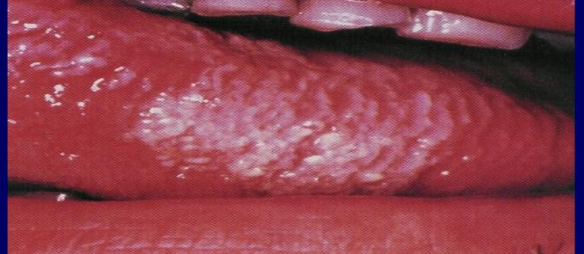
Epstein-Barr Virus
(EBV)
Immunocompetent Host
Immunocompromised Host
-Asymptomatic
-Infectious mononucleosis (glandular fever)
It could be Asymptomatic in some patients, and infectious mononucleosis in others.
-IP=4-7 weeks
-Fever,sore throat,tonsillitis,pharyngitis,malaise,
hepatosplenomegaly,abnormal liver enzymes,hepatitis
Complications :
(Acute airway obstruction,splenic rupture,CNS infection)
Lymphoproliferative disease(LD)
characterized by the abnormal proliferation of lymphocytes into a monoclonal lymphocytosis
Oral Hairy leukoplakia(OHL)
It causes white patches on your tongue. Sometimes the patches happen in other parts of your mouth.)
DNA Viruses: | RNA Viruses:
EBV Adenovirus | Coronavirus Rhinovirus Coxsackieviruses & picornaviruses
★ In this lecture we have two DNA viruses: EBV and adenovirus، as the rest of the viruses are RNA

Slide 11
Summary | Coronavirus | Rhinovirus | Epstein-Barr virus | Adenovirus
Family | Coronaviridae | Picornaviridae | Herpesviridae | Adenoviridae
Structural | Enveloped Single Strand RNA + Polarity | Non enveloped . Single Strand RNA +polarity | Enveloped Double stranded DNA genome | Non enveloped Double stranded DNA genome
Types | SARS-CoV SARS-CoV 2 MERS-CoV | - | - | -
Pathogenesis | - | - | - | Infection of epithelial cell lining of : Respiratory tract Conjunctiva Urinary tract Gastrointestinal tract Genital tract
Transmission | Inhalation of infectious aerosol droplets |  | Saliva (kissing disease) | Inhalation of infectious aerosol droplets
Symptoms | SARS-CoV: 2nd cause of common cold | 1st cause of common cold Clinical Sneezing symptoms Clear watery nasal discharge Mild sore throat ,Cough | Fever Sore throat Pharyngitis Malaise Hepatosplenomegaly | 1-Pharyngitis and tonsillitis 2-Pharyngoconjunctivitis 3-Conjunctivitis 4-Pneumonia: in preschool children 5-gastroenteritis 6-Acute hemorrhagic cystitis 7-UTI (Cervicitis and urethritis)
Syndrome | causes zoonotic disease (the virus is capable of infecting humans and animals including birds, camels, pigs and others). | - | - | -
Lab diagnosis | - | Detection of viral NA from nasopharyngeal aspirate (PCR) | Detection of IgM antibodies to EBV capsid Ag by ELISA (specific) Elevated WBC | Direct detection of Ag from nasopharyngeal aspirate by immunofluorescence assay PCR
Treatment | - | Usually self-limiting disease No specific treatment No vaccine | No specific treatment No vaccine
Extra | - | - | Causes mononucleosis § It is lymphotropic .It has oncogenic properties Burkitt’s lymphoma ,Nasopharyngeal carcinoma Socio-economic status: Low SE–early childhood High SE – adolescence | Does Everything other than Meningitis and Encephalitis

Slide 12
These MCQs where given by the girl’s doctor as examples
MCQs
1-C
2-B
3-D
4-D
5-A
6-C
1- What is the First cause of common cold ?
A-Coronavirus | B-Epstein-Barr Virus | C-Rhinovirus | D-Adenovirus
2-Which virus causes herpangina and pharyngitis ?
A-Epstein-Barr Virus | B-Coxsackieviruses | C-Adenovirus | D-Coronavirus
3-Which virus has an oncogenic properties ?
A-Rhinovirus | B-Coronavirus | C-Coxsackieviruses | D-Epstein-Barr Virus
4-This virus is known as the kissing disease :
A-Rhinovirus | B-Coronavirus | C-Coxsackieviruses | D-Epstein-Barr Virus
5-The genome of Adenovirus is:
A-Ds-DNA | B-Ss-DNA | C-Ds-RNA | D-Ss-RNA
6-How can EBV Virus affect an Immunocompetent host:
A-Lymphoproliferative Disease (LD) | B- Oral Hairy Leukoplakia (OHL) | C- Infectious mononucleosis | D- Burkitt’s Lymphoma
For more questions click here!

Slide 13
Microbiology Team⁴⁴²
Leaders
Shaden Albassam | Mohammed Alghamdi
Co-Leader Ahmad Bahmaid Members
Raghad Alnadeef | Yazeed Hussein
Ghada Binslmah | Talal Alharbi
Tharaa Alhowaish | Meshari Alshathri
Amani Alotaibi | Emad Almutairi
Nouf Alsaigh | Abdulrahman Al-Douir
Razan Almanjomi | Abdulrahman Binbakhit
Shahed Bukhari | Abdullah Alshahri
 | Abdulaziz Alnasser
 | Luay Almutair
 | Ali Dhafer Jabaan
 | Abdulaziz Alotaibi
Special Thanks to Microbiology Team⁴⁴¹
Thanks to the amazing Sara Alhamlan for the great theme!
Microbiology442@gmail.com

