Slide 1
Respiratory Fungal Infections
Editing File

Slide 2
Acquire the basic knowledge about fungal infections of the respiratory system.
Know the main fungi that affects the respiratory system.
Identify the clinical settings of such infections.
Know the laboratory diagnosis, and treatment of these infections.

Slide 3
Respiratory Fungal Infections
Respiratory Fungal infections are less common than viral and bacterial infections.
Some of them are more invasive, which makes them significantly harder to diagnose and treat.
Etiology of Respiratory Fungal Infection
Yeast (opportunistic) | ● Candidiasis ● Cryptococcosis (Cryptococcus neoformans, C. gattii)
Mould Fungi (opportunistic) | ● Aspergillosis (Aspergillus species) ● Zygomycosis (Zygomycetes, e.g. Rhizopus, Mucor) ● Other mould
Dimorphic Fungi :(Primary Infections) Team 439 Have 2 forms depending on environmental factors 1- it grows as yeast at body temperature 2- grows as mould at room temperature | ● Histoplasma capsulatum
 | ● Blastomyces dermatitidis
 | ● Paracoccidioides brasiliensis ● Coccidioides immitis
Team439: Fungal infections usually cause mild symptoms or self-limited in the immunocompetent host. In the immunocompromised host it causes severe infections and may disseminate throughout the body

Slide 4
Primary Systemic Mycoses
Primary systemic Infections
● Infections of the respiratory system (Inhalation)
● Dissemination seen in immunocompromised hosts (more severe)
● Common in North America and to a lesser extent in South America. Not common in other parts of the world.
Etiology: Dimorphic Fungi include:
Highly infectious
Primary Pathogens
Found in nature in soil of restricted habitats
They Include
Histoplasmosis
Blastomycosis
Coccidioidomycosis
Paracoccidioidomycosis

Slide 5
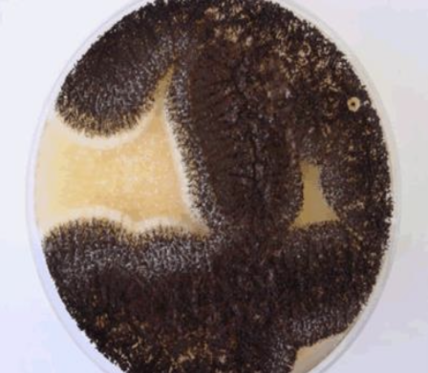
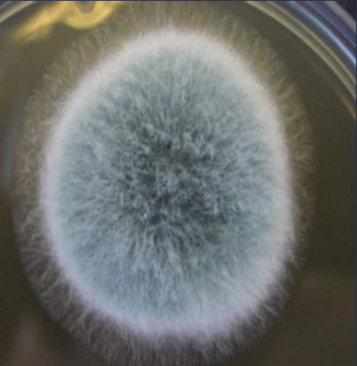
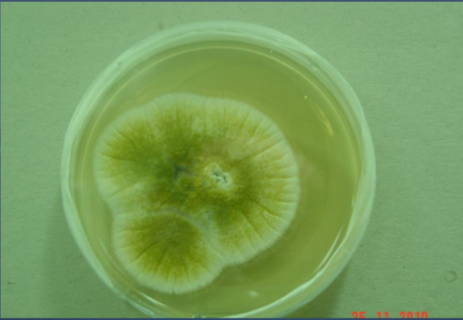
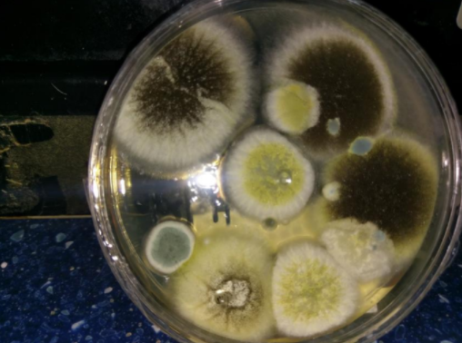
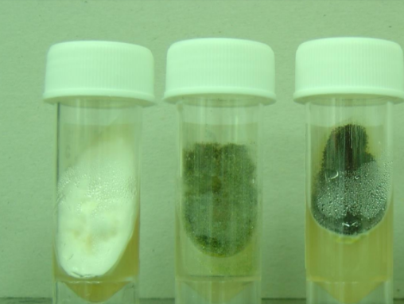
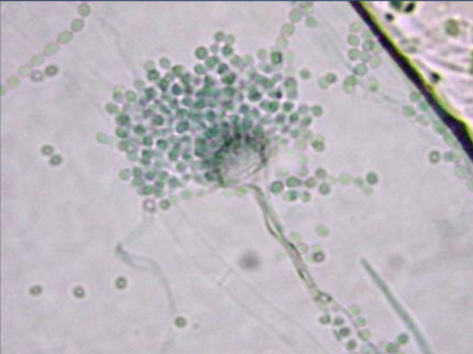
Aspergillosis:
Aspergillosis is a spectrum of diseases of humans and animals caused by members of the genus Aspergillus.
Clinical Presentations of Aspergillosis: | ● Mycotoxicosis: A condition caused by the ingestion of mycotoxin metabolite, toxins produced by aspergillus. The most common is aflatoxin. ● Allergy: In normal/immunocompetent individuals, when spores are inhaled macrophages will do their job and engulf them. However, some spores might escape, requiring more inflammatory mediators to eradicate them, causing allergy. But if patient is immunocompromised, it won’t be eradicated, causing an invasive disease ● Colonization (without invasion and extension) inpreformed cavities: E.g. it will line TB cavities and cause a mass (aspergilloma) ● Invasive disease of lungs :In immunocompromised. It is characterized by presence of fungal hyphae in lung tissue ● Systemic and disseminated disease.
Risk Factors | ➢ Bone marrow/ organ transplantation ➢ Cancer: Leukemia, lymphoma,.. etc ➢ AIDS ➢ Drugs: steroids,.. etc ➢ Diabetes ➢ Others
Aetiological Agents | Aspergillus species: .A. fumigatus, A. flavus, A. niger, A. terreus and A. nidulans.
Team439: لو شخص immunocompromised وجته Aspergillosis بتصیر invasive وتنتشر لو شخص عنده TB مثلا وسوا عنده Cavities وجاه بعدھا Aspergillosis . اللي بیصیر أنه الكافتیز ھذي بیجي فیھا Aspergilloma واللي ھي ball Fungus و تصیر colonized لكن ماراح ینتشر و بیصیر c
Aspergillus niger culture
Aspergillus Fumigatus
Aspergillus culture
Aspergillus culture (Mixture: A. flavus, A. niger, A.fumigatus)
Aspergillus
Aspergillus microscope

Slide 6
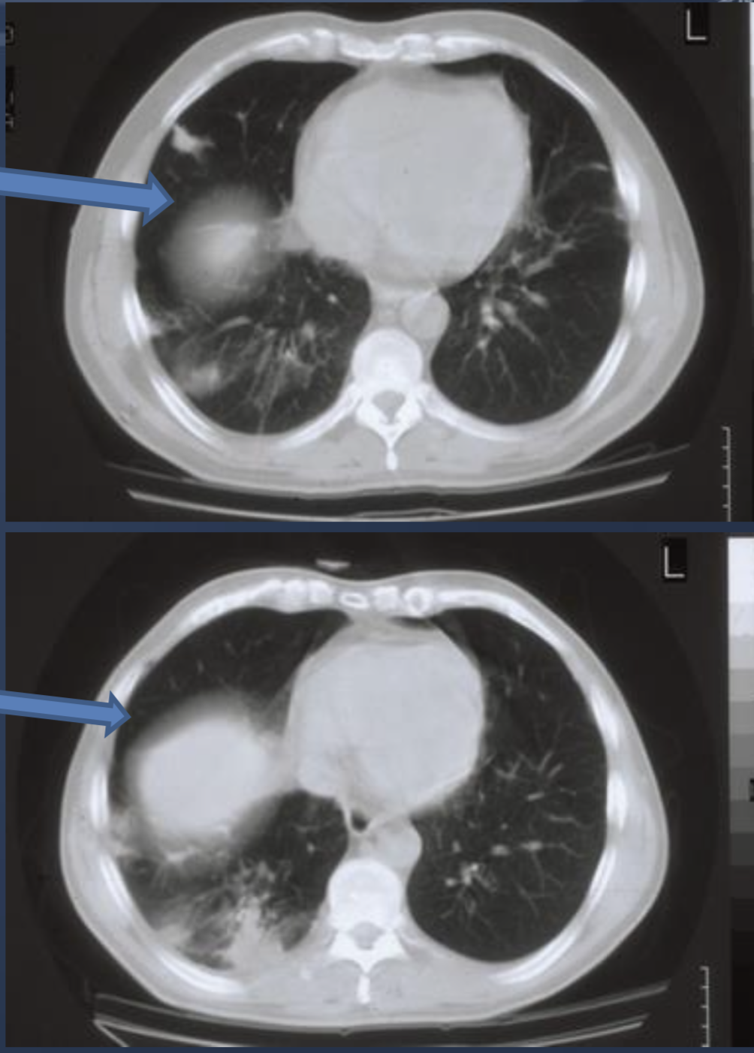
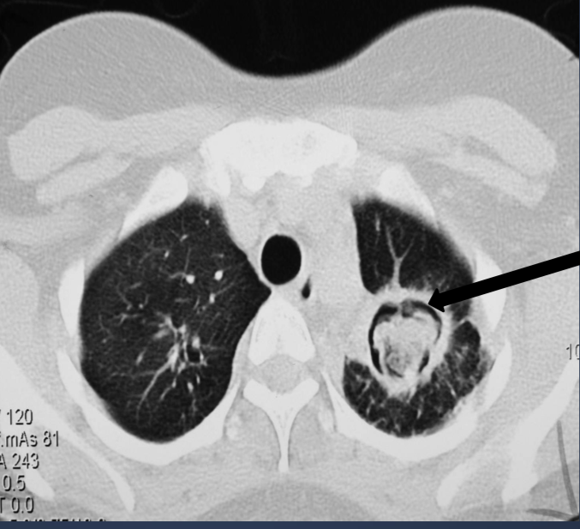
Classification of Aspergillosis
Airways/nasal exposure to airborne Aspergillus
Persistence without disease
colonisation of the airways or nose/sinuses
Allergic
-Allergic bronchopulmonary aspergillosis(ABPA)>in lung
-Allergic aspergillus sinusitis >in sinuses.
-Symptoms of Asthma
-Bronchial obstruction
- Eosinophilia
-Wheezing +/-
Also:
- Skin test reactivity to Aspergillus
- Serum antibodies to Aspergillus
- Serum IgE > 1000 ng/ml
- Culture is positive
2
1
3
4
Chronic Aspergillosis
(Colonizing Aspergillosis)
(Aspergilloma or Aspergillus fungal ball)
-Lung aspergilloma
-Maxillary (sinus) aspergilloma
● Signs include: Cough, hemoptysis, variable fever
● Radiology will show mass in the lung , radiolucent
crescent (it is the cavity filled with fungal ball)
(The fungi will grow in cavities in the lung, from previous TB or malignancy, then grow into a fungal ball-Aspergilloma)
Invasive Aspergillosis
Immunocompromised patients
● Signs: Cough , hemoptysis (coughing blood), fever,
leukocytosis (increased WBC in blood)
● Radiology will show lesions with halo sign
(In immunocompromised patients)
Aspergilloma is a clump of mold which exists in a body cavity such as a paranasal sinus or an organ such as the lung or a cavity caused by a disease like TB or tumors

Slide 7
Fungal Sinusitis
Clinical Presentation
Spectrum (EXTRA)
Diagnosis
Treatment
-Nasal polyps – and other symptoms of sinusitis. (recurrent polyps) -In immunocompromised: Could disseminate adjacent structures e.g. the eye then go to → cranium and become (Rhinocerebral). -The most common cause in KSA is Aspergillus flavus -In addition to Aspergillus,there are other fungi that can cause fungal sinusitis. -Aspergillus sinusitis has the same spectrum of Aspergillus disease in the lung.
Invasive: Could disseminate to brain & eye. Mostly in immunocompromised
Non-invasive: Aspergilloma, (localized), .
Allergic (Very common), nasal polyps.
Chronic
From 439
-Clinical and radiology -Precipitating antibodies useful in diagnosis -Tissue biopsy (best for invasive). -Culture - histology -Measurement of IgE level, RAST test
Depends on the type and severity of the disease and the immunological status of the patient. (Surgery and/or drugs)

Slide 8
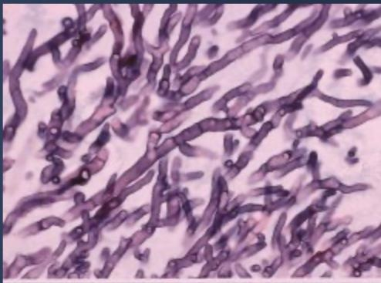
Diagnosis of Aspergillosis :
Specimen
Lab Investigations
Treatment of Aspergillosis
ٍRespiratory specimen | Sputum, BAL (BronchoAlveolar Lavage), Lung biopsy for invasive disease
Other Samples | Blood, etc.. For serology & detection of antigens
Direct Microscopy: We use Giemsa Stain, Grecott methenamine silver stain (GMS) ★ Will show fungal septate hyphae —> In lung biopsy-> proven case, In sputum-> probable case
Culture on SDA, Sabouraud Dextrose Agar
Serology: - Test for Antibody - ELISA test for galactomannan Antigen (specific for aspergillus)
PCR: - Detection of Aspergillus DNA in clinical samples
For invasive diseases, tissue biopsy is the best.
For allergic diseases,igE
Gold-Standard | Voriconazole
Alternative therapy | 1- Amphotericin B 2- Itraconazole 3- Caspofungin

Slide 9
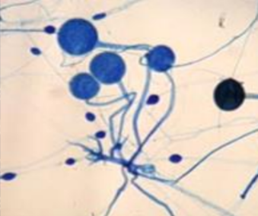
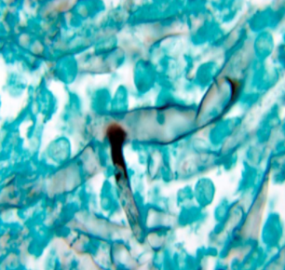
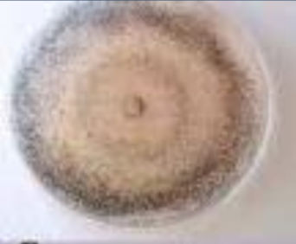
Zygomycosis
severe in immunocompromised—>invasive sinusitis—>disseminate to brain causing rhinocerebral zygomycosis
(high mortality)
1
2
Rhinocerebral zygomycosis
Most common clinical form
Starts as acute sinusitis
Pulmonary zygomycosis
Less common clinical form
Clinical Presentation (Pulmonary Zygomycosis)
Acute (Unlike aspergillosis) Rapid evolving clinical course (Rapidly progressive & needs urgent intervention) Consolidation, nodules, cavitation, pleural effusion,hemoptysis Infection may extend to chest wall, diaphragm, pericardium. Pulmonary infarction and hemorrhage. ★ Dr: you must know that the hallmark of this disease is tissue invasion, infarction, necrosis, hemoptysis, pneumonia etc.. Early recognition and intervention are critical.
2. Etiology (Pulmonary Zygomycosis)
Zygomycetes ,broad Non-septate hyphae e.g. Rhizopus (Remember that aspergillosis has septate hyphae)
3. Risk Factors
Transplant patients Malignancy AIDS Diabetic (ketoacidosis) (uncontrolled diabetes with ketoacidosis)
4. Diagnosis
Specimen | Respiratory specimens: - Sputum - BAL, BronchoAlveolar Lavage - Lung biopsy Other samples.
Direct microscopy | Giemsa stain, GMS stain (Silver stain) Will show broad non- septate fungal hyphae. Culture on SDA (no cycloheximide)
Serology | Not available
5. Treatment
Amphotericin B broad spectrum antifungal Surgery (in many cases surgery is needed)

Slide 10
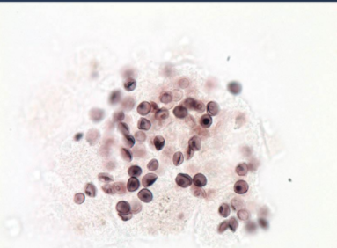
Pneumocystosis (PCP)
Was in the pathology lecture
Overview | -It is interstitial pneumonia of the alveolar area. -Affect compromised host (Common in AIDS patients) Pneumocystis pneumonia (PCP) is Opportunistic fungal pneumonia Only seen in immunocompromised patients
Etiology | -Pneumocystis jiroveci (yeast) -Naturally found in rodents (rats), other animals (goats, horses), Humans may contract it during childhood. (Children may contact it → latent; If they get infected with HIV → PCP) -Previously thought to be a protozoan parasite, but later it has been proven to be a fungus.
Risk factors | Especially common in AIDS patients
Laboratory Diagnosis | Patient Specimen: - Bronchoscopic specimens (BAL, BronchoAlveolar Lavage) - Sputum - Lung, biopsy tissue.
 | Histological sections or smears stained by: ❖ GMS stain. ❖ Immunofluorescence (better sensitivity) If positive —> will see cysts of hat-shape, cup shape,crescent
 | Does not grow in laboratory media e.g. SDA
Treatment | Trimethoprim-Sulfamethoxazole (one drug) Dapsone Note that it is treated by antibiotics, not antifungals.

Slide 11
Fungal infection keywords
All aspergillus shows: cough, hemoptysis, and fever
Asthma symptoms + skin test to aspergillus/ serum antibodies to aspergillus--> allergic aspergillosis
Mass in lung showing radiolucent crescent/aspergilloma --> chronic aspergillosis
Lesions in lung with halo sign --> invasive aspergillosis
Fungi in sinitus + ksa-->Aspergillus flavus
Treatment of any aspergillosis--> voriconazole(gold standard) or 1- Amphotericin B 2- Itraconazole 3- Caspofungin
Septate Fungi = aspergillosis
Non septate Fungi = zygomycosis
Treatment of zygomycosis = Amphotericin B
AIDS + immunofluorescence shows hat-shaped cysts + doesn't grow = pneumocystis
Treatment of pneumocystis is Trimethoprim-Sulfamethoxazole

Slide 12
MCQs
Answers Next Slide
1-A 38 years old man complained of cough, hemoptysis, and fever. CBC showed leukocytosis and the X-Ray showed a lesion with halo sign. He is diabetic. What is the diagnosis?
A)Fungal sinusitis | B)Invasive pulmonary Aspergillosis | C)Rhinocerebral zygomycosis | D)Pneumocystosis
2-A 45 years old woman complained of hemoptysis. She has a history of AIDs. X-ray showed consolidation and nodules. Sputum was collected and examined under the microscope, non-septate hyphae was observed. Positive culture on SDA. The patient’s disease was progressing rapidly. What is the diagnosis?
A)Pulmonary zygomycosis | B)Pneumocystosis | C)Allergic bronchopulmonary aspergillosis | D)Chronic aspergillosis
3-A 50 years old man complained of coughing and shortness of breath. He was recently diagnosed with AIDs. A lung biopsy was taken and histologically predominant findings showed cysts of hat-shaped with GMS stain. It failed to culture on SDA. What is the treatment that should be given to the patient?
A)Voriconazole | B)Amphotericin B | C)Dapsone | D)Caspofungin
4-A 40 years old man complained about cough and hemoptysis. He has a history of malignancy. A lung biopsy was collected and showed fungal septate hyphae after staining with Grecott methenamine silver stain. He had an ELISA test and tested positive for galactomannan antigen.What is the treatment that should be given to the patient?
A)Dapsone | B)O-hydroxybenzoic acid | C)Caspofungin | D)Rifampin
5-A 34 years old man complained of fever and hemoptysis. Histological section was taken and stained by immunofluorescence. It showed crescent shaped cysts. His treatment can be:
A)Trimethoprim – sulfamethoxazole | B)Itraconazole | C)Fluconazole | D)Rifampin

Slide 13
MCQs
6-Which of the following consider a Dimorphic Fungi?
A)Aspergillosis | B)Cryptococcosis | C)Coccidioides immitis | D) None of the above
7-What’s the best choice of treatment for Aspergillosis (gold standard) ?
A)Itraconazole | B)Cryptococcosis | C)Voriconazole | D)Amphotericin B
8-Which of the following consider as a risk factor of zygomycosis?
A)Malignancy | B)AIDS | C)Transplant patients | D)All of above
1-B
2-A
3-C; pneumocystis
4-C aspergillosis
5-A PCP
For more questions click here!
6-C
7-C
8-D

Slide 14
SAQ
A patient presented with cough, high fever, coughing of blood and had a history of cancer. The X-ray of the lung shows a mass and radiolucent crescent. Answer the following:
A)What is the diagnosis?
B)What other tests can be done?
C)How can you treat it?
D)The radiolucent crescent is a result of?
Answers Key
A)Chronic Aspergillosis
B)Microscopy, culture on SDA, test for antibody, PCR detection of aspergillus DNA.
C)Voriconazole Alternative therapy Amphotericin B, Itraconazole, Caspofungin
D)Aspergilloma OR Aspergillus fungal ball

Slide 15
Microbiology Team⁴⁴²
Leaders
Shaden Albassam | Mohammed Alghamdi
Co-Leader Ahmad Bahmaid Members
Raghad Alnadeef | Yazeed Hussein
Ghada Binslmah | Talal Alharbi
Tharaa Alhowaish | Meshari Alshathri
Amani Alotaibi | Emad Almutairi
Nouf Alsaigh | Abdulrahman Al-Douir
Razan Almanjomi | Abdulrahman Binbakhit
Shahed Bukhari | Abdullah Alshahri
 | Abdulaziz Alnasser
 | Luay Almutair
 | Ali Dhafer Jabaan
 | Abdulaziz Alotaibi
Special Thanks to Microbiology Team⁴⁴¹
Thanks to the amazing sara alhamlan for the great theme!
Microbiology442@gmail.com

