Slide 1
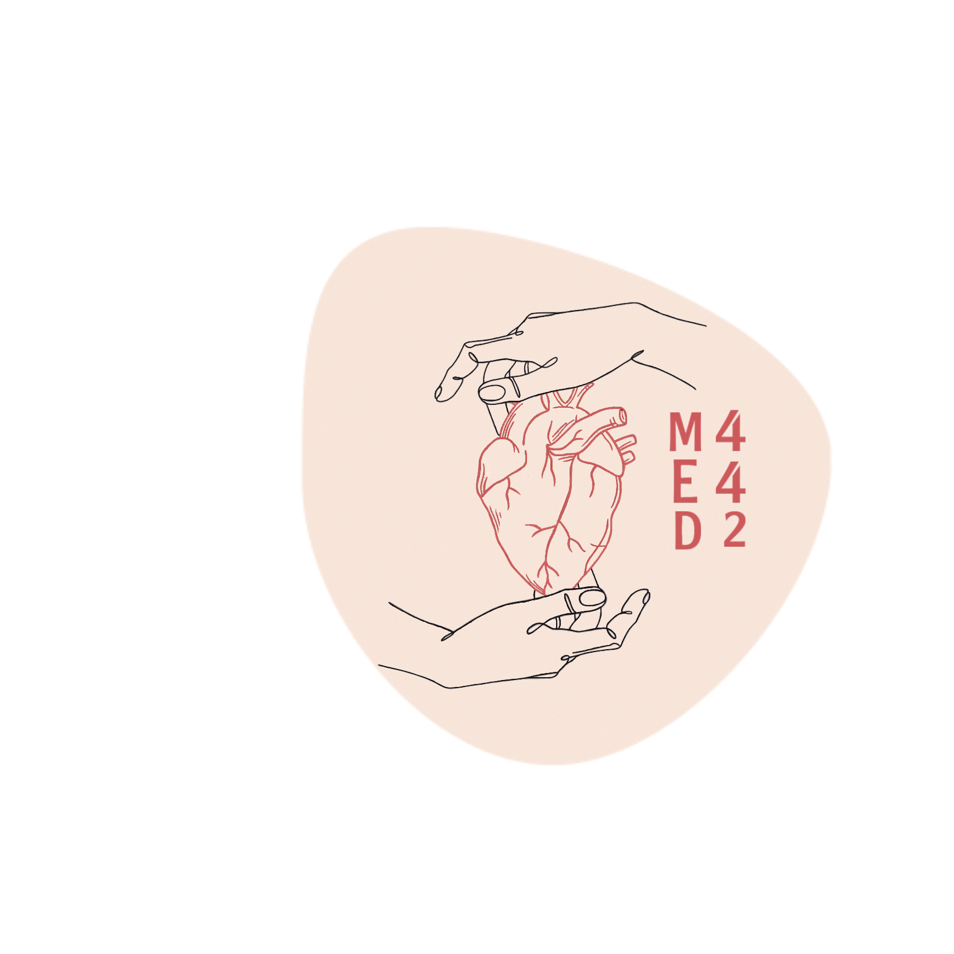
Bronchial Asthma
Colour index:
Main text
Important
In girls slides only
In boys slides only
Doctor‘s notes
Extra info.
Editing file

Slide 2
Objectives
01
02
03
Understand asthma as an episodic, reversible bronchoconstriction caused by increased responsiveness of the tracheobronchial tree to various stimuli.
Know that asthma is divided into two basic types: extrinsic or atopic allergic and intrinsic asthma.
Understanding the morphological changes (gross and microscopic) seen in the lungs in cases of severe asthma

Slide 3
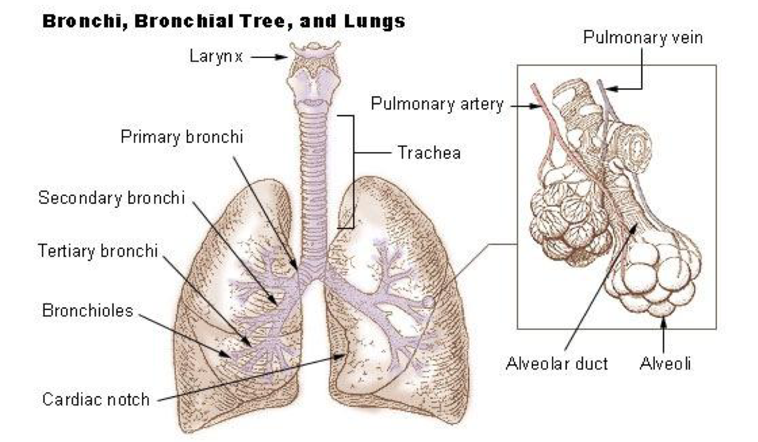
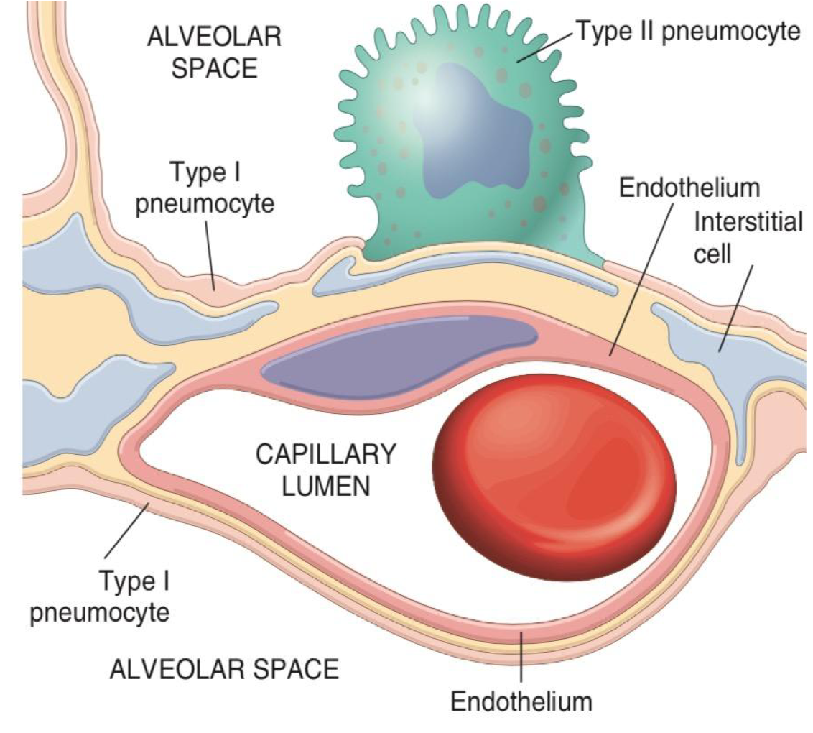
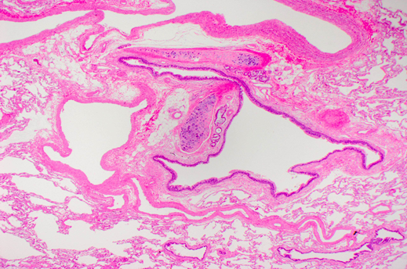
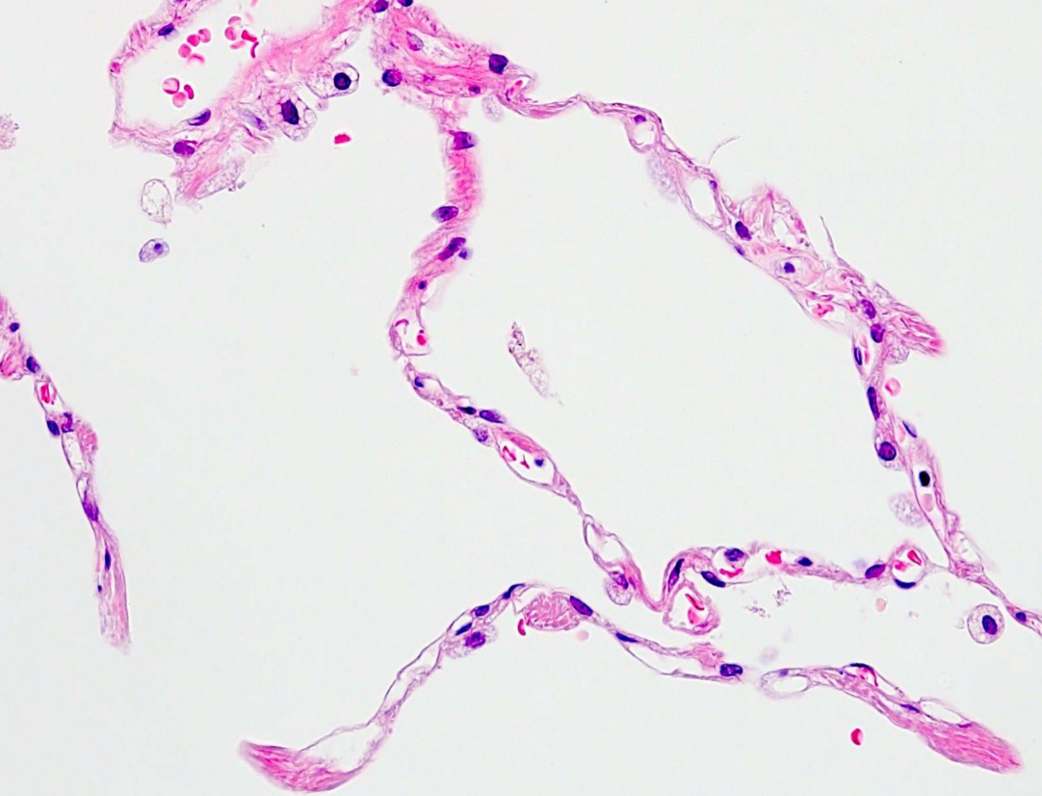
INTRODUCTION
Right lung divided into 3 lobes (upper, middle, and lower lobes) supplied by 3 bronchi
Left lung divided into 2 lobes (upper and lower lobes) supplied by 2 bronchi
Bronchi branch termed bronchioles (distinguished from bronchi by the lack of cartilage and submucosal glands within their walls)
Alveolar septa(wall)
Terminal bronchioles (acinai); are the functional units of the lungs and they form the site of gaseous exchange and lined by pneumocytes
Pulmonary acini are composed of respiratory bronchioles that proceed into alveolar ducts
Immediately branch into alveolar sacs (the blind ends of the respiratory passages)
Blood vessel
Bronchovascular bundle: bronchiole + blood vessels
Interstitium alveolar wall
Bronchiole
The alveolar walls (or alveolar septa) consist of the following components:
The capillary endothelium and basement membrane.
The pulmonary interstitium
Alveolar epithelium

Slide 4
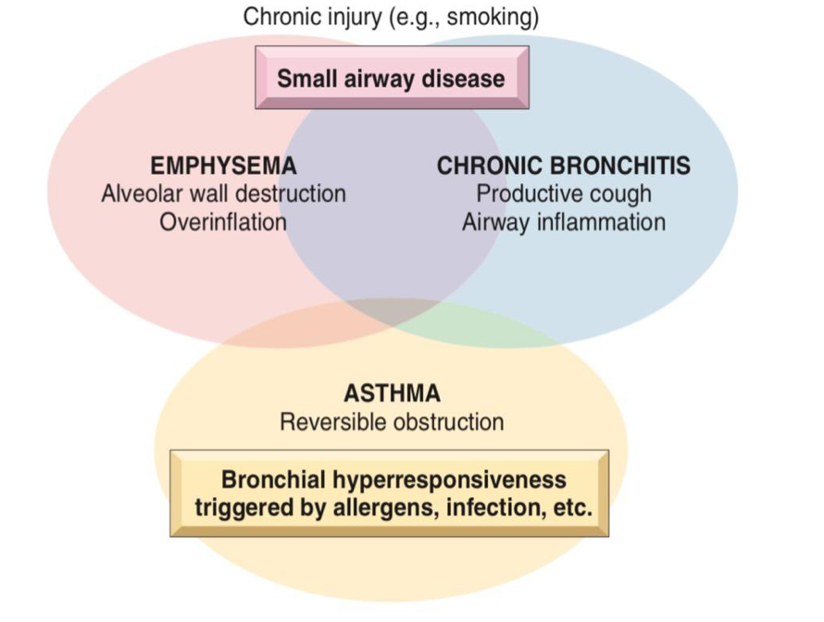
Obstructive lung diseases
Obstructive lung diseases
Characterized by limitation of airflow, usually resulting from an increase in resistance caused by partial or complete obstruction at any level (different from interstitial diseases)
What is going to be explained in this lecture
Any disease ends with the suffix “ectasis” refers to dilation or expansion
Bronchial asthma
Bronchiectasis
Chronic bronchitis
Emphysema
It should be noted that emphysema is defined on the basis of morphologic and radiologic features, whereas chronic bronchitis is defined on the basis of clinical features
Emphysema and chronic bronchitis often are grouped together under the rubric (category) of chronic obstructive pulmonary diseases (COPD)
Result in fusion of alveolar wall
“Wet cough (with phlegm)”

Slide 5
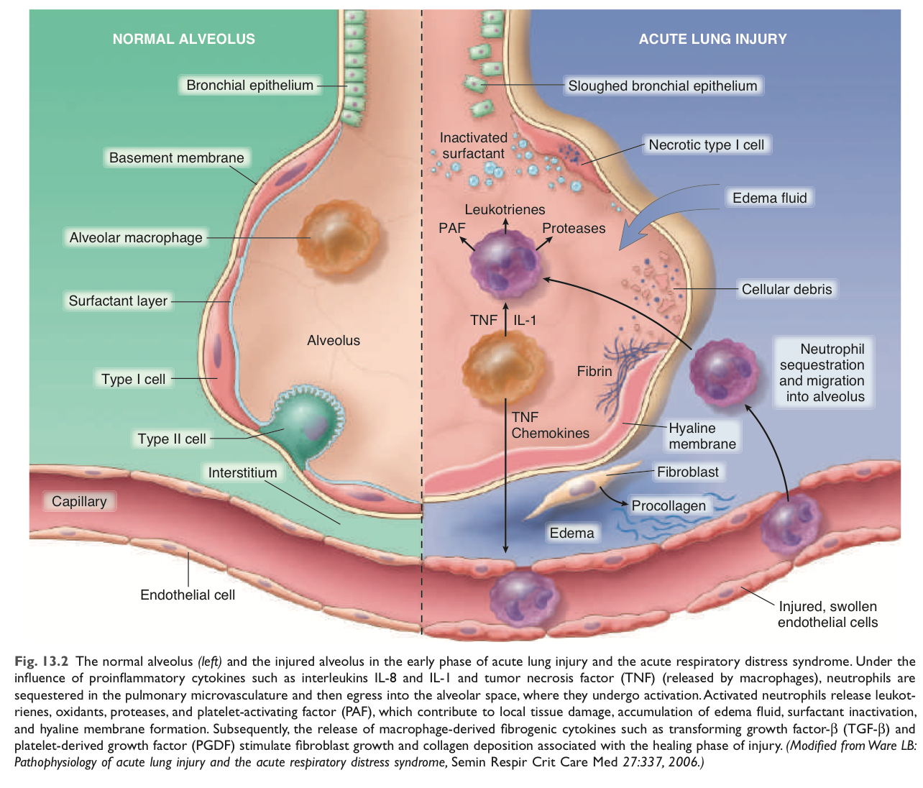
Extra slide
From Robbins basic pathology book
Differentiation between Normal and Injured alveoli:
This table will help you to differentiate between the 4 Obstructive pulmonary diseases:

Slide 6
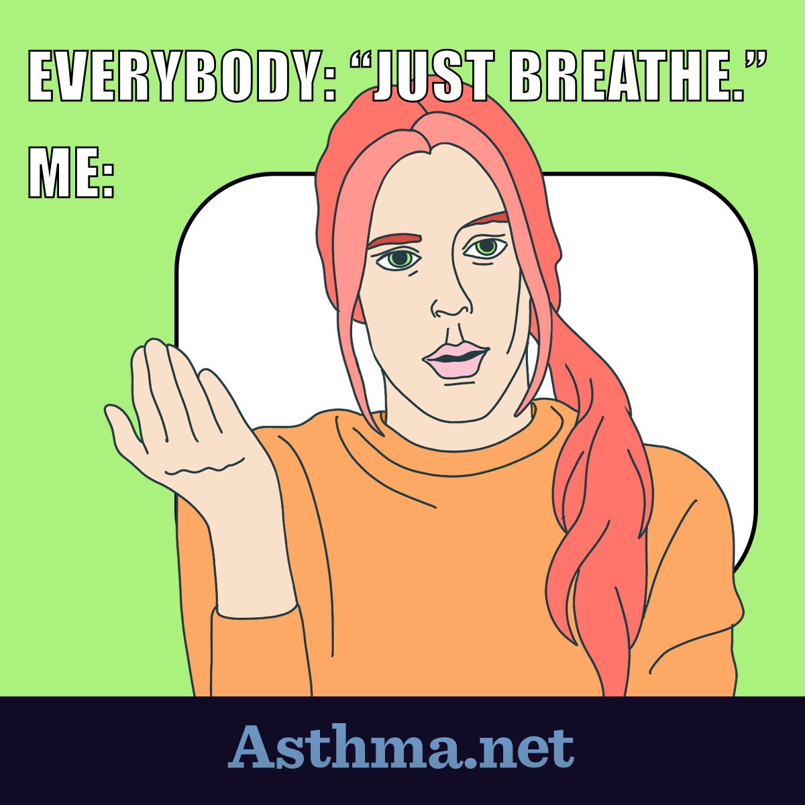
Bronchial asthma
Definition
Asthma is a chronic inflammatory disorder of the airways that causes recurrent (repeated) episodes of wheezing, breathlessness, chest tightness, and cough, particularly at night and/or early in the morning (due to vagal tone) .
An episodic, reversible bronchoconstriction caused by increased responsiveness of the tracheobronchial tree to stimuli. (bronchoconstriction can be reversed,either spontaneously or with treatment)
Intermittent (irregular intervals), reversible airway obstruction
Chronic bronchial inflammation with eosinophils (maily)
Hallmarks
Hypertrophy and hyperreactivity of bronchial smooth muscles
Increased mucus secretion
Inflammatory response
Cells that play a role in inflammatory responses in BA:
Eosinophils
Neutrophils
Mast cells
Lymphocytes
Macrophages
Epithelial cells

Slide 7
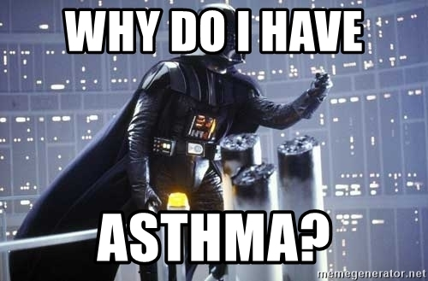
Epidemiology
Classification
The incidence of asthma has significantly increased in the Western world over the past 4 decades. Why?
Hygiene Hypothesis* is one explanation
A lack of exposure to infectious organisms in early childhood possibly non-pathogenic microorganisms as well
Results in
Defects in immune tolerance + hyperreactivity to stimuli later on
Atopic* (The most common) | Non-atopic chronic | Occupational | Drug induced
Triggered by immunologically-mediated hypersensitivity reaction TYPE I (allergy) against foreign substances or allergens (60-70% of cases) | Don’t have evidence of allergen sensitization. Respiratory and inhaled air pollutants are common triggers Ex: Exercise induced asthma, post-traumatic stress, or drug induced. | Asthma related to long term exposure to certain occupational hazard ex: wood, cotton, platinum, etc.attacks usually develop after repeated exposure to the inciting antigen(s). | Attack of asthma related to intake of some drugs ex; aspirin,Patients with aspirin sensitivity present with recurrent rhinitis, nasal polyps, urticaria, and bronchospasm
* :The hygiene hypothesis proposes that childhood exposure to germs and certain infections helps the immune system develop.
*: Atopy:is the tendency to develop an allergy.

Slide 8
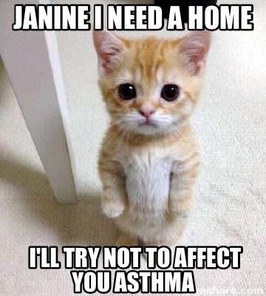
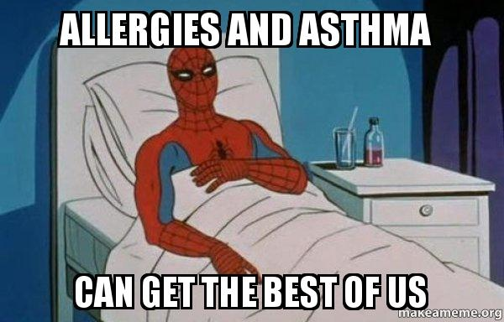
Hx=History | Atopic Asthma (Extrinsic) | Non-atopic Asthma (Intrinsic)
Underlying Abnormality | -Atopic asthma is associated with excessive reaction of Th2 cells stimulated by environmental antigens -Immune reaction (atopic) -60-70% of cases Aka Allergic Asthma | -No evidence of allergen sensitization and is triggered by non-immune stimuli such as psychological disturbance,stress or exercise -Abnormal autonomic regulation of airway -30-40% of cases Aka Non-allergic Asthma
Trigger Factors and Onset | -Allergens in dust, pollen, animal dander, food, or by infections. -The onset of asthmatic attacks is often preceded by allergic rhinitis, urticaria, or eczema. - Common in childhood. | Precipitated by viral infection and inhaled air pollutants associated with chronic eosinophilic infiltrate. Common in adulthood
History | Positive family Hx of allergy. | No family Hx (+ve family Hx is less common)
Skin Test | Positive (immediate wheal-and-flare reaction) | Negative
Allergens | Recognised | Not Identified
Genetics | Predisposition to IgE Abs | No predisposition
Progression | Improves | Worsens
Eosinophilia | Sputum+Blood | Sputum
Drug Hypersensitivity | Absent | Present

Slide 9
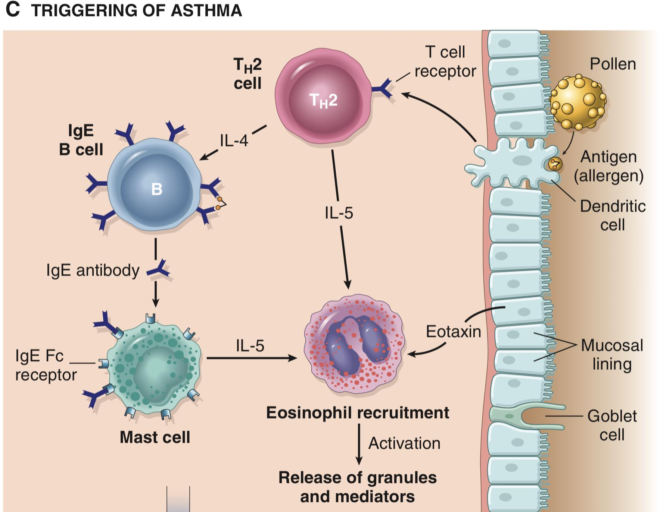
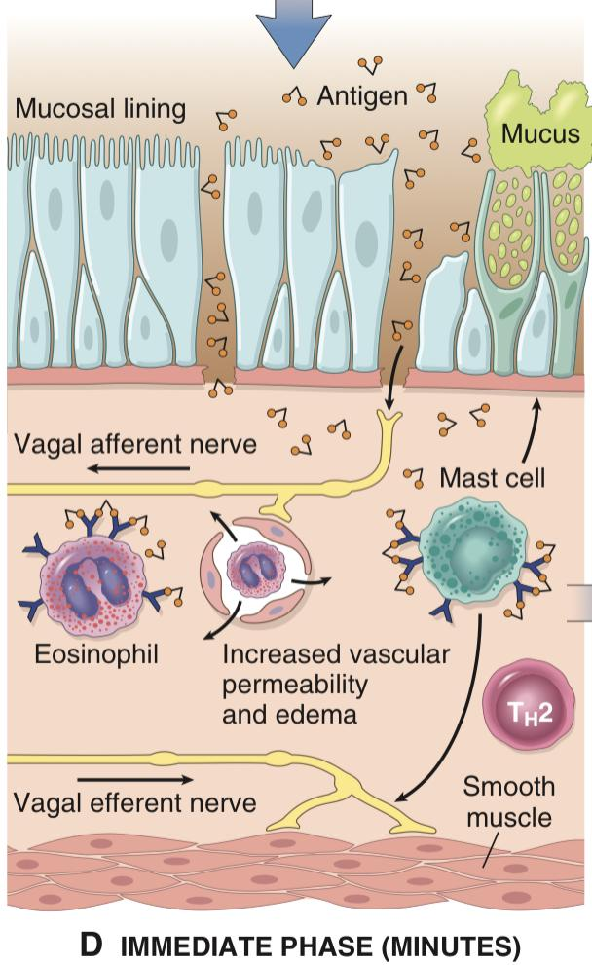
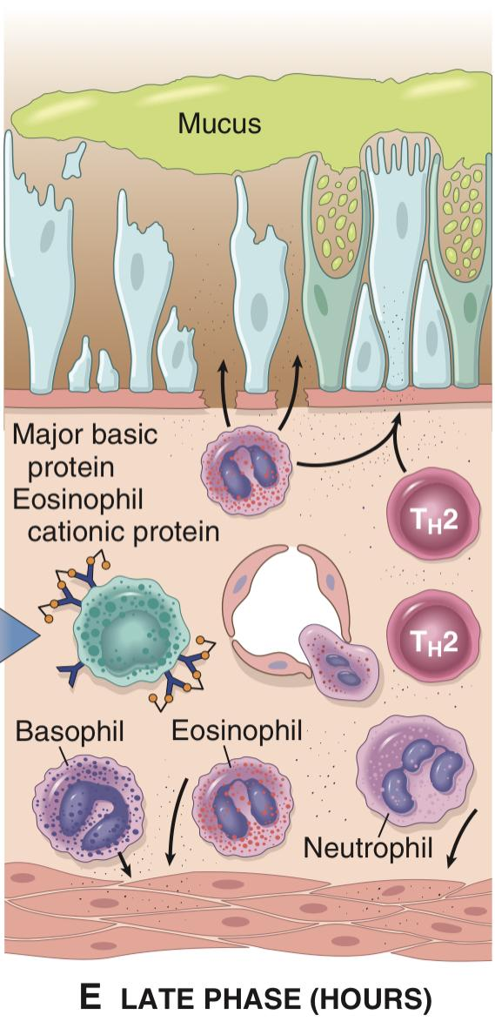
Pathogenesis
Major factors contributing to the development of asthma include genetic predisposition to type I hypersensitivity (atopy), acute and chronic airway inflammation, and bronchial hyperresponsiveness to a variety of stimuli.
1) Triggering of Atopic Asthma:
3. TH2 cells are activated and cytokines (IL-4 & IL-5) are released
1. Antigen enters the body.
2. Antigen is recognised by APC e.g. Dendritic cells, macrophages
4. FC portion of IgE-Ab attaches to mast cell receptor and stimulate the release of cytokines such as histamine and IL-5
6. Injured bronchial mucosal lining cells will secrete eotaxin which helps in the eosinophils recruitment.
5. Eosinophils will release granules and mediators toxic to epithelial cells.
*IgE is responsible for mast cell degranulation and the release of 1ry and secondary mediators leading to an early and late phase of the reaction...
2) Early Phase Reaction (mins)
(Stimulated right after the exposure of the antigen)
T-helper 2 cells secrete:
1. IL-4 and IL-3 → stimulates the production of IgE by B lymphocytes
2. IL-5 → activates eosinophils
3. IL-13 → stimulates mucus production (by stimulating Goblet cells)
-IL-9 →Damages the bronchial epithelium directly.
IL-10 also plays a role as an anti-inflammatory mediator, but can’t reduce the episode
Dominated by bronchoconstriction,
increased mucus production, and
Vasodilation (by way of the neural system)
Bronchoconstriction is triggered by
mediators released from mast cells
Histamine
Prostaglandin D2
Leukotrienes LTC4, D4, and E4
(The main substances released by mast cells)
Activated mast cell will lead to the stimulation of Vagus nerve which will cause bronchospasm
3) Late Phase Reaction (Hrs)
Inflammatory in nature
Inflammatory mediators stimulate epithelial cells to produce chemokines
Eotaxin that promote the recruitment of TH2 cells, eosinophils amplifying an inflammatory reaction that is initiated by resident immune cells
Several factors released from eosinophils (e.g., major basic protein, eosinophil cationic protein) cause damage to the epithelium.

Slide 10
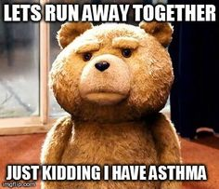
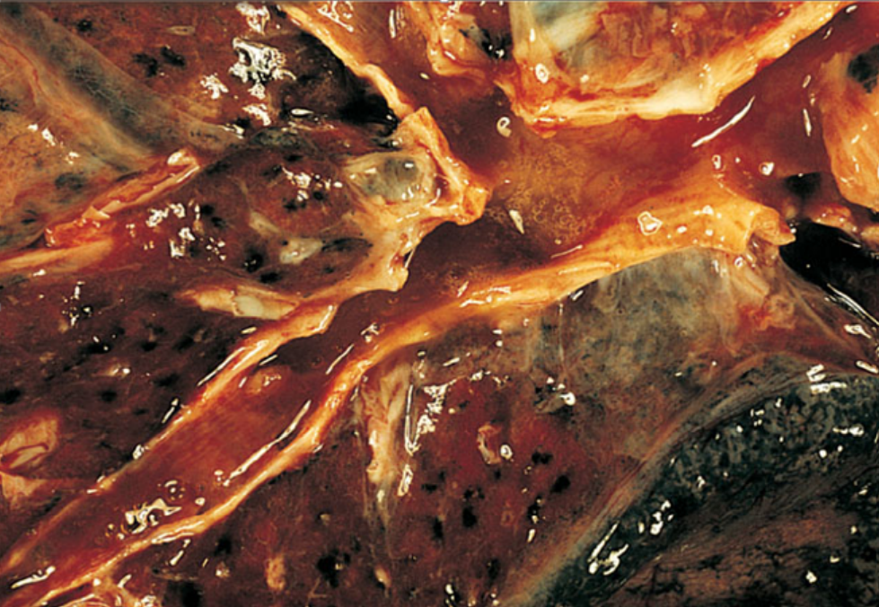
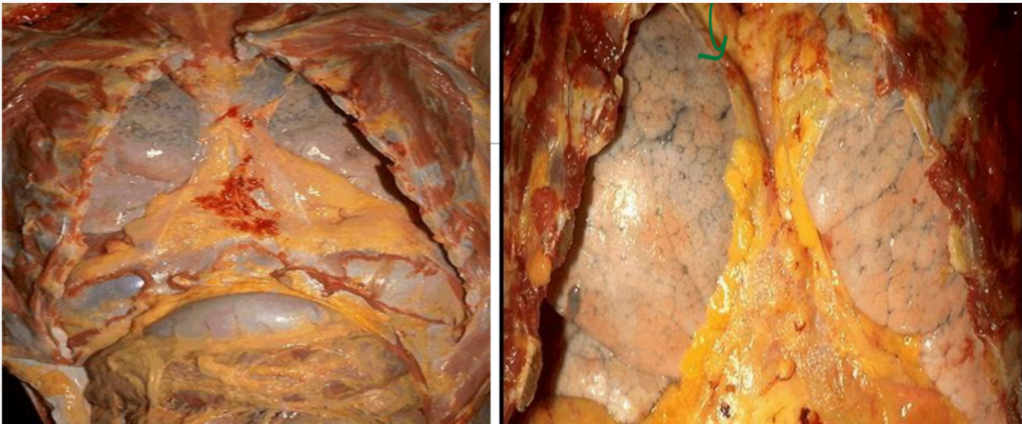
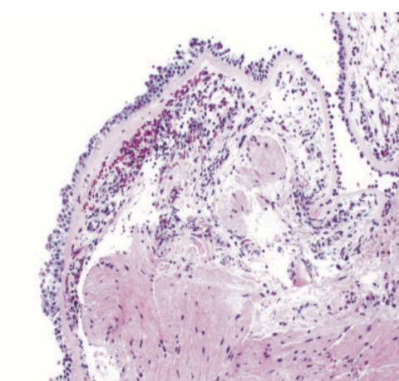
Etiology
Morphological Changes
Genetic predisposition to type I hypersensitivity (atopy)
01
02
Acute and chronic airway inflammation
Especially viral
Bronchial hyperresponsiveness
to stimuli.
03
To the end of the lecture
For example: smoke, fumes, cold air, stress, and exercise.
Gross Morphology
• Presence of congested (reddish) mucosa and mucoid secretions
• Occlusion of bronchi and bronchioles by thick tenacious mucus plugs (condensed mucus balls)
• Over-distention (hyper-inflated) of lungs due to over inflation (Accumulation of air)
• Small areas of atelectasis (Lung collapse)
Microscopic Morphology
Eosinophils are key inflammatory cells found in almost all subtypes of asthma; eosinophil products (such as major basic protein) are responsible for airway damage

Slide 11
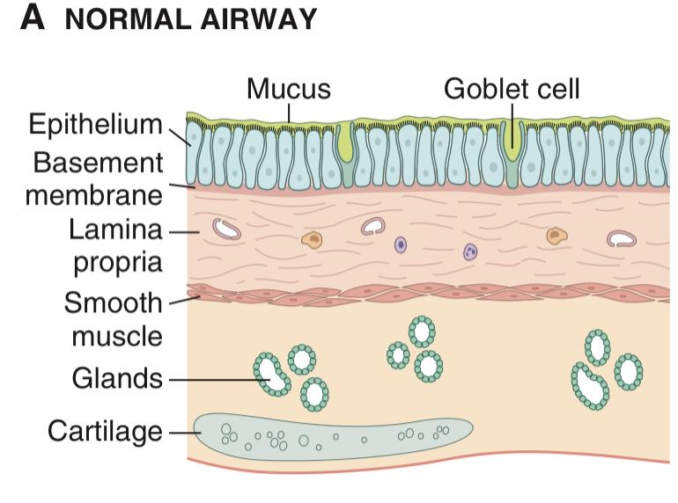
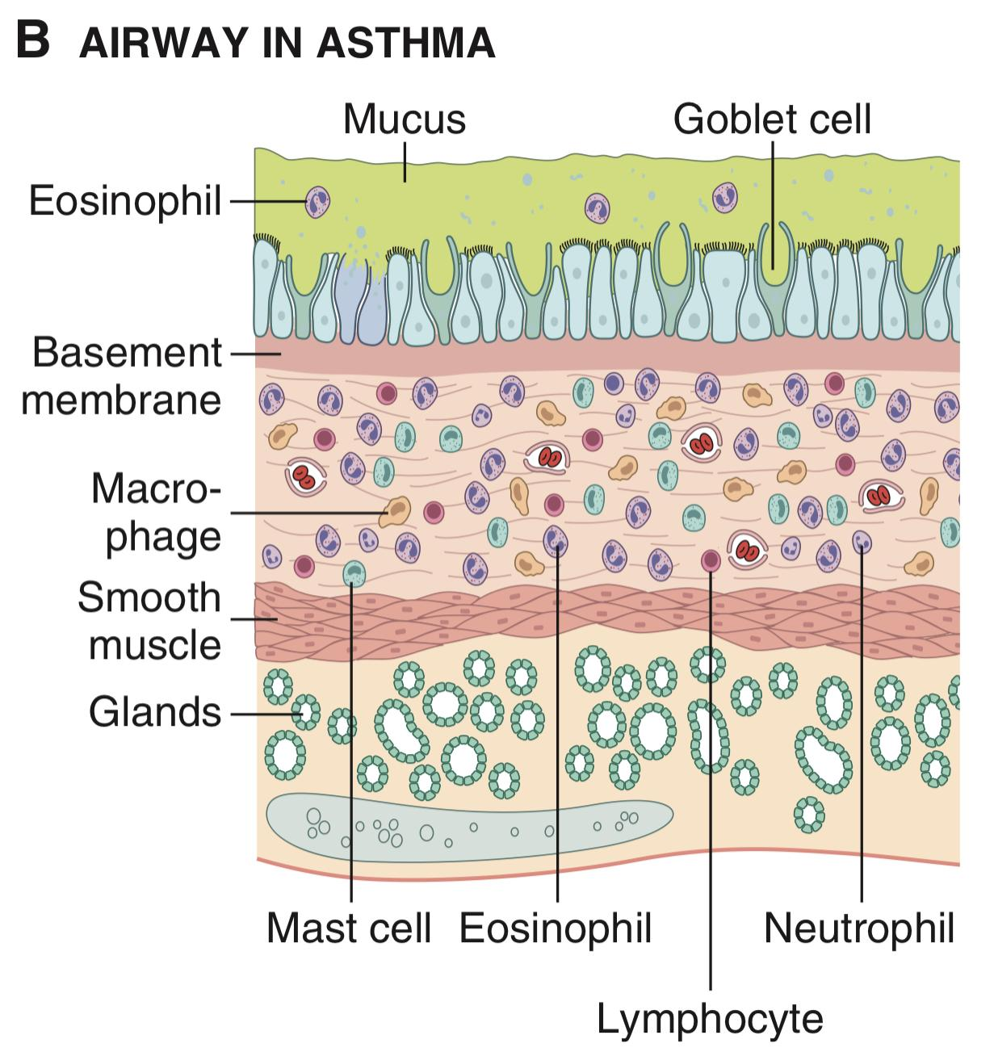
Microscopic Changes
Metaplasia of the airway epithelium (severe).
Hypertrophy**/hyperplasia of the bronchial wall muscle (smooth muscle)
Thickening airway wall
6
5
1
Airway Remodelling
4
Increased submucosal vascularity
Sub-basement membrane fibrosis
2
3
Increase in the size of submucosal glands and goblet cell.
Comparison of a normal airway and an airway involved in asthma:
Thickened
Submucosa with fibroblasts and vessels
Normal scattered inflammatory cells
Hyperplasia
Increased
1. Increase in goblet cells → Oversecretion of mucus.
2. Injured Epithelium.
3. Increase in inflammatory cells .
4. Hypertrophy of smooth muscles (increase in thickness).
5. Sometimes increased bronchial glands.
This is known as Airway Remodelling

Slide 12
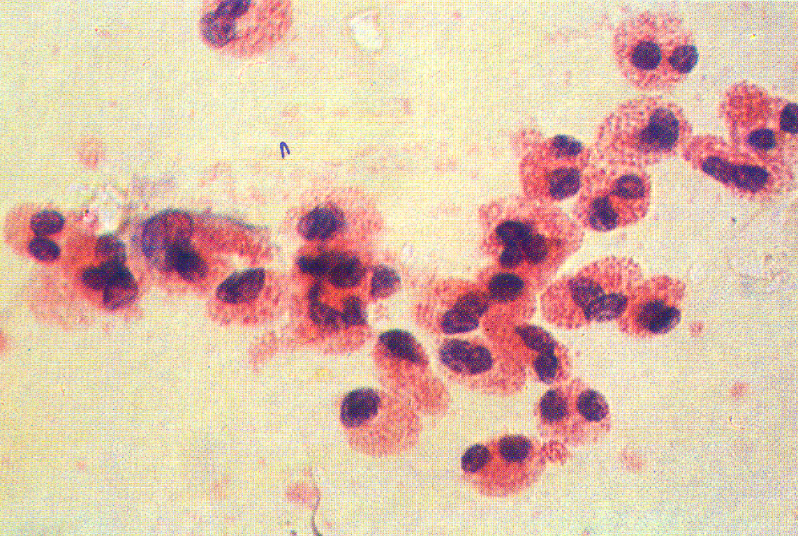
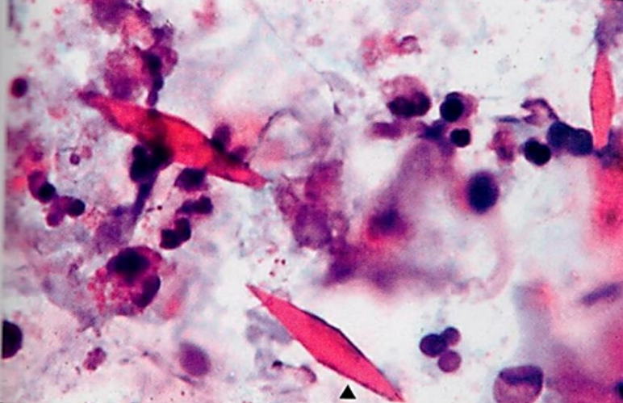
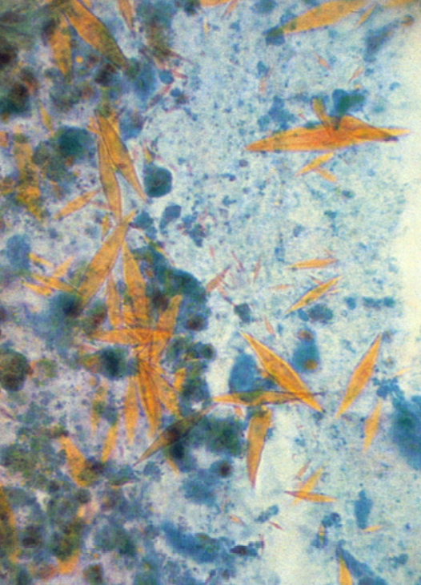
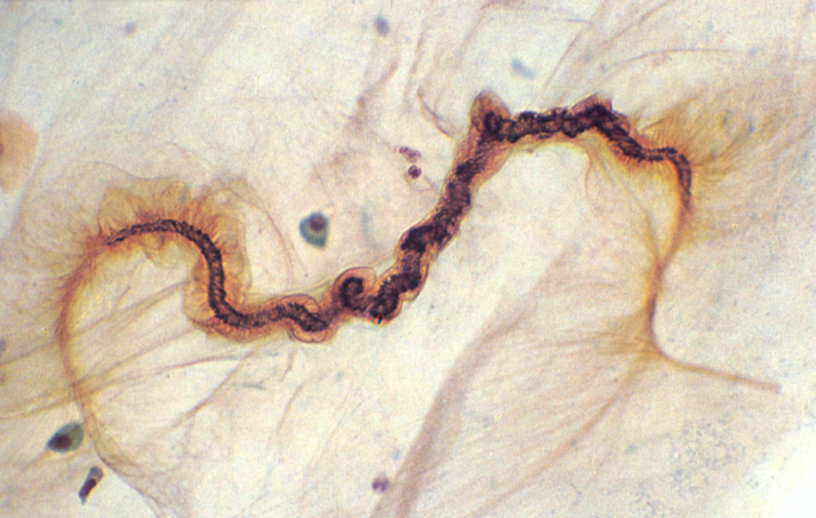
Microscopic Changes
Blood vessels
Eosinophils
Inflammation of bronchial wall (eosinophils (5-50%), mast cells, lymphocytes, plasma cells)
Eosinophils from a case of BA
Microscopic specimen of BA
(i.e. Crystals)
BA: Charcot-Leyden crystals.
(crystalloids made up of the (eosinophil protein galectin-10)
(from eosinophilic granules)
Mucous plugs containing whorls of shed epithelium (Curschmann spirals)

Slide 13
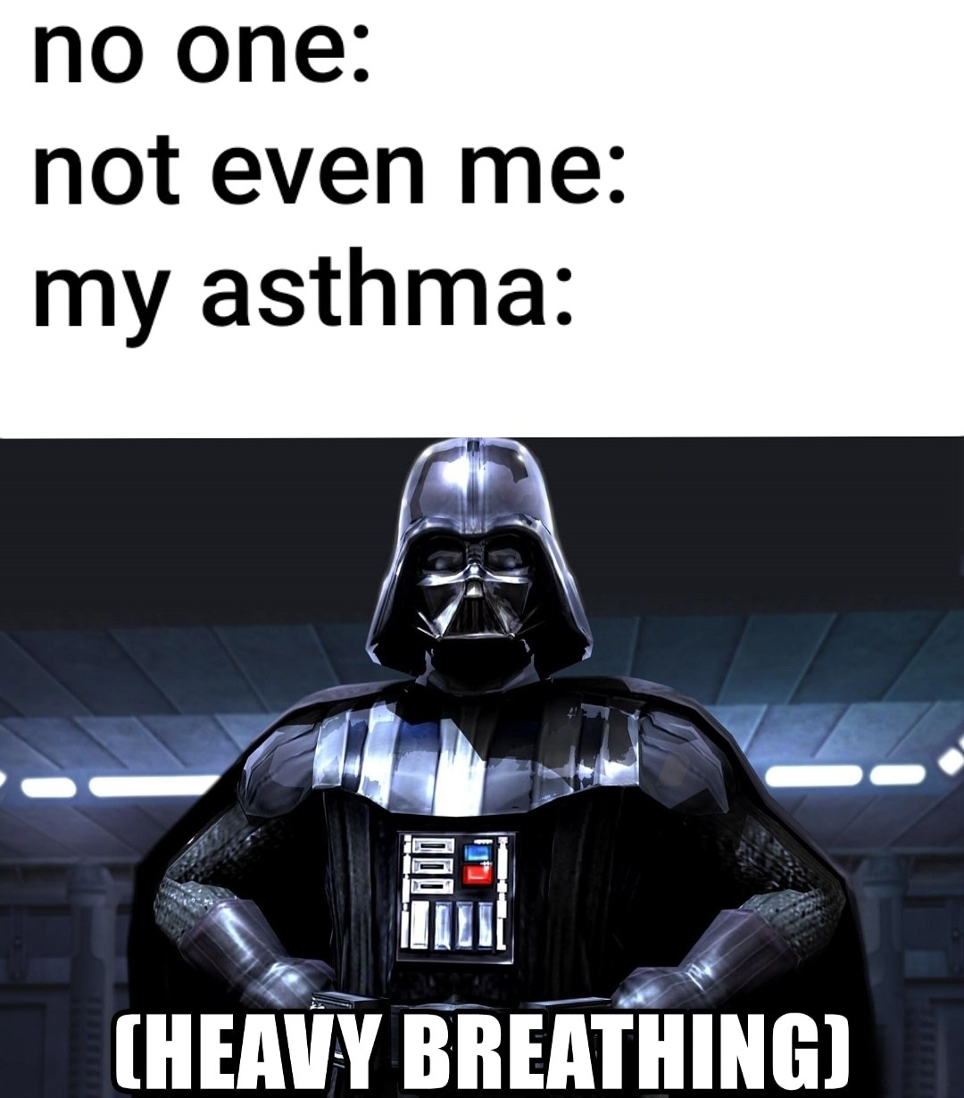
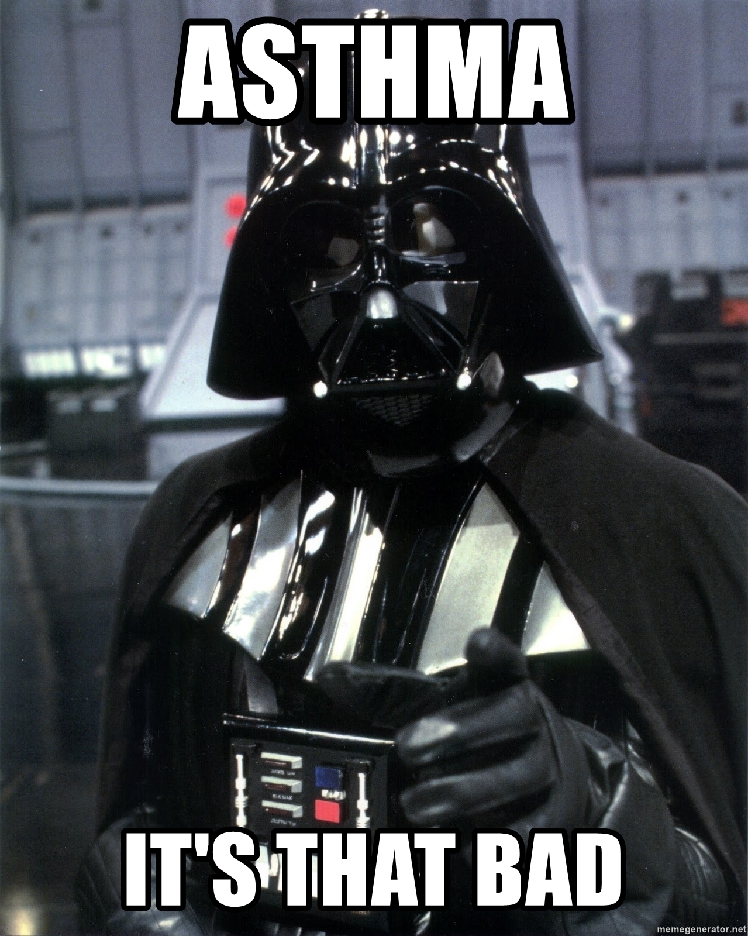
Clinical Features
Sounds of asthma
Click to check Rikabi’s notes
Large part of restrictive and part of obstructive lung diseases affect the spaces distal to the terminal bronchiole.
Severe dyspnea and wheezing due to bronchoconstriction and mucus plugging, which leads to trapping of air in distal
airspaces and progressive hyperinflation of the lung.
Clinical Features of Asthma
Attacks last from 1 to several hours and subside
(becomes less extreme)either spontaneously or with therapy. And may be followed by Nocturnal cough (night cough).
Intervals between attacks are characteristically free from overt(shown obviously) respiratory difficulties (so between the attacks the patient becomes normal and doesn’t experience any respiratory difficulties)
Clinical Course of BA
Status Asthmaticus
Click to check Rikabi’s notes
Click to check Rikabi’s notes
(spirometry)
The range of presentation in asthma. This patient was found incidentally to have a degree of reversible airways obstruction during a routine medical examination. Used to measure FEV1/FVS ratio to indicate if the disease is obstructive or restrictive, and to monitor the response treatment.
This patient presented as a medical emergency with acute severe breathlessness and diagnosed as a case of status asthmaticus (Overinflated lungs because of severe obstruction and air trapping) (very rare) which required immediate intensive care including intermittent positive-pressure ventilation. And it’s lethal.

Slide 14
Complications
Airway remodeling
Some persons with long standing asthma develop permanent structural changes in the airway with sub-basement membrane fibrosis, hypertrophy of muscle and progressive loss of lung function that increase airflow obstruction and airway responsiveness.
Chronic bronchitis
(inflammation of bronchial wall)
i.e. Asthmatic bronchitis: chronic bronchitis with superimposed asthma
Emphysema
(destruction of alveolar septal & trapping of air & fusion of alveolar space), pneumothorax (Presence of air in the pleural space) and pneumomediastinum (Presence of air in mediastinum) (rare complications)
Asthma Complications
Bronchiectasis
(Dilation mainly of the bronchial wall)
Superimposed infection(secondary infection) i.e. pneumonia
Respiratory failure
which require intubation
Status asthmaticus
Hypercapnia, acidosis, and severe hypoxia in some cases, cor pulmonale and heart failure develop.

Slide 15
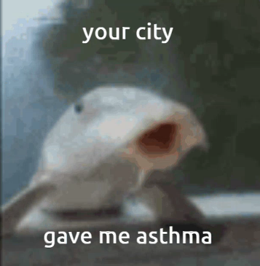
Diagnosis
Click to check Rikabi’s notes
Skin prick testing
IgE mediated type I hypersensitivity reaction to inhaled allergens
Also we could do RAST and MAST tests to measures specific IgE in the presence of a causative agent/allergen
A skin prick test is used to identify allergy, it checks immediate allergic reaction as much as 40 different substances at once (e.g. protein from the Dust, Pollen, Mold, Pet Dander, Dust Mites and Foods) It uses needles that barely penetrates the surface of the skin, it doesn’t cause bleeding. In adults, the test is usually done on the forearm. Children may be tested on the upper back. #Team439
All patients with asthma should be advised to avoid exposure to allergens to which they are sensitive.
Notes:
More space for Alrikabi note’s

Slide 16
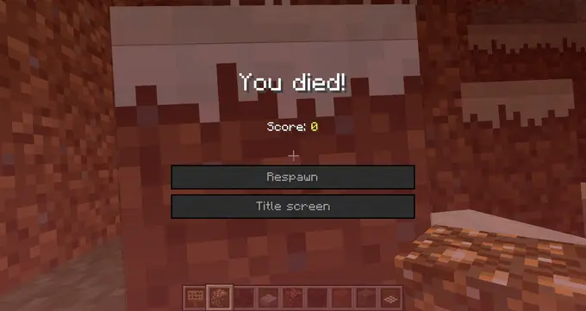
Prognosis
Prognosis of Asthma
Remission
(reduction)
Mortality (death)
Approximately 50% of cases of childhood asthma resolve spontaneously but may recur later in life.
Remission in adult-onset asthma is less likely.
Death occurs in approximately 0.2% of asthmatics.
Mortality is usually preceded by an acute attack and about 50% are more than 65 yo.
(Rare) ( associated with
non-atopic asthma)
Humoral and cellular mediators of airway obstruction (e.g., eosinophils) are common to both atopic and nonatopic variants of asthma, so they are treated in a similar way.
Treatment of Asthma
Medication
Control of Factors Contributing to Asthma Severity
Anti-inflammatory drugs, particularly
glucocorticoids
leukotriene inhibitors
Exposure to irritants or allergens has been shown to increase asthma symptoms and cause exacerbations.
Bronchodilators such as beta-adrenergic drugs (Ventolin)

Slide 17
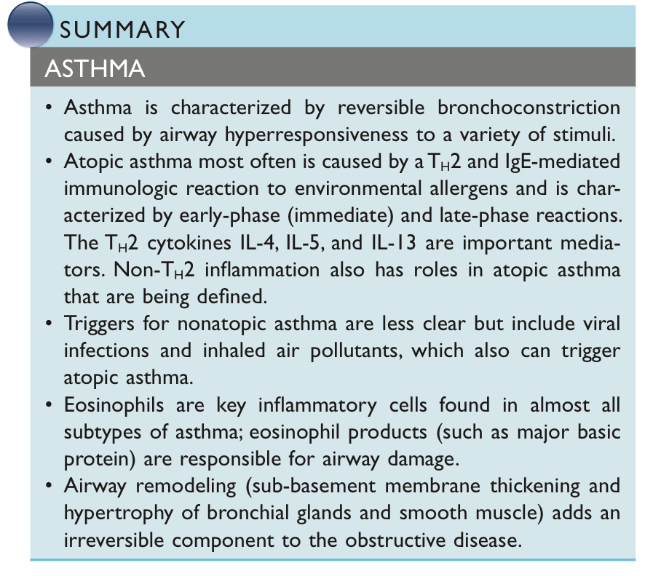
Summary
Asthma
Episodic attacks of bronchoconstriction (Reversible).
Site
Bronchus.
Microscopicchanges
Thickening basement membrane
Sub-basement membrane fibrosis
Increased submucosal vascularity
Increased submucosal glands and goblet cell size.
Airway epithelium metaplasia
Bronchial wall muscle hypertrophy
Etiology
Genetic predisposition to type I hypersensitivity (atopy)
Acute and chronic airway inflammation
Bronchial hyperresponsiveness to stimuli.
Signs/symptoms
Wheezing
Dyspnea
Cough
Types
Extrinsic (Atopic)
Intrinsic (Non-Atopic)

Slide 18
Dr. Al-Rikabi’s Notes
1
Structure and function
It’s important to know structure (anatomy & histology) function (physiology) of the respiratory system in order to understand the pathology.
The respiratory lining of Trachea and Bronchi is Columnar ciliated epithelium, if the cilia don’t move there will be a severe disease
clara cell = club cell
Lung tumors initiate forming abnormal proliferation from the respiratory epithelium cells such as goblet cell & clara cell... (will be discussed in separate lecture)
Lung damage (inflammation- injury...) affects Type 2 pneumocyte not Type 1
2
Diseases of the respiratory system
Chronic Obstructive Pulmonary Diseases (COPD) which are 4 diseases:
Bronchial asthma (الربو القصبي)
Emphysema (انتفاخ الرئة)
Bronchiectasis (توسع القصبات)
Chronic bronchitis (التهاب الشعب الهوائية المزمن)
Ectasia (also called ectasis) Is dilation or distention of a tubular structure, either normal or pathophysiological but usually the pathophysiological (except in atelectasis, where absence of ectasis is the problem).

Slide 19
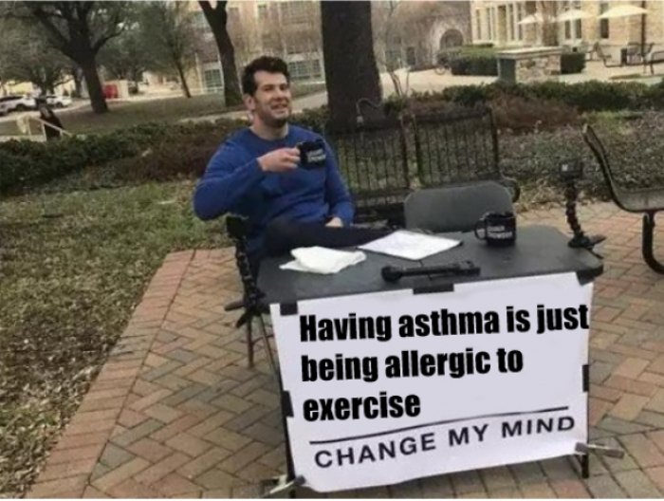
Dr. Al-Rikabi’s Notes
3
Definition and Clinical Features
Asthma is chronic obstructive and inflammatory airway diseases.
Characteristized by episodic increased responsiveness of the bronchial mucosa to various stimuli and it’s reversible.
Asthma comes in attacks (Episodic).
The major symptoms are dyspnea(breathlessness ضيق نفس) and many disease cause dyspnea especially heart and lungs diseases , and wheezing (صفير) due to the narrowing of bronchial tree and the degree of wheezing varies. which is because of the bronchospasm and accumulation of mucus plug during the attack.
Cough isn’t a major complaint in asthma.
The patient produce sputum which is clear and mucoid except in case of infection; it’ll be yellowish or greenish .

Slide 20
Dr. Al-Rikabi’s Notes
4
Classification of Asthma
1- Atopic Asthma
Those patient have multiple allergic manifestations such as: (allergic conjunctivitis, allergic rhinitis,allergic Sinusitis...)
Common in children
2- Non-atopic Asthma
Patients develop asthma attacks but they don’t have a known allergen.
Occurs in adults
Exercise-induced common(dehydration—>hyperosmolality—>damage—>IL secretion)
Aspirin (block PGs—> enhance leukotrienes C4, D4, E4—> bronchoconstriction)
Beta blockers
Common cold (viral antigens)
Stress
Upper respiratory tract infection e.g. rhinovirus, adenovirus & respiratory syncytial virus.
Atopy refers to the genetic tendency to develop allergic diseases such as allergic rhinitis, asthma and atopic dermatitis (eczema).

Slide 21
Dr. Al-Rikabi’s Notes
5
Pathogenesis
General Steps:
Antigen enters the respiratory tract.
It reaches the bronchi and the trachea and stimulates T helper cell (CD4).
CD4 → TH2 (sensitized form of T cells).
TH2 secrete cytokines (IL 4 - IL 5 - IL 13).
Cytokines can stimulate the vagus nerve which cause bronchoconstriction.
Role of Cytokine:
IL 4 + IL13
Stimulate B cells to produce IgE. (IL13 also increase the secretion of mucus)
IgE form a complex with antigen then set on specific receptor on mast cells.
Mast cell degranulates (release granules) which contain vasoactive amines
Vasoactive amines (histamine - PAF - serotonin) promotes (edema - bronchoconstriction)
IL5
Activate eosinophils.
Some leukotrienes
Bronchoconstriction
Role of Chemokines:
Respiratory epithelium secretes Eotaxin which stimulate the recruitment of eosinophils same as IL5.
To Conclude:
IL 4 + IL13 → stimulate B cells to produce IgE
IL13→ increase the secretion of mucus
IL5+ Eotaxin→ Activate eosinophils
Some leukotrienes → Bronchoconstriction

Slide 22
Dr. Al-Rikabi’s Notes
Chemokines: are a family of small cytokines, or signaling proteins secreted by cells. Their name is derived from their ability to induce directed chemotaxis in nearby responsive cells; they are chemotactic cytokines.
6
Morphology
Excess mucus due to the Increase action of goblet cells.
Recruitment of a large number of eosinophils due to the action of:IL5 (from TH2) + Eotaxin (from epithelial cell).
Smooth muscle contraction due to chemical mediators & stimulation of the vagus nerve.
Smooth muscle fibers become hypertrophied.

Slide 23
Dr. Al-Rikabi’s Notes
7
Diagnosis
Skin Prick Test is used in to assess allergens.
Spirometry:
If FEV1 is decreased it may indicate the patient has obstructive airway disease (asthma-emphysema… )
May also monitor the treatment and assess the patient responsiveness.
Sputum:
Sometimes used to diagnose different diseases.
How to differentiate between sputum and saliva?
Sputum has alveolar macrophages and bronchial epithelial cells.
Salvia doesn’t have alveolar macrophages and bronchial epithelial cells.
Curschmann's spirals founded in the sputum
8
Status Asthmaticus
Refers to asthma attack that doesn't improve with traditional treatments, such as inhaled bronchodilators. These attacks can last for long time (prolonged) and it’s not episodic.
They have high Co2 and low O2 levels due to the continues obstruction of their airways. Patients have to go to the hospital and seek immediate medical attention because it’s fetal.
Curschmann's spirals are a microscopic finding in the sputum of asthmatics. They are spiral-shaped mucus plugs from subepithelial mucous gland ducts of bronchi. They may occur in several different lung diseases

Slide 24
Which ONE of these cells produces eotaxin during asthmatic attack?
A. Basophils
B. Bronchial epithelium
C. Eosinophils
D. Mast cell
2. Which one of the following induce acute
asthma attack ?
A. Physical exercise
B. Oxygen therapy
C. Sudden weight loss
D. Severe burns
3. 60 years old female died due to asthma complications. Autopsy will show which of the following feature ?
A. Hyper secretion of watery fluid
B. Increased basophils in the mucosal layer
C. Accumulation of giant cells
D. Thickening of basement membrane
1.B 2.A 3.D

Slide 25
4. A 46-yo male was admitted and had dyspnea and had asthma with FEV1:0.45(lower than normal). What will you see in the sputum?
A. Horsfall protein
B. Curschmann spirals
C. Reink crystalloids
D. Monosodium urate
crystals
5. Which ONE of the following is produced by active Th2 in bronchial asthma ?
A. IL-4
B. TNF-a
C. FGF
D. IF-gamma
6. Which of the following is true regarding Extrinsic Asthma?
A. Hypersensitivity type IV
B. Hypersensitivity type I
C. Hypersensitivity type II
D. Hypersensitivity type III
4.B 5.A 6.B

Slide 26
Important to review
7. A 28-year-old male presents to the emergency department with severe dyspnea, which did not respond to his usual anti- asthmatic therapy for the last 48 hours. Laboratory investigations showed hypoxia and acidosis. Which one of the following most likely explains his symptoms and signs?
A. Aspirin induced asthma
B. Asthma caused by chronic exposure to toluene
C. Status asthmaticus
D. Viral infection
induced asthma
8. In which of the following conditions Charcot-Leyden Crystals are seen in the sputum?
A. Acute bronchitis
B. Bronchiectasis
C. Panacinar emphysema
D. Severe bronchial
asthma
9. Which ONE of the following cell types triggers inflammation of allergic asthma?
A. Eosinophils
B. Mast cells
C. Natural Killer (NK) cells
D. Neutrophils
7. C 8.D 9.B

Slide 27
Team leaders
Dema
Alkhattabi
Hassan Alabdullatif
Team members
Khalid alrasheed
Nawaf Alrefaei
Emad Almutairi
Othman Alabdullah
Mohamed ibn Saqyan
Ibrahim Alhezam
Talal alharbi
Saud Al Taleb
Ali Alzahrani
Omar Alkadhi
Shahed Albukhari
Walaa AlMutawa
Ajwan Aljohani

