Slide 1
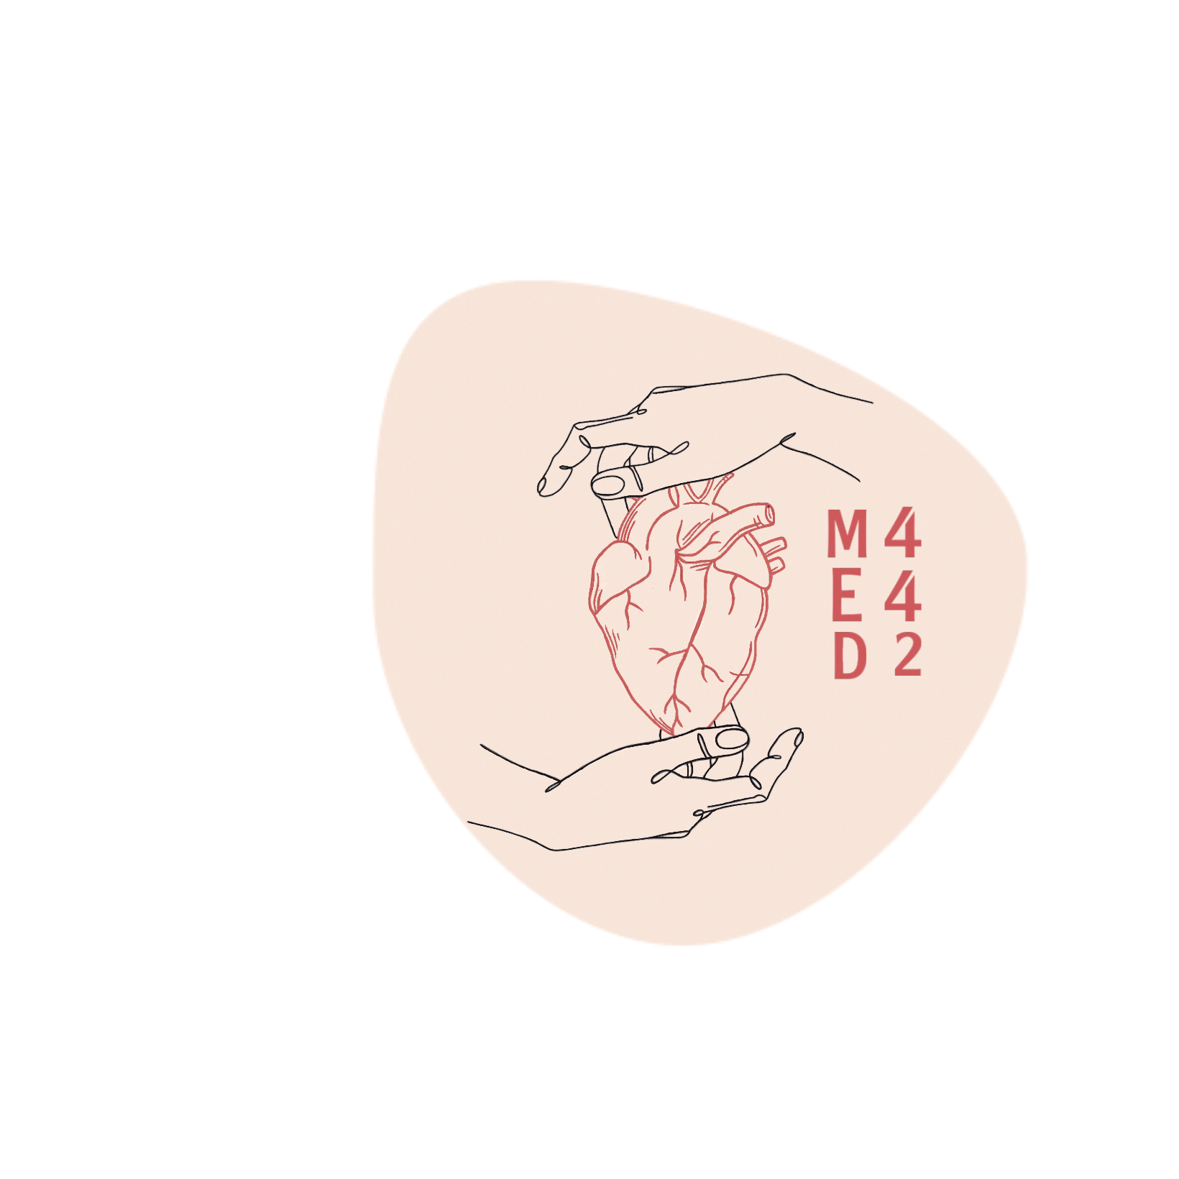
Pneumonia
Colour index:
Main text
Important
In girls slides only
In boys slides only
Doctor‘s notes
Extra info.
Editing file

Slide 2
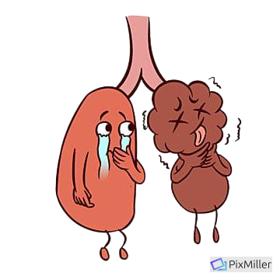
Objectives
1
Understanding that pneumonia is an inflammatory condition of the lung characterized by consolidation (solidification) of the pulmonary tissue
To be aware of the pathogenesis of pneumonia and its classification which principally include bronchopneumonia, lobar pneumonia and atypical pneumonia
Can appreciate the etiology and pathogenesis of lung abscess
2
3

Slide 3
It is very important to see Dr.Ammar’s notes at the end of the slides
Pulmonary infection
Definition:
Any infection in the lung “inflammation of the lung parenchyma”
Epidemiology
Responsible for one sixth of all deaths in the United States
(It is common)
Caused by
The vast majority are upper respiratory tract infections caused by viruses, but bacterial and fungal infections can also occur
Overview
Normally, the lung parenchyma remains sterile because of a number of highly effective immune and non-immune defense mechanisms that extend throughout the respiratory system from the nasopharynx to the alveolar air spaces
Classification of pneumonia
Pneumonia is classified by the specific etiologic agent, which determines the treatment, or, if no pathogen can be isolated, by the clinical setting in which the infection occurs
The vulnerability of the lung to infection despite these defenses is not surprising because:
Many microbes are airborne and readily inhaled into the epithelium of the lung
Underlying lung diseases render the lung parenchyma vulnerable to virulent organism 439
Nasopharyngeal flora are regularly aspirated during sleep, even by healthy individuals
Lung diseases often lower local immune defenses

Slide 4
Pulmonary infections
Predisposing factors (i.e. who’s at risk?)
1
Loss or suppression of the cough reflex: as a result of coma, anesthesia, neuromuscular disorders, drugs, or chest pain (may lead to aspiration of gastric contents).
2
Injury to the mucociliary apparatus: by either impairment of ciliary function or destruction of ciliated epithelium, due to cigarette smoke, inhalation of hot or corrosive gases, viral diseases, chronic diseases or genetic defects of ciliary function (e.g., the immotile cilia syndrome ciliary dyskinesia).
3
Retention and Accumulation of secretions in conditions such as cystic fibrosis and bronchial obstruction
4
Interference with the phagocytic or bactericidal action of alveolar macrophages (Decreased function of alveolar macrophages) by alcohol, tobacco smoke, anoxia, or oxygen intoxication
5
Pulmonary congestion and edema
6
Chronic diseases such as diabetes 441
7
Immunologic deficiencies (immunocompromised ), treatment with immunosuppressive agents, leukopenia that makes more susceptible for any kind of infection + pneumonia441
The clinical settings in which the infection occurs
Community-acquired acute pneumonia
Community-acquired atypical pneumonia
Hospital-acquired pneumonia (nosocomial)
Aspiration pneumonia
Chronic pneumonia
Necrotizing pneumonia and lung abscess
Opportunistic pneumonia (pneumonia in the immunocompromised host)

Slide 5
Pathogenesis & Classification of pneumonia
Pathogenesis of pneumonia
Pneumonia can be acute or chronic
Portal of entry for most pneumonias is
Inhalation of air droplets
Aspiration of infected secretions or objects
Hematogenous spread from one organ to other organs can occur
Causitave agent
Anatomic classification according to:
Gross anatomic distribution
Alveolar “Typical” | Bronchopneumonia | (Streptococcus pneumoniae, Haemophilus influenzae, Staphylococcus aureus) Represent an extension from preexisting bronchitis or bronchiolitis. Extremely common tends to occur in two extremes of life.
 | Lobar pneumonia | (Streptococcus pneumoniae) Acute bacterial infection of a large portion of a lobe or entire lobe. Classic lobar pneumonia is now infrequent.
 | Note: Overlap of the two patterns often occur.
Interstitial “Atypical” | - | Influenza virus (children) Mycoplasma pneumoniae.

Slide 6
Community-Acquired Acute Pneumonia (Typical)
Definition
Pneumonia acquired outside hospitals or extended-care facilities.
Usually, bacterial
Can follow URT (upper respiratory tract) infection.
It can be lobar or bronchopneumonia
Clinical features
Abrupt onset of :
Sudden onset high fever.
Shaking chills, pleuritic chest pain.
Productive cough of mucopurulent sputum occasional patients may have hemoptysis.
Reduced air entry and dullness by percussion
When fibrinosuppurative pleuritis is present, it is accompanied by pleuritic pain and pleural friction rub.
Most common
Streptococcus pneumoniae
intravenous
drug abuser
Staphylococcus aureus
Other common causes
Haemophilus influenzae, Moraxella catarrhalis,
Staphylococcus aureus, Legionella pneumophila,
Klebsiella pneumoniae, Pseudomonas aeruginosa spp,
Mycoplasma pneumoniae, Chlamydia pneumoniae and
Coxiella burnetii (Q fever)
Decreased or absent splenic function
Underlying chronic disease e.g. DM, COPD, and congestive heart failure
It is more common in:
Congenital or acquired immune deficiency
Important slide you should be aware of all the organisms and who is at risk

Slide 7
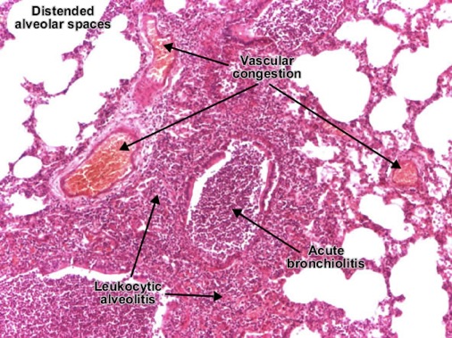
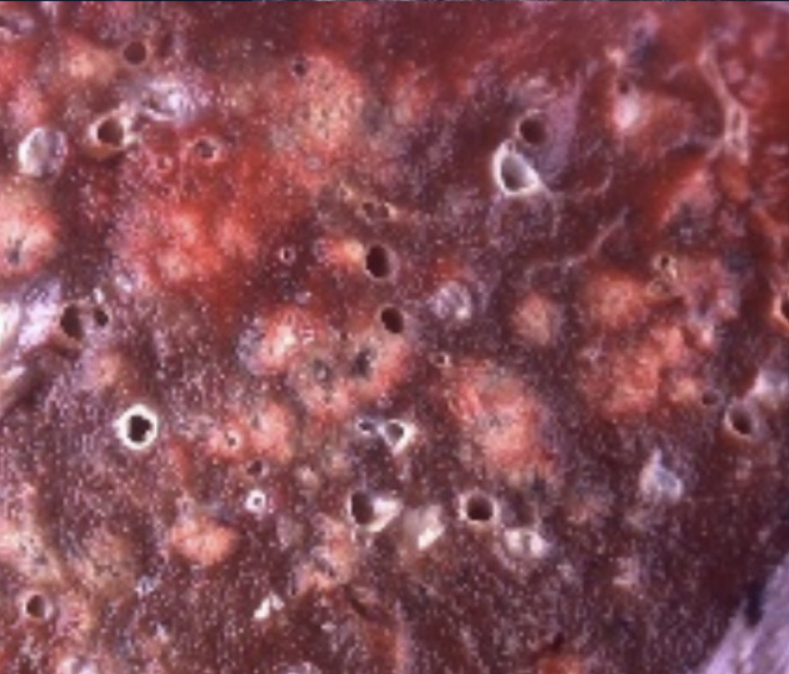
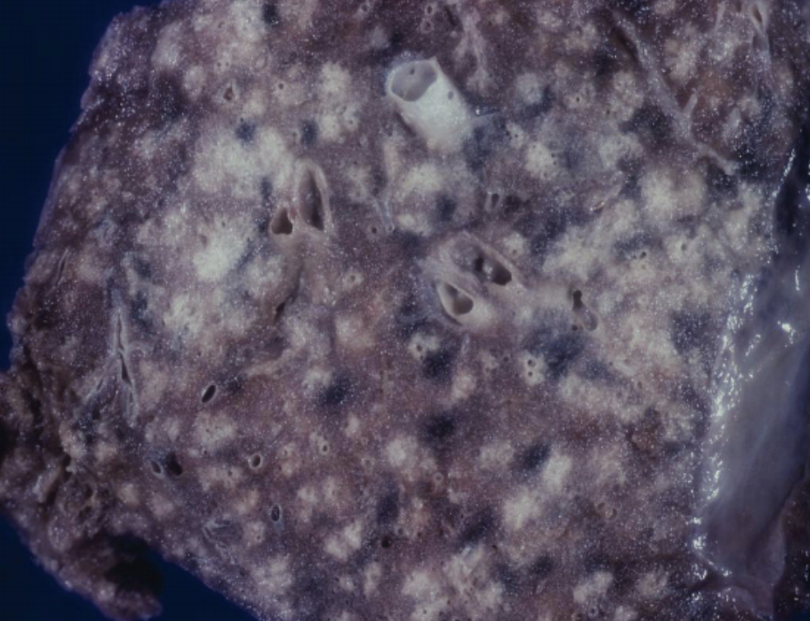
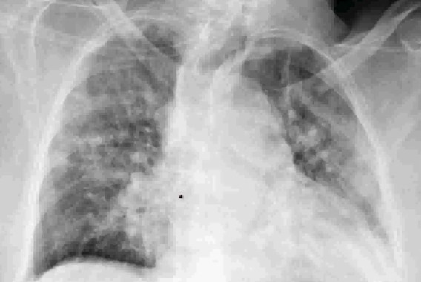
Community-Acquired Bacterial Pneumonia
 |  | Bronchopneumonia
Definition |  | Are focal/patchy areas of consolidated acute suppurative inflammation in one or more lobes. Usually it involves lower lobes (basal) bilaterally because there is a tendency of the secretions to gravitate into the lower lobes. Well developed lesions are 3 to 4 cm dry grey red ill defined nodules.
Etiology |  | Most common agents are: Streptococcus pneumoniae, Haemophilus Influenzae in COPD Pseudomonas Aeruginosa in CF Coliform bacteria Staphylococci (secondary bacterial pneumonia in children and healthy adults after viral respiratory illnesses)
 | Microscopy | Suppurative, neutrophil rich exudate filling the bronchi, bronchioles and adjacent alveolar spaces.
 | Gross | Patchy consolidation of the lung, slightly elevated, dry, granular, gray-red to yellow, and poorly delimited at their margins
 | Radiology | There are multiple small opacities usually basal and bilateral.
Morphology

Slide 8
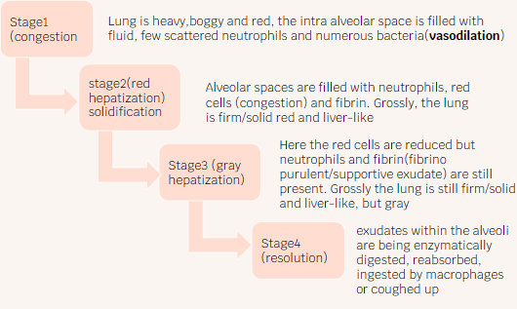
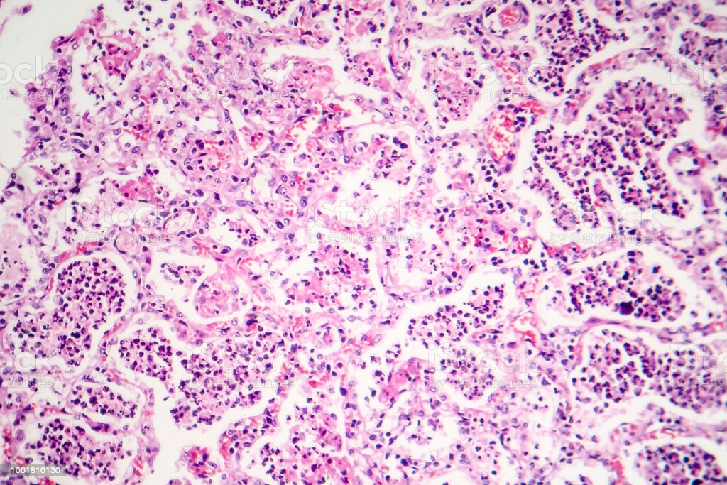
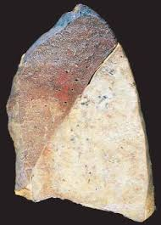
Community-Acquired Bacterial Pneumonia
 | Lobar Pneumonia
Definition | it is widespread involvement of a large area and even an entire lobe of lung (widespread fibrinosuppurative consolidation)
Casuses | 90-95% are caused by Streptococcus Pneumoniae (Pneumococci) type 1,2,3&7 Rare agents: K. pneumoniae - staphylococci - streptococci -H. Influenzae - Pseudomonas and Proteus
Stages of lobar pneumonia
Morphology | Red hepatization: Alveoli are filled with fibrin, RBC’s and neutrophils
Radiology | There is a radio opaque (consolidation) well circumscribed lobe
Stage 1
( congestion )
Lung is heavy, boggy and red, the intra alveolar space is filled with fluid. Few scattered neutrophils and numbers bacteria ( vasodilation )
Stage 2
( red hepatization solidification )
Alveolar spaces are filled with neutrophils. Red cells ( congestion ) and fibrin. Grossly the lung is firm / solid red and liver-like.
Stage 3
( gray hepatization )
Here the red cells are reduced but neutrophils and fibrin ( fibrino purulent/ suppurative exudate ) are still present.grossly the lung is still firm / solid and liver-like but grey.
Stage 4
( resolution )
Exudate within the alveoli are being enzymatically digested, reabsorbed, ingested by macrophages or coughed up

Slide 9
Complications of
typical Pneumonia
Empyema
Spread of infection to the pleural cavity, causing the intrapleural fibrinosuppurative reaction known as empyema
1
3
2
Bacteremic dissemination:
Bacteremic dissemination to the heart valves, pericardium, brain, kidneys, spleen, or joints, causing metastatic abscesses, endocarditis, meningitis, or suppurative arthritis
Abscess formation:
Tissue destruction and necrosis,
causing abscess formation (particularly common with type 3 pneumococci or Klebsiella infections)

Slide 10
Community-Acquired bacterial
Pneumonia atypical
Text
Text
Interstitial pneumonitis/ Primary atypical
Text
Characteristics & features
Text
Characterized by patchy inflammation in the lungs confined to the alveolar septae and pulmonary interstitium and therefore it is called interstitial pneumonitis.
The term atypical denotes the moderate amount of sputum, no physical findings of consolidation, only moderate elevation of white cell count, and lack of alveolar exudate
It is called atypical pneumonia because it not the typical pneumonia in which the inflammation is primarily in the alveolar spaces.
Etiology
The most common is Mycoplasma pneumonia (common in children and young adults)
Others include:
Chlamydia spp. (C. pneumonia etc.) and Coxiella burnetii (Q fever). Chlamydia is transmitted by inhalation of dried excreta of infected birds and causes ornithosis/psittacosis.
Respiratory syncytial viruses (H.metapneumovirus) (children)
Influenza types A and B (adults)
Influenza virus (children)
Adenovirus
SARS virus
Rhinoviruses
Rubeola virus
Varicella
(all of these agents also cause upper-respiratory tract infections) *Briefly all viruses that cause URTI

Slide 11
Community-Acquired bacterial
Pneumonia atypical
Predisposing factors
Malnutrition, alcoholism and any underlying debilitating disease
Test for Mycoplasma pneumoniae (Cold Agglutination test)
Positive in Mycoplasma (primary atypical pneumonia
serological assays.
polymerase chain reaction (PCR) .
Mechanism
The virus damage respiratory epithelium, producing an inflammatory response.
The process may extends to alveoli (interstitial inflammation), but some outpouring of fluid into alveolar spaces may also occur.
So that on chest films the changes may mimic those of bacterial pneumonia
Predisposing factors
● Epithelial damage leading to necrosis of the respiratory epithelium inhibits mucociliary clearance and predisposes to secondary bacterial infections. The most likely organism which cause secondary bronchopneumonia is S.aureus.
● Such serious complications of viral infection are more likely in infants, older adults, malnourished patients, alcoholics, and immunosuppressed individuals.
● In severe cases full-blown diffuse alveolar damage with hyaline membranes may develop

Slide 12
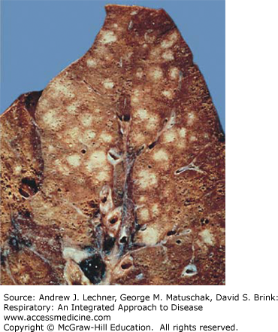
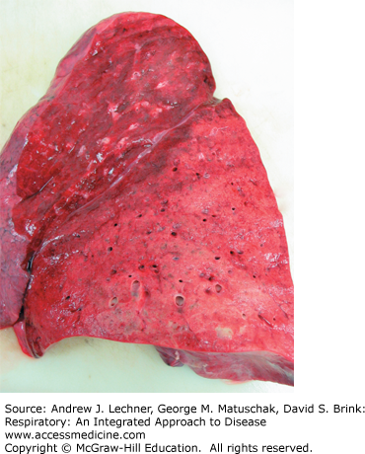
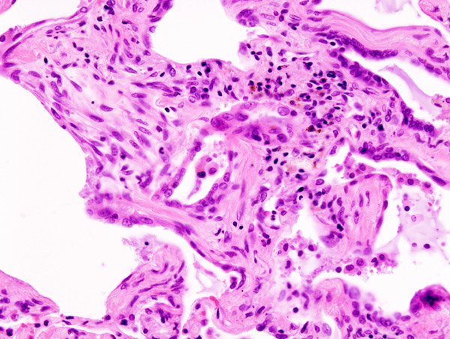
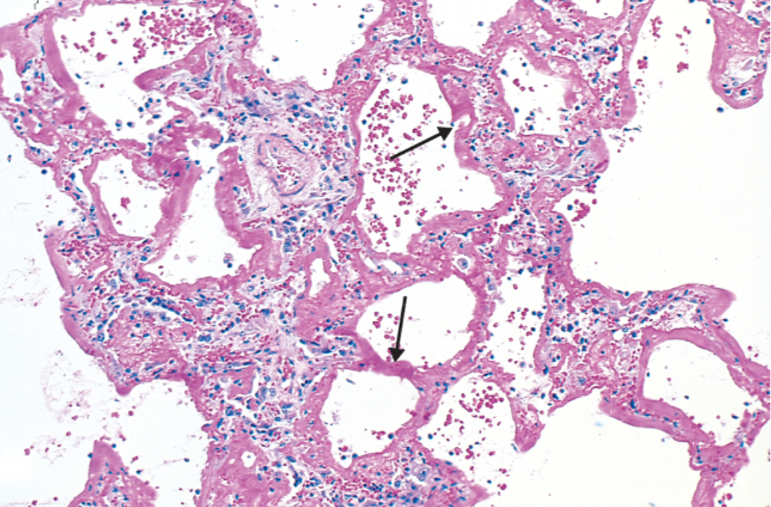
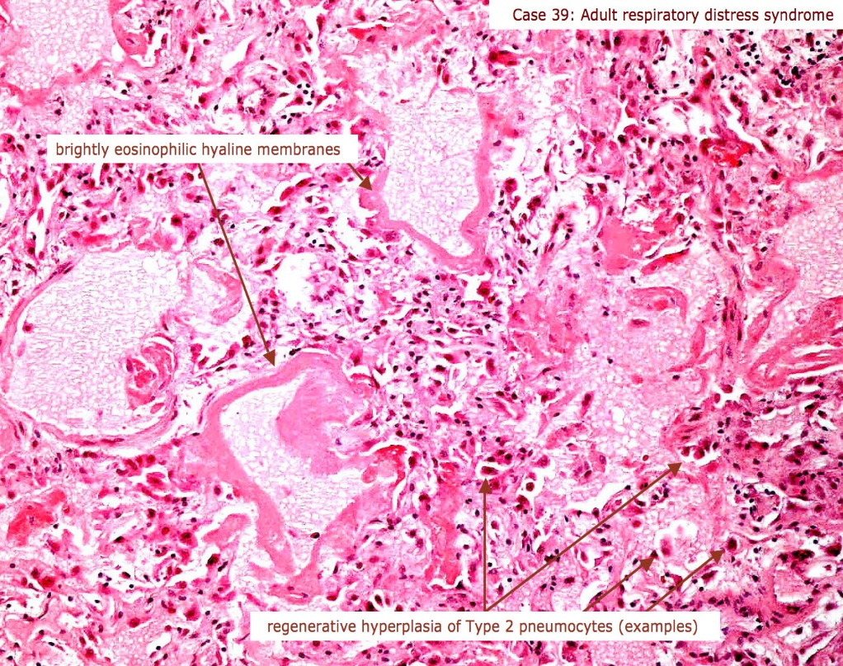
Morphology
Gross:
All causal agents produce essentially similar morphologic patterns
The lung involvement may be quite patchy or may involve whole lobes bilaterally or unilaterally
The affected areas are red-blue and congested. The pleura is smooth, and pleuritis or pleural effusions are infrequent
Viral Pneumonia
Picture #1 : bronchopneumonia (white-greyish patchy distribution)
Picture #2 : lobar pneumonia in red hepatization stage
439
The thickened alveolar walls are
infiltrated with lymphocytes and
some plasma cells which are
spilling edema over into alveolar
spaces
Micro:
Predominantly there is inflammation in the interstitium/alveolar wall
Alveolar septa are widened and edematous with mononuclear inflammatory infiltrate (and neutrophils in acute cases only)
Severe cases: Intra-alveolar proteinaceous material with pink hyaline membrane lining the alveolar walls (diffuse alveolar damage)
exudate/pinkish material deposits on the alveolar wall itself not inside the alveolar space
Reactive pneumocytes can be found as a result of inflammation (usually mistaken for cancer)

Slide 13
Clinical course
1
2
The clinical course is extremely varied
Many cases masquerade as severe upper respiratory tract
infections with respiratory distress or manifest as a fulminant,
life-threatening infection (in immunocompromised) or as chest colds
3
4
Cough may be absent, and the major manifestations may
consist only of fever, headache, muscle aches, and pains in the
legs
The ordinary sporadic form of the disease is usually mild with a
low mortality rate, below 1%. Interstitial pneumonia (good
prognosis)
5
Secondary bacterial infection by staphylococci or streptococci is common in such circumstances
The clinical course of atypical pneumonia is less severe than typical pneumonia.

Slide 14
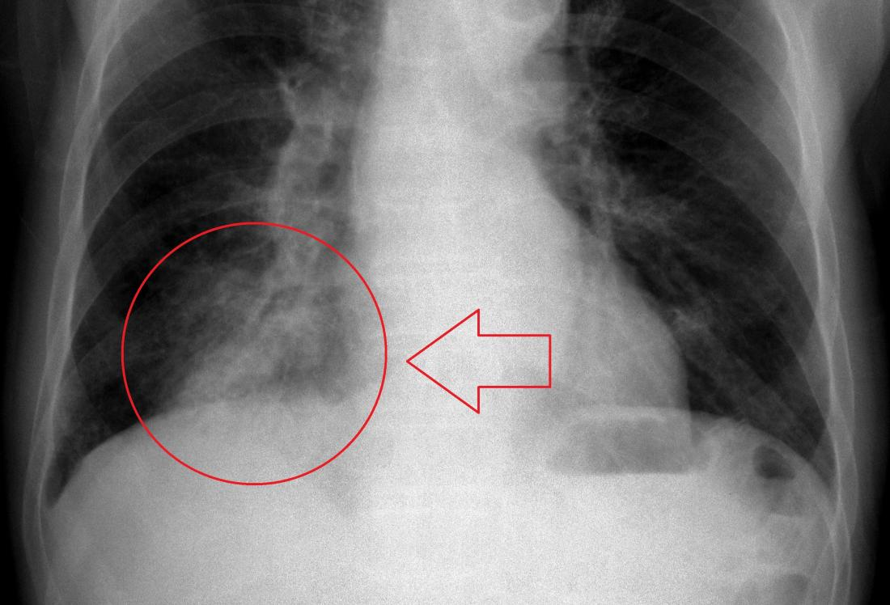
Other types of pneumonia
 | Hospital acquired Pneumonia
Overview | Nosocomial Pneumonia ● Acquire terminal pneumonias while hospitalized (nosocomial infection)
Etiology | Gram-negative organisms like Klebsiella, Pseudomonas aeruginosa and E.coli and methicillin resistant Staphylococcus aureus.
Predisposing factor | Severe underlying conditions e.g. immunosuppression, prolonged antibiotic therapy, intravascular catheter and pt. with mechanical ventilator.
 | Aspiration pneumonia
Overview | Occur in markedly debilitated patients, comatose, alcoholic, or those who aspirated gastric contents (sometimes even Norm.Flora) either while unconscious (e.g., after a stroke) or during repeated vomiting
Features | These patients have abnormal gag and swallowing reflexes that predispose to aspiration
Etiology | ● The resultant pneumonia is partly chemical because of the extremely irritating effects of the gastric acid, and partly bacterial (from the oral flora) ● typically, more than one organism is recovered on culture, aerobes being more common than anaerobes ● Chemical injury due gastric acid and bacterial infection (anaerobic bacteria admixed with aerobic bacteria, e.g. Bacteroides, fusobacterium and Peptococcus)
complications | Usually necrotizing, Pursues a fulminant clinical course, and is a frequent cause of death.In those who survive, lung abscess is a common complication.
Usually found in the lower right side of the lung because of the anatomy of the right bronchus

Slide 15
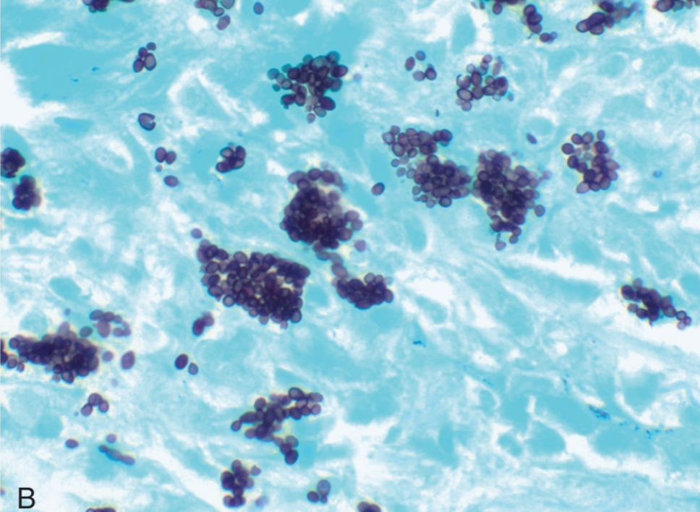
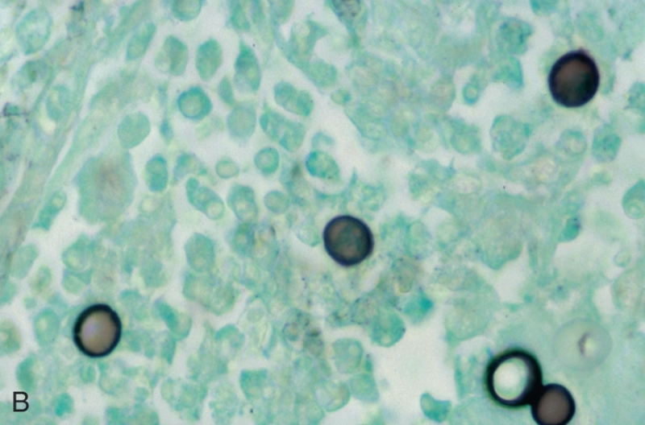
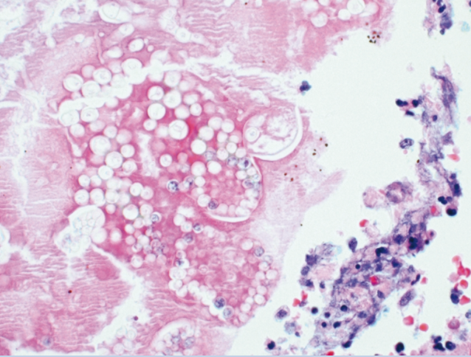
Other types of pneumonia
 | Chronic Pneumonia
Overview | ● Is most often a localized lesion in an immunocompetent person, with or without regional lymph node involvement. ● In the immunocompromised, there is usually systemic dissemination of the causative organism, accompanied by widespread disease ●Tuberculosis is by far the most important entity within the spectrum of chronic pneumonias.
Etiology | There is typically granulomatous inflammation. ● (M. tuberculosis) ● fungi (Histoplasma capsulatum, Coccidioides, immitis,Blastomyces)
Epidemiology | immunocompromised, immunocompetent.
Morphology
GMS stain (silver stain)
#1: histoplasma caspulatum
#2: Blastomyces immtis
#3:coccidioides immitis

Slide 16
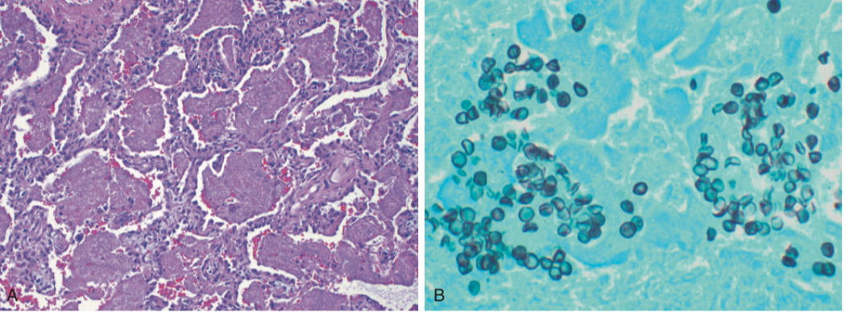
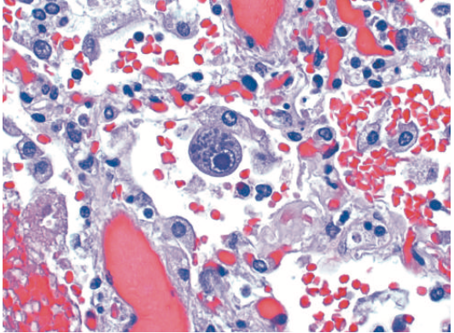
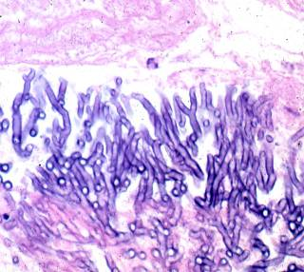
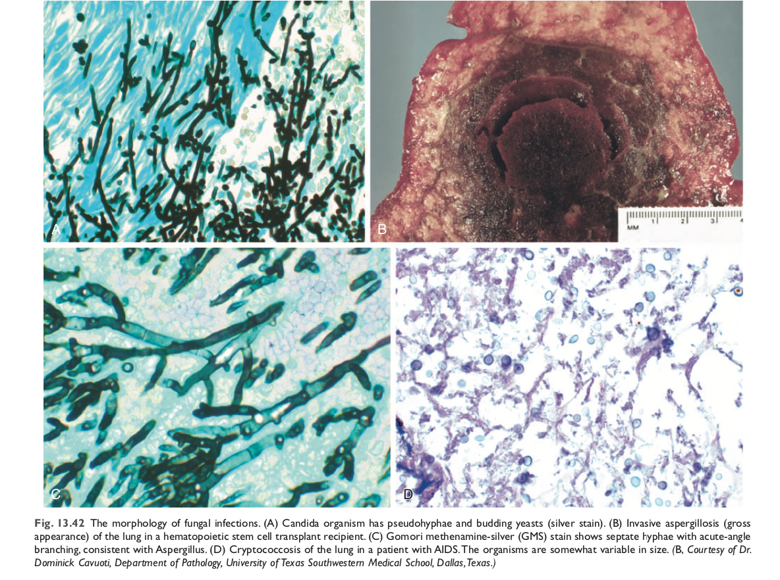
Other types of pneumonia
 | Opportunistic pneumonias
Etiology | ● Cytomegalovirus. ● Pneumocystis jiroveci (formerly P. carinii) ● Mycobacterium avium-intracellulare. ● Invasive aspergillosis. ● Invasive candidiasis. ● "Usual" bacterial, viral, and fungal organisms.
Epidemiology | ●Infections that affect immunosuppressed patients (AIDS, cancer patients and transplant recipients) ●Is one of the most common and serious complications in patients whose immune defenses are suppressed by disease, immunosuppressive therapy for organ transplants, chemotherapy for tumors, or irradiation
Clinical features | The appearance of a pulmonary infiltrate, with or without signs of infection (e.g., fever)
Morphology
Foamy,pink-staining exudate (cotton candy)
rod/Cup-like structures
CMV-infected cells: Enlarged nucleus with inclusions usually in immunocompromised

Slide 17
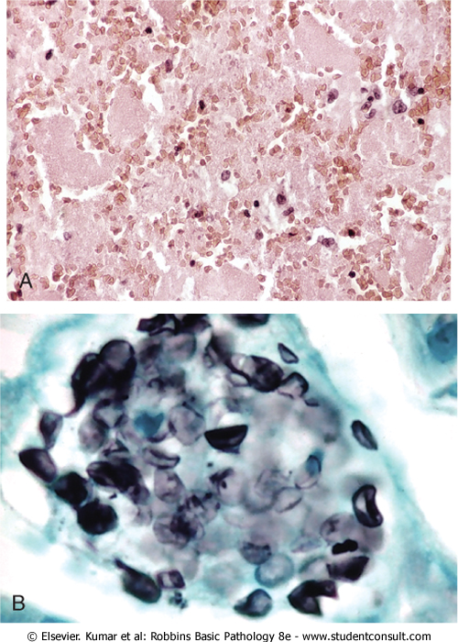
Other types of pneumonia
 | Pneumocystis Pneumonia
Etiology | ● P. jiroveci (formerly P. carinii) is an opportunistic infectious agent considered as a fungus. ● Seen in immunocompromised individuals especially AIDS.
Diagnosis | ● Identify the organism in bronchoalveolar lavage fluids or in a transbronchial biopsy specimen (granular material). ● Immunofluorescence antibody kits and PCR-based (very advanced not in all hospitals) assays.
Morphology | ● Characteristic intra-alveolar foamy, pink- staining exudate on H&E stains. (A) Organism is trapped in the Foamy material and can be seen on silver stain as oval cup shaped structures (B)

Slide 18
 | Lung abscess
Features | ●Is localized suppurative necrotic process within the pulmonary parenchyma ● tissue necrosis and marked acute inflammation. ● Abscess is filled with necrotic suppurative debris
Causative organisms | Staphylococci Streptococci Gram-negative organisms Anaerobes
Pathogenesis | ● Can follow aspiration ● As a complication of pneumonia ● Septic emboli ● Tumors ● Direct infection
Clinical features | ● Prominent cough producing copious amount of foul smelling and bad-tasting purulent sputum. ● Change in position evoke paroxysm of cough. ● Fever malaise and clubbing of fingers. ● Radiology shows fluid filled cavity.
Complications | ● Bronchopleural fistula and pleural involvement resulting in empyema. ● Massive hemoptysis, spontaneous rupture into uninvolved lung segments. ● Non-resolution of abscess cavity. ● Bacteremia could result in brain abscess and meningitis.
Prognosis | ● with antibiotic therapy 75% of abscess resolve.

Slide 19
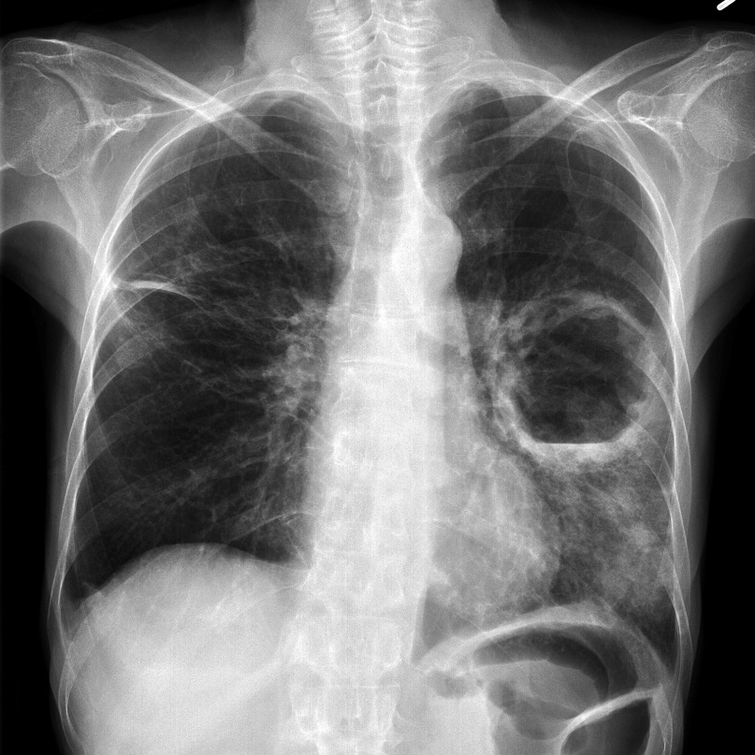
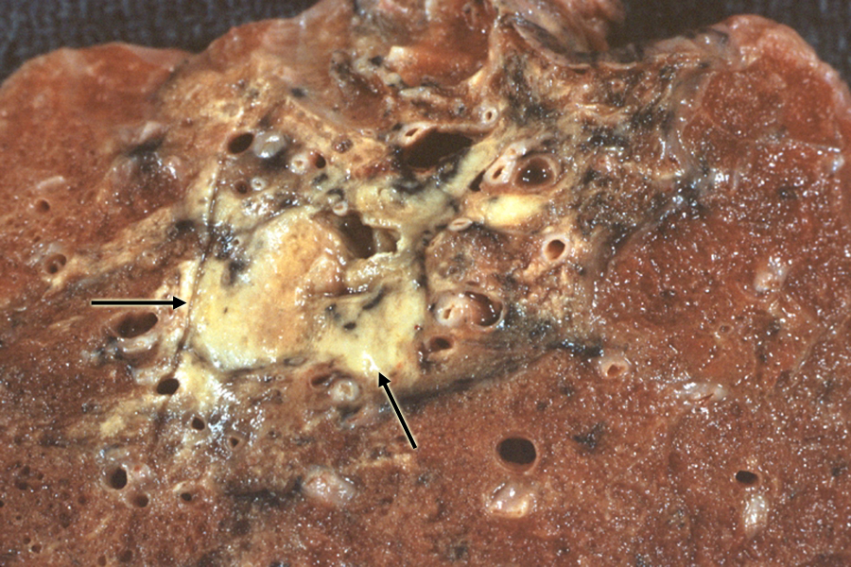
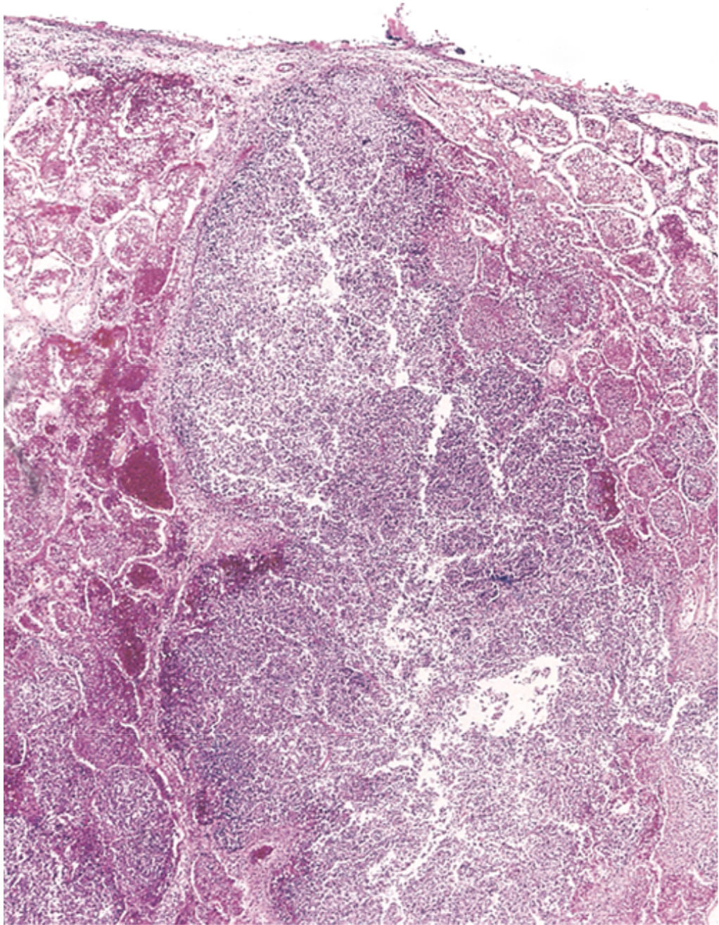
Lung abscess
Morphology
● Variable in size
● Single or multiple
● Pulmonary abscesses due to aspiration are more common on the right
(because of the more vertical right main bronchus) and are most often
single
● Abscesses that develop in the course of pneumonia or bronchiectasis
are usually multiple, basal, and diffusely scattered
● The cardinal histologic change in all abscesses is suppurative
destruction of the lung parenchyma within the central area of
cavitation
Filled with pus
Big cystic lesion filled with exudate

Slide 20
Dr. Ammar’s notes
1
Small overview
A- Pneumonia: inflammation of the lung parenchyma.
B- Predisposing factors:
diabetes mellitus
Old age
Chronic diseases
Immune deficiency
alcoholics
Malnutrition
(there are many other predisposing factors)
C- Symptoms:
Fever (pyrexia).
Chills.
Malaise.
Mucopurulent cough.
chest pain (specially when it reach the pleural cavity).
Rusty tasty sputum.
D- Investigations:
High WBC ( shift to the left)
High ESR
High C-reactive proteins
A "left shift" is a phrase used to note that there are young/immature white blood cells present. Most commonly, this means that there is an infection or inflammation present and the bone marrow is producing more WBCs and releasing them into the blood before they are fully mature.

Slide 21
Dr.Ammar’s notes
2
Classification
Classification can be based on 3 principal:
1- Clinical Classification
A- Community acquired pneumonia
B- Hospital acquired (Nosocomial) pneumonia
C- Aspiration pneumonia
2- pathological Classification
A- Lobar pneumonia
B- Bronchopneumonia
C- interstitial pneumonia
3- Based on the etiology (based on the organism)
streptococcus pneumonia
staphylococcus pneumonia
klebsiella pneumonia
Mycoplasma pneumonia
Lobar pneumonia: Inflammation and consolidation that affect one or two lobes
Mainly caused by streptococcus pneumonia
It Can be associated with:
1- pleuritis
2- lung abscess (specially if it caused by pyogenic organism eg: staphylococcus)
Lobar pneumonia happens in 4 stages:
Stage 1: congestion
Stage 2: red hepatization
Stage 3: grey hepatization
Stage 3: resolution
Complications:
Empyema

Slide 22
Dr.Ammar’s notes
Stage 1
( congestion )
Lung is heavy, boggy and red, the intra alveolar space is filled with fluid. Few scattered neutrophils and numbers bacteria ( vasodilation )
Stage 2
( red hepatization solidification )
Alveolar spaces are filled with neutrophils. Red cells ( congestion ) and fibrin. Grossly the lung is firm / solid red and liver-like.
Stage 3
( gray hepatization )
Here the red cells are reduced but neutrophils and fibrin ( fibrino purulent/ suppurative exudate ) are still present.grossly the lung is still firm / solid and liver-like but grey.
Stage 4
( resolution )
Exudate within the alveoli are being enzymatically digested, reabsorbed, ingested by macrophages or coughed up
Bronchopneumonia: Patchy and focal pneumonia that affects the bronchi, bronchioles and the surrounding alveoli.
It can be caused by many organisms.
Interstitial pneumonia: Characterized by patchy inﬂammation in the lungs conﬁned to the alveolar septae and pulmonary interstitium.
Mainly caused by obligated intracellular organisms: viruses - Mycoplasma - chlamydia.
Diagnosis: Cold Agglutination test is Positive in Mycoplasma primary atypical pneumonia
It’s called cold because we do the test under a low temperature.
- The mycoplasma will lead to the formation of some IgM in the circulation.
- We take a blood sample from the patient and add RBC’s form a sheep (lamb) to it.
- The RBC’s of the lamb will agglutinate because of the IgM.
Complications: Adult respiratory distress syndrome (ARDS).

Slide 23
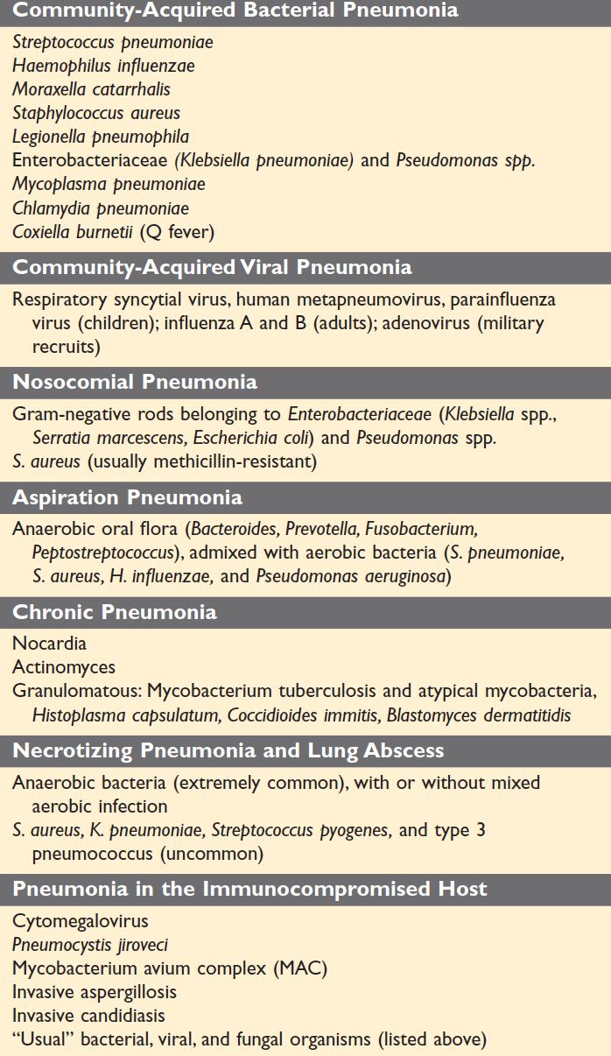
Dr.Ammar’s notes
Opportunistic pneumonia: happens mainly in patient that are immunocompromised such as (AIDS, cancer patient and transplant recipients)
Common organism that cause this type of pneumonia:
Pneumocystis jiroveci
Cytomegalovirus
Invasive aspergillosis

Slide 24
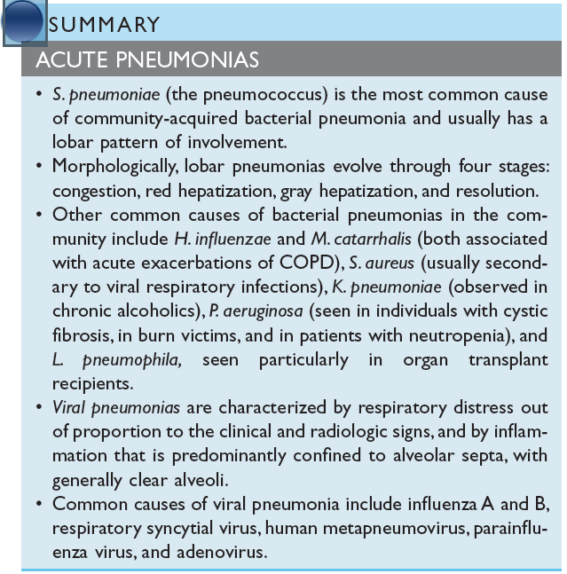
Robbins book
Gray hepatization Gray hepatization On gross examination, the lobe is red, firm,
and airless, with a liver-like consistency, hence the term hepatization.

Slide 25
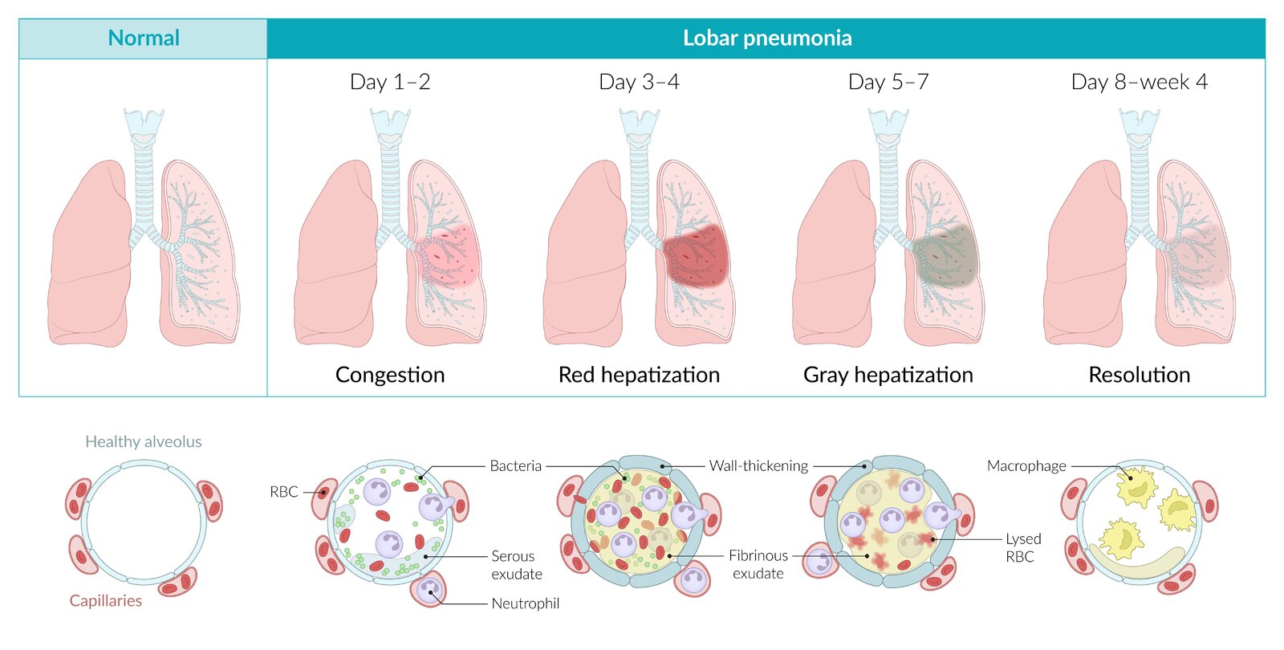
Summery
S. pneumoniae (the pneumococcus) is the most common cause of community-acquired bacterial pneumonia and usually has a lobar pattern of involvement.
Morphologically, lobar pneumonias evolve through four stages: congestion, red hepatization, gray hepatization, and resolution.
Other common causes of bacterial pneumonias in the community include H. influenzae and M. catarrhalis (both associated with acute exacerbations of COPD), S. aureus (usually secondary to viral respiratory infections), K. pneumoniae (observed in chronic alcoholics), P. aeruginosa (seen in individuals with cystic fibrosis, in burn victims, and in patients with neutropenia), and L. pneumophila, seen particularly in organ transplant recipients.
Viral pneumonias are characterized by respiratory distress out of proportion to the clinical and radiologic signs, and by inflammation that is predominantly confined to alveolar septa, with generally clear alveoli.
Common causes of viral pneumonia include influenza A and B, respiratory syncytial virus, human metapneumovirus, parainfluenza virus, and adenovirus.

Slide 26
MCQs
1. A 40-year-old woman with leukemia is treated with chemo- therapy. During treatment she develops increasing cough and shortness of breath. A chest X-ray shows diffuse lung infil- trates. Sputum cultures are negative, and the patient does not respond to routine antibiotic therapy. An open lung biopsy is diagnosed by the pathologist as viral pneumonia. Which of the following histopathologic findings would be expected in the lungs of this patient?
A. Clusters of epithelioid macrophages | B. Confluent areas of caseous necrosis | C. Fibrous scarring of lung parenchyma | D. Hyaline membranes and interstitial inflammation
2. What is the most common cause of Community-Acquired Bacterial Pneumonia (atypical)?
A. Hemophilus infileunzi | B. S.aurues | C. Streptococcus Pneumonia | D. Mycoplasma Pneumonia
3. A 48-year-old man with AIDS is admitted to the hospital with a fever of 38.7°C (103°F). The patient has a 2-week history of persistent cough and diarrhea. Laboratory studies show that the CD4+ cell count is less than 500/μL. A sputum culture reveals acid-fast organisms, which are further identified as Mycobacterium avium-intracellulare. This patient’s pneumonia is characterized by extensive pulmonary infiltrates of which of the following cell types?
A. CD4+ helper T cells | B. Eosinophils | C. Macrophages | D. Neutrophils
4. Which of the following isn’t a predisposing factor for CAP atypical pneumonia?
A. Alcoholism | B. Young children | C. Malnutrition | D. Both A & C
5. Which of the following is a possible complication of typical pneumonia?
A. Empyema | B. Bacterial dissemination | C. Abscess formation | D. All of the above
1. D
2.D
3.C
4. B
5.D

Slide 27
Team leaders
Dema
Alkhattabi
Hassan Alabdullatif
Team members
Khalid alrasheed
Nawaf Alrefaei
Emad Almutairi
Othman Alabdullah
Mohamed ibn Saqyan
Ibrahim Alhezam
Talal alharbi
Saud Al Taleb
Ali Alzahrani
Omar Alkadhi
Shahed Albukhari
Walaa AlMutawa
Ajwan Aljohani

