Slide 1
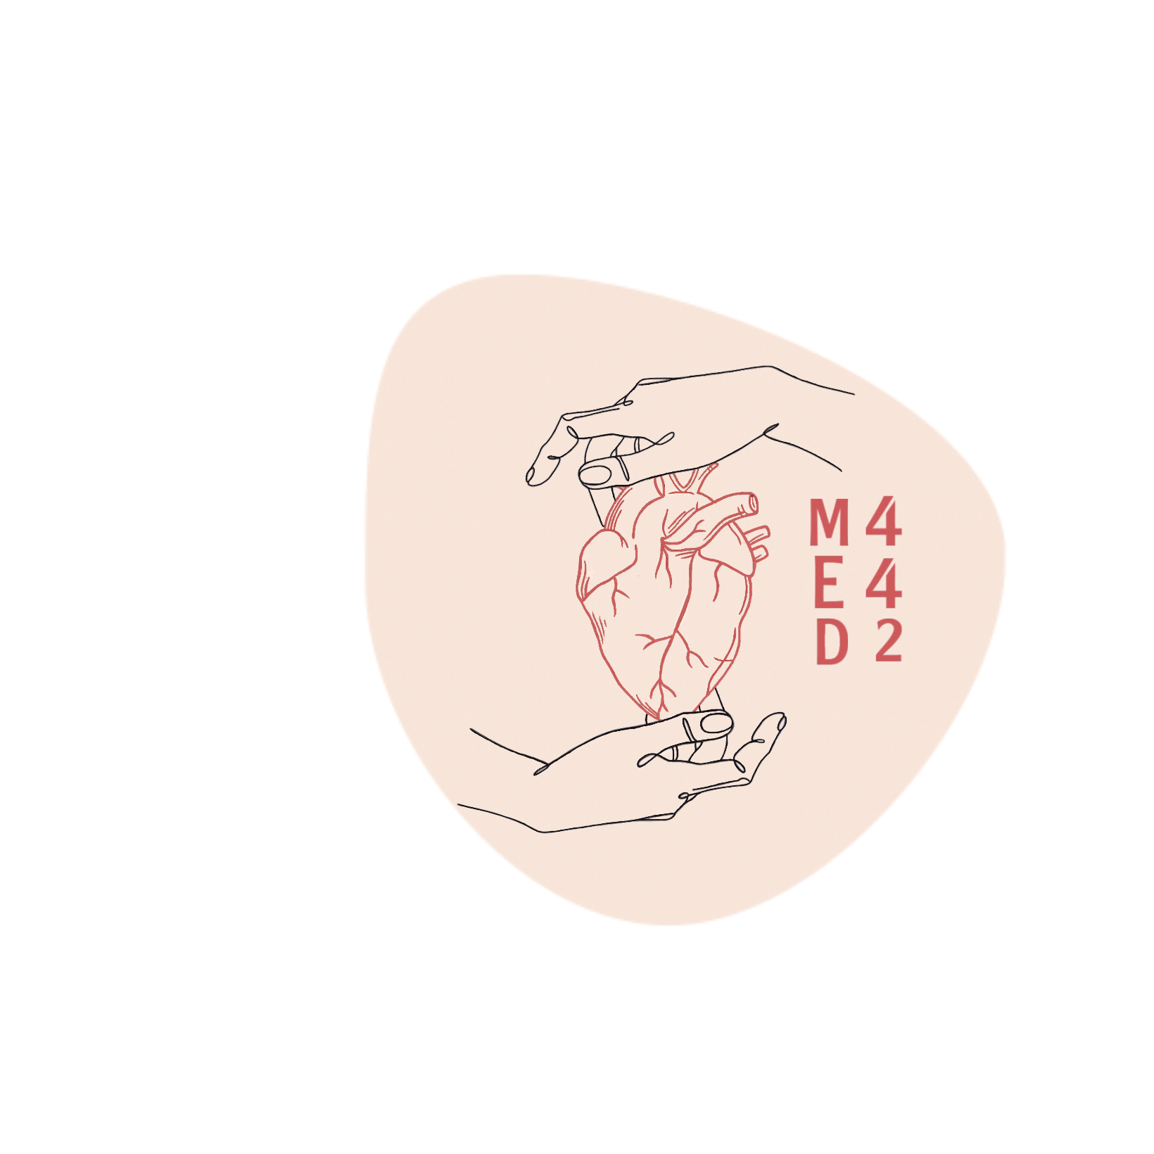
Pathology of Tuberculosis
Colour index:
Main text
Important
In girls slides only
In boys slides only
Doctor‘s notes
Extra info.
Editing file

Slide 2
Objectives
1
Define tuberculosis
2
Know the epidemiology of tuberculosis (TB)
List conditions associated with increased risk of Tuberculosis
3
4
5
In regards to Mycobacterial lung infection: Compare and contrast the
following in relation to their gross and histologic lung pathology:
– Primary tuberculosis (include a definition of the Ghon complex).
– Secondary or reactivation tuberculosis.
– Miliary tuberculosis.
6
7
8
9
10
Recognize the morphology of Mycobacteria and its special stain (the Ziehl-Neelsen) as well as the morphology of granulomas in TB (tubercles).
Know the Pathogenesis of tuberculosis
List organs other than lung that are commonly affected by tuberculosis.
Know the basis and use of tuberculin skin (Mantoux) test.
List the common clinical presentation of Tuberculosis
List the complication and prognosis of tuberculosis.

Slide 3
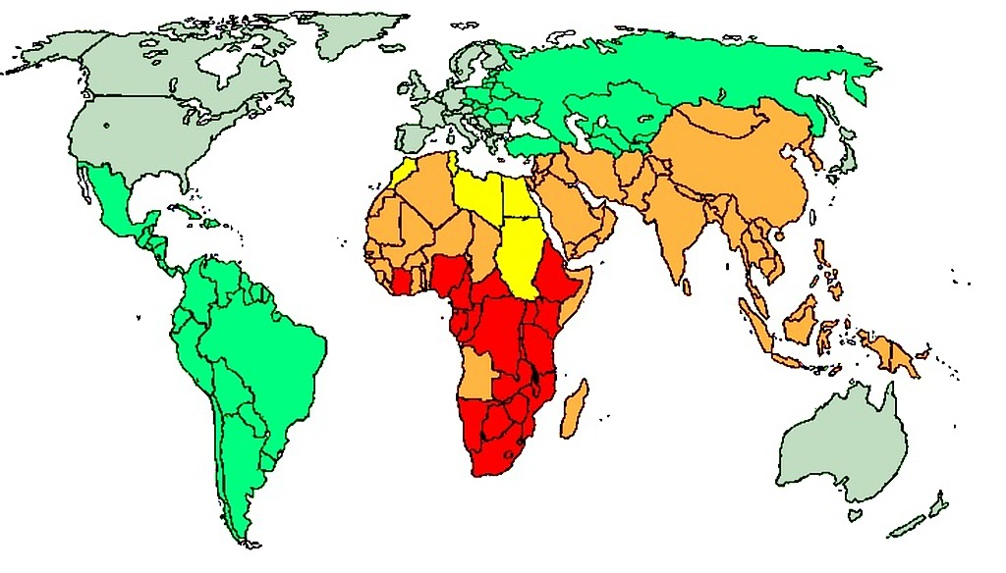
TUBERCULOSIS
1
Definition
Tuberculosis is a communicable chronic granulomatous disease caused by Mycobacterium tuberculosis. It usually involves the lungs but may affect any organ or tissue in the body. (Primary in the lung then disseminates)
2
Epidemiology
TB bacilli are strict aerobe, acid-fast (due to mycolic acid in cell wall).
It is estimated that 1.7 billion individuals are infected by tuberculosis worldwide, with 8 to 10 million new cases and 1.5 million deaths per year.
3
Risk factors
1-HIV:In areas of the world where HIV infection is prevalent, HIV infection is the dominant risk factor for the development of tuberculosis
Diabetes mellitus
Alcoholism
Chronic lung disease
(particularly silicosis)
2
3
4
5
6
7
8
chronic renal failure
Hodgkin's lymphoma
Immunosuppression
Malnutrition
1)Low immunity
2) Treatment lowers the immunity
4
Conditions under which TB flourishes:
crowding
Poverty
chronic debilitating illness
(immunocompromised)

Slide 4
Etiology & Pathogenesis
Mycobacteria are slender rods that are acid-fast (i.e., they have a high content of complex lipids that readily bind the Ziehl-Neelsen stain)
M. tuberculosis hominis is responsible for most cases of tuberculosis; reservoir of the infection is typically found in individual with active pulmonary disease
Etiology & Pathogenesis
Oropharyngeal and intestinal tuberculosis contracted by drinking milk contaminated with Mycobacterium bovis infection (Primary intestinal TB)
Other mycobacteria, particularly Mycobacterium avium complex, they cause disease in 10% to 30% of patients with AIDS
(Atypical mycobacteria)
Transmission usually is direct, by inhalation of airborne organisms in aerosols generated by expectoration or by exposure to contaminated secretions of infected individual

Slide 5
The Pathogenesis of Primary TB
Events occurring in the first 3 weeks after exposure (in non sensitized individual)
Organism resides in phagosomes of alveolar macrophages
Produces a protein (cord factor) that prevents fusion of lysosomes with phagosome.
1
In the alveolar macrophage, there’s a receptor called (macrophage mannose receptor and complement 3 receptor) that binds with a molecule present on the surface of the bacteria called mannose capped glycolipid.
2
Using the receptor, the macrophage recognizes the bacteria and start phagocytosis.
3
Bacteria then releases the cord factor that prevents the fusion of lysosomes with phagocytic vacuoles.
4
As a result, there’s intracytoplasmic proliferation of bacteria within the macrophage. (Phagosomal manipulation)→bacteremia and septicemia (asymptomatic/mild symptoms) so the bacilli can be found in the blood

Slide 6
Cont: The Pathogenesis of Primary TB
Important: what is the function of chemicals in red boxes
CD4
The development of resistance to the organism is accompanied by conversion to a positive result on tuberculin skin testing.
Cells and bacteria are not drawn to scale.
IFN-γ, Interferon γ; iNOS, inducible nitric oxide synthase; MHC, major histocompatibility complex; MTb, Mycobacterium tuberculosis; TNF, tumor necrosis factor
5
After 3 weeks, processed bacterial antigens reach the draining lymph nodes.
The APCs (dendritic cells and macrophages) present the antigen through MHC|| to CD4 T cells leading to activation of Th1 (by IL-12),As a result of stimulation of Th1, there’s a releasing of chemokines and IFN-gamma that activates macrophage. (After this step, tuberculin test can show positive since TH1 are responsible for immediate reaction)
6
Activated macrophages become large
and have abundant NO & free radicals, they will release TNF which will increase the recruitment of monocytes toward the focus of infection as well as nitric oxide synthase (iNOS). Arised nitric oxide levels, helps to create reactive nitrogen intermediates that appear to be particularly important in killing of mycobacteria; anti-microbial peptides (defensins) that are also toxic to mycobacterial organisms
7
8
All of that will lead to the formation of a collection of activated macrophages and lymphocytes (Granuloma).

Slide 7
Pathogenesis
Pathogenesis
Immunity to a tubercular infection is primarily mediated by TH1 cells, which stimulate macrophages to kill mycobacteria
This immune response, while largely effective, comes at the cost of hypersensitivity and the accompanying tissue destruction
Defects in any of the steps of a TH1 T cell response (including IL-12, IFN-γ, TNF, or nitric oxide production) result in poorly formed granulomas, absence of resistance, and disease progression (Increased severity, tissue destruction, and dissemination) occurs in immunocompromised or patients with gene defect. (E.g. in HIV patients, they have low CD4 T cell count)
Reactivation of the infection or reexposure to the bacilli in a previously sensitized host results in rapid mobilization of a defensive reaction but also increased tissue necrosis
Extra Information
Granuloma: a focal aggregate of immune cells that forms in response to a persistent inflammatory stimulus.
Granuloma formation begins with an inflammatory trigger, such as an infectious pathogen or a foreign body. Macrophages are recruited to the site of inflammation and activated as part of the innate immune response. If the recruited and activated macrophage is unable to remove the inflammatory stimulus efficiently, a further immune response may be triggered. The macrophages form a tight aggregate around the inflammatory stimulus and may become surrounded by a peripheral cuff of lymphocytes.

Slide 8
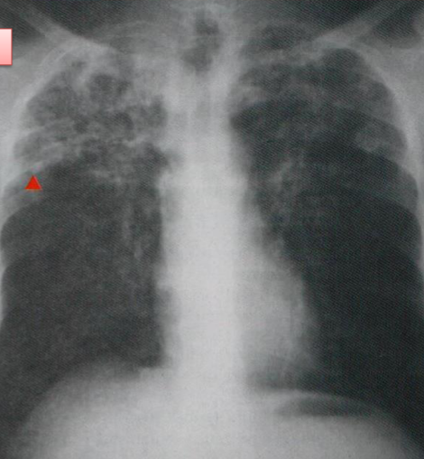
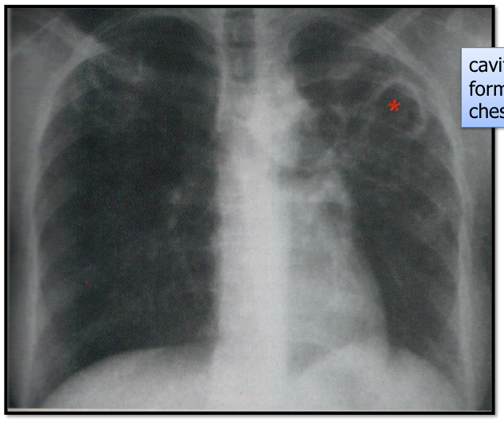
Primary Vs Secondary TB
Primary Tuberculosis | Secondary Tuberculosis (Reactivation Tuberculosis)
Form of disease that develops in a previously unexposed and therefore unsensitized patient (1st time exposure). About 5% of those newly infected acquire significant disease. | Pattern of disease that arises in a previously sensitized host (2nd time exposure). It may appear shortly after primary tuberculosis.
Method of infection: inhalation (MBT), ingestion (mycobacterium bovis from cow’s milk) | Endogenous due to reactivation of dormant primary lesions many decades after initial infection (especially in immunocompromised individuals or exogenous due to reinfection)
lower part of the upper lobe or in the upper part of the lower lobe. | Apex of lungs or upper part of lower lobe
Ghon focus, Ghon complex | Associated with cavitation (tissue destruction)
Noninfectious | Highly infectious in +ve patients
Both upper lobes are affected | Cavity formation

Slide 9
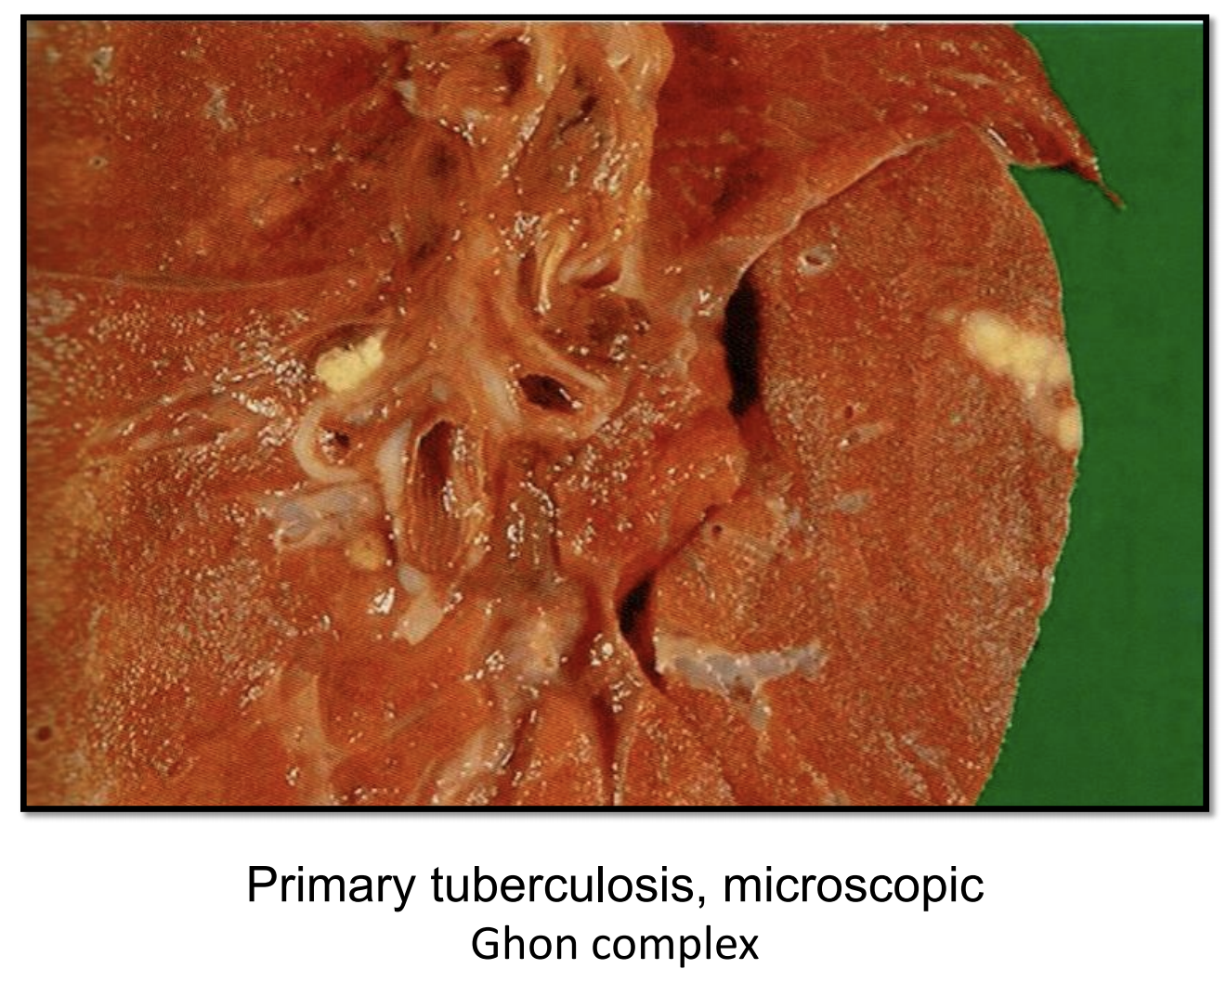
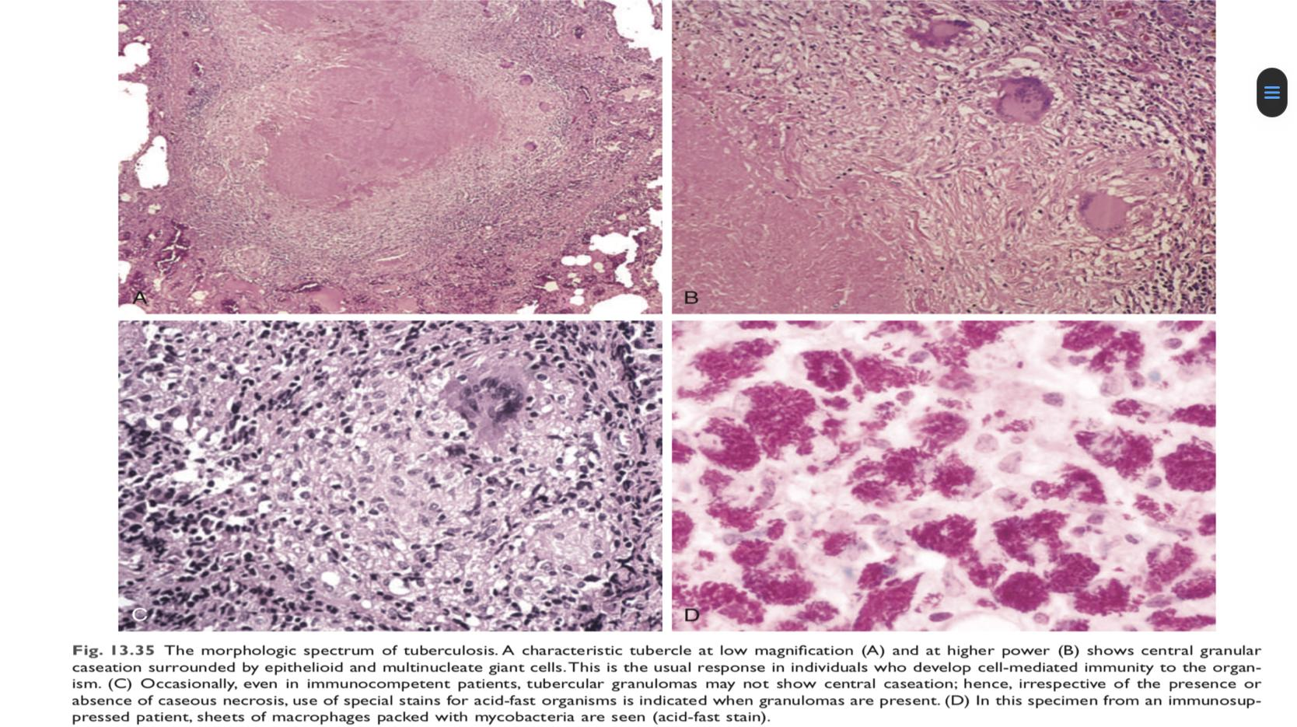
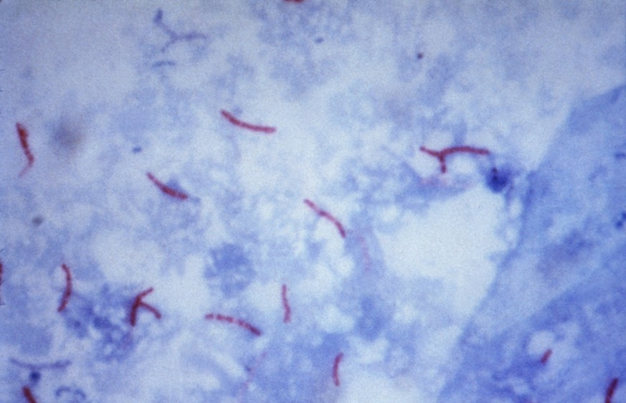
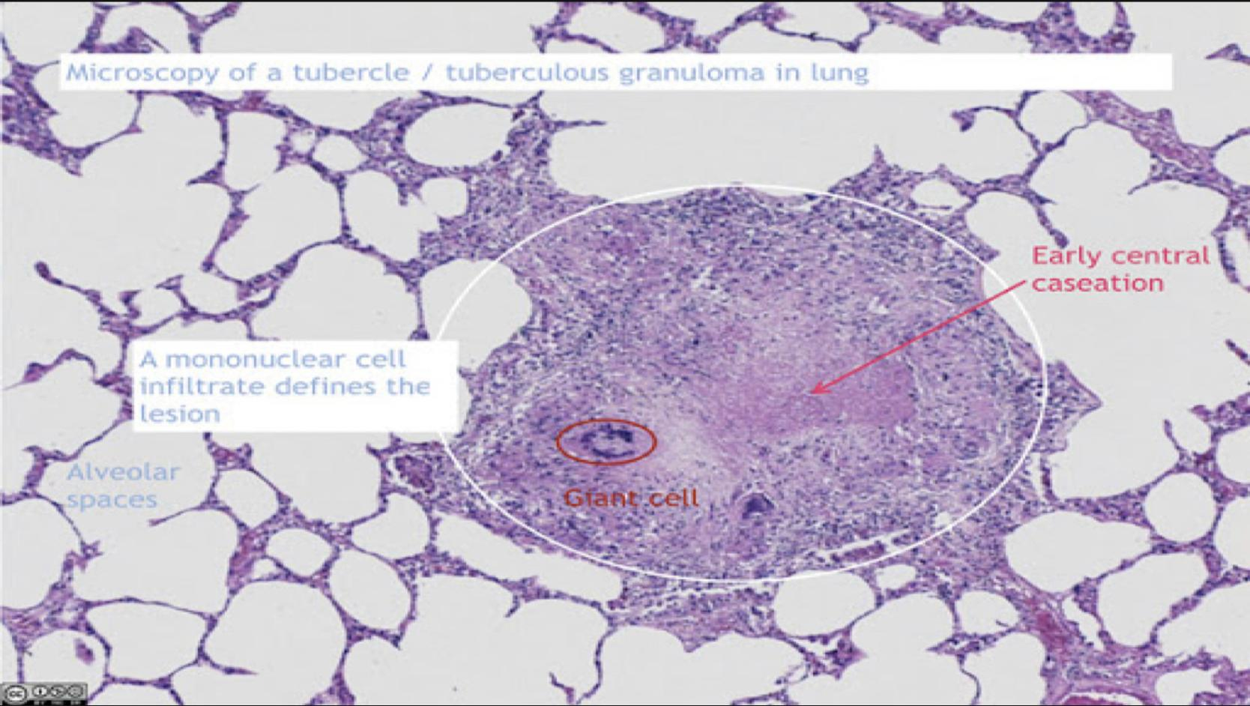
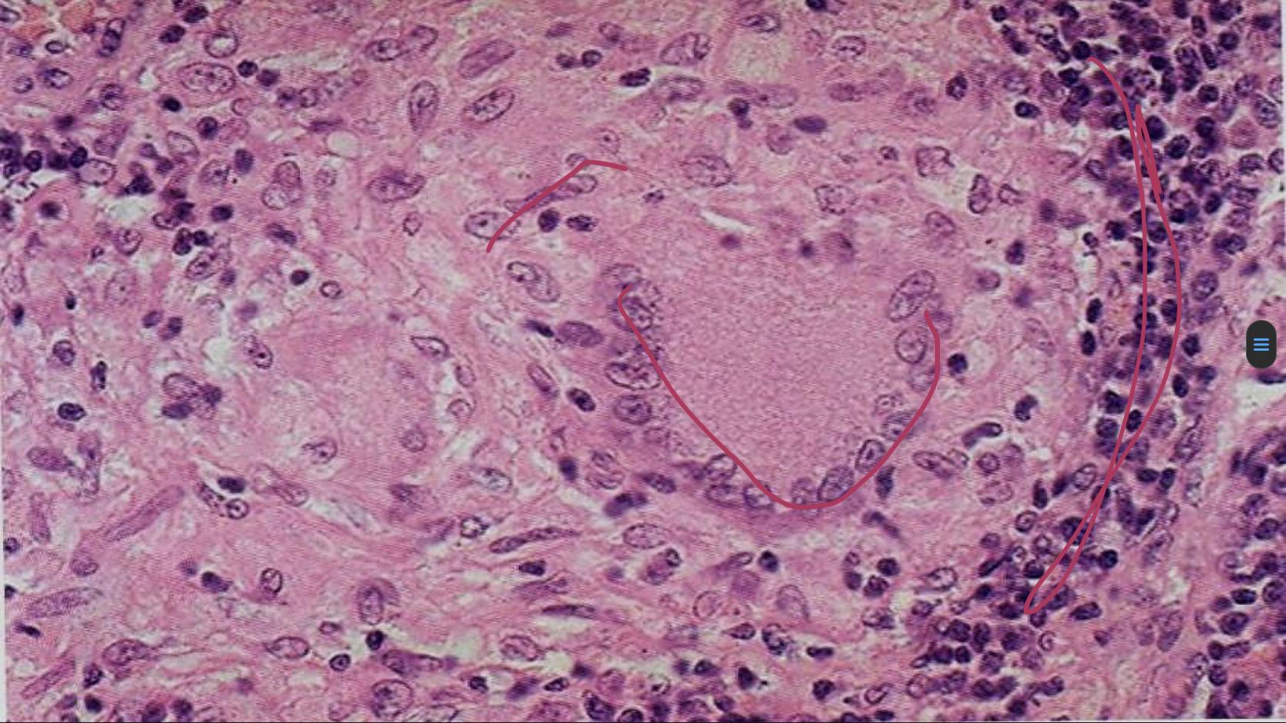
Primary Pulmonary TB
Gross Morphology | Ghon complex: Subpleural location, below interlobular fissure Upper part of the lower lobes or lower part of the upper lobes Ghon focus (caseous necrosis) in periphery. Ghon complex (caseous necrosis) in ipsilateral hilar lymph nodes. (central area) Hilar lymph nodes with caseation. Use of special stains for acid-fast organisms (Zeil-Neilson stain) is indicated when granulomas are present (red/pink)
The outcome Team 439 | Tuberculin test will be converted into +ve after 3 weeks. The result of stimulation with good immunity = majority of MTB are dead and followed by fibrosis with calcification of ghon focus as healing response (later on ranke complex is gunna develop). The infected person is asymptomatic or has flu like symptoms. 90% will have sero+ev (infected)! Test result and only 2-5 cases will develop a disease.
Pictures
Pinkish/eosinophilic material = necrosis→used to find the bacilli
(Langhans cells)
Ghon Complex
gray-white parenchymal
focus is under the pleura
Hilar lymph nodes with
caseation are seen (left).
lymphocytes

Slide 10
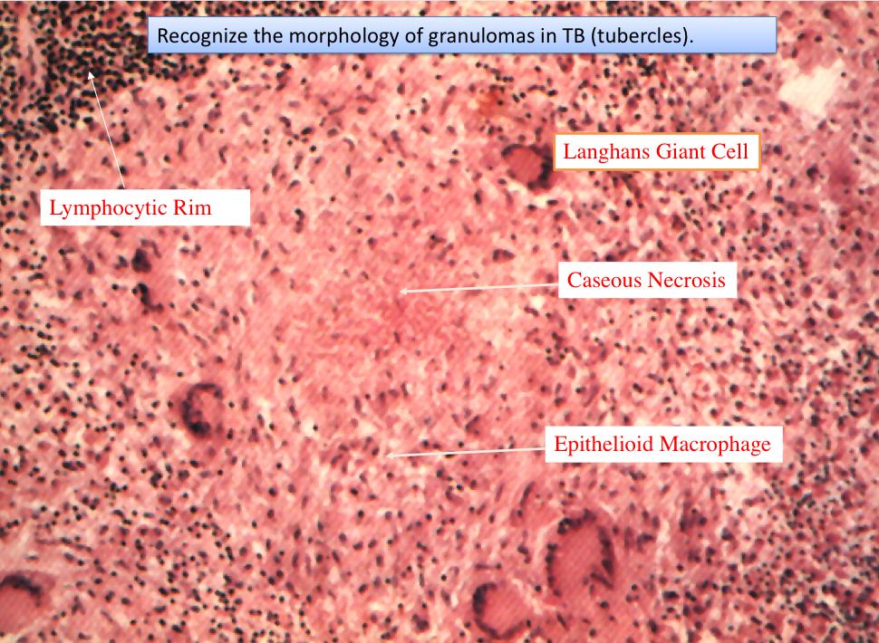
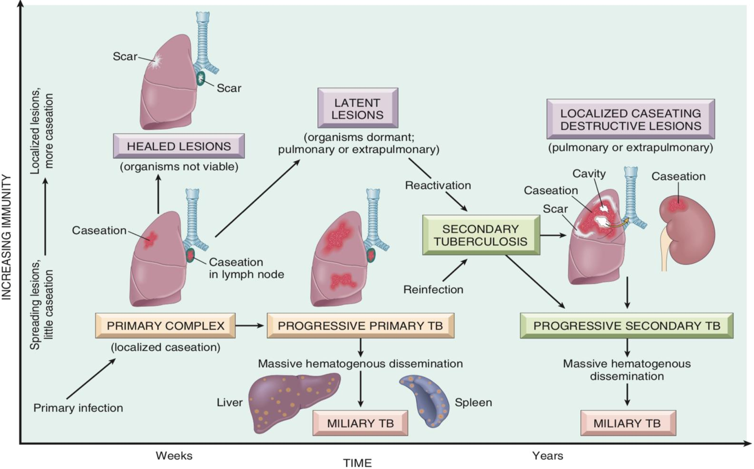
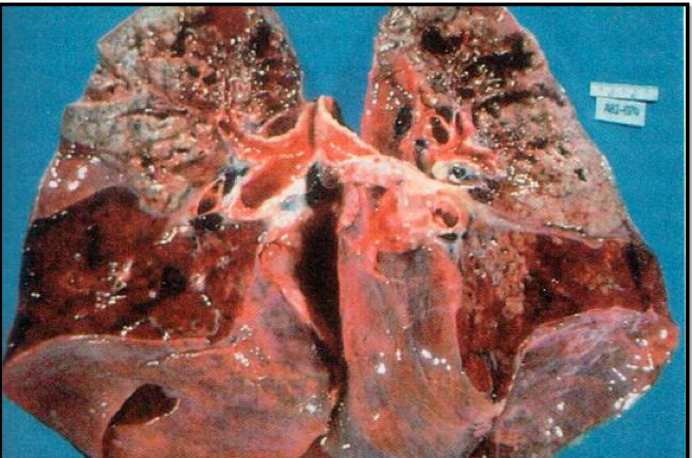
Secondary Tuberculosis
Definition
01
The pattern of disease that arises in a previously sensitized host. It arises due to reactivation of dormant primary lesions or due to reinfection .
02
Site
Classically localized to the apex of one or both upper lobes ,why? The reason is obscure but may relate to high oxygen tension in the apices
Complications
03
Miliary tuberculosis (tertiary TB)
Special thanks to 439 Team
Systemic spread
Artery
Vein
Miliary spread within the lung
Via left ventricle to whole body
Team 439: Secondary Tuberculosis (Reactivation Tuberculosis)
The apex of one or both upper lobes are affected with cavitation leading to erosion into & dissemination along airways , patient become infective
Why can secondary TB be more aggressive and disseminated? Because of the tissue destruction and erosion it can go to the blood easily.

Slide 11
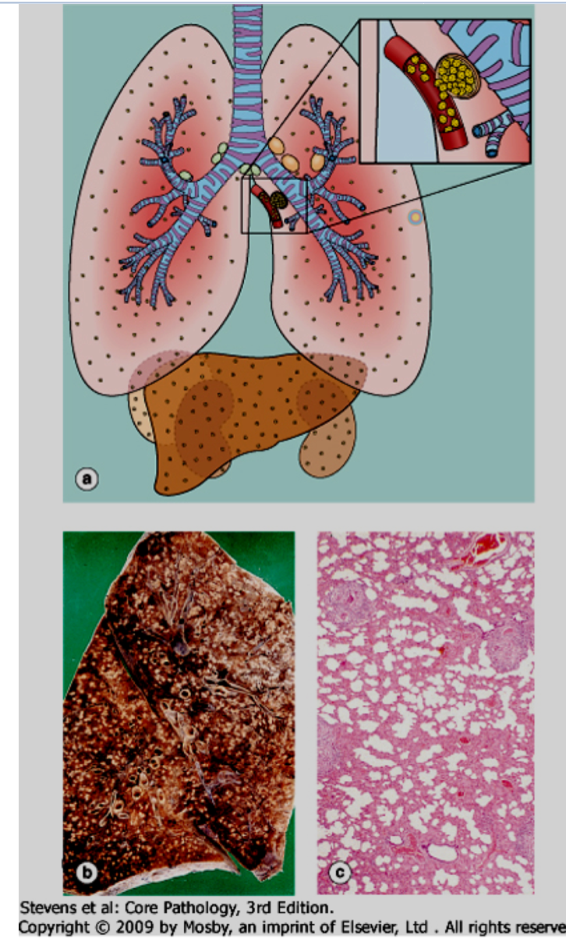
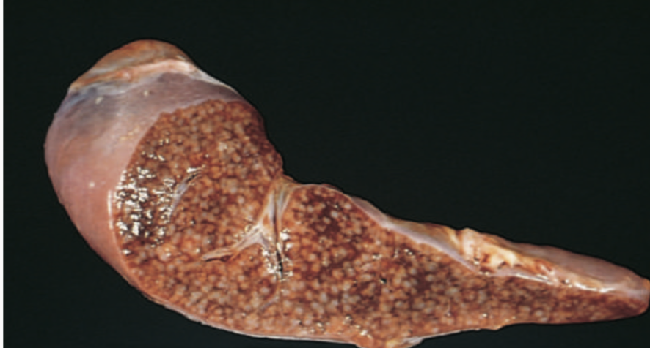
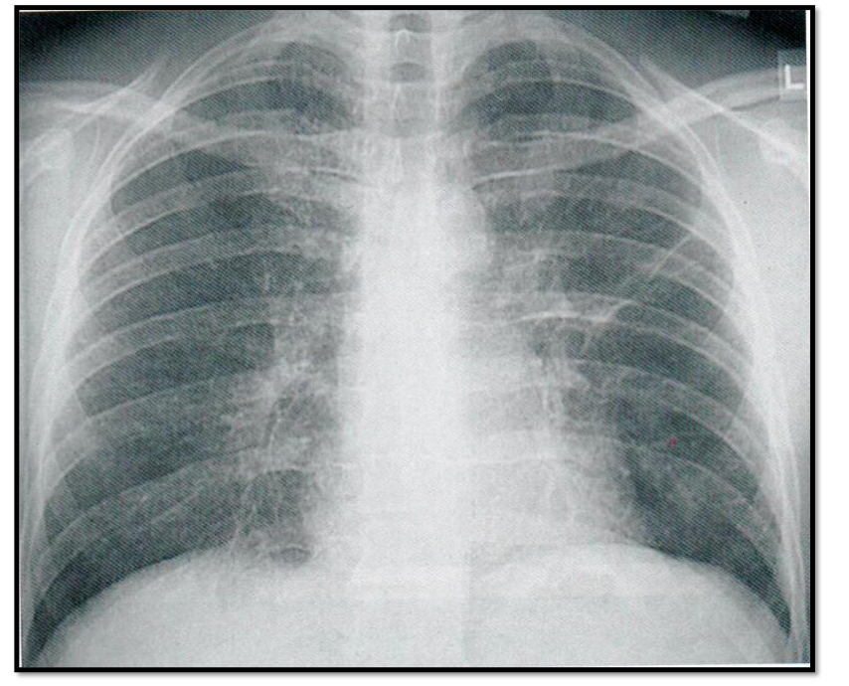
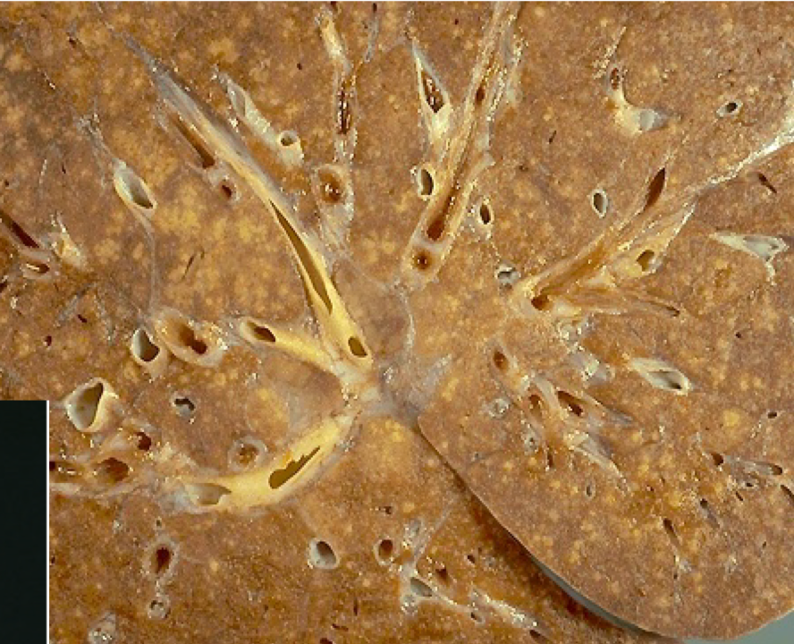
Miliary Tuberculosis (tertiary TB)
The whole lung is affected and TB disseminates. Countless amount of granuloma spread throughout the lung.
1
Hematogenous spread of TB organism throughout the body. (MTB can rupture the macrophages and escape into the bloodstream via lymphatic vessels)
Team 438: Dr. Al-Rikabi’s Notes: Both progressive primary tuberculosis and secondary tuberculosis can result in systemic seeding, causing life-threatening forms of disease such as miliary tuberculosis and tuberculous meningitis.
2
When bacteria in the lungs enters the pulmonary venous return to the heart; the organisms subsequently disseminate through the systemic arterial system and the lymphatic channels
3
Systemic miliary Tuberculosis
It produces multiple small yellow nodular lesions in several organs. Almost every organ in the body may be seeded. Lesions resemble those in the lung.
4
Pulmonary TB
In the lung there multiple lesions either microscopic or small, visible (2-mm) foci of yellow-white consolidation scattered through the lung parenchyma.
Team 438: Dr. Al-Rikabi’s Notes: Miliary TB:
MTB can rupture the macrophages and escape into the bloodstream via lymphatic vessels, and it can either:
End up back in the lung (pulmonary miliary TB)
Spread to other organs (multiple—>systemic miliary TB. Single—>Isolated-organ TB)
Organs include: liver, bone marrow, spleen, adrenal glands, meninges, kidneys, fallopian tubes, and epididymis
Spleen

Slide 12
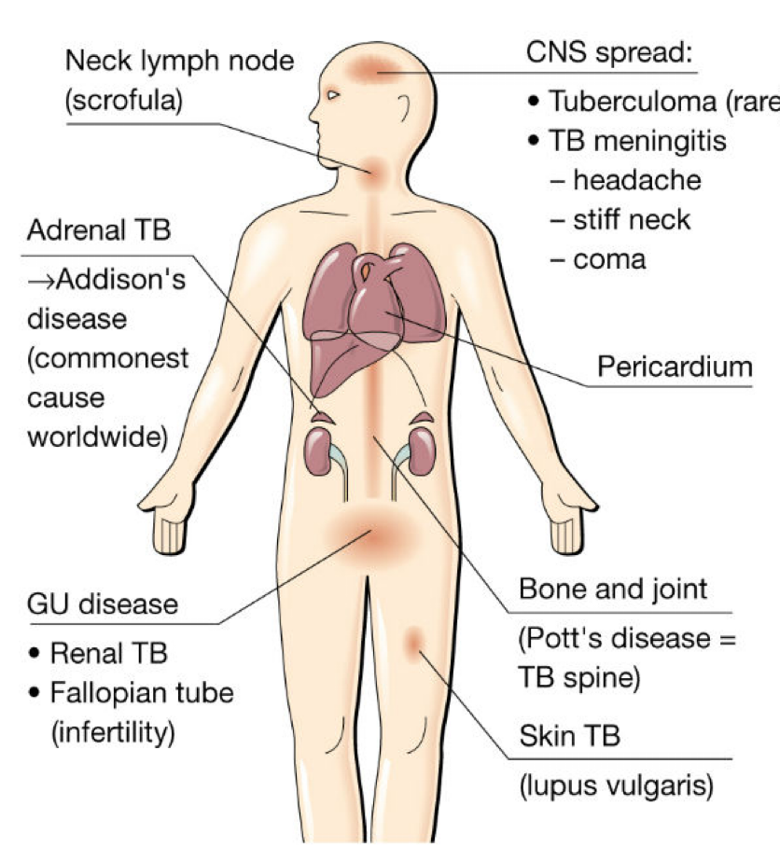
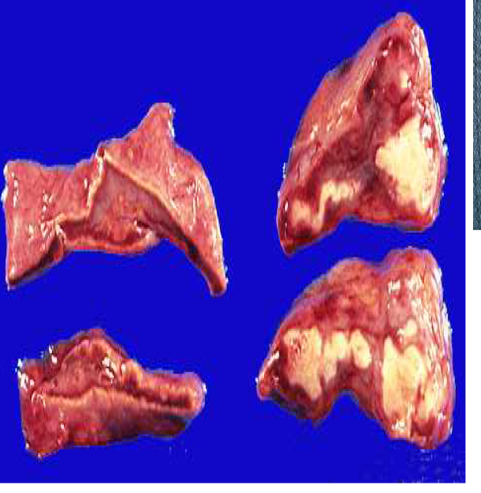
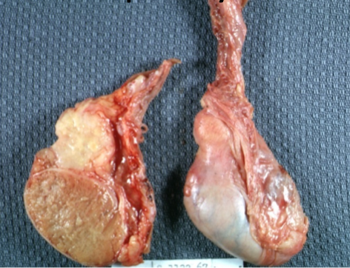
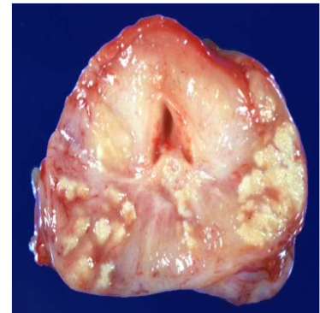
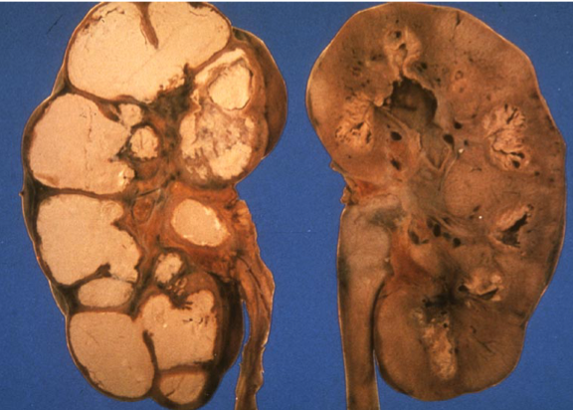
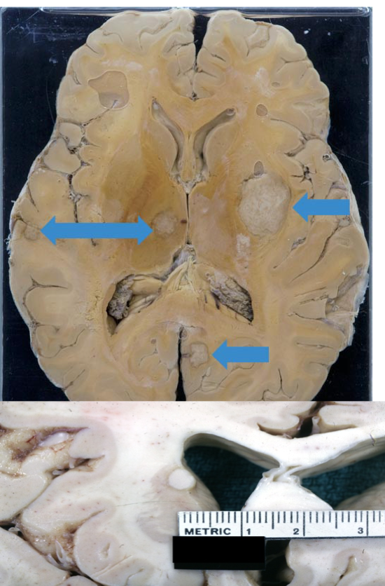
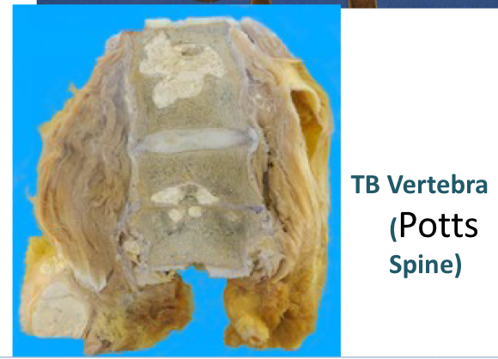
Extrapulmonary Tuberculosis
The symptoms differ depending on the affected organ.
1
Lymph nodes ( tuberculous lymphadenitis): are the most frequent form of extra pulmonary tuberculosis esp. in the cervical region
2
Pleura with effusion ( exudate )
3
Liver and spleen
4
Adrenals ,Fallopian tube and endometrium
5
Epididymis and prostate
6
Kidneys and intestinal tuberculosis
7
Meninges around the base of the brain ( tuberculous meningitis)
8
Bone marrow and Vertebrae ( Pott’s disease )
Team 438: Dr. Al-Rikabi’s Notes: Lymphadenitis:
Most frequent form of extrapulmonary tuberculosis, occurring in the cervical region
Scrofula (enlarged lymph nodes with caseous granuloma) In case of disease progression:
Granulomas erode the bronchi—>spread via cough—>open/cavitating tuberculosis
All the pictures are extra except the first one. Thanks to 439 team

Slide 13
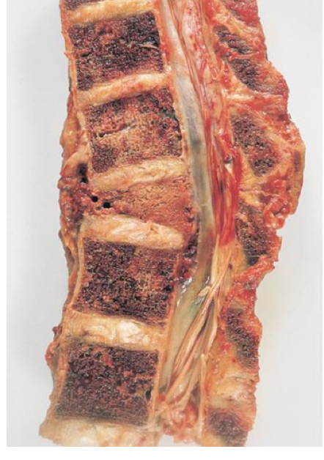
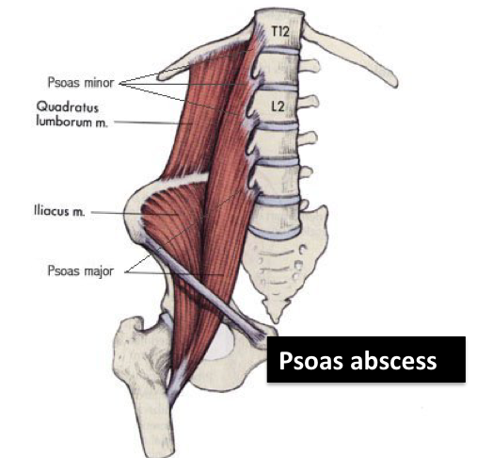
Pott’s Disease
Clinical Features
IMP
Vertebrae ( pott’s disease ). It collapses the spine and leads to paraspinal “cold” abscess. (Compressed scoliosis)
In these patients, infected material may track along tissue planes to present as an abdominal or pelvic mass .
1
May be asymptomatic (can occur in primary TB even with bacteremia)
2
Systemic manifestation:
General: Malaise, anorexia, weight loss, fatigue
Cough: Hemoptysis is present in about half of all cases of pulmonary tuberculosis.
Fever: low grade , night sweating
3
Depend on the organ system involved (e.g. tuberculous salpingitis may present as infertility, tuberculous meningitis with headache and neurologic deficits , pott disease with back pain and paraplegia).
If it disseminates→other symptoms will occur e.g.intestinal TB→abdominal pain, vomiting
Team 438: Dr. Al-Rikabi’s Notes Common symptoms of pulmonary TB:
Drenching night sweats
Malnutrition
Cough
Weight loss
Fever
Hemoptysis

Slide 14
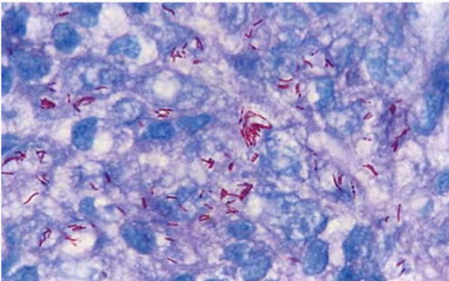
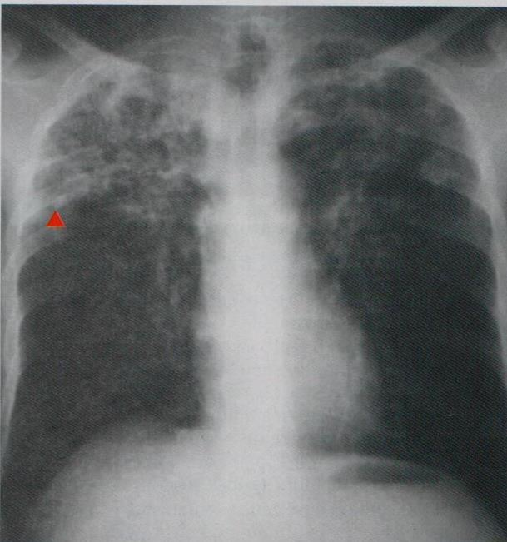
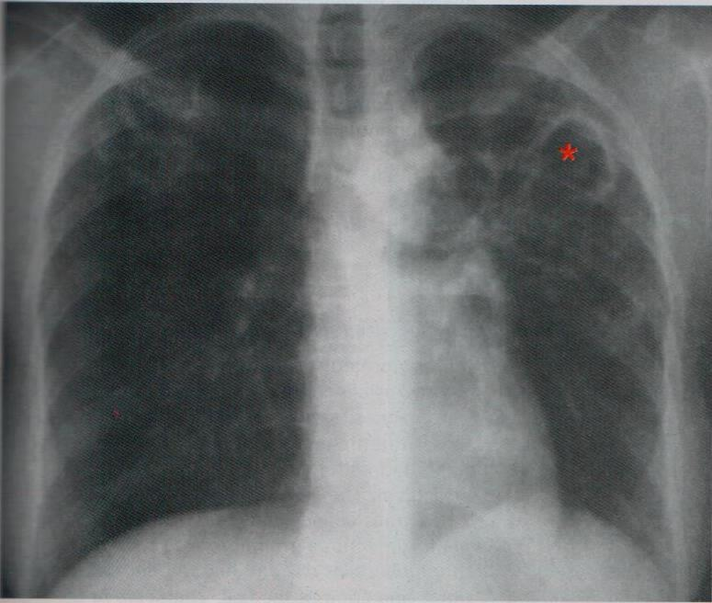
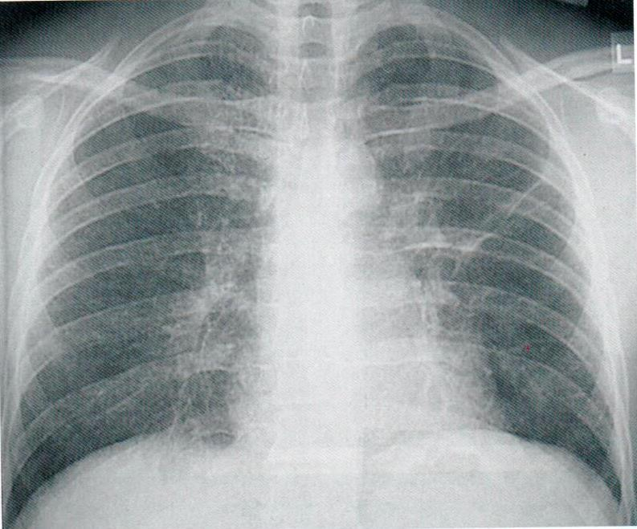
Diagnosis of TB
Based on history, physical & radiographic findings of consolidation or cavitation in the apices of the lungs.Ultimately, tubercle bacilli must be identified by:
1
Demonstration of acid-fast organisms in sputum
Sputum analysis
Culture (remains the gold standard)
PCR (amplification of M.TB DNA allows for rapid diagnosis)
2
Ziehl-neelsen (AFB) stain
The organism stains Red/pink
Ziehl-Neelsen stain shows red acid-fast staining M. tuberculi
3
Radiology
Chest X-Ray
4
Auramine stain (immunofluorescence)
Team 438: Dr. Al-Rikabi’s Notes Diagnosis:
Ziehl–Neelsen (Acid Fast Bacilli) stain (carbol fuchsin)
Mantoux test SC injection of 0.1ml PPD—>Look for erythema and induration (5+mm) 3 days after injection
Auramine stain (Immunofluorescent)
Molecular (depends on PCR—>highly sensitive)
Culture (best way because we can test the susceptibility) Normal culture takes 10 weeks, but liquid media can give results in 2 weeks After biopsy and seeing granulomas, recall that sarcoidosis and crohn’s disease both form granuloma. So, ask for where the patient is from to determine if it’s TB.
5
Mantoux skin test
Explained in the next slide
Both upper lobes are affected
Cavity formation
Cavity formation

Slide 15
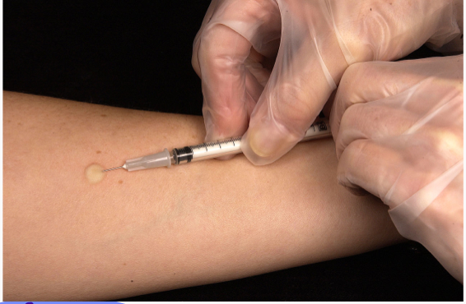
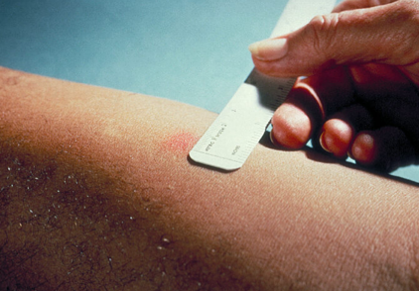
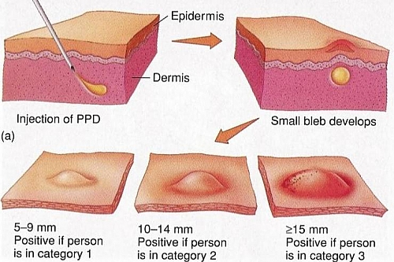
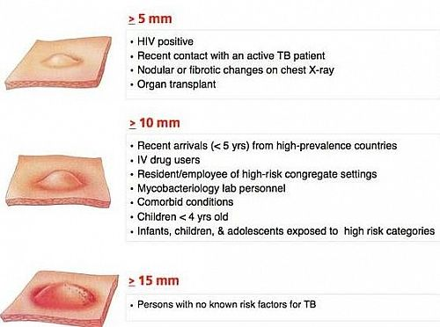
Prognosis
5
Mantoux skin test
A positive tuberculin skin test result signifies cell-mediated hypersensitivity to tubercular antigens, but doesn’t differentiate between infection and disease.
The size of induration is measured (48-72 hours) later
Positive results:induce a visible and palpable induration ( at least 5 mm in diameter)
False negative: reactions may be produced by certain viral infections, sarcoidosis, malnutrition, Hodgkin lymphoma, immunosuppression and AIDS.
False positive: reactions may result from infection by atypical mycobacteria.
The outcome depends on the adequacy of the host immune response and treatment.
The prognosis with proper treatment is generally good if infection are localized to the lung
If caused by drug resistant strains or occur in aged debilitated or immunosuppressed person who are at high risk for developing miliary TB
Prognosis

Slide 16
MCQs
1- GHON focus is generally located in:
A) upper part of the lower lobe. | B) lower part of the upper lobe. | C) upper part of upper lobe. | D) A and B
2- IL12 is secreted by which cell of the following:
A) Neutrophils | B) TH2 | C) Activated macrophages | D) TH1
3- The macrophages can recognize M.tuberculosis by:
A) FAS receptor | B) Mannose receptor | C) Intracellular receptor. | D) None of them
4- 20-year-old man from China is evaluated for persistent cough, night sweats, low-grade fever, and general malaise. A chest X-ray reveals findings “consistent with a Ghon complex.” Sputum cultures grow acid-fast bacilli. Examination of hilar lymph nodes in this patient would most likely demonstrate which of the following pathologic changes?
A) caseous necrosis | B) fat necrosis | C) Fibrinoid necrosis | D) Liquefactive necrosis
5- 53-year-old man develops weakness, malaise, cough with bloody sputum, and night sweats. A chest X-ray reveals numerous apical densities bilaterally. Exposure to Mycobacterium tuberculosis was documented 20 years ago, and M. tuberculosis is identified in the sputum. The patient subsequently dies of respiratory insufficiency. The lungs are examined at autopsy ). Which of the following best characterizes the histopathologic features of this pulmonary lesion?
A) Acute suppurative inflammation | B) Chronic inflammation | C) Granulomatous inflammation | D) Fibrinoid necrosis
1-D, 2-C, 3-B, 4-A, 5-C

Slide 17
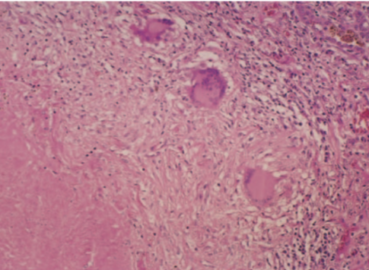
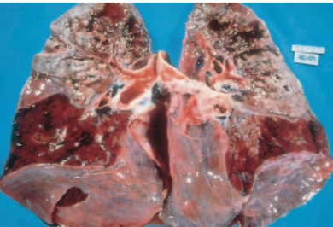
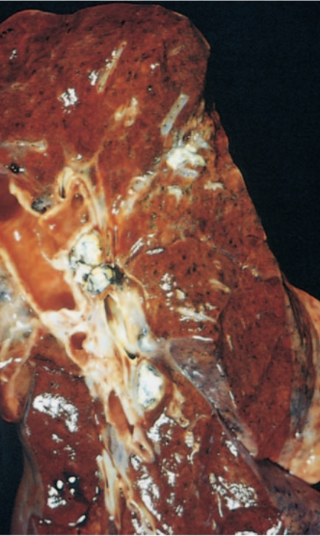
MCQs
6-A 46-year old woman goes to the physician for check up. On examination a tuberculin skin test is positive. A chest radiograph shows a left upper lobe mass. The mass is removed. The microscopic appearance of this lesion is shown in the figure. Which of the following is the most likely diagnosis?
A)Pulmonary infarction | B)Mycobacterium tuberculosis infection | C)Lung abscess | D)Primary adenocarcinoma
7-A 56-year-old man has had a fever, night sweats and a 3-kg weight loss over the past 4 months. In the past month, he has had episodes of hemoptysis. He dies of respiratory failure and hypoxemia. The appearance of the lungs at autopsy is shown in the figure. Infection with which of the following organism is most likely to have produced these findings?
A) Candida albican | B)Mycoplasma pneumonia | C)Mycobacterium tuberculosis | D)Influenza A
8-A previously healthy 20-year-old woman has had a low-grade fever for the past 2 weeks. On physical examination, her temperature is 37.7 C;there are no other remarkable findings. The gross appearance of the lung shown in the figure is representative of her disease.Which of the following studies most likely to report a positive result?
A)Tuberculin skin test | B)HIV serologic test | C)Antinuclear antibody | D)Rheumatoid factor
9-A 45-year-old man, a nonsmoker, has experienced a 3-kg weight loss over the past 3 months after the loss of his job. He recently developed a low-grade fever and cough with mucoid sputum production, and after 1 week, he noticed blood-streaked sputum. On physical examination, his temperature is 37.7°C. There are bilateral crackles in the left upper lobe on auscultation of the chest. Chest CT scan shows a 3-cm left upper lobe nodule with decreased attenuation centrally. Laboratory studies show hemoglobin, 14.5 g/dL; platelet count, 211,400/mm3; and WBC count, 9890/mm3 with 40% segmented neutrophils, 2% bands, 40% lymphocytes, and 18% monocytes. Which of the following findings in his sputum sample is most likely to be present?
(A) Acid-fast bacilli | (B) Branching septate hyphae | (C)Charcot-Leyden crystals | (D) Foreign body giant cells
6-B 7-C 8-A 9-A

Slide 18
Team leaders
Dema
Alkhattabi
Hassan Alabdullatif
Team members
Khalid alrasheed
Nawaf Alrefaei
Emad Almutairi
Othman Alabdullah
Mohamed ibn Saqyan
Ibrahim Alhezam
Talal alharbi
Saud Al Taleb
Ali Alzahrani
Omar Alkadhi
Shahed Albukhari
Walaa AlMutawa
Ajwan Aljohani

