Slide 1
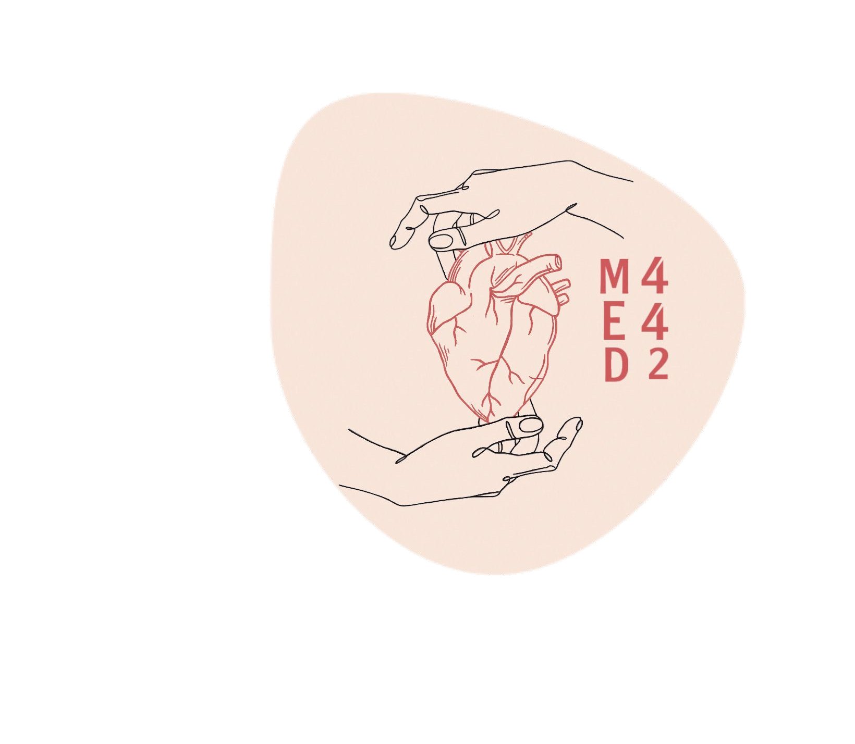
Chronic Obstructive Pulmonary Diseases
Colour index:
Main text
Important
In girls slides only
In boys slides only
Doctor‘s notes
Extra info.
Editing ﬁle

Slide 2
Objectives
Know that the major obstructive disorders and compare the major clinical and functional differences between them
Aware that the symptom common to all these disorders is "dyspnea" (difﬁculty in breathing) but each have their own clinical and anatomical characteristics
Deﬁne emphysema and the following forms of emphysema: panacinar emphysema, centriacinar emphysema
Deﬁne chronic bronchitis, describe its pathogenesis and the morphologic changes. Describe the mechanism of airway obstruction in a patient with chronic bronchitis
Deﬁne Bronchiectasis, its causes, presentation, morphology and signiﬁcant

Slide 3
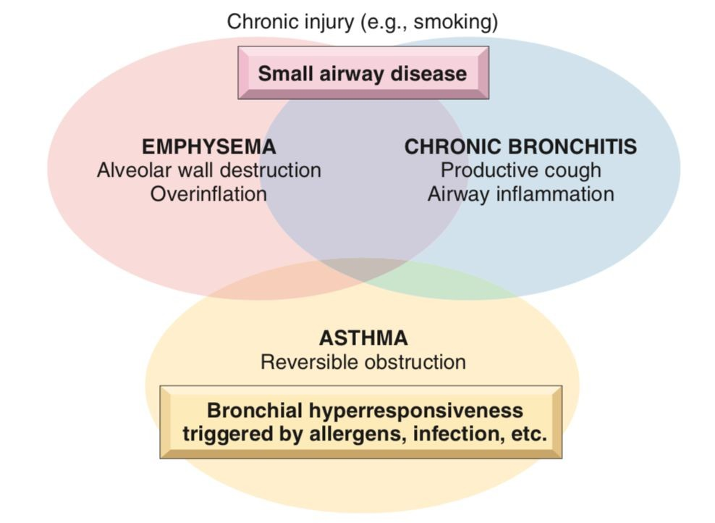
Obstructive Lung Diseases
Deﬁnition
Obstructive (airway) disease is characterized by an increase in resistance to air ﬂow caused by partial or complete obstruction at any level.
Each disease have distinct clinical and anatomic, but overlaps between emphysema, chronic bronchitis, and asthma are common.
Obstructive Lung Diseases
Bronchial Asthma
Bronchiectasis
Chronic obstructive pulmonary disease (COPD)
Chronic bronchitis
Emphysema
The anatomic distribution of these disorders also is somewhat different,
chronic bronchitis initially involves the large airways,
emphysema affects the acinus.
Emphysema and chronic bronchitis often are grouped together under the rubric of chronic obstructive pulmonary disease (COPD)
Emphysema can exists without chronic bronchitis (particularly in α1-anti-trypsin deﬁciency), but usually coexist
Remember
Chronic obstruction of lung airﬂow that interferes with normal breathing and not fully reversible
Traditionally, regarded as a combination of smoking-related lung disease: emphysema; chronic bronchitis
Pulmonary function tests:
Reduced FEV1 ,
Normal or near-normal FVC
FEV/FVC ratio is reduced

Slide 4
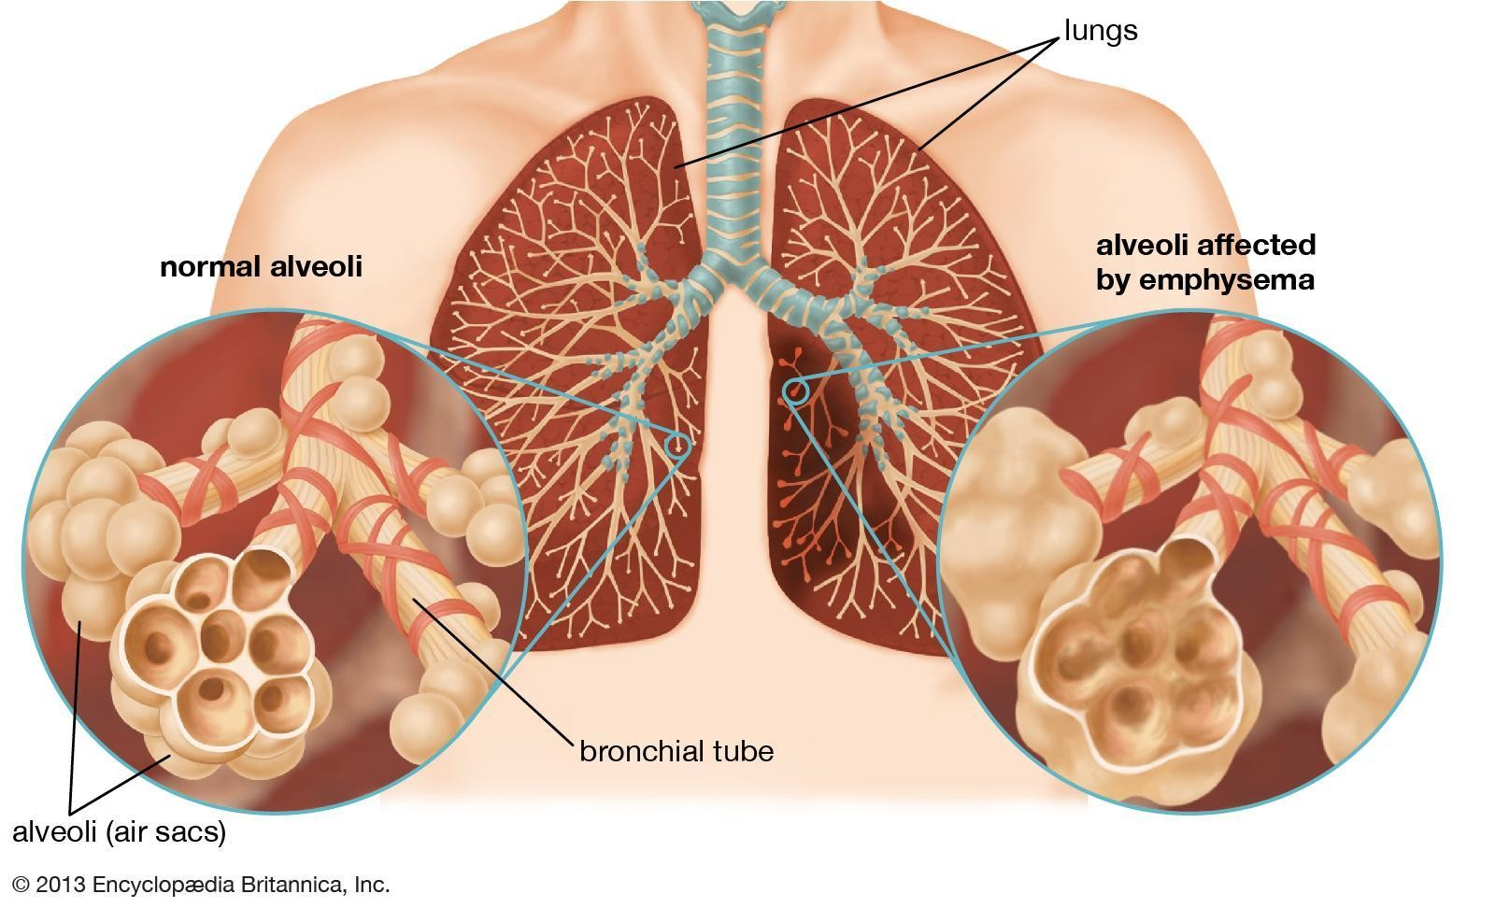
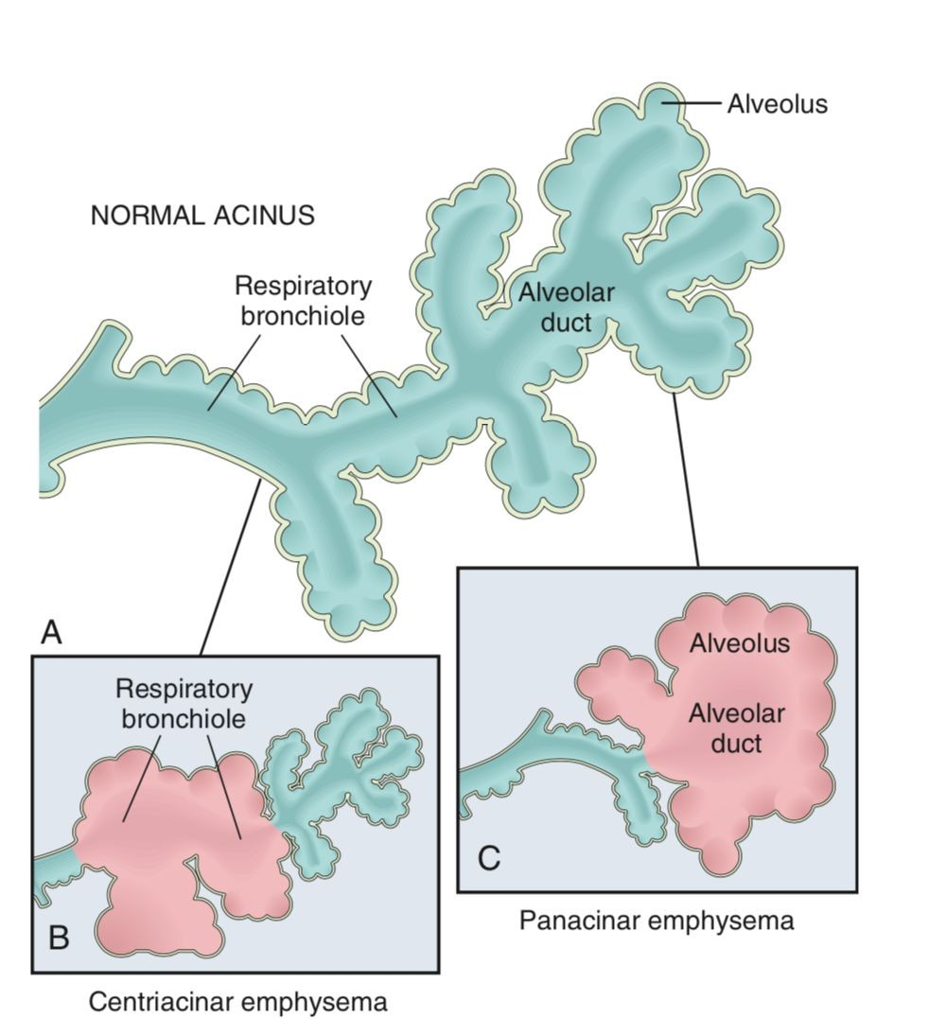
Emphysema
Deﬁnition
Is the abnormal permanent enlargement of the air spaces distal to the terminal bronchioles accompanied by destruction of their walls without obvious ﬁbrosis.
Types
Only ﬁrst two types cause signiﬁcant airway obstruction
Centriacinar
Panacinar
Distal acinar/ paraseptal
Irregular
Diagram of normal structure of the acinus, the fundamental unit of the lung
Centriacinar emphysema with dilation that initially affects the respiratory bronchioles
Panacinar emphysema with initial distention of all the peripheral structures (i.e., the alveolus and alveolar duct)

Slide 5
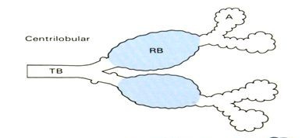
Classification of emphysema
 | Centriacinar | Panacinar | Distal acinar /paraseptal | Irregular
Etiology | Cigarette smoking | Alpha 1 antitrypsin deﬁciency | - | -
Location | Respiratory bronchioles and alveolar ducts (distal alveoli are spared) | Entire acinus (From the terminal bronchiole to the terminal blind alveolus) | Acinus proximal is normal Distal part is involved More adjacent to the pleura, along the lobular CT septa | Acinus irregularly involved
Features | Common and severe in upper lobes | Common in lower lobes | More severe in the upper half of the lungs. | -
Notes | Often associated with chronic bronchitis 20 times more common than panacinar | - | More striking adjacent to the pleura, along the lobular connective tissue septa. Adjacent to areas of ﬁbrosis, scarring or atelectasis Spontaneous pneumothorax in young adults (in centacinar too) | Associated with scarring (resemble scars of healed inﬂammatory diseases)
Figures

Slide 6
Conditions related to emphysema
This whole slide is from the girls slides only!!
Compensatory emphysema:
The dilation of residual alveoli in response to loss of lung substance elsewhere, such as occurs after surgical removal of a diseased lung or lobe.
Obstructive overinﬂation:
Expansion of the lung due to air trapping. A common cause is subtotal obstruction of an airway by a tumor or foreign object. Can be life threatening if expansion of the affected portion produces compression of the remaining normal lung.
Bullous emphysema:
Any form of emphysema that produces large subpleural blebs or bullae (spaces >1 cm).
Mediastinal (interstitial) emphysema:
Caused by entry of air into the interstitium of the lung, from where it may track to the mediastinum and sometimes the subcutaneous tissue.
❏ It may occur spontaneously if a sudden increase in intra alveolar pressure (as with vomiting or violent coughing) produces alveolar rupture
❏ Can develop in children with whooping cough
❏ Can occur in patients who have partial bronchial obstruction or
❏ in individuals with a perforating injury (e.g. fractured rib)
Subcutaneous emphysema:
When the interstitial air gets into the subcutaneous tissue with marked swelling of the head and neck and crackling crepitation over the chest.

Slide 7
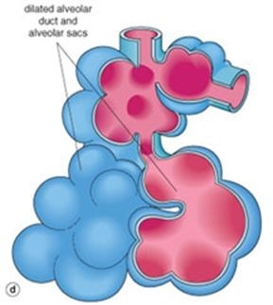
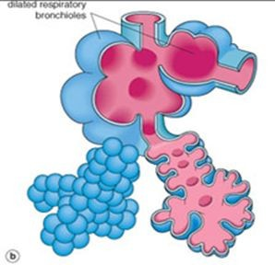
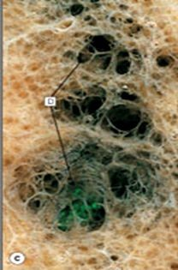
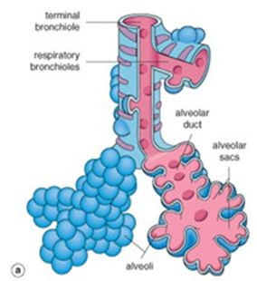
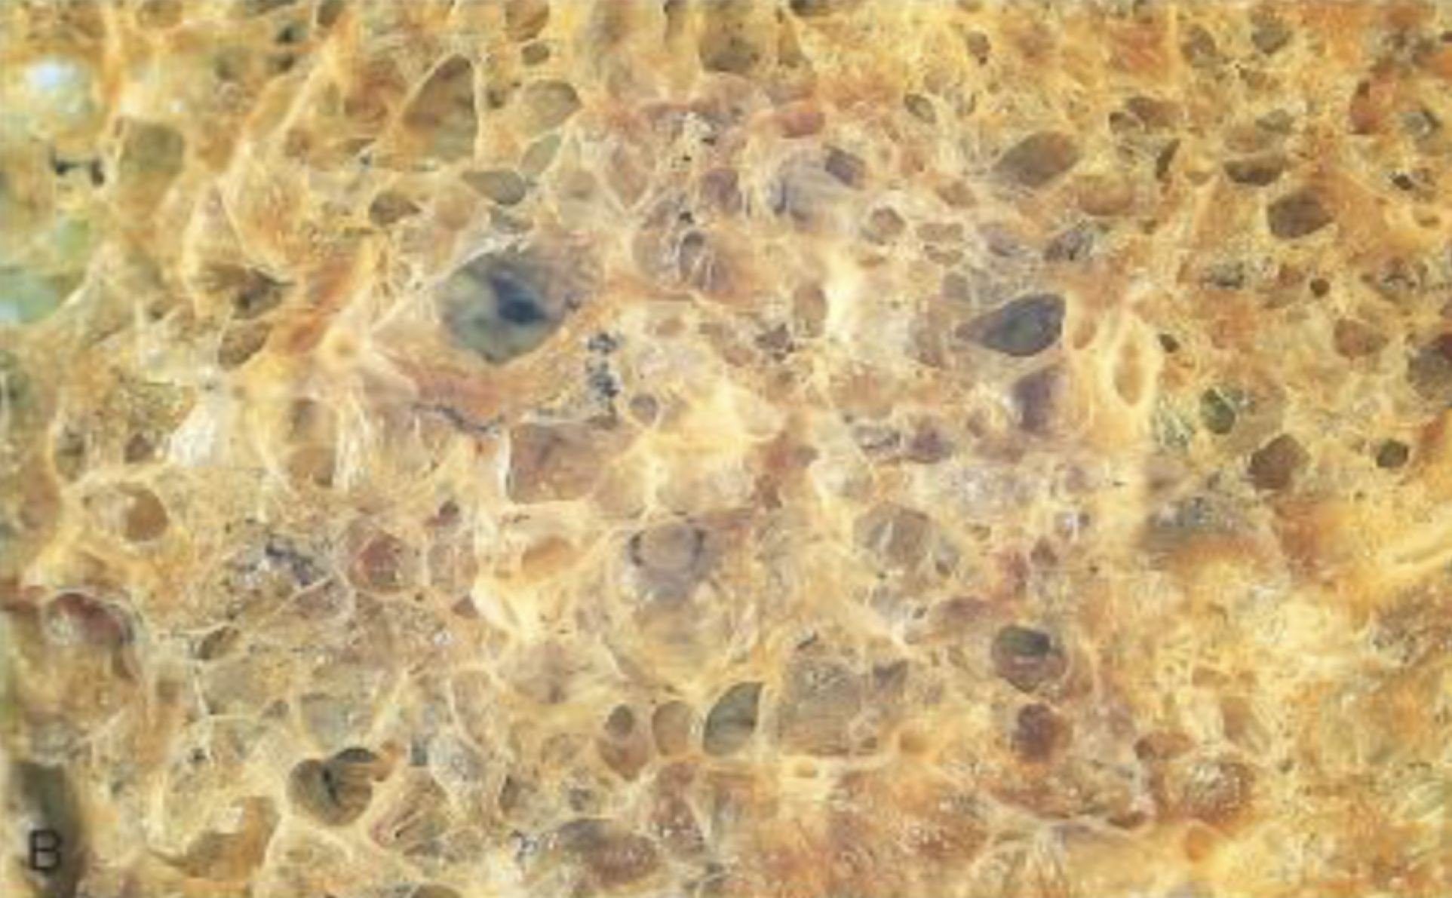
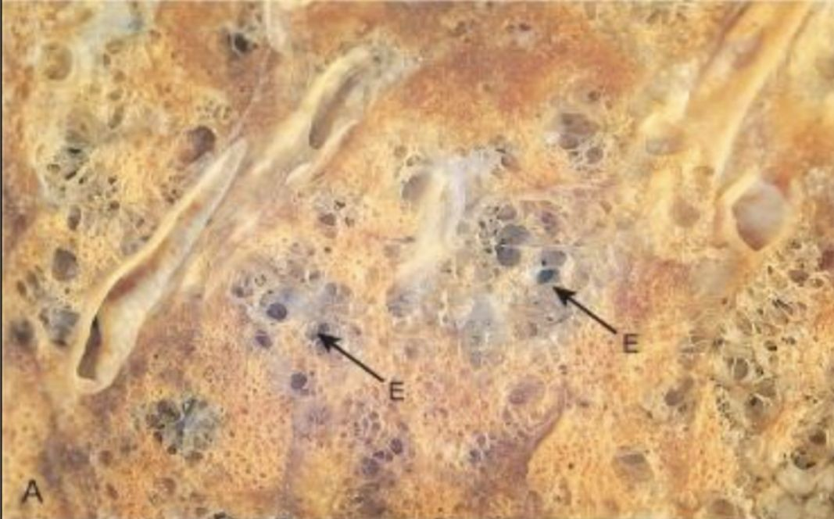
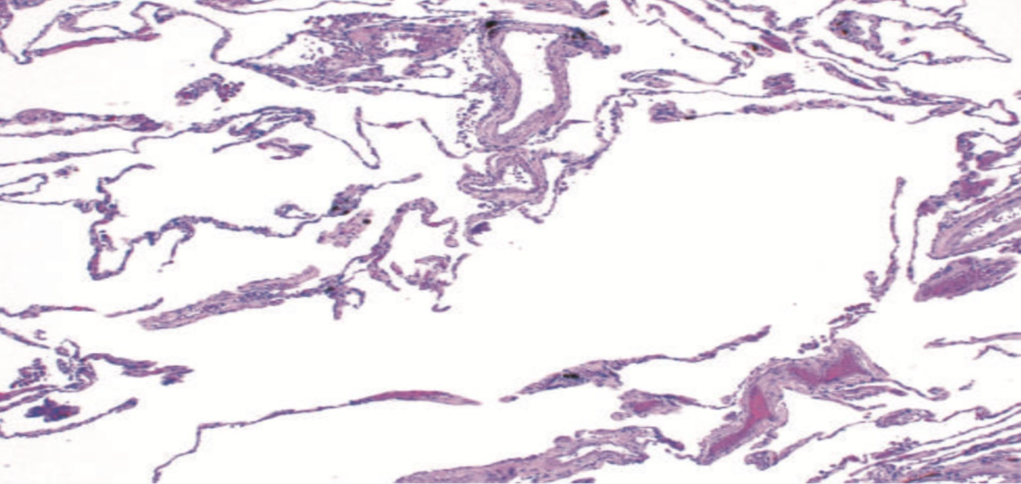
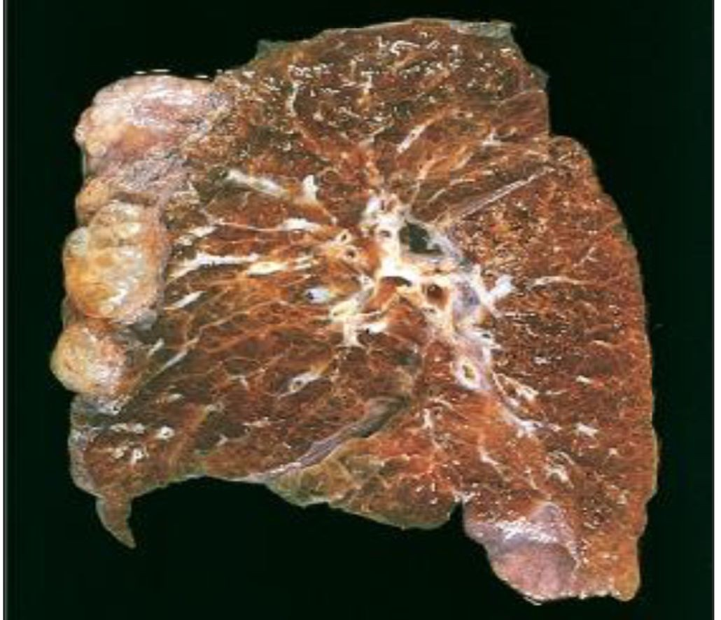
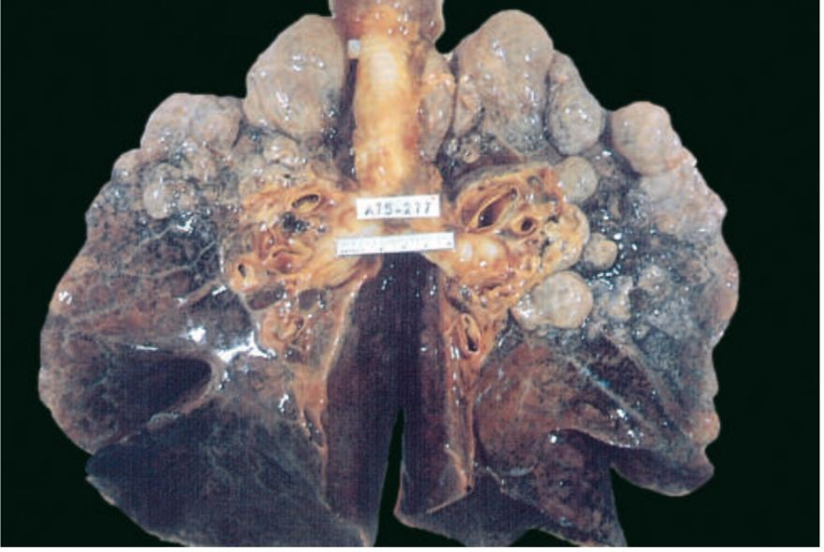
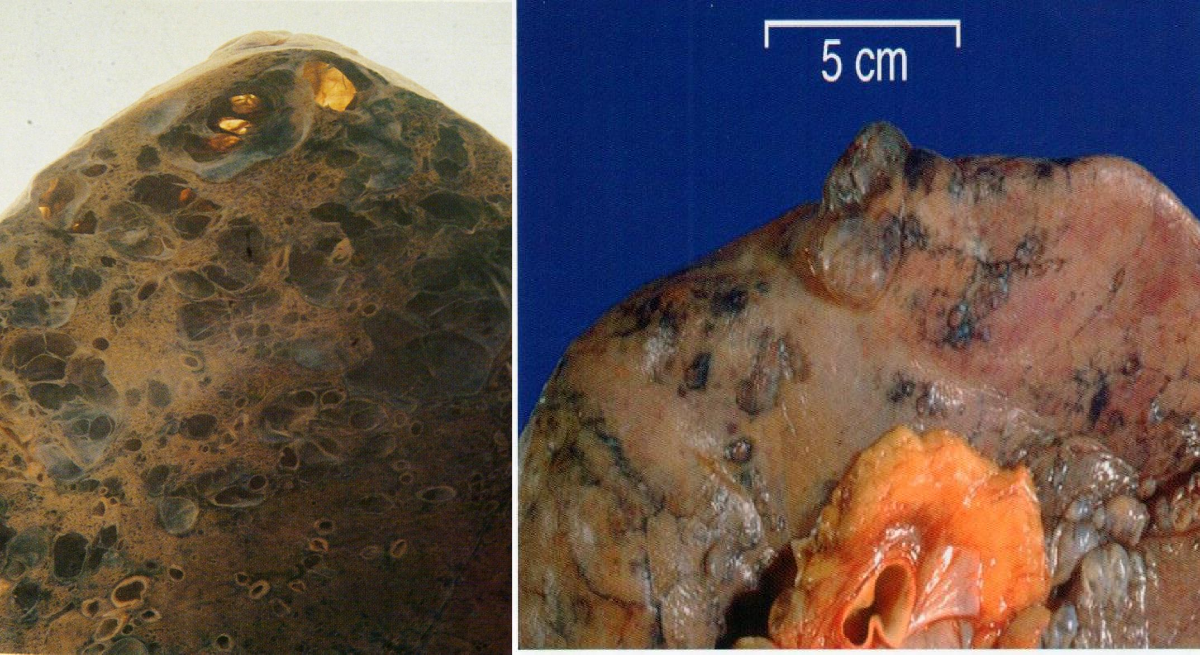
Morphology
cont…
Normal distal lung acinus
Panacinar (pale, voluminous lungs )
Centriacinar (Some parts are normal and some parts are dilated)
Microscopic morphology: Thinning, dilated and destroyed alveolar walls (septa) with coalescence (fusion) of air spaces without ﬁbrosis
#1
Gross morphology:
Bullous emphysema with large subpleural bullae (upper left)
Large apical blebs or bullae are more characteristic of irregular emphysema secondary to scarring and of distal acinar emphysema
Distal acinar /paraseptal: forming multiple cyst-like structures with spontaneous pneumothorax
#2
#3

Slide 8
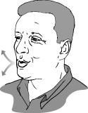
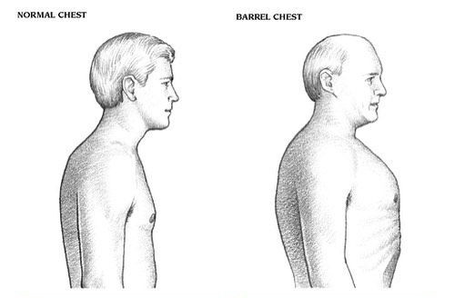
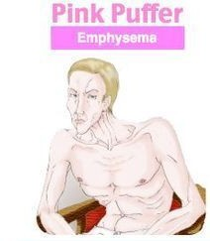
Clinical features
cont…
Pulmonary function test
Reduced FEV1 + Normal FVC + Reduced FEV1/FV
Dyspnea usually the ﬁrst symptom. Begins insidiously but is steadily progressive
Cough and Wheezing.
In patients with underlying chronic bronchitis or chronic asthmatic bronchitis
Weight loss
Is common and may be severe enough to suggest occult malignant tumor
Barrel-shaped chest
(In severe cases)
The hyperinﬂation result from:
air-trapping with inﬂammatory changes
hypersecretion of viscid contraction in the small airways.
Note the associated indrawing of the intercostal muscles. Similar changes are seen in patients with chronic bronchitis and asthma
Fish-mouth breathing
(In severe cases)
The patient starts to breathe out closed or nearly closed lips to keep the intrabronchial pressure high and prevent collapse of the bronchial wall and expiratory obstruction.
Later in expiration the lips are blown forwards and open, often with a grunt.
(Pursed-lip breathing)
Pink Puffer
(In severe cases)
Because of prominent dyspnea and adequate oxygenation of hemoglobin

Slide 9
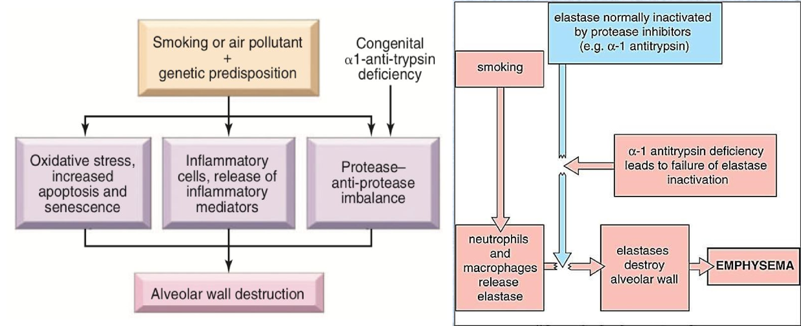
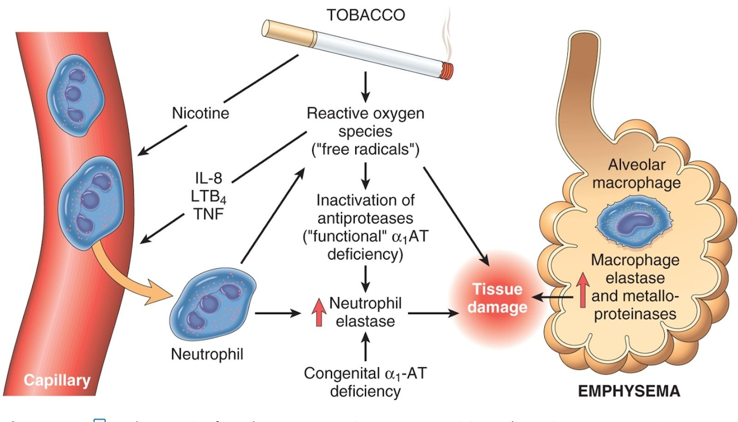
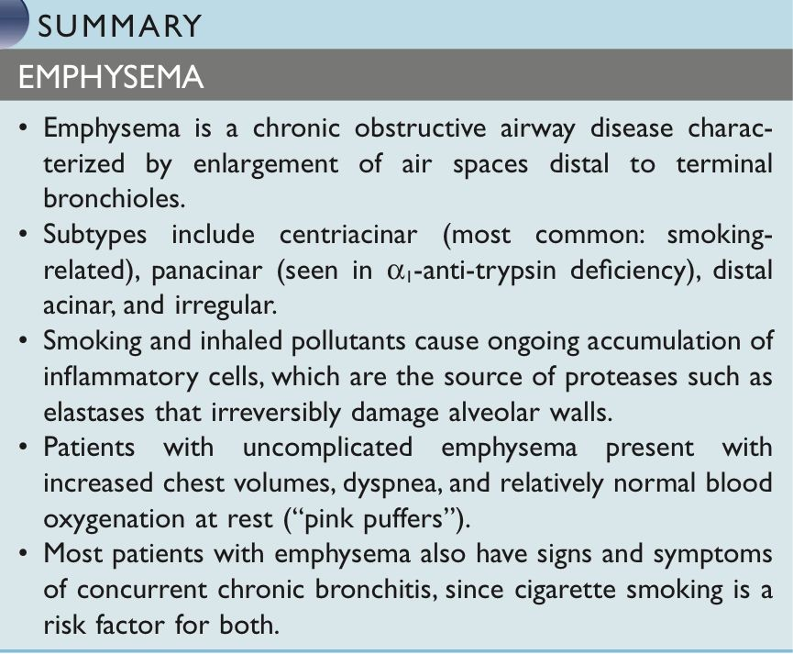
Pathogenesis
These 2 pictures explained the pathogenesis of emphysema:
Proteases such as elastase are secreted by alveolar macrophages and neutrophils and are responsible for the destruction of the alveolar parenchyma. (neutrophils are attracted by Inﬂammatory cytokines: IL8, LTB4, and TNF)
Complications
Death from emphysema is related to:
Pulmonary failure with respiratory acidosis, hypoxia and coma.
Secondary Pulmonary hypertension. (arising form both hypoxia-induced pulmonary vascular spasm and loss of pulmonary capillary surface area from alveolar destruction)
Right-sided heart failure (Cor pulmonale)
Pneumothorax

Slide 10
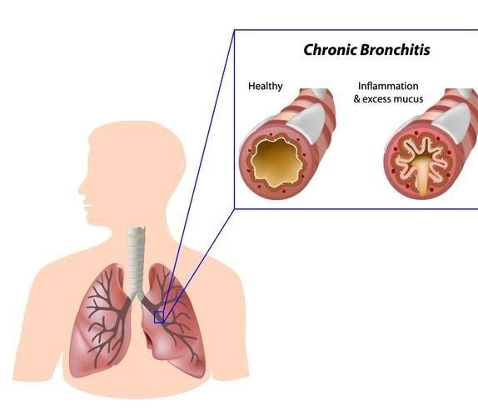
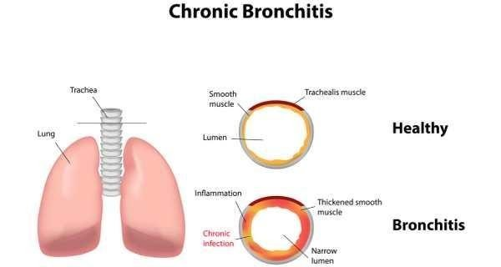
Chronic bronchitis
Deﬁnition:
Persistent productive cough for 3 consecutive months (at least) in 2 consecutive years (at least).
Causes
Cigarette smoking (most important).
Air pollutants.
Cystic ﬁbrosis.
Pathogenesis
Cigarette smoking , air pollutants and environmental irritants induce:
1
Hypertrophy of mucous secreting cells in trachea and bronchi increase goblet cells in bronchiole.
2
Chronic inﬂammation; macrophages, neutrophils.
3
Secretion of IL-13 by T lymphocytes.
4
Chronic inﬂammation with increased mucous formation leads to bronchiolar obstruction along with ﬁbrosis.
5
As result; mild or signiﬁcant airﬂow obstruction, which almost always complicated by emphysema.

Slide 11
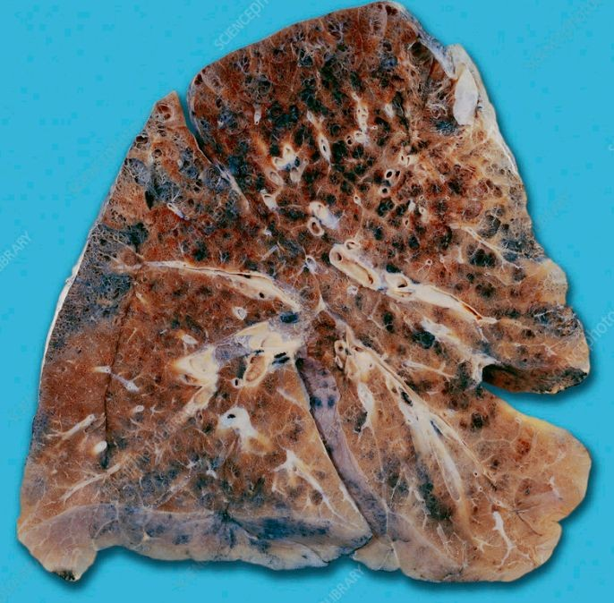
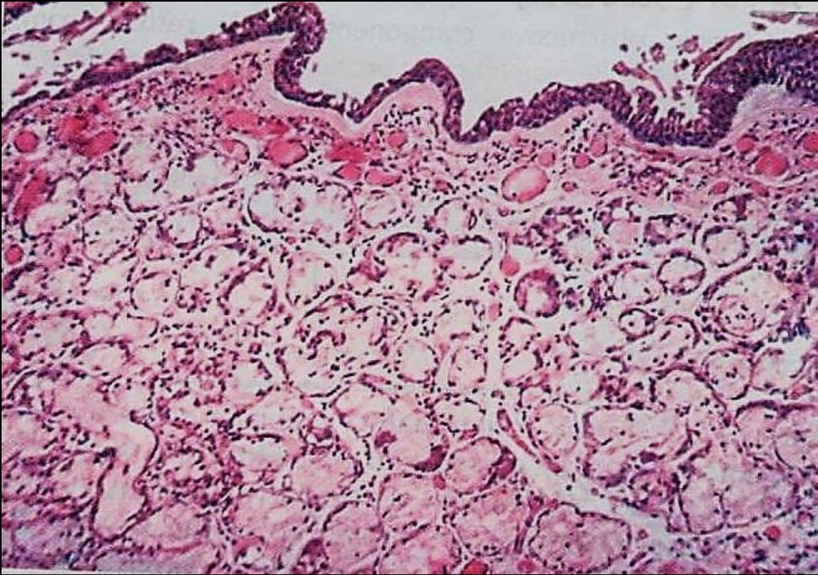
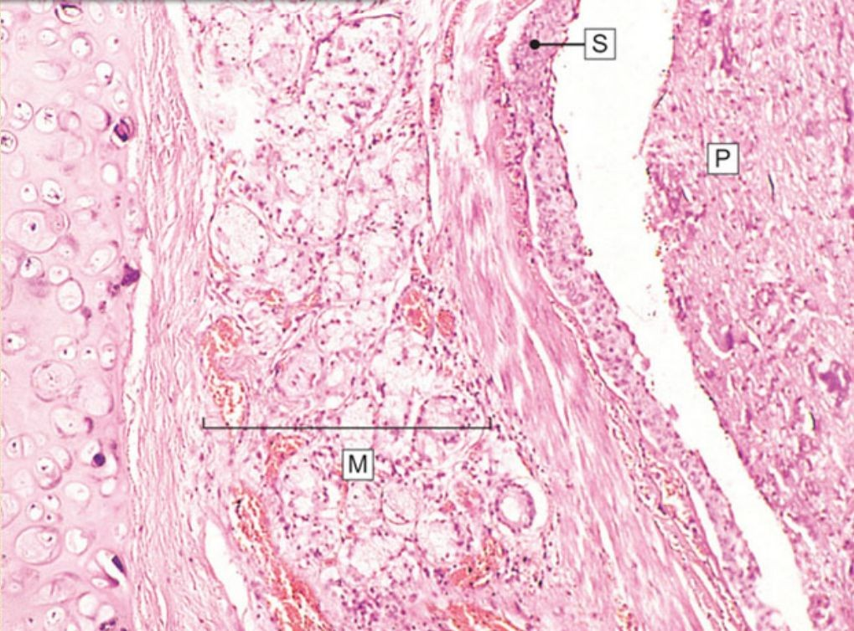
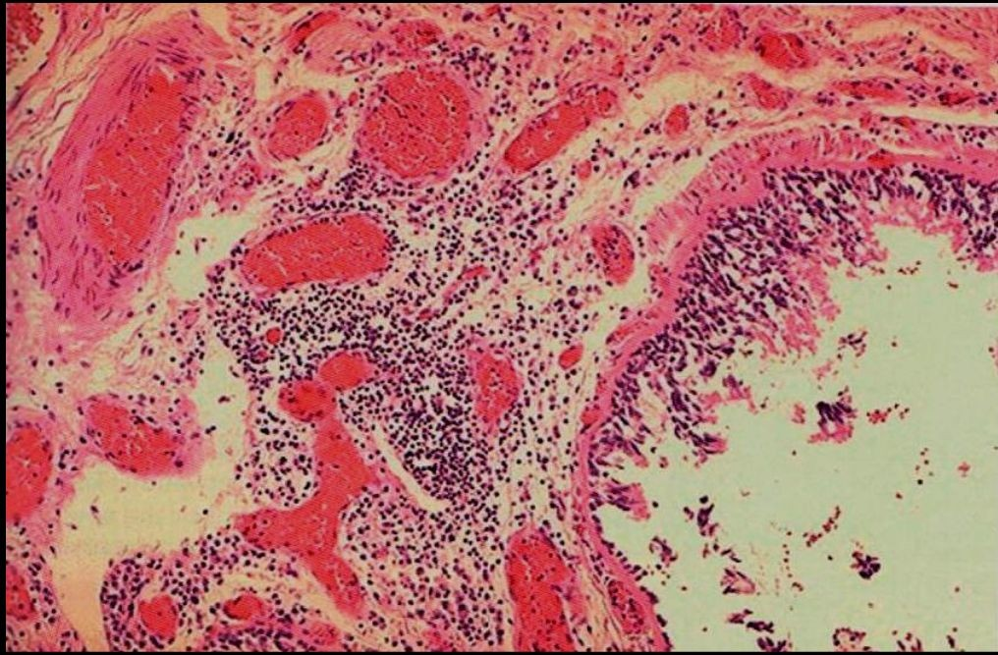
Morphology
Gross morphology:
Bronchial wall shows; Redness, swelling, covered by mucopurulent secretion.
Thickening of the wall Mild narrowing of bronchial lumen.
Small bronchioles are ﬁlled with secretion.
★ “Reid Index“: which is a mathematical relationship comparing the thickness of the mucus glandular tissue versus the distance from the epithelium to the level of the cartilage. ( it’s > 40-50% from the entire thickness of the bronchial wall in Chronic bronchitis) “Normally:<40%” (★ Doctor said “will come in exam”)
Microscopic
Histologic examination
Chronic inﬂammation.
Enlargement of mucus secreting glands.
Goblet cell metaplasia.
Bronchiolar wall ﬁbrosis.
In chronic bronchitis the main abnormality is secretion of abnormal amounts of mucus, causing plugging of the airway lumen (P).
Chronic inﬂammation in the bronchial wall.

Slide 12
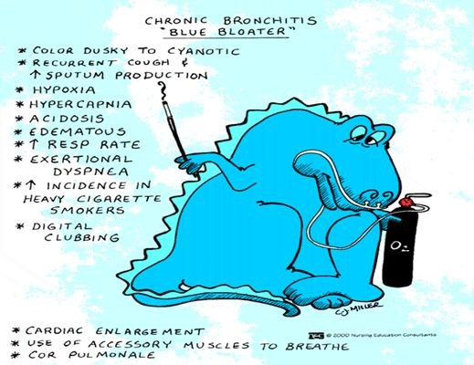
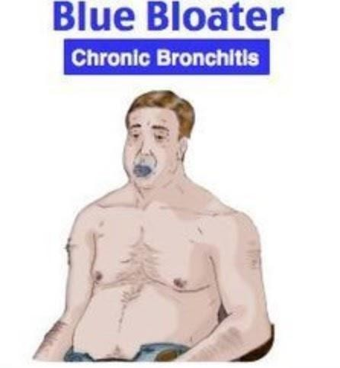
Clinical Complications & presentation
Clinical Complications:
1
Cough and sputum production persist indeﬁnitely without ventilatory dysfunction.
2
Outﬂow obstruction marked by hypercapnia, hypoxemia, and
cyanosis.
3
Patients with chronic bronchitis and COPD have frequent exacerbations, more rapid disease progression, and poorer outcomes than those with emphysema alone.
4
Death due to further impairment of respiratory functions after superimposed acute bacterial infections.
Clinical presentation:
Patient with emphysema who also has pronounced chronic bronchitis and a history of recurrent infections.
Dyspnea usually is less prominent, and in the absence of increased respiratory drive the patient retains carbon dioxide, becoming hypoxic and often cyanotic.

Slide 13
Comparison

Slide 14
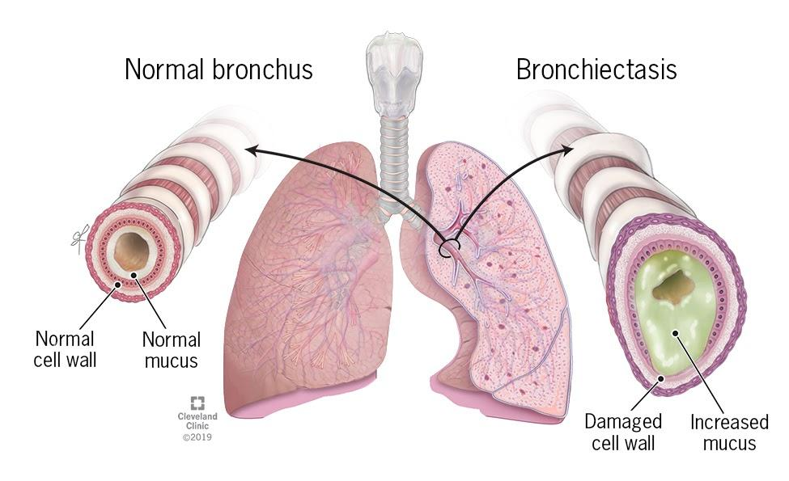
Bronchiectasis
Deﬁnition:
Permanent dilation of bronchi and bronchioles caused by destruction of smooth muscle and the supporting elastic tissue.
Not a primary disorder, as it always occurs secondary to persistent infection (ex:chronic necrotizing infections) or obstruction caused by a variety of conditions.
Etiology (causes):
1
Congenital or hereditary conditions
Cystic ﬁbrosis, intralobar sequestration
2
Bronchial obstruction Tumors, forging bodies
3
Postinfectious conditions bacteria, viruses and fungi
4
Other conditions
-Systemic lupus erythematosus(SLE)
-Rheumatoid arthritis

Slide 15
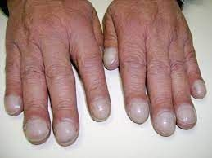
Pathogenesis
1
Obstruction & infections are the major cause.
After obstruction→ air is reabsorbed from the airways distal to the obstruction→ atelectasis.
Accumulation Of intraluminal secretions→ dilatation of the airways + Bronchial wall inﬂammation.
2
If the obstruction persists during the period of growth
These changes become irreversible
3
When superadded suppurative necrotizing type of infection
Extensive bronchial and bronchiolar wall damage
Atelectasis: a complete or partial collapse of the lung or an area of the lung
Clinical presentation
Severe persistent cough with sputum (mucopurulent sputum) sometime with blood.
Clubbing of ﬁngers.
Dyspnea.
Hypoxia, hypercapnia, cyanosis.
Clubbing of ﬁngers

Slide 16
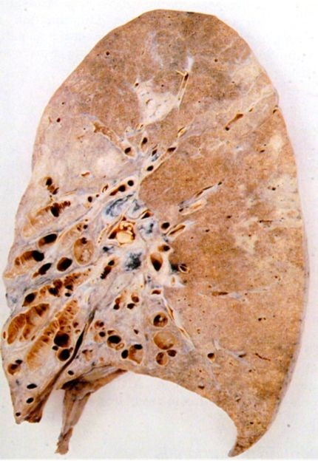
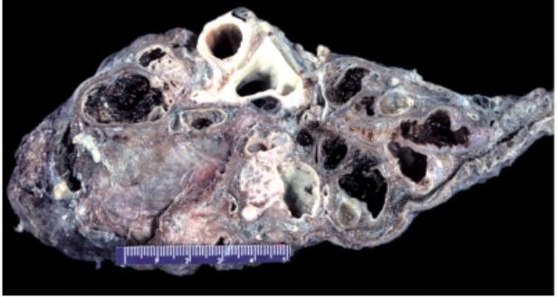
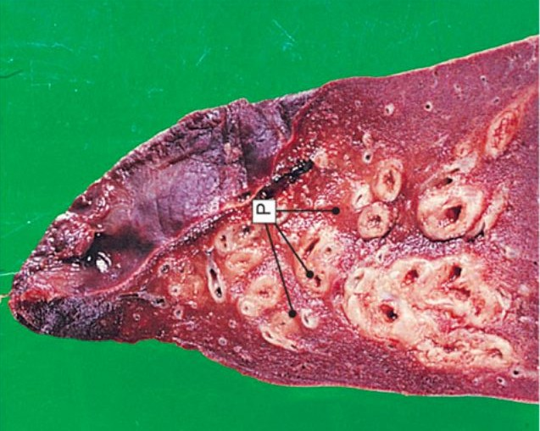
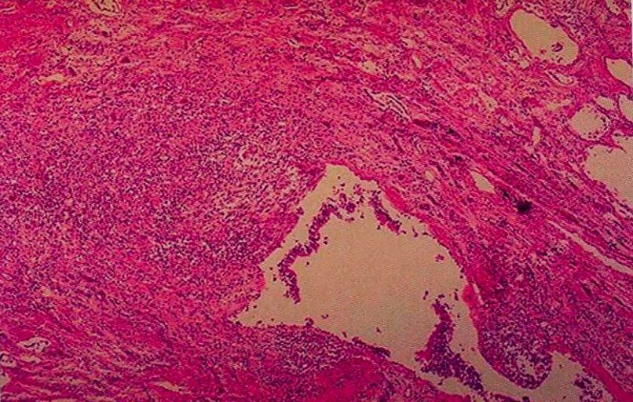
Morphology
Gross
Dilatation of bronchi with destruction of bronchial walls
Usually, lower lobes or distal
Dilatation about Four times the normal diameter
Mucosa: congested with ulcers
A lower lobe of lung surgically resected for bronchiectasis
Microscopic
Acute and chronic inﬂammation.
Destruction with abscess.
Epithelial ulcerations
Can show squamous metaplasia.
Glandular atrophy
Fibrosis of bronchiolar wall.

Slide 17
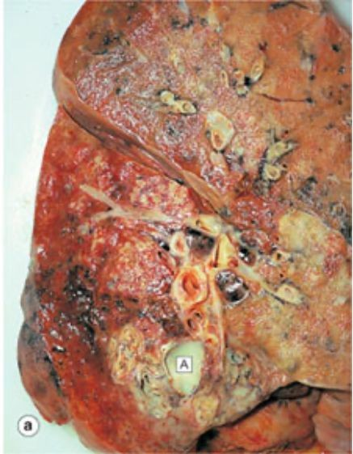
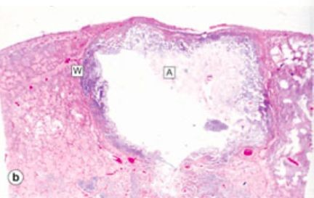
Complications
Signiﬁcant obstructive ventilatory defects, with hypoxemia, hypercapnia, pulmonary hypertension, and cor pulmonale.
Lung Abscess .
Rare complications: brain abscess and amyloidosis.
Amyloidosis: the name for a group of rare, serious conditions caused by a build-up of an abnormal protein called amyloid in organs and tissues throughout the body.
Lung Abscess

Slide 18
Dr. Al-Rikabi’s Notes
1
Emphysema
Definition (pathological):
Dilatation and destruction of the small airspaces distal to the terminal bronchioles, they are called pink puffers.
Pathogenesis:
Smoking irritates bronchial tree > inﬂammation > release proteases/elastases which destruction of alveolar wall.
α1 anti-trypsin (on a PI or PZ locus on chromosome 14) deactivates elastases and proteases.
Morphology:
Black lung color because of anthracosis and presentation of emphysematous bullae (bubbles).
(cont.) —>

Slide 19
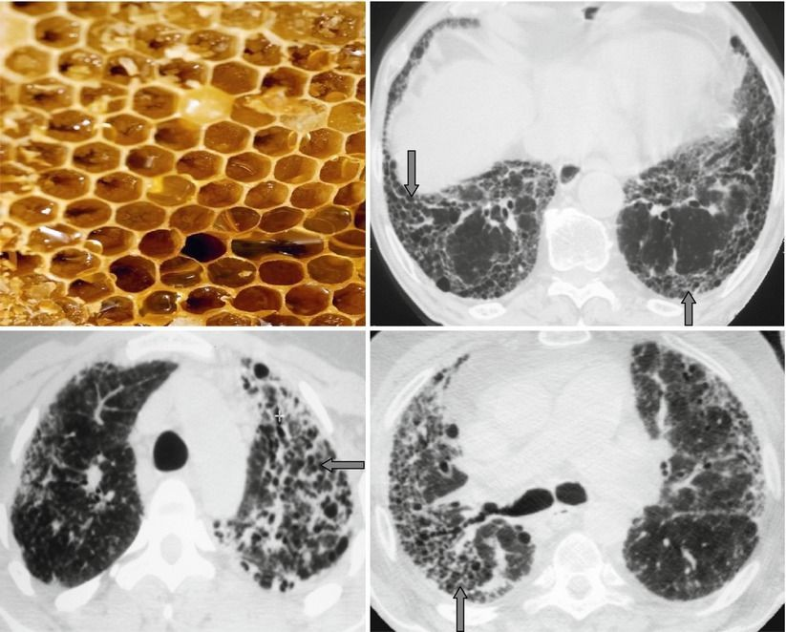
Dr. Al-Rikabi’s Notes
Types:
Paraseptal (distal):
Dilatation of the distal part of acini.
Idiopathic
May complicate to pneumothorax (rupture of bullae) atelectasis (managed via tube thoracostomy).
Centriacinar (Centrilobular):
Dilatation of the central part of the acini (formed by respiratory bronchiole).
Upper lobe of lung + smokers.
Panacinar (panlobular):
Acini are uniformly dilated.
Congenital by α1 anti-trypsin deﬁciency.
4-Irregular
Scarring of lung/ inﬂammatory condition.
From previous inﬂammatory disease.
Advanced emphysema:
Barrel chest (increased anteroposterior diameter).
Honeycomb lung appearance.
Honeycomb

Slide 20
Dr. Al-Rikabi’s Notes
2
Chronic Bronchitis
Definition:
persistent productive cough which usually lasts for 3 months over 2 consecutive years.
There is chronic inﬂammation of bronchial mucosa that is associated with hyperplasia/hypertrophy of mucous glands.
Causes:
Usually induced by cigarette smoking and air pollution.
Diagnosis:
Not through biopsy
We can observe that the patient is using accessory muscles. And pressing on his chest attempting to push out the air.
People with chronic bronchitis are called blue bloaters (due to cyanosis)
Complications:
Acute exacerbation of chronic bronchitis: it is the secondary acute exacerbation of chronic bronchitis.
Cor pulmonale: right ventricular failure due to pulmonary hypertension, when pulmonary pressure is more than 25 mmHg.
Pulmonary acidosis.

Slide 21
Dr. Al-Rikabi’s Notes
3
Bronchiectasis
Definition:
Abnormal and permanent dilatation of the bronchi and bronchioles associated with chronic inﬂammation and excessive secretions. May have dyspnea at different severities.
Characterized by:
Persistent productive cough.
Histologically we see a mixture of bacteria including anaerobes that cause the foul smell, chronic inﬂammatory cells and ﬁbrosis >destroyed/ulcerated walls.
Grossly we see secretions and abscess.
In x-ray we see it as bilateral, small dense (purulent) nodule-like areas with inﬂammation around the dilated bronchi.
Causes:
Obstruction: Tumor, Foreign body,Fibrosis or Mucous plugs
Cystic ﬁbrosis: caused by a gene in chromosome 7 (resulting in a dynein deﬁciency, diagnosed by checking Na through sweat) and Characterized by chronic pancreatitis and increased secretions
Immotile cilia syndrome (kartagener syndrome) (ciliary dyskinesia)
Immunodeﬁciency
Complications:
Abscesses: In the Lung or Brain
Amyloidosis (3 causes: chronic bronchiectasis, chronic osteomyelitis, migratory abscesses)

Slide 22
MCQs
1. A 55-year-old man is admitted to the hospital with increasing shortness of breath and dry cough for the past few years. He smokes 1.5 packs of cigarettes and drinks about four bottles of beer a day. He is constantly “gasping for air” and now walks with difﬁculty because he becomes breathless after only a few steps. Prolonged expiration with wheezing is noted. Physical examination shows a barrel chest, hyperresonance on percussion, and clubbing of the digits. The patient’s face is puffy and red, and he has pitting edema of the legs. A chest X-ray discloses hyperinﬂation, ﬂattening of the diaphragm, and increased retrosternal air space. Which of the following is the appropriate diagnosis?
A. Asthma | B.Chronic Bronchitis | C.Emphysema | D.Bronchiectasis
2.Which of the following best describes the expected histopathology of the lungs in the patient described in the previous question?
A.Destruction of the walls of airspaces without ﬁbrosis | B.Interstitial ﬁbrosis of the lung parenchyma | C.Prominent bronchial smooth muscle cell hyperplasia. | D.Thickening of the epithelial basement membrane
3.Ahmad 21 years old came to hospital, because he had productive cough for last 8 months, also he is a smoker. We did sputum culture, we found macrophages full of carbon, and a lot of neutrophil. What is the diagnosis?
A.Chronic Bronchitis | B.Asthma | C.Emphysema | D.Bronchiectasis
4.Which of the following is associated with formation of bullae?
A.Paraseptal | B.Panacinar | C.Centriacinar | D.irregular
5.Which of the following is complication to chronic bronchitis?
A.Cystic ﬁbrosis | B.Cor pulmonale | C.lung cancer | D.Pneumothorax
1.C 2.A 3.A 4.A 5.B

Slide 23
Team leaders
Dema Alkhattabi
Hassan Alabdullatif
Team members
Khalid alrasheed Nawaf Alrefaei Emad Almutairi Othman Alabdullah
Mohamed ibn Saqyan Ibrahim Alhezam Talal alharbi
Saud Al Taleb Ali Alzahrani Omar Alkadhi
Shahed Albukhari
Walaa AlMutawa
CREDITS: This presentation template was created by Slidesgo, including icons by Flaticon, and infographics & images by Freepik
Ajwan Aljohani

