Slide 1
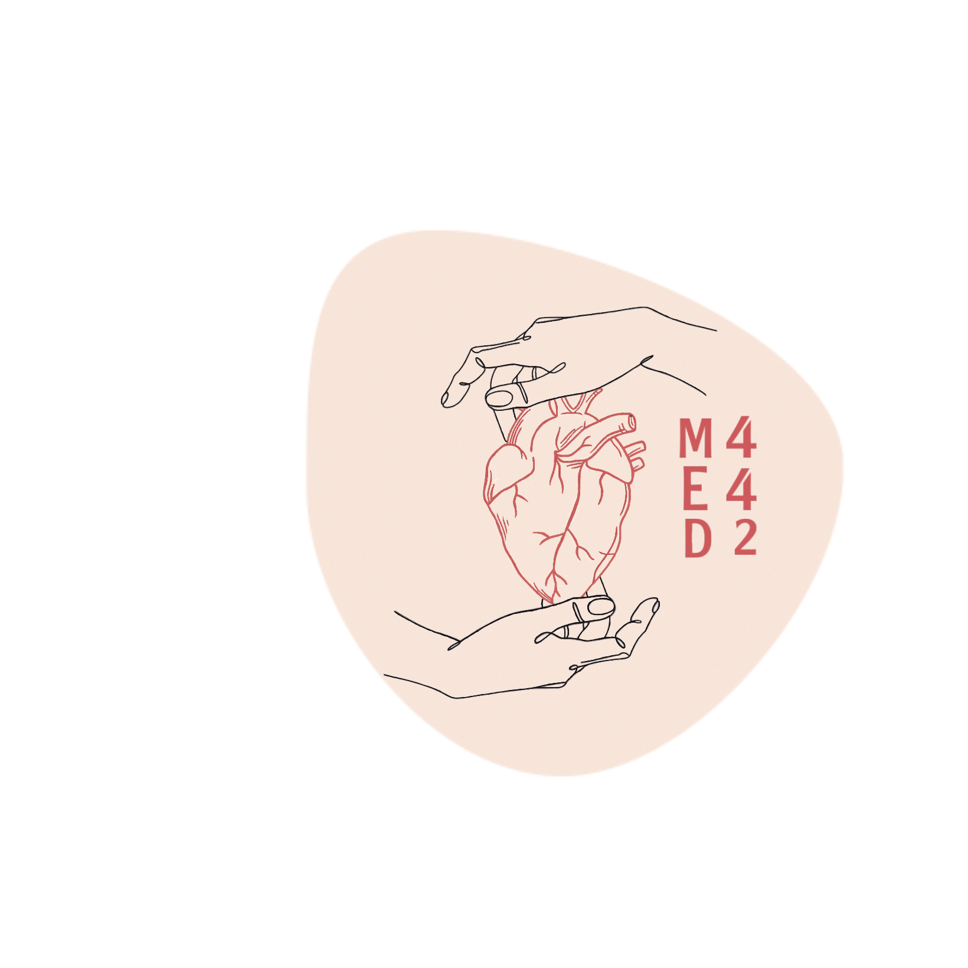
Lung Cancer
Colour index:
Main text
Important
In girls slides only
In boys slides only
Doctor‘s notes
Extra info.
Editing file

Slide 2
Objectives
Know the epidemiology of lung cancer
Aware of the new classification of bronchogenic carcinoma which include squamous carcinoma, adenocarcinoma, small cell and large cell (anaplastic) carcinomas
Understand the predisposing factors of bronchogenic carcinoma
Understands the clinical features and gross pathology of bronchogenic carcinoma. Know the precursors of squamous carcinoma (squamous dysplasia) and adenocarcinoma (adenocarcinoma in situ and atypical adenomatous hyperplasia)
Have a basic knowledge about neuroendocrine tumors with special emphasis on small cell carcinoma and bronchial carcinoid
Aware that the lung is a frequent site for metastatic neoplasms
شكوت إلى وكيعٍ سوء حفظي
فأرشدني إلى ترك المعاصي
وأخبرني بأن العلم نورٌ
ونورُ الله لا يهدى لعاصي
محمد بن إدريس الشافعي

Slide 3
INTRODUCTION
95% of primary lung tumors are carcinomas (epithelial cells)
Remaining 5% span a miscellaneous group that includes: carcinoids
mesenchymal malignancies (e.g., fibrosarcoma, leiomyomas)
lymphomas
benign lesions
Primary lung cancer is a common disease BUT metastatic tumors are more common than the primary tumors
Epidemiology
Carcinoma of the lung is the most important cause of cancer-related deaths in industrialized countries
Accounts for >30% of cancer deaths in men
Accounts for >25% of cancer deaths in women
Incidence of lung cancer is declining in men but increasing in women
Peak incidence is at 55 to 65 years of age

Slide 4
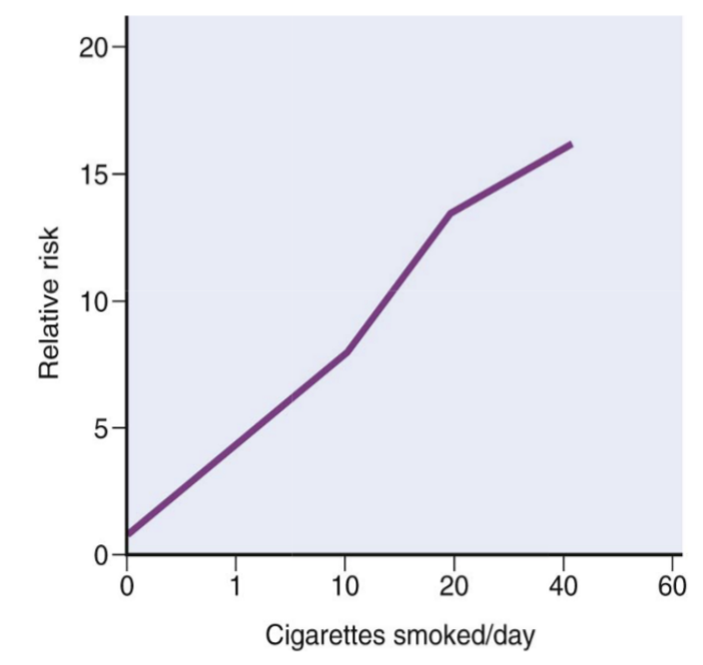
Etiology
85% of lung cancers occur in cigarette smokers.
Most lung cancer types are linked to cigarette smoking.
Strongest association: squamous cell carcinoma & small cell carcinoma.
Risk of developing lung cancer is directly proportional to: number of cigarettes smoked daily & number of years of smoking.
Risk is 20 - 40 times greater among habitual heavy smokers.
Risk is determined by number of
cigarettes smoked
Cessation of cigarette smoking for at least 15 years brings risk down.
Passive smoking increases the risk to approximately twice than Nonsmokers.
Cigarette smokers show various histologic changes, including squamous metaplasia of the respiratory epithelium which may progress to dysplasia, carcinoma in situ and ultimately invasive carcinoma

Slide 5
Etiology
Radiation
All types of radiation may be carcinogenic & increase risk of developing lung cancer. Radium & uranium workers are at risk.
Scarring
Sometimes old infarcts, wounds, scar, granulomatous infections are associated with adenocarcinoma.
Asbestos
Increased incidence of cancer with asbestos exposure, especially in combination with cigarette smoking.
Air pollution
May play some role in increased incidence.
Indoor air pollution especially by radon.
Predisposing factors
Gender
Women > Men
Industrial exposure
Nickel & chromates, coal, mustard gas, arsenic, iron etc.

Slide 6
Etiology
For unclear reasons, women are more susceptible to carcinogens in tobacco smoke than men
Female smokers have a much greater risk of death from lung cancer and COPD in recent years than female smokers 20 or 40 years ago
Female smokers today smoke more like men than women in previous generations, beginning earlier in adolescence and, until recently
Tumor sites
Central
Small cell CA
Squamous cell CA
Peripheral
Adenocarcinoma
Bronchial derived
Bronchioloalveolar
Large cell carcinoma

Slide 7
Precursor Lesions
Three types of precursor epithelial lesions are recognized:
01
squamous dysplasia & carcinoma in situ
Squamous cell carcinoma
02
Leads to
Atypical adenomatous hyperplasia
Adenocarcinoma
03
Leads to
Neuroendocrine tumors
Diffuse idiopathic pulmonary neuroendocrine cell hyperplasia
The term "precursor" does not imply that progression to invasion will occur in all cases.

Slide 8
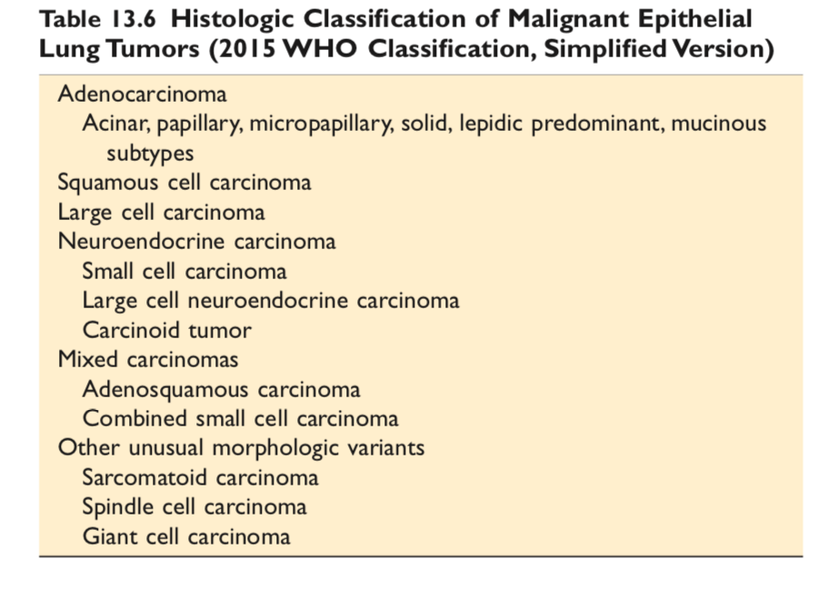
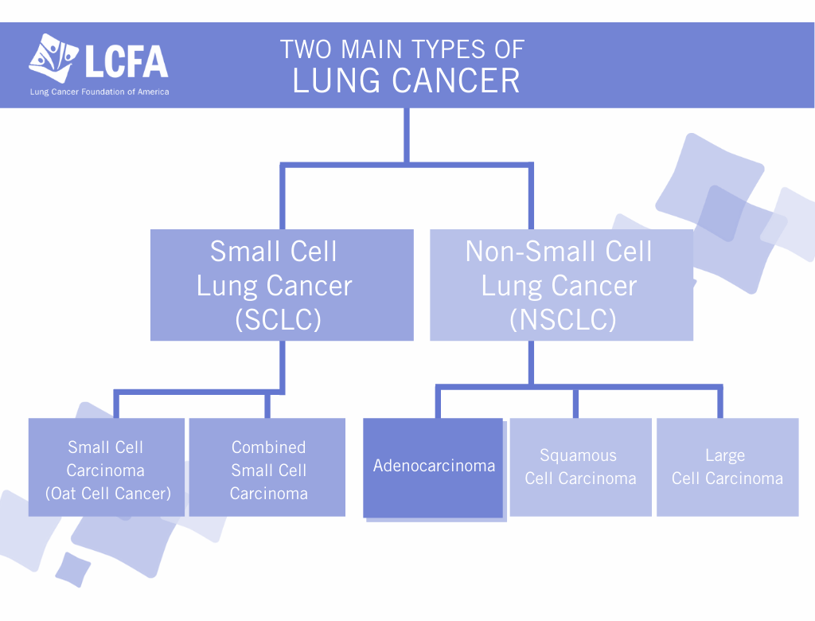
Classification

Slide 9
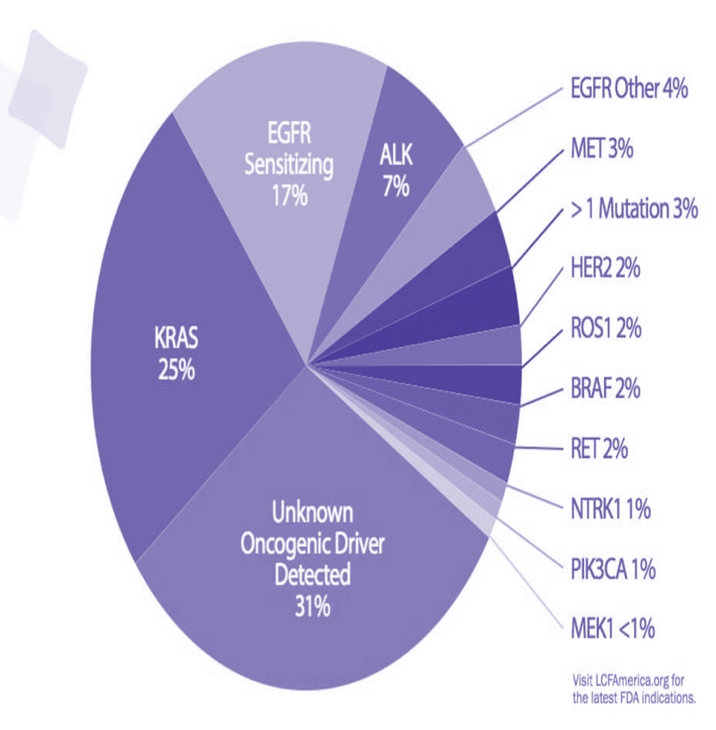
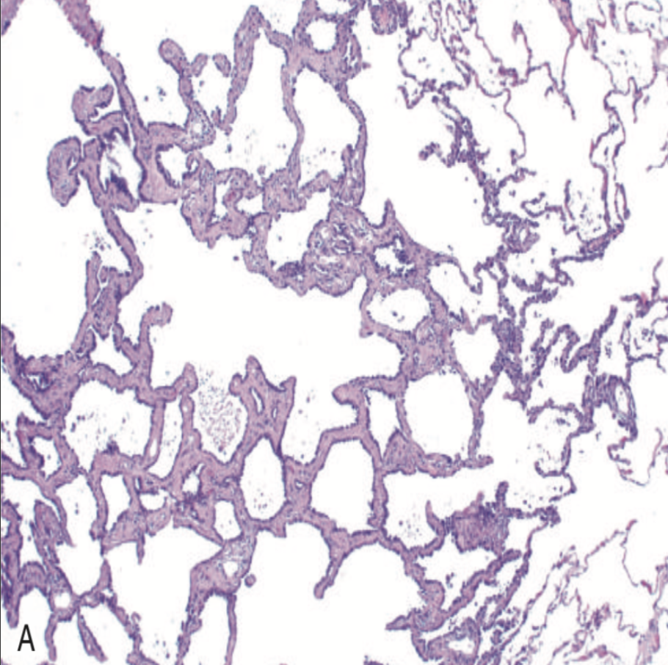
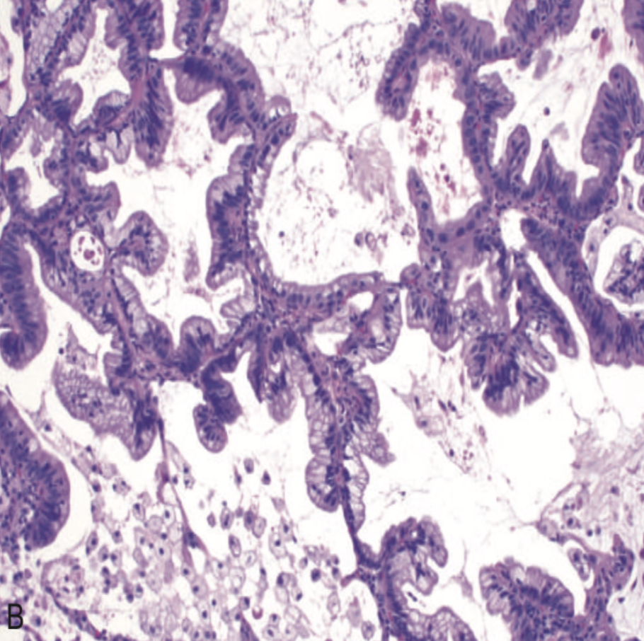
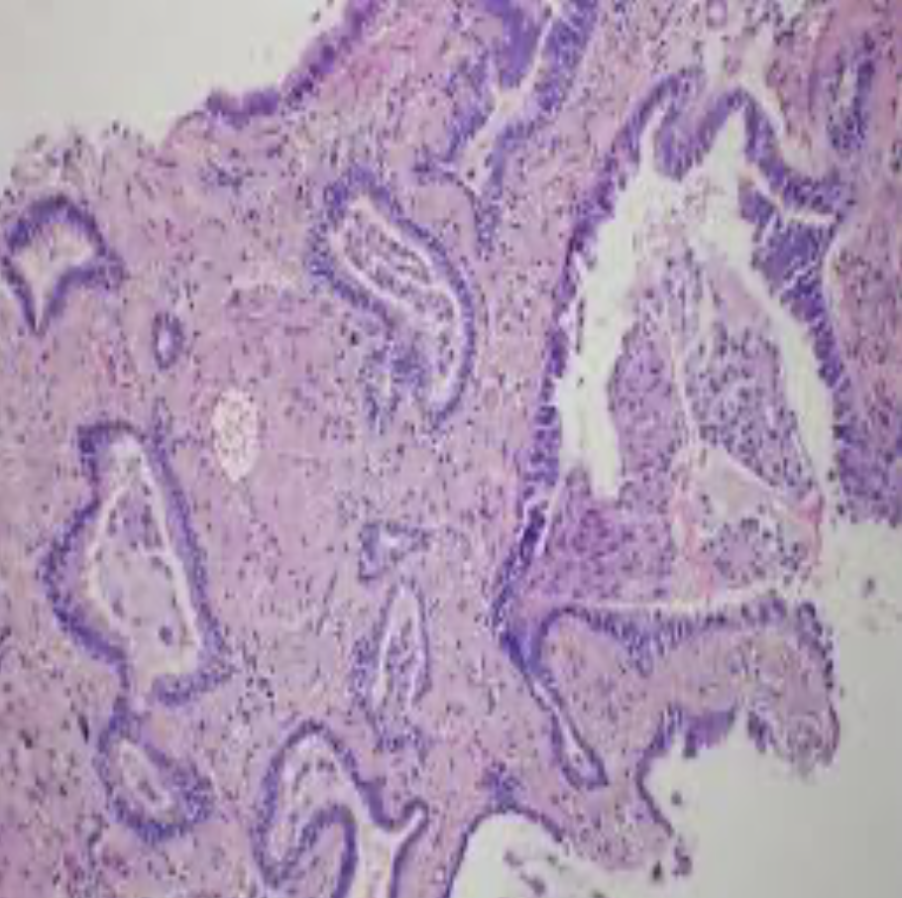
NSCLC:
Adenocarcinoma
Epidemiology:
Mutations:
Most frequent histologic subtype of bronchogenic carcinoma.
More common in young women.
10% in whites.
30% in asians (particularly those occurring in non-smoking women, harbor mutations that activate the epidermal growth factor receptor (EGFR)).
EGFR & KRAS mutations can occur and in 30% of adenocarcinomas.
Sites:
Peripheral tumors arising from the peripheral airways & alveoli.
Types:
Atypical adenomatous hyperplasia | Adenocarcinoma in situ (AIS) | Minimally invasive adenocarcinoma (MIA)
Small lesion (≤5 mm). Characterized by: dysplastic pneumocytes lining alveolar walls that are mildly fibrotic. Malignant cells grow along alveolar septae. | Less than 3 cm lesion. Composed entirely of: Dysplastic cells growing along preexisting alveolar septae. No growth patterns other than lepidic. No necrosis, LVI, or invasion component. | ≤3 cm Describes small solitary adenocarcinomas with either: Pure lepidic growth. Predominant lepidic growth with ≤ 5 mm of stromal invasion.

Slide 10
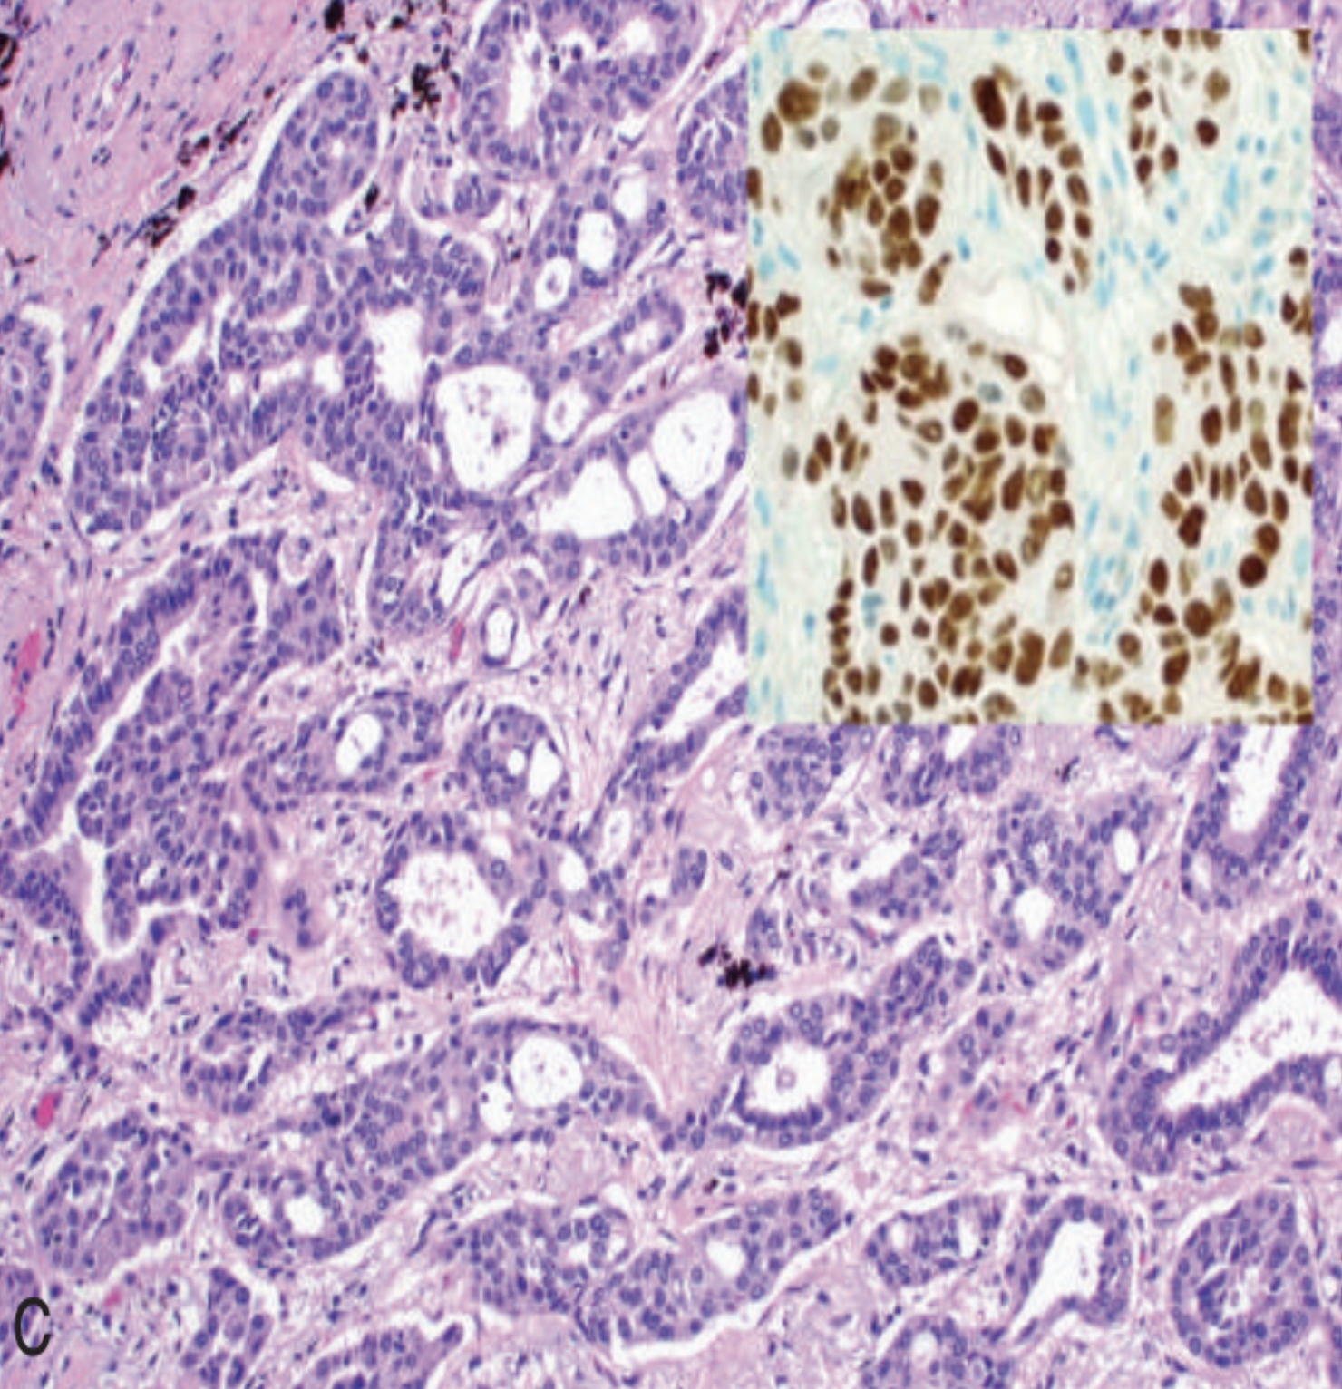
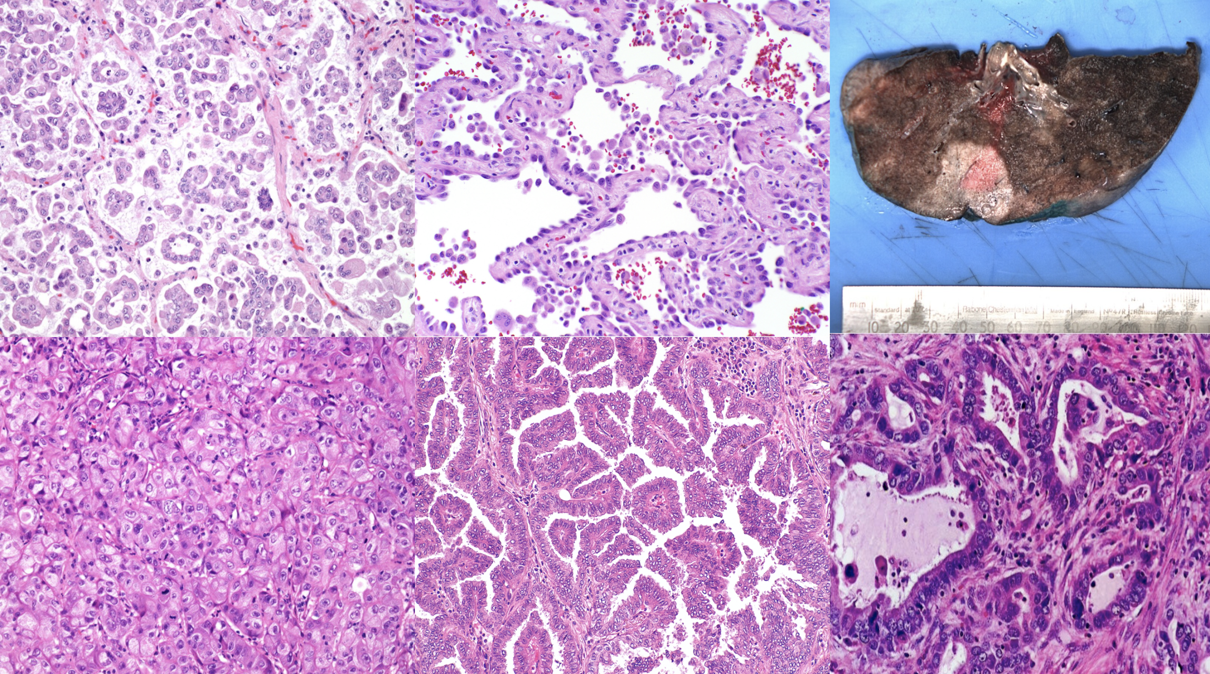
NSCLC: Adenocarcinoma
Histology
IHC: TTF-1 positive
Targeted therapies, such as EGFR inhibitor therapy for adenocarcinomas with EGFR mutations, can be effective.

Slide 11
NSCLC: Squamous Cell Carcinoma
Epidemiology:
More common in men than women
Closely correlated with a smoking history (25 times risk).
Second most common bronchogenic carcinoma.
Pathogenesis:
Large lesions may undergo central necrosis, giving rise to cavitation.
Development (over years) of squamous metaplasia or dysplasia in bronchial
epithelium → carcinoma in situ.
The small neoplasm reaches a symptomatic stage, when a well-defined tumor mass begins to obstruct the lumen of a major bronchus, often producing distal atelectasis & infection.
Extra Information:
● Poor prognosis
● Tumor cells secrete a parathyroid hormone (PTH)- like peptide leading to hypercalcemia
● Microscopically:
○ SqCC arise in the central airways (centrally located). So they appears as a hilar mass. Frequently cavitate
○ Tumors are graded according to degree of squamous differentiation
Respiratory
epithelium
Squamous
metaplasia
dysplasia
Carcinoma
in-situ
invasive
SCC

Slide 12
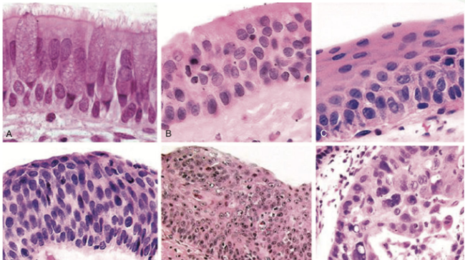
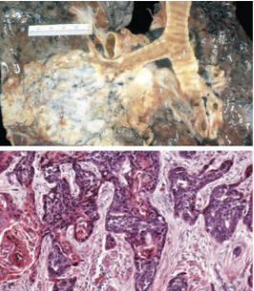
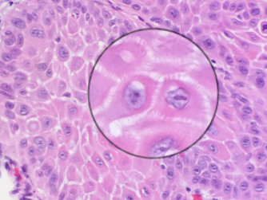
NSCLC: Squamous Cell Carcinoma
Histology
Tumors range from well- differentiated squamous cell neoplasms showing keratin pearls and intercellular bridges to poorly differentiated neoplasms exhibiting only minimal squamous cell features.
Large polygonal cells
Intercellular bridging

Slide 13
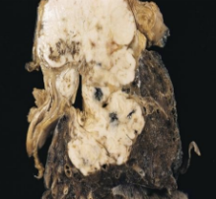
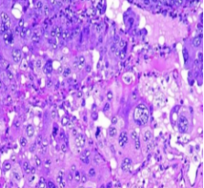
NSCLC: Large Cell Carcinoma
Definition:
Undifferentiated malignant epithelial tumors that lack the cytologic features of neuroendocrine carcinoma and show no evidence of glandular or squamous differentiation.
Poor prognosis.
May exhibit neuroendocrine or glandular differentiation markers when studied by immunohistochemistry or electron microscopy.
Epidemiology:
Frequency: 10%
strongly associated with smoking.
Site :
Usually located peripherally.
Cells :
Cells typically have large nuclei, prominent nucleoli, and moderate amounts of cytoplasm.
Made up of large and anaplastic cells.

Slide 14
Carcinoid Tumors
Definition:
Malignant tumors composed of cells that contain dense-core neurosecretory granules in their cytoplasm.
Epidemiology:
Account for 2% of all primary lung cancers
Shows no sex predilection.
Not related to cigarette smoking or other environmental factors.
Usually seen in adults.
Can occur in patients with Multiple Endocrine Neoplasia (MEN-I).
Site :
Can be central or peripheral in location..
Complications & Prognosis:
Tumor cells produce serotonin & bradykinin → carcinoid syndrome.
Low malignancy (slow growing tumor).
Often respectable & curable.
Spreads by direct extension into adjacent tissue.
Mainly seen as endobronchial lesions.
Types:
Atypical Carcinoid
Tumors display a higher mitotic rate and small foci of necrosis.
Higher incidence of lymph node & distant metastasis than typical carcinoids.
Typical Carcinoids
Composed of nests of uniform cells that have regular round nuclei with “salt-and-pepper” chromatin, absent or rare mitoses & little pleomorphism.

Slide 15
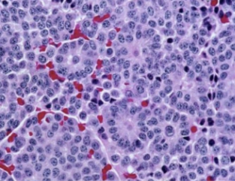
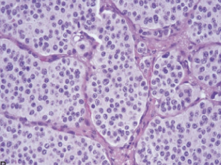
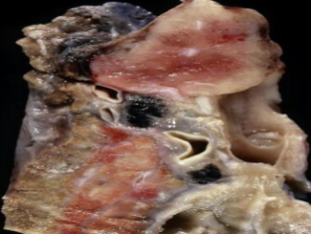
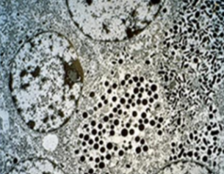
Carcinoid Tumors
Morphology
Both small cell carcinoma (high grade) and carcinoid (low grade) are neuroendocrine tumors as both arise from the neuroendocrine cells (from bronchial epithelium) normally present in the lung.
Composed of uniform cuboidal cells that have regular round nuclei with few mitoses and little or no anaplasia.
Electron microscopy:
Dense-core neurosecretory
granules

Slide 16
SCLC: Small Cell Carcinoma (Oat Cell Cancer)
Definition:
A type neuroendocrine tumors arising from neuroendocrine cells.
Epidemiology:
Strongly associated with cigarette smoking. 95% of patients are smokers.
More common in men.
Prognosis & Treatment:
Highly malignant and aggressive tumor → poor prognosis, rarely resectable.
Least likely form to be cured by surgery. usually already metastatic at diagnosis.
Chemotherapy responsive (but recur invariably).
Findings:
Ability to secrete a host of polypeptide hormones like ACTH (leading to Cushing’s syndrome), antidiuretic hormone (ADH), calcitonin, gastrin- releasing peptide and chromogranin.
Centrally located perihilar mass with early metastases (Early involvement of the hilar and mediastinal nodes).
Syndromes:
May be associated with paraneoplastic syndrome, e.g. Cushing’s and Eaton-Lambert syndrome.
AdrenoCorticoTropic Hormone (ACTH): usually from the pituitary→stimulates adrenal cortex to release cortisone. (Moonface/Hirsutism/Obesity → caused by cortisone released from the adrenal cortex).
AntiDiuretic Hormone (ADH): Inappropriate secretion →hyponatremia.

Slide 17
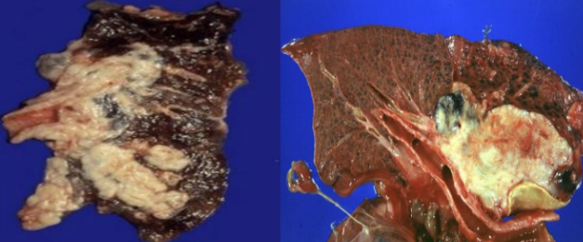
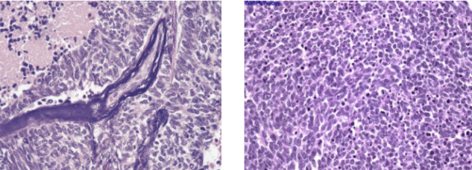
CLC: Small Cell Carcinoma (Oat Cell Cancer)
Morphology
Centrally located perihilar mass with early metastases (Early involvement of the hilar and mediastinal nodes)
Microscopically composed of small, dark, round to oval, lymphocyte-like cells with little cytoplasm.
Necrosis, apoptosis, crushing artifact.
Electron microscopy: dense-core neurosecretory granules.

Slide 18
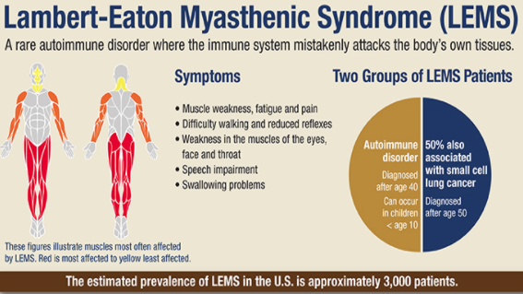
Lambert-Eaton Myasthenic Syndrome (LEMS)
Definition:
A rare autoimmune disorder where the immune system mistakenly attacks the body's own tissues.
Epidemiology:
Autoimmune disorder: diagnosed after age 40, Can occur in children < age 10
50% also associated with small cell lung cancer: diagnosed after age 50.
Symptoms:
Muscle weakness, fatigue and pain
Difficulty walking and reduced reflexes
Weakness in the muscle of the eyes, face and throat
Speech impairment
Swallowing problems

Slide 19
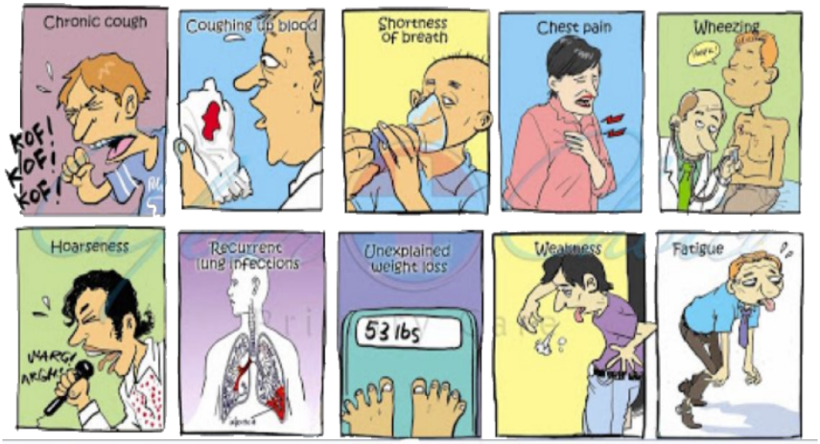
Clinical Picture
(Features of Bronchogenic Carcinoma)
Definition:
Can be silent (early stage, no symptoms) or insidious lesions.
Chronic cough (when the tumor gets larger) & expectoration, hemoptysis [coughing up of blood] (especially when cavitation starts), and bronchial obstruction, often with atelectasis (collapse or closure of a lung resulting in reduced or absent gas exchange).
Hoarseness[abnormal voice changes] (because of invasion of hilum-recurrent laryngeal nerve paralysis), chest pain (especially when it reaches pleura), superior vena cava syndrome, pericardial or pleural effusion.
Symptoms due to metastatic spread.

Slide 20
Clinical Picture
Superior vena cava syndrome:
Invasion leads to obstruction of venous drainage which leads to dilation of veins in the upper part of the chest and neck resulting in swelling and cyanosis of the face, neck, & upper extremities.
Pancoast Tumor (Superior Sulcus Tumor):
Apical (upper lobe) neoplasms may invade the brachial sympathetic plexus → severe pain, numbness & weakness in the distribution of ulnar nerve.
Pancoast tumor is often accompanied by destruction of the first and second ribs and thoracic vertebrae. It often coexist with ipsilateral enophthalmos Pancoast (Horner syndrome) (ptosis+asymmetrical miosis+anhidrosis)
Horner Syndrome:
Invasion of the cervical thoracic sympathetic nerves and it leads to ipsilateral enophthalmos, miosis, ptosis, and facial anhidrosis (inability to sweat normally-leads to dryness in facial areas).
Hoarseness:
from recurrent laryngeal nerve paralysis
Pleural effusion:
Often bloody

Slide 21
Paraneoplastic Syndrome
Definition:
Extrapulmonary, remote effects of tumors.
3% - 10% of lung cancers develop paraneoplastic syndromes.
Small Cell Lung Carcinoma
ACTH (leading to Cushing's syndrome)
ADH ( water retention and hyponatremia)
Carcinoid Tumor
Produce serotonin and bradykinin leading to carcinoid syndrome (flushing, wheezing, diarrhea, and cardiac valvular lesions)
Squamous Cell Carcinoma
May secrete parathyroid hormone-like peptide and prostaglandin E that lead to hypercalcemia
Adenocarcinoma
Can lead to hematologic manifestations (repeated coagulations, thrombosis in different parts of the body)
Complications:
Bronchiectasis
Pleural effusion
Obstructive pneumonia
Superior vena cava syndrome
Prognosis:
NSCLC have a better prognosis than SCLC
Outlook is poor for most patients

Slide 22
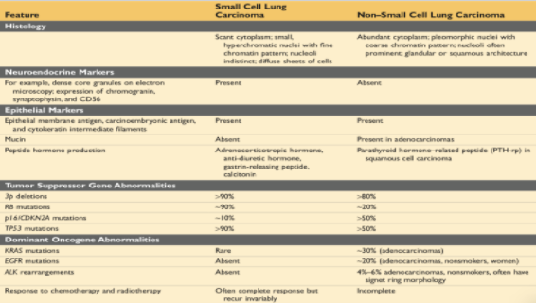
Paraneoplastic Syndrome
( Spread )
Lymphatic spread
Successive chains of nodes (scalene nodes)
Involvement of the supraclavicular node (Virchow’s node)
pericardial
Extend into the pericardial or pleural spaces.
InfIltrating the superior vena cava
esophagus
A tumour may extend directly into the esophagus, producing obstruction, sometimes complicated by a fistula
Distant metastasis
Distant metastasis to liver (30-50%), adrenals (>50%), brain (20%) and bone (20%).
Sympathetic plexus
May invade the brachial or cervical sympathetic plexus (Horner’s Syndrome)
Phrenic nerve
Phrenic nerve invasion usually causes diaphragmatic paralysis

Slide 23
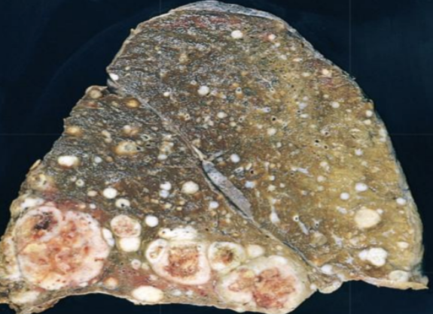
Metastatic Carcinoma
of the Lung
Pulmonary Metastases are More Common than Primary Lung Tumors
Metastatic tumors in the lung are typically multiple and circumscribed. When large nodules are seen in the lungs radiologically, they are called cannonball metastases
The common primary sites are the breast, stomach, pancreas, and colon

Slide 24
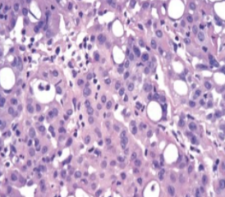
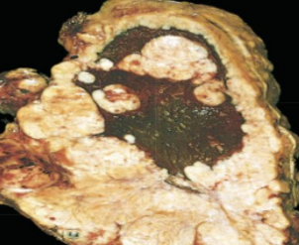
Mesothelioma
Definition:
Malignant tumor of mesothelial cells lining the pleura
Epidemiology:
Average age: 60 years.
Smoking is not related to mesothelioma.
Most patients (70%) have a history of exposure to asbestos.
Prognosis & Treatment:
Prognosis is poor: few patients survive longer than 18 months after diagnosis.
Highly malignant neoplasm.
Treatment is largely ineffective.
Findings:
3 main histological variants: epithelioid, spindle cell, biphasic.
Pleural mesotheliomas tend to spread locally (started as unilateral then spread to be bilateral) within the chest cavity, invading and compressing major structures.
Metastases can occur to the lung parenchyma and mediastinal lymph nodes, as well as to extrathoracic sites e.g. liver, bones, peritoneum etc.

Slide 25
Summery
The three major histologic subtypes are adenocarcinoma (most common), squamous cell carcinoma, and small cell carcinoma, each of which is clinically and genetically distinct.
Adenocarcinomas are the most common cancers overall and are especially common in women and in non-smokers.
Precursor lesions include atypical adenomatous hyperplasia and adenocarcinoma in situ for adenocarcinomas and squamous dysplasia for squamous cancer.
Tumors 3 cm or less in diameter characterized by pure growth along pre-existing structures without stromal invasion are called adenocarcinoma in situ.
SCLCs are best treated with chemotherapy, because almost all are metastatic at presentation. The other carcinomas may be curable by surgery if limited to the lung.
Targeted therapies, such as EGFR inhibitor therapy for adenocarcinomas with EGFR mutations, can be effective, an excellent example of personalized cancer therapy. Immunotherapies are under development and show promise.
Lung cancers commonly cause a variety of paraneoplastic syndromes.

Slide 26
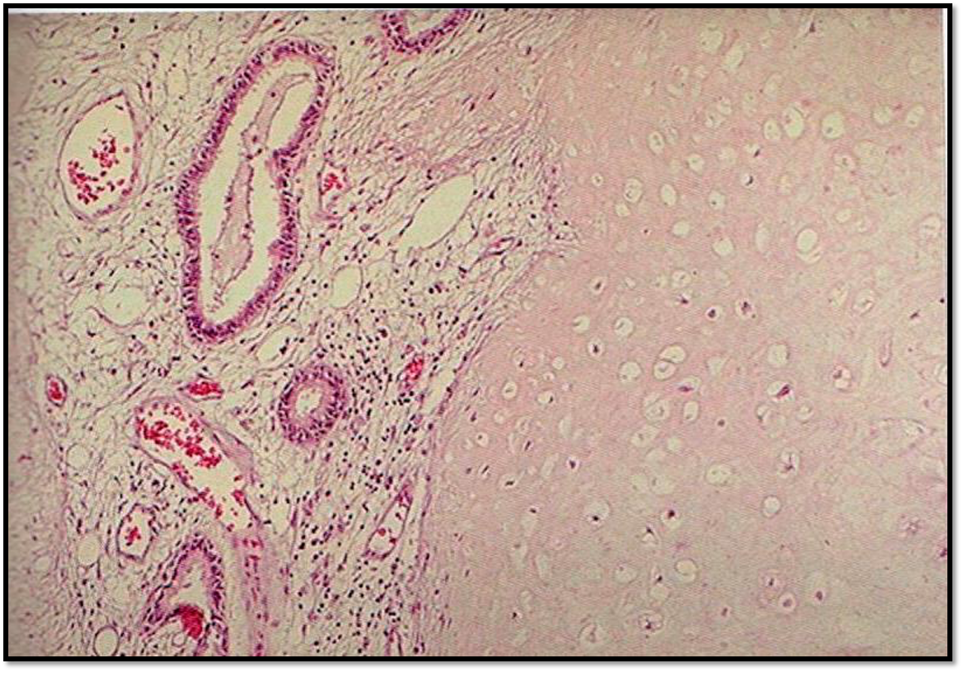
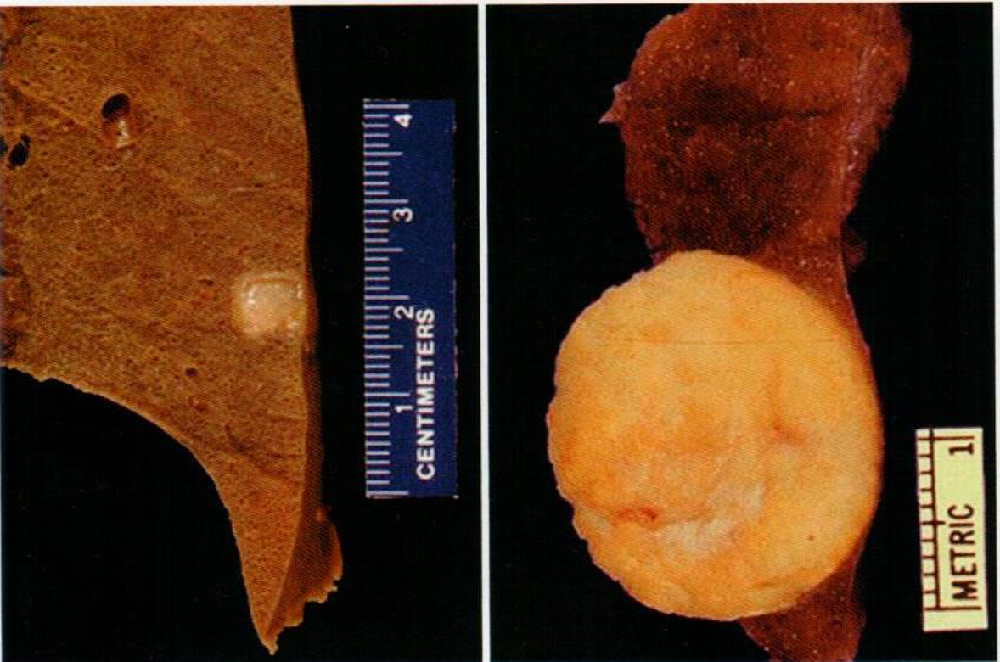
Dr. Al-Rikabi’s Notes
Lung Tumors
Malignant
Benign
Carcinoma: Malignant tumor of epithelial origin.
Benign tumor is rare in the lungs.
Sarcoma: malignant tumor of mesenchymal origin.
Hamartoma: abnormal mass of tissue consisting of various indigenous tissue. . نسيج سليم لكن في مكان خاطئ.
Malignant & metastatic tumors are more common in the lungs.
Metastatic tumors have multiple nodules.
Gross: well-circumscribed, rounded solid lesion (coin) with yellowish pale cut surface.
Primary tumor: the tumor which arise from the tissue itself.
Secondary (Metastatic) tumor: the tumor which metastate (transfer) from a tissue to another.
Histology: Cartilage, blood vessels, glands, inflammatory cells, mesenchymal tissue and fat.
Teratoma: Tumor (benign or malignant) which arises from 3 different germ cell layers.
Symptoms (General) | Unexplained weight loss. | Unexplained anemia. | Unexplained fatigue. | Unexplained fever (usually lymphoma).
Symptoms (Lung specific) | Unexplained cough. | Cyanosis (Could be due to Vena Cava syndrome). | Chest pain. | Hemoptysis. | Cachexia. Abnormal weight loss

Slide 27
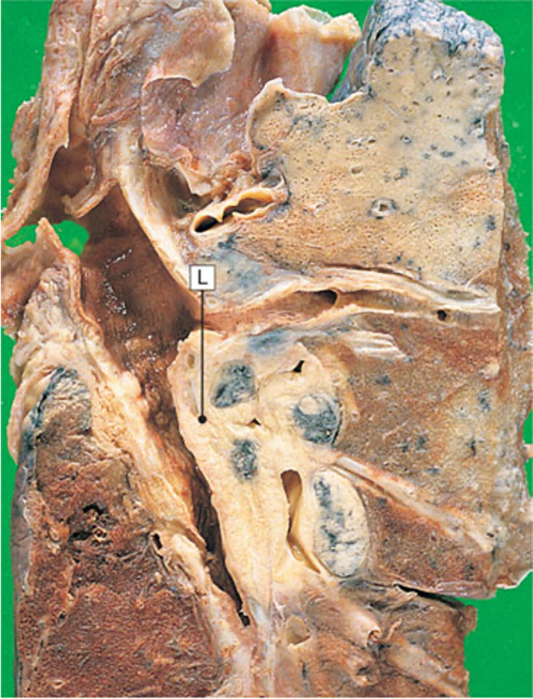
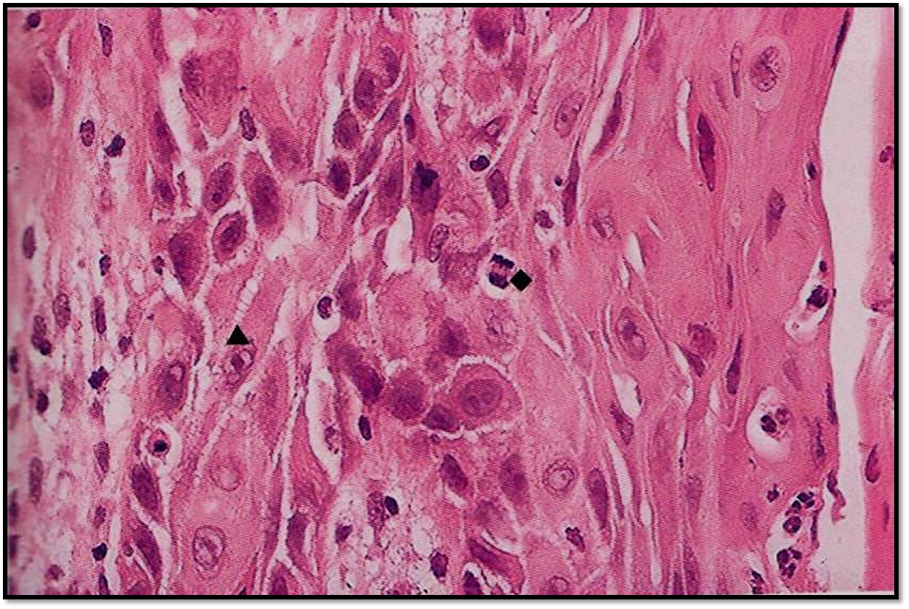
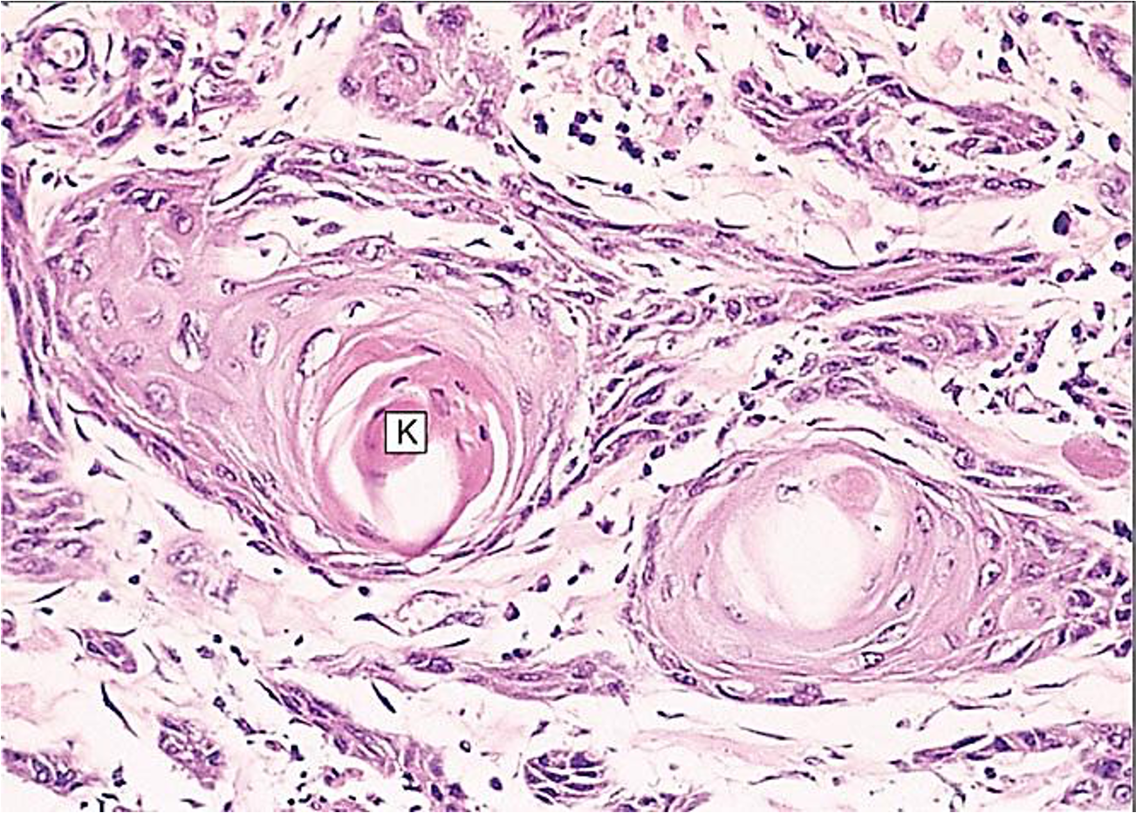
Dr. Al-Rikabi’s Notes
(Squamous cell carcinoma)
Presentation | It’s a non-small cell carcinoma. Centrally located. Present with hilar mass. Obstructive lesion of the bronchus leading to recurrent pneumonia. Could present with anthracotic lymph node due to excessive smoking and city residing. Can present with metastasis (Carcinoma—>Lymph node, Sarcoma—>Blood vessels) Clubbing (due to COPD in smoker).
Syndromes | Paraneoplastic syndromes: like Cachexia. Hypercalcemia (The tumor secretes proteins similar in structure and function to PTH). It is a different between SqCC & SCC.
Histologically | The tumor produces keratin to emulate the function of squamous cells. Different grades of differentiation.

Slide 28
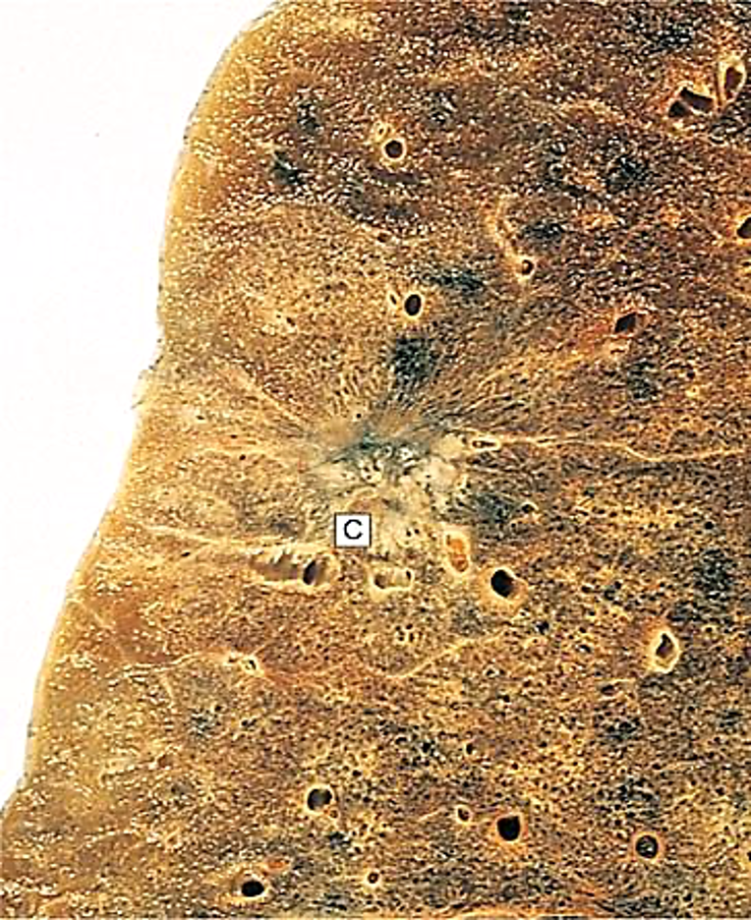
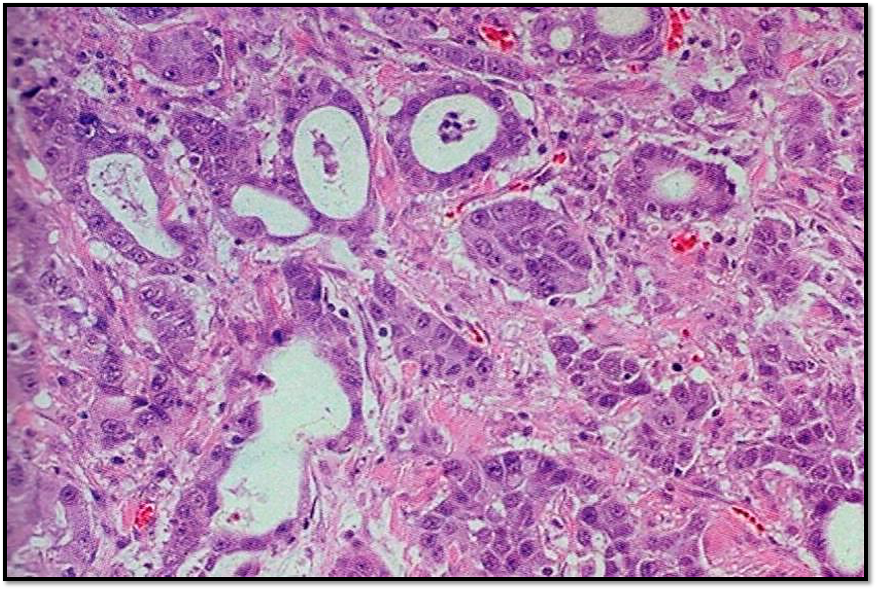
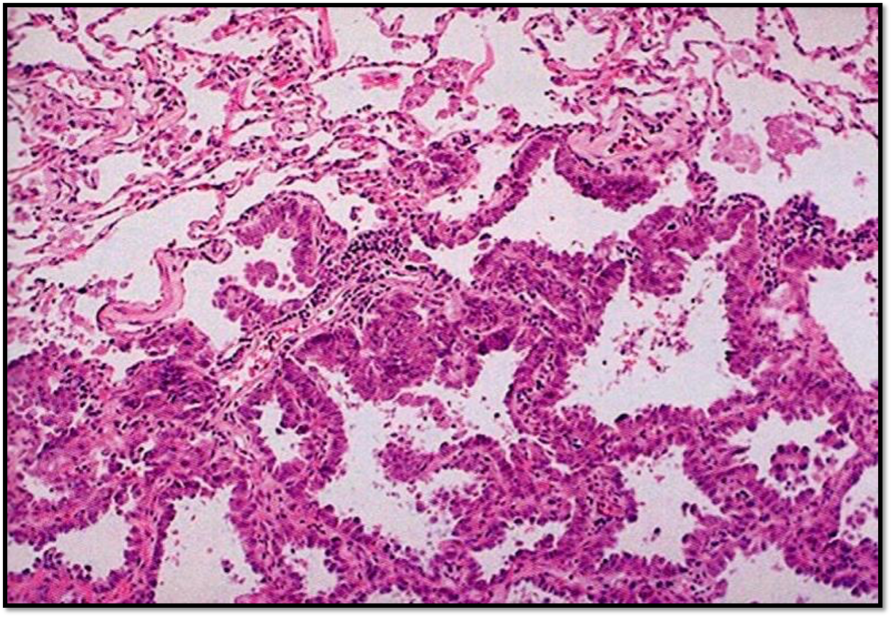
Dr. Al-Rikabi’s Notes
(Adenocarcinoma of the lung)
Present with peripheral mass related to a scar.
Unrelated to smokers, more common in women.
Aries from glands (Secretion of mucus).
Well differentiated tumors (Type I) secrete more mucus than poorly differentiated tumors (Type III).
Bronchioloalveolar carcinoma:
1- Now called Adenocarcinoma In-situ (Atypical malignant cells confined (stay) within basement membrane).
2- Atypical glandular cells line the alveoli (along the basement membrane)—>hyperplasia.
3- Severe dysplasia involving all epithelial layers without rupturing the membrane.
4- Called Frank carcinoma once it ruptures the basement membrane.
5- Lepidic pattern of growth. But once invasive (>3cm) it forms desmoplasia (fibrosis).
6- 25% of patients have a mutation in EGFR gene (Tyrosine kinase inhibitors used against it—targeted).
Others: anti-ALK , anti-CD20 (B cell marker—>rituximab).

Slide 29
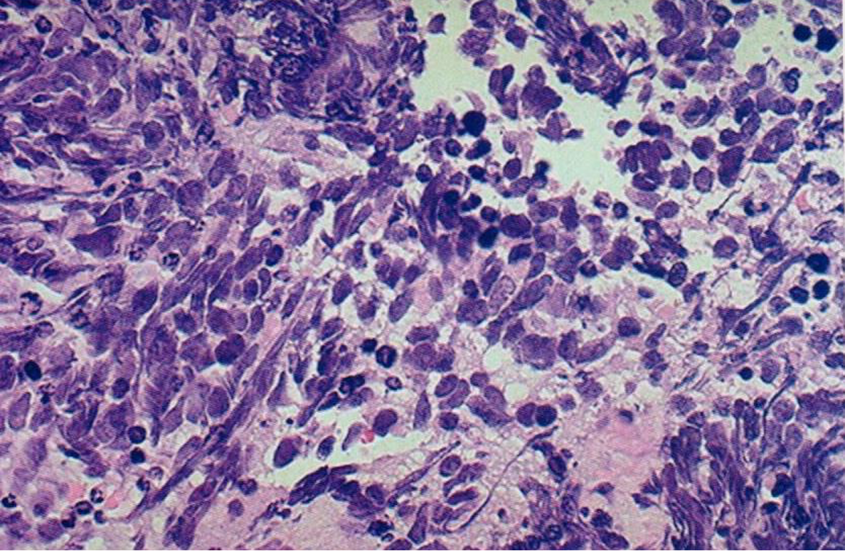
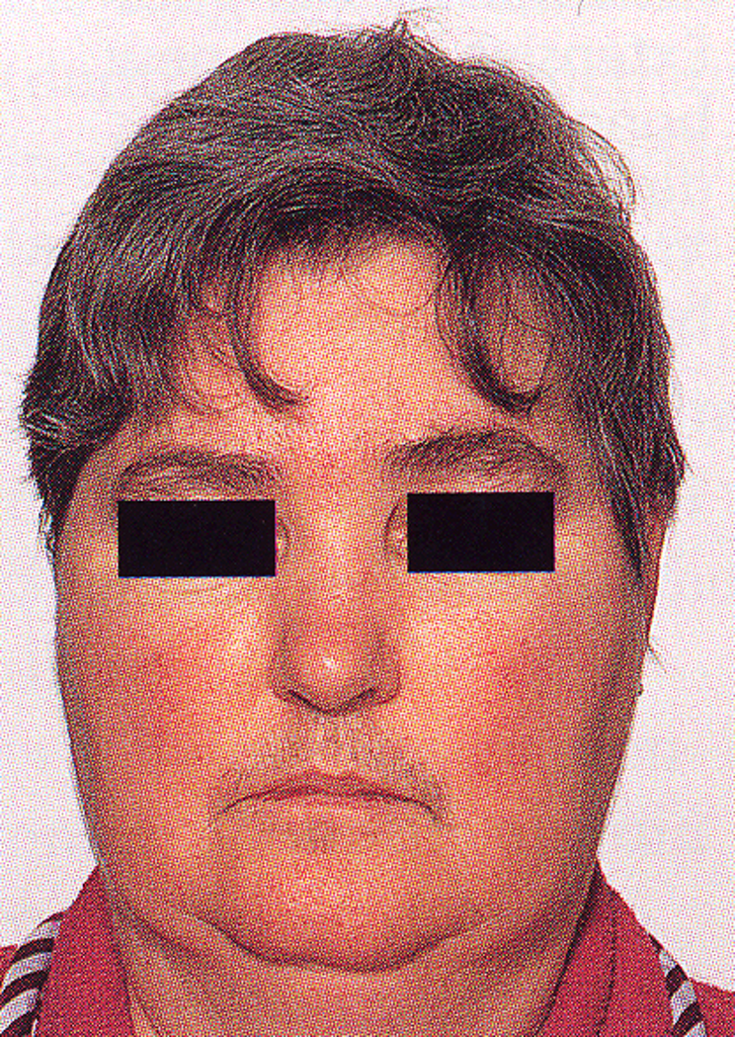
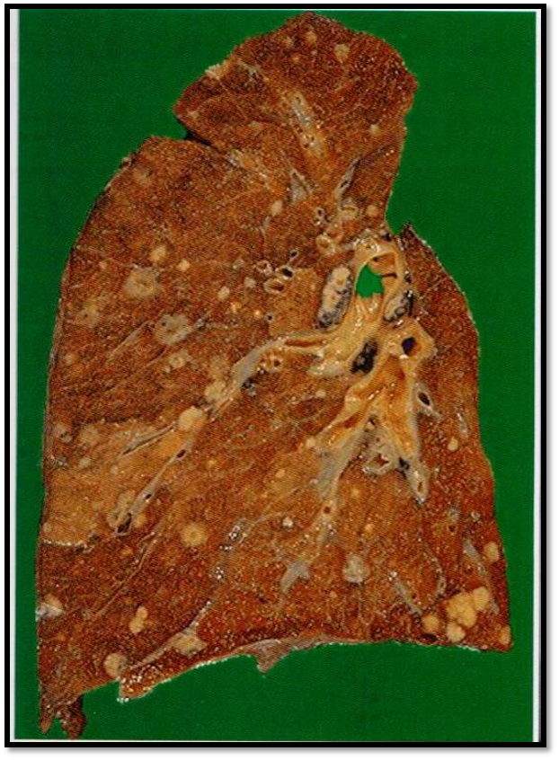
Dr. Al-Rikabi’s Notes
(Small cell (Oat cell) carcinoma)
Presentation | Poorly differentiated tumor, Arises from the neuroendocrine cells in the walls of bronchi. Inappropriate hormone secretions. (paraneoplastic syndrome secondary to ACTH secretion) ACTH: Adrenocorticotropic hormone (usually from the pituitary)—>stimulates adrenal cortex to release. Cortisone ADH: Anti-Diuretic hormone. The tumor secretes a protein similar to the structure of ACTH, does the same effect. It is more present in smokers. Not treated with surgery (already metastasized). Chemotherapy is used for treatment.
Syndromes | ADH secretions impair micturition and cause loss of electrolytes leading to hyponatremia. Moonface, Hirsutism & Obesity which are caused by cortisone released from the adrenal cortex.
Moon face syndrome
Metastases

Slide 30
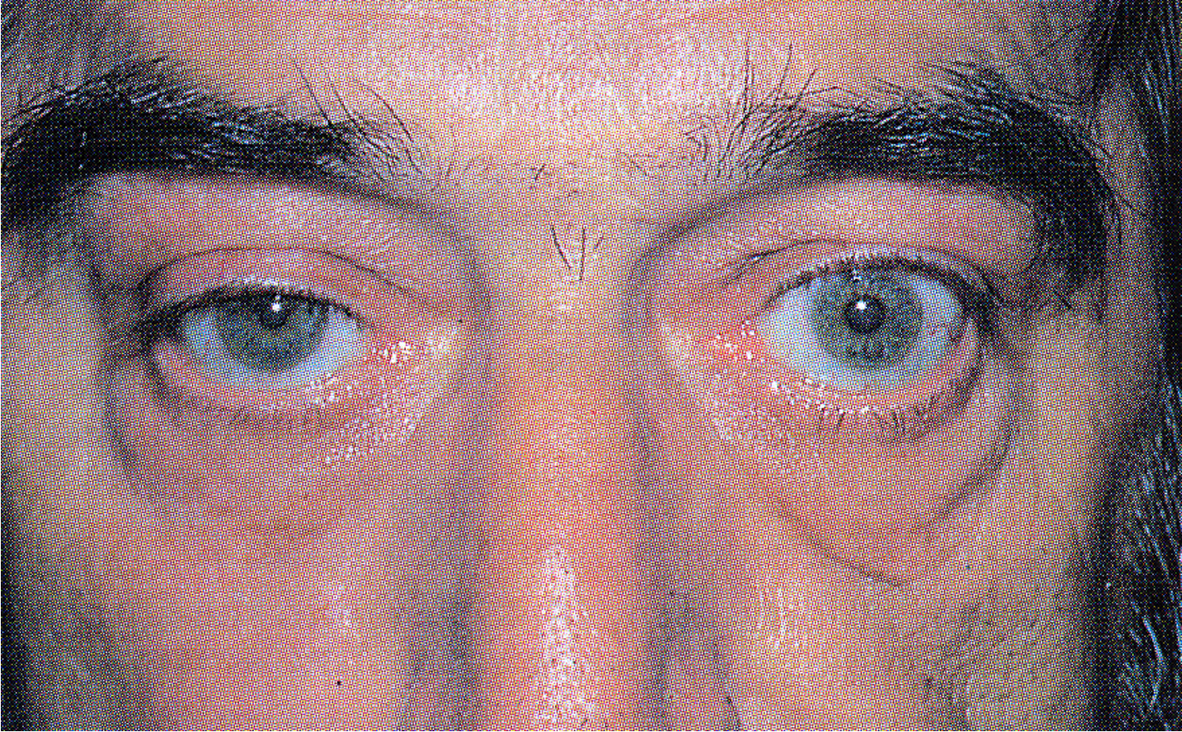
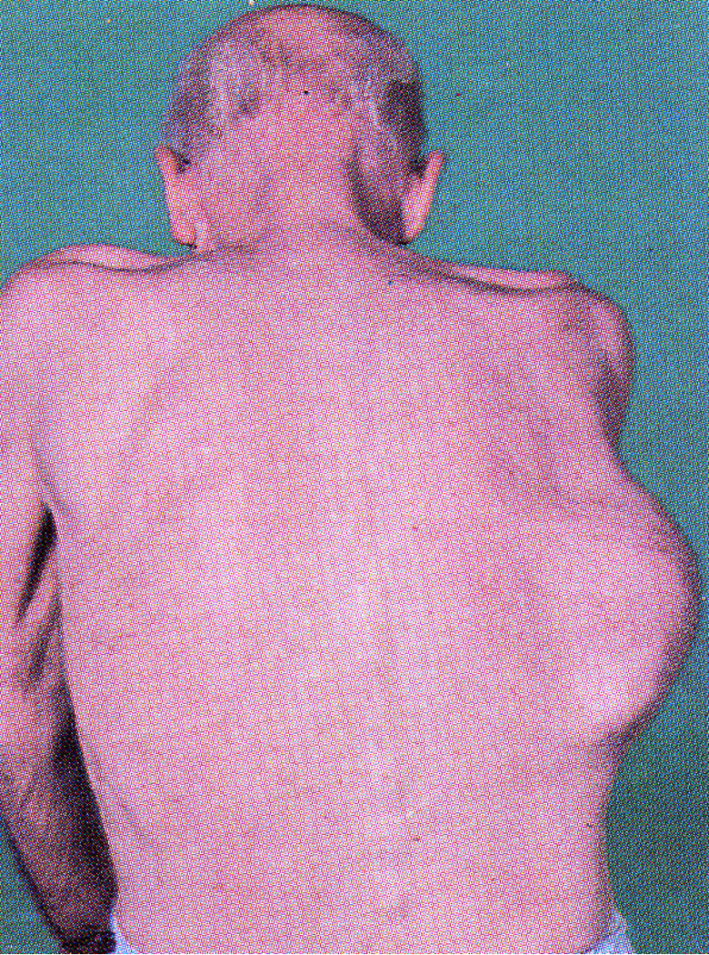
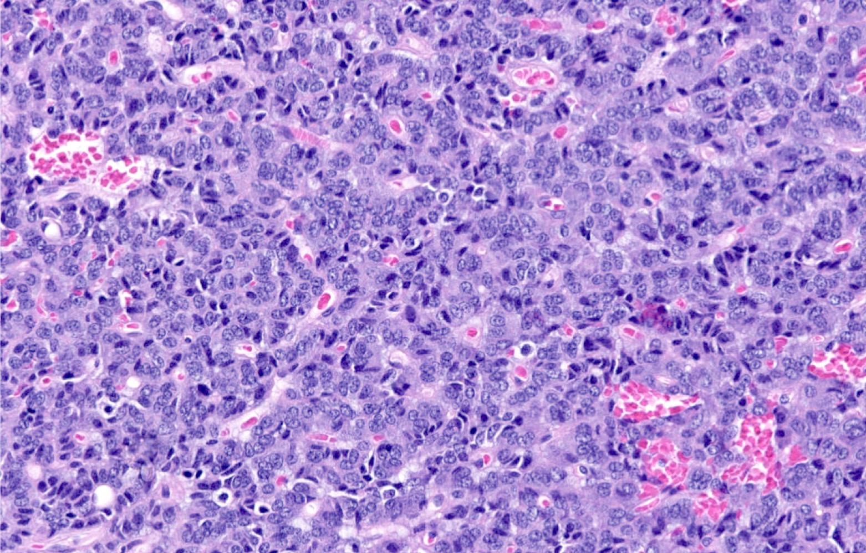
Dr. Al-Rikabi’s Notes
(Different lung tumors)
Pancoast tumor | Apical tumor (affect the upper lobe). Bronchogenic carcinoma (Could be ethear squamous or adeno). Present with Horner’s syndrome. (Ptosis, asymmetrical miosis with anhidrosis inability to sweat).
Mesothelioma | Affects the pleura and it is caused by Asbestos.
Carcinoid tumor | Very well differentiated neuroendocrine tumor. Localized tumor and can be excised (removed). Salt & Pepper microscooply appearance. Can lead to carcinoid syndrome (vasoactive amines—>palpitations, diarrhea, abdominal pain, heart changes)

Slide 31
Mcqs
1-D 2-A 3-C 4-A 5-D
1- Squamous dysplasia and carcinoma in situ can lead to ?
A.teratoma | B.Neuroendocrine tumors | C.Carcinoid tumors | D.Squamous cell carcinoma
2- Mesothelioma is caused by ?
A.Asbestos | B.Radiation | C.Scarring | D.Gender
3- A 60 year old man has a moon face and hypokalemia and obesity and signs of cushing’s syndrome. What is the diagnosis ?
A.Large cell carcinoma | B.Hamartoma | C.Small cell carcinoma | D.Squamous cell carcinoma
4- A 57 year old male has a peripherally located tumor the tumor is undifferentiated and there is no evidence of glandular or squamous differentiation , the cells have a large and prominent nucleoli and the patient is a chronic smoker after diagnosis the physician determined that the prognosis is poor. What is the most likely cause ?
A.Large cell carcinoma | B.Hamartoma | C.Small cell carcinoma | D.Squamous cell carcinoma
5- A 70 year old male who is a chronic smoker and previously diagnosed with metaplasia in lung tissue and after progression of the tumor it was found to be a central tumor ,the lumen of a major bronchus is blocked which lead to atelectasis and infection. What is the diagnosis ?
A.Large cell carcinoma | B.Hamartoma | C.Small cell carcinoma | D.Squamous cell carcinoma

Slide 32
Team leaders
Dema
Alkhattabi
Hassan Alabdullatif
Team members
Khalid alrasheed
Nawaf Alrefaei
Emad Almutairi
Othman Alabdullah
Mohamed ibn Saqyan
Ibrahim Alhezam
Talal alharbi
Saud Al Taleb
Ali Alzahrani
Omar Alkadhi
Shahed Albukhari
Walaa AlMutawa
Ajwan Aljohani

