Slide 1
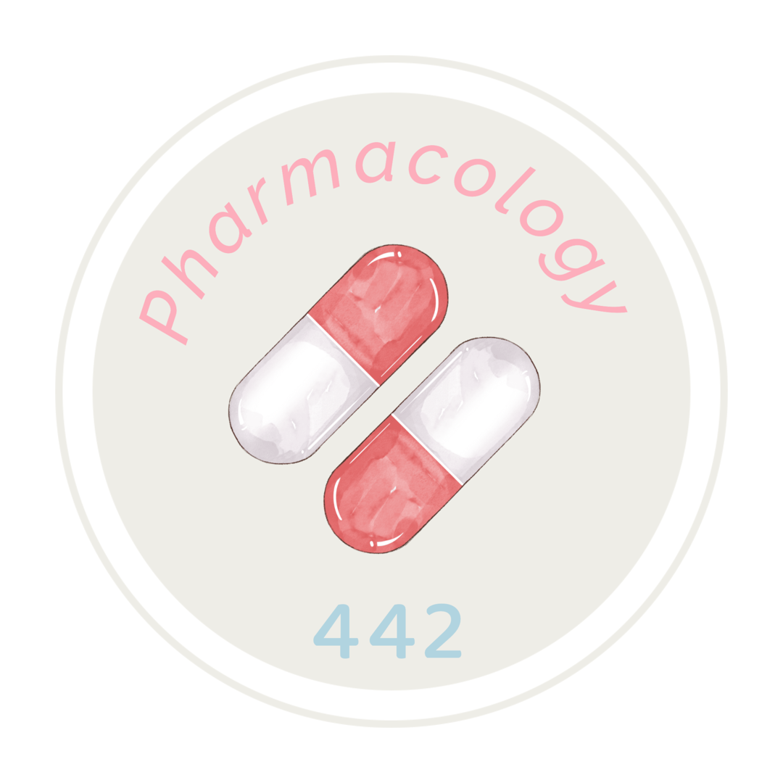
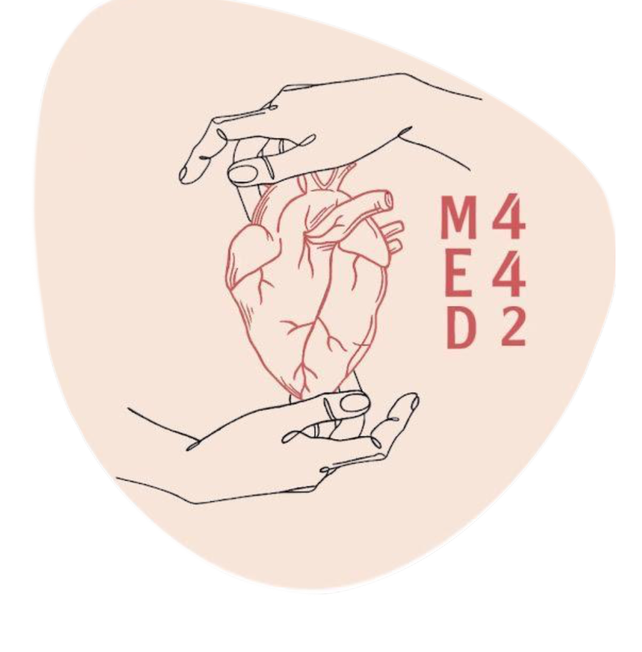
Anticholinergic Drugs
Helpful Video
Click here for video timestamps
Important
Main text
Male slide
Female slide
Extra info
Doctor notes
Editing file

Slide 2
Objectives:
Identify the classification of anticholinergic drugs
Describe pharmacokinetics and dynamics of muscarinic antagonists
Identify the effects of atropine on the major organ systems
list the clinical uses of muscarinic antagonists
know adverse effects & contraindications of anticholinergic drugs
Identify at least one antimuscarinic agent for each of the following special uses: mydriasis, cyclopedia, peptic ulcer & parkinsonism

Slide 3
Anticholinergic Drugs
Anti Parasympathetic drugs
Classifications
Antimuscarinics
Peripheral receptors
Antinicotinic
Central
According to Source
According to selectivity
Ganglion Blockers
Neuro-muscular Blockers
According to structure
(used to treat hypertension,but not anymore)
e.g muscle relaxants
Antimuscarinics
According to source | Natural Alkaloids (Plant derived) non-selective, block all the muscarinic receptors (M1,M2,M3,M4 and M5) | Atropine (Hyoscyamine) Extracted from a plant called Atropa belladona Hyoscine (Scopolamine) from a plant called Hyoscyamus nigra | Pharmacokinetics of Atropine and Hyoscine: Lipid Soluble Good Oral Absorption Good distribution Can cross BBB (cause CNS effect) Hyoscine has better BBB penetration
 | Synthetic/Semi-synthetic atropine substitutes Very Selective to muscarinic receptors | Homatropine (Semisynthetic) Tropicamaide Ipratropium Pirenzepine Benztropine Oxybutynin Darifenacin Glycopyrrolate
According to Structure | Tertiary | Atropine (Hyoscyamine) Hyoscine (Scopolamine) | (can cross BBB, Lipid soluble)
 | Quaternary | Glycopyrrolate Ipratropium | (can’t cross BBB, Water soluble)
According to Selectivity | Non-selective | Atropine (Hyoscyamine) Hyoscine (Scopolamine) Ipratropium | --
 | Selective | Pirenzepine (M1) Darifenacin (M3) | --
صنعوا للاتروبين مشتقات لان فيه سلبيتين
1- it is tertiary amine so it can cross BBB, had CNS actions
2- non-selective, block M1,M2,M3,M4,M5
So these drugs do not have CNS actions and are selective

Slide 4
Mechanism of Action
Must to know each drug selective to which
organ/disease
Reversible competitive blockade of muscarinic receptors, some like atropine block nicotinic receptors in toxic doses (reverses muscarinic effects of cholinergic drugs).
Salivary, bronchial, and sweat glands are most sensitive.
Gastric glands and gastric smooth muscles are the least sensitive.
Smooth muscle and heart are intermediate.
Atropine & hyoscine can block all muscarinic receptors (M1,M2,M3,M4,M5) because they are (not selective).
System or Organ | Cholinergic Action (Parasympathetic) | Anticholinergic Action (Sympathetic)
Eye | Circular muscle of iris Contraction (miosis). Ciliary muscle Contraction. Result in: 1/ Accommodation for near vision 2/ ↓ Intraocular pressure | Circular muscle of iris Relaxation (mydriasis). “Dilatation of eye pupil” Ciliary muscles Relaxation (cycloplegia). Result in: 1/ Loss of accommodation for near vision. 2/ Loss of light reflex. 3/ ↑ Intraocular pressure(I.O.P), thus contraindicated in glaucoma
CVS | Bradycardia (↓H.R.) | 1/ Tachycardia (↑H.R.) Blocks M2 2/↑Conduction speed in AV node of the heart
Urinary Bladder | Contraction of smooth muscles, Relaxation of sphincter (Urination). | Relaxation of smooth muscle, Contraction of sphincter (Urinary retention)
Exocrine Glands | Increase of: sweat, saliva, lacrimal, bronchial and intestinal secretions. | ↓ all secretions.
GIT | ↑ peristalsis, ↑ secretion, Relaxation of sphincter (Diarrhea) | ↓ peristalsis (muscle contractions in the digestive tract), ↓ secretion, Contraction of sphincter (constipation) إمساك
Respiratory System | 1/ Bronchoconstriction 2/ ↑ bronchial secretion | 1/ Bronchodilatation 2/ ↓ bronchial secretion

Slide 5
System | Drugs | Clinical Uses | Pharmacodynamic Actions
CNS | Benztropine | Parkinsonism *Mnemonic: To park your car you’ll need Benzene to move it (Team 439) | -Antiparkinsonian effect (block basal ganglia)
 | Hyoscine (preventative, taken before symptoms) | Motion sickness (vomiting) “antiemetic Effect” Pre-anesthetic + an Amnesia effect ( شعور الفقدان بالذاكرة عشان المریض ما یتذكر شيء من العملیة) Antispasmodic *Mnemonic: people feel motion sickness as the plane goes Higher (Hyoscine) | -Hyoscine → (sedative effect) -Antiemetic effect (block vomiting center)
 | Atropine (I.V / I.M) | Pre-anesthetic, Antispasmodic | -Atropine at clinical doses, initial stimulation followed by depression (sedative effect) High doses of atropine cause cortical excitation, restlessness, disorientation, Hallucination and delirium(confusion) followed by respiratory depression and coma.
CVS |  | Sinus Bradycardia. Used to increase heart rate through vagolytic effects (inhibits action of Vagus nerve to the heart), causing increase in cardiac output. | Atropine cause initial bradycardia followed by tachycardia due to blockade of M2-receptors on SA node. ↑ AV conduction (+ ve dromotropic effect). ↓ vasodilation induced by cholinergic agonists. Toxic dose: Cutaneous vasodilation will cause → (atropine flush). Atropine does not influence Blood pressure.
Eye | Tropicamide, Homatropine | Ophthalmic Disorders: Ophthalmic examination of Retina (fundus examination) نحتاج البؤبؤ یتوسع عشان نقدر نشوف قاع العین (الشبكیة) بالفحص mydriasis فلازم یصیر *Mnemonic: - We have an ophthalmologist in our home - You should visit the ophthalmologist after returning from a tropical country | Passive mydriasis due to paralysis of circular muscle. Cycloplegia (loss of near accommodation) due to paralysis of ciliary muscle Loss of light reflex. ↑Intraocular pressure (I.O.P) contraindicated to Glaucoma. ↓ in lacrimal secretion it will cause Dry and sandy eye
Respiratory System | Ipratropium (inhalation) | Bronchial asthma & chronic obstructive pulmonary disease (COPD) -Pre-operative medication when | Relaxation of bronchial muscles (Bronchodilators) - Can not cross BBB - No systemic side effects. - nonselective muscarinic Antagonist ↓Bronchial secretion →↑ Viscosity
Important slide

Slide 6
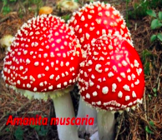
Cholinergic Poisoning
System | Drugs | Clinical Uses | Pharmacodynamic Actions
GIT | Glycopyrrolate, Hyoscine butyl bromide | - Intestinal Spasm (antispasmolytic) - Biliary and renal colics (مغص) - Irritable bowel syndrome (IBS) Irritable bowel syndrome (IBS) is a common condition that affects the digestive system. It causes symptoms like stomach cramps, bloating, diarrhoea and constipation - Antispasmodics in Hypermotility | Dryness of mouth (xerostomia) (Because atropine blocks M3 which is responsible for the secretion) ↓ Gastric acid secretion (atropine blocks M1 which is responsible for the secretion of HCL) Relaxation of smooth muscles ↓ GIT Motility → Antispasmolytic effect ↑ Sphincter contraction Constipation Because there is M3 and if it works: 1- construction of the smooth muscles 2- relaxation of sphincter So if the patient takes atropine M3 will be blocked and this leads to: 1- relaxation of the smooth muscles 2- contraction of the sphincter وبالتالي سبب امساك
 | Pirenzepine | Peptic Ulcer
 | Atropine + Diphenoxylate 439: (Not Important) د.حنان حذفته | Used for treatment of Traveler’s diarrhea with opioid 439: (Not important) Traveler's diarrhea is a digestive tract disorder that commonly causes loose stools and abdominal cramps. It's caused by drinking water or eating foods that have bacteria and viruses.
Genitourinary tract (GUT) | Oxybutynin, Darifenacin | Urinary incontinence & Urinary urgency caused by minor inflammatory bladder disorders | - Relaxation of smooth muscles of urinary bladder - Sphincter contraction - Urinary Retention - Contraindicated in old men (+60 y.o) with prostatic hyperplasia
Secretions | - | hyperhidrosis | - ↓ Salivary Secretion → Dry mouth - ↓ Sweating (M3 blockage) → dry skin - Contraindicated In Children: modest dose → “Atropine Fever” (Bizarre effect) - ↓ Bronchial secretion → ↑ Viscosity - ↓ Lacrimal secretion → sandy eye
• Cholinesterase inhibitors “insecticides”. Mushroom poisoning. It causes hyperhidrosis (excessive sweating)
• Treatment: Atropine reverses muscarinic effects of cholinergic poisoning.
Cholinesterase inhibitors will increase Ach in the brain and Ach will work on all Muscarinic Receptors (M1,M2,M3,M4,M5) and this will lead to death so atropine will block Muscarinic receptors

Slide 7
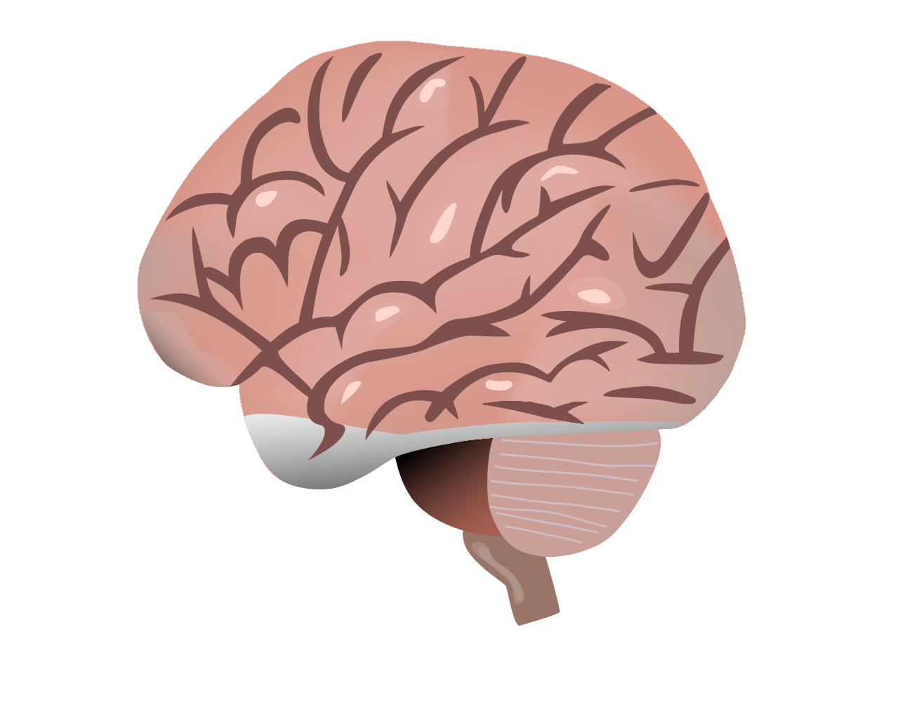
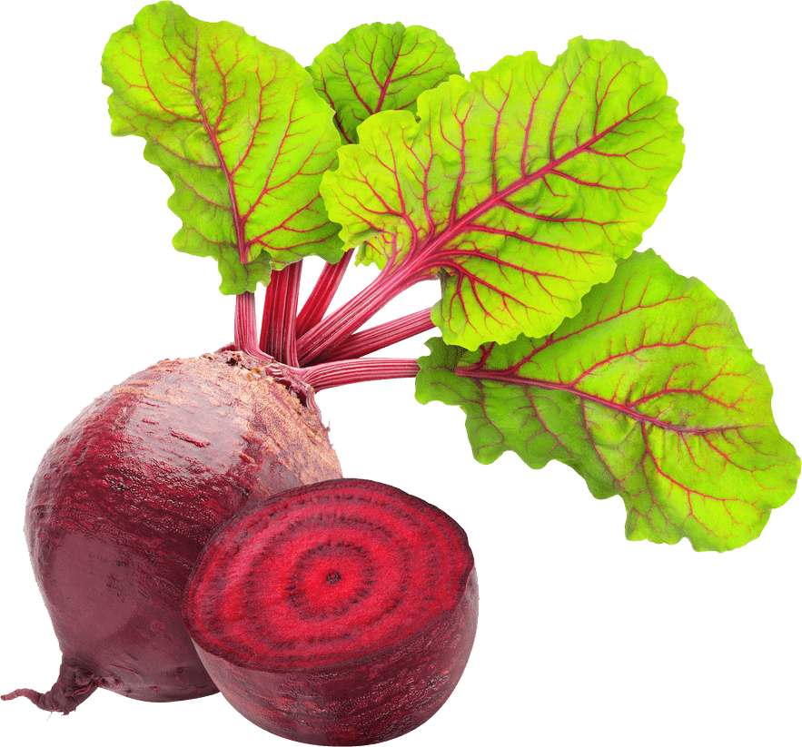
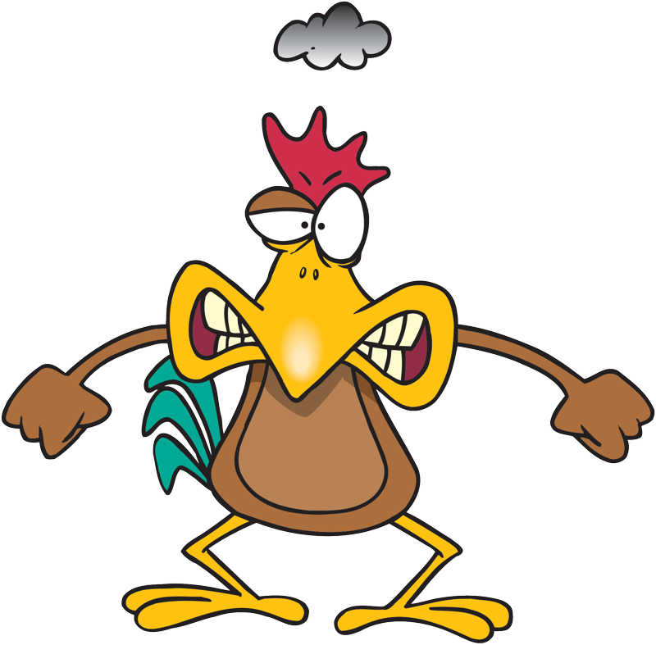
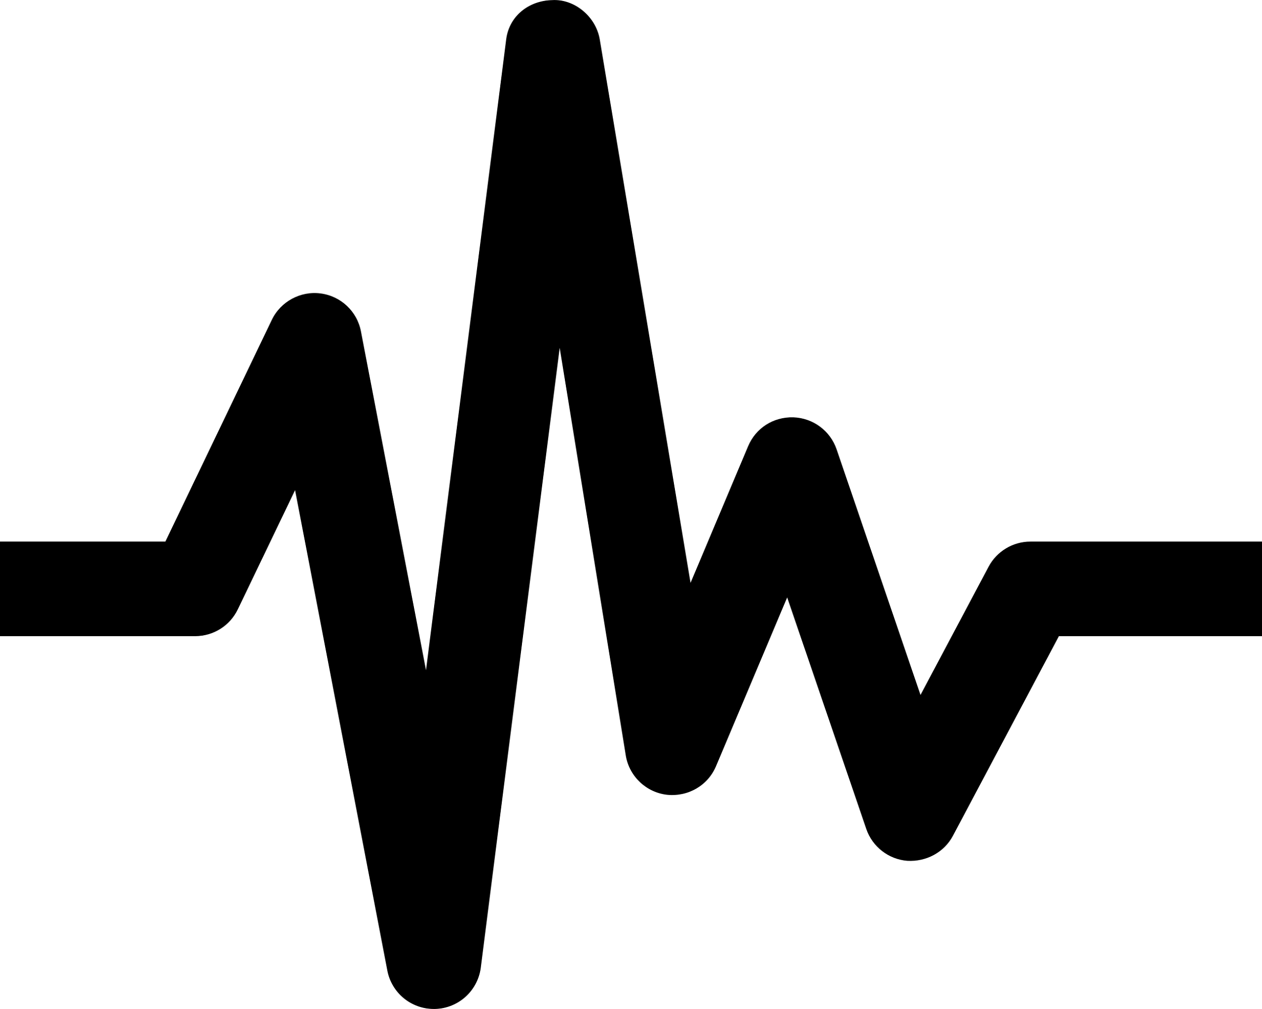
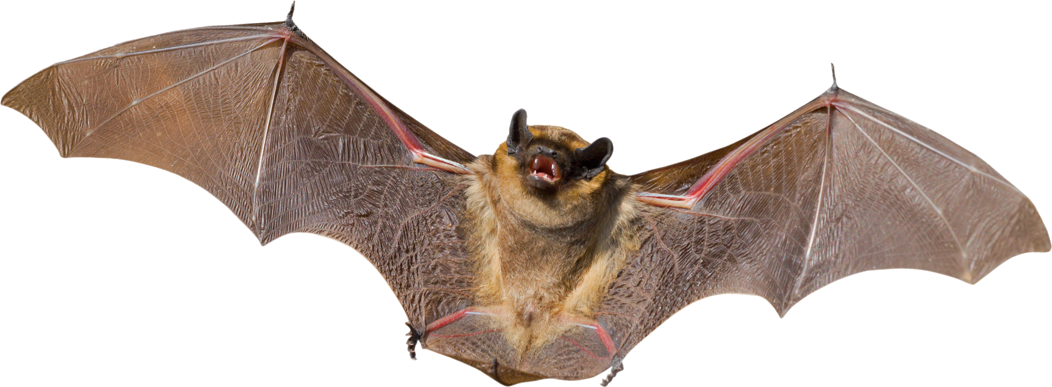
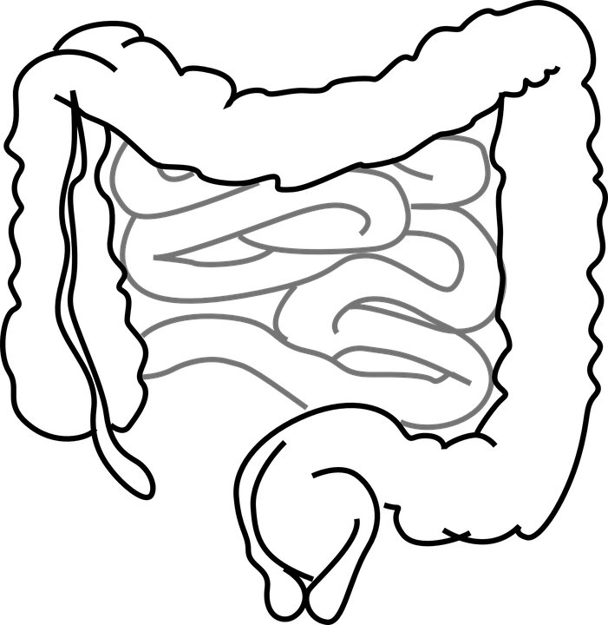
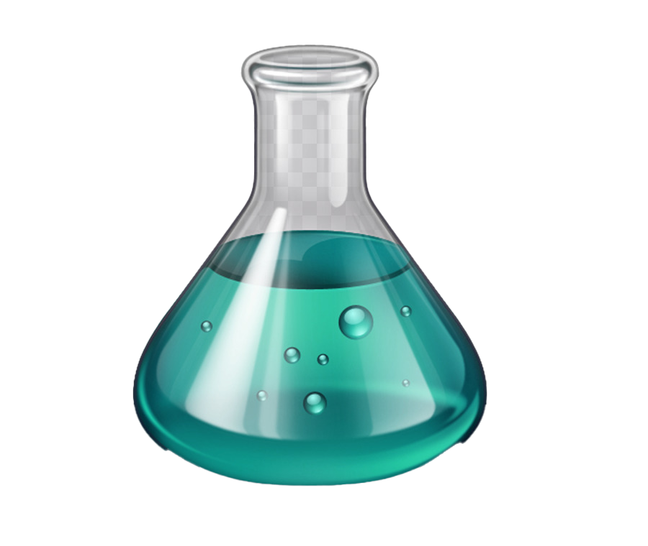
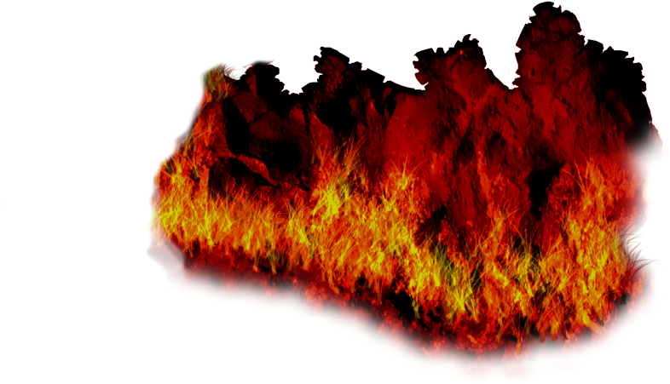
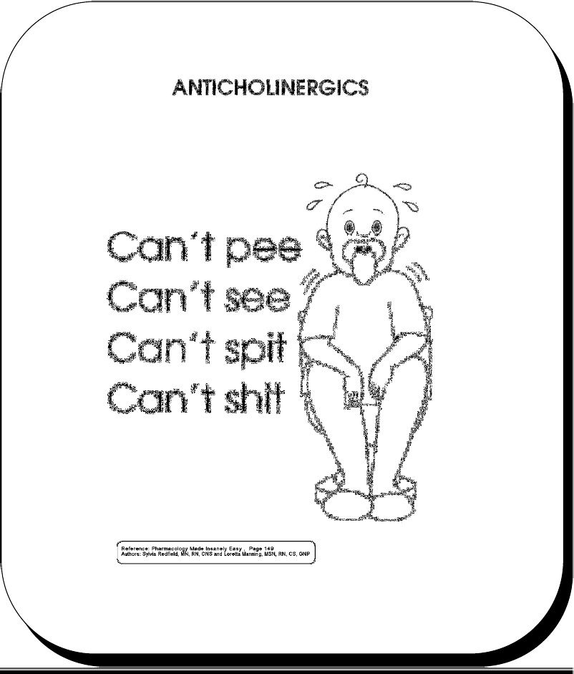
Adverse Effects
Mnemonics
Contraindications
Confusion, agitation (Anxiety), delirium (هذيان)
Mydriasis,blurred vision (cycloplegia)
Dry mouth, hot flushed skin
Dry as Bone
Red as Beet
Tachycardia
Constipation, urinary retention
Mad as hen
Blind as Bat
Increased Body temperature (hyperthermia)
Full as Flask
Hot as Hell fire
Atropine like action
د. فودة: زغلولة الناشفة حبست زوجها ابو سريع
blurred vision
Dry mouth
Constipation, urinary retention
Glaucoma
Tachycardia
Children in case of atropine
Constipation - Paralytic ileus
Old patients with prostate hypertrophy
Tachycardia secondary to thyrotoxicosis (excess circulating thyroid) or cardiac insufficiency.
Glaucoma (angle-closure glaucoma).

Slide 8
Summary
Uses of antimuscarinic drugs
Antimuscarinics reverse action of cholinomimetics on muscarinic receptors.
Are useful in many applications including intestinal spasm, urinary urgency, vomiting, parkinsonism, asthma and peptic ulcer.
Are contraindicated in constipation, prostate hypertrophy, tachycardia and glaucoma.
Drug | Organ | Uses
Atropine (Hyoscyamine) | CNS | Pre-anesthetic medication Antispasmodic
Hyoscine (Scopolamine) | CNS | Pre-anesthetic medication, Vomiting (Motion sickness), antispasmodic
Benztropine (very high lipid solubility) | CNS | Parkinson's disease (dopamine is low, Ach is high) M1 in the basal ganglia يقفل الدواء وبتحكم في الاسيتايل كولين فيساعد في علاج المرض
Tropicamide & Homatropine | Eye | Fundus examination فحص قاع العين
Ipratropium | Respiratory | Asthma, COPD, inhalation
Pirenzepine Selective - blocks M1 only so reduces HCL | Stomach | Peptic ulcer
Glycopyyrolate | GIT | Antispasmodics in hypermotility
Oxybutynin Darifenacin Block M3 | UT | Urinary urgency, Urinary incontinence

Slide 9
Quizzes from Dr’s Slides
1- A patient is brought into the emergency room. Upon examination you find the following: a high fever, rapid pulse, no bowel sounds and dilated pupils that do not respond to light. His lungs are clear. His face is flushed and his skin is dry. He is confused, disorientated and reports 'seeing monsters'. Based on these symptoms, you suspect he has been 'poisoned'. Which of the following, is the MOST obvious cause of poisoning?
A. Neostigmine | B. Physostigmine | C. Atropine sulfate | D. Acetylcholine
2- You are working in the post anesthesia care unit of a hospital. You have just received a patient back from surgery and you are monitoring his status. Knowing that the patient has received atropine, which of the following statements/observations is UNEXPECTED?
A. The patient is complaining of extreme thirst. | B. The patient complains that he is unable to clearly see the clock located just across from him. | C. The patient's heart rate is elevated. | D. The patient reports he has cramping and diarrhea.
1- C 2-D
1- Can antimuscarinic drugs reverse the action of neostigmine on skeletal muscles?
2- What is the antidote that can be used in atropine toxicity?
1- antimuscarinic drugs have no actions on the skeletal muscles because skeletal muscles do not contain muscarinic receptors, only nicotinic.
2-Physostigmine

Slide 10
Click here for Summary
441
439
MCQs
Click here
Atropine In a Toxic dose can Cause what on CVS?
A)Cutaneous vasodilatation | B)atropine flush | C)viscosity | D)A&B
atropine fever Is Pharmacodynamic action on what?
A)CNS | B)Secretions | C)GIT | D)Urinary Tract
With Ophthalmic disorders what is the best to use?
A)Tropicamide | B)Ipratropium | C)atropine | D)duaa
In case of Parkinsonism which drug to use?
A)Hyoscine | B)homatropine | C)Benztropine | D)A&C
Which drug is Selective?
A)Atropine | B)Darifenacin | C)Pirenzepine | D)B&C
SAQs
1-D 2-B 3-A 4-C 5-D
1-What is the reason of both Passive mydriasis and Cycloplegia in the eye?
2-if a patient had hyperhidrosis which is a sign of cholinergic poisoning
How would you treat him and what is the mechanism of the treatment ?
3-What are the 3 uses of Atropine and Hyoscine? from the DR
4-who is the the master of pharma?
1-due to paralysis of circular muscle
2-Atropine by reverses muscarinic effects of cholinergic poisoning.
3-Sedative effect-Antiemetic effect-Antiparkinsonian effect
4-of course you!!
Click here

Slide 11
THE LEADERS OF PHARMACOLOGY AND MEMBERS
Mayssam Aljaloud
Shatha Alshabani
Noura bin hammad
Jana Alhazmi
Alanoud Almarzuqi
Shahad Aljeri
Fatima Halawi
Lina alyahya
Norah Alrashoud
Fay aldossari
Reema Alhussein
Reema alquraini
Saif Alotaibi
Mohammad Alrashed
Rakan Alromayan
Abdulaziz Al Shalhoub
Yazeed Alshehry
Abdullah Alsubaie
Azzam Alotaibi
Faisal Alomar
Hasan Alabdullatif
Sub leader:
Rahaf Almotairi
Contact us: pharmacology442@gmail.com

