Slide 1
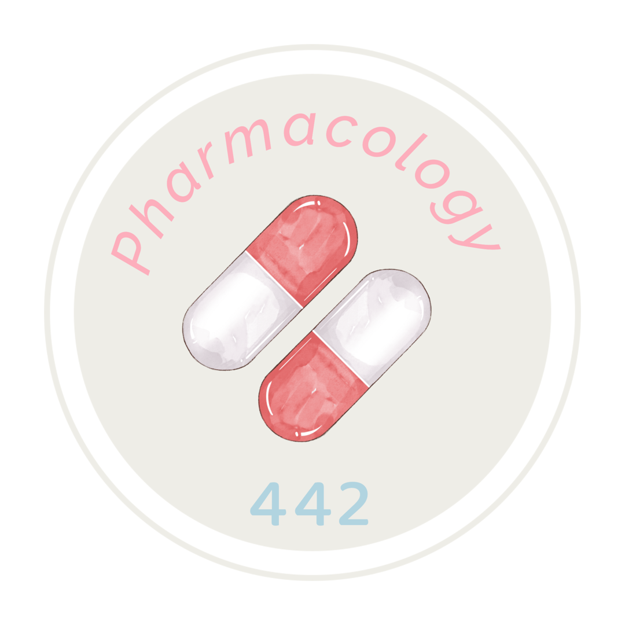
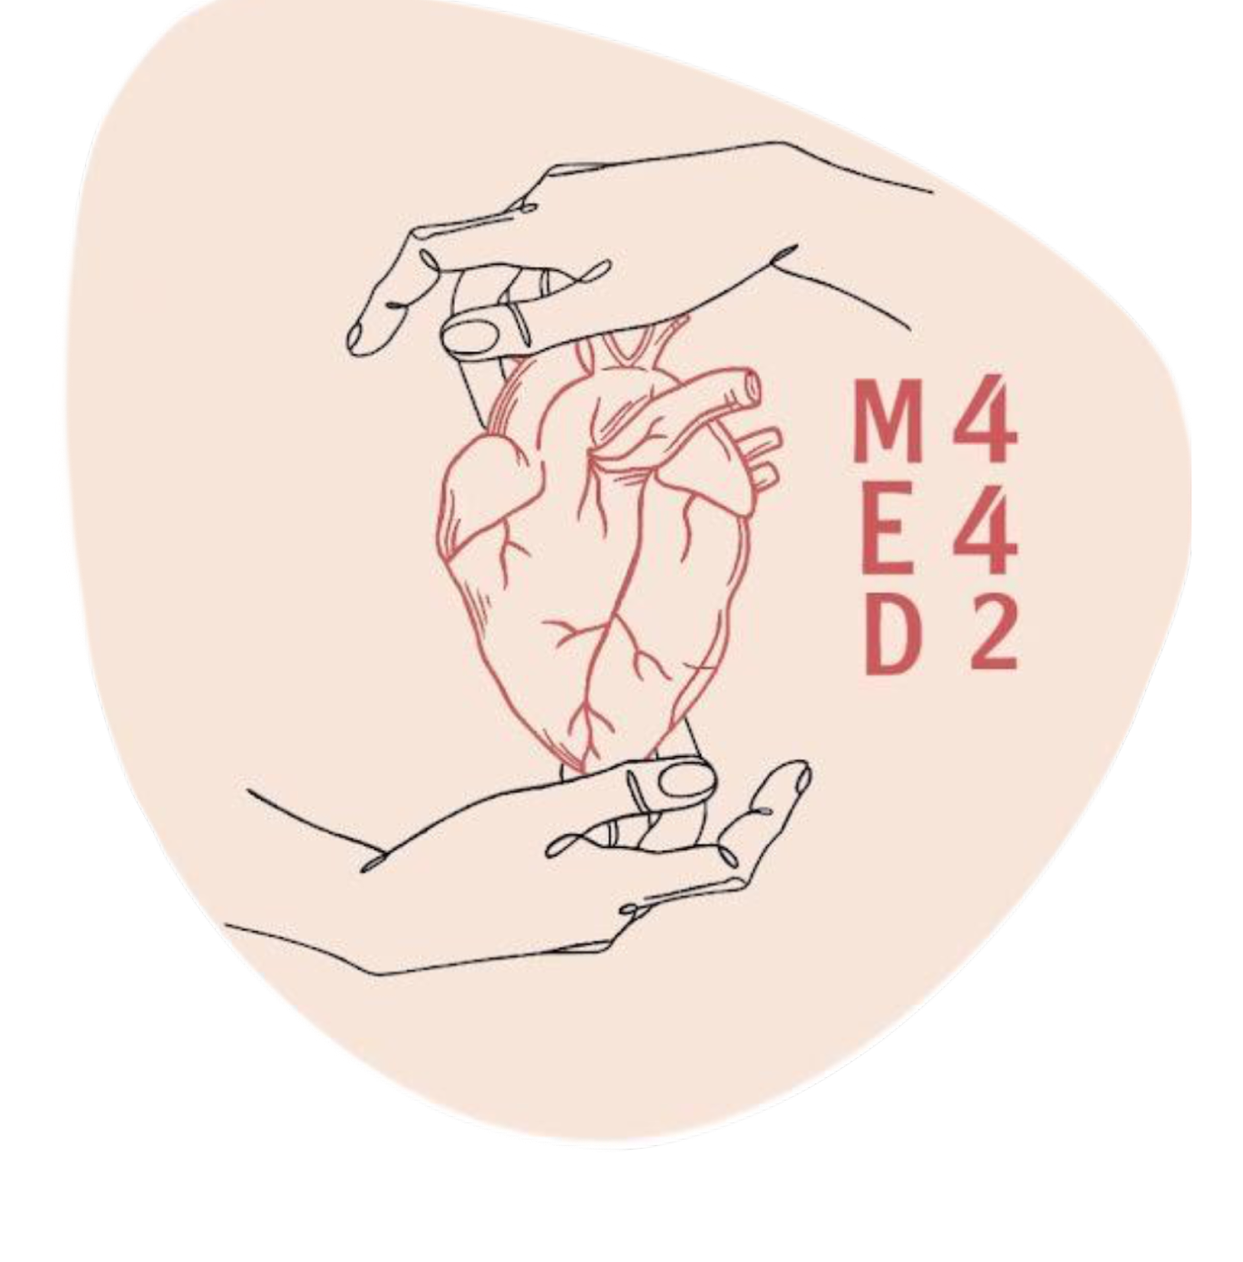
Adrenergic agonists
Important
Main text
Male slide
Female slide
Extra info
Doctor notes
Editing file

Slide 2
Objective
Classify adrenergic agonists according to chemical structure, receptor selectivity and mode of action
Discuss pharmacodynamic actions, ADRs, indications and
contraindications of adrenergic agonists
From team 441

Slide 3
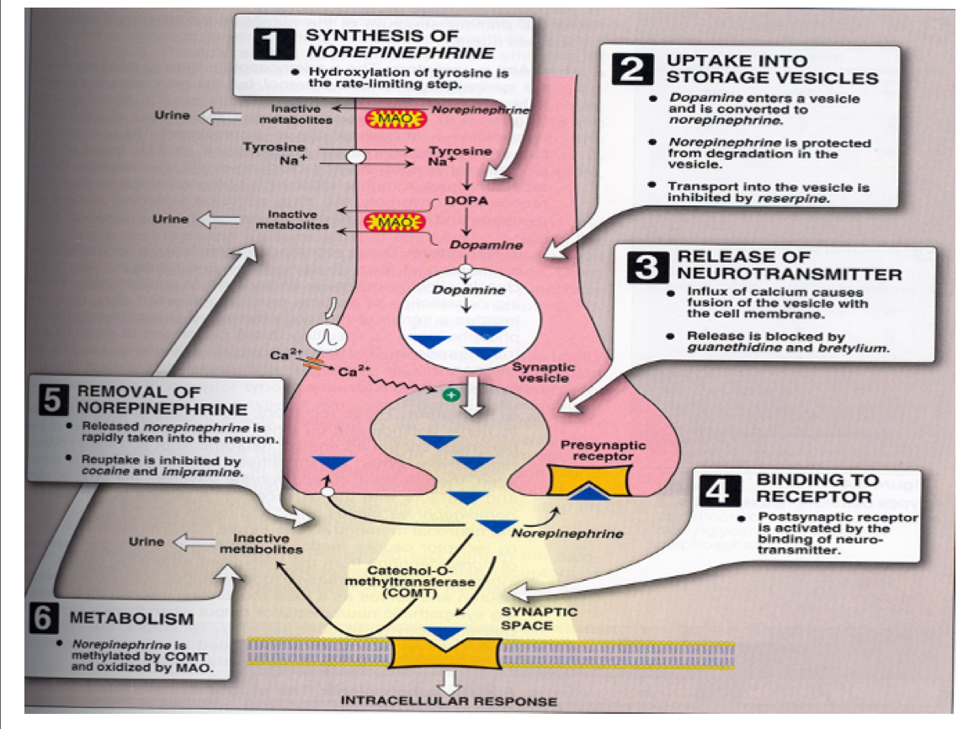
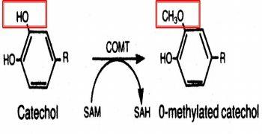
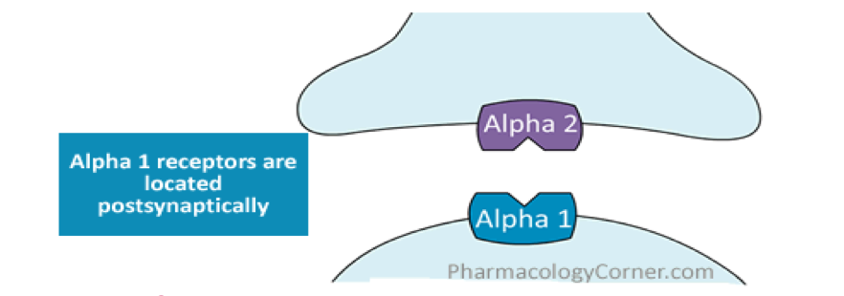
Neurotransmission at Adrenergic Neurons
In this lecture you must know each drug
1-selectivity
2-Actions
3-Receptor
The next 3 slides are important for understanding the lecture.
Adrenergic drugs work on the sympathetic nervous system, they’re also called sympathomimetics.
Adrenergic Transmission:
Synthesis of norepinephrine
Storage of norepinephrine
Storage in vesicles
Release of norepinephrine
Release by Calcium-dependent
exocytosis
Binding to postsynaptic receptors
Which can be one of these
receptors: α1, β1, β2 and β3
Ending of action by:
Neuronal reuptake into
neuron
Monoamine oxidase (MAO) in
neuronal mitochondria*
Catechol-O-methyltransferase (COMT) in synaptic space**
Thanks team437
*Mono-amine oxidase (MAO):
It’s enzyme responsible for the metabolism of catecholamines as adrenaline and serotonin by using the Oxygen to remove an amine
group (plus the adjacent hydrogen atom) from a molecule.
**Catechol -O-methyl transferase (COMT):
Enzymes that degrade catecholamines (such as epinephrine, and norepinephrine), catecholestrogens, and various drugs and substances having a catechol structure.
CH3 وظيفته انه ينقل للأكسجين مجموعة ميثايل
Epinephrine = adrenaline
Norepinephrine = noradrenaline
Adrenergic Receptor
α adrenoreceptors
β adrenoreceptors
Dopaminergic Receptors
α1
α2
β1
β2
β3
e.g.D1

Slide 4
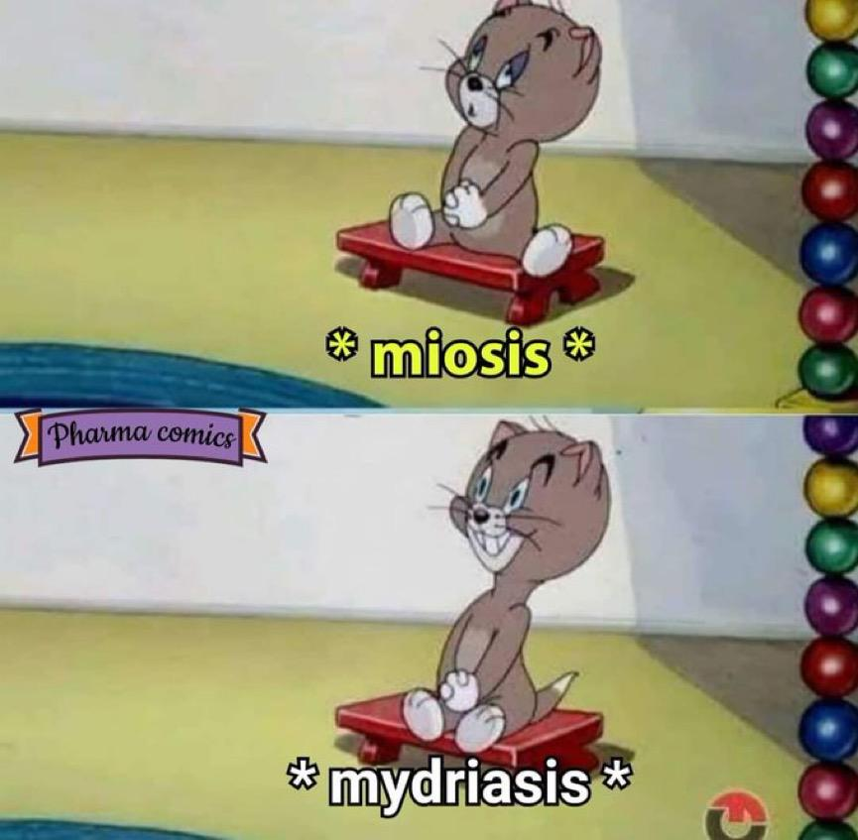
Location
postsynaptically
presynaptically
Stimulation of pre-synaptic α2 adrenoceptors Inhibition of norepinephrine release and sympathetic system (negative feedback).
α1, β1, β2 and β3
α2
β2
Stimulation of pre-synaptic β2 Release of norepinephrine (NE) & sympathetic stimulation (positive feedback).
All sympathetic actions
● Mydriasis (dilatation of eye pupil) α1 (miosis is constriction of eye pupil)
● Increase heart rate. β1
● Bronchodilation β2
● Inhibit peristalsis of GIT and secretion. α1 & β2
● Relaxation of GIT muscles (constipation). β2 α1
● Relaxation of urinary bladder. β2
● Relaxation of the uterus (Delay premature labor) β2
● Increase conversion of glycogen to glucose (hyperglycemia) α1 & β2

Slide 5
Post-synaptic(located in tissue)
α1 Postsynaptic α1are excitatory in function except in GIT(inhibition) | β2 Inhibitory in function | β1 excitatory in function | β3
Present in smooth muscle |  | Mainly in heart and juxtaglomerular cells of kidney | In adipose tissue
Contraction of radial muscle of eye mydriasis. (Active mydriasis) | Relaxation of skeletal muscles and coronary blood vessels (vasodilation) | 1-Increase heart rate: +chronotropic effect (Tachycardia) (Increase heart rate) 2-Increase force of contraction: +inotropic effect (increases contractility) 3-Increase conduction velocity: +dromotropic effect (Dromotopic effect means an effect in the speed of conduction of electrical impulses) 4-Increase blood pressure 5-Increase renin release (this is an enzyme produced by the kidney in response to stretch receptors found on blood vessels, its function is to increase blood pressure) | ⬆️ lipolysis ⬆️ free fatty acids.
Contraction of pregnant uterus. | Relaxation of uterus (Delay premature labor)
Vasoconstriction of skin & peripheral blood vessels which increases peripheral resistance then lead to hypertension. | Relaxation of bronchial smooth muscle.
Contraction of sphincters in GIT & urinary bladder. Relaxation of GIT muscles. Relaxation of urinary bladder muscle
ــــــ | Tremor of skeletal muscle (as a side effect)
Increase blood glucose level(hyperglycemia) by:
⬆️Glycogenolysis (increase blood glucose level). | ⬆️Glucagon release from pancreas ⬆️Liver and muscle glycogenlysis

Slide 6
Classification of sympathomimetics
1-Mode of action
2-Chemistry
3-Spectrum of action
1-According to Action
Mixed (Dual acting) | Direct-acting:direct stimulation of adrenergic receptors | Indirect-acting:
Direct and indirect stimulation of adrenergic receptors e.g. ephedrine, pseudoephedrine. | e.g. adrenaline, noraderanaline, isoprenaline, dopamine, salbutamol phenylephrine, clonidine, dobutamine, methoxamine. | Increase NA release from pre-synaptic adrenergic nerve endings e .g. amphetamine, tyramine Inhibit NA uptake its availability in synapse. e.g. Cocaine & antidepressants
2-According to Chemistry COMT = catechol-O methyl transferase MAO= MonoAmine oxidase
Catecholamines | Non-catecholamines
have catechol ring | Lack catechol ring
water soluble (polar) | Lipid soluble
Not effective orally. | Effective orally.
Poor penetration into CNS | Cross well BBB Prominent CNS effects
inactivated by COMT & MAO in GIT | Not inactivated by COMT in gut wall
short half-life. | Long half-life.
e.g. adrenaline,noradrenaline, dopamine Isoprenaline, ADRE NORA IS DOBA = ادري نورا از دوبا | e.g. Ephedrine,amphetamine, phenylephrine.
3-According to Spectrum of Action
Non-selective adrenergic agonists | Selective agonists
Adrenaline ( α1, α2 , β1 , β2, β3) Noradrenaline (α1, α2 , β1) (β1نورا تدخل القلب ) Isoprenaline (β1, β2, β3) Dopamine (D1, β1, α1) | Phenylephrine (α1) a -Methyldopa - clonidine (α2) Dobutamine (β1) Salbutamol, terbutaline,ritodrine (β2)

Slide 7
Adrenaline = Epinephrine
Receptor | Direct Action/ Non-selective α1 α2 β1 β2 β3
Overview | (Natural, Catecholamine) released from adrenal medulla secondary to stress, hunger, fear (Well, since it’s a catecholamine then we know that it’s polar and we shouldn’t give it orally because it will be degraded by COMT/MAO etc..) Fast onset of action & Short duration of action.
Administration | Not effective orally (inactivated by intestinal enzymes). Given I.V, S.C, inhalation.
Actions | Heart: Inotropic,chronotropic ( increase HR),dromotropic (β1) Blood Pressure:↑ Systolic (β1) (α1) (Prominent action)↓ Diastolic (at low dose: β2, at a high dose α1 (Minorly) Vascular: - Vasoconstriction of blood vessels in skin + peripheral (α1) - Vasodilation of blood vessels of skeletal muscles and coronaries (β2) Eye: Mydriasis (α1) → no effect on accommodation Lung: Bronchodilation (β2) (because we need oxygen) GIT: ↓ motility (β2) / contract sphincter (α1) Urinary bladder: - Relaxation of detrusor muscle (β2) - Contraction of sphincter (α1) CNS: Little (rare), (Since it’s a catecholamine, it has poor BBB penetration) headache, tremors & restlessness (usually in case of overdose) Pregnant Uterus Relaxation tocolytic effect (β2) Tocolytic action means relaxation of pregnant uterus Metabolism: ↓ insulin (α2), ↑ glucagon (β2) ↑ liver glycogenolysis +skeletal muscle glycolysis (β2) (prof.hanan said skip this point) (Hyperglycemia) ↑ adipose lipolysis (β3)

Slide 8
Adrenaline = Epinephrine
Uses | Locally: ➢ Haemostatic (control bleeding) (by vasoconstriction): (Stops it) Nasal packing epistaxis (nasal bleeding) & in dental practice., & as a decongestant (α1).. ➢ Combined with local anesthetic to: ↓ absorption of the local anesthetic and toxicity & ↑ duration of action Adrenaline causes vasoconstriction so there will be less blood flow امتصاص الدواء یكون بطيء .to the area which will reduce the absorption of the local anesthetic. Therefore, the duration of the local anesthetic will be increased ↓ side effects of local anesthetic. (Cause it’s not absorbed quickly in a large amount so it will not produce prominent side effects) ↓ bleeding from the incision. (Vasoconstriction) Systemically: ➢ In acute asthma S.C., inhalation, emergency bronchodilation (β2) + ↓ mucosal edema due to vasoconstriction (α1). *Remember edema is caused by vasodilation due to inflammatory mediators Selective Beta2 are better in asthma by inhalation ➢ Anaphylactic shock (Hypersensitivity reactions) is the drug of choice as it is adrenaline will increase BP & bronchodilation). Hypersensitivity reactions are caused by histamine release which cause hypotension & bronchoconstriction so adrenaline is given to reverse these actions ➢ Cardiac arrest (i.v.). N.B selective Beta1 are better
ADR | - Tachycardia, palpitation, arrhythmias, angina pains(chest pain) -Headache, weakness, tremors, anxiety and restlessness. - Hypertension → cerebral hemorrhage and pulmonary edema. - Coldness of extremities (due to vasoconstriction) → tissue necrosis (prof.hanan said skip this point) -Nasal stuffiness: rebound congestion if used as decongestant.
Contradictions | - Coronary heart diseases (CHD), Ischemic heart disease: - Arrhythmia, Myocardial infarction - Hypertension, peripheral arterial disease (because they have low blood flow to extremities & adrenaline cause vasoconstriction) - Hyperthyroidism. (There is an increased amount of thyroxine hormone which can cause tachycardia) - Closed-angle glaucoma ciliary ”iris” relaxation ↓ filtration angle) > ↑ IOP (prof.hanan said skip this point)

Slide 9
Drug | Noradrenaline (Norepinephrine) | Isoprenaline
Classification | Natural, Catecholamine non-selective agonist It is naturally released from postganglionic adrenergic fibers. (Not much used therapeutically because it causes severe vasoconstriction) | Synthetic ,direct acting catecholamine. Longer effect (no reuptake-no destruction by MAO) (Which leads to longer action)
Administration | ONLY administered by I.V may cause necrosis using IM or SC (due to vasoconstriction) | Parenteral in cardiac arrest inhalation rarely in acute attack of asthma
Receptor | Mainly on α adrenoceptors (α1, α2, β1, weak action on β2) | non-selective agonist ( β1,β2 & β3 )
Pharmacological Action | - Severe vasoconstriction (α1) - Reflex bradycardia due to severe Vasoconstriction. (The body tries to regulate itself) - Increase force of contraction but decrease heart rate (β1) | β1 : -inotropic effect - chronotropic effect - increase cardiac output β2 : - Vasodilation of blood vessels of skeletal muscles and coronaries -Bronchodilation - Relaxation of uterus - Hyperglycemia β3 : - lipolysis
Uses | Locally: As a local haemostatic with local anesthetic (to reduce tachycardia & irritability, but as side effect, may produce necrosis & sloughing of the skin). | - Used mainly in cardiac arrest to increase heart rate (Parenteral) Better than adrenaline because it has less side effects - Rarely in acute attack of asthma (inhalation)
 | Systemically: 1-hypotensive states :in septic shock (hypotension) if fluid replacement and inotropes fail. | Contraindications: 1-hyperthyroidism Thyroid gland over produces thyroxine which also increases cardiac output 2-Congestive heart disease CHD

Slide 10
Drug | Dopamine | Dobutamine | Phenylephrine
Classification | Natural catecholamine & CNS neurotransmitter Direct acting a precursor to norepinephrine in noradrenergic nerves | Synthetic catecholamine Direct acting Metabolized by COMT , thus has a short duration | Synthetic NON catecholamine Direct acting has prolonged duration of action since its not inactivated by COMT
Administration | Given parenterally by infusion | IV infusion | Orally (Since it’s not catecholamine
Receptor | D1 > β1 > α1 (in order, depending on dose) | Selective β1–agonist | Selective α1
Pharmacological Actions | Low dose (Dopaminergic Receptor D1): - Vasodilatation of mesenteric, coronary, renal blood vessels. (Thus improves blood flow to viscera.) ,Has diuretic action (increase excretion of urine due to vasodilation of renal blood vessels) intermediate dose: (β1) +ve inotropic (increased cardiac output) +ve chronotropic (increased heart rate) high dose: (α1) Vasoconstriction On heart : Inotropic, chronotropic effect On BP:according the dose first decrease(D1)then increase due to Beta1 followed by alpha1 effect | On heart: +ve Inotropic with little chronotropic effect. as it increases cardiac output and heart contractility. On BP: Hardly any effect; β1 & β2 counterbalance + no α1 | -Vasoconstriction -increased both systolic & diastolic blood pressure (hypertension) due to vasoconstriction (α1) -Reflex Bradycardia Adverse effects: Hypertension. Thus, another drug is more preferable to produce hypertension that doesn’t last for long. This drug is Midodrine. It peaks in 20 min, duration 30 min only. Midodrine: Selective α1, given orally
Uses | Drug of choice in treatment of shocks: Septic, Hypovolemic (after fluid replacement),or Cardiogenic (I.V infusion). It increases the BP & CO by β1 receptor but without causing renal impairment (D1) because it increases CO and causing vasodilation (more blood goes to the kidney so it’s not impaired) Can be given in acute heart failure (HF) but Dobutamine is better because it’s selective and does not change o2 demand. | - Short term management of Cardiac decompensation after cardiac surgery - In acute myocardial infarction (AMI) & heart failure. | Nasal decongestant topically, nasal drops in allergic rhinitis, cold Vasopressor agent: hypotension & terminate atrial tachycardia (reflex bradycardia). Local Haemostatic with local anesthesia Mydriatic: In ophthalmic solutions to facilitate eye examination.

Slide 11
Selective β2 Agonist
Drug | Salbutamol | Ritodrine | Terbutaline
Classification | Selective β2–agonist , Non catecholamines Direct acting | Selective β2–agonist Non catecholamines | Selective β2–agonist
Administration | -Orally -Inhalation -injection. (preferred as inhalation for local effect on the respiratory system) | Orally injection | ---
Effect | Bronchodilation Little effect on heart (β1) (Because of its 4 hrs action, longer acting preparations exist ; Salmeterol & Formoterol) | Tocolytic drug (relaxation of uterus). Ritodrine= Tocolytic= Beta Two | Bronchodilator & Tocolytic
Uses | Acute attack of asthma & COPD | Treat premature labor. (labour that begins before the 37th week of gestation) | ---
Selective α2 Agonist
Drug | Clonidine | Brimonidine
Classification | Synthetic, Direct acting Selective presynaptic α2 agonist | Selective α2 agonist
Administration | Orally or as patch. | ---
Action | - Acts centrally (α2) at nucleus tractus solitarius to ↓ sympathetic outflow to heart & vessels. Inhibit sympathetic vasomotor centers. Clonidine stimulates the alpha 2 adrenergic receptors in the vasomotor center of the brain, leading to inhibition of activity of sympathetic nerves to the peripheral tissues | ---
Uses | As antihypertensive in essential hypertension to lower BP. Essential hypertension = primary (unknown cause) | Glaucoma treatment (reduce aqueous humor production by the ciliary body) *Note that drugs that treats glaucoma either reduce the production, or they increase the drainage of the aqueous humor

Slide 12
Adrenergic Stimulants
 | Indirect Acting Sympathomimetics | Dual Acting Sympathomimetics
Drug | Amphetamine α & β | Ephedrine α & β | Pseudoephedrine
Classification | Synthetic, Non-catecholamine. | Plant alkaloid, synthetic, Non-catecholamine | ---
Administration | Given orally Since it’s not a catecholamine, it is not destroyed by enzymes → Prolonged duration action |  | ---
Excretion | Excreted mostly unchanged (excretion is increased by acidification of urine) | --- | ---
Action | Acts indirectly & Depletes vesicles from stored Norepinephrine→Tachyphylaxis (gradual decrease in the effect after a short period of time with repeated administration. Ex: the evening dose has less effect than the morning dose) While tolerance occurs after a few days. | 1- Direct action on receptors 2- Indirect by releasing NE from adrenergic endings → depletes stores 3-Tachyphylaxis | ---
Effects | -Has CNS stimulant effects: Mental alertness, wakefulness, concentration & self-confidence followed by depression & fatigue on continued use. - Euphoria→ causes abuse - ↓ Weight by: ↓appetite & ↑energy expenditure | CNS stimulant effects (less than amphetamine) Tachyphylaxis | Vasoconstriction of blood vessels, mainly those located in the nasal passages causing a decrease in symptoms of nasal congestion.)نفس الـ Phenylephrine)
Uses | No more used therapeutically as it induces psychic and physical dependence and psychosis. | No more therapeutically used but is abused by athletes and prohibited during games | Used as nasal & ocular decongestant & in flu remedies.

Slide 13
Summary for Uses of Sympathomimetics
Hypotension
-Midodrine
-Phenylephrine
-Norepinephrine
-Phenylpropanol
(prof.hanan said skip this drug)
Cardiogenic shock &
acute heart failure
-Dobutamine
-Dopamine
-Epinephrine
Shock
-Dopamine
-Norepinephrine
Cardiac arrest
-Dobutamine
-Epinephrine
-Norepinephrine
Bronchial asthma
-Salbutamol
-Salmeterol
-Formoterol
-Terbutaline
-Isoprenaline
Premature labor
-Ritodrine
-Terbutaline
Nasal decongestant
-Pseudoephedrine
-Phenylephrine
Sports Illegal use
Ephedrine
Amphetamine

Slide 14
Summary
Drug | Receptor | Uses
Adrenaline | α1, α2, β1, β2, β3 | -Combined with local anesthetic -Haemostatic (Stops bleeding) -In acute asthma -Anaphylactic shock -Cardiac arrest
Noradrenaline | α1, α2, β1, weak β2 | -local haemostatic with local anesthetic to reduce tachycardia. -in septic shock (after fluid replacement)
Isoprenaline | β1, β2, β3 | -cardiac arrest (preferred) -Rarely in acute attack of asthma
Dopamine | D1 > β1 > α1 (in order) | -Treatment of shocks: septic, Hypovolemic (after fluid replacement), cardiogenic (I.V)
Dobutamine | β1 | - Short term management of Cardiac decompensation. - Acute myocardial infarction (AMI) & heart failure.
Phenylephrine | α1 | - Vasopressor (anti-hypotensive) - Haemostatic with Local anesthesia. - Mydriatic - Nasal decongestant
Salbutamol | β2 | - Acute attack of asthma & COPD.
Ritodrine | β2 | -Treat premature labor.
Terbutaline | β2 | __
Clonidine | α2 | -Antihypertensive
Brimonidine | α2 | -Glaucoma treatment
Amphetamine | __ | No more used therapeutically
Ephedrine | __ | No more therapeutically used but is abused by athletes
Pseudoephedrine | __ | - Nasal & ocular decongestant - In flu remedies.

Slide 15
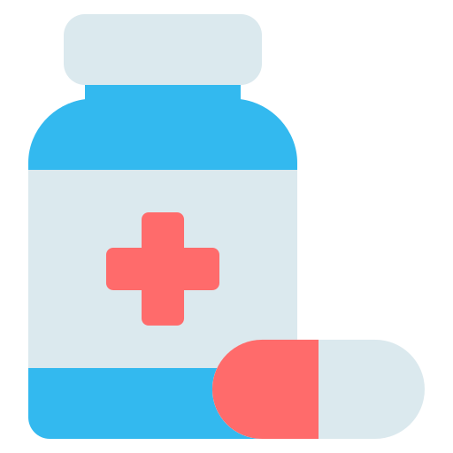
MCQs
1-which drug is Direct Acting?
A)Tyramine | B)adrenaline | C)ephedrine | D)antidepressants
2-what is the drug of choice in case of Anaphylactic Shock?
A)Isoprenaline | B)Dobutamine | C)Adrenaline | D)Salbutamol
3-which drug act on receptor depending on dose?
A)Dopamine | B)Dobutamine | C)Phenylephrine | D)Ritodrine
4-a patient had cardiac surgery what is the drug of choice?
A)Phenylephrine | B)Dobutamine | C)Terbutaline | D)Ritodrine
5-to Treat premature labor what drug to use?
A)Salbutamol | B)Pseudoephedrine | C)Ritodrine | D)Clonidine
SAQ
1-B 2-C 3-A 4-B 5-C
1-Give 2 drug of Indirect Acting that Can not bind to receptors directly and Stimulate adrenergic receptors +explain the mechanism?
2-list the Selective Adrenergic Agonist?
3-what is the Action of Adrenaline on Pregnant Uterus?
4-you survived this lecture reward yourself💪
1-amphetamin–Tyramine
by increasing noradrenaline release from presynaptic adrenergic nerve endings.
2-Phenylephrine–Methyldopa and clonidine—Dobutamine-Salbutamol- terbutaline-ritodrine
3-relaxation tocolytic effect (β2) ‘prominent action’
Click here

Slide 16
THE LEADERS OF PHARMACOLOGY AND MEMBERS
Mayssam Aljaloud
Shatha Alshabani
Noura bin hammad
Jana Alhazmi
Alanoud Almarzuqi
Shahad Aljeri
Fatima Halawi
Lina alyahya
Norah Alrashoud
Fay aldossari
Reema Alhussein
Reema alquraini
Saif Alotaibi
Mohammed alrashed
Rakan alromayan
Abdulaziz al shalhoub
Yazeed alshehry
Abdullah alsubaie
Azzam alotaibi
Faisal alomar
Hasan alabdullatif
Sub leader:
Rahaf Almotairi
Contact us: pharmacology442@gmail.com

