Slide 1
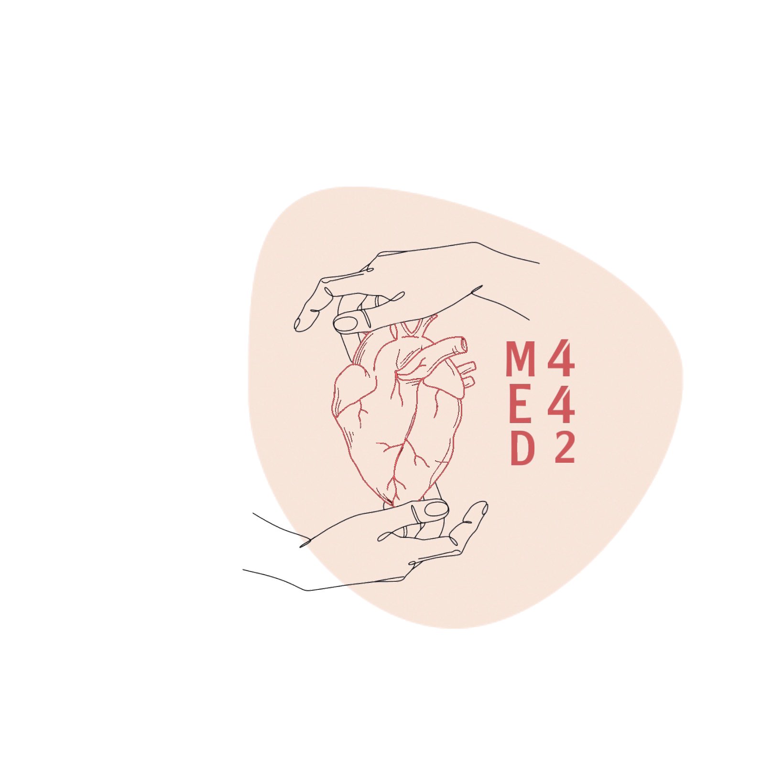
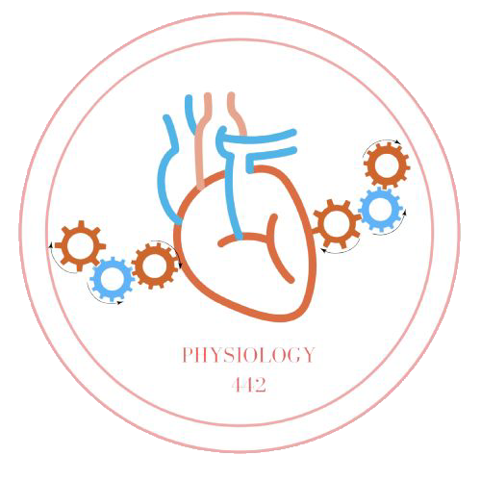
L-10
Effects of exercise on the respiratory system
Color index:
Main text
Important
Doctor notes
Boys slides
Girls slides
Extra
Editing file

Slide 2
Objectives:
1- Describe the effects of moderate and severe exercise on oxygen consumption, and ventilation volumes. Explain the respiratory changes in exercise (e.g Oxygen consumption, pulmonary ventilation and VO2 max).
2- Interpret the effects of exercise on arterial PO4, PCO2 and PH+.
3- Define the diffusing capacity of the respiratory membrane, and its typical values at rest, and explain its changes in exercise.
4- Explain the concept of oxygen debt (definition, value, types, significance).
5- Discuss the effects of smoking on pulmonary ventilation in exercise.
6- Discuss the factors stimulate ventilation (hyperventilation) in exercise.
7- Outline the relation between the chemical and nervous factors in the control of respiration during exercise.

Slide 3
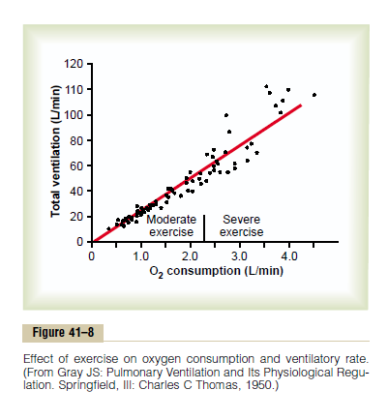
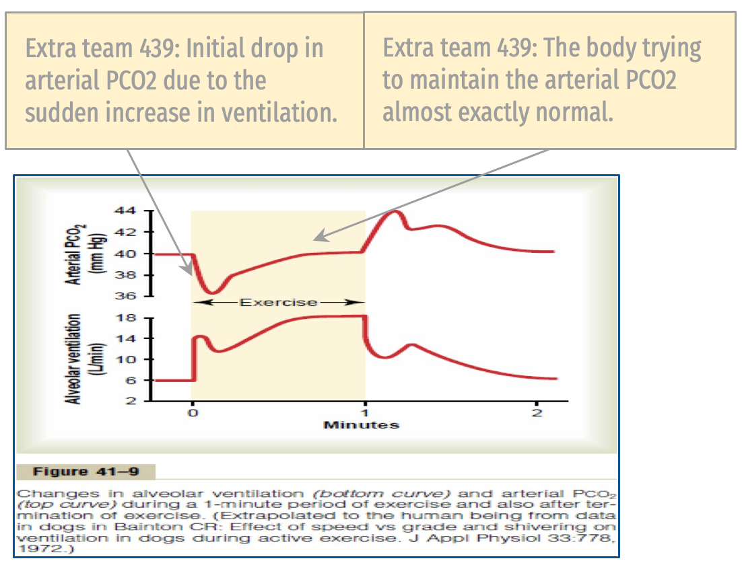
Effect of Exercise on Ventilation
During heavy exercise:
O2 consumption and CO2 formation can increase as much as 20 folds.
Yet, in the healthy athlete, alveolar ventilation ordinarily increases almost exactly in step with the increased level of O2 metabolism.
Therefore the arterial PO2,PCO2, PH all remain almost exactly normal.
VERY IMPORTANT
Important
استهلاك O2 وإنتاج CO2 يزيد مع التمرين بس ليش ضغطهم ثابت؟ السبب وراء تساوي ضغط في حالتي الراحة والتمرين إن الزيادة في استهلاك الـ O2 يقابلها زيادة الـ alveolar ventilation فالأكسجين صح يستهلك لكنه يعوض بنفس الوقت.
Notice the ↑ O2 consumption as well as ↑ of ventilation

Slide 4
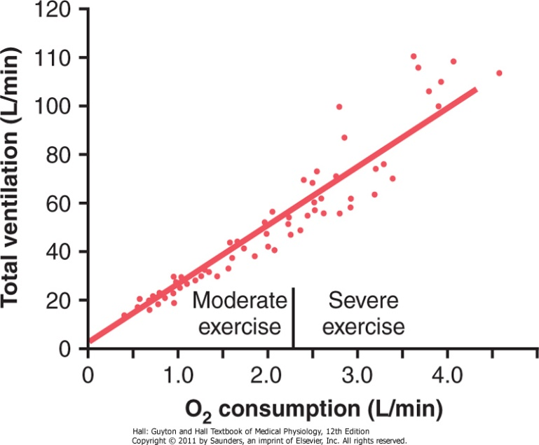
Oxygen Consumption (VO2) and Pulmonary Ventilation (VE) in Exercise
At rest:
Normal (VO2)
For a young man: 250ml/min
Effect of exercise on oxygen consumption and ventilatory rate:
VO2 and VE increase about 20-fold between the resting state and maximal intensity exercise
Linear relationship, increase in O2 consumption will increase the ventilation
O2 consumption
(VO2)
Untrained average male:
3600 ml/min
At maximal aerobic metabolism:
The rate of oxygen usage (L/min) Increased (VO2 Max)
Athletically trained average male:
4000 ml/min
Marathon runner male:
5100 ml/min

Slide 5
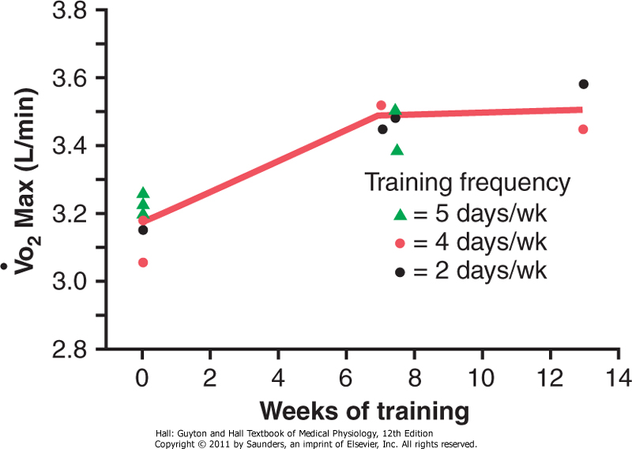
Effect of Training on VO2 Max
Factors increasing VO2 Max
Training
increases only about 10%
Minor factor
Genetically determined
major factors in the form of:
Increase in Vo2 Max over a period of 7 to 13 weeks of athletic training.
Male Dr’s: Exercising up to 5 days a week will make the developmental of VO2 Max progress grow slowly. Therefore, taking rest is important
Chest sizes in relation to body size
The power of respiratory muscles contraction

Slide 6
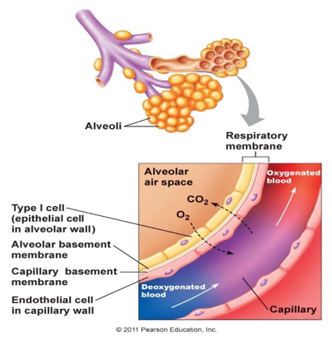
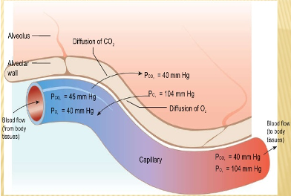
Diffusion capacity of the respiratory membrane
Definition: is the volume of gas that diffuses through the membrane each minute for a pressure difference of 1 mmHg.
Unit: ml/min/mmHg.
It measures the volume for only 1 mmhg pressure difference across the respiratory membrane. gas volume at other pressures differences is obtained by multiplying the diffusion capacity by that pressure difference.
Volume of gas diffusing through the membrane= diffusion capacity x ΔP
Ex. Oxygen diffusion capacity (at rest: 21 ml/min/mmHg).
Definition: is a measure of the rate at which oxygen can diffuse from the pulmonary alveoli into the blood.
Unit: is expressed in terms of milliliters (mls) of O2 that will diffuse each minute for each millimeter of mercury (mmHg) difference between alveolar PO2 and pulmonary blood PO2.
E.g : The volume of O2 diffusing through the membrane each minute If the oxygen pressure difference across the respiratory membrane is 11 mmHg = (11x21) = 230 ml, is it enough?
it’s enough to supply the O2 needed by the tissues during rest.
N.B: During rest tissues consume 250ml O2/min.

Slide 7
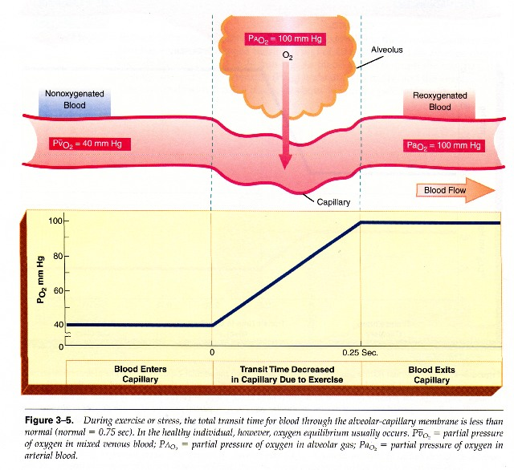
Increased Oxygen Diffusing Capacity During Exercise
The diffusing capacity for oxygen increases about three times during exercise ( ⁓ 64 ml/mmHg/min). This is due to:
Increased number of the open pulmonary capillaries which were dormant, and dilation of the already opened vessels to their maximal. This increases the surface area for gas exchange
Increased alveolar ventilation per minute.
Better matching of ventilation of the alveoli (V) with the perfusion of the pulmonary capillaries (Q) i.e (V/Q ratio). (become equal at base, middle and apex of the lung)
The curve show how the blood remain a little time in the pulmonary capillaries But that doesn’t affect the saturation of O₂
At rest the blood normally stays in the lung capillaries about three times as long as necessary to cause full oxygenation (means that we only need 1\3 of the time) . Therefore, even with shortened time of exposure of the blood to the alveolar air in exercise, the blood is still fully oxygenated or nearly so.
During exercise:
O2 Requirement increases→ Cardiac output increases → Time blood remained pulmonary capillaries decreases, but the blood is almost completely saturated with O2 when it leaves the pulmonary capillaries because of what we said.

Slide 8
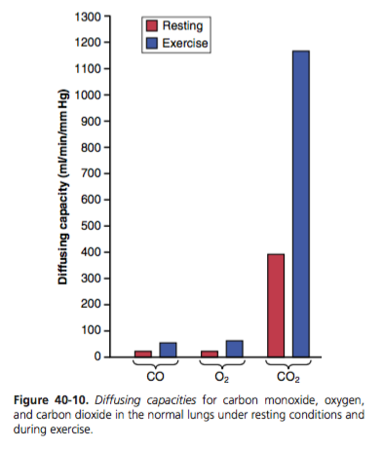
Diffusing capacity For Oxygen And Carbon Dioxide
 | O2 Diffusing capacity | CO2 Diffusing capacity CO2 Diffusion coefficient: 20 Times greater than O₂→ CO2 diffuses 20 times greater than oxygen (The most diffusing gas across the respiratory membrane)
During rest | 21 ml/min/mmHg | 400 ml/min/mmHg (20 times greater than of O2 during rest)
During exercise Increases 3 times than rest | ⁓ 64 ml/min/mmHg The diffusing capacity for oxygen increases about three times during exercise Why? previous slide | 1200 to 1300 ml/min/mmHg (20 times greater than of O2 during exercise)
Diffusing capacity during exercise increases.
Diffusion capacity of CO₂ greater than O₂, due to the ↑solubility of CO₂, remember?
X20
X20

Slide 9
Recovery of The Aerobic System After Exercise
Oxygen Debt: is the amount of extra O2 that must be taken after strenuous exercise to restore the muscles to the resting conditions. About 11.5 liters of O2
When a person stops exercising, the rate of oxygen uptake does not immediately return to pre-exercise levels.
It returns slowly (the person continues to breathe heavily for at least a few minutes and sometimes for as long as 1 hour thereafter).
This extra oxygen is used to repay the oxygen debt acquired during exercise.

Slide 10
How Much Is The Oxygen Debt After Heavy Exercise?
Stored oxygen
Definition: | The body contains about 2 liters of stored oxygen O2 that can be used for aerobic metabolism even without breathing any new oxygen.
Consists of: total= 2 liters | 0.5 Liter in the air of the lungs. 0.25 Liter dissolved in the body fluids (e.g plasma). 1 Liter combined with the hemoglobin of the blood. 0.3 Liter stored in the muscle fibers, combined mainly with myoglobin, and hemoglobin.
Stored O2 During heavy exercise |  | Stored O2 After the exercise
In heavy exercise, almost all this stored oxygen is used within a minute or so for aerobic metabolism. |  | After the exercise is over, this stored oxygen must be replenished by breathing extra amounts of oxygen over and above the normal requirements.
In addition (to the consumption of stored O2) about 9 liters more oxygen must be consumed to reconstitute the phosphagen system and the lactic acid system. All this extra oxygen that must be “repaid,” about 11.5 liters, is called the oxygen debt. (2+9≈11.5)

Slide 11
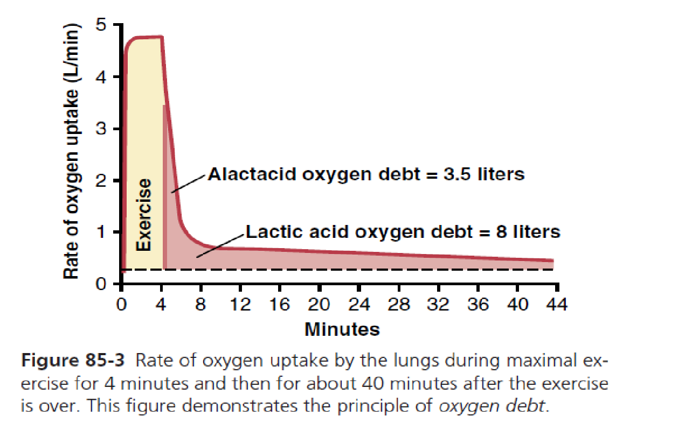
The Principles of O2-Debt
Figure 85-3 shows that
During exercise | After exercise
During the first 4 minutes, the person exercises heavily, and the rate of oxygen uptake increases more than 15-fold. | Even after the exercise, the oxygen uptake still remains above normal. There’s a gradual (not sudden) decrease but still higher than normal, because O2 is needed to restore the resting condition.
O2 uptake at first after the exercise | O2 uptake later after the exercise
At first it is very high while the body is reconstituting the phosphagen system (phosphocreatine+ATP) and repaying the stored oxygen portion of the oxygen debt [Alactacid O2 debt]= 3.5 L. (Alactacid= NON lactic acid) | Then it is still above normal at a lower level for another 40 minutes while the lactic acid is removed (converted to glucose) [Lactic acid O2 debt] = 8 L.
Total O2 debt= alactacid O2 debt + lactic acid O2 debt= 3.5+8=11.5

Slide 12
Uses of the Oxygen Debt After Completion of Strenuous Exercise
Oxygen Debt is about 11.5 L of O2, this additional oxygen is used to:
(1) Reconvert the lactic acid that has accumulated during exercise back into glucose.
(Lactic acid→glucose)
(2) Reconvert adenosine monophosphate and ADP to ATP.
AMP→ATP, ADP→ ATP
(3) Reconvert creatine and phosphate to phosphocreatine.
Creatine + Phosphate = PC
(4) Re-establish normal concentrations of oxygen bound with hemoglobin and myoglobin.
(5) Raise the concentration of oxygen in the lungs to its normal level.

Slide 13
Effects of Smoking on Pulmonary Ventilation in Exercise
Nicotine constricts the terminal bronchioles and increases resistance of air flow into and out of the lungs. (Nicotine promotes barrier formation on the respiratory membrane which makes it difficult for O2 to enter)
Smoke irritation causes increased fluid secretion into the bronchial tree and swelling of epithelial layer.
Nicotine paralyze the cilia of the respiratory epithelial cell surface. This lead to fluid and waste accumulation and reduced level of performance.
Chronic smokers may develop emphysema (Obstruction of bronchioles + chronic bronchitis + destruction of alveoli (decrease alveolar surface area, increase lung compliance) so slight exercise cause respiratory distress.

Slide 14
What Cause hyperventilation During Exercise?
Neural signals from the motor areas of the brain to the respiratory center. The motor cortex of the brain, on transmitting motor impulses to the exercising muscles, transmits at the same time collateral impulses into the brain stem to excite the respiratory center.
An additional sensory signals transmitted into the respiratory center from the contracting muscles and moving joints (proprioceptors).
Increased body temperature stimulates the (hypothalamus) which stimulates the respiratory centers.
Respiratory center stimulation by:
Possibility that the neurogenic factor (the impulses from the motor cortex) for control of ventilation during exercise is a learned response (conditioned reflex).
for more about conditioned and unconditioned reflexes watch the video

Slide 15
Relation Chemical and Nervous Factors in Control of Respiration During Exercise
Direct nerve impulses from the motor cortex stimulate the respiratory center almost the proper amount to supply the extra oxygen required for exercise and to blow off extra carbon dioxide.
Then chemical factors play a significant role in bringing about the final adjustment of respiration required to keep the O2, CO2, and H+ ion concentrations of the body fluids as nearly normal as possible.
Occasionally, the nervous respiratory control signals are either too strong or too weak.
Chemical factors only play a major role when the impulses are too strong or too weak (which happen sometimes), but most of the time impulses are normal and the factors that play a major role are the nervous factors.
تكون المستقبلات على ال blood vessel بحيث إذا تغيرت تراكيز الغازات ترسل إشارات لتزيد معدل التنفس.

Slide 16
Summary of Factors That Stimulate Ventilation During Exercise
↑Temperature
Conditioned response
↑ Plasma epinephrine and potassium concentration
Joints
Respiratory Control Center
When it is contracted it will send impulses to the respiratory center.
Oscillatory change in arterial (PO2, PCO2, H+) via chemoreceptors
Motor cortex
Skeletal muscles
E.g. using the stairs needs alveolar ventilation from 4-6 so the body provides 8 to wash out the CO2 so the range keeps fluctuating and sometimes provides more than needed which may normal with fluctuation to release less CO2. We tune this by blood gases working on chemoreceptors.
Motor cortex sends impulses to the respiratory center and skeletal muscles at the same time.

Slide 17
Summary of Factors That Stimulate Ventilation During Exercise
Peripheral chemoreceptors
Receptors lung tissue
Proprioceptors
Core temperature
Chemical state of blood
(in medulla)
Subcortical regions brain
Motor cortex
Brainstem (medulla & pons)
Ventilatory muscles

Slide 18
MCQ
For more questions
1-C, 2-C, 3-D, 4-B
1- During heavy exercise, the arterial PO, PCO2, PH all…….
A) Changed and increase. | B) Changed and decreased. | C) Remain almost exactly normal. | D) Can be either A or B.
2- Which of the following statement is false?
A) One of the factors that increase the VO2 is chest sizes in relation to body size. | B) At rest the blood normally stays in the lung capillaries about three times as long as necessary to cause full oxygenation. | C) Nicotine dilate the terminal bronchioles and decreases resistance of airflow into and out of the lungs. | D) Alveolar ventilation increase almost exactly in step with the increased level of oxygen metabolism.
3- The most diffusing gas across the respiratory membrane is….
A) O2. | B) CO. | C) N. | D) CO2.
4- During exercise, the diffusion capacity of O2 increases about….times than its at rest.
A) 20. | B) 3. | C) 50. | D) 10.

Slide 19
SAQ
1) Why does arterial PO2,PCO2, PH all remain almost exactly normal even in exercise?
-Because alveolar ventilation increases with the oxygen metabolism during exercise
2) What are the factors that increase oxygen consumption?
1-Training increase only about 10% (Minor factor).
2- Genetically determined factors(major factors) (Chest sizes in relation to body size, The power of respiratory muscles contraction).
3) Enumerate two uses of the additional oxygen consumption After Completion of Strenuous Exercise:
1-convert ADP and AMP into ATP.
2-converting lactic acid to glucose .

Slide 20
Team leaders
Deema aljuribah Mishal Alsuwayegh Waleed Alrashoud
Team members
Maram Beyari
Raghad Alnadeef
Hend Almogary
Farah Alfayez
Kadi Khalid aldoosari
Farah mohammed Alqazlan
Ghada Binslmah
Shatha Alshabani
Faisal Ali
Othman Aldraihem
Abdullah Alqarni
Rayan Alotaibi
Faisal Alkhunein
Mishari Alenezi
Bandar Almutiri
Fahad Alhelelah
Rayan Bosaid
Ibraheem Alkanhal
Saad Alhammad
Emad Almutairi
Ahmad Almarshed
Salman Almutaz
Osama Alzahrani
Physio442@gmail.com

