Slide 1
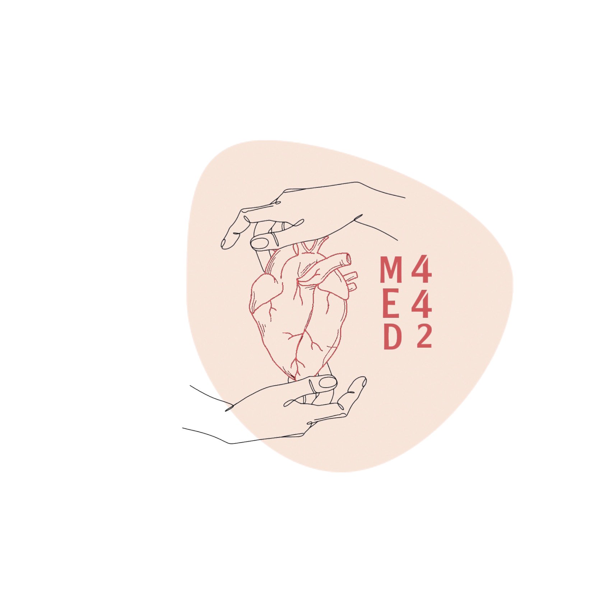
L-9
Low & High Altitude
Color index:
Main text
Important
Doctor notes
Boys slides
Girls slides
Extra
Editing file

Slide 2
Objectives:
Describe the effects of exposure to low and high barometric pressures on the body.
Describe the body acclimatization to low barometric pressure.
Define decompression sickness and explain how it can be avoided.
Understand the effects of high nitrogen pressure, and nitrogen narcosis.
Describe the acute and chronic mountain sickness

Slide 3
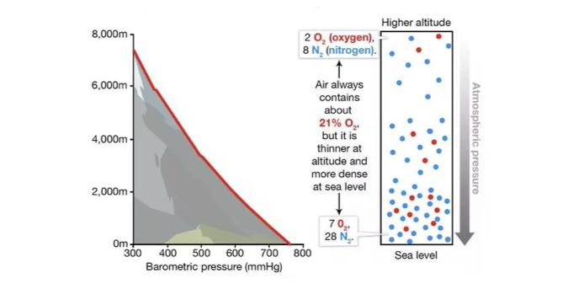
Girls slides
The impact of altitude on oxygen level

Slide 4
EXTRA SLIDE thx. To 441 team.
Low & High Altitude
Altitude
High Altitude
Climb mountains
Low Altitude
Deep sea diving
Decreased barometric pressure.
Increased barometric pressure.
↓760 mmHg
↓PO2
↑760 mmHg
↑PO2,↑PN2
PCO2 is the same
Causes of: Hypoxia.
causes of: Nitrogen narcosis ,Decompression sickness, and Oxygen toxicity.

Slide 5
Effect of Increased Barometric Pressure
(Deep Sea Diving)
When humans descend below the sea, the pressure around them increased.
To prevent the lungs from collapse air must be supplied also under high pressure.
This exposes the blood in the lungs to extremely high alveolar gas pressure (hyperbarism).
Under certain limits these high pressures cause tremendous alterations in the physiology of the body.

Slide 6
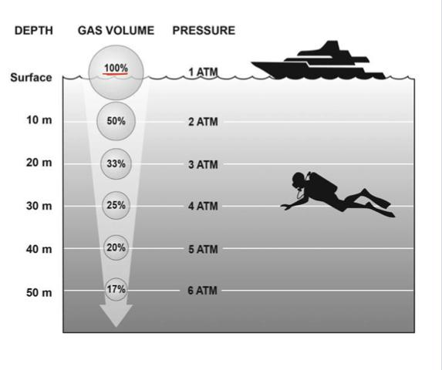
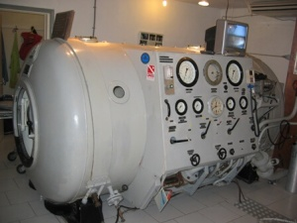
Effect of Increased Barometric Pressure
(Deep Sea diving) CONT.
The surrounding pressure increases by 1 atmosphere for every 10 meters (33 feet) of depth in sea water. So the diver is exposed to 2 atmospheric pressures.
Therefore, at a depth of 31 meters (100 feet) in the ocean the diver is exposed to a pressure of 4 atmospheres.
These problems confront SCUBA (self contained underwater breathing apparatus..)

Slide 7
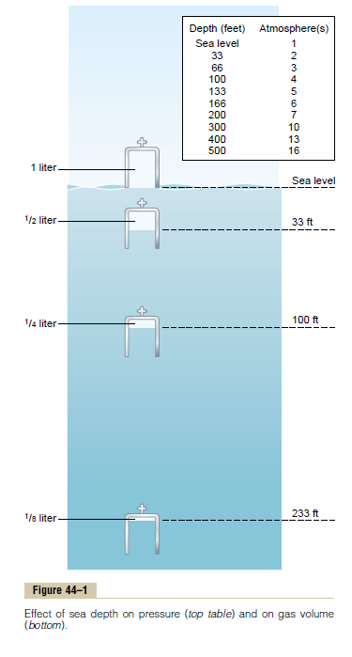
Effect of Increased Barometric Pressure (Deep Sea diving) CONT.
1
Effect of depth on the volume of the gases: ↓
At depth, there is compression of gases to smaller and smaller volumes.
i.e 1 Liter (sea level )→ 1/2 Liter at 33 feet and so on.
Inverse proportion.
2
Effect of depth on density of gases: ↑
There is increase in the density of gases and hence increased work of breathing.
Direct proportion.
3
Nitrogen effect at high nitrogen pressure:
Nitrogen will have 2 principle effects:
Nitrogen narcosis (anesthetic effect).
Decompression sickness.

Slide 8
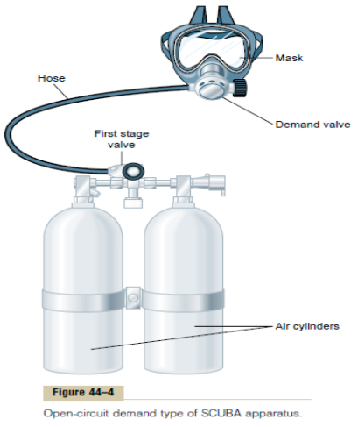
Girls slides
SCUBA Apparatus
The scuba, or self- contained underwater breathing apparatus, used by recreational, scientific, commercial, and military divers.
It permits divers to move independently under water.
This system consists of the following components:
one or more tanks of compressed air.
A first-stage "reducing" valve for reducing the very high pressure from the tanks to a low pressure level.
A combination inhalation "demand" valve and exhalation valve.
A mask and tube system with small "dead space.".

Slide 9
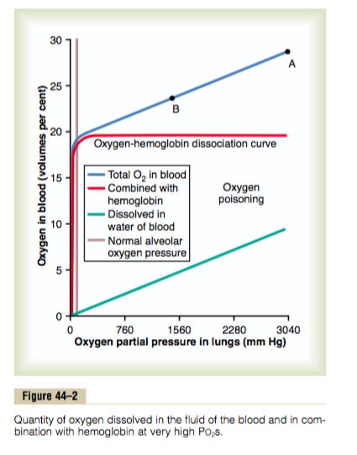
Oxygen Toxicity When Breathing Hyperbaric Air
(Effect of Very High PO2 on Blood Oxygen Transport)
When the Po2 in the blood rises above 100 mm Hg, the amount of oxygen dissolved in the water of the blood increases markedly.
Acute Oxygen Poisoning:
The extremely high tissue Po2 that occurs when oxygen is breathed at very high alveolar oxygen pressure can be detrimental to many of the body’s tissues.
At 4 atmospheres pressure of oxygen (Po2 = 3040 mm Hg) will cause:
Brain seizures followed by coma in most people within 30 to 60 minutes.
Other symptoms include: nausea, muscle twitchings, dizziness, disturbances of vision, irritability, and disorientation.

Slide 10
Oxygen Toxicity When Breathing Hyperbaric Air Cont.
Molecular oxygen (O2) has little capability of oxidizing other chemical compounds.
Instead, it will first be converted into an “active” form of oxygen called: oxygen free radicals. For example: superoxide and hydrogen peroxide.
At high levels, these oxygen free radicals can have serious destructive and even lethal effects on the cells.

Slide 11
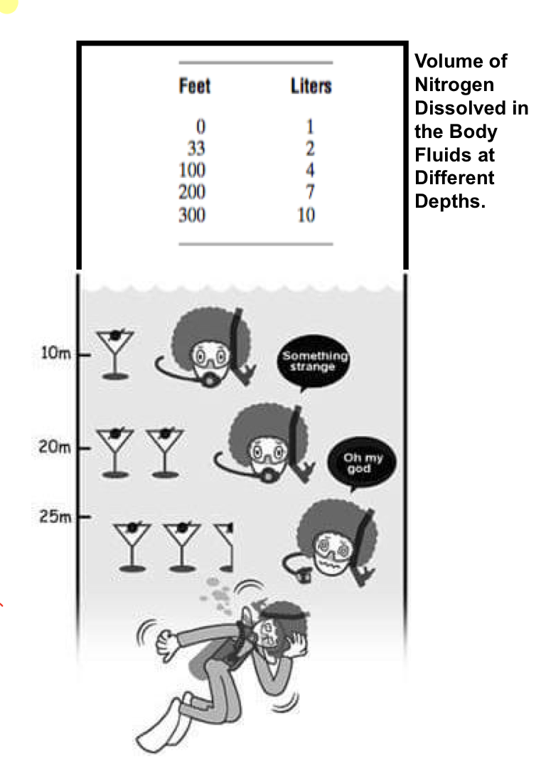
Nitrogen Narcosis
Nitrogen like most other anesthetic gases, dissolve freely in the fats of the body including the membranes and other lipid structures of the neurons (after one hour).
This leads to alteration of the electrical conductance of the membranes, reduces their excitability and subsequent narcosis develops.
At 120 feet: the diver loses many of his cares and starts to have changes in consciousness.
At 150 feet: there is a feeling of euphoria and drowsiness and impaired performance.
At higher pressure: loss of coordination and finally coma might develop.

Slide 12
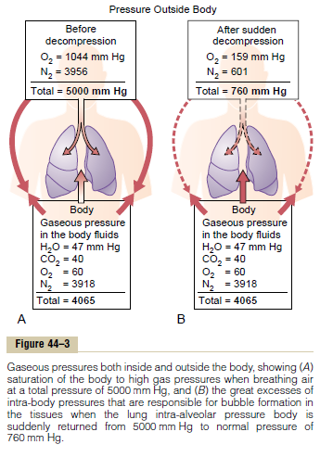
Decompression Sickness (Bends, Compressed Air Sickness, Caisson Disease, Diver’s Paralysis, Dysbarism).
It is a syndrome caused by a decrease in the ambient pressure which occurs in animals and humans when the tissues of the body contain an excess of physically inert gas.
During descent
On ascending
The high partial pressure of nitrogen (encountered when breathing compressed air at depth) forces this gas into solution in body tissue particularly in fat (it has a high N2 solubility)
This inert gas comes out of physical solution forming a gaseous phase (bubbles), leading to symptoms and signs

Slide 13
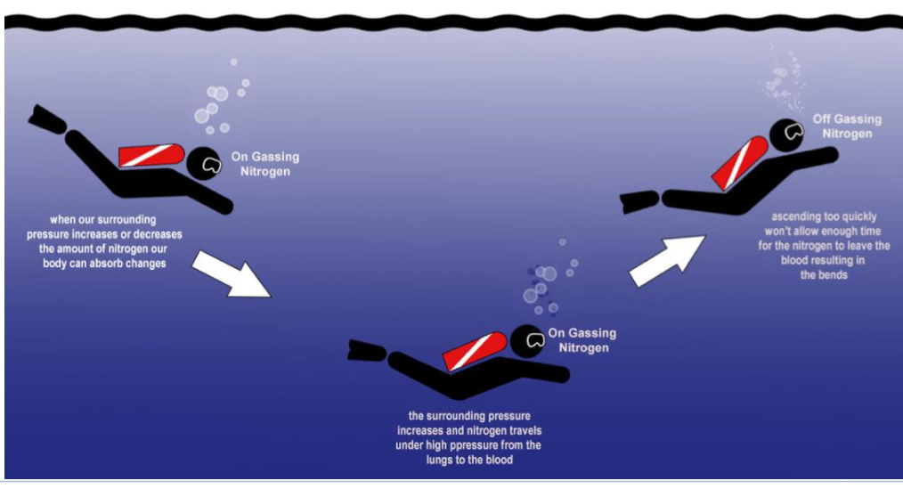
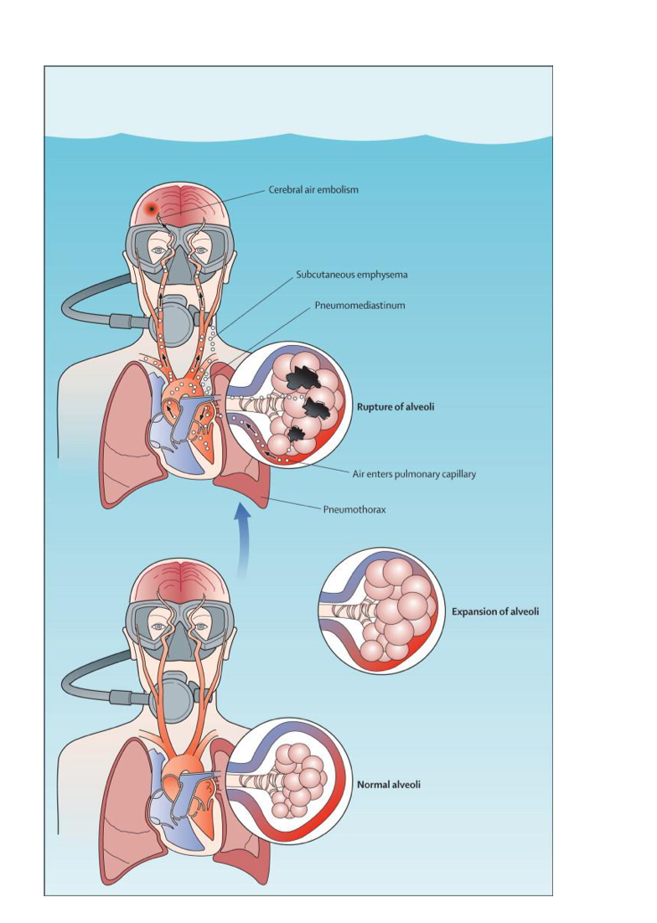
Decompression sickness Cont.
During slow ascent,
N2 is slowly removed from the tissues since the partial pressure there is higher than that in the arterial blood and alveolar gas.
If decompression is rapid,
bubbles of gaseous nitrogen are released, in tissues and blood, causing the symptoms of decompression sickness (the bends or caisson disease).

Slide 14
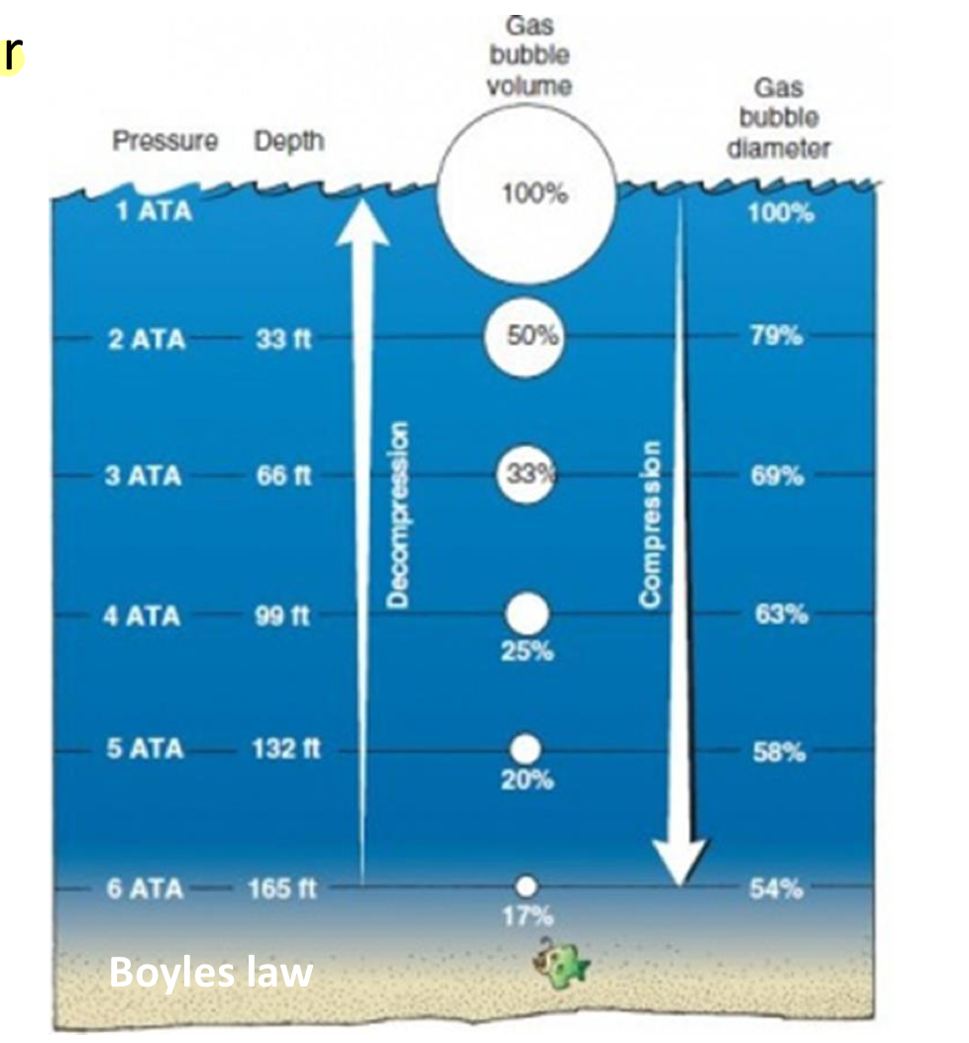
Laws Behind Decompression Sickness
Girls slides
Pascals Law applies to the diving body (without air filled areas such as lungs) states that the pressure applied to any part of the enclosed liquid will be transmitted equally in all directions through the liquid.
Boyles Law applies to the diving body's air filled areas such as lungs, sinuses, middle ear, and states that the volume and pressure of a gas at a given temperature are inversely related.

Slide 15
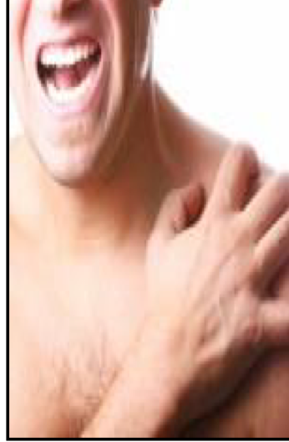
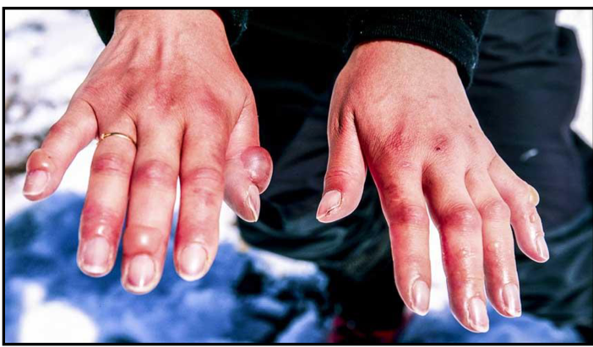
Symptoms & Signs of Decompression Sickness (DS)
The mildest form of DS:
Locally:
fatigue or drowsiness after decompression.
there is skin itch
Other severe symptoms :
Decompression sickness shock:
capillaries become permeable to plasma and hypovolemia rapidly develops.
Thoracic pains: dyspnea, substernal pain, cyanosis, and cough.
Edema may be prominent and shock is also usually complicated by pulmonary edema.
Bubbles in the tissues:
Cause severe pains particularly around the joints.
Neurological symptoms include paresthesia, itching, paralysis, and inner ear disturbances.
Bubbles in the coronary arteries: may cause myocardial damage.

Slide 16
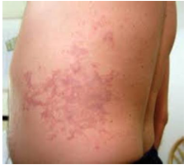
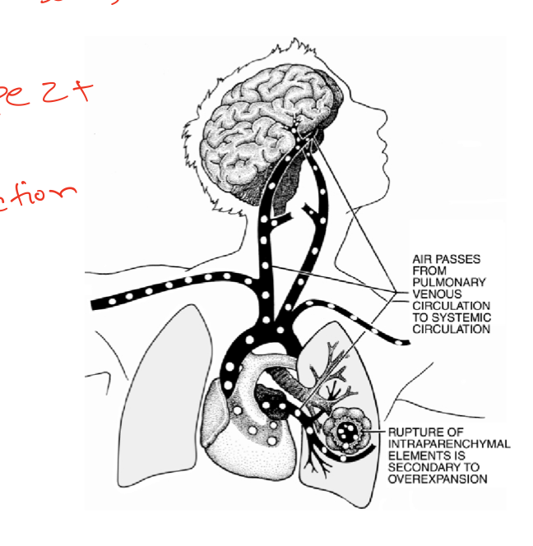
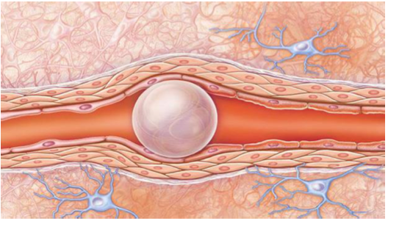
Types of Decompression Sickness
Girls slides
Type | ( pain only DCS )
Involves the joints and extremities, with constitutional symptoms
Usually only single joint is involved, most commonly:
Shoulder
Elbow
Knee
Skin and lymphatics
Pruritus, stinging, paresthesias, hot/cold sensations
Fine scarletiniform rash from nitrogen movement through sweat glands
Cutis marmorata-marbling rash, purplish-bluish discoloration.
Pitting edema, peripheral swelling from lymphatic blockage
Type II (Serious DCS)
Some consider multiple joint involvement qualifies as Type II
Spinal cord involvement:
Ascending paralysis
Signs often cannot be traced to single location in the cord (may have skip lesions)
Limb weakness, paresthesias, or paralysis.
Urinary retention, fecal incontinence, or priapism.
Vestibular ("staggers") involvement:
Vertigo, hearing loss, tinnitus.
Differentiated from inner ear barotrauma which usually occurs on descent.
Pulmonary "chokes"
Cough, hemoptysis, dyspnea, substernal chest pain.
Type III (Type II + gas embolism)
Variety of stroke symptoms/signs.
•May spontaneously resolve.

Slide 17
Treatment of Decompression Symptoms
Rapid recompression in a pressure chamber followed by slower decompression
This reduces the volume of the
bubbles and forces them back into solution.
In a very deep dive, the risk of decompression sickness can be reduced if a helium-O2 mixture is breathed during the dive.
Also it is important to reduce the oxygen concentration in the gaseous mixture to avoid oxygen toxicity that would cause seizures.
Why is Helium more desirable than nitrogen in deep dives?
1⁄7 the molecular weight of nitrogen.
1⁄4-1⁄5 the narcotic effect of nitrogen on CNS.
low density leading to decreased airway resistance of diver.
Helium is about 1⁄2 as soluble as nitrogen in body fluids.
This reduces the quantity of bubbles that can form in tissues when the diver is decompressed after diving.
Diffuses out of the tissues during decompression several times as rapidly as does nitrogen, thus reducing the problem of decompression sickness

Slide 18
Effects of Low Oxygen Pressure on the Body
( Aviation-Ascend to High Altitude)
At the sea level the barometric pressure is 760 mmHg.
At 10,000 feet is 523 mmHg.
At 50,000 feet 87 mmHg.
This decrease in barometric pressure is the basic cause of all the hypoxia problems in high altitude in physiology.

Slide 19
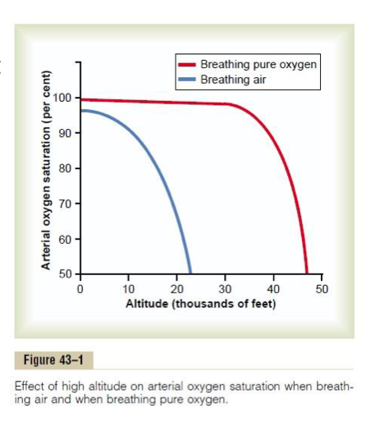
Alveolar PO2 at different altitudes
As the barometric pressure decreases, the oxygen partial pressure decreases proportionally, remaining less than 21 % of the total barometric pressure.
At sea level PO2= 159 mmHg
At 20,000 feet PO2= 40 mmHg.
At 50,000 feet PO2= only 18 mmHg.
Even at high altitude CO2 is continuously excreted from the pulmonary blood into the alveoli. Also, water vaporizes into the inspired air from the respiratory surfaces.
Therefore, these two gases dilute the oxygen in the alveoli, thus reducing the oxygen concentration and therefore hypoxia develops.

Slide 20
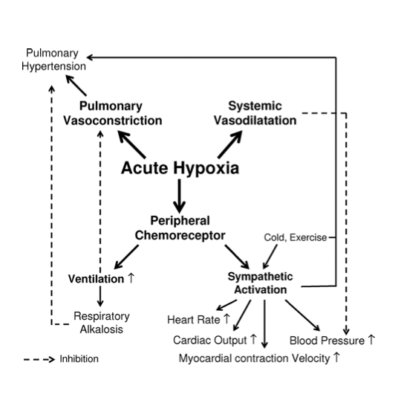
Effects of Acute Hypoxia
At 12.000 feet | Above 18,000 feet | Above 23,000 feet
• Drowsiness • Lassitude ارهاق • Mental and muscle fatigue •Sometimes headache •Occasionally nausea •Sometimes euphoria (happiness) | All the effects at 12,000 and 1- Twitching 2-Or convulsions | Coma (for un-acclimatized person)

Slide 21
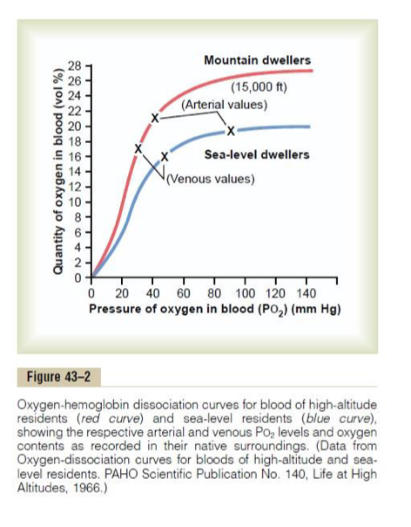
Acclimatization to low PO2
Girls slides
Acclimatization means :
the process or result of becoming accustomed to a new climate or to new conditions.
A person remaining at high altitudes for days , weeks or years becomes more and more acclimatized to low PO2.
So that it causes fewer deleterious effects on the body and it becomes possible for the person to work harder without hypoxic effects or to ascend to still higher altitude.

Slide 22
Chronic Breathing of Low O2 Stimulates
Respiration — Phenomenon of “Acclimatization”
Mountain climbers who ascend a mountain slowly, over a period of days rather than hours, can breath much more deeply and therefore can withstand far lower atmospheric O2 concentrations than when they ascend rapidly. This phenomenon is called acclimatization.
The reason for acclimatization is that, within 2 to 3 days, the respiratory
center in the brain stem loses about four fifths of its sensitivity to changes in PCO2 and hydrogen ions.
The excess blow-off of CO2 that normally would inhibit an increase in respiration fails to occur and low O2 can drive the respiratory system to a much higher level of alveolar ventilation than under acute conditions.
Instead of the 70 percent increase in ventilation that might occur after acute exposure to low O2, the alveolar ventilation often increases 400 to 500 percent after 2 to 3 days of low O2, which helps immensely in supplying additional O2 to the mountain climber.
It causes fewer deleterious effects on the body and it becomes possible for the person to work harder without hypoxic effects or to ascend to still higher altitude.

Slide 23
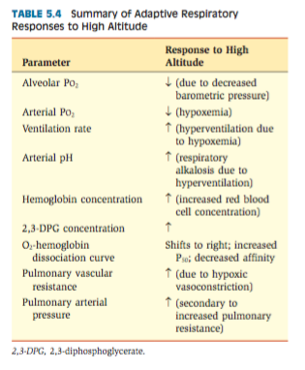
Principle means of acclimatization
1- Increase in pulmonary ventilation.
2- Increased red blood cells.
3-Increased diffusing capacity of the lungs.
4- Increased vascularity of the tissues.
5-Increased ability of the cells to utilize oxygen despite the low PO2 through increased number of mitochondria and oxidative enzymes activity.

Slide 24
HYPOXIA-INDUCIBLE FACTORS ( HIFs): A MASTER SWITCH” FOR THE BODY’S RESPONSE TO HYPOXIA
Hypoxia-inducible factors (HIFs) are DNA-binding transcription factors that respond to decreased oxygen availability and activate several genes that encode proteins needed for adequate oxygen delivery to tissues and energy metabolism.
HIFs are found in virtually all oxygen-breathing species, ranging from primitive worms to humans.
Some of the genes controlled by HIFs, especially HIF-1, include the following:
Genes associated with vascular endothelial growth factor, which stimulates angiogenesis.
Erythropoietin genes that stimulate red blood cell production.
Mitochondrial genes involved with energy utilization.
Glycolytic enzyme genes involved with anaerobic metabolism.
Genes that increase availability of nitric oxide, which causes pulmonary vasodilation.

Slide 25
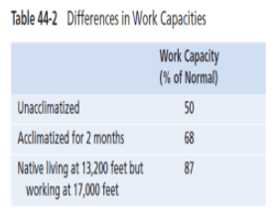
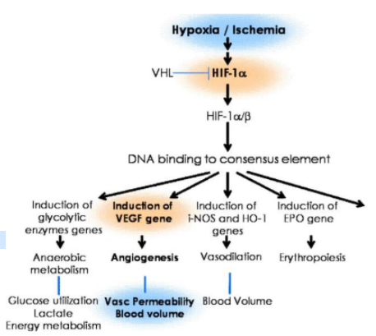
Cont. HIFs
In the presence of adequate oxygen, the subunits of HIF required to activate various genes are downregulated and inactivated by specific HIF hydroxylases.
In hypoxia, the HIF hydroxylases are themselves inactive, allowing the formation of a transcriptionally active HIF complex. Thus, the HIFs serve as a “master switch” that permits the body to respond appropriately to hypoxia.

Slide 26
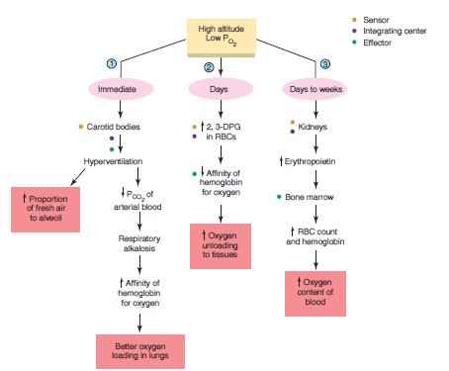
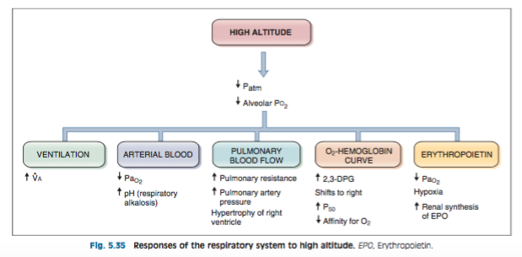
Body Response to High Altitude/
Acclimatization to Low PO2

Slide 27
Acute Mountain Sickness- High Altitude Pulmonary Edema
Girls slides
Lower levels of oxygen and reduced air pressure are the primary causes of Acute Mountain Sickness.
These symptoms may range from mild to severe depending on the severity of the condition.
the onset of symptoms of Acute Mountain Sickness is usually within hours of arriving at that altitude.
The symptoms of severe form of Acute Mountain Sickness include:
Some of the symptoms of mild Acute Mountain Sickness are:
. Persistent coughing
. Chest congestion
. Individual looks pale
. Loss of balance
. Ambulation difficulties
Dizziness, Headaches, Muscle pain, Inability to sleep, Nausea along with vomiting Irritable mood, Appetite loss, Swelling of the upper and lower extremities, Increased heartbeat, Difficulty breathing with any strenuous activity.
There may be fluid build-up in the lungs causing shortness of breath even with slight activity.

Slide 28
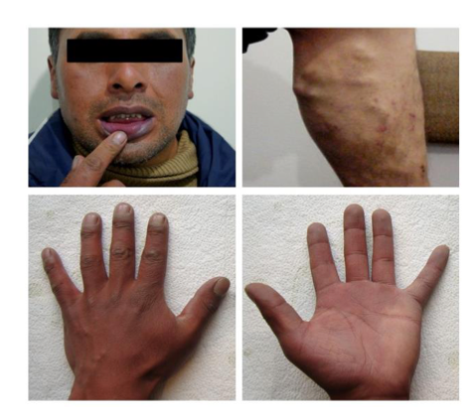
Chronic Mountain Sickness
Girls slides
CMS is defined as a clinical syndrome that occurs in Natives or lifelong altitude residents (>2500m), and it is characterized by excessive erythrocytosis and severe hypoxemia.
Frequently, it is associated with moderate or severe pulmonary hypertension that may evolve to cor-
pulmonale and lead to congestive heart failure.
Typical CMS patient. Note the deep purplish color of lips and gums as a consequence of EE and low SpO2. Vein dilatation is particularly evident in the lower limbs, and characteristic clubbing of fingers and marked cyanosis are evident in nail beds and palms of the hands. CMS, chronic mountain sickness; EE, excessive
erythrocytosis.
The clinical picture of CMS gradually disappears upon
descent to low altitudes and reappears after returning
to high altitude.

Slide 29
MCQ
For more questions
Q1- As a climber ascends to altitude, which of the following increases?
A-Barometric pressure | B-Saturated water vapor | C-Arterial Pco2 | D- Alveolar ventilation
Q2- When the Po2 in the blood rises above 100 mm Hg, the amount of oxygen dissolved in the blood:
A- Increases | B- Decreases | C- Does not change
Q3- At ……. attitude ,The ……. In barometric pressure is the basic cause of hypoxia problems.
A- High , Increase | B- Low , Increase | C- High , Decrease | D- Low , Decrease
Q4- which of the following has high capacity of oxidizing other chemical compounds?
A- Oxygen | B-hydrogen peroxide | C- Carbon dioxide | D-hydrogen
Q1:D Q2:A Q3:C Q4:B

Slide 30
SAQ
Q1/Enumerate the effects of nitrogen at high nitrogen pressure (in increased barometric pressure)?
Q2/What is the role of HYPOXIA-INDUCIBLE FACTORS ( HIFs)?
Answers:
Q1/ 1-Decompression thickness.
2-Nitrogen narcosis .(slide 6)
Q2/ DNA-binding transcription factors that activating several genes that encode proteins needed for adequate oxygen delivery to tissues and energy metabolism. (slide 20)

Slide 31
Team leaders
Deema aljuribah Mishal Alsuwayegh Waleed Alrashoud
Team members
Maram Beyari
Raghad Alnadeef
Hend Almogary
Farah Alfayez
Kadi aldoosari
Farah Alqazlan
Ghada Binslmah
Shatha Alshabani
Raghad Alkhudair
Faisal Ali
Othman Aldraihem
Abdullah Alqarni
Rayan Alotaibi
Faisal Alkhunein
Mishari Alenezi
Bandar Almutiri
Fahad Alhelelah
Rayan Bosaid
Ibraheem Alkanhal
Saad Alhammad
Emad Almutairi
Ahmad Almarshed
Salman Almutaz
Osama Alzahrani
Haifa Almuddahi
Haifa Alamri
Jana Alhazmi
Meznah Ahmad
Maha Alkoryshy
Physio442@gmail.com

