Slide 1
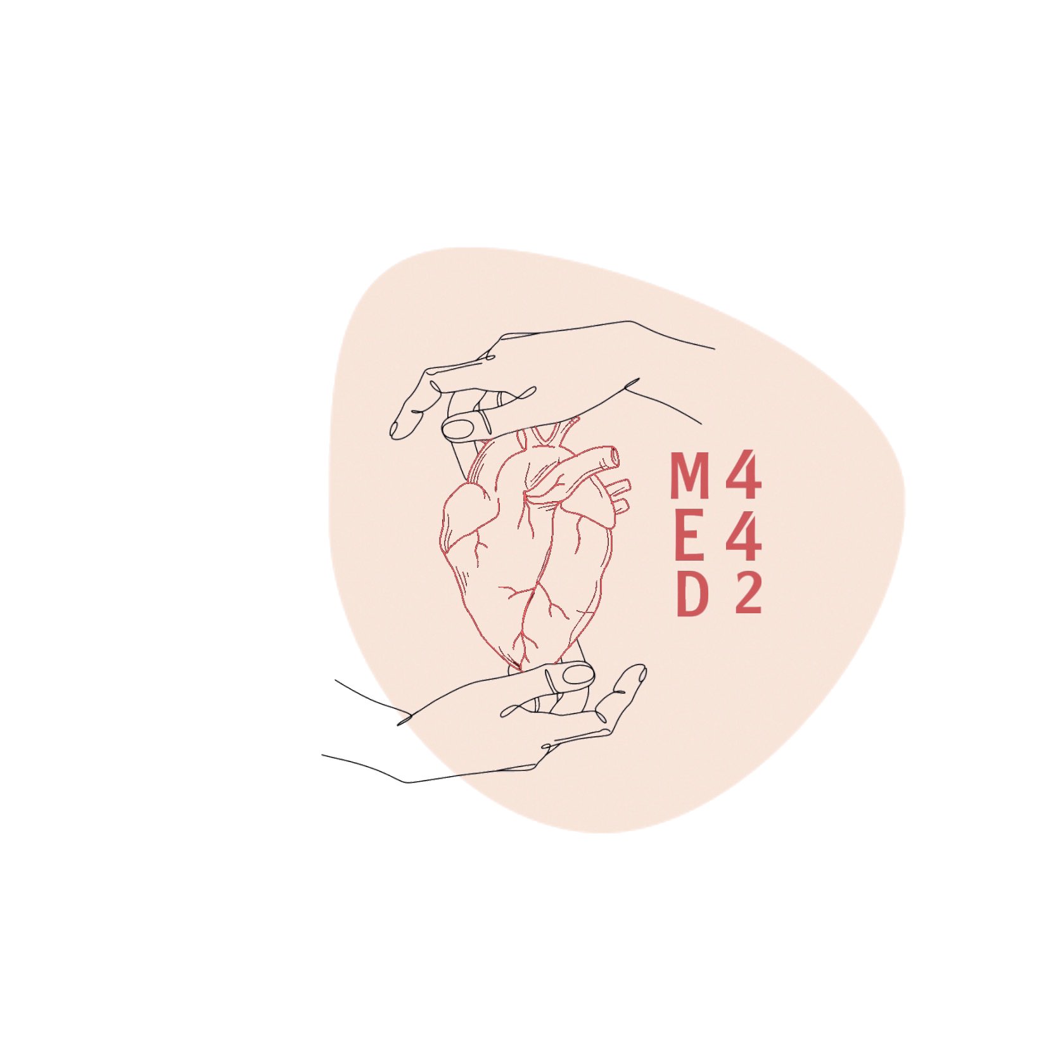
L-2
Mechanics of Pulmonary Ventilation
Color index:
Main text
Important
Doctor notes
Boys slides
Girls slides
Extra
Editing file

Slide 2
Objectives:
By the end of this lecture you will be able to:
1- List the muscles of respiration and describe their
roles during inspiration and expiration.
2- Identify the importance of the following pressures in
respiration: atmospheric, intra-alveolar, intrapleural,
and transpulmonary.
3- Explain why intrapleural pressure is always
subatmospheric under normal conditions, and the
significance of the thin layer of the intrapleural fluid
surrounding the lung.
4- Define lung compliance and list the determinants of
compliance.

Slide 3
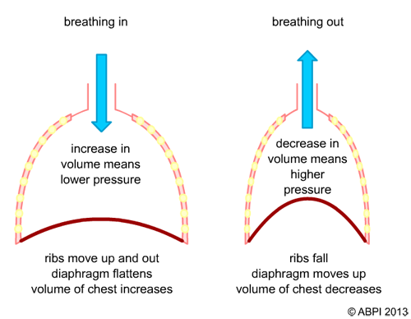
Helping video
Mechanics of Breathing
Pulmonary Ventilation : The physical movement of air into and out of the lungs.
Air movement depends upon Boyle’s Law
P X V = K
P1 x V1= P2 x V2
P= pressure
V= volume
K =constant
The P is inversely proportional to the V
في حالة الشهيق يقل الضغط وتزيد الكثافة
في الزفير يزيد الضغط وتقل الكثافة
العلاقة بين P , V عكسية, اذا زاد واحد يقل الثاني والعكس صحيح
Volume depends on the movement of diaphragm & ribs

Slide 4
Muscles of Breathing
Normal Inspiration
Diaphragm (most important muscle) (if it contracts it increases the vertical diameter, increasing the volume)
External intercostal muscles (it elevates the ribs, increasing the antero-posterior diameter also increasing the volume)
Deep forceful inhalation (inspiration)
Muscles of resting inspiration (above)+ Accessory muscles of inspiration participate to increase size of the thoracic cavity:(they work only in forceful inspiration or if there is a disease)
Sternocleidomastoid elevate sternum
Scalene elevate first two ribs
Anterior serrati elevates many ribs
Pectoralis minor elevate 3rd–5th ribs

Slide 5
Muscles of Breathing
Normal expiration:
passive process that depends on the recoil tendency of lung → no muscle contraction (it means relaxation of diaphragm and external intercostal muscle )
During forceful expiration:
active process
Contraction of muscles of exhalation (expiration) increases pressure in abdomen and thorax e.g
Abdominal muscles
Internal intercostal

Slide 6
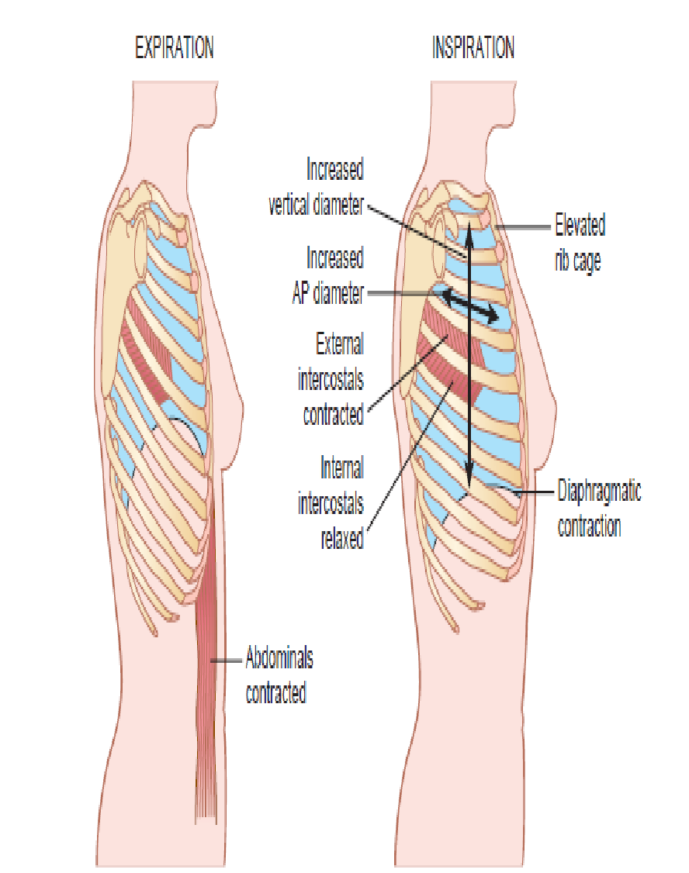
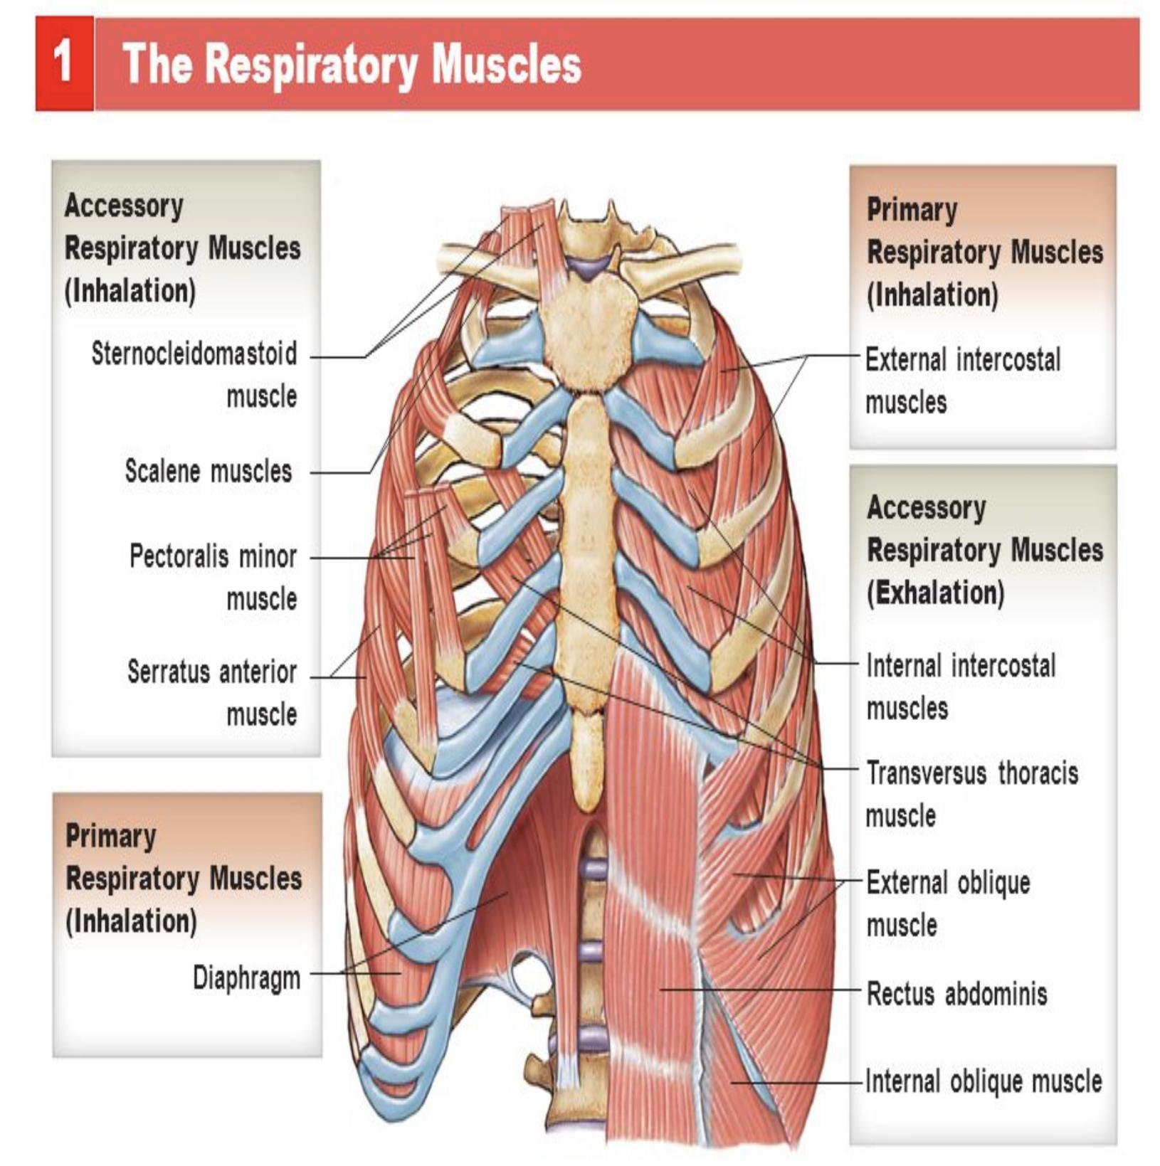
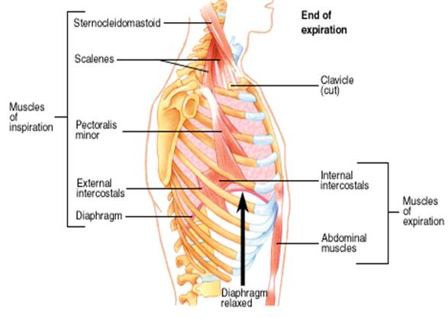
Muscles of Breathing

Slide 7
Different Pressures That Affect Respiration
Atmospheric: pressure within the atmosphere (outside the lung)
(760 mmHg)
Alveolar (intra-alveolar/intrapulmonary): pressure inside the lung (Alveoli) (760/0 mmHg)
Intrapleural: pressure within the pleural cavity (756/ -4mmHg)
(prevent the collapsing of the lung)
Transpulmonary: the difference between alveolar and pleural pressure (760-756= 4 mmHg)

Slide 8
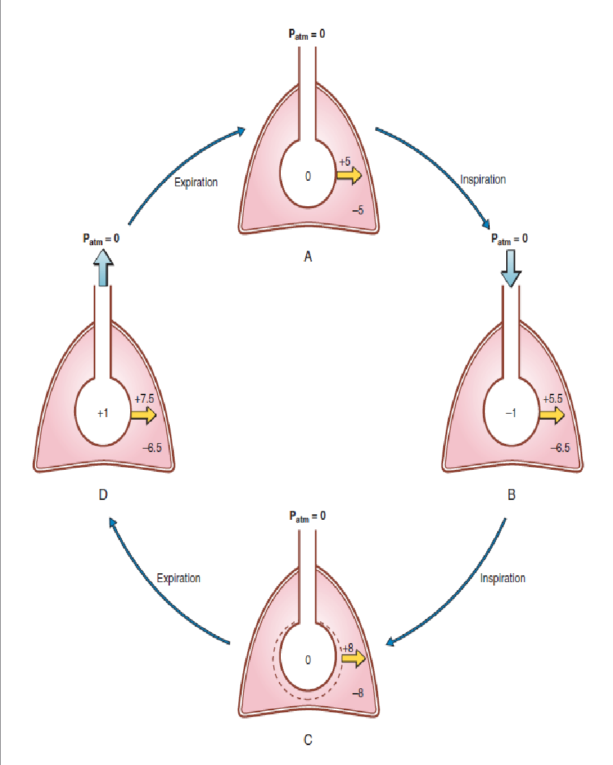
Different Pressures That Affect Respiration
A → B:
Alveolar pressure = atmospheric =760/ 0 mmHg
Diaphragm contract & descent + external intercostal muscles contract & elevated ribs → vertical + antero-posterior + lateral diameters of thoracic cavity increased → increased volume → alveolar pressure decreased (- 1 mmHg).
B → C:
Air moves from area of high pressure (atmosphere) to area of low
pressure (lung)
Air keeps entering the lung until the pressure is equalized between
atmosphere & lung (0 mmHg -peak point of inspiration-).
C → D:
Inspiratory muscles relax (diaphragm ascent + external intercostal cause ribs to fall). → thoracic cavity decreased → decreased volume → alveolar pressure increased (+ 1 mmHg).
D → A:
Air moves from area of high pressure (lung) to area of low pressure (atmosphere).
Air keeps exiting the lung until the pressure is equalized between
atmosphere & lung
(0 mmHg).

Slide 9
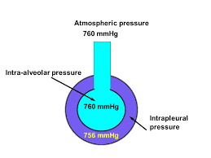
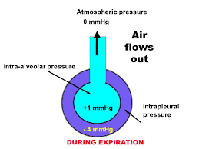
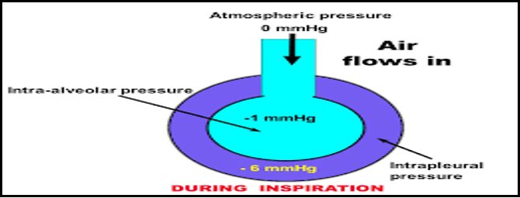
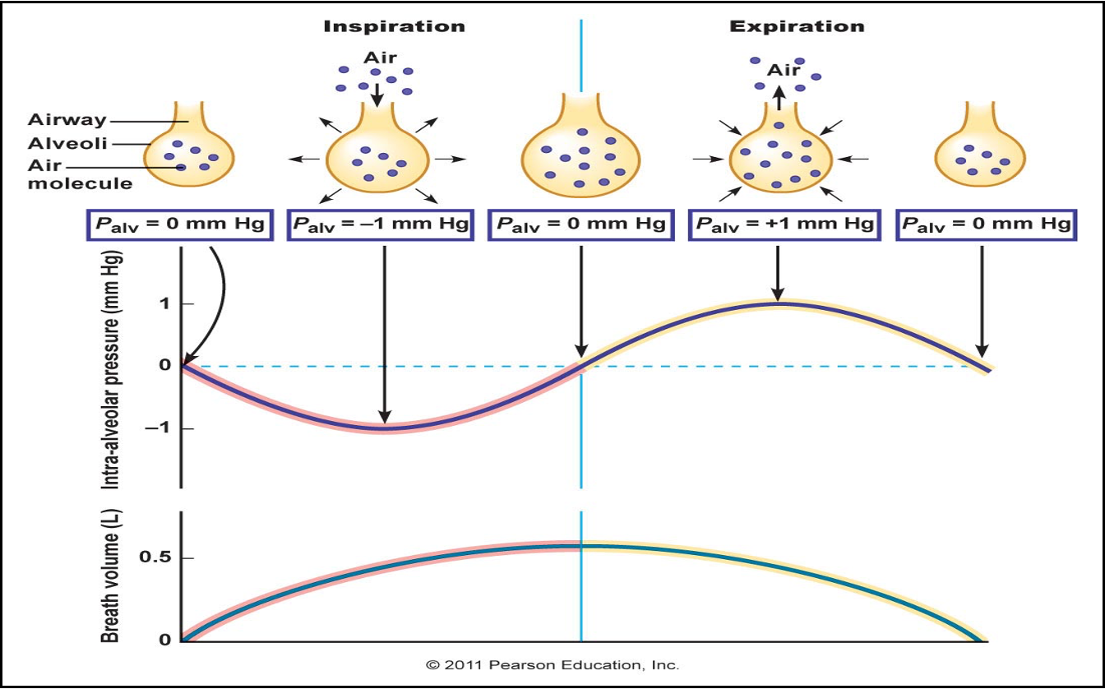
Intra-Alveolar Pressure
The pressure in all parts of the respiratory airways
Between breaths (no inspiration or expiration):
0 mmHg (zero pressure)
During inspiration:
-1 mmHg
Air/tidal volume flows outside → inside lungs.
Lung volume will increase.
At the end of inspiration:
0 mmHg
Air flow stops.
During expiration (the pressure will increased):
+1 mmHg
Becomes +ve with respect to the atmosphere.
Air/tidal volume flows inside → outside lungs.
Lung volume will decrease.

Slide 10
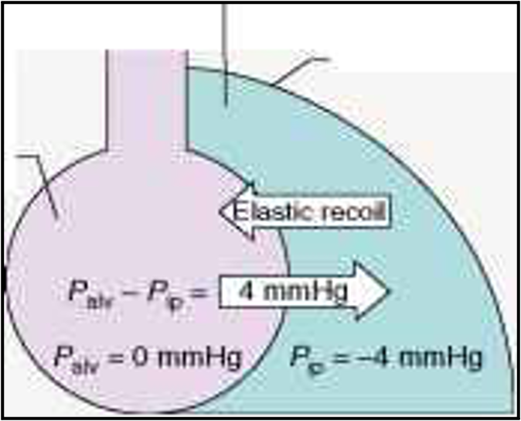
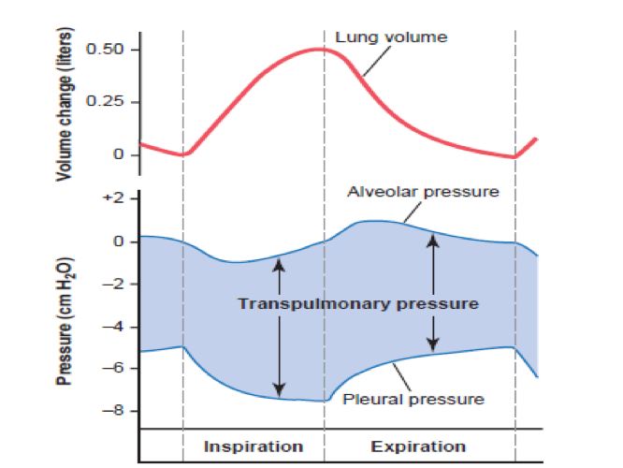
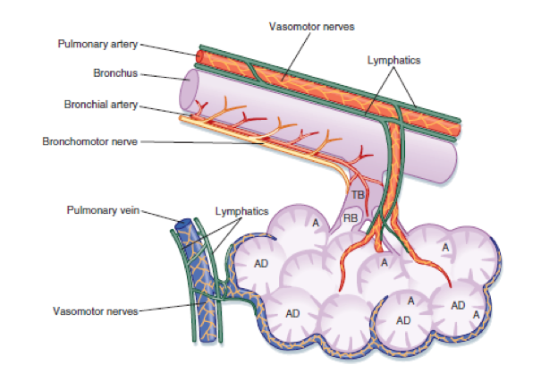
Intrapleural Pressure (IPP)
Intrapleural pressure: pressure of the fluid found in the thin
space between lung pleura and chest wall pleura.
Pressure in the pleural space is negative with respect to atmospheric pressure
at the end of normal expiration (-5 cm H₂O).
Why is it negative??
two opposing forces:
The lung's elastic tissue which cause it to recoil
The chest wall’s tissue which cause it to expand
2. The pleural space is a potential space (empty) due to continuous suction of
fluids by lymphatic vessels (which is also the basis of the negative pressure found
in most tissue spaces of the body).

Slide 11
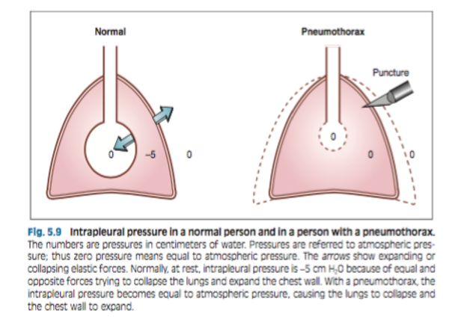
Values of IPP
During resting position (between breaths):
-5 cm H₂O (-4 mmHg).
Intrapleural pressure during resting position: the amount of suction required to hold the lungs open to their resting level.
During resting inspiration:
Becomes more negative.
-7.5/-8 cm H₂O
Pneumothorax:Intrapleural pressure becomes equal to atmospheric pressure → lungs collapse + chest wall expands.

Slide 12
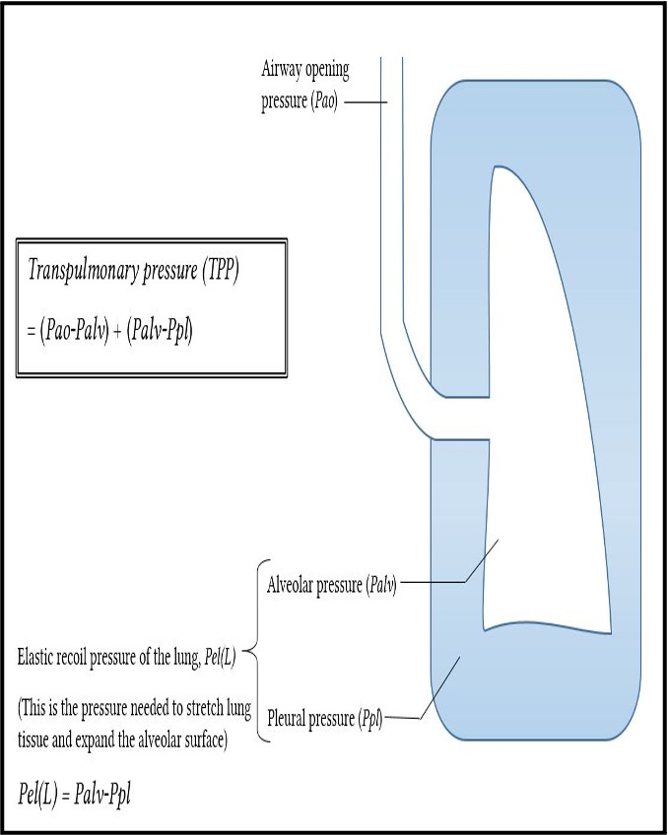
Transpulmonary Pressure (TPp)
Transpulmonary/Extending Pressure: the difference between alveolar pressure (Palv) and the pleural pressure (Ppl).
TPp = Palv - Ppl
Measures the elastic forces in lungs that tend to collapse the lungs. (recoil pressure)
The bigger the volume of the lung the higher will be its tendency to recoil. E.g TLC
It prevents lung collapse
(always positive)
During rest (0 - -5 = +5)

Slide 13
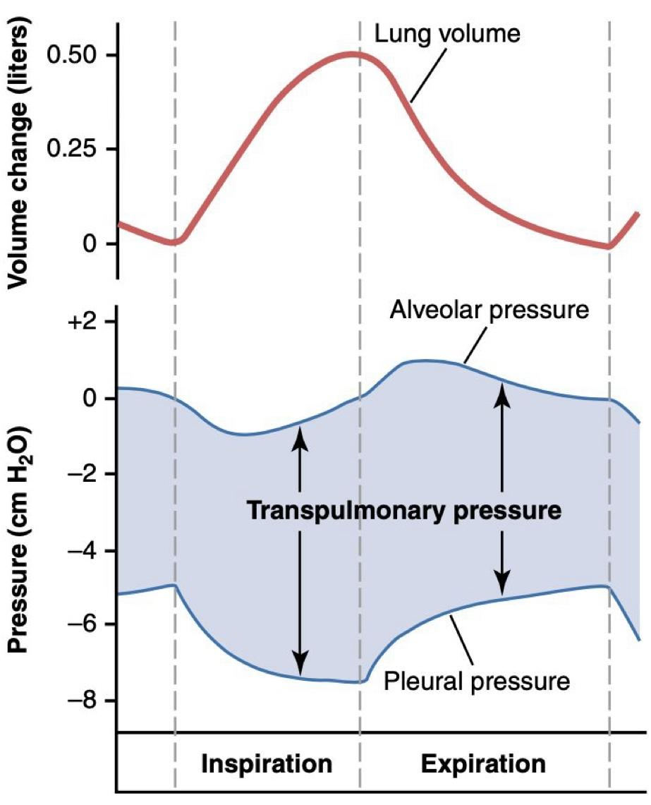
Compliance of the Lung (CL)
Helping video
Helping video
Lung Compliance (CL): the extent to which the lungs will expand for each unit increase in the transpulmonary pressure is called the lung compliance (CL)
ΔV
CL =
ΔP
CL :
For both lungs in adult: 200 ml of air/cm H₂O
For lungs & thorax together: 110 ml/cm H₂O
Team 439:
Thick rubber Low compliance
Thin rubber High compliance
CL: is the ratio of the change in the lung volume produced per unit change in the distending (transpulmonary/recoli) pressure.

Slide 14
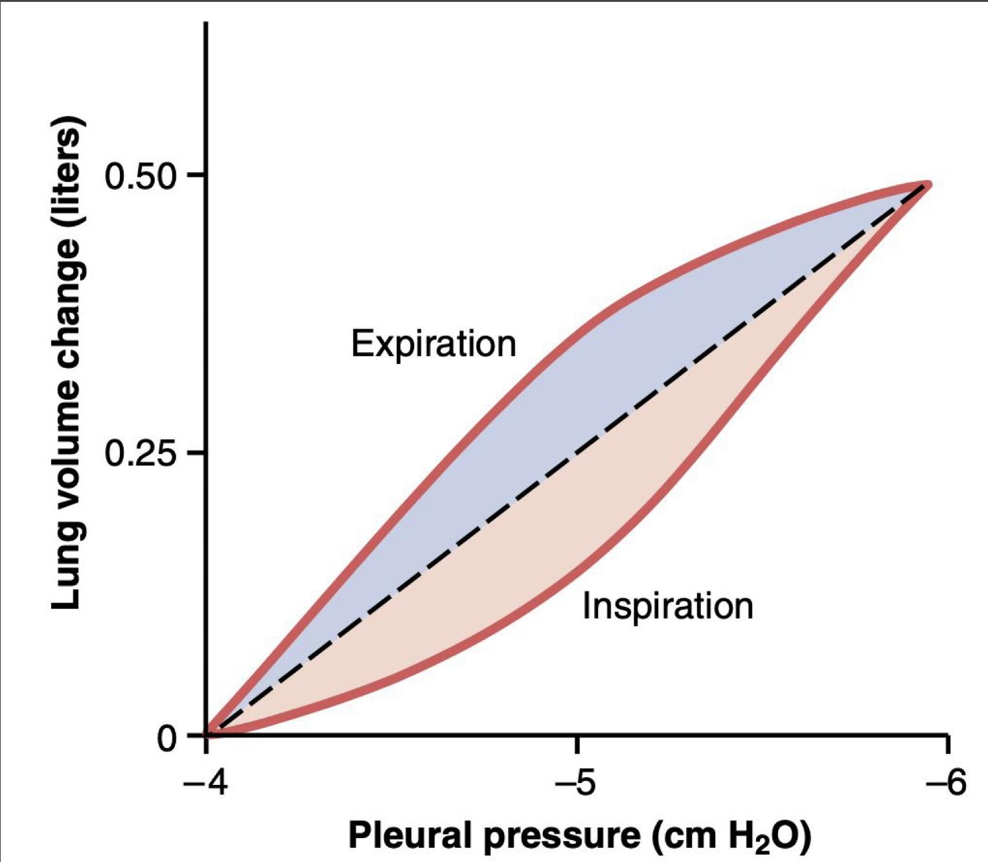
Compliance Diagram of the Lungs
The characteristic of the compliance diagram are determined by the elastic forces of the lungs.
These can divided into:
⅓ is due to elastic fibers/forces of lung tissue itself. Caused by: elastin and collagen fibers.
⅔ of the elastic forces caused by surface tension of the fluid that lines the inside walls of the alveoli and other lung air spaces.
The diagram shows compliance of the lungs only

Slide 15
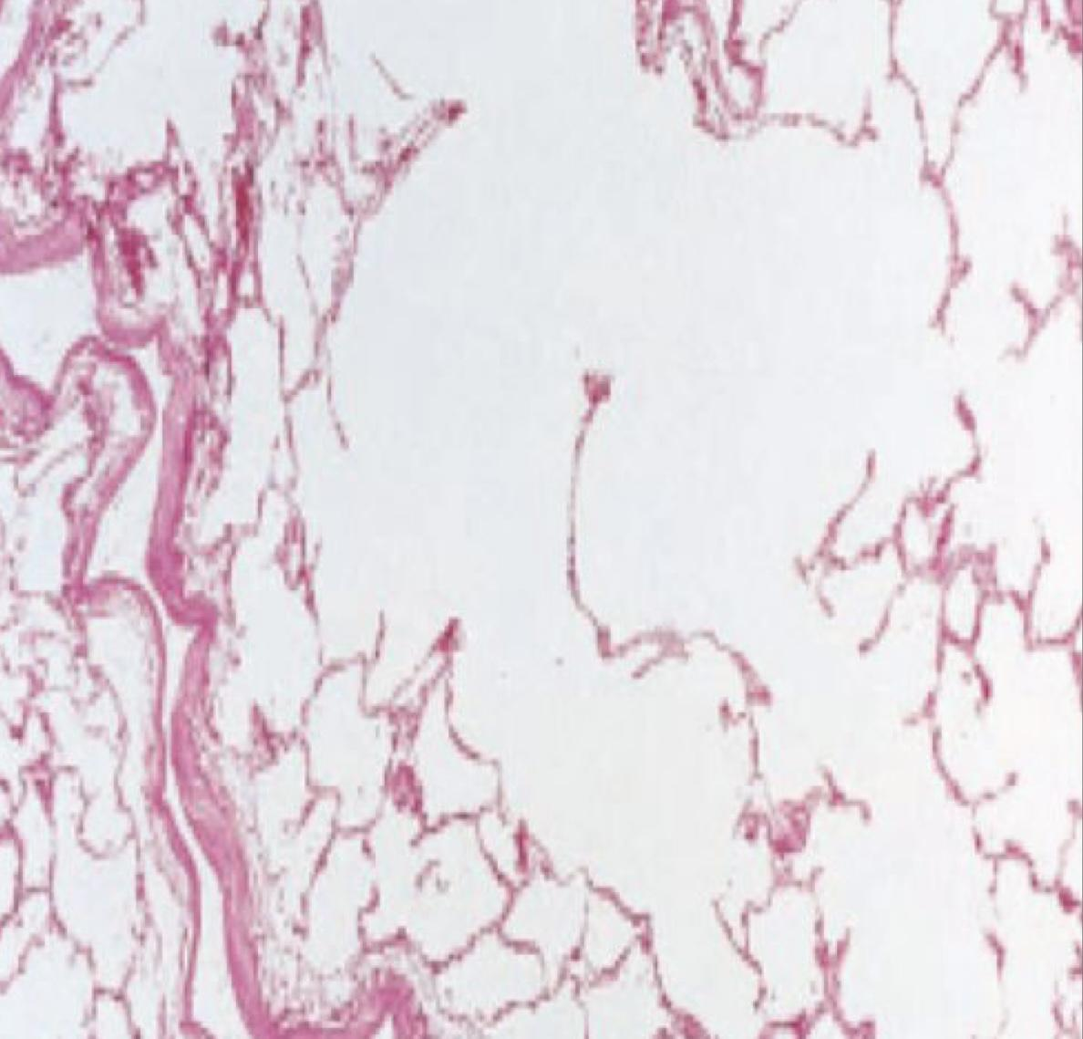
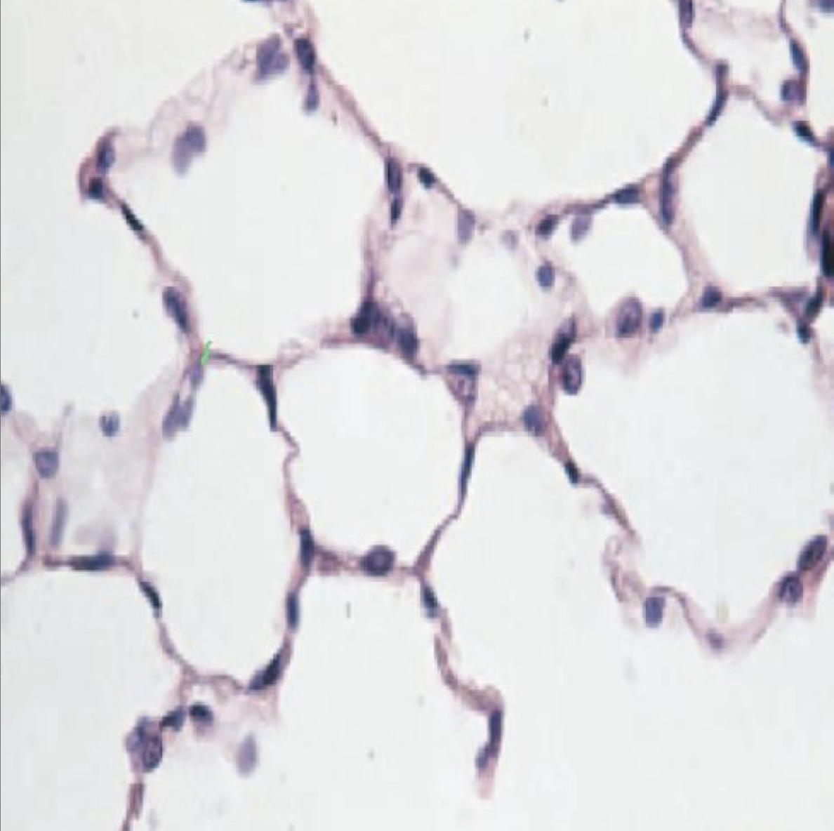
Diseases Affecting Lung Compliance
All lung diseases will decrease the lung compliance, except emphysema
Lung compliance is increased in :
Lung compliance is reduced in :
Emphysema
Pulmonary fibrosis
Elastic fibers are replaced by collagen (less elastic) , so the compliance will decrease
Pulmonary Edema
Because it destroys the alveolar septal tissue rich with with elastic fibers that normally oppose lung expansion.
Diseases of chest wall:
Kyphosis - scoliosis - paralysis of muscles.
Kyphosis: تحدب الظهر
Scoliosis: (ميلان العمود الفقري) (الجنف)

Slide 16
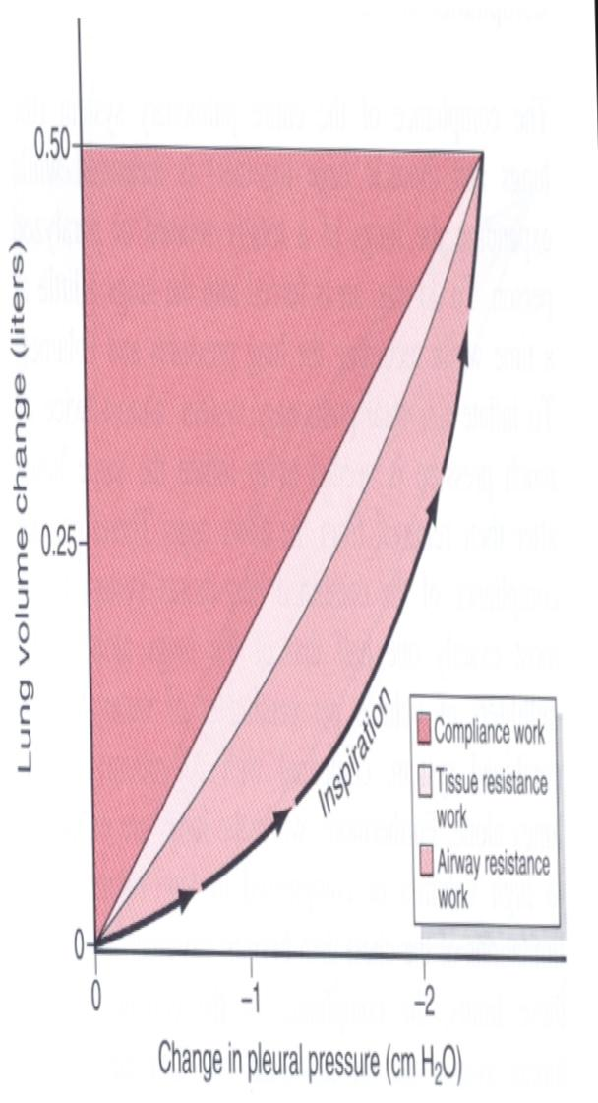
The Work of Inspiration
The work of inspiration is divided into three parts:
Hh Expand the lungs against the lung and chest elastic forces (65%)
Compliance/elastic work
To overcome the viscosity of the lung and chest wall structures. (7%)
Tissue resistance work
Required to overcome airway resistance during the movement of air in the lungs. (28%)
Airway resistance work
During pulmonary diseases all 3 types of work are increased.

Slide 17
Energy Required for Respiration
Energy required for respiration is 3-5% of total energy expended (used) by the body.
Heavy exercise: can increase 50 folds, especially if the person has any degree of increased airway resistance or decreased pulmonary compliance.
One of the major limitations on the intensity of exercise that can be performed is the person’s ability to provide enough muscle energy for the respiratory process alone.

Slide 18
MCQ
For more questions
Click here
1- A healthy 25-year-old medical student participates in a 10km charity run for an american heart association. Which muscle does the student use (contract) during the expiration?
A) Diaphragm and external intercostal | B) Diaphragm and internal intercostal | C) Internal intercostal and abdominal recti | D) Scaleni
2- The pleural pressure of normal 56-years old woman is approximately -5 cm H₂O during resting conditions immediately before inspiration, what is the pleural pressure in (cm H₂O) during inspiration?
+1 | B) +4 | C) 0 | D) -7.5
3- Using the equation PV=constant; if the volume of thoracic cavity decreases, the pressure inside the thoracic cavity will..
Increase | B) Decrease | C) Stay the same | -
4- When the pressure within the thoracic cavity decreases (compared to atmospheric pressure) air will……………….the lungs
Exit | B) Enter | C) Not enter or exit | -
Answers :
C
D
A
B

Slide 19
SAQ
1-Enumerate the different types of work of inspiration?
2-explain the compliance of the lung?
3-why the emphysema increased the lung compliance?
Answers :
1- compliance/elastic work, tissue resistance work, airway resistance work
2-the extent to which the lungs will expand for each unit increase in the transpulmonary pressure is called the lung compliance (CL), also is the ratio of the change in the lung volume produced per unit change in the distending (transpulmonary/recoli) pressure.
3- Because it destroys the alveolar septal tissue rich with with elastic fibers that normally oppose lung expansion.

Slide 20
Team leaders
Deema aljuribah Mishal Alsuwayegh Waleed Alrashoud
Team members
Maram Beyari
Raghad Alnadeef
Hend Almogary
Farah Alfayez
Kadi aldoosari
Farah Alqazlan
Ghada Binslmah
Shatha Alshabani
Raghad Alkhudair
Faisal Ali
Othman Aldraihem
Abdullah Alqarni
Rayan Alotaibi
Faisal Alkhunein
Mishari Alenezi
Bandar Almutiri
Fahad Alhelelah
Rayan Bosaid
Ibraheem Alkanhal
Saad Alhammad
Emad Almutairi
Ahmad Almarshed
Salman Almutaz
Osama Alzahrani
Haifa Almuddahi
Haifa Alamri
Jana Alhazmi
Meznah Ahmad
Maha Alkoryshy
Physio442@gmail.com
Thanks to Raneem Alwatban for the notes

