Slide 1
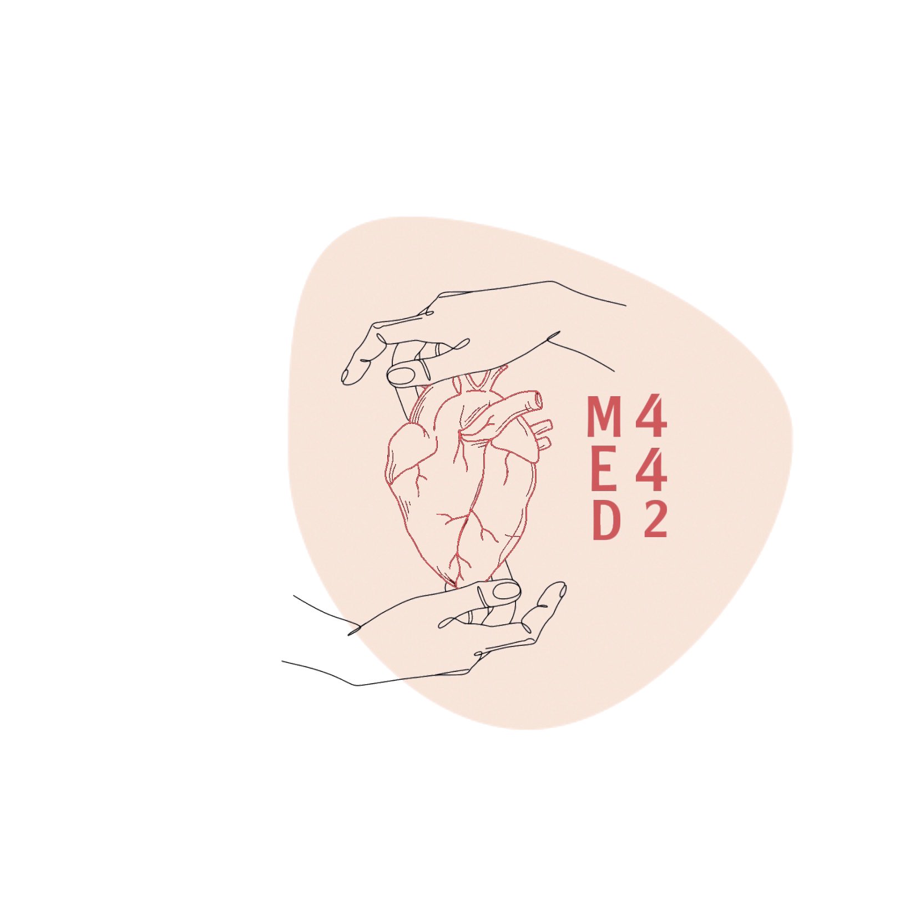
L-3
Respiratory Ventilation (Assessment of Lung Function)
Color index:
Main text
Important
Doctor notes
Boys slides
Girls slides
Extra
Editing file

Slide 2
Objectives:
Define the various lung volumes and capacities and provide typical values for each.
Define ventilation rate, their typical values, and their measurement.
Describe FEV1 and its role in differentiating obstructive and restrictive lung diseases.
Describe the types of dead space. State a volume for the anatomical dead space.
Define the term minute volume and state a typical value.
Distinguish minute ventilation from alveolar ventilation.

Slide 3
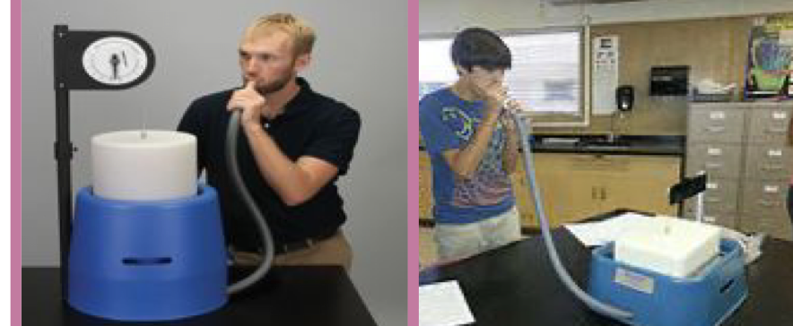
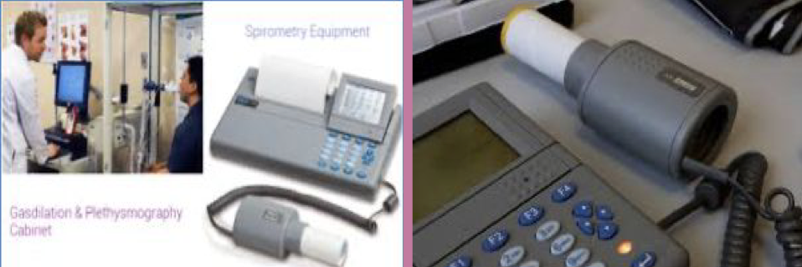
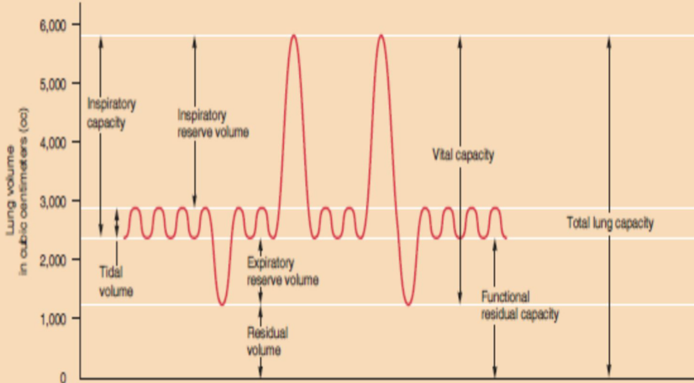
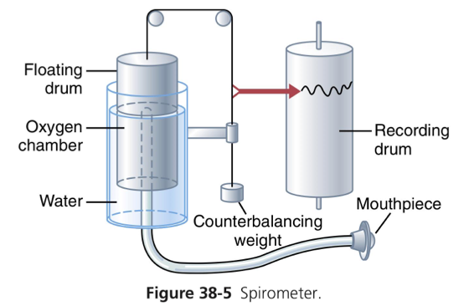
Pulmonary Function Test
Functionality of the lung is measured using spirometry.
There are two types of spirometers: dynamic and simple.
The reading is presented in the form of a spirogram.
Simple spirometer
Dynamic spirometer
Extra information from Guyton and Hall Textbook of Medical Physiology:
The spirometer consists of a drum (counterbalanced by a weight) inverted over a chamber of water.
● Inside the drum: breathing gas (air or O2) + a tube that connects the mouth with the gas chamber.
● One breathes into & out of chamber → drum rises and falls → an appropriate recording is made on a moving sheet of paper.
Spirogram

Slide 4
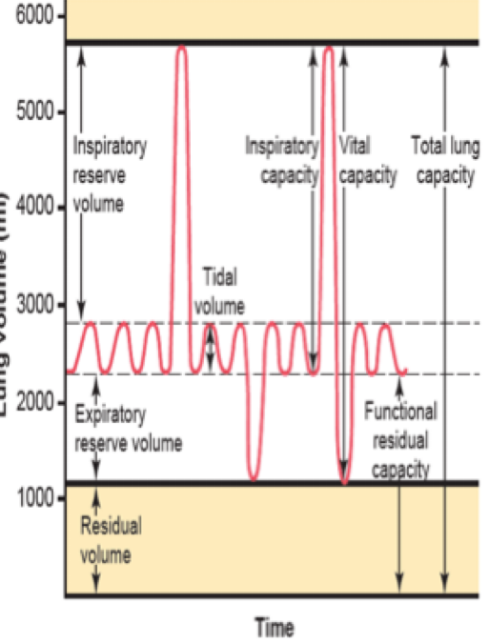
Lung Volumes
Tidal Volume (TV)
Inspiratory Reserve Volume (IRV)
Expiratory Reserve Volume (ERV)
Residual Volume (RV)
Volume of air inspired or expired with each normal breath. (نفس طبيعي)
~500 ml
Extra volume of air that can be inspired above the normal tidal volume when the person inspires with full force (Deep inhalation)
(لين تمتلي الرئتين)
~3000 ml
Maximum extra volume of air that can be expired by forceful expiration after the end of a normal tidal expiration.
(تحاول تطلع كل الهواء)
~1100 ml
Volume of air remaining in the lungs after the most forceful expiration.
(هواء متبقي في الرئتين ما تقدر تطلعه)
~1200 ml

Slide 5
Lung (Pulmonary) Capacities
Two or more lung volumes are described as pulmonary capacity
Inspiratory Capacity (IC)
Functional Residual Capacity (FRC)
The Vital Capacity (VC)
Total lung capacity (TLC)
Amount of air that remains in the lungs after normal tidal expiration. Acts as a buffer against extreme changes in alveolar gas levels with each breath.
FRC=ERV+RV=1100+1200=2300ml
Maximum amount of air a person can expel from the lungs after first filling the lungs to their maximum extent and then recording expiring to the maximum extent.
VC=TV+IRV+ERV=
500+3000+1100=4600ml
Is the maximum volume to which the lungs can be expanded with the greatest possible effort.
All volumes:
TLC=TV+IRV+ERV+RV=
500+3000+1100+1200
=5800ml
Amount of air a person can breathe in, beginning at the normal expiratory level and distending the lungs to the maximum amount.
IC=TV+IRV=500+3000=3500ml
All lung volumes and capacities are 20-25% less in women than men (because of muscle mass in men) They are greater in large athletic people than in small asthenic people.

Slide 6
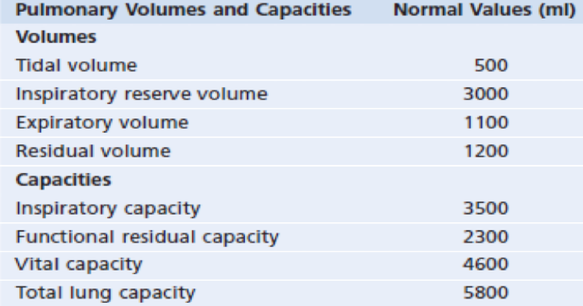
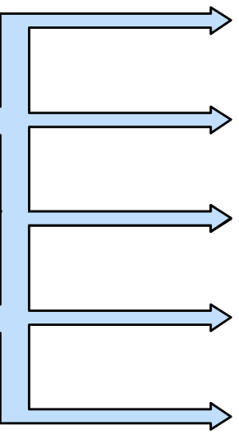
Lung Volumes and Capacities Contd.
In Boys’ Slides
Average Pulmonary Volumes and Capacities
for a Healthy Young Adult Man
Interrelations among pulmonary volumes and capacities
VC = IRV + TD + ERV
VC = IC + ERV
TLC = VC + RV
TLC = IC + FRC
FRC = ERV + RV
TLC= Total Lung Capacity
VC=Vital Capacity
FRC=Functional residual capacity
IC= inspirational capacity
IRV= inspirational reserve volume
ERV= Expiratory Reserve Volume
TD= Tidal Volume
علاقات رياضية وتحتاج فهم

Slide 7
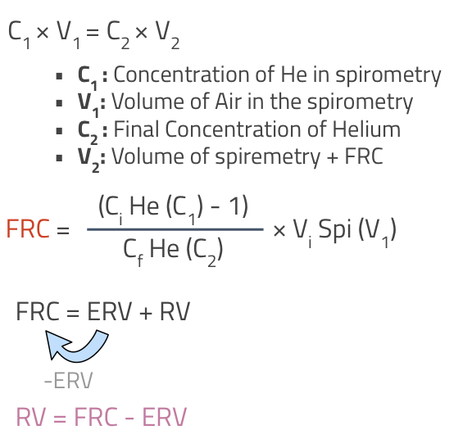
Determination of the FRC, RV and TLC
Thanks to 441
Closed Circuit Helium Dilution Method
RV can’t be measured directly with a spirometer.He is added to air in the device → gas is inhaled until equilibrium is reached between He in spirometer and lungs→completely expired to measure RV
Example: FRC= [(C1/C2)-1] x V1
If C1= 10 =[(10/5)-1] x 2000
C2=5
V1=2000 RV=FRC-ERV
ERV=1100 =2000-1100

Slide 8
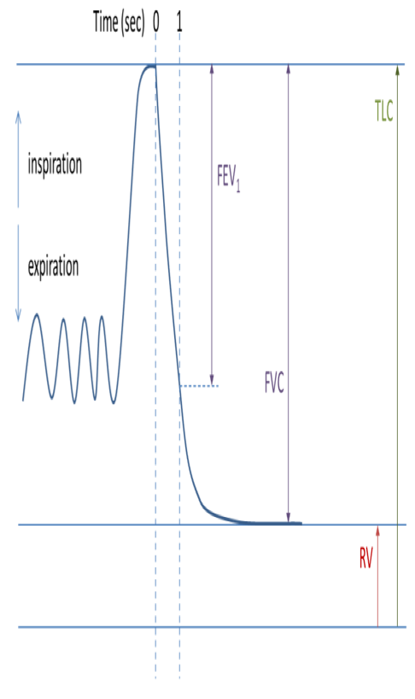
Forced Expiratory Volumes -
Forced Vital Capacity (FVC) and FEV1
Timed Vital Capacity
The person is asked to inspire as deeply as possible and then to breath out as hard and as fast as he can.
The expiration is continued until he expired all the air out and thus forced vital capacity is obtained.
During this process the volume of air that can be forcibly expired in the first second is called FEV1. The cumulative volume expired in 2 seconds is called FEV2, and the cumulative volume expired in 3 seconds is called FEV3.
Normally, the entire vital capacity can be forcibly expired in 3 seconds, so there’s no need for “FEV4”

Slide 9
FEV1/FVC Ratio
Normally it is about 0.8, meaning that 80% of the vital capacity can be expired in the first second of forced expiration.
FVC and FEV1 are useful indices of lung disease. Specifically, the fraction of the vital capacity that can be expired in the first second, FEV1/FVC.
Importance: This ratio differentiates between obstructive and restrictive lung diseases.
In patients with obstructive lung diseases such as asthma, emphysema and chronic obstructive pulmonary disease (COPD), both FVC and FEV1 are decreased, but FEV1 is decreased more than FVC is. Thus FEV1/FVC is also decreased, which is typical of airway obstruction with its increased resistance to expiratory air flow.
In a patient with a restrictive lung disease such as fibrosis, both FVC and FEV1 are decreased but FEV1 is decreased less than FVC is. Thus in fibrosis, FEV1/FVC is actually increased or almost normal.

Slide 10
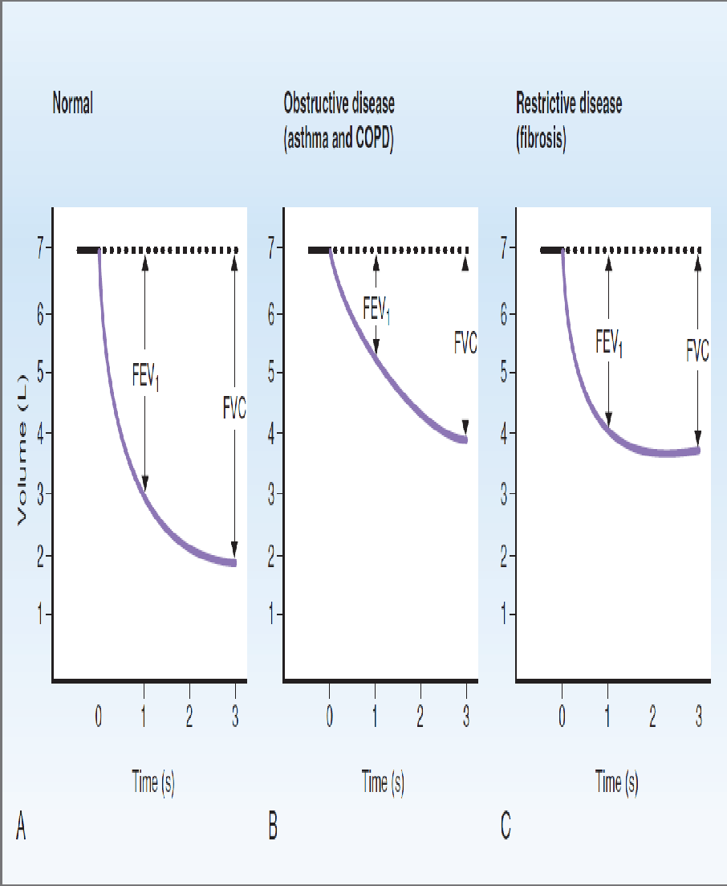
FVC and FEV1 in normal subjects and patients with lung disease

Slide 11
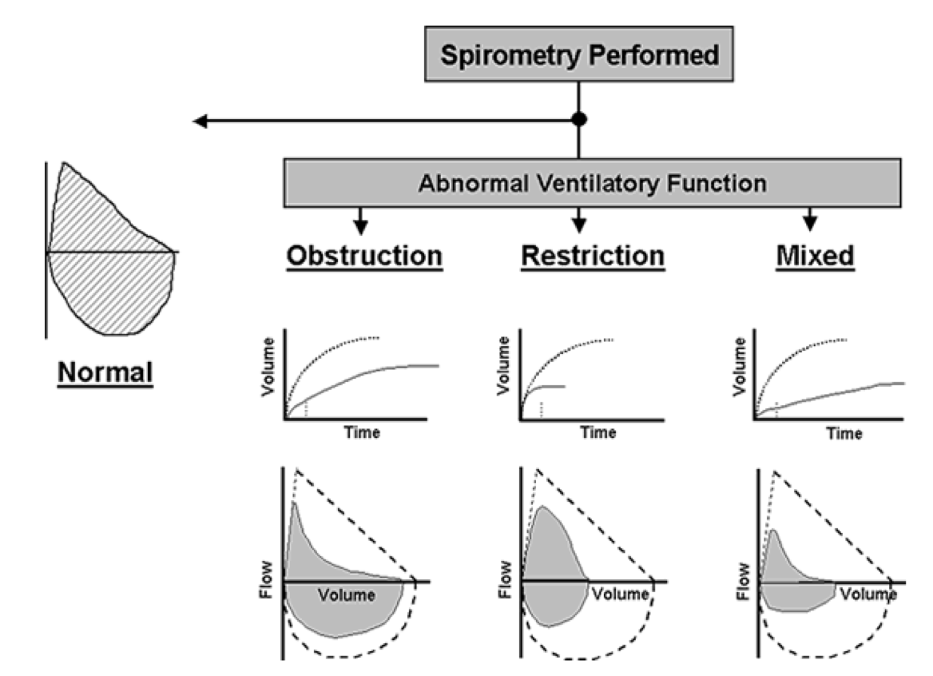
In Boys’ Slides

Slide 12
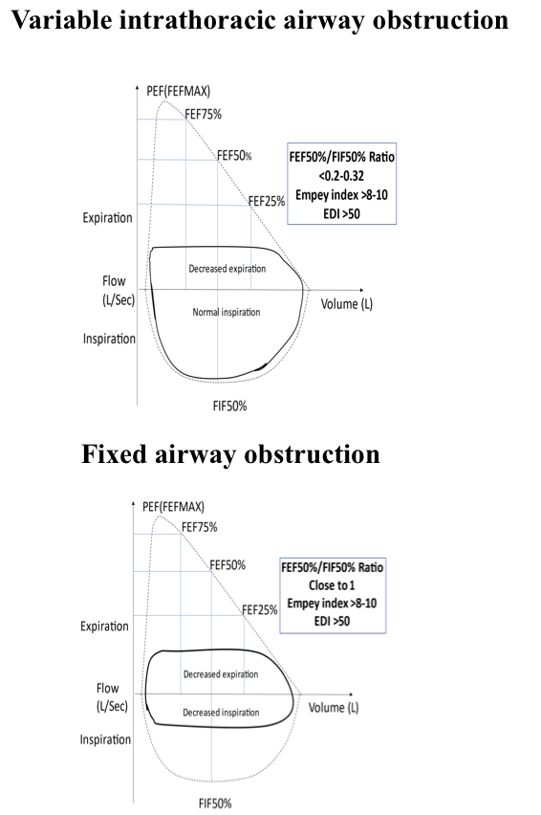
In Boys’ Slides
(Extra Slide)

Slide 13
Minute Respiratory Volume (MRV)
MRV = Respiratory rate x Tidal volume (average: 500ml)
= RR X TV
= 12 X 500 = 6L/min.
it could rise to 200 L/min or 30 times more than
normal if RR = 40 TV = 4600 ml in young adult men
It could rise more than normal value if RR = 40,
= 40 x 500 = 20L/min.

Slide 14
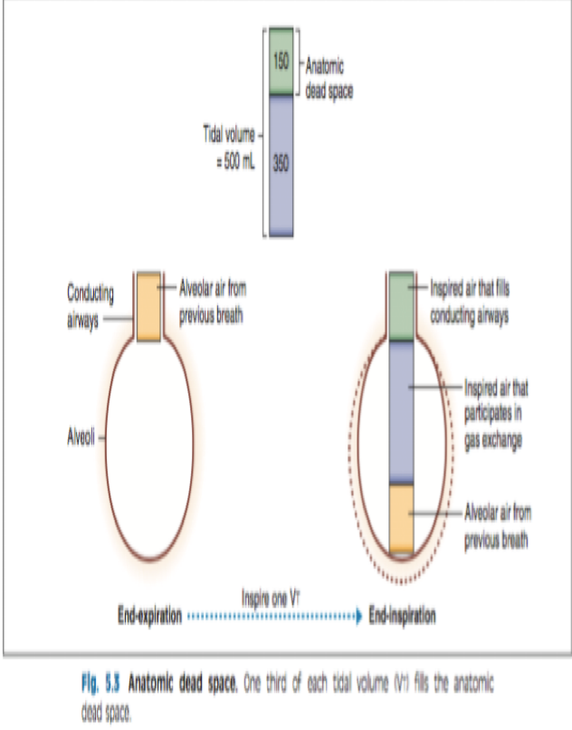
Dead Space & Its Effect on Alveolar Ventilation
Dead space: is the volume air not participating in gas exchange.
1- Anatomical dead space: volume of air present in the conducting respiratory passages (150 ml) =1/3 of tidal volume. {On expiration, this air is expired first, before any of the air from the alveoli reaches the atmosphere}
2- Non functioning alveoli (Functional dead space): alveoli that cease to act in gas exchange because they are not perfused by capillary blood supply (due to collapse or obstruction) (It’s in the respiratory region but it doesn’t have blood capillaries that’s why it doesn’t share in the gas exchange )
3-Physiological dead space: summation of non functioning alveoli and anatomical dead spaces.
In healthy subjects both anatomical dead space = physiological dead space.

Slide 15
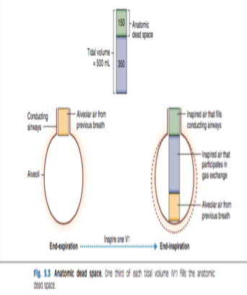
Alveolar Ventilation per Minute
Rate of alveolar ventilation per minute:
Is the total volume of new air entering the adjacent gas exchange area (the respiratory zone) each minute.
= (TV- Dead space volume) x RR
= (500-150) x 12 = 350 x 12
= 4200 ml/min= (4.2 L/min)
Alveolar ventilation is one of the major factors determining the concentrations of oxygen and carbon dioxide in the alveoli.

Slide 16
MCQ
For more questions
Click here
1- What device do we use to measure the functionality of the lung
Thermometer | B. Spirometer | C. Spirogram | D. Hygrometer
2- Which of the following is true regarding men and women lung capacity
Men have more by 20-25% | B. Women have more by 20-25% | C. They have the same capacity | D. None are true
3- The ratio of the FEV1/FVC decreases in
interstitial pulmonary fibrosis | B. COPD | C. Bronchial asthma | D. Both B &C
4- In healthy subjects anatomical dead space =
Minute respiratory volume | B.FEV1/FVC ratio | C. Physiological dead space | D. None
-1.B
-2.A
-3.D
-4.c

Slide 17
SAQ
What is Vital Capacity ?
How much Tidal Volume present in a healthy man ?
What’s the difference between the anatomical and the physiological dead space?
What’s the rate of alveolar ventilation per minute?
Maximum amount of air a person can expel from the lungs after first filling the lungs to their maximum extent and then recording expiring to the maximum extent. VC=TV+IRV+ERV=500+3000+1100=4600ml
500ml
The anatomical dead space is present in the conducting region while the physiological is present in the respiratory region
The total volume of new air entering the adjacent gas exchange area (the respiratory zone) each minute, = 4.2L/min

Slide 18
Team leaders
Deema aljuribah Mishal Alsuwayegh Waleed Alrashoud
Team members
Maram Beyari
Raghad Alnadeef
Hend Almogary
Farah Alfayez
Kadi aldoosari
Farah Alqazlan
Ghada Binslmah
Shatha Alshabani
Raghad Alkhudair
Faisal Ali
Othman Aldraihem
Abdullah Alqarni
Rayan Alotaibi
Faisal Alkhunein
Mishari Alenezi
Bandar Almutiri
Fahad Alhelelah
Rayan Bosaid
Ibraheem Alkanhal
Saad Alhammad
Emad Almutairi
Ahmad Almarshed
Salman Almutaz
Osama Alzahrani
Haifa Almuddahi
Haifa Alamri
Jana Alhazmi
Meznah Ahmad
Maha Alkoryshy
Physio442@gmail.com

