Slide 1
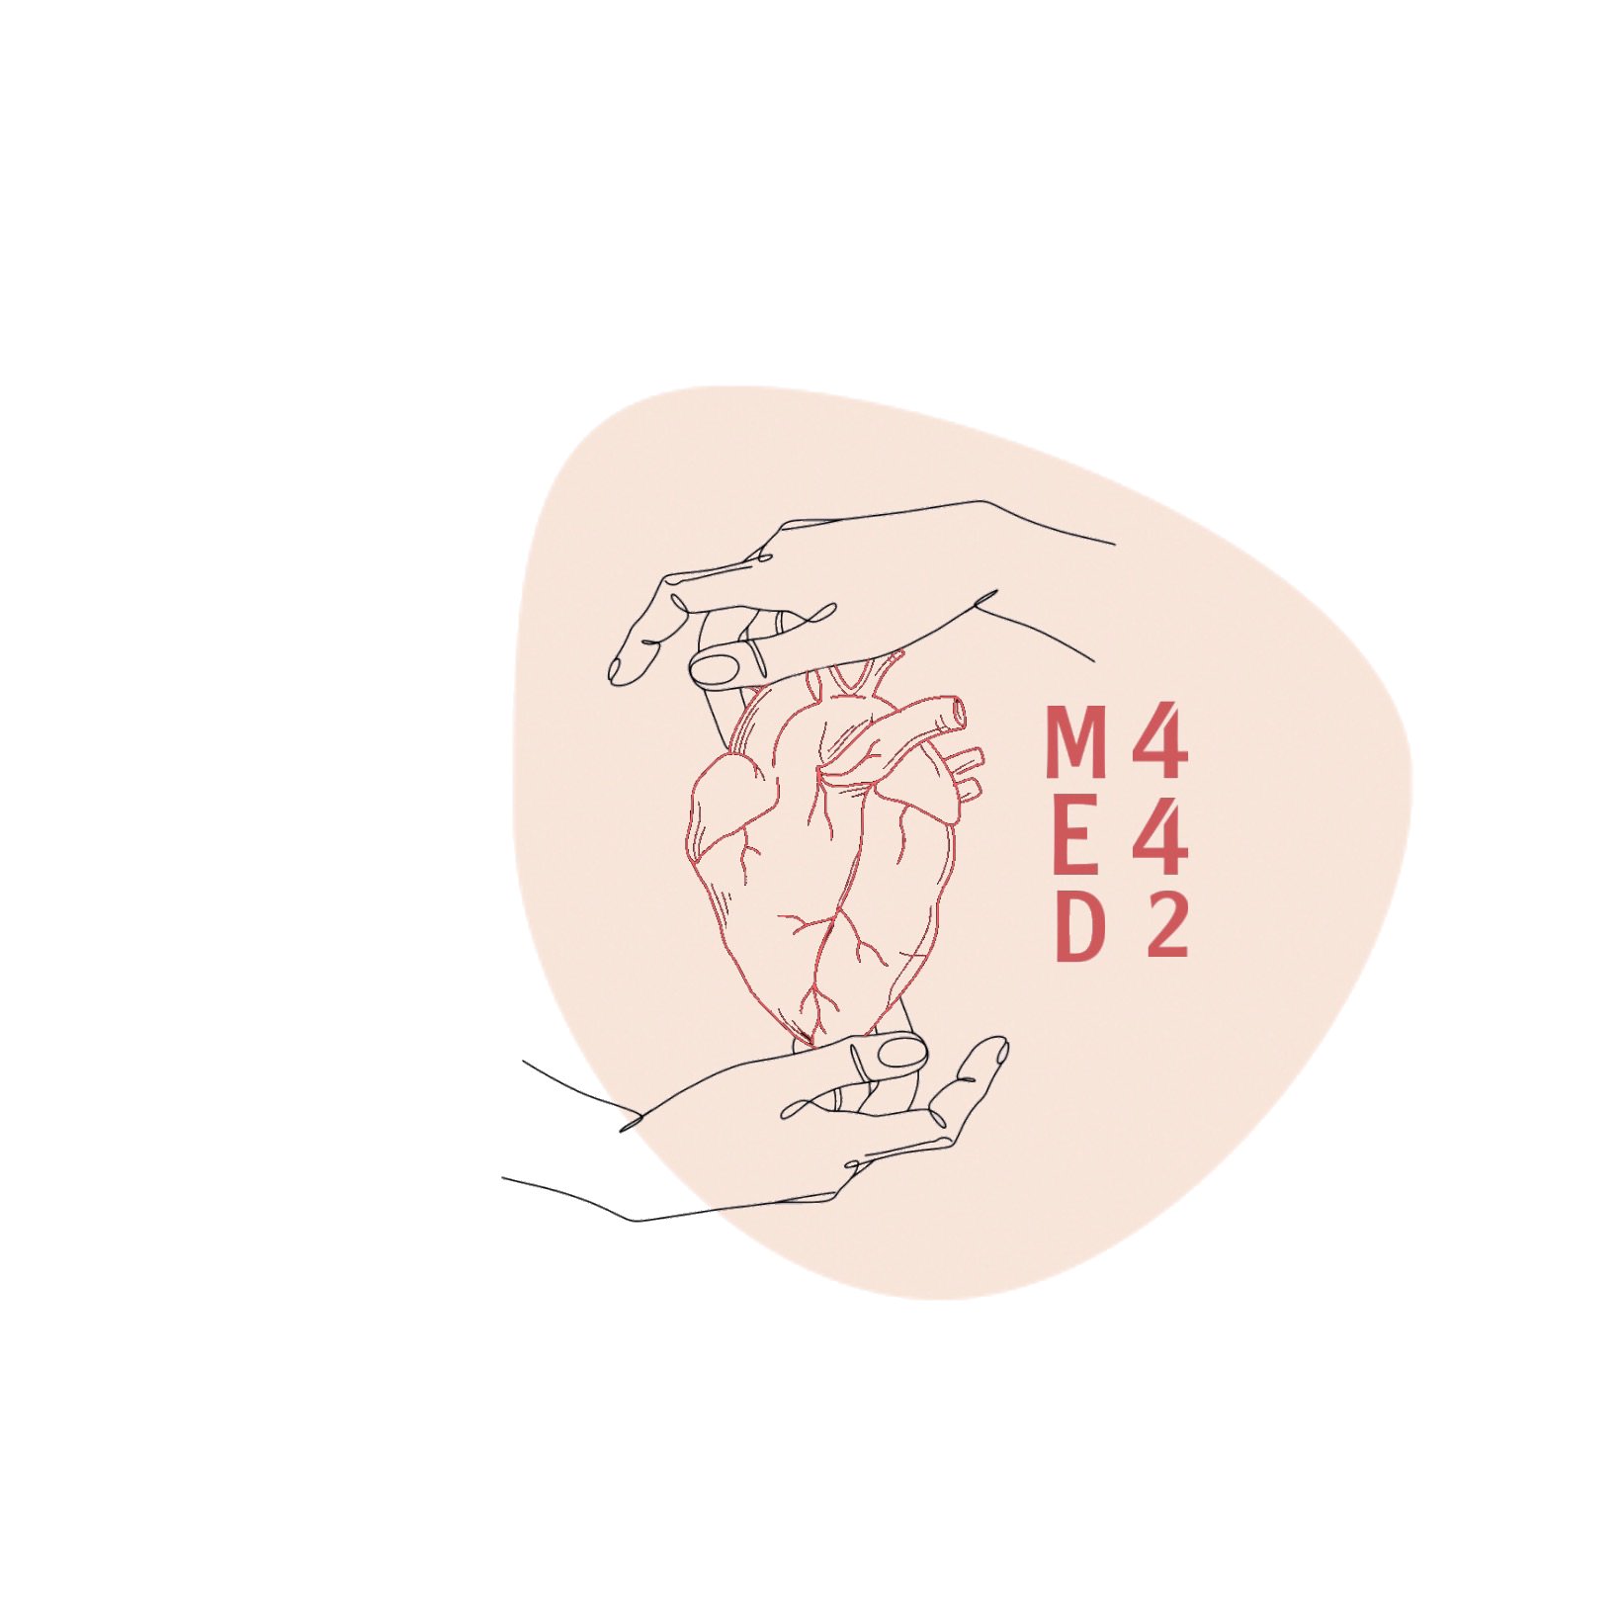
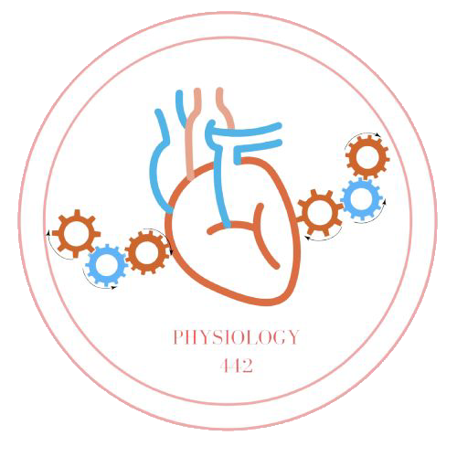
L-4
Oxygen & carbon dioxide transport
For helping videos
Color index:
Main text
Important
Doctor notes
Boys slides
Girls slides
Extra
Editing file

Slide 2
Objectives:
Understand the forms of oxygen transport in the blood, the importance of each
Differentiate between O₂ capacity, O₂ content and O₂ saturation
Describe (Oxygen - hemoglobin dissociation curve)
Define the P50 and its significance
Explain how DPG, temperature, H⁺ ions and PCO₂ affect affinity of O₂ for hemoglobin and the physiological importance of these effects
Describe the three forms of carbon dioxide that are transported in the blood and the chloride shift

Slide 3
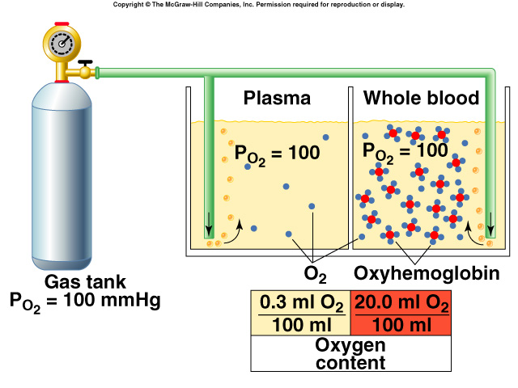
Forms of O₂ transport in blood
The presence of hemoglobin (Hb) in the red blood cells allows the blood to transport 30 to 100 times as much oxygen as could be transported in the form of dissolved oxygen in the water of the blood.
Forms of O₂ Transport in Blood
Bound to hemoglobin
(mostly - 97%)
Dissolved state
(lesser extent - 3%)
Dissolved in plasma
O₂ binds to heme group on hemoglobin.
4 O₂ / Hb (hemoglobin).
Oxyhemoglobin
Increased PO₂ → Hb bind to O₂.
Decreased PO₂ → Hb release O₂.
Special thanks to 441
High PO₂ → great Hb saturation.

Slide 4
Terminology
O₂ content
O₂ binding capacity
Percent saturation
Dissolved O2
01
amount of O2 in blood (ml O2/100 ml blood)
02
maximum amount of O2 bound to hemoglobin (ml O2/100 ml blood) measured at 100% saturation.
03
O₂ content x 100
% of heme groups bound to O2
% saturation of Hb =
O₂ - binding capacity
04
Unbound O2 in blood (ml O2/100 ml blood).

Slide 5
Transport of O₂ in arterial blood
Blood is 100% saturated with O₂:
Each gram of Hb carry 1.34 ml O₂
An adult has 15 g Hb/100 ml (dl) blood
O2-content* = 15 g Hb x 1.34 ml O₂
O2- content* = 20 ml per 100 ml blood (dl) = 20.1 ml
Amount of O2 released from Hb to tissues: 5 ml O2/ 100 ml blood.
O2-content* in venous blood at rest = 19.4 ml - 5 ml
O2-content*in venous blood = 14.4 ml
During strenuous exercise:
O2 uptake by tissue increases 3 - 5 folds.
15 ml O2 is taken by tissues from each dl of blood or /100 ml blood
O2 content* in venous blood = 19.4 - 15
O2-content* in venous blood = 4.4 ml O2/dl or /100 ml blood.
Blood is 97% saturated with O₂:
20.1*0.97 = 19.4
Each 100 ml blood contain 19.4 ml O₂
At rest, tissues consume 230-250 ml O2 /min and produce 200-450ml CO2.

Slide 6
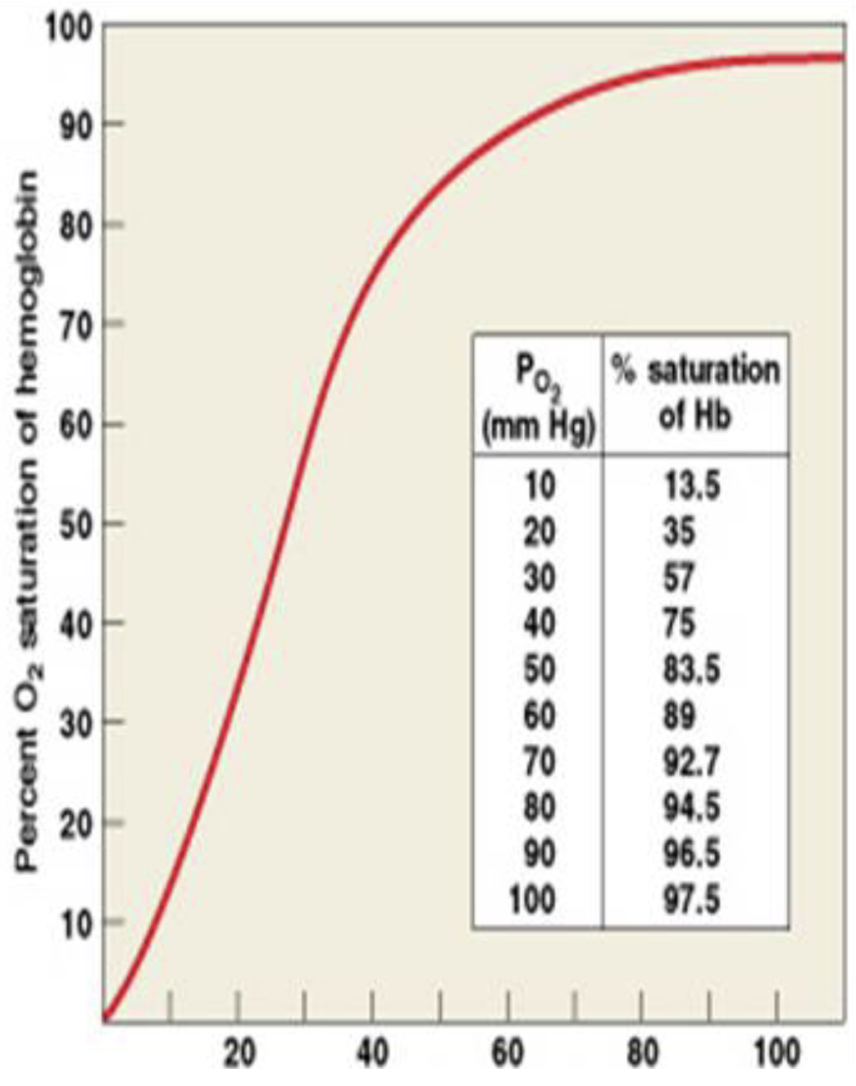
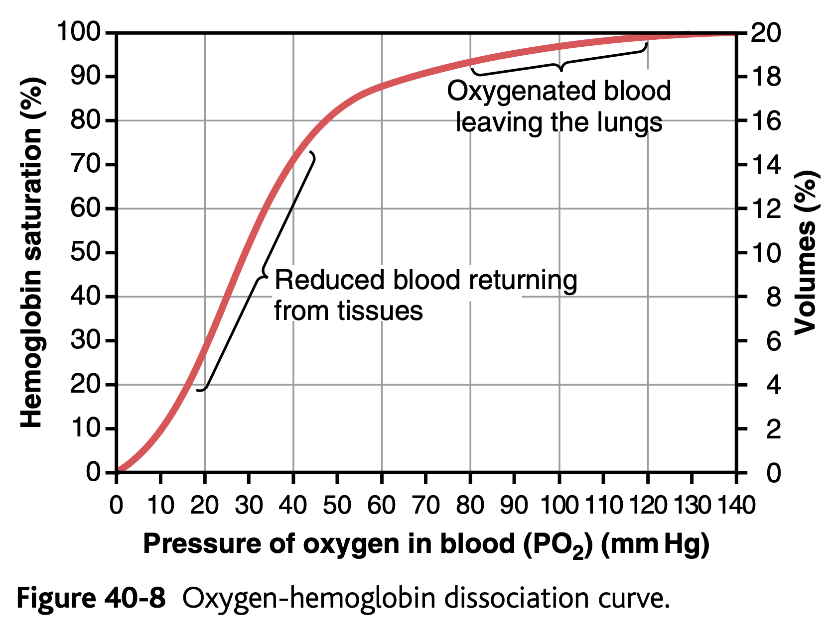
Oxygen hemoglobin saturation curve
Higher PO₂ → greater Hb saturation.
PO₂ & Hb O₂ relation is not linear, it is sigmoidal (S- shaped)

Slide 7
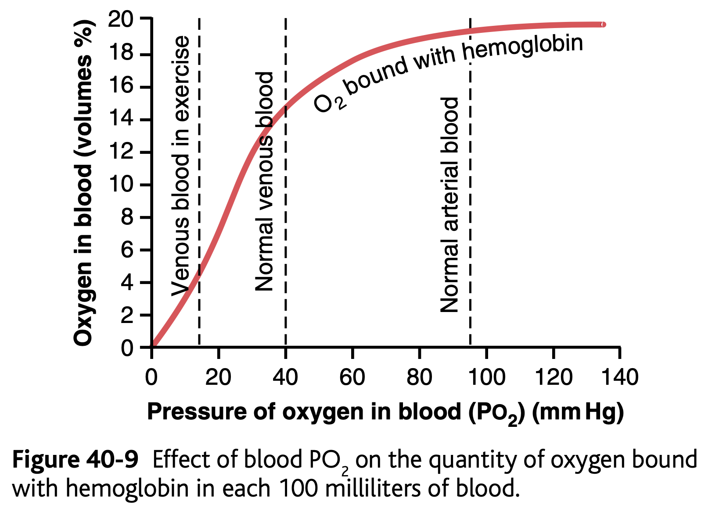
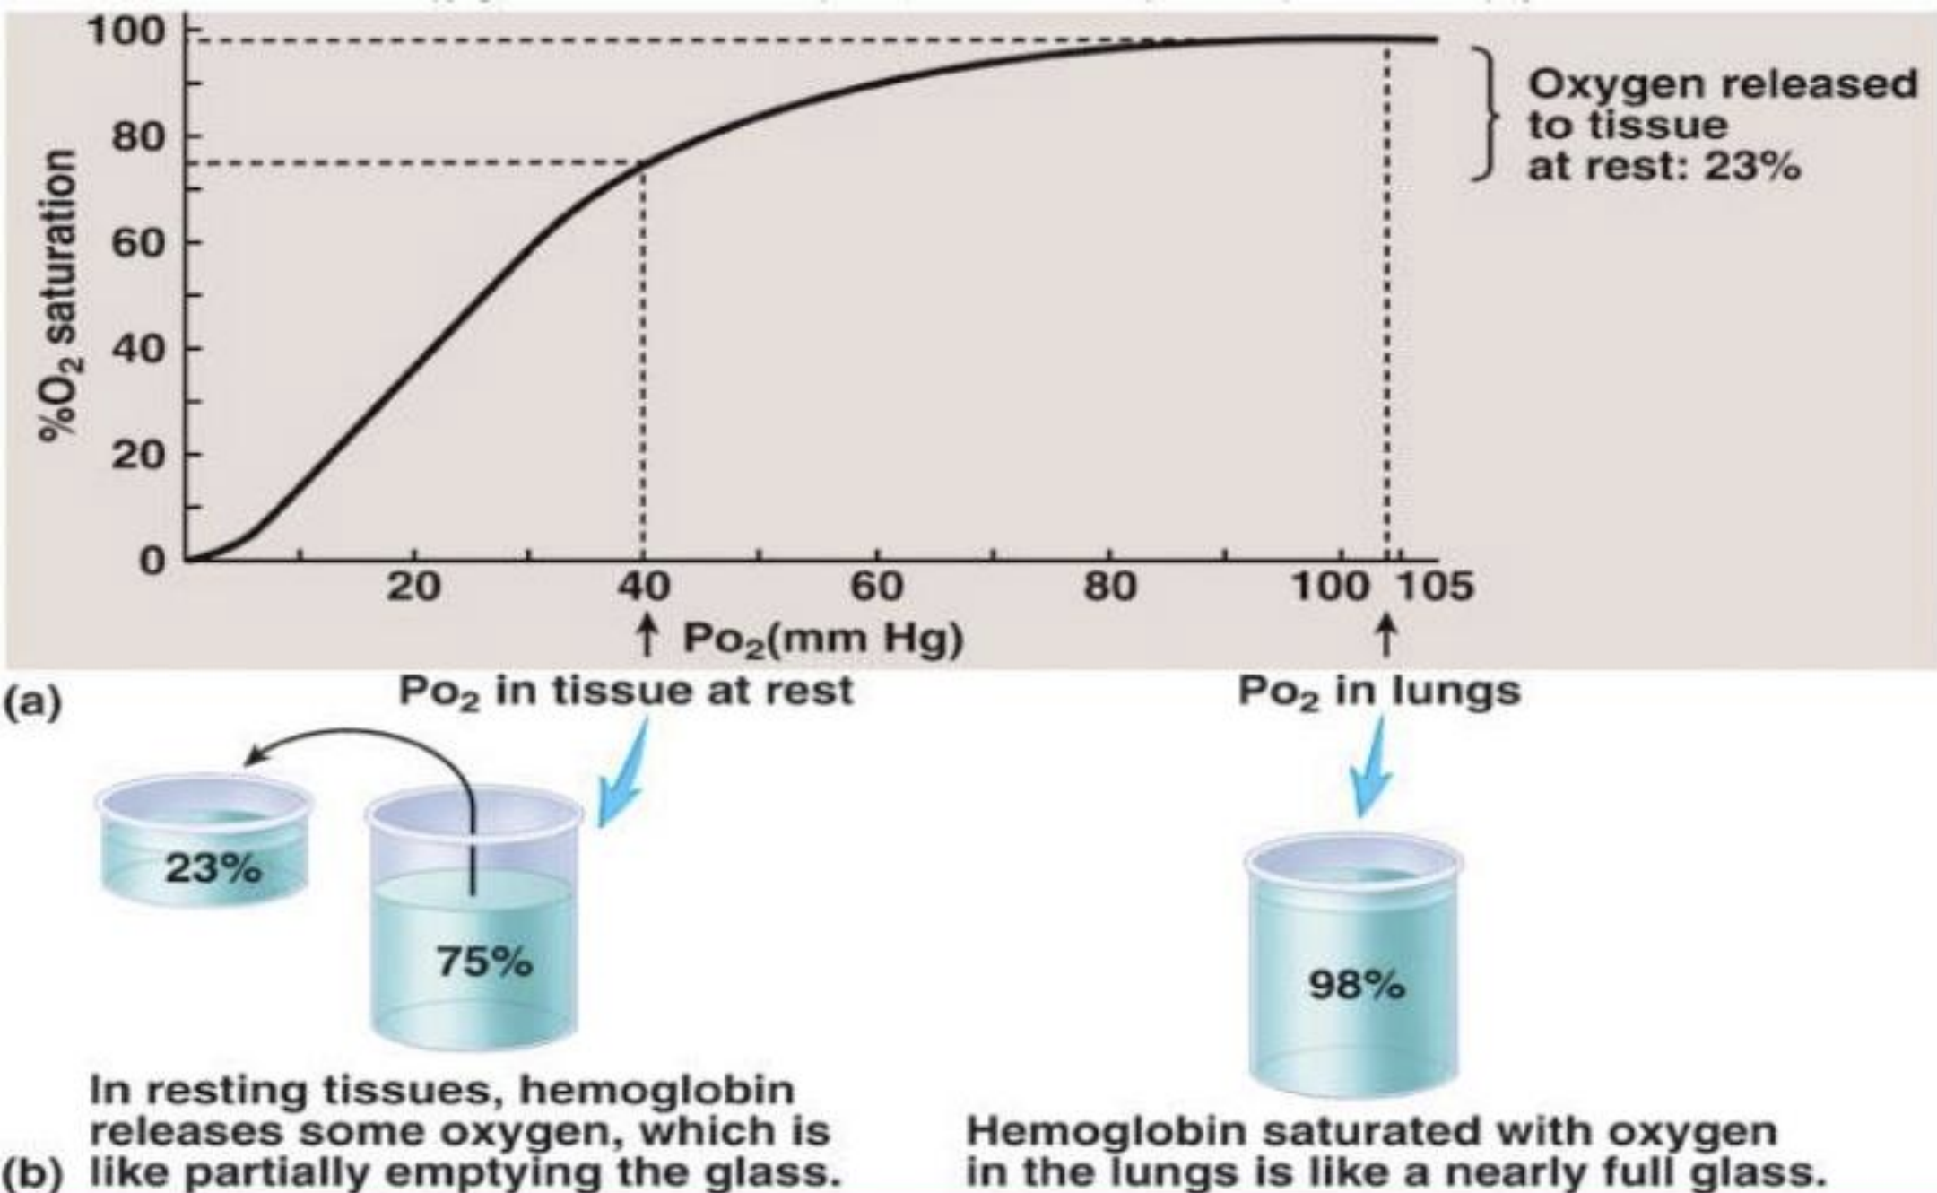
Oxyhemoglobin Dissociation Curve
Importance of curve:
Gives indication when Hb is fully loaded & when it is not
During Exercise:
Amount of O2 consumption by tissue increases leaving only 4.4 mL O2 in venous return.
In systemic arterial blood: In venus return
Partial pressure of O2 ≈ 95 mmHg containing 19.4 mL of O2. Partial pressure of O2 ≈ 40 mmHg containing 14.4 mL O2.(blood after supplying tissue with 5 ml O2)

Slide 8
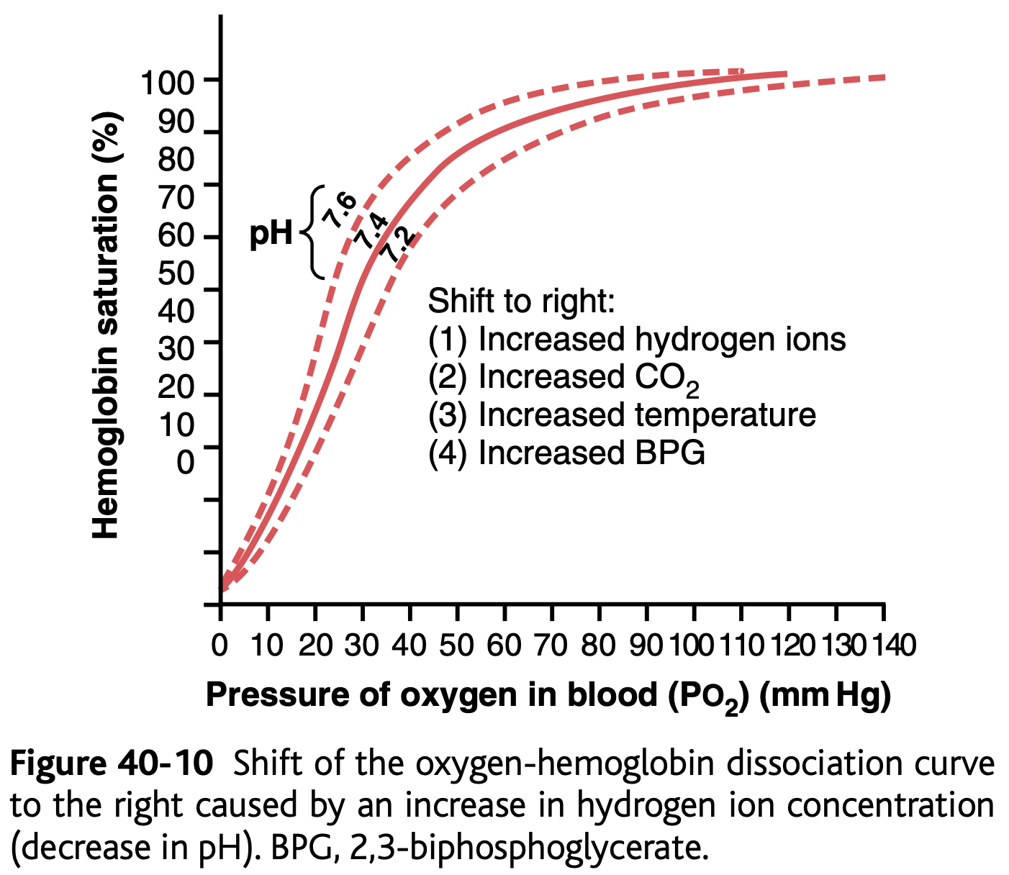
Factors Shifting O2-Hb Dissociation Curve
The position of dissociation curve can be determined by measuring P50.
P50: arterial PO2 at which 50% of Hb is saturated with O₂
Fetal Hb has a P50 of 20 mmHg
Adult Hb has a P50 of 26.5/27 mmHg
Fetal Hb has higher affinity to O₂ than adult Hb → decreased P50 → left shift in relation to adult curve
Decreased P50
Increased affinity of Hb to O2
Curve shifts to left.
Normal P50
26.5m Ipsum
P50
Increased P50
Decreased affinity of Hb to O2
Curve shifts to right.

Slide 9
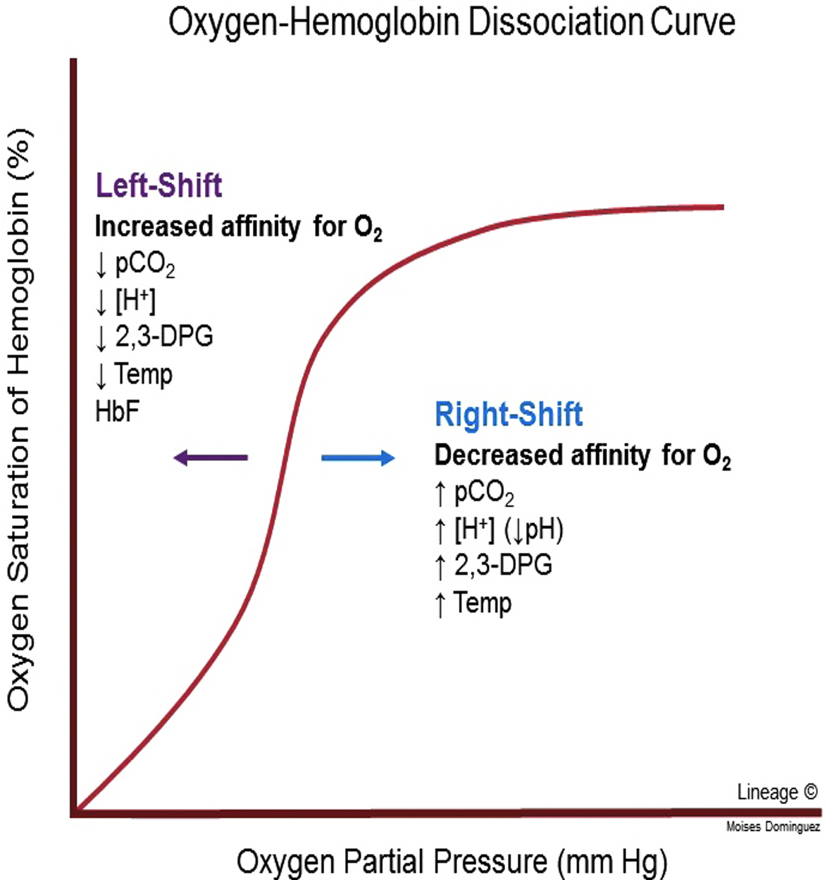
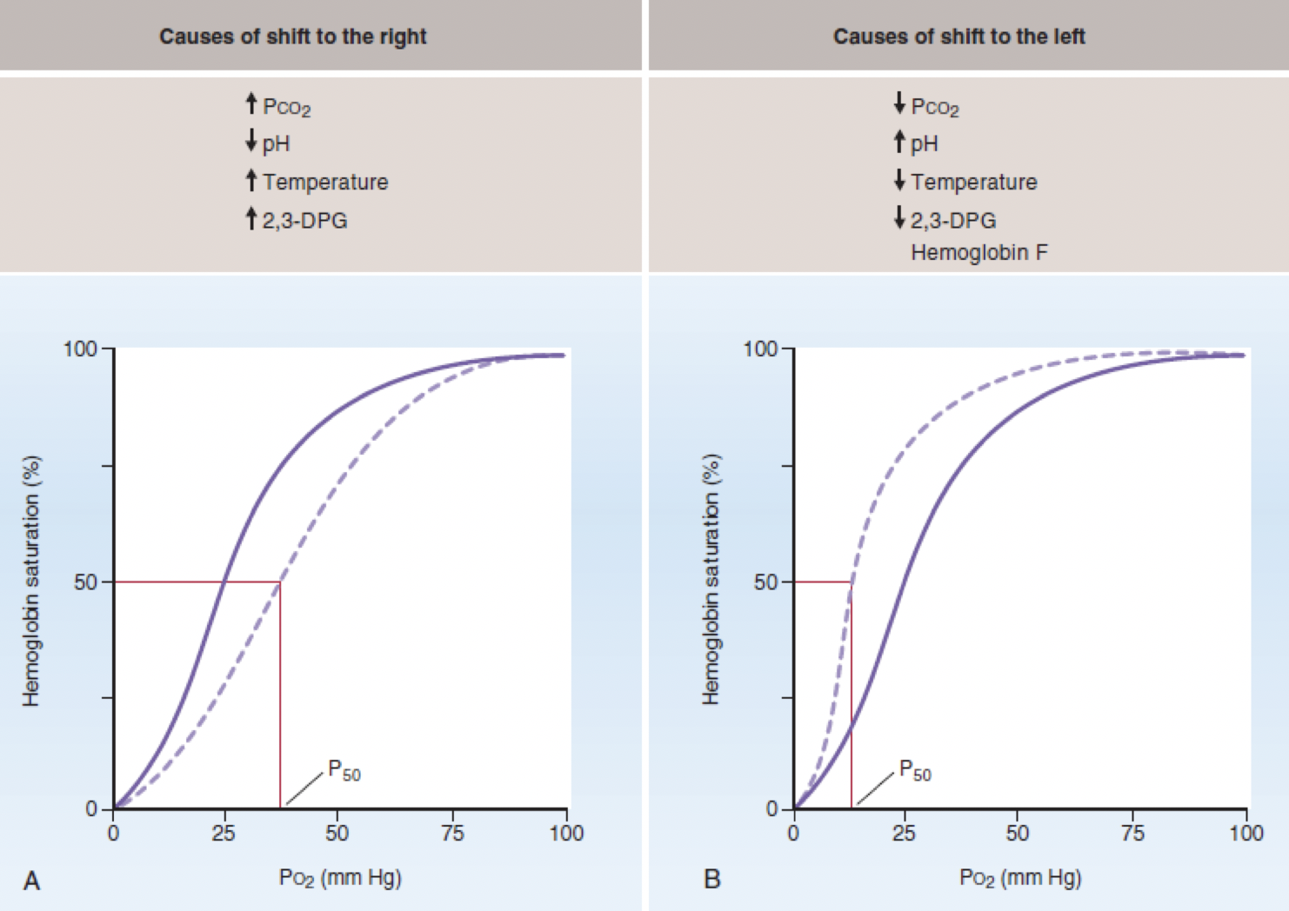
Right & Left Shifts of Dissociation Curve
Loading/attachment of O₂ to Hb → left shift.
O₂ is unloaded to tissues from Hb → right shift.
Factors shifting the curve to the right:
Increased 2,3 DPG (facilitates O₂ release) (2,3 DPG is the end product of Hb metabolism)
Synthesized in RBCs from glycolytic pathway.
Binds tightly to reduced Hb.
Increased in anemia & hypoxemia → serves as an important adaptive response in maintaining tissue oxygenation.
Increased H⁺
Increased temperature
Increased PCO₂
During exercise: curve shifts to the right

Slide 10
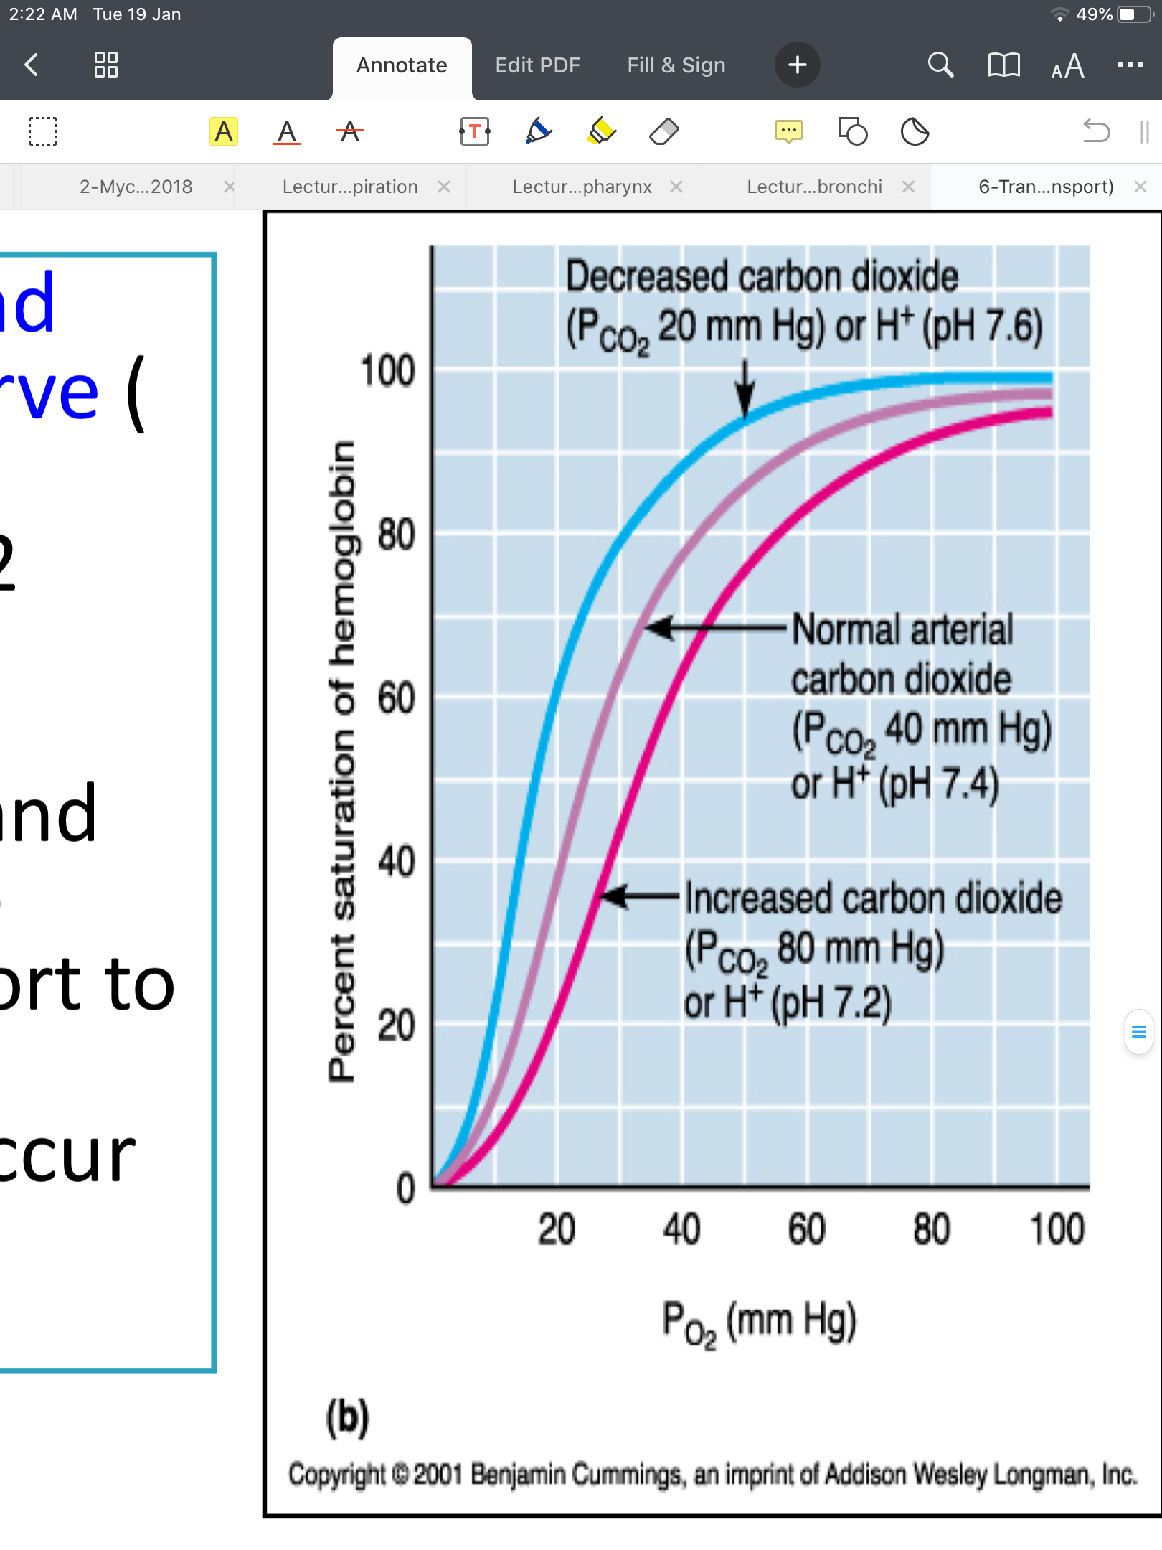
Effect of CO2 & H+ on the Curve (Bohr effect)
Reminder: PCO₂ & H+ shift the curve to the right → O₂ is released → tissues get O₂.
At lung:
CO₂ diffuses from blood to alveoli → decrease blood CO₂ & H⁺ → shift curve to left → increase O₂ affinity to Hb → more O₂ transport to tissues.
At tissues: the reverse occurs.
Increased CO₂ & H⁺ produced by tissues during metabolism → shift curve to right → release/unload O₂ from Hb to tissues.
Lung: high PO2→ increased O₂ affinity & binding with Hb → left shift.
Tissues: low PO2 → decreased O₂ affinity & binding with Hb→ right shift.

Slide 11
Transport of O₂ in Dissolved State
Only 3% of O₂ is transported in the dissolved state.
0.17 ml of O₂ is normally transported in the dissolved state to tissues per each 100 ml of blood.
At normal arterial PO2 (95 mmHg): ~ 0.29 ml of O₂ is dissolved in each 100 ml of blood.
40 mmHg PO2 of blood in tissue capillaries: only 0.12 of O₂ remains dissolved.
Importance of O₂ dissolved
Importance of O₂ dissolved:
Determines PO₂ in blood.
It is the form of Oxygen used directly by tissues.
-We ignore dissolved O2 when
calculating O2 content because it is small
-Dissolve state is important to transport O2 to places blood can't reach like cornea of eye & cartilage.

Slide 12
Shift of Dissociation Curve in Exercise
In Female Slides Only
Exercise increases temperature, H+, 2,3 DPG → shift the curve to the right.
Utilization Coefficient: percentage of blood that gives up its O2 as it passes through tissues capillaries.
O₂ delivered to tissues
Utilization coefficient =
O₂ content of arterial blood
At rest:
Utilization coefficient = 5 ml / 20 ml
Utilization coefficient = 25%
During exercise:
Utilization coefficient = 15 ml / 20 ml
Utilization coefficient = 75 - 85%

Slide 13
Combination of Hb with CO
(Displacement of O₂)
CO combines with Hb at the same point on the Hb molecule as does O₂.
The affinity of Hb to CO is very high (250 times) compared to O₂.
CO binds with Hb about 250 times as much as O₂
CO combination with Hb → left shift of the O₂-Hb curve.
CO binds to Hb → Hb is unable to bind with O2 → hypoxia
CO + Hb → carboxyhemoglobin

Slide 14
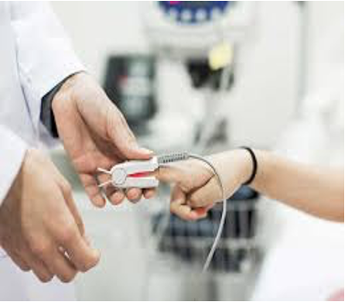
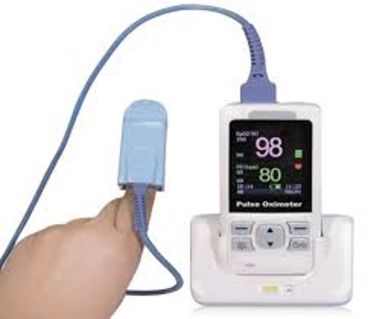
Pulse Oximetry
Pulse Oximetry: a device that measures percent saturation of arterial blood (example: of the finger) using dual-wavelength spectrophotometry.
Oxyhemoglobin & deoxyhemoglobin have different absorbance characteristics → the machine calculates percent saturation from absorbance at two different wavelengths.
Pulse oximetry measures arterial percent saturation. Why?
Because arterial blood “pulses”.
Venous & capillary blood don’t “pulse” → background absorbance from venous & capillary blood is subtracted out.
Pulse oximetry does not directly measure PaO₂.
Knowing percent saturation → estimating (تقدير) PaO₂ from O₂-hemoglobin dissociation curve.

Slide 15
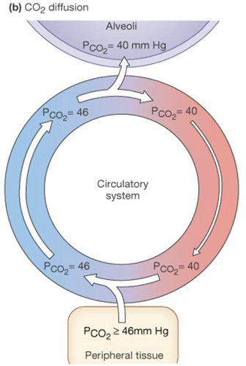
Transport of Carbon Dioxide in Blood
Forms of CO₂ Transport in Blood
High solubility of CO₂ → high dissolved CO₂
Carbaminohemoglobin
(with Hb ; 23%)
Bicarbonate ions (HCO₃)
(70%)
Dissolved CO₂
(7%)
Most
Determines PCO₂ of blood.
Each 100 ml of blood carry 4 ml of CO₂ from tissues.
Hemoglobin is releasing 5 ml of O₂ to the tissues
Thanks to team 441

Slide 16
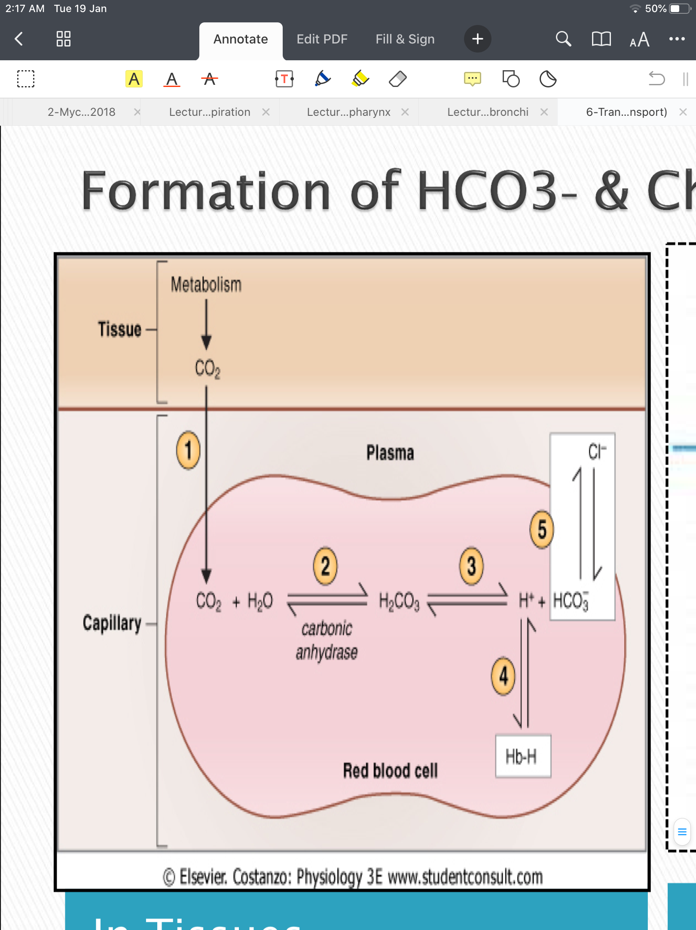
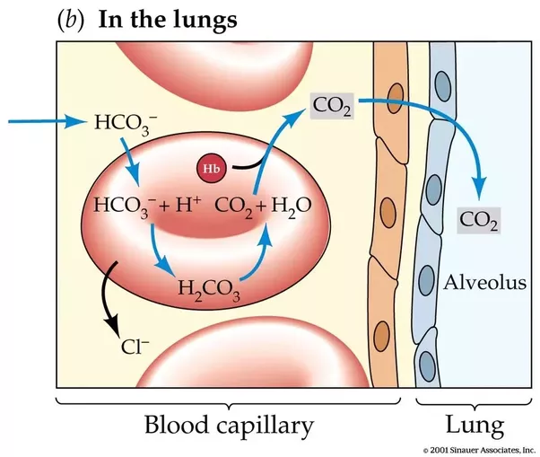
Formation of HCO3-& Chloride Shift
Thanks to team 441
ما ينفع كل الـCO_{2,} يكون ذايب بالدم عشان ما يصير acid.
In Tissues
In Pulmonary Capillaries
Forms of CO₂ in blood:
Bicarbonate (HCO₃⁻)
Bound to Hb in RBC
Dissolved
Chloride shift: when HCO₃ (weak acid - easy to dissociate) leaves the RBC → Cl will enters (keep the negatively of RBC in tissue capillary.
Bicarbonate found in plasma acts as a buffer preventing pH change of blood.
أول ما ياخذ الدم الـCO₂ من الـtissues، جزء من الـCO₂ رح يدخل الـRBCs ويرتبط مع ماء وينتج H₂CO₂ بمساعدة الـcarbonic anhydrase. بعدها رح يرتبط الـH₂CO₂ بـH⁺ منتجة لنا الـ HCO₃⁻ اللي بيطلع بالدم يمشي للرئة.
إذا وصلنا للرئة، زم نرجع الـHCO₃⁻¹ إلى CO₂ داخل الـRBC: (لأن فيها enzyme اسمه carbonic anhydrase)
يتحد الـHCO₃⁻¹ مع الـH⁺¹ بمساعدة الانزيم وينتج H₂CO₂ اللي بننزع منها الماء (dehydrolized) ويطلع لنا الـCO₂.

Slide 17
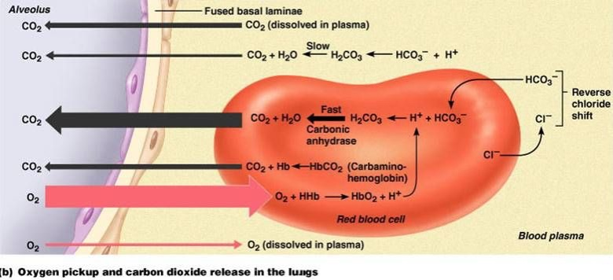
The Haldane Effect
Bohr effect: effect of CO₂ on O₂.
Haldane effect: effect of O₂ on CO₂.
O₂ binds with Hb at lungs → CO₂ is released into alveoli → CO₂ transport is increased.
Binding of Hb with O₂ at the lung → Hb becomes a stronger acid → CO₂ is displaced from blood into alveoli.
Change in blood acidity during CO2 transport:
Change (fall) of 0.04 unit in venous blood due to increased CO2 in it:
Arterial blood pH: 7.41
Venous blood (higher PCO2): 7.37 (More acidic)
الـCO_{2,}قلنا acid، والـHb لما يشبك عليه الـO₂ بيكون acid فبيطلق الـCO₂ (للـalveoli) عشان ياخذ الـO₂ مكانه.
قانون: الـacid ما يقدر يرتبط بـacid.

Slide 18
Respiratory Exchange Ratio (Respiratory Quotient)
Rate of CO₂ output
=
Normal diet (normally): R = ⅘ = 82% = 0.825
Carbohydrate diet: R = 1
Fats diet: R = 0.7
reason for the difference
When O₂ is metabolized with carbohydrates → 1 molecule of CO₂ is formed for each molecule of O₂ consumed.
When O₂ reacts with fats → large share of O₂ combines with H atoms from fats to form water instead of CO₂.
R
Rate of O₂ uptake

Slide 19
MCQ
For more questions please click on the icon
1.B 2.B 3.D 4.D
Q1. What percentage of oxygen is bound to hemoglobin
A. 3% | B. 97% | C.79% | D.93%
Q2. Higher PO₂ → ????
A. Lower Hb saturation | B. Greater Hb saturation | C. No difference | D. none of the above
Q3. Normal P50=?
A. 0.265 | B. 265 | C. 2.65 | D. 26.5
Q4. Which of the following is a form of CO₂ in blood
A. Dissolved CO₂ | B.Carbaminohemoglobin | C. Bicarbonate (HCO₃) | D. All of the above

Slide 20
SAQ
Q1- Define O₂ content
Q2- Why does pulse oximetry measure arterial percent saturation?
Q3- how is respiratory quotient calculated?
Q4- Explain how HCO₃ is formed?
Answers
1- amount of O₂ in blood
2- slide 14
3-rate of CO₂ output over Rate of O₂ uptake
4-slide 16
For more questions click on the icon

Slide 21
Team leaders
Deema aljuribah Mishal Alsuwayegh Waleed Alrashoud
Team members
Maram Beyari
Raghad Alnadeef
Hend Almogary
Farah Alfayez
Kadi aldoosari
Farah Alqazlan
Ghada Binslmah
Shatha Alshabani
Faisal Ali
Othman Aldraihem
Abdullah Alqarni
Rayan Alotaibi
Faisal Alkhunein
Mishari Alenezi
Bandar Almutiri
Fahad Alhelelah
Rayan Bosaid
Ibraheem Alkanhal
Saad Alhammad
Emad Almutairi
Ahmad Almarshed
Salman Almutaz
Osama Alzahrani
Physio442@gmail.com

