Slide 1
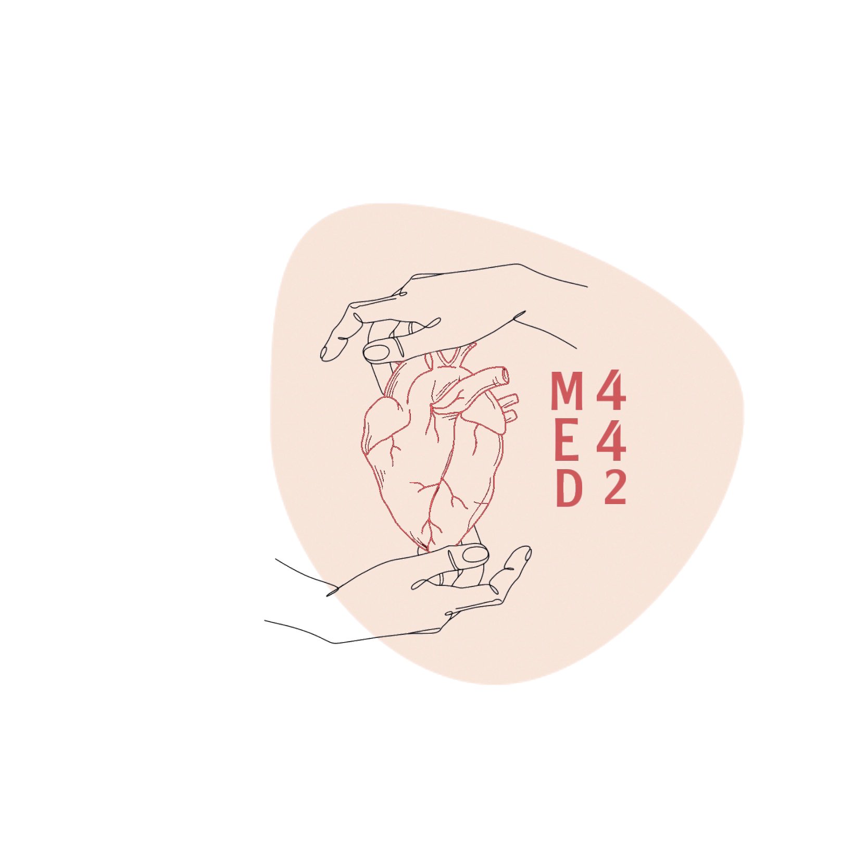
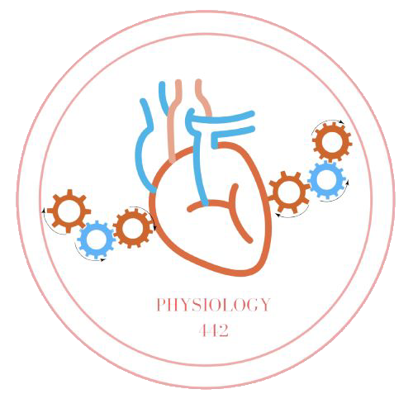
L-5
Gas exchange and transfer
For helping videos
Color index:
Main text
Important
Doctor notes
Boys slides
Girls slides
Extra
Editing file

Slide 2
Objectives:
Define partial pressure of a gas and how is influenced by altitude .
Understand that pressure exerted by each gas in a mixture of gases is independent of pressure exerted by other gases (Dalton's Law).
Understand that gases in a liquid diffuse from higher partial pressure to lower partial pressure (Henry’s Law).
Describe the factors that determine the concentration of a gas in a liquid.
Describe the components of the alveolar-capillary membrane (i.e., what does a molecule of gas pass through).
Know the various factors determining gas transfer: Surface area, thickness, partial pressure difference, and diffusion coefficient of gas.
State the partial pressures of oxygen and carbon dioxide in the atmosphere, alveolar gas, at the end of the pulmonary capillary, in systemic capillaries, and at the beginning of a pulmonary capillary.

Slide 3
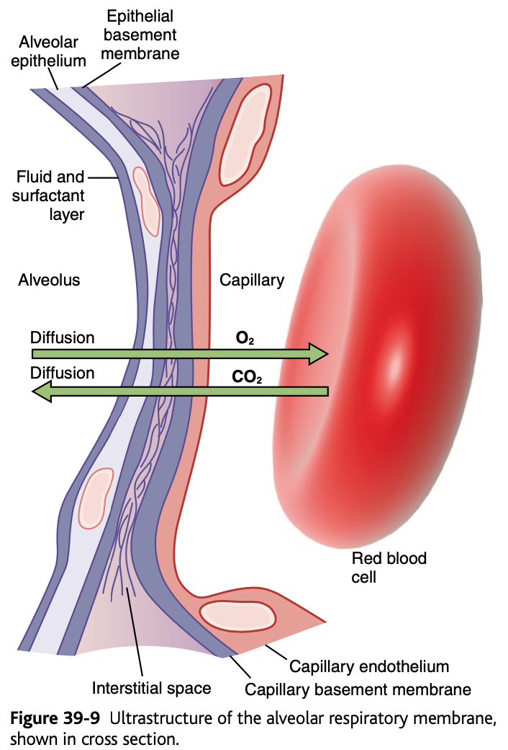
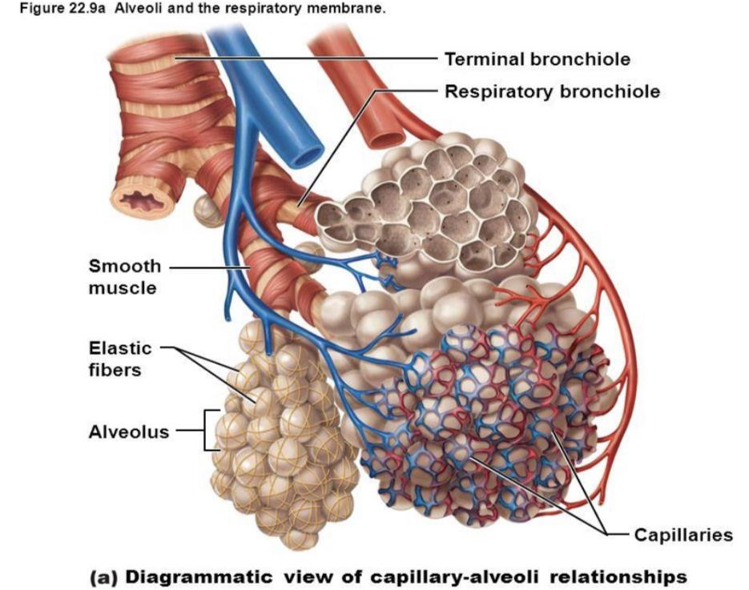
Gas Exchange through Respiratory Membrane
After ventilation of alveoli with fresh air the next step is → diffusion of O₂ & co₂ across respiratory membrane (alveolo-capillary membrane).
Thickness: 0.2 - 0.6 micrometer.
Total surface area: 50 - 100 m² or 70 m² in normal adult human male.
Total quantity of blood in lungs’ capillaries at any given instant: 60 - 140 ml.
This small amount of blood spread over the entire surface of a 25 × 30-foot floor → it is easy to understand the rapidity (سرعة) of the respiratory exchange of O₂ & CO₂.
EXTRA:
diffusion=انتشار الغازات
The thickness of membrane is 0.2 (too thin) to make the passage of gases easier

Slide 4
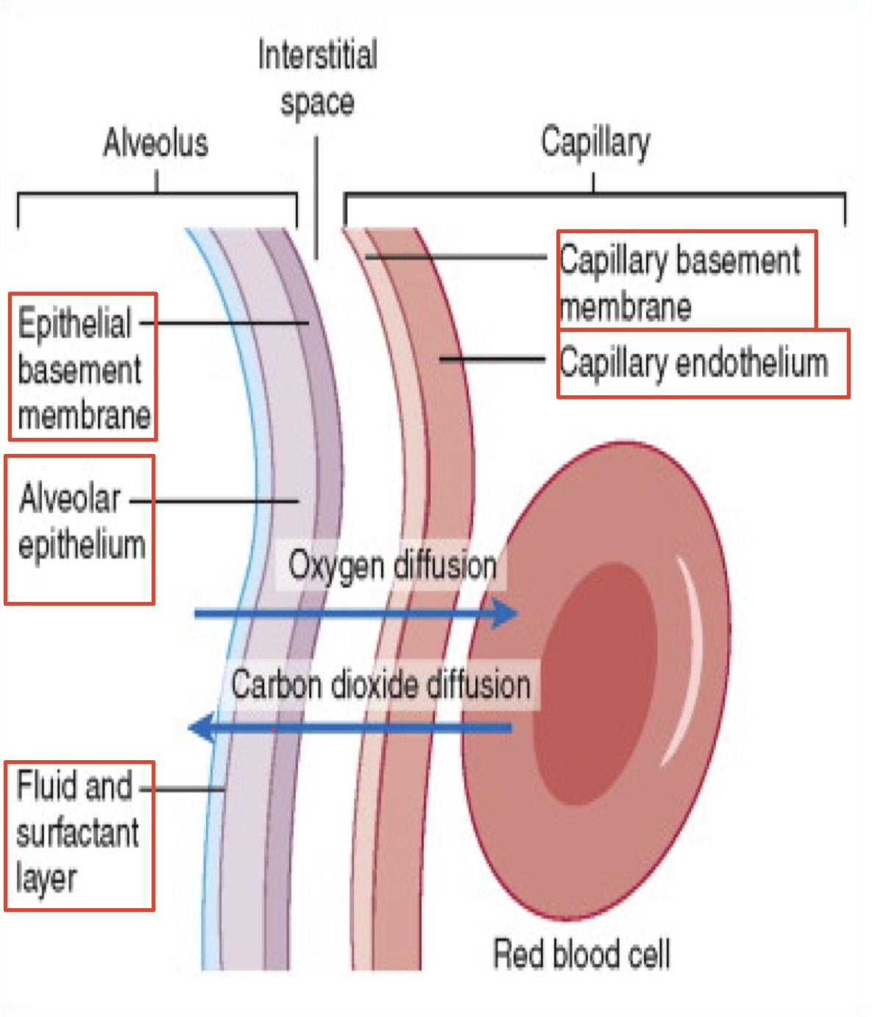
Respiratory Membrane Layers
In Male Slides Only
1
A layer of fluid containing surfactant that lines alveolus &
reduces surface tension of alveolar fluid.
2
Alveolar epithelium, which is composed of thin epithelial cells.
3
An epithelial basement membrane.
4
A thin interstitial space between alveolar epithelium & capillary membrane.
5
A capillary basement membrane that in many places fuses with alveolar epithelial basement membrane.
6
The capillary endothelial membrane.

Slide 5
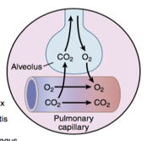
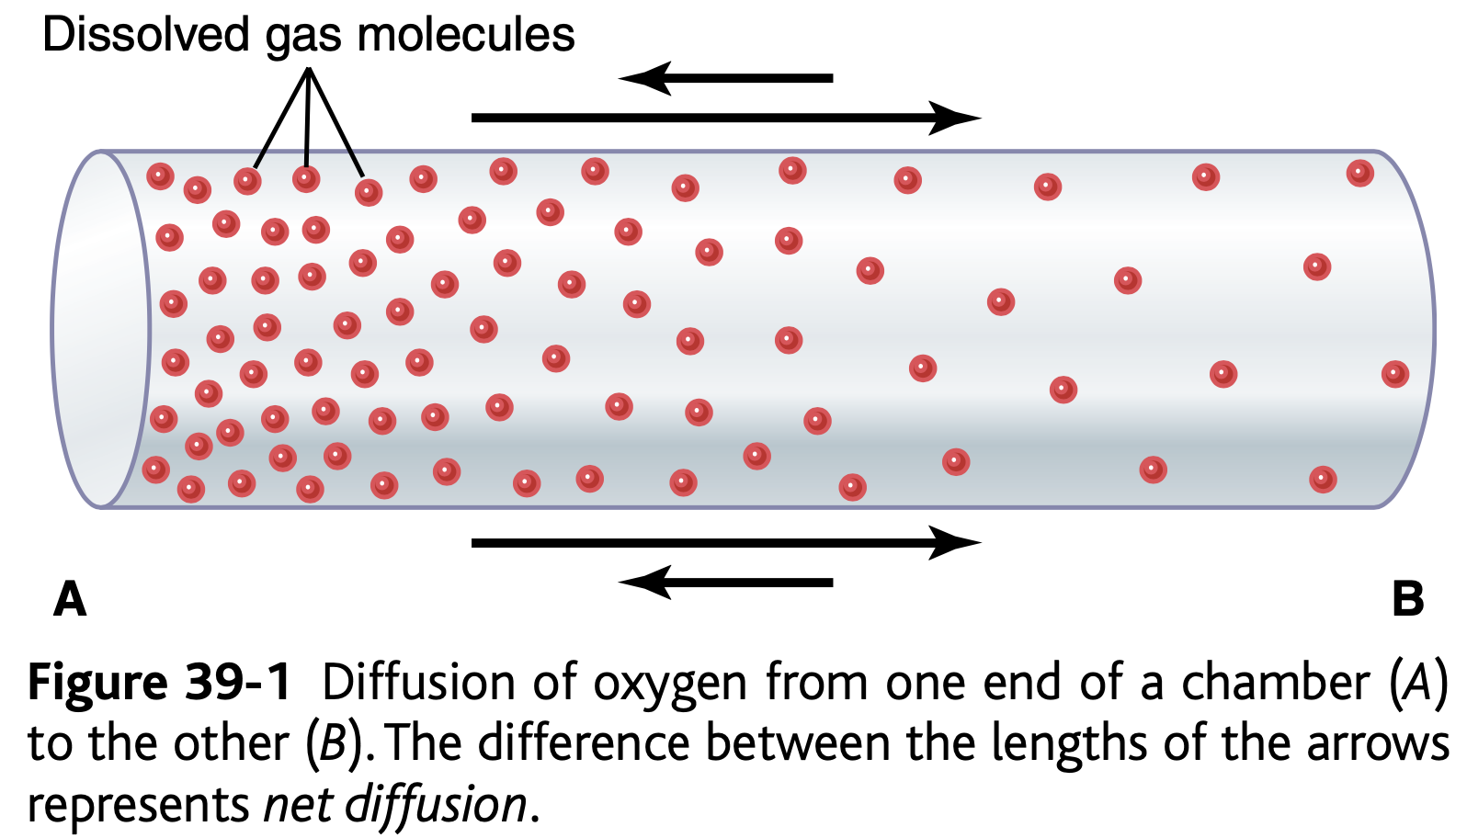
Partial Pressure of Gases
Helpful video
Another one:)
Gases of physiological importance: O₂ & CO₂.
باختصار الضغط عباره عن القوه على المساحه
بمعنى اخر هو ان جزيئات الغاز رايحه باتجاه سطح معين
Pressure is caused by: constant impact of kinetically moving molecules against a surface.
Partial Pressure of the Gas: the pressure caused by a gas alone.
Pressure of a gas acting on surfaces of respiratory passages & alveoli is proportional to the summated force of impact of all molecules of that gas striking the surface at any time.
Pressure of a gas is directly proportional to the concentration of gas molecules.
Gas exchange during respiration occurs primarily through diffusion. Diffusion is a process in which transport is driven by a concentration gradient. Gas molecules move from a region of high concentration to a region of low concentration

Slide 6
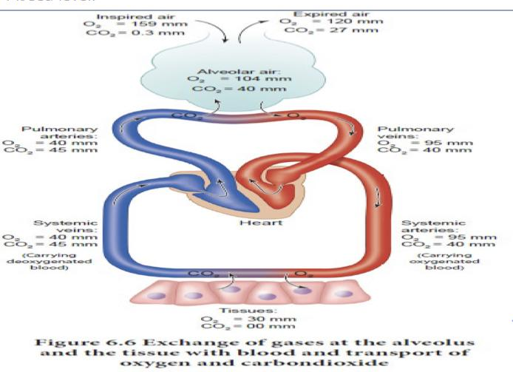
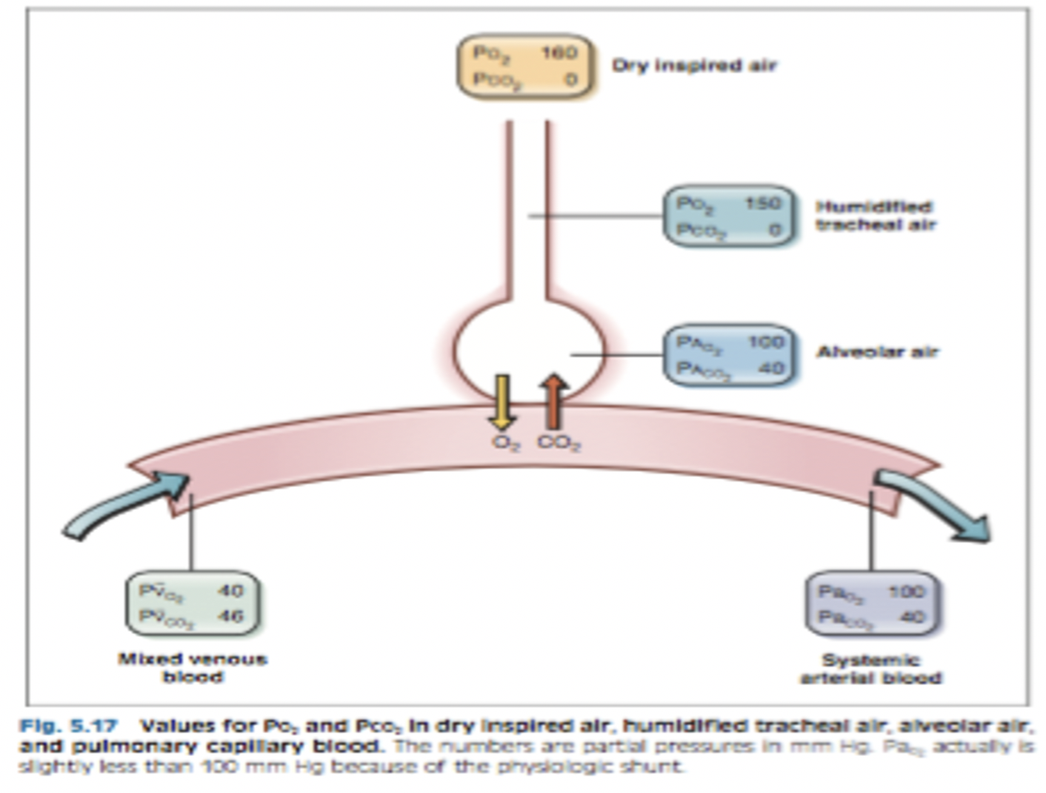
Humidification of the air in the respiratory passage
Atmospheric air: nitrogen + O₂ + almost no CO₂ & little water vapor. (CO₂ should be absent under normal conditions)
As soon as atmospheric air enters respiratory passages, it is exposed to fluids that cover respiratory surfaces.
Even before air enters alveoli: becomes almost totally humidified.
Nitrogen doesn’t diffuse to blood ( Normally )
441
Values for PO₂ & PCO₂ in inspired dry, humidified tracheal, alveolar air, & pulmonary blood.

Slide 7
Dalton’s Law of Partial Pressures
Dalton’s Law of Partial Pressures: the partial pressure of a gas in a mixture of gases is the pressure that gas would exert if it occupied the total volume of the mixture.
Partial pressure: total pressure multiplied by fractional concentration of dry gas.
Dalton's law:
PX=PB X F
PX = partial pressure of gas (mmHg)
PB = barometric pressure (760 mmHg)
PH₂O = water vapor pressure at 37°C (47 mmHg)
F = fractional concentration of gas (0.21 no unit)
For humidified gas: PX = (PB − PH₂O)× F
Barometric pressure (PB): the sum of partial pressures of O₂, CO₂, N₂, & H₂O.
Percentages of gases in dry air at a barometric pressure of 760 mmHg:
O₂ = 21% (0.21)
N₂ = 79% (0.79)
CO₂ = 0% (0)
Air is humidified in airways → water vapor pressure (47 mmHg at 37°C) is obligatory.

Slide 8
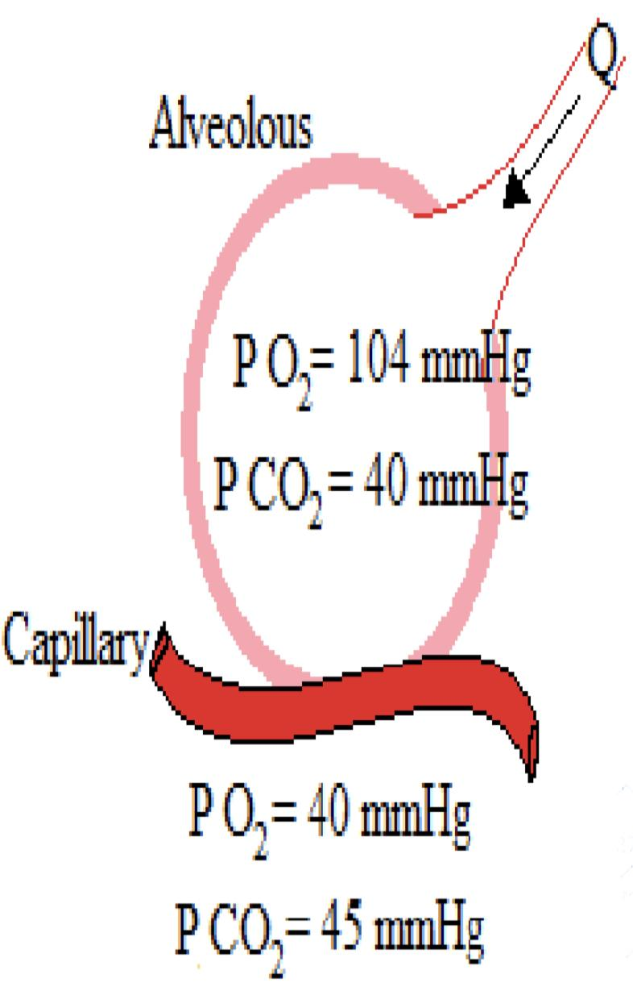
Partial Pressures of O₂ & CO₂
The old air is the residual volume
Also it decreases because it diffuse into the blood
O₂ concentration in atmosphere: 21%
PO₂ in atmosphere:
= 760 mmHg x 21%
= 160 mmHg
Mixes with “old” air already present in alveoli → PO₂ becomes 104 mmHg in alveoli.
CO₂ concentration in atmosphere: 0.04%
PCO₂ in atmosphere:
= 760 mmHg x 0.04%
= 0.3 mmHg
Mixes with high CO₂ levels from residual volume in the alveoli → PCO₂ becomes 40 mmHg in alveoli.
because of the diffusion of co2 from blood to alveoli.
now the lung is high with co2 conc so it will leave the lung to the lower conc
79% of The atmospheric air is nitrogen and the 21% is the O2
From 441

Slide 9
Factors affecting Gas diffusion
In o2 therapy we increase partial P
Partial pressure يحدد الغاز من وين بيروح لوين
Fick’s Law/Principle
D α ΔP x A x S
d x √MW
Mucous مثلا واحد عنده باحد الرئتين
سهل؟diffusionهل بيصير ال
لا بسبب ان المساحه صارت اقل
-Surface area is decreased by dissection of alveoli or capillary
d: Diffusion distance.
Thickness of respiratory membrane.
Distance of diffusion increases if there is edema or fibrosis
S: Solubility of gas in the body fluids.
MW: Molecular weight of gas.
S
P: Partial pressure differences
Diffusion Coefficient of Gas (D) =
√MW
A: Surface area for gas exchange.
Total surface area of respiratory membrane: 50 - 100 m² in normal adult
Fluid Temperature:
Body’s temperature remains reasonably constant → usually not considered.
The higher diffusion coefficient the better

Slide 10
Cont ..Factors affecting Gas diffusion
MW of O₂ < MW CO₂ ; CO₂ is 20 or 24 times more soluble than O₂.
Net result: CO₂ diffusion ~20 times faster than O₂ diffusion.
Factors determining the partial pressure of a gas in a solution:
1-Gas concentration
2-Solubility/diffusion coefficient of gas
Henry’s Law
Partial Pressure =
Dissolved in the blood
Concentration of dissolved gas
Solubility coefficient
التناسب عكسي مع الذوبان لذلك الضغط الجزئي لثاني الاكسيد اقل
Partial pressure of CO₂ (for a given conc.) is less than one twentieth (5%) that exerted by O₂.
Relative rates at which different gases at the same pressure level will diffuse are proportional to their diffusion coefficient:
O₂ = 1.0 CO₂ = 20.0 N₂ = 0.53

Slide 11
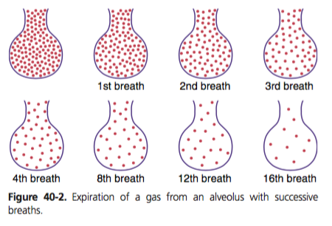
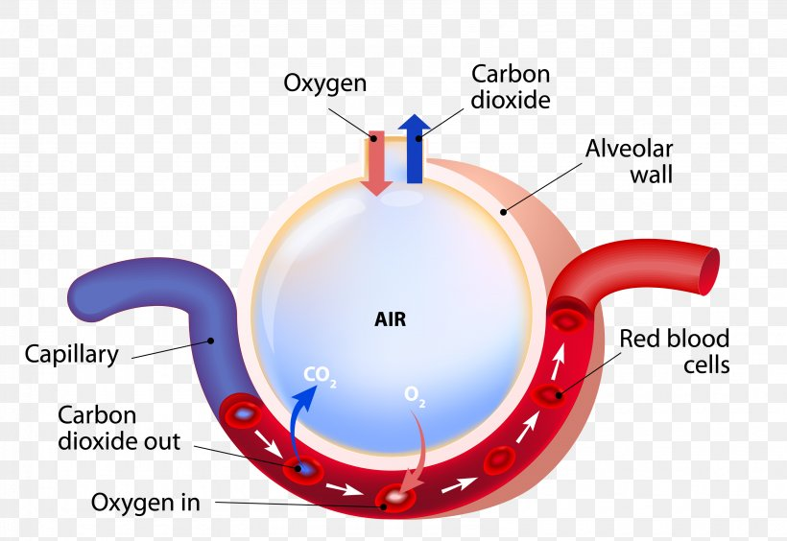
Alveolar air & its relation to atmospheric air
Alveolar and atmospheric air concentrations of gases are different due to
4 Reasons:
The alveolar air is only partially replaced by atmospheric air with each breath.
- Only 350 milliliters of new air is brought into the alveoli with each normal inspiration, and the same amount of old alveolar air is expired.
- i.e The volume of alveolar air replaced by new atmospheric air with each breath is only one seventh of the total.
Oxygen (O2) is being absorbed from the alveolar air into the pulmonary blood.
Carbon dioxide (CO2) is diffusing from the pulmonary blood into the alveoli.
Dry atmospheric air is humidified even before it reaches the alveoli.

Slide 12
Importance of the Slow Replacement of Alveolar Air
The importance of slow replacement of alveolar air:
EXTRA
الO2 اللي نستنشقه مايستبدل كله أول مايوصل للAlveoli بس بالتدريج على كميات بسيطة حتى ما تتأثر تراكيز المواد داخل الجسم، لأن لو حصل اضطراب في التراكيز، راح تتأثر الpH في الدم؛ على سبيل المثال :كلما زاد تركيز الCO2 في الدم يتحول ببعض الانزيمات الى مركبات منها أيون الهيدروجين اللي يساهم في حامضية الدم.
عشان تكون الصورة واضحة:
↑CO2 + H2O→(HCO3-) + (↑H+)
Catalytic enzyme: carbonic anhydrase
Prevent sudden changes in gas concentrations in blood.
Makes the respiratory control mechanism much more stable.
Helps preventing excessive increases & decreases in:
Tissue oxygenation
Tissue CO2 concentration
Tissue pH
when respiration is temporarily interrupted.
- في الصورة: النقاط الحمراء تمثل الهواء القديم والفراغ بالأبيض هو الهواء الجديد اللي يدخل الalveoli.
- مع كل نفس، يستبدل جزء بسيط فقط من الهواء إلى أن يستبدل الهواء بشكل كامل.

Slide 13
Male slides Only
Transport of O2 in Arterial Blood
98% of the blood that enters the left atrium from the lungs has just passed through the alveolar capillaries and has become oxygenated up to a PO2 of about 104 mm Hg.
2% of the blood has passed from the aorta through the bronchial circulation, which supplies mainly the deep tissues of the lungs and is not exposed to lung air.
This blood flow is called “shunt flow,” meaning that blood is shunted and bypass the gas exchange areas. (will be explained next slide)
Upon leaving the lungs, the PO2 of the shunt blood is approximately that of normal systemic venous blood—about 40 mm Hg.
When this blood combines in the pulmonary veins with the oxygenated blood from the alveolar capillaries, this is called (Venous admixture).
This causes the PO2 of the blood entering the left heart and pumped into the aorta to fall to about 95 mm Hg.

Slide 14
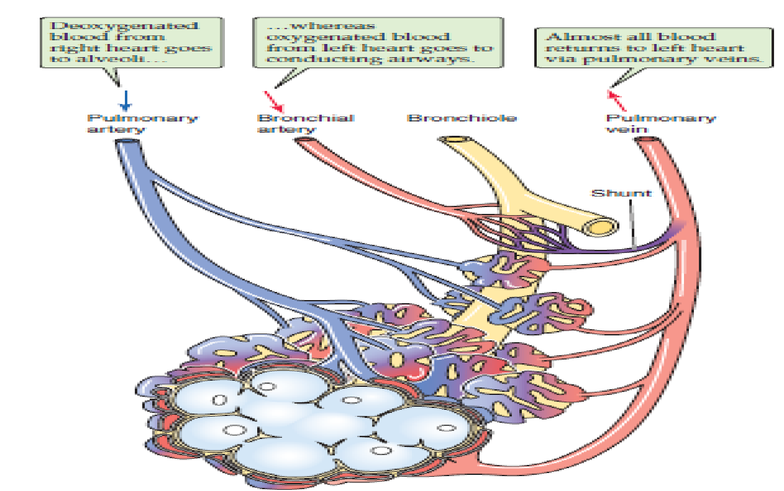
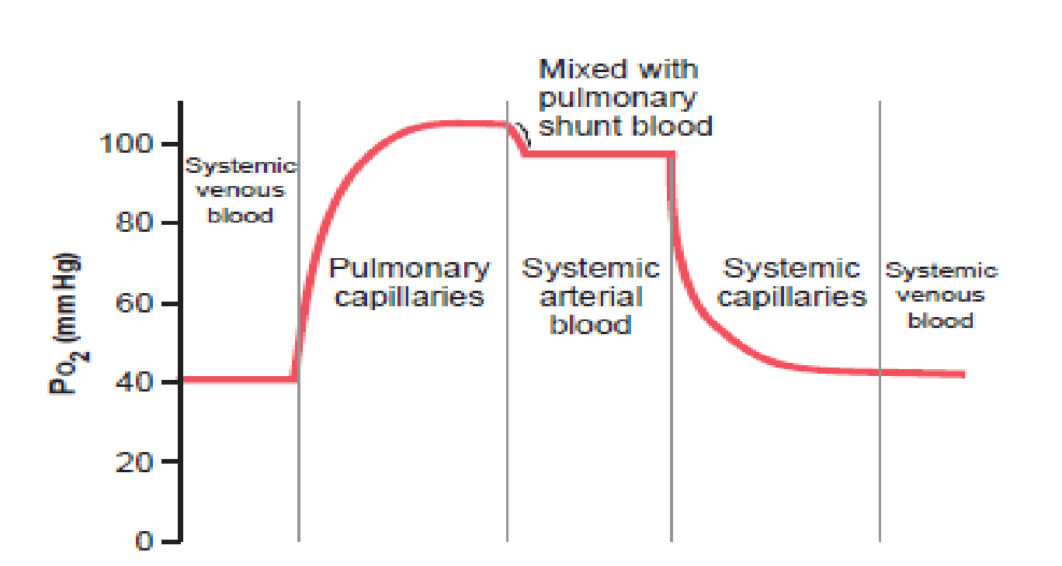
Pulmonary shunt
Male slides Only
As the blood in the pulmonary vein is
transported to the left atrium in order to be
pumped to the systemic tissues, PO2
Changes from 104 → 95 as this blood is mixed with some blood from the bronchial tree veins to nourish the lung tissue itself (the only venous blood in left atrium). (Team441)
Team439:
1. All arteries in the body are oxygenated except pulmonary artery.
2. All veins in the body are deoxygenated except the pulmonary vein.

Slide 15
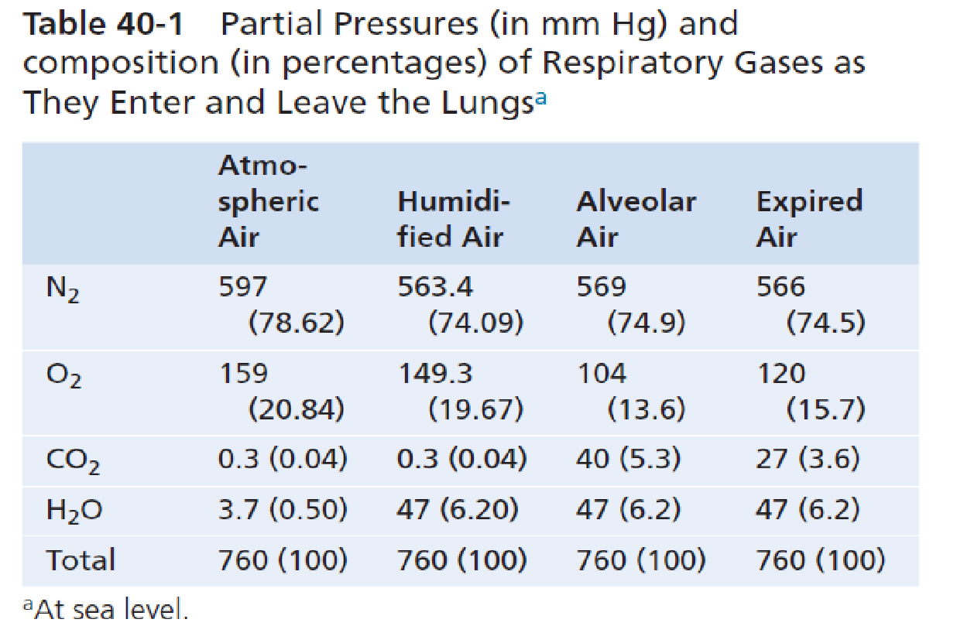
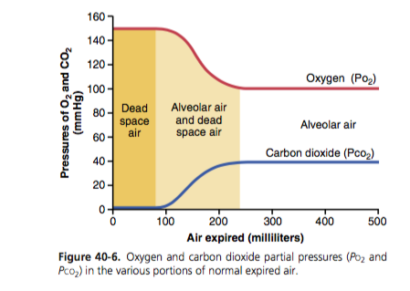
PO2 & PCO2 in Normal Expired Air
Conduction zone: dead space air
- PO2 decreases as it enters conduction zone (160 → 149)
- PCO2 does not change
Respiratory zone: normal expired air + alveolar air
- PO2 begins to decrease (149 → 104)
- PCO2 begins to increase (~0 → 40) from capillaries.(Team441)
Normal expired air, containing both dead space air and alveolar air.
Normal expired air has gas concentrations & partial pressures that is
between those of alveolar air and humidified atmospheric air.

Slide 16
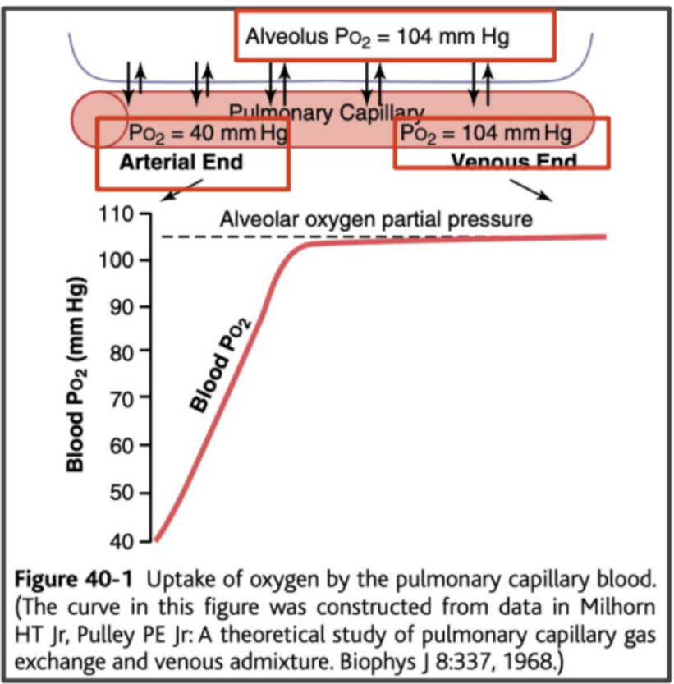
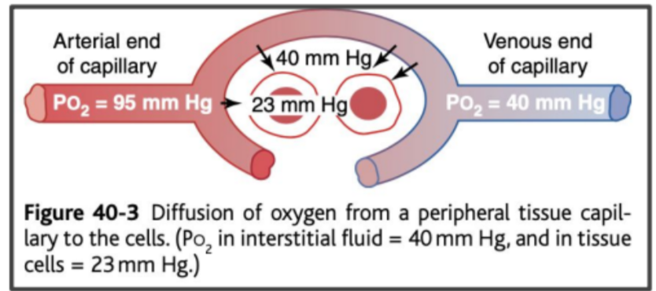
Diffusion of O2
1-Alveoli →Pulmonary capillaries
2-Systemic capillaries →Tissues

Slide 17
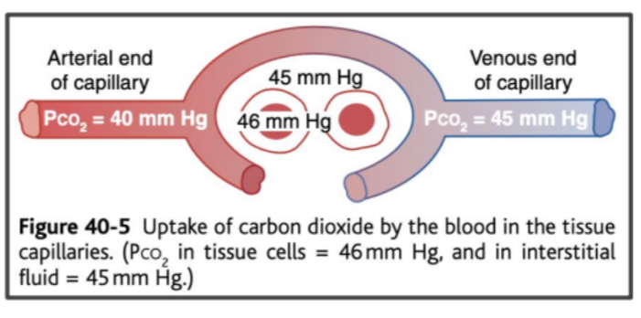
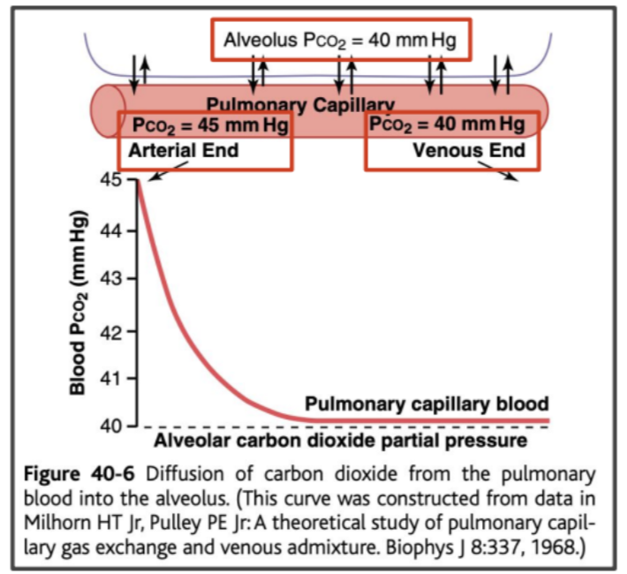
Diffusion of CO2
1-Peripheral tissue cells → Capillaries
2-Pulmonary capillaries → Alveoli

Slide 18
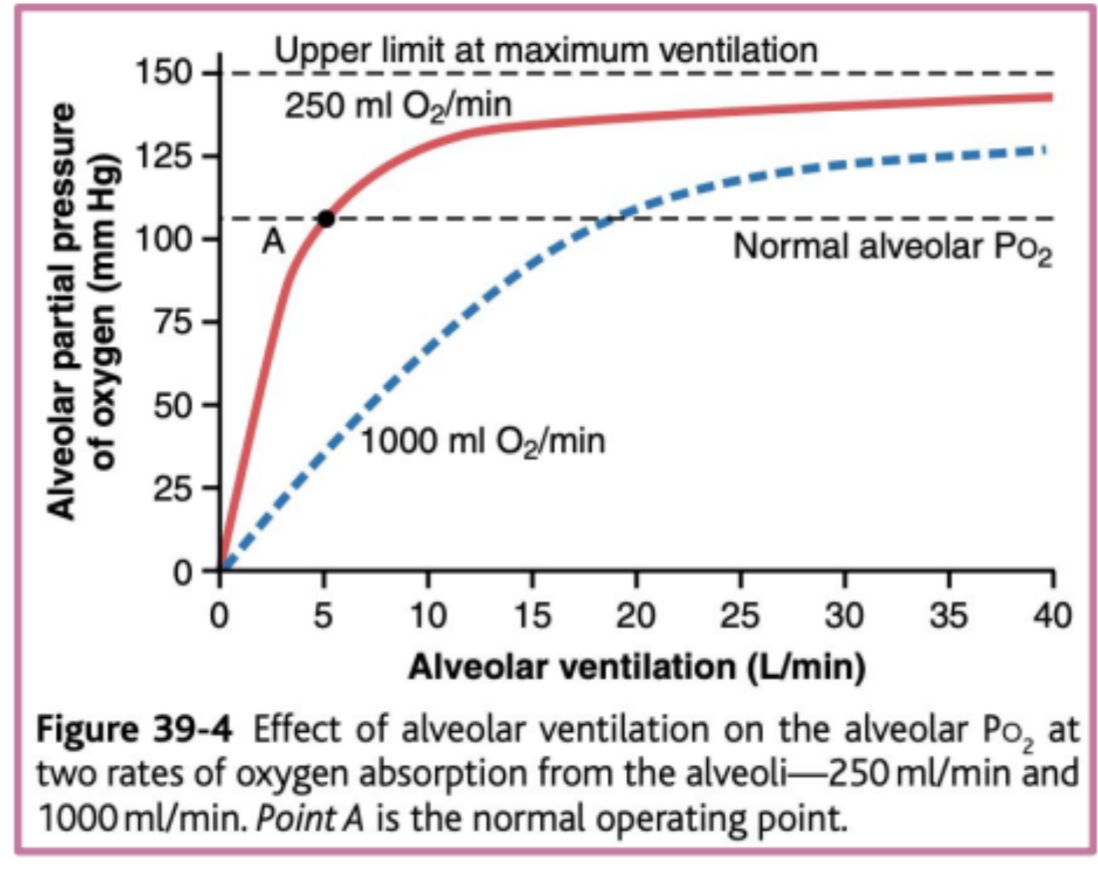
Female Slides Only
O2 Concentration in Alveoli
At resting conditions:
-250 ml of O2 are extracted by tissues per minute.
-At ventilation rate: 4.2 L/min.
During exercise:
-1000 ml of O2 is extracted by tissues per minute.
-Rate of alveolar ventilation must increase 4 times to maintain the alveolar PO2 at normal value (104 mmHg).
O2 concentration in alveoli & O2 partial pressure are controlled by:
- Rate of absorption of O2 into blood.
- Rate of entry of new O2 into lungs by the ventilatory process.

Slide 19
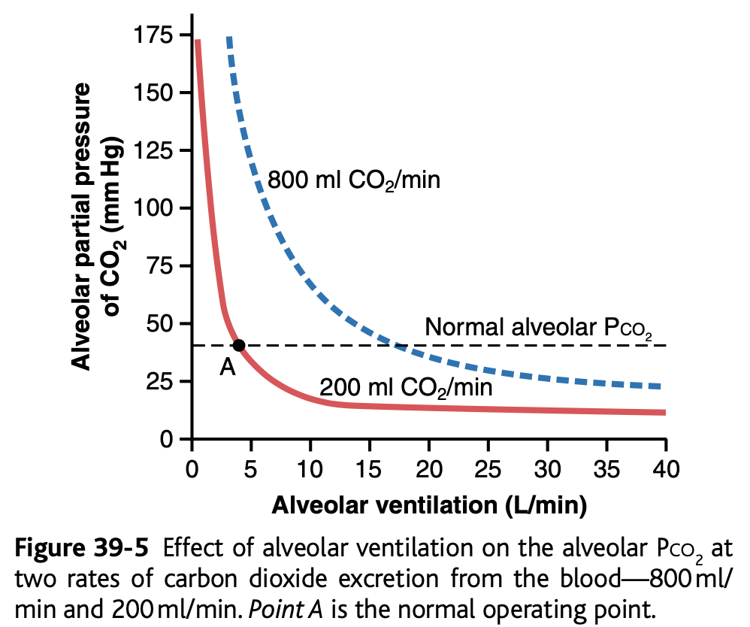
Female Slides Only
Alveolar Ventilation & Alveolar PCO2
Normal rate of CO₂ excretion: 200 ml/min
Ventilation rate: 4.2 L/min (normal).
Alveolar PCO₂ increases directly in proportion to the rate of CO₂ excretion by tissues.
Alveolar PCO₂ decreases in inverse proportion to alveolar ventilation.

Slide 20
MCQ
1.A 2.B 3.C 4.A
Q1. Which of the following factors does not affect the gas diffusion?
A.Velocity | B.Distance | C.Molecular weight | D.Pressure difference
Q2. Oxygen (O2) partial pressure in the alveoli is?
A. 95 mmHg | B. 104 mmHg | C. 160 mmHg | C. 760 mmHg
Q3. Carbon-dioxide (CO2) partial pressure in the alveoli is?
A. 0.3 mmHg | B. 104 mmHg | C. 40 mmHg | D. 45 mmHg
Q4. Increased thickness of the respiratory membrane causes ….. In gas diffusion. Increased size of particle causes …… in gas diffusion.
A. decrease-decrease | B.decrease-increase | C. increase-decrease | D. increase-increase

Slide 21
SAQ
Q1- why does the atmospheric air is composed of almost entirely N and O2 and almost no CO2?
Q2- enumerate 3 of the factors affecting the gas diffusion?
Q3- why does the CO2 diffuse more than O2?
Q4- what is the importance of slow replacement of alveolar air?
Answers
1- because the trees use the co2
2- partial pressure,surface area,MW
3-because it is more soluble
4-slide 12
For more questions click on the icon

Slide 22
Team leaders
Deema aljuribah Mishal Alsuwayegh Waleed Alrashoud
Team members
Maram Beyari
Raghad Alnadeef
Hend Almogary
Farah Alfayez
Kadi Khalid aldoosari
Farah mohammed Alqazlan
Ghada Binslmah
Shatha Alshabani
Faisal Ali
Othman Aldraihem
Abdullah Alqarni
Rayan Alotaibi
Faisal Alkhunein
Mishari Alenezi
Bandar Almutiri
Fahad Alhelelah
Rayan Bosaid
Ibraheem Alkanhal
Saad Alhammad
Emad Almutairi
Ahmad Almarshed
Salman Almutaz
Osama Alzahrani
Physio442@gmail.com

