Slide 1
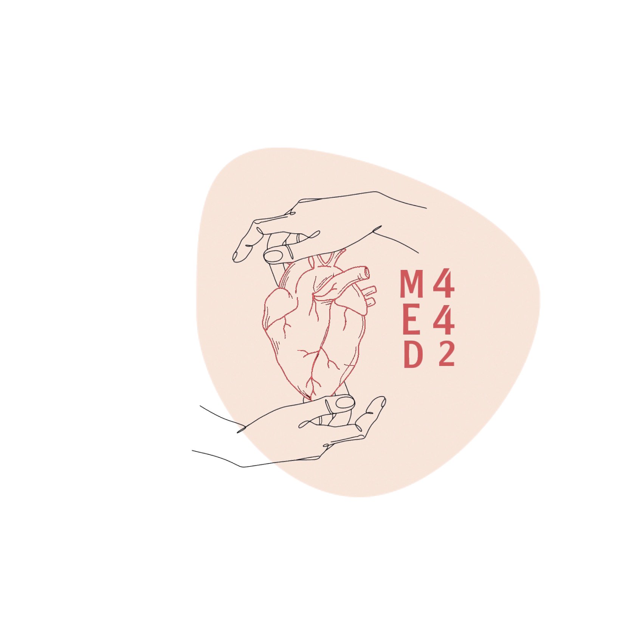
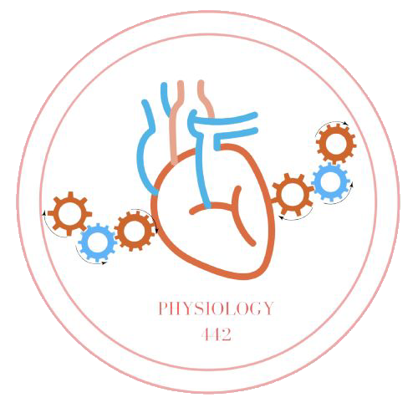
L-6
Ventilation, perfusion, ratio
Helpful video
Color index:
Main text
Important
Doctor notes
Boys slides
Girls slides
Extra
Editing file

Slide 2
Objectives:
Recognize the high pressure and low pressure circulations supplying the lung
Identify the meaning of the physiological shunt in the pulmonary circulation
State the different lung zones according to the pulmonary blood flow
Define the V/Q ratio and its regional variation
Explain the clinical significance of the V/Q ratio
Describe the abnormal patterns of the V/Q ratio vice, shunt and dead space patterns

Slide 3
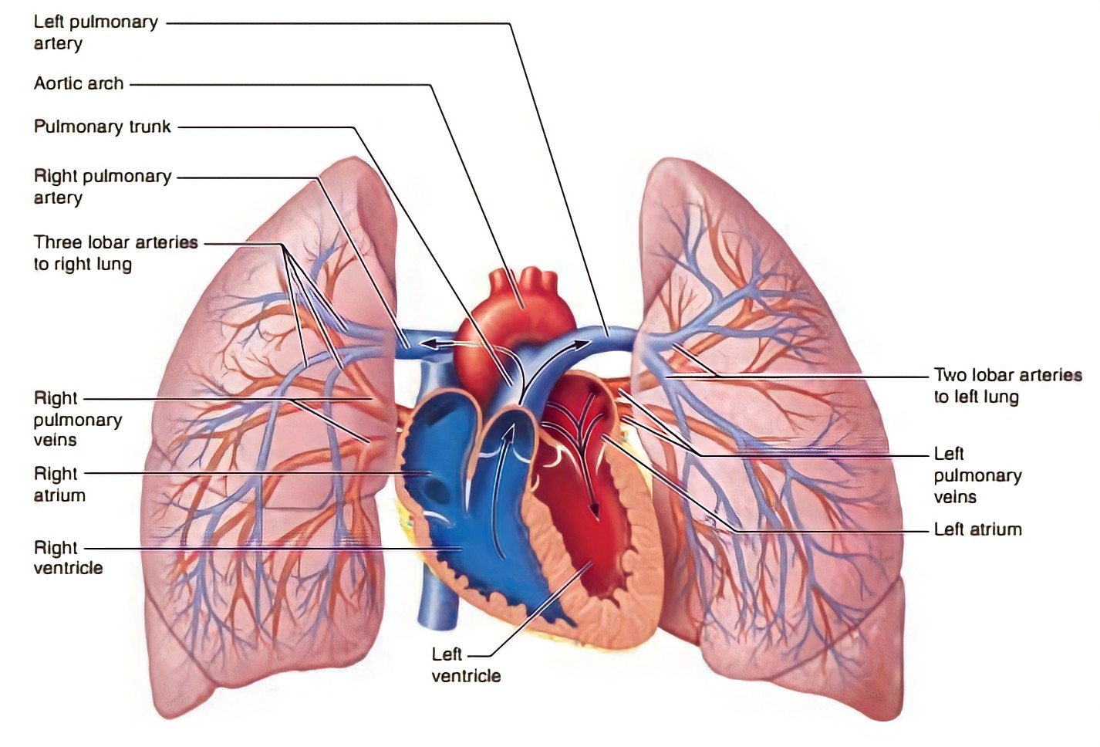
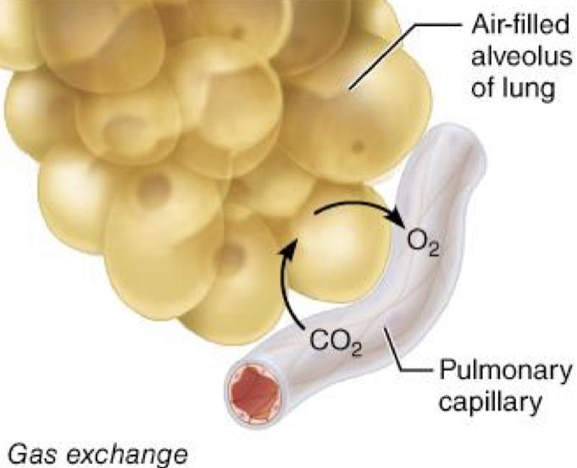
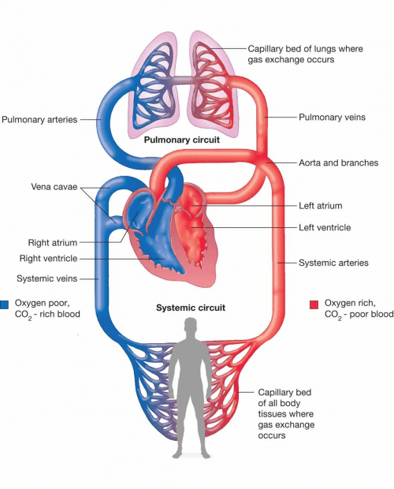
Pulmonary circulations
In female slides only
The pulmonary arterial system is shown in blue to indicate that the blood carried is oxygen-poor
The pulmonary venous system is shown in red to indicate that the blood transported is oxygen-rich
Blood volume of the lungs :
450 ml
9% of total blood volume
Approximately 70 ml in pulmonary capillaries
Lungs serve as blood reservoir (100-250 ml)

Slide 4
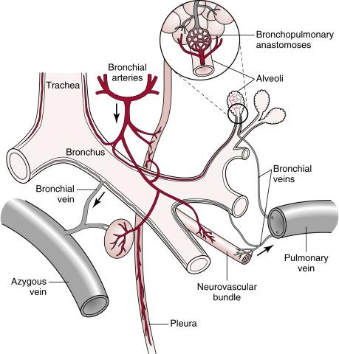
Pulmonary circulations
Pulmonary circulations
High-pressure/low-flow circulation
Low-pressure/high-flow circulation
Supplies systemic arterial blood to:
● Trachea
● Bronchial tree (including terminal bronchioles)
● Supporting tissues of lung
● 0uter coats (adventitia) of pulmonary arteries & veins
Supplies venous blood from all parts of the body to alveolar capillaries where oxygen (O2) is added & carbon dioxide (CO2) is removed.
Bronchial arteries: branches of thoracic aorta.
Supply most of systemic arterial blood at a
pressure that is only slightly lower than aortic pressure.
● Pulmonary artery (receives blood from right
ventricle) and its arterial branches carry blood to
alveolar capillaries for gas exchange.
● Pulmonary veins then return blood to left atrium to be pumped by left ventricle through systemic
circulation.

Slide 5
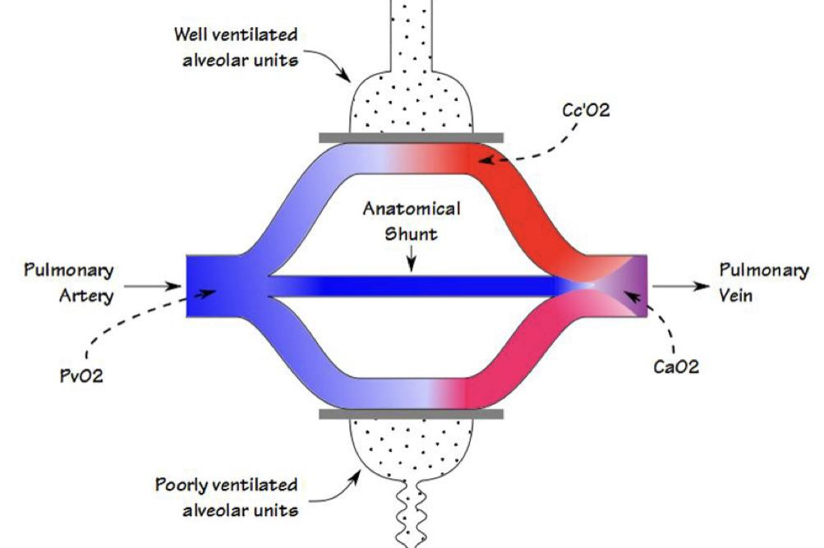
In female slides only
Physiological shunt
1
It is defined as a diversion through which the venous blood is mixed with arterial blood
2
Flow of deoxygenated blood from bronchial circulation into pulmonary veins without being oxygenated makes up part of normal physiological shunt
3
Flow of deoxygenated blood from thebesian veins into cardiac champers directly.
4
Physiological shunt results in venous admixture ( mixing of oxygenated blood with deoxygenated blood)

Slide 6
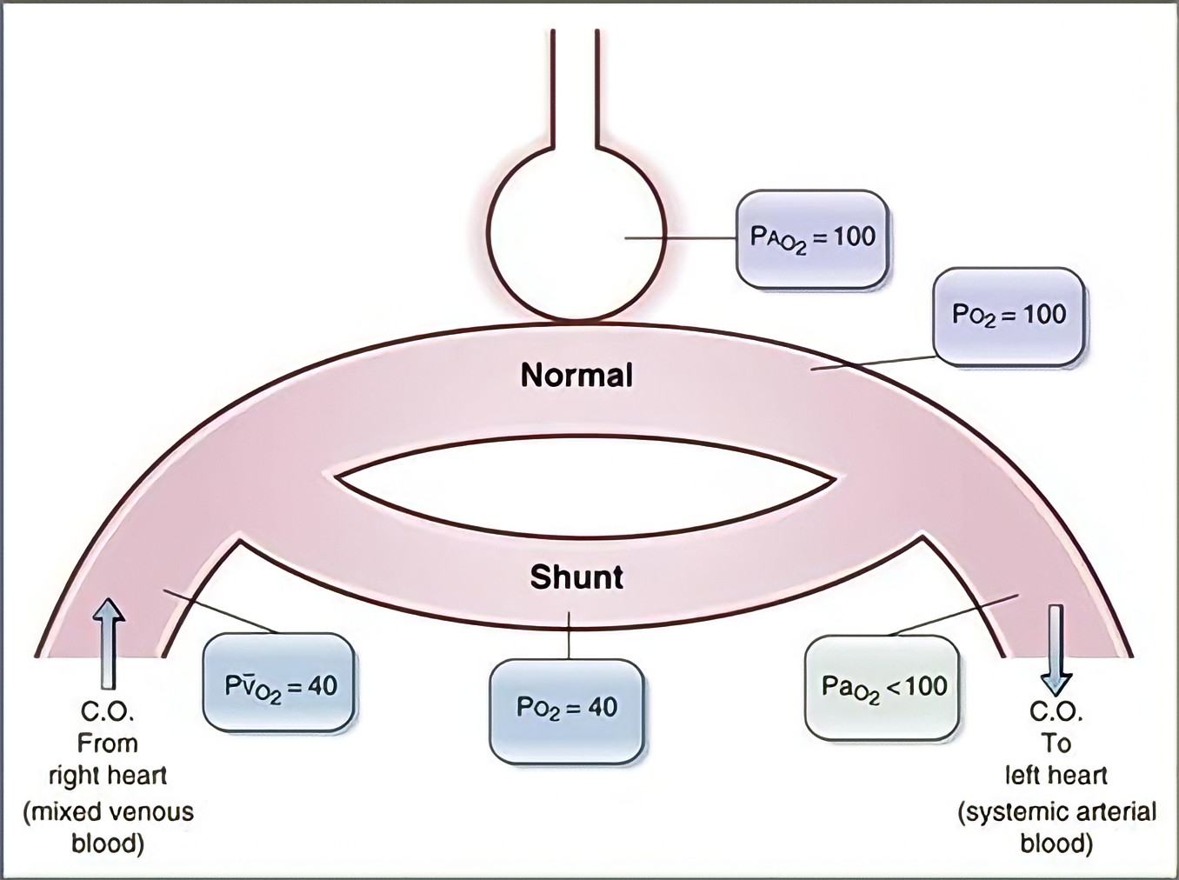
Physiological shunt
1
The blood that flows to lungs through small bronchial arteries that originate from the systemic circulation amounts to 1 - 2% of the total cardiac output.
1
2
The bronchial arterial blood is oxygenated blood, supplies the supporting tissues of the lungs,including the connective tissue,septa,and large and small bronchi
2
3
3
After this bronchial blood & arterial blood passes through supporting tissues, it empties into pulmonary veins and enters the left atrium, rather than passing back to the right atrium (shunt blood)
4
4
The flow into left atrium and left ventricular output are about 1-2% greater than that of right ventricular output.

Slide 7
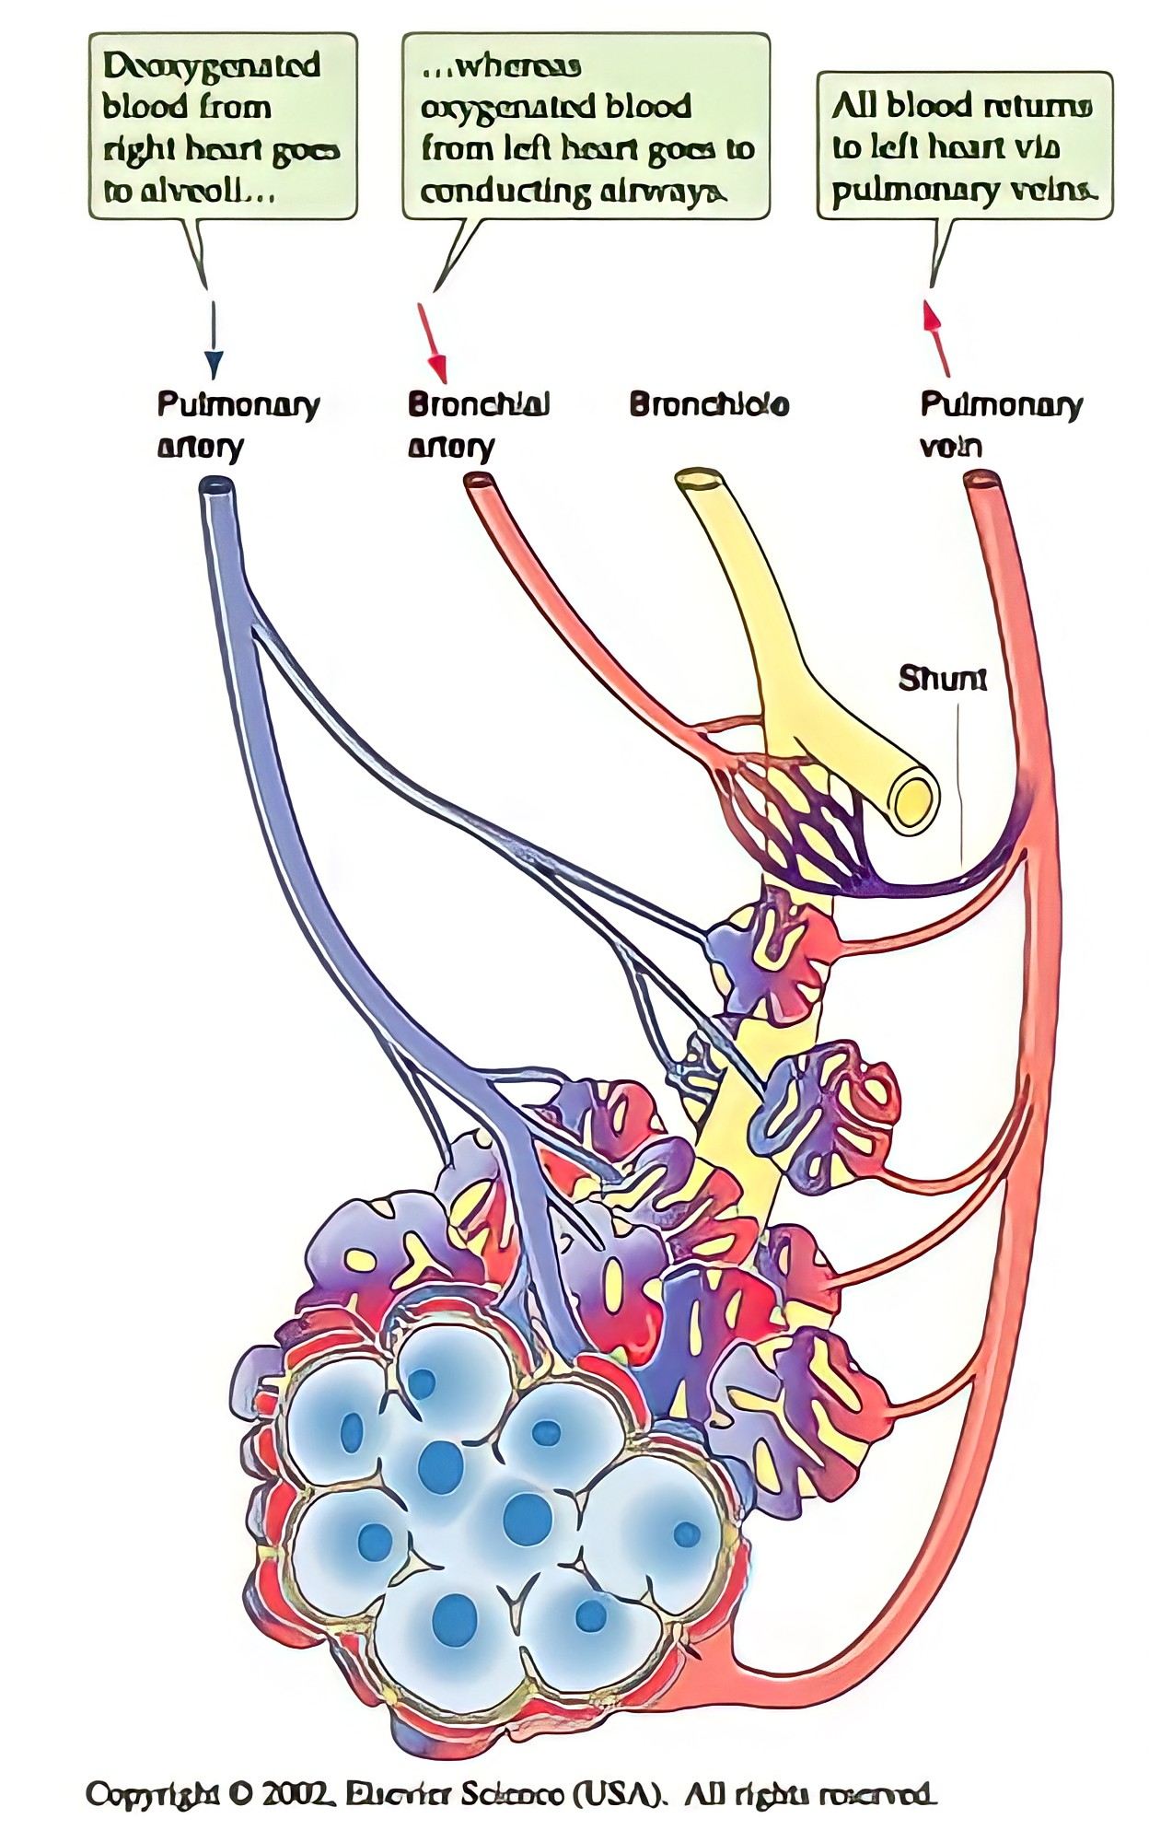
shunts
In Male Slides Only
Shunt
A portion of the pulmonary blood flow that bypasses the alveoli (no gas exchange)
Physiological shunt
Bronchial blood flow & coronary blood flow (2%) bypasses the alveoli.
Abnormal shunt
Example: right to left shunt
Will not be treated by high O2 supply
Useful diagnostic tool.

Slide 8
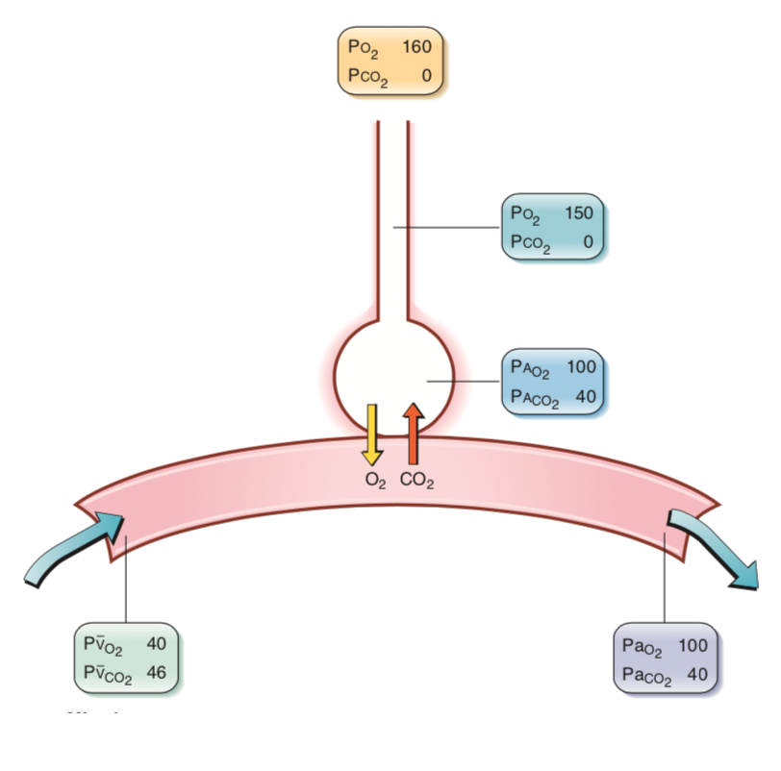
Regulation of Pulmonary Blood Flow
Regulation of pulmonary Blood flow
The major factor regulating pulmonary blood flow is the partial pressure of O2 in alveolar gas (PaO2 )
Decrease in PAO2 below 70 mmHg —> pulmonary vasoconstriction
Adaptive mechanism: blood flow is directed away from poorly
ventilated region
Example: In high altitude PaO2 is reduced—> global vasoconstriction
Other factors:
Cardiac output
Decreased alveolar oxygen
Chemical factors,vasoconstrictor or dilator
Hydrostatic pressure
Physical activity
Fetal pulmonary blood flow circulation is about 15% of cardiac output due to global vasoconstriction.

Slide 9
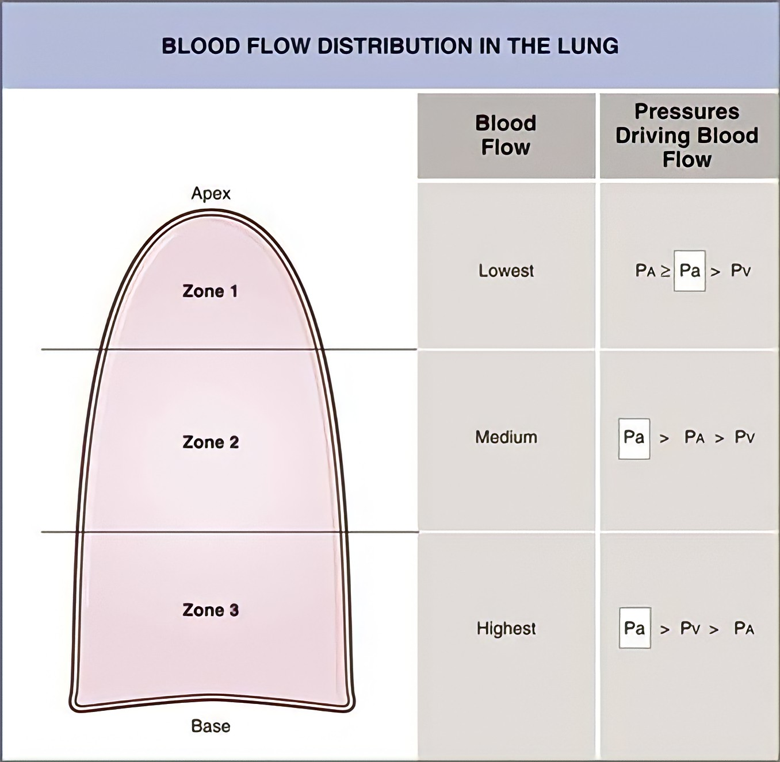
Effect of hydrostatic pressure on blood flow
Lowest point in lungs: normally ~30 cm below highest point this represents 23 mm Hg pressure difference —> ~15 mmHg of which is above the heart & 8 below it.
Gravitational effect :
hydrostatic pressure is affected by gravity
pulmonary arterial pressure in uppermost portion of the lung of a standing person is ~15 mmHg less than pulmonary arterial pressure at the level of the heart.
Pressure in the lowest portion of lungs is ~8 mmHg greater.
Position:
In Standing position at rest —> there is little flow in the top of the lung
In supine position —> blood flow is nearly uniform
Pressure differences have profound effects on blood flow through different areas of lungs → the effect determines/depicts blood flow per unit of lung tissue at different levels of lung in upright person.

Slide 10
Regulation of Pulmonary Blood Flow
Regulation of pulmonary Blood flow
The major factor regulating pulmonary blood flow is the partial pressure of O2 in alveolar gas (PaO2 )
Decrease in PAO2 below 70 mmHg —> pulmonary vasoconstriction
Adaptive mechanism: blood flow is directed away from poorly
ventilated region
Example: In high altitude PaO2 is reduced—> global vasoconstriction
Other factors:
Cardiac output
Decreased alveolar oxygen
Chemical factors,vasoconstrictor or dilator
Hydrostatic pressure
Physical activity
Fetal pulmonary blood flow circulation is about 15% of cardiac output due to global vasoconstriction.

Slide 11
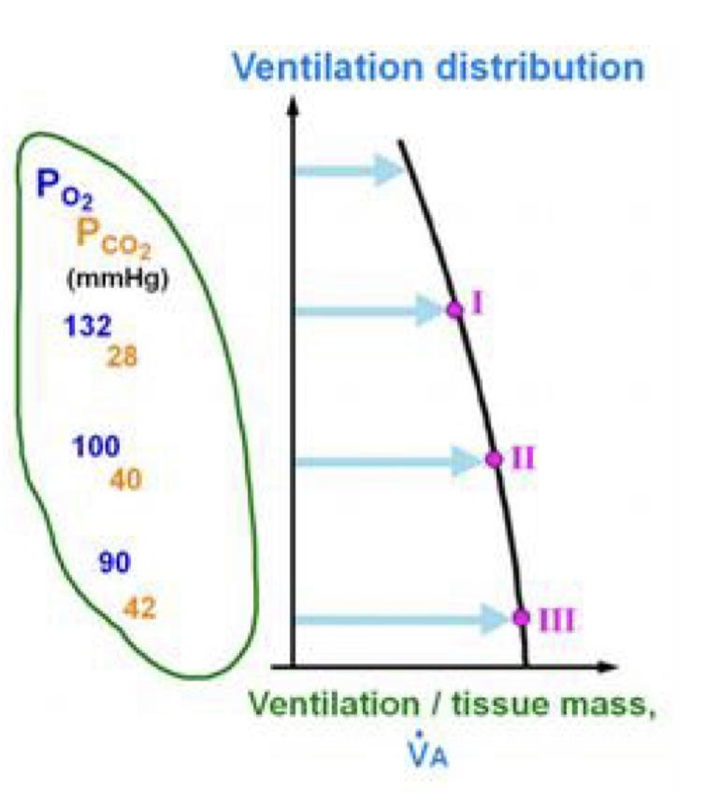
In female slides only
Distribution of ventilation
The right lung is slightly better ventilated than the left.
In a lateral position:
The dependent lung is better ventilated in a spontaneously breathing patient
The non-dependent lung is better ventilated in a ventilated patient
In an erect patient :
-the bases of the lung are better ventilated
-The weight of lung above compresses the lung below,improving the compliance of dependent lung whilst
stretching the non-dependent lung
This is only significant at low inspiratory flow rates
The V/Q ratio in the bases is ~0.6
The V/Q ratio in the apices is > 3

Slide 12
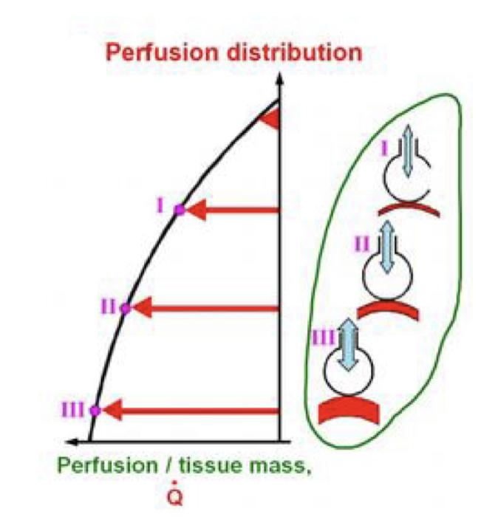
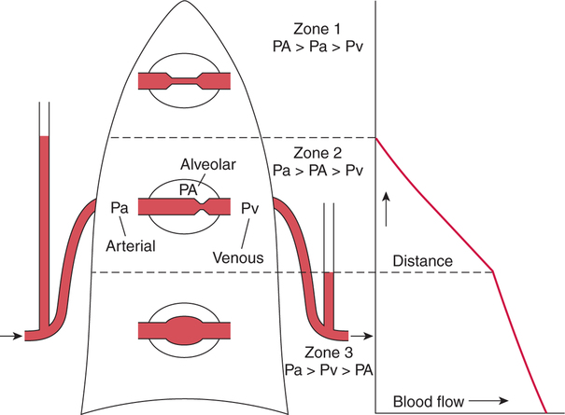
In female slides only
Distribution of perfusion
The pulmonary circulation is a low pressure circulation
Gravity therefore has a substantial effect on fluid pressure
Consequently, the distribution of blood throughout the lungs is uneven
The bases perfused better than the apices

Slide 13
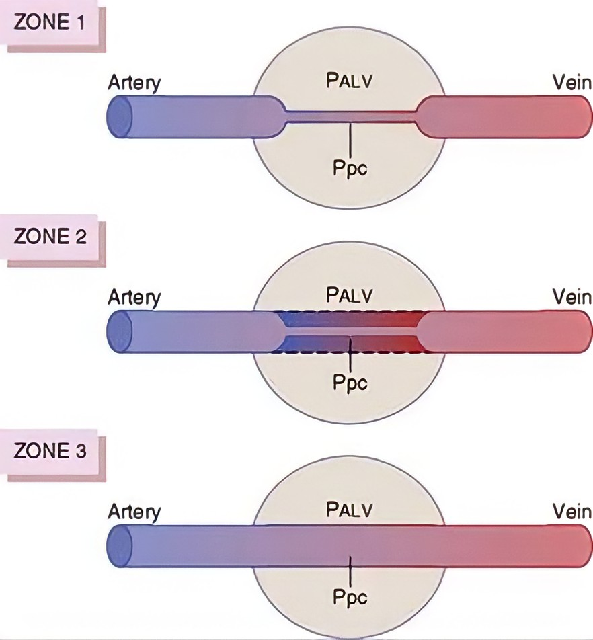
Effect of hydrostatic pressure gradient in the lungs on regional pulmonary blood flow
 | ■ Local alveolar capillary pressure in that area of lung never rises higher than alveolar air pressure during any part of cardiac cycle (alveolar pressure (PALV) is more greater than arterial pressure) → almost no blood flow during all portions of cardiac cycle. ■ Almost closure of capillaries
Zone 1
■ Systolic pressure > alveolar air pressure
■ diastolic pressure < alveolar air pressure
only during peaks of pulmonary arterial pressure.
Zone 2
→ intermittent blood flow
Zone 3
Alveolar (pulmonary)capillary pressure and arterial pressure > alveolar
air pressure during the entire cardiac cycle → continuous blood flow
Normally, lungs have only zones 2 & 3 blood flow:
Zone 2 (intermittent flow) in the apices.
Zone 3 (continuous flow) in all the lower areas.

Slide 14
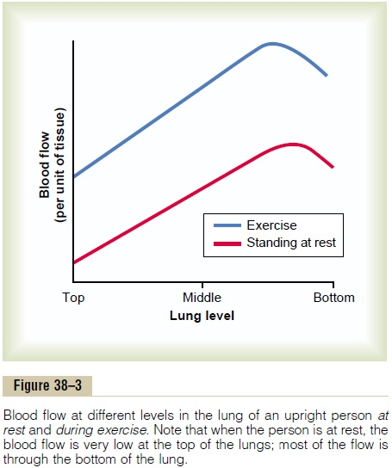
Exercise & Blood Flow at different levels in the lung
In the standing position at rest, there is little flow in the top of the lung but about five times as much flow in the bottom.
The blood flow in all parts of the lung increases during exercise
A major reason for increased blood flow is the pulmonary vascular pressures rise enough during exercise to convert the lung apices from a zone 2 pattern into a zone 3 pattern of flow.

Slide 15
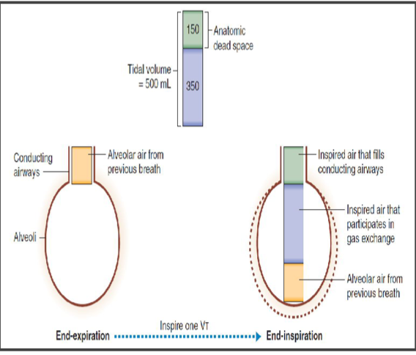
Dead space & its effect on ventilation
1- Anatomical dead space.
Is the volume of air in respiratory conducting pathways.
150 ml = ⅓ of tidal volume.
Air in dead space expired first.
2- Functional dead space.
Alveoli that tend to act in gas exchange due to collapse or obstruction.
3- physiological dead space.
The summation of alveolar & anatomical dead space.
In Male slides Only

Slide 16
Ventilation – Perfusion (V/Q) Ratio
V/Q ratio :
Is the ratio of alveolar ventilation to pulmonary blood flow per minute.
(V) alveolar ventilation at rest = 4.2 L/min
( perfusion-Q ) pulmonary blood flow = right ventricular output ( 5L/min)
Normal V/Q ratio = 4.2 / 5 = 0.84
Alveolar ventilation is 80% of value for pulmonary blood flow if tidal volume & cardiac output are normal
Exchange of O2&Co2 is nearly optimal, Alveolar PO2 is 104 mmHg.
Alveolar PCO2 is 140 mmHg.

Slide 17
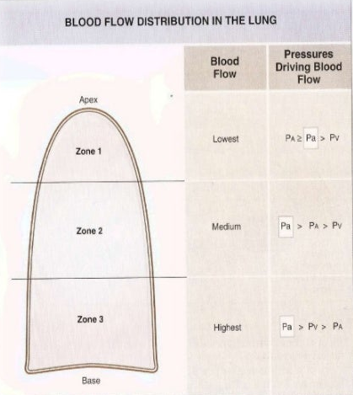
Variation in V/Q in the Zones of Lung
Apex is more ventilated than perfused.
■ Apex V/Q ratio = 3
■ Moderate degree of physiologic or
normal dead space. ( mimics dead space )
Base is more perfused than ventilated.
■ Base V/Q ratio = 0.6
■ Physiologic or normal shunt.( mimics shunt )
V/Q is uneven in the three zones:
■ Average V/Q ratio = 0.84
During exercise & lying flat in bed,
V/Q ratio becomes more homogenous
among different parts of the lung.

Slide 18
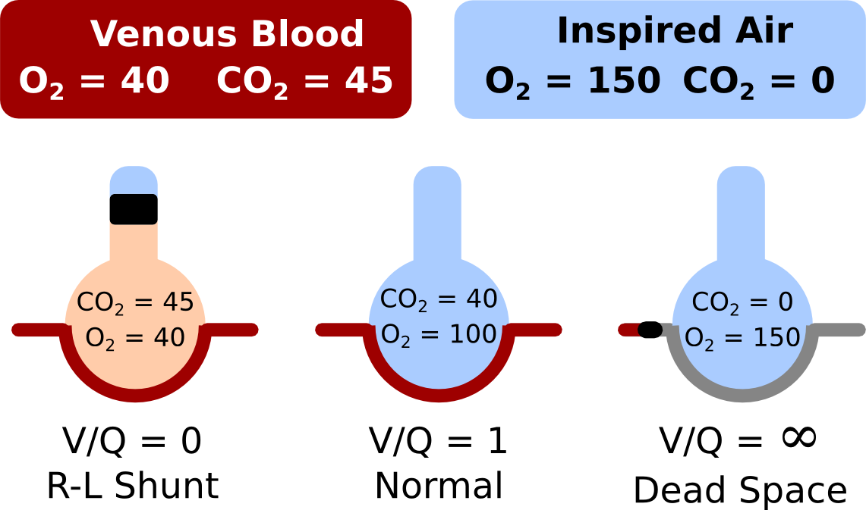
Alveolar PO2 and PCO2 When V/Q equals = 0
In female slides only
When ( V ) is zero , like in case of bronchial obstruction , the V/Q ratio will be zero even if there is perfusion ( Q).
Without alveolar ventilation , air in alveolus = venous return to lungs.
The normal venous blood (V ) has a PO2 of 40mmHg and PCO2 of 45mmHg. (Shunt blood ).
these are the normal partial pressures of O2&Co2 in alveoli that have blood flow but no ventilation.

Slide 19
Alveolar PO2 and PCO2 When V/Q ratio equals Infinity
In female slides only
There is ventilation but no perfusion ( Q) , like in case of pulmonary artery occlusion by thrombus or embolism , so the V/Q ratio will be infinite.
There will be no capillary blood flow to carry O2 or Co2 to alveoli.
The inspired air has no O2 to the blood, or Co2 from the blood.
normal inspired and humidified air has a PO2 of 149 mmHg and a PCO2 of 0 mmHg & these will be the partial pressures of the two gases in alveoli.

Slide 20
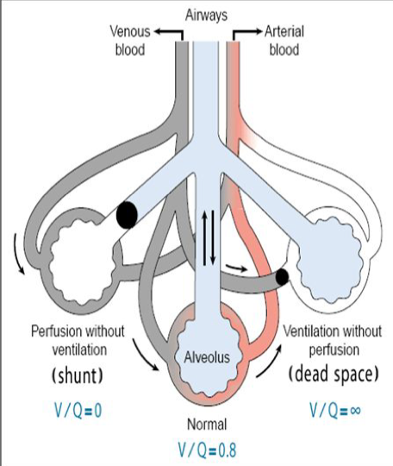
Importance of the V/Q Ratio
Physiological shunt : total quantitative amount of shunted blood per minute.
any mismatch in ratio result in hypoxia
Main function is determining of of state of oxygenation in body
Less than normal
More than normal
Part of venous blood pass through pulmonary veins without oxygenated ( shunted blood )
No exchange of gas through respiratory membrane of affected alveoli
Physiologic dead space , high ventilation & low alveolar blood flow i
Ratio zero/infinity

Slide 21
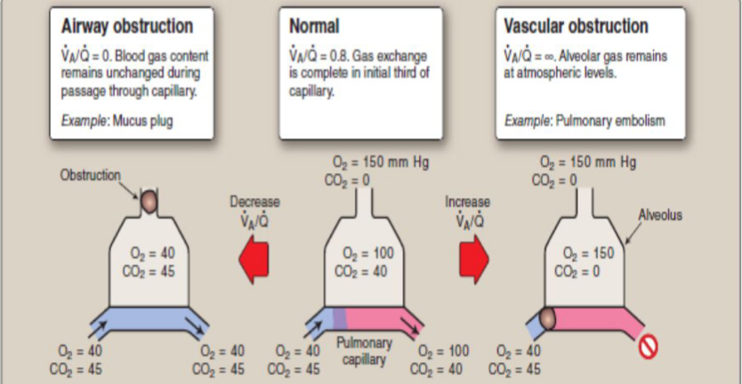
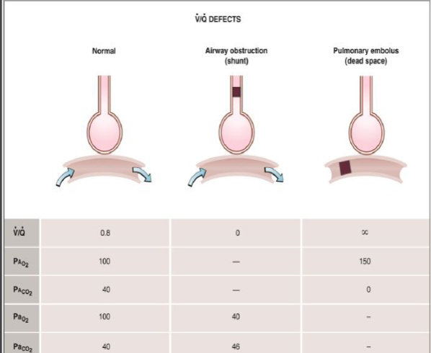
Abnormalities of the V/Q Ratio
Changes in V/Q ratio can be caused by changes in ventilation or perfusion or both.
Airway obstruction → alveolar ventilation is affected (shunt). ( = 0 )
Pulmonary embolism → perfusion is affected (dead space). ( = infinity )

Slide 22
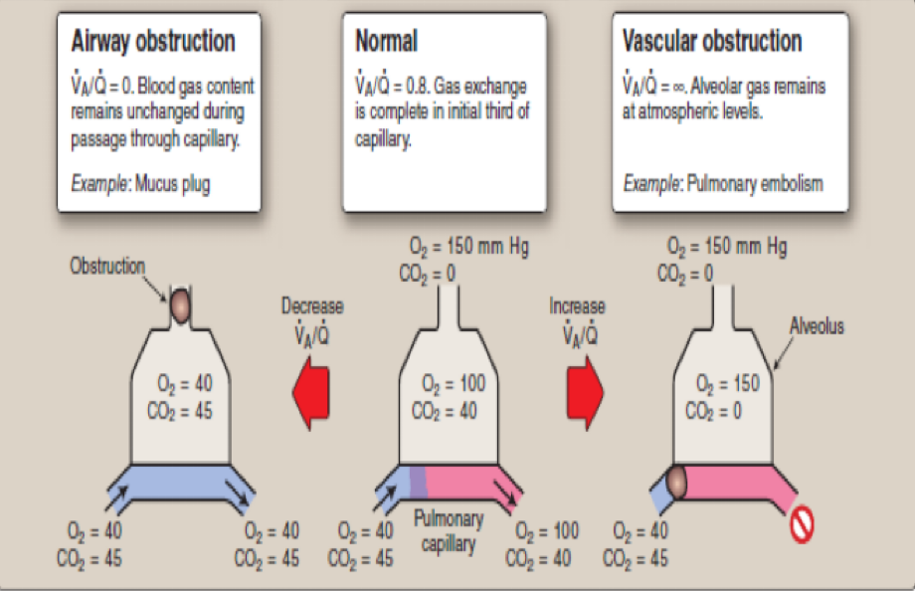
Effects of V/Q abnormalities on PO2 and Pco2

Slide 23
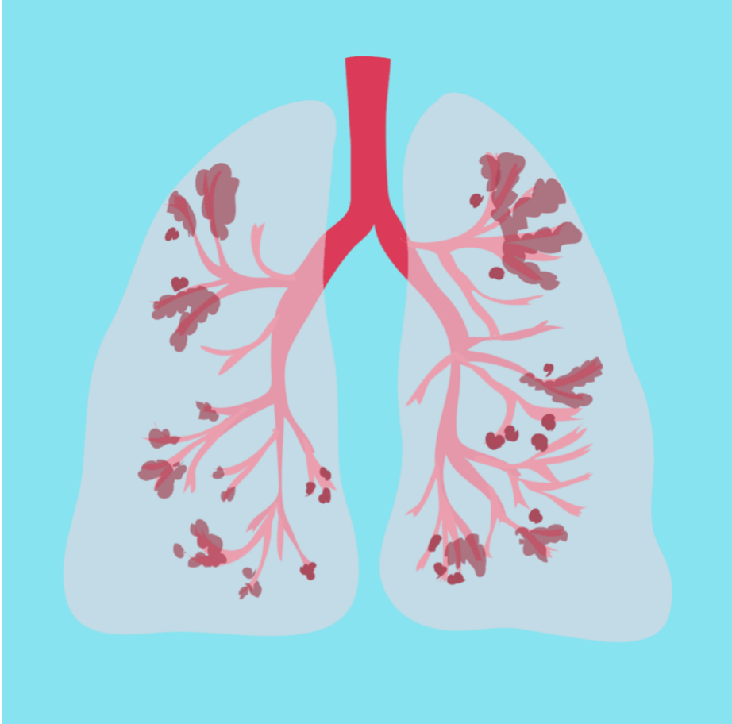
Causes of V/Q mismatch
Female slide only
Pulmonary edema
Pneumonia
Asthma
Causes of V/Q dismatch
COPD
Airway obstruction
Chronic bronchitis

Slide 24
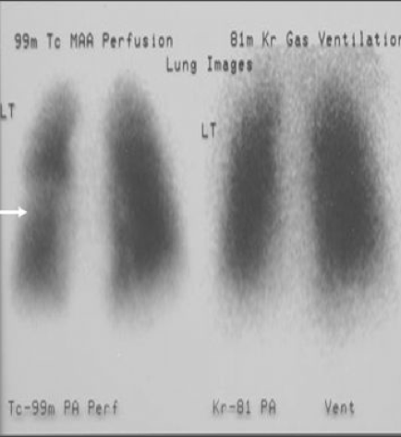
Abnormal V/Q Ratio in COPD
Eg: Chronic smokers with emphysema
COPD: bronchial obstruction in some areas & destruction of alveolar septa in other areas with patent alveoli.
COPD patients have some areas of the lung exhibit serious physiologic shunt & other areas serious physiologic dead space.
Both conditions tremendously decrease the effectiveness of the lungs as gas exchange organs → as little as 10% of normal.
COPD is the most prevalent cause of pulmonary disability today.

Slide 25
Clinical Application
Clinical Application
In male slides only

Slide 26
MCQ 1 A 2.B 3.C 4.A
For more questions please click on the icon
1.Example of abnormal shunt is ?
A) Right to left | B) Left to right | C)Right | D) Left
2. The blood flow in all parts of the lung …………….during exercise ?
A) decrease | B) increase | C) doesn’t change | D) stop
3. Apex in zone 1 with V/Q ratio = 3 is ?
less ventilated | B) more perfused | C) mimics dead space | D) mimics shunt
4. A patient comes with asthma , what would be the affected process ?
Alveolar ventilation | Perfusion | Both | None

Slide 27
SAQ
Q1) Enumerate the type of pulmonary circulations and what they supplies?
Q2) what is the Causes of V/Q mismatch
Q3) Enumerate the factors of regulation of pulmonary blood flow ?
1)High-pressure/low-flow circulation, Supplies systemic arterial blood to Trachea ,Bronchial tree ,Supporting tissues of lung ,0uter coats
Low-pressure/high-flow circulation , Supplies venous blood from all parts of the body to alveolar capillaries
2) COPD,Pneumonia,Asthma,Pulmonary edema
3) Cardiac output,Decreased alveolar oxygen,Chemical factors,vasoconstrictor or dilator,Hydrostatic pressure

Slide 28
Team leaders
Deema aljuribah Mishal Alsuwayegh Waleed Alrashoud
Team members
Maram Beyari
Raghad Alnadeef
Hend Almogary
Farah Alfayez
Kadi Khalid aldoosari
Farah mohammed Alqazlan
Ghada Binslmah
Shatha Alshabani
Jana alhazmi
Faisal Ali
Othman Aldraihem
Abdullah Alqarni
Rayan Alotaibi
Faisal Alkhunein
Mishari Alenezi
Bandar Almutiri
Fahad Alhelelah
Rayan Bosaid
Ibraheem Alkanhal
Saad Alhammad
Emad Almutairi
Ahmad Almarshed
Salman Almutaz
Osama Alzahrani
Physio442@gmail.com

