Slide 1
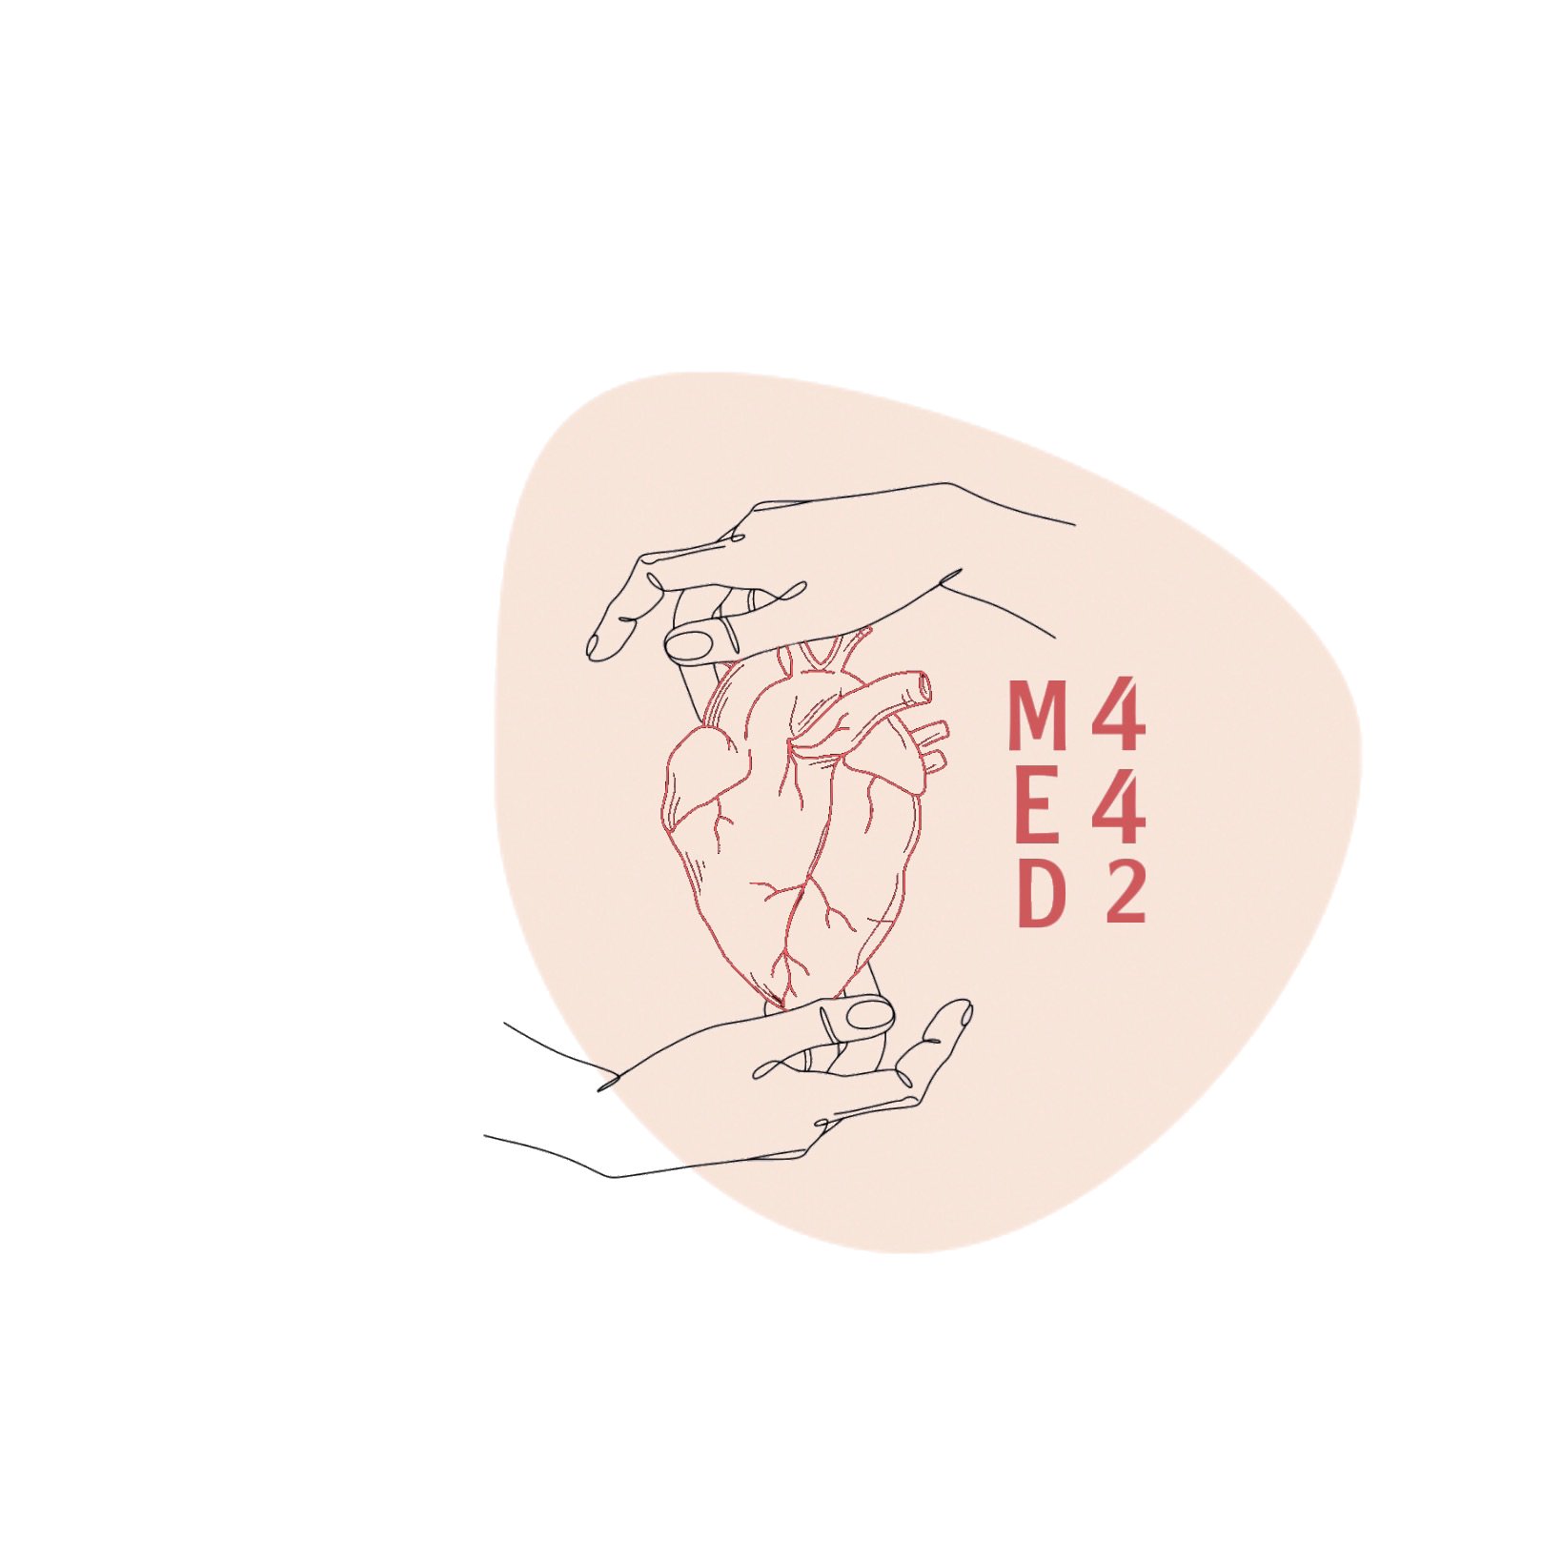
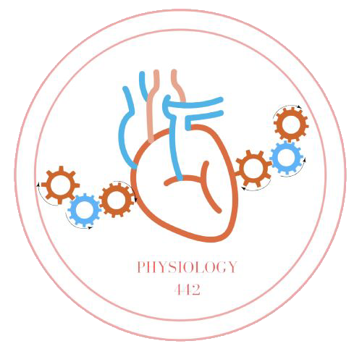
L-7
Hypoxia and Cyanosis
For helping videos
Color index:
Main text
Important
Doctor notes
Boys slides
Girls slides
Extra
Editing file

Slide 2
Objectives:
Define hypoxia and list its various physiological and pathological causes.
Outlines the treatment of hypoxia.
Define hypercapnea and list its causes and manifestations.
Define hypo-ventilation and hyper-ventilation in terms of arterial PCO2 and PO2.
Define cyanosis and its clinical presentation

Slide 3
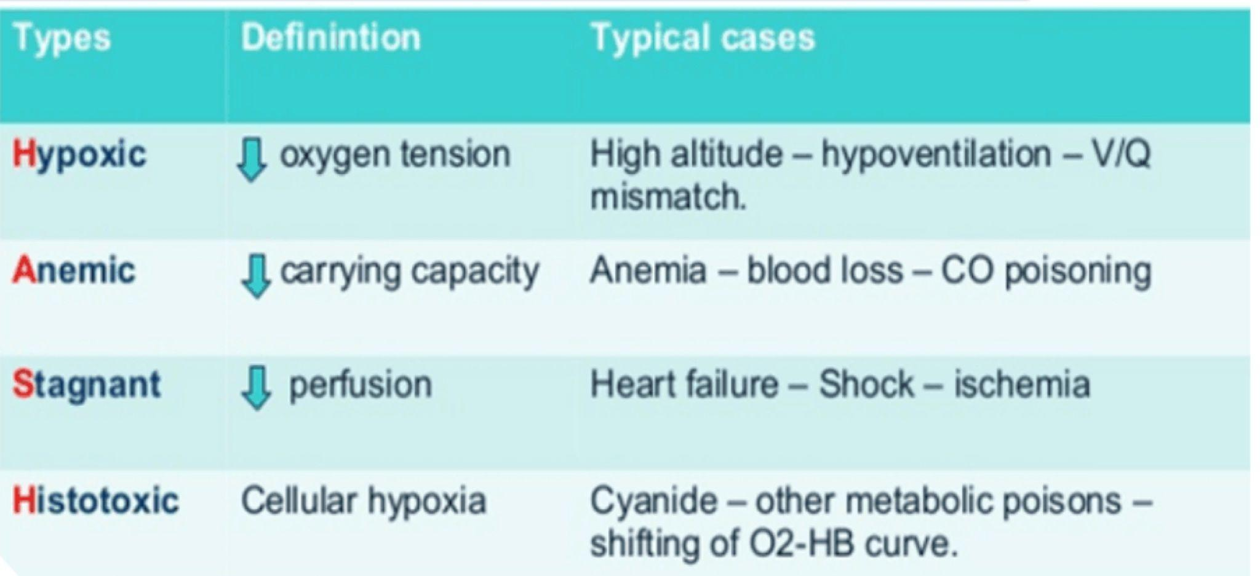
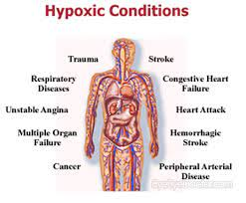
Hypoxia
Hypoxia: Is defined as deficiency of oxygen in the tissue cells.
Histotoxic hypoxia
Stagnant hypoxia
Hypoxic or Arterial hypoxia
Anemic hypoxia
Classification of Hypoxia

Slide 4
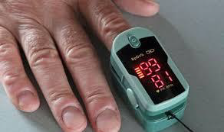
What Do We Need for Normal Oxygenation?
Female slides only
Oxygen in the air 20.8%.
•Action of chest wall and diaphragm.
•Patent respiratory passages.
•Elastic alveoli.
•Surfactant.
•Wall of alveoli and capillary.
•RBCs, haemoglobin.
•Adequate venous and arterial circulation.
•Capillary walls.
•Tissue fluid.
•Tissue cells.
•Mitochondria.

Slide 5
Causes of Hypoxia
Male slides only
1. Inadequate oxygenation of blood in the lungs because of extrinsic reasons:
a. Deficiency of O2 in the atmosphere
b. Hypoventilation (neuromuscular disorders)
2. Pulmonary diseases:
a. Hypoventilation by increased airway resistance or decreased pulmonary compliance.
b. Abnormal alveolar ventilation/perfusion ratio.
c. Diminished respiratory membrane diffusion.
3. Venous-to-arterial shunts (“right-to-left” cardiac shunts)
”A right-to-left shunt allows deoxygenated systemic venous blood to bypass lungs & return to body”
4. Inadequate O2 transport to the tissues by the blood:
a. Anemia or abnormal hemoglobin.
b. General or localized circulatory deficiency (peripheral, cerebral, coronary vessels).
c. Tissue edema.
5. Inadequate tissue capability of using O2:
a. Poisoning of cellular oxidation enzymes or toxicity.
b. Diminished cellular capacity for using oxygen because of vitamin deficiency.

Slide 6
Causes of Hypoxia
Extra Information
Cause | Mechanism | PaO₂
↓ Cardiac output | ↓ Blood flow | -
Hypoxemia | ↓PaO₂ ↓ O₂ saturation of hemoglobin ↓ O₂ content of blood | ↓
Anemia | ↓ Hemoglobin concentration ↓ O₂ content of blood | -
Carbon monoxide (CO) poisoning | ↓ O₂ content of blood Left shift of O₂- hemoglobin curve | -
Cyanide poisoning | ↓ O₂ utilization by tissues | -
*Thanks to 441 phisiology team

Slide 7
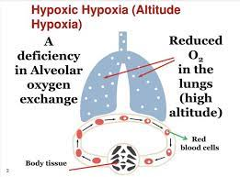
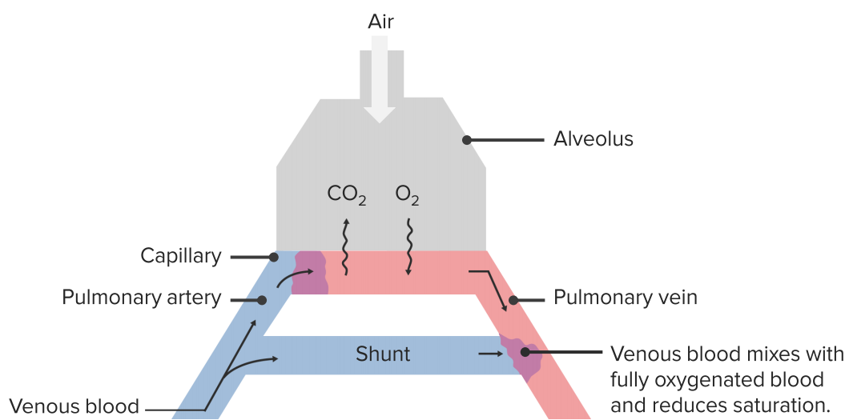
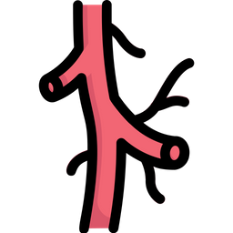
Types of Hypoxia
 | Definition | Causes
Arterial (Hypoxic) Hypoxia Hypoxemia | Reduced arterial PaO₂ | Inadequate blood oxygenation in the lung: O2 deficiency in the atmosphere (high altitudes, breathing in a closed space) Hypoventilation (increased airway resistance/decreased pulmonary compliance) Pulmonary Disease: Alveolar hypoventilation Diffusion abnormalities Reduced respiratory membrane diffusion Right to left shunt Ventilation-perfusion imbalance (including increased physiological dead space & physiological shunt).
Shunt: an abnormal communication between right & left sides of heart or between systemic & pulmonary vessels, allowing blood to flow directly from one circulatory system to the other.

Slide 8
Causes of Arterial Hypoxia
Cause | PaO₂ | A -a gradient | Supplemental O₂ helpful?
High altitude (↓PB; ↓PIO₂) | ↓ | Normal | Yes
Hypoventilation (↓POA₂) | ↓ | Normal | Yes
Diffusion defect (eg. fibrosis) | ↓ | Increased | Yes
V/Q defect | ↓ | Increased | Yes
Right-to-left shunt | ↓ | Increased | Limited
A : Alveolar pressure of O2 a: arterial pressure of O2 Gradient: Ratio of A/a

Slide 9
Types of Hypoxia
 | Definition | Causes
Anemic Hypoxia | Caused by reduction in the O₂ carrying capacity of the blood, due to decreased amount of Hb or abnormal type of Hb which is unable to carry O₂. | PO₂ & %Hb-O₂ is normal. Anemia Abnormal Hb Carboxyhemoglobin Methemoglobin
المسؤول عن ضغط الأكسجين هو الأكسجين الذائب بالدم وليس الأكسجين المرتبط بالهيموجلوبين لذلك يكون الضغط طبيعي في هذه الحالة
المشكلة هنا متعلقة بكمية الهيموجلوبين بالدم
المشكلة هنا متعلقة بكمية الهيموجلوبين بالدم

Slide 10
Types of Hypoxia
 | Definition | Causes
Stagnant Hypoxia | Caused by reduced blood flow through the tissues more and more O₂ is extracted from blood. Slow circulation → less O₂ is carried by blood at the lung → hypoxia. | General slowing of the circulation As in heart failure & shock. Local slowing Example: vasoconstriction, cold, arterial wall spasm.

Slide 11
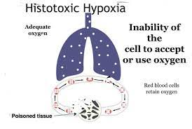
Types of Hypoxia
المشكلة تكون في فشل الخلية في التنفس الخلوي بسبب تسمم في الجسم وليس نقص في الأكسجين
 | Definition | Causes
Histotoxic Hypoxia | Inability of tissues to use O₂ due to inhibition of the oxidative enzyme activity. | Deficiencies of some of the tissue cellular oxidative enzymes or other elements in the tissue oxidative system Examples: Beriberi disease in which several important steps in tissue utilization of oxygen and the formation of CO2 are compromised because of vitamin B deficiency Cyanide poisoning causing blockade of the cytochrome oxidase activity.

Slide 12
What are the clinical effects of Hypoxia?
According to the degree of hypoxia it could lead to:
Impairment of judgment.
inability to perform complex calculations.
Headache, nausea, irritability, dyspnea.
Increased heart rate. The heart will receive signals that the body needs more o2–>cardiac output increases causing palpitation
Reduction in muscle working capacity. Due to ATP deficiency
Coma and death may result.
Sudden oxygen drop
Sudden drop of oxygen to less than 20 mmHg (16,000 m) causes loss of consciousness in about 20 seconds, death in 4-5 min.

Slide 13
Treatment of Hypoxia
Female slides only
Improve the blood oxygen saturation
Target saturation in illness is 94-98%. Normal is 98%-99%
In CO2 retainer 88-92%. Such as obese patient, CODP, or has neuromuscular abnormalities. The rate of excretion of co2 is low so they will retain co2 in their bodies, the proper percentage for them is 88%-92%.
Adjunct airway.
Upright posture.
Oxygen therapy.
Aids to ventilation.
Spontaneous breathers CPAP ( continuous positive airway pressure).
Ventilated PEEP ( positive end expiratory pressure).

Slide 14
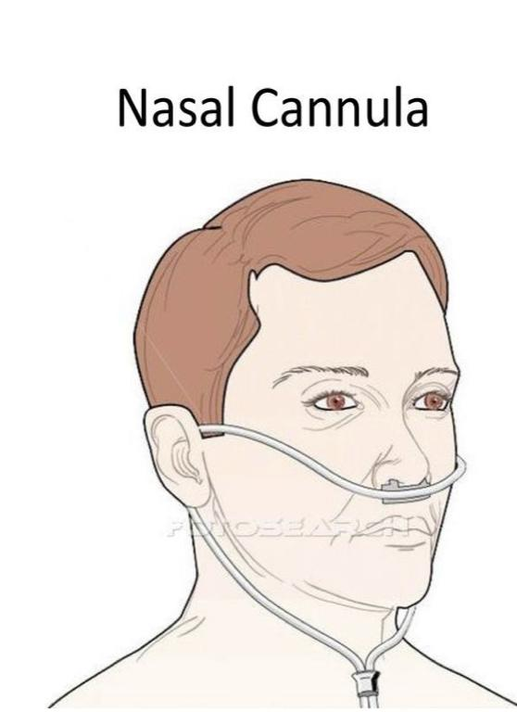
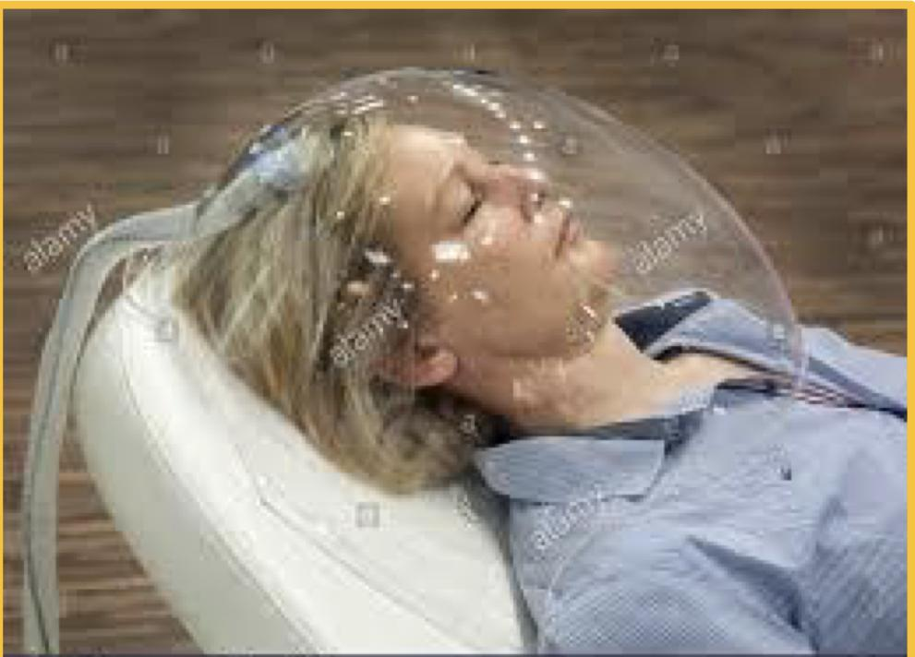
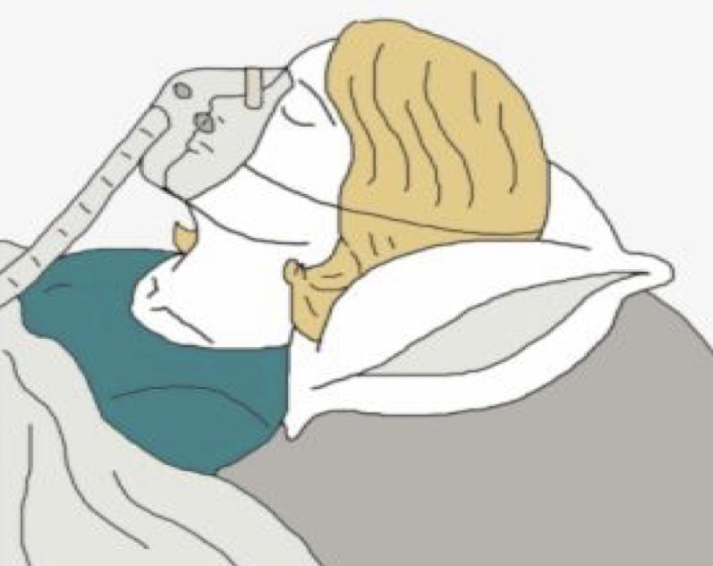
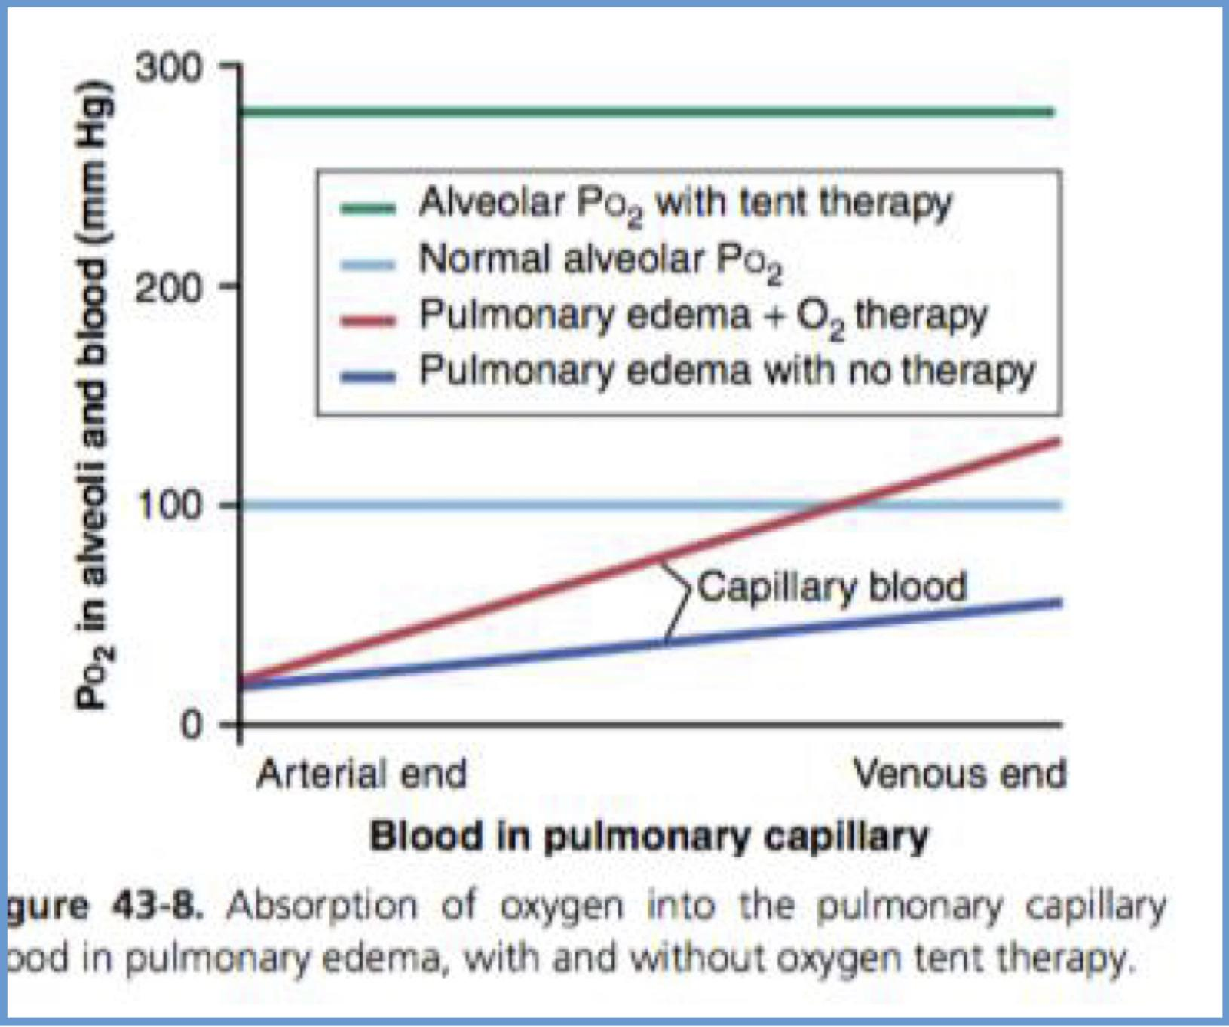
Treatment of hypoxia by Oxygen
O2 can be administered By:
Intranasal tube
Placing the patients head in a tent that contains air fortified with O2.
Allowing the patient to breathe pure O2 (100% O2)
or high concentrations of O2 from a mask
Useful in hypoxic hypoxia, but of less value in other types of hypoxia.
Histotoxic hypoxia will not benefit from O2 therapy

Slide 15
Benefits of oxygen therapy to different types of hypoxia
Male slides only
Recalling the basic physiological principles of the different types of hypoxia, one can readily decide when O2 therapy will be of value.
Atmospheric hypoxia:O2 therapy can completely correct the depressed O2
level in the inspired gases and, therefore, provides 100 % effective therapy.
hypoventilation hypoxia: a person breathing 100% O2 can move five times as
much O2 into the alveoli with each breath as when breathing normal air.
hypoxia caused by anemia or abnormal hemoglobin :O2 therapy is less
effective because normal O2 is available in the alveoli but the defect is in
transporting O2 to the tissues.
hypoxia caused by inadequate tissue use of O2: O2 therapy is of no benefit
because O2 is available in the alveoli and no abnormality in O2 pickup by the
lungs or transport to the tissues but tissue enzyme are incapable of utilizing the
O2 that is delivered.

Slide 16
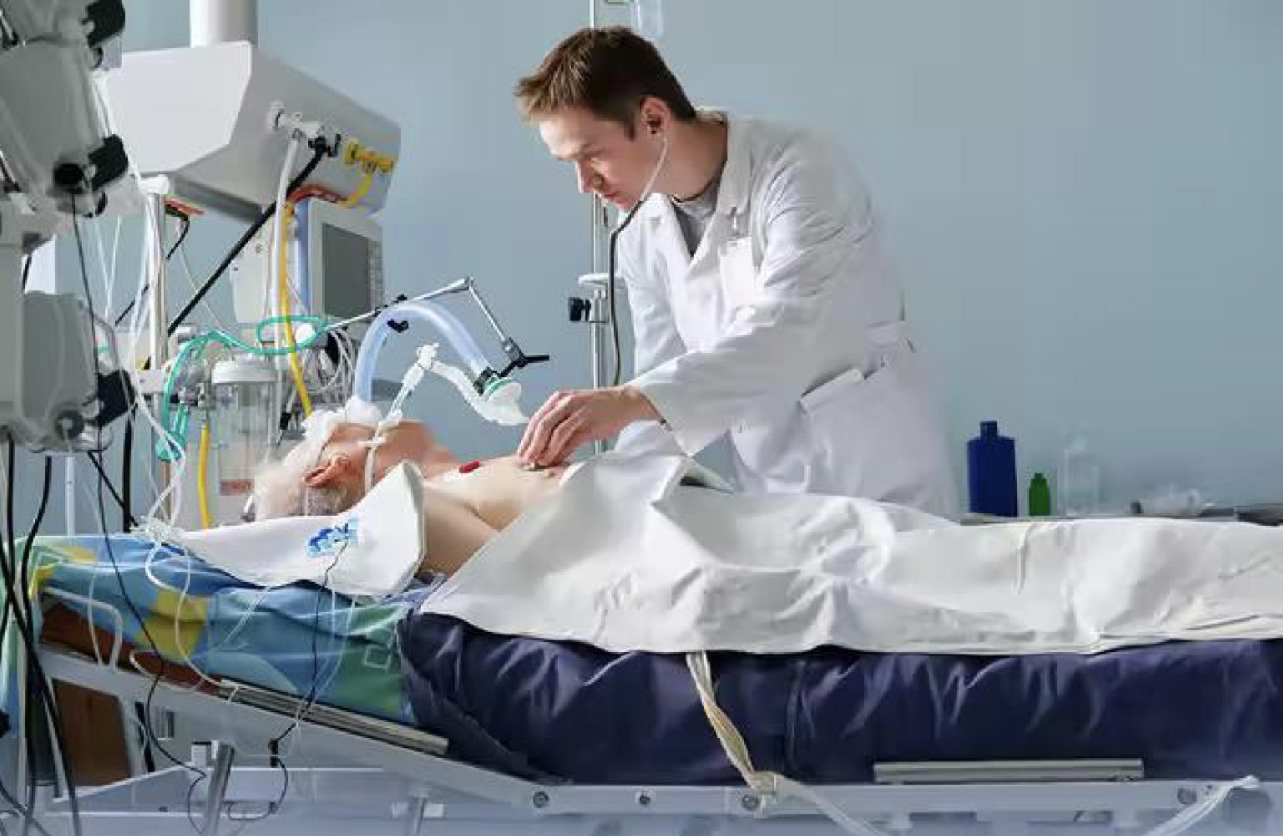
Mechanical ventilation
Female slides only
A mechanical ventilator is a machine that helps a patient breathe (ventilate) when they are having surgery or cannot breathe on their own due to a critical illness.
The patient is connected to the ventilator with a hollow tube (artificial airway) that goes in their mouth and down into their main airway or trachea.

Slide 17
Indications of oxygen therapy
Female slides only
High O2 concentration 15 L/min:
Moderate concentration O2
(10-15ml/min)
Low Oxygen
Cardiac arrest or resuscitation
Shock
Sepsis
Major trauma
Anaphylaxis
Carbon monoxide poisoning
Acute asthma
Pneumonia
Lung cancer
Sickle cell crises
COPD
morbid obesity.

Slide 18
Hypercapnia
Hypercapnia is an excess of CO2 in body fluids, it usually occurs with hypoxia, PCO2 increases above 52 mmhg, and it decreases pH.
Associated hypoxia is caused by: hypoventilation or circulatory deficiency.
Hypoxia caused by hypoventilation: CO2 transfer between alveoli & atmosphere is affected as much as is O2 transfer. Hypercapnia then occurs along with the hypoxia.
Circulatory deficiency: diminished flow of blood decreases CO2 removal from tissues, resulting in tissue hypercapnia in addition to tissue hypoxia. However, the transport capacity of the blood for CO2 is more than three times that for O2→ resulting tissue hypercapnia is much less than the tissue hypoxia.
Thanks to team 441
بمعنى انه راح يكون عندنا هايبر كابينا لكنها اقل بكثير من الهايبوكسيا اللي صارت لان الدم عنده امكانيه انه يحمل ثاني اوكسيد الكربون ثلاث اضعاف الاوكسجين اللي يقدر يشيله

Slide 19
Hypercapnia
Male slides only
When Hypoxia is caused by decreased O2 in the atmosphere (air), decreased Hb (anemic), or poisoning of oxidative enzymes (histotoxic) → hypercapnia isn’t concomitant of these types of hypoxia.
Hypoxia is caused by poor diffusion through the pulmonary membrane → hypercapnia doesn’t occur because CO2 is 20 times more diffusible than O2 and if it begins to occur (the hypoxia) it will stimulate pulmonary ventilation to correct the hypercapnia.
CO2 rises from 80 to 100 mmHg → the person becomes lethargic and semicomatose
Thanks to team 441

Slide 20
Features of Hypercapnia
Air hunger Dyspnea ( At PCO2 between 60-70 mmHg).
At these higher levels of PCO2, the excess CO2 now begins to depress respiration rather than stimulate it, thus causing a vicious circle:
More CO2 further decrease in respiration then more CO2, and so forth-culminating rapidly in a respiratory death.
Peripheral vasodilatation
Sweating
Warm extremities and bounding pulse
Muscle twitching
Headache, drowsiness and semi-coma (PCO2 rises to 80 to 100 mm Hg).
Papilledema ( swelling of optic disc).
Anaesthesia & death can result when the PCO2 rises to 120 to 150 mm Hg (due to depression of the respiratory center).

Slide 21
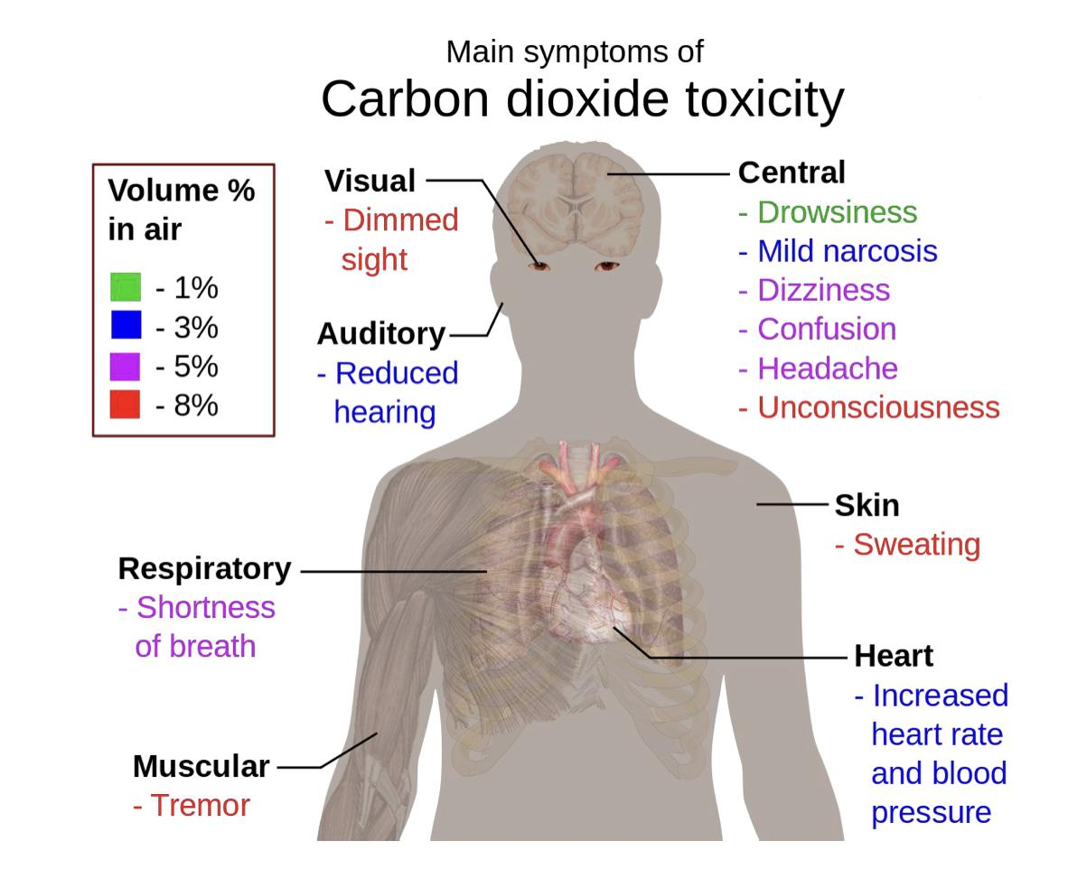
Signs and symptoms of hypercapnia
Female slides only
No need to memorise

Slide 22
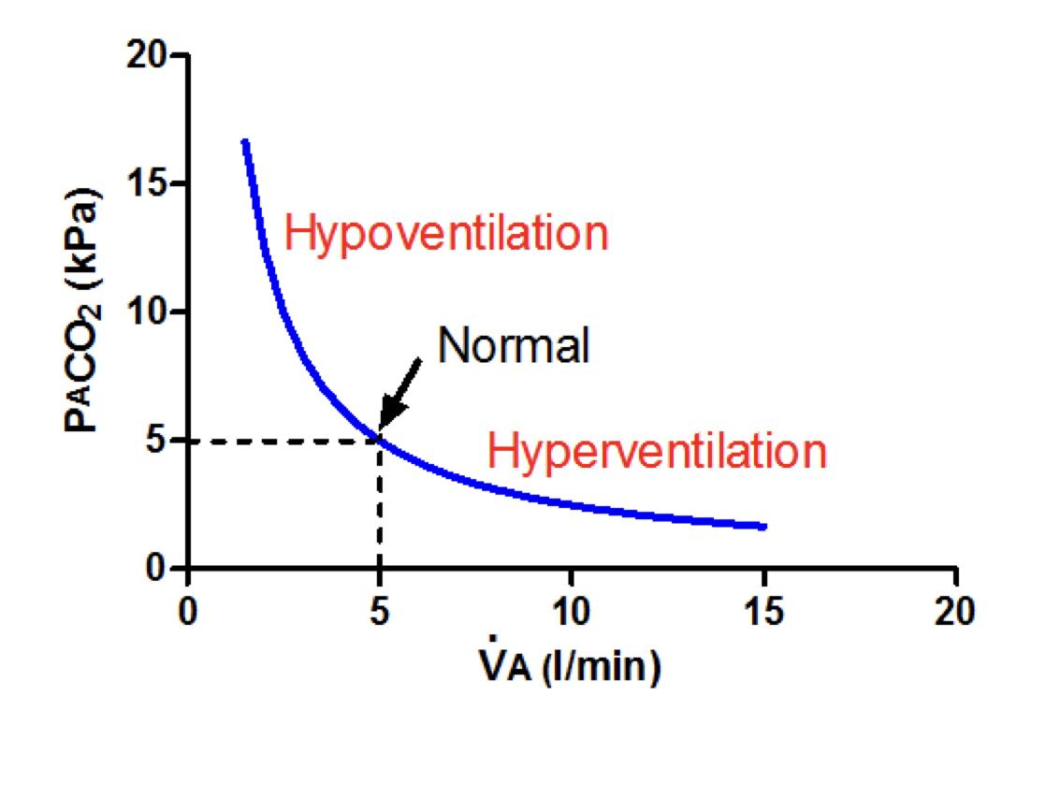
Hypo and hyper-ventilation
Hyperventilation
Hypoventilation
Female slides only
is excessive VA such that too much CO2 is blown out of the body, not breathing too quickly as the word is commonly (mis)used.
is the opposite, you retain too much CO2.

Slide 23
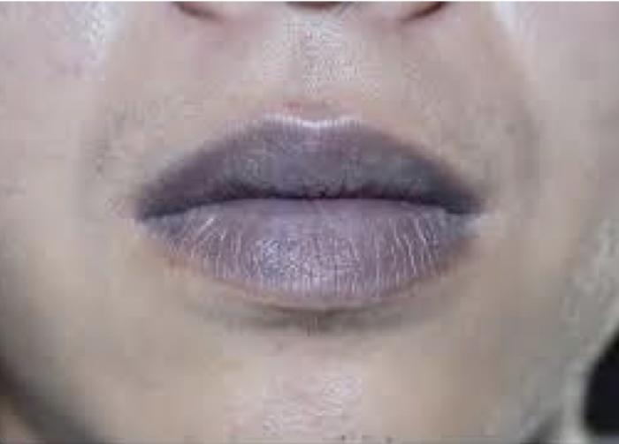
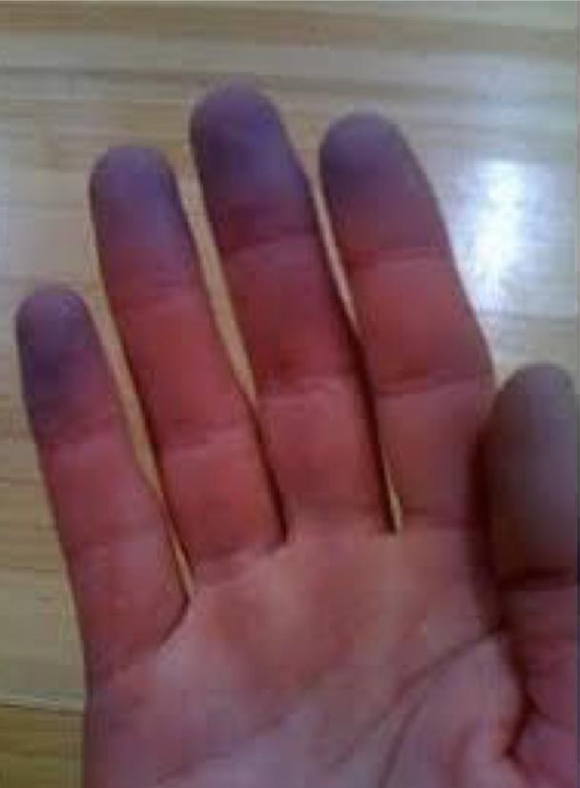
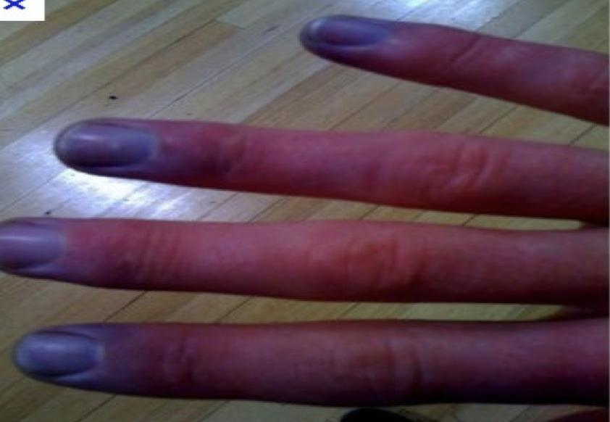
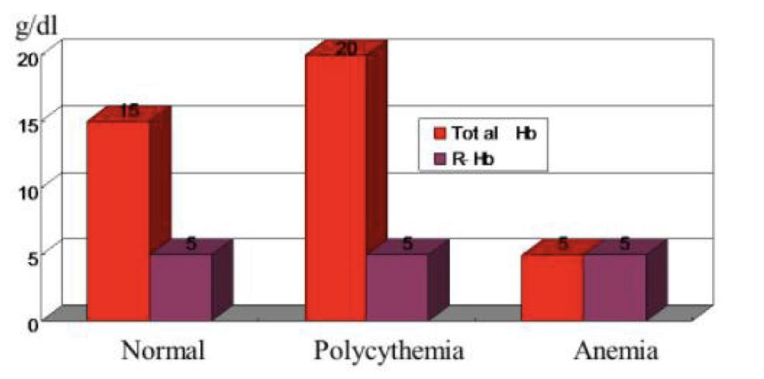
Cyanosis
A blue discoloration of the skin and mucus membrane due to more than 5
g/100 ml of reduced (deoxygenated) hemoglobin in the skin blood vessels
especially the capillaries.
Oxygen Saturation(86-85%).
This deoxygenated hemoglobin has an intense dark blue purple color that is transmitted through the skin.
Two types:
Central: chest, neck, tongue, lips.
Peripheral: finger, toes, tip-off nose ,ears.
A person with anemia almost never develop cyanosis due to low amount of Hb for
5 grams to be deoxygenated/100ml blood.
In polycythemia vera (excess red blood cells), excess Hb that can
become deoxygenated can cause cyanosis even under normal conditions.

Slide 24
MCQ
For more questions please click on the icon
Q1) A
Q2) B
Q3) D
Q4) C
Q1) Hypercapnia is an
excess of CO2 in body fluids | B) Deficiency of CO2 in body fluids | C) excess of O2 in body fluids | D) Deficiency of O2 in body fluids
Q2) Which one of these is not a clinical effect of hypoxia?
Death | B) Decrease heart rate | C) Headache | D) Dyspnea
Q3) Arterial O2 content is reduced in which of the following conditions?
A) Stagnant hypoxia B) Anemic hypoxia C) Histotoxic hypoxia D) arterial hypoxia
Q4) Anemic hypoxia means ?
decreased O2 saturation B) decreased O2 because slow rate of circulation C) decreased ability to carry O2 D)increased oxygen carrying capacity

Slide 25
SAQ
In a treatment of hypoxia o2 can be administered by ?
Define hypoxia ?
1))By giving oxygen therapy in an intranasal tube or a tent or high oxygen tension mask
2))Hypoxia : Is defined as deficiency of oxygen in the tissue cells.

Slide 26
Team leaders
Deema aljuribah Mishal Alsuwayegh Waleed Alrashoud
Team members
Maram Beyari
Raghad Alnadeef
Hend Almogary
Farah Alfayez
Kadi Khalid aldoosari
Farah mohammed Alqazlan
Ghada Binslmah
Shatha Alshabani
Faisal Ali
Othman Aldraihem
Abdullah Alqarni
Rayan Alotaibi
Faisal Alkhunein
Mishari Alenezi
Bandar Almutiri
Fahad Alhelelah
Rayan Bosaid
Ibraheem Alkanhal
Saad Alhammad
Emad Almutairi
Ahmad Almarshed
Salman Almutaz
Osama Alzahrani
Physio442@gmail.com

