Slide 1
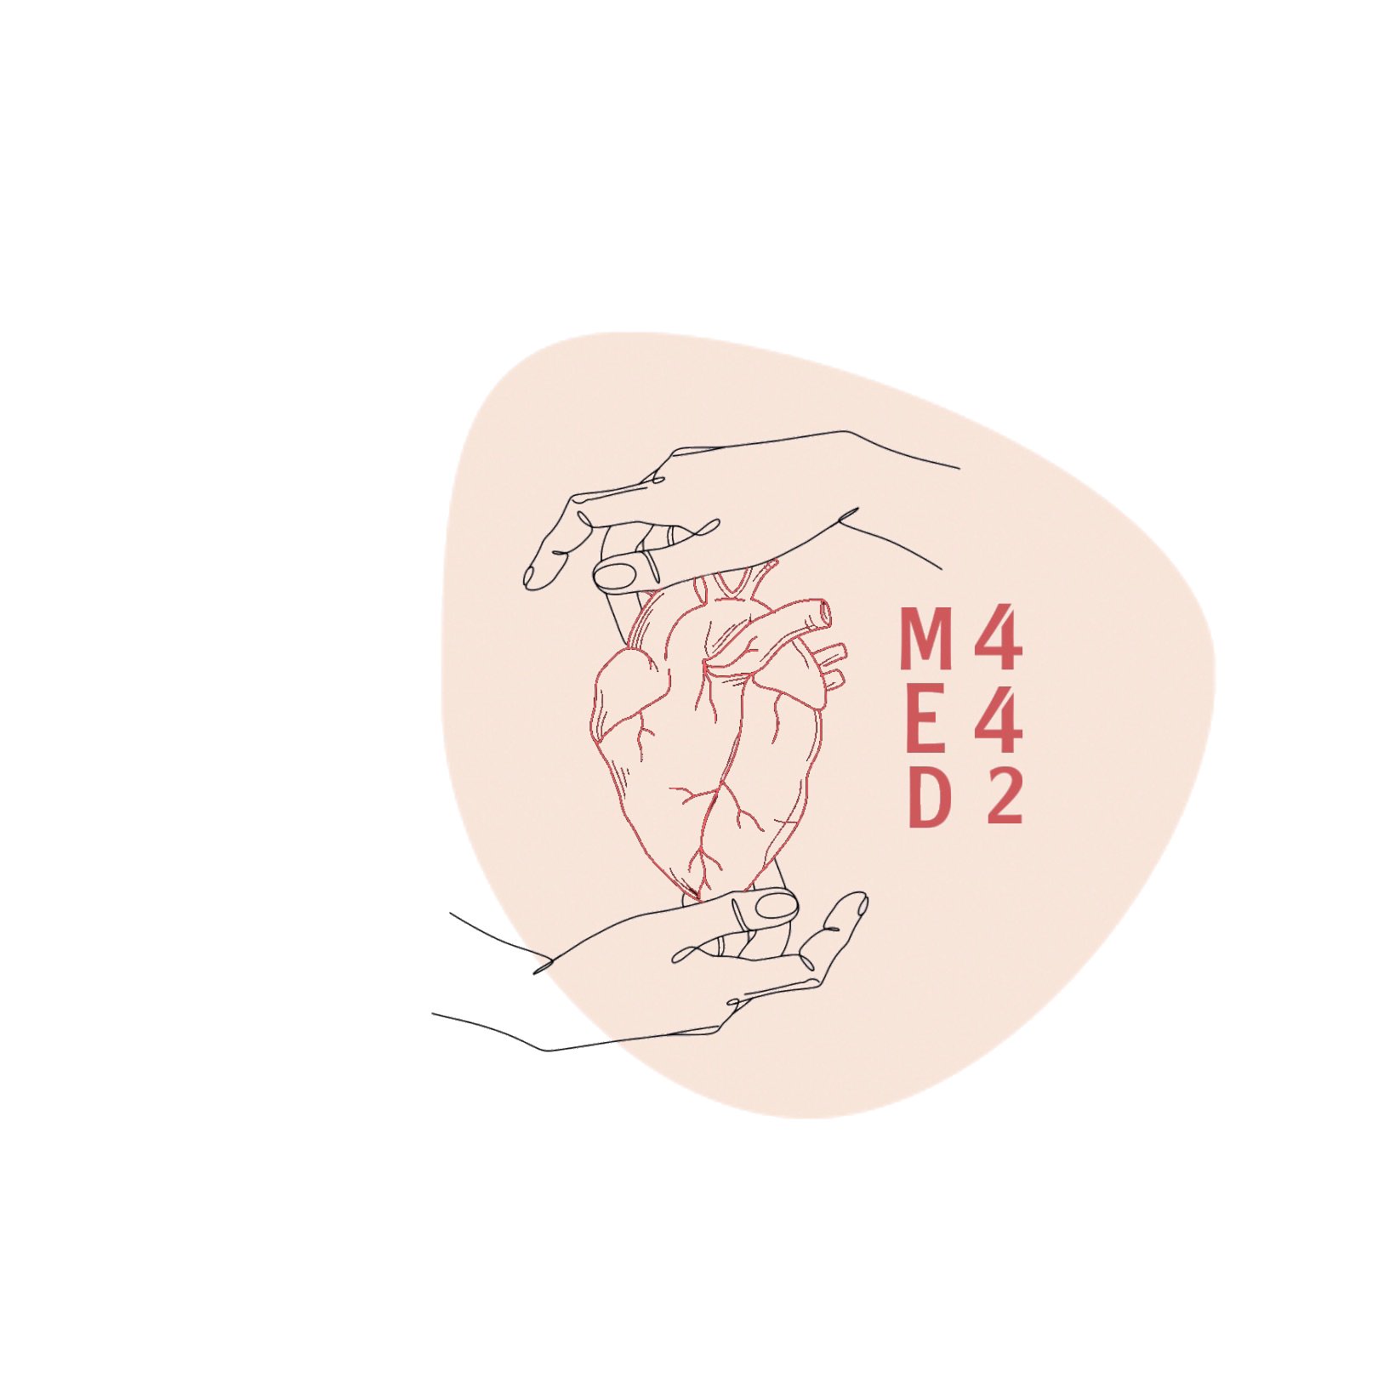
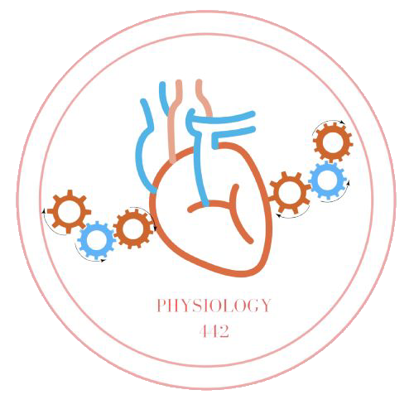
L-8
Control of breathing
*ترتيب سلايدات التيم يختلف عن ترتيب السلايدات الاساسيه للأختلاف بين ترتيب سلايدات البنات والاولاد
Color index:
Main text
Important
Doctor notes
Boys slides
Girls slides
Extra
Editing file

Slide 2
Objectives:
By the end of this lecture, you should be able to:
Understand the role of the medulla oblongata in determining the basic pattern of respiratory activity.
List some factors that can modify the basic breathing pattern like e.g. A- The Hering-Breuer reflexes, B- The proprioreceptor reflexes, C- the protective reflexes, like the irritant, and the J-receptors.
Understand the respiratory consequences of changing PO2, PCO2, and PH.
Describe the locations and roles of the peripheral and central chemoreceptors.
Compare and contrast metabolic and respiratory acidosis and metabolic and respiratory alkalosis.

Slide 3
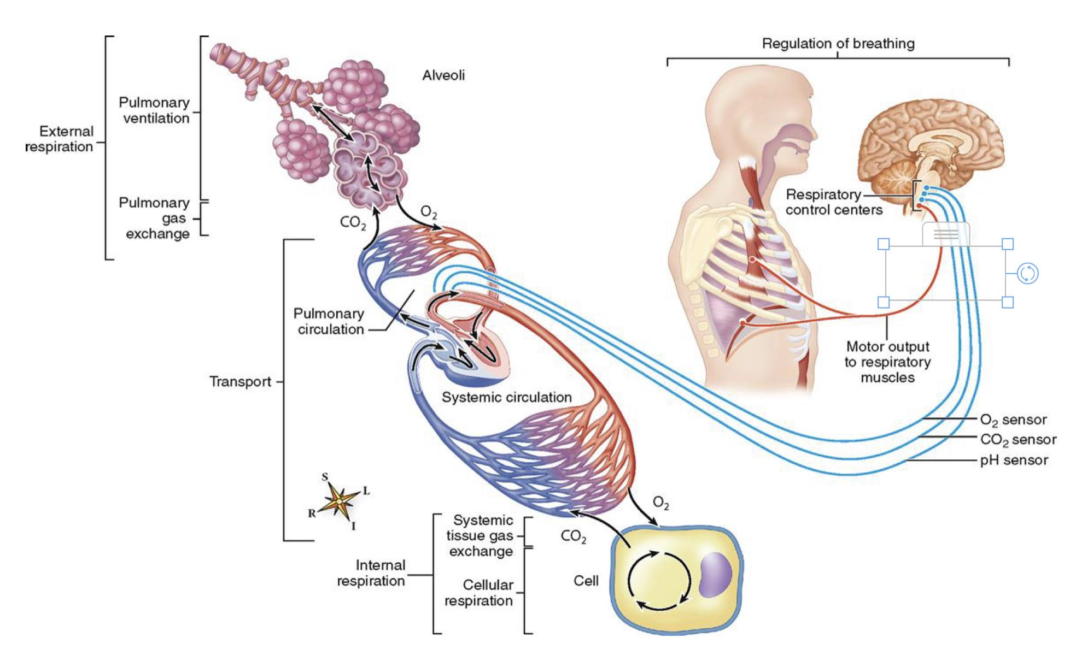
Boys slides
The overall processes of External Respiration
- The goal of respiration is to maintain proper concentrations of O2, CO2, and H+ in the tissues.
- The nervous system normally adjusts the rate of alveolar ventilation almost exactly to the demands of the body.

Slide 4
Control of rate and depth of respiration
- The respiratory activity is highly responsive to changes in each of these substances.
Arterial PO2:
When PO2 is VERY low (Hypoxia): ventilation increases in rate and depth I.e the patient will hyperventilate.
Arterial pH:
As hydrogen ions increase (acidosis), alveolar ventilation increases.
Arterial PCO2:
The most important regulator of ventilation is PCO2,
small increases in PCO2: greatly increases ventilation.

Slide 5
CONTROL OF VENTILATION
Several mechanisms are involved which can be grouped into two main categories which are closely integrated:-
Nervous control mechanism.
Chemical control mechanism.
Medullary respiratory centers
Pontine Respiratory centers
Central chemoreceptors
Peripheral chemoreceptors

Slide 6
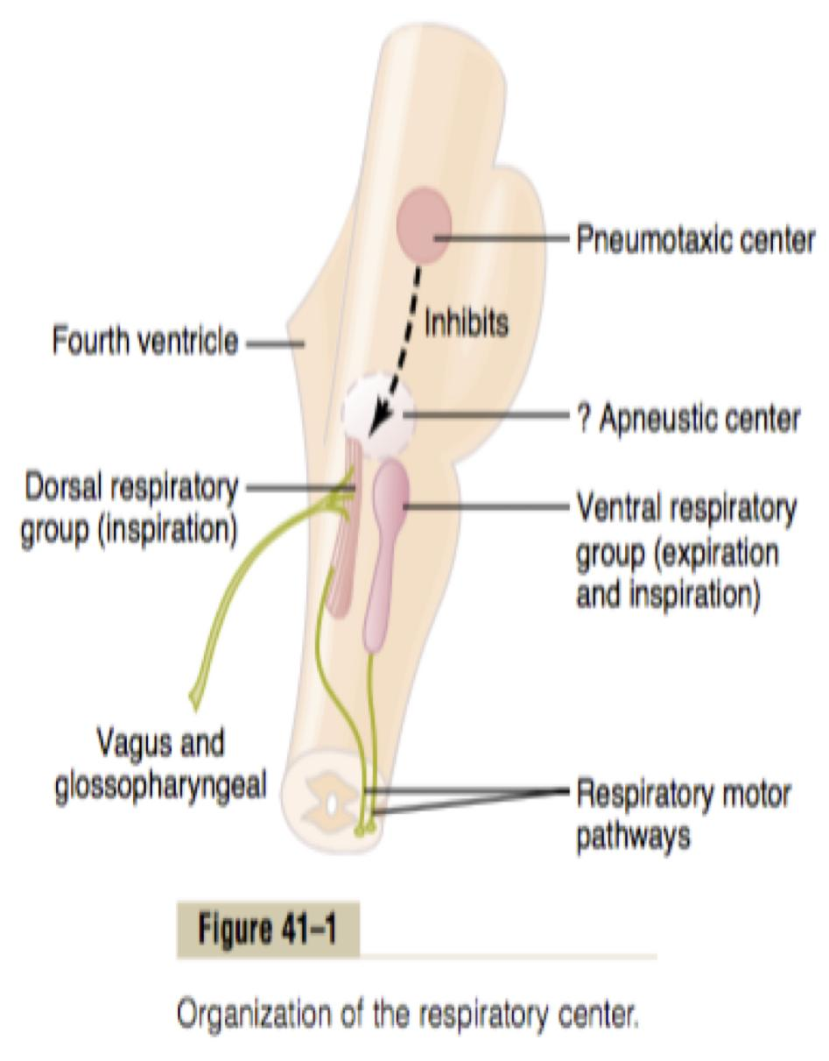
RESPIRATORY NEURONAL CENTER
Composed of several groups of neurons.
Located in the entire length of the medulla and pons.
More detailed in the next slides
1- Dorsal respiratory group (DRG): located in the dorsal portion of the medulla, which mainly
causes inspiration.
2- Ventral respiratory group (VRG): located in the ventrolateral part of
the medulla, which mainly
causes forced expiration.
Can be divided into four major groups of neurons:
3- The pneumotaxic center:
located dorsally in the
superior portion of the pons, It mainly controls rate and depth of breathing by turning off the inspiratory signals from the DRG.
3- The apneustic center:
located in the inferior
portion of the pons, it turns on stimulatory impulse to
the DRG of neutrons.

Slide 7
The medullary respiratory center stimulates basic inspiration for about 2 seconds and then basic expiration for about 3 seconds (5sec/ breath = 12breaths/min).
Determines basic rhythm of breathing (rhythmicity center).
Causes contraction of diaphragm and external intercostals.
The rhythmicity center receives impulses from:
1. Inspiratory area
(Dorsal Respiratory Group)-DRG:
Medullary Respiratory centers
1-Higher brain centers.
2-Centers in the brain stem (medulla and pons).
3-Special receptors (respiratory reflexes).
Located within the nucleus of the tractus solitaries (NTS), which is the sensory termination of both the vagal (X) and the glossopharyngeal nerves (IX) (which transmit sensory signals into the respiratory center from: Peripheral chemoreceptors, baroreceptors and several types of receptors in the lungs.
The rhythmicity center sends excitatory impulses via the intercostal and phrenic nerves to the external intercostal muscles and diaphragm.
From 439:
DRG keep the Rhythm, How?
Signals start weak and then get stronger, diaphragm will contracts , after that signals stop and diaphragm get back to its normal state بمعنى ان الإشارات تبدأ بالتدريج ثم تتوقف

Slide 8
Located in the entire length of the medulla and pons.
2. Expiratory area
(Ventral Respiratory Group)-VRG:
Activated by inspiratory area during forceful breathing.
Medullary Respiratory centers
Causes contraction of the internal intercostals and abdominal muscles ( mainly expiratory).

Slide 9
Pontine Respiratory centers
2. Pneumotaxic area:
•Inhibits the inspiratory area of medulla to stop inhalation.
•limitation of inspiration also shortens expiration and the entire period of each respiration.
•It transmits inhibitory impulses to the apneustic center and to the inspiratory area to switch off inspiration.
•Therefore, breathing is more rapid when pneumotaxic area is active.
1. Apneustic area:
Stimulates inspiratory area of medulla to prolong inhalation. Therefore, slow respiration and prolonged respiratory cycles will result if it is stimulated.
It receives inhibitory impulses from the sensory vagal fibers and inhibitory impulses from the pneumotaxic center.
Transition between inhalation and
exhalation is controlled by:

Slide 10
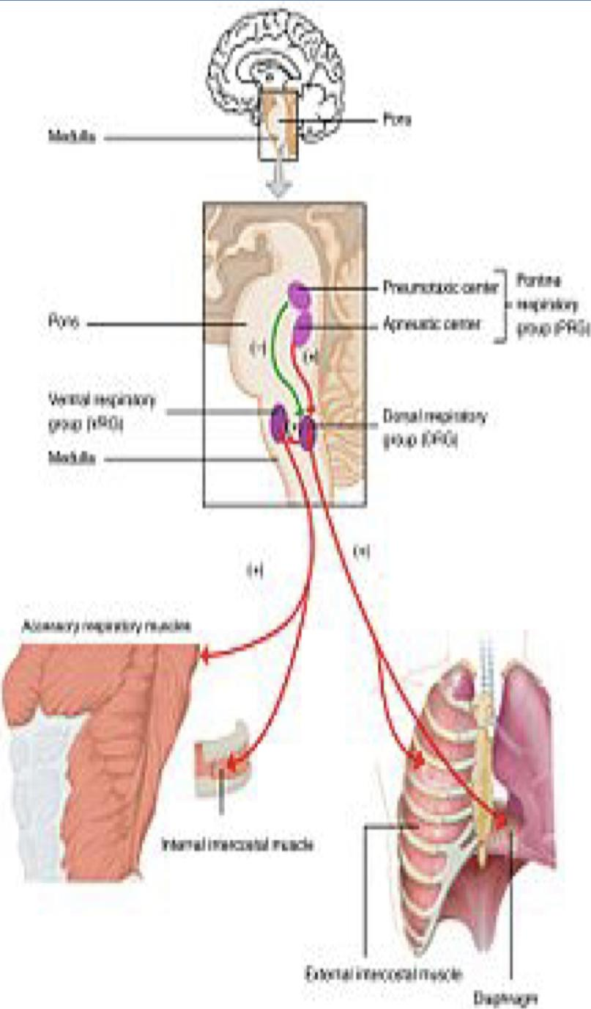
Hering-Breuer inflation reflex
Normal tidal volume ~ 500ml
When the lung becomes overstretched (tidal volume is (>≈1.5 L/breath), the stretch receptors located in the wall of bronchi and bronchioles transmit signals through the vagus nerve to DRG producing effect similar to pneumotaxic center stimulation.
It Switches off inspiratory signals and thus stops further inspiration .
This reflex also increases the rate of respiration as does the pneumotaxic center.
This reflex appears to be mainly a protective mechanism for preventing excessive lung inflation.

Slide 11
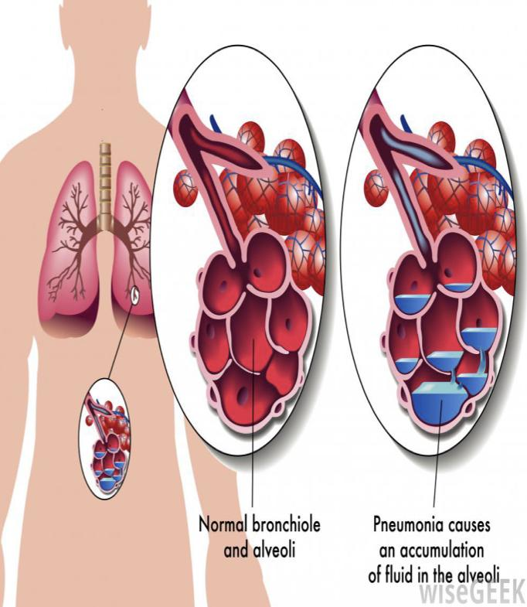
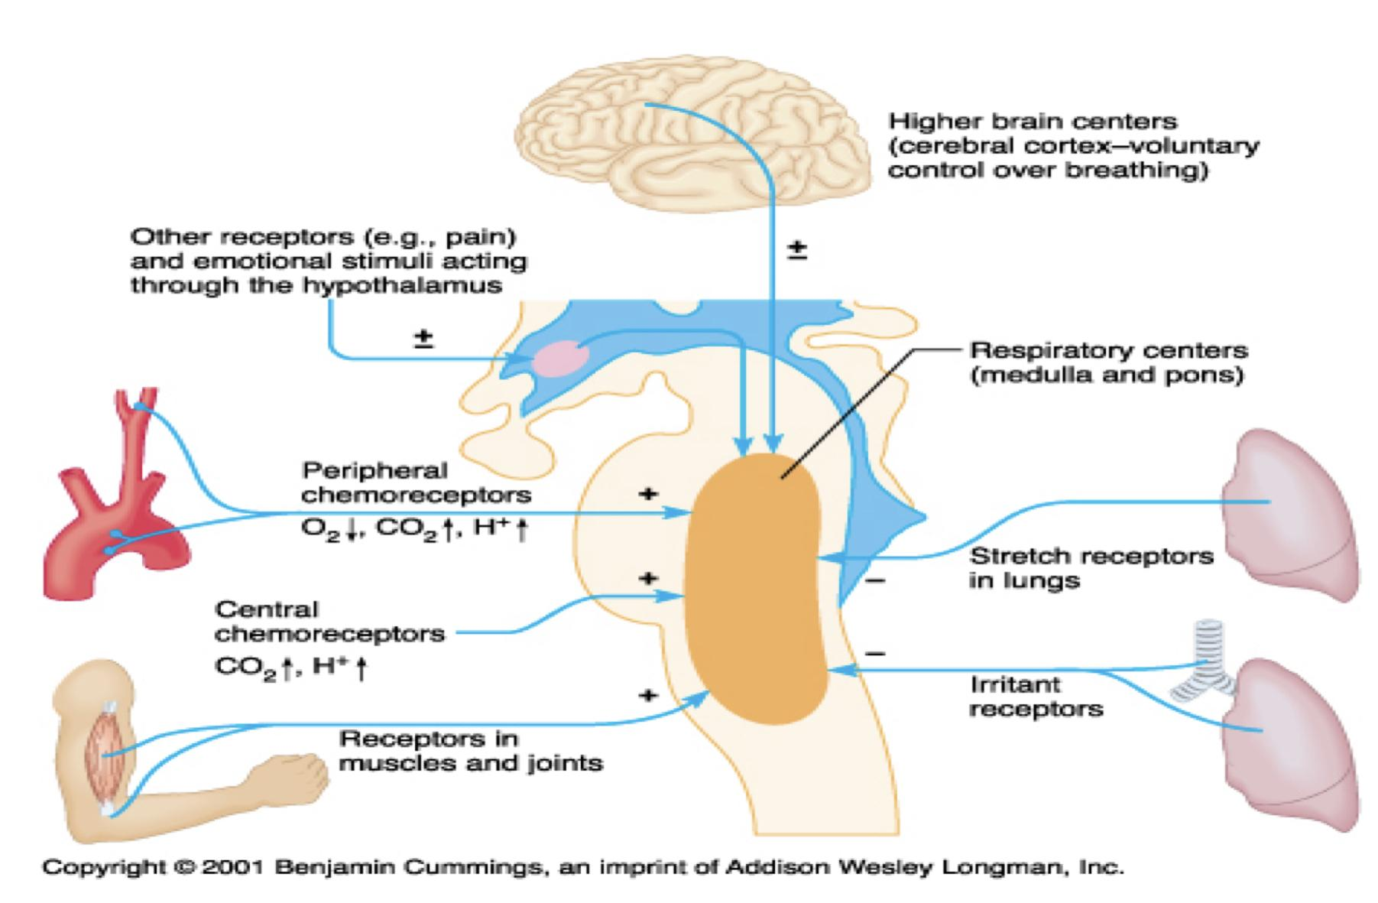
Other Factors Influencing Respiration
irritant receptors in the airways | Lung J receptors:
The epithelium of the trachea, bronchi, and bronchioles is supplied with sensory nerve endings called pulmonary irritant receptors. that are stimulated by irritants that enters the respiratory airways These receptors initiate coughing and sneezing They may also cause bronchoconstriction in persons with diseases such as asthma and emphysema. | sensory nerve endings (few receptors ) in the alveolar walls in juxtaposition to the pulmonary capillaries. Are stimulated when the pulmonary capillaries become engorged with blood or when pulmonary edema occurs in congestive heart failure. Their excitation may give the person a feeling of dyspnea. e.g. in CHF, their stimulation cause the patient feels dyspnea and increase in breathing rate.

Slide 12
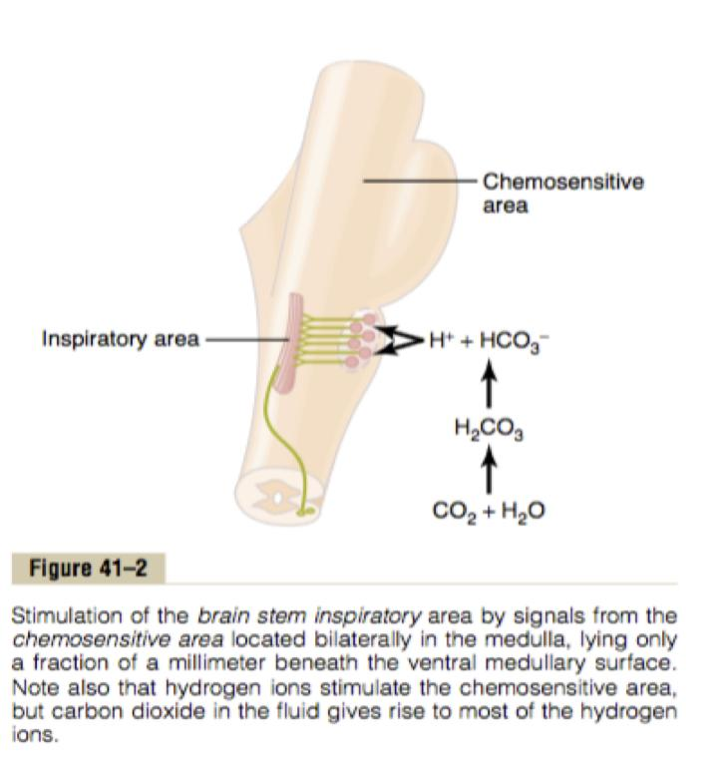
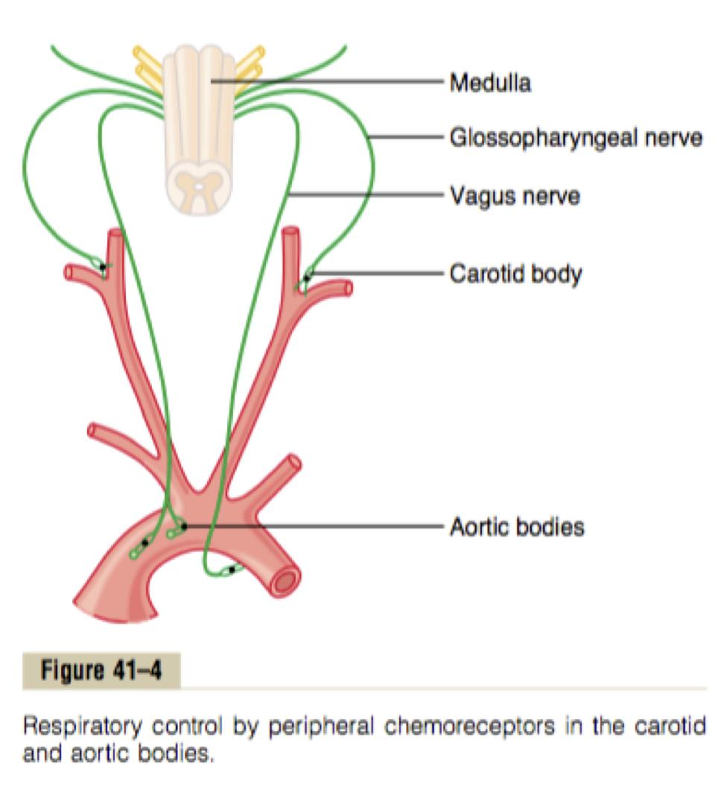
Chemical Control of Respiration
Boys slides
The rhythmicity center is affected by chemical changes in the blood via two types of chemoreceptors:
Central Chemoreceptors
Chemical Control
Peripheral Chemoreceptors
Peripheral chemoreceptors sensitive to O2&CO2&H Central chemoreceptors sensitive to CO2&H

Slide 13
Peripheral Chemoreceptors
Located mainly in the carotid and aortic bodies but may
be found anywhere in the circulatory system.
Highly sensitive to changes in arterial PO2 and to a lesser
extent to PCO2 and pH.
When stimulated, send excitatory impulses to
the rhythmicity center (the inspiratory neurons (DRG) ) through CN glossopharyngeal IX and vagus nerves X.
Fall of PO2, rise in PCO2 and fall of pH, stimulate the chemoreceptors to increase ventilation.

Slide 14
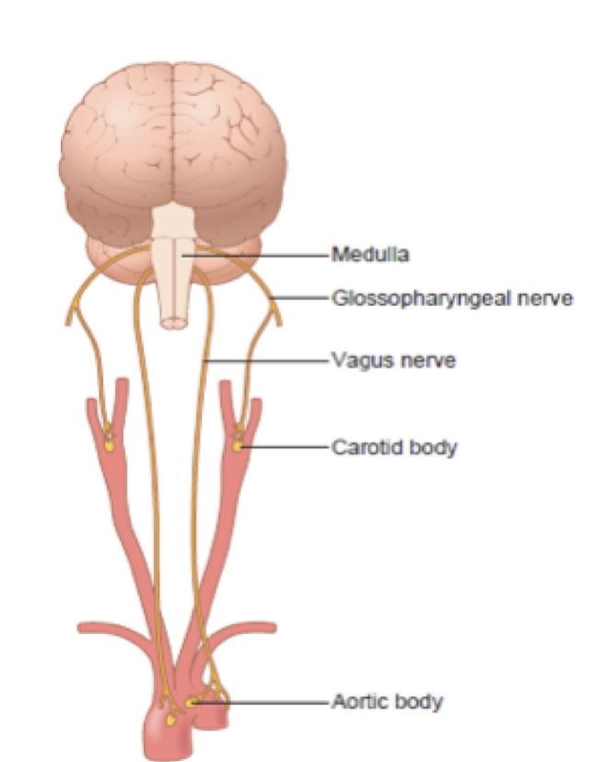
Respiratory control by peripheral chemoreceptors in carotid and aortic bodies
Boys slides
Normal PO2, PCO2 and pH, low grade of tonic activity in the nerves.
↓ PCO2 and ↑ pH causes low tonic activity which cause decrease ventilation
In metabolic acidosis: ↓ pH causes increase in ventilation to wash out CO2 and to bring pH to normal.
In metabolic alkalosis: ↑ pH causes decrease ventilation, CO2 retained in the blood to compensate.

Slide 15
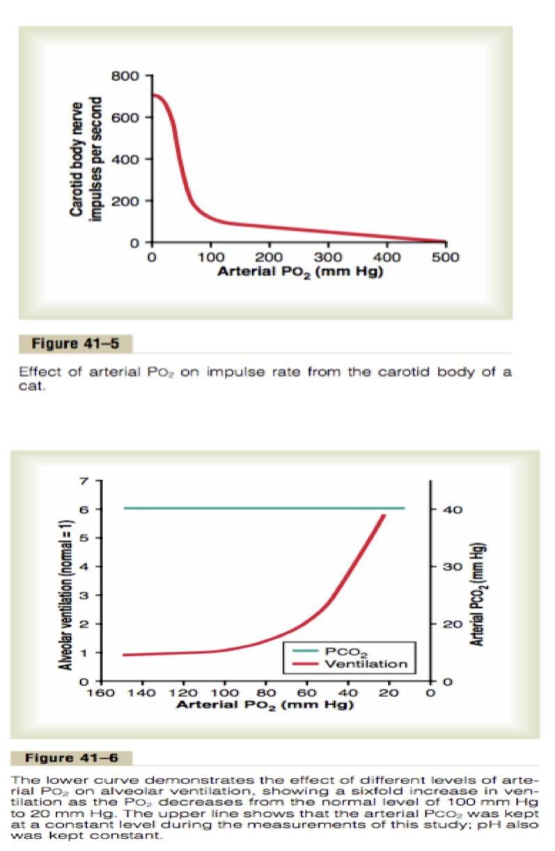
Peripheral chemoreceptors system activity
Role of oxygen in respiratory control
Most of the chemoreceptors are in the carotid bodies. However, a few are also in the aortic bodies.
When the oxygen concentration in the arterial blood falls below normal, it acts almost entirely on peripheral chemoreceptors - the chemoreceptors become strongly stimulated.
Impulse rate is particularly sensitive to changes in arterial PO2 in the range of 60 down to 30 mm Hg.
Under these conditions, low arterial PO2 obviously drives the ventilatory process quite strongly.
Because the effect of hypoxia on ventilation is modest for PO2 values greater than 60 to 80 mm Hg, the PCO2 and the hydrogen ion response are mainly responsible for regulating ventilation in healthy humans at sea level.

Slide 16
Central Chemoreceptors
Highly sensitive to the hydrogen ion concentration of the CSF (cerebrospinal fluid).
The central chemoreceptors Most probably located under the ventral surface (ventrolateral) of the medulla oblongata (which is bathed with cerebrospinal fluid) and has direct connections with the inspiratory area (DRG).
evoked by arterial PCO2 (CO2 can freely cross the blood- brain barrier(BBB) into CSF, while BBB is relatively
impermeable to H+ and HCO-3 ions)

Slide 17
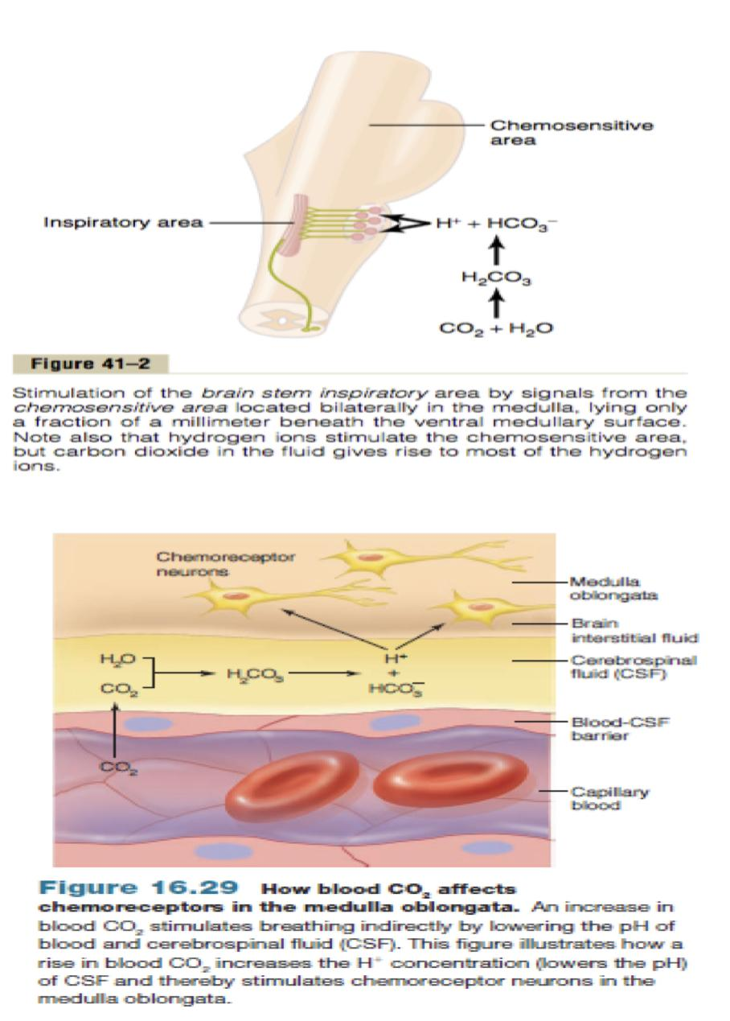
Effect of CO2 on central chemoreceptors
Although carbon dioxide has little direct effect in stimulating the neurons in the chemosensitive area, it does have a potent indirect effect.
It does this by reacting with the water of the tissues to form carbonic acid, which dissociates into hydrogen and bicarbonate ions; the hydrogen ions then have a potent direct stimulatory effect on respiration.
Hydrogen ions can’t cross BBB, so CO2 will enter BBB easily then produce H+ ions and HCO-3, then H+ ions will stimulate the chemoreceptors.

Slide 18
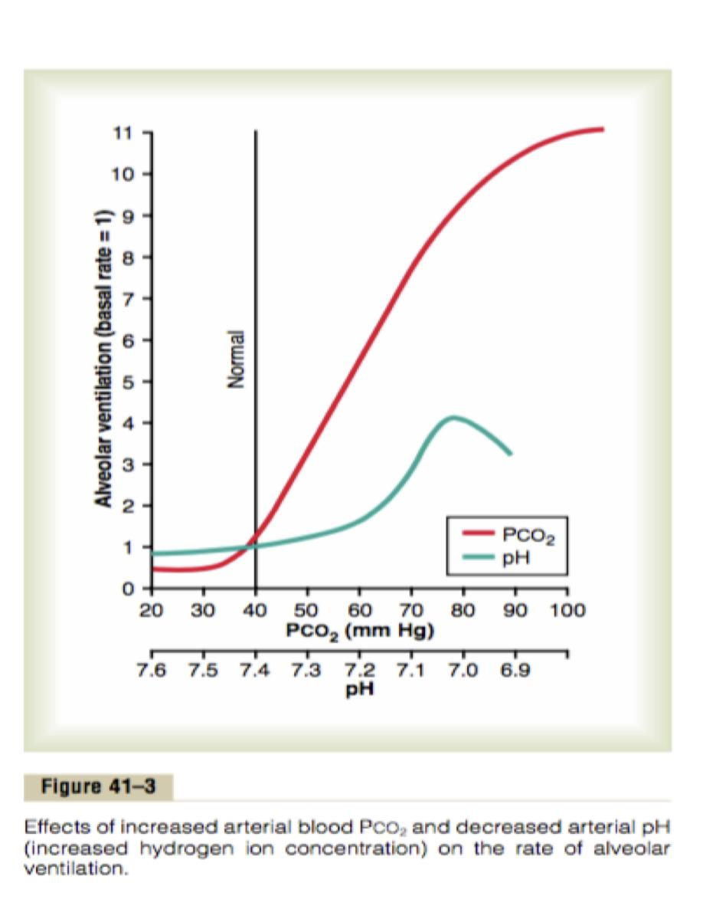
CO2 have a more potent effect in stimulating chemosensitive neurons than do blood pH
Blood- brain barrier is nearly impermeable to H+ ions, but CO2 passes this barrier very easily.
When the blood PCO2 increases, so does the PCO2 of both the interstitial fluid of the medulla and the CSF.
In these fluids, the CO2 reacts with the water to form new H+ ions.
More H+ ions are released into the respiratory chemosensitive sensory area of the medulla when the blood CO2 concentration increases than when the blood H+ ion increases.
For this reason, respiratory center activity is increased very strongly by changes in blood CO2.

Slide 19
A change in CO2 concentration has a potent acute effect on controlling respiratory drive but only a weak chronic effect after a few days’ adaptation.
Excitation of the respiratory center by CO2 is great after the blood CO2 first increases, but it gradually declines over the next 1 to 2 days.
The kidneys increase the blood HCO3, which binds with H+ ions in the blood and CSF to reduce their concentrations.
3
1
Part of this decline results from renal readjustment of the H+ ion concentration in the circulating blood back toward normal after the CO2 first increases.
4
Over a period of hours, the HCO3 ions slowly diffuse through the BBB– CSF barriers and combine directly with the H+ ions adjacent to the respiratory neurons as well, thus reducing the H+ ions back to near normal.
2
Kidney balance the CO2 level by:
1.Increasing bicarbonate level which works as buffer. 2. Execret H ions in urine.

Slide 20
Effect of CO2 and H ion Concentration on Chemoreceptor Activity.
An increase in either carbon dioxide concentration or hydrogen ion concentration stimulate the central chemoreceptors which act on the respiratory center, causing increased strength of both the inspiratory and the expiratory motor signals to the respiratory muscles (hyperventilation).
increased CO2 or H+ concentration in blood also excites simulate the peripheral chemoreceptors and, in this way, indirectly increases respiratory activity.
The effects of CO2 or H+ on the central chemoreceptors are (about seven times) more powerful than their effects on the peripheral chemoreceptors.
There is one difference between the peripheral and central effects of carbon dioxide: the stimulation of the peripheral chemoreceptors occurs as much as five times as rapidly as central stimulation, so that the peripheral chemoreceptors might be especially important in increasing the rapidity of response to carbon dioxide at the onset of exercise.

Slide 21
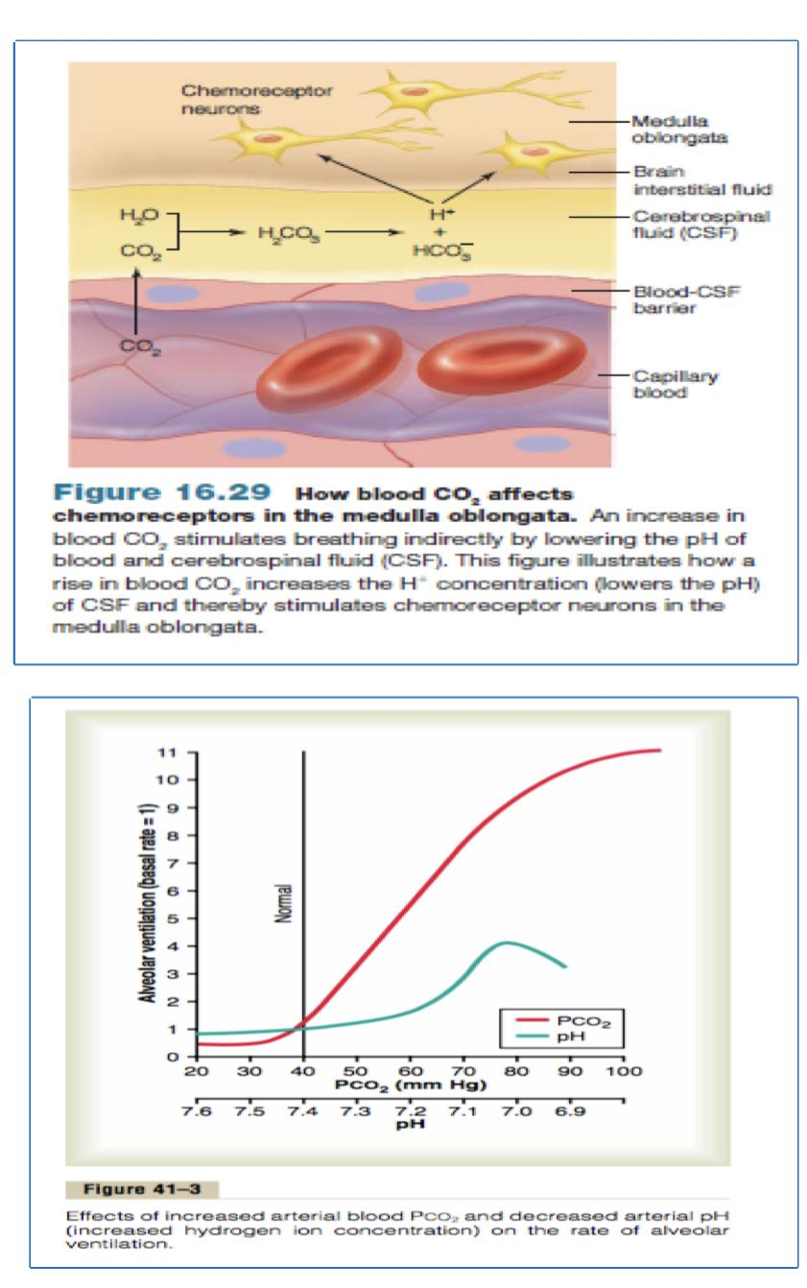
Direct effect of H+ ions on the central chemoreceptors
Girl’s slides only
The central chemoreceptors are especially excited by H+ ions.
In fact, it is believed that H+ ions may be the only important direct stimulus for these neurons.
However, The blood- brain barrier (BBB) is nearly impermeable to H+ ions, but CO2 passes this barrier very easily.
For this reason, changes in H+ ion concentration in the blood have considerably less effect in stimulating the central chemosensitive neurons than do changes in blood CO2 even though CO2 is believed to stimulate these neurons secondarily by changing the hydrogen ion concentration.

Slide 22
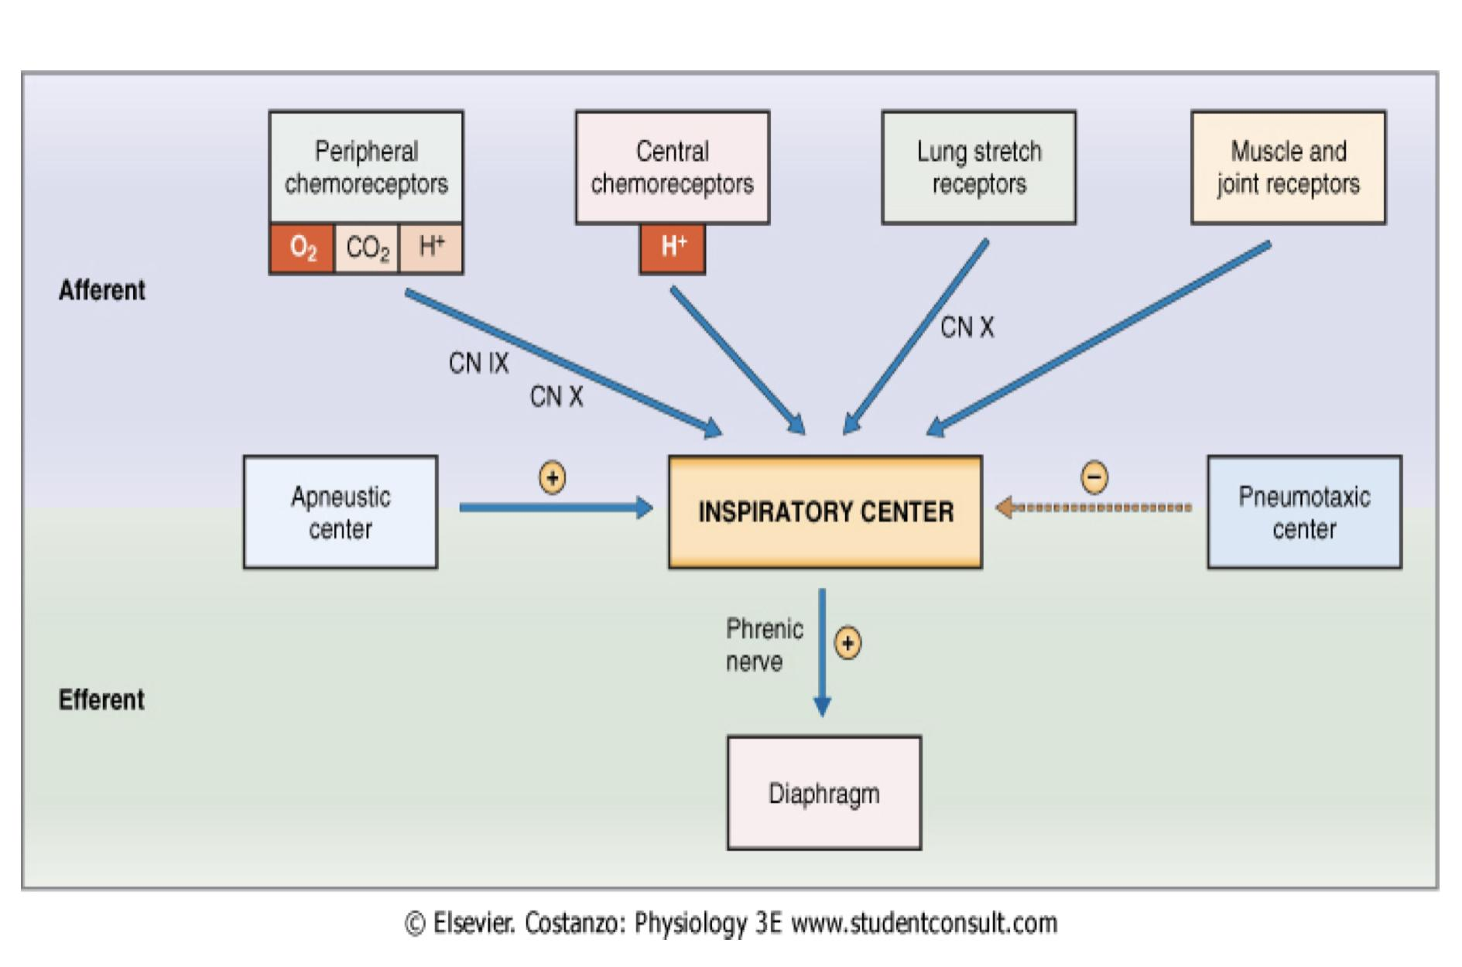
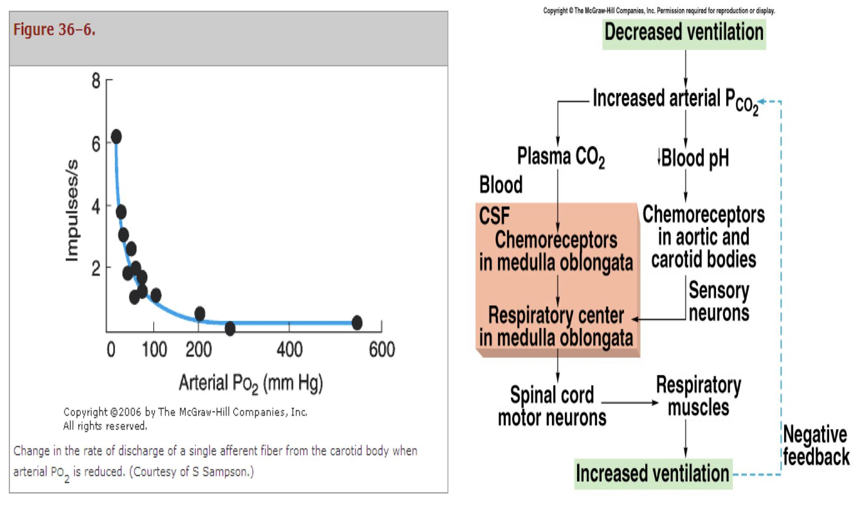
Summary:
Summary of Chemoreceptor Control of Breathing
Summary of factors affecting respiration
Vagus and glossopharyngeal
Phrenic and intercostal

Slide 23
Summary
Respiratory acidosis
Respiratory alkalosis
Metabolic Acidosis
Metabolic Alkalosis
Hypoventilation
Hyperventilation
Ingestion, infusion or production of fixed acid
Ingestion, infusion or excessive renal reabsorption of bases such as bicarbonate
Accumulation of CO2 in the tissues
PCO2 increases
Excessive loss of CO2
PCO2 decreases (35 mmHg)
Decrease renal excretion of hydrogen ions.
Excessive loss of fixed acids from the body.
pH decrease
pH increase
Loss of bicarbonate or other bases from the extracellular compartment.
pH increases
Metabolic disorders such as diabetic ketoacidosis.
———
The respiratory system can compensate for metabolic acidosis or alkalosis by altering alveolar ventilation

Slide 24
MCQ
For more questions
Q1: what is the most important regulator of ventilation?
PO2 | B. PCO2 | C. Ph | P.
Q2. Causes contraction of diaphragm and external intercostals?
A.DRG | B. VRG | C. The apneustic center | D. The pneumotaxic center
Q3: Where are the main peripheral chemoreceptors located?
Carotid body | B. Medulla Oblongata | C. Midbrain | D. Both A&B
Q4: which one of the following has little direct effect in stimulating the neurons in the chemosensitive
PO4 | B. HCl | C. CO2 | D. CH3O
Key answers:
1-B
2-A
3-A
4-C

Slide 25
SAQ
Q1. The respiratory activity is highly responsive to changes in which substances? And how?
Arterial PO2:
When PO2 is VERY low (Hypoxia): ventilation increases.
Arterial PCO2:
The most important regulator of ventilation is PCO2, small increases in PCO2: greatly increases ventilation.
Arterial pH:
As hydrogen ions increase (acidosis), alveolar ventilation increases.
Q2. What is the difference between Respiratory acidosis and Respiratory alkalosis?
Slide 24

Slide 26
Team leaders
Deema aljuribah Mishal Alsuwayegh Waleed Alrashoud
Team members
Maram Beyari
Raghad Alnadeef
Hend Almogary
Farah Alfayez
Kadi aldoosari
Farah Alqazlan
Ghada Binslmah
Shatha Alshabani
Raghad Alkhudair
Faisal Ali
Othman Aldraihem
Abdullah Alqarni
Rayan Alotaibi
Faisal Alkhunein
Mishari Alenezi
Bandar Almutiri
Fahad Alhelelah
Rayan Bosaid
Ibraheem Alkanhal
Saad Alhammad
Emad Almutairi
Ahmad Almarshed
Salman Almutaz
Osama Alzahrani
Haifa Almuddahi
Haifa Alamri
Jana Alhazmi
Meznah Ahmad
Maha Alkoryshy
Physio442@gmail.com

