Slide 1
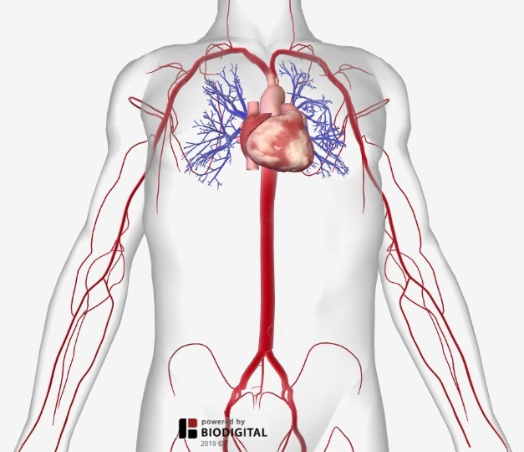
Major Arteries OF The Body
Department of Anatomy
Dr. SAMEERAH SHAHEEN
Assistant Professor
MBBS, Msc, PhD
sshahee@ksu.edu.sa
03 March 2022

Slide 4
Notes:
functional end artery: an artery having only ineffectual anastomoses, so that it is unable to maintain viability of the tissue supplied when occlusion of the artery occurs.

Slide 8
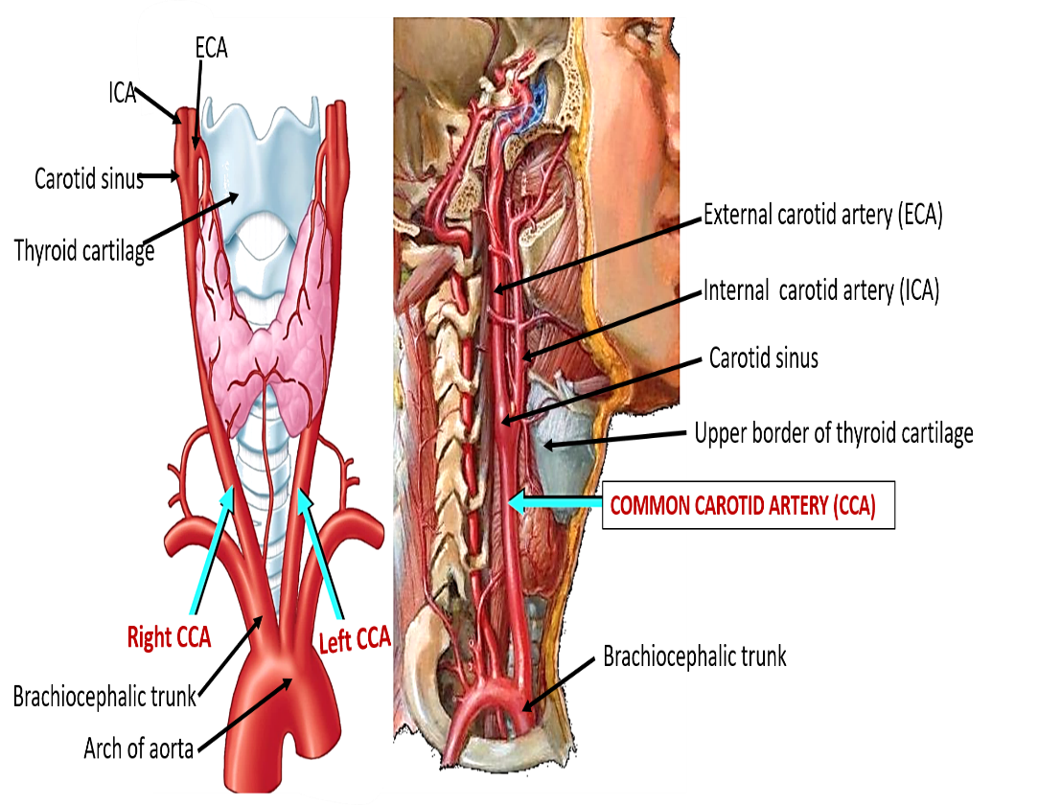

Slide 12
Notes:
Axillary , Brachial, Radial , Ulnar, Palmar Arches : Superficial & Deep
Axillary
It passes through the Axilla.
It continues in the arm as the Brachial artery.
Brachial
It descends close to the medial side of the Humerus
It passes in front of the elbow joint (cubital fossa).
At the level of neck of radius, it divides into two terminal branches
Radial
Ulnar
Ulnar
The larger terminal branch
Radial
The smaller terminal branch
Palmar Arches
superficial & deep Palmar arches are formed by both Ulnar & Radial.

Slide 15
Notes:
Celiac Trunk
Left Gastric artery
Stomach
Hepatic artery
Liver & Pancreas
Splenic artery
Spleen
Superior Mesenteric Artery
Pancreas
Small Intestine
Duodenum, Jejunum & Ileum
Large Intestine
Right 2/3 of Transverse Colon
Inferior Mesenteric Artery
Large Intestine
left 1/3 of transverse colon & descending colon
Rectum & Anal Canal
Testicular or Ovarian
Renal
Suprarenal
Common Iliac

Slide 16
Notes:
Supplies:
Uterus
Vagina
Pelvic Walls
Perineum
Rectum & Anal Canal
Urinary Bladder
The external iliac artery
The Source of arterial supply to the lower limb
Deep to the Inguinal Ligament it become the femoral artery

Slide 17
Notes:
Femoral artery
Popliteal artery
Anterior tibial artery
Posterior tibial artery
Dorsalis pedis artery
Medial & Lateral planter arteries
Anterior Tibial Artery
It is the smaller terminal branch
It continues to the dorsum of foot as the Dorsalis Pedis artery
Posterior Tibial Artery
It terminates by dividing into Medial & Lateral Planter arteries to supply the sole of the foot.

Slide 18
Notes:
Carotid pulse at the upper border of thyroid cartilage
Facial Pulse at the lower border of the mandible.
Superficial Temporal Pulse in front of the ear.

Slide 19
Notes:
Radial Pulse in front of the distal end of the radius

Slide 20
Notes:
Femoral artery midway between Anterior Superior Iliac spine & symphysis pubis
Popliteal artery in the depths of popliteal fossa
Dorsalis Pedis artery in front of ankle (between the 2 malleoli)

Slide 21
Good Luck & All the Best

