Slide 1
BLOOD SUPPLY OF THE HEART

Slide 2
Objectives
At the end of the lecture the student should be able to know about;
The arterial supply of the cardiac muscle regarding (origin, course, distribution and branches).
The coronary anastmosis.
The arterial supply to the conducting system of the heart.
The venous drainage of the heart regarding (origin, tributaries and termination).
Nerve supply of the coronary arteries
Clinical application; Coronary heart diseases , Angina pectoris

Slide 3
The arterial supply of the heart is provided by Coronary Arteries :
Right Coronary artery &
Left Coronary artery
They originate from the initial part of the Ascending Aorta; Immediately above the aortic valve.
They are distributed over the cardiac surface, within the subepicadium connective tissue.

Slide 4
Right Coronary Artery
Arises from the Anterior (right) aortic sinus of the ascending aorta.
Runs forward between pulmonary trunk and right auricle.
Descends vertically in the right atrioventricular groove.
At the inferior border of the heart it is continuous posteriorly along the atrioventricular groove to anastomose with the left coronary artery in the posterior interventricular groove .

Slide 5
Right Coronary Artery
Right Coronary Artery Supplies:
Right atrium, and Right ventricle,
Parts of Left Atrium, Left ventricle & Atrioventricular septum.

Slide 6
Branches
(1) Right Conus artery:
To the infundibulum and the upper part of the anterior wall of the right ventricle.
(2) Anterior Ventricular arteries;
2 or 3 branches, suppling the anterior surface of the right ventricle.
(3) Marginal artery; is the largest branch, runs along the inferior margin toward the apex.

Slide 7
Branches
(4) Posterior ventricular arteries; (2 branches)
To the diaphragmatic surface of the right ventricle.
(5) Atrial branches:
To the right atrium; anterior and lateral surfaces.
Posterior surface of both atria
(6)The Artery of the SAN, also supplies both atria.

Slide 8
Branches
(7) Posterior interventricular arteries ;
Runs toward the apex, to supplies:
a. Diaphragmatic surface of the R & L Ventricles.
b. Posterior part of the IVS excluding its Apex.
C. Septal branch to the AVN.
(N.b) in 10% it is replaced by a branch from the left coronary

Slide 9
Left Coronary Artery
The Larger of the two coronaries.
Arises from the Posterior ( left )aortic sinus of the ascending aorta.
Passes forward between the pulmonary trunk and the left auricle.
Enters the atrioventricular groove and divides into
Anterior interventricular artery &
Circumflex artery
It supplies greater part of left atrium, left ventricle, including the apex, and ventricular septum

Slide 10
Anterior interventricular (descending) artery
Descends in the anterior interventricular groove (with great cardiac vein) toward the apex of the heart,
(in most individuals it passes around the apex and anastomoses with the right coronary in the posterior Inter Ventricular groove, in one third it ends at the apex )
It Supplies; the right and left ventricles, and the anterior part of Ventricular Septum.
It may give also; Left diagonal artery, which may arise from trunk of the left coronary
And a small Left conus artery to supply the pulmonary conous

Slide 11
Circumflex artery
Winds around the left margin of the heart in the atrioventricular groove it gives;
A Left Marginal artery; supplies the left margin of the left ventricle to the apex.
Anterior ventricular and Posterior ventricular branches supply the left ventricle,
Atrial branches to the left atrium.

Slide 12
Variations of the Coronary Arteries
Affecting the diaphragmatic surfaces of both ventricles due to the origin, size, and distribution of the posterior interventricular artery
Right dominance:
In (90 %) of population, the Posterior Interventricular artery is a branch of the Right Coronary.
Left dominance:
In the rest (10%), the Posterior Interventricular artery arises from the Circumflex branch of the Left Coronary A

Slide 13
Coronary Anastomosis
Anastomoses between terminal branches of the right and left coronaries exist but not large enough to provide adequate blood supply.
A sudden block of one of the large branches of either arteries leads to myocardiac infarction

Slide 14
Arterial Supply of Conducting System
Sinoatrial node (SAN), atrioventricular node (AVN) & atrioventricular bundle (AVB) are usually supplied by Right coronary.
Right bundle branch (RBB) of (AVB) is supplied by Left coronary.
Left bundle branch (LBB) of (AVB) is supplied by both right and left coronaries.

Slide 15
Arterial Supply of Conducting System

Slide 16
Summary of the arterial supply

Slide 17
Summary of the arterial supply

Slide 18
Venous Drainage of the heart
Blood of the heart is drained into the right atrium through;
*Coronary sinus
*Directly into the right atrium

Slide 19
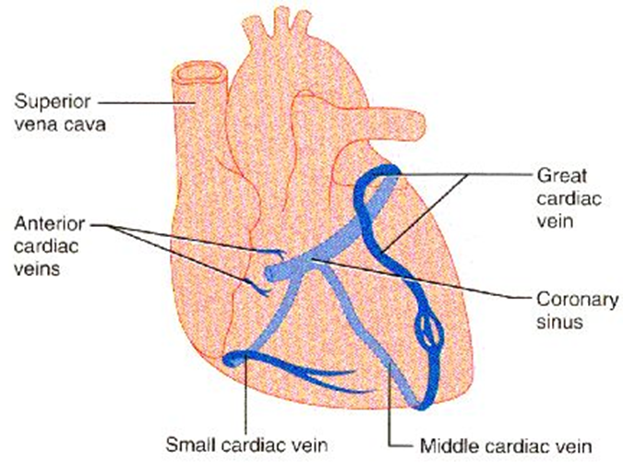
The Coronary Sinus
It is the direct continuation of the Great Cardiac Vein.
Lies in the posterior part of the AV groove, it opens in the right atrium to the left of the inferior vena cava opening
It is guarded by a valve.
Drains most of the venous blood of the heart.
Tributaries:
Great cardiac vein
Middle Cardiac Vein.
Small Cardiac Vein.
Oblique vein of left atrium.

Slide 20
The main tributaries of the coronary sinus are:
Great cardiac vein (anterior interventricular vein) – the largest tributary of the coronary sinus. It originates at the apex of the heart and ascends in the anterior interventricular groove. It then curves to the left and continues onto the posterior surface of the heart. Here, it gradually enlarges to form the coronary sinus.
Small cardiac vein – located on the anterior surface of the heart, in a groove between the right atrium and right ventricle. It travels within this groove onto the posterior surface of the heart, where it empties into the coronary sinus.

Slide 21
The main tributaries of the coronary sinus are:
Middle cardiac vein (posterior interventricular vein) – begins at the apex of the heart and ascends in the posterior interventricular groove to empty into the coronary sinus.
Posterior cardiac vein – located on the posterior surface of the left ventricle. It lies to the left of the middle cardiac vein and empties into the coronary sinus.

Slide 22
Venous Drainage
Direct Veins into the right atrium
1. Anterior cardiac veins: open directly into the Right Atrium.
2. Venae Cordis minime ; small veins open directly into the heart champers

Slide 23
Nerve supply of the coronary arteries
The coronary vessels are supplied by autonomic nervous system via the cardiac plexus which is situated below the arch of aorta
The sympathetic supply arise from the cervical and upper thoracic portion of the sympathetic chain
The parasympathetic supply comes from the vagus nerve
Post ganglionic sympathetic suppling the coronary arteries, leads to vaso-dilatation of the coronary arteries
Post ganglionic parasympathetic suppling the coronary arteries, leads to vaso-constriction of the coronary arteries.

Slide 24
Coronary heart diseases
Can result in reduced blood flow to the heart as a result of narrowing or blockage of the coronary arteries.
This may be due to atherosclerosis, thrombosis, high blood pressure, diabetes or smoking.
All these factors lead to a reduced flow of blood to the heart through physical obstruction or changes in the vessel wall.

Slide 25
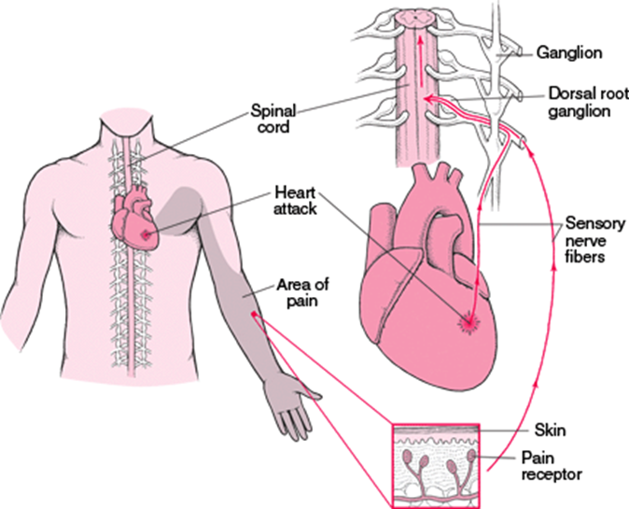
Cardiac pain ( Angina pectoris)
Originates due to acute myocardial ischemia
Afferent nerve fibers ascend through cardiac branch of the sympathetic trunk entering the posterior root of upper 4 thoracic nerves
The pain is referred to skin area supplied by corresponding spinal nerves upper 4 intercostal nerves and intercostobrachial nerve
The intercostobrachial nerve communicates with medial cutaneous nerve of the arm and distributed to the skin of the medial side of the upper part of the left arm
It may be felt in the neck or the jaw

Slide 26
Thank you

