Slide 1
Oxidative Stress
Cardiovascular System Block

Slide 2
Objectives
By the end of this lecture, the First Year students will be able to:
Define oxidative stress
Understand the harmful effects of oxidative stress to the cell and its diseases
List the types, sources and effects of Reactive Oxygen Species (ROS)
List various antioxidants in the body
Understand the role of glutathione system in detoxifying oxidants in the body
Discuss how G6PD deficiency leads to oxidative stress
Understand the role of Reactive Nitrogen Species (RNS) in contributing to oxidative stress
Correlate the role of oxidative stress to pathogenesis of atherosclerosis

Slide 3
Overview
Oxidative stress
Reactive Oxygen Species (ROS): types, sources, effects
Antioxidants
Glutathione system
G6PD deficiency
Nitric oxide (NO): Reactive Nitrogen Species (RNS)
Oxidative stress and atherosclerosis

Slide 4
Oxidative stress
A condition in which cells are exposed to excessive levels of:
  Reactive Oxygen Species (ROS) or
  Reactive Nitrogen Species (RNS)
Cells are unable to neutralize their deleterious effects with antioxidants
Oxidative stress is implicated in atherosclerosis, CAD, ageing

Slide 5
Oxidative stress
Cellular imbalance of oxidants and antioxidants damages:
  DNA, proteins, lipids
Diseases due to oxidative stress:
  Inflammatory diseases (rheumatoid arthritis), atherosclerosis, CAD, obesity, cancer, G6PD deficiency hemolytic anemia

Slide 6
Reactive Oxygen Species (ROS)
Incomplete reduction of oxygen to water produces ROS
ROS are continuously formed:
  As byproducts of aerobic metabolism
  Thru reactions with drugs and toxins
  When cellular antioxidant level is low
  Creating oxidative stress in cell
ROS can damage DNA, proteins, unsaturated lipids → cell death
Cells have protective antioxidant mechanisms that neutralize ROS

Slide 7
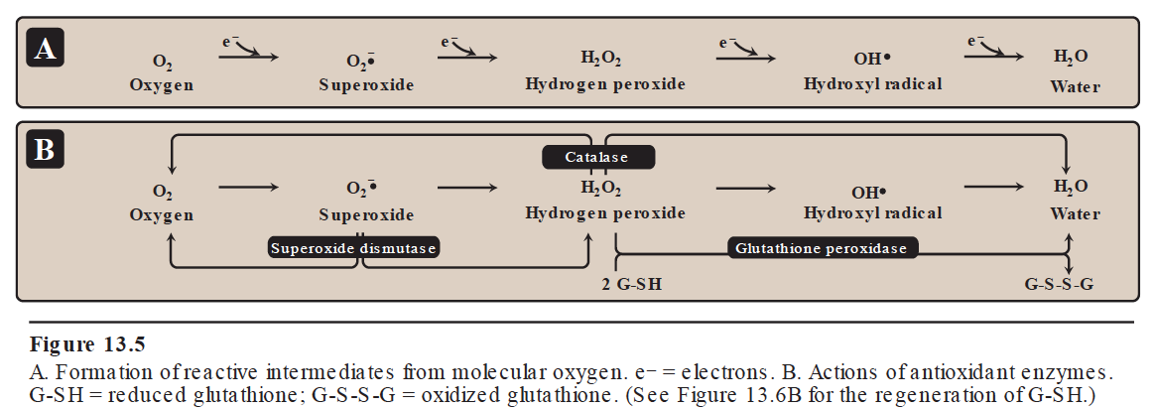
Reactive Oxygen Species (ROS)

Slide 8
Types and sources of ROS
Free radicals:
  Superoxide (O₂•⁻)
  Hydroxyl radical (OH•)
Non-free radical:
  Hydrogen peroxide (H₂O₂)
Sources:
  Aerobic metabolism
  Partial reduction of molecular oxygen in ETC
  Ingestion of drugs, toxins, chemicals

Slide 9
Antioxidants
Enzymes:
  Superoxide dismutase
  Catalase
  Glutathione system
Vitamins:
  Vitamins A, C, E
  β-Carotene

Slide 10
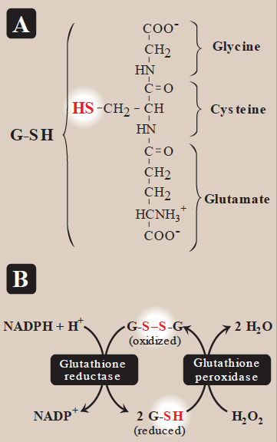
Glutathione system
Present in most cells
Chemically detoxifies H₂O₂
Catalyzed by glutathione reductase
Uses NADPH that reduces glutathione which reduces H2O2

Slide 11
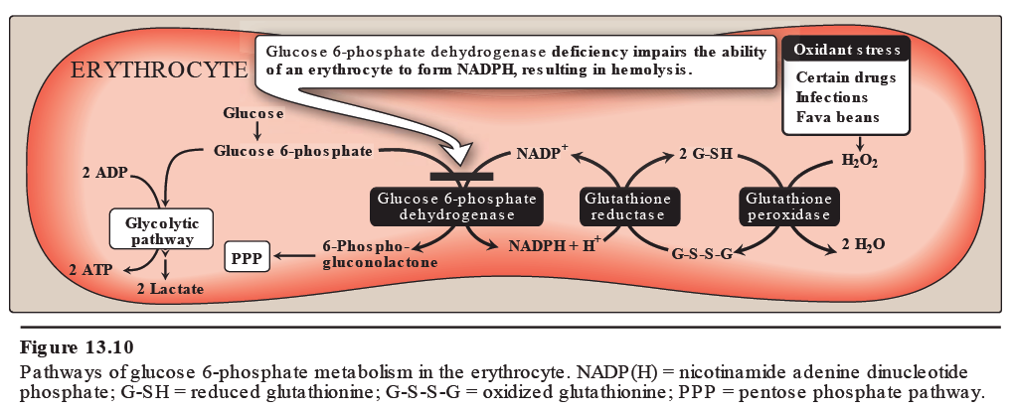
G6PD deficiency
Leads to NADPH deficiency
Cells are unable to reduce free radicals
Oxidation of cellular proteins is increased causing impaired cell functions

Slide 12
Effects of ROS
Lipid peroxidation (polyunsaturated fatty acids)
DNA damage
Protein denaturation
Cytoskeletal damage
Chemotaxis
Cell signaling effects
  Release of Ca²⁺ from intracellular stores
Altered vascular tone
Increased endothelial cell permeability

Slide 13
Nitric oxide (NO)
Endothelial-derived relaxing factor
Causes vasodilation by relaxing vascular smooth muscle
NO is a gas with short half-life (3-10 sec)
NO + Oxygen/Superoxide → Nitrates, Nitrites, Peroxynitrite (O=NOO⁻)
Peroxynitrite is a Reactive Nitrogen Species (RNS)

Slide 14
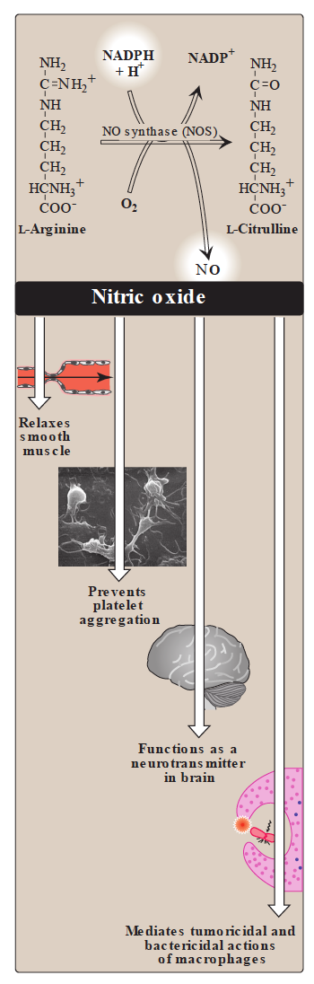
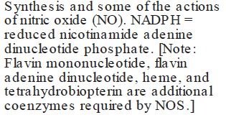

Slide 15
Nitric oxide (NO)
NO is produced by nitric oxide synthase:
  eNOS in the endothelium (vaso-relaxation)
  nNOS in the neural tissue (neurotransmission)
  iNOS in macrophages, neutrophils (infection)
  bNOS (bacterial)
iNOS activity (normally low) increased by infection and pro-inflammatory cytokines
Activated macrophages produce O₂•⁻ radical + NO → OH• radical → highly bactericidal
Increased iNOS activity → free radicals → oxidative stress

Slide 16
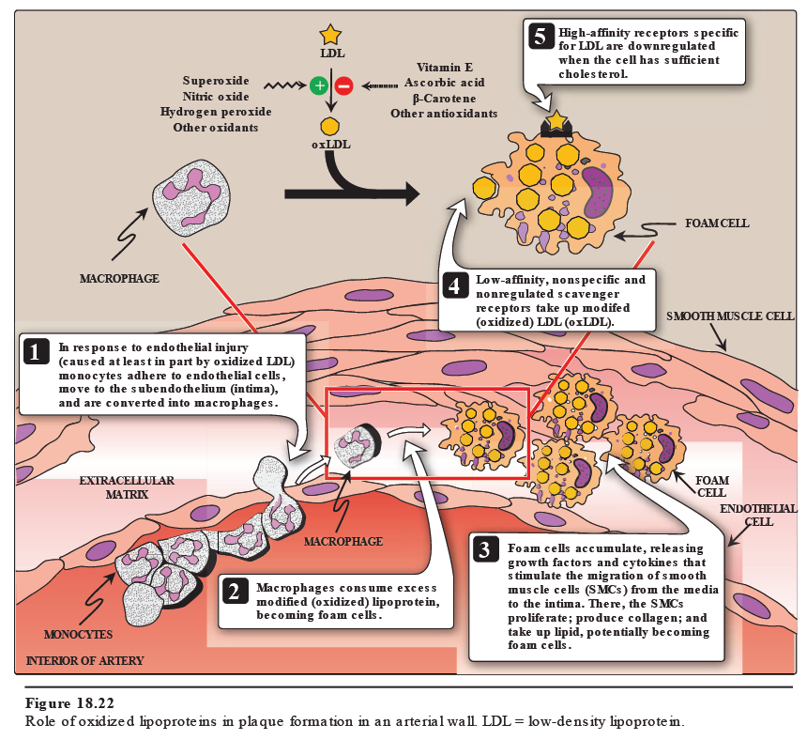
Oxidative stress and atherosclerosis

Slide 17
Take home message
Oxidative stress is due to excessive production of ROS and NOS in the cells.
Cells neutralize these oxidants by a number of antioxidant processes.
Imbalance between oxidants and antioxidants in the cells can result in the development of many diseases including atherosclerosis.

Slide 18
References
Lippincott’s Biochemistry, 6th Edition, Chapter 13, pp. 148-152. Lippincott Williams & Wilkins, New York, USA.

