Slide 1
Biochemical Markers of
Myocardial Infarction
Cardiovascular System Block

Slide 2
Objectives
By the end of this lecture, the First Year students will be able to:
Describe the general sequence of events of myocardial infarction (MI)
List the criteria for diagnosis of MI
Discuss the features of an ideal MI marker
Understand the significance of changes in plasma marker levels over time
Identify the properties and diagnostic value of cardiac troponins, creatine kinase, h-FABP and BNP
Know about markers with potential clinical use

Slide 3
Overview
Myocardial infarction (MI)
Criteria for diagnosis of MI
Case example for MI
Features of an ideal MI marker
Time-course of plasma enzyme changes
Cardiac troponins I and T
Creatine kinase (CK-MB)
Heart fatty acid binding protein (h-FABP)
B-type natriuretic peptide (BNP)

Slide 4
Myocardial infarction (MI)
Occlusion of coronary arteries
Restricted blood supply (oxygen) to heart tissue (ischemia)
Damage to heart tissue (infarction)
Release of enzymes and other proteins into the blood (markers)

Slide 5
Criteria for diagnosis of MI
Recommended by the European Society of Cardiology and American College of Cardiology
Requires presence of at least two of the following characteristics:
Typical heart attack symptoms
Characteristic rise and fall pattern of a cardiac marker in plasma
Rise and gradual fall of cardiac troponins
More rapid rise and fall of CK-MB
Typical ECG pattern
Reference: Alpert JS, Thygesen K, Antman E, Bassand JP. J Am Coll Cardiol. 2000, 36(3):959.

Slide 6
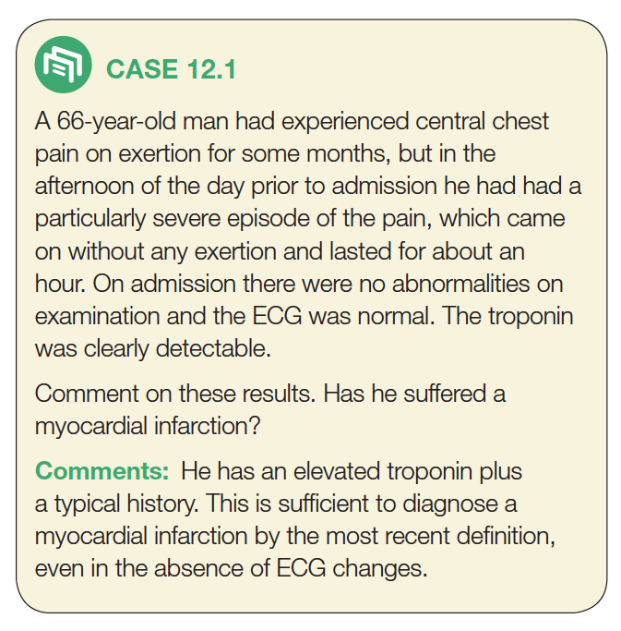

Slide 7
1. Typical heart
attack symptoms
2. Characteristic
Pattern of a cardiac
biomarker

Slide 8
Features of an ideal cardiac marker
High concentration in the myocardium
High sensitivity (detected even in low concentration at early stages of the disease)
High specificity (specifically detecting damage of cardiac tissue, and is absent in non-myocardial tissue injury)

Slide 9
Features of an ideal cardiac marker
Rapid release into plasma following myocardial injury
Good prognostic value (strong correlation between plasma level and extent of myocardial injury)
Easily measured (detectable by rapid, simple and automated assay methods)

Slide 10
Plasma cardiac markers
CURRENT MI MARKERS
Cardiac troponin T (cTnT)
Cardiac troponin I (cTnI)
Creatine kinase-MB (CK-MB)
MARKERS WITH POTENTIAL CLINICAL USE
Heart fatty acid binding protein (h-FABP)
(for detecting heart tissue ischemia)
MARKERS NO LONGER USED
Aspartate Transaminase (AST)
Lactate dehydrogenase (LDH)
Ischemia modified albumin (IMA)
Myoglobin

Slide 11
Markers of diagnostic value in MI:
Cardiac troponins T and I
Creatine kinase (CK-MB)
Markers of diagnostic value in tissue ischemia:
Heart fatty acid binding protein (h-FABP)
Markers of diagnostic value in heart failure:
B-type natriuretic peptide (BNP)

Slide 12
Time-course of plasma enzyme changes
Plasma enzymes follow a pattern of activities after MI
The initial lag phase lasts for about 3 hours
Enzymes rise rapidly to peak levels in 18-36 hours
The levels return to normal based on enzyme half-life
Rapid rise and fall indicates diagnostic value

Slide 13
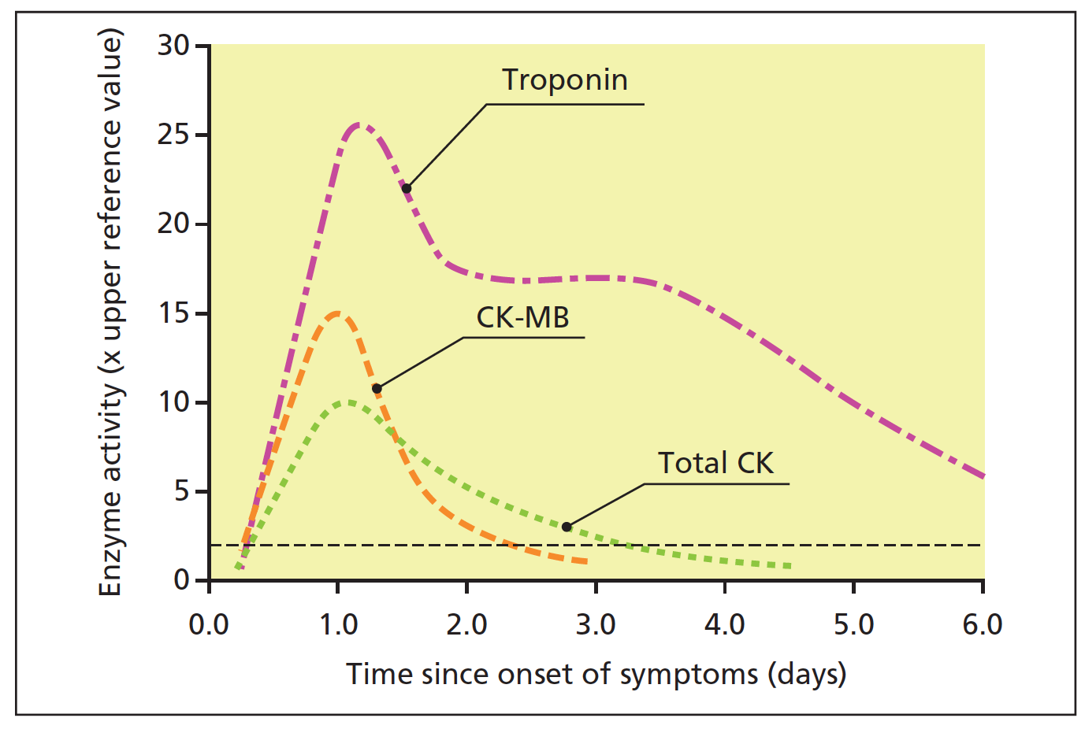

Slide 14
Blood samples collected after MI:
Baseline (upon admission)
Between 12 and 24 hours after the onset of symptoms

Slide 15
Time-course of plasma
marker changes after MI

Slide 16
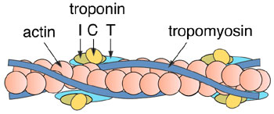
Troponins
Troponins are structural proteins in cardiac myocytes and in skeletal muscle
Cardiac troponins (cTn) are structurally different from muscle troponins
Involved in the interaction between actin and myosin for muscle contraction

Slide 17
Troponins
cTn are mainly bound to proteins, with small amount soluble in the cytosol
Highly specific markers for detecting MI
Two main cardiac troponins (cTn):
cTnI: inhibitory protein
cTnT: binds to tropomyosin

Slide 18
Troponins
Detectable in plasma in 4-6 h. after MI
Level peaks in 12-24 h.
Remain elevated for up to 10 days
After MI, cytosolic troponins are released rapidly into the blood (first few hours)
Structurally bound troponins are released later for several days

Slide 19
Creatine kinase (CK)
Three main CK isoenzymes with two polypeptide chains B or M
Type | Composition | Comment
Skeletal Muscle | 98% CK-MM 2% CK-MB | Elevated in muscle disease
Cardiac muscle | 70-80% CK-MM 20-30% CK-MB | Cardiac muscle has highest amount of CK-MB
Brain | CK-BB
Plasma | Mainly CK-MM

Slide 20
CK-MB
CK-MB is more sensitive and specific for MI than total CK
It rises and falls transiently after MI
Detectable in plasma in 3-10 h. after MI
Peaks in blood in 12–24 h.
Returns to normal in 1.5-3 days
Relative index =
CK-MB mass / Total CK x 100
More than 5 % is indicative for MI

Slide 21
CK-MB
Advantages:
Useful for early diagnosis of MI
Useful for diagnosis of re-infarction
Disadvantages:
Not significant if measured after 2 days of MI (delayed admission)
Not highly specific (elevated in skeletal muscle damage)

Slide 24
Heart fatty acid binding protein (h-FABP)
(Heart tissue ischemia marker)
A cytosolic protein involved in fatty acid transport and metabolism
A promising marker to be used in combination with troponins
Higher amounts in myocardium than in brain, kidney and skeletal muscle
Appears in plasma as early as 30 min. after acute ischemia
Peaks in blood in 6-8 h.
Returns to normal levels in 24-30 h.

Slide 25
B-type natriuretic peptide (BNP) (Heart failure marker)
A peptide produced by the ventricles of the heart in response to:
Myocardial stretching and ventricular dysfunction after MI
Causes vasodilation, sodium and water excretion and reduces blood pressure
A marker for detecting congestive heart failure
Its serum levels are high in some pulmonary diseases
But in heart failure its levels are markedly high
An important marker for differential diagnosis of pulmonary diseases and congestive heart failure

Slide 26
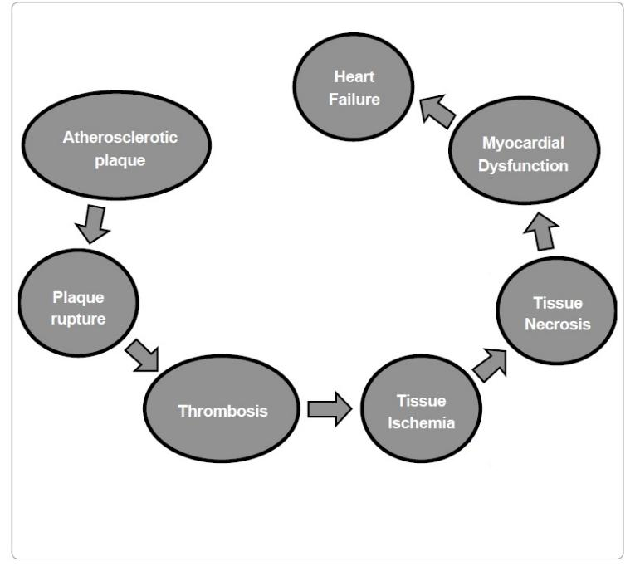
BNP
BNP
cTn
CK-MB
h-FABP
Pathogenesis of MI with special focus on the biomarkers implicated in the development of MI.

Slide 27
Take home message
cTn
Currently the most definitive markers and are replacing CK-MB
Highly specific to heart muscle damage
They remain elevated in plasma longer than CK-MB
They have higher sensitivity and specificity than CK-MB
CK-MB
Its main advantage is for detecting re-infarction
h-FABP
An early marker for detecting acute ischemia prior to necrosis
BNP
A cardiac marker that can be used for differential diagnosis of pulmonary diseases and heart failure

Slide 28
References
Lecture Notes on Clinical Biochemistry 9th Edition, Chapter 12, pp. 160-164, A.F. Smith, Blackwell Publishing, UK.
Sharma, N. and Ahmad, M.I. Biomarkers in acute myocardial infarction. J. Clin. Exp. Cardiol. 2012, 3: 11-18.

