Slide 1
DEVELOPMENT OF THE HEART

Slide 2
Objectives
By the end of this lecture the student should be able to:
Describe the formation, sit, union divisions of the of the heart tubes.
Describe the formation and fate of the sinus venosus.
Describe the partitioning of the common atrium and common ventricle.
Describe the partitioning of the truncus arteriosus.
List the most common cardiac anomalies.

Slide 3
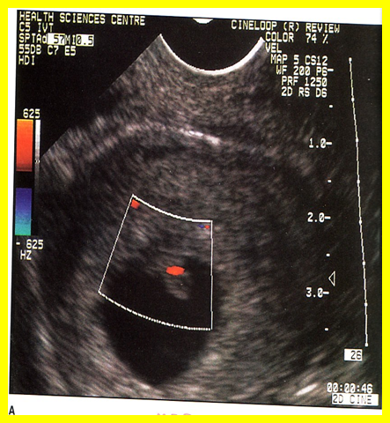
DEVELOPMENT OF HEART
The CVS is the first major system to function in the embryo.
The heart begins to beat at (22nd – 23rd ) days.
Blood flow begins during the beginning of the 4th week and can be visualized by Ultrasound Doppler

Slide 4
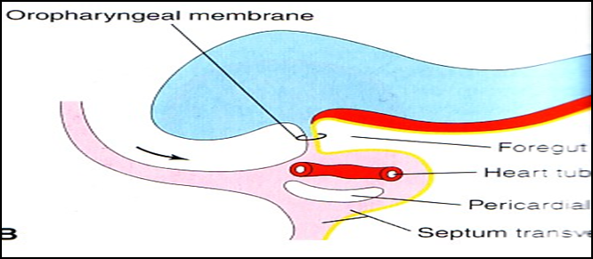
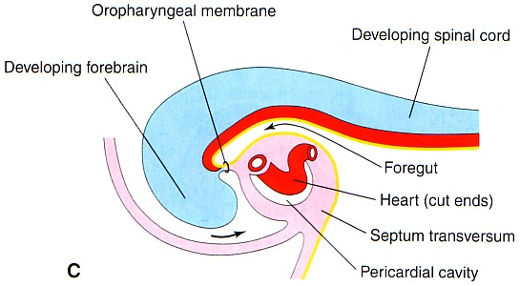
FORMATION OF THE HEART TUBE
The heart is the first functional organ to develop.
It develops from Splanchnic Mesoderm in the wall of the yolk sac (Cardiogenic Area): Cranial to the developing Mouth & Nervous system and Ventral to the developing Pericardial sac.
The heart primordium is first evident at day 18 (as an Angioplastic cords which soon canalize to form the 2 heart tubes).
As the Head Fold completed, the developing heart tubes change their position and become in the Ventral aspect of the embryo, Dorsal to the developing Pericardial sac.
.

Slide 5
After Lateral Folding of the embryo, the 2 heart tubes approach each other and fuse to form a single Endocardial Heart tube within the pericardial sac.
Fusion of the two tubes occurs in a Craniocaudal direction.

Slide 6
The heart tube grows faster than the pericardial sac, so it shows 5 alternate dilations separated by constrictions.
These are:
Sinus Venosus.
Truncus Arteriosus.
Bulbus Cordis.
Common Ventricle.
Common Atrium.
The endocardial heart tube has 2 ends:
1. Venous end (Caudal): Sinus Venosus.
2. Arterial end (Cranial): Truncus arteriosus

Slide 7
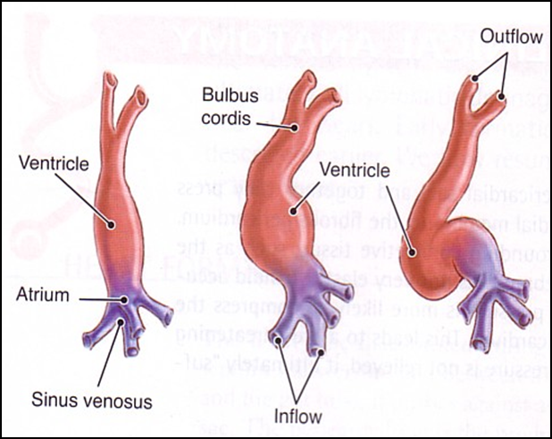
U-SHAPED HEART TUBE
Bulbus cordis and ventricle grow faster than other regions.
So the heart bends upon itself, forming
The U-shaped heart tube, (Bulboventricular loop).

Slide 8
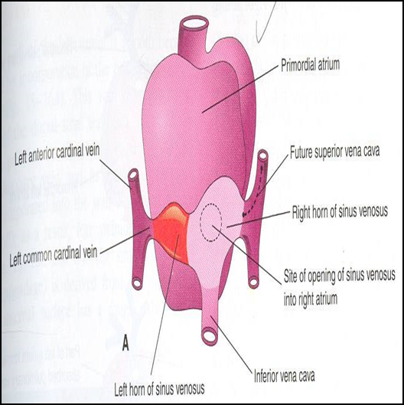
S-Shaped Heart Tube
As the heart tube develops it bends, upon itself and forms S shaped heart tube:
SO, the Atrium and Sinus venosus become Cranial in position & Dorsal to the Truncus arteriosus, Bulbus cordis, and Ventricle.
By this stage the sinus venosus (opens in the dorsal surface of the atrium) has developed 2 lateral expansions, (Horns) :Right and Left

Slide 9
Veins Draining into Sinus Venosus
Each horn of the sinus venosus receives
3 veins:
1.Common cardinal
2.Vitelline
3.Umbilical
C Cardinal vein from the fetal body.
Vitelline from the yolk sac.
Umbilical from the placenta.

Slide 10
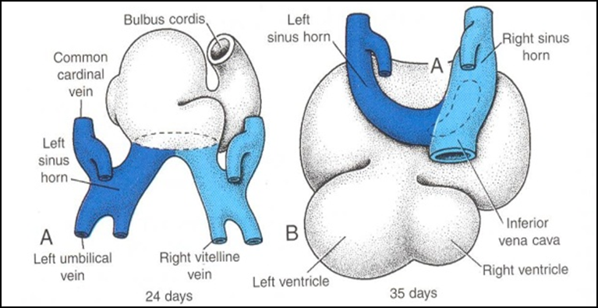
Fate of Sinus Venosus
The Right Horn forms the smooth posterior part of the right atrium; sinus venirium.
The Left Horn and Body atrophy and form the Coronary Sinus.
The Left Common cardinal vein forms the Oblique Vein of the Left Atrium.

Slide 11
Right Atrium
The right atrium is developed from:
Rough Trabeculated anterior part (musculi pectanti) of the right atrium is derived from the primordial common atrium.
The right horn of the sinus venosus forms the smooth posterior part of the right atrium.
These two parts are demarcated by the crista terminalis internally and sulcus terminalis externally.

Slide 12
Left Atrium
Rough Trabeculated part: derived from the common primordial atrium.
The smooth part:
derived from the absorbed Pulmonary Veins.

Slide 13
Partitioning of Primordial Heart
Partitioning of:
1- Atrioventricular canal.
2- Common atrium.
3- Common ventricle.
4- Truncus arteriosus & Bulbus cordis.
It begins by the middle of 4th week.
It is completed by the end of 5th week.

Slide 14
Endocardial Cushions
They appear around the middle of the 4th week as Mesenchymal Proliferation.
They participate in formation of :
(1) A.V canals and valves.
(2) Atrial septa.
(3) Membranous part of Ventricular septum.
(4) Aortic and Pulmonary channels (Spiral septum).

Slide 15
Partitioning of the atrioventricular canal
Two Endocardial Cushions are formed on the dorsal and ventral walls of the AV canal.
The AV endocardial cushions approach each other and fuse to form the Septum Intermedium.
Dividing the AV canal into right & left canals.
These canals partially separate the primordial atrium from the ventricle.

Slide 16
Partition of the Common Atrium
Septum Primum
It is sickle- shaped septum that grows from the roof of the common atrium towards the fusing endocardial cushions (septum intermedium)
So it divides the common atrium into right & left halves.

Slide 17
Ostium Primum
The two ends of septum primum reach to the growing endocardial cushions before its central part.
Now the septum primum bounds a foramen called ostium primum.
It serves as a shunt, enabling the oxygenated blood to pass from right to left atrium.
The ostium primum become smaller and disappears as the septum primum fuses completely with the septum intermedium to form the AV septum.

Slide 18
Septum Secundum
The upper part of septum primum that is attached to the roof of the common atrium shows gradual resorption forming an opening called ostium secondum.
Another septum descends on the right side of the septum primum called Septum Secundum.
It forms an incomplete partition between the two atria.
Consequently a valvular oval foramen forms, (Foramen Ovale)

Slide 19
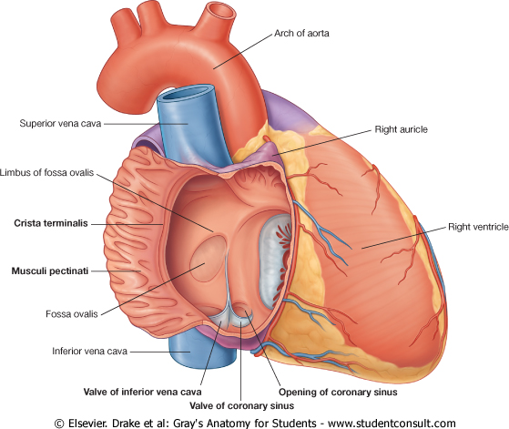
Fate of foramen Ovale
At birth when the lung circulation begins, the pressure in the left atrium increases.
The valve of the foramen ovale is pressed against the septum secundum and obliterates the foramen ovale.
Its site is represented by the Fossa Ovalis:
Its floor represents the persistent part of the septum primum.
Its limbus (anulus) is the lower edge of the septum secundum.

Slide 20
Partitioning of Primordial Ventricle
Muscular part of the interventricular septum:
Division of the primordial ventricle is first indicated by a median muscular ridge, the primordial interventricular septum.
It is a thick crescentic fold which has a concave upper free edge.
This septum bounds a temporary connection between the two ventricles called Interventricular foramen.

Slide 21
Interventricular Septum
The Membranous part
of the IV septum is derived from:
1- A tissue extension from the right side of the Endocardial Cushion.
2- Aorticopulmonary septum.
3- Thick Muscular part of the IV septum.

Slide 22
BULBUS CORDIS
The bulbus cordis forms the smooth upper part of the two ventricles.
Right Ventricle:
Conus Arteriosus or (Infundibulum) which leads to the pulmonary trunk.
Left ventricle:
Aortic Vestibule leading to ascending aorta.

Slide 23
Partition of Truncus Arteriosus
In the 5th week, proliferation of mesenchymal cells (Endocardial Cushions) appear in the wall of the truncus arteriosus ,they form a Spiral Septum:
A. It divides the Lower part of the Truncus Arteriosus into Right & Left parts
B. It divides the Middle part of Truncus Arteriosus into Anterior & Posterior parts.
C. It divides the Upper part of the Truncus Arteriosus into Left & Right parts.

Slide 24
MAJOR CARDIAC ANOMALIES

Slide 25
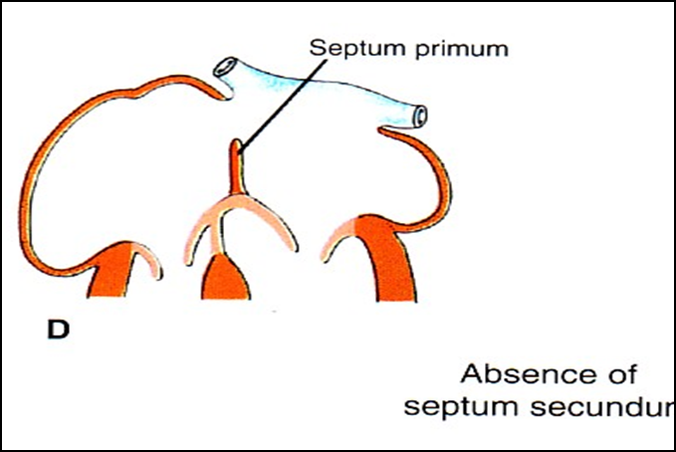
Atrial Septal Defects (ASD)
Types :
1. Absence of both septum primum and septum secundum, leads to Common Atrium.
2. Absence of Septum Secundum

Slide 26
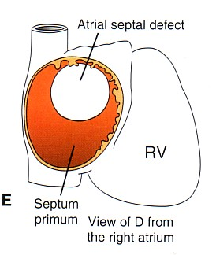
3. Large (Patent) foramen ovale : Excessive resorption of septum primum

Slide 27
VENTRICULAR SEPTAL DEFECT
Roger’s disease
Absence of the Membranous part of interventricular septum (persistent IV Foramen).
Usually accompanied by other cardiac defects.

Slide 28
TETRALOGY OF FALLOT
Fallot’s Tetralogy:
1-VSD.
2- Pulmonary stenosis.
3-Overriding of the aorta
4- Right ventricular hypertrophy.

Slide 29
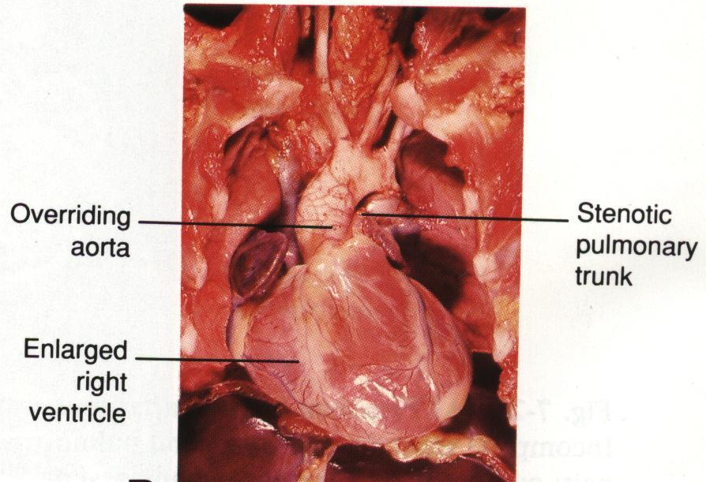
TETRALOGY OF
FALLOT
Blue Baby

Slide 30
TRANSPOSITION OF GREAT ARTERIES (TGA)
TGA is due to abnormal rotation or malformation of the aorticopulmonary septum, so the right ventricle joins the aorta, while the left ventricle joins the pulmonary artery.
It is one of the most common causes of cyanotic heart disease in the newborn
Often associated with ASD or VSD

Slide 31
Persistent Truncus Arteriosus
It is due to
failure of the development of the aorticopulmonary (spiral) septum.
It is usually accompanied with VSD.
It forms a single arterial trunk arising from the heart and supplies the systemic , pulmonary & coronary circulations.

Slide 32
THANK YOU

