Slide 1
Sympatholytic Drugs & adrenergic blockers (α-receptor Antagonists)
Prof. Hanan Hagar
Pharmacology Unit
College of Medicine

Slide 2
By the end of this lecture, the student should be able to
Outline the mechanisms of action of adrenergic neuron blockers
Classify α-receptor blockers into selective & non- selective
Know the pharmacokinetic aspects & pharmacodynamic effects of α adrenergic blockers.
Identify the specific uses of non selective and selective α -adrenergic blockers.

Slide 3
Adrenergic Neuron Blockers
Adrenoceptor Blockers
Alpha & beta- adrenergic receptor blockers

Slide 4
Classification of sympatholytics
Adrenergic neuron blockers
are drugs that prevent the release of noradrenaline from adrenergic nerve ending, thus prevent its interaction with the adrenergic receptors.
Adrenergic receptor blockers
are drugs that prevent the interaction of NA, A and other sympathomimetics with the alpha receptors
α-receptor antagonists
β-receptor antagonists

Slide 5
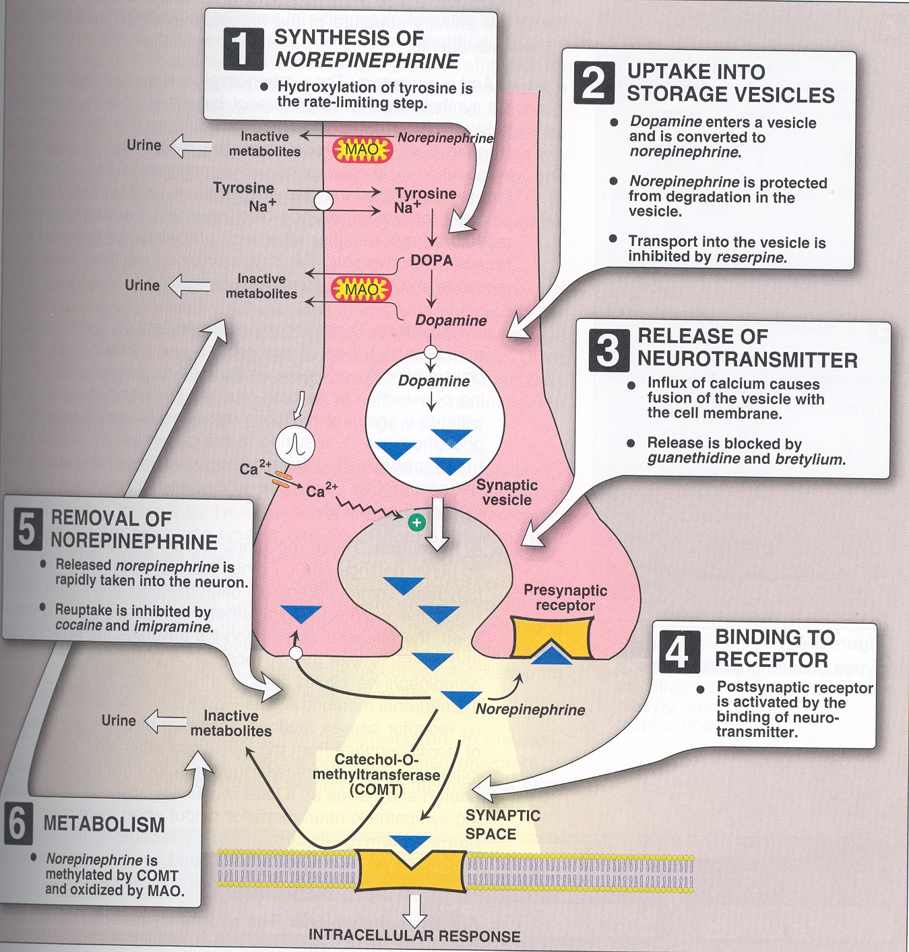
Classification of sympatholytics

Slide 6
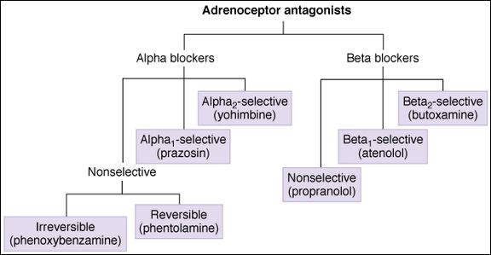
Adrenergic receptor blockers

Slide 7
Adrenergic neuron blockers
Adrenergic neuron blockers
Depletion of storage sites
e.g. reserpine
Inhibition of neurotransmitter release & enhance uptake
e.g. guanethidine
Formation of False Transmitters
e.g. α-Methyl dopa
Stimulation of presynaptic α₂ receptors
e.g. Clonidine and α-Methyl dopa

Slide 8
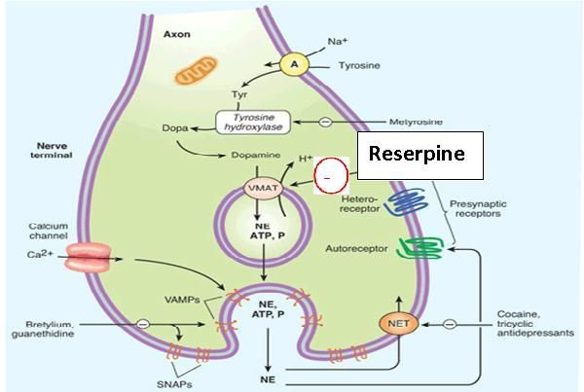
mechanisms of Adrenergic blockers
Interferes with NA storage = Depletion of storage sites
RESERPINE
Interference with the transport of noradrenaline into the storage vesicles

Slide 9
mechanisms of Adrenergic blockers
Inhibition of Transmitter Release
Guanethidine
Interference with the release of noradrenaline and increases the neuronal uptake of noradrenaline

Slide 10
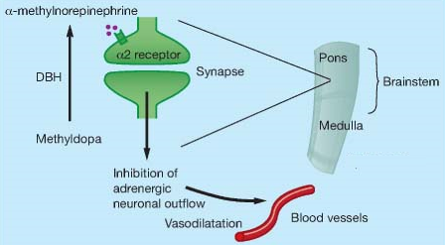
mechanisms of Adrenergic blockers
Formation of false neurotransmitter
α-Methyl dopa
Forms false transmitter that is released instead of NE
Acts as central α ₂ receptor agonist to inhibit NE release
Drug of choice in treatment of hypertension in pregnancy ( gestational hypertension & pre-eclampsia ).

Slide 11
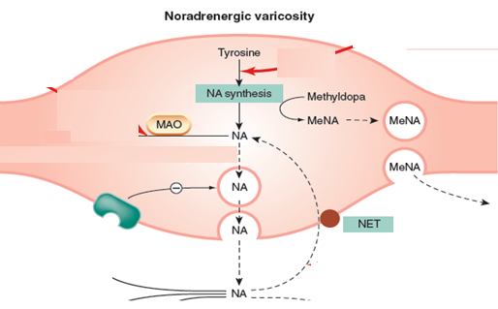
mechanisms of Adrenergic blockers
Formation of False Transmitters
α-Methyl dopa

Slide 12
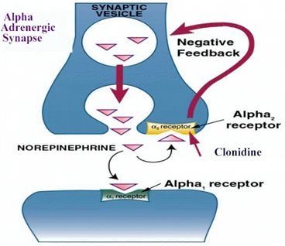
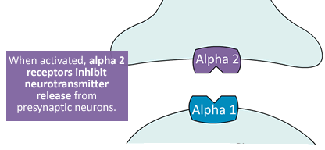
mechanisms of Adrenergic blockers
Stimulation of presynaptic α₂ receptors
Clonidine and α-Methyldopa

Slide 13
mechanisms of Adrenergic blockers
Clonidine
Acts as central α₂ receptor agonist to inhibit NE release
suppresses sympathetic outflow activity from the brain.
Little used as antihypertensive agent due to rebound hypertension upon abrupt withdrawal.
Apraclonidine
is used in open angle glaucoma as eye drops.
acts by decreasing aqueous humor formation.

Slide 14
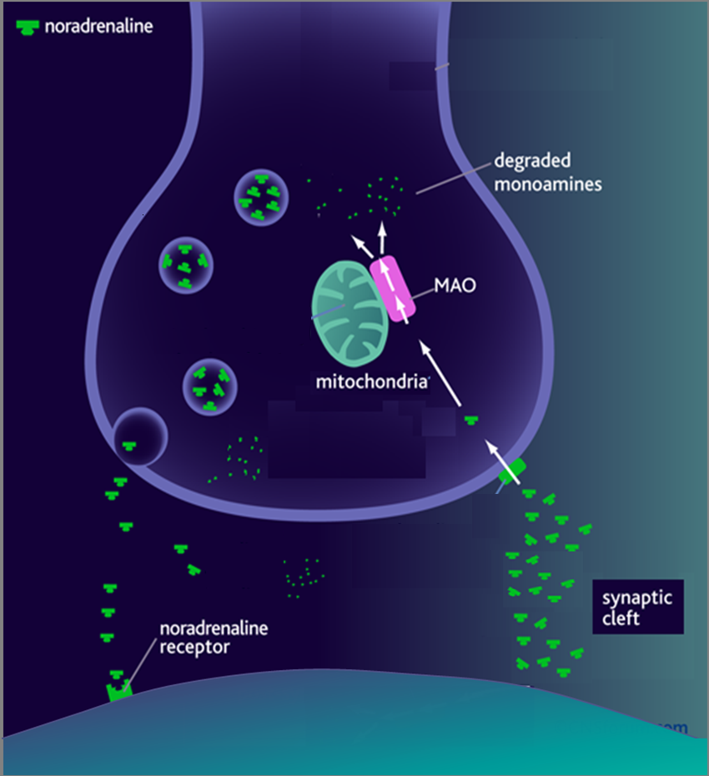
1. Adrenergic Neuron Blockers [SYMPATHOLYTICS]
1. METHYLDOPA
α-methyl tyrosine
Norepinephrine (NE)
Na
Dopa
Tyrosine
False Transmitters
Tyrosine
◉
Antihypertensive in PREGNANCY
DA
2. RESERPINE
NE
Depletes Stores
α₂
NET
4. Clonidine
Presynaptic α₂ agonist
3. Gaunthidine
○ Inhibit Release
○ Enhance Uptake
2. Adrenoceptor Blockers [ADRENOLYTICS]
α₁
β₁
β₂
COMT

Slide 15
Adrenergic receptor blockers
Include
α-receptor antagonists
β-receptor antagonists

Slide 16
Classification of α-receptor Antagonists
Non-selective antagonists e.g. phenoxybenzamine & phentolamine.
α₁-selective antagonists e.g. prazosin, doxazosin.
α_{1A}-selective antagonists e.g. Tamsulosin
α₂-selective antagonists e.g. yohimbine

Slide 17
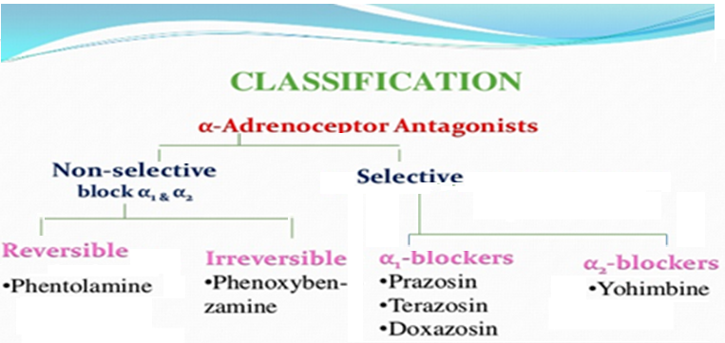
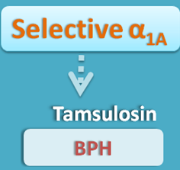
Classification of α-receptor Antagonists

Slide 18
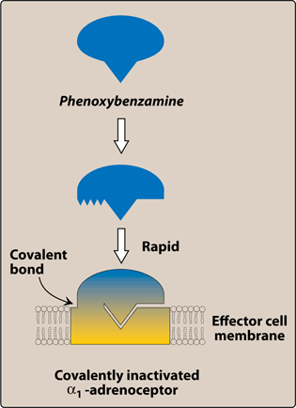
Non-Selective α- Adrenoceptor Antagonists
Phenoxybenzamine:
Irreversible blocker
α₁ and α₂ receptors
Greater affinity
Forms covalent bond with
receptor
Long-acting (24 hrs)
Phentolamine:
Reversible blocker
Competitive antagonist
α₁ & α₂ receptors.
Short acting (4 hrs).

Slide 19
Pharmacological actions
Both drugs cause:
Vasodilatation →Decrease peripheral vascular resistance
Postural hypotension.
Reflex tachycardia:
due to the fall in B.P mediated by baroreceptor reflex and due to α₂ blockade.

Slide 20
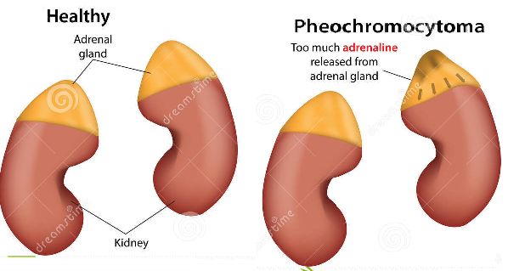
Therapeutic Uses:
Pheochromocytoma removal: should be given before
surgical removal to protect against hypertensive
crisis.

Slide 21
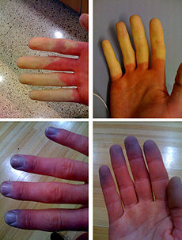
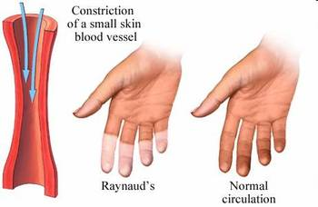
Therapeutic Uses:
Hypertension
Peripheral vascular diseases as Reynaud's disease (vasospasm): causes fingers and toes to feel numb and cold in response to cold temperature.

Slide 22
Adverse Effects of non-Selective α- Adrenoceptor
Antagonists :
Orthostatic hypotension (first dose effect)
Reflex tachycardia
Headache, vertigo & drowsiness
Nasal stuffiness or congestion
Male sexual dysfunction (inhibits ejaculation).

Slide 23
Contraindicated:
Both drugs can precipitate arrhythmias and
angina and are contra-indicated in patients with
decreased coronary perfusion.

Slide 24
Selective α1- Antagonists
Prazosin, Doxazosin, Terazosin
ends with the suffix "-osin
Prazosin (short half-life)
Doxazosin, terazosin (long half life)
All are given orally

Slide 25
Selective α1- Antagonists
Pharmacological effects of α₁–antagonists:
Relaxation of arterial and venous smooth muscles → Vasodilatation →reduce peripheral vascular resistance
Postural hypotension
Reflex tachycardia (less than non-selective α blockers)
Relaxation of smooth muscle in the prostate and bladder →increase the urine outflow through the urethra.

Slide 26
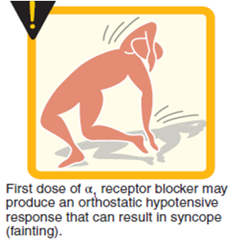
First dose effect of Selective α1- Antagonists
it can cause first-dose hypotension, syncope, dizziness, and headache due to vasodilation and vascular smooth muscle relaxation
Medications should be given at night to minimize orthostatic hypotension.
Side effects:
similar to non selective alpha blockers

Slide 27
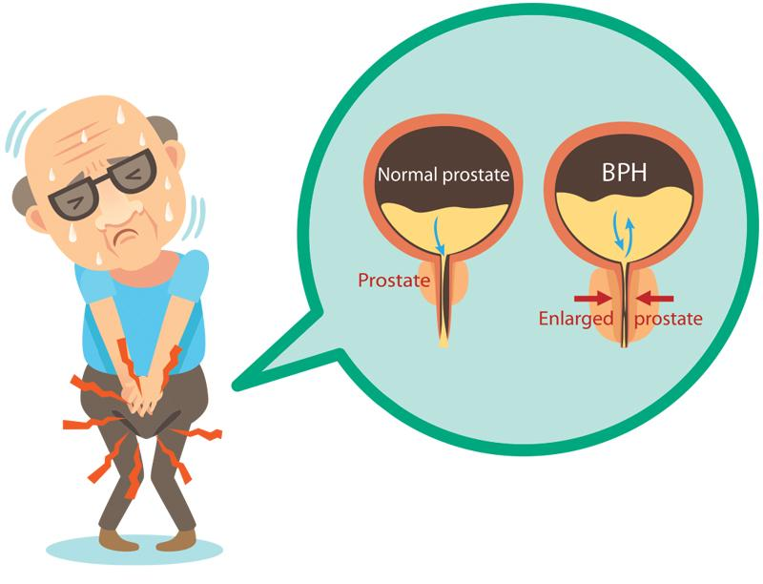
Therapeutic Uses:
Benign prostatic hypertrophy (BPH)
Treatment of hypertension
Reynaud's disease

Slide 28
Selective α_{1A}–antagonists Tamsulosin
Is a selective α_{1A} antagonist (Uroselective).
α_{1A} receptors present in bladder neck & prostate
Causes relaxation of smooth muscles of bladder neck & prostate →improve urine flow.
Has minimal effect on blood pressure.
Is used in the treatment of benign prostatic hypertrophy (BPH).

Slide 29
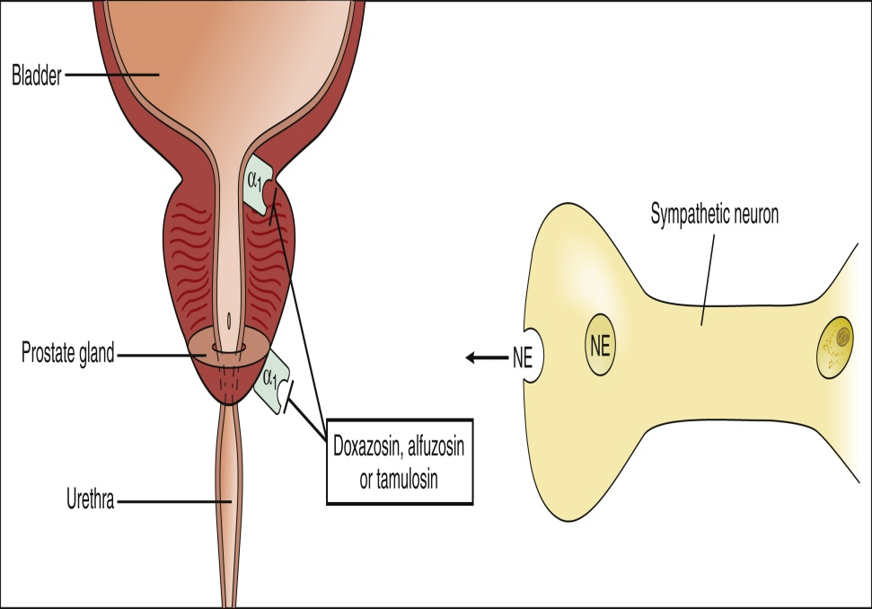
Selective α_{1A} antagonist Tamsulosin
Adverse effects of α1A- Antagonists
as before with non selective but to a lesser degree

Slide 30
α₂-selective antagonists
e.g. yohimbine
Increase nitric oxide released in the corpus cavernosum thus producing vasodilator action and contributing to the erectile process.
Used as aphrodisiac in the treatment of erectile dysfunction.

Slide 31
Adrenergic neuron blockers
False neurotransmitter formation
α-Methyldopa
Depletion of stores
Reserpine
Inhibition of release
Guanethidine
Stimulation of presynaptic α-receptors
Clonidine
Synopsis
SUMMARY

Slide 32
SUMMARY
alpha blockers
Uses
Pheochrocytoma
Hypertension
BPH
PVD
Adverse effects
Tachycardia
Postural hypotension
Nasal stuffiness
Sexual dysfunction

