Slide 1
Cardiovascular Pharmacology
Antiarrhythmic drugs
Drugs in heart failure
Antihypertensive drugs
Antianginal drugs
Antihyperlipidemic drugs
Notes:
Antiarrhythmic: irregularity in the heart rhythm
HF: if the heart loose its normal function as a pump ….
Antiangina: for angina pectoris الذبحة الصدرية

Slide 2
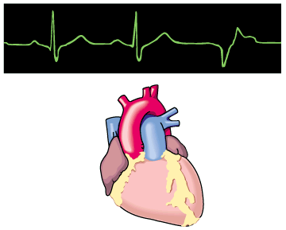
Antiarrhythmic Drugs
Dr. Aliah Alshanwani

Slide 3
Learning objectives
By the end of this lecture, students should be able to:
Understand definition of arrhythmias & their
different types
- describe different classes of Antiarrhythmic drugs & their mechanism of action
understand their pharmacological actions, clinical
uses, adverse effects & their interactions with
other drugs.

Slide 4
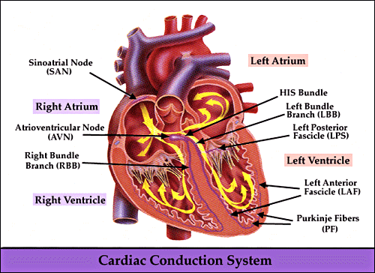
Notes:
I’m sure u have been receiving CV lectures of anatomy & physiology, so I’m not going to spend long time in introduction.
Generate/ discharge electrical potential spontaneously Unless ….
1-The electrical impulse that triggers a normal cardiac contraction originates at regular intervals in the SAN. Normal hrt rhythm is generated & driven by the spontaneous firing of pacemakers cells of the SAN located in the posterior wall of the right atrium. In normal sinus rhythm, the impulses generated by the SAN travel through the atria & converge at the AVN where the speed of conduction is reduced to give the atria sufficient time to contract & empty their contents into the ventricles prior to ventricular contraction. Impulses from the AVN travel into the ventricles via the Bundle of His, & then branch into the left & right bundle branches, the terminal Purkinje fibers, & finally are conducted to the ventricular myocytes.
2-Bec of this spread of electrical activity from the atria to the ventricles, every atrial depolarization & contraction is normally followed by ventricular depolarization & contraction. So there is normally a 1-to-1 correspondence between atrial & ventricular depolarization & contraction.
Normally, the top chambers (atria) contract & push blood into the bottom chambers (ventricles). Then the ventricles contract to pump the blood into the lungs & other parts of the body.

Slide 5
CARDIAC CONDUCTION SYSTEM
- S.A. node
- Inter-nodal pathways
- A.V. node
- Bundle of His and branches
- Purkinje fibers
Notes:
All of these 5 strs are capable of generating electrical potential

Slide 6
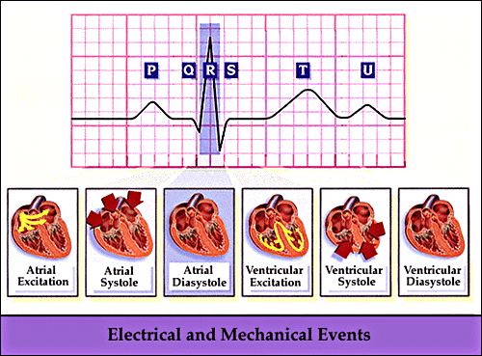
Electrocardiogram (ECG)
Notes:
The electrical events that occur in the heart are reflected by ECG
In the heart:
If it’s contract : Systole
If it’s relaxation of the hrt muscle: diastole
The ionic currents that are thought to contribute to the cardiac action potential
Normal hrt rhythm is generated & driven by the spontaneous firing of pacemakers cells of the SAN located in the posterior wall of the right atrium. These cells have an intrinsic firing rate of 100-110 depolarizations / second. HE, this intrinsic rate is under the control of autonomic nerves, w may either increase or decrease this rate. At rest, the SA rate, & TF HR when the hrt is in sinus rhythm (i.e., controlled by SA node), may be in the range of 60-80 beats/minutes (bpm), w is well below the intrinsic firing rate. This reduced resting rhythm is due to vagal tone. Efferent vagus nerve fibers innervating the SA node normally have a high level of activity under resting conditions. These nerves release Ach, w binds to muscarinic (M₂) Rs on the SA nodal cells to cause the decrease in firing rate. The SA node is also innervated by sympathetic fibers. These autonomic nerves release NE, w binds principally to β₁-adrenoceptors located on SA nodal cells. When the activity of sympathetic efferent nerves is increased, the SA node firing rate increases. Normally, there is a reciprocal relationship between the parasympathetic & sympathethic influences acting on the SA node so that a reduction in HR is brought about by increased vagal activity & decreased sympathetic activity. The opposite changes produces an increase in HR.
T is the recovery of the ventricles

Slide 7
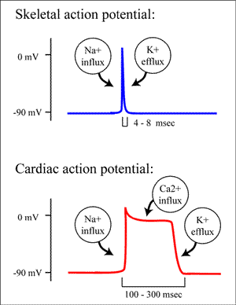
CARDIAC ACTION POTENTIAL
Notes:
Sk m AP is v. short, nerve is even shorter
Cardiac is much longer bec the hrt has a property called a refractory period, will not repolarize completely until 300 ms
Refractory period = recovery time

Slide 8
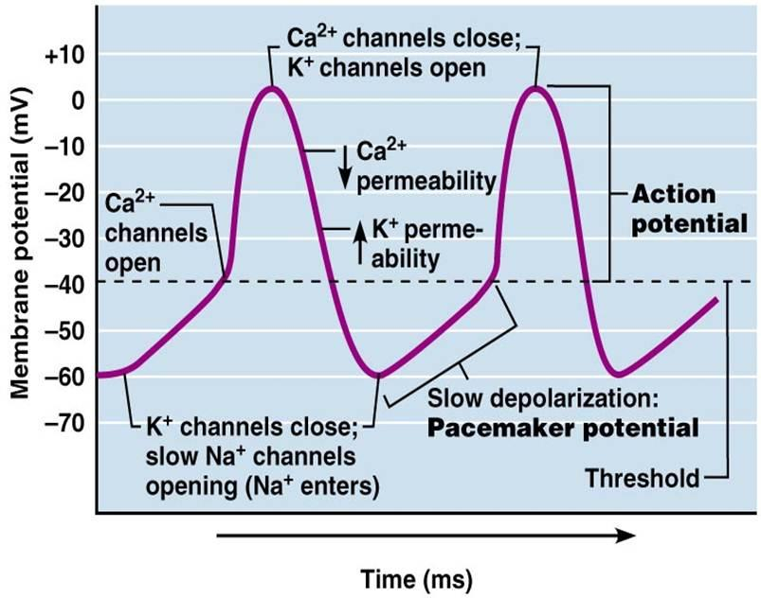
CARDIAC ACTION POTENTIAL
Pacemaker (SA node)
Notes:
Phase 4, 0, 3
4: Na in
0 Ca in
3 K in

Slide 9
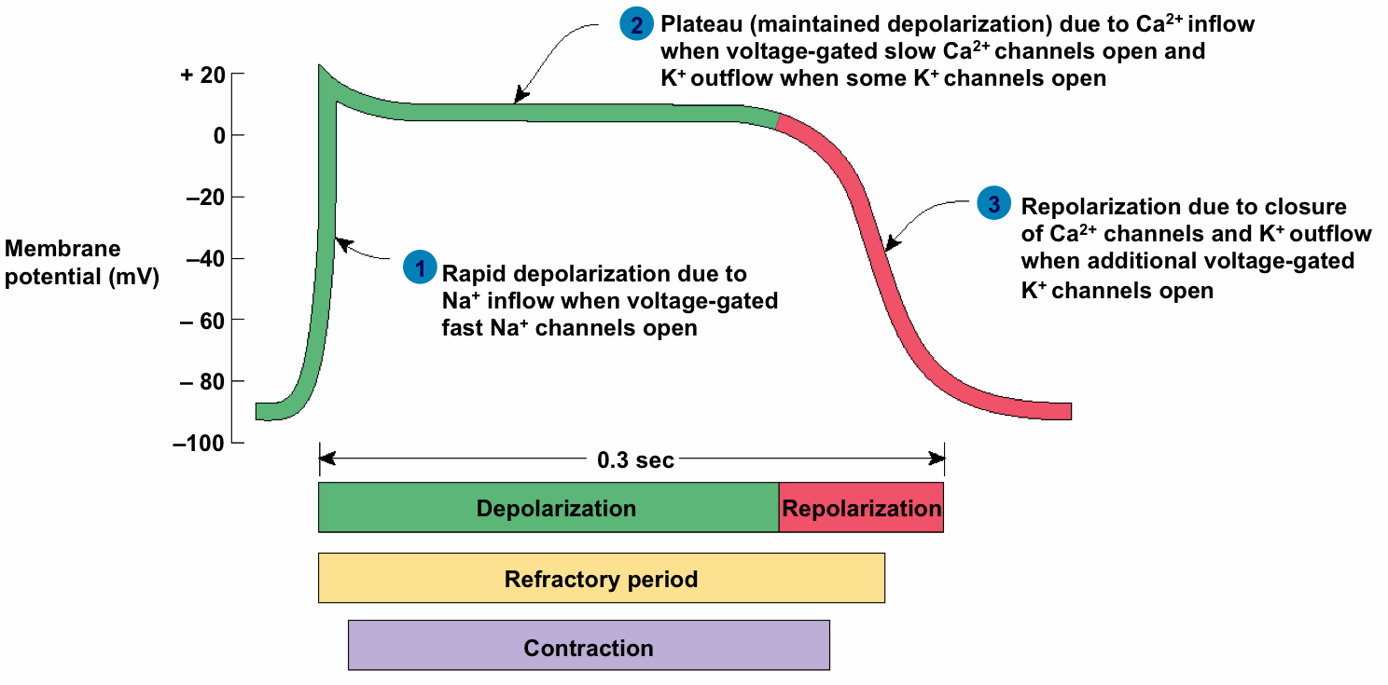
CARDIAC ACTION POTENTIAL
Non-pacemaker (ventricular muscle)

Slide 10
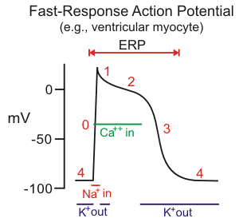
Notes:
Phase 4 resting constant K out
Na entry >> rapid dep ph 0 Also voltage gated L-type Ca open
Ph 1 Na inactivated and K out
voltage gated Ca in >>platue
Then rapid repolazation due to Ca close & K open back to the resting phase 4
ERP: Effective refractory period

Slide 11
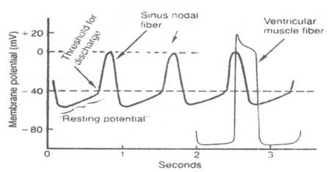
Difference between pacemaker and non-pacemaker action potential

Slide 12
WHAT IS ARRHYTHMIA?
An abnormality in the :
■ rate ............... high= tachycardia
low = bradycardia
Notes:
Many factors can precipitate or exacerbate arrhythmias: ischemia, hypoxia, acidosis or alkalosis, electrolyte abnormalities, excessive catecholamine exposure, autonomic influences, drug toxicity (eg, digitalis or antiarrhythmic drugs), overstretching of cardiac fibers, & the presence of scarred or otherwise diseased tissue. HE, all arrhythmias result from (1) disturbances in impulse formation, (2) disturbances in impulse conduction, or (3) both.
Arrhythmias can be divided into categories: altered rate, premature beats & altered conduction.
Altered Rate
Normal resting HR are between 60 & 100 bpm. A rate greater than 100 bpm is called tachycardia & a rate lower than 60 bpm is called bradycardia.
There are subcategories of altered rate such as sinus tachycardia or bradycardia (rate is determined by SA node), atrial tachycardia or bradycardia (rate governed by atrial pacemaker site), supraventricular tachycardia, & ventricular tachycardia (rhythm originating from within ventricles). Atrial tachycardias having a rate of 250-350 bpm (>200 bpm in ventricles) are call flutter, & can be either atrial or ventricular in origin. Fibrillation occurs (either atrial or ventricular) when the frequency is so high & irregular that the rate cannot be determined.

Slide 13
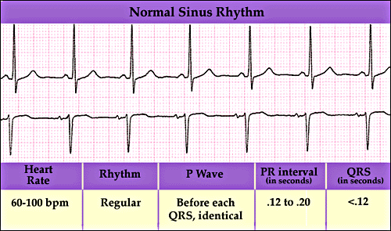

Slide 14
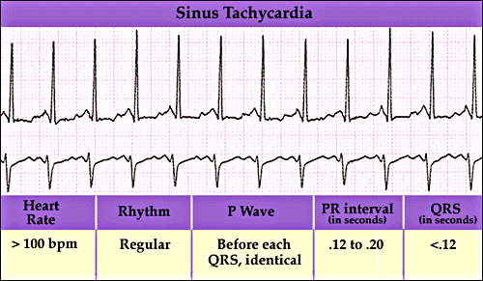
Notes:
Sinus tachycardia - high sinus rate of 100-180 beats/min as occurs during exercise or other conditions that lead to increased SA nodal firing rate.
So what cause tachycardia ?
1- abnormal automaticity = enhanced automaticity this occurs when the cell membranes become abnormally permeable to Na during phase 4 w result in increase the slope of depolarization & leading to generation of impulses faster than SAN
2- triggered activity = abnormal leakage of +ve ions to the cardiac cells >>> AP after depolarization during phase 2,3 or 4 ,,, triggering premature AP
3- Reentry. Ex Wolff-Parkinson-White syndrome in w an extra or accessory pathway exist between the upper & lower chamber of the hrt

Slide 15
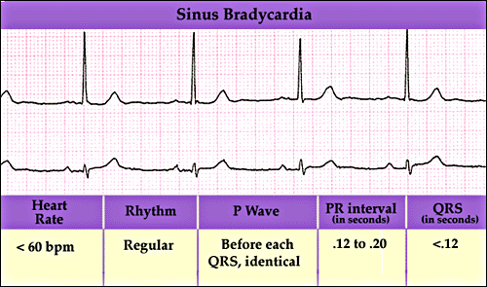
Notes:
Sinus bradycardia - low sinus rate <60 beats/min.

Slide 16
WHAT IS ARRHYTHMIA?
An abnormality in the :
■ rate ............... high= tachycardia
low = bradycardia
■ regularity ..... Extrasystoles
(PAC, PVC)
Notes:
Systole refers to the time when the left ventricle of the hrt contracts. Extrasystole is also known as extra systole, premature beat, premature contraction, premature systole, premature ventricular beat or PVB, or PVC. Irregular: extrasystole
PAC: premature atrial contraction
PVC: premature ventricular contraction
Extrasystole: A premature contraction of the hrt that is independent of the normal rhythm of the hrt & that arises in response to an impulse in some part of the hrt other than the normal impulse from the SAN. The extrasystole is followed by a pause, as the hrt electrical system "resets" itself & the contraction following the pause is usually more forceful than normal. These more forceful contractions are frequently perceived as palpitations

Slide 17
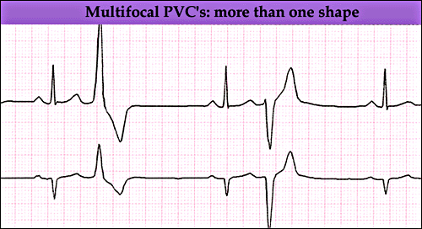
Notes:
Multifocal PVC: is a relatively common event where the heartbeat is initiated by Purkinje fibers in the ventricles rather than by the sinoatrial node, the normal heartbeat initiator.
In a PVC, the ventricles contract first and before the atria have optimally filled the ventricles with blood, which means that circulation is inefficient.
Multifocal PVCs arise when > than one site in the ventricles initiate depolarization, causing each peak on the ECG to have a different shape. If 3 or more PVCs occur in a row it may be called ventricular tachycardia.

Slide 18
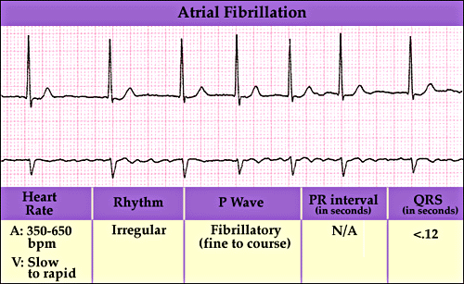
Notes:
Atrial fibrillation - uncoordinated atrial depolarizations. In atrial fibrillation, the atria beat irregularly. In atrial flutter, the atria beat regularly, but faster than usual & > often than the ventricles, so you may have 4 atrial beats to every 1 ventricular beat.
Atrial flutter is < common than atrial fibrillation
Atrial flutter is < common, but has similar symptoms (feeling faint, tiredness, palpitations, shortness of breath or dizziness).

Slide 19
WHAT IS ARRHYTHMIA?
An abnormality in the :
■ rate ............... high= tachycardia
low = bradycardia
■ regularity ..... extrasystoles
■ site of origin ... ectopic pacemakers
■ or disturbance in conduction
Notes:
Premature Beats
Sometimes a cell within the atria /ventricles that is not normally a pacemaker cell (called an ectopic foci) spontaneously fires off an AP. When this occurs, it can cause what is called a premature beat. An ectopic pacemaker or ectopic focus is an excitable group of cells that causes a premature hrt beat outside the normally functioning SAN of the hrt. It is thus a cardiac pacemaker that is ectopic, producing an ectopic beat. Acute occurrence is usually non-life-threatening, but chronic occurrence can progress into tachycardia, bradycardia / ventricular fibrillation. In a normal hrt beat rhythm, the SAN usually suppresses the ectopic pacemaker activity due to the higher impulse rate of the SAN. HE, in the instance of either a malfunctioning SAN / an ectopic focus bearing an intrinsic rate superior to SAN rate, ectopic pacemaker activity may take over the natural hrt rhythm. As a rule, premature ectopic beats (i.e. with a shorter than the prevailing preceding R-R' interval) indicate increased myocyte or conducting tissue excitability, whereas late ectopic beats (i.e. with a prolonged preceding R-R' interval) indicate proximal pacemaker or conduction failure with an escape 'ectopic' beat.
Atrial tachycardia - a series of 3 or > consecutive atrial premature beats occurring at a frequency >100/min; usually due to abnormal focus within the atria & paroxysmal in nature.
If this occurs in the atria the impulse will generally be conducted to the ventricles & produce an early depolarization & contraction of the atria & ventricles.
If the premature beat originates from a ventricular ectopic foci, this will lead to an early depolarization & contraction in the ventricles without affecting the atrial rhythm.
Altered Conduction
Delays in the conduction of electrical impulses within the hrt produce abnormal electrical activation of the hrt that are termed conduction defects. These most commonly occur at the AVN.

Slide 20
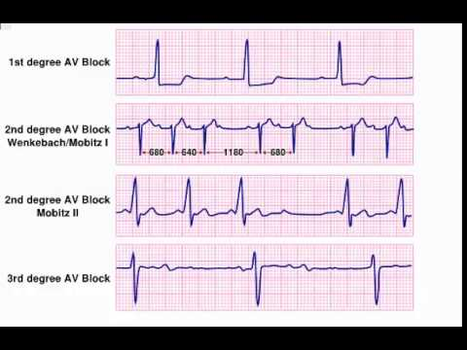
Disturbances in conduction
Notes:
<severe conduction delays at the AVN will only delay the time it takes for the impulse to reach the ventricles (called a first degree AV block).
HE, if AV nodal conduction is depressed sufficiently, only some of the impulses may be able to travel into the ventricles leading to a loss of the 1-to-1 correspondence between the atria & ventricles (called a second degree AV block).
If the AV node (or Bundle of His) become completely blocked, the atrial will depolarize normally, but ventricular depolarization will no longer be triggered by atrial impulses. When this occurs, pacemaker sites within the ventricle will drive ventricular rate, although at a much lower rate (30-40 bpm) than normal sinus rate (>60 bpm). This is called a third degree AV block.
Conduction blocks can also occur in the ventricular bundle branches. These blocks do not normally alter the ventricular rhythm, although they will alter ventricular activation & ventricular mechanical function. Special types of partial conduction blocks, sometimes in conjunction with abnormal conduction pathways (e.g., Wolff-Parkinson-White syndrome), can lead to reentry pathways that produce tachycardia.

Slide 21
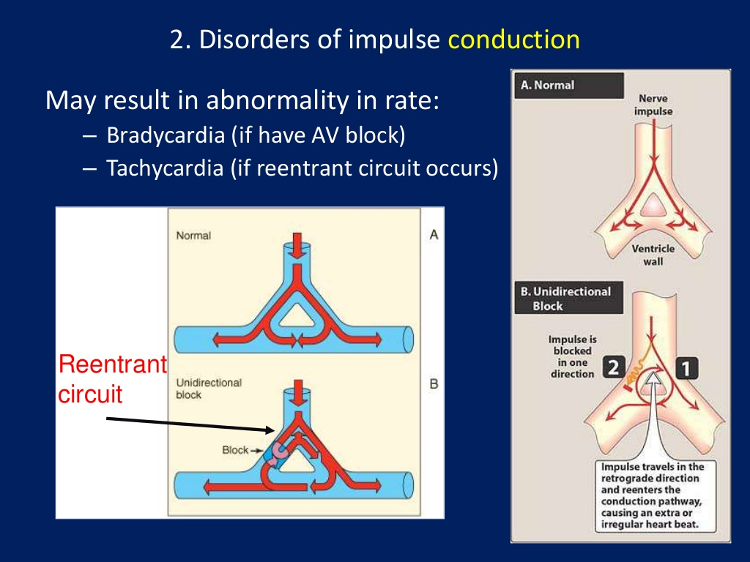

Slide 22
Therapeutic use of antiarrhythmic drugs
The ultimate goal of therapy
⬇
Restore normal rhythm & conduction
⬇ ⬇
Maintenance of Prevention of more
normal rhythm serious arrhythmias

Slide 23
How antiarrhythmic drugs produce these effects?
Slow conduction velocity
Altering the excitability of cardiac cells by prolonging the effective refractory period (ERP)
Suppressing ectopic pacemaker activity by inhibiting phase 4 slow depolarization
Notes:
If not from SAN : ectopic pacemaker
Conduction velocity: the speed with w an electrical impulse can be transmitted through excitable tissue, as in the movement of an AP through His-Purkinje fibers of the heart.
it occurs because the fast Na channels remain closed until the cell fully repolarizes.

Slide 24
CLASSIFICATION
OF
ANTIARRHYTHMIC DRUGS

Slide 25
Vaughn Williams classification
CLASS I
Na+ channel blockers
(membrane stabilizing drugs)
CLASS II:
β- adrenoceptor blockers
CLASS III:
Drugs that prolong action potential duration
CLASS IV:
Calcium channel blockers.
Notes:
Antiarrhythmic drugs:
1-decrease the automaticity of ectopic pacemakers > than that of the SAN. 2- reduce conduction & excitability & increase the RP to a greater extent in depolarized tissue than in normally polarized tissue. This is accomplished chiefly by selectively blocking the Na / Ca channels of depolarized cells. Therapeutically useful channel-blocking drugs bind readily to activated channels (ie, during phase 0) or inactivated channels (ie, during phase 2) but bind poorly / not at all to rested channels. TF, these drugs block electrical activity when there is a fast tachycardia (many channel activations & inactivations per unit time) /when there is significant loss of resting potential (many inactivated channels during rest). This type of drug action is often described as use-dependent / state-dependent; that is, channels that are being used frequently, or are in an inactivated state, are > susceptible to block. Channels in normal cells that become blocked by a drug during normal activation inactivation cycles will rapidly lose the drug from the Rs during the resting portion of the cycle.
Class I action is Na channel blockade.
Inhibit the Na channels in the open /activated state >>> 1- decrease the up rise of ph0 depolarization & 2- slows conduction velocity
2. Class II action is sympatholytic. Drugs with this action reduce β-adrenergic activity in the heart.
3. Class III action manifests as prolongation of the APD. Most drugs with this action block the rapid component of the delayed rectifier K current, IKr.
4. Class IV action is blockade of the cardiac Ca current. This action slows conduction in regions where the AP upstroke is Ca-dependent, eg, the SA & AV nodes.

Slide 26
CLASS I
Drugs that block the influx of Na ions through Na channels
⬇
1- decrease the rate of rise of
rapid depolarization (Phase O)
2- decrease phase 4 slow
depolarization
(suppress pacemaker activity)
(membrane stabilizing effect)
Notes:
Drugs with local anesthetic action
Act by blocking fast Na channels & reduce the Na current, INa. They are the oldest group of antiarrhythmic drugs & are still widely used.

Slide 27
CLASS I
Sub classified according to their effect on action potential duration :
- Ia : prolong action potential duration
- Ib : shorten action potential duration
- Ic : no effect on action potential duration
Notes:
these drugs, these are divided into 3 subtypes.
Because of variations between Subclasses of this action reflect effects on the cardiac AP duration (APD) & the kinetics of Na channel blockade.
Drugs with class 1A action prolong the APD & dissociate from the channel with intermediate kinetics;
drugs with class 1B action shorten the APD in some tissues of the heart & dissociate from the channel with rapid kinetics; &
drugs with class 1C action have minimal effects on the APD & dissociate from the channel with slow kinetics.

Slide 28
CLASS I a
Ia : prolong action potential duration
e.g.
Quinidine
Procainamide
Notes:
Quinidine in 1920
Procainamide in 1950

Slide 29
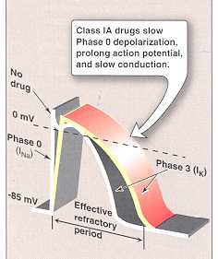
Notes:
it slows the upstroke of the AP, slows conduction, & prolongs the QRS duration of the ECG, by blockade of Na channels.
The drug also prolongs the AP duration by blockade of several K channels.
A: block fast Na ch & prolong repolarization by blocking some K ch >>> Prolong both AP & ERP
Grey color: b4 the drug
Red: after the drug

Slide 30
CLASS I a
QUINIDINE
Other pharmacological actions :
1- Anticholinergic effect:
⬇
Increase conduction through the A.V. node
(risk of ventricular tachycardia)
2- α-adrenergic blocking effect:
⬇
may cause vasodilatation & reflex sinus tachycardia
(seen more after I.V. dose)
3- ECG changes:
- prolongs P-R and Q-T interval
- widens QRS complex
Notes:
Quinidine also has modest anticholinergic w means antimuscarinic actions in the heart, has atropine-like effect
Ach usually what does it do to the heart?
1- slow the rate
2- slow the conduction
Atropine is a muscarinic R antagonist that is used to inhibit the effects of excessive vagal activation on the heart, w is manifested as sinus bradycardia & AVN block. TF, atropine can temporarily revert sinus bradycardia to normal sinus rhythm & reverse AV nodal blocks by removing vagal influences.
So risk of ventric Tachy, but fortunately after IV. So Quinidine is CI IV

Slide 31
CLASS I a
QUINIDINE
Therapeutic uses:
- atrial flutter & fibrillation
maintaining sinus rhythm after cardioversion
Notes:
Atrial fibrillation - uncoordinated atrial depolarizations. In atrial fibrillation, the atria beat irregularly. In atrial flutter, the atria beat regularly, but faster than usual & > often than the ventricles.
At present, electrical cardioversion is the most effective way to restore sinus rhythm & is largely used in hospital setting. Unfortunately, this procedure requires conscious sedation or anesthesia. On the other hand, pharmacological cardioversion does not require patients’ sedation but is < efficacious than electrical cardioversion. It also appears to be most effective when initiated within 7 days after the onset of AF. Drugs mainly used in pharmacological cardioversion such as amiodarone (Vaughan Williams’ class III) & propafenone or flecainide (class IC) are known to be very effective in the first hours from the onset of the arrhythmia, while their ability to restore sinus rhythm decreases later in time. Though simpler to be performed, pharmacological cardioversion still presents some disadvantages, including the risk of drug-induced torsade de pointes ventricular tachycardia or other serious arrhythmias.
So what do we still use Quinidine for?
cardioversion technique relies on the application of a selected amount of energy, via two electrodes (paddles) causing defibrillation.

Slide 32
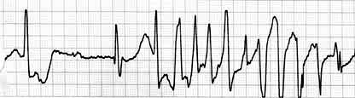
CLASS Ia
QUINIDINE
Adverse effects :
quinidine syncope: episodes of fainting
due to torsades de pointes (twisting of the spikes)
developing at therapeutic plasma levels
Notes:
Torsades de pointes is a specific form of polymorphic ventricular tachycardia in patients with a long QT interval. It is characterized by rapid, irregular QRS complexes, w appear to be twisting around the ECG baseline. This arrhythmia may cease spontaneously or degenerate into ventricular fibrillation. It causes significant hemodynamic compromise & often death. Diagnosis is by ECG. Treatment is with IV magnesium, measures to shorten the QT interval, & direct-current defibrillation when ventricular fibrillation is precipitated.

Slide 33
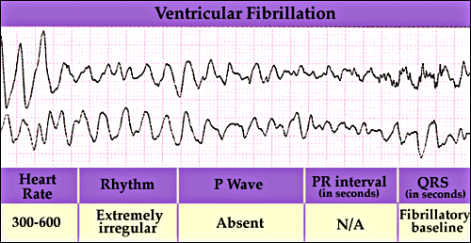
Torsades de pointes
- may terminate spontaneously or lead to
⬇
fatal ventricular fibrillation
Notes:
Torsade: Abnormal QRS
Ventricular fibrillation >>> zero contraction, no pump

Slide 34
CLASS I a
QUINIDINE
Adverse effects :
Anticholinergic adverse effects:
Dry mouth
Blurred vision
Urinary retention
constipation
Hypotension
- due to depressing contractility & vasodilatation
GIVEN ORALLY (Rarely given I.V.)

Slide 35
CLASS I a
PROCAINAMIDE
Similar to quinidine except :
1- less toxic on the heart...
can be given I.V.
2- more effective in ventricular than in
atrial arrhythmias
3 – Less anticholinergic or α-blocking actions
Notes:
Arrhythmia is a case of emergency, so we can’t wait for Quinidine to act orally, So procainamide is IV

Slide 36
CLASS I a
PROCAINAMIDE
Adverse effects:
- In long term therapy it causes reversible
lupus erythematosus-like syndrome
- Hypotension
- Torsades de pointes (at toxic dose)
- Hallucination & psychosis
Notes:
A troublesome adverse effect of long-term procainamide therapy is a syndrome resembling lupus erythematosus & usually consisting of arthralgia & arthritis. These drugs cause an autoimmune response (the body attacks its own cells. So can NOT be used for a long time bec of lupus erythematous-like syndrome
Procainamide has ganglion-blocking properties. This action reduces peripheral vascular resistance & can cause hypotension, particularly with IV use. SO should be used with caustion.
Procainamide’s cardiotoxic effects include excessive AP prolongation, QT-interval prolongation, & induction of torsades de pointes arrhythmia & syncope. Excessive slowing of conduction can also occur. New arrhythmias can be precipitated
Still be used but not that much

Slide 37
CLASS I b
Shorten action potential duration
e.g.
Lidocaine
Mexiletine
Notes:
Lidoc. Is most popular LA in dentistry
But in arrhyth we use it systemically.

Slide 38
Notes:
drugs with class 1B action shorten the APD in some tissues of the heart & dissociate from the channel with rapid kinetics; &

Slide 39
CLASS Ib
LIDOCAINE
Therapeutic uses :
treatment of emergency ventricular arrhythmias
e.g. :
1 - during surgery
2 - following acute myocardial infarction
- NOT effective in atrial arrhythmias
- NOT effective orally (3% bioavailability)
Only given I.V. bolus or slow infusion
t_{1/2} = 2 hours
Notes:
Lidocaine blocks activated & inactivated Na channels with rapid kinetics; the inactivated state block ensures greater effects on cells with long AP such as Purkinje & ventricular cells, compared with atrial cells. The rapid kinetics at normal resting potentials result in recovery from block between APs & no effect on conduction. In depolarized cells, the increased
inactivation & slower unbinding kinetics result in the selective depression of conduction. Little effect is seen on the ECG in normal sinus rhythm.
extensive first-pass hepatic metabolism, only 3% of orally administered lidocaine appears in the plasma

Slide 40
CLASS Ib
LIDOCAINE
Adverse effects:
hypotension
similar to other local anesthetics,
causes CNS adverse effects such as:
- paresthesia
- tremor
- dysarthria (slurred speech)
- tinnitus
- confusion
- convulsions
Notes:
Lidocaine is one of the least cardiotoxic of the currently used Na channel blockers. Proarrhythmic effects, including SAN arrest, worsening of impaired conduction, & ventricular arrhythmias, are uncommon with lidocaine use.
Lidocaine’s most common adverse effects—like those of other local anesthetics—are neurologic…….. These occur most commonly in elderly /otherwise vulnerable patients or when a bolus of the drug is given too rapidly. The effects are dose-related & usually short-lived
Fortunately these signs start b4 the convulsion, so these signs are warning signs

Slide 41
CLASS Ib
MEXILETINE
- EFFECTIVE ORALLY
Therapeutic uses :
1- ventricular arrhythmia
2- digitalis-induced arrhythmias
t_{1/2} = 10 hours
ADVERSE EFFECTS :
1- nausea, vomiting
2- tremor, drowsiness, diplopia
3- arrhythmias & hypotension
Notes:
So after patients’ situation is stabilized by lido,,, we can use mexiletine at home
Diplopia: double vision

Slide 42
CLASS Ic
have no effect on action potential duration
e.g.
Flecainide

Slide 43
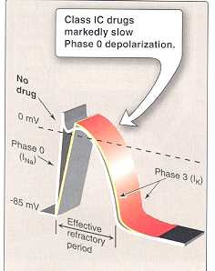
Notes:
drugs with class 1C action have minimal effects on the APD & dissociate from the channel with slow kinetics.

Slide 44
CLASS Ic
FLECAINIDE
Therapeutic uses :
supraventricular arrhythmias
- Wolff-Parkinson-White syndrome
- very effective in ventricular arrhythmias, but
very high risk of proarrhythmia
- should be reserved for resistant arrhythmias
Notes:
Supraventricular tachycardia (SVT) is an abnormally fast heart rhythm arising from improper electrical activity in the upper part of the hrt. There are 4 main types: atrial fibrillation, paroxysmal supraventricular tachycardia (PSVT), atrial flutter, & Wolff–Parkinson–White syndrome. Symptoms may include palpitations, feeling faint, sweating, shortness of breath, / chest pain. They start from either the atria / AVN. They are generally due to 1 of 2 mechanisms: re-entry / increased automaticity. The other type of fast heart rhythm is ventricular arrhythmias—rapid rhythms that start within the ventricle.

Slide 45
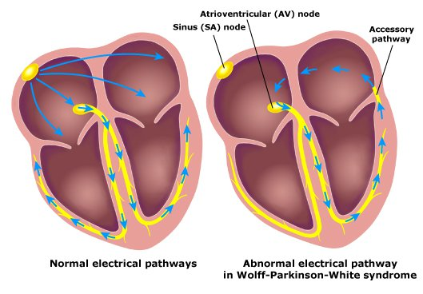
Wolff-Parkinson-White syndrome
Pre-excitation of the ventricles due to an accessory pathway known as the Bundle of Kent.
Notes:
In normal SAN signal the impulses reach the purkinji fibber & & bundle branches wait until further signal from SAN
But in WPW syndrome this accessory pathway appear in this area the signal travel from ventricles back to atria causing them to contract b4 the SAN fires again. This create abnormal electrical activation casing tachyarrhythmia.

Slide 46
CLASS Ic
FLECAINIDE
Adverse effects:
1- proarrhythmia
2- CNS :
dizziness, tremor, blurred vision,
abnormal taste sensations, paraesthesia
3- heart failure due to -ve inotropic effect.
Notes:
-ve inoropic = reduce force of heart contraction

Slide 47
CLASS II DRUGS
β- ADRENOCEPTOR BLOCKERS
pharmacological actions :
block β₁- receptors in the heart
⬇
reduce the sympathetic effect on the heart
⬇
1 - decrease automaticity of S.A. node &
ectopic pacemakers
2 - prolong RP (slow conduction) of the A.V node
Notes:
Automaticity is the cardiac cell's ability to spontaneously generate an electrical impulse (depolarize).

Slide 48
CLASS II DRUGS
β- ADRENOCEPTOR BLOCKERS
Therapeutic uses :
1- atrial arrhythmias associated with emotion:
e.g. : - after exercise
- thyrotoxicosis
2- WPW
3- digitalis-induced arrhythmias.

Slide 49
CLASS II DRUGS β- ADRENOCEPTOR BLOCKERS
Therapeutic uses :
Esmolol :
- very short acting (half-life = 9 min.)
- given I.V. for rapid control of ventricular rate in
patients with atrial flutter or fibrillation
Propranolol, Atenolol, Metoprolol :
- used in patients who had myocardial infarction to
reduce incidence of sudden death due to ventricular
arrhythmias.

Slide 50
CLASS III DRUGS
Prolong the action potential duration & RP
Prolong phase 3 repolarization
Notes:
These drugs prolong APs, usually by blocking K channels in cardiac muscle. AP prolongation by most of these drugs exhibits the undesirable property of “reverse use dependence”: AP prolongation is least marked at fast rates (where it is desirable) & most marked at slow rates, where it can contribute to the risk of torsades de pointes.

Slide 51
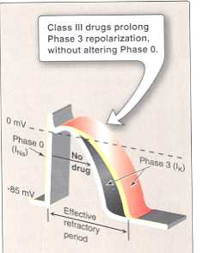

Slide 52
CLASS III DRUGS
AMIODARONE
pharmacological actions :
- prolongs action potential duration & therefore
prolongs RP (Main effect)
- additional class Ia, II & IV effects
- vasodilating effects
(due to its α & calcium channel blocking effects)

Slide 53
CLASS III DRUGS
AMIODARONE
Therapeutic uses :
1- main use : serious resistant ventricular arrhythmias
2- maintenance of sinus rhythm after cardioversion
3- resistant supraventricular arrhythmias (e.g. WPW)

Slide 54
CLASS III DRUGS
AMIODARONE
Adverse effects:
- exacerbation of ventricular arrhythmias (high dose)
- bradycardia & heart failure
- pulmonary fibrosis
- hyper- or hypothyroidism
- photodermatitis & skin deposits (avoid exposure to the sun).
Notes:
worsening

Slide 55
CLASS III DRUGS
AMIODARONE
Adverse effects:
- Neurological:
e.g. tremors & peripheral neuropathy
- nausea, vomiting & constipation
- corneal micro deposits
- hepatocellular necrosis
Notes:
Amiodarone-induced corneal deposits. ... The deposits are in the corneal epithelium basal cell layer, & occur in stages (mild, moderate, and severe), w seem to correlate with dosage (> 400 mg/day) & duration (> 6 months) of treatment.

Slide 56
CLASS III DRUGS
AMIODARONE
Pharmacokinetics:
- extremely long t_{1/2} = 13 - 103 DAYS
- metabolized by CYP3A4 and CYP2C8 to its major
active metabolite: N-desethylamiodarone
- eliminated primarily by hepatic metabolism
- cross placenta & appear in breast milk.

Slide 57
CLASS III DRUGS
AMIODARONE
Drug Interactions:
1 - Co-administration of amiodarone with drugs
that prolong the QT interval increases the risk
of Torsades de Pointes
e.g. :
macrolide antibiotics (Clarithromycin, Erythromycin)
azole antifungals (Ketoconazole)
Notes:
Long QT syndrome is a hrt rhythm disorder that can cause serious irregular hrt rhythms (arrhythmias). In long QT syndrome, your hrt muscle takes longer than normal to recharge between beats.

Slide 58
CLASS III DRUGS
AMIODARONE
Drug Interactions:
2- Drugs (or substances) that inhibit CYP3A4 & CYP2C8 enzymes cause increase in serum concentration of amiodarone
e.g. : Loratadine, Ritonavir, Trazodone
Cimetidine, Grapefruit juice
3- Drugs that induce these enzymes
Cause decrease in serum concentration of amiodarone
e.g. : Rifampin
Notes:
Trazodone: antidepressant medication

Slide 59
PURE CLASS III
Ibutilide
Given by rapid I.V. infusion
Used for the acute conversion of atrial flutter or fibrillation to normal sinus rhythm
Causes QT interval prolongation
(may cause torsades de pointes).
Notes:
Ibutilide: slows cardiac repolarization by blockade of the rapid component (IKr) of the delayed rectifier K current.
The primary electrophysiological action of class III agents is selective prolongation of repolarization without conduction slowing. This effect is usually mediated by block of one or more K currents w results in prolongation of the AP duration & refractoriness in both atrial & ventricular myocardium. The magnitude of increases in ERP decreases as the HR is increased, i.e. these drugs display ‘reverse use-dependence’.

Slide 60
Class 1V
Calcium channel blockers
Verapamil, Diltiazem
main site of action is A.V.N & S.A.N
cause:
- slowing of conduction
- prolongation of ERP

Slide 61
Class 1V
Calcium channel blockers
Therapeutic uses :
1- atrial arrhythmias
2- re-entry supraventricular arrhythmias
e.g. WPW
3- NOT effective in ventricular arrhythmias.

Slide 62
ADENOSINE
Mechanism of action :
inhibits c.AMP by binding to adenosine A1 receptors
causing the following actions:
1 - opening of potassium channels
(hyperpolarization)
2 - decreasing conduction velocity mainly at AV node
(negative dromotropic effect)
3- inhibiting phase 4 pacemaker action potential at SA node
(negative chronotropic effect)
Notes:
Hyperpolarization by efflux of K ions, is the opposite of a depolarization.
The two main types of K⁺ channels in cardiac cells are inward rectifiers & voltage-gated K⁺ channels.
A dromotropic agent is one w affects the conduction speed in the AVN, & subsequently the rate of electrical impulses in the hrt.
This influx of K, hE, is larger when the membrane potential is > negative than the equilibrium potential for K⁺ (~-90mV). As the membrane potential becomes > positive (i.e. during cell stimulation from a neighbouring cell), the flow of K into the cell via the K_{ir} decreases. TF, K_{ir} is responsible for maintaining the resting membrane potential & initiating the depolarization phase. HE, as the membrane potential continues to become > positive, the channel begins to allow the passage of K⁺ out of the cell. This outward flow of K ions at the > positive membrane potentials means that the K_{ir} can also aid the final stages of repolarisation.
Adenosine is a nucleoside that occurs naturally throughout the body. Its half-life in the blood is less than 10 seconds.
Its cardiac MOA involves 1- activation of an inward rectifier K+ current & 2- inhibition of Ca current.
The results of these actions are marked hyperpolarization & suppression of Ca-dependent AP. When given as a bolus dose, adenosine directly inhibits AV nodal conduction & increases the AV nodal refractory period but has lesser effects on the SA node. Adenosine is currently the drug of choice for prompt conversion of PSVT to sinus rhythm bec of its high efficacy (90– 95%) & very short duration of action. It is usually given in a bolus dose of 6 mg followed, if necessary, by a dose of 12 mg. An uncommon variant of ventricular tachycardia is adenosine-sensitive. The drug is less effective in the presence of adenosine receptor blockers such as theophylline or caffeine, & its effects are potentiated by adenosine uptake inhibitors such as dipyridamole.

Slide 63
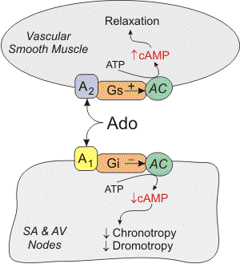

Slide 64
ADENOSINE
Therapeutic uses :
■ drug of choice for acute management of
paroxysmal supraventricular tachycardia
■ preferred over verapamil
(safer & does not depress contractility)
half-life = less than 10 sec

Slide 65
ADENOSINE
Adverse effects:
■ flushing in about 20% of patients
■ shortness of breath & chest burning in 10%
of patients (due to bronchospasm)
■ brief AV block (contraindicated in heart block)

Slide 66
New Antiarrhythmic Drugs
Dronedarone
a noniodinated congener of amiodarone
has antiarrhythmic properties belonging to all four classes
Used for maintenance of sinus rhythm following cardioversion in patients with atrial flutter or fibrillation.
Notes:
Like amiodarone, dronedarone has multichannel actions, including blocking IKr, IKs, ICa, & INa. It also has β-adrenergic-blocking action. The drug has a half-life of 24 hours & can be administered twice daily at a fixed dose of 400 mg. Dronedarone absorption increases twofold to threefold when taken with food, & this information should be communicated to patients as a part of the dosing instructions.
Dronedarone elimination is primarily nonrenal. It inhibits tubular secretion of creatinine, resulting in a 10–20% increase in serum creatinine; hE, because the GFR is unchanged, no adjustments are required. Dronedarone is both a substrate & an inhibitor of CY3A4 & should not be co-administered with potent inhibitors of this enzyme, such as the azole & similar
antifungal agents, & protease inhibitors.

Slide 67
New Antiarrhythmic Drugs
Dronedarone
WARNINGS
should not be used in patients with severe (class IV) heart failure. Risk of death may be increased in these patients
should not be used in patients with permanent atrial fibrillation. Risk of death & stroke, may be increased in these patients.

Slide 68
BRADYARRHYTHMIAS
ATROPINE
■ used in sinus bradycardia after myocardial
infarction & in heart block
■ in emergency heart block isoprenaline may
be combined with atropine (caution)
Notes:
Isoprenaline IV slowly, analog of epinephrine; beta-sympathomimetic that acts on the heart
-Accelerate SA pacemaker
-enhance AV conduction
-increase CO.

Slide 69
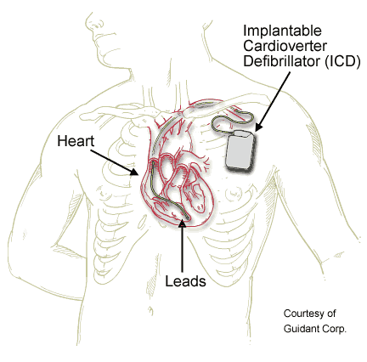
NONPHARMACOLOGIC THERAPY
OF ARRHYTHMIAS
Implantable Cardiac Defibrillator (ICD)
- can automatically detect & treat fatal
arrhythmias such as ventricular fibrillation
Notes:
Another form of nonpharmacologic therapy is the implantable cardioverter-defibrillator (ICD), a device that can automatically detect & treat potentially fatal arrhythmias such as ventricular fibrillation. ICDs are now widely used in patients who have been resuscitated from such arrhythmias, & several trials have shown that ICD tr reduces mortality in patients with coronary artery disease who have an ejection fraction ≤ 30% & in patients with class II or III HF & no prior history of arrhythmias. The increasing use of nonpharmacologic antiarrhythmic therapies reflects both advances in the relevant technologies & an increasing appreciation of the dangers of long-term therapy with currently available drugs.

Slide 70

Thank you

