Slide 1


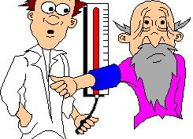
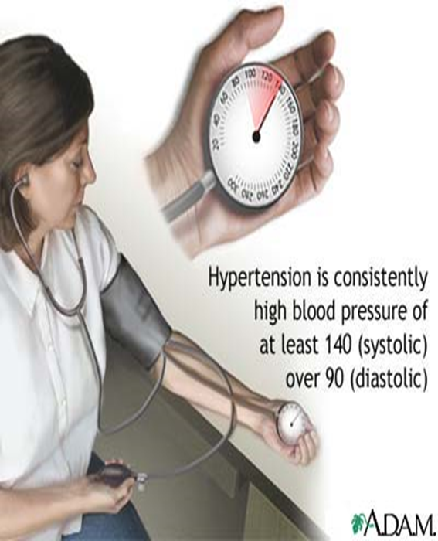
Antihypertensive drugs
Cardiovascular-Pharmacology

Slide 2

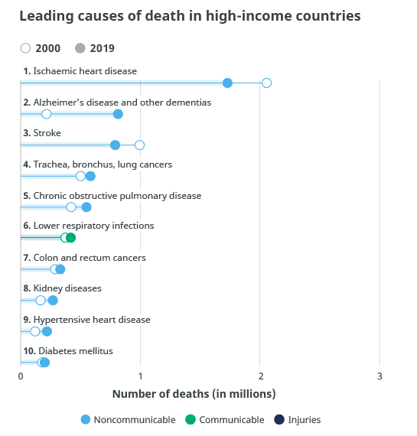

Antihypertensive drugs
Hypertension
Prevalence 25-30%
In majority of cases, its symptomless ‘Silent Killer’

Slide 3
The rule of halves of Hypertension
For every 800 adults in the community
400 are hypertensive (either ↑ SBP or ↑ DBP or both)
Of them only 200 are diagnosed HT
Of them only 100 are started on treatment
Of them only 50 are on correct drug
Of them in only 25 the goal B.P. is attained
Means 25 ÷ 400 = 6% only have goal BP.

Slide 4

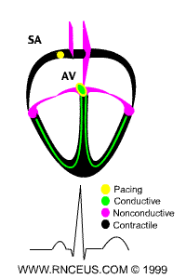
Anti-hypertensive drugs
ILOS
Outline
Outline the pharmacologic classes of drugs used in treatment of hypertension.
Describe
Describe the mechanism of action , therapeutic uses & common ADRs of each class of drugs.
Select
Select an antihypertensive drug to treat a specific patient according to efficacy, safety and suitability.

Slide 5
Antihypertensive drugs
Classification:
Diuretics.
Drugs acting on the renin-angiotensin- aldosterone system (RAAS).
Calcium channel blockers.
Vasodilators.
Sympatholytic Drugs.

Slide 6

Antihypertensive drugs
1) Diuretics
i-Thiazide Diuretics
ii-Loop Diuretics
iii-Potassium-Sparing Diuretics

Slide 7
Antihypertensive drugs
1) Diuretics
i-Thiazide Diuretics
Examples: Hydrochlorothiazide, Chlorthalidone.
Mechanism of Action: The initial diuresis lasts 4-6 weeks and then replaced by a decrease in PVR.

Slide 8
1) Diuretics
Thiazide Diuretics
Initial Effect
↓ Sodium, Water
Retention
↓ Blood volume
Long Term Effect
↓ Na⁺ in vessels wall
↑ Na⁺-Ca²⁺ exchange
↓ Cardiac Output
↓ Ca²⁺ in smooth muscle
↓ Peripheral Resistance
Decrease in BP

Slide 9
Antihypertensive drugs
1) Diuretics
ii- Loop Diuretics
Example: furosemide.
iii- Potassium-Sparing Diuretics
Useful in hypertensive patients with either renal impairment, or heart failure.
have minimal effect on lowering BP
Loop diuretics produce more potent diuresis but a smaller decrease in PVR.

Slide 10
Antihypertensive drugs
1) Diuretics
Diuretics may be adequate in mild to moderate hypertension.
According to ALLHAT trial, chlorthalidone is superior to an ACE inhibitor, a calcium channel blocker and an alpha1-adrenergic antagonist in preventing one or more CVD events.

Slide 11
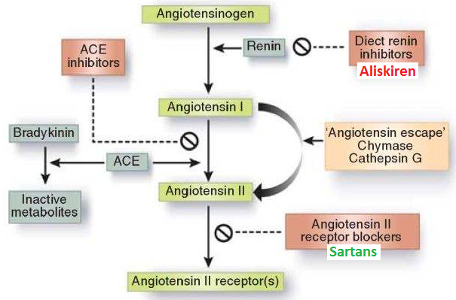
Antihypertensive drugs
2) Drugs acting on the renin- angiotensin - aldosterone system

Slide 12
Antihypertensive drugs
2) Drugs acting on the renin- angiotensin - aldosterone system
i-Direct renin inhibitors
ii-Angiotensin-converting enzyme inhibitors (ACEI)
iii- Angiotensin receptors blockers.

Slide 13
Antihypertensive drugs
2) Drugs acting on the renin- angiotensin - aldosterone system
i- Direct renin inhibitors
Example: aliskiren (Tekturna) “only renin inhibitor on the market”
Inhibits (renin) the first and rate limiting step of the RAAS
Approved as monotherapy or in combination therapy for hypertension. However, because it represents a new drug class and has not been shown to prevent CV events, it is not preferred as first-line therapy.

Slide 14
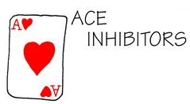
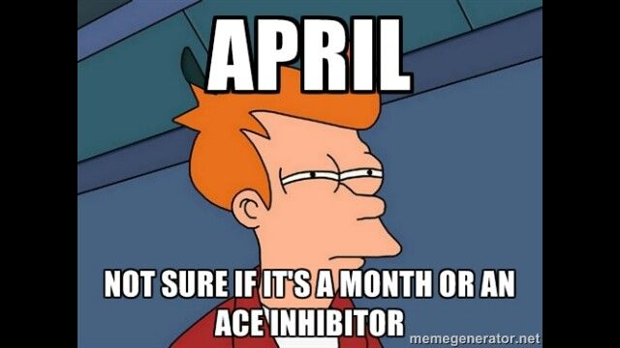
Antihypertensive drugs
2) Drugs acting on the renin- angiotensin - aldosterone system
ii- Angiotensin-converting enzyme inhibitors (ACEI)
Examples: Captopril, Lisinopril, Enalapril, Ramipril.
Particularly effective when hypertension results from excess renin production (renovascular hypertension).

Slide 15
Antihypertensive drugs
2) Drugs acting on the renin- angiotensin - aldosterone system
ii- Angiotensin-converting enzyme inhibitors (ACEI)
Pharmacokinetics:
Polar, excreted in urine.
Do not cross BBB.
Have a long half-life & given once daily.
Rapidly absorbed from GIT after oral administration.
Food reduces their bioavailability.
It takes 2-4 weeks to see the full antihypertensive effect of ACEIs.
Enalaprilat is the active metabolite of enalapril given by i.v. route in hypertensive emergency.
Enalapril & ramipril are prodrugs.

Slide 16
Antihypertensive drugs
2) Drugs acting on the renin- angiotensin - aldosterone system
ii- Angiotensin-converting enzyme inhibitors (ACEI)
Clinical Uses:
Treatment of essential hypertension
Hypertension in patients with chronic renal disease, ischemic heart disease, diabetes
Treatment of heart failure.

Slide 17
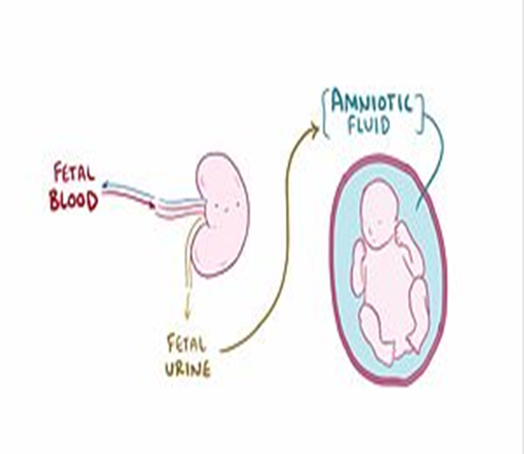
Antihypertensive drugs
2) Drugs acting on the renin- angiotensin - aldosterone system
ii- Angiotensin-converting enzyme inhibitors (ACEI)
Adverse Drug Reactions:
Dry cough
Cause renal agenesis/failure in the fetus, resulting in oligohydraminosis.
Acute renal failure, especially in patients with renal artery stenosis.
Severe hypotension in hypovolemic patients.

Slide 18
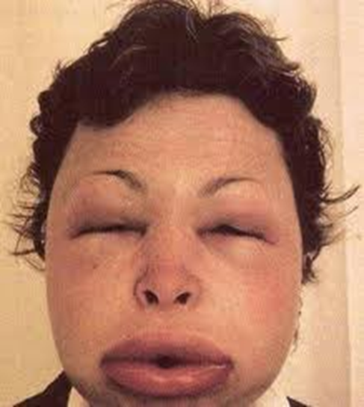
Antihypertensive drugs
2) Drugs acting on the renin- angiotensin - aldosterone system
ii- Angiotensin-converting enzyme inhibitors (ACEI)
Adverse Drug Reactions:
Angioneurotic edema, swelling in the nose, throat, tongue, larynx.
First dose effect.
Skin rash, fever
Dysgeusia
Proteinuria and neutropenia.
ADRs Specific to Captopril

Slide 19
Antihypertensive drugs
2) Drugs acting on the renin- angiotensin - aldosterone system
ii- Angiotensin-converting enzyme inhibitors (ACEI)
Contraindications:
During the second and third trimesters of pregnancy due to the risk of: fetal hypotension, anuria, renal failure & malformations.
NSAIDs.
Renal artery stenosis.
Potassium-sparing diuretics.

Slide 20
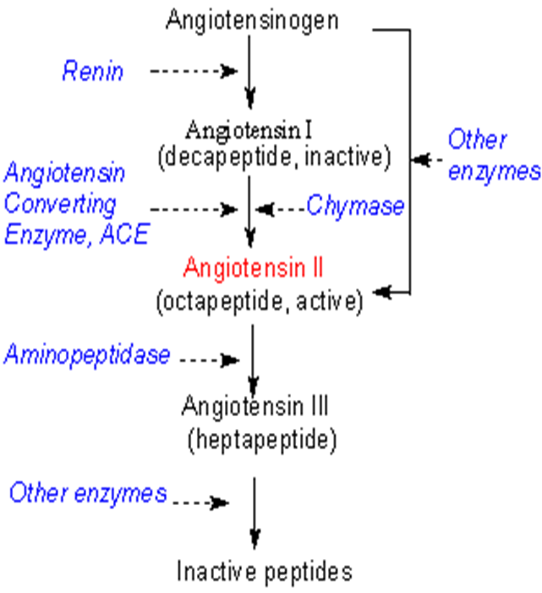
Antihypertensive drugs
2) Drugs acting on the renin- angiotensin - aldosterone system
iii- Angiotensin-receptors blockers (ARBs)
Examples: Losartan, Valsartan.
No effect on bradykinin, no cough, no angioedema
Cause selective block of AT1 receptors.
Produce more complete inhibition of angiotensin.

Slide 21
Antihypertensive drugs
2) Drugs acting on the renin- angiotensin - aldosterone system
iii- Angiotensin-receptors blockers (ARBs)
Pharmacokinetics:
Has a potent active metabolite, Orally effective.
Long half-life, taken once daily, Does not cross BBB.
Same contraindications as ACEI.
No active metabolites
Valsartan
Same ADRs, except for dry cough & angioneurotic edema.
Losartan

Slide 22
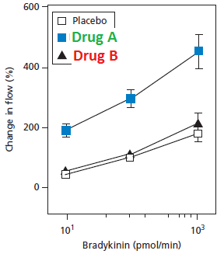
The brachial artery was continuously infused with bradykinin and the blood flow is monitored. Placebo, drug A and drug B (both affect the RAAS) induced the effects on blood flow shown in the graph.
What is drug A? Justify!
What is drug B? Justify!

Slide 23

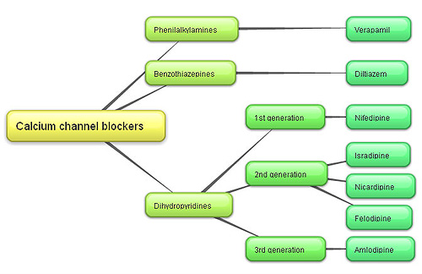
Antihypertensive drugs
3) Calcium channel blockers
Verapamil act more on the myocardium.
Nifedipine Dihydropyridine group act mainly on smooth muscle
Diltiazem has intermediate effect
Very
Nice
Drugs

Slide 24
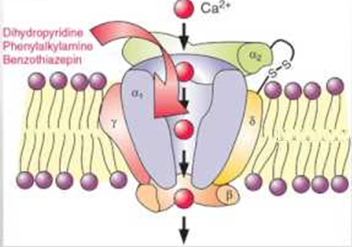
Antihypertensive drugs
3) Calcium channel blockers
Mechanism of Action:
Block the influx of calcium through calcium channels resulting in:
1- Peripheral vasodilatation
2- Decrease cardiac contractility

Slide 25
Antihypertensive drugs
3) Calcium channel blockers
Pharmacokinetics:
Given orally or IV
Well absorbed
Onset 1-3 min after IV, 0.5-2hr after oral
Verapamil & diltiazem have active metabolites, nifedipine has not
Verapamil and nifedipine are highly bound to plasma proteins (more than 90%) while diltiazem is less Bound ( 70-80%).
Sustained-release preparations can permit once-daily dosing.

Slide 26
Antihypertensive drugs
3) Calcium channel blockers
Clinical Uses:
Treatment of chronic hypertension
Nicardipine can be given by I.V. route in hypertensive emergency.
Sustained- release formulations are preferred for the treatment of hypertension due to the short half- life of CCBs.

Slide 27
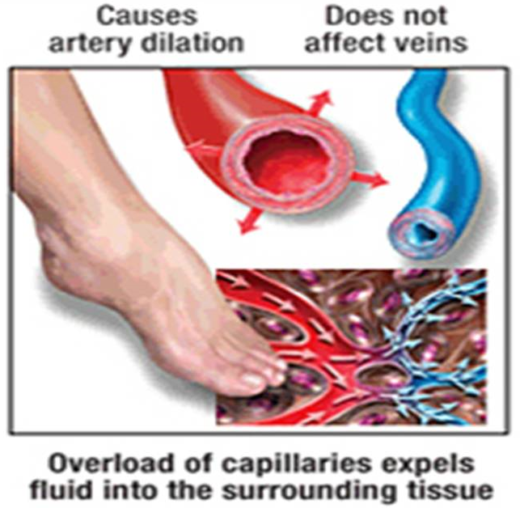
Antihypertensive drugs
3) Calcium channel blockers
ADRs:
Headache, Flushing, Hypotension
Nifedipine: Tachycardia
Verapamil & Diltiazem: Peripheral edema (ankle edema)
Verapamil: Constipation.

Slide 28
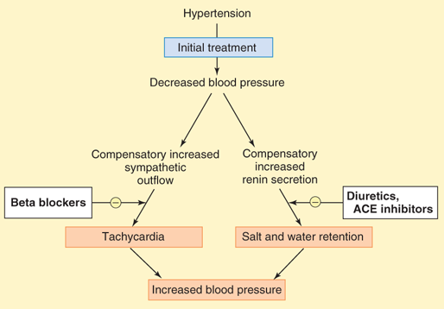
Antihypertensive drugs
4) Vasodilators
Vasodilators:
Classified into arterial, venous or mixed vasodilators
Once vasodilators are administered, fall in BP produced, will activate the sympathetic system & the RAAS.

Slide 29
Antihypertensive drugs
4) Vasodilators
Sodium nitropruside | Diazoxide | Minoxidil | Hydralazine
Arterio & venodilator | Arteriodilator | Arteriodilator | Arteriodilator | Site of action
Release of nitric oxide ( NO) | Opening of potassium channels | Opening of potassium channels in smooth muscle membranes by minoxidil sulfate ( active metabolite ) | Release of nitric oxide ( NO) | Mechanism of action
Intravenous infusion | Rapid intravenous | Oral | Oral | Route of admin.

Slide 30
Antihypertensive drugs
4) Vasodilators
Sodium nitropruside |  | Diazoxide | Minoxidil |  | Hydralazine | Continue Vasodilators
1.Hpertensive emergency |  | 1.Hypertensive emergency | 1.Moderate –severe hypertension |  | 1.Moderate -severe hypertension. | Therapeutic uses
In combination with diuretic & β-blockers
2.Severe heart failure | 2.Treatment of hypoglycemia due to insulinoma |  | 2. baldness | 2.Hypertensive pregnant woman

Slide 31
Antihypertensive drugs
4) Vasodilators
Sodium nitropruside | Diazoxide | Minoxidil |  | Hydralazine |  | Continue Vasodilators
Severe hypotension | Hypotension, reflex tachycardia, palpitation, angina, salt and water retention ( edema) |  |  |  |  | Adverse effects
1.Methemoglobin during infusion 2. Cyanide toxicity 3. Thiocyanate toxicity | Inhibit insulin release from β cells of the pancreas causing hyperglycemia Contraindicated in diabetics |  | Hypertrichosis. Contraindicated in females |  | lupus erythematosus like syndrome | Specific adverse effects

Slide 32
Antihypertensive drugs
5) Sympatholytic Drugs
i- ß-Adrenoceptor blockers
ii- α-Adrenoceptor blockers
iii- Centrally-acting

Slide 33
Antihypertensive drugs
5) Sympatholytic Drugs
i- ß-Adrenoceptor blockers:
Examples: Propranolol, atenolol, metoprolol
They should not be the primary agent for primary prevention but are effective as add-on therapy.
May take two weeks for optimal therapeutic response
Evidence support the use of ß-blockers in patients with concomitant coronary artery disease
When discontinued, ß- blockers should be withdrawn gradually.

Slide 34
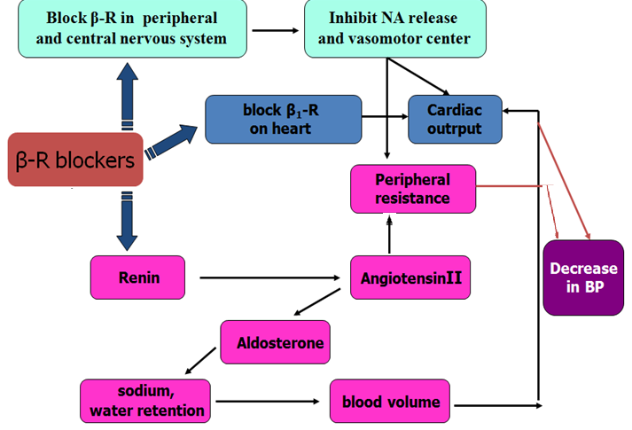
Antihypertensive drugs
5) Sympatholytic Drugs
i- ß Adrenoceptor blockers:
Mechanism of action/ They lower blood pressure by:
Decreasing cardiac output.
Inhibiting the release of renin.
Central mechanism.

Slide 35
Antihypertensive drugs
5) Sympatholytic Drugs
i- ß Adrenoceptor blockers ADRs:
Adverse Drugs Reactions:
Hypoglycaemia
Fatigue
Mask the symptoms of hypoglycaemia in diabetics
Increased triglycerides
Aggravate peripheral arterial disease
Erectile dysfunction.

Slide 36
Antihypertensive drugs
5) Sympatholytic Drugs
ii- α- Adrenoceptor blockers:
Block α- receptors in arterioles and venules.
Reduce blood pressure by decreasing both afterload & preload.
Prazosin, short- acting causes first dose hypotension & postural hypotension.
Doxazosin is preferred, long half- life.

Slide 37
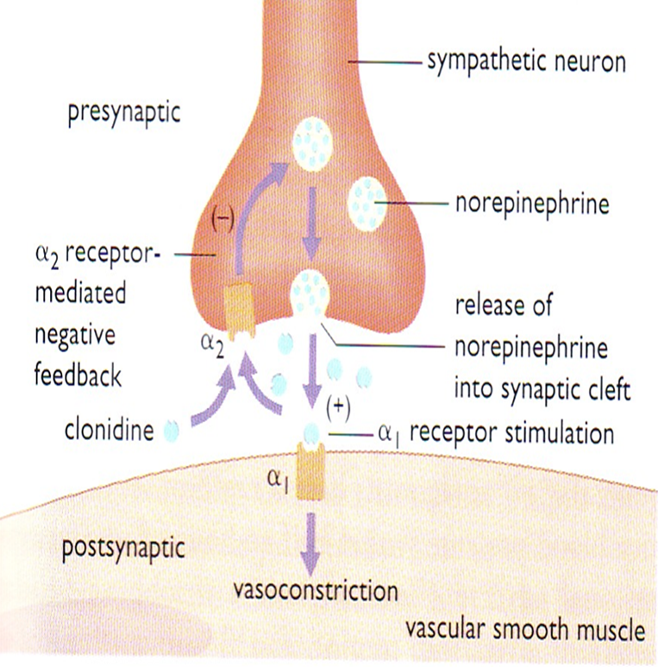
Antihypertensive drugs
5) Sympatholytic Drugs
iii- Centrally- acting:

Slide 38
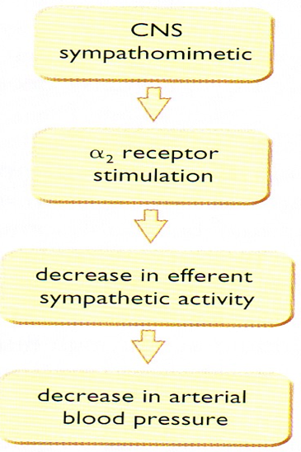
Antihypertensive drugs
5) Sympatholytic Drugs
iii- Centrally- acting:
A- Clonidine
α2-agonist, diminishes central adrenergic outflow & ↑ parasympathetic outflow
Abrupt withdrawal may lead to rebound hypertension
Does not decrease renal blood flow or glomerular filtration
Useful in the treatment of hypertension complicated by renal disease and resistant hypertension

Slide 39
Antihypertensive drugs
5) Sympatholytic Drugs
iii- Centrally-acting:
B- α- methyldopa
An α- 2 agonist, is converted to methyl noradrenaline centrally to diminish the adrenergic outflow from the C.N.S
Lead to reduced total peripheral resistance, and a decreased in blood pressure
α -Methyldopa is the first line treatment of hypertension in pregnancy

Slide 40

Clinical Case

Slide 41
Clinical case
Osman a 51-year-old man (95 Kg weight, 176 cm tall) is referred for further evaluation of his BP. He is a computer engineer and has a past history of type 2 diabetes for 5 years and high BP for 12 years. His somatic complaints include fatigue and dry mouth. He has no known history of hypertension target-organ damage, and his medications are listed in the accompanying table. He has no remarkable family history other than hypertension in both parents. His examination was otherwise unremarkable (including normal heart sounds and no peripheral edema), aside from mild arteriolar narrowing in the fundus. His seated BP was 156/90 mmHg and 158/90 mmHg in the right arm (similar to the left arm), with a regular heart rate of 70 beats/min. His BP did not change on standing. His urinalysis showed an unremarkable dipstick evaluation. The patient was suspected as having drug-resistant hypertension.

Slide 42
Clinical case
Name | Dose | Frequency
Hydrochlorothiazide | 25mg | Daily
Valsartan | 160mg | Daily
Diltiazem, long-acting | 300mg | Daily
Clonidine | 0.2mg | Twice daily
Metoprolol, long acting | 100mg | Daily
Simvastatin | 40mg | Daily
Fenofibrate | 145mg | Daily
Metformin | 1g | Twice daily
Diuretic
ARB
CCBs
α2-agonist
β-blocker

Slide 43
Clinical case
Osman a 51-year-old man (95 Kg weight, 176 cm tall) is referred for further evaluation of his BP. He is a computer engineer and has a past history of type 2 diabetes for 5 years and high BP for 12 years. His somatic complaints include fatigue and dry mouth. He has no known history of hypertension target-organ damage, and his medications are listed in the accompanying table. He has no remarkable family history other than hypertension in both parents. His examination was otherwise unremarkable (including normal heart sounds and no peripheral edema), aside from mild arteriolar narrowing in the fundus. His seated BP was 156/90 mmHg and 158/90 mmHg in the right arm (similar to the left arm), with a regular heart rate of 70 beats/min. His BP did not change on standing. His urinalysis showed an unremarkable dipstick evaluation. The patient was suspected as having drug-resistant hypertension.

Slide 44
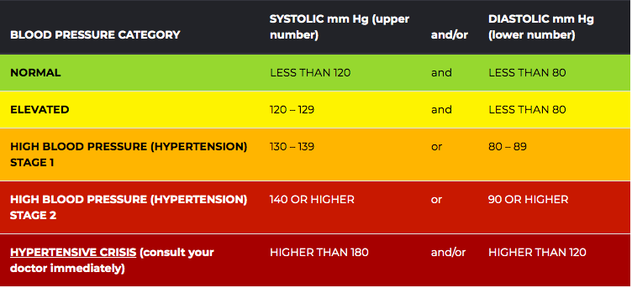
Clinical case
What stage of hypertension is Osman? (156/90 mmHg)

Slide 45


Clinical case
The seated BP of Osman was 156/90, what are the target BP values for treatment of hypertensive patients?
Osman is diabetic, what are the target BP values for Osman?

Slide 46
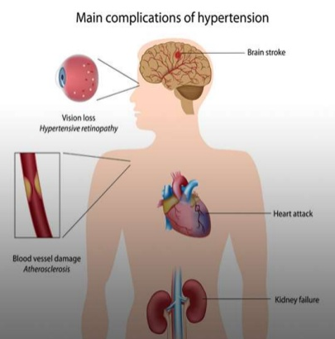
Clinical case
Osman has no history of hypertension-target organ damage. Which organs are affected adversely by persistent high BP?

Slide 47
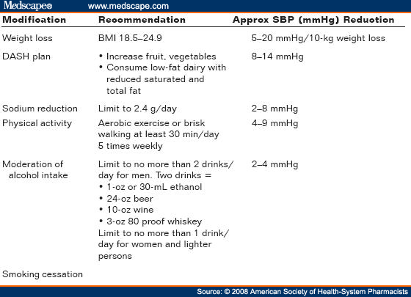
Clinical case
Osman is 95kg big. Is this weight proper for his length (176cm)?
BMI= 30.7
If Osman has to reduce his weight, what other lifestyle modifications should he do?

Slide 48
Clinical case
The BP of Osman did not change on standing. What is your conclusion?
The BP of Osman was almost the same in both arms. What does that imply?

Slide 49
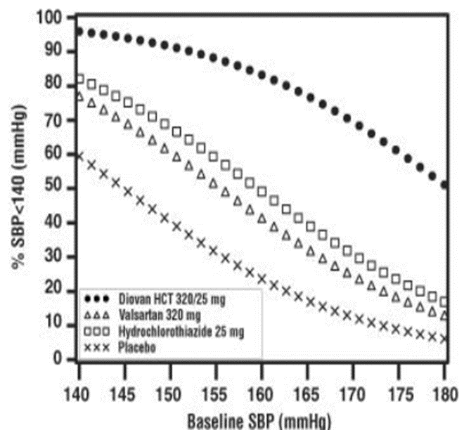
Clinical case
Osman was prescribed hydrochlorthiazide & valsartan. What is the rationale for combining hydrochlorothiazide and valsartan?
Osman was prescribed hydrochlorothiazide & diltiazem. What is the benefit of combining hydrochlorothiazide and diltiazem?

Slide 50
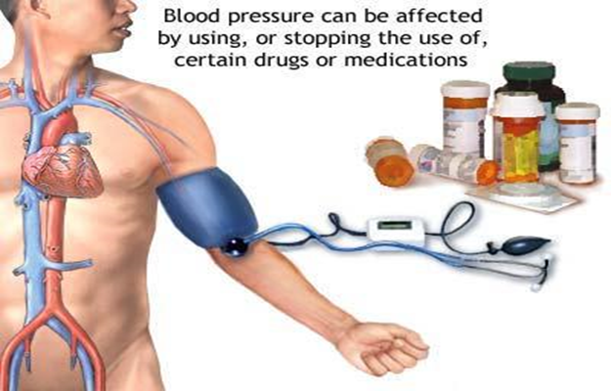
Clinical case
Is the concomitant prescribing of clonidine, diltiazem and metoprolol to Osman wise?

Slide 51
Clinical case
List as many reasons as you can, why Osman failed to respond to antihypertensive therapy?

Slide 52
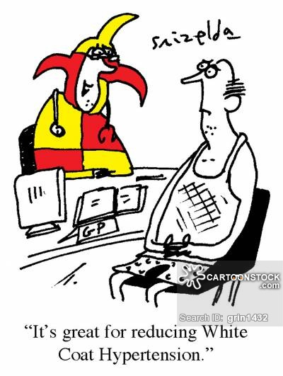
Clinical case
Could the “White coat phenomenon” be the cause for Osman’s high blood pressure readings?
In a Turkish study involving 438 patients, 43% were found to be white coat hypertensives

Slide 53
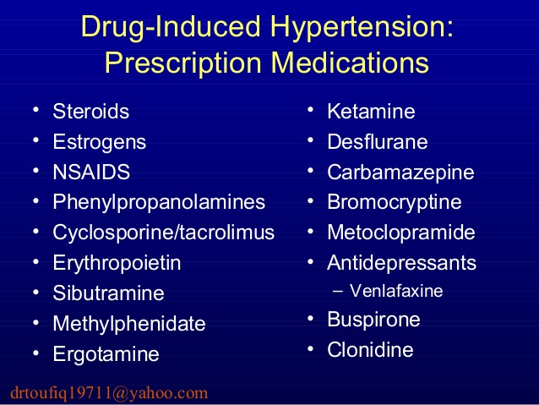
Clinical case
Could the failure of control of Osman’s BP be due to secondary drug–induced effects?
Which drugs elevate blood pressure?

Slide 54
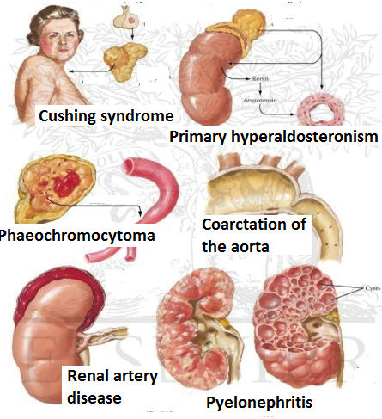
Clinical case
Could Osman be misdiagnosed? And the high BP is due to secondary disease causes?
Which secondary diseases cause elevation of BP?

Slide 55
Clinical case
Could the failure of Osman control of BP be due to the use of inappropriate combinations of drugs?
Use of combinations→↓ individual dose→↓ ADRs
Select a drug that ↓ the ADR of another, e.g. thiazides versus ACEI
Select a drugs that act by different mechanisms

Slide 56
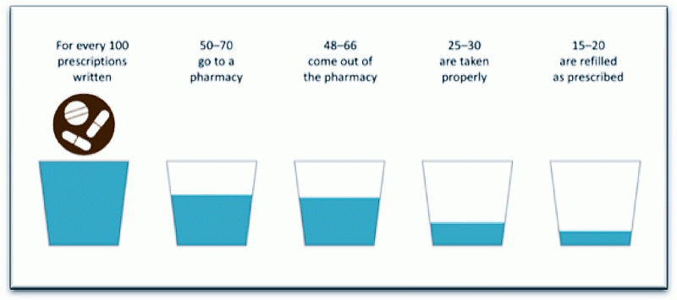
Clinical case
Could the failure of control of Osman’s BP be attributed to non adherence?
Could the somatic complaints
(fatigue and dry mouth)
indicate the adherence of
the patient to medication
regimen and which drugs
cause these symptoms?

Slide 57
Clinical case
What suggestions do you have for Osman’s treatment modification in order to attain BP goals?

Slide 58
Thanks..
e-mail: aaloneazi@ksu.edu.sa

