Slide 1
THROMBOLYTIC DRUGS (Fibrinolytic drugs) By Prof. Hanan Hagar

Slide 2
Learning objectives
To know mechanism of action of thrombolytic therapy.
To differentiate between different types of thrombolytic drugs.
To describe indications, side effects and contraindications of thrombolytic drugs.
To recognize the mechanisms, uses and side effects of antiplasmins.

Slide 3
Definition of Thrombolytics
Thrombolytic agents are drugs used to lyse already formed blood clots in clinical settings where ischemia may be fatal.

Slide 4
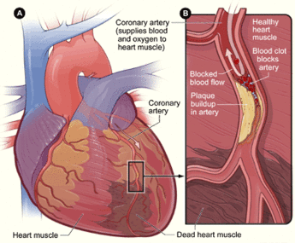
Myocardial infarction
An acute myocardial infarction, also called a heart attack, happens when a blood vessel in the heart suddenly becomes blocked
When a blood vessel in the heart gets blocked, blood cannot get to part of the heart. This part of the heart does not get enough oxygen. This is called ischemia.
When the heart muscle becomes ischemic (does not get enough blood and oxygen), the ischemia often causes chest pain. This is called Angina Pectoris
If the ischemia lasts long enough, the heart muscle that is not getting enough oxygen dies. This is called an infarction.
https://upload.wikimedia.org/wikipedia/commons/transcoded/5/5c/Heart_attack_animation.ogv/Heart_attack_animation.ogv.360p.webm
Treatment: (thrombolytics) and percutaneous coronary intervention (coronary angioplasty).

Slide 5
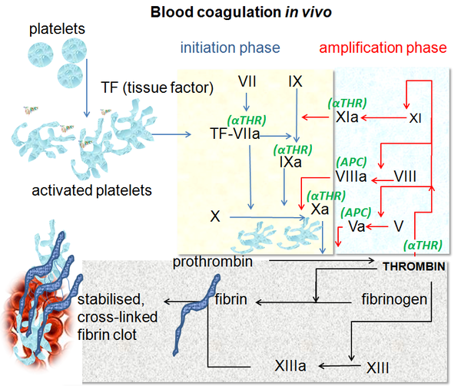
Thrombus Formation
Fibrin is a white insoluble fibrous protein formed by the action of thrombin on fibrinogen when blood clots. it forms a network that traps red cells and platelets.

Slide 6
Mechanism of action of thrombolytic drugs
They have common mechanism of action by
stimulating activation of plasminogen via
converting plasminogen (pro-enzyme) to
plasmin (active enzyme) → lysis of the
insoluble fibrin clot into soluble derivatives.

Slide 7
What is plasmin?
Plasmin: is a nonspecific protease capable of
breaking down:
Fibrin
Other circulating proteins including fibrinogen, clotting factor V & factor VIII.

Slide 8
Thrombolytic drugs
Plasminogen activators
Plasminogen
Thrombolytics
(Plasminogen activators)
Plasmin
Soluble degradation
products
Insoluble fibrin

Slide 9
Indications of thrombolytics
used for the treatment of thromboembolic disorders as:
Acute myocardial infarction (ST elevation, STEMI).
Acute ischemic stroke.
Peripheral artery occlusion.
Deep venous thrombosis.
Pulmonary embolism.

Slide 10
Types of thrombolytic drugs
Non-fibrin specific
Streptokinase
Anistreplase
Urokinase
Fibrin specific
Tissue plasminogen
Activators (t-PA)
Alteplase
Reteplase
Tenecteplase

Slide 11
Fibrin specific plasminogen activators
Fibrin specific plasminogen activators activate mainly plasminogen bound to clot surface and have less effect on circulating plasminogen.
PAI= plasminogen activator inhibitor

Slide 12
Non-fibrin specific plasminogen activators
Activate both plasminogen bound to clot surface and circulating plasminogen in blood leading to extensive systemic plasminogen activation, with degradation of several plasma proteins including fibrinogen, factor V, and factor VIII.

Slide 13
Fibrin-specific thrombolytic drugs | Non fibrin-specific thrombolytic drugs
activate mainly plasminogen bound to clot surface (fibrin specific) | Activate plasminogen bound to clot surface and circulating plasminogen in blood
Degrade mainly fibrin clots | Degrade fibrin clots as well as fibrinogen and other plasma proteins.
More selective in action (clot or fibrin specific) | Less selective in action
Less systemic plasminogen activation | Extensive systemic plasminogen activation
Less risk of bleeding | More risk of bleeding
Alteplase Reteplase Tenecteplase | Streptokinase Anistreplase Urokinase

Slide 14
Non fibrin-specific thrombolytic drugs
e.g. Streptokinase – Anistreplase – Urokinase
activates plasminogen both in blood and at the clot surface thus produces clot lysis and systemic fibrinolysis leading to bleeding.
Notes:
extensive systemic plasminogen activation, with degradation of several plasma proteins including fibrinogen, factor V,
and factor VIII.

Slide 15
Fibrin-specific thrombolytic drugs
are tissue plaminogen activators
e.g. Alteplase – Reteplase -Tenecteplase
selective in action (clot or fibrin specific)
binds preferentially to plasminogen at the fibrin surface (non-circulating) rather than circulating plasminogen in blood.
Risk of bleeding is less than non specific agents.
Activity is enhanced upon binding to fibrin.

Slide 16
Non fibrin-specific thrombolytic drugs
Streptokinase
Anistreplase
Urokinase

Slide 17
Streptokinase (SK)
Is a bacterial protein produced by B-hemolytic streptococci.
It acts indirectly by forming plasminogen-streptokinase complex "activator complex" which converts inactive plasminogen into active plasmin.
Streptokinase is non-fibrin specific
can degrade fibrin clots as well as fibrinogen and other plasma proteins.

Slide 18
Mechanism of action
of streptokinase
Plasminogen
+ Streptokinase
Activator complex
Streptokinase + Plasminogen
Plasmin
Soluble degradation
products
Fibrin

Slide 19
Streptokinase
T 1/2 = less than 20 minutes.
given as intravenous infusion (250,000 U then 100,000 U/h for 24-72 h).
It is the least expensive among others.
used for venous or arterial thrombosis.

Slide 20
Side effects of streptokinase
Antigenicity: high-titer antibodies develop 1 to 2 weeks after use, precluding retreatment until the titer declines.
Allergic reaction: like rashes, fever, hypotension
Bleeding due to activation of circulating plasminogen (systemic fibrinolysis).
Not fibrin specific.

Slide 21
Precautions
Not used in patients with:
Recent streptococcal infections or
Previous administration of the drug
These patients may develop fever, allergic reactions and resistance upon treatment with streptokinase due to antistreptococcal antibodies.

Slide 22
Anistreplase (APSAC)
Anisoylated Plasminogen Streptokinase Activator Complex (APSAC) acylated plasminogen combined with streptokinase.
It is a prodrug, de-acylated in circulation into the active plasminogen-streptokinase complex.
T_{1/2} is 70-120 min

Slide 23
Advantages
Given as a bolus I.V. injection (30 U over 3 - 5 min.).
Longer duration of action than streptokinase.
More thrombolytic activity.
Greater clot selectivity.

Slide 24
Disadvantages
Similar but less than streptokinase alone in:
Antigenicity.
Allergic reactions.
Minimal fibrin specificity
Systemic lysis.
But more expensive than streptokinase

Slide 25
Urokinase
Human enzyme synthesized by the kidney
obtained from either urine or cultures of
human embryonic kidney cells.
is a direct plasminogen activator.
Given by intravenous infusion (300,000 U over 10 min then 300,000 U/h for 12h).

Slide 26
Urokinase
Has an elimination half-life of 12-20 minutes.
Used for the lyses of acute massive pulmonary emboli
Advantages No anaphylaxis (not antigenic).
Disadvantages
Minimal fibrin specificity
Systemic lysis (acts upon fibrin-bound and circulating plasminogen).
Expensive (its use is now limited).

Slide 27
Tissue Plasminogen Activators (t-PAs)
All are recombinant human tissue plasminogen activators (t–PA).
Prepared by recombinant DNA technology.
Include drugs that end with suffix “plase”
Alteplase
Reteplase
Tenecteplase

Slide 28
Mechanism of t-PAs
They activate fibrin-bound plasminogen rather than free plasminogen in blood.
Their action is enhanced by the presence of fibrin.
They bind to fibrin in a thrombus and convert the entrapped plasminogen to plasmin followed by activated local fibrinolysis with limited systemic fibrinolysis.

Slide 29
Advantages of t-PAs
Fibrin-specific drugs (clot specific).
Limited systemic fibrinolysis.
Reduced risk of bleeding
Not-antigenic (can be used in patients with recent streptococcal infections or antistreptococcal antibodies).

Slide 30
Alteplase
is a recombinant form of human tPA.
has very short half life (~5 min)
is usually administered as an intravenous bolus followed by an infusion.
(60 mg i.v. bolus + 40 mg infusion over 2 h).
Uses
In ST-elevation myocardial infarction (STEMI)
Pulmonary embolism.

Slide 31
Reteplase
A variant of recombinant tPA
It has longer duration than alteplase (15 min.)
Has enhanced fibrin specificity
Given as two I.V. bolus injections of 10 U each
Uses
In ST-elevation myocardial infarction (STEMI)
Pulmonary embolism.

Slide 32
Tenecteplase
Is another modified human t-PA.
prepared by recombinant technology
It has half life of more than 30 min.
It can be administered as a single IV bolus.
It is more fibrin-specific & longer duration than alteplase.
It is only approved for use in acute myocardial infarction.

Slide 33
What is the role of thrombolytic therapy in antithrombotic plan ?
The goal of thrombolytic therapy is rapid restoration of blood flow in an occluded blood vessel by accelerating proteolysis of the already formed thrombus.

Slide 34
Rational for use of thrombolytic drugs in AMI
Improvement of ventricular function
Reduction of the incidence of congestive heart failure
Reduction of mortality following AMI.
Thrombolytic drugs need to be given immediately to the patient after diagnosis of MI, delay in administration will be of no value.

Slide 35
What is the role of thrombolytic therapy in antithrombotic plan ?
Thrombolytic therapy is one part of an overall antithrombotic plan that frequently includes anticoagulants, antiplatelet agents and mechanical approaches to rapidly restore blood flow and prevent re-occlusion.

Slide 36
Contraindications to thrombolytics
Absolute contraindications include:
Active internal bleeding
Cerebral hemorrhagic stroke
Recent intracranial trauma or neoplasm
Major surgery within two weeks
Relative contraindications include:
Active peptic ulcer
Severe uncontrolled hypertension
Notes:
Active internal bleeding; history of cerebrovascular accident; recent intracranial or intraspinal surgery or trauma; intracranial neoplasm, arteriovenous malformations, or aneurysm; known bleeding diathesis; severe uncontrolled hypertension

Slide 37
Contraindications to thrombolytics
Absolute | Relative
Previous intracranial hemorrhage or stroke of unknown origin at any time | Transient ischaemic attack in the preceding 6 months
Ischaemic stroke in the preceding 6 months | Oral anticoagulant therapy
CNS damage or neoplasms or AV malformation | Pregnancy or within one week postpartum
Recent major trauma/surgery/head injury (within the preceding 3 weeks) | Refractory hypertension (systolic pressure >180 mmHg and/or diastolic pressure >110 mmHg)
GI bleeding within the past month | Advanced liver disease
Known bleeding disorder (excluding menses) | Infective endocarditis
Aortic dissection | Active peptic ulcer
Non-compressible punctures in the past 24 hrs (e.g., liver biopsy, lumbar puncture) | Prolonged or traumatic resuscitation

Slide 38
Fibrinolytic Inhibitors
Fibrinolytic inhibitors (Antiplasmins) inhibit plasminogen activation and thus inhibit fibrinolysis and promote clot stabilization.

Slide 39
Fibrinolytic Inhibitors Antiplasmins
Aminocaproic Acid & tranexamic cid
acts by competitive inhibition of plasminogen activation
Given orally
Aprotinin
It inhibits fibrinolysis by blocking the action of plasmin (plasmin antagonist)
Gien orally or i.v.

Slide 40
Thrombolytic drugs
Plasminogen activators
Plasminogen
Aminocaproic acid
tranexamic acid
Plasmin
Aprotinin
Soluble degradation
products
Insoluble fibrin

Slide 41
Uses of Fibrinolytic Inhibitors
Adjuvant therapy in hemophilia
Fibrinolytic therapy-induced bleeding (antidote).
Post-surgical bleeding
These drugs work like antidotes for fibrinolytic drugs. Similar to Protamine (Antidote of the anticoagulant, heparin) or Vitamin K (Antidote of the oral anticoagulant warfarin).

