Slide 1
Drugs for hyperlipidemia-I & II
By
Anfal Bin Dayel, Ph.D
Assistant Professor
Department of Pharmacology and Toxicology
College of Pharmacy, KSU
Slides adopted from Dr. Osama Yousuf

Slide 2
Objectives
Define hyperlipidemia vs normal lipid levels
Discuss the non-pharmacological treatment of hyperlipidemia.
Classify lipid lowering agents targeting exogenous and endogenous pathways.
Expand on the pharmacology of drugs related to each group.
Hint on adjuvant drugs that can help in lipid lowering.

Slide 3
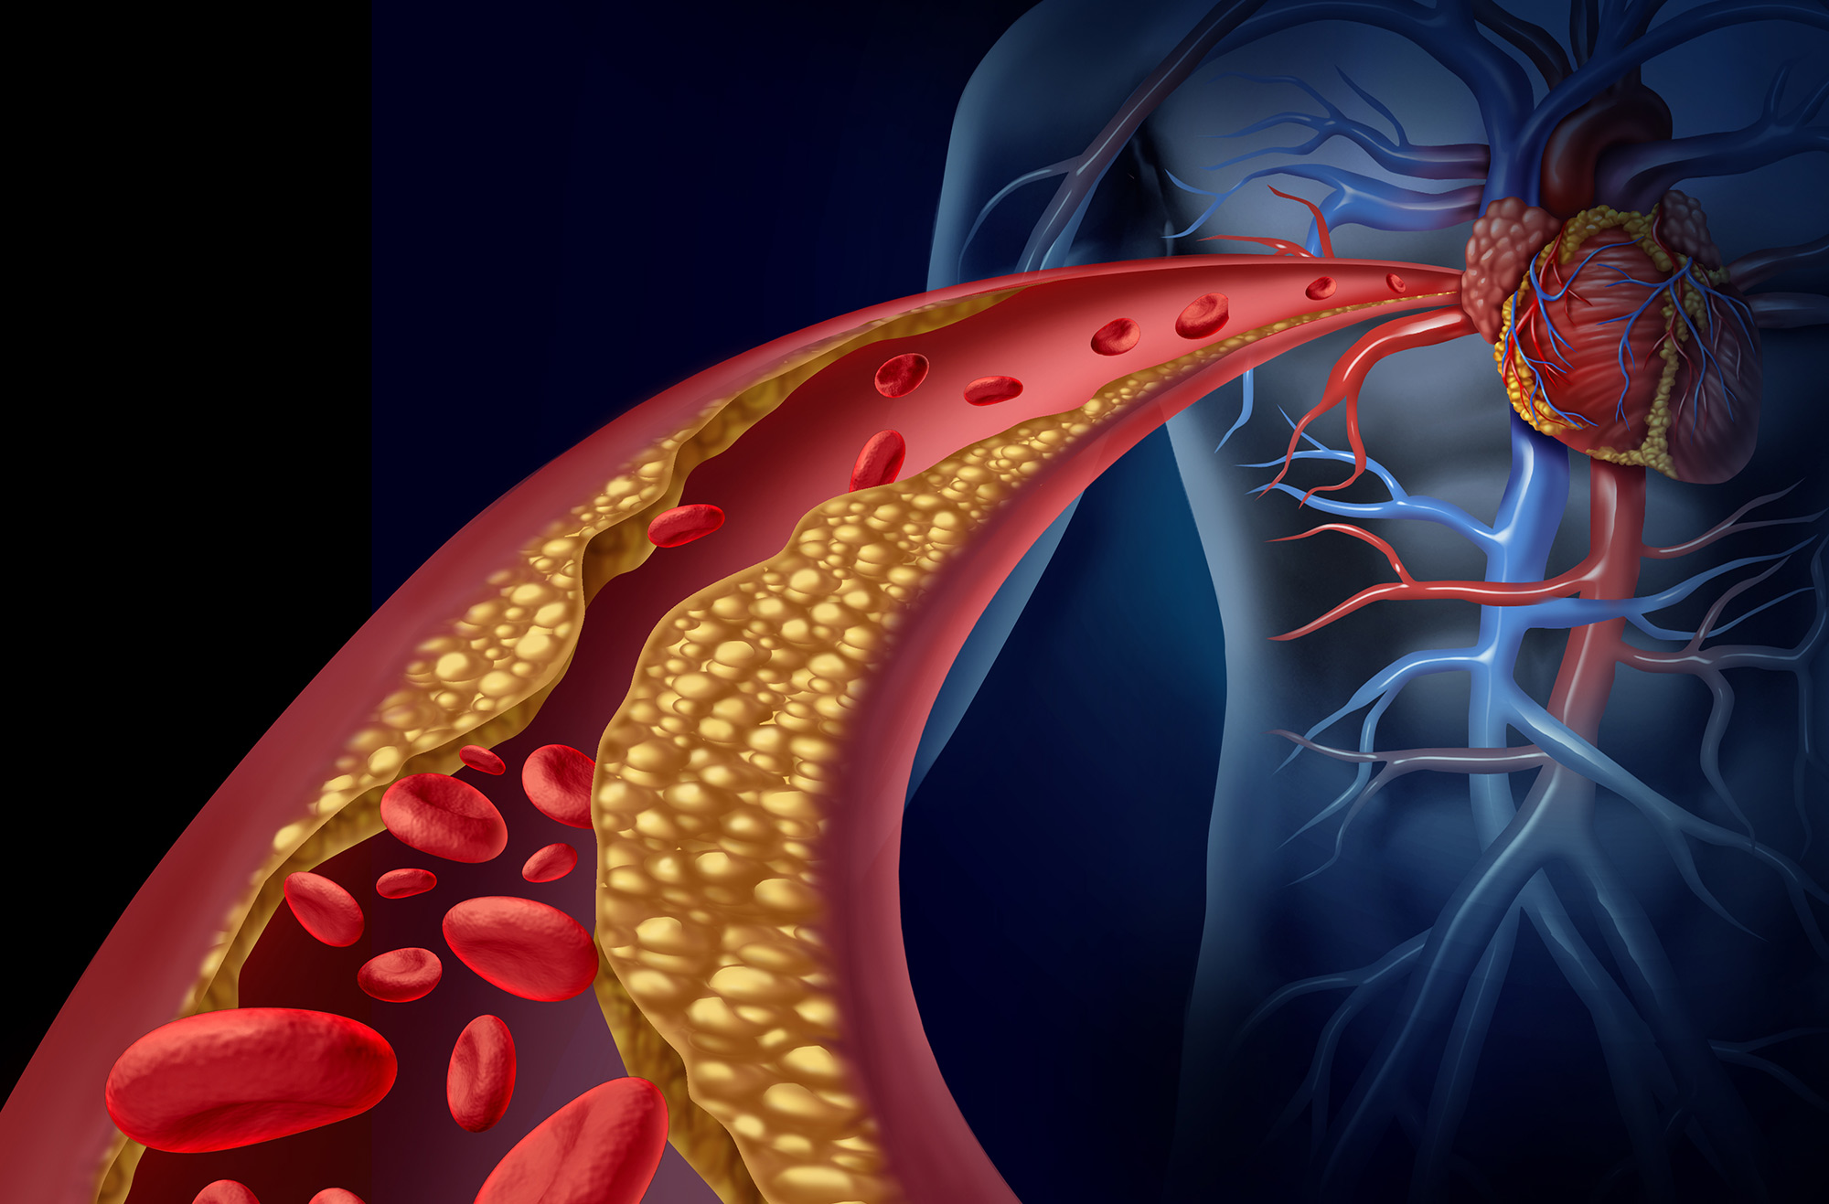
Definition
Hyperlipidemia is a major cause of atherosclerosis which may lead to cardiovascular disease and ischemic cerebrovascular disease.

Slide 4
Definition
Denotes abnormally  levels of any or all Lipids and/or Lipoproteins [LP] in blood.
Lipids originate from two sources:
endogenous lipids, synthesized in the liver.
exogenous lipids, ingested and processed in the intestine.

Slide 5
Definition
The principle lipids in the blood are:
Cholesterol (C).
Triglycerides (TG).
Phospholipids (PL).
Cholesterol esters (CE).
Non-estrified fatty acids (NEFA).

Slide 6
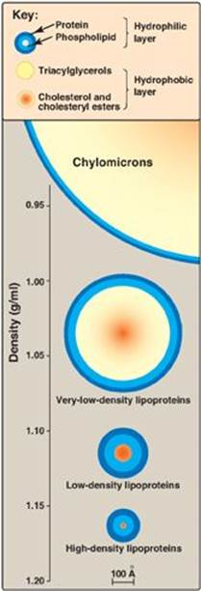
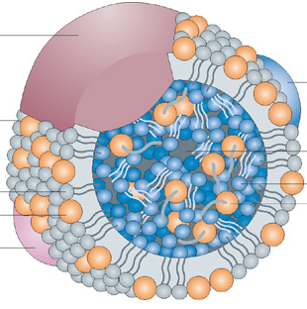
Definition
Structure of a lipoprotein
Apoprotein
Apoprotein
Phospholipid
Triacyl glycerides
Unesterified cholesterol
Cholesterol ester
Apoprotein

Slide 7
Familial Hyperlipoproteinemia
LProteinemia | LP | Lipids | Risk
Type I | CM | TGs | -
Type IIa | LDL | C | 
Type IIb | VLDL & LDL | TG & C | 
Type III | IDL | TGs & C | 
Type IV | VLDL | TGs | 
Type V | VLDL & CM | TGs & C | _
CM = chylomicron; VLDL = very–low-density lipoprotein; LDL = low-density lipoprotein; IDL = intermediate-density lipoprotein

Slide 8
Treatment of hyperlipidemia
Therapeutic strategies for treatment of hyperlipidemia:
Therapeutic lifestyle changes.
Antihyperlipidemic agents.

Slide 9
Therapeutic lifestyle changes
Healthy diet; optimal quantitative & qualitative fat content:
Diet has < 30% of calories as fat, < 7% as saturated fat and <200mg cholesterol/day.
Avoid trans-fatty acids and acute increase in C intake.
Use vegetable oils rich in unsaturated fatty acids: oleic acid and linolenic acids.
Diet should also contain plant.
Stanols (interfere with the formation of micellar cholesterol) and soluble fibers.
Eat food high in antioxidants vitamins.

Slide 10
Therapeutic lifestyle changes
Regular exercise.
Cessation of hazardous habits; smoking, alcohol, …etc.
Losing weight.
Can achieve a fall in LDL-C of 8-15% … but long-term compliance is a problem.

Slide 11
Anti-hyperlipidemic agents.
Anti-hyperlipidemic agents
According to the M.O.A
According to site of action
M.O.A: Mechanism of action

Slide 12
Antihyperlipidemic agents
Inhibits cholesterol absorption in the intestine :
-Ezetimibe.
Sequester bile acids in the intestine:
- Exchange resins.
Agents targeting exogenous cholesterol:
-Ezetimibe.
-Colestipol.
-cholestyramine.
Agents targeting endogenous cholesterol:
-Statins.
- Fibrates.
-Nicotinic acid.
Alter relative levels & patterns of different plasma LPs:
-Fibrates.
- Nicotinic acids.
A-according to the M.O.A
B-according to site of action
Adjuvant agents:
-Omega-3-Fatty Acids.
- Stanols
Inhibits synthesis of cholesterol:
Inhibitors of hydroxy methyl glutaryl
coenzyme A reductase (Statins).
M.O.A: Mechanism of action

Slide 13
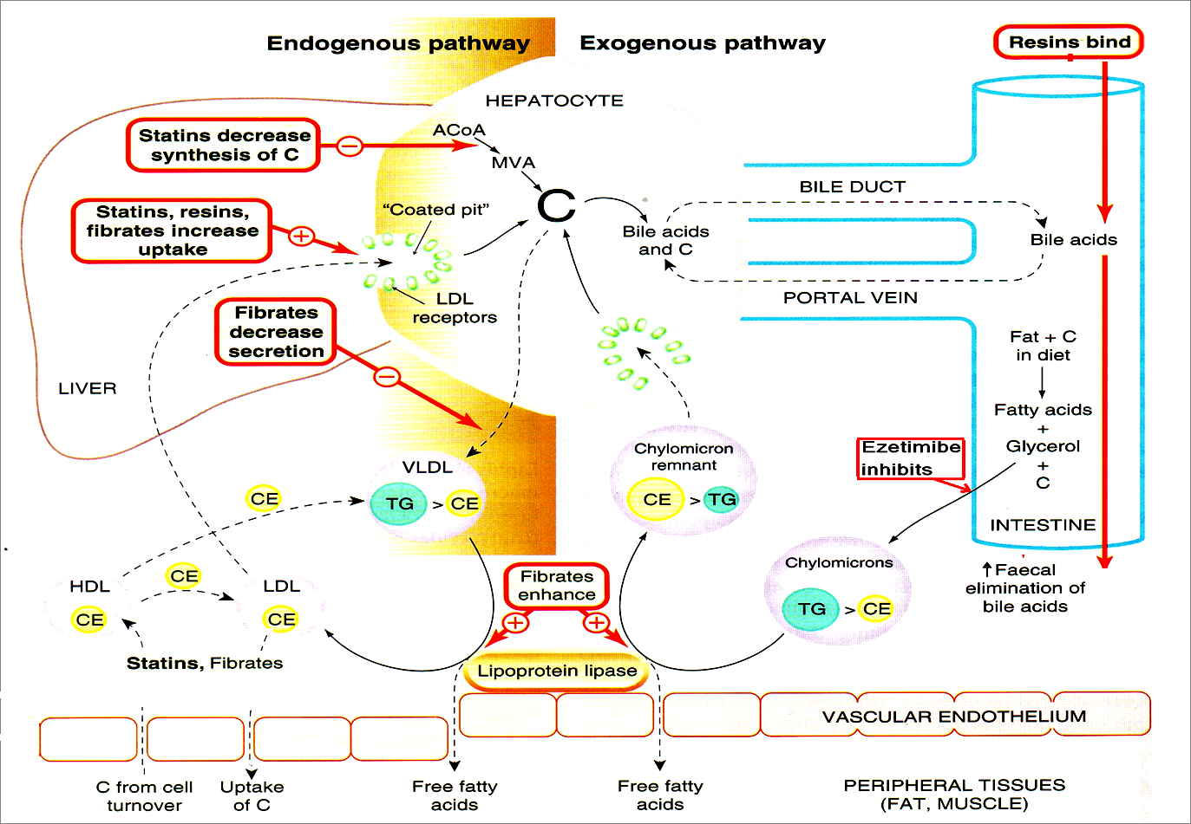
TARGETING ENDOGENOUS PATHWAYS
TARGETING EXOGENOUS PATHWAYS
Improve endothelial function

Slide 14
Cholesterol Absorption Inhibitors
Ezetimibe

Slide 15
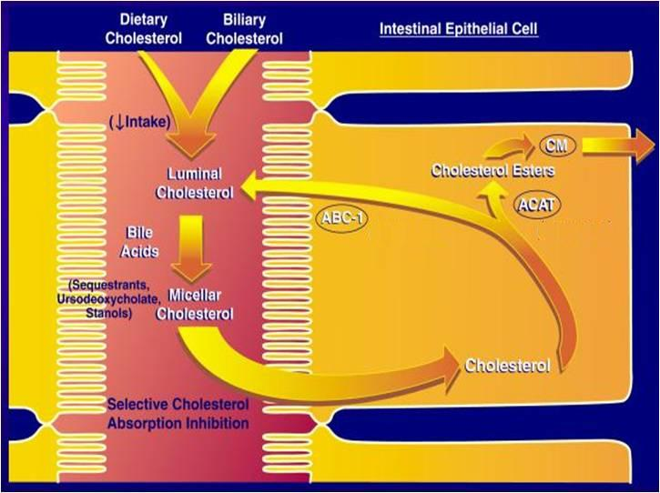
Ezetimibe: Mechanism of action
NPC1L1

Slide 16
Ezetimibe: Mechanism of action
Mechanism of action:
Blocks C transporter located on brush border of small intestine  pool of C available to the liver  up regulate LDL receptor, trapping more LDL particles from blood.

Slide 17
Ezetimibe: Pharmacological action
Pharmacological action:
LDL 20%.
◉ TG 8%.
 HDL 1-4%.
No effect on steroids, lipid-soluble vitamins, bile acids.

Slide 18
Ezetimibe: Pharmacokinetics
Pharmacokinetics
Absorbed and conjugated in intestine to active glucuronide.
Reaches peak blood level in 12–14 hours.
Undergoes enterohepatic circulation.
Its half-life is 22 hours.
Most of the drug is excreted in feces.

Slide 19
Ezetimibe: Indications
Indications
As Monotherapy:
Primary prevention of low risk of CHD which needs modest LDL.
As Combination Therapy: (safe)
With statins; synergistic in moderate/severe  LDL.
Or If must  statins dose because of side effects.
Or with other lipid lowering drugs; as fibrates.
Ezatimibe

Slide 20
Ezetimibe: Adverse effects
Adverse effects
Not common.
GIT disturbance, headache, fatigue, arthralgia and myalgia.

Slide 21
Exchange Resins Bile Acid Sequestrants
Cholestyramine
Colestipol
Colesevelam

Slide 22
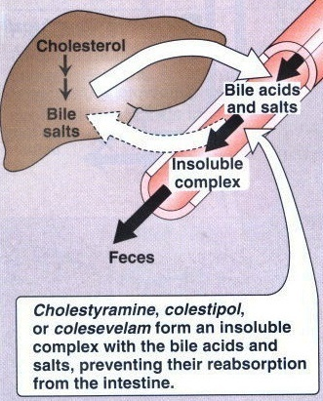
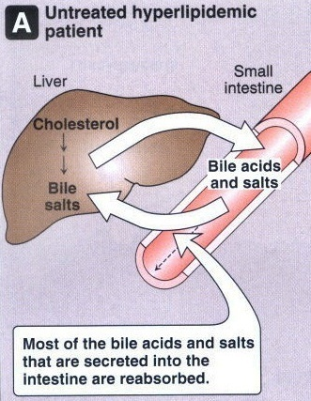
Resins: Mechanism of Action

Slide 23
Bile Acid-Binding Resins
Moderately effective with excellent safety record.
Large MW polymers which bind to bile acids and the acid-resin complex is excreted so their fecal excretion  10 folds
Prevents enterohepatic cycling of bile acids.
Obligates the liver to synthesize replacement bile acids from cholesterol.

Slide 24
Bile Acid-Binding Resins
The liver increases the number of LDL receptors to obtain more cholesterol.
The levels of LDL-C in the serum are reduced as more cholesterol is delivered to the liver.
Excellent choice for people that cannot tolerate other types of drugs.

Slide 25
Resins : Adverse Effects
Resins are clinically safe as they are not systemically absorbed.
GIT upset: abdominal discomfort, bloating, constipation.
Decreased absorption of: fat soluble vitamins (Vitamin A, D, K).
The concentration of HDL-C is unchanged.

Slide 26
Resins: Drugs interactions
Interfere with the absorption of:
Statins, Ezetimibe.
Chlorothiazides, Digoxin, Warfarin.
N.B. wait 1 hour before or 4 hrs. after administration of resins.
Colesevelam has not been shown to interfere with the absorption of co-administered medications and is a better choice for patients on multiple drug regimens.

Slide 27
Resins: Contraindications
Contraindications
Complete biliary obstruction (because bile is not secreted into the intestine).
Chronic constipation.
Severe hypertriglyceridemia (TG >400 mg/dL).

Slide 28
HMG-Co A Reductase Inhibitors
Hydroxy Methyl Glutaryl-Coenzyme A (HMG-CoA) reductase inhibitors or Statins are the most effective and best-tolerated agents for treating hyperlipidemia.
Statins are considered as first-line drugs when LDL-lowering drugs are indicated.

Slide 29
Statins: Mechanism of Action
Statins are potent competitive inhibitors of (HMG-CoA) reductase, which catalyzes an early, rate-limiting step in do-novo hepatic C synthesis. Thus, HMG-Co A is not converted to mevalonic acid

Slide 30
Statins: Preparations
Rosuvastatin.
Atorvastatin.
Simvastatin.
Pravastatin.
Lovastatin.
Used alone or with other anti-hyperlipidemic drugs (Ezetimibe) for treatment of drug-resistant dyslipidemia.

Slide 31
Pleiotropic Antiatherogenic effects [> in Vessels]
Improve endothelial function.
vascular inflammation.
Stabilization of atherosclerotic plaque.
platelet aggregability.
Antithrombotic actions.
Enhanced fibrinolysis …etc.

Slide 32
Statins: Pharmacokinetics
Most statins have a high first-pass clearance by the liver.
Greater than 95% of most of these drugs are bound to plasma proteins with short half-life.
Drug-drug interactions involve specific interactions with the cytochrome P-450 drug metabolizing system, especially CYP3A4.

Slide 33
Statins: Pharmacokinetics
All statins are taken orally at bedtime because of hepatic C synthesis is maximal between midnight and 2:00 a.m. , except atorvastatin taken at any time because of its long half-life (14 hours).

Slide 34
Statins: Indications
As monotherapy;
2ndry Prevention; In all ischemic insults [stroke, AMI, …..etc.] So given from1st day of ischemic attack.
Pry Prevention;
1. Patients with hyperlipidemia and with other risks for ischemic insults.
2. Type IIa Hyperlipoprotinemia.
If no control  combine (sequestrants / ezatimibe, niacin,.. ) to  C.
As Combination therapy;
1. Mixed dyslipidaemias; added to fibrates or niacin if necessary.
2. In diabetics and patients with insulin resistance [metabolic syndrome] because these patients will possess small dense LDL (severely atherogenic) + evident endothelial dysfunction + increased thrombotic profile.

Slide 35
Statins: Adverse Effects

Slide 36
Statins: Adverse Effects
Common side effects: Headache , myalgia, fatigue, GI intolerance, and flu-like symptoms.
Hepatotoxicity, raised concentrations of liver enzymes (serum aminotransferases).
Myopathy (increased creatine kinase [CK] released from muscles)
Teratogenicity, statins should be avoided during pregnancy.

Slide 37
Statins: Drug Interactions
Statins potentiate the action of oral anticoagulant and anti-diabetic drugs (by displacement from plasma protein binding sites).
Drugs that increase the risk of statin-induced myopathy include:
Other antihyperlipidemics (fibrates).
Drugs metabolized by 3A4 isoform of cytochrome P450: erythromycin, verapamil, cyclosporin, ketoconazole.
Pravastatin and fluvastatin are the statins of choice in patients taking other drugs metabolized by cytochrome 3A4 system.

Slide 38
Statin-induced myopathy
Muscle aches, soreness, or weakness associated with an elevation of creatine kinase (CK) , are the best indicator of statin-induced myopathy.
Failure to recognize myopathy and to discontinue drug therapy can lead to rhabdomyolysis, myoglobinuria, and acute renal necrosis.
serum transaminase  can progress to evident hepatotoxicity.
So lab investigations recommended every 6 month  if levels  up
to 3 folds at any time, statin must be stopped then dose adjusted.
 creatine kinase activity (index of muscle injury)  Measured only if myalgia or myositis develops  if  3-5 folds  we statin doses / omit combination with fibrates…..

Slide 39
Niacin (Nicotinic Acid)
Water soluble B-complex vitamin with multiple actions
Niacin is the most effective medication for increasing HDL cholesterol levels and it has positive effects on the complete lipid profile.
It is useful for patients with mixed dyslipidemias.
Niacin exerts greatest beneficial effects on wide range of lipoprotein abnormalities.

Slide 40
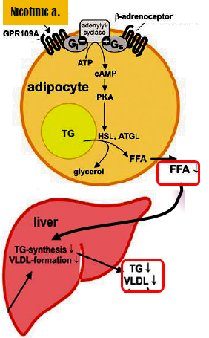
Niacin: Mechanism of action
In adipose tissue: it binds to adipocytes nicotinic acid receptors, this will lead to decrease in free fatty acids mobilization from adipocytes to the liver resulting in ↓ TG and thus VLDL synthesis.
In liver: niacin inhibits hepatocyte
2-diacylglycerol acyltransferase, a key enzyme for TG synthesis
Thus, it decreases VLDL production (decreased TG synthesis and estrification)
3. In plasma: it increases LPL activity that increases clearance of VLDL & chylomicron

Slide 41
Niacin: Pharmacological of actions
Effect on VLDL:  VLDL by:
1)  synthesis in liver.
2) increased clearance in plasma.
3)  mobilization of free fatty acids from adipose tissue.
Effect on LDL:  LDL due to reduction in its precursor (VLDL)
Effect on HDL: Induces remarkable increase in HDL-C (The catabolism of HDL can be inhibited by nicotinic acid through a mechanism that is largely unknown).
Niacin also promotes hepatic apoA-I production and slows hepatic clearance of apoA-I and HDL.

Slide 42
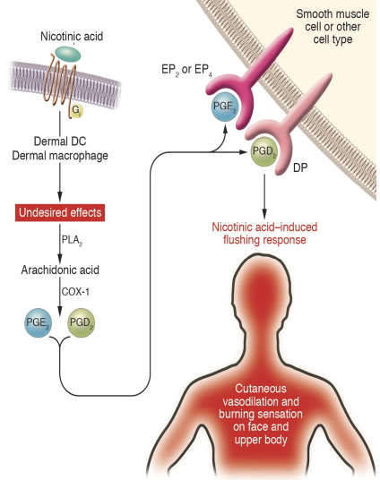
Niacin : Adverse Effects
The most common side effect is cutaneous flushing, (which is prostaglandin -mediated , can be avoided by low dose aspirin ½ h before niacin).

Slide 43
Niacin : Adverse Effects
GIT disturbances: Dyspepsia , nausea , vomiting , reactivation of peptic ulcer ( can be decreased if taken after meal).
High doses:
Reversible  liver enzymes hepatotoxicity.
Impairment of glucose tolerance  overt diabetes.
 uric acid.

Slide 44
Niacin : Indications
Monotherapy or in combination with fibrate, resin or statin
Type IIa hypercholesterolemia.
Type IIa, IIb hypercholesterolemia & any combined hyperlipidemia.
Patient with hypertriglyceridemia & low HDL-C.

Slide 45
Niacin : Contraindications
Gout.
Peptic ulcer.
Hepatotoxicity.
Diabetes mellitus.

Slide 46
Fibric acid Derivatives (Fibrates)
Clofibrate.
Gemfibrozil.
Fenofibrate

Slide 47
Fibrates :Mechanism of Action
Fibrates are agonists of peroxisome proliferator activated receptors (PPARα) which are a class of intracellular receptors that modulate fat metabolism.
They increase genes transcription for lipoprotein lipase (LPL) leading to increased catabolism of TG in VLDL and chylomicrons.

Slide 48
Fibrates: pharmacological effects
 LPL activity, which increases clearance of VLDL & chylomicron in plasma
A marked reduction in TG (due to
stimulation of catabolism of VLDL)
 FFA uptake by the liver
 LDL-C uptake by the liver
in HDL-C (by increasing the production of the apoprotein components of HDL).
 excretion of hepatic C in bile , thus endogenous hepatic C synthesis may be decreased.

Slide 49
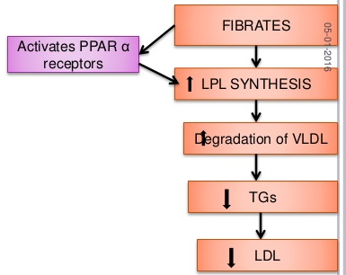
Fibrates: pharmacological effects

Slide 50
Fibrates : Adverse Effects
GIT (indigestion, abdominal pain, diarrhea).
Myositis : can occur resulting in weakness and tenderness of muscles, use of fibrates with statins is generally inadvisable.
Gallstones: Clofibrate increases C content of bile, predisposes to gallstones, and its use is therefore limited to patients who have cholecystectomy.
Notes:
.

Slide 51
Fibrates : Adverse Effects
G.I.T upset, headache, fatigue, weight gain.
Rash, urticaria, hair loss.
Myalagia, Myositis, Rhabdomyolysis Acute renal failure  Occurs >
In alcoholics,
If combined with statins (each –ve metabolism of other).
Or In impaired renal function.
Fibrates should be used with caution in patients with biliary tract disease, as they increase the risk of cholesterol gallstones as a result of an increase in the cholesterol content of bile.

Slide 52
Fibrates: Indications
1st-line defense for:
mixed dyslipidemia (i.e. raised serum TG and C).
Patients with low HDL and high risk of atheromatous disease (often type 2 diabetic patients).
Patients with severe treatment- resistant dyslipidemia (combination with other lipid-lowering drugs).

Slide 53
Fibrates: Drug interactions
Increased risk of myopathy when combined with statins.
Displace drugs from plasma proteins (e.g. oral anticoagulants and oral hypoglycemic drugs).

Slide 54
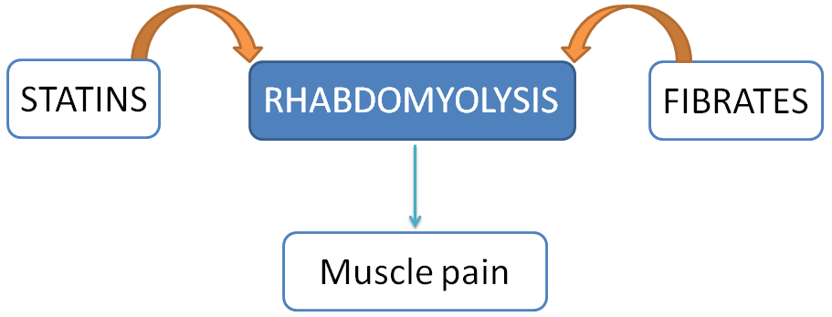
Fibrates: Contraindications
Patients with impaired renal functions
Pregnant or nursing women
Preexisting gall bladder disease

Slide 55
Adjuvants in hyperlipidemia
Omega -3-FA
β-Sitosterol

Slide 56
Omega -3-FA
found in fish oils containing highly unsaturated FA
Mechanism
Pharmacological Effects
◉ enzymes involved in TG synthesis
 beta-oxidation of FFA
◉ TGs
◉ platelet function
Prolongation of bleeding time
Anti-inflammatory effects
Some vascular protection
Indications
Approved as adjunctive for treatment of very high TGs
β-Sitosterol
found in plants with structure similar to C
Mechanism &Pharmacological Effects
Compete with dietary & biliary C absorption  levels LDL levels +10%
Indications
Given as food supplement before meal in hypercholestrolemia

Slide 57
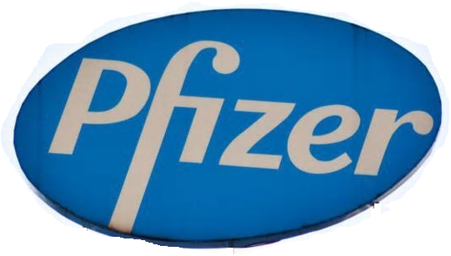
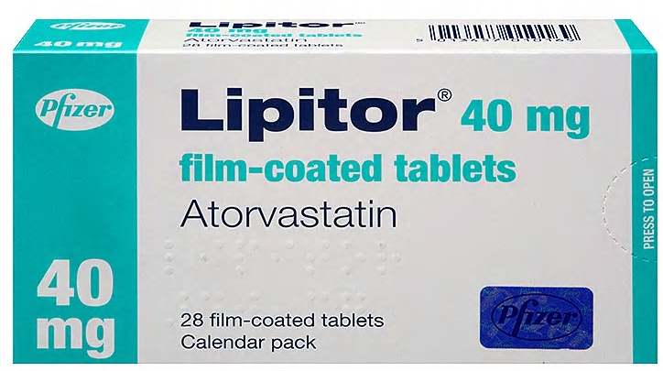
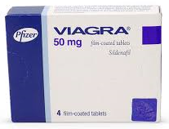
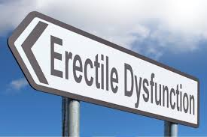

Slide 58
Summary
Hyperlipidemia is a major cause of atherosclerosis which may lead to cardiovascular disease.
Antihyperlipidemic agents can be classified according to mechanism of action and site of action.

Slide 59
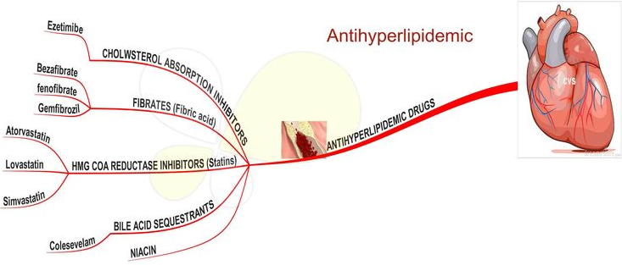
Summary

Slide 60
Thank you

