Slide 1
Electrocardiography (ECG)
بسم الله الرحمن الرحيم
By Asma M. Al yahya
MBBS, MSc, PhD

Slide 2
Objectives
Define ECG & list uses of ECG
Understand basic ECG principles
Describe ECG leads and Einthoven’s triangle
Recognize ECG waves, Intervals and, segments
Determine rate and normal heart rhythm
Have some idea about ECG abnormalities in common clinical conditions

Slide 3
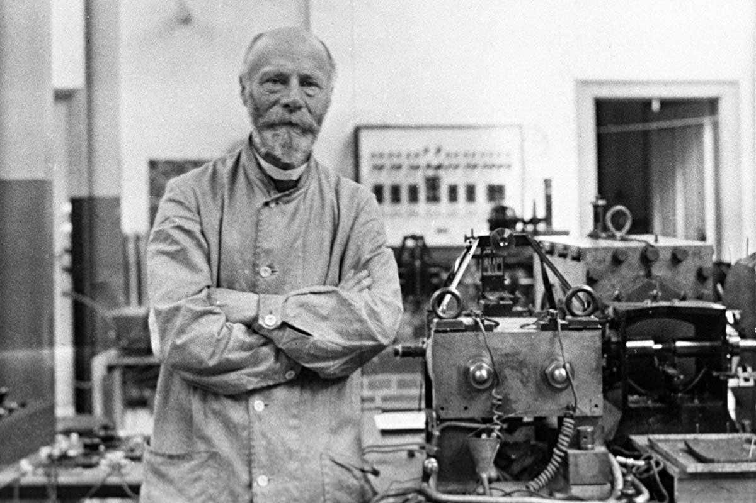
The ECG’s origin dates back to the discovery of the heart muscle’s electric activity. In 1901, Willem Einthoven (Dutch doctor and physiologist) made a breakthrough that facilitated the first steps towards electrocardiography, for which he subsequently won a Nobel Prize in 1924
ECG is used as a technique to diagnose cardiac disease and to detect abnormal heart rhythm. They may also be used as a general health assessment in certain occupations, including aviation, diving and the military

Slide 4
What is the ECG?
It is the sum of electrical activity of the heart transmitted to surface of body.
It is a simple and important tool for providing evidence to support a diagnosis, and is sometimes crucial for patient management.
It records the electrical activity of the heart by surface electrodes.
The tracing shows waves of different shapes connected to each other by intervening intervals.

Slide 5
Terminology
ECG: Electrocardiogram refers to the recording of electrical changes that occurs in heart during a cardiac cycle. It may be abbreviated as ECG or EKG.
Electrocardiograph: It is an instrument that picks up the electric currents produced by the heart muscle during a cardiac cycle of contraction and relaxation.

Slide 6
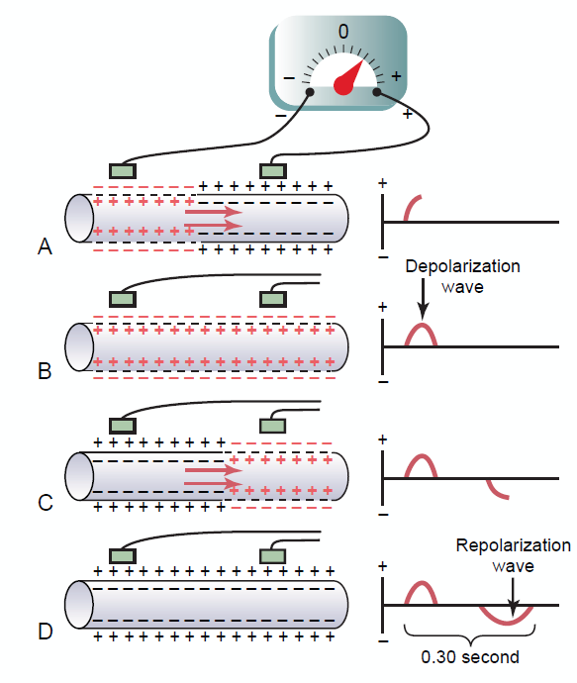
Working principle of electrocardiograph
When the depolarization wave spread through heart, electrical currents pass into the surrounding tissue (body fluids are good conductors) and can be recorded from surface electrodes
Cardiac muscle fiber:
A: halfway depolarization
B: complete depolarization
C: halfway repolarization
D: complete repolarization

Slide 7
The Normal Electrocardiogram (ECG)
How does a 12-lead ECG work?
The ECG is a graphical representation of the heart’s electrical activity, plotting its voltage on a vertical axis against time on a horizontal axis.

Slide 8
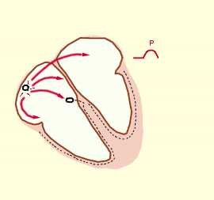
Wiring of the heart

Slide 9
Principles of Vectorial Analysis of Electrocardiograms
heart current flows in a particular direction in the heart at a given instant during the cardiac cycle.
A vector is an arrow that points in the direction of the electrical potential generated by the current flow, with the arrowhead in the positive direction.
Direction of a Vector Is Denoted in Terms of Degrees
And length of the arrow is proportional to the voltage of the potential.
In a normal heart, the average direction of the vector during spread of the depolarization QRS wave through the ventricles is called the mean QRS vector, and is about +59 degrees
Notes:
Overall, considerably more current flows downward from the base of the ventricles toward the apex than in the upward direction. Therefore, the summated vector of the generated potential at this particular instant, called the instantaneous mean vector, is represented by the long black arrow drawn through the center of the ventricles in a direction from base toward apex. Furthermore, because the summated current is considerable in quantity, the potential is large and the vector is long.
In a normal heart, the average direction of the vector during spread of the depolarization wave through the ventricles, called the mean QRS vector, is about +59 degrees, which is shown by vector A drawn through the center of Figure 12-2 in the +59-degree direction. This means that during most of the depolarization wave, the apex of the heart remains positive with respect to the base of the heart, as discussed later in the chapter

Slide 12
-
+

Slide 15
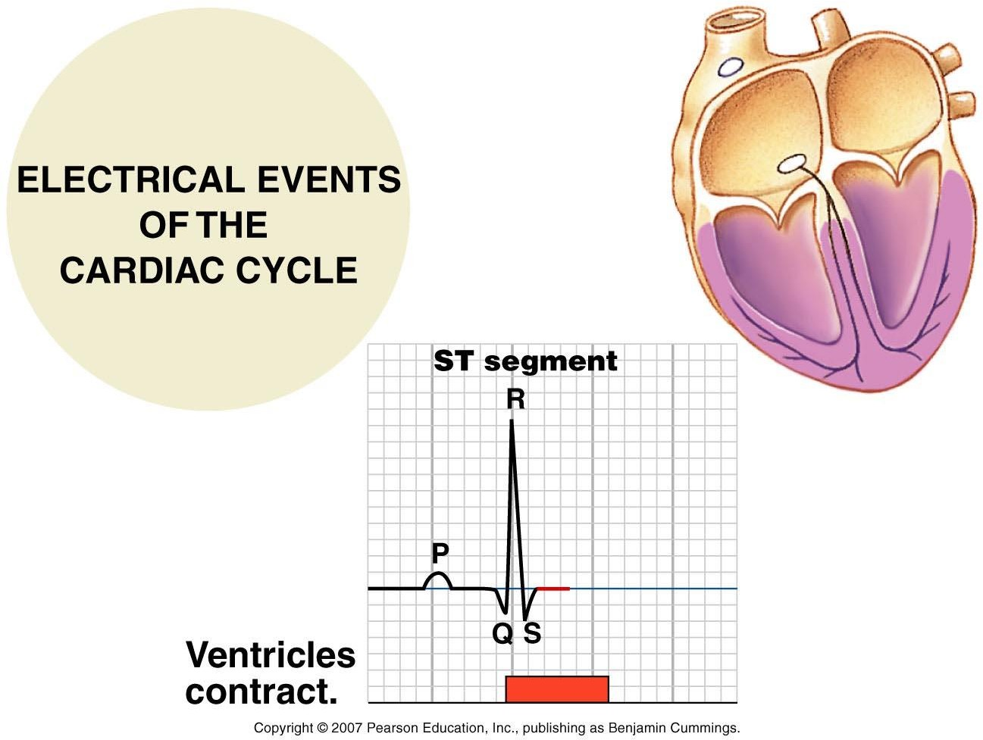

Slide 18
ECG waves, segments and intervals
P wave = Atrial depolarization.
PR segment = depolarization of the AV node. It’s a flat line because the wave is not strong enough to be recorded on the voltmeter.
PR interval = Wave goes over the atrium and through the AV node and ends just before it activates the ventricles to depolarize.
Q wave = Ventricular Septal Depolarization
R wave = major ventricular muscle depolarization.
S Wave = Basal Ventricular depolarization.
The beginning of the QRS complex is the start of ventricular systole and that goes until the end of the T wave. Ventricular diastole starts when the T wave ends.
ST segment = During the ST segment, all the ventricular myocardium is depolarized. All have positive charges. So there is no potential difference to be recorded by the voltmeter (ECG machine). So there is a flat line.
ST interval=the initial, slow phase of ventricular repolarization
T-P interval= It represents the time when the heart muscle cells are electrically silent
T wave= ventricular repolarization.
QT interval = Important because it captures the beginning of ventricular depolarization through the plateau phase to the ventricular repolarization. It covers the entire ventricular activity. R-R interval= the duration between each cardiac cycle
U wave= Sometimes the electrical activity of the ventricular papillary muscle is out of phase with the rest of the ventricles and will record as a “U” wave that shows after the T wave.
Segment is the region between two waves (elevation or depression or progression)
Interval is a duration of time that includes one segment and one or more waves.
Notes:
A segment in an ECG is the region between two waves. PR segment starts at the end of the P wave and ends at the start of the QRS complex. The ST segment starts at the end of the QRS wave and ends at the start of the T wave. The TP segment is found between the end of the T wave and the beginning of the next P wave; It is the true isoelectric segment in the ECG. ** With segments, you talk about morphology: elevation or depression or progression of segments.
An interval in an ECG is a duration of time that includes one segment and one or more waves. The PR (or PQ) interval starts at the start of the P wave and ends at the start of the QRS. It denotes the conduction of the impulse from the upper part of the atrium to the ventricle. The QRS interval covers the QRS complex from beginning to end. [The QRS complex also covers an interval]. The QT interval starts at the start of the QRS and ends at the end of the T wave. It denotes the electrical systole of the heart.**Intervals are only described based on their duration of time.
P wave = Atrial depolarization.
PR segment = depolarization of the AV node. I.e. When current is passing through the AV node. It’s a flat line because the wave is not strong enough to be recorded on the voltmeter.
PR interval = Wave goes over the atrium and through the AV node and ends just before it activates the ventricles to depolarize.
Q wave = Ventricular Septal Depolarization
R wave = Resultant or major ventricular muscle depolarization. The resultant vector is directed downward and leftward.
S Wave = Basal Ventricular depolarization, i.e. depolarization of the base of the ventricles. Note the apex of the heart is the L. pointed end. The base of the ventricles connects to the atria.
ST segment = During the ST segment, all the ventricular myocardium is depolarized. All have positive charges. So there is nothing potential difference to be recorded by the voltmeter (ECG machine). So you have a flat line.
T wave represents ventricular repolarization.
QT interval = Important because it captures the beginning of ventricular depolarization through the plateau phase to the ventricular repolarization. It covers the entire ventricular activity. During this time, the action potential was generated and terminated in the ventricular tissue. The beginning of the QRS complex is the start of ventricular systole and that goes until the end of the T wave. Ventricular diastole starts when the T wave ends.
U wave. Sometimes the electrical activity of the ventricular papillary muscle is out of phase with the rest of the ventricles and will record as a “U” wave that shows after the T wave

Slide 19
0.6-1.20
duration of the R-R interval depends on the heart rate
0.12-0.20
QT-QRS
0.35-0.45
T=0.30-0.35
0.08-1.00
0.06-0.10
Duration in seconds

Slide 20
Abnormal p waves
1. Anything that causes the right atrium to become hypertrophied (such as tricuspid valve stenosis or pulmonary hypertension) causes the P wave to become peaked.
2. Left atrial hypertrophy (usually due to mitral stenosis) causes a broad and bifid P wave.

Slide 21
Abnormal QRS complexes
Broad QRS complex(>100ms) (increased width indicates that depolarization has spread through ventricles by an abnormal and therefore slow pathway):
Ex. BBB, hyperkalemia
Increased height (An increase of muscle mass in either ventricle will lead to increased electrical activity):
Ex. ventricular hypertrophy
Hyperkalemia

Slide 22
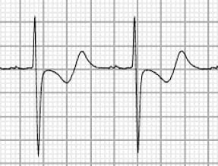
T wave abnormalities
Peaked T waves: hyperkalemia
Inverted T waves: ischemia
Biphasic T waves: Biphasic T waves due to Hypokalaemia

Slide 23
What information can be obtained?
(1) Rate and Rhythm of the heart
(2) Heart’s orientation
(3) Size of its chambers
(4) Presence of ischemia or infarction in the heart along with its location and extent
(5) Electrolyte imbalance
(6) Drug effects

Slide 24
The 12-Lead ECG
A lead means a viewpoint of the heart
12-lead ECG is an ECG recording that looks at the heart from 12 different viewpoints providing a complete picture of the heart’s electrical activity.
12-lead ECG is composed of six limb leads and six chest leads.
Limb leads look at the heart in the coronal (frontal) plane while chest leads look at the heart in a horizontal plane

Slide 25
The 12-Lead ECG
Bipolar lead records the potential difference between two electrodes, e.g. limb leads I, II and III
Unipolar lead records the potential of one electrode, e.g. limb leads aVR, aVL and aVF as well as chest leads are unipolar

Slide 26
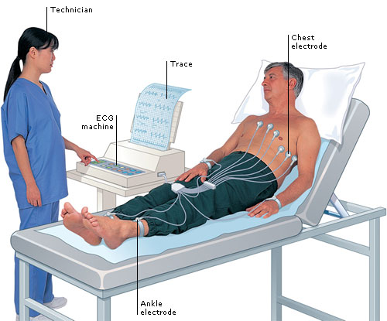
The ECG has 12 leads and 10 electrodes
(6 chest+ 3 limb and augmented+ 1 earth)
Notes:
12 leads but only 10 electrodes
In fact, only NINE (9) leads are really required!
Six leads (the chest leads) are dedicated unipolar leads that that only record a single trace - these are the V leads.
Three leads (the limb leads) double to provide both augmented unipolar leads as well as bipolar leads. From these leads the three standard traces are obtained as well as the three augmented (aV) unipolar traces…
Twelve in all!
The R leg lead is just an earth - nothing is recorded from it…

Slide 27
Limb leads
Four electrodes placed on:
left arm (LA)
right arm (RA)
left leg (LL)
right leg (RL)-earth
Three electrodes will record six leads (views) of the heart in the coronal plane, namely;
Lead I, lead II, lead III, aVR, aVL and aVF.
Notes:
Limb leads
Four electrodes placed on:
left arm (LA)
right arm (RA)
left leg (LL)
right leg (RL)
The four electrodes will record six leads (views) of the heart in the coronal plane, namely;
Lead I, lead II, lead III, aVR, aVL and aVF. Leads I, II and III are bipolar leads whereas aVR, aVL and aVF are unipolar leads

Slide 28
Axis for Each Standard Bipolar Lead and Each Unipolar Limb Lead
The hexagonal reference system
Each lead is a pair of electrodes connected to the body on opposite sides of the heart, and the direction from negative electrode to positive electrode is called the “axis” of the lead.
Notes:
Lead I is recorded from two electrodes placed respectively on the two arms. Because the electrodes lie exactly in the horizontal direction, with the positive electrode to the left, the axis of lead I is 0 degrees.
In recording lead II, electrodes are placed on the right arm and left leg. The right arm connects to the torso in the upper right-hand corner and the left leg connects in the lower left-hand corner. Therefore, the direction of this lead is about +60 degrees.
By similar analysis, it can be seen that lead III has an axis of about +120 degrees; lead aVR, +210 degrees; aVF, +90 degrees; and aVL −30 degrees. The directions of the axes of all these leads are shown in Figure 12-3, which is known as the hexagonal reference system. The polarities of the electrodes are shown by the plus and minus signs in the figure.

Slide 29
Limb leads
Bipolar lead: have a negative and positive pole. Electrical potential differences are measured between the poles
Unipolar lead: No negative lead The heart is the negative pole Electrical potential difference is measured between the lead and the heart.

Slide 30
Einthoven’s Law
the sum of the potentials recorded in leads I and III will equal the potential in lead II.
Lead I + Lead III= Lead II

Slide 31
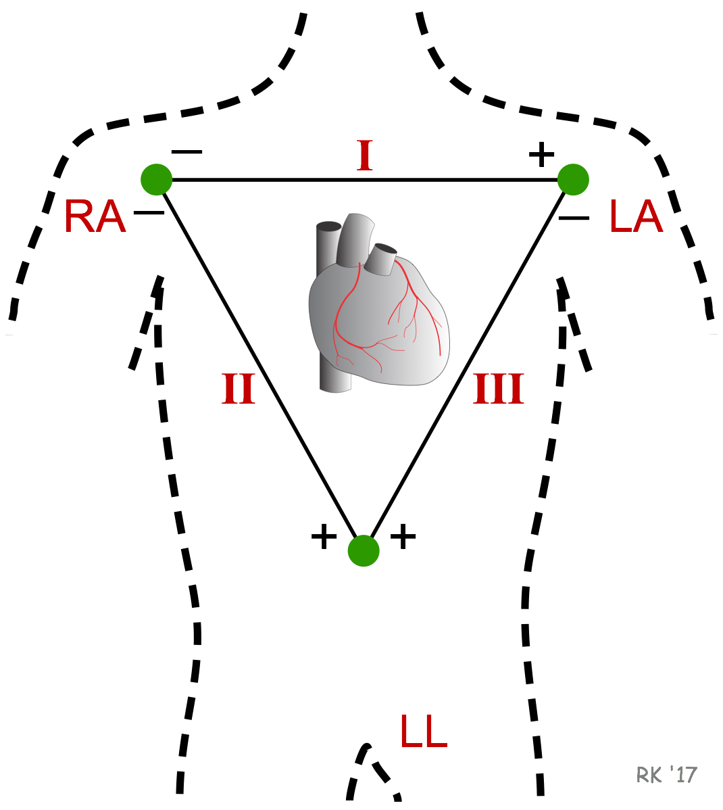

Slide 32
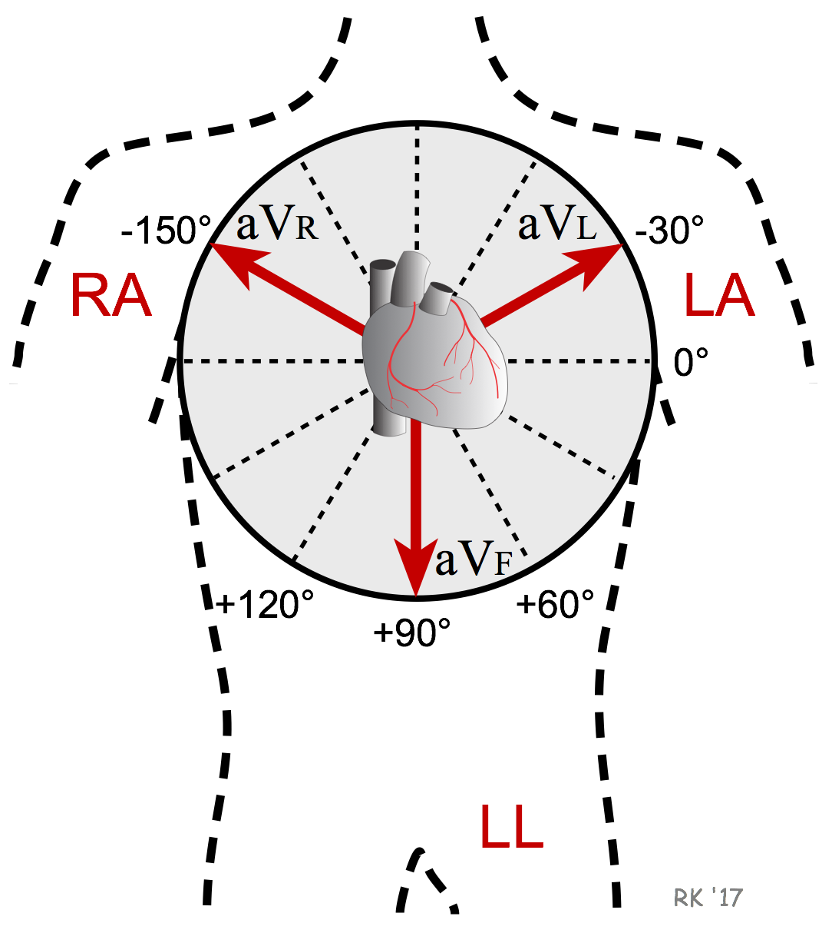

Slide 33
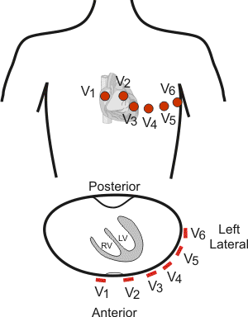
Precordial (chest Wilsons) leads
V1: 4th intercostal space (ICS), right sternal border.
V2: 4th ICS, left sternal border.
V3: midway between V2 and V4.
V4: 5th ICS, mid-clavicular line
V5: 5th ICS (horizontal to V4), anterior axillary line.
V6: 5th ICS (horizontal to V4), mid-axillary line.
Notes:
Precordial (chest) leads
unipolar leads recorded using six electrodes placed in the following manner:
V1: 4th intercostal space (ICS), right sternal border.
V2: 4th ICS, left sternal border.
V3: midway between V2 and V4.
V4: 5th ICS, mid-clavicular line
V5: 5th ICS (horizontal to V4), anterior axillary line.
V6: 5th ICS (horizontal to V4), mid-axillary line.

Slide 35
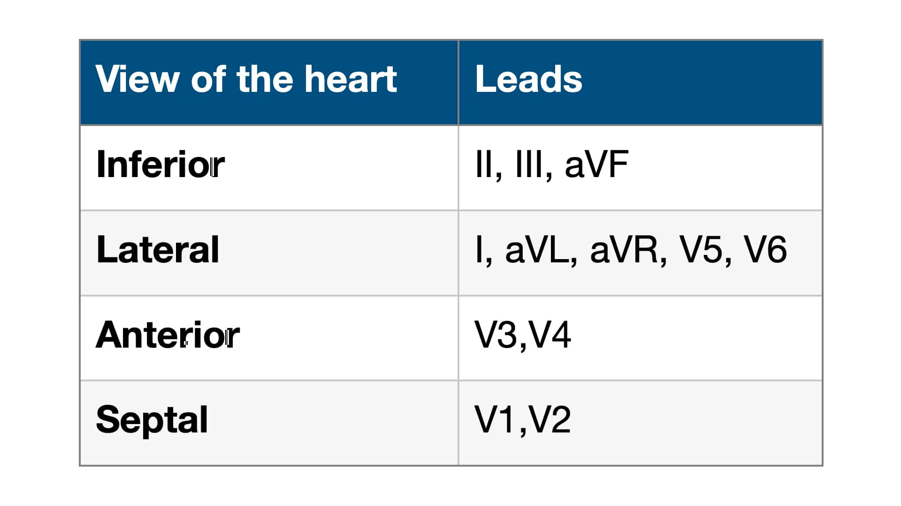
Each lead views the heart from positive electrode

Slide 36
ECG Interpretation
The ECG paper
ECG waves and intervals
Heart rhythm determination
Heart rate calculation
Calculation of the cardiac axis

Slide 37
The ECG paper
The ECG is recorded on graph paper.
The paper runs at a standard speed of 25mm/sec.
The horizontal axis denotes time while the vertical axis denotes voltage.
The graph paper is divided into large and small squares.
Each large square contains 5 small squares of 1 mm length.
Given that the paper runs at a rate of 25 mm/sec, horizontally, one small square of 1 mm length represents 0.04 sec.

Slide 38
The ECG paper
Large square
Small square

Slide 39
Heart rhythm determination
The heart rhythm refers to the regularity of heart beat.
Heart rhythm can be determined by observing R-R intervals on ECG.
If the R-R intervals are the same duration, the rhythm is said to be regular (sinus rhythm), whereas if the R-R intervals are variable in length the rhythm is said to be irregular (arrhythmia).

Slide 41
Sinus arrhythmia
The heart usually beats faster during inspiration and slower during expiration, showing unequal R-R intervals on the ECG strip.
The R-R intervals are shorter during inspiration and wider during expiration.
This pattern of arrhythmia is physiologic and is due to the different firing rate of SA node during inspiration and expiration

Slide 42
Inspiration increases the heart rate by decreasing vagal tone.
Notes:
Mechanism
Sinus arrhythmia is a normal physiological phenomenon, most commnonly seen in young, healthy people.
The heart rate varies due to reflex changes in vagal tone during the different stages of the respiratory cycle.
Inspiration increases the heart rate by decreasing vagal tone.
With the onset of expiration, vagal tone is restored, leading to a subsequent decrease in heart rate.

Slide 43
Heart rate calculation
1. Regular heart rhythm
The heart rate can be calculated from the ECG using one of the following formulas:

Slide 44
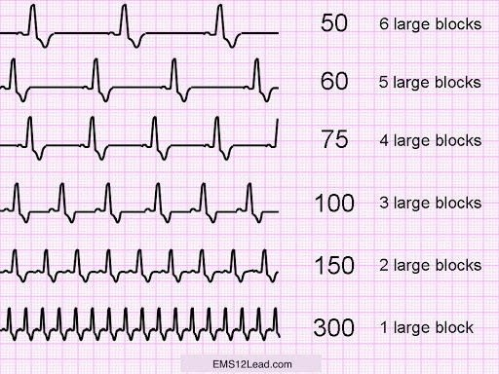
Heart Rate = 300/Large squares between R-R
OR
1500/Small squares between R-R

Slide 45
Heart rate
The normal range of heart rate is between 60 – 100 beats/minute.
higher than 100 beats/minute
less than 60 beats/minute
Tachycardia
Bradycardia

Slide 46
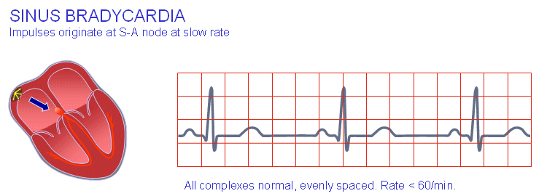
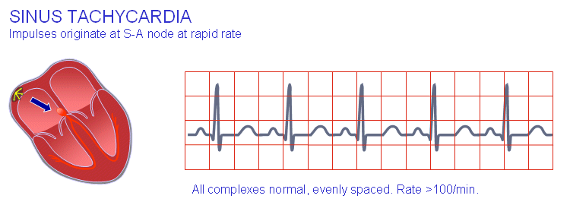

Slide 47
2. Irregular heart rhythm
Count the number of QRS complexes in 30 large squares (which equals the number of QRS complexes in 6 seconds).
Then multiply the number of QRS complexes counted in 6 seconds by 10 to get the number of QRS complexes in one minute i.e. the heart rate

Slide 48
Calculating heart rate when the rhythm is irregular

Slide 49
Calculation of the cardiac axis
The electrical axis is the average direction of the current flow in the heart during a cardiac cycle.
The cardiac axis refers to the general direction in which the heart depolarizes.
The cardiac axis is expressed as an angle and is measured in degrees.
The depolarization wave normally spreads through the ventricles in a direction from base of the heart to its apex.
Notes:
he cardiac axis refers to the general direction in which the heart depolarises.
Each wave of depolarisation begins at the Sinoatrial node, then spreads to the Atrioventricular node, before travelling to the Bundle of HIS and the Purkinje fibres to complete an electrical cardiac cycle.
When viewing the heart from the front, imagine a clock face. In the case of a normal cardiac conduction pathway, the wave of electrical activity travels from 11 o’clock to 5 o’clock.
A pathology that affects the conduction pathway of the heart will therefore affect the way the wave of depolarisation causes the heart to contract.
There are more than a couple of factors that influence cardiac axis:
Those of an anatomical persuasion:
The heart’s anatomical position in the thoracic cavity (dextrocardia), or abnormal thoracic anatomy
Abnormal diaphragm position (pregnancy and obesity, among others)
And those that are pathological, some examples of which are:
Conduction abnormailities
Prior myocardial infarction
Pulmonary embolism
Hypertrophy
Ischaemia

Slide 50
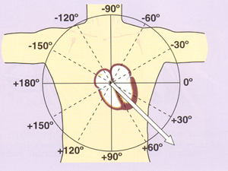
Calculation of the cardiac axis ..
Lead I will be looking at the heart from the left at an angle of 0 degrees.
Any deviation below that line is expressed as a positive number whereas deviations above the line are expressed as negative numbers.
Lead II is considered to be looking at the heart at an angle of +60⁰
Lead III looks at the heart at +120⁰

Slide 51
The axial reference system

Slide 52
Normal cardiac axis
Normal cardiac axis lies between -30 to +90 degrees.
Left axis deviation (LAD) between -30 to -90 which is then called
right axis deviation (RAD) +90 to +180
Beyond these values, it will be extreme axis deviation
Notes:
The normal cardiac axis lies between -30 to +90 degrees.
Certain pathological conditions causes the cardiac axis to deviate to the left (between -30 to -90) which is then called left axis deviation (LAD)
while other pathological conditions causes it to shift to the right (+90 to +180) and it is called right axis deviation (RAD).
Beyond these values, it will be extreme axis deviation

Slide 54
The accurate way to determine the cardiac axis
Use two limb leads, namely leads I and III.
Looking at the QRS complexes in these leads, calculate the size and polarity of the QRS complex in each by subtracting the depth of S wave from the height of the R wave.
Construct a vector diagram and draw arrows that represent the sum of size and polarity for each lead on the diagram.
Drop a perpendicular line from the tip of each arrow. The point at which the two perpendicular lines meet, constitute the tip of the cardiac axis.
Draw a line from that point to zero point and this will be the cardiac axis,

Slide 56
The quick and easy way to determine the cardiac axis
Is by applying the “rule of thumb” on the direction of QRS complex in leads I and III/aVF of the ECG.
If the QRS complex is predominantly positive in both leads I and III, then the cardiac axis is normal.
If the QRS complex is predominantly positive in lead I and predominantly negative in lead III, this means left axis deviation.
If the QRS complex is predominantly negative in lead I and predominantly positive in lead III, this means right axis deviation.
If the QRS complex is predominantly negative in both leads I and III, this is extreme axis deviation.

Slide 58
The ECG trace analysis
Patients details
Calculate the heart rate.
Comment on the rhythm of the heart.
Name the waves and intervals and calculate their duration.
Determine the cardiac axis.

Slide 59
The ECG ‘Rule of Fours’

Slide 60
ECG in Presence of ischemia

Slide 61
ECG in Electrolyte imbalance (hyperkalemia)
Peak T wave

Slide 62
ECG -Drug effects
scooping of the ST-T complex produced by digitalis

Slide 63
12 Lead ECG Explained, Animation
https://www.youtube.com/watch?v=kwLbSx9BNbU

