Slide 1
The cardiac Cycle
بسم الله الرحمن الرحيم
Asma M Al yahya
MBBS, PhD
MED CVS CARDIAC CYCLE

Slide 2
Lecture : Cardiac Cycle
Enumerate the phases of cardiac cycle
Explain the effect of heart rate on duration of systole and diastole
Recognize the pressure, electrical, sound and volume changes during cardiac cycle
Correlate different phases of cardiac cycle with various changes in events.
Compare and contrast left and right ventricular pressures and volumes during the normal cardiac cycle.
Describe atrial pressure waves & their relationship to cardiac cycle
Describe the use of the pressure-volume loop in describing the phases of the cardiac cycle
Ref: Physiology by Guyton and Hall
Physiology by Costanzo
MED CVS CARDIAC CYCLE
‹#›

Slide 3
Cardiac Cycle
The cardiac (mechanical and electrical) events that occur from the beginning of one heartbeat to the beginning of the next.
Mechanical Events:
Pressure changes during cardiac cycle
Volume changes during cardiac cycle
Heart sounds
Electrical Events
Electrocardiogram (ECG)
https://youtu.be/IS9TD9fHFv0
MED CVS CARDIAC CYCLE
‹#›

Slide 4
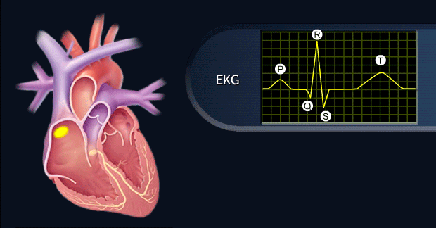
Cardiac Cycle, how does it start?
Each cycle is initiated by spontaneous generation of an action potential in the sinus node
MED CVS CARDIAC CYCLE
‹#›
Notes:
Each cycle is initiated by spontaneous generation of an action potential in the sinus node

Slide 5
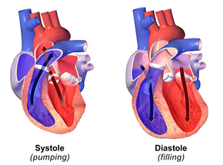
Systole and Diastole
The cardiac cycle consists:
Atrial and ventricular systole and
Atrial and ventricular diastole.
MED CVS CARDIAC CYCLE
MED CVS CARDIAC CYCLE
MED CVS CARDIAC CYCLE
‹#›
Notes:
of a period of relaxation called diastole, during which heart fills with blood, followed by a period of contraction called systole.

Slide 6
Atrial systole
Atrial Events
Atrial diastole
Phases of cardiac cycle
Ventricular systole
Ventricular Events
Ventricular diastole

Slide 7
Duration of Cardiac Cycle
Duration of cardiac cycle =reciprocal of heart rate=1/HR
Example: heart rate is 75 beats/min,
Duration of cardiac cycle is =
1/75 = 0.0133 min x 60 (1 minute=60 sec)=0.8 sec
MED CVS CARDIAC CYCLE
‹#›

Slide 8
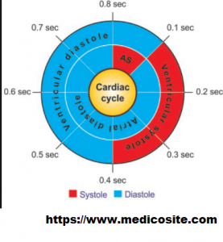
Duration of Cardiac Cycle
Atrial:
Atrial systole (AS)= 0.1 sec
Atrial diastole= 0.7 sec
Ventricular:
Ventricular systole= 0.3 sec
Ventricular diastole= 0.5 sec
0.8
0.8
MED CVS CARDIAC CYCLE
‹#›

Slide 9
Events of cardiac cycle for left ventricle (LV)
Atrial Systole
Isovolumetric Ventricular Contraction
Rapid Ventricular Ejection
Reduced Ventricular Ejection
Isovolumetric Ventricular Relaxation
Rapid Ventricular Filling
Reduced Ventricular Filling (Diastasis)
MED CVS CARDIAC CYCLE
Notes:
Figure 4–25 The cardiac cycle. The mechanical and electrical events that occur during one cycle are
shown. Atrial systole (A); isovolumetric ventricular contraction (B); rapid ventricular ejection (C); reduced
ventricular ejection (D); isovolumetric ventricular relaxation (E); rapid ventricular filling (F); reduced ventricular
filling (diastasis) (G).

Slide 10
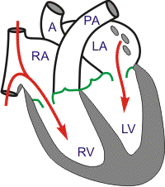
Atrial Systole (atrial contraction)
P wave
Atrial contraction
Atrial pressure increases
What valve is open?
LV is filling
S4 is not audible in normal adults
MED CVS CARDIAC CYCLE
Notes:
LV is relaxed during this phase, and because MV is open ► LV is filling.
mitral Valve: Open
Aortic Valve: Closed
Atrial Systole (A)
Atrial systole is atrial contraction. It is preceded by the P wave on the ECG, which marks depolarization of the atria. Contraction of the left atrium causes an increase in left atrial pressure. When this increase in atrial pressure is reflected back to the veins, it appears on the venous pulse record as the a wave. The left ventricle is relaxed during this phase, and because the mitral valve (AV valve of the left side of the heart) is open, the ventricle is filling with blood from the atrium, even prior to atrial systole. Atrial systole causes a further increase in ventricular volume as blood is actively ejected from the left atrium to the left ventricle through the open mitral valve.
The fourth heart sound (S4) is not audible in normal adults, although it may be heard in ventricular hypertrophy, where ventricular compliance is decreased. When present, S4 coincides with atrial contraction. The sound is caused by the atrium contracting against, and trying to fill, a stiffened ventricle.

Slide 11
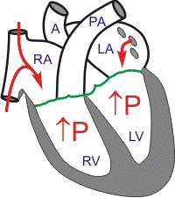
B. Isovolumetric Ventricular Contraction
ventricles contract with no emptying
QRS
LV contracts
with no significant shortening of fibers.
LVP increases
LVP > LAP
What valve is open?
MV closes (S1)
MED CVS CARDIAC CYCLE
Notes:
In this period, ventricles contract with no emptying.
All Valves Closed
LV contracts
with no shortening of fibers (Isovolumetric).
an early phase of ventricular systole in which the cardiac muscle exerts increasing pressure on the contents of the ventricle without significant change in the muscle fiber length and the ventricular volume remains constant
Isovolumetric Ventricular Contraction (B)
Period of Isovolumic (Isometric) Contraction. Immediately after ventricular contraction begins, the ventricular pressure rises abruptly, as shown in Figure 9-6, causing the A-V valves to close. Then an additional 0.02 to 0.03 second is required for the ventricle to build up sufficient pressure to push the semilunar (aortic and pulmonary) valves open against the pressures in the aorta and pulmonary artery. Therefore, during this period, contraction is occurring in the ventricles, but there is no emptying. This is called the period of isovolumic or isometric contraction, meaning that tension is increasing in the muscle but little or no shortening of the muscle fibers is occurring.

Slide 12
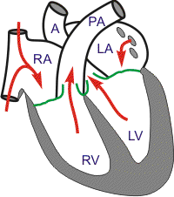
C. Rapid Ventricular Ejection
The end of this phase coincides with the end of the ST segment
LV contracts
increasing LVP
LVP > aortic pressure
The left ventricular pressure rises > 80 mm Hg causes the opening of the aortic valves
aortic valve opens
Most of the stroke volume is ejected during rapid ventricular ejection
blood is ejected from LV into aorta
70 % of blood
MED CVS CARDIAC CYCLE
Notes:
End of this phase coincides with end of ventricular contraction.
MV Remains Closed
Period of Ejection. When the left ventricular pressure rises slightly above 80 mm Hg (and the right ventricular pressure slightly above 8 mm Hg), the ventricular pressures push the semilunar valves open. Immediately, blood begins to pour out of the ventricles, with about 70 percent of the blood emptying occurring during the first third of the period of ejection and the remaining 30 percent emptying during the next two thirds. Therefore, the first third is called the period of rapid ejection, and the last two thirds, the period of slow ejection.
Rapid Ventricular Ejection (C) The ventricle continues to contract, and ventricular pressure reaches its highest value. When ventricular pressure becomes greater than aortic pressure, the aortic valve opens. Now blood is rapidly ejected from the left ventricle into the aorta through the open aortic valve, driven by the pressure gradient between the left ventricle and the aorta. Most of the stroke volume is ejected during rapid ventricular ejection, dramatically decreasing ventricular volume. Concomitantly, aortic pressure increases as a result of the large volume of blood that is suddenly added to the aorta. During this phase, atrial filling begins and left atrial pressure slowly increases as blood is returned to the left heart from the pulmonary circulation. This blood will, of course, be ejected from the left heart in the next cycle. The end of this phase coincides with the end of the ST segment (or the beginning of the T wave) on the ECG and with the end of ventricular contraction

Slide 13
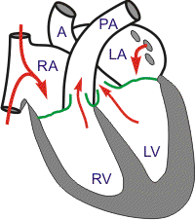
D. Reduced Ventricular Ejection
ventricles begin to repolarize
(T wave)
marked by the beginning of the T wave on the ECG
LV contraction is weaker
LVP falls but is still higher than aorta
aortic valve is still open
blood continues to be ejected into aorta
30%
MED CVS CARDIAC CYCLE
Notes:
Because aortic valve is still open, blood continues to be ejected from the LV into the aorta
AV remains Open;
MV Remains Closed
Reduced Ventricular Ejection (D)
During reduced ventricular ejection, the ventricles begin to repolarize, which is marked by the beginning of the T wave on the ECG. Ventricular pressure falls because the ventricles are no longer contracting. Because the aortic valve is still open, blood continues to be ejected from the left ventricle into the aorta, albeit at a reduced rate; ventricular volume also continues to fall, but at a reduced rate. Even though blood continues to be added to the aorta from the left ventricle, blood is “running off” into the arterial tree at an even faster rate, causing aortic pressure to fall. Left atrial pressure continues to increase as blood returns to the left heart from the lungs.

Slide 14
E. Isovolumetric Ventricular Relaxation
Full repolarize-tion of ventricles
End of T wave
LV relaxes
LVP < aortic pressure
All Valves Closed
aortic valve closes (S2)
MED CVS CARDIAC CYCLE
Notes:
At the end of systole, ventricular relaxation begins suddenly, allowing both the right and left intraventricular pressures to decrease rapidly. The elevated pressures in the distended large arteries that have just been filled with blood from the contracted ventricles immediately push blood back toward the ventricles, which snaps the aortic and pulmonary valves closed. For another 0.03 to 0.06 second, the ventricular muscle continues to relax, even though the ventricular volume does not change, giving rise to the period of isovolumic or isometric relaxation. During this period, the intraventricular pressures decrease rapidly back to their low diastolic levels. Then the A-V valves open to begin a new cycle of ventricular pumping.
Isovolumetric Ventricular Relaxation (E) Isovolumetric ventricular relaxation begins after the ventricles are fully repolarized, marked by the end of the T wave on the ECG. Because the left ventricle is relaxed, left ventricular pressure decreases dramatically. When left ventricular pressure falls below aortic pressure, the aortic valve closes. The aortic valve closes slightly before the pulmonic valve, producing the second heart sound (S2). Inspiration delays closure of the pulmonic valve and causes splitting of the second heart sound; that is, during inspiration, the pulmonic valve closes distinctly after the aortic valve. Splitting occurs during inspiration because the associated decrease in intrathoracic pressure produces an increase in venous return to the right side of the heart. The resulting increase in right ventricular enddiastolic volume causes an increase in right ventricular stroke volume by the Frank-Starling mechanism and prolongs right ventricular ejection time; the prolongation of ejection time delays closure of the pulmonic valve relative to the aortic valve. At the point where the aortic valve closes, the aortic pressure curve shows a “blip,” called the dicrotic notch or incisura. Because all valves are closed again, no blood can be ejected from the left ventricle, nor can the left ventricle fill with blood from the atria. Therefore, during this phase, ventricular volume is constant (isovolumetric)

Slide 15
F. Rapid Ventricular Filling
LVP falls< LA pressure
MV opens
ventricle begins to fill with blood
Rapid flow of blood from atria to ventricles ► S3, which is normal in children but is not heard in normal adults.
S3, is known as the “ventricular gallop,”
LV volume increases rapidly.
80%
MED CVS CARDIAC CYCLE
Notes:
Rapid filling lasts for the first third of diastole.
MV Open
The third heart sound (S3), also known as the “ventricular gallop,” occurs just after S2 when the mitral valve opens, allowing passive filling of the left ventricle. The S3 sound is actually produced by the large amount of blood striking a very compliant left ventricle.
A S3 can be a normal finding in children, pregnant females and well-trained athletes
Rapid Ventricular Filling (F)
When ventricular pressure falls to its lowest level (and slightly below left atrial pressure), the mitral valve opens. Once the mitral valve opens, the ventricle begins to fill with blood from the left atrium, and ventricular volume increases rapidly. Ventricular pressure remains low, however, because the ventricle is still relaxed and compliant. (The high compliance of the ventricle means that volume can be added to it without changing pressure.) The rapid flow of blood from the atria to the ventricles produces the third heart sound (S3), which is normal in children but is not heard in normal adults; in middle-aged or older adults, the presence of S3 indicates volume overload, as in congestive heart failure or advanced mitral or tricuspid regurgitation. During this phase (and for the remainder of the cardiac cycle), aortic pressure decreases as blood runs off from the aorta into the arterial tree, to the veins, and then back to the heart

Slide 16
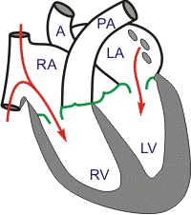
G. Reduced Ventricular Filling (Diastasis)
It is the final portion of ventricular filling, which occurs at a slower rate than in the previous phase.
20 %
Longest phase of cardiac cycle
heart rate alters the time available for diastasis
MED CVS CARDIAC CYCLE
Notes:
Changes in heart rate alter the time available for diastasis because it is the longest phase of the cardiac cycle.
During the last third of diastole, the atria contract and give an additional thrust to the inflow of blood into the ventricles; this accounts for about 20 percent of the filling of the ventricles during each heart cycle.
Reduced Ventricular Filling (Diastasis) (G)
Reduced ventricular filling, or diastasis, is the longest phase of the cardiac cycle and includes the final portion of ventricular filling, which occurs at a slower rate than in the previous phase. Atrial systole marks the end of diastole, at which point ventricular volume is equal to end-diastolic volume. Changes in heart rate alter the time available for diastasis because it is the longest phase of the cardiac cycle. For example, increases in heart rate reduce the time interval before the next P wave (i.e., the next cycle) and reduce, or even eliminate, this final portion of ventricular filling. If diastasis is reduced by such an increase in heart rate, ventricular filling will be compromised, end-diastolic volume will be reduced, and, as a consequence, stroke volume also will be reduced (recall the Frank-Starling relationship).

Slide 17
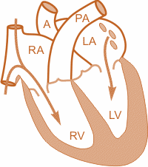
PRESSURE CHANGES IN CARDIAC CYCLE
Remember
Events are the same in the right & left sides of the heart, but with lower pressures in the right side
Fluids, flow according to pressure gradients—that is, they move from regions that are higher in pressure to regions that are lower in pressure.
Notes:
Fluids, whether gases or liquids, are materials that flow according to pressure gradients—that is, they move from regions that are higher in pressure to regions that are lower in pressure. Accordingly, when the heart chambers are relaxed (diastole), blood will flow into the atria from the veins, which are higher in pressure. As blood flows into the atria, the pressure will rise, so the blood will initially move passively from the atria into the ventricles. When the action potential triggers the muscles in the atria to contract (atrial systole), the pressure within the atria rises further, pumping blood into the ventricles. During ventricular systole, pressure rises in the ventricles, pumping blood into the pulmonary trunk from the right ventricle and into the aorta from the left ventricle. Again, as you consider this flow and relate it to the conduction pathway, the elegance of the system should become apparent.

Slide 18
Events of cardiac cycle
A
B
C
D
E
F
G
Atrial Systole
Isovolumetric Ventricular Contraction
Rapid Ventricular Ejection
Reduced Ventricular Ejection
Isovolumetric Ventricular Relaxation
Rapid Ventricular Filling
Reduced Ventricular Filling (Diastasis)
MED CVS CARDIAC CYCLE
Notes:
Atrial Systole
Isovolumetric Ventricular Contraction
Rapid Ventricular Ejection
Reduced Ventricular Ejection
Isovolumetric Ventricular Relaxation
Rapid Ventricular Filling
Reduced Ventricular Filling (Diastasis)

Slide 19
Effect of Heart Rate on Duration of Cardiac Cycle
heart rate
duration of
cardiac cycle
The duration of the action potential and the period of contraction (systole) also decrease, but not by as great a percentage as does the relaxation phase (diastole).
‹#›
MED CVS CARDIAC CYCLE
Notes:
Effect of Heart Rate on Duration of Cardiac Cycle. When heart rate increases, the duration of each cardiac cycle decreases, including the contraction and relaxation phases. The duration of the action potential and the period of contraction (systole) also decrease, but not by as great a percentage as does the relaxation phase (diastole).
At a normal heart rate of 72 beats/min, systole comprises about 0.4 of the entire cardiac cycle. At three times the normal heart rate, systole is about 0.65 of the entire cardiac cycle. This means that the heart beating at a very fast rate does not remain relaxed long enough to allow complete filling of the cardiac chambers before the next contraction.

Slide 20
End-Diastolic Volume, End-Systolic Volume, and Stroke Volume Output
During diastole, filling of ventricles increases volume of ventricle to 110 -120 ml. this is called the end-diastolic volume, EDV).
During systole, the volume ejected is about 70 ml, this is called the stroke volume (SV) output.
Stroke Volume: The volume of blood ejected on one ventricular contraction
Stroke volume = end-diastolic volume – end-systolic volume
The remaining volume in each ventricle, about 40 to 50 ml, is called the end-systolic volume (ESV).
By increasing the EDV and decreasing the ESV, the SV output can be increased.
‹#›
MED CVS CARDIAC CYCLE
Notes:
During diastole, normal filling of the ventricles increases the volume of each ventricle to about 110 to 120 ml. This volume is called the end-diastolic volume.
Then, as the ventricles empty during systole, the volume decreases about 70 ml, which is called the stroke volume output.
The remaining volume in each ventricle, about 40 to 50 ml, is called the end-systolic volume.
The fraction of the end-diastolic volume that is ejected is called the ejection fraction—usually equal to about 60 percent.
When the heart contracts strongly, the end-systolic volume can be decreased to as little as 10 to 20 ml. Conversely, when large amounts of blood flow into the ventricles during diastole, the ventricular end-diastolic volumes can become as great as 150 to 180 ml in the healthy heart. By both increasing the end-diastolic volume and decreasing the end-systolic volume, the stroke volume output can be increased to more than double normal.

Slide 21
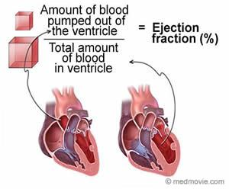
Ejection Fraction, and Cardiac Output
Cardiac output = Volume ejected per minute (mL/min)
Cardiac output = Stroke volume × Heart rate
Ejection fraction: the fraction (%) of the end-diastolic volume that is ejected in one stroke volume.
Ejection fraction=Stroke volume /End-diastolic volume X100
‹#›
Notes:
Cardiac output = Volume ejected per minute (mL/min)
Stroke volume = Volume ejected in one beat (mL)

Slide 22
Stroke Volume, Ejection Fraction, and Cardiac Output
PROBLEM. A man has an EDV of 110 mL, an ESV volume of 40 mL, and a heart rate of 75 beats/min. What is his stroke volume, his cardiac output, and his ejection fraction?
Stroke volume = EDV− ESV = 110-40=70 ml
Cardiac output= SV× HR =70X75=5250 mL/min
Ejection fraction= SV/EDVX100 = 70 /110X100 = 0.64X100= 64%
Normal ejection fraction is about 60 – 65 %.
Ejection fraction is good index of ventricular function.
‹#›
Notes:
Cardiac output = Volume ejected per minute (mL/min)
Stroke volume = Volume ejected on one beat (mL)

Slide 23
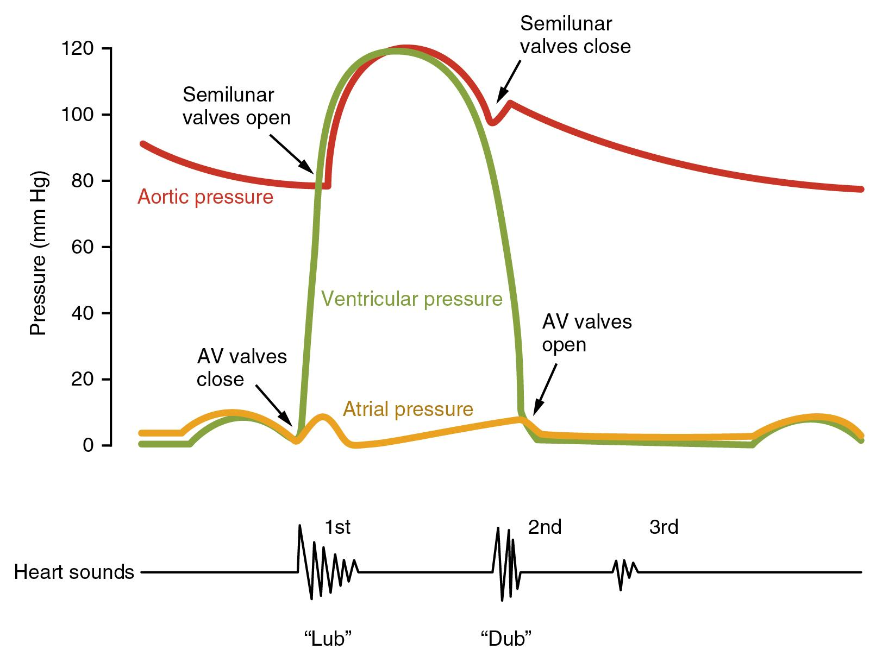
Pressure Changes in the Atria—a, c, and v Waves-(yellow line)
a: atrial contraction
c : bulging of the A-V valves backwards (due to increase in pressure in ventricles), at beginning of ventricular contraction
V: Results from flow of blood into atria at end of ventricular contraction.
a
c
V
‹#›
MED CVS CARDIAC CYCLE
Notes:
a: atrial contraction ( right atrial pressure increases 4-6 mm Hg during atrial contraction, and left atrial pressure increases 7-8 mm Hg.
c : at beginning of ventricular contraction, bulging of the A-V valves backward toward the atria because of increasing pressure in the ventricles.
V: end of ventricular contraction; Results from flow of blood into atria from veins while A-V valves are closed.
Pressure Changes in the Atria—a, c, and v Waves. In the atrial pressure curve of Figure 9-6, three minor pressure elevations, called the a, c, and v atrial pressure waves, are noted. The a wave is caused by atrial contraction. Ordinarily, the right atrial pressure increases 4 to 6 mm Hg during atrial contraction, and the left atrial pressure increases about 7 to 8 mm Hg. The c wave occurs when the ventricles begin to contract; it is caused partly by slight backflow of blood into the atria at the onset of ventricular contraction but mainly by bulging of the A-V valves backward toward the atria because of increasing pressure in the ventricles. The v wave occurs toward the end of ventricular contraction; it results from slow flow of blood into the atria from the veins while the A-V valves are closed during ventricular contraction. Then, when ventricular contraction is over, the A-V valves open, allowing this stored atrial blood to flow rapidly into the ventricles and causing the v wave to disappear.

Slide 24
Aortic Pressure Curve
The entry of blood into the arteries causes the walls of these arteries to stretch and the pressure to increase to about 120 mm Hg
Incisura (dicrotic notch)
caused by backward flow of blood immediately before closure of valve.
After Aortic valve has closed, pressure in the aorta decreases slowly throughout diastole to 80 mm Hg (diastolic pressure).
‹#›
MED CVS CARDIAC CYCLE
Notes:
When the left ventricle contracts, the ventricular pressure increases rapidly until the aortic valve opens. Then, after the valve opens, the pressure in the ventricle rises much less rapidly, because blood immediately flows out of the ventricle into the aorta and then into the systemic distribution arteries.
The entry of blood into the arteries causes the walls of these arteries to stretch and the pressure to increase to about 120 mm Hg.
Next, at the end of systole, after the left ventricle stops ejecting blood and the aortic valve closes, the elastic walls of the arteries maintain a high pressure in the arteries, even during diastole.
A so-called incisura- a downward notch in the curve recording aortic blood pressure that occurs between systole and diastole and is caused by backflow of blood for a short time before the aortic valve closes.
After the aortic valve has closed, the pressure in the aorta decreases slowly throughout diastole because the blood stored in the distended elastic arteries flows continually through the peripheral vessels back to the veins. Before the ventricle contracts again, the aortic pressure usually has fallen to about 80 mm Hg (diastolic pressure), which is two thirds the maximal pressure of 120 mm Hg (systolic pressure) that occurs in the aorta during ventricular contraction.

Slide 25
Volume-Pressure Diagram” During the Cardiac Cycle; Cardiac Work Output
Phase III
It is divided into four phases.
Phase I: Period of filling.
Phase II: Period of isovolumic contraction.
Phase III: Period of ejection.
Phase IV: Period of isovolumic relaxation.
Phase IV
All valves closed
Phase II
All valves closed
Phase I
‹#›
Notes:
Phase I: Period of filling. This phase in the volume-pressure diagram begins at a LVV of 50 ml and a diastolic pressure of 2 to 3 mm Hg. The amount of blood that remains in LV after the previous heartbeat, 50 ml, is called ESV. As venous blood flows into LV from the LA, the ventricular volume increases to 120 ml, called EDV , an increase of 70 ml. Therefore, the volume-pressure diagram during phase I extends along the line point A to point B, with the volume increasing to 120 ml and diastolic pressure rising to about 5 to 7 mm Hg.
Phase II: Period of isovolumic contraction. During isovolumic contraction, the volume of LV does not change because all valves are closed. However, LVP increases to equal pressure in the aorta, at a pressure value of about 80 mm Hg, as depicted by point C.
Phase III: Period of ejection. During ejection, systolic pressure rises even higher because of still more contraction of LV. At the same time, LVV decreases because the aortic valve has now opened and blood flows out of the ventricle into the aorta. Therefore, the curve labeled “III,” or “period of ejection,” traces the changes in volume and systolic pressure during this period of ejection.
Phase IV: Period of isovolumic relaxation. At the end of the period of ejection (point D), the aortic valve closes, and LVP falls back to the diastolic pressure level. The line labeled “IV” traces this decrease in intraventricular pressure without any change in volume. Thus, the ventricle returns to its starting point, with about 50 ml of blood left in the ventricle and at an atrial pressure of 2 to 3 mm Hg.

Slide 26
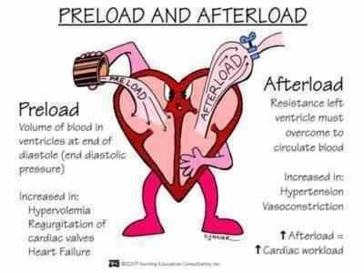
Concepts of Preload and After load of ventricle
Preload: the end-diastolic pressure when the ventricle has become filled.
Afterload: the pressure in the aorta leading from the ventricle.
In many abnormal functional states of the heart or circulation, the preload and afterload, or both are severely altered from normal.
MED CVS CARDIAC CYCLE
‹#›
Notes:
Concepts of Preload and Afterload.
In assessing the contractile properties of muscle, it is important to specify the degree of tension on the muscle when it begins to contract, which is called the preload, and to specify the load against which the muscle exerts its contractile force, which is called the afterload. For cardiac contraction, the preload is usually considered to be the end-diastolic pressure when the ventricle has become filled. The afterload of the ventricle is the pressure in the aorta leading from the ventricle. In Figure 9-8, this corresponds to the systolic pressure described by the phase III curve of the volume-pressure diagram. (Sometimes the afterload is loosely considered to be the resistance in the circulation rather than the pressure.) The importance of the concepts of preload and afterload is that in many abnormal functional states of the heart or circulation, the pressure during filling of the ventricle (the preload), the arterial pressure against which the ventricle must contract (the afterload), or both are severely altered from normal

Slide 27
A. Increased preload: 🡩 venous return → increase in SV based on the Frank–Starling relationship….reflected in increased width of the PV loop.
B. Increased afterload: due to an increase in aortic pressure →
decrease in stroke volume….is reflected in decreased width of the PV loop.
C. Increased contractility: → increased width & height of the PV loop.

Slide 28
Heart Sounds
Function of the Valves
Atrioventricular (A-V) valves (tricuspid and mitral) prevent backflow of blood from ventricles to atria during systole
Semilunar valves (aortic and pulmonary artery) prevent backflow from aorta and pulmonary arteries into ventricles during diastole.
These valves, close and open passively (pressure gradients)
MED CVS CARDIAC CYCLE
‹#›
Notes:
Function of the Valves
A-V valves (tricuspid and mitral) prevent backflow of blood from ventricles to atria during systole
Semilunar valves (aortic and pulmonary artery) prevent backflow from aorta and pulmonary arteries into ventricles during diastole.
These valves, close and open passively (pressure gradients)

Slide 29
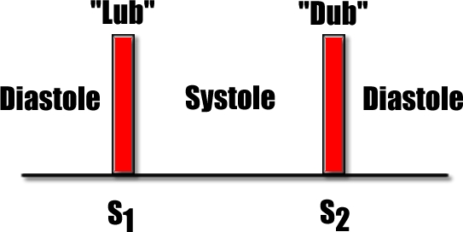
Heart Sounds
Closing of valves causes audible sounds.
No sounds occur when valves are open.
Listening with a stethoscope to a normal heart, one hears
“lub, dub, lub, dub.
First heart sound (S1): ” The “lub” is associated with closure of A-V valves at beginning of systole.
Second heart sound (S2) “dub” is associated with closure of the semilunar (aortic and pulmonary) valves at end of systole.
MED CVS CARDIAC CYCLE
‹#›
Notes:
Listening with a stethoscope to a normal heart, one hears a sound usually described as “lub, dub, lub, dub.” The “lub” is associated with closure of the atrioventricular (A-V) valves at the beginning of systole, and the “dub” is associated with closure of the semilunar (aortic and pulmonary)
valves at the end of systole. The “lub” sound is called the first heart sound, and the “dub” is called the second heart sound, because the normal pumping cycle of the heart is considered to start when the A-V valves close at the onset of ventricular systole.
Some of the common mechanisms by which heart sounds are generated include (1) opening or closure of the heart valves, (2) flow of blood through the valve orifice, (3) flow of blood into the ventricular chambers, and (4) rubbing of cardiac surfaces.

Slide 30
Cause of heart sounds
The cause is vibration of the taut valves immediately after closure, along with vibration of the adjacent walls of the heart and major vessels around the heart.
MED CVS CARDIAC CYCLE
‹#›
Notes:
When listening to the heart with a stethoscope, one does not hear the opening of the valves because this is a relatively slow process that normally makes no noise. However, when the valves close, the vanes of the valves and the surrounding fluids vibrate under the influence of sudden pressure changes, giving off sound that travels in all directions through the chest.
When the ventricles contract, one first hears a sound caused by closure of the A-V valves. The vibration is low in pitch and relatively long-lasting and is known as the first heart sound. When the aortic and pulmonary valves close at the end of systole, one hears a rapid snap because these valves close rapidly, and the surroundings vibrate for a short period. This sound is called the second heart sound.

Slide 31
Murmurs
abnormal heart sounds, known as “heart murmurs,”
Occur in:
Valvular disease
Conginital heart disease
Hyperdynamic circulations
MED CVS CARDIAC CYCLE
‹#›

Slide 32
Heart sounds
https://youtu.be/dBwr2GZCmQM
MED CVS CARDIAC CYCLE

Slide 33
Atrial Systole
Isovolumetric Ventricular Contraction
Rapid Ventricular Ejection
Reduced Ventricular Ejection
Isovolumetric Ventricular Relaxation
Rapid Ventricular Filling
Reduced Ventricular Filling (Diastasis)
MED CVS CARDIAC CYCLE
Notes:
S₃ occurs when rapidly rushing blood flow from the atria is suddenly decelerated by the ventricle when it reaches its elastic limit.
The exact mechanism of S₄ generation is debatable. The ventricular theory proposes that S₄ is generated by sudden deceleration of the jet of blood as it enters a ventricle with decreased compliance.

Slide 35
Abbreviations
AP: action potential
EDV; end diastolic volume
ESV:end systolic volume
HR: heart rate
LVP: left ventricular pressure
MV: mitral valve
RVP: right ventricular pressure
‹#›

Slide 36
THANK YOU
Insert Image

