Slide 1
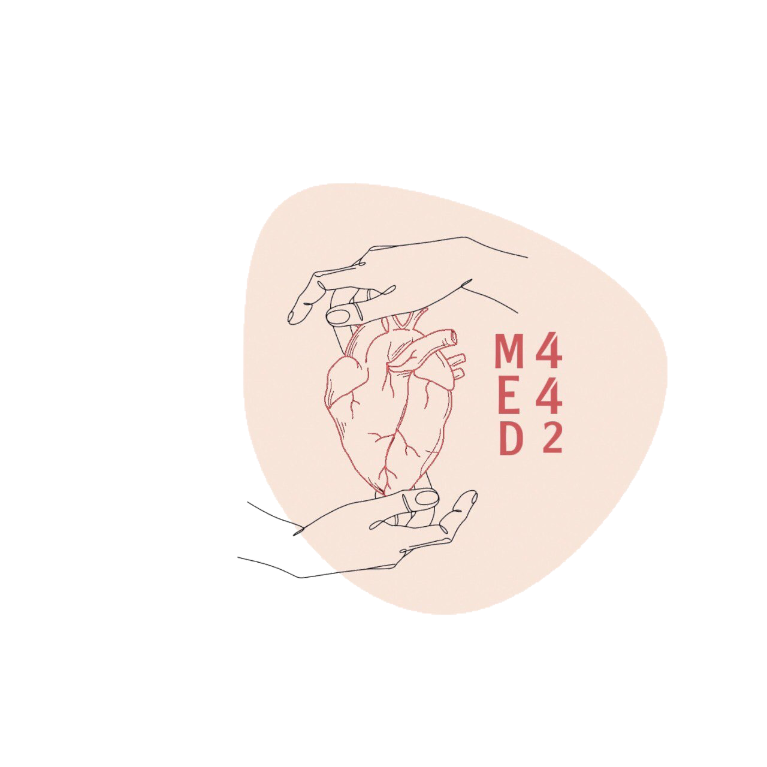
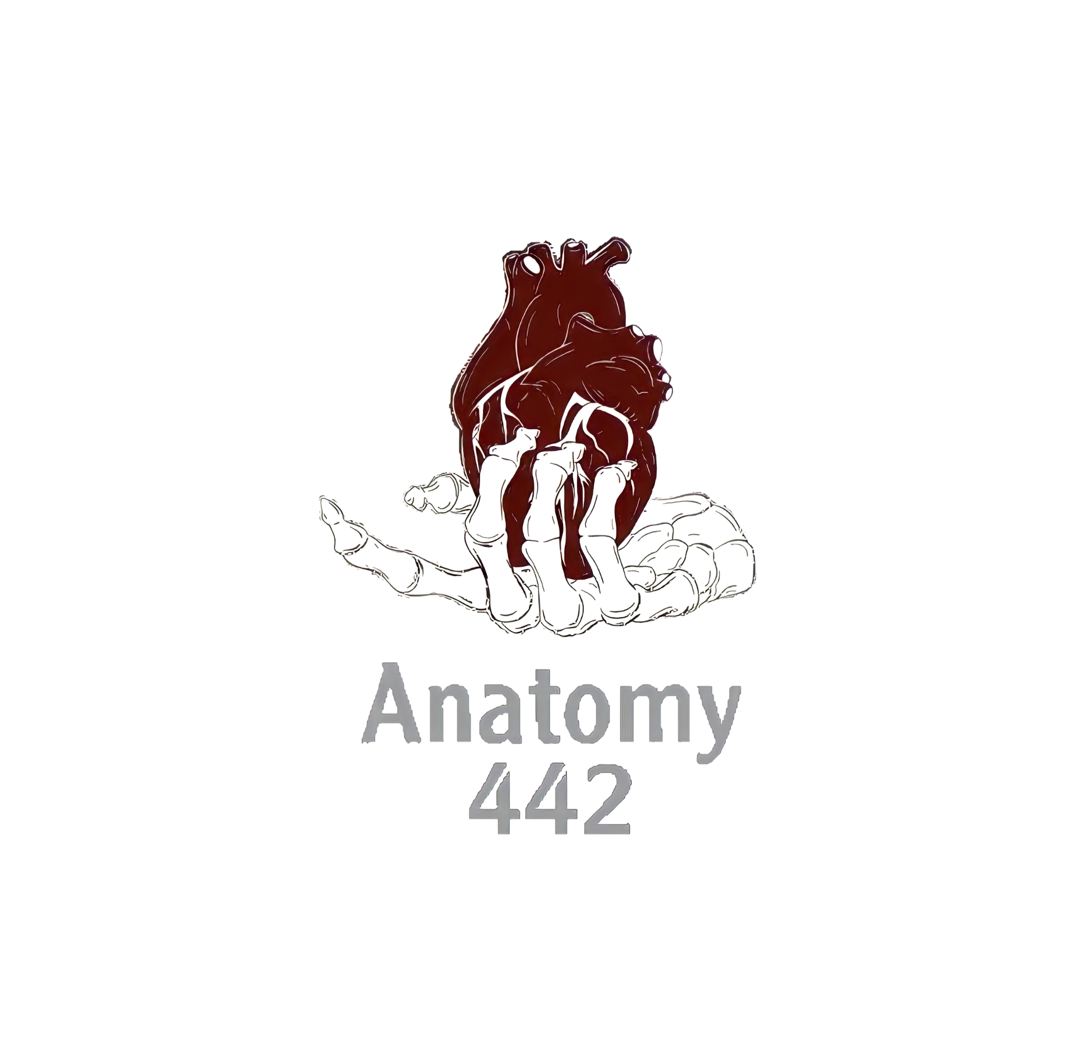
1
By Faisal Alomar
Anatomy of the Heart
____________
CVS Block
Editing File
Color Index:
Main Text
Male’s Slides
Female’s Slides
Important
Doctor’s Notes
Extra Info

Slide 2
Objectives
Describe the shape of heart regarding : apex, base, sternocostal
and diaphragmatic surfaces.
Describe the interior of heart chambers : right atrium, right
ventricle, left atrium and left ventricle.
List the orifices of the heart :
• Right atrioventricular (Tricuspid) orifice.
• Pulmonary orifice.
• Left atrioventricular (Mitral) orifice.
• Aortic orifice.
Describe the innervation of the heart
Briefly describe the conduction system of the Heart

Slide 3
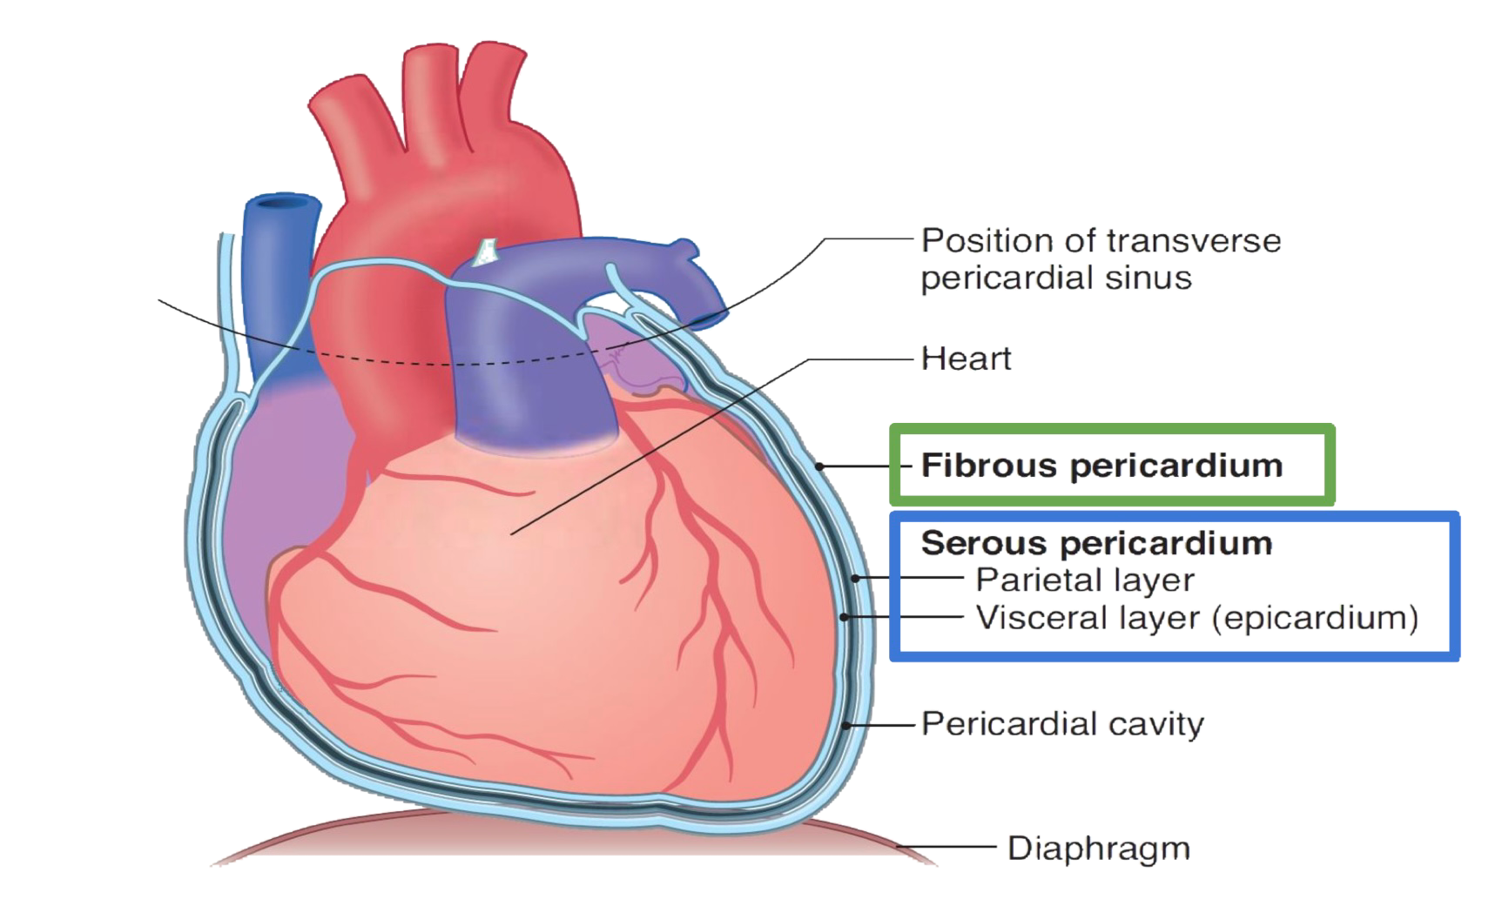
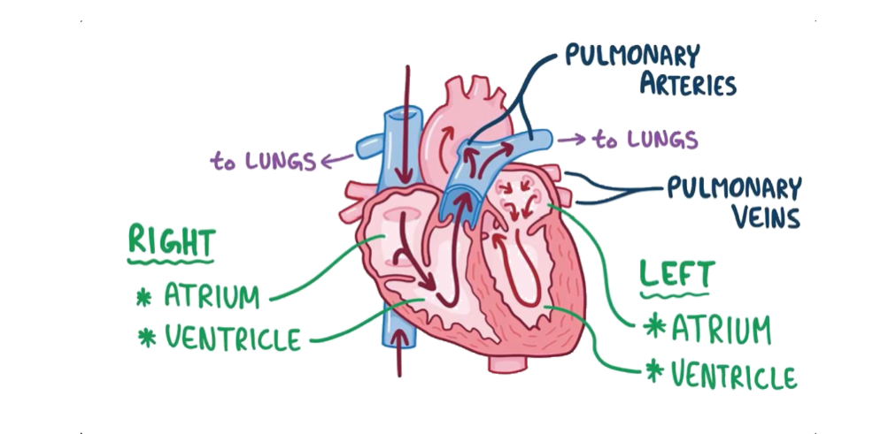
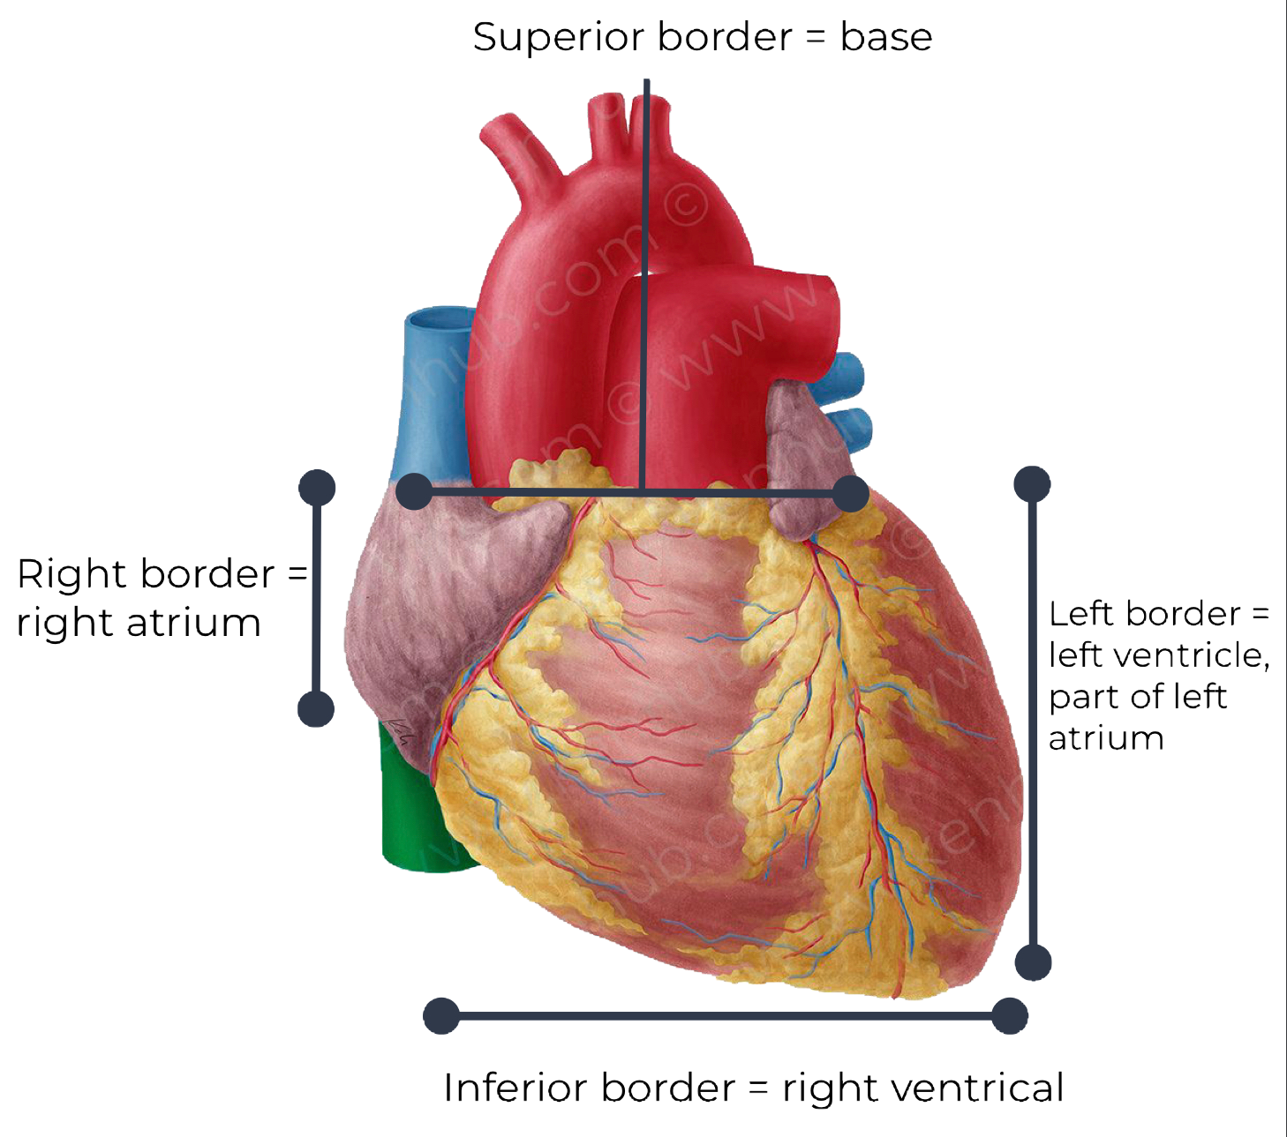
1
The Heart
• It lies in the middle mediastinum
• It is surrounded by a fibroserous sac called pericardium which is differentiated into:
1- outer fibrous layer (Fibrous pericardium)
2- inner serous sac (Serous pericardium)
Subdivided into : parietal layer and visceral layer
The Heart is somewhat pyramidal in shape, having:
External features: | Internal features:
Apex | consists of 4 chambers:
Sterno-costal (anterior surface) | 2 atria(right & left) 2 ventricles (right & left).
Base (posterior surface) | right atrium lies anterior to the left atrium, right ventricle lies anterior to the left ventricle.
Diaphragmatic (inferior surface)
 | Borders
Upper Border | Right Border | Lower Border | Left Border
Is formed by the 2 atria & It is concealed by ascending aorta & pulmonary trunk. | formed by right atrium | Is formed mainly by right ventricle + apical part of left ventricle. | formed mainly by left ventricle + auricle of left atrium.

Slide 4
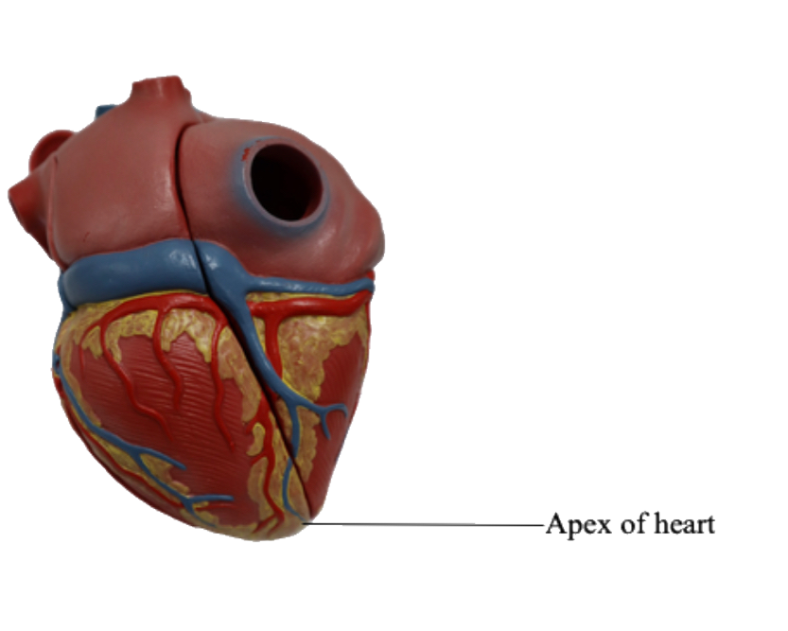
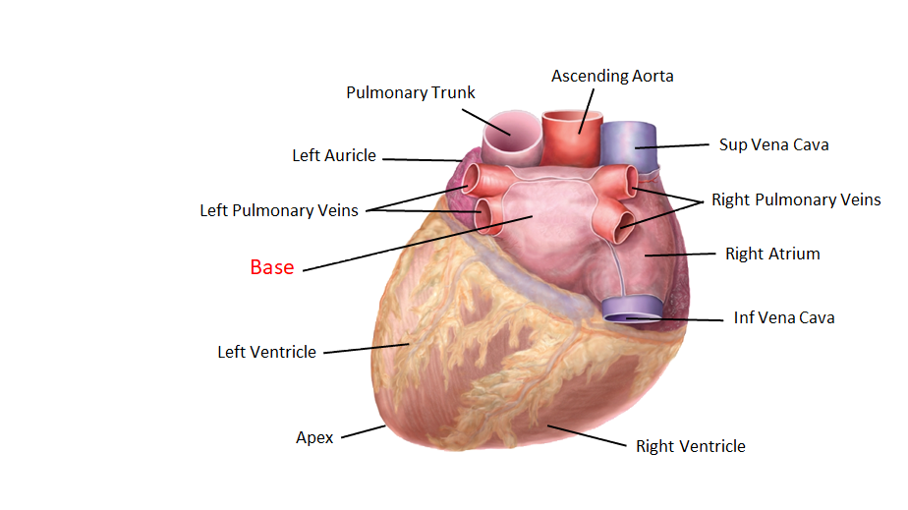
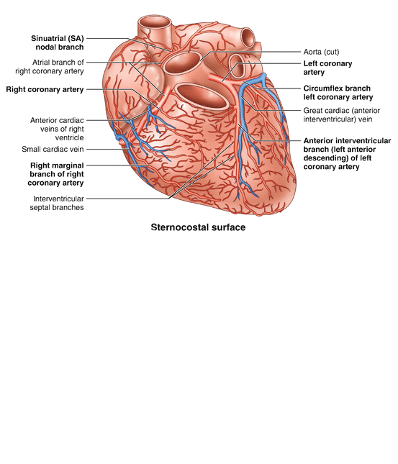
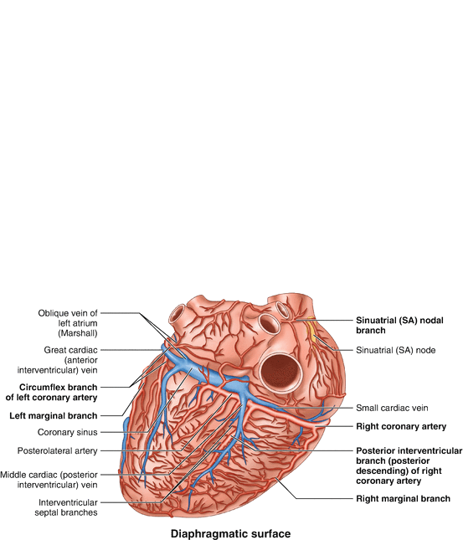
2
External features of the heart
Apex of the Heart
Base of the Heart (Posterior Surface)
Directed downwards, forwards and to the left.
It is formed by the left ventricle.
Lies at the level of left 5th intercostal space 3.5 inch from midline.
It is formed by the 2 atria, mainly left atrium, into which open the 4 pulmonary veins.
It is directed backwards.
Lies opposite middle thoracic vertebrae(T5-T7)
Is separated from the vertebral column by descending aorta, esophagus and oblique sinus of pericardium
Bounded inferiorly by post part
sulcus ,which lodges the coronary sinus
Note That:
Base of the Heart :
• Is called the base because the heart is pyramid shaped;
• The base lies opposite to the apex
• The heart does not rest on its base; it rests on its diaphragmatic (inferior) surface.
External features
This surface is formed mainly by the
right atrium and the right ventricle
Sterno-costal (Anterior) Surface
Diaphragmatic (Inferior) Surface
Divided by coronary (atrio-ventricular) groove into :
Atrial part:
formed mainly by right atrium.
Ventricular part:
the right 2/3 is formed by right ventricle, while the left 1/3 is formed by left
ventricle. So, it is also formed of some of the left ventricle.
The 2 ventricles are separated
by anterior interventricular
groove, which lodges :
Anterior interventricular artery
(branch of left coronary).
Great cardiac vein.
The coronary groove lodges
the right coronary artery.
Formed by the 2-ventricles mainly left ventricle(left 2/3)+ small portion of right ventricle
Slightly concave as it rests on diaphragm
Directed inferiorly & backward.
Separated from base of heart by posterior part of coronary sulcus
The 2-ventricles are separated by posterior interventricular groove which lodges:
-Posterior interventricular artery
-Middle cardiac vein

Slide 5
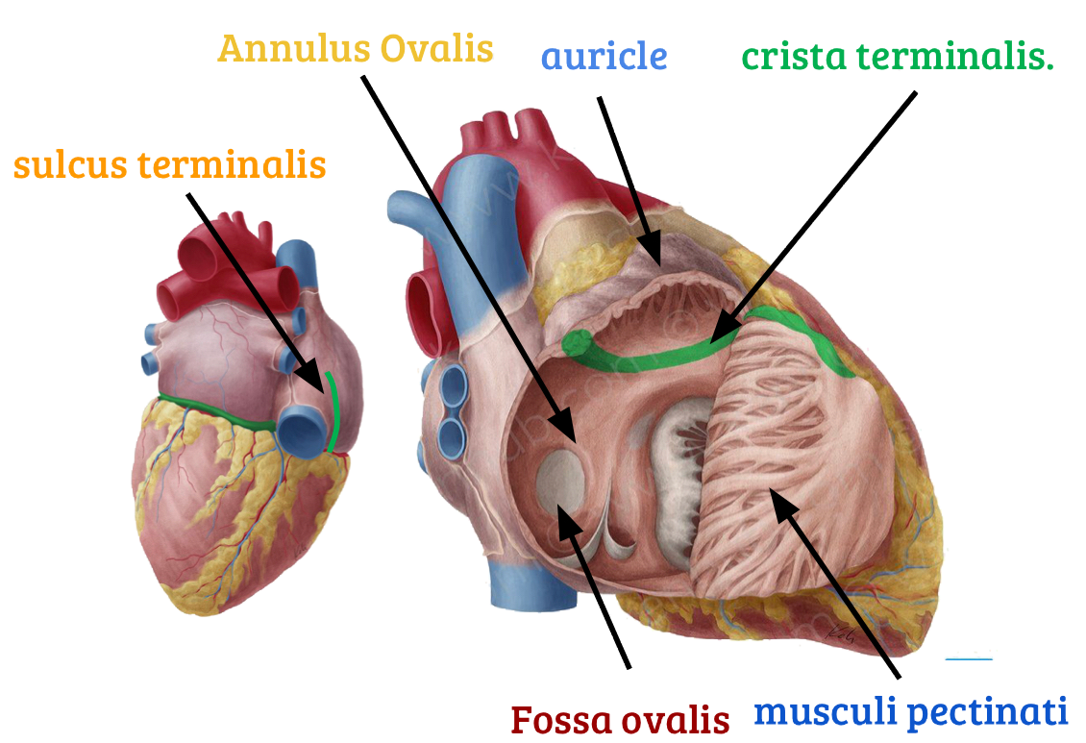
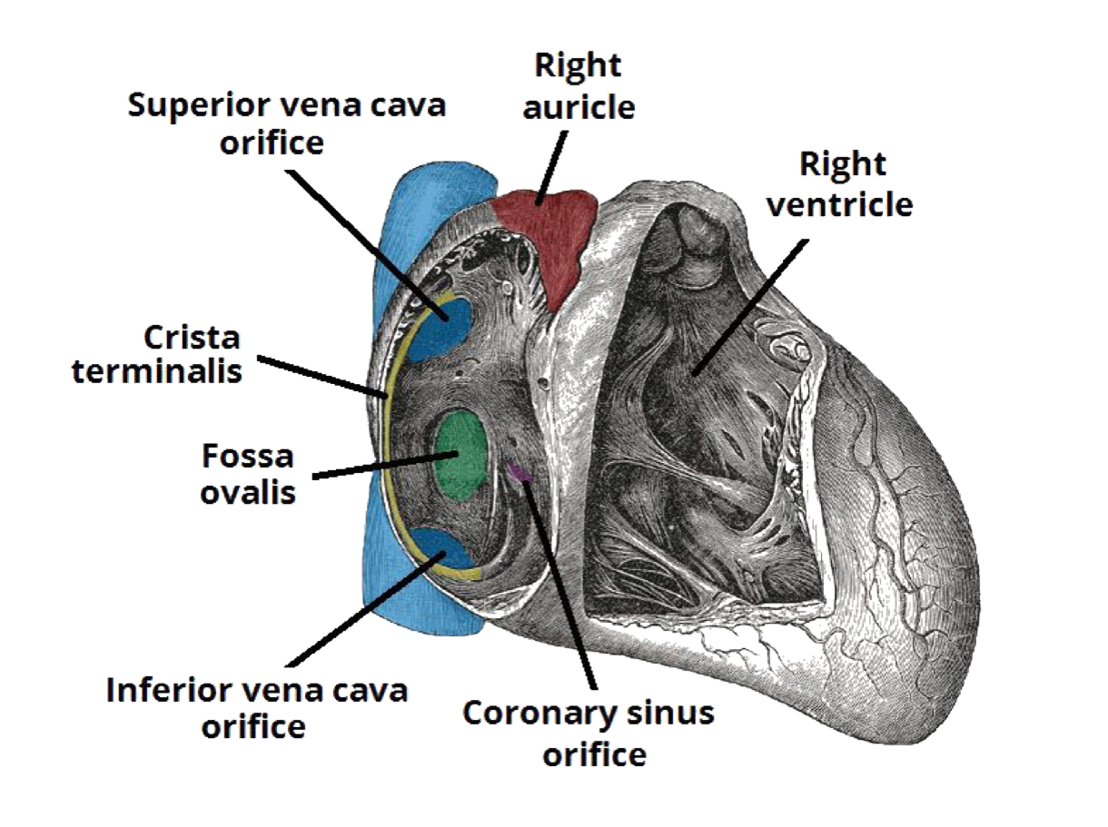
3
Chambers of the heart
-The heart is divided by vertical septa into four chambers: the right and left atria and the right and left ventricles. The right atrium lies anterior to the left atrium, and the right ventricle lies anterior to the left ventricle
Atriums
Right Atrium
The right atrium consists of a main cavity and a small outpouching, the auricle. On the outside of the heart at the junction between the right atrium and the right auricle is a vertical groove, the sulcus terminalis, which on the inside forms a ridge, the crista terminalis. Crista terminalis divides the right atrium into: 1- Anterior part: rough and trabeculated by bundles of muscle fibres (musculi pectinati). 2- Posterior part (sinus venarum) is smooth. -The interatrial septum carries an oval depression called Fossa ovalis The margin of this depression is called Anulus ovalis -The blood leaves right atrium to right ventricle via tricuspid valve. Openings in right atrium: SVC --- has no valve IVC --- guarded by a valve Coronary sinus: has a well- defined valve Right atrioventricular orifice lies anterior to IVC opening, it is surrounded by a fibrous ring which gives attachment to the tricuspid valve Small orifices of small veins

Slide 6
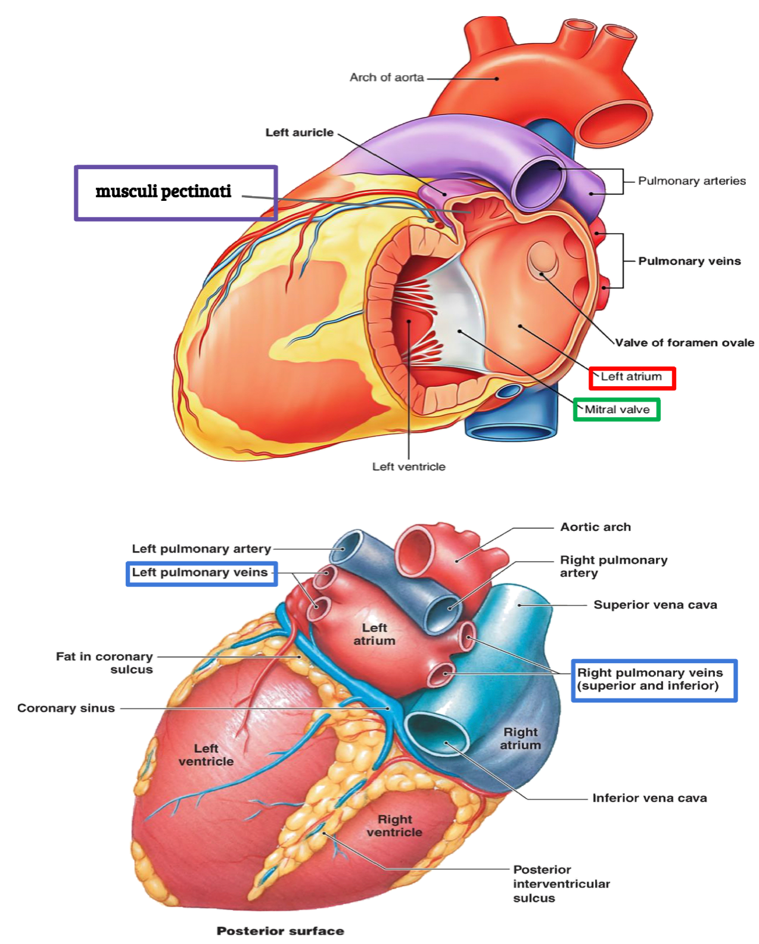
4
Chambers of the heart
Atriums
Left Atrium
The left atrium communicates with the left ventricle through the left atrioventricular orifice and with the aorta through the aortic orifice. It forms the greater part of base of heart. Its wall is smooth except for small musculi pectinati in the left auricle. Receives 4 pulmonary veins which have no valves. Sends blood to left ventricle through the left atrioventricular orifice which is guarded by mitral valve (Bicuspid valve).

Slide 7
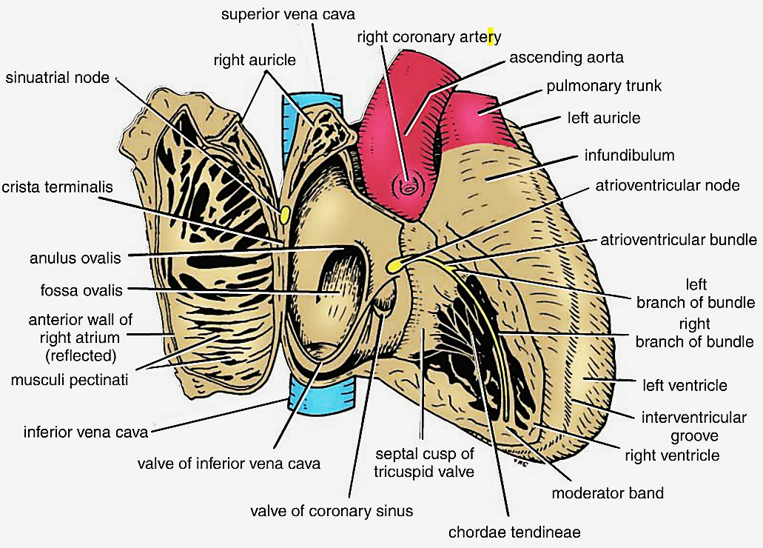
5
Chambers of the heart
Ventricles
Right ventricle
Its wall is thinner than that of left ventricle Its wall contains projections called trabeculae carnae. 􏰀The right ventricle communicates with right atrium through right atrioventricular orifice pulmonary trunk through pulmonary orifice The part of right ventricle leading to the pulmonary trunk becomes funnel shaped, and referred as the infundibulum the wall of infundibulum is smooth and contains no trabeculae Large projections arise from the walls called papillary muscles Anterior papillary muscle Posterior papillary muscle Septal papillary muscle Each papillary muscle is attached to the cusps of tricuspid valve by tendinous threads called chordae tendinae. Interventricular septum is connected to anterior papillary muscle by a muscular band called moderator band Blood leaves the right ventricle to pulmonary trunk through pulmonary orifice.

Slide 8
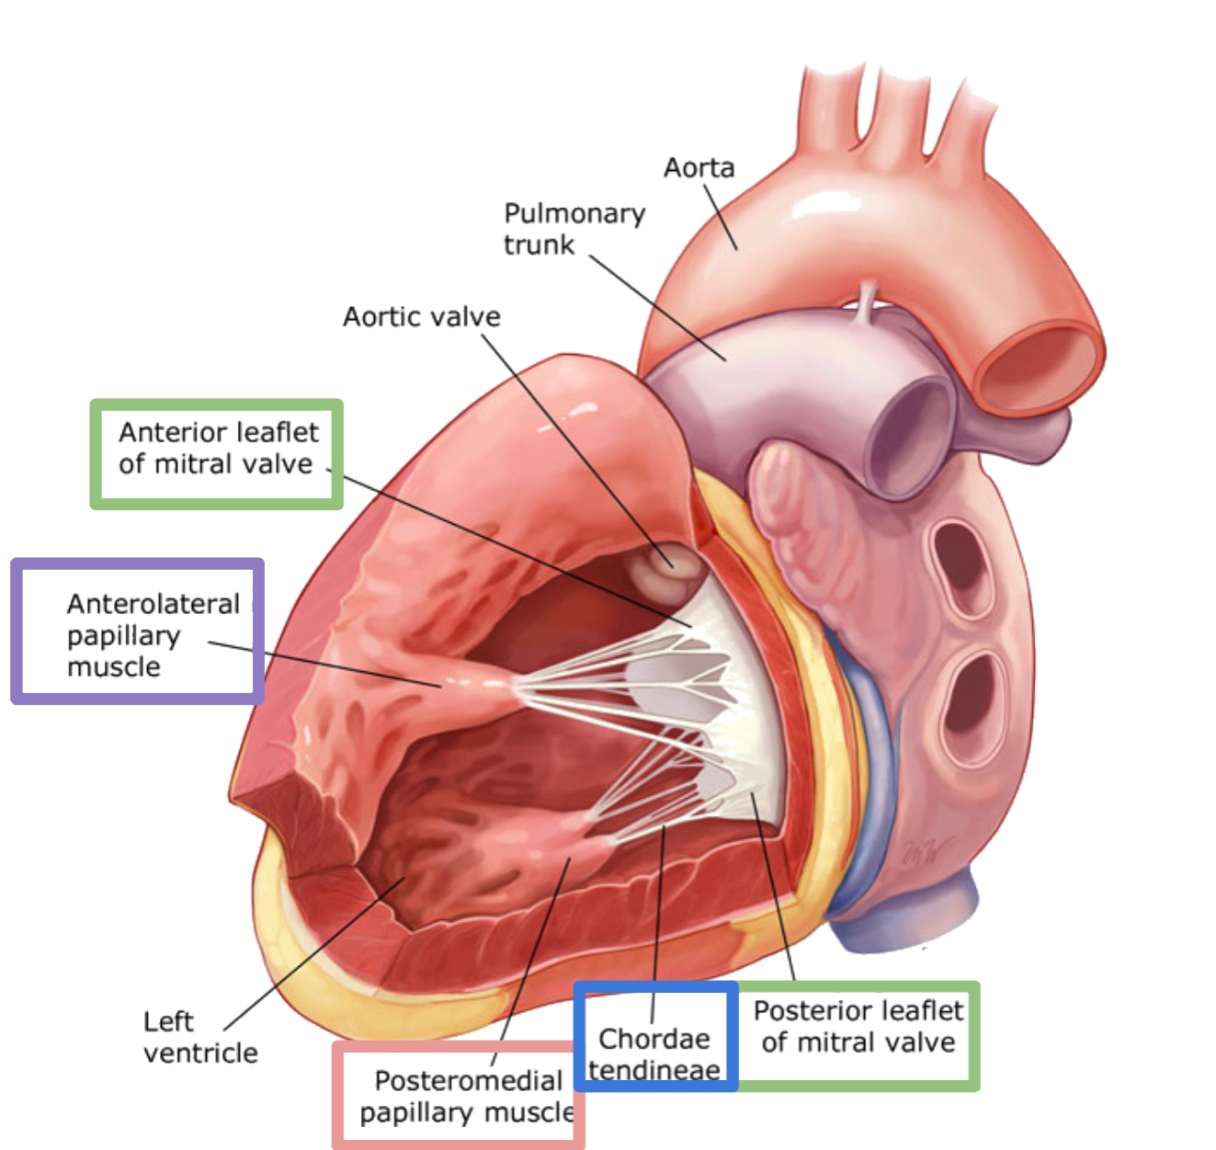
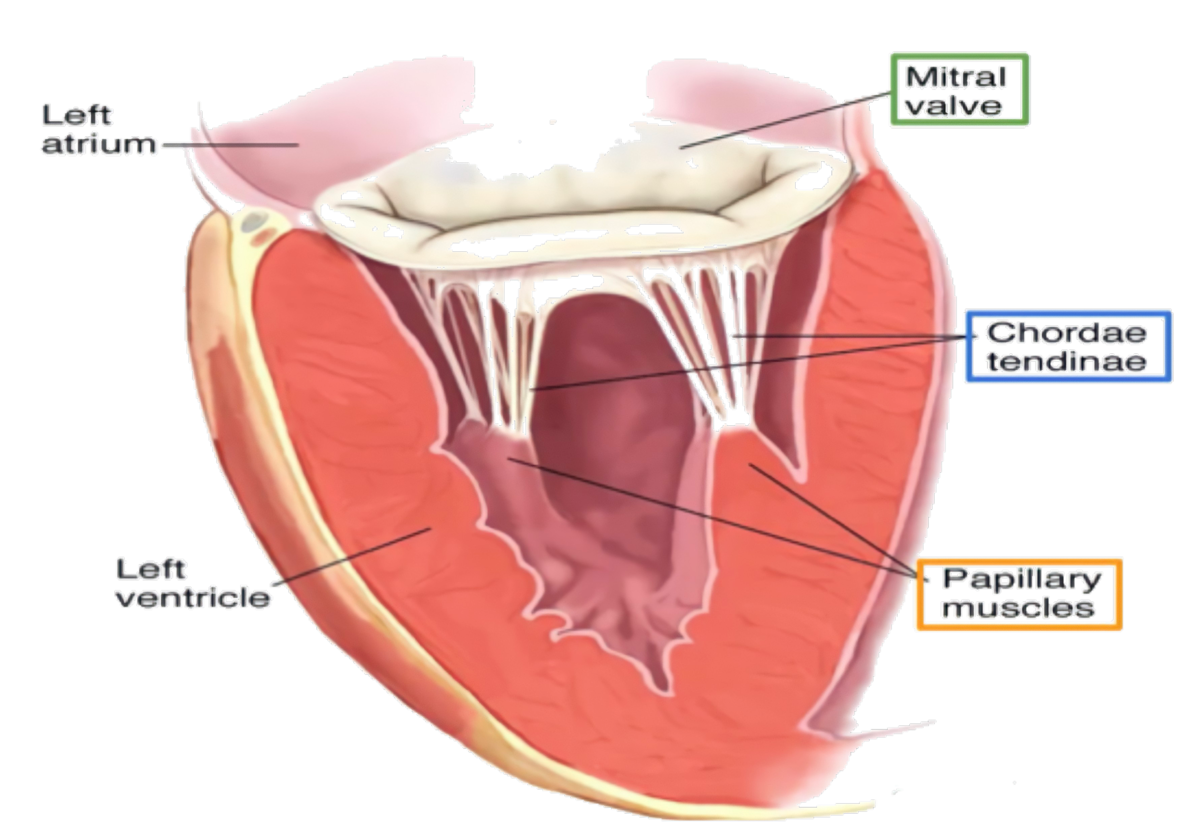
6
Chambers of the heart
Ventricles
Left ventricle
Its wall is thicker than that of right ventricle It receives blood from left atrium through left atrio-ventricular orifice which is guarded by mitral valve.(bicuspid) Its wall contains: trabeculae carneae. 2 large papillary muscles anterior posterior They are attached by chordae tendineae to cusps of mitral valve.. The blood leaves the left ventricle to the ascending aorta through the aortic orifice. The part of left ventricle leading to ascending aorta is called aortic vestibule. The wall of this part is fibrous and smooth.

Slide 9
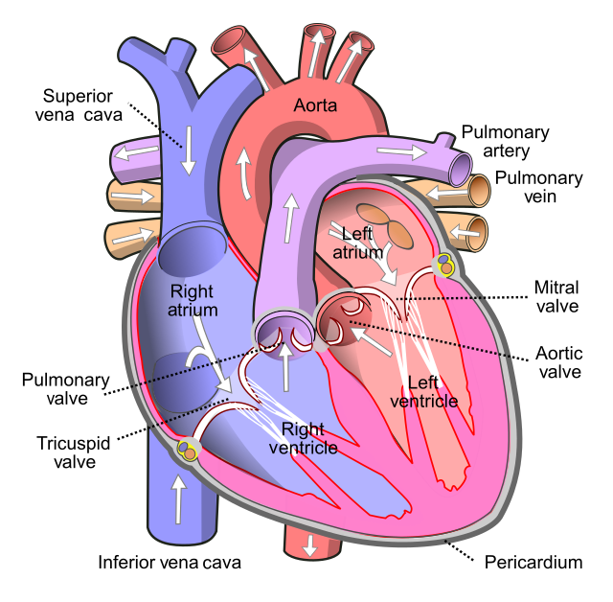
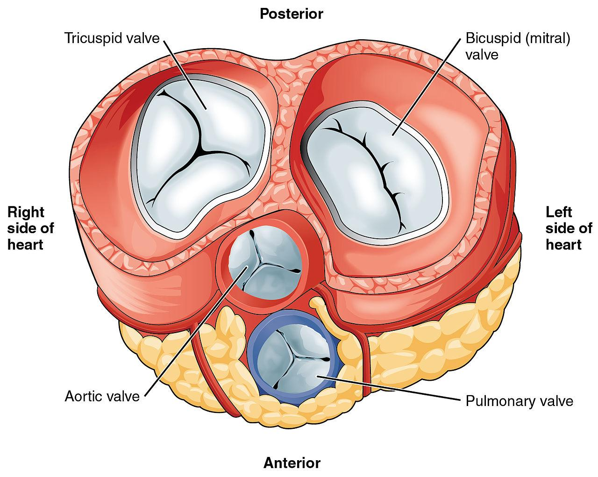
7
Internal Features of the Heart
Orifices
Semilunar orifices
Atrioventricular orifices
Pulmonary Orifice
Aortic Orifice
Right Tricuspid Orifice
Left Mitral (bicuspid) Orifice

Slide 10
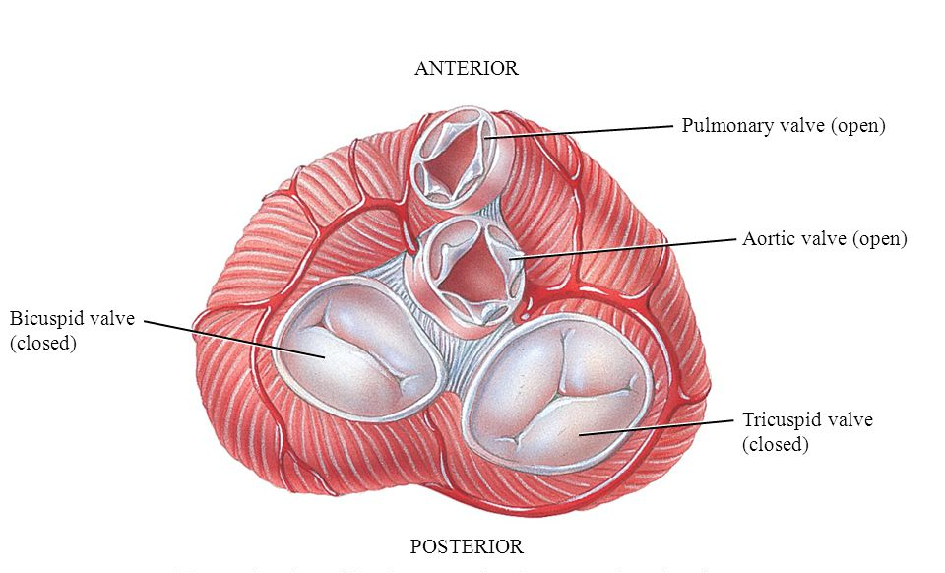
8
Semilunar Orifices
Surrounded by a fibrous ring which gives attachment to the cusps of the pulmonary valve.
􏰁-The valve is formed of 3 semilunar cusps
2 anterior
one posterior.
which are concave superiorly and convex inferiorly
No chordae tendineae or papillary muscles are attached to these cusps
Pulmonary Orifice
Surrounded by a fibrous ring which gives attachment to the cusps of aortic valve
-Aortic valve is formed of 3 semilunar cusps which are similar to those of pulmonary valve, but the position of the cusps differs being
one anterior
2 posterior.
Aortic Orifice

Slide 11
9
Atrioventricular Orifices
Right Tricuspid Orifice
About one inch wide, admitting tips of 3 fingers.
It is guarded by a fibrous ring which gives attachment to the cusps of tricuspid valve.
It has 3-cusps (anterior- posterior-septal or medial).
The atrial surface of the cusps are smooth, while their ventricular surfaces give attachment to the chordae tendinae.
• Smaller than the right, admitting only tips of 2 fingers.
Guarded by a mitral valve. •Surrounded by a fibrous ring which gives attachment to the cusps of mitral valve.
Mitral valve is composed of 2 cusps:
Anterior cusp : lies anteriorly and to right.
Posterior cusp : lies posteriorly and to left.
The atrial surfaces of the cusps are smooth, while ventricular surfaces give attachment to chordae tendinae.
Left Mitral (bicuspid) Orifice

Slide 12
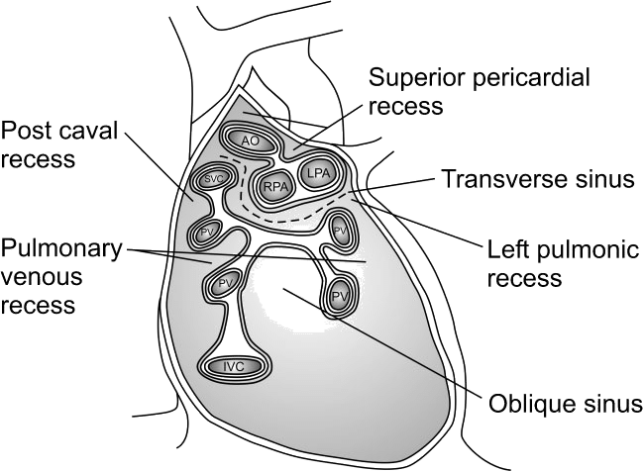
10
Nerve Supply
The heart is supplied by sympathetic & parasympathetic fibers via the cardiac plexus situated below arch of aorta.
The sympathetic fibres arise from the cervical & upper thoracic ganglia of sympathetic trunks (accelerate heart rate)
The parasympathetic fibres arise from the vagus nerves slow heart rate (constriction of coronary arteries)
Postganglionic fibres reach heart along – SAN, AVN & nerve plexus around coronary arteries.
Pericardial Sinuses
[only in girls slides]
Transverse Sinus:
It is a recess of serous pericardium between ascending aorta & pulmonary T. anteriorly , and upper parts of 2 atria & S.V.C. Posteriorly.
Oblique Sinus :
It lies posterior to the heart.
It is a recess of serous pericardium behind the base of heart (left atrium), separate base from descending aorta, esophagus & vertebral column.

Slide 13
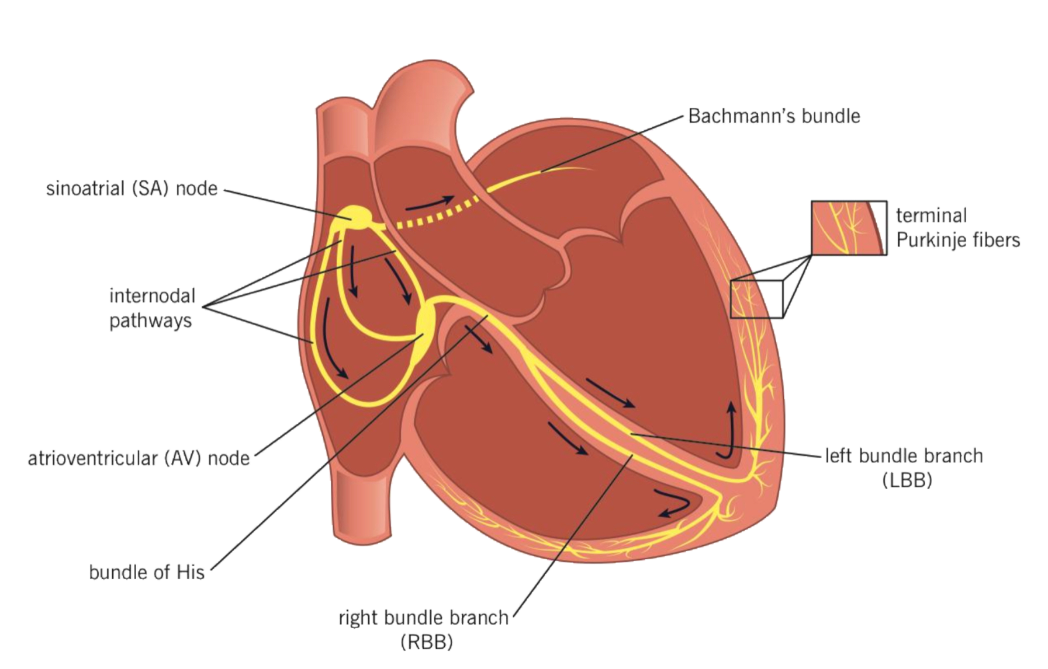
11
Conduction System
• The beating of the heart is regulated by the intrinsic conduction
(nodal) system
• Its function is to ensure that the chambers of the heart contract in the
proper rhythm and sequence:
• The main center is the sinoatrial (SA) node, located in the right atrium.
• SA node is called the pacemaker of the heart, because it generates the
impulse.
• The atrioventricular (AV) node is located at the junction of the atria and the ventricles.
• The atrioventricular (AV) bundle (bundle of His) is located in the
interventricular septum
• The Purkinje fibers are located inside the walls of the ventricles

Slide 14
Quiz
MCQs
Q1: Which heart chamber would you expect to have the thickest myocardial wall?
A- The right ventricle
B- The left ventricle
C- The left atrium
D- The right atrium
Q2: Immediately after leaving the right ventricle, blood enters which structure of the circulatory system?
A- The aorta
B- The pulmonary trunk
C- The left ventricle
D- The right atrium
Q3: What is the name of the valve separating the right atrium from the right ventricle?
A- Bicuspid valve
B- Mitral valve
C- Right semilunar valve
D- None of these
Q4: Blood pumped out of the heart circulates the body and returns to the heart. Which vessel connects directly to the right atrium?
A- Aorta
B- Pulmonary arteries
C- Superior and inferior venae cavae
D- Carotid artery
Q5: After passing through the bicuspid valve, blood enters which structure?
A- Left ventricle
B- Right atrium
C- Left atrium
D- Right ventricle
Q6: Which correctly lists all the valves of the heart?
A- Tricuspid valve, bicuspid valve, aortic valve, and brachial valve
B- Tricuspid valve, pulmonary valve, bicuspid valve, and aortic valve
C- Tricuspid valve and aortic valve
D- Tricuspid valve, pulmonary valve, and aortic valve
SAQs
Answers: 1.B 2.B 3.D 4.C 5.A 6.B
Q1: Enumerate the openings of the right atrium?
A: SVC, IVC, Coronary sinus, Right atrioventricular orifice, small orifice of small veins.
Q2: What forms the upper border of the heart?
A: Two atria concealed by ascending aorta & pulmonary trunk.
Q3: What does the anterior interventricular groove lodge?
A: Anterior interventricular artery & Great cardiac vein

Slide 15
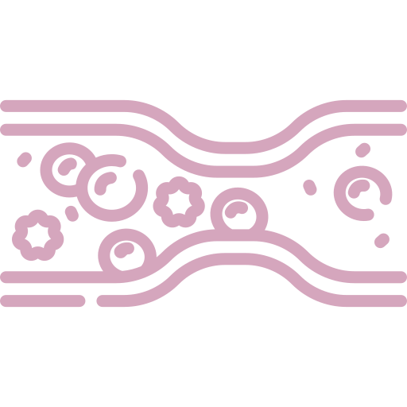
Members Board
Team Leaders
Mohammad Alrashed
Najla Aldhbiban
Team Members
Abdullah Alsalem
Nouf Alsaigh
Faisal Alomar
Nouf Aldalaqan
Mishal Alsuwayegh
Nouf Aldhalaan
Waleed Alrashoud
Raneem Alwatban
Emad Almutairi
Deema Aljuribah
Saud Altaleb
Haifa Alamri
Nawaf Alturki
Farah Alqazlan
Abdulkarim Salman
Nourah Alfawaz
Fahad Abdullah
Lina Almohsen
anatomyteam442@gmail.com

