Slide 1
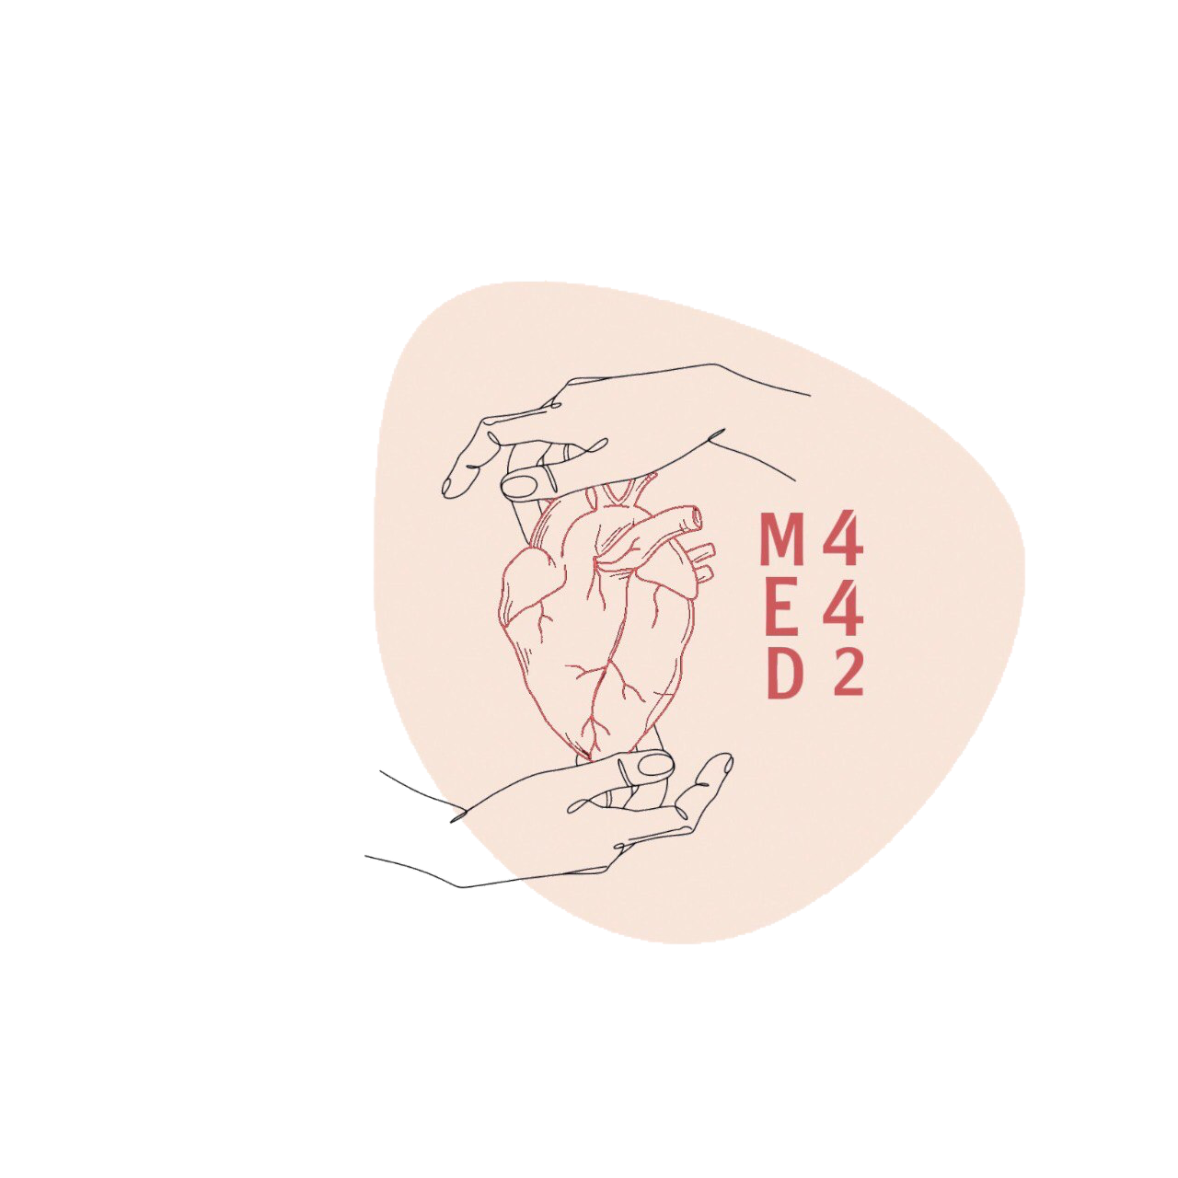
2
By Faisal Alomar
Major Arteries of the Body
____________
CVS Block
Editing File
Color Index:
Main Text
Male’s Slides
Female’s Slides
Important
Doctor’s Notes
Extra Info

Slide 2
Objectives
Define the word ‘artery’ and understand the general principles of the arterial system.
Define arterial anastomosis and describe its significance.
Define end arteries and give examples.
Describe the aorta and its divisions & list the branches from each part.
List major arteries and their distribution in the head & neck, thorax, abdomen and upper & lower extremities
List the main pulse points in the body

Slide 3
1
General Principles of Arteries
Arteries carry blood from the heart to the body.
All arteries carry oxygenated blood, except the pulmonary artery which carry deoxygenated blood from the heart to the lungs.
The flow of blood depends on the pumping action of the heart.
Arteries have elastic wall containing no valves.
The branches of arteries supplying adjacent areas normally anastomose with one another freely providing backup routes for blood to flow if one artery is blocked, e.g. arteries of limbs.
An end artery is an artery that is the only supply of oxygenated blood to a portion of tissue.
The arteries whose terminal branches do not anastomose with branches of adjacent arteries are called “end arteries”.
end arteries are of two types:
Anatomic (True) End Artery:
Functional End Artery:
When no anastomosis exists between the artery and adjacent arteries,
E.g. artery of the retina.
When an anastomosis exists but is incapable of providing a sufficient supply of blood,
E.g. splenic artery, renal artery and coronary artery.

Slide 4
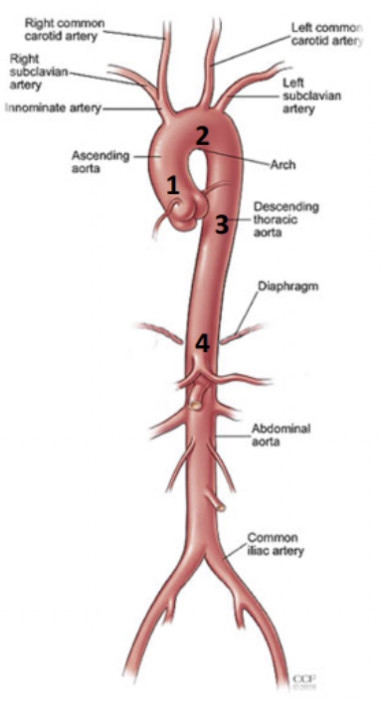
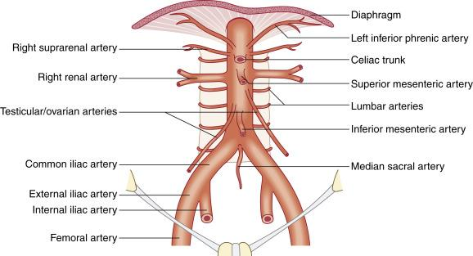
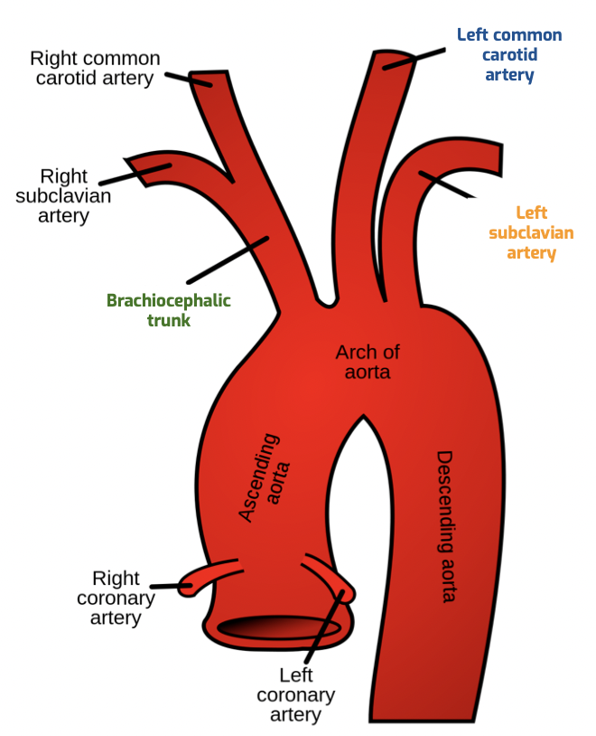
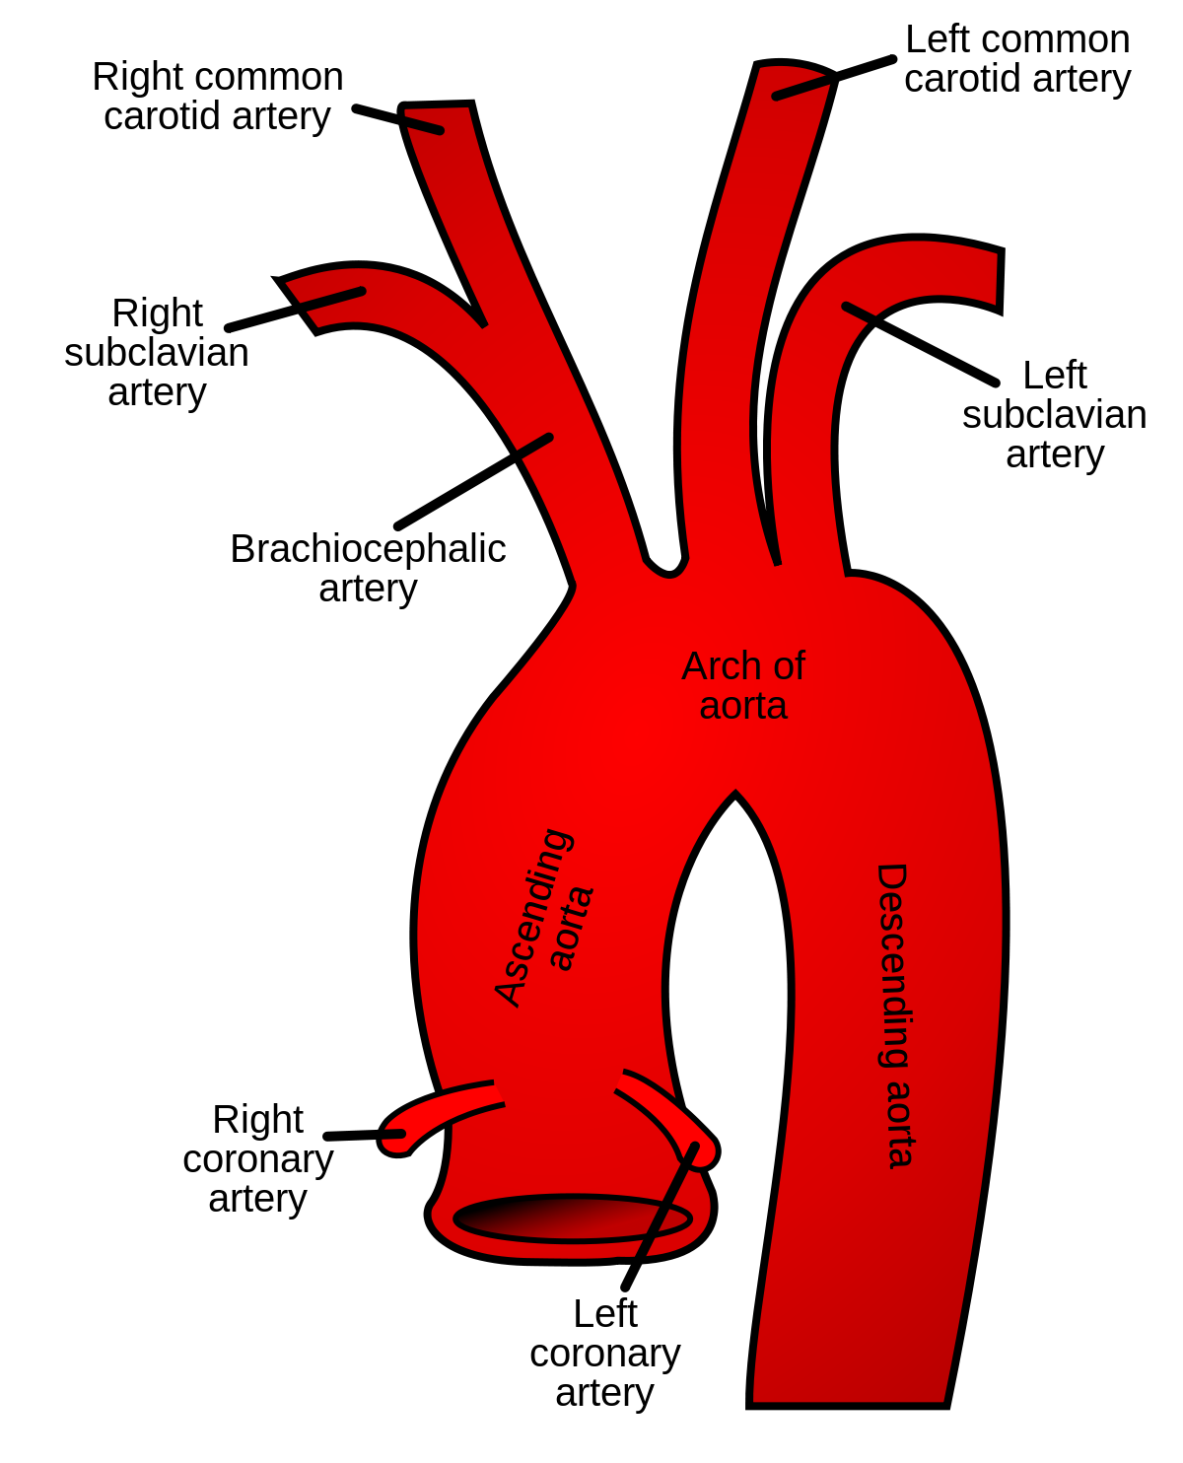
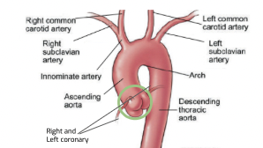
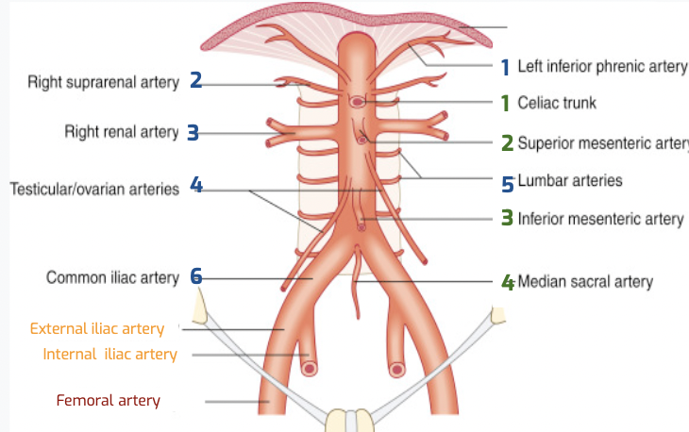
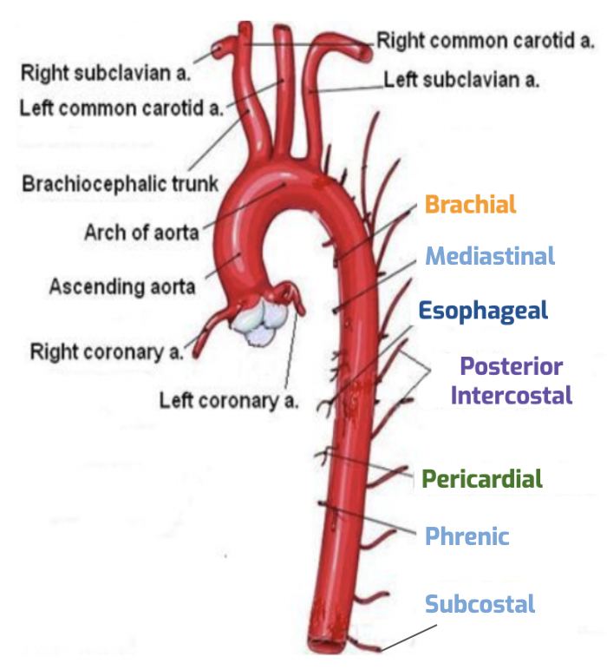
2
Aorta
The largest artery in the body , Carries oxygenated blood to all parts of the body, Is divided into 4 parts:
1. Ascending aorta | 2. Arch of aorta
• Originates from left ventricle at the level of lower border of the 3rd left costal cartilage. • Continues as the arch of aorta, at the level of the sternal angle (lower border of T4). • Has three dilatations at its base, called aortic sinuses • Branches: - Right & Left coronary arteries (supplying heart), arise from anterior & left posterior aortic sinuses, respectively. | • Continuation of the ascending aorta. • Leads to descending aorta. • Located behind the lower part of manubrium sterni and on the left side of trachea. • Branches: 1- Brachiocephalic trunk. 2- Left common carotid artery. 3- Left subclavian artery.
3. Descending thoracic aorta | 4. Abdominal aorta
• It is the continuation of aortic arch, at the level of the lower border of T4. • At the level of the 12th thoracic vertebra, it passes through the diaphragm and continues as the abdominal aorta • Branches: 1- Pericardial 2- Esophageal 3- Bronchial 4- Posterior intercostal In boys slides: 5- Mediastinal 6-Superior phrenic 7-Subcostal | • It enters the abdomen through the aortic opening of diaphragm. • At the level of lower border of L4, it divides into two common Iliac arteries. • Branches: divided into two groups: • Single branches (Supplying Gastrointestinal Tract) 1-Coeliac 2-Superior mesenteric 3-Inferior mesenteric 4-Median sacral: Pelvis & sacrum • Paired branches 1- Inferior phrenic 2- Middle suprarenal 3- Renal 4- Gonadal testicular/ovarian 5-Four pairs of lumbar 6-Common iliac,its branches: 1-External iliac artery: continues at midpoint of inguinal ligament as femoral artery the main supply for lower limb 2-internal iliac artery: supplies pelvis
2
1
1
3
2
4
5
3
Right and Left
coronary artery
6
4
External iliac artery
Internal iliac artery
Femoral artery
Bronchial
Each single branch is corresponding with a paired branch

Slide 5
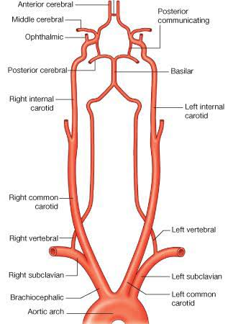
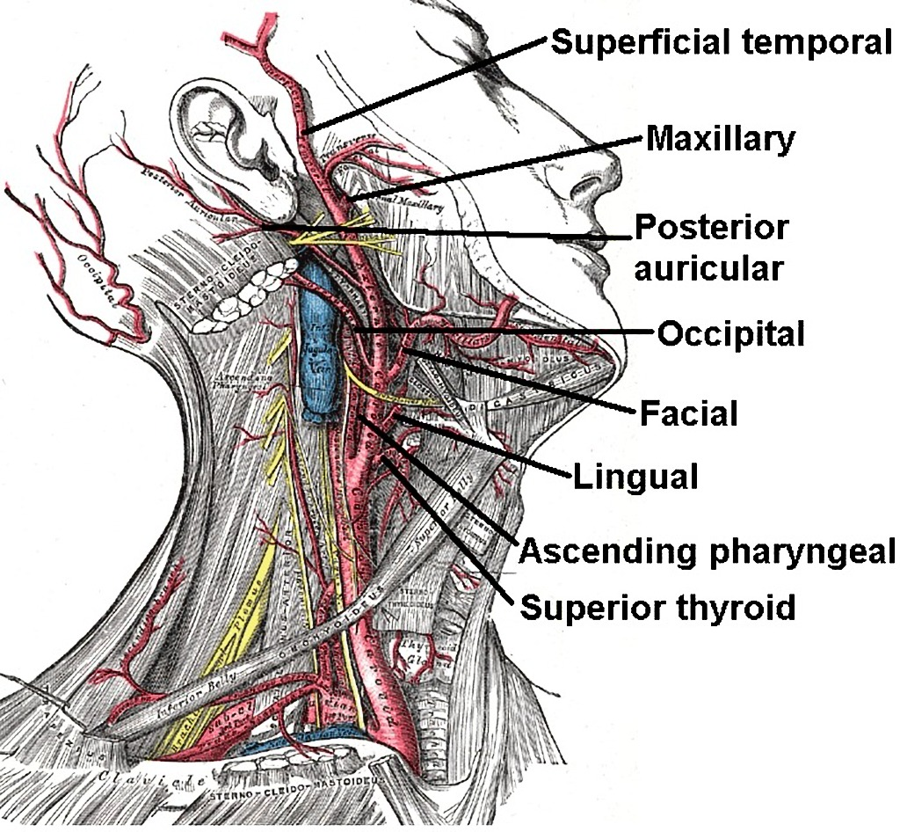
3
Common Carotid Artery
Origin: Left from aortic arch, Right from brachiocephalic trunk.
Each common carotid divides (At the level of the disc between C3 & C4) into two branches:
External Carotid
Internal Carotid
-It divides behind neck of mandible into: Superficial temporal & maxillary arteries, It supplies:
-Scalp: 1-Superficial temporal artery
2-Occipital artery
3-Posterior auricular arteries
-Face: 4-Facial artery
-Maxilla & mandible: 5-Maxillary artery
-Tongue: 6-Lingual artery
-Pharynx: 7-Ascending pharyngeal artery
-Thyroid gland: 8-Superior thyroid artery
-4 branches inside the cranium only
-Has no branches in the neck.
-Enters the cranial cavity, joins the
Basilar artery (formed by the
union of two vertebral arteries) and forms “arterial circle of Willis” to supply brain.
-In addition, it supplies:
-Nose
-Scalp
- Eye
Superficial temporal
Basilar
Maxillary
Posterior auricular
External common artery
Internal common artery
Occipital
Facial
Lingual
Ascending pharyngeal
Superior thyroid

Slide 6
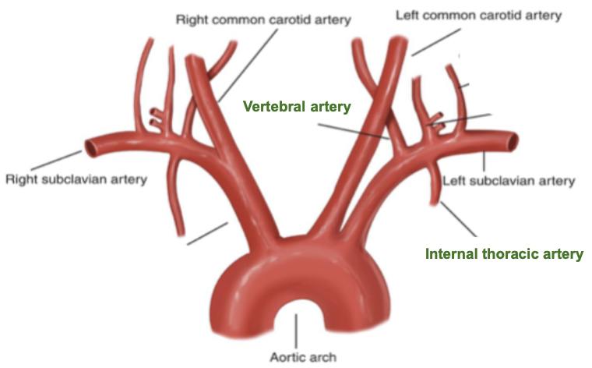
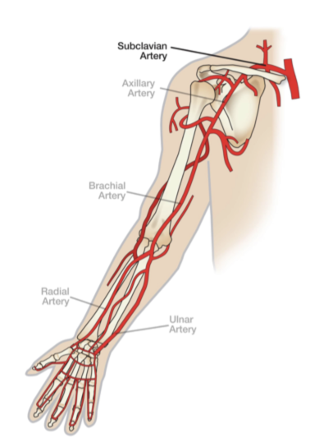
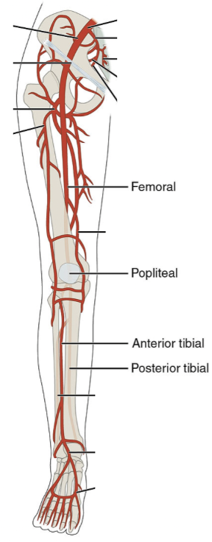
4
Arteries Of The Limbs
Upper Limb
1
Subclavian Artery
Origin:Left: from arch of aorta, Right: from brachiocephalic trunk, Main branches:
1-Vertebral artery: supplies brain & spinal cord
2-Internal thoracic artery: supplies thoracic wall
It continues, at lateral outer border of first rib, as Axillary artery: artery of upper limb
Subclavian
At the lower border of teres major muscle it becomes brachial artery continues at opposite neck of radius
Axillary
it descends to divide into:
1. Radial artery: The smaller terminal branch
2. Ulnar artery: The larger terminal branch
brachial
The superficial and deep palmar arches are formed by both Ulnar & radial arteries.
Radial
Ulnar
Lower Limb
2
Femoral
Femoral Artery
-the main arterial supply to lower limb
-is the continuation of external iliac artery behind the midpoint of the inguinal ligament
Popliteal
Passes through adductor hiatus and continues as Popliteal Artery which is Deeply placed in the popliteal fossa
Anterior Tibial
Posterior Tibial
It Divides at lower end of popliteal fossa into:
1-Anterior Tibial Artery smaller
2-Posterior Tibial Artery Larger

Slide 7
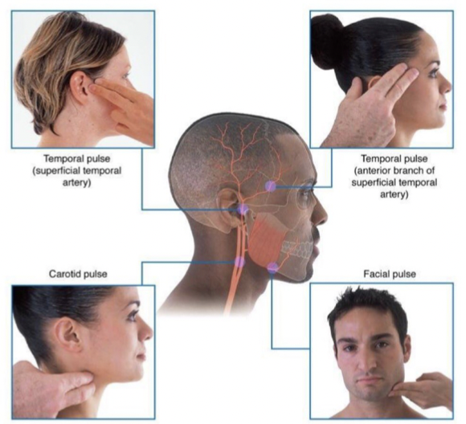
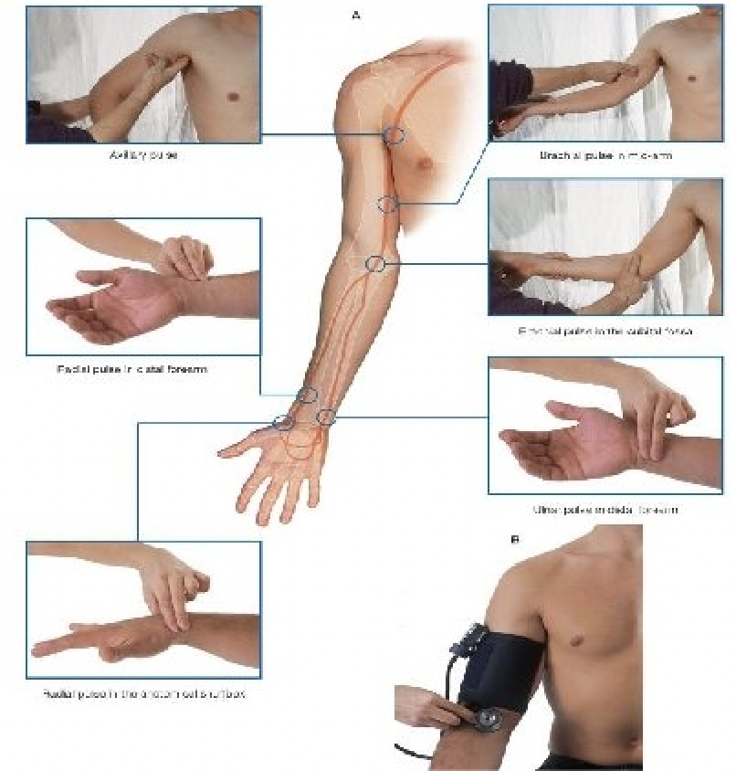
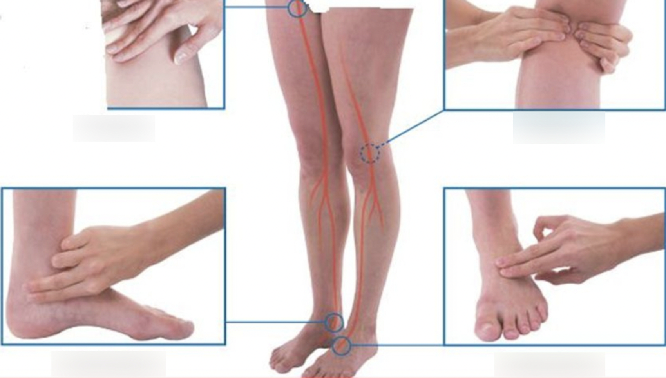
5
Pulse Points
1
Head and Neck
1. Temporal pulse:
a. Superficial temporal artery
b. Anterior branch of Superficial temporal
artery
2. Carotid pulse “Upper border of thyroid cartilage”
3. Facial pulse “Lower border of mandible”
1b
1a
3
2
2
Upper Limb
1
2a
1. Axillary pulse
2. Brachial pulse in
a. Mid arm
b.Cubital fossa
3. Radial pulse in :
a. Distal forearm (lateral to FCR)
b. Anatomical snuffbox
4.Ulnar pulse
3a
2b
4
3b
3
Lower Limb
1. Femoral pulse “Midway between the anterior superior iliac fossa and symphysis pubis”
2. Popliteal pulse
3. Posterior tibial ”Behind the malleolus”
4. Dorsalis pedis pulse
1
2
3
4

Slide 8
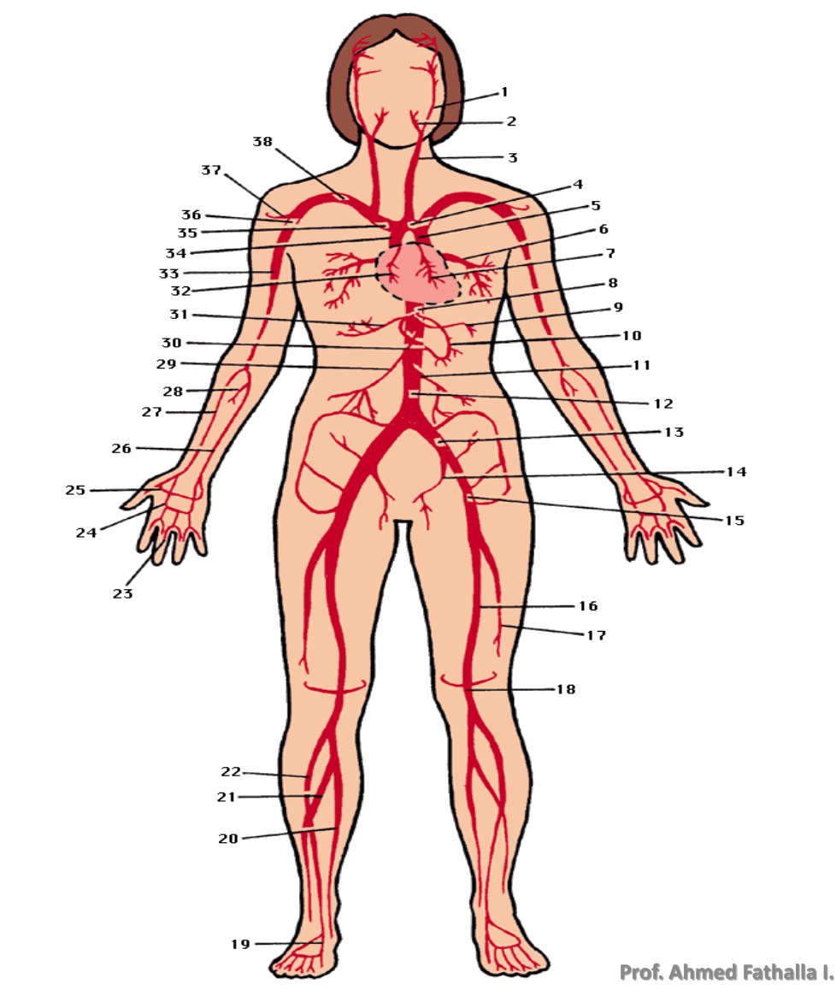
6
Summary
Principal Arteries of the Human Body:
1) internal carotid artery, 2) external carotid artery, 3) common carotid artery, 4) arch
of the aorta, 5) descending aorta, 6) pulmonary vein, 7) left coronary artery, 8)
celiac artery, 9) splenic artery, 10) left gastric artery, 11) inferior mesenteric artery,
12) abdominal aorta, 13) common iliac artery, 14) internal iliac artery, 15) external
iliac artery, 16) femoral artery, 17) profunda femoris artery, 18) popliteal artery, 19)
dorsalis pedis, 20) posterior tibial artery, 21) peroneal artery, 22) anterior tibial
artery, 23) digital artery, 24) superficial palmar arch, 25) deep palmar arch, 26) ulnar
artery, 27) radial artery, 28) common interosseous artery, 29) superior mesenteric
artery, 30) right gastric artery, 31) hepatic artery, 32) right coronary artery, 33)
brachial artery, 34) ascending aorta, 35) brachiocephalic artery, 36) axillary artery,
37) anterior circumflex humeral artery, 38) subclavian artery

Slide 9
Quiz
MCQs
Q1: Which one of the following is a single branch of the abdominal aorta?
A- Inferior phrenic
B- Gonadal
C- Lumbar
D- Inferior mesenteric
Q2: At which vertebral level, the right common iliac artery arises?
A- L4
B- T12
C- L3
D- L5
Q3: Which one of the following is a branch of the
external carotid artery?
A- Internal thoracic
B- Vertebral
C- Basilar
D- facial
Q4: Which one of the following is an end functional artery?
A- Retinal
B- Splenic
C- Femoral
D- Brachial
Q5: Which one of the following structures is supplied by internal carotid artery?
A- Pharynx
B- Eye
C- Thyroid gland
D- Tongue
Q6: Which one of the following arteries could be palpated opposite the lower border of the mandible?
A- Facial
B- Lingual
C- superficial temporal
D- External carotid
SAQs
Answers: 1. D 2. A 3. D 4. B 5. B 6. A
Q1: Enumerate the branches of the external carotid artery?
1- lingual artery
2- occipital artery
3- pharyngeal artery
4- superior thyroid artery
5- facial artery
Q2: Mention the two branches of common carotid artery?
1- external carotid artery
2- internal carotid artery
Q3: What are the two types of end arteries?
1- functional end arteries
2- anatomical end arteries

Slide 10
Members Board
Team Leaders
Mohammad Alrashed
Najla Aldhbiban
Team Members
Abdullah Alsalem
Nouf Alsaigh
Faisal Alomar
Nouf Aldalaqan
Mishal Alsuwayegh
Nouf Aldhalaan
Waleed Alrashoud
Raneem Alwatban
Emad Almutairi
Deema Aljuribah
Saud Altaleb
Haifa Alamri
Nawaf Alturki
Farah Alqazlan
Abdulkarim Salman
Nourah Alfawaz
Fahad Abdullah
Lina Almohsen
anatomyteam442@gmail.com

