Slide 1
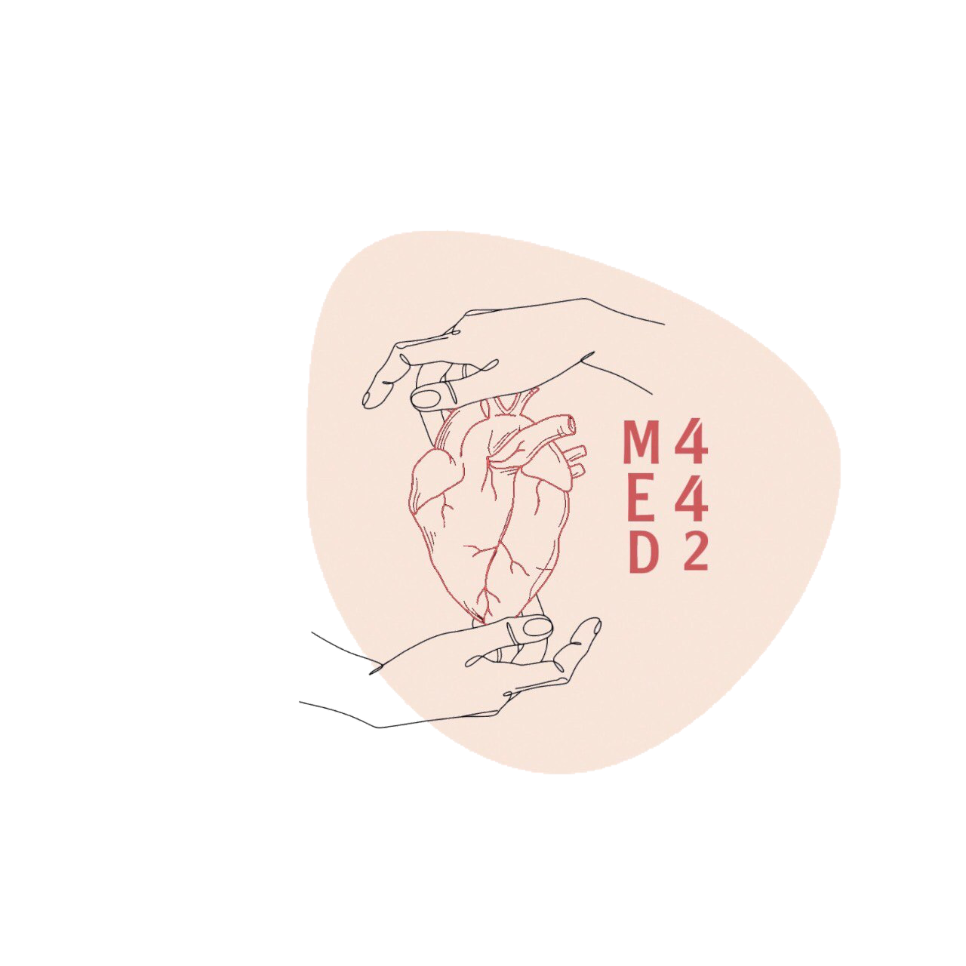
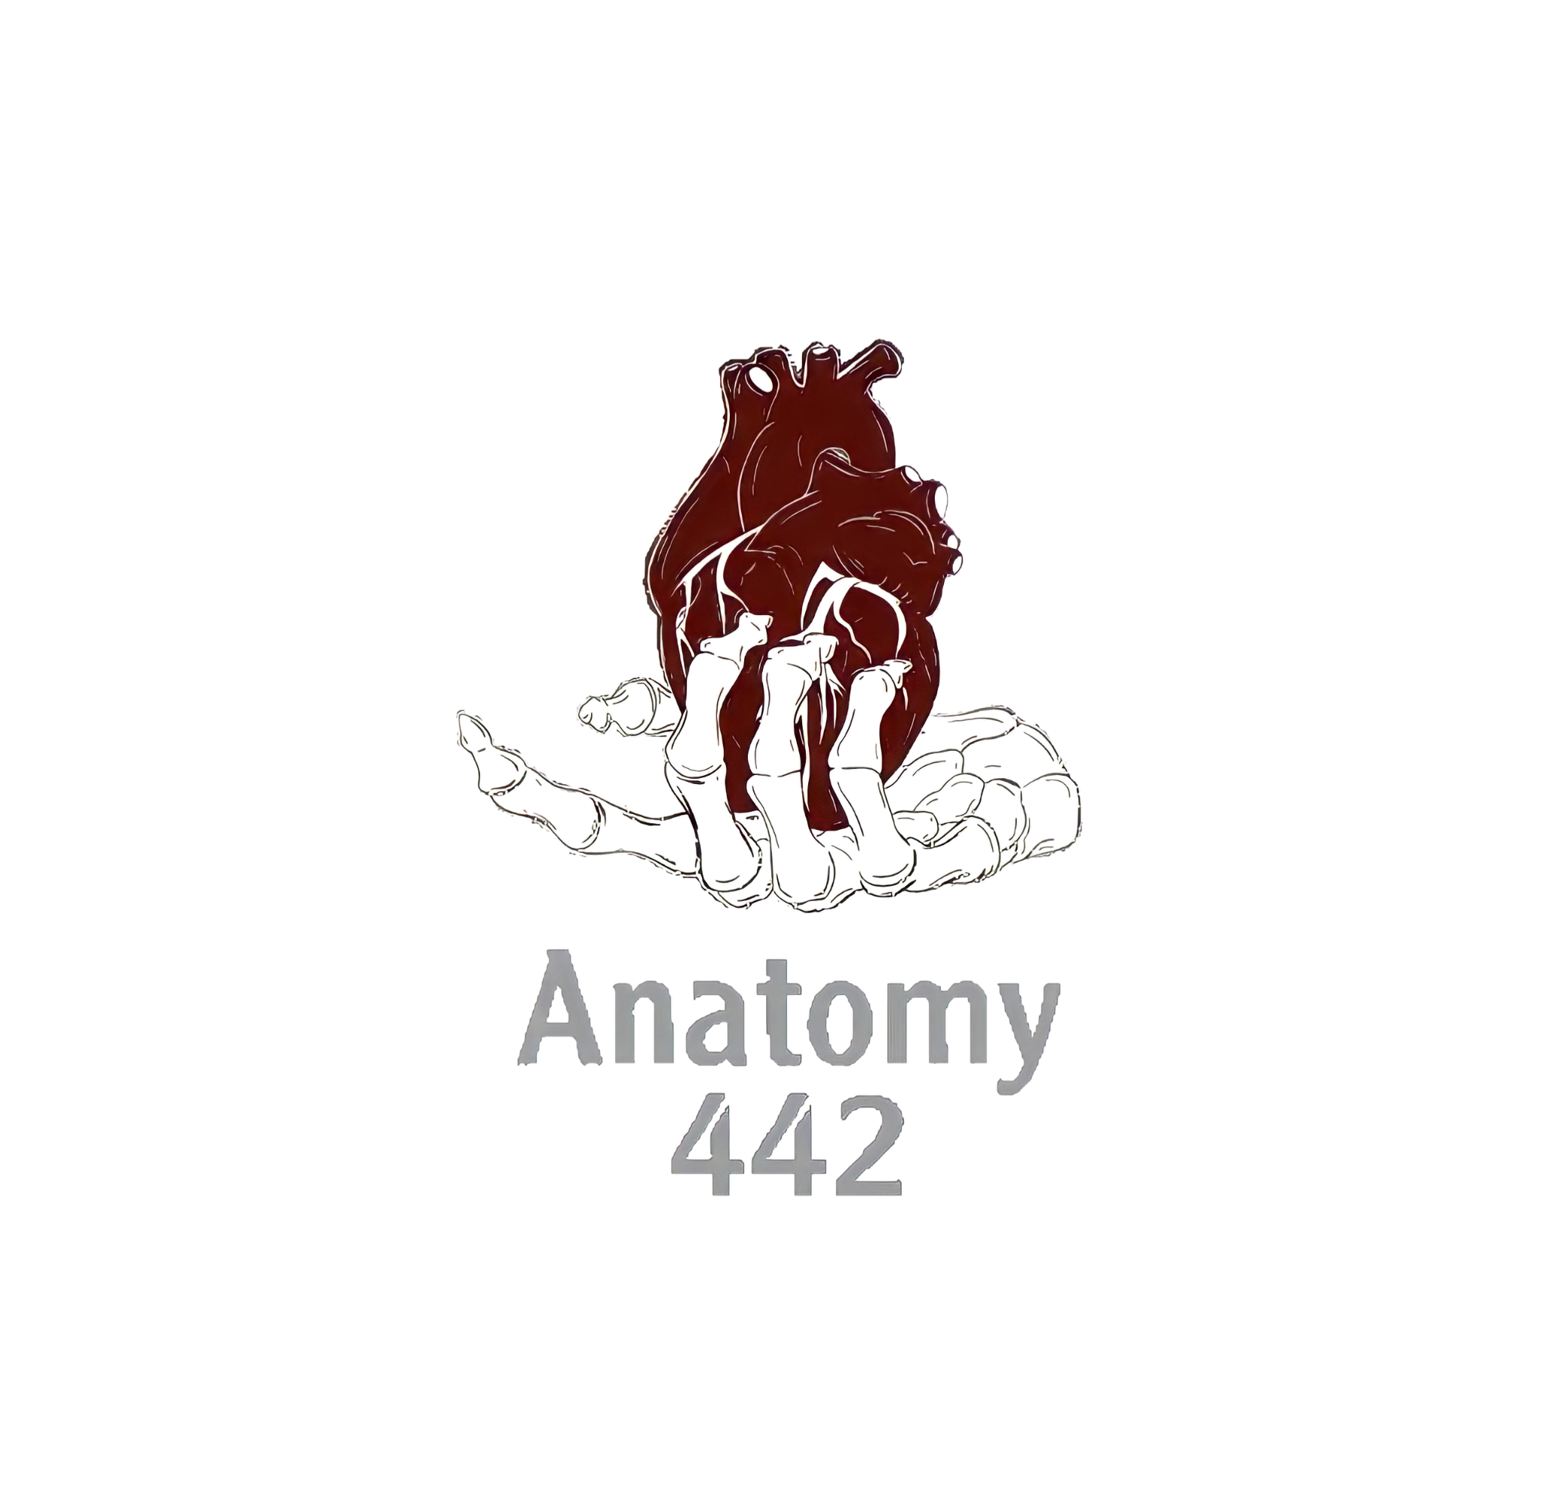
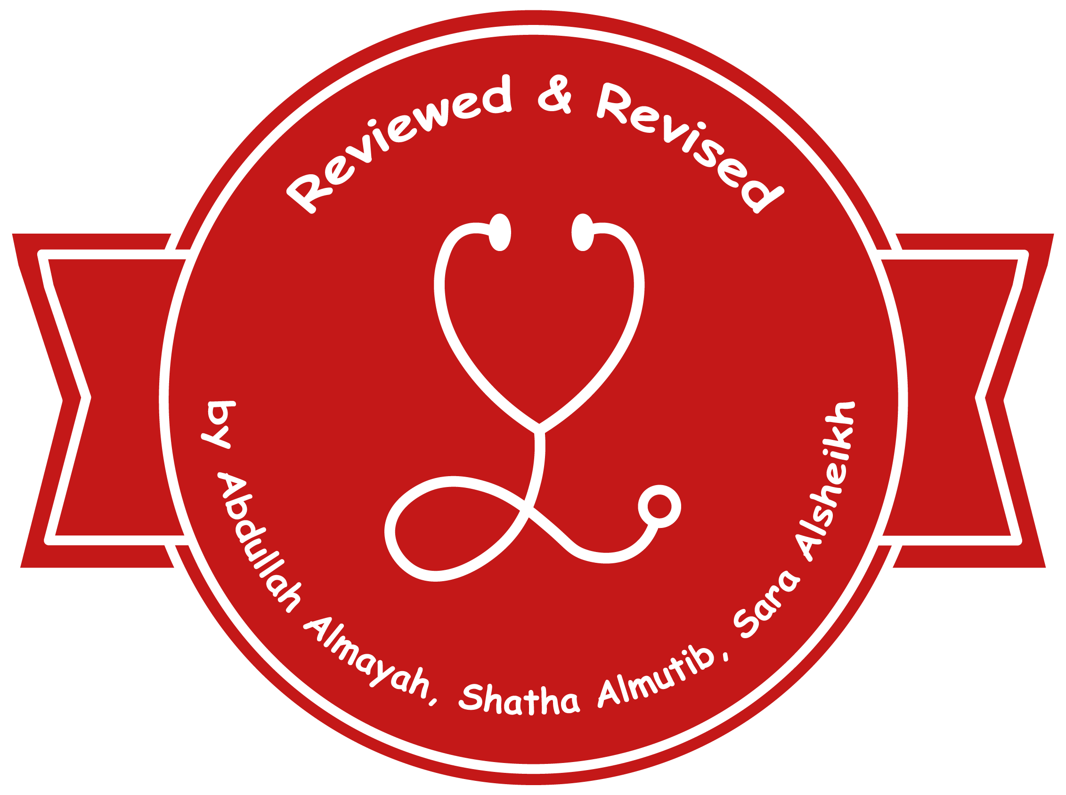
3
By Faisal Alomar
Major Veins of the Body
____________
CVS Block
Editing File
Color Index:
Main Text
Male’s Slides
Female’s Slides
Important
Doctor’s Notes
Extra Info

Slide 2
Objectives
Define the veins, and understand the general principle of the venous system.
Describe the superior & inferior Vena Cava and their tributaries.
List major veins and their tributaries in the body.
Describe the Portal Vein.
Describe the Portocaval Anastomosis.

Slide 3
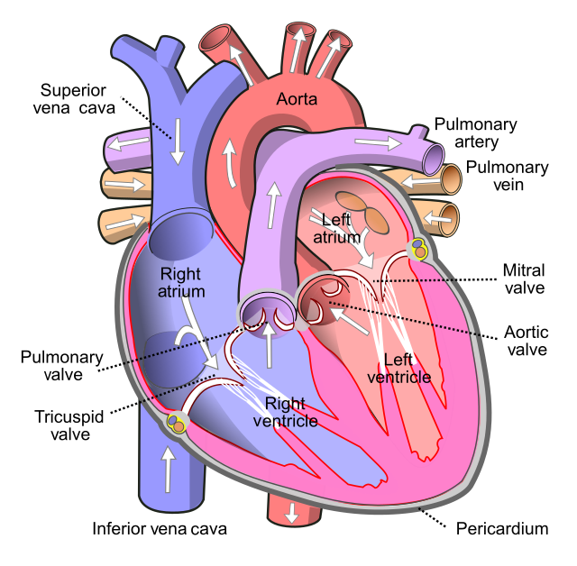
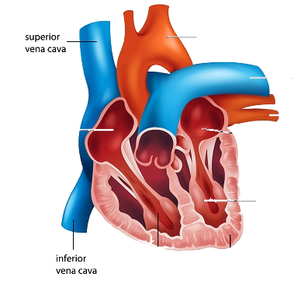
1
Veins
Veins are blood vessels that bring blood back to the heart.
All veins carry deoxygenated blood
with the exception of the pulmonary veins (which carry oxygenated blood from the lungs to the heart) and umbilical vein (during fetal development)
Veins Can Be Classified In 2 Ways Based On:
Location
Circulation
Superficial Veins: close to the surface of the body and have NO corresponding arteries
Deep Veins: found deeper in the body and have corresponding arteries
Veins of the Systemic Circulation:
Superior and Inferior Vena Cava with their tributaries
Veins of the Portal Circulation:
Portal vein

Slide 4
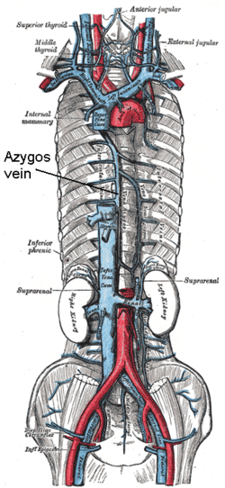
2
General Principles of the Veins
Males Slides
Veins have thinner wall, wider lumen and less muscular tissue than arteries.
Veins have valves that prevent backflow of blood.
Veins carry blood under low or negative pressure.
Systemic veins: are veins draining into the right atrium of the heart.
They are arranged into Three Groups:
Veins draining the heart.
Veins draining the upper limbs, head & neck, and thorax which end into the superior vena cava.
Veins draining the lower limbs, abdomen and pelvis which end into the inferior vena cava.
Superior Vena Cava
Formed by: the union of the right and left Brachiocephalic veins, behind the lower border of the 1st right costal cartilage.
Brachiocephalic (innominate) veins are formed by the union of internal jugular and subclavian veins.
Drains Venous Blood From:
-Head & neck
-Thoracic wall
-Upper limbs
It Passes downward and enter the right atrium (where it ends at the level of the right 3rd costal cartilage)
Receives: azygos vein on its posterior aspect just before it enters the heart (just before its termination).

Slide 5
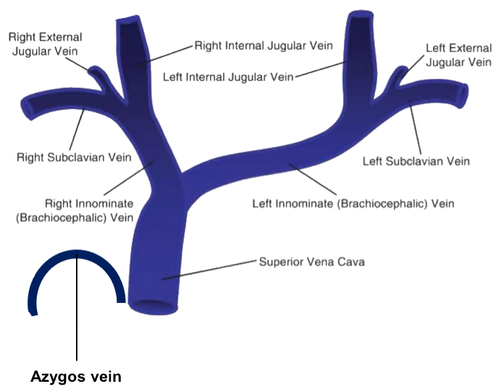
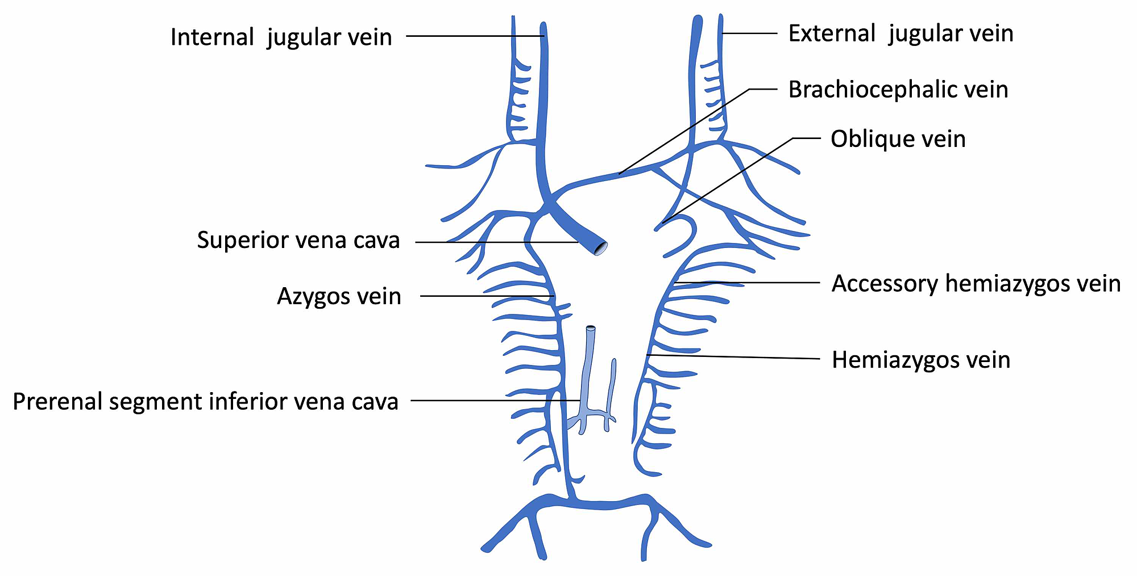
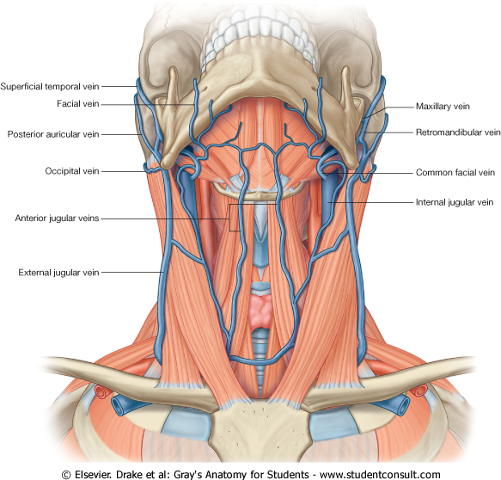
3
Azygos Vein
Males Slides
It connects inferior vena cava with superior vena cava and can provide an alternative path for blood to the right atrium when either of the venae cavae is blocked.
N.B.: Azygos = single / unpaired.
Inferior vena cava
Veins of Head & Neck
External Jugular veins
Superficial Veins
Anterior jugular veins
Two Divisions:
Internal Jugular vein
Deep Veins
Subclavian vein

Slide 6
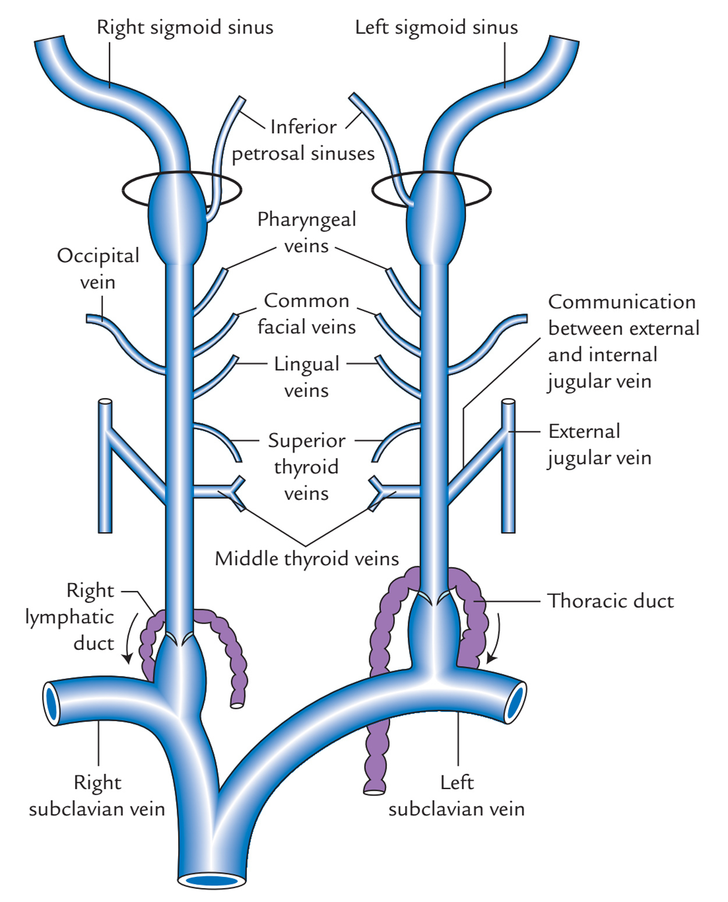
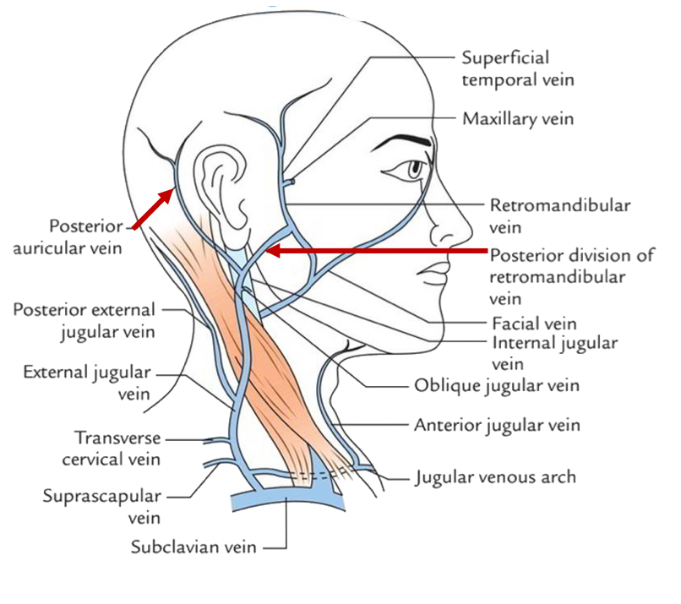
4
Veins of Head & Neck
Superficial Veins |  | Deep veins
External Jugular vein | Anterior Jugular Vein | Internal Jugular vein
Begins just behind the angle of mandible and formed by union of posterior auricular vein with the posterior division of retromandibular vein. | It begins in the upper part of the neck by the union of the submental veins, below the chin. | Joins the subclavian vein to form the brachiocephalic vein, behind the sternoclavicular joint. Drains blood from the brain, face, head & neck. It is the largest vein in the neck It is the continuation of the sigmoid sinus through the jugular foramen.
Lies (descends) superficial to the sternomastoid muscle It passes down the neck and it is the only tributary of the subclavian vein (it it’s ends in it). It drains the superficial structures of: Outside of the skull, head & neck Deep parts of the face. | It descends close to the median line of the neck, medial to the sternomastoid. At the lower part of the neck, it passes laterally beneath (deep to) sternomastoid muscle to drain into the external jugular vein. Just above the sternum, the two anterior jugular veins communicate by a transverse vein (joined to the opposite vein) to form the jugular arch. It drains the superficial structures in the anterior aspect of the neck | It descends in the neck along with the internal and common carotid arteries and vagus nerve, within the carotid sheath. It has 7 tributaries. Tributaries: Superior thyroid. Middle thyroid. Lingual Facial Pharyngeal Occipital veins Dural venous sinuses (Inferior petrosal sinus).
Mnemonic: Med School Only Let Fun People In
1
2
3
4
5
6
Jugular Arch
7

Slide 7
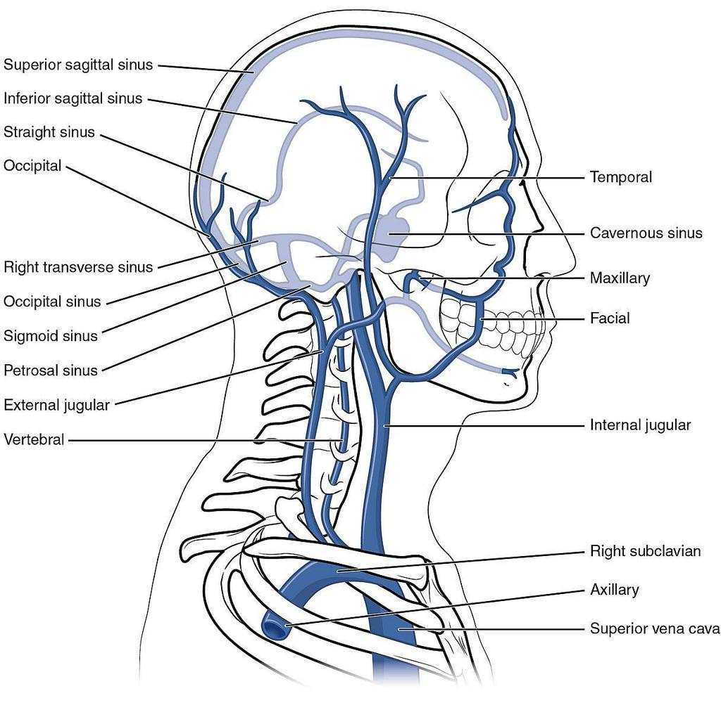
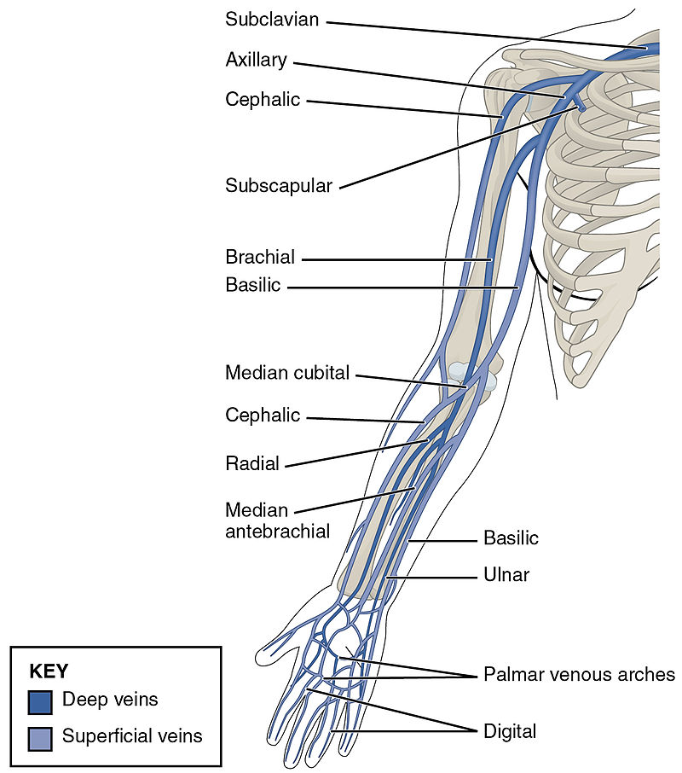
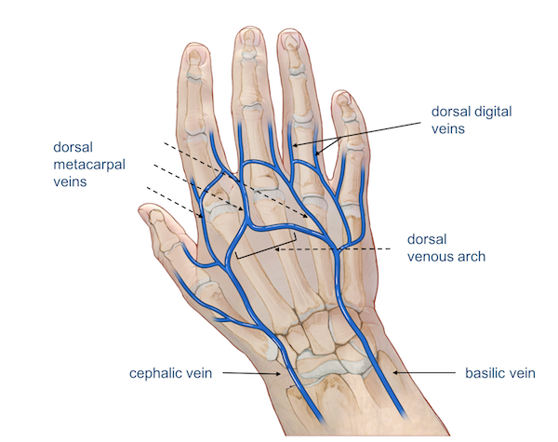
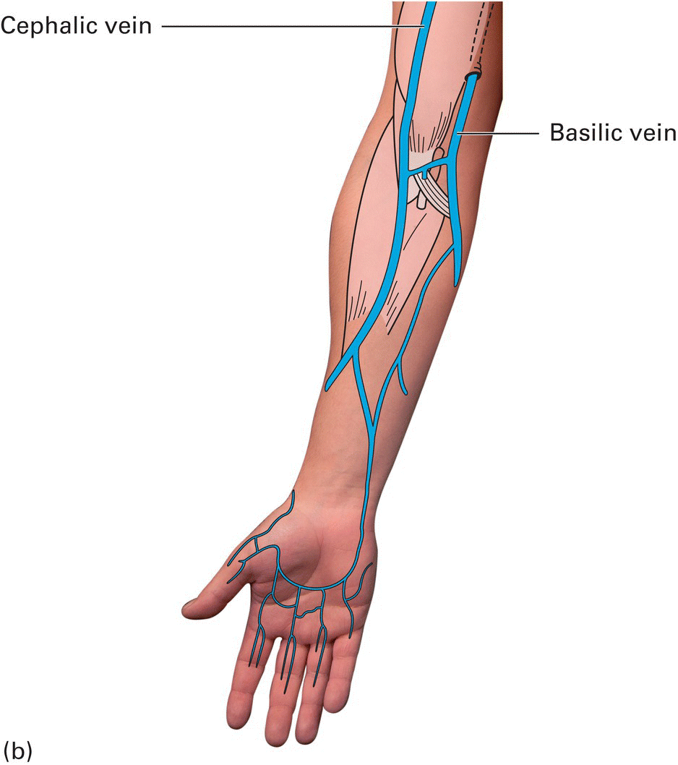
5
Subclavian Vein
Males Slides
It is the continuation of the axillary vein, at the outer border of the first rib.
It joins the internal jugular vein, behind the sternoclavicular joint, to form the brachiocephalic vein.
It has only one tributary: external jugular vein.
Veins of Upper Limbs
Cephalic vein
Superficial Veins
Basilic Vein
Two Divisions:
Venae comitantes
Deep Veins
Axillary vein

Slide 8
6
Veins of Upper Limbs
Superficial Veins |  | Deep Veins
Cephalic vein | Basilic Vein | Venae Comitantes | Axillary Vein
Ascends in the superficial fascia on the lateral side of biceps (forearm and arm). It arises from the lateral end of the dorsal venous arch of hand. It runs in the deltopectoral groove. | It arises from the medial end of the dorsal venous arch of hand. Ascends in the superficial fascia on the medial side of the biceps (forearm and arm). | Which accompany all the large arteries (and are situated one on either side of the corresponding artery.) usually in pairs. Venae comitantes of the radial artery join those of the ulnar artery to form the venae comitantes of the brachial artery. | Formed by the union of basilic vein and the venae comitantes (brachial veins) of the brachial artery.
It pierces the clavipectoral fascia to end into the axillary vein. Drains into: the Axillary vein. | Halfway up the arm (middle of the arm): it pierces the deep fascia At the lower border of teres major; it joins the venae comitantes of the brachial artery to form the Axillary vein. | Venae comitantes of the brachial artery join the basilic vein which continues as the axillary vein. | It drains/ continue (At the outer border of the first rib) as the subclavian vein
Median Cubital Vein:
It links the cephalic vein and basilic vein in the cubital fossa.
It is a frequent site for venipuncture.

Slide 9
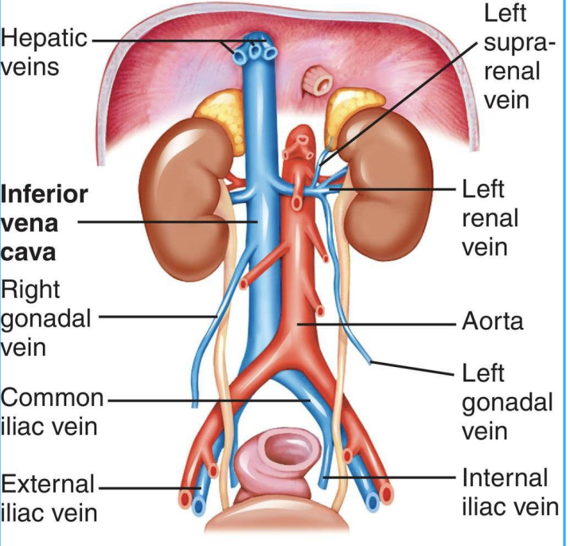
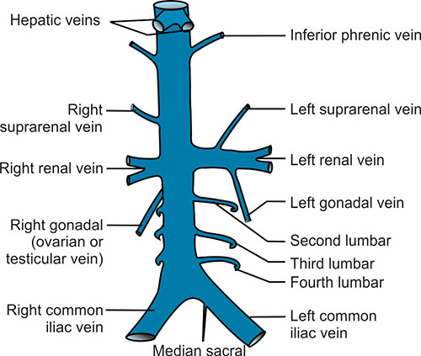
7
Inferior Vena Cava
Formed by: the union of the 2 common iliac veins behind the right common iliac artery at the level of the 5th lumbar vertebra (L5).
Drains most of the blood from the:
body below the diaphragm (abdomen, pelvis & lower limbs.) to the right atrium
Ascends on the right side of the abdominal aorta.
Pierces the central tendon (It enters the thorax through the inferior vena caval opening) of diaphragm at the level of the 8th thoracic vertebra(T8).
It ends by opening into the right atrium, at the level of right 6th costal cartilage (T9).
Tributaries of Inferior Vena Cava: very important
Two common (right/left) Iliac Veins
Median Sacral Vein
Four paired (right/left) Lumbar Veins
Right Gonadal Vein
paired (right/left) Renal Veins
Right Suprarenal vein
(right/left) Hepatic Veins
Paired (right/left) Inferior Phrenic Veins.
Mnemonic:
I Like To Rise So High
N.B.: Left gonadal & left suprarenal veins drain into the left renal vein.
Tributaries of IVC = paired branches of abdominal aorta:
Minus 2: left gonadal & left suprarenal veins
Plus 2: right & left hepatic veins
Hepatic Veins
Inferior Phrenic Vein
Right Suprarenal Vein
Left Suprarenal Vein
Right Renal Vein
Left Renal Vein
Left Gonadal Vein
Right Gonadal (Testicular or Ovarian) Vein
Second Lumbar
Third Lumbar
Fourth Lumbar
Right Common Iliac
Left Common Iliac
Median Sacral

Slide 10
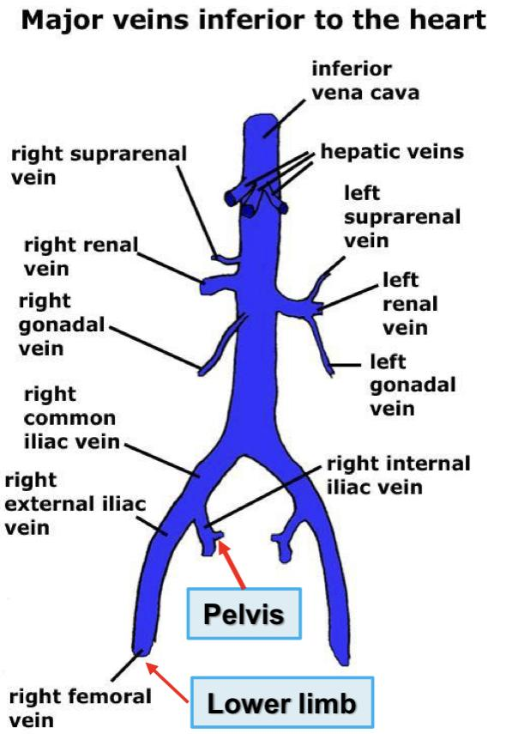
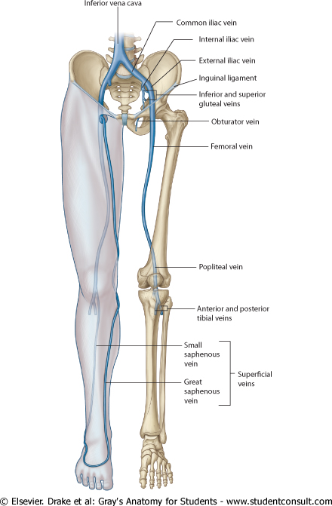
8
Tributaries of Common Iliac
Males Slides
External Iliac Vein: continuation of femoral vein of the lower limb.
Internal Iliac Vein: drains the pelvis.
Pelvis
Lower Limb
Veins of Lower Limbs
Great (long) Saphenous Vein
Superficial veins
Small (short) Saphenous Vein
Two Divisions:
Venae comitantes
of the anterior and
posterior tibial
arteries.
Deep veins
Popliteal vein
Femoral vein

Slide 11
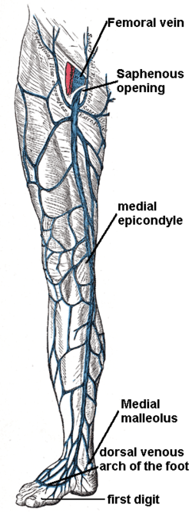
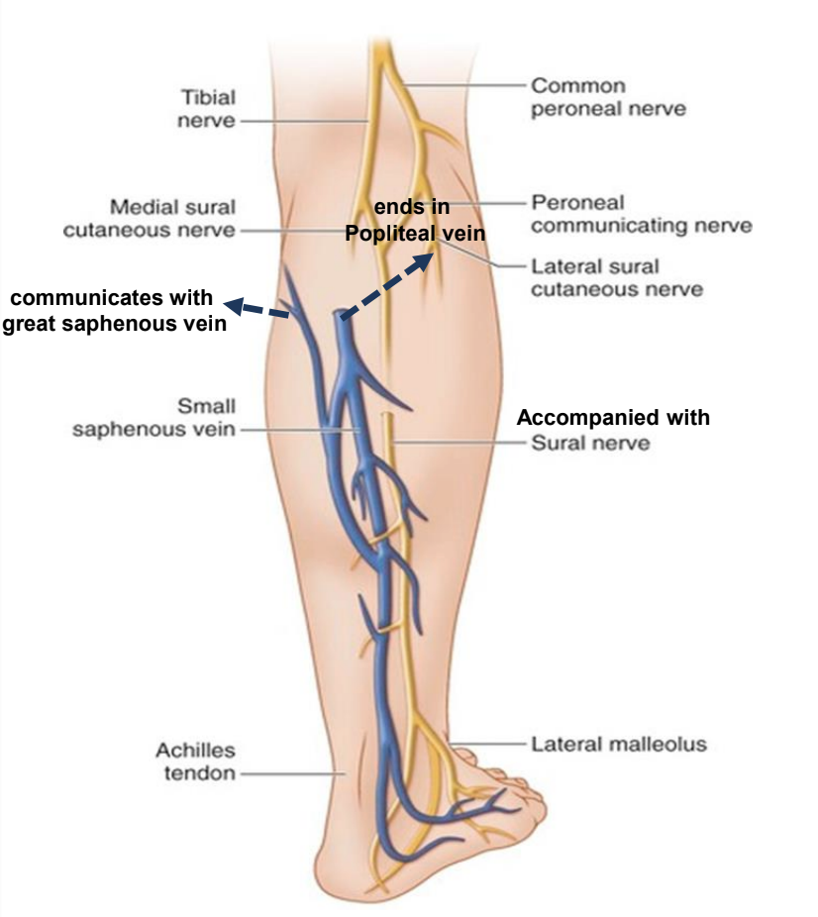
9
Veins of Lower Limbs
Superficial Veins
Great (long) Saphenous Vein | Small (short) Saphenous Vein
The longest vein in the body It begins as the medial end of the dorsal venous arch of the foot. It ascends obliquely upward (accompanied with saphenous nerve): In front of medial malleolus of tibia. On medial surface of tibia (in superficial fascia in medial side of the leg). On medial side of knee (behind the knee and curves upward on the medial side of the thigh) In front of the thigh, hooks through the lower part of the saphenous opening in the deep fascia to join the femoral vein about 1.5 in. (4 cm) below and lateral to the pubic tubercle. It is connected to the small saphenous vein by one or two branches that pass behind the knee. It is connected to the deep veins by numerous perforating veins (which have valves that allow blood flow from superficial to deep veins) | Begins the lateral end of the dorsal venous arch of the foot. Runs along the lateral border of the foot, ascends below then behind the lateral malleolus, to the lateral border of the tendocalcaneus then to posterolateral aspect of the leg (accompanied with the sural nerve) to reach the popliteal fossa. Pierces the deep fascia in the lower part of the popliteal fossa. Tributaries: Veins from the back of the leg & from the foot + communicating vein with long (great) saphenous vein. Drains into the popliteal vein Has numerous valves along its course. Anastomosis freely with great saphenous vein.

Slide 12
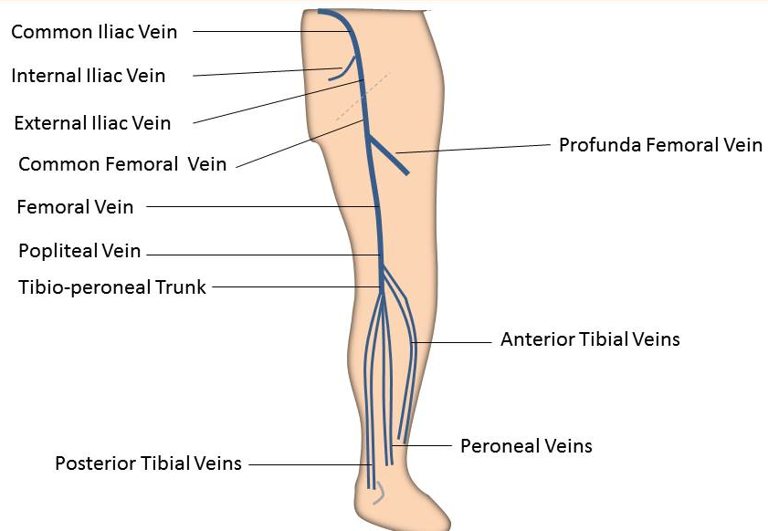
10
Veins of Lower Limbs
Deep Veins:
Venae Comitantes:
Comprise the venae comitantes, which accompany all the large arteries, usually in pairs.
The venae comitantes of the anterior tibial artery join the venae comitantes of the posterior tibial artery to form the popliteal vein.
The popliteal vein passes through the adductor hiatus and continues as the femoral vein.
The femoral vein ascends behind the inguinal ligament and continues as the external iliac vein.
Deep veins receive blood from superficial veins through perforating veins
Femoral Vein
Popliteal Vein
Anterior Tibial Vein
Posterior Tibial Vein
Mechanism of Venous Return From the Lower Limb
Deep veins receive saphenous blood from superficial veins through perforating veins.
The blood is pumped upward in the deep veins toward the heart by the contraction of the calf muscles (calf pump).
This action of “calf pump” is assisted by the tight sleeve of deep fascia surrounding these muscles.
Perforating veins possess valves that prevent the backflow of the blood into the superficial veins.

Slide 13
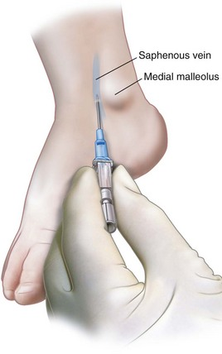
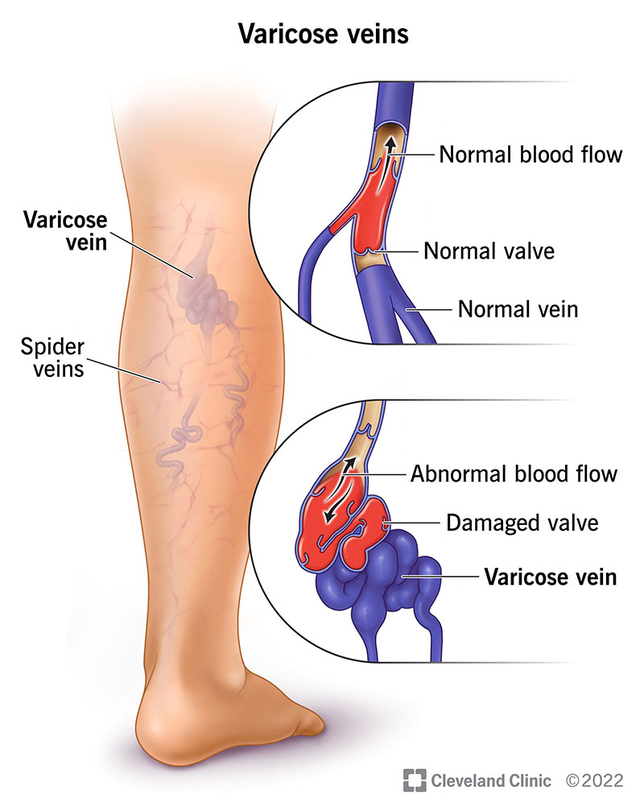
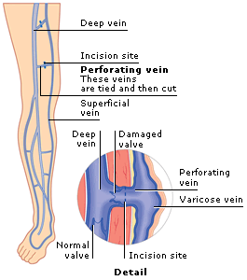
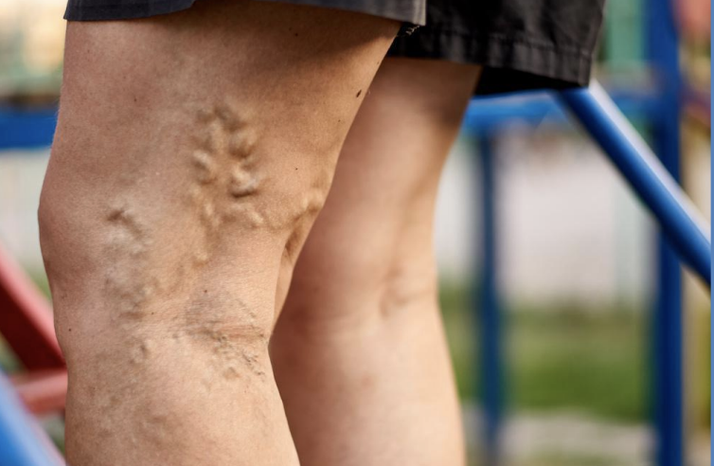
11
Clinical Application of the Great Saphenous Vein
The great saphenous vein is used in venous cutdown (emergency procedure in which the vein is exposed surgically and then a cannula is inserted into the vein under direct vision). When using great saphenous vein, we should take care of the saphenous nerve.
It is also used in coronary bypass surgery (bypass the blocked portion of the coronary artery with a piece of a healthy blood vessel from elsewhere in the body to restore blood flow into the heart) and in intravenous injection of fluids due to other venous collapse.
So, The great saphenous vein is used in venous grafting and saphenous vein cutdown may be necessary for inserting the needle or cannula (take care of the saphenous nerve)
Varicose Veins of the Lower Limb
They are dilated, tortuous and palpable superficial veins of the lower limb.
The main cause of varicose veins is incompetence of the valves in the perforating veins.
If valves become weakened or damaged, the direction of blood flow is reversed. Superficial veins become enlarged, twisted and engorged with blood.
Most common in posterior & medial parts of the lower limb, particularly in old people.

Slide 14
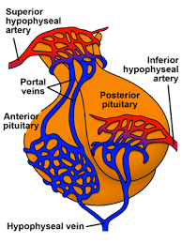
12
Portal System
A vascular arrangement in which blood collected from one set of capillaries of one organ is transported to another set of capillaries of another organ by a connecting vein or veins.
A portal venous system is a series of veins or venules that directly connect two capillary beds (of arteriole & venule).
It includes the hepatic portal system and hypophyseal portal system. (hypothalamus)
Hepatic Portal System
The hepatic portal vein is not a true vein because it does not drain into the heart.
It is formed by the union of superior mesenteric and splenic veins, behind the neck of pancreas.
Before reaching the liver It ends by dividing into right & left terminal branches that enter the liver.
Its tributaries are:
Left & right gastric veins: draining the stomach.
Paraumbilical veins: draining superficial veins around the umbilicus (drains veins from the skin of the anterior abdominal wall to the hepatic portal vein).
Cystic vein: draining the gallbladder, joins its right branch.
The liver receives a blood supply from two sources. The first is the hepatic artery which delivers oxygenated blood from the general circulation. The second is the hepatic portal vein delivering (drains) deoxygenated blood from the gastrointestinal tract and spleen containing nutrients to the liver.

Slide 15
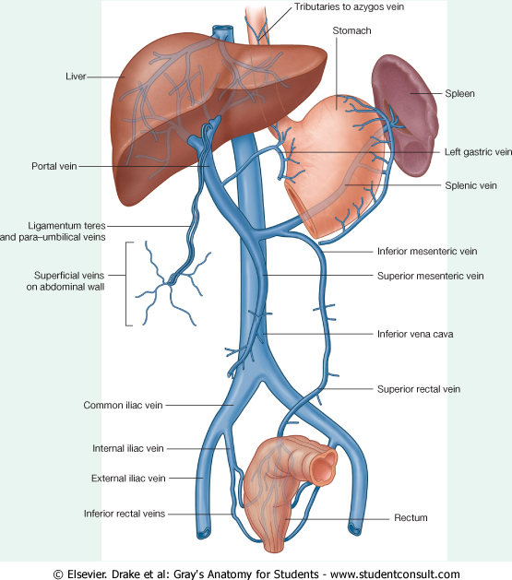
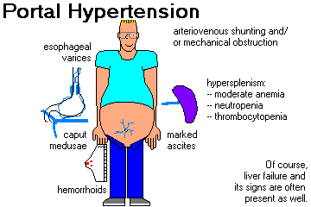
13
Portocaval (Portosystemic) Anastomosis
A portocaval anastomosis (also known as portal systemic anastomosis) is a specific type of anastomosis that occurs between the veins of portal circulation and those of systemic circulation.
The anastomotic channels become dilated (varicosed) in case of portal hypertension.
Importance of Portocaval Anastomosis
Males slides
The importance of portocaval anastomoses is to provide alternative routes of circulation when there is a blockage in the liver or portal vein.
Even though this is useful, bypassing the liver may be dangerous, since it is the main organ in charge for detoxification and breaking down of substances found in the gastrointestinal tract, such as medications.
Esophageal varices
Caput Medusae
Marked Ascites
Hemorrhoids

Slide 16
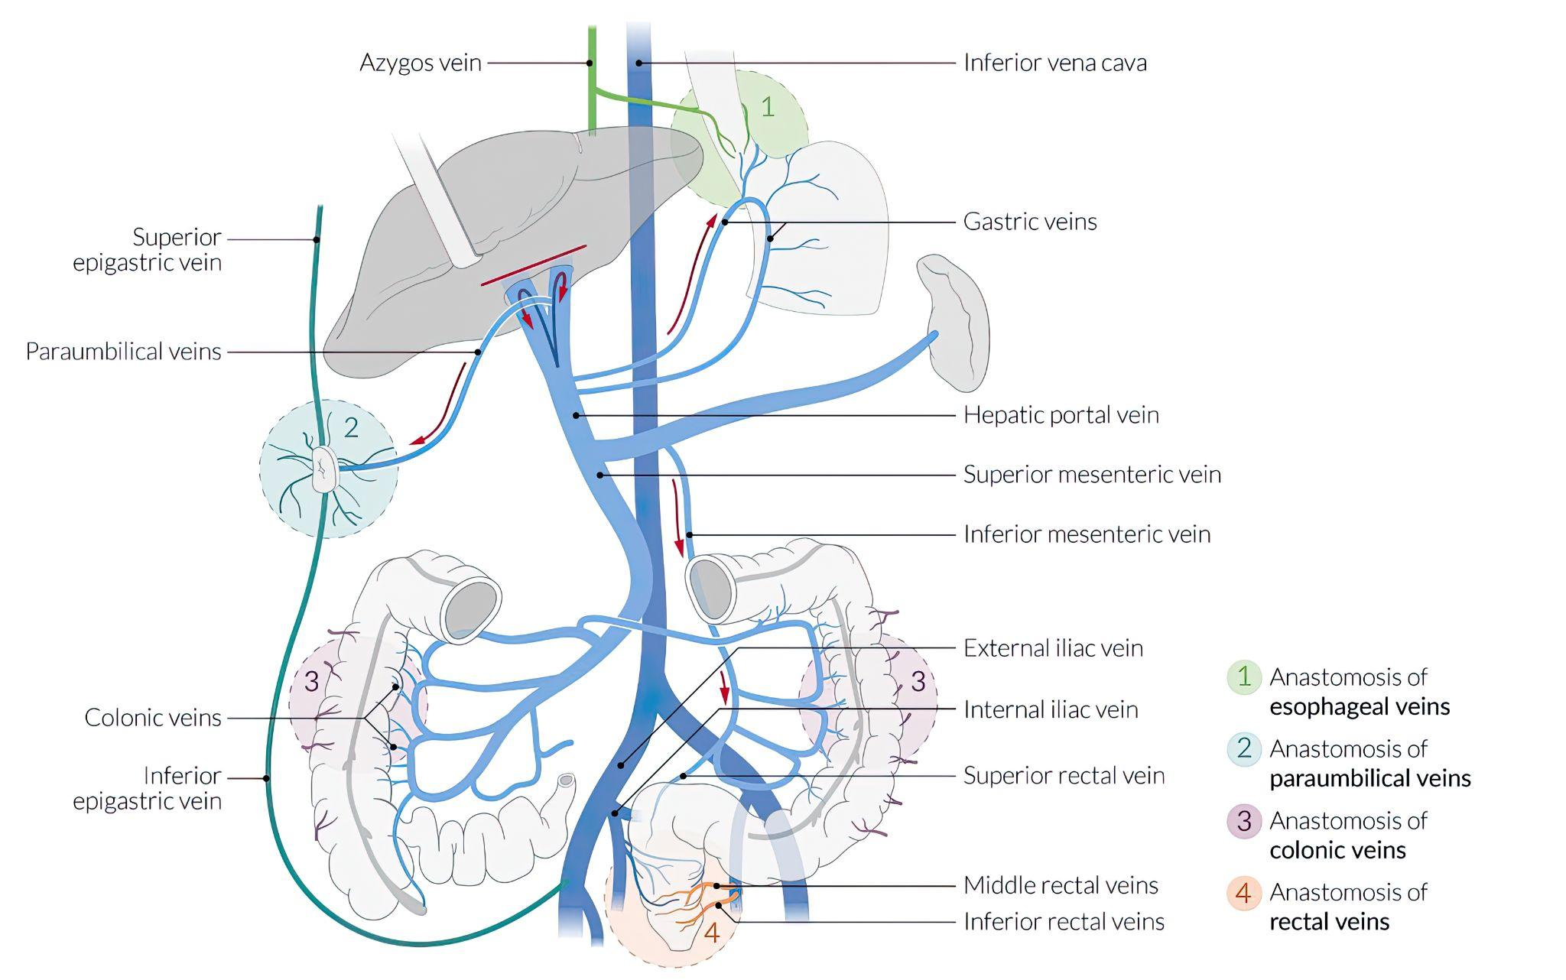
14
Sites of Portocaval Anastomosis
Lower part of esophagus (esophageal tributaries of left gastric vein with esophageal tributaries of azygos vein).
Upper part of anal canal / Lower part of rectum: superior rectal vein with middle and inferior rectal veins.
Paraumbilical region: paraumbilical veins with superficial veins of the anterior abdominal wall (superficial epigastric vein).
Retroperitoneal region: veins of the colon with veins of the posterior abdominal wall.
Bare area (posterior surface) of liver: left branch of portal vein with inferior phrenic veins
Patent ductus venosus (intrahepatic portosystemic shunt) during fetal development. Portosystemic shunts may be congenital or may be acquired with diseases that cause portal hypertension. Umbilical vein & portal vein shunt blood via patent ductus venosus into IVC. (Hepatomegaly, ascites and signs of portal hypertension)
Effects of Portal Hypertension of Portocaval Anastomosis
In cases of portal hypertension (e.g. liver cirrhosis), the pressure increases in sites of portocaval anastomosis.
Veins become congested and dilated. Obstructed portal blood flow may lead into:
Esophageal varices: enlarged veins around the lower end of esophagus which might rupture and cause hematemesis (vomiting of blood).
Caput medusae: swollen veins around the abdomen.
Hemorrhoids: swollen and enlarged veins inside the anal canal (internal) and outside and around the anus (external).They are painful (external) and may bleed (internal).

Slide 17
Quiz
MCQs
Q1: Which of the following veins connect SVC with IVC
A- internal iliac vein
B- azygos vein
C- saphenous vein
D- subclavian vein
Q2: All veins carry deoxygenated blood except?
A- anterior jugular vein
B- superior vena cava
C- pulmonary vein
D- axillary vein
Q3: Inferior vena cava is at the level of
A- T5
B- C5
C- T6
D- L5
Q4: Which of the following veins is used for venous grafting?
A- Great saphenous vein
B- Cephalic vein
C- Basilic vein
D- Small saphenous vein
Q5: Which vein is superficial to the sternomastoid?
A- Jugular arch
B- Internal jugular
C- External jugular
D- Maxillary
Q6: Which vein is a tributary of the IVC?
A- Splenic
B- Left Gonadal
C- Right Suprarenal
D- Inferior mesenteric
SAQs
Answers: 1. B 2. C 3. D 4. A 5. C 6. C
Q1; Enumerate the tributaries of Inferior vena cava?
Slide 9, Click to go to slide
Q2; Enumerate the tributaries of internal jugular vein?
Slide 6, Click to go to slide

Slide 18
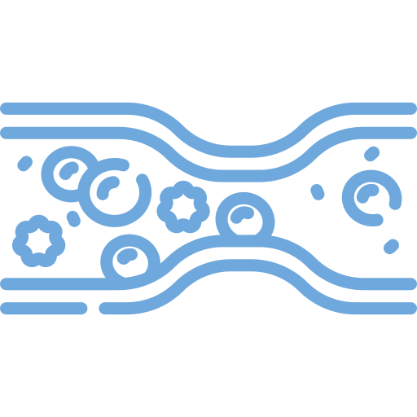
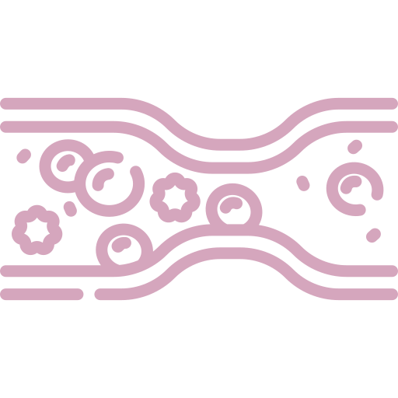
Members Board
Team Leaders
Mohammad Alrashed
Najla Aldhbiban
Team Members
Abdullah Alsalem
Nouf Alsaigh
Faisal Alomar
Nouf Aldalaqan
Mishal Alsuwayegh
Nouf Aldhalaan
Waleed Alrashoud
Raneem Alwatban
Emad Almutairi
Deema Aljuribah
Saud Altaleb
Haifa Alamri
Nawaf Alturki
Farah Alqazlan
Abdulkarim Salman
Nourah Alfawaz
Fahad Abdullah
Lina Almohsen
anatomyteam442@gmail.com

