Slide 1
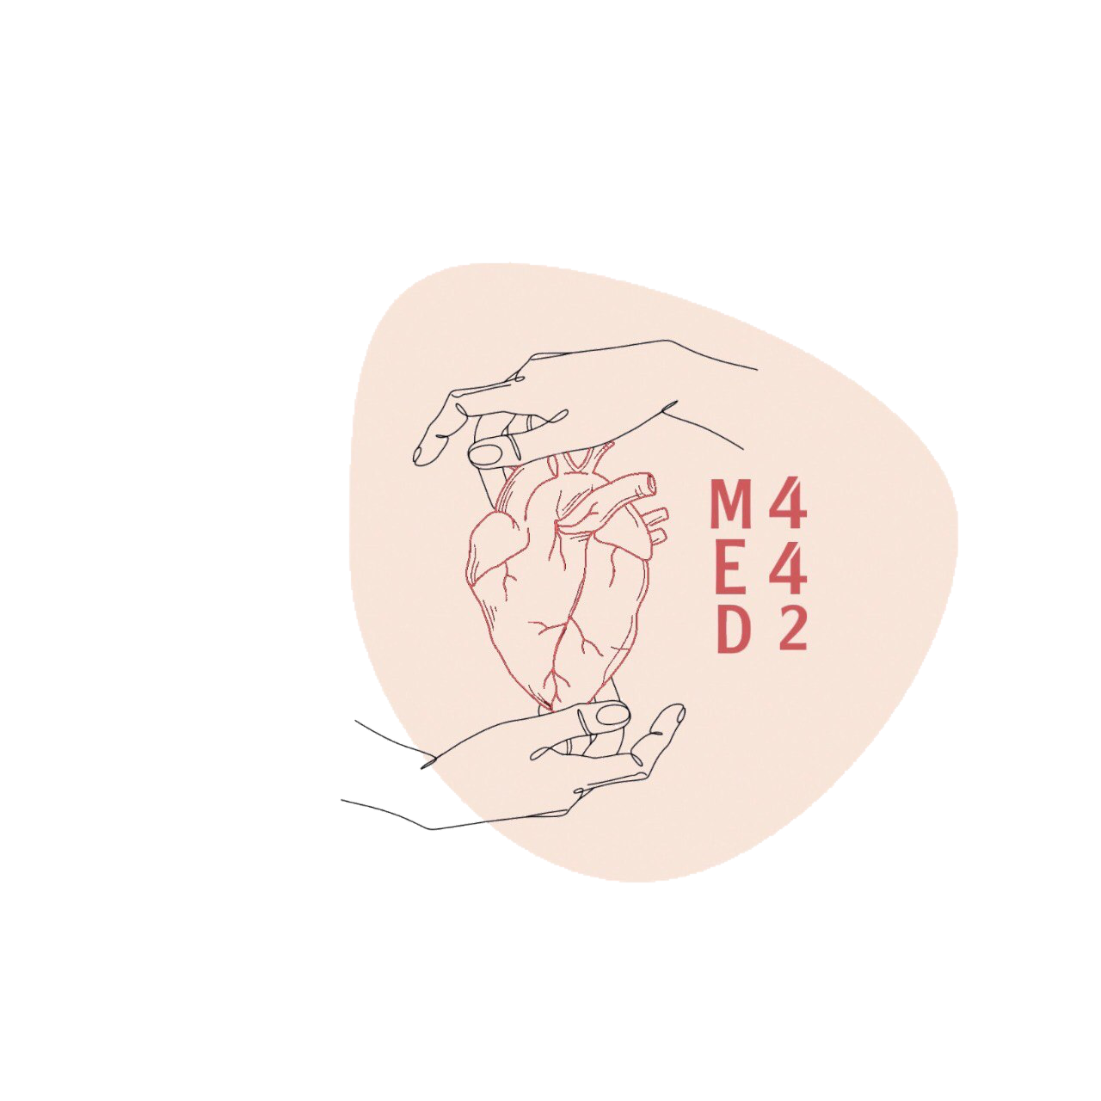
4
By Faisal Alomar
Anatomy of the Arterial Supply and Venous Drainage of the Heart
____________
CVS Block
Editing File
Color Index:
Main Text
Male’s Slides
Female’s Slides
Important
Doctor’s Notes
Extra Info

Slide 2
Objectives
At the end of the lecture the student should be able to know about:
The arterial supply of the cardiac muscle regarding (origin, course, distribution and branches).
The coronary anastomosis.
The arterial supply to the conducting system of the heart.
The venous drainage of the heart regarding (origin, tributaries and termination).
Nerve supply of the coronary arteries
Clinical application; Coronary heart diseases , Angina pectoris

Slide 3
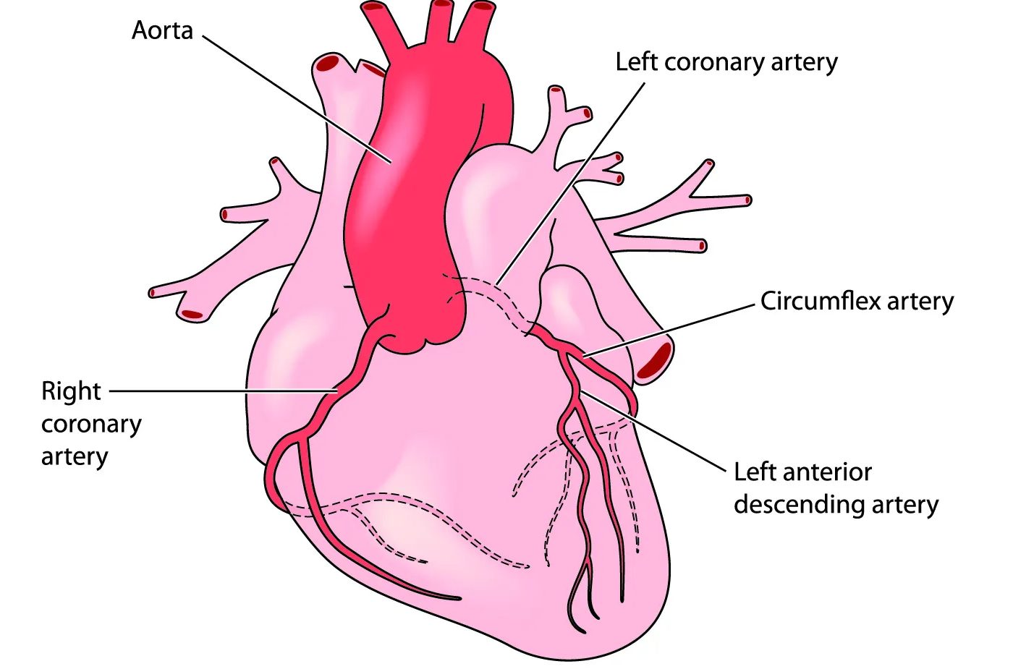
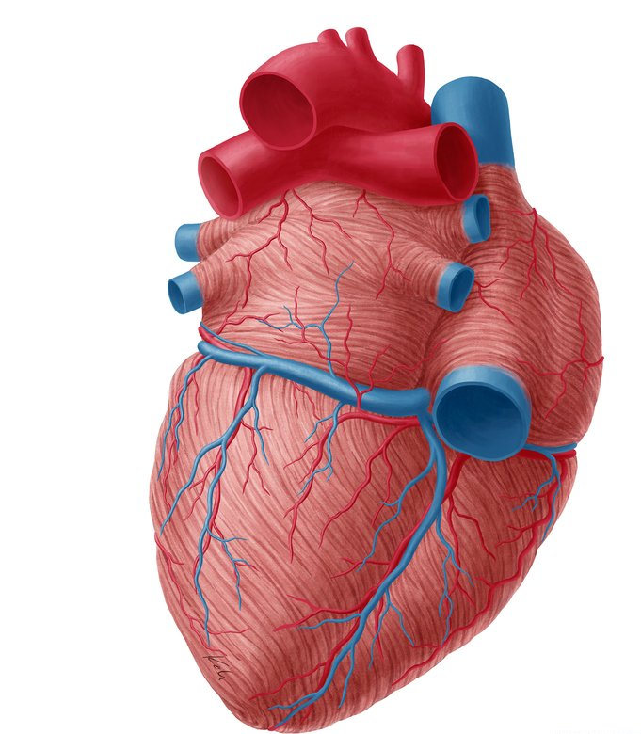
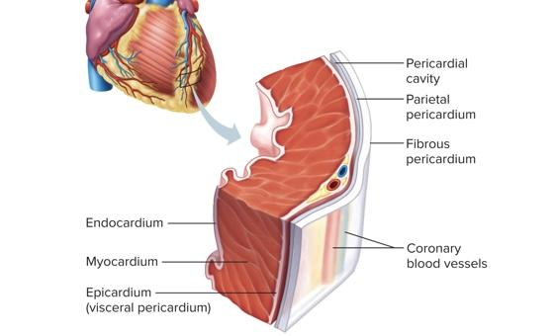
1
The Arterial Supply
The arterial supply of the heart is provided by Coronary Arteries:
1
Right Coronary
Artery
2
Left Coronary
Artery
They originate from the initial part of the Ascending Aorta; Immediately above the aortic valve.
They are distributed over the cardiac surface, within the subepicardium connective tissue.

Slide 4
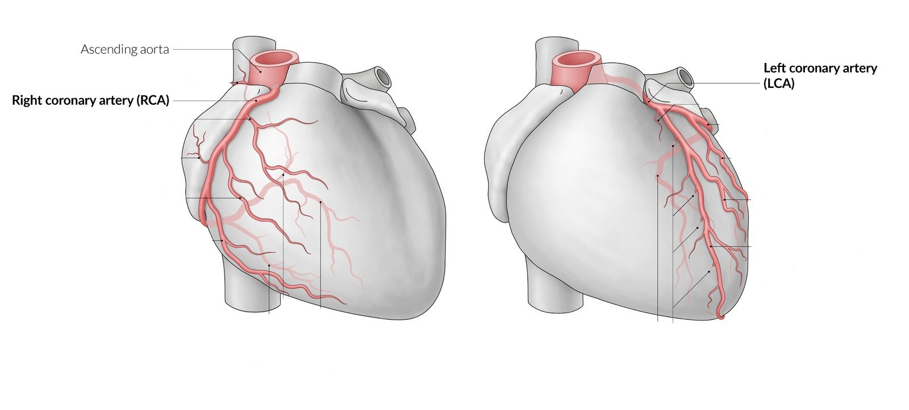
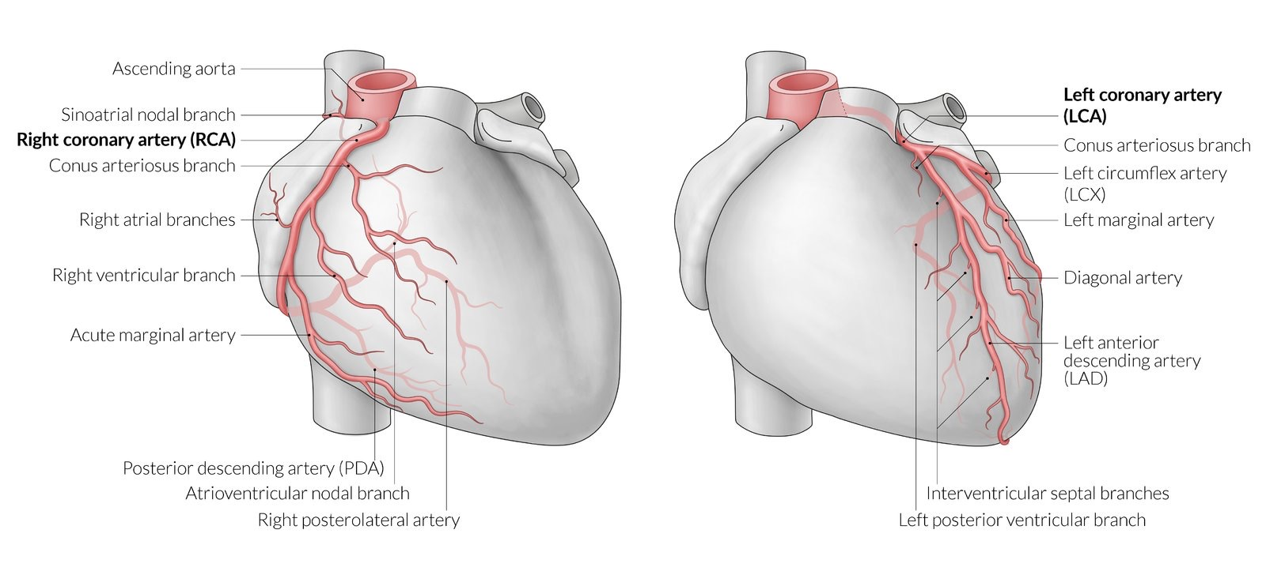
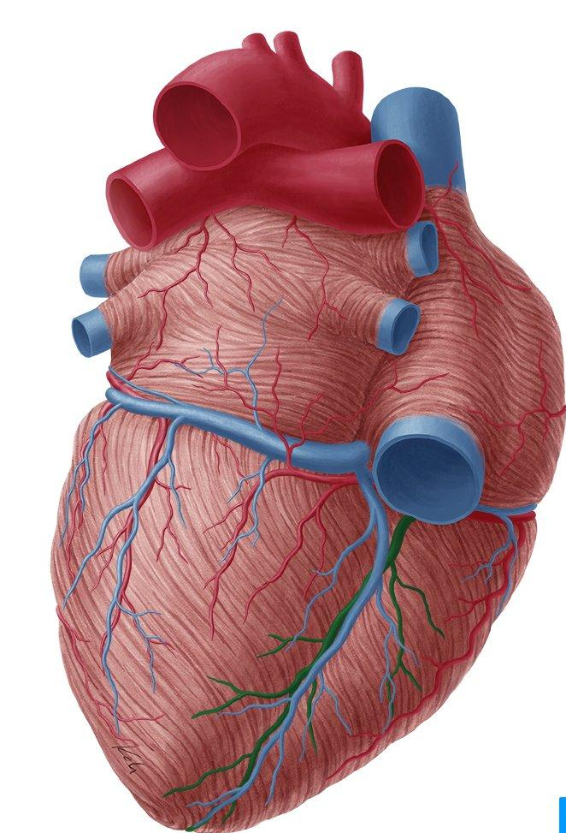
2
The Arterial Supply
Right Coronary
Artery
1
Arises from the anterior (right) aortic sinus of the ascending aorta.
Runs forward between pulmonary trunk and right auricle.
Descends vertically in the right atrioventricular groove.
At the inferior border of the heart it is continuous posteriorly along the atrioventricular groove to anastomose with the left coronary artery in the posterior interventricular groove.
Right Coronary Artery Supplies:
1- Right atrium, and Right ventricle,
2- Parts of Left Atrium, Left ventricle & Atrioventricular septum.
It doesn’t supply the apex even if it reaches the apex
Branches
1
Right Conus Artery
(Conus arteriosus branch)
5
To the infundibulum and
the upper part of the anterior wall
of the right ventricle.
Atrial Branches
2
To the right atrium; anterior and lateral surfaces. Posterior surface of both atria
Anterior Ventricular Arteries
6
2 or 3 branches, supplying
the anterior surface
of the right ventricle.
The Artery of the SAN
3
Supplies both atria
Marginal Artery
7
Posterior Interventricular Arteries
is the largest branch, runs along the inferior margin toward the apex.
It doesn’t reach the apex
(Posterior descending artery)
Runs toward the apex, to supplies:
A. Diaphragmatic surface of the R & L Ventricles.
B. Posterior part of the IVS excluding its Apex.
C. Septal branch to the AVN
.- (N.b) in 10% it is replaced by a branch from the left coronary
4
Posterior Ventricular Arteries
To the diaphragmatic surface of the right ventricle. (2 branches)
Posterior view
SAN: Sinoatrial node
IVS: Interventricular septum
AVN: Atrioventricular node

Slide 5
3
The Arterial Supply
Left Coronary
Artery
2
The larger of the two coronaries.
Arises from the Posterior (left) aortic sinus of the ascending aorta
Passes forward between the pulmonary trunk and the left auricle and enters the (left) atrioventricular groove
divides into Anterior interventricular artery & Circumflex artery
It supplies:
Greater part of left atrium, left ventricle, including the apex, and ventricular septum.
Branches
Anterior Interventricular Artery
Circumflex Artery
(Left anterior descending artery)
Descends in the anterior interventricular groove (with great cardiac vein) toward the apex of the heart.
(in most individuals it passes around the apex and anastomoses with the right coronary in the posterior Interventricular groove, in one third it ends at the apex)
Winds around the left margin of the heart in the atrioventricular groove
it gives:
1- A Left Marginal artery; supplies the left margin of the left ventricle to the apex.
2-Anterior ventricular and Posterior ventricular branches supply the left ventricle
3-Atrial branches to the left atrium.
It Supplies:
1-the right and left ventricles
2- the anterior part of ventricular septum, including the apex.
It may give also:
1-Left diagonal artery, which may arise from trunk of the left coronary
2- a small Left conus artery to
supply the pulmonary conous

Slide 6
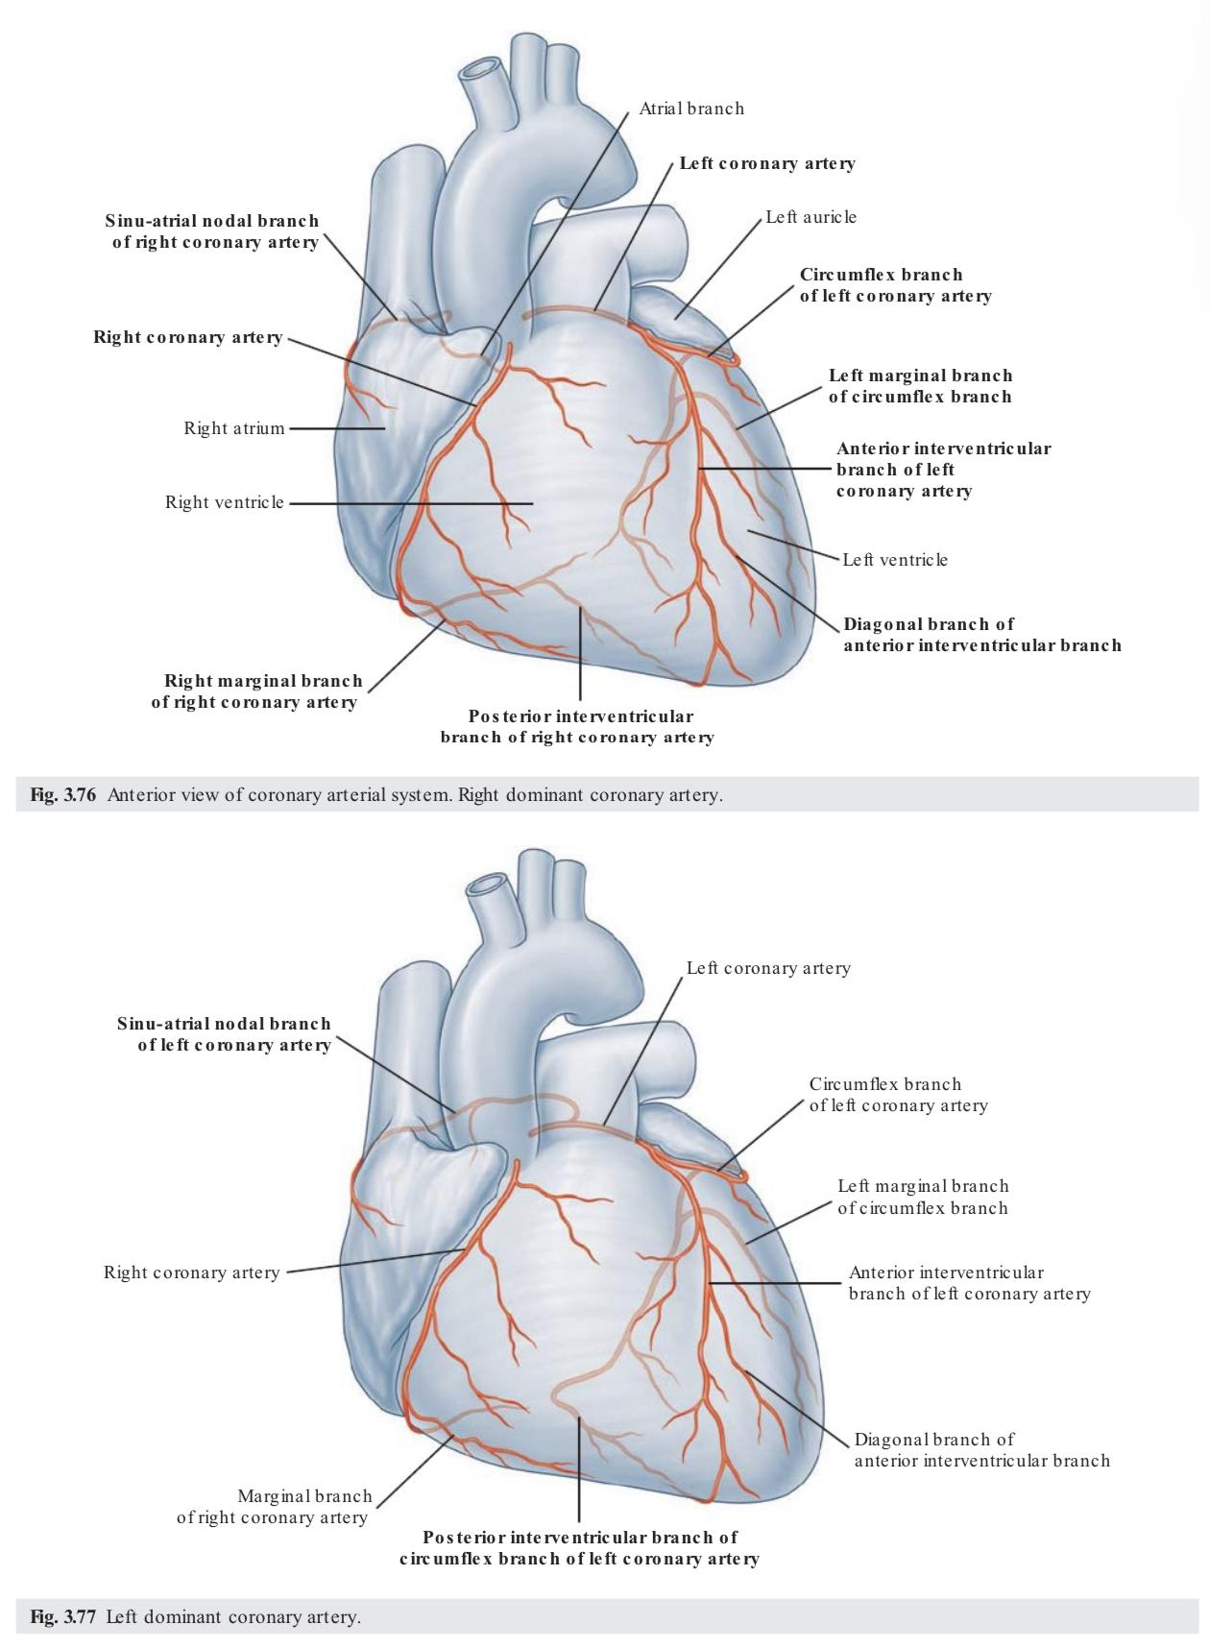
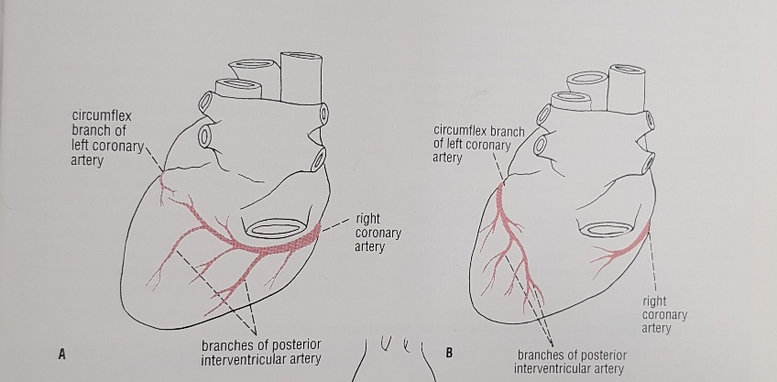
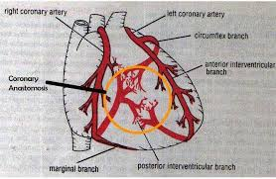
4
Variations of the Coronary Arteries
Affecting the diaphragmatic surfaces of both ventricles due to the origin, size, and distribution of the posterior interventricular artery
Right Dominance
1
In (90%) of population, the posterior Interventricular artery is a branch of the Right Coronary.
Left Dominance
2
In the rest (10%), the posterior Interventricular artery arises from the Circumflex branch of the Left Coronary
Right dominance
90% of people
Posterior view
Left dominance
10% of people
Coronary Anastomosis
Anastomoses between terminal branches of the right and left
coronaries exist but not large enough to provide adequate blood
supply. (Functional end arteries)
A sudden block of one of the large branches
of either arteries leads to myocardial infarction

Slide 7
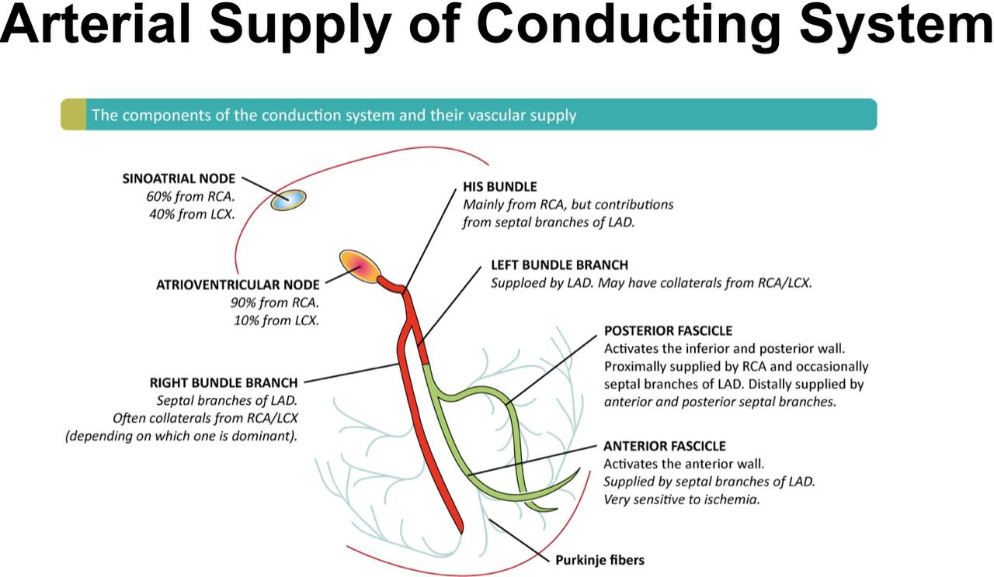
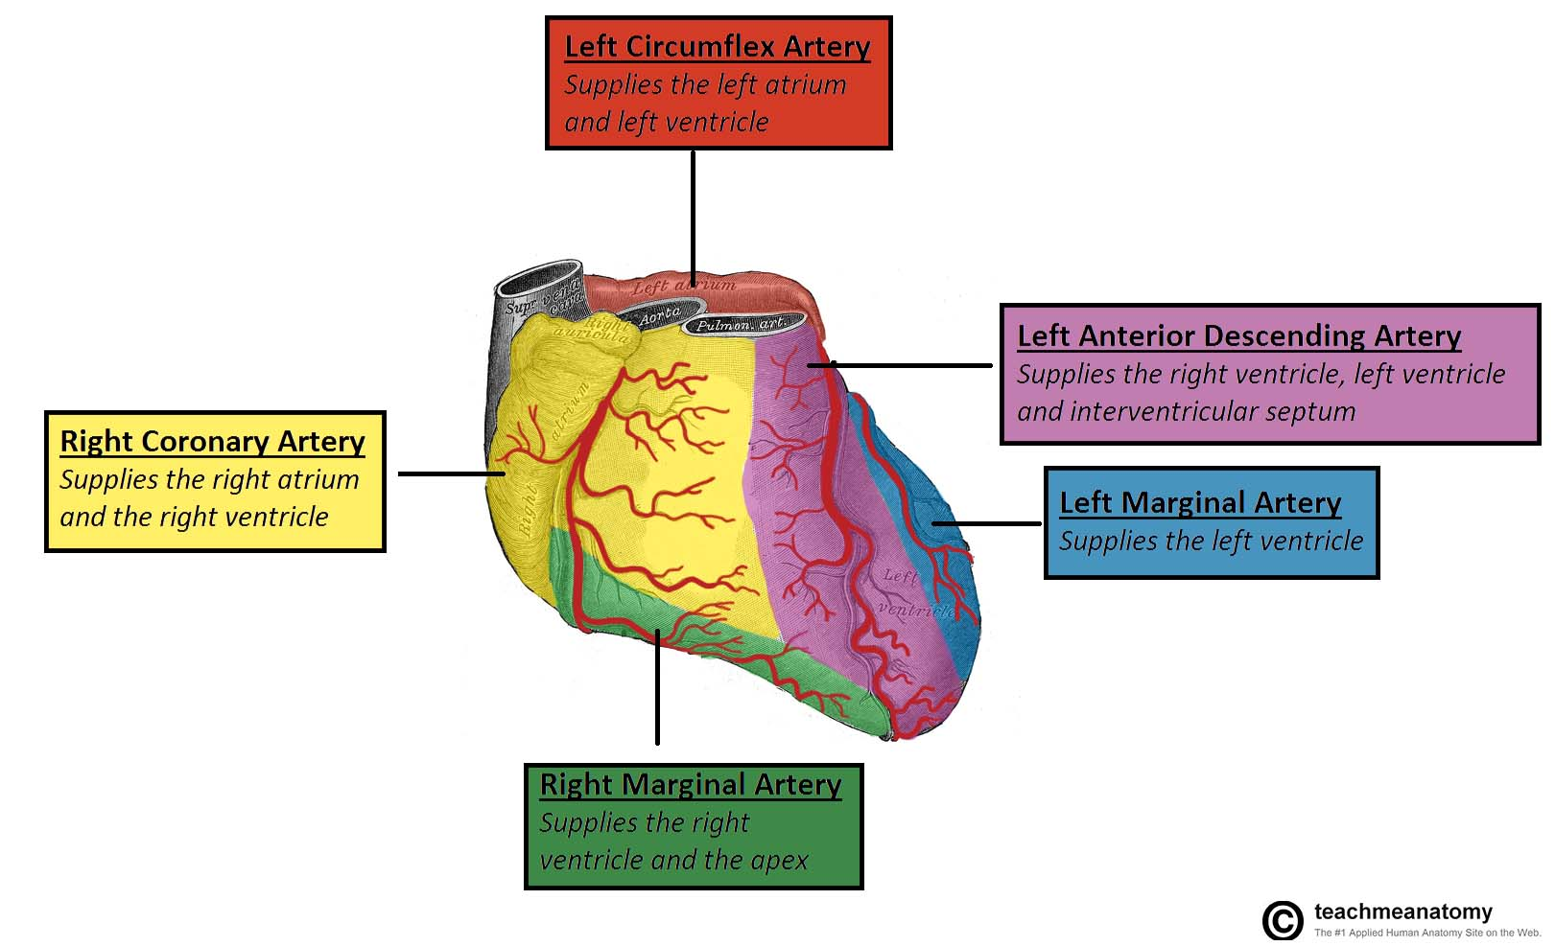
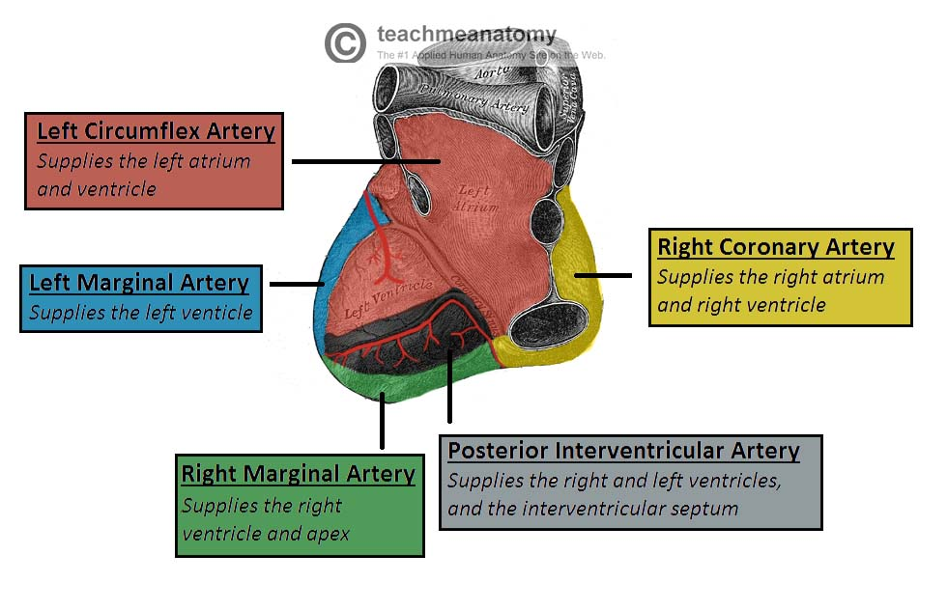
5
Arterial Supply of Conducting System
Important for MCQs
Right Coronary Supplies
Left Coronary Supplies
Both Supply
1
SA Node (SAN)
1
Right Bundle Branch of AVB
1
Left Bundle Branch of AVB
2
AV Node (AVN)
Arterial Supply of Conducting System
3
AV Bundle (AVB)
Summary of the Arterial Supply
Left Circumflex Artery:
Supplies the left atrium and the left ventricle
Left Anterior Descending Artery:
Supplies the right ventricle, left ventricle and interventricular septum
Right Coronary Artery:
Supplies the right atrium and the right ventricle
Left Marginal Artery:
Supplies the left ventricle
Right Marginal Artery:
Supplies the right ventricle
Left Circumflex Artery:
Supplies the left atrium and the left ventricle
Left Marginal Artery:
Supplies the left ventricle
Right Coronary Artery:
Supplies the right atrium and the right ventricle
Right Marginal Artery:
Supplies the right ventricle
Posterior Interventricular Artery:
Supplies the right and left ventricles and the interventricular septum

Slide 8
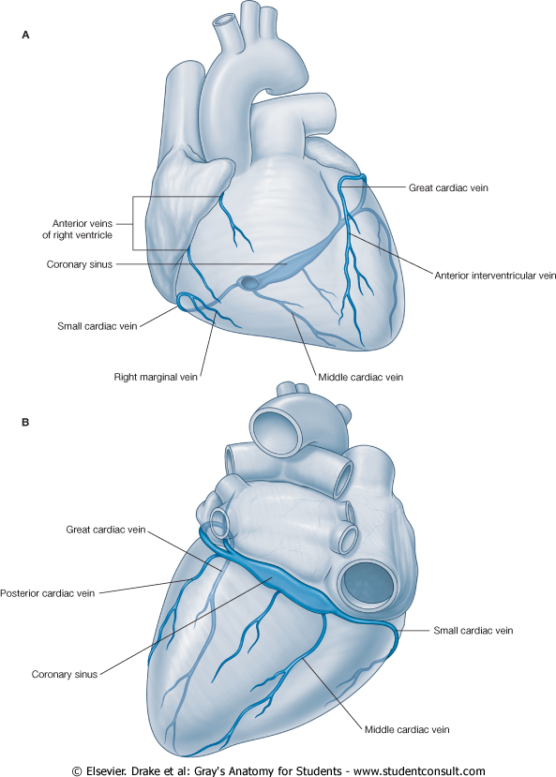
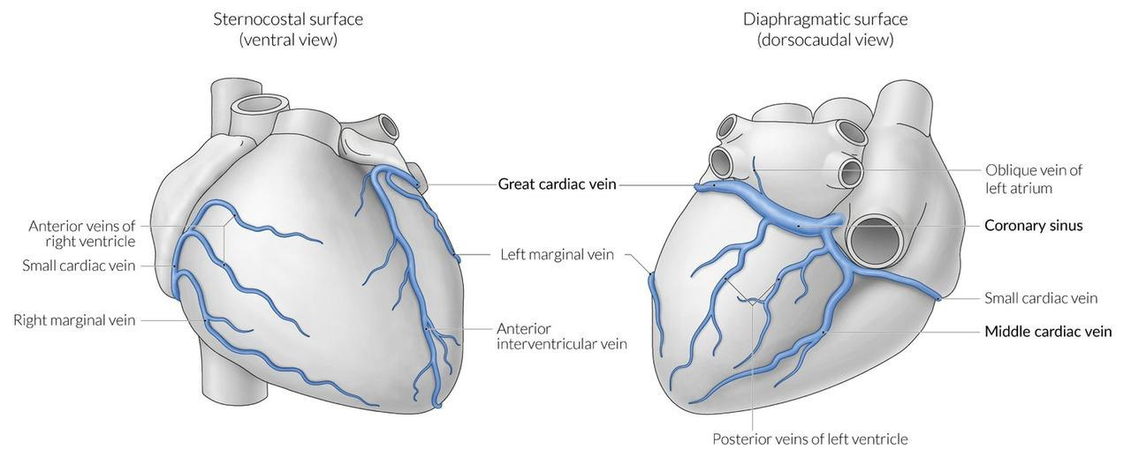
6
Venous Drainage of the Heart
Blood of the heart is drained into the Right Atrium through:
Coronary Sinus 2. Directly into the Right Atrium
1
Coronary Sinus
It is the direct continuation of the Great Cardiac Vein.
Lies in the posterior part of the AV groove, it opens in the right atrium to the left of the inferior vena cava opening
Great Cardiac Vein
It is guarded by a valve.
Small Cardiac Vein
Middle Cardiac Vein
Drains most of the venous blood of the heart.
Great Cardiac Vein
Tributaries:
Posterior cardiac vein
Small Cardiac Vein
1
4
Middle Cardiac Vein
Great Cardiac Vein
Middle Cardiac Vein
2
3
Small Cardiac Vein
Oblique vein of left atrium
2
Directly into the Right Atrium
Posterior veins of left ventricle
1
Posterior cardiac vein
غير عن
Posterior left ventricular vein
غير عن
Oblique vein of the left atrium
Anterior Cardiac Veins: Open directly into the Right Atrium.
2
Venae Cordis Minimae: (small cardiac veins): Open into the heart chambers.

Slide 9
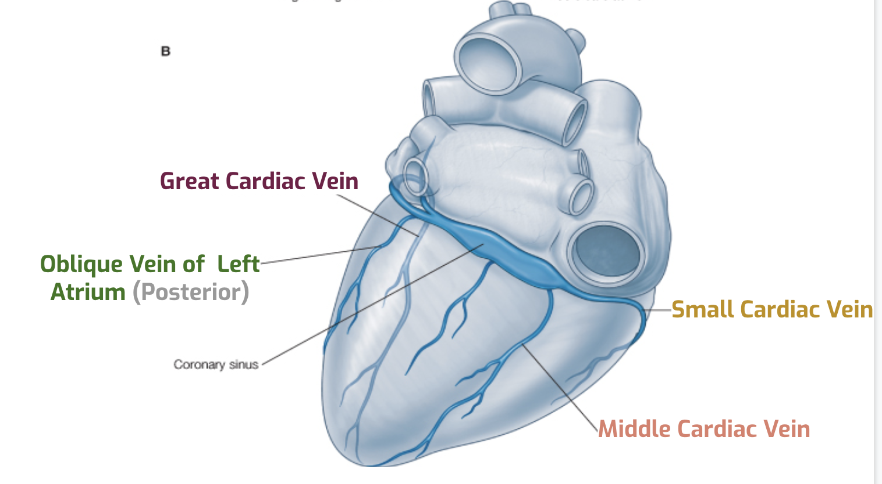
7
Main Tributaries of the Coronary Sinus
(Cardiac Veins )
1
Great Cardiac Vein
2
Small Cardiac Vein
(anterior interventricular vein) - the largest tributary of the coronary sinus.
- originates at the apex of the heart and ascends in the anterior interventricular groove.
- then curves to the left and continues onto the posterior surface of the heart.
- Here, it gradually enlarges to form the coronary sinus.
located on the anterior surface of the heart, in a groove between the right atrium and right ventricle. It travels within this groove onto the posterior surface of the heart, where it empties into the coronary sinus.
Great Cardiac Vein
Small Cardiac Vein
Posterior Cardiac Vein
Middle Cardiac Vein
3
Posterior Cardiac Vein
4
Middle Cardiac Vein
located on the posterior surface of the left ventricle.
It lies to the left of the middle cardiac vein and
empties into the coronary sinus.
(posterior interventricular vein)
– begins at the apex of the heart and ascends in the posterior interventricular groove to
empty into the coronary sinus.

Slide 10
8
Nerve Supply of the Coronary Arteries
The coronary vessels are supplied by autonomic nervous system via the cardiac plexus which is situated below the arch of aorta
The sympathetic supply arise from the cervical and upper thoracic portion of the sympathetic chain
The parasympathetic supply comes from the vagus nerve
Postganglionic sympathetic supplying the coronary arteries, leads to vaso-dilatation of the coronary arteries
Postganglionic parasympathetic supplying the coronary arteries, leads to vaso-constriction of the coronary arteries.
Extra explanation from the doctor :
The effect of sympathetic system on coronary artery is vasodilation because we need more blood supply but the parasympathetic will cause vasoconstriction because when we are at rest we do not need that much blood, this is a special case related to coronary artery which is different than other blood vessels
Coronary Heart Diseases
8
8
This may be due to atherosclerosis, thrombosis, high blood pressure, diabetes or smoking.
Can result in reduced blood flow to the heart as a result of narrowing or blockage of the coronary arteries.
All these factors lead to a reduced flow of blood to the heart through physical obstruction or changes in the vessel wall.

Slide 11
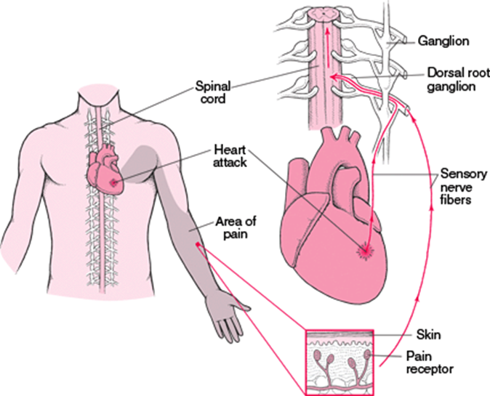
9
Cardiac Pain (Angina Pectoris)
Originates due to acute myocardial ischemia
Afferent nerve fibers ascend through cardiac branch of the sympathetic trunk entering the posterior root of upper 4 thoracic nerves
The pain is referred to skin area supplied by corresponding spinal nerves upper 4 intercostal nerves and intercostobrachial nerve
The intercostobrachial nerve communicates with medial cutaneous nerve of the arm and distributed to the skin of the medial side of the upper part of the left arm
It may be felt in the neck or the jaw and can radiate to medial side of left arm and shoulder

Slide 12
Quiz
MCQs
Q1: Coronary arteries are distributed on cardiac surface within?
A- parietal layer of pericardium
B- endocardium
C- fibrous layer of pericardium
D- subepicardium connective tissues
Q2: Most of people are right dominance in which their posterior interventricular artery is a branch of?
A- Circumflex artery
B- Right coronary artery
C- Right marginal artery
D- Left coronary artery
Q3: What is the largest branch of the right coronary artery?
A- Right marginal artery
B- Posterior interventricular artery
C- Anterior ventricular branch
D- Sinoatrial branch
Q4: Which of the following supply both left and right coronary arteries ?
A- AV bundle (AVB)
B- Right Bundle Branch (RBB) of (AVB)
C- Left bundle Branch (LBB) of (AVB)
D- SA node (SAN)
Q5: Which of the following is true about the coronary sinus ?
A- Lies in the posterior part of the AV groove.
B- indirect continuation of the Great Cardiac Vein.
C- It empties into left atrium
D- It is NOT guarded by a valve
Q6: Anterior cardiac vein opens directly to which chamber of the heart ?
A- Left atrium
B- Right ventricle
C- Right atrium
D- Left ventricle
SAQs
Answers: 1. D 2. B 3. A 4. C 5. A 6. C
Q1: Enumerate 5 branches of right coronary artery
1- Atrial branches 2- Anterior ventricular branches 3- Right marginal branch 4- Posterior ventricular branches 5- Sinoatrial branch
Q2: Enumerate the main tributaries of the coronary sinus
1- Great cardiac vein 2- Middle cardiac vein 3- Small cardiac vein 4-Oblique vein of left atrium (posterior)
Q3: Where the sympathetic and parasympathetic supply arise from? And what are there effects on the coronary arteries?
The sympathetic supply arise from the cervical and upper thoracic portion of the sympathetic chain. It causes vasodilatation.
The parasympathetic supply comes from the vagus nerve. It causes vasoconstriction.

Slide 13
Members Board
Team Leaders
Mohammad Alrashed
Najla Aldhbiban
Team Members
Abdullah Alsalem
Nouf Alsaigh
Faisal Alomar
Nouf Aldalaqan
Mishal Alsuwayegh
Nouf Aldhalaan
Waleed Alrashoud
Raneem Alwatban
Emad Almutairi
Deema Aljuribah
Saud Altaleb
Haifa Alamri
Nawaf Alturki
Farah Alqazlan
Abdulkarim Salman
Nourah Alfawaz
Fahad Abdullah
Lina Almohsen
anatomyteam442@gmail.com

