Slide 1
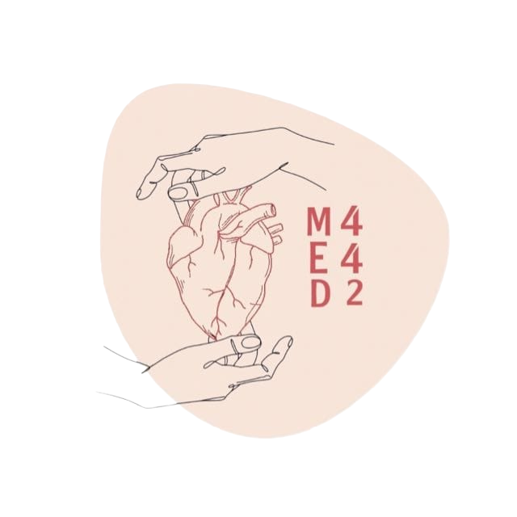
Lactic Acidosis
L:1
W:2
Color Index:
● Main text
● Important
● Notes
● Boys slides
● Girls slides
● Extra

Slide 2
Overview
objectives
Define metabolic acid-base disorders including lactic acidosis
Understand the causes and clinical effects of metabolic acidosis and alkalosis
Recall the lactate metabolism in the body
Differentiate between the types of lactic acidosis
Understand the clinical significance of measuring anion gap
Discuss the causes and diagnosis of lactic acidosis in conditions such as myocardial infarction
ولم أر في عيوب الناسِ عيبًا
كنقص القادرين َعلى التّمامِ
أبو الطيب أحمد المتنبي
Introduction to metabolic acid-base disorders
Metabolic acidosis
Metabolic alkalosis
Lactic acidosis
Definition
Lactate metabolism in tissue
Mechanisms involved in lactic acidosis
Types and causes of lactic acidosis
Diagnosis and treatment

Slide 3
Metabolic acid-base disorders
Blood gas results
It is the changes in bicarbonate concentration in the extracellular fluid (ECF) cause metabolic acid-base disorders.
Occur due to high concentration or loss of H+ ions.
This change of bicarbonate will lead to either :
Metabolic acidosis
Metabolic alkalosis
In both, the function of the body will be affected because of the change in PH
It is a test that help us to know if it is metabolic acidosis or alkalosis by inspecting the HCO3 concentration
Acidosis
Alkalosis
H+ elevated
H+ decreased
HCO3 decreased
HCO3- increased
Equation of Carbonic acid-Bicarbonate buffering system
If HCO3- normal, so it is not metabolic
Controlled by respiratory
Controlled by renal
CO2
H2O
H2CO3
H+
HCO3-
Metabolic acidosis
Metabolic alkalosis

Slide 4
Anion gap
It is the difference between the sum of :
[ (Na+K) - (Cl+HCO3) ]
Na+ and K+ (cations) And Cl – and HCO3– (anions)
It helps in assessing acid-base problems
Diabetic
ketoacidosis
Normal anion gap | (3-11) mEq/L
High anion gap | More than 11 mEq/L ( acidosis )
Low anion gap | less than 3 mEq/L ( alkalosis )
Renal disease
Metabolic acidosis
High anion gap occurs in :
Lactic acidosis
Metabolic acidosis can be accompanied by a normal anion gap like in the case of
(Chronic Diarrhea) because you will loss HCO3- and the Cl- will be high due to
compensation of HCO3-
مثل احد اخذ overdose من أدوية حمضيتها عالية
Poisoning

Slide 5
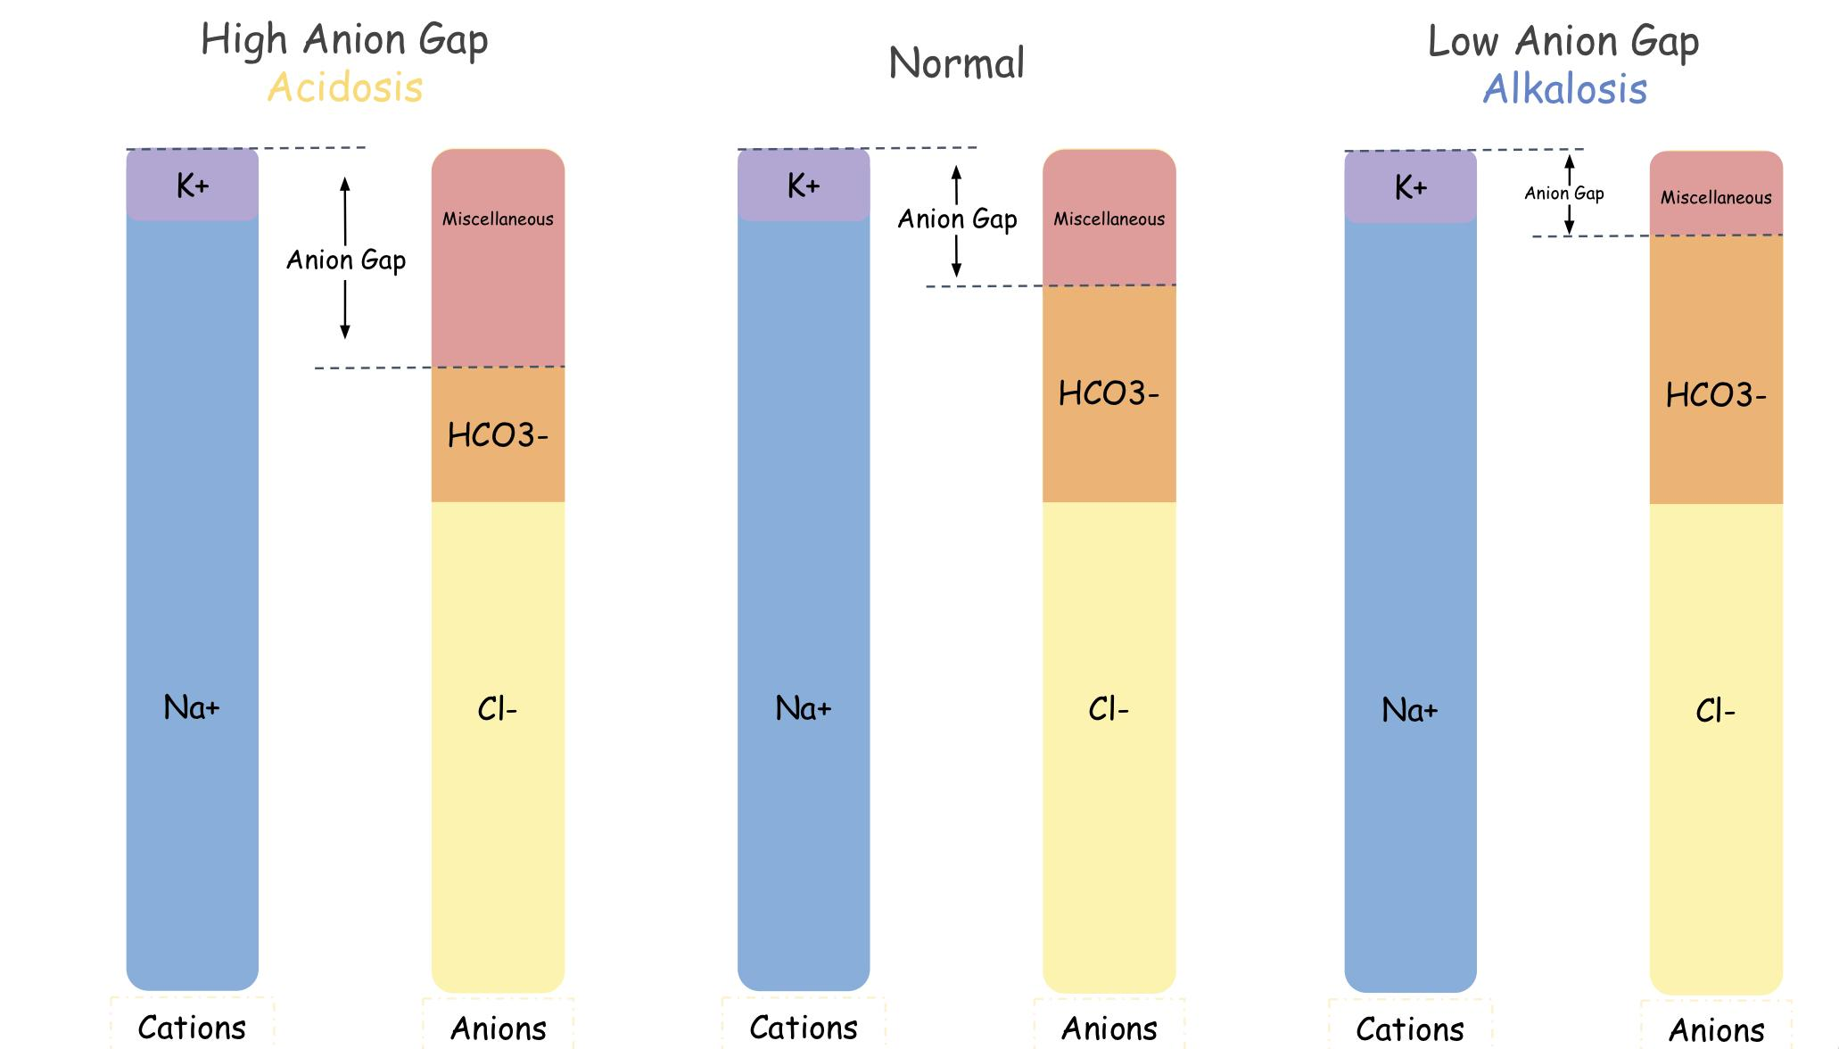
فرضاً ال cation تركيزه 20 وال anions تركيزه 15 في الوضع الطبيعي، ال anion gap بيكون ناتج طرحهم يساوي 5.
في ال Acidosis تقل قيمة ال anions الى مثلاً 5 ليه ؟ لان دخلت مادة acid ونعرف ان ال acid عندهم شحنة سالبة لذلك بيروح لل anions وبيزيد ال anion gap وبيصير ناتج الفرق يساوي 15 اذاً acidosis.
In anions we only count HCO3 and cl
( we don't count protein for example )

Slide 6
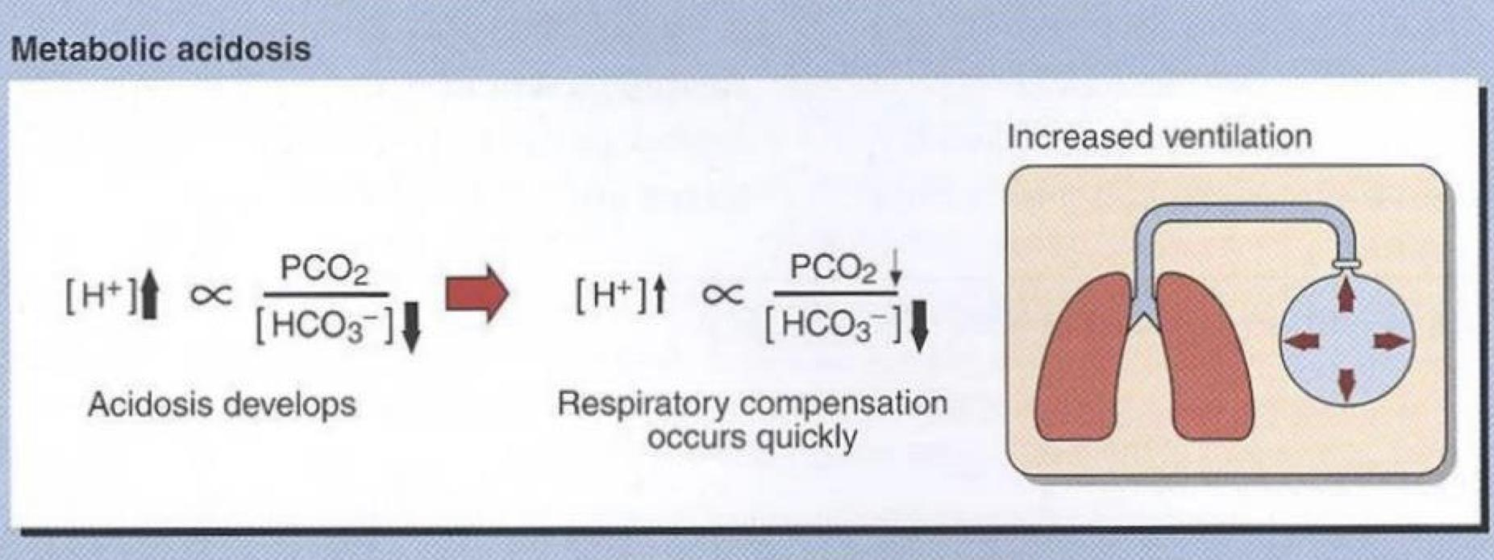
Metabolic acidosis
Clinical effects of acidosis
It is the Reduction in bicarbonate (HCO3) conc. of ECF
Hyperventilation is the compensatory physiological response to acidosis to remove CO2
Increased H+ conc. stimulates respiratory response
Hyperventilation: deep, rapid, and gasping respiratory pattern
Arrhythmia, cardiac arrest
Loss of consciousness, coma, death
Ingestion of H+ or drugs metabolized to acids
production of H+ ions
Causes
Loss of HCO3- e.g chronic diarrhoea in Diarrhea
Impaired excretion of H+
After compensation
Before compensation

Slide 7
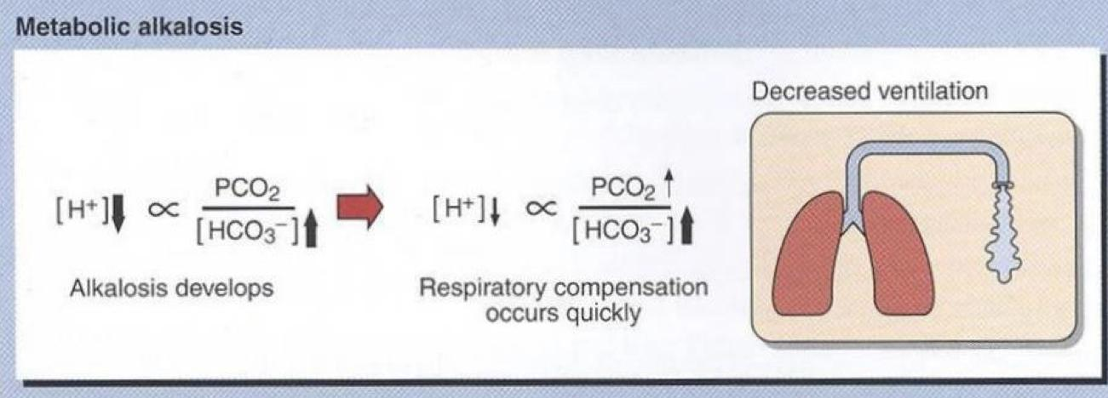
Metabolic alkalosis
Clinical effects of alkalosis
Increase in bicarbonate conc. in ECF
Hypoventilation (depressed breathing)
Increases PCO2 to compensate alkalosis
Respiratory arrest
Confusion, coma, death
Causes
Ingestion of sodium bicarbonate
Loss of H+ ions in gastric fluid due to vomiting
Potassium deficiency as a result of diuretic therapy
In hypokalemia cells will take H+ from ECF to inside the cell to become neutralied because K+ & H+ have the same charge thus less H+ in ECF and alkalosis

Slide 8
Lactic acidosis
Mechanisms involved in Lactic acidosis
Lactic acidosis happens when there is an increase in lactic acid conc. ( hyperlactemia ) or impaired lactic acid clearance .
Lactate is unmeasured anion (measured anions are HCO − and Cl−) → therefore, it has High anion gap.
Elevated conc. of plasma lactate is called lactic acidosis
Occurs either due to
Failure of circulatory system (hypoxia) type A
Disorders of carbohydrate metabolism type B
The enzyme that converts pyruvate to acetyl coA is not working so the pyruvate will be converted to lactic acid , causing hyperlactemia
Lactic acidosis can occur due to:
Excessive tissue lactate production
Impaired hepatic metabolism of lactate
Definition and causes are important

Slide 9
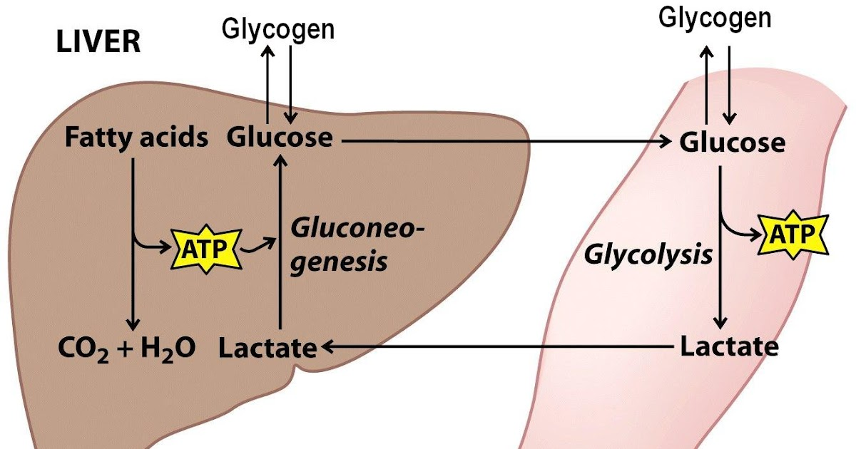
Lactate metabolism in tissue
The Cori Cycle
The body tissues produce ~ 1500 mmoles of lactate each day
The lactate enters blood stream and metabolized mainly by the liver (Cori cycle)
All tissues can produce lactate under anaerobic conditions.
Pyruvate is converted to lactate by lactate dehydrogenase enzyme
The skeletal muscles produce high amounts of lactate during vigorous exercise
Lactate is metabolized in liver (60%) and kidney (30%) to glucose
Some lactate is metabolized to CO2 and water (Krebs cycle)
Pyruvate + NADH + H+
In the muscle:
Glucose is converted into lactate by anaerobic glycolysis.
Lactate is released into the blood and is transported to the liver.
In the liver:
Lactate → glucose (gluconeogenesis).
Glucose is transported to the muscles (for energy again).
Lactate dehydrogenase
muscles
Lactate + NAD+

Slide 10
Types and causes of lactic acidosis
Type A
Due to: | Hypoxia causes:
inadequate supply of oxygen (hypoxia) to tissues (most common): Myocardial infarction Pulmonary embolism Uncontrolled hemorrhage (bleeding) Tissue hypoperfusion (shock, cardiac arrest, acute heart failure, etc.) Anaerobic muscular exercise | impaired oxidative phosphorylation and decreased ATP synthesis,This produces lactate as a final product.
To survive: | Adaptive response:
the cells switch to anaerobic glycolysis for ATP synthesis ,This produces lactate as a final product. | The amount of oxygen required to recover from oxygen deficiency is called oxygen debt (definition)
Type B
Due to:
disorders in carbohydrate metabolism. (Congenital lactic acidosis is due to deficiency of pyruvate dehydrogenase enzyme. (important) ) Chronic hepatic disease accompanied by shock or bleeding. Liver failure . Drug intoxication (poisoning)

Slide 11
Diagnosis and treatment
Hyperlactemia: 2 – 5 mmols/L risk for lactic acidosis
Diagnosis done by measuring blood lactate levels
Severe lactic acidosis: > 5 mmols/L
Treatment
Avoiding sodium bicarbonate. In acidosis in general it’s known that adding sodium bicarbonate will help to get PH back to its normal range but in lactic acidosis for unknown reasons it will make it worse by increasing lactic acidosis
Restoring adequate tissue oxygen (Because most of the time the cause of lactic acidosis is hypoxia)
Correcting the underlying conditions

Slide 12
Take home message
Lactic acidosis can be caused by hypoxia, excessive production and impaired clearance of lactic acid.
It carries clinical significance in the diagnosis of myocardial infarction, pulmonary embolism and other metabolic conditions

Slide 13
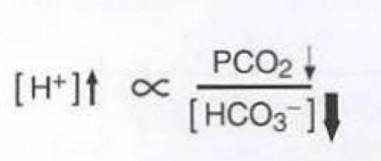
MCQs
Q1 Reduction in bicarbonate conc. of ECF is :
A.metabolic alkalosis | B.metabolic acidosis | C.respiratory alkalosis | D.Because of loss of H+
Q2 Hypoventilation (depressed breathing) Increases PCO2 to compensate which condition :
A.Metabolic alkalosis | B.Metabolic acidosis | C.Respiratory acidosis | D.None of them
Q3 this equation is :
A.Metabolic alkalosis after compensation | B.Metabolic acidosis after compensation | C.metabolic acidosis before compensation | D.Metabolic alkalosis before compensation
Answers : Q1B Q2A Q3B

Slide 14
MCQs
Q4 What can cause congenital Lactic Acidosis ?
A.pyruvate dehydrogenase enzyme | B.ATP synthase | C.Lactate dehydrogenase | D.phosphorylase
Q5The amount of oxygen required to recover from oxygen deficiency is called?
A.Alkalosis | B.Lactic Acidosis | C.oxygen debt | D.Metabolic acidosis
Q6The lactate enters blood stream and metabolized mainly by?
A.liver | B.kidney | C.Intestine | D.muscle
Answers : Q4A Q5 C Q6A

Slide 15
SAQs
Q1 numerate the causes of metabolic alkalosis ?
Q2 define Metabolic acidosis
Q3 what is the compensatory physiological response to acidosis
Q1:
• Loss of H+ ions in gastric fluid due to vomiting
• Ingestion of sodium bicarbonate
• Potassium deficiency as a result of diuretic
therapy
Q2: Reduction in bicarbonate conc. of ECF
Q 3 : Hyperventilation

Slide 16
Our Team
Leaders
Team members
Arwa Alghamdi
Mohammed Ibn Saqyan
Fatima Halawi
Mohammed Aljarba
Meshari Alshathri
Mohammed Abdulaziz Alrashoud
Amer Alghamdi
Mashael Alsuliman
Shahad Alsakar
Raseel Alwehibi
Roaa Alharbi
Razan Alasmari
Wafa Alqhtani
Sarah Albenmousa
Biochemksumed442@gmail.com

