Slide 1
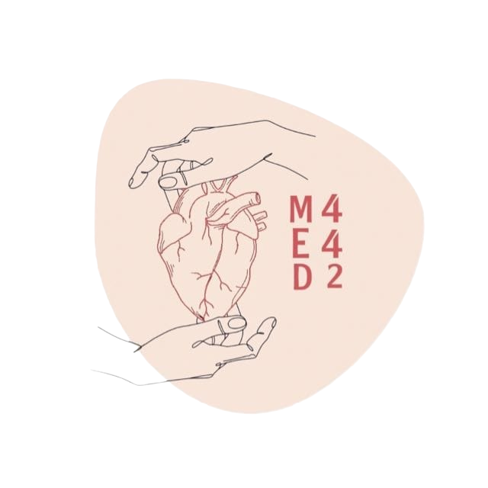
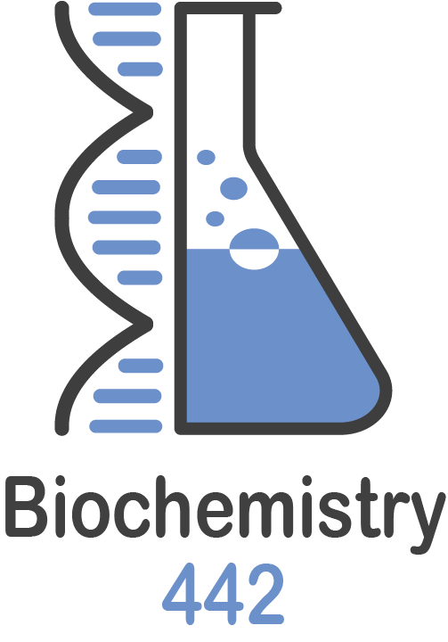
Cholesterol Metabolism
L:2
Update:1
Color Index:
● Main text
● Important
● Notes
● Boys slides
● Girls slides
● Extra

Slide 2
objectives
Understand the structure and functions of cholesterol
Discuss the regulation of cholesterol homeostasis in the body
Comprehend the important steps of cholesterol synthesis pathway
Identify different levels of regulation of cholesterol synthesis
Discuss the association of hypercholesterolemia with abnormal cholesterol metabolism
Understand the role of statins in the treatment of hypercholesterolemia

Slide 3
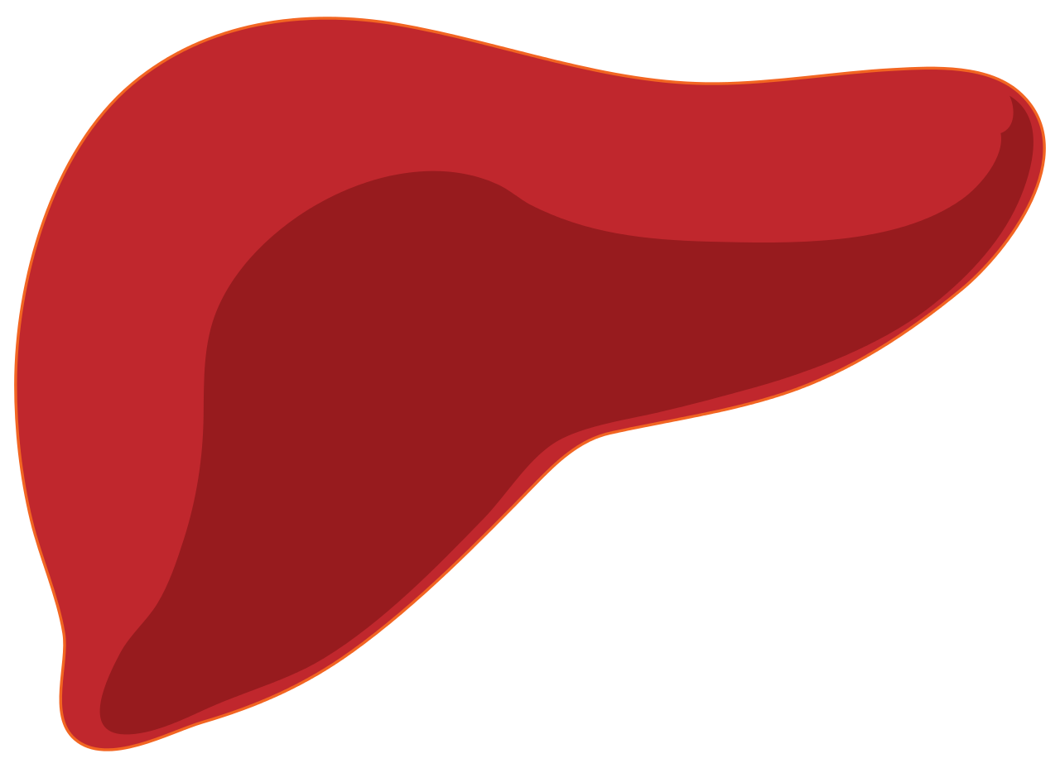
Cholesterol
Major sources of liver cholesterol
1 - Dietary
cholesterol
(Absorbed as)
Chylomicron
remnants
2- De novo
“From the new”
synthesis in the
liver
3- Cholesterol
synthesized in
extrahepatic tissues
”outside the liver”
(Transported as) HDL
Most important animal steroid
❖ Functions :
-Maintains membrane fluidity
(present between the phospholipids)
-Insulating effect on nerve fibers
-Cholesterol is the parent (precursor)
molecule for :
Liver Cholesterol
Pool
Liver plays a central role in the regulation of cholesterol homeostasis
Bile acids and bile salts
Steroid hormones
Vitamin D₃
1- Secretion of
VLDL
2- Free cholesterol
secreted in the bile
3- Conversion to
bile acid/salts
Major routes by which cholesterol leaves the liver

Slide 4
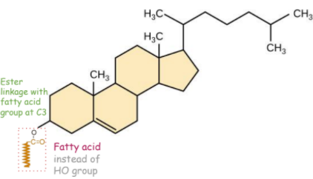
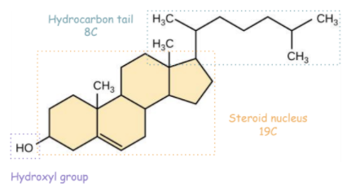
Cholesteryl Ester (CEs)
Cholesterol Synthesis
Most plasma cholesterol is esterified with a fatty acid
Present in small amounts in most cells
CEs are not present in membranes
More hydrophobic than cholesterol
Enzymes involved in
biosynthesis are partly
located in ER and
partly in cytoplasm
Synthesized in all tissues
Major sites for synthesis
where it gets modified to other
molecules :
- liver - adrenal cortex
- testes & ovaries - intestine
All carbon atoms are
derived from acetyl
CoA

Slide 5
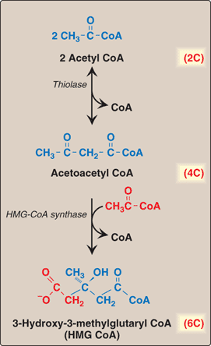
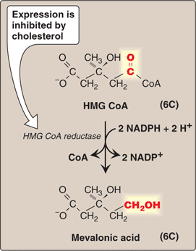
1- Synthesis of HMG-CoA:
2- Synthesis of Mevalonic acid:
HMG CoA synthase is present in both cytosol and mitochondria of liver
Mitochondrial-ketogenesis (ketone body synthesis)
Cytosolic – cholesterol synthesis
Rate limiting and key step
Occurs in cytosol
HMG CoA reductase is an ER membrane enzyme with catalytic unit hanging in the cytosol

Slide 6
Further steps in synthesis:
Production of a 5-carbon unit:
Isopentenyl pyrophosphate (IPP)
Condensation to a 30C compound squalene
Cyclization of squalene to 30C
lanosterol
Synthesis of 27-Carbon cholesterol after a number of reactions (defect in this leads to Smith-Lemli-Opitz Syndrome)

Slide 7
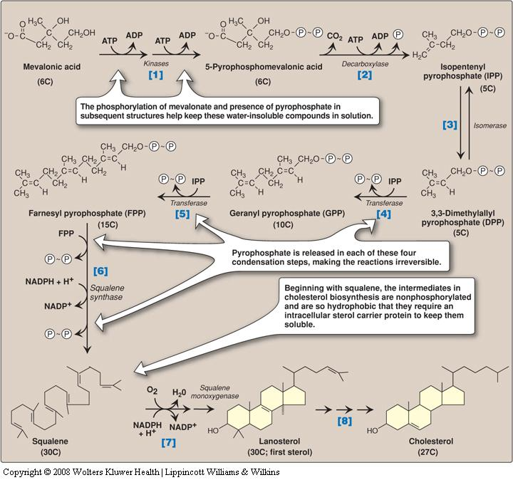
Regulation of Cholesterol
Synthesis:
-HMG CoA reductase is the rate-limiting enzyme of cholesterol synthesis
Dr said :only focus on the red boxes

Slide 8
HMG CoA reductase regulation
Sterol-dependent regulation of gene expression
Cholesterol concentration in the body determine the gene expression
Sterol-accelerated enzyme degradation
More cholesterol Faster degradation
Sterol-independent phosphorylation/ dephosphorylation
Hormonal regulation

Slide 9
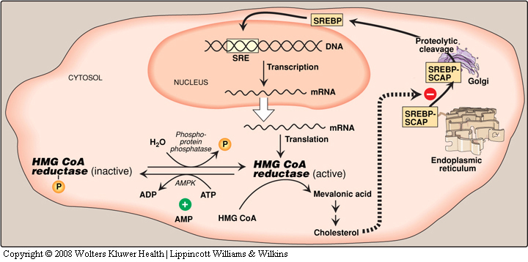
1) Sterol dependent regulation of gene expression of HMG CoA
When sufficient cholesterol is present transcription is suppressed and vice versa.
Sterol Regulatory Element (SRE ) is a recognition sequence in DNA.
SRE Binding Protein (SREBP) will bind to SRE, is essential for transcription of this gene.
SREBP Cleavage-Activating Protein (SCAP) is an intracellular cholesterol sensor.

Slide 10
Sterol-dependent regulation
High cholesterol
Low cholesterol
SCAP (already bound to SREBP) will bind to INSIG
protein (insulin induced gene protein) in ER membrane
SCAP-SREBP moves to Golgi bodies
SCAP-SREBP is retained تبقى in the ER.
INSIG protein prevents them from leaving to Golgi bodies
SCAP is removed from SREBP
(by proteolytic cleavage found in Golgi bodies)
Down regulation of cholesterol synthesis
(HMG CoA reductase will be inhibited)
It’s the rate limiting enzyme, remember?
SREBP will bind to SRE in DNA
HMG CoA gene will be activated

Slide 11
2) Sterol-independent (enzyme) phosphorylation and dephosphorylation
AMP- activated protein kinase (AMPK) for
phosphorylation
Phosphorylated form of enzyme is inactive
AMPK is active
AMP
ATP
Dephosphorylated form is active
Phosphoprotein Phosphatase is active
Low ATP or High AMP cholesterol synthesis
decreases
ATP
AMP

Slide 12
3) Hormonal regulation
Insulin and thyroxine increase upregulation of
enzyme expression
Cholesterol
Gene
Transcription
Glucagon and cortisol have opposite effect
Translation
Excretion of cholesterol
HMG CoA
reductase
Activation
By conversion of bile acid and bile salts, excreted in the feces.
○ Secretion of cholesterol in bile
○ Transported to intestine for elimination
Insulin
thyroxine
HMG CoA
Inhibition
Glucagon
Cortisol
Statin
Cholesterol
In the intestine, some cholesterol is converted by bacteria into coprostanol and cholestanol before excretion.

Slide 13
Hypercholesterolemia
High concentration of cholesterol in blood lead to atherosclerosis by depositing in blood vessels .
Statin drugs are used to decrease plasma cholesterol levels
Statins are structural analogs of HMG CoA reductase
Statins inhibit enzyme activity by competitive inhibition
β-Sitosterols/ Phytosterols
They are plant sterols, poorly absorbed by humans.
Block the absorption
of dietary cholesterol.
Clinically useful in the dietary treatment of
hypercholesterolemia.

Slide 14
Take Home Messages
Cholesterol is important various body functions
Liver plays a major role in the cholesterol homeostasis in the body
HMG CoA reductase is a rate-limiting enzyme for cholesterol synthesis

Slide 15
MCQs
Q1 the major sites for synthesis cholesterol?
A liver | B heart | C kidney | D lungs
Q2 Which one of these is the rate limiting enzyme in cholesterol synthesis ?
A HMG-CoA synthase | B HMG-CoA reductase | C thiolase | D squalene synthase
Q3 What is the first sterol during cholesterol synthesis pathway ?
A cholesterol | B squalene | C mevalonic acid | D lanosterol
Answers : Q1A Q2B Q3D

Slide 16
MCQs
Q4 the HMG-CoA synthase is present in both?
A cytosol | B intestin | C mitochondria of liver | D both A and C
Q5 increase upregulation of enzyme expression by?
A insulin | B cortisol | C statin | D Glucagon
Q6 increase synthesis of cholesterol when?
A AMP is high | B ATP is low | C ATP is high | D both B and A
Answers : Q4 D Q5 A Q6 C

Slide 17
SAQs
Q1 mention the major sites for synthesis cholesterol?
Q2 mention 2 of the function of cholesterol ?
Q3 some cholesterol is converted by bacteria into?
Q1 liver, adrenal cortex, testes, ovaries and intestine
Q2 maintains membrane fluidity , insulating effect on nerve fibers.
Q3 coprostanol and cholestanol .

Slide 18
Our Team
Leaders
Team members
Arma Alghamdi
Mohammed Ibn Saqyan
Fatima Halawi
Mohammed Aljarba
Meshari Alshathri
Mohammed Abdulaziz Alrashoud
Amer Alghamdi
Mashael Alsuliman
Shahad Alsakar
Raseel Alwehibi
Roaa Alharbi
Razan Alasmari
Wafa Alqhtani
Sarah Albenmousa
تعلم فليس المرءُ يولدُ عالماً وليس أخو علمٍ كمن هو جاهلُ
وإن كبير القوم لا علم عنده صغير إذا التفت عليه الجحافل
وإن صغير القومِ إن كان عالماً كبيرٌ إذا ردت إليه المحافلُ
محمد بن ادريس الشافعي
Biochemksumed442@gmail.com

