Slide 1
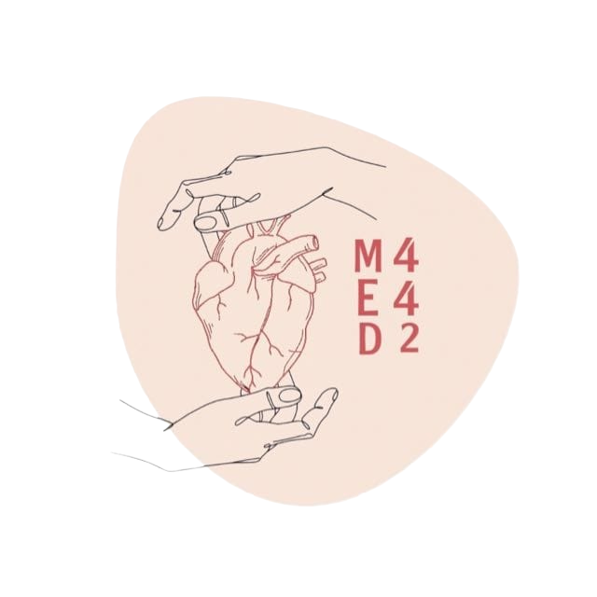
Biochemical Markers of Myocardial Infarction
Color Index:
● Main text
● Important
● Notes
● Boys slides
● Girls slides
● Extra
L:3
W:5

Slide 2
objectives
Describe the general sequence of events of myocardial infarction (MI)
List the criteria for diagnosis of MI
Discuss the features of an ideal MI marker
Understand the significance of changes in plasma marker levels over time
Identify the properties and diagnostic value of cardiac troponins, creatine kinase, h-FABP and BNP
Know about markers with potential clinical use

Slide 3
Myocardial Infarction (MI)
Criteria for Diagnosis of (MI)
Occlusion of coronary arteries | Restricted blood supply (O2) to heart tissue (ischemia) | Damage to heart tissue (infraction) | Release of enzymes and other proteins into the blood (markers)
•Recommended by the European Society of Cardiology and American College of Cardiology
•Requires the presence of at least 2 of the following characteristics:
* with contenues measurements of the Criteria for diagnosis of MI
troponin every 4hr, first it will be reduced, then it rise quickly, then fall gradually.
Typical heart attack symptoms
Characteristic rise and fall pattern of a cardiac marker in plasma
Typical ECG pattern
E.g Chest pain radiate to the left shoulder Nausea,Sweating,Shortness of breath
•Rise and gradual fall of cardiac troponins
•More rapid rise and fall of CK-MB
E.g. elevated ST segment.

Slide 4
Features of an Ideal Cardiac Marker
1-High concentration in the myocardium
2-High sensitivity
Detected even in low concentration at early stages of the disease.
3-High specificity
Specifically detecting damage of cardiac tissue, and is absent in non-myocardial tissue injury.
4-Rapid release into plasma following myocardial injury
5-Good prognostic value
Strong correlation between plasma level and extent of myocardial injury.
6-Easily measured
Detectable by rapid, simple and automated assay methods.
كثيره في الدم كل ما كان الجزء المتضرر اكبر
The biomarker
يعني كل ما كانت كمية

Slide 5
Plasma Cardiac Markers
Markers of Diagnostic Value
Cardiac markers = Cardiac enzymes
Current MI markers
Markers with
potential clinical use
Markers no
longer used
Low specificity
•Aspartate Transaminase (AST)
•Lactate dehydrogenase (LDH)
•Ischemia modified albumin (IMA)
•Myoglobin
•Cardiac troponin T (cTnT)
•Cardiac troponin I (cTnI)
•Creatine kinase-MB (CK-MB)
•Heart fatty acid binding protein (h-FABP)
*detecting heart tissue ischemia
Myocardium Bound
In myocardial infarction
In Tissue Ischemia
In Heart Failure
•Cardiac troponins T and I
•Creatine kinase (CK-MB)
•Heart fatty acid binding protein (h-FABP)
•B-type natriuretic peptide (BNP)
Useful in early stage diagnosis
Useful in late stage diagnosis

Slide 6
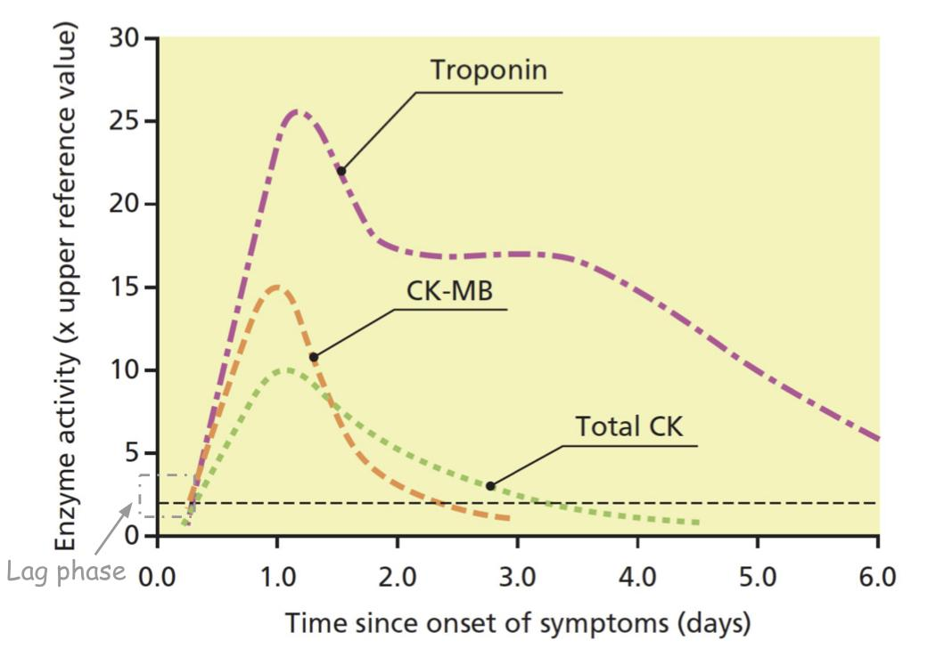
Time-Course of Plasma Enzyme Changes
Time-course of plasma biochemical marker elevation after changes after MI
Enzyme | Abnormal activity detectable (Hours) | Peak value of abnormality | Duration of abnormality (Days)
Troponin T or I | 4-6 | 12-24 | 3-10
CK-MB isoenzyme | 3-10 | 12-24 | 1.5-3
Total CK | 5-12 | 18-30 | 2-5
•Plasma enzymes follow a pattern of activities after MI
•The initial lag phase lasts for about 3 hours
•Enzymes rise rapidly to peak levels in 18-36 hours
•The levels return to normal based on enzyme half-life
•Rapid rise and fall indicates diagnostic value
Blood samples collected after MI:
•Baseline (upon admission)
•Between 12 and 24 hours after the onset of symptoms
Lag phase: a phase in which the conc. of plasma enzymes has not changed yet.
“No elevation in markers appears”
*CK-MB: Rapid rise and fall. Troponin: Rapid rise and gradual fall.

Slide 7
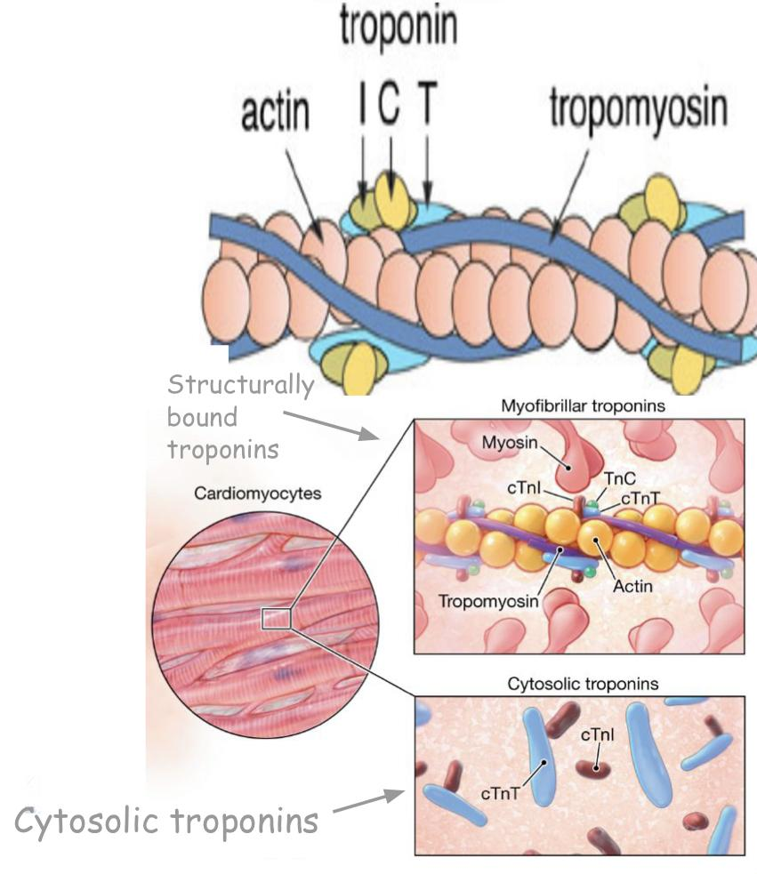
Troponins ‘’the most important biomarker’’
-Troponins are structural proteins in cardiac myocytes and in skeletal muscle
-Cardiac troponins (cTn) are structurally different from muscle troponins .
-Involved in the interaction between actin and myosin for muscle contraction.
-Highly specific markers for detecting MI.
Enzyme | Detectable in plasma | Level peaks in | Remain elevated
Troponin | 4-6 after MI | 12-24 h | Up to 10 days
- After MI cytosolic troponins are released rapidly into the blood (first few hours).
- Structurally bound troponins are released later for several days
Two main cardiac troponin(cTn)
Location of cardiac troponins
cTnI
(Inhibitory protein)
cTnT
Binds to Tropomyosin
Mainly bound to proteins
Small amounts soluble in the cytosol
Troponin C is present in both cardiac and skeletal muscle cells, while cTnI and cTnT are expressed as cardiac muscle-specific isoforms

Slide 8
Creatine Kinase (CK)
Three main CK isoenzymes with two polypeptide chains B or M
Type | Composition | Comment
Skeletal muscle | 98% CK-MM 2% CK-MB | Elevated in muscle disease
Cardiac muscle | 70-80% CK-MM 20-30% CK-MB | Cardiac muscle has highest amount of CK-MB
Brain | CK-BB | —
Plasma | Mainly CK-MM | —

Slide 9
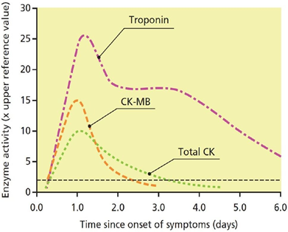
CK-MB
Relative index
CK-MB mass / Total CK x 100
More than 5 % is indicative for MI
-CK-MB is more sensitive and specific for MI than total CK.
-It rises and falls transiently (Last only for a short time) after MI.
Enzyme | CK-MB
Detectable in plasma | 3-10 h After MI
Peaks in blood in | 12-24 h
Returns to normal in | 1.5-3 days
CK-MB
Advantages
Disadvantages
1- Useful for early diagnosis of MI.
2- Useful for diagnosis of re-infarction.
1- Not significant if measured after 2 days of MI
2-Not highly specific (elevated in skeletal muscle damage)

Slide 10
Heart Fatty Acid Binding Protein (h-FABP)
(Heart Tissue Ischemia Marker)
B-Type Natriuretic Peptide
(BNP) (Heart Failure Marker)
Definition | ●A cytosolic protein involved in fatty acid transport and metabolism. ●It’s a promising marker to be used in combination with troponins.
Existing | Higher amounts in myocardium than in brain, kidney & skeletal muscle.
Appearance | ●Appears in plasma as early as 30 min. after acute ischemia. ●Peaks in blood in 6-8 h. ●Returns to normal levels in 24-30 h.
Definition | A peptide produced by the ventricles of the heart in response to myocardial stretching & ventricular dysfunction after MI.
It causes | 1. Vasodilation 2. Sodium and water excretion 3. Reduces blood pressure
Marker for | ● Detecting congestive heart failure. ● Differential diagnosis of pulmonary diseases and congestive heart failure (Important marker)
Facts | ● Its serum levels are high in some pulmonary diseases but in heart failure its levels are markedly high.

Slide 11
Pathogenesis of MI
-With special focus on the biomarkers implicated in the development of MI.
1
Atherosclerotic plaque
2
Plaque rupture
3
Thrombosis
4
Tissue ischemia
H-FABP
5
Tissue necrosis
6
Myocardial dysfunction
cTn CK-MB
BNB
7
Heart failure
BNB

Slide 12
Cases
A 66-year-old man had experienced central
chest pain on exertion for some months, but in the afternoon of the day prior to admission he had a particularly severe episode of the pain, which came on without any exertion and lasted for about an hour. On admission there were no abnormalities on examination and the ECG was normal.
The troponin was clearly detectable.
A well-trained marathon runner collapsed as he was approaching the finishing line. An ECG was normal but CK was elevated at 9500 U/L (reference range 30-200 UL), and the CK-MB was 14 % of the total CK (normally <6%). Troponin was undetectable.
Comments:
Comments:
Typical heart attack symptoms
Characteristic Pattern of Cardiac biomarker
He has an elevated troponin & a typical history.
This is sufficient to diagnose a myocardial
infarction by the most recent definition, even in
the absence of ECG changes.
The total CK is substantially elevated and CK -MB > 6 % can usually be taken to mean that it is of myocardial origin. However, the normal ECG and troponin are both reassuring. in trained endurance athletes, the proportion of CK-MB in muscle increases from the normal low levels and may be as high as 10-15 % . An elevated CK- MB in such individuals can no longer be taken to imply a cardiac origin for the raised CK. Extreme exercise, especially in unfit individuals, causes an elevated CK, potentially to very high levels.

Slide 13
Take Home Messages
cTn
✦ Currently the most definitive markers and are replacing CK-MB
✦ Highly specific to heart muscle damage
✦ They remain elevated in plasma longer than CK-MB
✦ They have higher sensitivity and specificity than CK-MB
CK-MB
✦ Its main advantage is for detecting re-infarction
h-FABP
✦ An early marker for detecting acute ischemia prior to necrosis
BNP
✦ A cardiac marker that can be used for differential diagnosis of pulmonary
diseases and heart failure

Slide 14
SUMMARY
CLICK HERE
SHOUT OUT TO TEAM441

Slide 15
MCQs
Q1: What is the marker of diagnostic value in heart failure ?
A:Cardiac troponins T and I | B:Creatine kinase (CK-MB) | C :B-type natriuretic peptide (BNP) | D:Heart fatty acid binding protein (h-FABP)
Q2:Which isn’t an ideal feature of a cardiac marker?
A:High sensitivity | B:slow release | C:High concentration | D:rapid release
Q3: After how many hours would the troponin be detectable?
A:12-24 | B:4-6 | C:6-10 | D:12-36
Answers : Q1:C Q2:B Q3:B

Slide 16
MCQs
Q4: Our brain is mainly composed of:
A: CK-MB | B: CK-MM | C: CK-BB | D: CK-BM
Q5: In heart failure BNP causes?
A: Vasodilation | B:NA & water excretion | C: Reduces BP | D: All of the above
Q6: An important marker for differential diagnosis of pulmonary diseases and congestive heart failure?
A: h-FABP | B: BNP | C: CK-MB | D: CK-MM
Answers : Q4.C Q5.D Q6.B

Slide 17
SAQs
Q1:list the 3 characteristics for the diagnosis of MI .
Q2:list 3 current MI markers.
Q3: Mention the advantages and disadvantages of CK-MB
Q1 :slide #3
Q2
•Cardiac troponin T (cTnT)
•Cardiac troponin I (cTnI)
•Creatine kinase-MB(CK-MB)
Q3: Slide #9

Slide 18
Our Team
Leaders
Team members
Sara Alotaebe
Mohammed Ibn Saqyan
Raseel Alwehibi
Mashael Alsuliman
Hoor Aloraini
Nouf Aldhalaan
Fatima Halawo
Biochemksumed442@gmail.com

