Slide 1
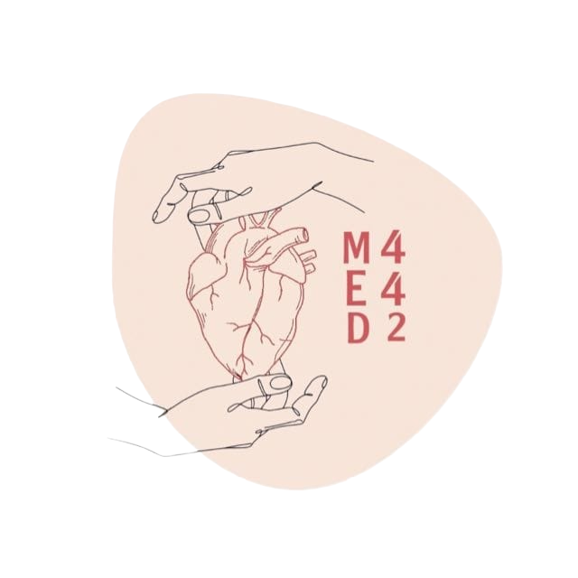
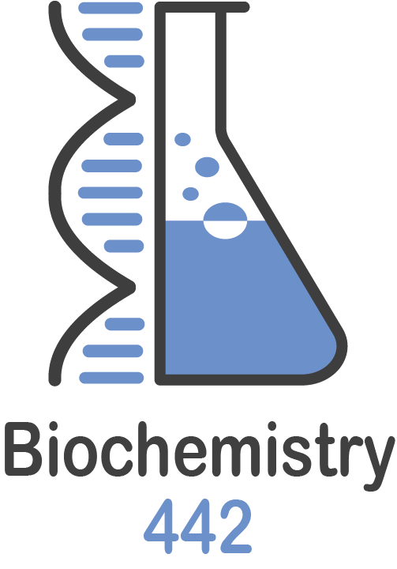
Lipoprotein metabolism
L:4
Color Index:
● Main text
● Important
● Notes
● Boys slides
● Girls slides
● Extra

Slide 2
Objectives
Define and list the types, structure and composition of lipoproteins.
Understand various functions of lipoprotein particles
Compare the functions of lipoprotein particles and their implications in disease
Understand the metabolism of chylomicrons, VLDL and LDL particles
Discuss the functions of lipoprotein lipase and its role in disease
List the diseases due to imbalance in the metabolism of lipoproteins

Slide 3
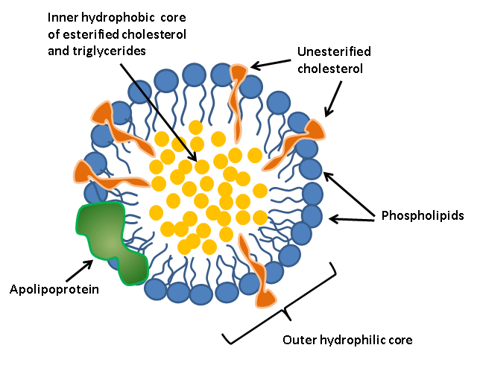
Compositions of lipoproteins:
Neutral lipid core(hydrophobic):
-Triacylglycerols (TAGs)
-Cholesteryl esters
Hydrophilic shell:
-Amphipathic apolipoproteins
-Phospholipids
-Free cholesterol
-Lipids are hydrophobic molecules and transported in plasma as lipoprotein particles
-Lipoproteins keep lipid contents soluble while transporting them to and from the tissues
Types of lipoproteins
Lipoproteins
1-Chylomicrons (lowest density, largest) 2-VLDL (very low density lipoproteins)
3-LDL (low density lipoproteins)
4-HDL (high density lipoproteins)
Plasma lipoproteins are spherical
macromolecular complexes of:
-Lipids
-Specific proteins (apolipoproteins)
TAGs are mainly transported by:
-Chylomicrons
-VLDL
Cholesterol mainly transported by:
-LDL
-HDL
Lipoproteins differ in:
1-Lipid and protein composition
2-Size
3-Density
4-Site of origin

Slide 4
Apolipoproteins
Chylomicrons
Types:
- Assembled(formed) in the intestinal mucosal cells
- Apo B-48, B-100
- Apo C-I, C-II, C-III
- Apo E
- The milky appearance of plasma after a meal is due to chylomicrons
Functions:
Functions:
1-Provide structure to lipoprotein particles
2- Provide recognition sites for cell-surface receptors
3-Activators or coenzymes for the enzymes involved in lipoprotein metabolism
Is to Transport to peripheral tissue:
1- Dietary TAGs (90%)
2- Cholesterol
3- Fat-soluble vitamins
4- Cholesteryl esters

Slide 5
Very low density lipoprotein (VLDL):
- Produced and secreted by the Liver.
- Mainly composed of the following:
● Endogenous TAGs (60%).
● Some cholesterol (both free and esterified).
- Imbalance in hepatic TAG synthesis and secretion
Of VLDL can lead to:
● Obesity.
● Type 2 diabetes mellitus.
liver
Plasma
Tissue
Degradation
VLDL carries these lipids
(TAGs & cholesterols) from the
liver to peripheral tissues
TAGs will be delivered to the peripheral tissues by VLDL
It will be degraded by an enzyme called Lipoprotein lipase (LPL) into
Glycerol
Free FAs

Slide 6
VLDL metabolism
Liver secretes nascent newly formed/ immature endogenously synthesized TAG-rich VLDL particles.
Nascent VLDL contains APO B-100 and TAGs and cholesterol
When the mature VLDL reaches the peripheral tissue, extracellular lipoprotein lipase, activated by apo C-II, degrades TAG in VLDL into free FAs & Glycerol, This explains the lower TAG content of LDL and HDL.
Now the molecule just having apo B-100, and carrying much less TAGs, it becomes LDL, and then LDL binds to specific receptors on extrahepatic tissue and on the liver, where they are endocytosed.
2
4
1
3
5
In the circulation apo C-II and apo E are transferred from HDL to nascent VLDL and when it has apo B-100 + apo C-II it is called mature VLDL.
Apo C-II and apo E are returned to HDL.

Slide 7
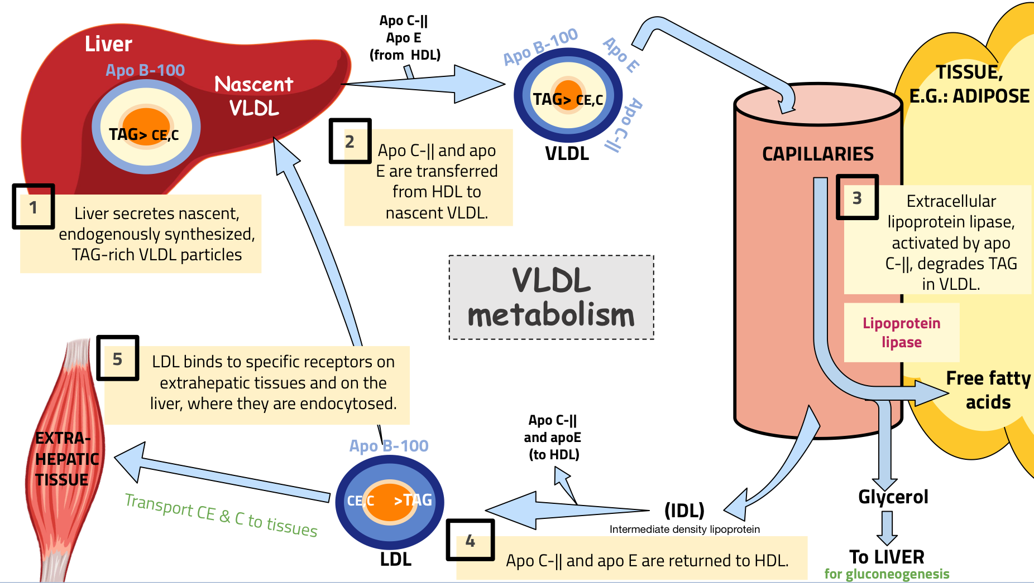
Thanks to 441

Slide 8
VLDL metabolism
01
02
03
04
Release from the liver:
Modification in the circulation:
Conversion to LDL:
Apo E:
exists in three isoforms:
- TAGs in VLDL are degraded by lipoprotein lipase (LPL).
-VLDL becomes smaller and denser.
Surface components (apo C and E) are returned to HDL → LDL is produced.
-VLDL transfers TAGs to HDL in exchange for cholesteryl esters.
-This exchange is catalyzed by cholesteryl ester transfer protein (CETP).
After modifications, VLDL is converted to:
● LDL.
● IDL (Intermediate density lipoprotein) (taken up by liver cells thru apo E).
● VLDL remnants.
Apo E exists in three isoforms:
● Apo E-2 (Poorly binds to receptors).
● Apo E-3.
● Apo E-4.
-As nascent particles containing:
● TAGs and cholesterol.
● Apo B-100.
- Obtain apo C-II and apo E from circulating HDL particles.
-Apo C-II is required for activation of LPL.

Slide 9
Low density lipoprotein (LDL)
High density lipoprotein (HDL)
01
01
Produced from VLDL particles
Produced in the liver and intestine
01
Production
02
- Mainly: Protein, phospholipids,cholesterol, cholesteryl esters
02
-Mainly contains cholesterol and cholesteryl esters.
-Apo B-100 lipoprotein
02
Contents
- Apo A-1, C-2 and E lipoproteins
03
-Provides cholesterol to peripheral tissue
-LDL binds to cell surface receptors thru Apo B-100.
(receptor-mediated endocytosis)
03
Take up cholesterol from peripheral tissues to the liver
03
Functions

Slide 10
Lipoprotein lipase ( LPL )
Site
Synthesis
01
02
03
04
05
Description
Activation
Deficiency
Anchored by heparin sulfate to the capillary walls of most tissues
Mainly in adipose tissue, cardiac and skeletal muscle
Insulin stimulates LPL synthesis
Extracellular enzyme that degrades lipids
e.g. Degrades TAGs into free fatty acids and glycerol
Requires apo C-II for activation
Deficiency of LPL or apo C-II causes:
Type 1 hyperlipoproteinemia
(familial LPL deficiency)

Slide 11
VLDL Disease
Thanks to 439
Disease | About | Causes | Leads to
Hypolipoproteinemia | - | (A=not or without ; beta= apo B) Abetalipoproteinemia is due to inability to load apo B (B-48 & B-100) with lipids. | ● Few VLDLs and chylomicrons are formed. ● TAGs accumulate in liver and intestine (decrease in plasma).
Steatohepatitis | (Fatty liver disease) | Imbalance between: ● TAG synthesis in the liver . ● Secretion from the liver. | ● accumulation of TAGs in the liver (fatty liver).
Type I hyperlipoproteinemia | A rare, autosomal recessive disease | Due to familial deficiency of LPL or its coenzyme (apo C-II) | ● Causes excessive accumulation of chylomicrons in plasma(≥1000 mg/dl) (hyperchylomicronemia). ● High fasting plasma TAGs are observed in these patients.
Type III hyperlipoproteinemia | Also called familial dysbetalipoproteinemia, or broad beta disease | Individuals homozygous for apo E-2 are deficient in clearing: ● Chylomicron remnants. ● IDL from the circulation. | ● hypercholesterolemia . ● premature atherosclerosis. ● Xanthomas: multiple small, yellow skin growths

Slide 12
Take Home Messages
Lipoproteins are important for transportation of lipids to and from liver
and peripheral tissues
Different types of lipoproteins perform different functions in the body
Imbalance in the metabolism of lipoproteins leads to accumulation of
lipids in the tissues and circulation increasing the risk for atherosclerosis
and coronary heart disease

Slide 13
MCQs
Q1 which one of these lipoproteins has the highest density ?
A- HDL | B-VLDL | C-chylomicrons | D-LDL
Q2-Extracellular lipoprotein lipase activated by ?
A-apo C-II | B-apo C-lll | C-apo B-100 | D-apo E
Q3-Deficiency of LPL or apo C-II causes:
A-atherosclerosis | B-Hypolipoproteinemia | C-Type 1 hyperlipoproteinemia | D-Type lll hyperlipoproteinemia
Answers : Q1-A Q2-A Q3-C

Slide 14
MCQs
Q4- what types of apolipoprotein is transferred to nascent VLDL to become mature VLDL ?
A- apo B-100 , apo c-II | B- apo B-100 , apo E | C- apo c-II , apo E | D- apo E , apo B-48
Q5 -VLDL mainly composed of :
A- cholstry ester | B- cholesterol | C- dietary TAGs | D- endogenous TAGs
Q6- Type I hyperlipoproteinemia lead to :
A-hyperchylomicronemia | B- premature atherosclerosis. | C- hypercholesterolemia | D- fatty liver
Answers : Q4-C Q5-D Q6-A

Slide 15
SAQs
Q1- Mention 2 of apolipoproteins function ?
Q2- By which lipoproteins differ from each other ?
Q3 after VLDL metabolism there are three types of lipid produced, mention them ?
Q1 1-Provide structure to lipoprotein particles
2- Provide recognition sites for cell-surface receptors
Q2- 1-Lipid and protein composition. 2-Size. 3-Density. 4-Site of origin
Q3- 1- LDL 2- IDL 3- VLDL remnants

Slide 16
Our Team
Leaders
Team members
Arma Alghamdi
Mohammed Ibn Saqyan
Fatima Halawi
Mohammed Aljarba
Meshari Alshathri
Mohammed Abdulaziz Alrashoud
Amer Alghamdi
Mashael Alsuliman
Shahad Alsakar
Raseel Alwehibi
Roaa Alharbi
Razan Alasmari
Wafa Alqhtani
Sarah Albenmousa
شكوت إلى وكيعٍ سوء حفظي
فأرشدني إلى ترك المعاصي
وأخبرني بأن العلم نورٌ
ونورُ الله لا يهدى لعاصي
محمد بن إدريس الشافعي
Biochemksumed442@gmail.com

