Slide 1
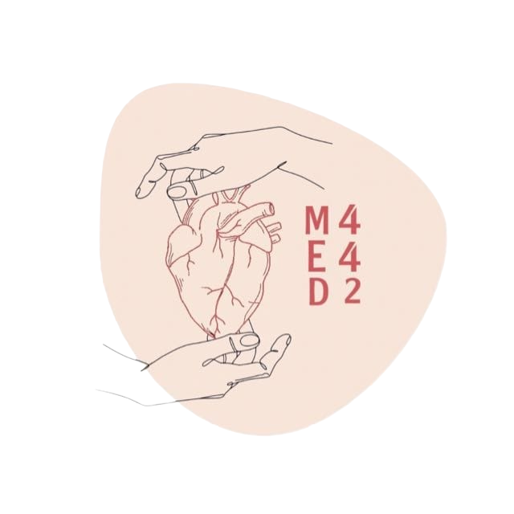
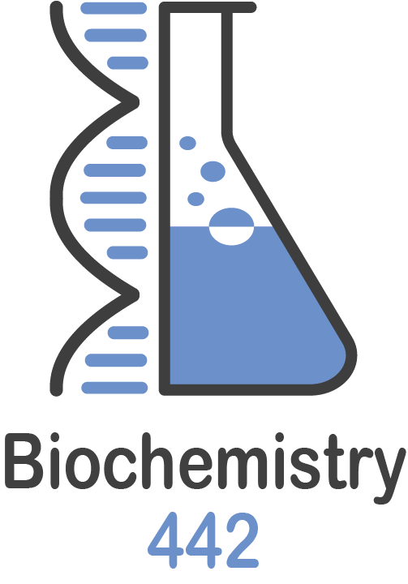
Lipoprotein and
Atherosclerosis
L:5
W:5
Color Index:
● Main text
● Important
● Notes
● Boys slides
● Girls slides
● Extra

Slide 2
objectives
Correlate the imbalance in lipoprotein metabolism with the development of atherosclerosis
Understand the functions and metabolism of LDL and HDL cholesterol
Describe the receptor-mediated endocytosis of LDL and its regulation
Recognize how LDL is considered a bad cholesterol whereas HDL a good cholesterol
Understand the biochemistry of atherosclerosis and its laboratory investigations
Discuss the role of lipoprotein(a) in the development of heart disease
Overview
Receptor-mediated endocytosis of LDL and its regulation
LDL is bad cholesterol
High density lipoprotein (HDL) and its functions
Metabolism of HDL
HDL is good cholesterol
Atherosclerosis
Lipoprotein(a)

Slide 3
Overview
Cholesterol homeostasis is a balance between cholesterol transport:
1. From the liver to peripheral tissues by LDL
2. From peripheral tissues to the liver by HDL
Imbalance in the above leads to:
Cholesterol deposition in blood
Thickening and narrowing of the lumen of arteries
Atherosclerosis vessels
Heart disease

Slide 4
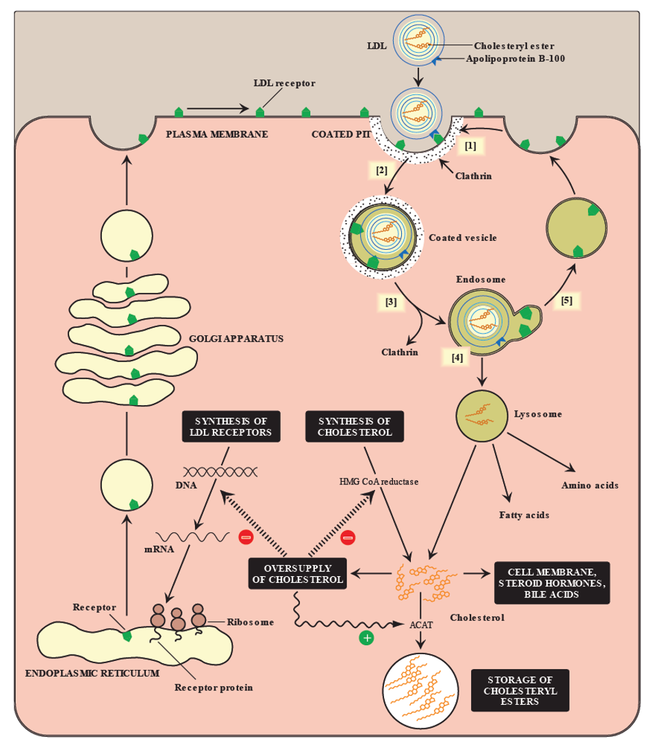
Receptor-mediated endocytosis of LDL particle
Binding of Apo B-100 to LDL receptor glycoprotein
The LDL receptors are more concentrated on the coated pit of the cell surface (coated by clathrin)
Endocytosis
Endosome formation (LDL vesicle fuses with other vesicles)
Separation of LDL from its receptor
Receptor is recycled
LDL degraded by lysosomes releasing: Free cholesterol, fatty acids, amino acids, phospholipids
1
2
3
4
5
6

Slide 5
Regulation of LDL endocytosis
Special thanks to team 441
Up regulation:
Low intracellular cholesterol level causes:
Down regulation:
High intracellular cholesterol level causes:
Recycling of LDL receptors
Increased receptor synthesis
What will we do ?
Degradation of LDL receptors
Increased receptor synthesis at gene level
how?
Inhibition of receptor synthesis at gene level
Increase in cell surface receptors
What will happen?
Reduction in cell surface receptors
increase uptake of LDL by cells
The result?
Decreased uptake of LDL by cells
Increased de novo (new) synthesis of cholesterol
Anything else can help?
Decreased de novo synthesis of cholesterol

Slide 6
High density lipoprotein (HDL)
Nascent HDL:
Mature HDL:
Disk-shaped
Nascent HDL + cholesteryl esters à
HDL₃
HDL₃ + more cholesteryl esters→ spherical HDL₂
Contains apo A-I, C-II \and E lipoproteins
Mainly contains phospholipids
HDL₂ transfers cholesterol to the liver

Slide 7
Functions of HDL
Transports cholesterol to liver from:
Suitable for cholesterol uptake due to:
Reservoir of apoproteins
(Apo C-II and E)
1- High content of phospholipids
Peripheral tissues
Other lipoproteins
Cell
membranes
2- Phospholipids solubilize cholesterol and provide fatty acids for cholesterol esterification

Slide 8
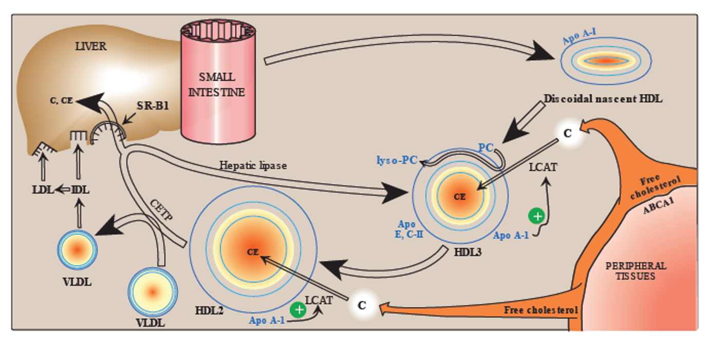
HDL metabolism
Extra slide from doctors notes
Special thanks to team 441
1
Small intestine releasing discoidal nascent HDL
(immature HDL)
(PC =phosphatidylcholine) = (lecithin) so we can
say LCAT or PCAT
LCAT = lecithin-cholesterol acyltransferase
2
Free cholesterol is removed from peripheral tissues by ABCA1
Free cholesterol is then transformed to cholesteryl esters before it fuses with HDL by LCAT which taked a fatty acid from phosphatidylcholine (pc) and gives it to the free cholesterol. The pc is then converted to lysosomal phosphatidylcholine as a byproduct this mechanism allows the binding of free cholesterol to nascent HDL producing HDL3
3
4
HDL3 collects more tissue cholesterol to form HDL2 (mature HDL)
HDL2 gives some of its cholesteryl esters to vldl using cholesteryl ester transferase protein (cept) and and the rest goes to liver by binding to SR-B1 which converts HDL2 back to HDL3 using hepatic lipase
5
SR=scavenger receptor and some are found in macrophage and play a role in atherosclerosis (SR-A)

Slide 9
HDL (GOOD CHOLESTEROL) | LDL (BAD CHOLESTEROL)
HDL transports cholesterol from peripheral tissues to the liver for degradation | Transports cholesterol to peripheral tissues
High HDL levels have inverse correlation with atherosclerosis | Elevated LDL levels → increased risk for atherosclerosis / heart disease
Reduces cholesterol level in tissues and circulation (reverse cholesterol transport) | Deficiency or defects in LDL receptors results in: Decreased uptake of cholesterol by cells Increased accumulation of cholesterol in blood vessels
Reverse cholesterol transport includes: Cholesterol efflux from peripheral tissues to HDL Cholesterol esterification Binding and transfer of cholesteryl ester-rich HDL₂to liver Release of lipid-depleted HDL₃ | Familial hypercholesterolemia Patients are unable to clear LDL from blood Premature atherosclerosis and heart disease

Slide 10
6-Cholesteryl esters accumulate in
macrophages converting them to foam cells.
*(foam cells contribute to plaque formation
And atherosclerosis).
1-LDL uptake by cells is receptor mediated.(specific uptake)
5-Unlike LDL receptors, the SR-A is not down-regulated in response to high intracellular cholesterol.
2-Additionally, macrophages possess scavenger receptors called scavenger receptor class A (SR-A). (not specific uptake, can react with other molecules)
Atherosclerosis
4-Chemically-modified LDL contains oxidized lipids and
Apo B (some free radicals attack lipids and oxidize them)
3-The macrophages take up
chemically-modified LDL by endocytosis.

Slide 11
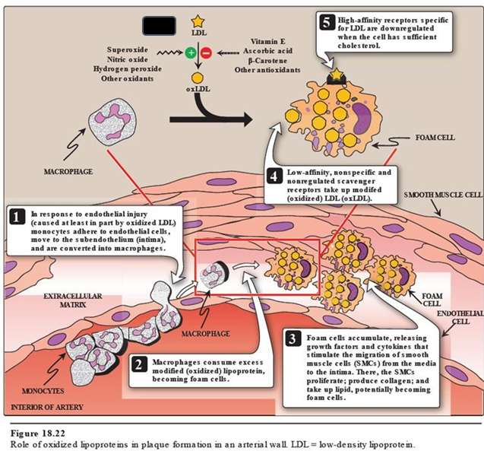
Atherosclerosis
The specific LDL receptors (which has high
affinity to LDL) get down-regulated
(stop working) if the cell has enough cholesterol
The SR-A (which has low affinity to LDL)
continue to take up the oxidized LDL
*Belongs to the previous slide
-In response to endothelial injury (caused at least in part by oxidized LDL) monocytes adhere to endothelial cells, move to the subendothelium (intima), and are converted into macrophages.
01
*Animation
02
-Macrophages consume excess modified (oxidized)
lipoprotein, becoming foam cells.
-Foam cells accumulate, releasing growth factors and cytokines that stimulate the migration of smooth muscle cells (SMCs) from the media to the intima. There, the SMCs proliferate; produce collagen; and take up lipid, potentially becoming foam cells.
03
-Low-affinity, non-specific and non-regulated scavenger receptors take up modified (oxidized) LDL (oxLDL).
04
-High-affinity receptors specific for LDL are downregulated
when the cell has sufficient cholesterol.
05
-It will be either increase in the free radicals (left side) or deficiency
in the antioxidants (right side). That lead to modify LDL onto oxLDL,
which can react with SR-A despite the cholesterol level.
06

Slide 12
Lab investigations of atherosclerosis
Lab investigations
Fasting serum investigations
Serum lipoprotein electrophoresis
Serum apo-protein levels
(e.g., apo-B) This test measures the amount of apo-B in the blood.
(the protein portion of apolipoprotein)
1-TAG level (reflects chylomicron and VLDL levels).
2-Total cholesterol level
(reflects LDL, HDL and cholesterol levels)
3-LDL level (will be high),
HDL level (will be low)

Slide 13
Lipoprotein (a)
LDL + apo a = Lp(a)
type of fatty acids that is unsaturated
(has double bond) C=C and has H in
different sides (If H are in same sides
it called cys fatty acids)
-Lp(a) is identical in structure to LDL particle.
-Contains apo(a) in addition to apo B-100.
-High plasma Lp(a) level is associated with increased
risk of coronary artery disease.
-Circulating levels of Lp(a) are determined by:
1- Genetics (mainly).
2- Estrogen (decreases Lp(a) levels).
3-Diet(trans FAs increase Lp(a) levels).
-The apo(a) protein is structurally similar to plasminogen
Plasminogen is an enzyme that turns into plasmin which needed in blood clot degradation (keep the blood flow and breakdown thrombus) Since apo(a) is similar to plasminogen it will mislead
the factor that activate plasminogen (= it won’t turn into plasmin). Which will stop the fibrinolytic pathway and the thrombus won’t be broken down.
Competes with plasminogen
Slows the breakdown of blood clots
Triggering heart attack
A risk factor for coronary heart disease ( CAD )

Slide 14
Take Home Messages
✦ Imbalance in the LDL and HDL metabolism causes increased accumulation of lipids in the body
✦ LDL is bad cholesterol whereas HDL is good cholesterol
✦ The pathogenesis of atherosclerosis includes the uptake of oxidized LDL by
macrophages through scavenger receptor class A (SR-A) producing foam cells andatherosclerotic plaque
✦ Individuals with high level of plasma Lp (a) are at higher risk for coronary heart
disease

Slide 15
SUMMARY
CLICK HERE
SHOUT OUT TO TEAM441

Slide 16
MCQs
Q1:The banding of ………… on the LDL particle to the LDL receptor Glycoprotein in the cell surface
A: C-II | B: C-I | C: B-100 | D: B-48
Q2: Nascent HDL shape is ………… shaped
A: Biconcave | B:Round | C:Tringuler | D:Disc
Q3: HDL2 gives cholesteryl ester to the liver and VLDL by what ?(liver/VLDL)
A:(SCAP/ABCA1) | B:(SR-A1/CEPT) | C:(SR-A1/SCAP) | D:(SR-B1/CEPT)
Answers : Q1:C Q2:D Q3:D
SR=scavenger receptor and some are found in macrophage and play a role in atherosclerosis

Slide 17
MCQs
Q4:Circulating levels of Lp(a) are determined by:
A: Genetics. | B: Estrogen. | C: Diet. | D.All of the above.
Q5:In atherosclerosis, The fasting serum investigations will show that the LDL will be ……., and HDL will be .……..
A: Low,high | B: High,low | C: Low,low | D: High,high
Q6:In atherosclerosis, High-affinity receptors specific for LDL are …………. when the cell has sufficient cholesterol.
A: Upregulated. | B: Downregulated. | C: Remains the same. | D: /
Answers : Q4.D Q5.B Q6.B

Slide 18
SAQs
Q1: list three effects of the up-regulation of LDL endocytosis
Q2:list three functions of HDL
Q3: Mention the lab investigations in Atherosclerosis?
Q1:slide(5)
Q2:slide(7)
Q3: slide(13)

Slide 19
Our Team
Leaders
Team members
Arwa Alghamdi
Mohammed Ibn Saqyan
Fatima Halawi
Mohammed Aljarba
Meshari Alshathri
Mohammed Abdulaziz Alrashoud
Amer Alghamdi
Mashael Alsuliman
Shahad Alaskar
Raseel Alwehibi
Roaa Alharbi
Razan Alasmari
Wafa Alqhtani
Sarah Albenmousa
العلم يبني بيوتا لا عماد لها
والجهل يهدم بيت العز و الكرمِ
أحمد شوقي
Biochemksumed442@gmail.com

