Slide 1
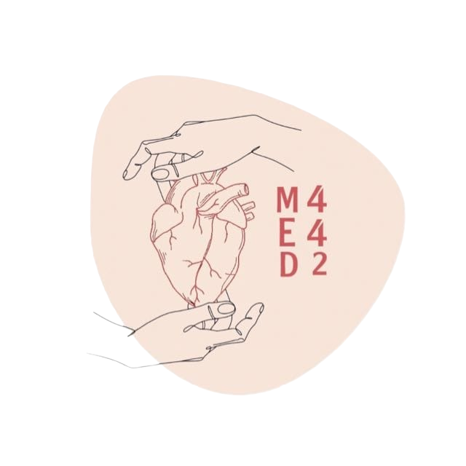
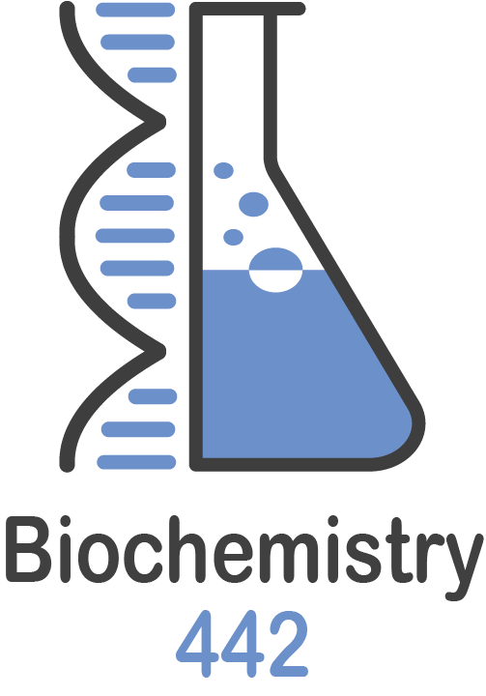
oxidative stress
L:6
W:5
Color Index:
● Main text
● Important
● Notes
● Boys slides
● Girls slides
● Extra

Slide 2
objectives
Define oxidative stress.
Understand the harmful effects of oxidative stress to the cell and its diseases.
List the types, sources and effects of Reactive Oxygen Species (ROS).
List various antioxidants in the body.
Understand the role of glutathione system in detoxifying oxidants in the body.
Discuss how G6PD deficiency leads to oxidative stress.
Understand the role of Reactive Nitrogen Species (RNS) in contributing to oxidative stress .
Correlate the role of oxidative stress to pathogenesis of atherosclerosis.

Slide 3
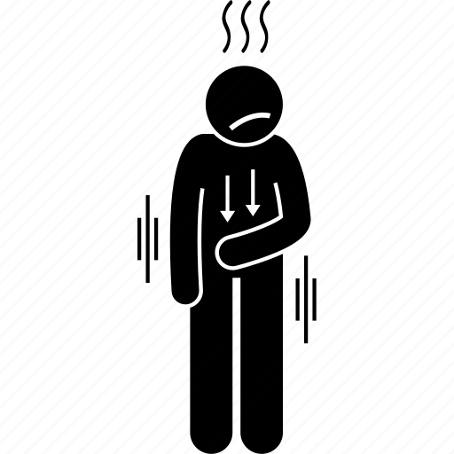
Oxidative stress
Note 439: they’re produced normally in the cells, and we have a system to take care of these species which is (Antioxidant Machinery) but if the production of these reactive species is too much , our antioxidant machinery will not work sufficiently , also If there’s inflammation in the body it will lead to oxidative stress.
A condition in which cells are exposed to excessive levels of:
- Reactive Oxygen Species (ROS)
Or
- Reactive Nitrogen Species (RNS)
Cells are unable to neutralize their deleterious(harmful) effects with antioxidants.
Oxidative stress is implicated (appear) in atherosclerosis, CAD (coronary artery disease), ageing.
Cellular imbalance of oxidants and antioxidants damages ( or target ) : DNA, proteins, lipids
Inflammatory diseases (rheumatoid arthritis)
Atherosclerosis
CAD
Disease due to oxidative stress:
Obesity
Cancer
G6PD deficiency hemolytic anemia

Slide 4
Reactive Oxygen Species (ROS)
They are present at low and stationary level in normal cells
Reduction is the gain of electrons during a reaction While Oxidation is the loss of electrons during a reaction.
● Incomplete reduction of oxygen to water produces ROS.
● ROS are continuously formed:
➔ As byproducts of aerobic metabolism .
➔ Thru reactions with drugs and toxins .
➔ When cellular antioxidant level is low ( Increase oxidation or Decrease antitoxin)
➔ Creating oxidative stress in cell.
● ROS can damage DNA, proteins, unsaturated lipids → cell death
● Cells have protective antioxidant mechanisms that neutralize ROS.

Slide 5
Reactive Oxygen Species (ROS)
A
Formation of reactive intermediate from molecular oxygen :
Note:The dot ( ● ) means an electron
Actions of antioxidant enzymes:
B
Note: (B) is the same reaction in (A) but with antioxidant
G-SH: Reduced glutathione.
G-S-S-G: Oxidized glutathione .
Hydrogen peroxide: Can be converted to H2O either directly by catalase or indirectly by glutathione peroxidase . Superoxide: Is converted to O2 by superoxide dismutase
The problem begins when the reduction of oxygen to water stops in Superoxide, Hydrogen peroxide or Hydroxyl radical. one or two of these ROS will accumulate in our body and cause diseases.
.

Slide 6
Types and sources of ROS
Types and sources of ROS
Free radicals
sources
Non-free radical
-Superoxide (O2●-).
- Hydroxyl radical (OH●) . (unpaired electrons)
-Aerobic metabolism.
- Partial reduction of molecular oxygen in ETC.
- Ingestion of drugs, toxins, chemicals.
- Hydrogen peroxide (H2O2).
(Paired electrons)
Antioxidants :
Enzymes
● Superoxide dismutase ● Catalase
● Glutathione system ( details in next slide)
Vitamins
● Vitamins A, C, E.
● beta-Carotene
Antioxidants

Slide 7
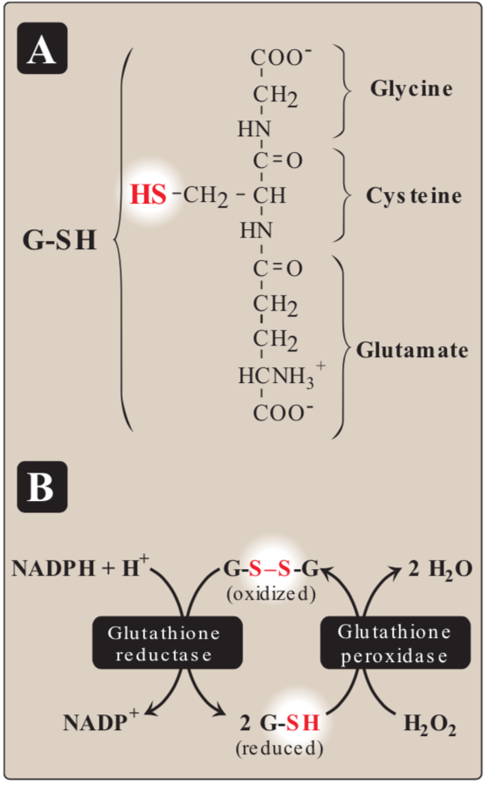
Glutathione system
Present in most cells
In mitochondria
Chemically detoxifies
H2O2 into water
(hydrogen peroxide)
Catalyzed by glutathione reductase
Reducing agent
Uses NADPH that reduces glutathione which reduces H2O2
Oxidizing agent
Reduced glutathione (G-SH) consists of: glycine, cysteine , glutamate.

Slide 8
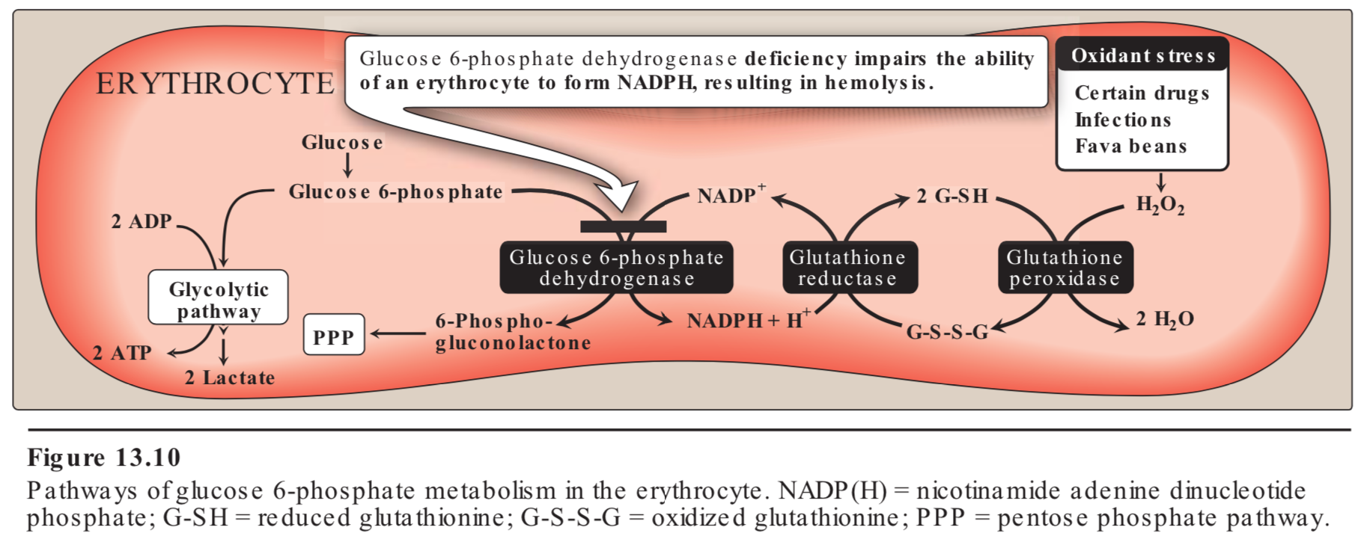
G6PD deficiency
حنا قلنا أھمیة NADPH وكيف یؤثر على العملیة طيب وش المشكلة ھنا ؟ الNADPH یجي من انزیم اسمه glucose-6-phosphate dehydrogenase زي ما ھو واضح بالصورة
طیب اللي عندھم خلل بھالانزیم !NADPH No= deficiency
والعملیة كلھا ما راح تصیر ویزید Radicle وتموت الخلیة.
طیب لیش خصصنا بس RBCs ما قلنا باقي الخلایا رغم أن النقص على كل أنواع الخلایا؟ باختصار في RBCs ما فیه مصدر ل NADPH غیر ھالمصدر لأنه ما یصنع طاقة عكس باقي الخلایا اللي عندھا مصادر أخرى.
طيب ما عندها إلا هالمصدر ليش؟
because it doesn't have a nucleus
Leads to NADPH deficiency
Cells are unable to reduce free radicals
Oxidation of cellular proteins is increased
causing impaired cell functions
from 441

Slide 9
Effects of ROS
1
Lipid peroxidation (polyunsaturated fatty acids)
5
Chemotaxis
2
DNA damage
6
Cell signaling effects ( Release of Ca2 + from intracellular stores )
3
Protein denaturation
7
Altered vascular tone
4
Cytoskeletal damage
8
Increased endothelial cell permeability

Slide 10
Nitric Oxide (NO)
NH2
|
C=NH2
|
NH
|
CH2
|
CH2
|
CH2
|
HCNH3
|
COO
NH2
|
C=O
|
NH
|
CH2
|
CH2
|
CH2
|
HCNH3
|
COO-
+
+
NADPH+H
NADP
Is an Endothelial-derived relaxing factor (EDRF)
NO synthase (NOS)
Causes vasodilation by relaxing
Vascular smooth muscle
O2
NO
L- Arginine
L- Citrulline
Is a gas with short half-life (3-10 sec)
NO is formed by the reduction reaction
from L-Arginine to L-Citrulline
- SHORT HALF LIFE = FAST EFFECT.
- The short half life indicates fast effect of NO
NO + Oxygen/Superoxide Nitrates,
Nitrites,Peroxynitrite (O=NOO- )
Nitric Oxide
Synthesis and some of the actions of nitric oxide (NO). NADPH = reduced nicotinamide adenine dinucleotide phosphate. [Note: Flavin mononucleotide, flavin adenine dinucleotide, heme, and tetrahydrobiopterin are additional coenzymes required by NOS.]
Relaxes smooth
muscle
Prevents platelet
aggregation
Functions as
neurotransmitter
in brain
Mediates tumoricidal
and bactericidal
actions of
macrophages
Peroxynitrite is a Reactive Nitrogen Species
(RNS)

Slide 11
Nitric oxide synthase
NO is produced by nitric oxide synthase
Types
eNOS
nNOS
iNOS
bNOS
Location
Endothelium
Neural tissue
Macrophage, Neutrophils
Bacteria
Function
Vaso-relaxation
Neurotransmission
Infection
iNOS activity (normally low)
increased by :
- Infection.
- Pro-inflammatory cytokines

Slide 12
Nitric oxide synthase
Activated macrophages
produce O2●- radical + NO
Which will produce OH● radicals
which is highly bactericidal
(Good effect)
1-infection
2- pro-inflammatory
cytokines
increased
iNOS activity
which will lead to
oxidative stress
Production of free
radicals
(Bad effect)

Slide 13
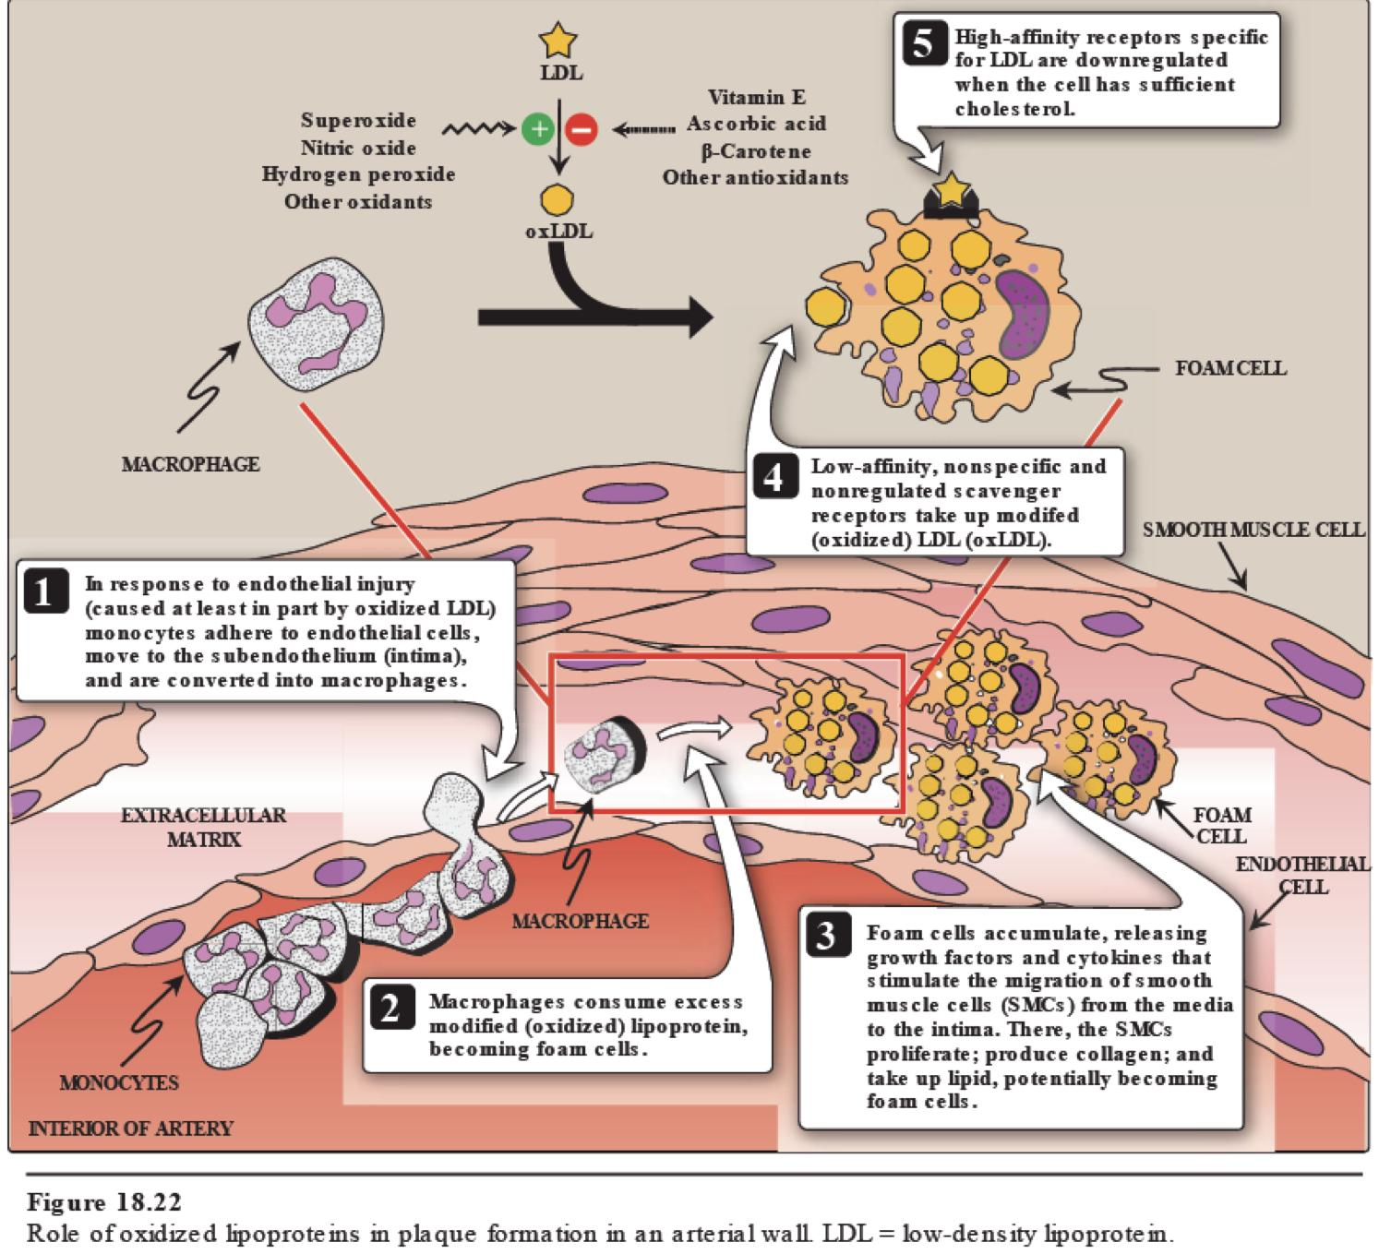
Oxidative Stress And Atherosclerosis
From 437
1. Superoxide, nitric oxide, hydrogen peroxide, or any other
oxidant oxidize LDL to oxLDL
2. oxLDL binds to scavenger receptors “on the surface of
macrophages”
☆ Unlike the LDL receptor, the scavenger receptor is not
downregulated in response to increased intracellular cholesterol
.
3. Cholesteryl esters accumulate in macrophages and cause
their transformation into “foam” cells
4. “foam” cells participate in the formation of atherosclerotic
plaque

Slide 14
Take Home Messages
Oxidative stress is due to excessive production of ROS and NOS in the cells.
Cells neutralize these oxidants by a number of antioxidant processes.
Imbalance between oxidants and antioxidants in the cells can result in
the development of man diseases including atherosclerosis.

Slide 15
MCQs
Q1 :Which of the following is a Free radical ?
A:Water | B:Hydrogen peroxide | C:Oxygen | D:Superoxide
Q2:Which of the following is an antioxidant Enzyme ?
A : Vitamins A | B:Glutathione system | C : Vitamins C | D:beta-Carotene
Q3: Superoxide dismutase is used to convert Superoxide into ?
A :O2 + water | B:water + Hydrogen peroxide | C:O2 + Superoxide | D:O2 + H2O2
Answers : Q1) D Q2) B Q3) D

Slide 16
MCQs
Q4 : Which one of the following amino acid does not participate in forming Glutathione (G-SH) ?
A: Glycine | B :Cysteine | C: Arginine | D: Glutamate
Q5: Which of the following is a function of nNOS ?
A: Vasodilation | B: Neurotransmission | C :Infection | D: Vasoconstriction
Q6 : Which enzyme will convert L-Arginine to L-Citrulline?
A: Glutathione reductase | B: Glucose 6-phosphate dehydrogenase | C: Glutathione peroxidase | D:NO synthase
Answers : Q4) C Q5) B Q6) D

Slide 17
SAQs
Q1: Mention 4 diseases caused by oxidative stress :
Q2 How does G6PD deficiency cause oxidative stress ?
Q3 List 4 effects of ROS
Q1 : Obesity - cancer -CAD -Atherosclerosis
Q2 : NADPH deficiency → Cells are unable to reduce free radicals → Oxidation of cellular proteins is increased causing → impaired cellular Functions.
Q3 : Lipid peroxidation - DNA damage - Cytoskeletal damage - Increased endothelial cell permeability

Slide 18
Our Team
Leaders
Team members
Arwa Alghamdi
Mohammed Ibn Saqyan
Fatima Halawi
Mohammed Aljarba
Meshari Alshathri
Mohammed Abdulaziz Alrashoud
Amer Alghamdi
Mashael Alsuliman
Shahad Alasakar
Raseel Alwehibi
Roaa Alharbi
Razan Alasmari
Wafa Alqhtani
Sarah Albenmousa
كلما أدبني الدهر
اراني نقص عقلي
وكلما ازددت علما
زادني علما بجهلي
محمد بن إدريس الشافعي
Biochemksumed442@gmail.com

