Slide 1
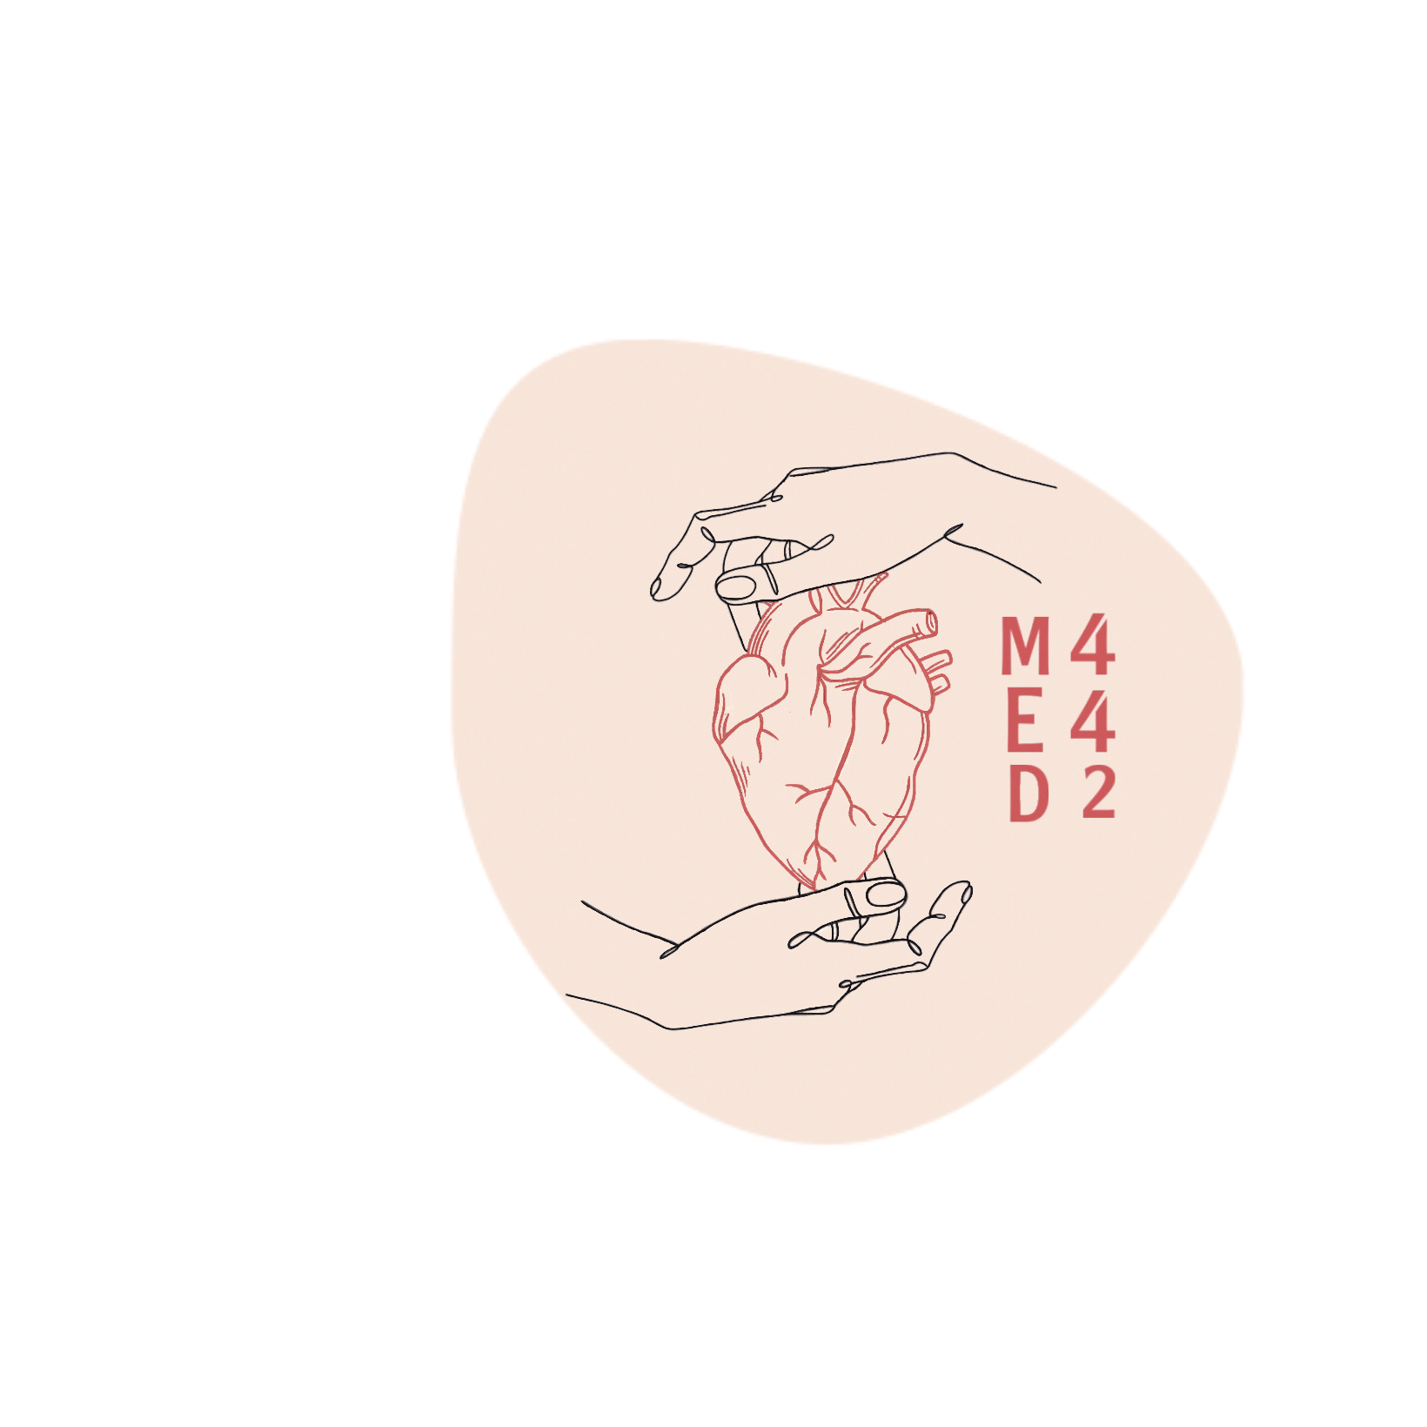
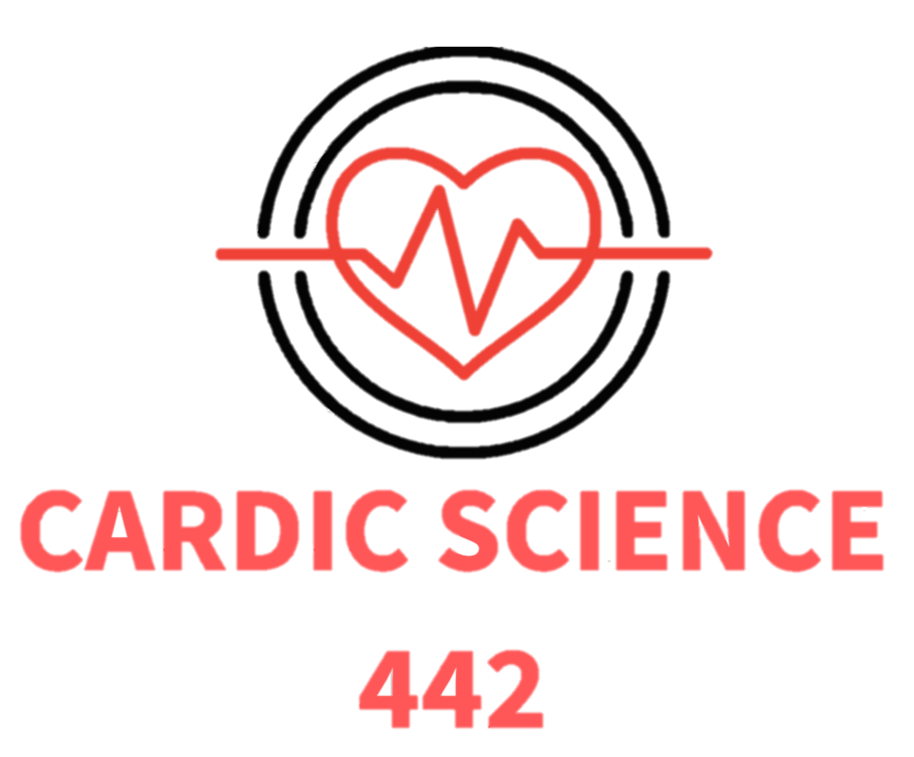
Cardiac science
Arrhythmias
Color index
Main Text
● Important
● Girls’ Slides
● Boys’ Slides
● Dr’s Notes
● Extra Info

Slide 2
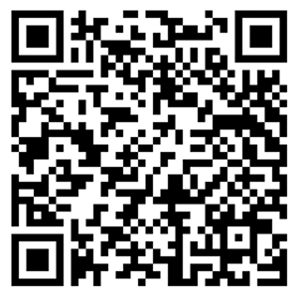
Objectives
1
Describe sinus arrhythmias
2
Describe the main pathophysiological causes of cardiac arrhythmias
3
Explain the mechanism of cardiac block
4
Enumerate the common arrhythmias and describe the basic ECG changes
5
Explain the origin of an ectopic foci
We recommend you to check the hyperlinked videos of the ECG strips from this lecture
And for revision, check this summary made by team 441 (click!)

Slide 3
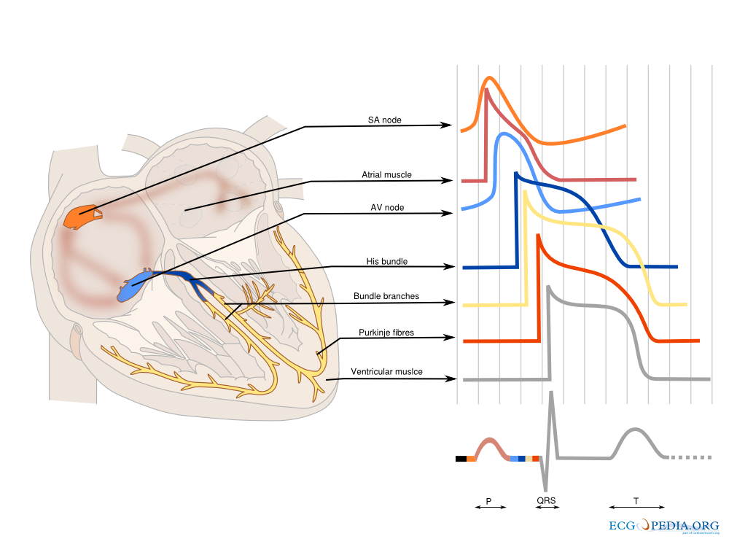
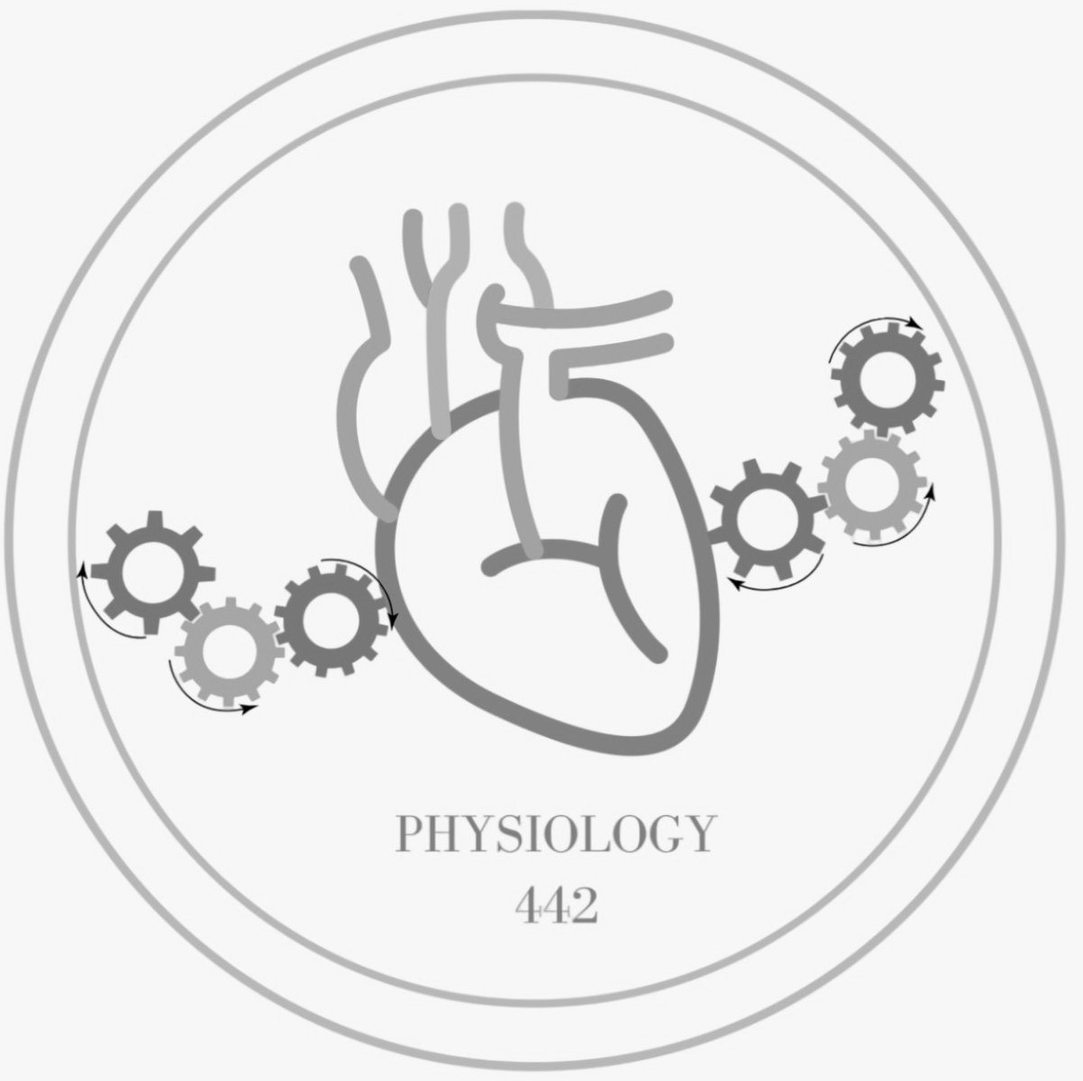
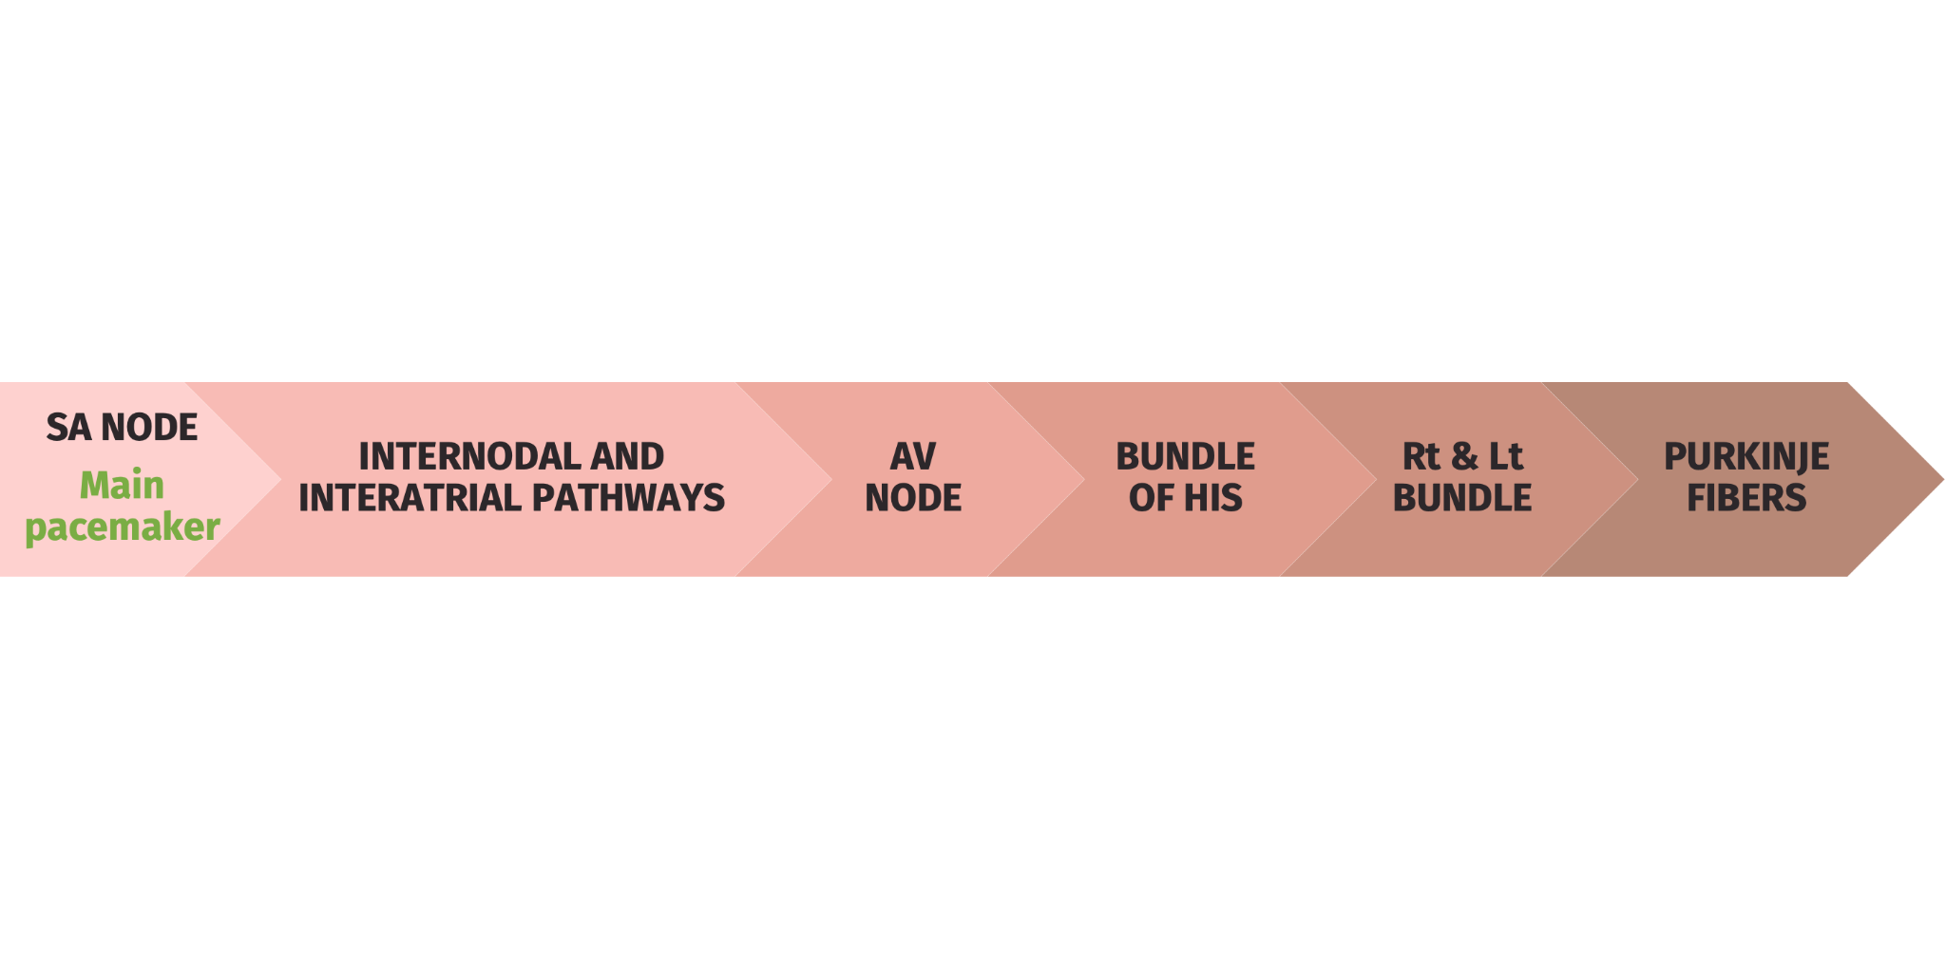
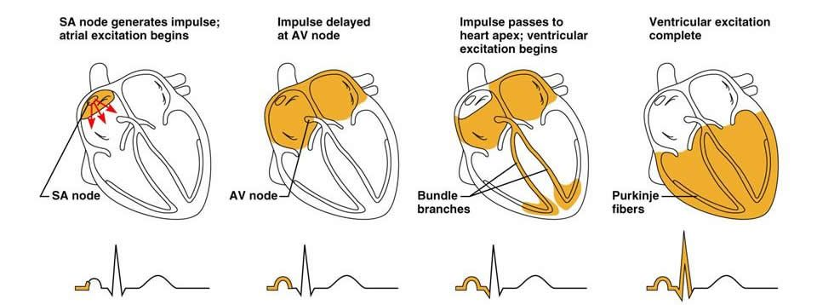
Depolarization and Repolarization (boys’ slides)
Active and passive transport of electrolytes across the cell membrane initiate the action potential which triggers events that lead to mechanical movement (contraction in atrial muscle tissues)
Electrical conduction and normal conduction system
Potential areas capable of beginning cardiac conduction
SA node:
60-100 bpm (avg:70)
AV node:
45-60 bpm
Purkinje fibers:
15-45 bpm
Sequence of cardiac excitation
(boys’ slides)
Another illustration:

Slide 4
Normal sinus rhythm
Originating from SA node | Regular | Single p-wave precedes every QRS complex | P wave in the same direction as QRS complex (upright) | P-R interval is constant and within normal range | P-P interval is constant
 | Irregular: ventricular fibrillation | Cessation of P wave: sinoatrial block |  | Abnormal range (prolongation): 1, 2 AV block Not constant ( progression): Mobitz1
abnormalities are discussed in next slides →
Interpretation
(girls’ slides)
Develop a systemic approach to reading EKGs and use it every time
The systems we’ll practice: rate, rhythm (including intervals and blocks)
Other basics: Axis (the direction of the electrical activity of the heart), ischemia, Hypertrophy (we’ll practice them in the upcoming years)
Sinus Arrhythmia
(boys’ slides)
Result from spillover of signals from the medullary respiratory center into the adjacent vasomotor center during inspiration and expiratory cycles of respiration
The spillover signals cause alternate increase and decrease in the number of impulses transmitted through the sympathetic and vagus nerves to the heart ( it’s normal in children)

Slide 5
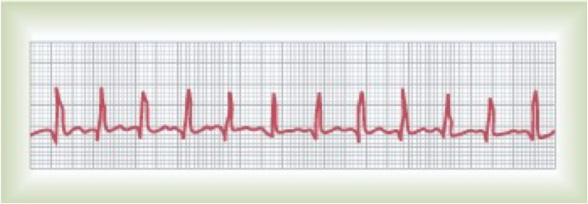
Heart rate
 | Sinus Bradycardia (abnormal sinus rhythm) | Normal | Sinus tachycardia (abnormal sinus rhythm)
rate | Slow heart rate < 60 beats per minute | 60-100 bpm | Heart rate > 100 beats per minute
Causes | Parasympathetic stimulation Expiration sleeping Old age |  | Sympathetic stimulation inspiration Increased body temperature Drugs: digitalis
ECG | Prolonged R-R intervals (QRS complexes are far apart) |  | Decreased R-R interval (QRS complexes are close)
sinus bradycardia and tachycardia abnormality is related to the heart rate NOT to the heart rhythm
Heart rate calculation
(girls’ slides)
Heart rate in regular heart rhythm
No of big boxes | Rate
1 | 300
2 | 150
3 | 100
4 | 75
5 | 60
Heart rate in Irregular heart rhythm=
number of QRS complexes in 30 large squares (number of QRS complexes in 6 seconds) X10
What is the heart rate?
(300 / 6) = 50 bpm
"300" /"Number of large squares between R − R"
Or
"1500" /"Number of small squares between R − R"
Revise practical lecture “ECG” for this part

Slide 6
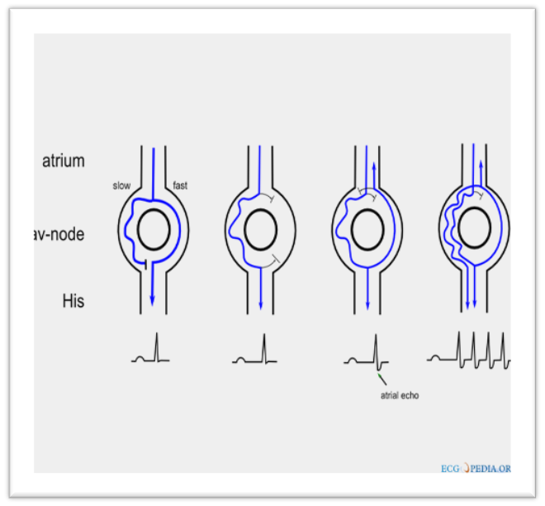
Causes/Mechanisms of Cardiac Arrhythmias
Abnormal rhythmicity (automaticity) of the pacemaker , caused when automatic foci take over
Shift of the pacemaker from the sinus node to another place in the heart (e.g. from SA node to AV node)
Blocks at different points in the spread of impulse through the heart (e.g. blockade of ca2+ channel)
Abnormal pathways of impulse transmission through the heart
Spontaneous generation of spurious impulses in almost any part of the heart (e.g. premature atrial contractions)
Trigger (stimulation in the relative refractory period)
Reentry (abnormal extra connection between the atria and ventricle that leads to circuit formation and causes tachycardia. E.g. atrial flutter)
Classification of Cardiac Arrhythmias
Rate above or below normal (tachy vs. Brady)
Regular or irregular rhythm
Narrow or broad QRS complex
Relation to P waves
(its presence and direction)
Supraventricular Vs. ventricular

Slide 7
Common arrhythmias
(girls’ slides) No need to memorize it
Origin | SA node | Atria | AV node | Ventricles
Bradyarrhythmia | ● Sinus Bradycardia ● Sick Sinus Syndrome | - | ● Conduction Blocks (1st,2nd, 3rd) ● Junctional escape rhythm | ● Ventricular escape rhythm
Tachyarrhythmia | ● Sinus tachycardia | •Atrial Premature Beats •Atrial Flutter •Atrial Fibrillation •Paroxysmal SVT •Multifocal Atrial Tachycardia | - | • Ventricular premature Beats • Ventricular Tachycardia • Torsades de pointes • Ventricular Fibrillation
Differential diagnosis of tachycardia
(girls’ slides) No need to memorize it
Tachycardia | Narrow Complex | Wide Complex
Regular | ●Sinus tachycardia ●Supraventricular tachycardia ●Atrial flutter | ●Sinus tachycardia with aberrancy ●Supraventricular tachycardia with aberrancy ●Ventricular Tachycardia
Irregular | ●Atrial Fibrillation ●Atrial Flutter with variable conduction ●Multifocal Atrial Tachycardia | ●Atrial Fibrillation with aberrancy ●Atrial Fibrillation with WPW ●Ventricular Tachycardia

Slide 8
1st, 2nd and 3rd degree A-V block
Highly recommended, timelapse :7:05
1st degree A-V block
PR interval duration | Prolonged (0.2 seconds)
Constant or progressive P-R interval | Constant
Presence of drop beat (drop beat= absence of QRS complex) | WITHOUT drop beat (QRS complexes are present)
2nd degree A-V block
 | Mobitz (I) (physiological) | Mobitz (II) (pathological)
PR interval duration | Prolonged (P-R interval > 0.25 second)
Constant or progressive P-R interval | Progressive | Constant
Presence of drop beat (drop beat= absence of QRS complex) | WITH DROP BEAT Only few impulses pass to the ventricles-> atria beat faster than ventricles-> “dropped beat” of the ventricles
3rd degree A-V block (complete) (purkinje system takeover->very slow)
Complete dissociation of P wave and QRS waves →The ventricle escape from the influence of S-A node (atria and ventricles work in isolation of each other)
Atrial rate is 100 beats/min | Ventricular rate is 40 beats/min
Pathological condition related: Stokes-Adams Syndrome: AV block comes and goes

Slide 9
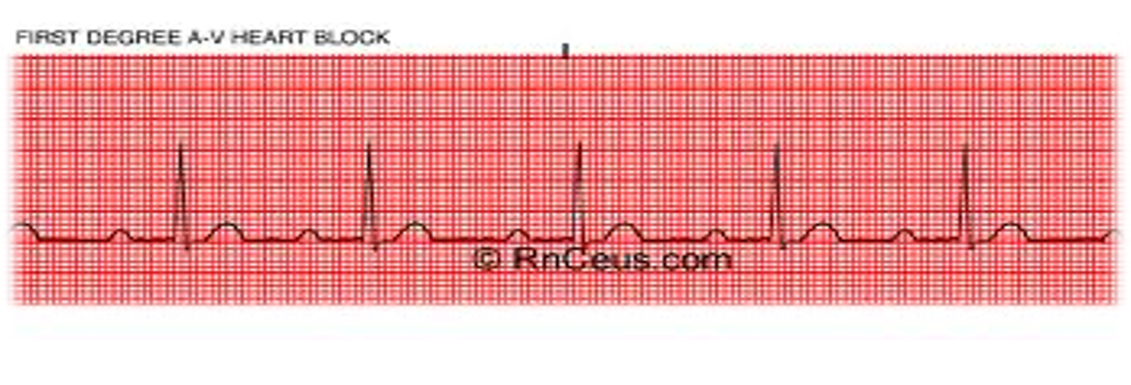
1st, 2nd and 3rd degree A-V block cont..
1- look at p wave, if absent then it could be SA node block, if present it could be one of AV node block types 2- if P wave is present, look for the drop beat, if it’s absent the it’s 1st degree AV block 3-if drop beat is present, then It could be mobitz I or II 4-look to the P-R interval, if it’s progressive then it’s mobitz I, if it’s constant then it’s mobitz II 5-if the P-R interval is nether progressive nor constant, but have complete dissociation, then it’s 3rd degree A-V node block
(from the lecture) | Simple approach (not systematic. remember there’s other arrhythmias than these, this is just for simplifying)
 | First degree A-V block -P wave? Present -Drop beat? Absent Then, it’s 1st degree Block | Time lapse: 7:05 - 8:38
 | 2nd Degree Heart(AV node) Block, mobitz I -P wave? Present -drop beat? Present -P-R interval? Progressive Then, it’s mobitz I | Time lapse 8:39 -9:37
 | 2nd Degree Heart(AV node) Block, mobitz II -drop beat? Present -P-R interval? Constant Then, it’s mobitz II | Time lapse 9:37- 11:38
 | Third Degree Heart(AV node) block (complete) | Time lapse 11:38-13:05

Slide 10
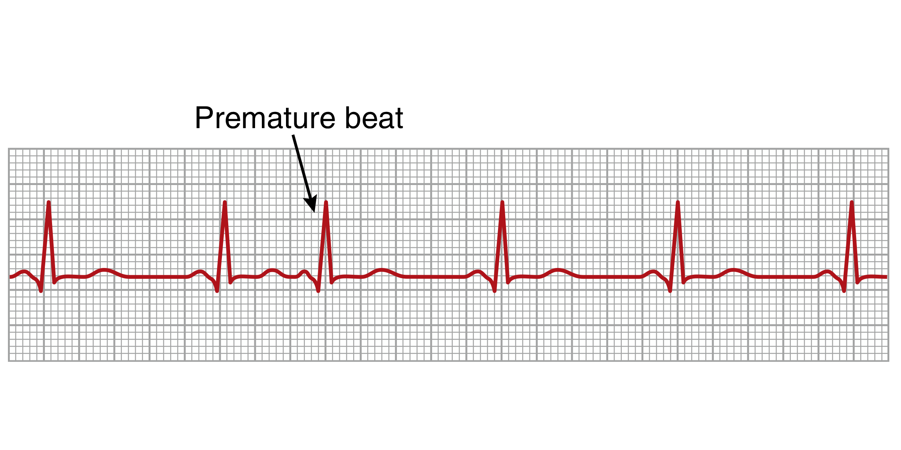
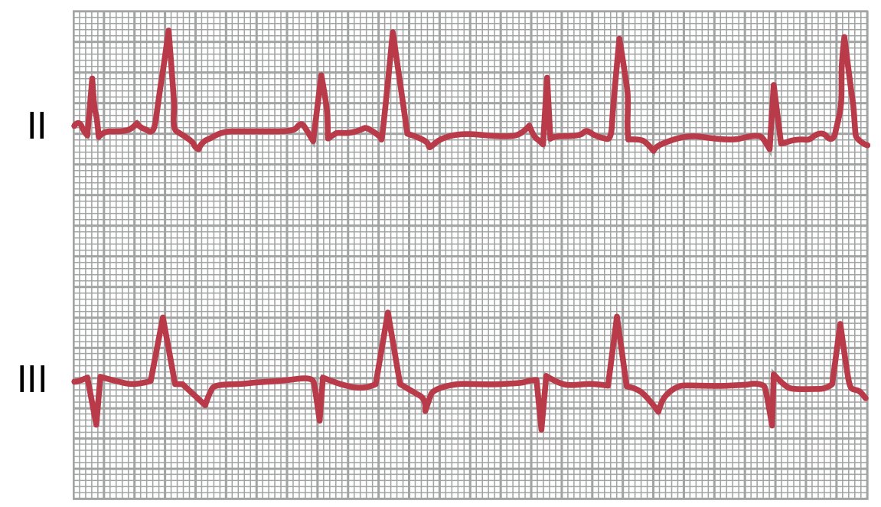
Premature Contractions (ectopic beat)
(girls’ slides)
What is it? | Contractions that occur early before the next normal sinus impulse (before P wave send the impulse out), thus we’ll see QRS complex occurs prior to the next expected beat
Result from? | Premature contractions (extrasystoles) or ectopic beat result from ectopic foci that generate abnormal cardiac impulses (pulse deﬁcit)
Originate in? (places other than SA node) | Ectopic foci can cause premature contractions that originate in: The atria (but not in SA node), A-V junction, The ventricles
Causes? | Ischemia, Irritation of cardiac muscle by calcified foci, Drugs like caffeine
Premature Atrial Contractions (girls’ slides)
Features | Short P-R interval: | depending on how far the ectopic foci from the AV node
 | Pulse deficit: | if there is no time for the ventricles to fill with blood
 | Compensatory pause: | The time between the premature contraction and the succeeding (next) beat is increased
Premature ventricular Contractions (girls’ slides)
Features | Prolong QRS complex | because the impulses are carried out with myocardial fibers with slower conduction rate than Purkinje fibers
 | Increase QRS complexes voltage | because QRS wave from one ventricle can not neutralize the one from the other ventricle
 | T wave has an electrical potential of opposite polarity of that of the QRS | because of the slow conduction in the myocardial fibers, the fibers that depolarizes first will repolarize first
Causes | drugs, caffeine, smoking, lack of sleep, emotional irritations

Slide 11
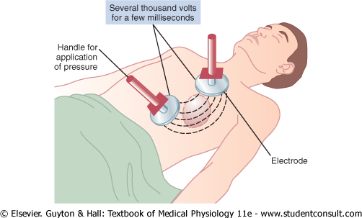
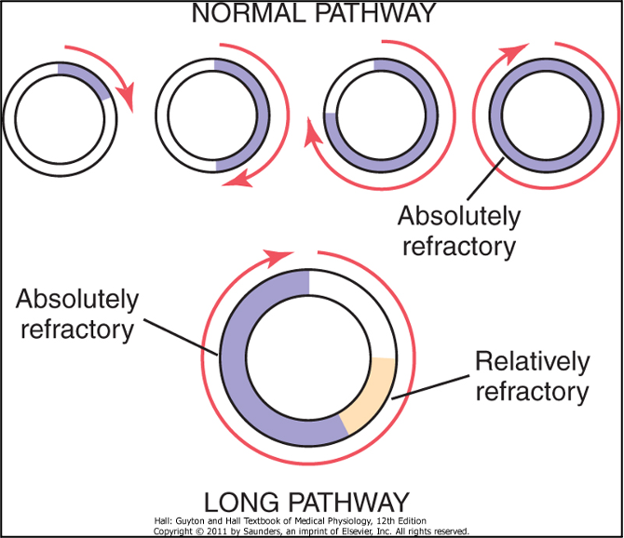
Ventricular Fibrillation
The most serious of all arrhythmias
cause/ mechanism:
impulses stimulate one part of the ventricles, then another, then itself, many parts contract at the same time while other parts relax (circus movement)
Features:
Tachycardia, Irregular rhythm, Broad QRS complex, No P wave, low amplitudes
Chaotic and rapid rate
Causes :
sudden electrical shock, ischemia
Treatment :
DC shock
Notice: Broad QRS complex, No P wave, Chaotic and rapid rate
Atrial Fibrillation
A person can live for years with atrial ﬁbrillation
Features:
No P wave, or high frequency of low voltage P wave
Irregularly irregular (means its irregularity doesn’t have a pattern)
Narrow QRS complex
Causes :
It occurs more frequently in patients with enlarged heart
Treatment :
DC shock
cause/ mechanism:
same mechanism as
Ventricular FIbrillation
- it can occur only in atria without affecting the ventricles
-The atria do not pump if they are ﬁbrillating
-The efficiency of ventricles pumping/ﬁlling is decreased 20-30%, thus the cardiac output will decrease 20-30%
Both of ventricular and atrial fibrillation have irregular rhythm, no P wave, but the ventricular has BROAD QRS complex, while atrial has NARROW QRS complex
Notice: narrow QRS complex, No P wave

Slide 12
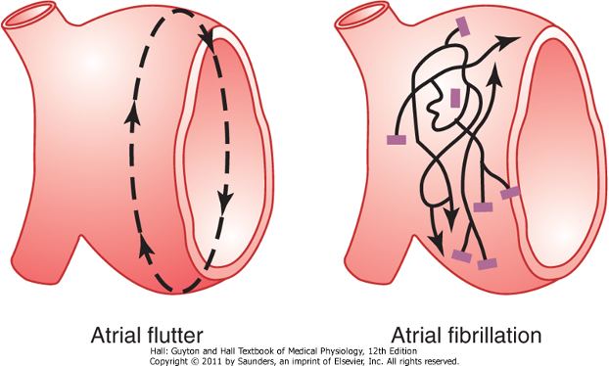
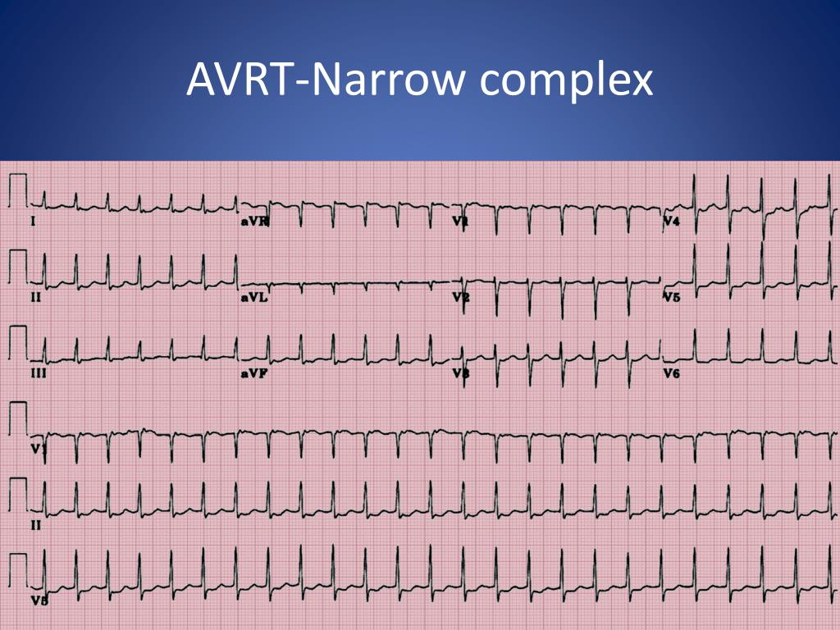
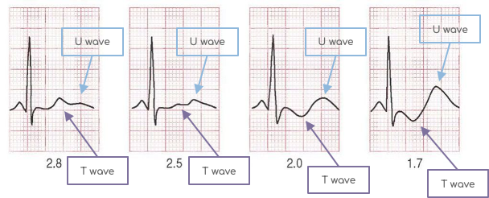
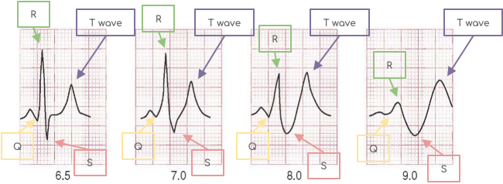
Atrial flutter
14:35-16:05
A single large wave travels around and around in the atria
(notice in the picture that atrial fibrillation has multiple impulses generated from different locations, while the atrial flutter has only one that is large) (reentry circuit)
Atrial rate: The atria contracts at high rate (250 bpm)
Amount of blood: Because one area of the atria is contracted and another one is relaxed, the amount of blood pumped by the atria is slight
Rhythm: The refractory period of the AV node causes 2-3 beats of atria for one single ventricular beat ; 2:1 or 2:3 rhythm
Saw-tooth appearance أسنان المنشار,طعس ووادي Narrow QRS complex
AVRT-Narrow complex
(Supraventricular tachycardia (SVT) )
Ventricular Tachycardia
(wide complex)
Narrow QRS complex
tachycardia
Regular rhythm
Wide QRS complex
Caused by: Ischemia, Electrolytes abnormalities
Regular rhythm
Hypokalemia (Flat T wave)
Hyperkalemia (Tall peaked T wave)

Slide 13
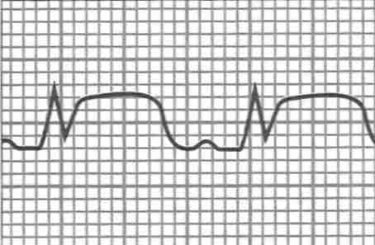
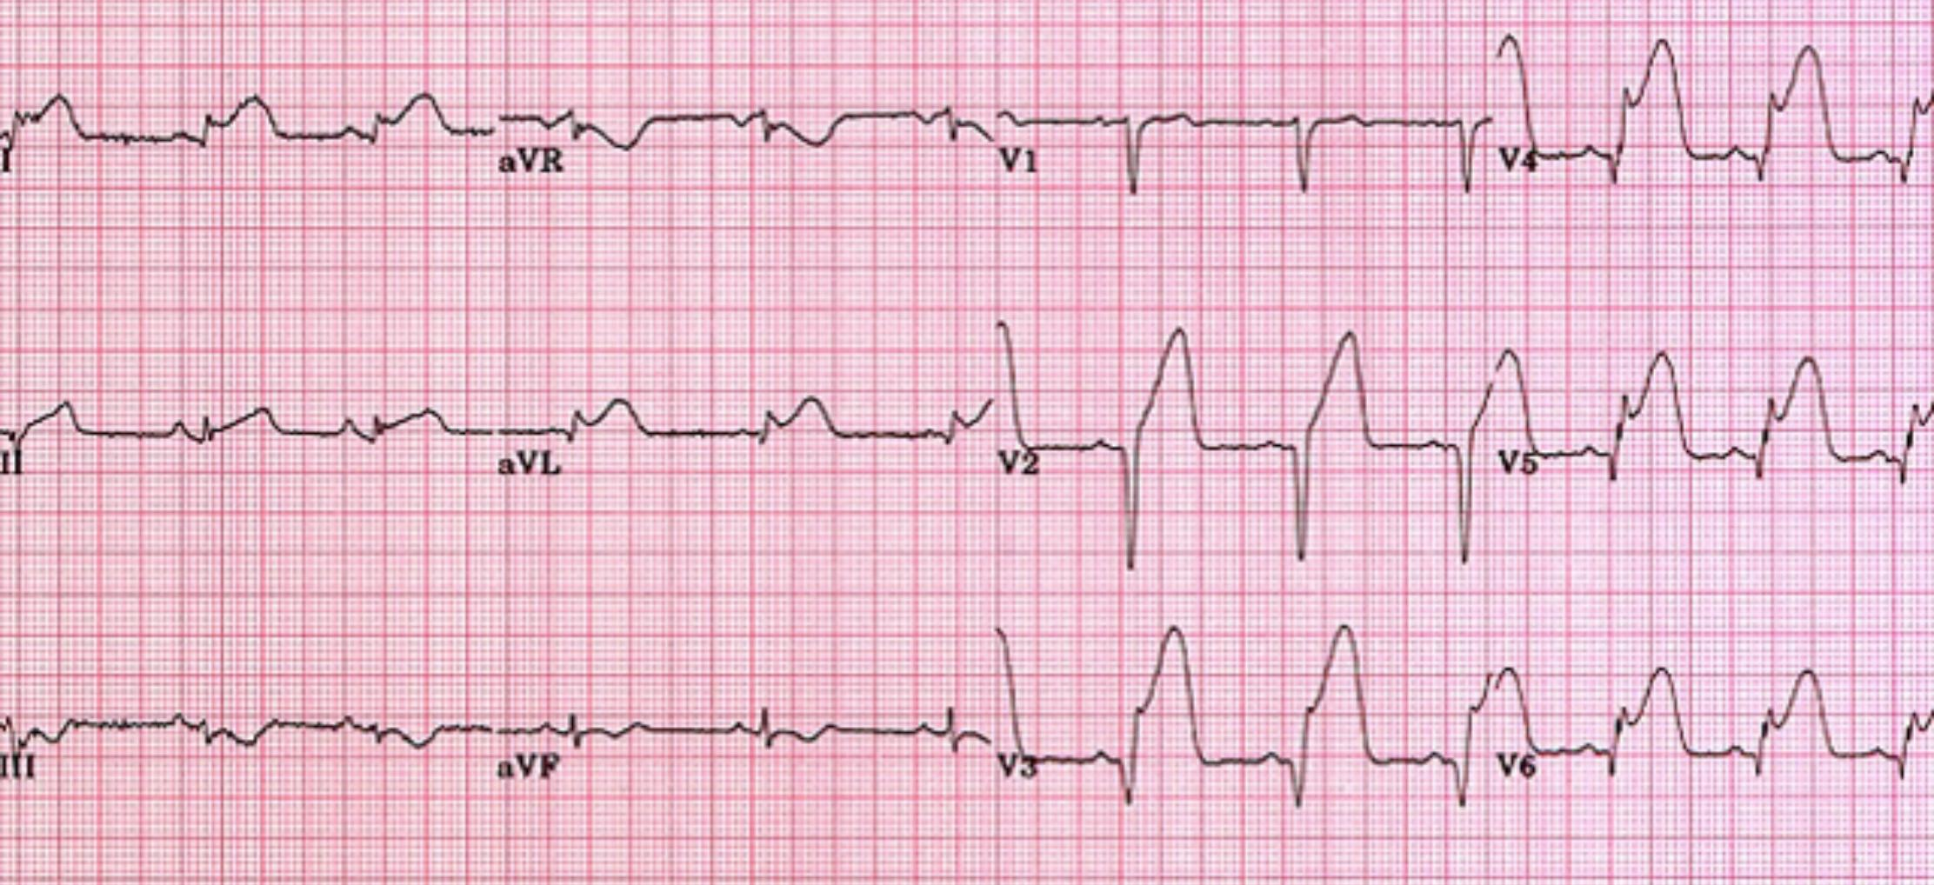
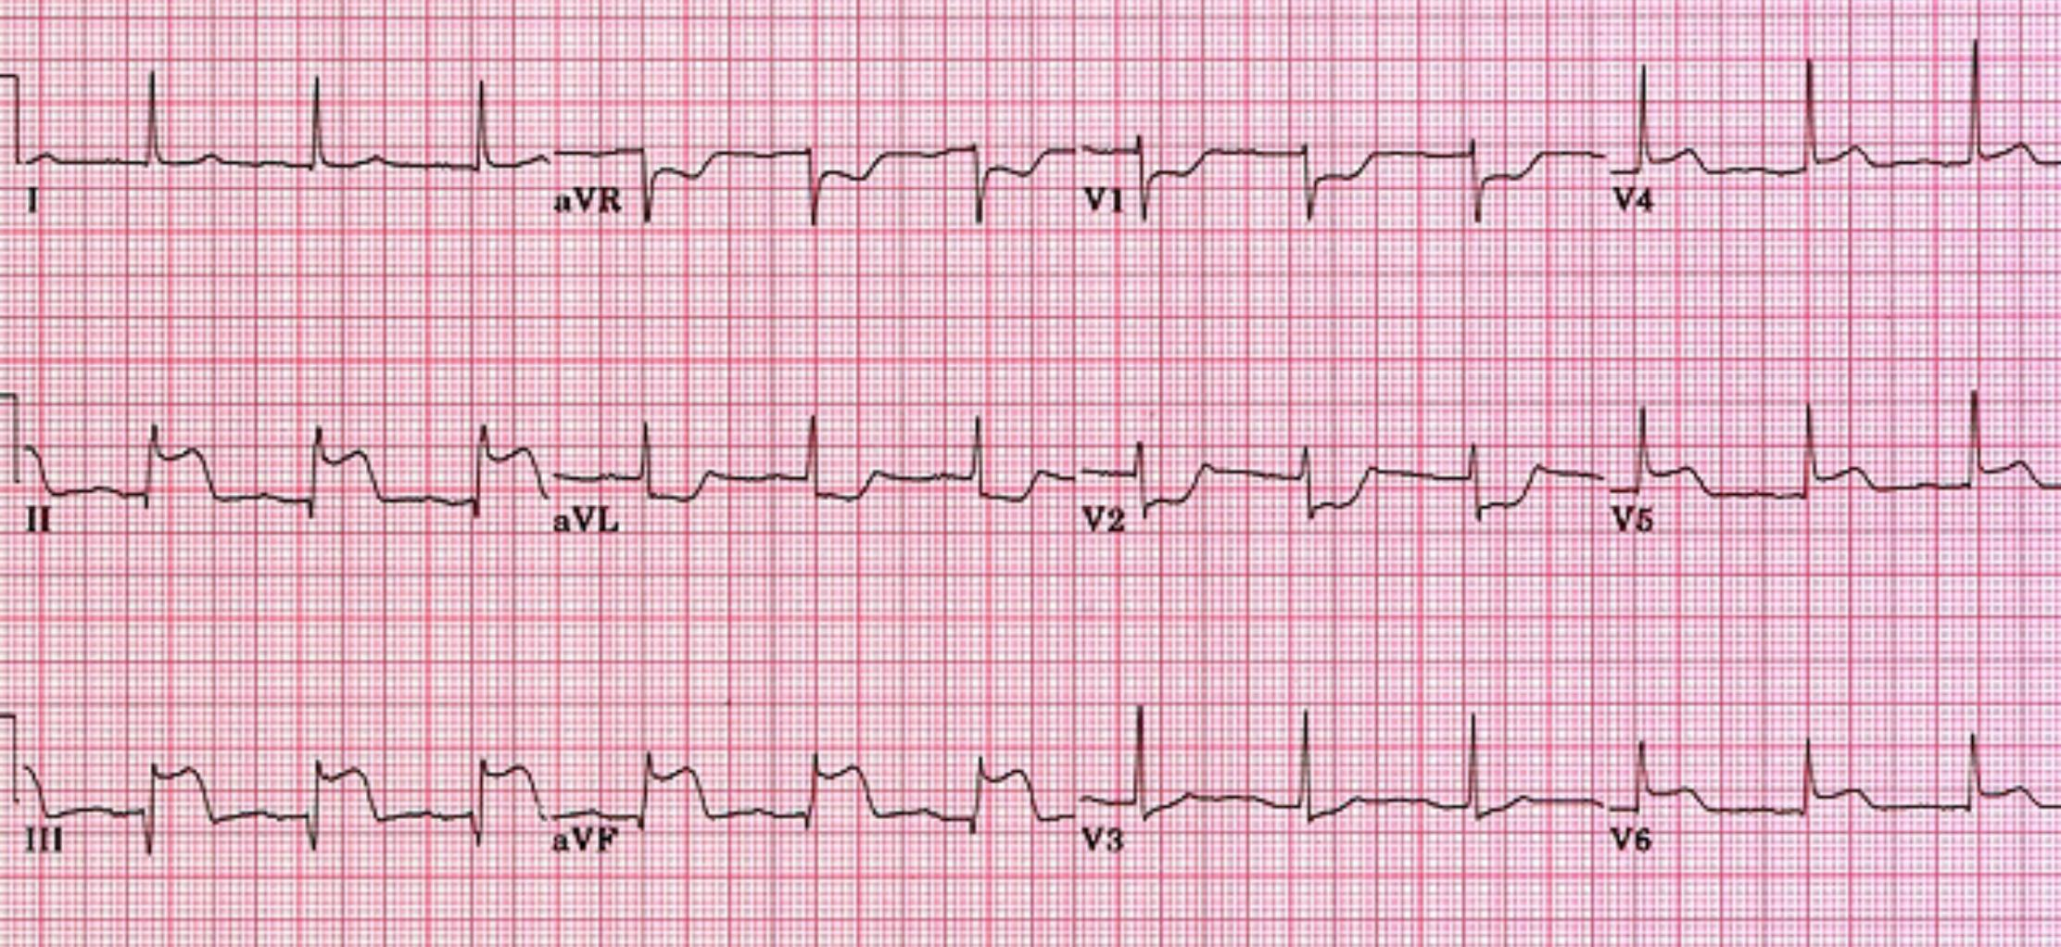
Ischemia and the ECG
(boys’ slides)
One of the common uses of the ECG is in acute assessment of chest pain
Cause of ischemia: restriction of blood flow to the myocardium either reversibly or irreversibly:
1- Reversible: angina pectoris | 2- Irreversible: myocardial infarction Complete loss of blood supply to the myocardium resulting in necrosis or death of tissue Ischemia->Injury-> Infarction
Inverted T wave-> ST segment depression | ST segment elevation Deep Q wave STEMI : ST-Elevation Myocardial Infarction
Timelapse: 6:18-7:05 | Time lapse: 5:05-6:18
Antero-Lateral MI
Infero-Posterior MI
Occlusion of the Left Anterior Descending Artery (LAD)
ST elevation in leads V2-V6, I, aVL
Reciprocal ST depression in leads III, aVF
Occlusion of the Right Coronary Artery (RCA)
ST elevation in leads II, III, aVF
Reciprocal ST depression in aVL

Slide 14
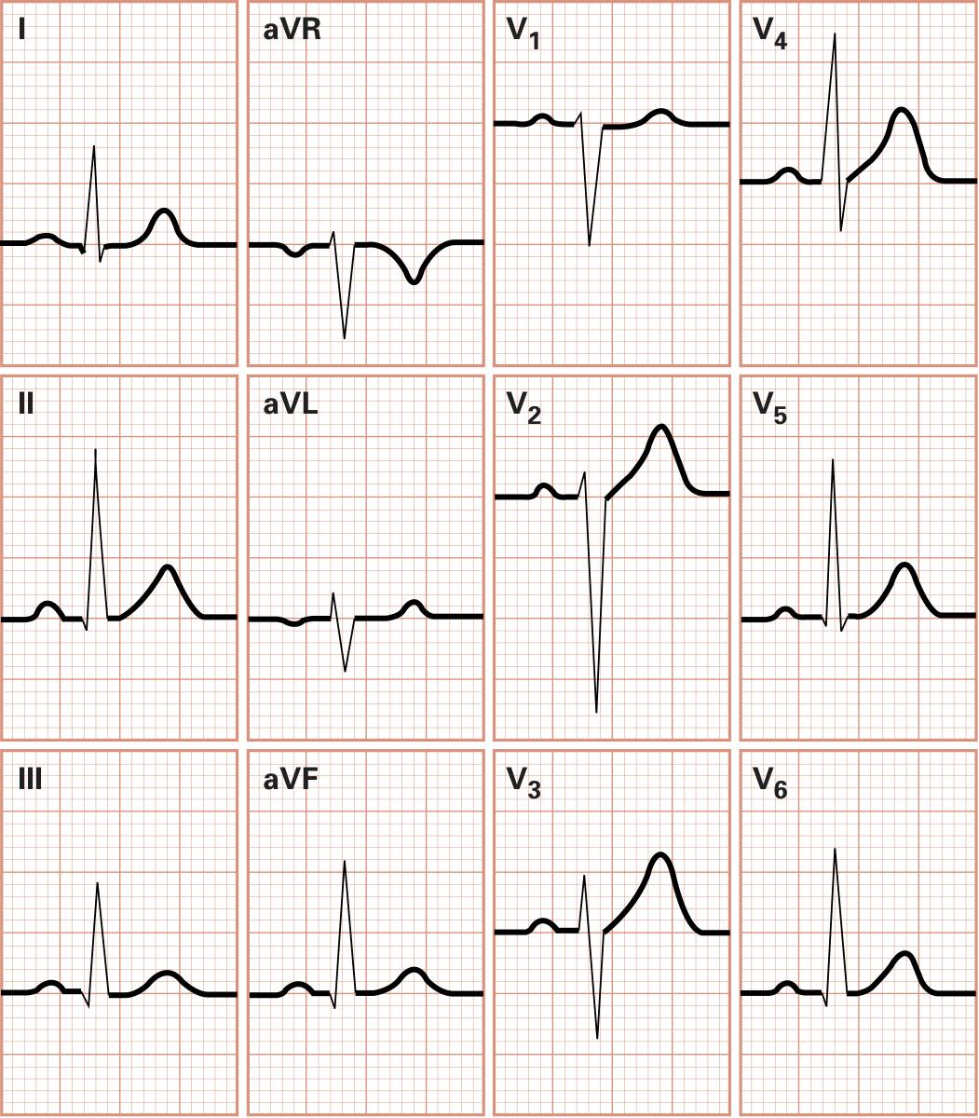
Reference (boys’ slides)
The Normal 12-Lead ECG
Location of MI by ECG Leads
Inferior: RCA
Right coronary artery
Anterior: LAD
Left Anterior Descending Artery
Lateral: LCX
Left Circumﬂex Artery

Slide 15
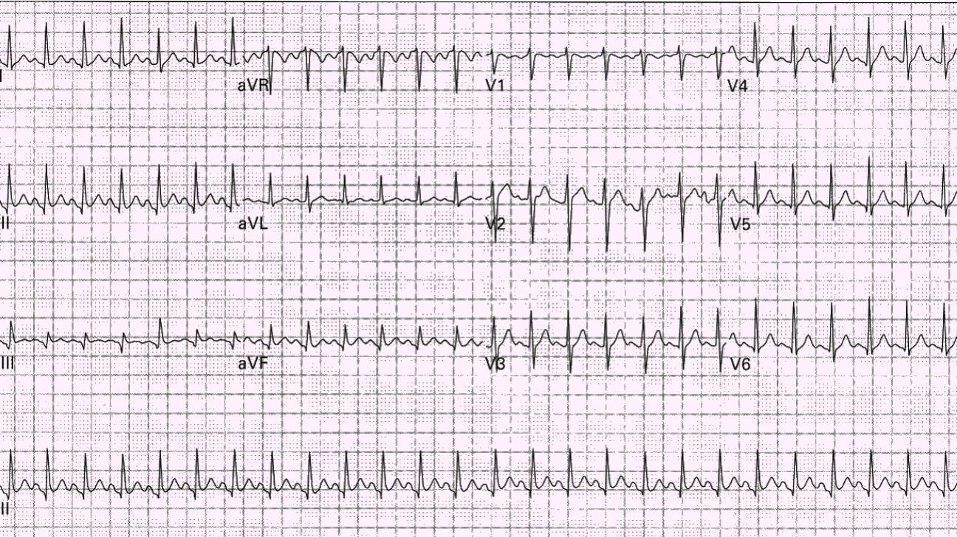
MCQ
Q1/ Which one of the following occurs in patients with enlarged heart ?
A/ Ventricular ﬁbrillation
B/ Atrial ﬁbrillation
C/Atrial ﬂutter
D/Ventricular ﬂutter
Q2/ Which one of the following is the most serious arrhythmia ?
A/ Ventricular ﬁbrillation
B/ Atrial ﬁbrillation
C/Atrial ﬂutter
D/Ventricular ﬂutter
Q3/ Which one of the following can causes Premature Contractions ?
A/ Ventricular ﬁbrillation
B/ Bradycardia
C/ Ischemia
D/Ventricular ﬂutter
?Q4/The following ECG is for 24 year-old pregnant woman with three days of frequent vomiting, which of the following interpretations is the most accurate?
A/sinus tachycardia, Pathological
B/ sinus bradycardia, pathological
C/sinus tachycardia, physiological
D/sinus bradycardia, physiological
Q1/ Which of the following is NOT a feature of normal sinus rhythm ?
A/constant P-R interval
B/ upright P wave
C/Originate in SA node
D/P wave after every QRS complex
1/B 2/A 3/C 4/C 5/D

Slide 16
Helpful videos (special thanks to team441)
1nd° Block
I
2nd° Block
II
3nd° Block
Ventricular Fibrillation
Atrial Fibrillation
Atrial Flutter
Premature Ventricular Contraction
Premature Atrial Contraction

Slide 17
Team leaders:
Hend Almogary
Mishari Alanezi
LOGO designed by:
Sara alotaibi
CVSmed442@gmail.com
CREDITS: This presentation template was created by Slidesgo

