Slide 1
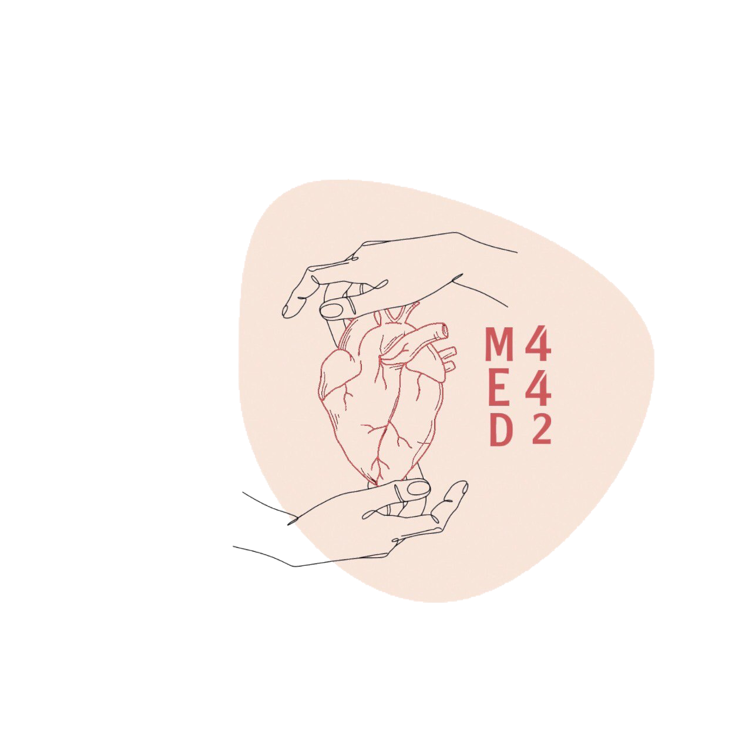
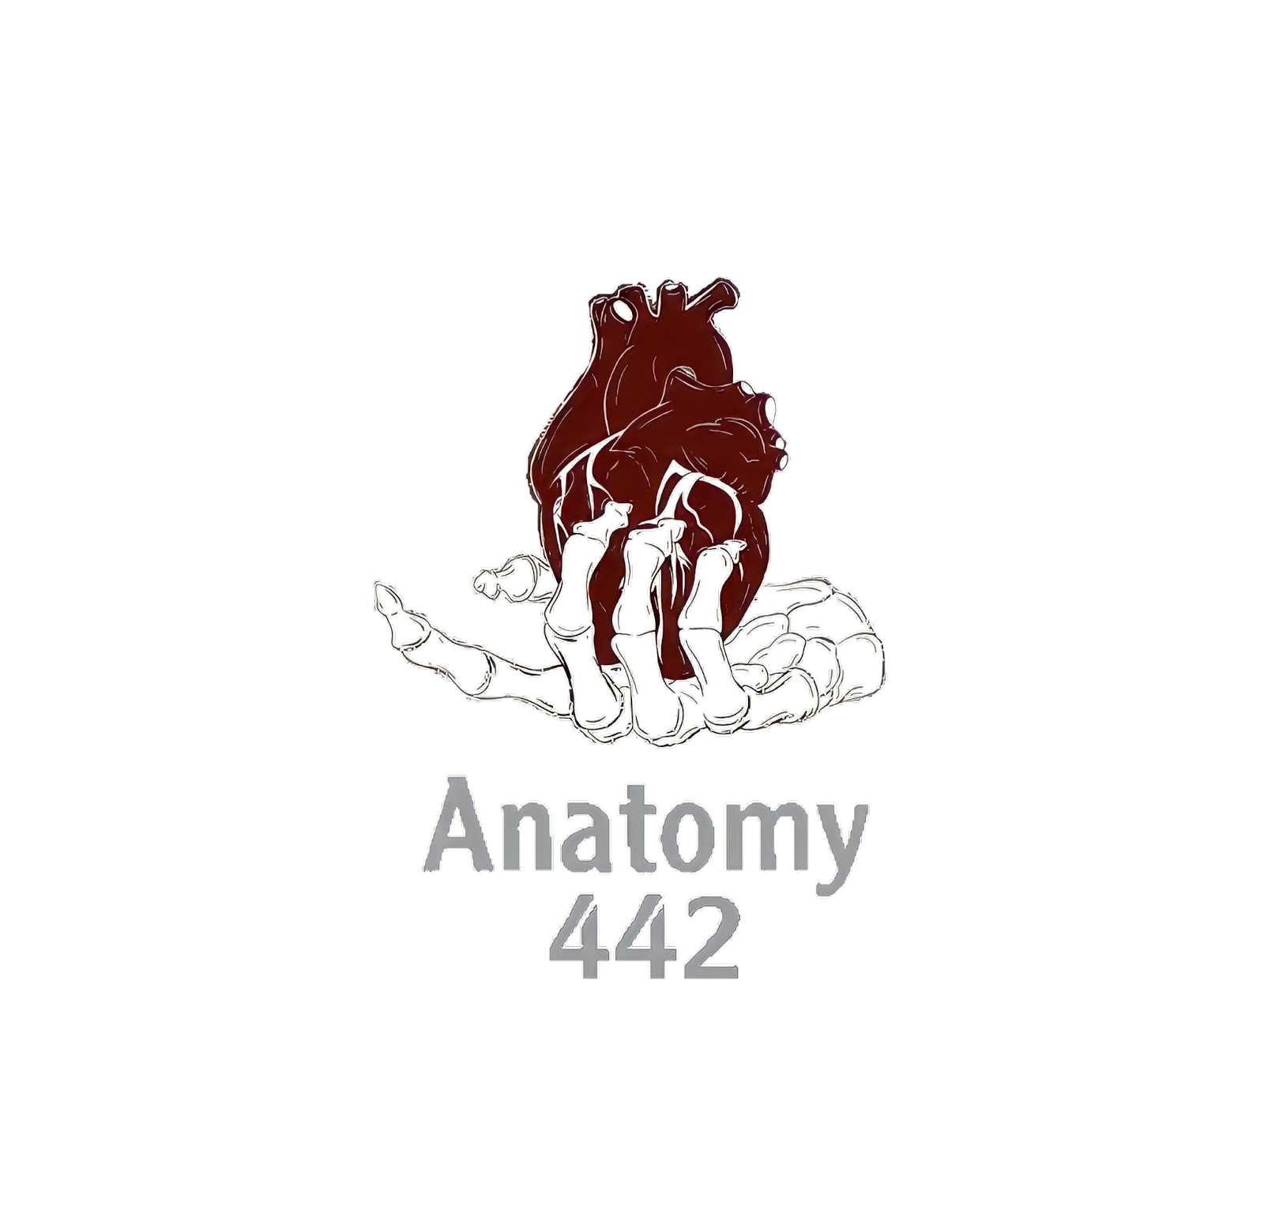
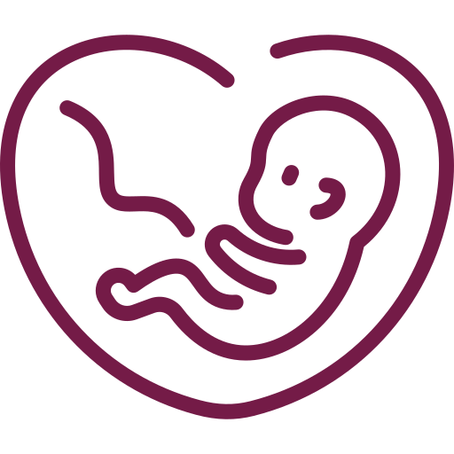
By Faisal Alomar
The Development of the Heart
____________
CVS Block
Editing File
Color Index:
Main Text
Male’s Slides
Female’s Slides
Important
Doctor’s Notes
Extra Info

Slide 2
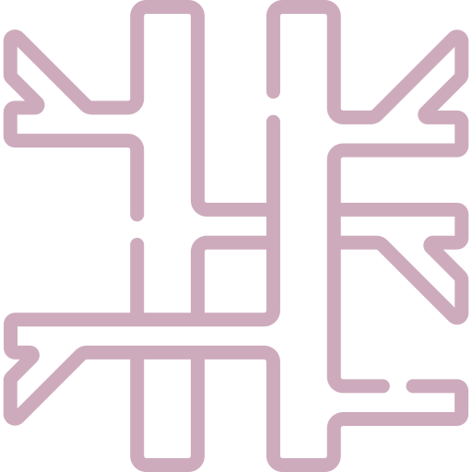
Objectives
By the end of this lecture the student should be able to:
Describe the formation, sit, union divisions of the of the heart tubes.
Describe the formation and fate of the sinus venosus.
Describe the partitioning of the common atrium and common ventricle.
Describe the partitioning of the truncus arteriosus.
List the most common cardiac anomalies.
We Highly Recommend that you watch this video before studying this lecture

Slide 3
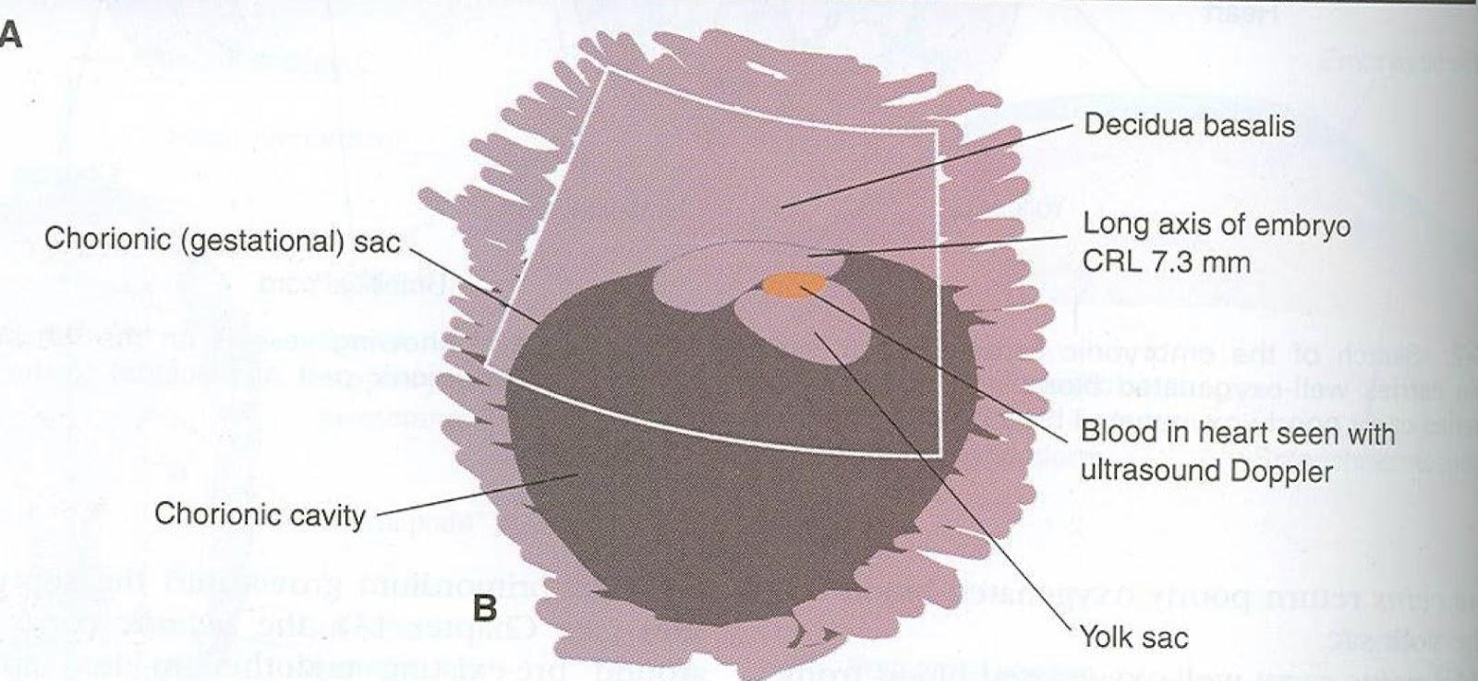
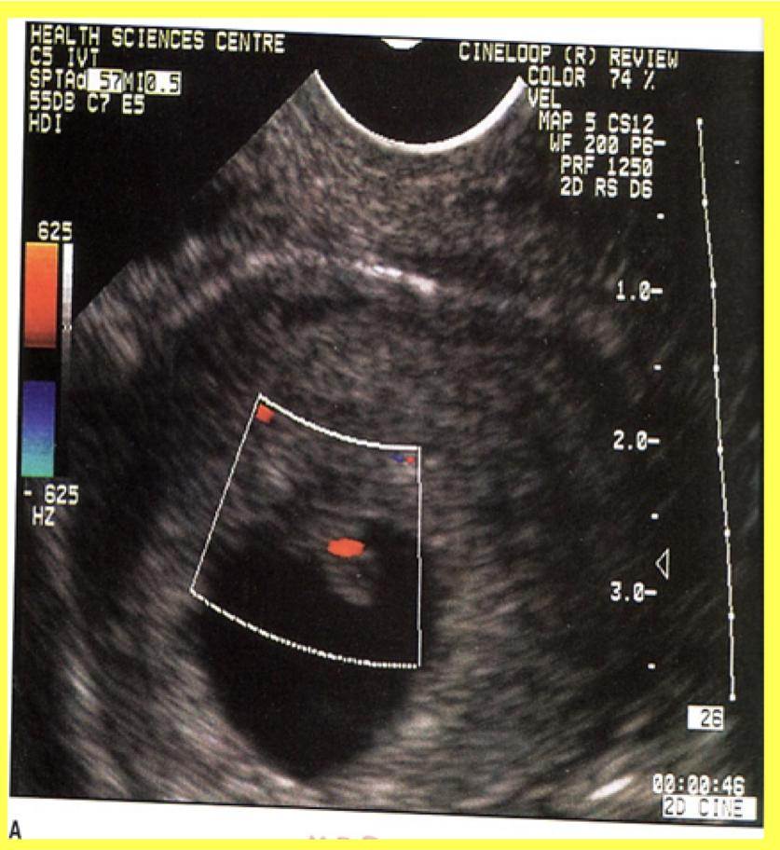
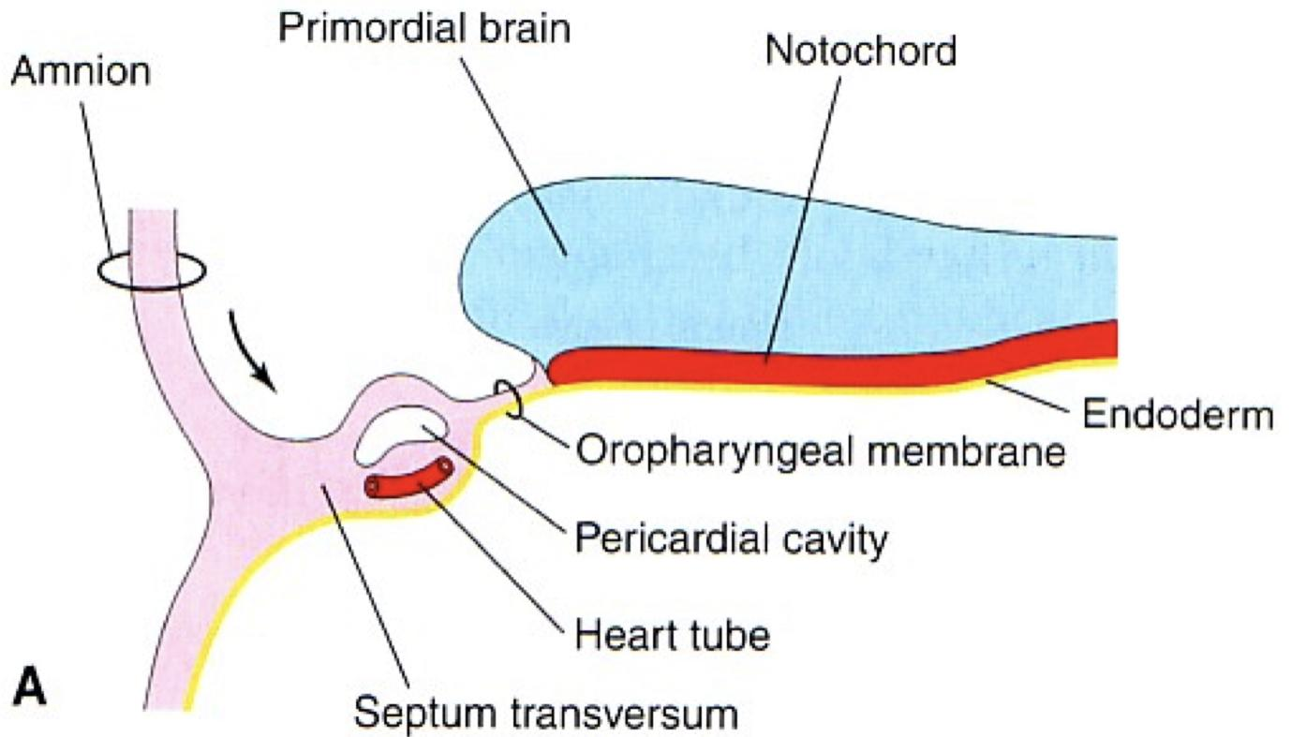
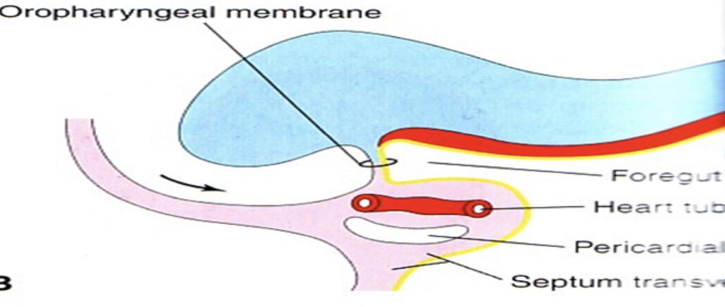
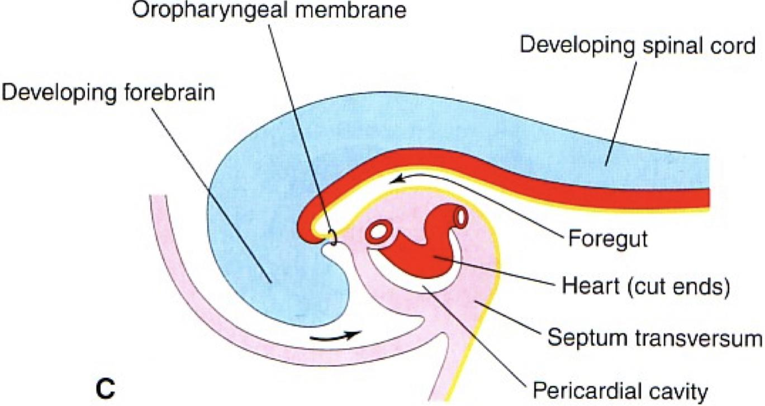
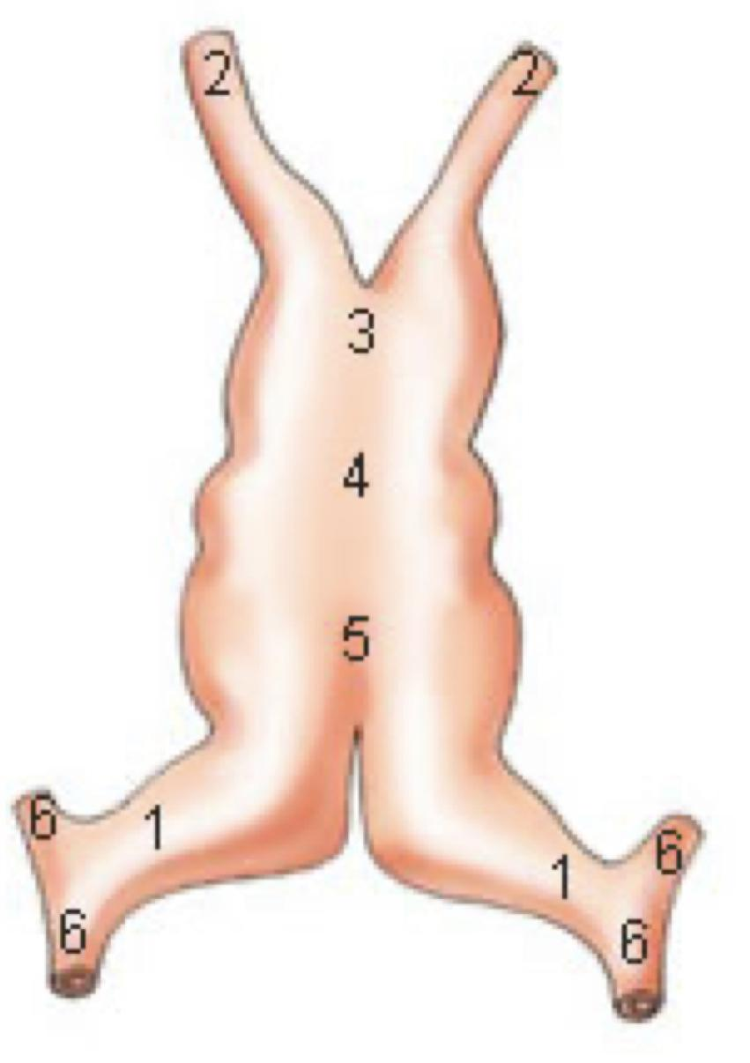
1
Development of the heart
Development of Heart Tube
The CVS is the first major system to function in the embryo.
The heart begins to beat at (22nd – 23rd ) days.
Blood flow begins during the beginning of the 4th week and can be visualized by Ultrasound Doppler.
Formation of the Heart Tube
1
The heart is the first functional organ to develop.
3
The heart primordium is first evident at day 18 (as an Angioplastic cords which soon canalize to form the 2 heart tubes).
2
It develops from Splanchnic Mesoderm in the wall of the yolk sac (Cardiogenic Area):
Cranial to the developing Mouth & Nervous system .
Ventral to the developing Pericardial sac.
4
As the Head Fold completed
the developing heart tubes change their position and become in the Ventral aspect of the embryo, Dorsal to the developing Pericardial sac.
Development of the Heart Tube
After Lateral Folding of the embryo
the 2 heart tubes approach each other and fuse to
form a single Endocardial Heart tube within the pericardial sac.
Fusion of the two tubes occurs in a Craniocaudal direction.

Slide 4
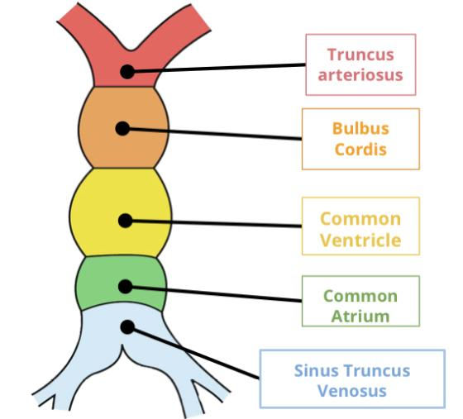
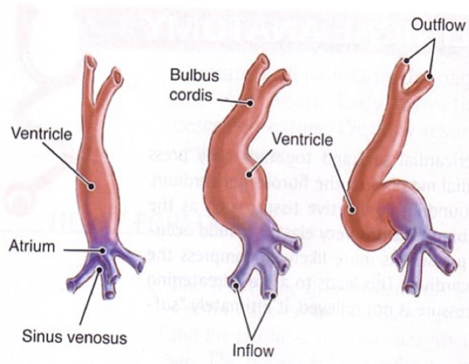
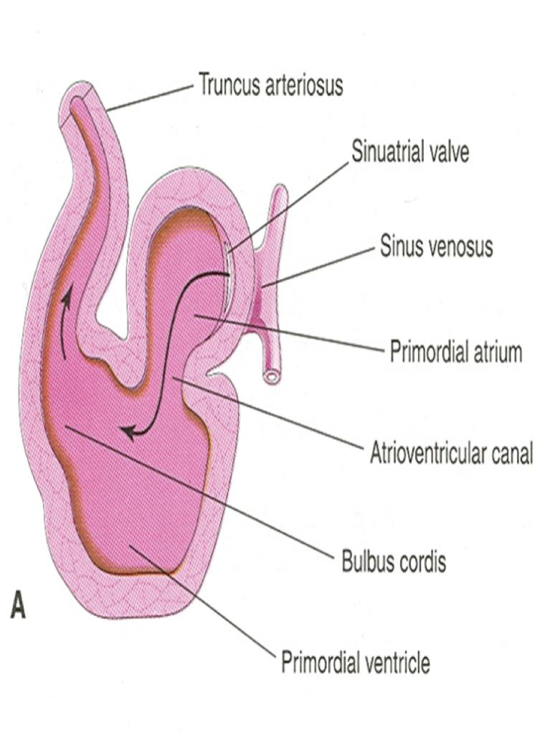
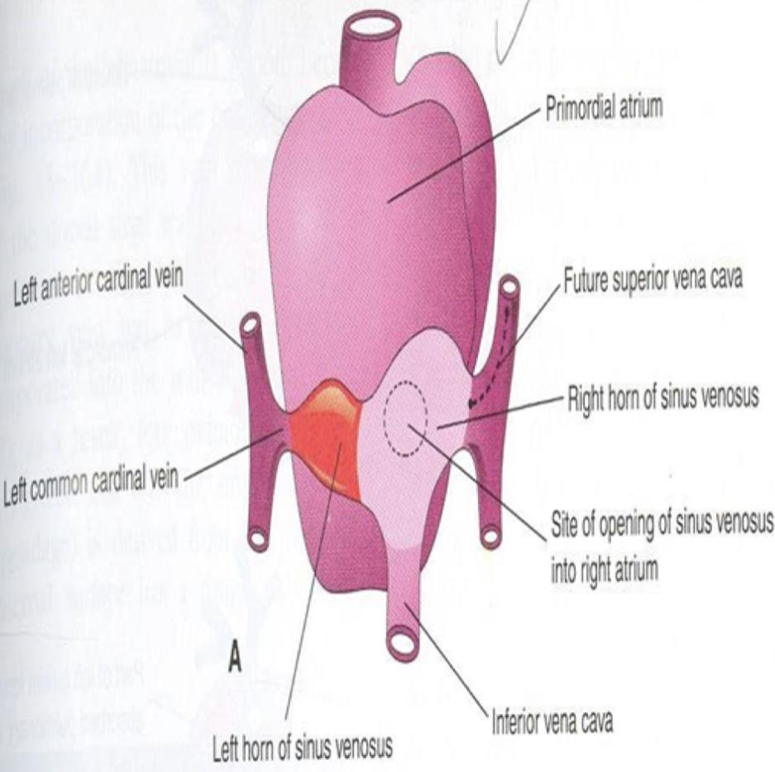
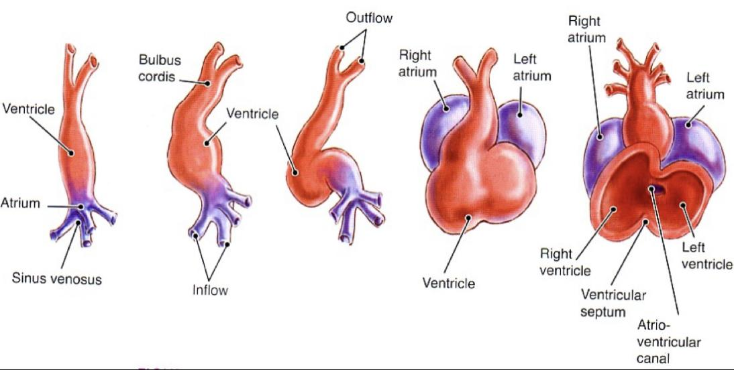
2
Heart tube
Fate of the Heart Tube
The heart tube grows faster than the pericardial sac, so it shows 5 alternate
dilations separated by constrictions.
These are:
1
Sinus Venosus
2
Truncus Arteriosus
3
Bulbus Cordis
4
Common Ventricle
5
Common Atrium
The endocardial heart tube has 2 ends :
Thanks to 441 .
1-Venous end (Caudal): Sinus Venosus .
2- Arterial end (Cranial): Truncus arteriosus.
Shape of the Heart Tube
U-Shaped Heart Tube
S-Shaped Heart Tube
- Bulbus cordis and ventricle grow faster than other regions.
- So the heart bends upon itself, forming The U-shaped heart tube, (Bulboventricular loop).
As the heart tube develops it bends , upon itself and forms S-shaped heart tube:
SO, the Atrium and Sinus venosus become Cranial in position & Dorsal to the Truncus arteriosus, Bulbus cordis, and Ventricle.
By this stage the sinus venosus (opens in the dorsal surface of the atrium) has developed 2 lateral expansions, (Horns) :Right and Left

Slide 5
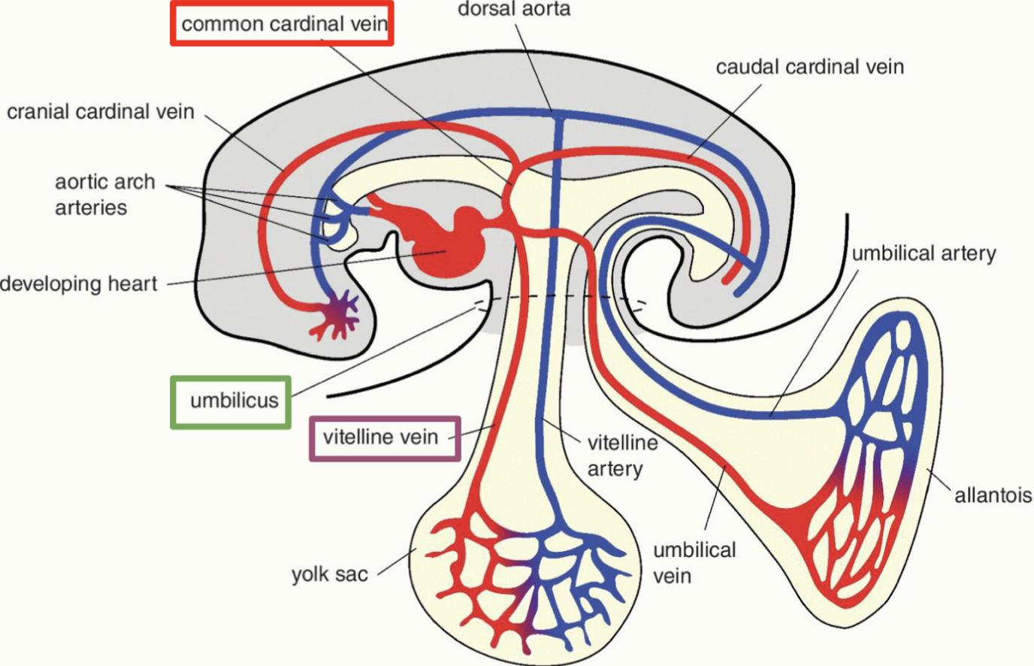
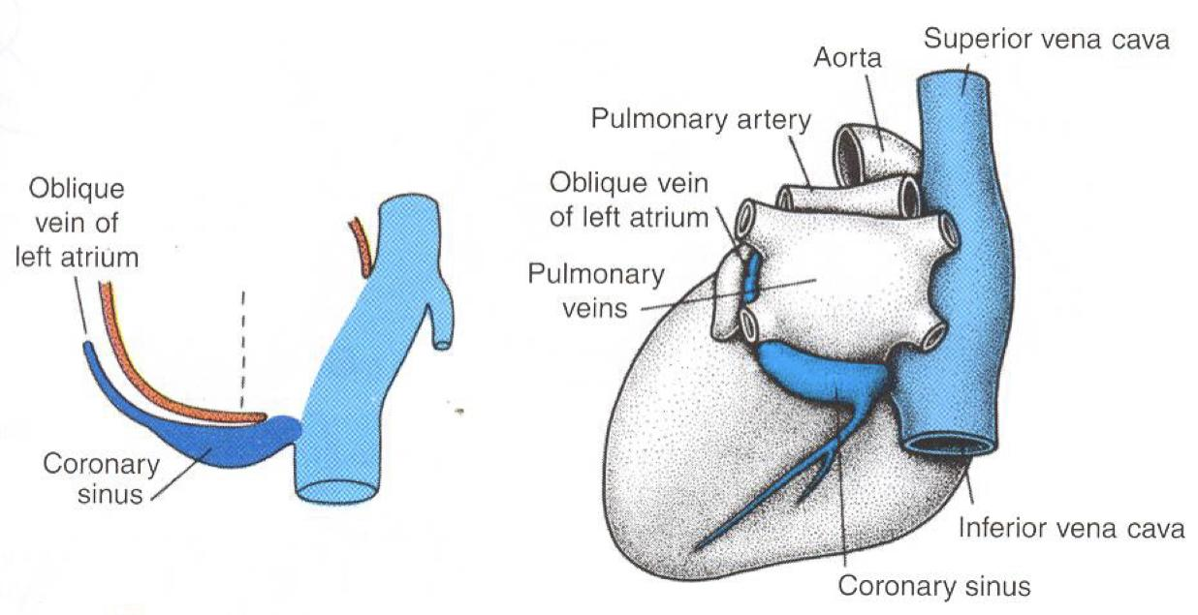
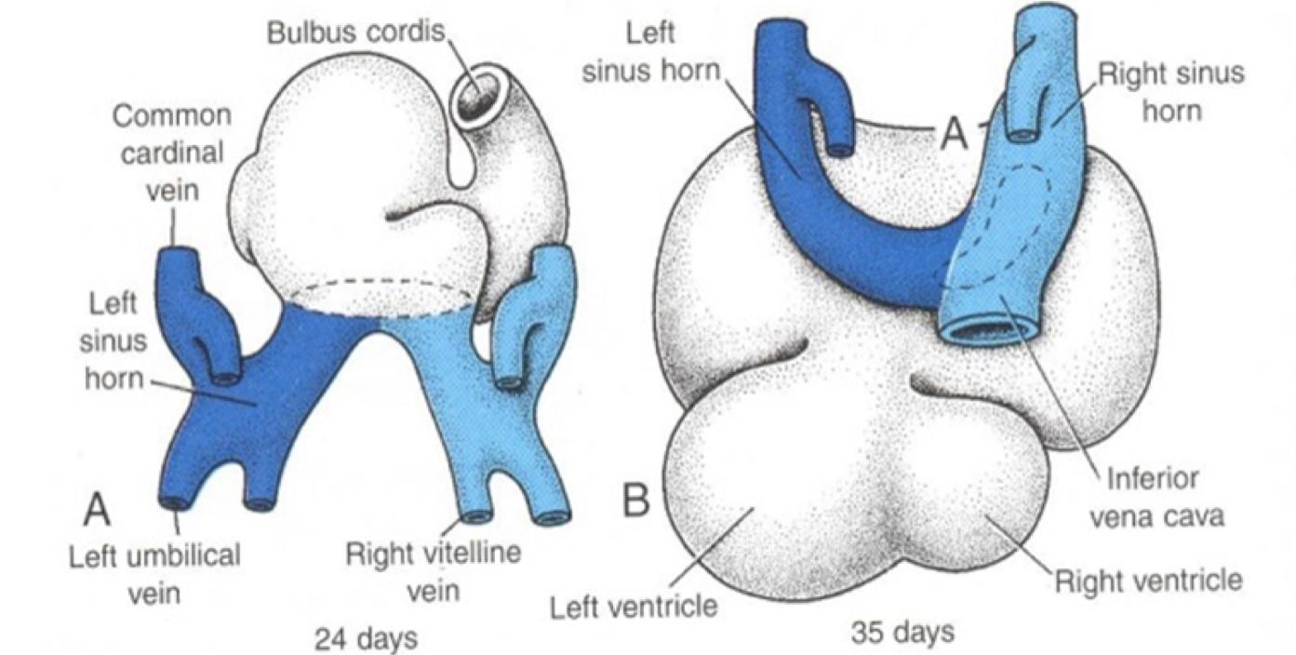
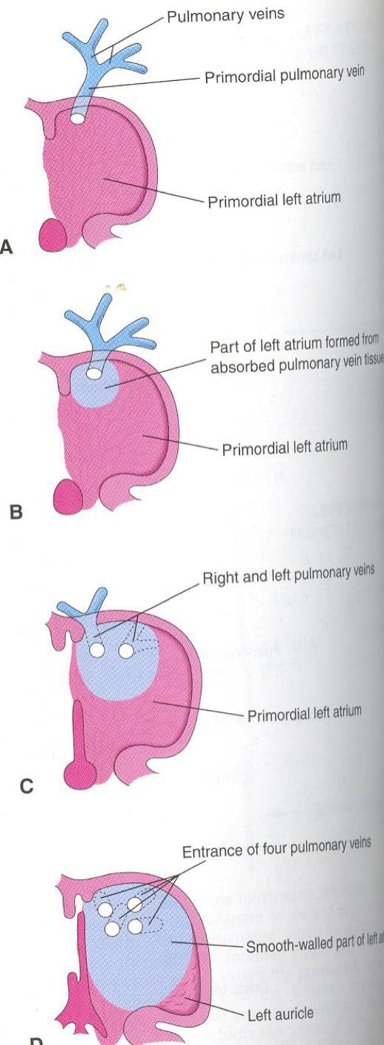
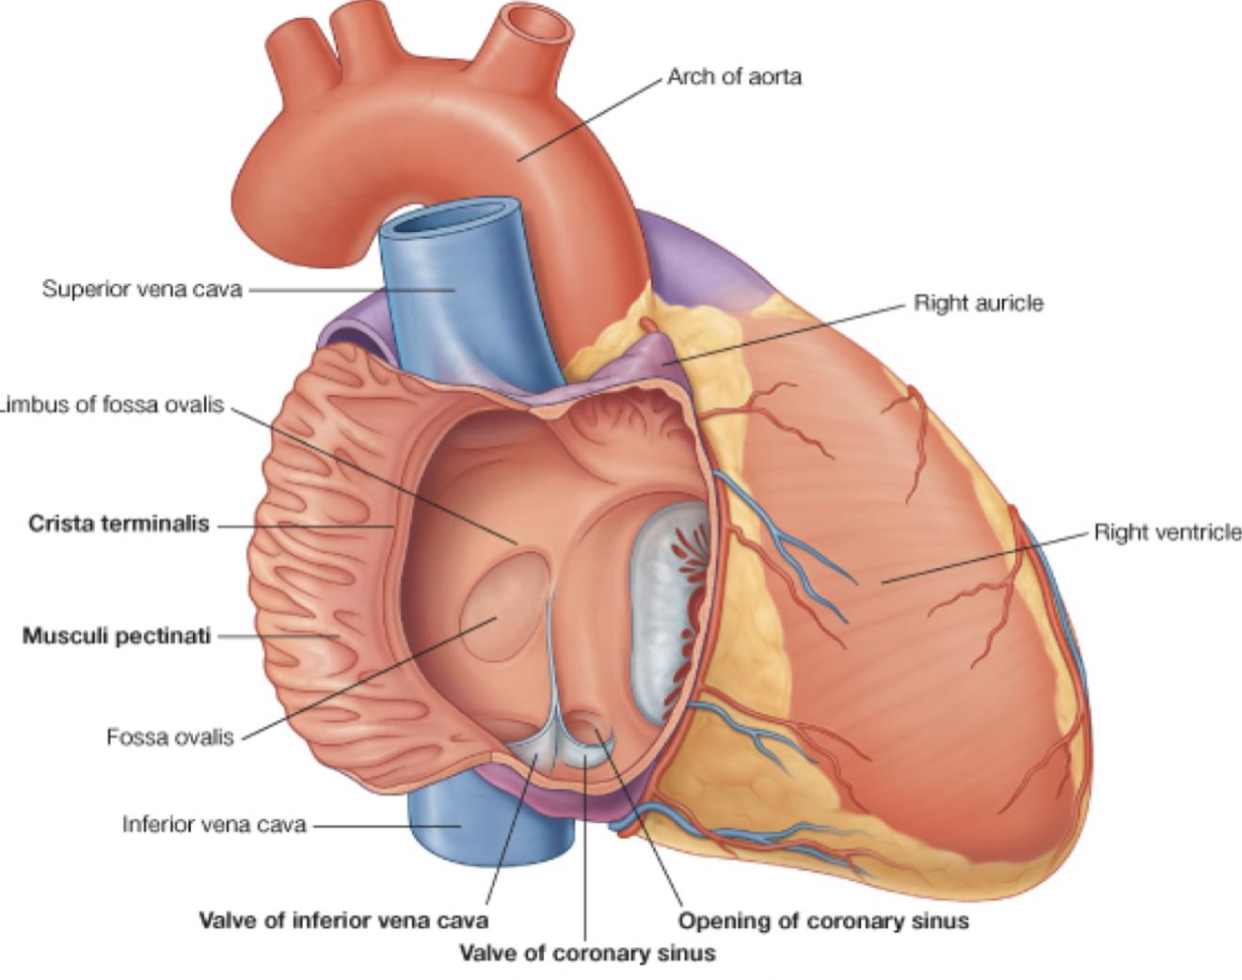
3
Fate of Sinus Venosus
Veins Draining into Sinus Venosus
Each horn of the sinus venosus receives 3 veins:
- Common cardinal
- Vitelline
- Umbilical
- Cardinal vein from the fetal body.
- Vitelline from the yolk sac.
- Umbilical from the placenta.
Each vessel is paired at this stage
(not illustrated)
Fate of Sinus Venosus
The Right Horn forms the smooth posterior part of the right atrium; sinus venirium.
The Left Horn and Body atrophy and form the Coronary Sinus.
The Left Common cardinal vein forms the Oblique Vein of the Left Atrium.
Development of the atriums
Right Atrium | Left Atrium
The right atrium is developed from:
-Rough Trabeculated anterior part (musculi pectanti) of the right atrium is derived from the primordial common atrium.
-The right horn of the sinus venosus forms the smooth posterior part of the right atrium.
-These two parts are demarcated by the crista terminalis internally and sulcus terminalis externally.
-Rough Trabeculated part: derived from the common primordial atrium.
-The smooth part: derived from the absorbed Pulmonary Veins.

Slide 6
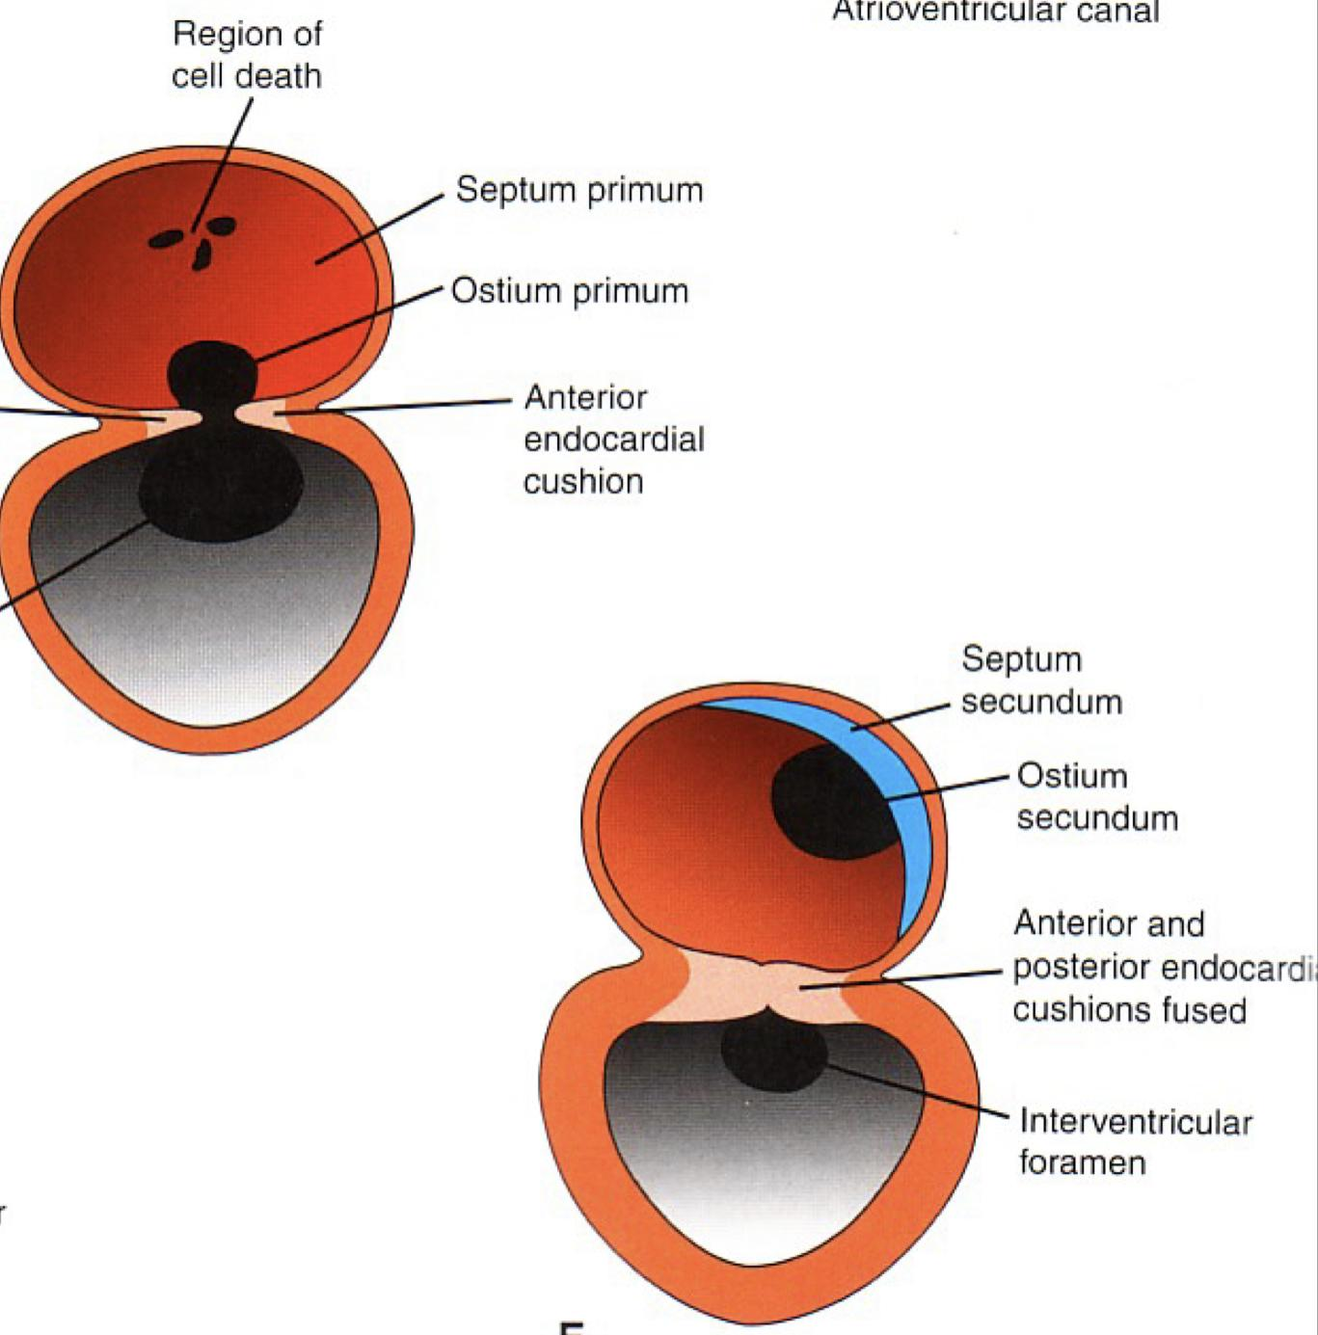
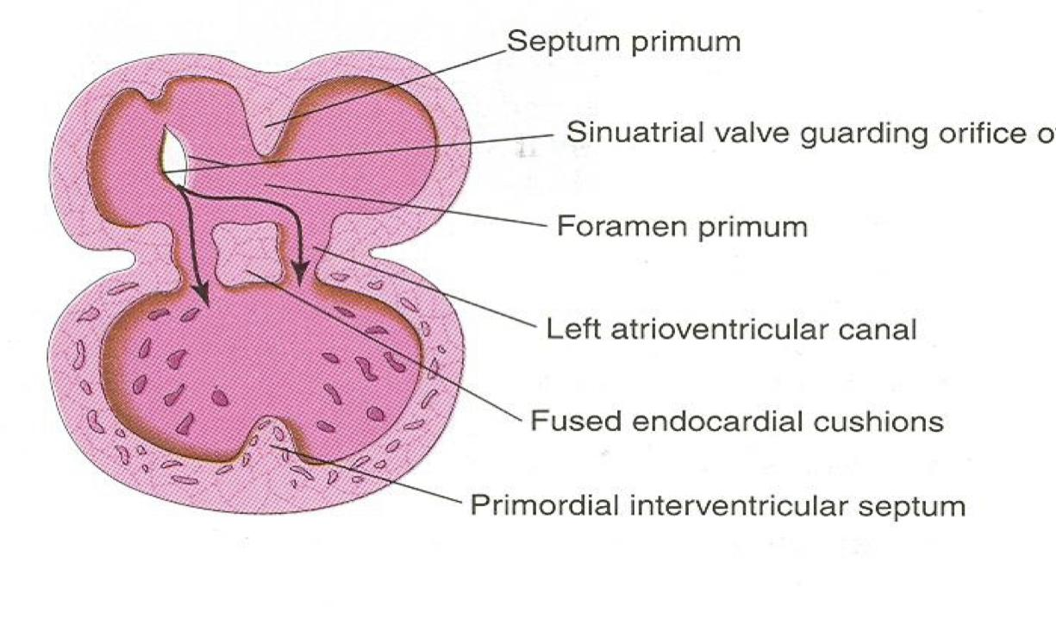
4
Partitioning of Primordial Heart
Partitioning of Primordial Heart
Partitioning of:
1
Atrioventricular canal.
3
Common ventricle.
4
Truncus arteriosus & Bulbus cordis.
2
Common atrium.
It begins by the middle of 4th week.
It is completed by the end of 5th week.
Endocardial cushions
They appear around the middle of the 4th week as Mesenchymal Proliferation.
They participate in formation of :
1
A.V canals and valves. (AV=atrioventricular)
3
Membranous part of Ventricular septum.
2
Atrial septa.
4
Aortic and Pulmonary channels (Spiral septum).
Partitioning of the atrioventricular canal
Two Endocardial Cushions are formed on the dorsal and ventral walls of the AV canal.
The AV endocardial cushions approach each other
and fuse to form the Septum Intermedium.
Dividing the AV canal into right & left canals.
These canals partially separate the primordial atrium from the ventricle.

Slide 7
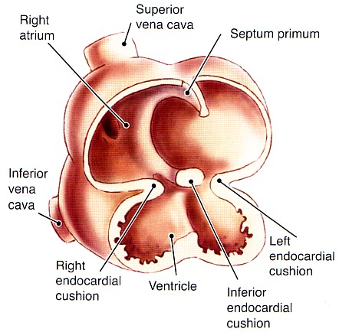
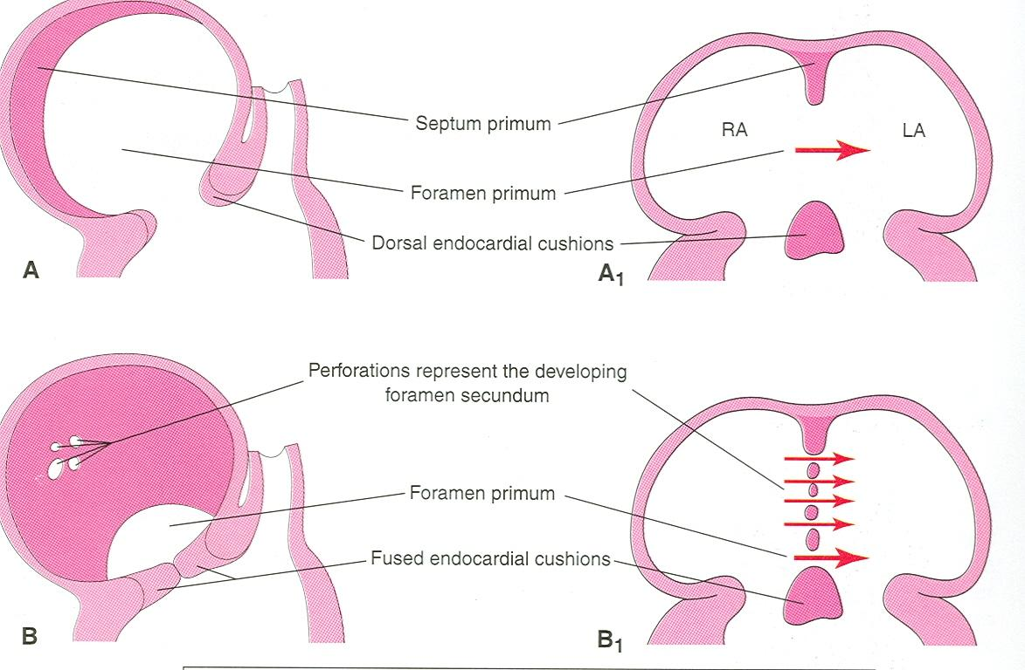
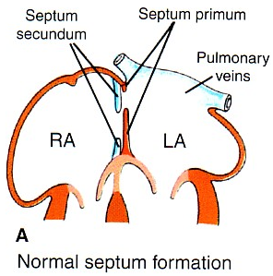
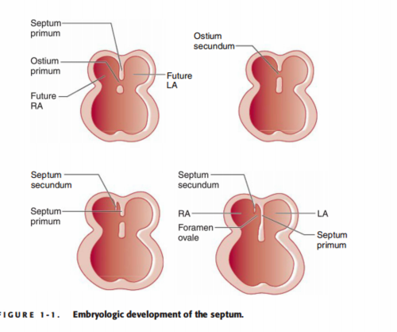
5
Partition of Common Atrium
Septum Primum | Ostium Primum | Septum Secundum
It is sickle- shaped septum that grows from the roof of the common atrium towards the fusing endocardial cushions (septum intermedium) | The two ends of septum primum reach to the growing endocardial cushions before it’s central part. | The upper part of septum primum that is attached to the roof of the common atrium shows gradual resorption forming an opening called ostium secundum.
So it divides the common atrium into right & left halves. | Now the septum primum bounds a foramen called ostium primum. | Another septum descends on the right side of the septum primum is called Septum Secundum.
 | It serves as a shunt, enabling the oxygenated blood to pass from right to left atrium | it forms an incomplete partition between the two atria
 | The ostium primum become smaller and disappears as the septum primum fuses completely with the septum intermedium to form the AV septum. | Consequently a valvular oval foramen forms, (Foramen Ovale)

Slide 8
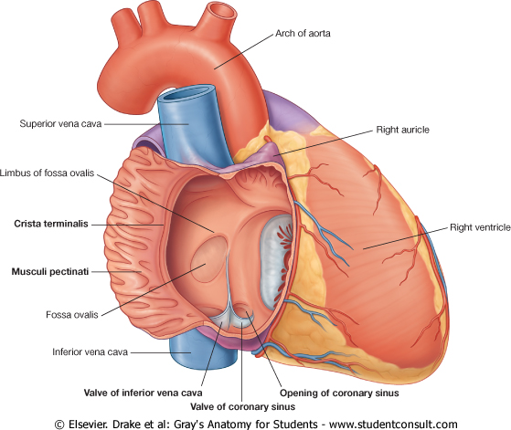
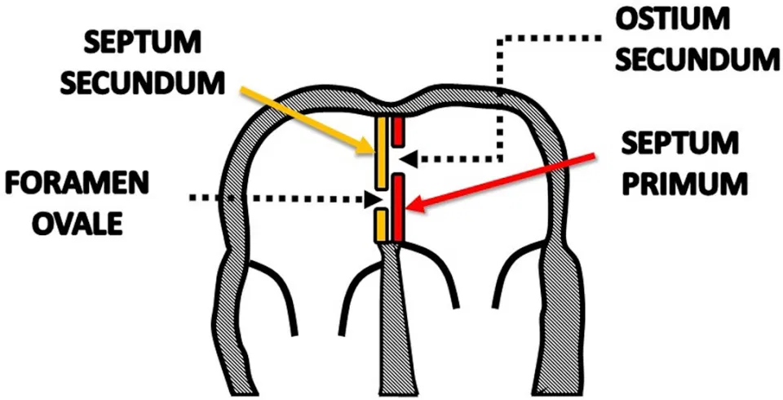
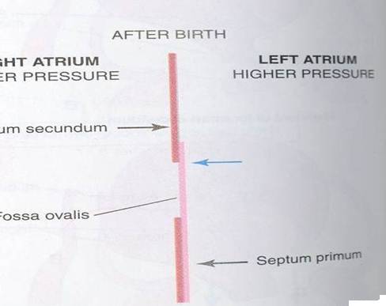
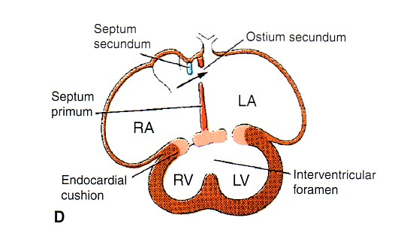
Partition of Common Atrium & Ventricle
6
Fate of foramen Ovale
At birth when the lung circulation begins, the pressure in the left atrium increases.
The valve of the foramen ovale is pressed against the septum secundum and obliterates the foramen ovale.
Its site is represented by the Fossa Ovalis: [1]
Its floor represents the persistent part of the septum primum. [2]
Its limbus (annulus) is the lower edge of the septum secundum. [3]
Partitioning of Primordial Ventricle
Interventricular septum consists of:
1
Muscular part
2
Membranous part
1st: Muscular part of the interventricular septum:
Division of the primordial ventricle is first indicated by a median muscular ridge, the primordial interventricular septum.
It is a thick crescentic fold which has a concave upper free edge.
This septum bounds a temporary connection between the two ventricles called Interventricular foramen.

Slide 9
7
Partitioning of Primordial Ventricle
Interventricular Septum
2nd: The Membranous part:
The Membranous part of the IV septum is derived from:
1
A tissue extension from the right side of the Endocardial Cushion.
2
Aorticopulmonary septum.
3
Thick Muscular part of the IV septum.
Bulbus Cordis
The bulbus cordis forms the smooth upper part of the two ventricles.
Left ventricle:
Right Ventricle:
Aortic Vestibule leading to ascending aorta.
Conus Arteriosus or (Infundibulum) which leads to the pulmonary trunk.
Partition of Truncus Arteriosus
In the 5th week, proliferation of mesenchymal cells (Endocardial Cushions) appear in the wall of the truncus arteriosus ,they form a Spiral Septum:
It divides the Lower part of the Truncus Arteriosus into Right & Left parts
It divides the Middle part of Truncus Arteriosus into Anterior & Posterior parts.
It divides the Upper part of the Truncus Arteriosus into Right & left parts.

Slide 10
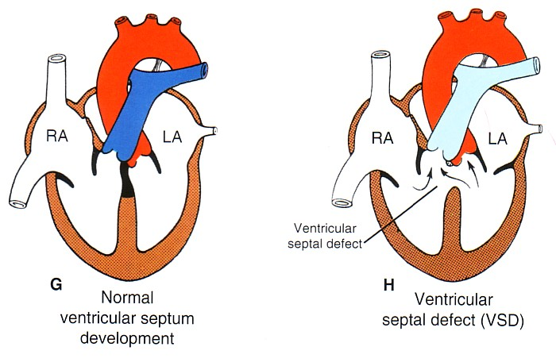
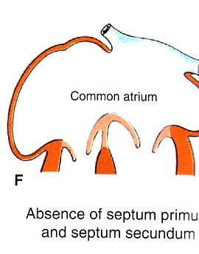
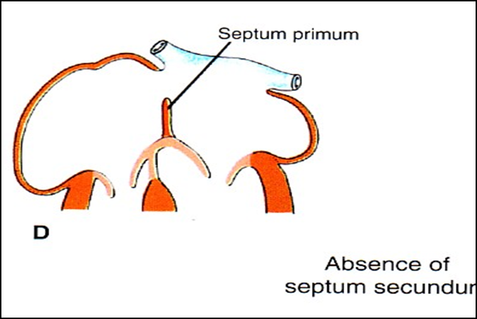
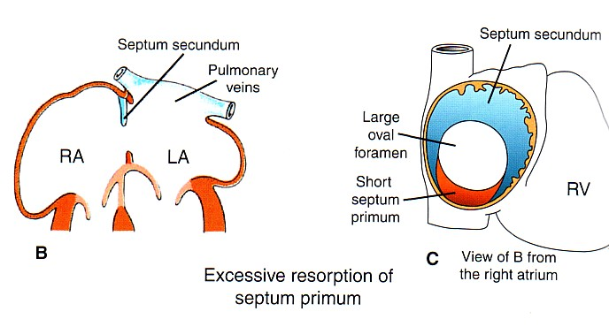
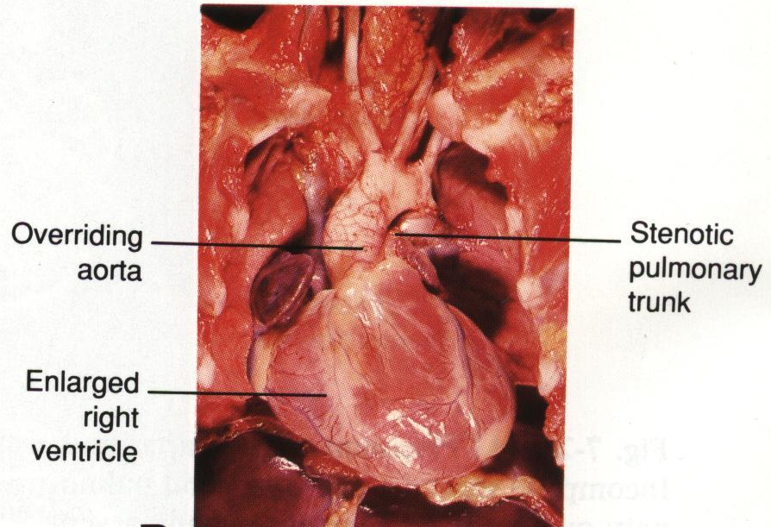
8
Major Cardiac Anomalies
Atrial Septal Defects (ASD)
Ventricular Septal Defect (VSD)
Types:
Absence of both septum primum and septum secundum, leads to Common Atrium.
Roger’s disease
Absence of the Membranous part of interventricular septum (persistent IV Foramen).
Usually accompanied by other cardiac defects.
1
2
Absence of Septum Secundum
3
Large (Patent) foramen ovale : Excessive resorption of septum primum
[1]
[2]
[3]
Tetratology of Fallot
Transposition of Great Arteries (TGA)
1
VSD.(Ventricular septal defect)
Pulmonary stenosis.
Overriding of the aorta
Right ventricular hypertrophy.
TGA is due to abnormal rotation or malformation of the aorticopulmonary septum, so the right ventricle joins the aorta, while the left ventricle joins the pulmonary artery.
It is one of the most common causes of cyanotic heart disease in the newborn
Often associated with ASD or VSD
2
3
4
Blue baby

Slide 11
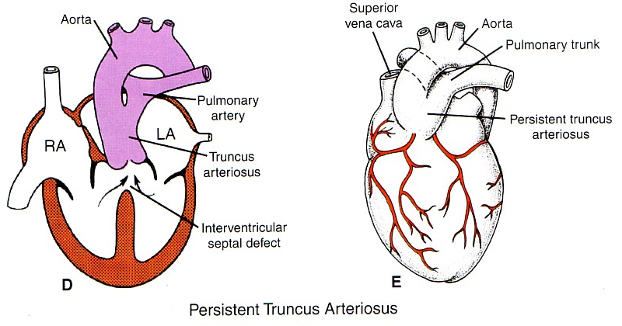
9
Persistent Truncus Arteriosus
It is due to:
failure of the development of the aorticopulmonary (spiral) septum.
It is usually accompanied with VSD.
It forms a single arterial trunk arising from the heart and supplies the systemic, pulmonary & coronary circulations.

Slide 12
Quiz
MCQs
Q1: The heart begins to beat at
A- 22nd -23rd week | B- 10th -13th week | C- 22nd -23rd days | D- 10th-13th days
Q2: The smooth posterior part of right atrium is formed by
A- right horn of the sinus venosus | B- left horn of the sinus venosus | C- Primordial common atrium | D- crista terminalis
Q3: partitioning of primordial heart is completed by
A- the middle of the 4th week | B- the middle of the 5th week | C- the end of the 4th week | D- the end of the 5th week
Q4: Which of the following is characterized by absence of the membranous part of interventricular septum?
A- Persistent truncus arteriosus | B- Atrial septal defect (ASD) | C- TGA | D- Roger’s disease
Q5: Which of the following forms the smooth upper part of the 2 ventricles?
A- Bulbus cordis | B- Sinus venosus | C- infundibulum | D- I don’t know :)
Q6: Which of the following veins drains from the fetal body?
A- Common cardinal | B- Vitelline | C- Umbilical | D- Middle cardiac
Answers: 1. C 2. A 3. D 4. D 5. A 6. A

Slide 13
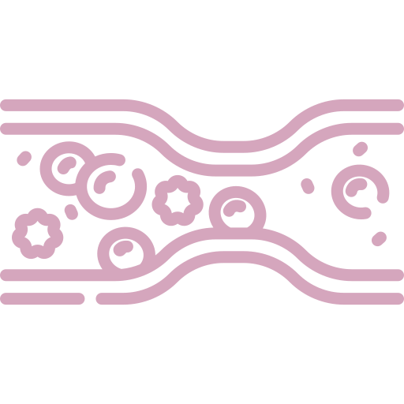
Members Board
Team Leaders
Mohammad Alrashed
Najla Aldhbiban
Team Members
Abdullah Alsalem
Nouf Alsaigh
Faisal Alomar
Nouf Aldalaqan
Mishal Alsuwayegh
Nouf Aldhalaan
Waleed Alrashoud
Raneem Alwatban
Emad Almutairi
Deema Aljuribah
Saud Altaleb
Haifa Alamri
Nawaf Alturki
Farah Alqazlan
Abdulkarim Salman
Nourah Alfawaz
Fahad Abdullah
Lina Almohsen
anatomyteam442@gmail.com

