Slide 1
Rheumatic Heart Disease
Important
Drs’ notes
Text
Extra
Editing File

Slide 2
Objectives
Recommended video
To understand basis of rheumatic fever as an immunologically mediated late complication of streptococcal infection.
To know that autoimmunity results from production of cross reacting antibodies (mimicry) against streptococcal antigens.
To describe rheumatic heart disease as one of the several manifestations of rheumatic fever.
To know the signs, symptoms, pathogenesis, treatment and prophylaxis of rheumatic heart disease.

Slide 3
Rheumatic fever
Definition
Epidemiology
Rheumatic fever is an acute, multisystem, autoimmune inﬂammatory disease which may develop after a Group A Streptococcal infection Such as: - Streptococcal throat infection (pharyngitis) - Scarlet fever
Can involve the heart, joints, skin, and brain
~3%of persons with untreated group A streptococcal pharyngitis develop rheumatic fever
15-20 million new cases a year in developing countries
It commonly appears in children ages 5 through 15
Risk factors
Other views in the literature exist,due to :
Crowding
The various HLA-typing methods
Individual (HLA) Susceptibility
Antigen-presenting cells bearing the HLA-DR7 molecule from RHD patient preferentially recognize heart tissue proteins
Ways of grouping the cases
Low standard of living

Slide 4
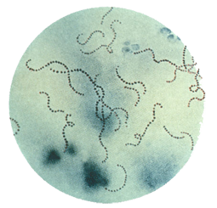
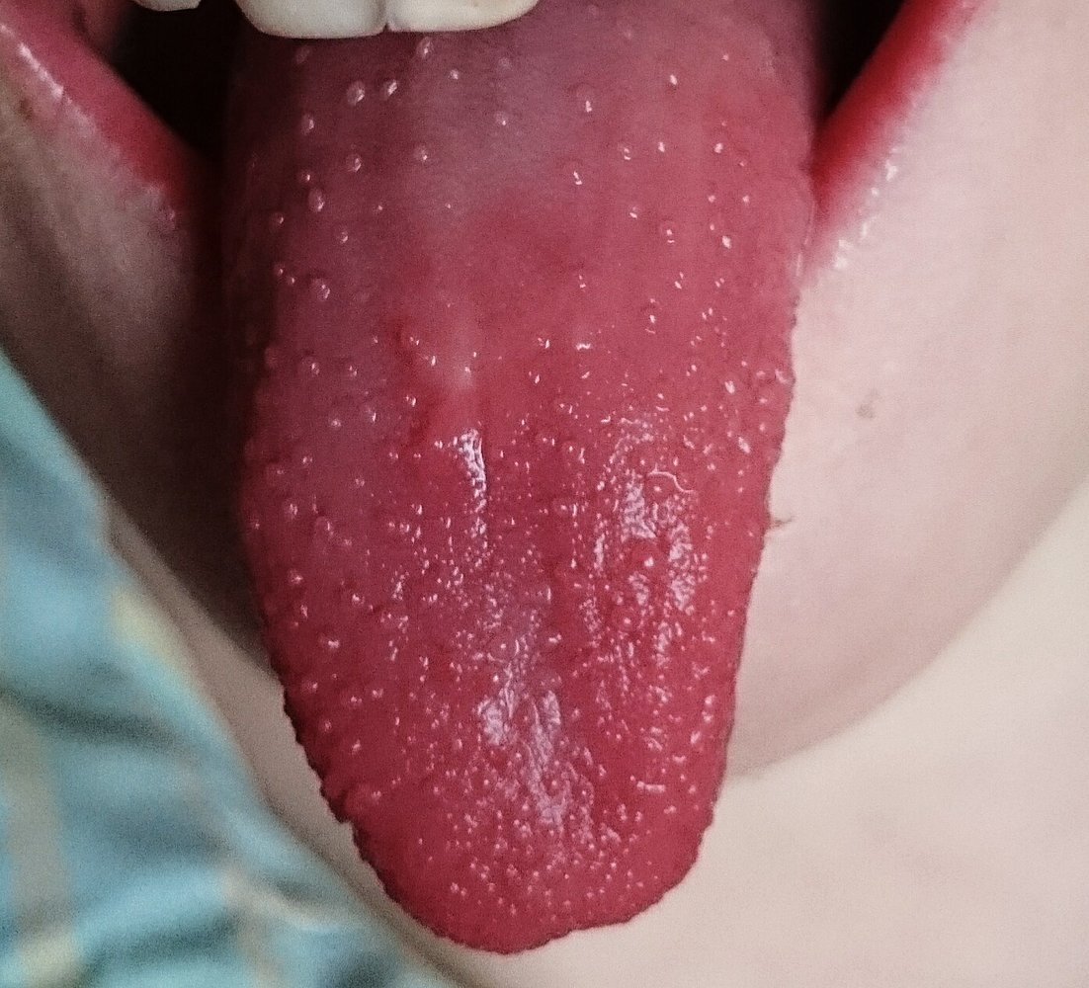
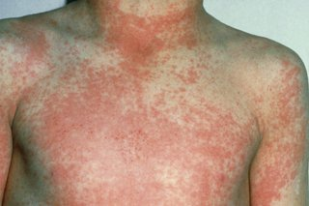
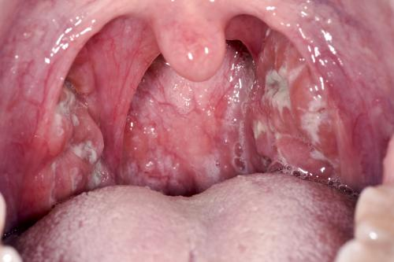
Causative organism
- Streptococcus pyogenes
Caused by streptococcus group A β-haemolytic streptococcus
Antibody and cellular immune response cross reacts with human connective tissue
- Scarlet fever
Clinical manifestations of RF appear ~3 weeks (1–5 weeks) after streptococcal infection
- Pharyngitis
Streptococcal infections could cause pharyngitis or scarlet fever

Slide 5
Virulence factors
Important slide
M protein
Adherence of Streptococcus pyogenes to host cells & inhibiting the host immune response
Hyaluronic acid capsule
Camouﬂages the bacterium
Streptokinases
Dissolve blood clots
Peptidases
Degrades proteins involved in immune response
Pyrogenic toxins
Stimulate fever, rash & shock
Streptolysins
Lyse erythrocytes, leukocytes & platelets

Slide 6
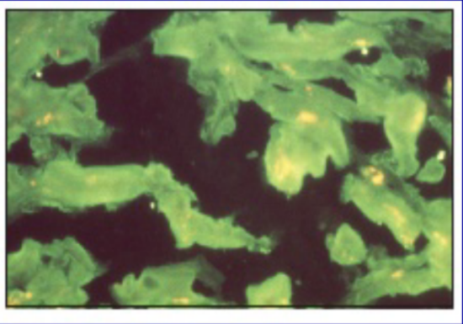
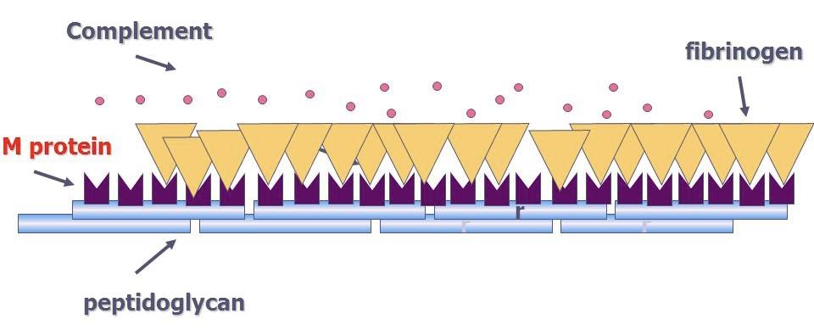
Pathogenesis
Rheumatic fever affect the periarteriolar connective tissue
It is believed to be caused by antibody cross-reactivity
This cross-reactivity is a Type II hypersensitivity reaction and is termed molecular mimicry
Immunofluorescent staining of heart muscle with serum is used to diagnose RF disease
Immunofluorescent staining of heart muscle with serum obtained from an acute rheumatic fever patients
1
Group A streptococcus pyogenes has a cell wall composed of branched polymers which sometimes contain M proteins that are highly antigenic
2
Pathogenesis steps
The antibodies which the immune system generates against the “M proteins” may cross react with cardiac myofiber protein myosin and smooth muscle cells of arteries, inducing cytokines and tissue destructions
3
This inflammation occurs through direct attachment of complement and Fc receptor-mediated recruitment of neutrophils and macrophages

Slide 7
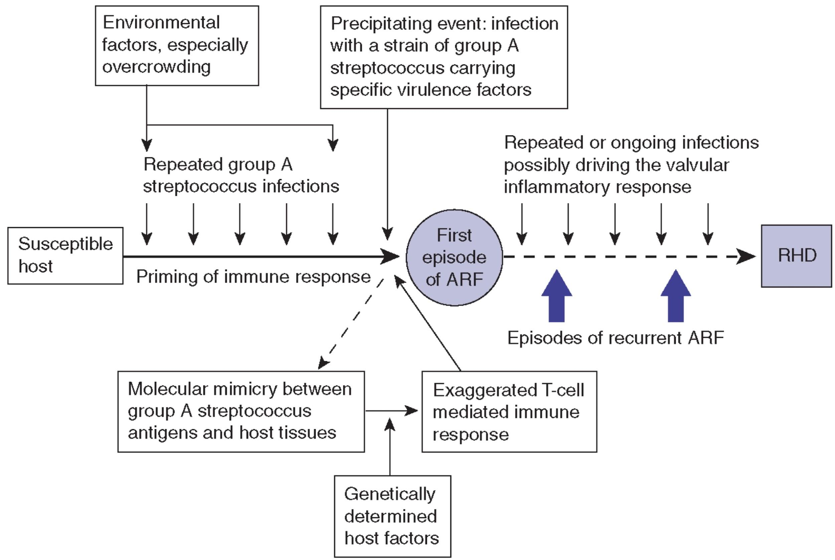
Pathophysiology
1.
During a Streptococcus infection, activated antigen
presenting cells (APCs) such as macrophages present the bacterial antigen to helper T cells
2.
Helper T cells subsequently activate self reactive B cells and induce the production of antibodies against the cell wall of Streptococcus
3.
However the antibodies may also react against the
myocardium and joints, producing the symptoms of rheumatic fever
HLA-DR7 molecule is a subtype of MHC II. Its role is unknown.

Slide 8
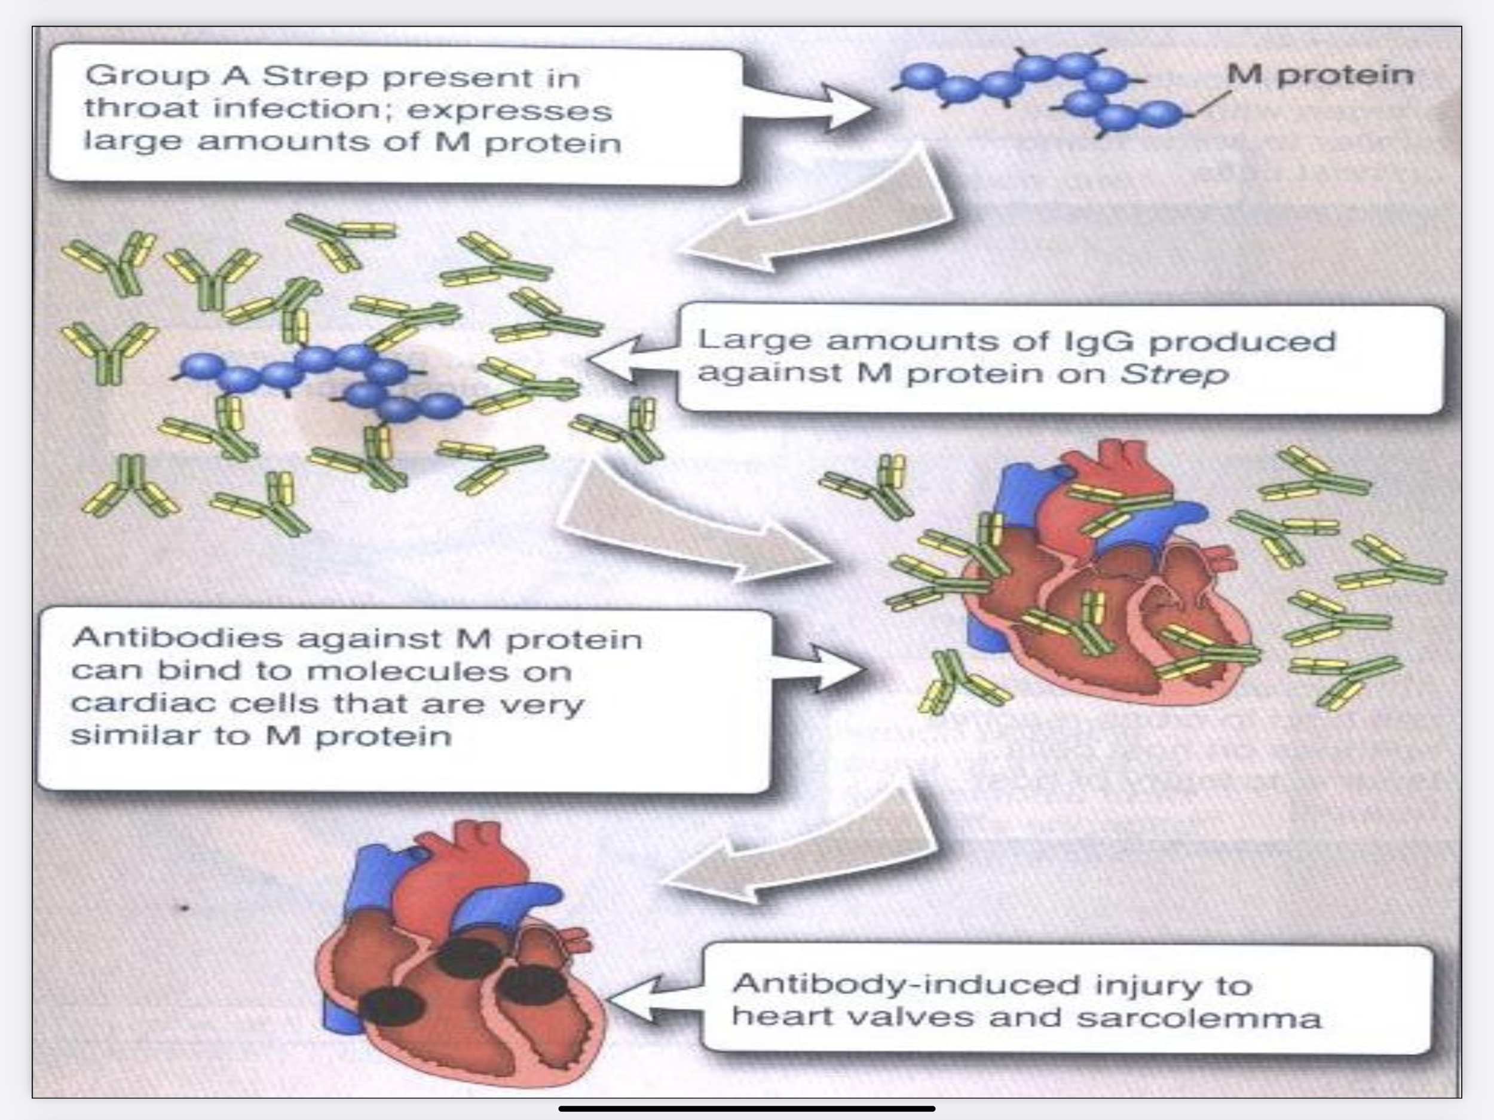
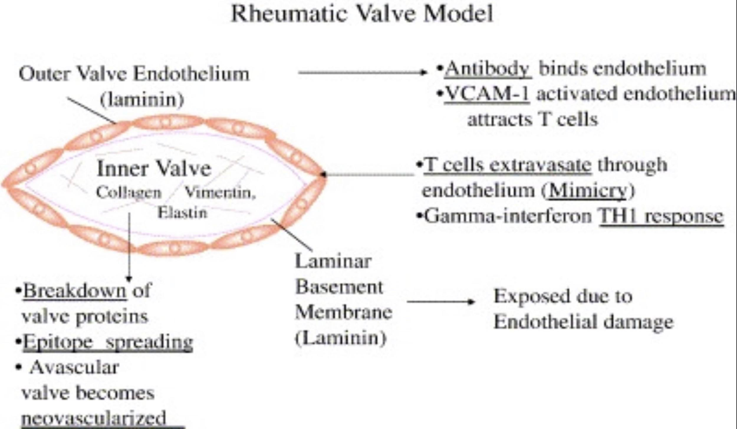
Pathophysiology
Diagram illustrating the process of initial mimicry which leads to granuloma formation, gamma interferon production and scarring in the valve. After the initial process has developed inﬂammation in the valve, other proteins in the valve may then be recognized by the immune system leading potentially to epitope spreading and responses against other valve proteins such as vimentin and collagen.

Slide 9
Pathogenesis
435
1. Group A streptococcus cell wall composed of M proteins that are highly antigenic
2. Activated antigen presenting cells present the bacterial antigen to helper T cells
3. Helper T cells activate self reactive B cells and produce antibodies against the cell wall of streptococcus (anti-group A carbohydrate antibody) IgG antibodies. Also it activates cross-reactive T cells which release TNF, IFN-y, IL-2 and other cytokines
4. Antibodies may cross react with myocardium, valvular tissue and joints producing the symptoms of RF. This inflammation occurs through direct attachment of complement and Fc receptor-mediated recruitment of neutrophils and macrophages
5. Up-regulates the vascular cell adhesion molecule-1 (VCAM-1) on the valve and T-cells adhere to the VCAM-1 on the valve endothelium and extravasate into the valve
6. Tissue destruction (endothelium) making the inner structure of the valve exposed “laminar basement membrane”
7. Granuloma formation, gamma interferon production and scarring in the valve

Slide 10
Clinical presentation
Heart
Joints (arthritis)
Up to 60% of patients with ARF progress to Rheumatic Heart Disease (RHD)
only manifestation of ARF (acute rheumatic fever) with significant potential to cause long-term disability and/or death
The endocardium,pericardium,or myocardium may be affected (pancarditis)
Valvular damage is the hallmark of rheumatic carditis. The mitral valve is almost affected.
This is usually polyarthritis, sometimes flitting from joint to joint (migratory), affecting the larger joints more than the smaller ones.
Swelling,redness and tenderness are the common findings and occasionally joint effusions.
Left ventricle has been cut open to display characteristic severe thickening of mitral valve, thickened chordae tendineae, and hypertrophied left ventricular
Inﬂamed knee Joint

Slide 11
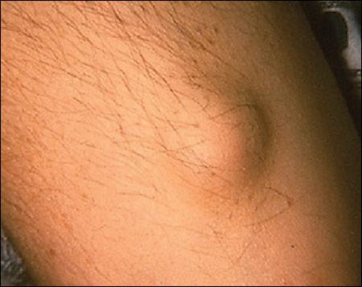
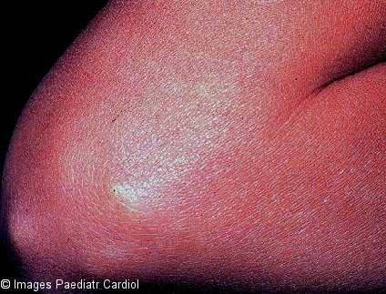
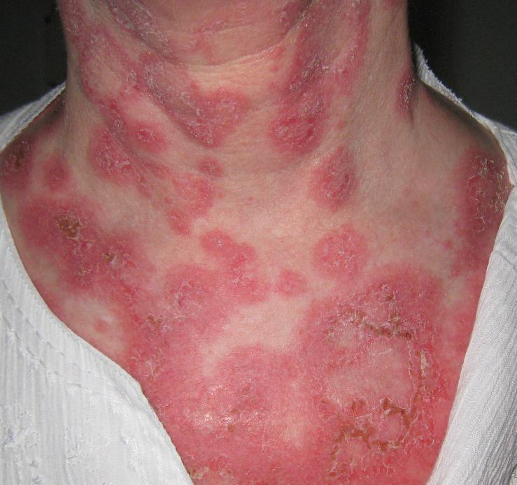
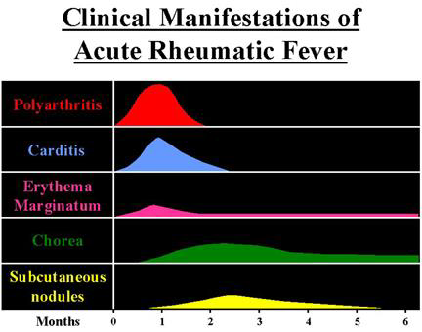
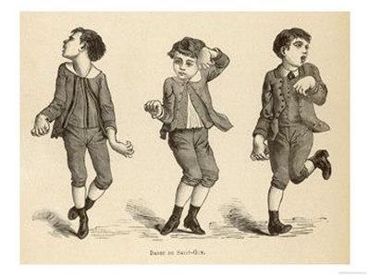
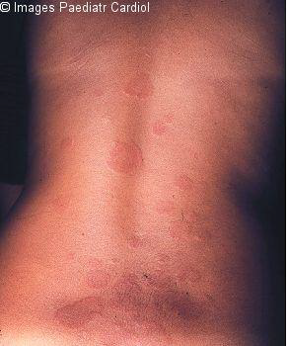
Clinical presentation
Subcutaneous nodules
These are painless, round, ﬁrm lumps over laid by normal looking skin
They range from a few millimeters to 1.5 cm in diameter ,and are normally localized over bony prominences like the elbow, shin and spine, they sometimes last longer than a month
Central Nervous System
Sydenham's chorea
Occurs in children, rare in adults
The choreiform movements affect particularly the head and the upper limbs
They may be generalized or restricted to one side of the body (hemichorea) (=either right or left)
Chorea eventually resolves completely, usually within 6 weeks
likely due to molecular mimicry, with autoantibodies reacting with brain ganglioside
Skin
Erythema Marginatum
Skin lesions: The classical erythema marginatum lesions with prominent margins slightly raised

Slide 12
Rheumatic Fever – Clinical course
Subsequent attacks
Acute, recurring, chronic
Symptoms prone to recur with subsequent Streptococcal infections
Chronic disease leads to fibrosis (chordae of heart valves + valve cusps) which makes the valves stiff and unable to move the blood in proper way
Increased vulnerability to reactivation of disease with subsequent streptococcal infections
Same symptoms with each attack
Carditis worsens with each attack
Heart valves (mitral) are frequently deformed (Mitral)
Heart failure develops after decades
Opened stenotic mitral valve
Stenotic mitral valve seen from left atrium

Slide 13
Investigation of Rheumatic Fever
Treatment of Rheumatic Fever
1
Antistreptolysin O (ASO) titer
– At least 80% of patients with ARF have an elevated antistreptolysin O titer at presentation
(Rising titer is more convincing)
1
Treat ﬁrst strep throat infection with penicillin
2
Anti-DNAse B
2
Treat other manifestations symptomatically
3
Anti-hyaluronidase test
3
Prophylactic long term anti-strep therapy
given to anyone who has had rheumatic fever
4
Throat culture for group A streptococci (2 - 3 cultures) (gold standard )

Slide 14
Take home messages
Rheumatic Heart Disease Results From Cross Reacting antibodies binding the heart valves.
Repeated attacks of Streptococcal throat infection over the years damage heart valves resulting in either stenotic or incompetent heart valves.
Treatment Involves Surgical Replacement of the damaged heart valves.
In patients with Rheumatic Fever long term administration of penicillin is recommended for prevention of future infections by group A Streptococcus.

Slide 15
MCQs:
Q1: Rheumatic fever is an inﬂammatory disease which may develop after infection of :
A) Haemophilus influenzae | B) Group A Streptococcal | C) Staphylococcus aureus | D) Mycobacterium tuberculosis
Q2: Virulence factors of Group A streptococcus :
A) Cell wall | B) Autolysins | C) M protein | D) capsule
Q3: The antibody cross-reactivity which cause rheumatic fever is :
A) Type I hypersensitivity reaction | B) Type II hypersensitivity reaction | C) Type III hypersensitivity reaction | D) Type IV hypersensitivity reaction
Q4: The only manifestation of acute rheumatic fever with potential to cause long term disability :
A) the joints | B) the CNS | C) the skin | D) the heart
Q5: One of the Investigations of rheumatic fever is :
A) Anti-DNAse A | B) Anti-DNAse B | C) Anti-DNAse C | D) Anti-DNAse D
1-B
2-C
3-B
4-D
5-B

Slide 16
CARDIOVASCULAR BLOCK
Immunology team 442
DONE BY
Fay Aldossari
Abdulrahman Alqurashi
Immunologymed442@gmail.com

