Slide 1
Infective Endocarditis
Editing File

Slide 2
Define and Differentiate the various types of Endocarditis
Discuss the Epidemiology, risk factors and pathogenesis of Infective Endocarditis
Recognize the clinical presentation of Infective Endocarditis
Discuss the Culture Negative Endocarditis
Describe the Laboratory diagnosis and investigation of Infective Endocarditis
Recall the commonest causative organisms of Infective Endocarditis
Discuss the Management , treatment and prevention of Infective Endocarditis

Slide 3
Infectious Endocarditis (IE)
Definition
An infection of the heart’s endocardial surface.
Endocardium not myocardium يصيب الغشاء المبطن للقلب
Classification into four groups according to the infecting organism (organisms are very important)
Native Valve IE (الvalve طبيعي وليس صناعي) (Infection of the heart’s valves) | Staphylococcus aureus (30%, especially in IV drug users) (Acute) Strep. (55%), mostly S. viridans (subacute) Enterococci (5-10%) GNB=HACEK (5%) Fungi
Prosthetic Valve IE (Infection of prosthetic valve) (Valve صناعي) | 7 -25 % of cases of infective endocarditis. 0.94 per 100,000 bioprosthetic. Initially mechanical valves at greater risk for first 3 months, then risk same at 5 years: 1-3.1% risk at 1 year. 2-5.7% at 5 year.
Intravenous drug abuse (IVDA) IE | Staph. aureus (50-60%)
Nosocomial IE | A rare complication of nosocomial bacteraemia; however, it is an infection of great importance because of its high mortality and because in many cases it is potentially preventable
Early < 12 months after surgery (1 - 3.1%) | Late >12 months after surgery (2 - 5.7%)
Staph aureus Staph epidermidis | Staph aureus Staph epidermidis Viridans strep Enterococcus

Slide 4
Further Clinical Classification according to the presentation
 | Acute (It takes a few time) | Subacute (It takes months)
Affects: | normal heart valves | damaged heart valves
Onset: | Rapidly destructive | Indolent nature Not acute symptoms
Fatality: | If not treated usually fatal within 6 weeks | If not treated usually fatal by 1 year
Causative organism: | Usually by virulence bacteria like staph.aureus Commonly Staph: Metastatic foci | Commonly viridans streptococci Usually the organism is low virulent or unvirulant
Symptoms: The most important symptom of endocarditis is fever | High grade fever and chills SOB (shortness of breath) Arthralgias/ myalgias Abdominal pain Pleuritic chest pain Back pain | Low grade fever Anorexia Weight loss Fatigue Arthralgias/ myalgias Abdominal pain N/V *nausea and vomiting (Non specific symptoms)
 | The onset of symptoms is usually ~2 weeks or less from the initiating bacteremia

Slide 5
Epidemiology
Numbers are not important
Incidence: 1.7— 6.2 / 100 000 person years not common
Male: Female 1:7
Becoming a disease of the elderly because of A decreased incidence of rheumatic heart disease
Median age:
PreABx era (pre antibiotics era)—35y
Now —58y
It became more common in elderly patients Due to two factors:
The decline of rheumatic heart disease
The increasing proportion of elderly
Pathophysiology
Turbulent (non stream (not smooth) blood flow disrupts the endocardium making it “sticky”. (blood hits the endothelial lining of heart = injury)
Bacteremia delivers the organisms to the endocardial surface.
Bacteremia should naturally be resolved, but if someone had priorly injured or abnormal heart valve this simple bacteremia might lead to disasters (in this case it might leads to endocarditis)
Adherence of the organisms to the
endocardial surface
Eventual invasion of the valvular
leaflets (cusps)
المفروض الدم يمر بانسيابية بس لما يكون فيه مشاكل في القلب مثلًا الصمامات ضيقة لاسباب مرضية او خلقية هذا الصمام الضيق اللي يعترض حركة الدم يسبب
Mechanical injury of the blood then this injury will lead to deposition of the components of the blood (especially the platelets) so this will lead to form the thrombus (sterile thrombus not infectious) this not the cause of endocarditis but it can be ) كأنها قنبلة موقوتة
And once the bacteremia occurs due to several causes including the oral normal flora when there is wound in the oral cavity,or by the colon normal flora. The sterile thrombus converted to infectious and now it’s easy to detached and become embolism and this embolism can go to the vital organs (brain,lung,heart) and by going to the heart it will invade the valvular leaflets or cusps

Slide 6
Risk Factors (very important)
Injection drug use | 100X ⬆ risk in young staphylococcus aureus ( in young people )
IVDU (IV drug use) | Rates 150- 2000/ 100000 person years. Higher among patients with known valvular heart disease.
Cardiac Abnormality Details are not important focus only in Red Color
HIV infection not important | A number of cases of IE have been reported in patients with HIV infection It has been suggested that HIV infection is an independent risk factor for IE in IDU (injecting drug user)
Rheumatic valve disease not important | Predisposition for young in some countries 37%-76% of cases (it’s more common in developing countries) Mitral 85%, Aortic 50% Degenerative valvular lesions MV Prolapse and associated mitral regurgitation - 5 to 8 times higher IE risk Aortic valve disease (stenosis or/and regurgitation) is present in 12 to 30 % of cases
Other risks | Poor dental hygiene Hemodialysis DM (Diabetes Mellitus) HIV
High risk | Moderate risk | Low/ no risk
Previous IE 4.5 (2.5 to 9)% Aortic valve disease 12-30% Rheumatic valve disease Prosthetic valve Coarctation Complex cyanotic congenital | MVPw (mitral valve prolapse) /MR/thickened leaflets- 5 to 8 times (100/ 100000 person years) Mitral Stenosis Tricuspid valve Pulmonary Stenosis Hypertrophic Obstructive Cardiomyopathy (HOCM) | ASD (atrial septal defect) (secundum) CABG (coronary artery bypass grafting )
Structural cardiac abnormality: 75% of pts will have a pre existing structural cardiac abnormality 10-20% have congenital heart disease

Slide 7
Diagnostic approach (very important)
History of prior cardiac lesions ask about history of cardiac injury or damage by any disease. E.g. RHD or atherosclerosis. A recent source of bacteremia ask the patient about recent dental procedures or endoscopy etc..
Physical Examination Not Important just in Red Color | Look for small and large emboli with special attention to the fundi (in the eye)use fundoscopy) , conjunctivae, skin (skin rash is one of the presentations) skin rash is either due to haemorrhage which is due to the emboli itself, or vasculitis which is due to antigen antibody complex formation, and digits Cardiac examination may reveal signs of new regurgitation murmurs and signs of CHF (congestive heart failure) Neurologic evaluation may detect evidence of focal neurologic impairment. Signs: Fever Heart murmur Nonspecific signs: petechiae, subungal or “splinter” hemorrhages (it’s a pathognomonic sign, which means if it’s present then we immediately know that the patient has endocarditis), clubbing, splenomegaly, neurologic changes. More specific signs -Osler’s Nodes, Janeway lesions, and Roth Spots.
Other aspects clinical diagnosis not important | You should know: which valve is involved?, Is it the right(Lung) or left(Aorta) heart?, and where would emboli go? Evaluate heart function Pump, acute valve dysfunction conduction Look for evidence emboli Look for Bleeding (intracranial, elsewhere mycotic aneurysm )
Diagnostic approach (Very important) | 1-Positive blood culture results(Specific): (microbiologically) A minimum of three blood cultures should be obtained over a time period based upon the severity of the illness. 2-Additional laboratory Nonspecific test: An elevated ESR and/or an elevated level of CRP is usually present. Most patients quickly develop a normochromic normocytjc anemia. The WBC count may be normal or elevated.
Additional laboratory tests Just Know the Red Color | Abnormal urinalysis: The combination of RBC casts on urinalysis and a low serum complement level may be an indicator of immune-mediated glomerular disease Abnormal ECG: the echocardiogram more important than ECG New AV, fascicular, or bundle branch block. PERIVALVULAR INVASION monitoring pacing Echocardiogram (by ultrasound)

Slide 8
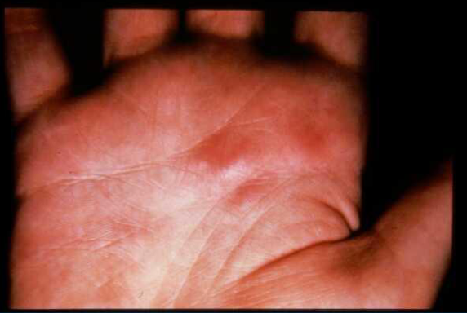
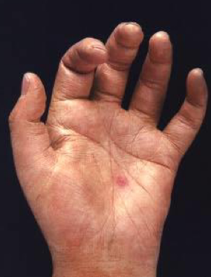
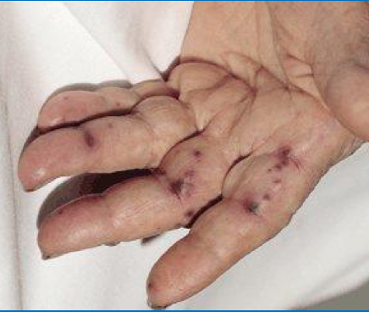
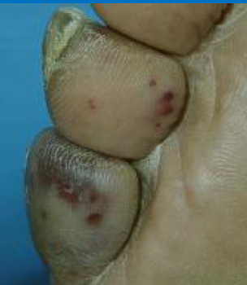
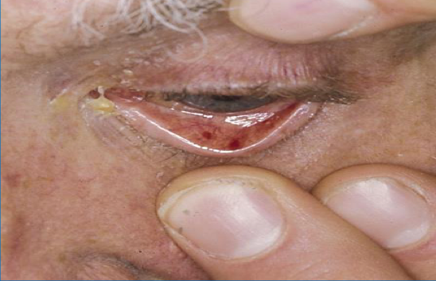
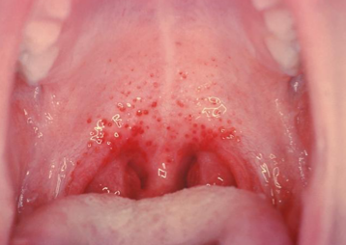
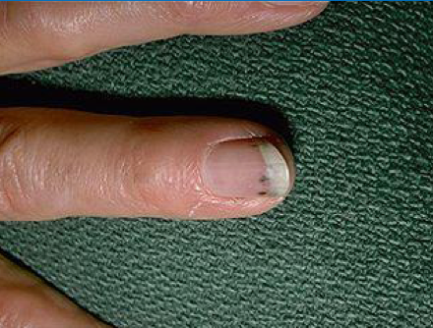
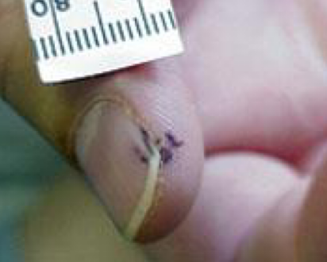
Specific signs for endocarditis
Osler nodes | Janeway Lesions
Painful and erythematous nodules Located on pulp of fingers and toes More common in subacute IE | Erythematous, blanching macules Nonpainful Located on palms and soles
Non - Specific signs for endocarditis
Petechiae |  | Splinter Hemorrhages
Often located on extremities or mucous membranes |  | Non Blanching. Linear reddish-brown lesions found under the nail bed. Usually do NOT extend the entire length of the nail
Look to the mucous membranes everywhere.
It may caused by the Antigen-Antibody complex

Slide 9
Echocardiographic Findings
Oscillating intracardiac mass:
On valve or supporting structure
In the path of regurgitation jets
On implanted material
in the absence of an alternate anatomic explanation
Abscess:
New partial dehiscence of prosthetic valve
New valvular regurgitation
(increase or change in pre-existing murmur not sufficient)
Improved diagnostic value of echocardiography in patients with infective endocarditis by transoesophageal approach A prospective study.
Eur Heart J, 1988 Jan;9(i): 43.5396 patients were studied consecutively with TEE ( trans esophegal echo) and TTE
TEE sensitivity 100 percent for vegetations as compared to 63 percent with TTE
Both TTE and TEE had specificity of 98%
25% of vegetations less than 5 mm, 69% of vegetations 6-10 mm, and 100% of vegetations greater than 11 mm detected by TEE were also observed with TTE
Why is The Blood Culture Negative?
Culture Negative Infective Endocarditis
Previous antibiotics intake
Fastidious Bacteria
How hard did you look?
1
How hard did you look?
2
Previous Antibiotics intake
3
Fastidious Bacteria
4
Brucella
5
HACEK: 2-3 Weeks incubation, subculturing
6
Tend to see subacute w / vave destruction / CHF Congestive heart failure
-How Hard did you look?
-Previous
7
Hemophilus paraphrophilus, aphrophilus , Parainfluenzae
8
Aggregatibacter (Actinobacillus) Actinomycetemcomitans
9
Cardiobacterium hominis
10
Eiken corrodens
11
Kingella spp.

Slide 10
How will you detect the organism if the culture came negative ?
Laboratory test | Etiology
PCR of vegetation/emboli | Tropheryma whippelii, bartonella
Histology/stain /culture of vegetation/emboli | Fungus
Prolonged, enriched cultures | HACEK animal bite
Lysis centrifugation system (Isolator) | Bartonella, legionella (BCYE), fungal
Serology | Endemic fungi, bartonella, Q fever, brucella ,legionella, chlamydia
Thioglycolate or cysteine supplemented media | S.aureus satellitism: Abiotrophia (NVS)
Poor Prognostic Factors Not Important
1
Female
2
S. aureus
3
Older age
4
Prosthetic valve
5
Diabetes mellitus
6
Low serum albumin
7
paravalvular abscess
8
Heart failure
9
Embolic events
10
Vegetation size
11
Apache ll score (Acute Physiologic
Assessment and Chronic Health Evaluation II)
Is a severity of disease classification system

Slide 11
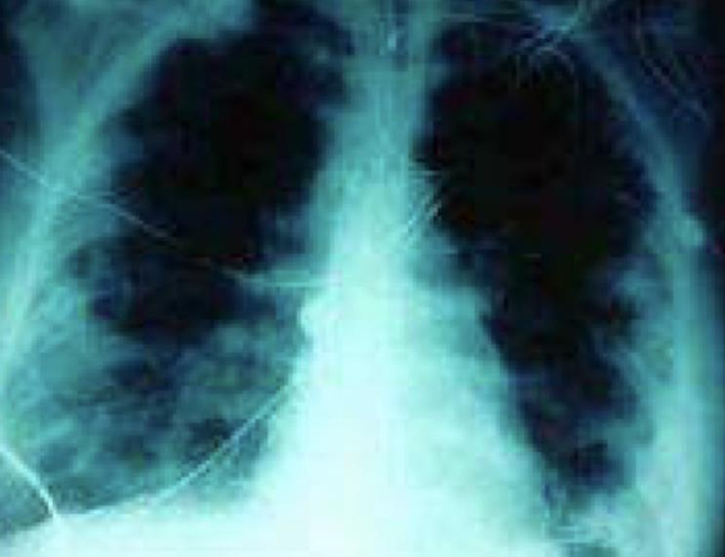
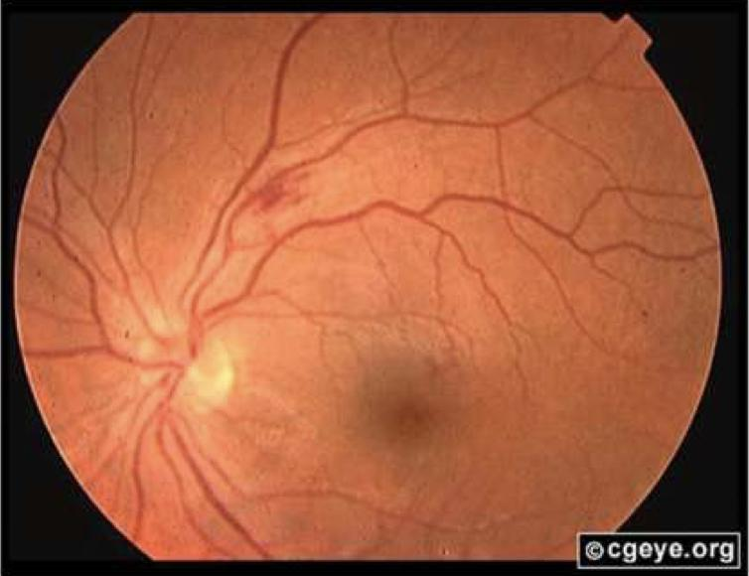
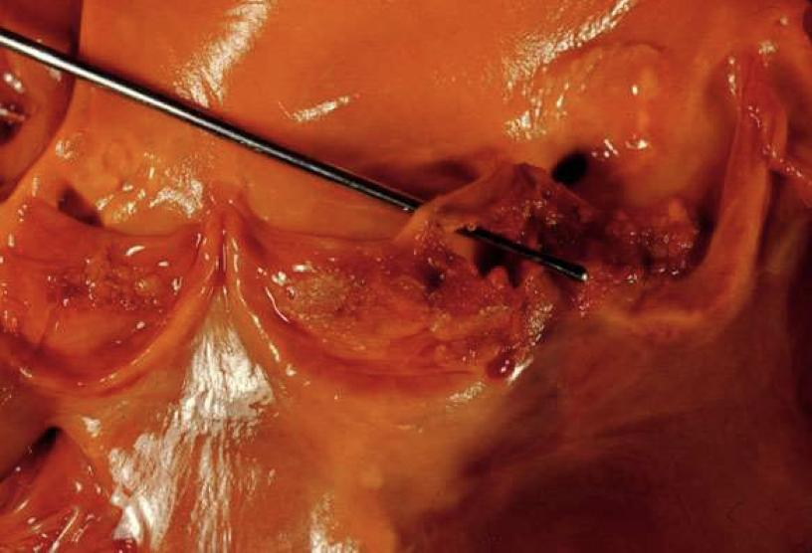
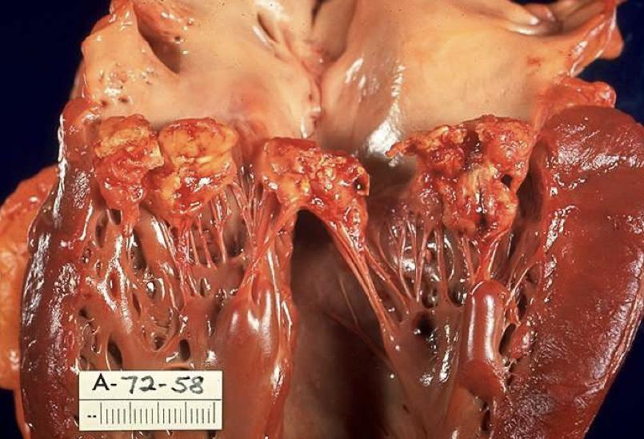
Complications
Embolic complications.
Local spread of the infection.
Metastatic spread
of the infection
Formation of immune complexes leading to:
Glomerulonephritis, arthritis
Complications
Embolic complications | Occur in up to 40% of patients with IE Predictors of embolization : Size of vegetation. Left-sided vegetations. Virulent organisms (Fungal pathogens, S. aureus, and Strep. Bovis). Incidence decreases significantly after initiation of effective antibiotics. Includes: 1-Brain: Stroke 2-Heart : Myocardial infarction (Fragments of valvular vegetation or vegetation-induced stenosis of coronary ostia). 3- Lung / Pulmonary circulation: Hypoxia from septic pulmonary emboli. 4-Abdomen: Abdominal pain (splenic or renal infarction) 5-Extremities: Ischemic limbs 6- Eye: septic retinal embolus
Local spread of infection (inside the heart) | 1- Heart failure due to extensive valvular damage. 2- Paravalvular abscess (30-40%): Most common in aortic valve, IVDU, and S. aureus May extend into adjacent conduction tissue causing arrhythmias. Higher rates of embolization and mortality. 3-Pericarditis 4- Fistulous intracardiac connection Abnormal connection between one of the coronary arteries and a heart chamber or another blood vessel.
Metastatic spread of infection | 1-Metastatic abscess: Kidneys, spleen, brain, soft tissues 2-Meningitis and/or encephalitis 3-Vertebral osteomyelitis (especially staph aureus in older people) 4-Septic arthritis
1
2
Picture (1) : Acute S.Aureus IE with Perforation of the Aortic Valve & Aortic Valve Vegetations
Picture (2) : Acute S.Aureus IE with Mitral Valve Ring Abscess extending into Myocardium

Slide 12
Modified Duke Criteria
In 1994 investigators from Duke University modified the previous criteria to include the role of echocardiography in diagnosis.
They also expanded the category of predisposing heart conditions to include intravenous drug use.
Proposed:2000, Addresses TEE, Broad “Possible categories.
S.Aureus risks (13-25% S,Aureus Bacteremia have IE)
Rejected
Resolution of illness with four days or less of antibiotics.
Modified Duke Criteria
Modified Duke Criteria
2 major
1 major, 2 minor
5 minor
Possible
Microorganism: demonstrated by culture or histology in a valvular vegetation , or in an embolized vegetation (vegetation that has embolized), or in an intracardiac abscess.
Definite
Pathological lesion: vegetation, or intracardiac abscess confirmed by histological evidence.
Major Criteria Just Know the Red Color | 1- Microbiological evidence: Positive blood culture (BC) Typical organism from two separate blood cultures. Two blood cultures positive for organisms typically found in patient with IE (e.g.: s.aureus,s.viridans, HACEK organisms) Persistently positive blood cultures. Single positive blood culture for for Coxiella Burnetii, or titer greater than 1:800. If the organism was typical or common within IE patients, u need 2 positive blood cultures to meet a major criteria. However, if the organism was atypical such as coxiella, 1 single blood culture is enough to meet a major criteria.
 | 2-Examination evidence / endocardial Involvement: New (not changed) murmur of Regurgitation.
 | 3- Positive Echo: (Transesophageal echocardiography if prosthetic valve, complicated, or pretest probability possible IE)
Minor Criteria The boys doctor said: it is a clinical so it is not important and maybe we ask about it and maybe not الصميلي مايخلي حركاته | 1-Predisposition: Predisposing to heart condition or IV drug use.
 | 2- Fever greater than 38C.
 | 3- Vascular phenomena: Includes: major arterial emboli (emboli travelling within the arterial circulation) causing: Mycotic aneurysm, Intracranial or conjunctival hemorrhages, Janeway lesions. Excludes : Petechiae, and Splinter Hemorrhages.
 | 4-Immunologic phenomena: Rheumatoid factor (RF). Roth’s spots (retinal hemorrhage with pale center). Glomerulonephritis. Osler’s nodes.
 | 5-Microbiological evidence: Positive blood culture but NOT meeting major criteria. Serology test.

Slide 13
Treatment of I.E
General Considerations:
Antimicrobial therapy should be administered in a dose designed to give sustained bactericidal (very important)serum concentrations throughout much or all of the dosing interval.
In vitro determination of the minimum inhibitory concentration (enough dosage) of the etiologic cause of the endocarditis should be performed in all patients.
The duration of therapy has to be sufficient to eradicate microorganisms growing within the valvular vegetations.
The need for prolonged therapy in treating endocarditis has stimulated interest in using combination therapy to treat endocarditis
Valve | Native | Prosthetic
MSSA / MRSA | Cloxacillin (or vancomycin in case of MRSA) | Cloxacillin (or vancomycin in case of MRSA) In addition to Gentamicin & Rifampin
Streptococcus (strept.viridans) | Treatment depends on MIC (Minimum inhibitory concentration) Lower MIC means less antibiotic is needed. So: If MIC is low (<0.1), we need to use one antibiotic. (Penicillin alone or Cephalosporin alone) If MIC is intermediate (>0.1-0.5), we need to use 2 antibiotics (Penicillin in addition to Gentamicin) If MIC is high (>O.5), we need to use 2 antibiotics but for longer time (Ampicillin in addition to Gentamicin)
HACEK | Cephalosporin (ceftriaxone)
Bartonella Not important | Doxycycline + gentamicin | -
Q-fever Not important | Doxycycline +or- hydroxychloroquine | 35% surgical
Indications for Surgery: important (Boys doctor)
1. Refractory CHF.
2. Perivalvular invasive disease.
3. Recurrent systemic emboli, particularly in the presence of large vegetations.
4. Uncontrolled infection on maximal medical therapy.
5. Some pathogens : Pseudomonas, brucella, coxiella, fungi, enterococci.
(these always need surgery especially fungi)
Pseudomonas & Brucella loves the Valve
6. Usually advised with combined therapy.

Slide 14
Treatment of I.E, contd..
In case of prosthetic valve endocarditis, When do we need surgery? And when medical therapy alone is enough?
Surgical intervention is needed | Perivalvular infection valve. Dehiscence, a surgical complication where the edges of a wound no longer meet. Excessively mobile prosthesis on echo results in hemodynamic instability. Prosthetic infection with S. aureus usually needs surgery. Relapse and recurrence after surgery about 7% in 6 years. S. aureus risk rate of death is 0.18 in (surgery + antibiotics) vs (antibiotics alone).
Medical treatment may be sufficient (No surgery) | 12 months or more post surgery. Viridans group streptococci (VGS) or HACEK or Enterococci. No perivalvular extension (the valve extend to the adjacent periannular areas and erode into nearby cardiac chambers)
Prophylaxis
Predisposing Cardiac Conditions | Prosthetic cardiac valve or prosthetic material used for cardiac valve repair Previous infective endocarditis (IE) Congenital Heart Disease Cardiac Transplantation recipients Any Manipulation of gingival tissue, dental periapical regions, or performationg the oral mucosa.
Timing | One hour prior to procedure قبل العملية بساعة نعطيه علاج
Treatment | Amoxicillin or clindamycin

Slide 15
Infective Endocarditis
Classification | Acute | Subacute |  | Native |  | Prosthetic | IVDU
★Common organisms | Staph. aureus | Strept. viridans |  | Staph. aureus Strept. viridanS |  | Staph. Epidermidis Strept. viridans | Staph. aureus
★Pathophysiology | Endothelial injury → Bacteremia → Adherence → invasion & disease.
Risk Factors | Cardiac abnormalities (High: Previous IE & Aortic valve disease) (Moderate: other valves), IV drug use, Rheumatic heart disease, and others.
Diagnosis Remember : know the involved side of the heart (Right → Lung) (Left → Other sites) | Microbiology: minimum of 3 blood cultures. (Negative culture? Maybe fastidious or previous antibiotics) Echocardiography: see vegetations & abscess (TEE is better than TTE) Non-specific lab tests, ECG, and Urinalysis.
★ Clinical Presentation | New regurgitation heart murmurs and signs of CHF (worsening murmur). Continuous fever. Specific signs: Osler’s Nodes, Janeway lesions, and Roth Spots Nonspecific signs: petechiae, splinter hemorrhages
 | Acute |  |  |  | Subacute
 | Few days, Very sick Normal heart is affected, rapid destruction Usually fatal within 6 weeks High grade fever and chills. |  |  |  | 1-2 weeks, mildly sick Damaged heart is affected, slow destruction Usually fatal by one year Low grade fever
Complications | Embolic: a part of the vegetation travels somewhere else and embolize & causes infection. E.g. brain → stroke, Heart → myocardial infarction, Eye → retinal embolus, Lung → pulmonary emboli. Local spread: infection inside the heart. (heart failure, paravalvular abscess, pericarditis) Metastatic spread: bacteria spreads through bacteremia e.g. osteomyelitis.
Treatment | Valve | Native |  |  | Prosthetic
 | ★MSSA / MRSA | Cloxacillin (or vancomycin in case of MRSA) |  |  | Cloxacillin (or vancomycin in case of MRSA) In addition to Gentamicin & Rifampin
 | ★Streptococcus (strept.viridans) | MIC is low (<0.1), we need to use one antibiotic. (★Penicillin alone or Cephalosporin alone) If MIC is intermediate (>0.1-0.5), we need to use 2 antibiotics (★Penicillin in addition to Gentamicin) If MIC is high (>O.5), we need to use 2 antibiotics but for longer time (Ampicillin in addition to Gentamicin)

Slide 16
MCQs
1-C
2-B
3-A
4-B
5-D
6-c
1- A 60 year old woman came to the hospital for Mitral Valve replacement, one week later she has fever and chest pain, an echocardiography was done and vegetation was seen on the mitral valve which one of the following organisms may cause that?
A-Staph Aureus | B- Streptococcus Viridans | C-Staph Epidermidis | D-Streptococcus pyogens
2-A 21 Year old college male student presented in the ER with infective Endocarditis in tricuspid valve and the blood culture shows staph aureus , What is the most common cause?
A-Artificial Heart Valve | B-Intravenous Injection | C-Congenital Heart Disease | D-Rheumatic Heart Disease
3-A Rheumatic heart disease patient developed endocarditis after dental extraction, what is the causative organism?
A-Streptococcus Viridans | B-Streptococcus Pyogenes | C-Streptococcus Pneumoniae | D-Staphylococcus aureus
4-Which one of laboratory tests is used for diagnosis of Endocarditis?
A-CBC | B-Blood Culture | C-ASO | D-ECG
5-A 35 Year old male was admitted to the hospital because of mitral valve regurgitation, in the Lab , Investigations of blood showed gram (+) In chains and alpha-hemolytic with green color. What is the most likely organism ?
A-Staph Aureus | B-Staph Epidermidis | C-Streptococcus Faecalis | D-Streptococcus Viridans
6-Infective Endocarditis is an infection of?
A-Pericardium | B-Myocardium | C-Endocardium and Heart valves | D-Endocardium Only

Slide 17
Cases/SAQ
1-A 20 year patient who recently had Mitral valve replacement was admitted to the hospital with persistent fever and malaise. Endocarditis was clinically suspected. Blood culture grew Gram (+) Cocci in Clusters which are Catalase (+) and Coagulase (-) :
A- What is a Major risk factor of Endocarditis?
B- What is most probable organism?
C- What is the suggested antimicrobial agent for treatment?
2-A 30 Year old male , is a drug addict, was diagnosed with Infective Endocarditis:
A- What is the Causative Organism ?
B- What is the Affected Valve?
Answers Key
1A -Prosthetic Valve
1B - Staph Epidermidis
1C -Cloxacillin + Rifampin + Gentamicin
2A - Staphylococcus Aureus
2B - Tricuspid

Slide 18
Microbiology Team⁴⁴²
Leaders
Shaden Albassam | Mohammed Alghamdi
Team Members Razan alotaibi
Rahaf Almotairi | Ahmad bahmaid
Mayssam aljaloud | Emad Almutairi
Nada Albedaiwi | Zyad Alodan
Amani Alotaibi
Special Thanks to Microbiology Team⁴⁴¹
Microbiology442@gmail.com

