Slide 1
Rheumatic Fever, Endocarditis, & Heart Valves
Rheumatic Fever by Ninja nerd
Endocarditis by Osmosis
Video
Video
Rheumatic Fever by
Dr. Abdel-Motaal Fouda
Video
Editing File

Slide 2
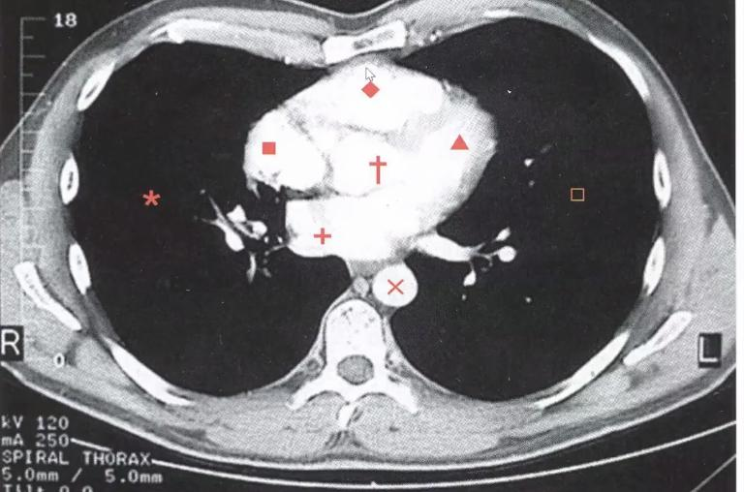
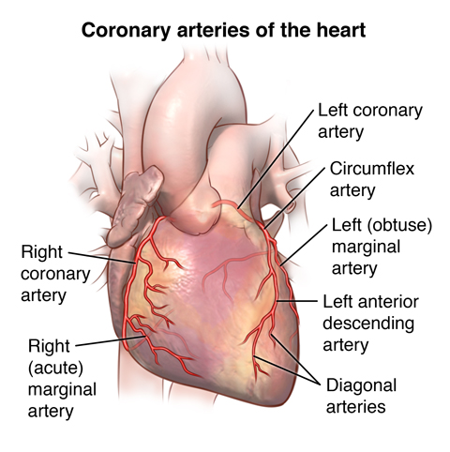
Objectives (Updated)
1. Have basic knowledge about the pathogenesis of acute rheumatic fever.
2. Identify the pathology of Aschoff bodies.
3. Understand the pathological causes and pathophysiological consequences of stenosis and incompetence of all the cardiac valves but particularly the mitral and aortic valves.
4. Identify and correlate the clinical features of rheumatic fever and its diagnosis based on the updated jones criterias.
5. Understand the pathology of infective endocarditis so as to be able to identify patients at risk.
6. Know the causes and manifestations of pericardial fluid accumulation and pericarditis.
Key principles to be discussed:
Pathology and manifestations of rheumatic heart disease as a major cause of valvular diseases in the Middle East and Saudi Arabia.
Complications of rheumatic heart disease including atrial fibrillation, valvular and atrial thrombus formation with systemic embolism, cardiac failure and infective endocarditis.
Infective endocarditis: predisposing factors, clinical acute and subacute forms, common pathogenic bacteria in IE and complications including valve perforation, thrombosis and septic embolization of the vegetations.
Causes and consequences of valvular heart disease with special emphasis on aortic and mitral valve including "floppy or prolapsed" mitral valve.
Introduction
CT Scan of Mediastinum
Coronary Arteries
Heart Valves
The heart has 4 valves:
Aortic valve
Tricuspid valve
Mitral valve
Pulmonary valve
Left lung
Right lung
Left ventricle
Right ventricle
Left atrium
Right atrium
Thoracic arch
Branches of Pulmonary artery

Slide 3
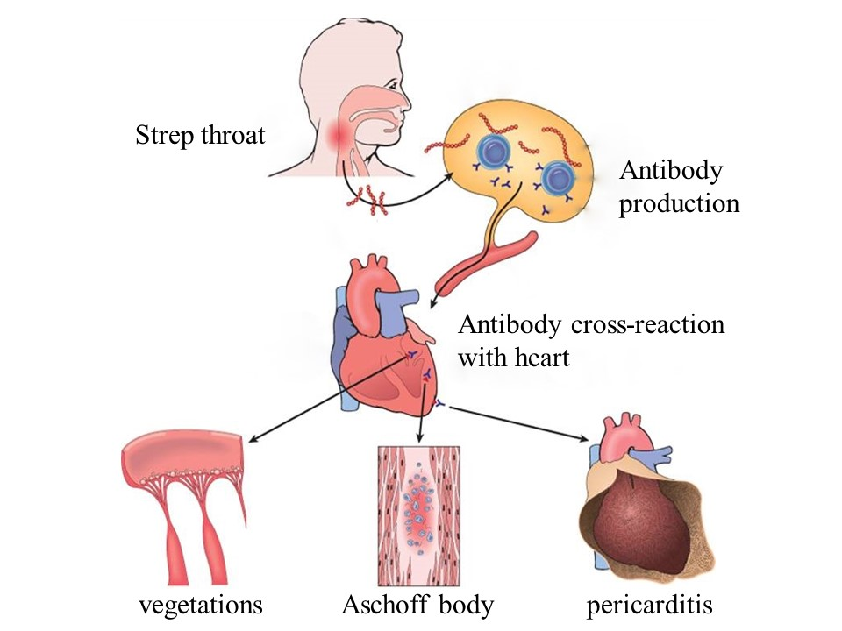
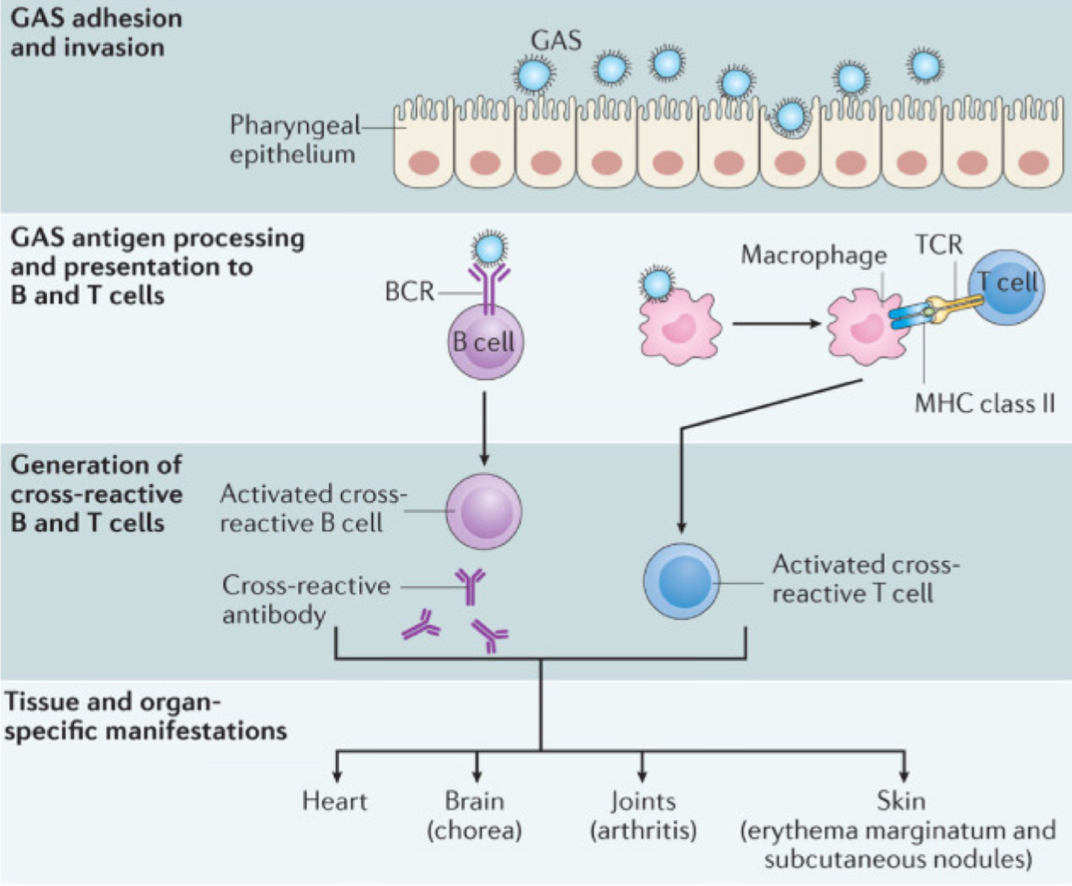
Acute Rheumatic Fever
Acute Rheumatic Fever
Acute, immune mediated, multi-system (antibodies attack organs), non-suppurative inflammatory disease that occurs a few(1,2-5) weeks after (post) group A-beta hemolytic streptococcal infection with cardiac and extracardiac manifestations.
Inflammation mainly in: heart, joints (Especially the large joints), CNS & skin.
Only 3% of patients with group A streptococcal pharyngitis.
Mainly in children 5 - 15 years of age.
Major health problem in 3rd world countries & crowded, low socioeconomic urban areas.
Incidence & mortality has declined over the past 30 years due to improved socioeconomic condition & rapid diagnosis and treatment of strep. Pharyngitis.
Etiopathogenesis:
Not yet clear & not completely understood
1
Linked to streptococcal infection: occurs 1 - 5 weeks after pharyngeal infection (sore throat) by GAS.
Most likely an immune mediated process: Streptococci stimulates formation of antibodies → antibodies cross react with heart & joints antigens (Molecular Mimicry) → antigen-antibody reaction → inflammation.
2
Reminder: When an infectious agent (bacteria / virus) produces antigens so similar to those on normal tissue cells that the antibodies stimulated to react against the foreign antigen also recognize the similar self antigen; hence, the two antigens are said to be cross-reactive (Immunology team 441)
3
Repeated attacks or a single severe attack → chronic rheumatic heart disease → cardiac failure.
Will be discussed later..

Slide 4
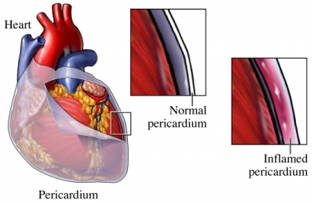
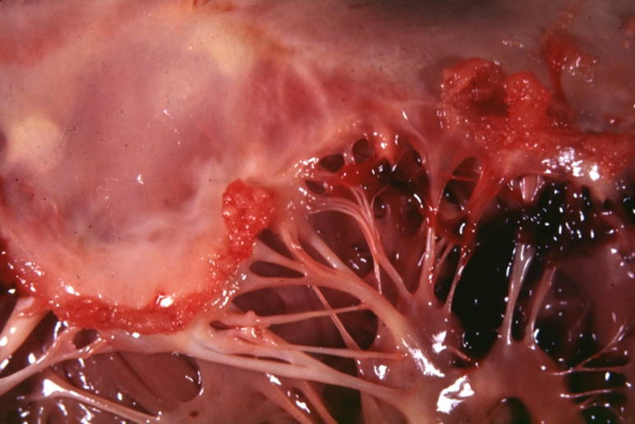
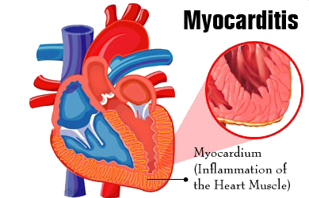
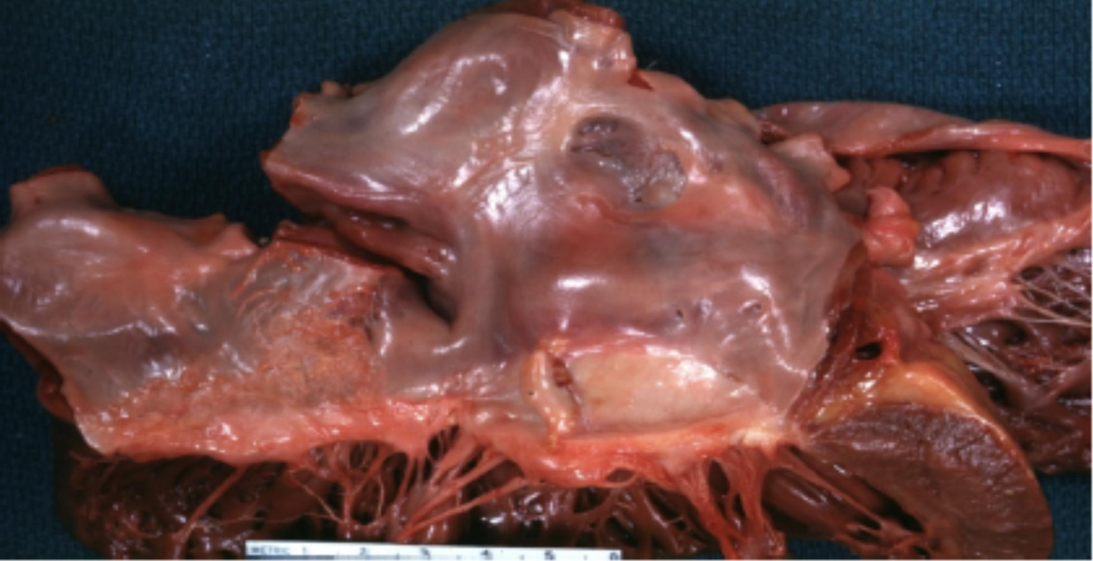
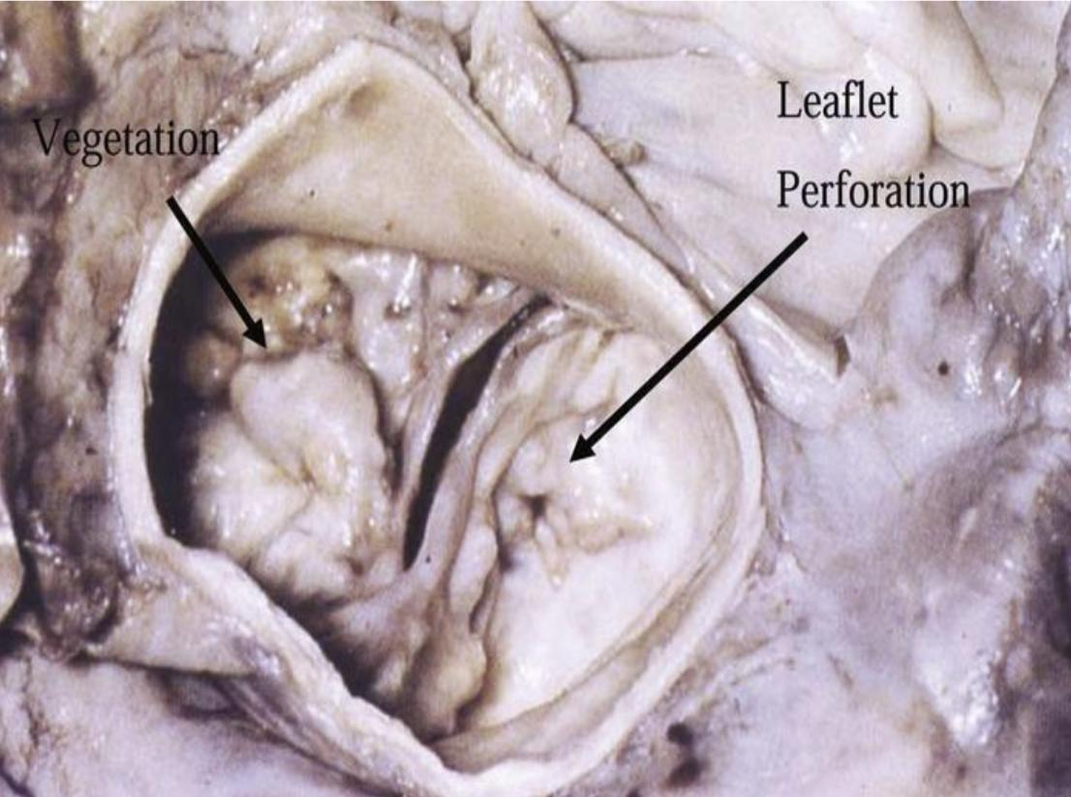
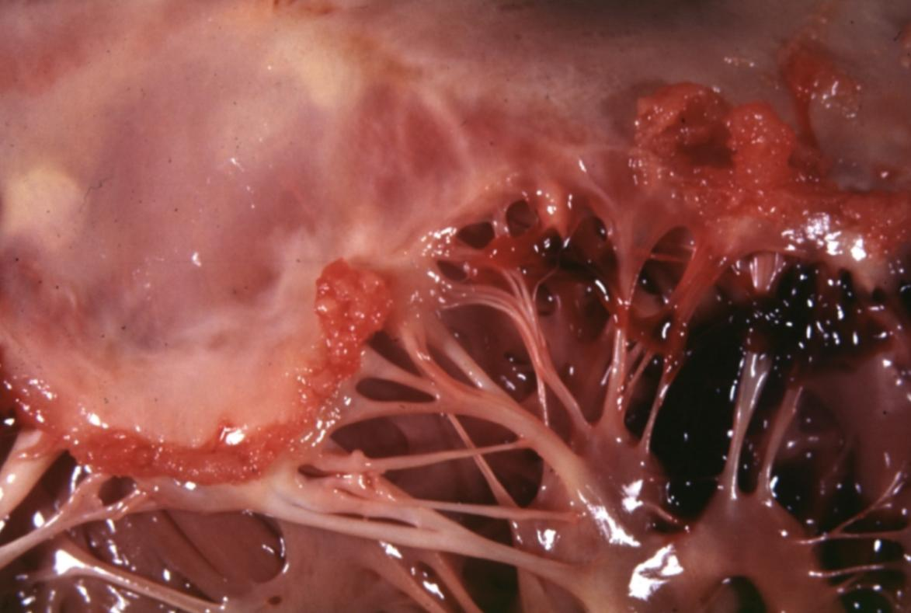
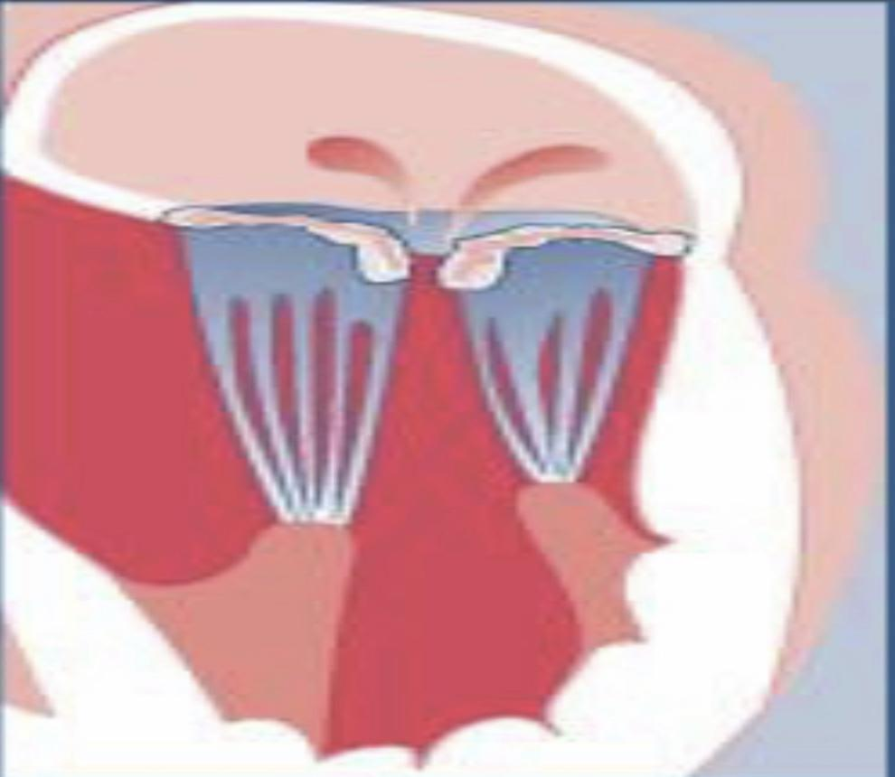
Rheumatic Heart Disease
Rheumatic Heart Disease
A heart disease caused by Rheumatic fever (RF). Can be acute or chronic.
It’s totally different from Rheumatoid arthritis.
Cardiac Manifestations of Rheumatic Fever
Other names:
-Acute rheumatic heart disease -Acute rheumatic carditis / pancarditis.
Patients present with pancarditis (inflammation in all 3 layers of heart: endocardium - myocardium - pericardium.
1- Pericarditis
Inflammation of Pericardium: fibrinous / serofibrinous secretion in pericardium between visceral & parietal layers. Bread & Butter Appearance
3- Endocarditis
Inflammation of Endocardium: includes inflammation of heart valves (valvulitis) & chordae tendineae → fibrin deposition on valve leaflets → forms rheumatic vegetations (tiny thrombi along lines of closure”على الحواف”). Mainly mitral & aortic valve. Acute inflammation either: Resolve completely Progress to scarring & chronic fibrotic deformities of heart valves & chordae tendineae → chronic rheumatic heart disease years later.
2- Myocarditis
Inflammation of Myocardium: formation of Aschoff bodies, can cause sudden death.
4- Subendocardial lesions
Seen commonly in left atrium(posterior wall), called MacCallum plaques.
MacCallum plaques
Rheumatic Vegetation
Tiny (size of pin’s head)(تشبه الثآليل), sessile(immobile) arranged in a row & firmly with underlying tissue.
Situated(located) in the valve cusp, a few millimeters away from free margin (traumatized area).
Robbins: Valve involvement results in fibrinoid necrosis & fibrin deposition along lines of closure → disturbance in cardiac function.

Slide 6
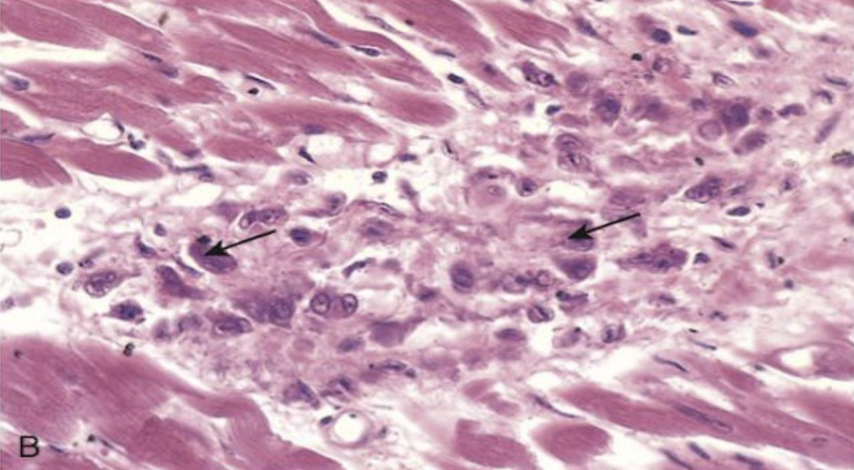
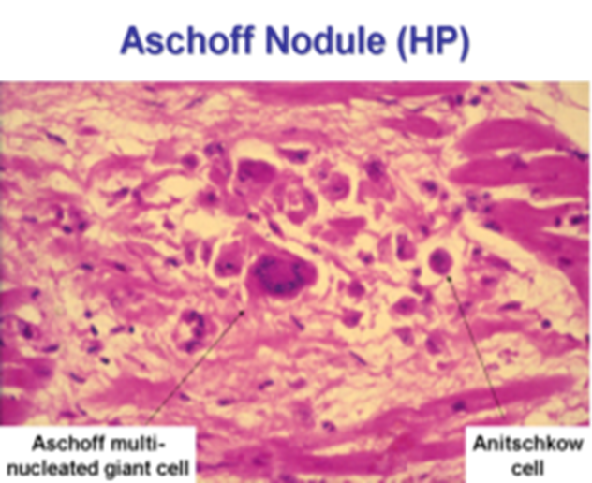
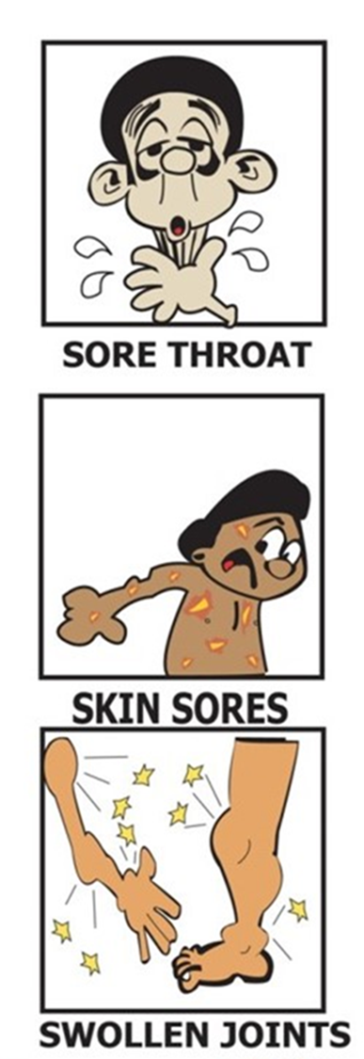
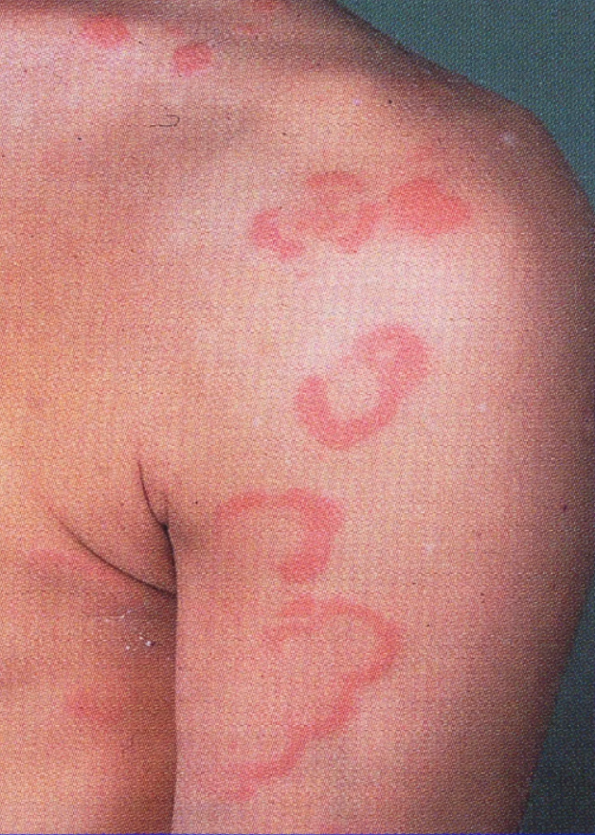
Aschoff Bodies & Extra cardiac manifestations
Definition of Aschoff Bodies | They are multiple tiny granulomatous lesions of the heart. They are situated next to small arteries and are characteristically seen in the myocardium (rheumatic myocarditis).
Components | An Aschoff body, consists of: a focus of eosinophilic collagen necrosis (representing the site of antibody-antigen reaction), plump activated macrophages/ histiocytes called Anitschkow/ caterpillar cells(فيها تشعبات). Some of the macrophages become multinucleated to form Aschoff giant cells. chronic inflammation.
Site | They are found mainly in the myocardium and pericardium. Uncommon in the endocardium and heart valves.
They ultimately heal by fibrosis resulting in a nodule of scar tissue.
Extracardiac manifestations of Rheumatic FEVER, Involvement of other organs:
Joints: Arthralgia | Joints: Migratory polyarthritis which is fleeting arthritis in the large joints e.g. knee, ankle, elbow wrist etc. It is self limiting with no chronic deformities. Aschoff bodies may be present in the synovial membrane, joint capsule, ligament etc. with joint effusion.
Skin: skin nodules and erythema marginatum(Redness forming a margin). | Subcutaneous tissue: Rheumatic nodules mainly seen over the bony prominence e.g. knuckle, elbow, patella etc.
Lung: uncommon, chronic interstitial inflammation and fibrinous pleuritis. | Neurological disorder: Sydenhem’s chorea (St. Vitus' dance). characteristized by series of rapid involuntary purposeless movements of the face and arms. This occurs late in the disease.

Slide 7
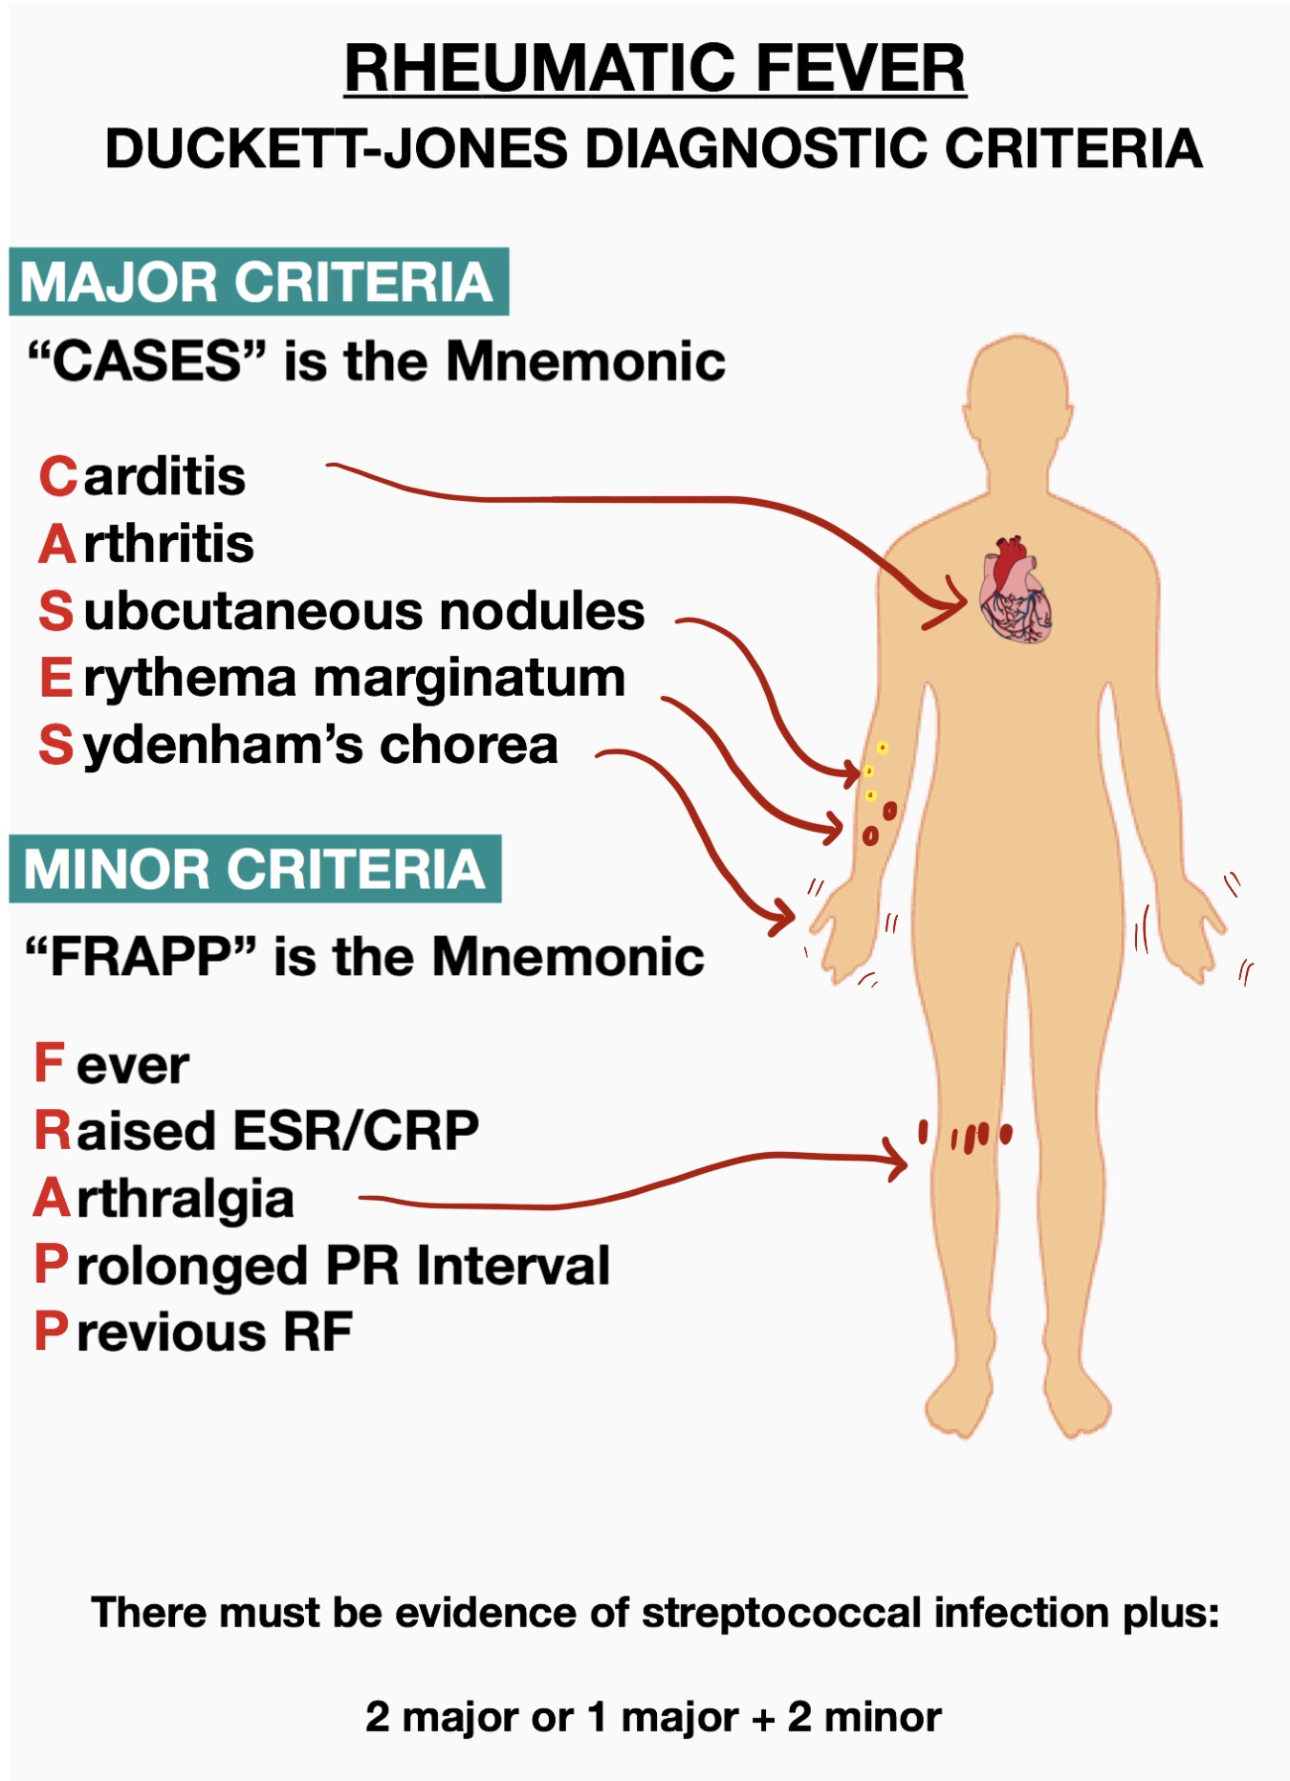
Clinical features of acute rheumatic fever
1
Peak incidence: 5-15 years.
2
History of sore throat: symptoms start 10 days to 6 weeks after by group A Streptococcal pharyngitis
3
By that time the symptoms start the throat/pharyngeal cultures are usually negative. (the disease is about Ab not GAS)
4
Serum antistreptolysin O (ASO titer/ antibodies to group A streptococcal antigens), anti-DNAase B and antihyaluronidase are raised & provide evidence of an infection with group A Streptococcus.
5
Acute symptoms usually subside within 3 months.
6
The mortality from acute rheumatic carditis is low.
Diagnosis
There is no specific test for rheumatic fever.
The diagnosis is made based on the clinical findings when either:
1. two major
or
2. one major and two minor
clinical features / criteria are met. This is called as the Jones criteria.
Jones criteria
Major criteria
-Carditis, Carditis features:
Murmurs, pericardial friction rubs, weak heart sounds, tachycardia and arrhythmias cardiomegaly, pericarditis, and congestive heart failure.
-Migratory polyarthritis of the large joints
-Erythema marginatum of the skin
-Subcutaneous nodules
-Sydenhem’s chorea (St. Vitus' dance)
Minor criteria
Elevated acute phase reactants:
● Elevated ESR (erythrocyte sedimentation rate) ≥ 60 mm/hour.
● Increased CRP (C-Reactive protein).
● leukocytosis
Arthralgia
Fever
ECG changes
previous rheumatic fever

Slide 8
CHRONIC RHEUMATIC HEART DISEASE
Myocarditis and Pericarditis
Typically resolve without permanent sequelae
Acute valvulitis or Chordae tendinitis
-Heals by fibrosis (scarring) and result in Irreversible deformity of the involved cardiac valve and chordae tendineae.
-Severe valvular scarring develops months or years after acute RF.
-Most harmful effect of rheumatic disease is due to involvement of cardiac valves The valve leaflets develop diffuse fibrosis, become thickened, shrunken and less movable which can lead to cardiac failure, thromboembolism and infective endocarditis
Component of rheumatic fever
Valves affected in chronic rheumatic heart disease:
Mitral valve alone(common)
Combined mitral/aortic valve (Usually after Mitral valve damage) (So usually left heart)
Tricuspid valve(rare)
Pulmonary valve(practically never affected)
Left side of heart is more commonly involved than the right Therefore patient can have mitral stenosis (most common), mitral regurgitation, aortic stenosis and aortic regurgitation. (all are structures found on left side of heart).
Valves damage
Stenosis
Regurgitation
Fibrosis of valve leaflets
(reduction of diameter)
Fibrosis of chordae tendineae (improper closure)
Manifestations occur many years after the initial episode of rheumatic fever
Cardiac murmurs
Congestive heart failure
Arrhythmias
Signs & symptoms
(depends on valve involved)
Infective endocarditis
Thromboembolism
Treatment:
may require valve surgery

Slide 9
Cont.
Complications
Bacterial infective endocarditis
the scarred valves of rheumatic heart disease provide an attractive environment for bacteria to grow.
Mural thrombi
form in cardiac chambers. They give rise to thromboemboli, which can produce infarcts in various organs
5
1
4
2
Congestive heart failure
3
Atrial fibrillation
Adhesive pericarditis
Summary (Female slides)
Strept. Infection
Immunological
Multi-system
Pancarditis
Pan = all
pericardium
myocardium
(Endocardium)Valvular
Bread and Butter
Aschoff bodies
Aortic
Fibrinous
mitral
High pressure
Fish mouth /
Button hole

Slide 10
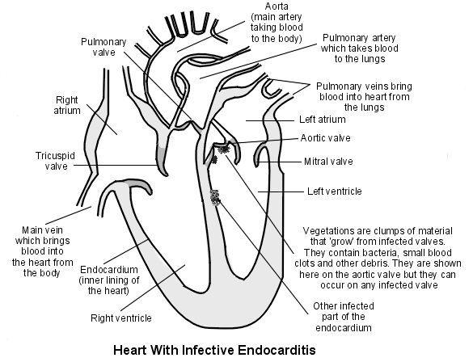
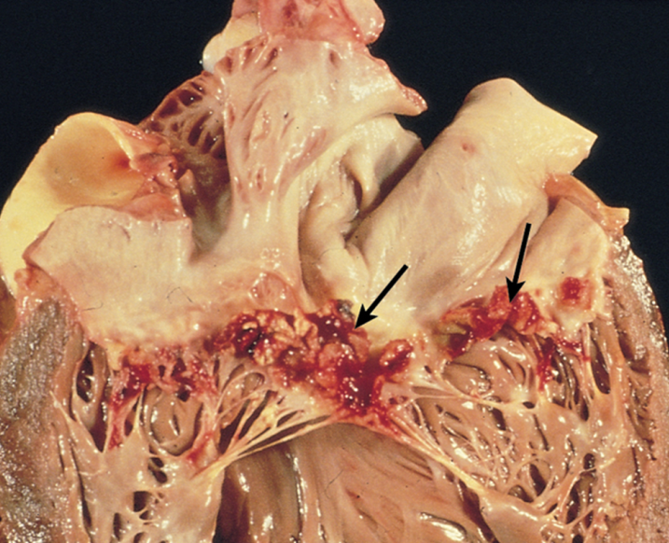
infective endocarditis(IE)
Definition
infection of the cardiac valves or inner (mural) surface of the endocardium, resulting in the formation of an adherent mass of thrombotic debris that contains micro-organisms.
Infective endocarditis is a particularly difficult infection to eradicate because of the avascular nature of the heart valves (because it has no capillaries so the drug can’t reach it easily).
Depends to some extent on the infecting organism and the stage at which the infection is treated.
About 1/3rd of cases of Staph. aureus endocarditis are still fatal.
Prognosis
 | Acute IE | Subacute
Causative organism | Staphylococcus aureus (Highly virulent) | α-hemolytic streptococci viridans (low virulent)
Infected valves | Infect even healthy valves | Previously abnormal/ damaged valves
Host reaction | has little local host reaction (لأنه يهجم بسرعة ما يمدي الجسم يسوي ردة فعل) | induces a local inflammatory reaction.
Progress | Rapidly | Slowly
Site | Mitral valves are the most common sites of IE followed by aortic valve. In IV drug users, the right side valves (tricuspids) are commonly involved. Vegetations (growth) can be single or multiple, involve one or more valve(s), differ in appearance according to the causative agent.
When the blood get in contact with the vegetations that contain the organism it will transport it to different tissues
Thrombotic debris

Slide 11
Risk factors of IE
In Children
an underlying cardiac lesion (congenital heart disease is most common).
In Adult
more than half of adults with bacterial endocarditis have no predisposing cardiac lesion)
1
Mitral valve prolapse and congenital heart disease
The common risk factors for bacterial endocarditis in adults.
2
Rheumatic heart disease
3
Intravenous drug abusers
can inject micro-organisms intravenously when taking intravenous drugs, leading to IE.
The tricuspid valve (right side of the heart)is most commonly infected. About 50% of the IE in IV drug abusers are caused by S. aureus.
4
People with prosthetic valves (the most predisposing)
at high risk of developing IE . Prosthetic valve endocarditis is caused commonly by coagulase-negative staphylococci (e.g. S. epidermidis).
5
Transient bacteremia from any procedure
may lead to infective endocarditis e.g.
dental procedures
urinary catheterization
infected indwelling vascular catheters gastrointestinal endoscopy
obstetric procedures.
6
elderly
They have degenerated of heart valves e.g. calcific aortic stenosis
7
Diabetics and pregnant women

Slide 12
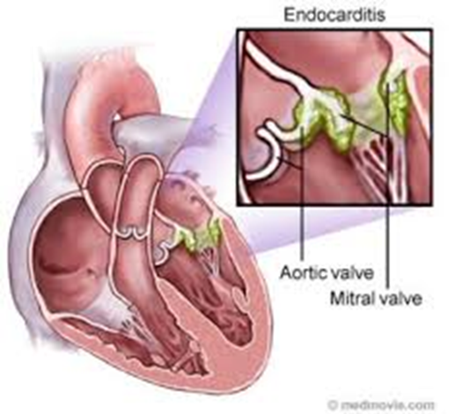
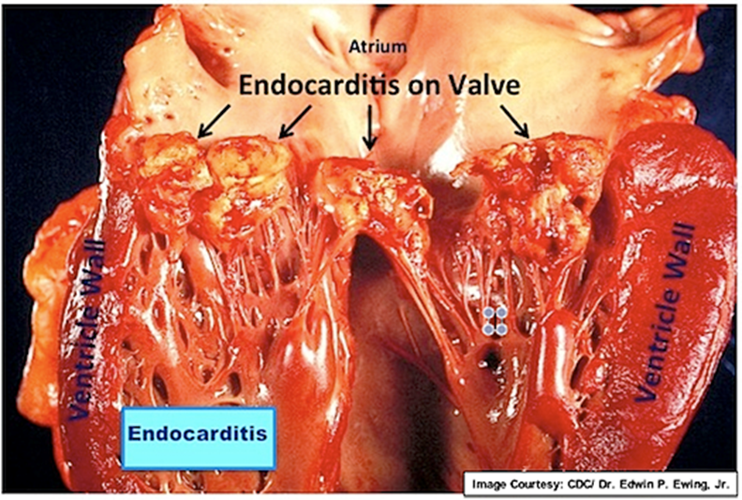
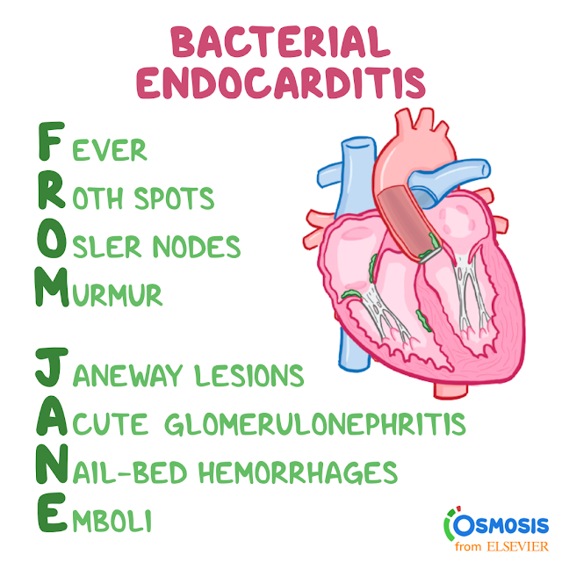
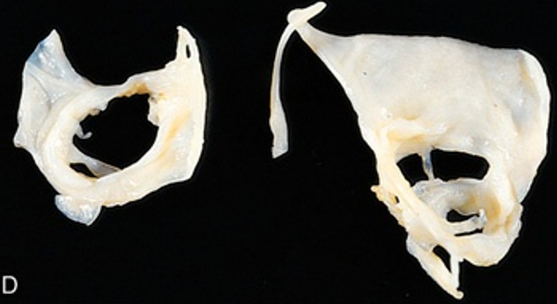
IE cont.
Common clinical features
fever, fatigue, weight loss and chills.
Cardiac murmurs.
Splenomegaly, petechiae, clubbing of the fingers.
Positive blood culture for the organisms (only minority of cases remain negative).
Complications
Ulceration and perforation of valves
Rupture of chordae tendineae
healed endocarditis with perforations on bicuspid aortic valve.
Arrhythmias, valvular regurgitation and congestive heart failure (due to destruction of a valve).
Septicemia
Septic systemic embolization of infected vegetations which travel to multiple sites, causing infarcts or abscesses in many organs (e.g. neurologic deficits due to embolization to the brain or infarcts of the myocardium due to embolization to the coronary artery)
In IV drug addicts (tricuspid valve/ right sided endocarditis)
🡪 pulmonary emboli.
Mycotic/ infected aneurysms of vessels
Renal failure

Slide 13
Other types of endocarditis
Libman-Sacks endocarditis (LSE)
Less common
Non-infective
verrucous endocarditis associated with elevated levels of circulating immune complexes.
Seen in patients with systemic lupus erythematosus (الذئبة الحمراء) (common in females)
Endocarditis seen in carcinoid syndrome
Secretory products of carcinoid syndrome, especially 5-hydroxytryptamine
(serotonin) can cause endocarditis.
The endocardial plaques are seen in the right side of heart
Nonbacterial thrombotic endocarditis (NBTE) (marantic endocarditis)
Characterized by sterile vegetations on the leaflets of the cardiac valves. There is no infective organism. It is aseptic.
Pathogenesis/ association:
Subtle endothelial abnormalities.
Hypercoagulability.
Association with malignancy (50%) and other debilitating diseases.
Aortic valve most common site.
May embolize to different parts of the body including brain, but the emboli are sterile.
Diagrammatic comparison of the lesions in the four major forms of vegetative endocarditis. The rheumatic fever phase of RHD (rheumatic heart disease) is marked by a row of warty, small vegetations along the lines of closure of the valve leaflets. IE (infective endocarditis) is characterized by large, irregular masses on the valve cusps that can extend onto the cords. NBTE (nonbacterial thrombotic endocarditis) typically exhibits small, bland vegetations, usually attached at the line of closure. One or many may be present. LSE (Libman-Sacks endocarditis) has small or medium-sized vegetations on either or both sides of the valve leaflets.

Slide 14
Valvular Heart Disease
Types
Causes
Stenosis of valves
Regurgitation of valves
Congenital
Acquired
failure to open
Insufficiency or failure to close
Post inflammatory scarring e.g. as a late complication of rheumatic fever (most common) or secondary to various other inflammatory processes.
Both cause murmur
Can occur even with prosthetic cardiac valves
Female’s dr: focus on: mitral valves prolapse, stenosis and aortic stenosis
Can be secondary to thrombus formation or infectious endocarditis.
MITRAL VALVE
Mitral valve Prolapse
Mitral regurgitation
Mitral stenosis
Mitral regurgitation
Skipped by female’s dr
usually due to rheumatic heart disease.
can also be due to mitral valve prolapse, infective endocarditis, papillary muscle injury in myocardial infarction etc.
Leads to left vent. hypertrophy and dilatation.

Slide 15
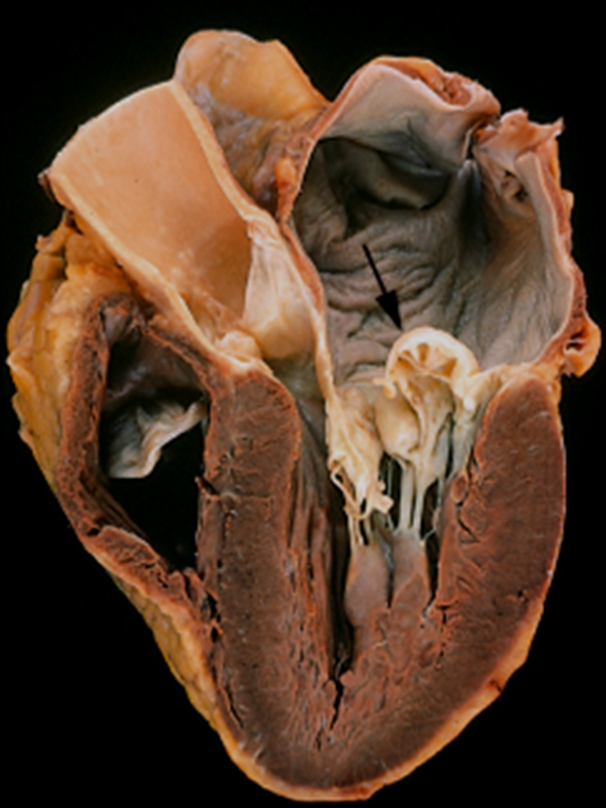
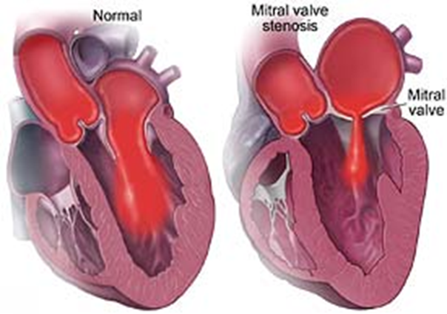
 | Mitral valve Prolapse | Mitral stenosis
Epidemiology | Most frequent valvular lesion in developed countries. Seen in young women | Mitral stenosis is more common than mitral regurgitation.
Caused by | — | Rheumatic heart disease.
Pathogenesis | Unknown | Induces a local inflammatory reaction.
Clinical features | Most patients asymptomatic but can occasionally lead to mitral insufficiency and arrhythmias. | Opening snap followed by diastolic rumble
Complications | Patients are predisposed to infective endocarditis ( subacute) | Right heart may be affected later (right ventricular hypertrophy)
Morphology | There is myxoid/mucoid degeneration of the valve which causes ballooning of mitral valves (floppy cusp) It results in stretching of the mitral valve, producing a parachute deformity of the cusp with prolapse of the cusp into the atrium during systole. These changes produce a characteristic systolic murmur + mid systolic clicks | Leaflets are thickened, fibrotic and fused leading to fish mouth/buttonhole deformity (stenosed valve looks like fish's mouth or buttonhole) Increased pressure, dilatation and hypertrophy of left atrium. secondary deposition of Ca++ Pulmonary hypertension and lungs are firm and heavy (chronic passive congestion).
 | Can be associated with with Marfan syndrome

Slide 16
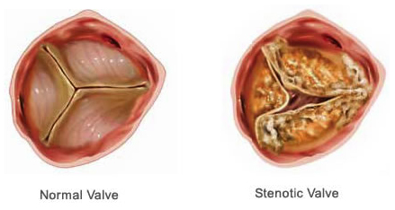
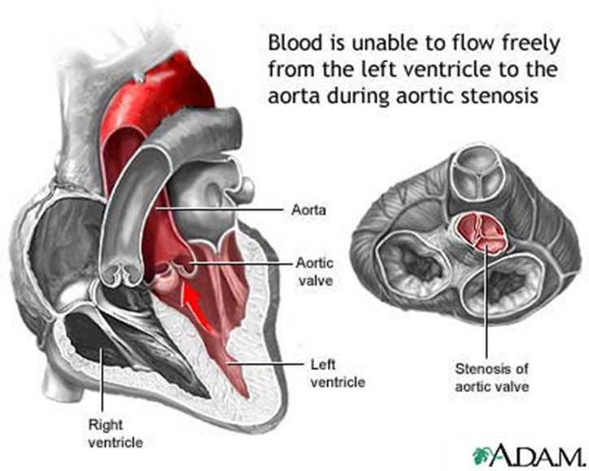
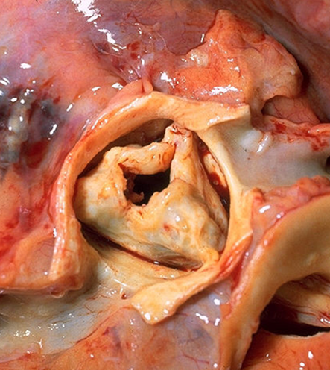
AORTIC VALVE
 | Aortic stenosis | Aortic regurgitation/ insufficiency Skipped by female’s dr
Caused by | calcification and is called as calcific aortic stenosis | Non-dissecting aortic aneurysm. Rheumatic heart disease Infective endocarditis Syphilitic (luetic) aortitis (rare)
affect | Normal aortic valve as part of the aging degenerative process in > 60 yrs old. Congenital bicuspid aortic valve Valves scarred by rheumatic heart disease | ـــــــــ
Pictures |  | ـــــــــ
Right side of heart
Valvular heart disease of the right side of heart is very uncommon.
Take home message
Rheumatic fever is immune mediated and multisystem disease.
The myocardial inflammatory lesions are called Aschoff bodies.
The most important functional consequence of rheumatic heart disease is valvular stenosis and regurgitation.
Infective endocarditis can occur in previously damaged or prosthetic heart valves.
Pericardial disease is characterized by pericardial fluid accumulation and inflammation.

Slide 17
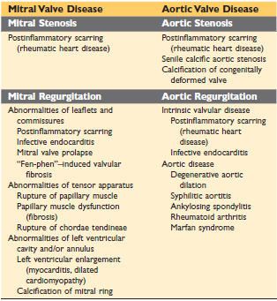
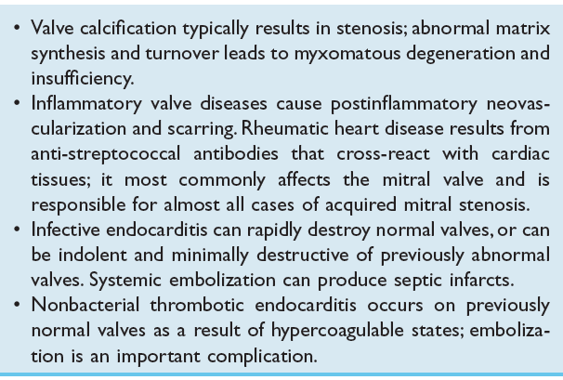
Summary thanks 441
Rheumatic fever
type | Acute | Chronic (chronic rheumatic heart disease)
cause | Post group A streptococcus infection | sever/ repeated attacks of rheumatic fever
Characteristic | Aschoff bodies | - Scarring - Thickened valvular cusps
site | Pericarditis: fibrinous or serofibrinous secretion "Bread and butter Myocarditis: Aschoff bodies Endocarditis: rheumatic vegetations Subendocardial lesions: MacCallum plaques. | ● Left side of the heart ● Mitral valve alone ● Followed by Combination of mitral/ aortic valve ● Tricuspid valve is rarely affected. ● Pulmonary valve is practically never affected.
Clinical features | 1. Elevated antistreptolysin O 2. Jones criteria: - Two major - One major & two minor | 1. Cardiac murmurs 2. Thromboembolism 3. Infective endocarditis
complications | ـــــــــ | ● Bacterial infective endocarditis ● Mural thrombi ● Congestive heart failure ● Adhesive pericarditis ● Atrial fibrillation.

Slide 18
Infective Endocarditis
type | acute | Subacute
site | Mitral valve followed by aortic valve, tricuspid valve is seen in IV drug users
Cause | highly virulent organisms (staphylococcus aureus) | low virulent organism (a-hemolytic streptococci viridans)
affect | normal/healthy valves | previously abnormal/ damaged valves
Progress | progresses rapidly About 1/3rd of cases are fatal | progresses slowly
Host reaction | Has little local host reaction. | induces a local inflammatory reaction
Clinical features | ● Fever ● Cardiac murmur ● petechiae ● clubbing of the fingers. ● Splenomegaly ● +ve blood culture for the organisms
complication | ● Ulceration and perforation of valves ● Rupture of chordae tendineae ● Arrhythmias ● valvular regurgitation ● Renal failure ● Septicemia ● congestive heart failure ● Septic systemic embolization of infected vegetations ● In IV drug addicts pulmonary emboli. ● Mycotic/ infected aneurysms of vessels.
Valvular Heart Disease
cause | Congenital Acquired: post inflammatory scarring e.g. as a late complication of rheumatic fever
types
Stenosis of valves: failure to open | Regurgitation of valves: Insufficiency or failure to close
mitral | Aortic | mitral | Aortic
cause | RHD | Calcification | RHD mitral valve prolapse IE papillary muscle injury | Non-dissecting aortic aneurysm. RHD Infective endocarditis Syphilitic (luetic) aortitis (rare)

Slide 19
Prof. Al-Rikabi’s Notes
(we advise to study the lecture first to understand the full picture)
It’s important to Know the introduction of heart & mediastinum anatomy. (click here)
Rheumatic fever
It is totally different from rheumatoid arthritis (that we took in the MSK) don’t confuse between them.
What is Rheumatic fever?
It is an inflammatory and multi system disease(can affect joint,heart,and skin) which usually affects young people and children from age 5 to 15 (we can see patient out of this range but this range is the common)
It is caused by an infection(recurrent untreated pharyngitis or tonsillitis), this infection is caused by:
Group A, beta haemolytic streptococci (3%)
why do patients with rheumatic fever come to you?
They come to you because of the JONES CRITERIAS
So what are these criteria?
These criterias will help me to diagnose rheumatic fever and they are divided into 2 parts : Major and minor
The evidence of an infection with GAS can be provided by:
by serology by locking for antistreptolysin O.
Throat swab (THE BEST).
anti-DNAase B
Clinical history
Jones criteria
There are 5 major criteria:
Pancarditis : it causes inflammation in all layers of the heart
Migratory Polyarthritis: inflammation of joints and it affects shoulder, knee and ankle joints (could be the 1st sign)
chorea Sydenham's (St. Vitus' dance) داء الرقص (RARE): involuntary movements, caused by an Infection in the CNS (Brain & basal ganglia) by rheumatic fever
Erythema marginatum of the skin Seen in the trunk & limbs
Rheumatic nodules (rare)

Slide 20
Jones criteria cont.
There are 5 minor criteria:
Mild fever ( unexplained ) pyrexia
Arthralgia , different than arthritis , it is pain without an inflammation of joints
Prolonged ESR (erythrocyte sedimentation rate) ≥ 60 mm/hour
Elevated CRP
Changes in the ECG (prolongation in the PR interval)
Previous rheumatic fever
Pathogenesis
It is a bacterial disease but doesn’t mean it is a direct infection by the bacteria to these structures (joints, hearts, skin, etc…)
These bacteria have protein M and this protein’s molecular structure resembles the molecular structures of certain components that We see in the heart and the joint because of these resembles there is an immunological reaction to the protein M and there is an immunological reaction against normal structures which are similar in their molecular composition to the protein M thats why it affects these different structures .
So it is an immune mediated that induced by the bacteria.
Rheumatic fever likes to affect the valves especially and commonly the mitral valve
- it can affect the aortic valve
- rare in tricuspid valve
-Never affects the pulmonary valve
Aschoff bodies
The classic pathological lesion in the rheumatic fever is the aschoff nodules(or bodies) and it is an inflammatory focus which is only found in the rheumatic fever
Components:
areas of necrotic collagen
chronic inflammatory cells probably lymphocytes
macrophages that are called Anitschkow cells
multinucleated cells that are called aschoff cells
Aschoff nodules Mostly in hemodynamic areas where blood is always flowing:
1. can found in all layer of the heart (pericardium, myocardium and endocardium).
2. The cusps of the valves.
3. Posterior wall of the left atrium (Maccallum Plaque).

Slide 21
Infective endocarditis
Bacterial infection that affects the endocardium.
IE is especially seen in mitral and aortic valve.(rare in tricuspid)
Risk factors:
Congenital malformed valves (genetics)
Acquired malformation from rheumatic fever
Iv drug addicts
Prosthetic valve
Has 2 types: acute and subacute:
Acute : uncommon /caused by staph aureus /secondary from another infection site/ affects normal valves.(drug abuse)
Subacute :common/ caused by strep viridans/ patients comes with mild fever malaise septicemia /through cardiograph we find endocarditis with large vegetations
Subacute Affects منطقة ضعيفة زي واحد جته rheumatic fever وبعدين صار عنده mitral valve disease.
Rheumatic fever is from GAS so this new bacteria is superimposed to this already infected.
Treatment:
IV antibiotics to treat infection then valve replacement.
Complications: septic emboli, infected infaction, multiple abscess, glomerulonephritis.
signs: osler's nodes على رؤوس الأصابع micothrombi that can be painful.
Before minor dental injury (or any procedure) to protect them from IE we cover them with ab especially if they have valve disease or replaced valves.
IV drug users:
can get it from fungus, staph aureus,and strep epidermidis.
Can be seen in tricuspid valve

Slide 22
Other types of endocarditis
Nonbacterial thrombotic endocarditis (NBTE) (marantic endocarditis):
Characterized by sterile vegetations on the leaflets of the cardiac valves. There is no infective organism. It is aseptic. The culture should be taken when the patient has high fever
Pathogenesis/ association:
Subtle endothelial abnormalities.
Hypercoagulability.
Association with malignancy (50%) and other debilitating diseases(comorbidity)
May embolize to different parts of the body including brain, but the emboli are sterile
Other types of endocarditis cont.
Endocarditis seen in carcinoid syndrome:
Secretory products of carcinoid syndrome, especially 5-hydroxytryptamine
(serotonin) can cause endocarditis. And above the cancer the patient has hypertension, osteoarthritis, depression, old age, etc…
Changes in the heart in both ( RF & IE )
We said that the mitral valve is affected so there will be vegetations on the cusps of the valve it is in the line of the closure (عالحواف) or in left atrium(posterior wall), called MacCallum plaques because there is a hemodynamic stress.This is a chronic inflammation so it makes fibrosis at the late stages
Because it interferes in the functions of the valve and there will be 2 things in the valve :
1.stenosis (because of the dystrophic calcification يصير فيه تضيق)
2.regurgitation (incompetence) so during systole and diastole في تسريب بالدم
stenosis and regurgitation at the same time then we call it mitral valve disease.
This is the pathogenesis
Stenosis and regurgitation develop murmurs.
Mitral stenosis (fish mouth deformity):
-Cusps التحمت due to chronic fibrosis and adhesions
-advanced RF and he’s prone to subacute endocarditis
-Calcified valves is due to dystrophic calcification which is often associated with chronic inflammatory regions.

Slide 23
pericarditis
Inflammation of the pericardium, one of its causes RF but it could be caused by: autoimmune diseases, uremia , infection (Like TB) & cancer.
If the patient present with accumulation of fluid in the pericardial cavity e.g. 2L while the normal value is about 30ml, so he has pericardial effusion which causes cardiac tamponade (pressure on the heart) , this interferes with the cardiac systole and diastole, the symptoms increase when he tries to sleep and he needs about 3 pillows or if he set up the symptoms decrease. The Symptoms include, Sensation of tightness in the chest (due to cardiac tamponade) and
The accumulated fluid is an exudate fluid ( rich in protein e.g. fibrin ) (High specific gravity) this happens due to inflammation or infection so if you culture it, it will give +ve result. on the other hand if it was Transudate Fluid (Low in protein) (Not many inflammatory cells) this happens due to uremia or heart failure

Slide 24
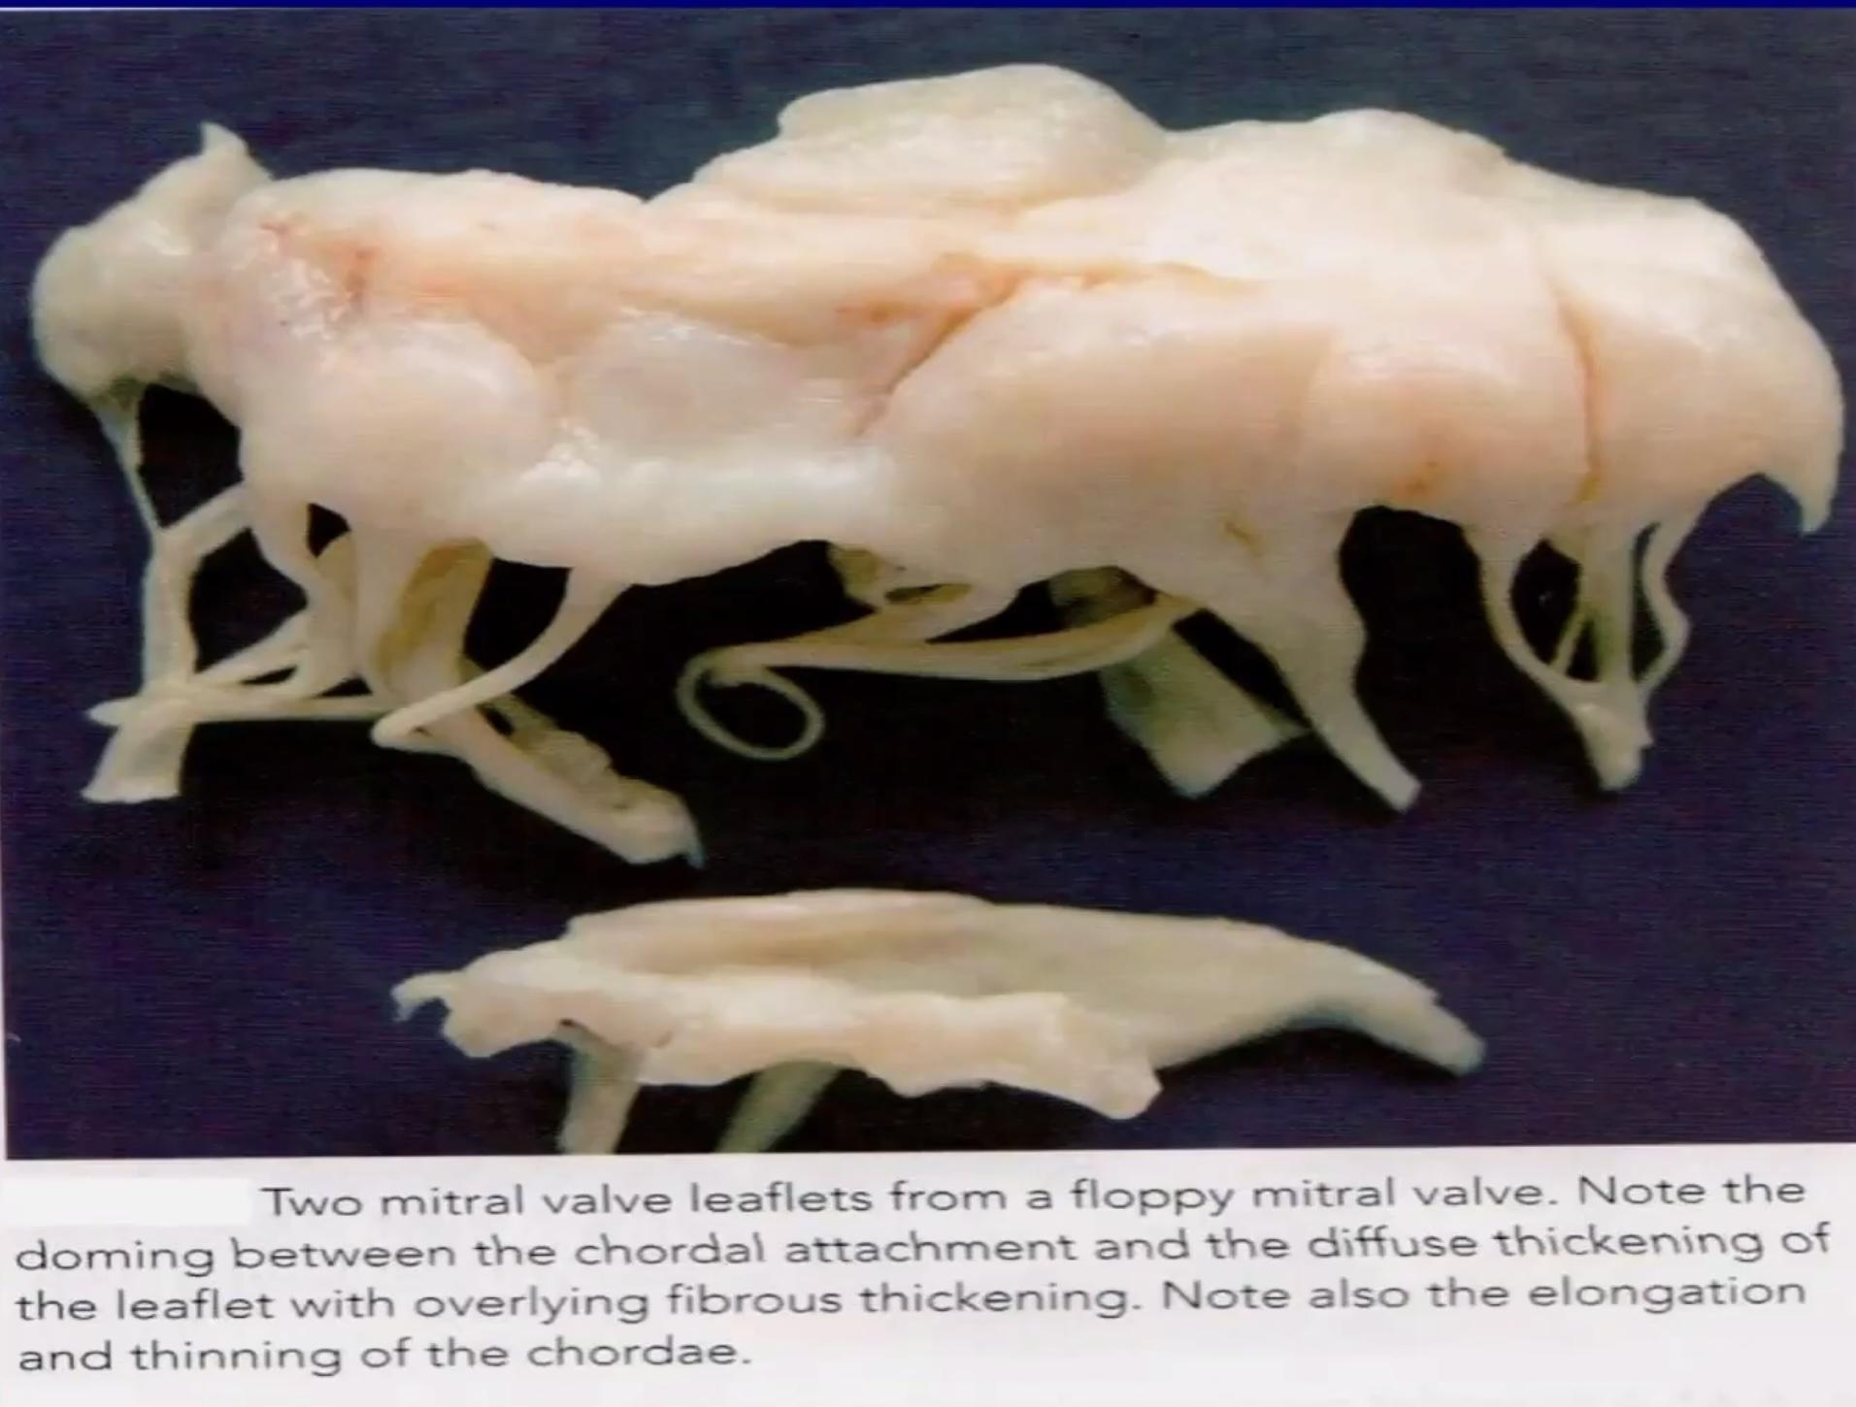
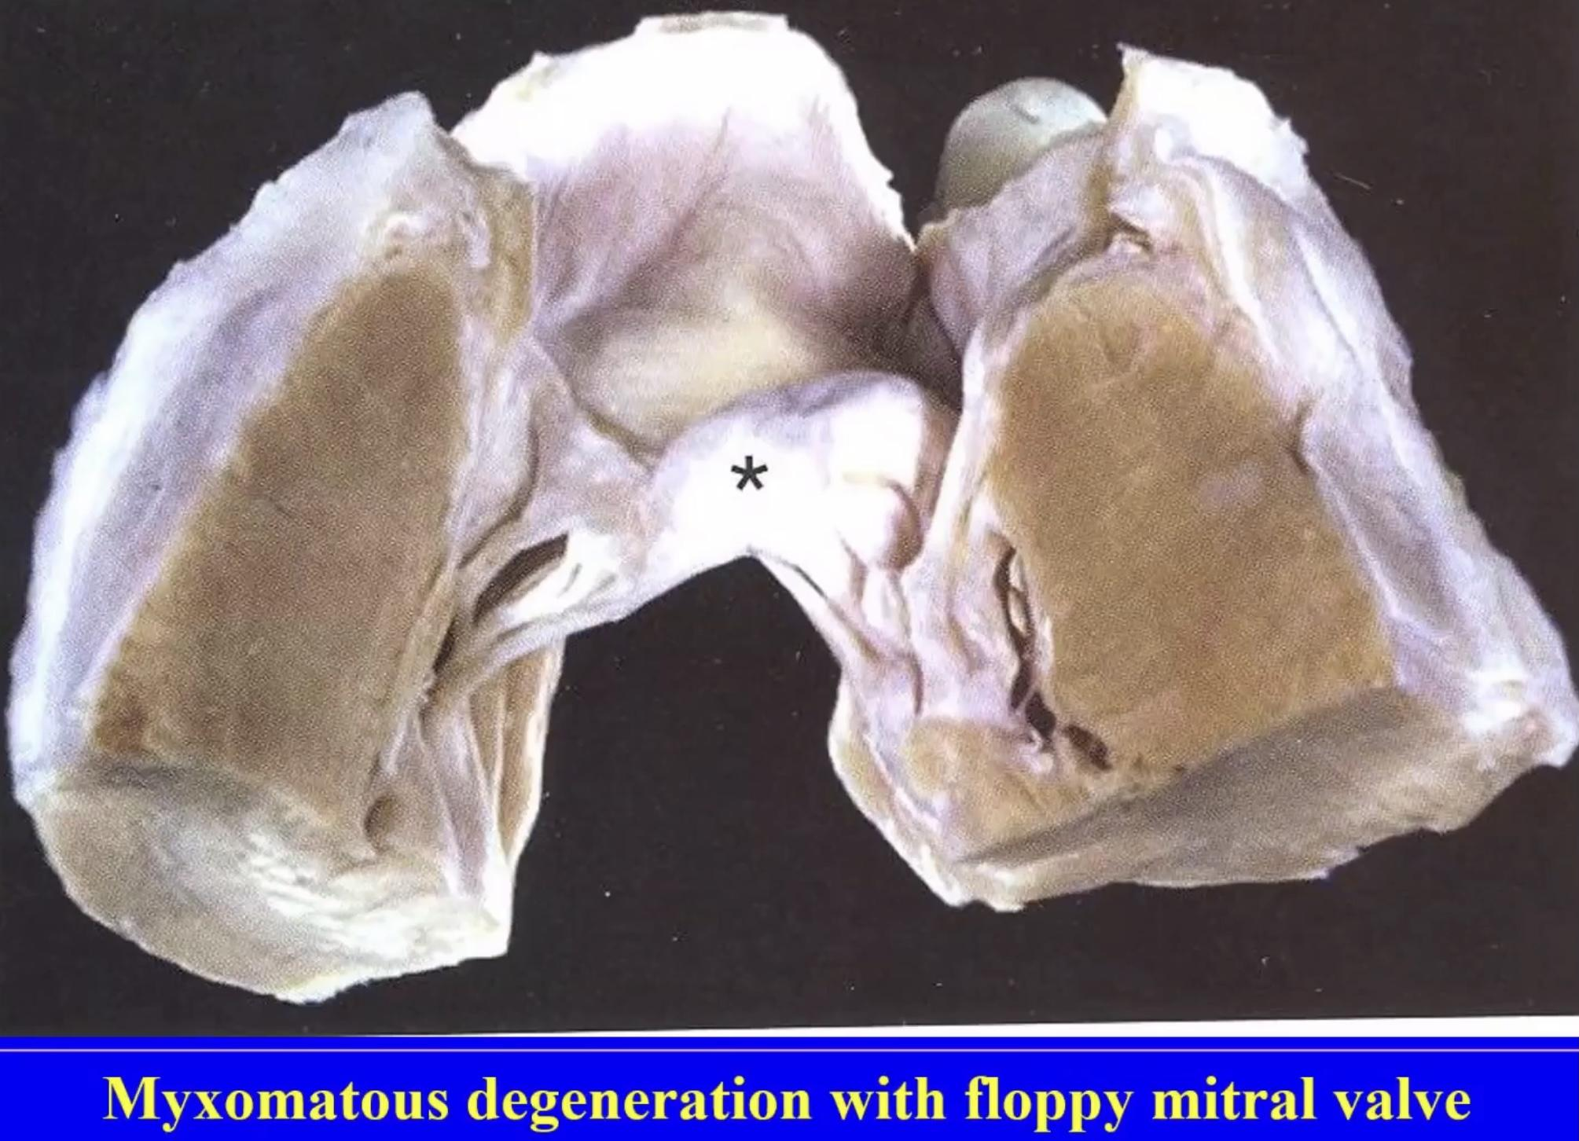
Myxomatous Mitral Valve (Floppy mitral valve)
(Another type but no relation with rheumatic fever)
But that is one of the important Valves diseases infect Mitral valve
particularly that name floppy( ارتخاء) mitral valve/ mitral valve incompetence/ mitral valve regurgitation.
Valves structure is abnormal occur in accumulation of Myxomatosis material at should be ( connective tissue of the valves have myxomatous material accumulating inside the CT) يسوي ارتخاء لل tissues وهذا الشي بيخلي valve doesn’t close or open خصوصاً ال closure راح يسوي regurgitation that common in the females (mid- age ) sometimes they don’t suffer from any things( diagnosis by stethoscope and phonocardiography) .because floppy mitral valve Usually cause systolic murmur + mid systolic clicks ( نسمع طقه بنص systolic murmur) that will develop to secondary subacute endocarditis or heart failure after long periods.
valves are very dilated , chondrites tends تكون مرخية because accumulation of mono polysaccharides that sometimes associated with syndromes like “Marfan” or “Ehlers Danlos” syndrome ——> abnormalities in elastic fibers in human body مو شرط تصير هالسيندروم مع الكل السيدات ممكن تسمع mid systolic murmur + mid systolic click( بششش تبقز —>الصوت الي نسمعه لان سكر الصمام يطبق طبق لان مرخي ) murmur—-> لان في تسريب للدم( في regurgitation, incompetence) .
Parachuting ( مظلة) of mitral valve in side the atrium ( open and close but not in completely because blood flow.

Slide 25
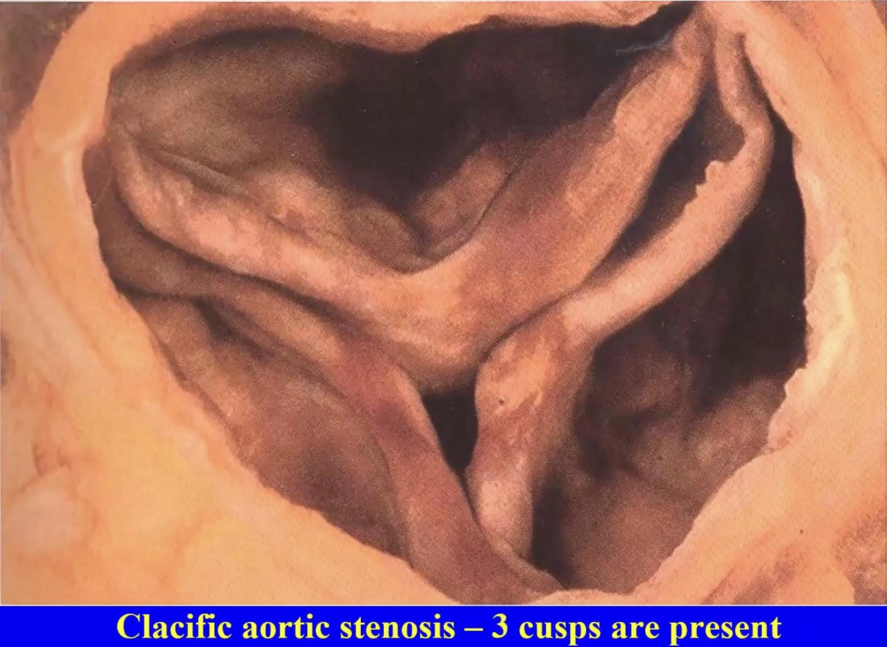
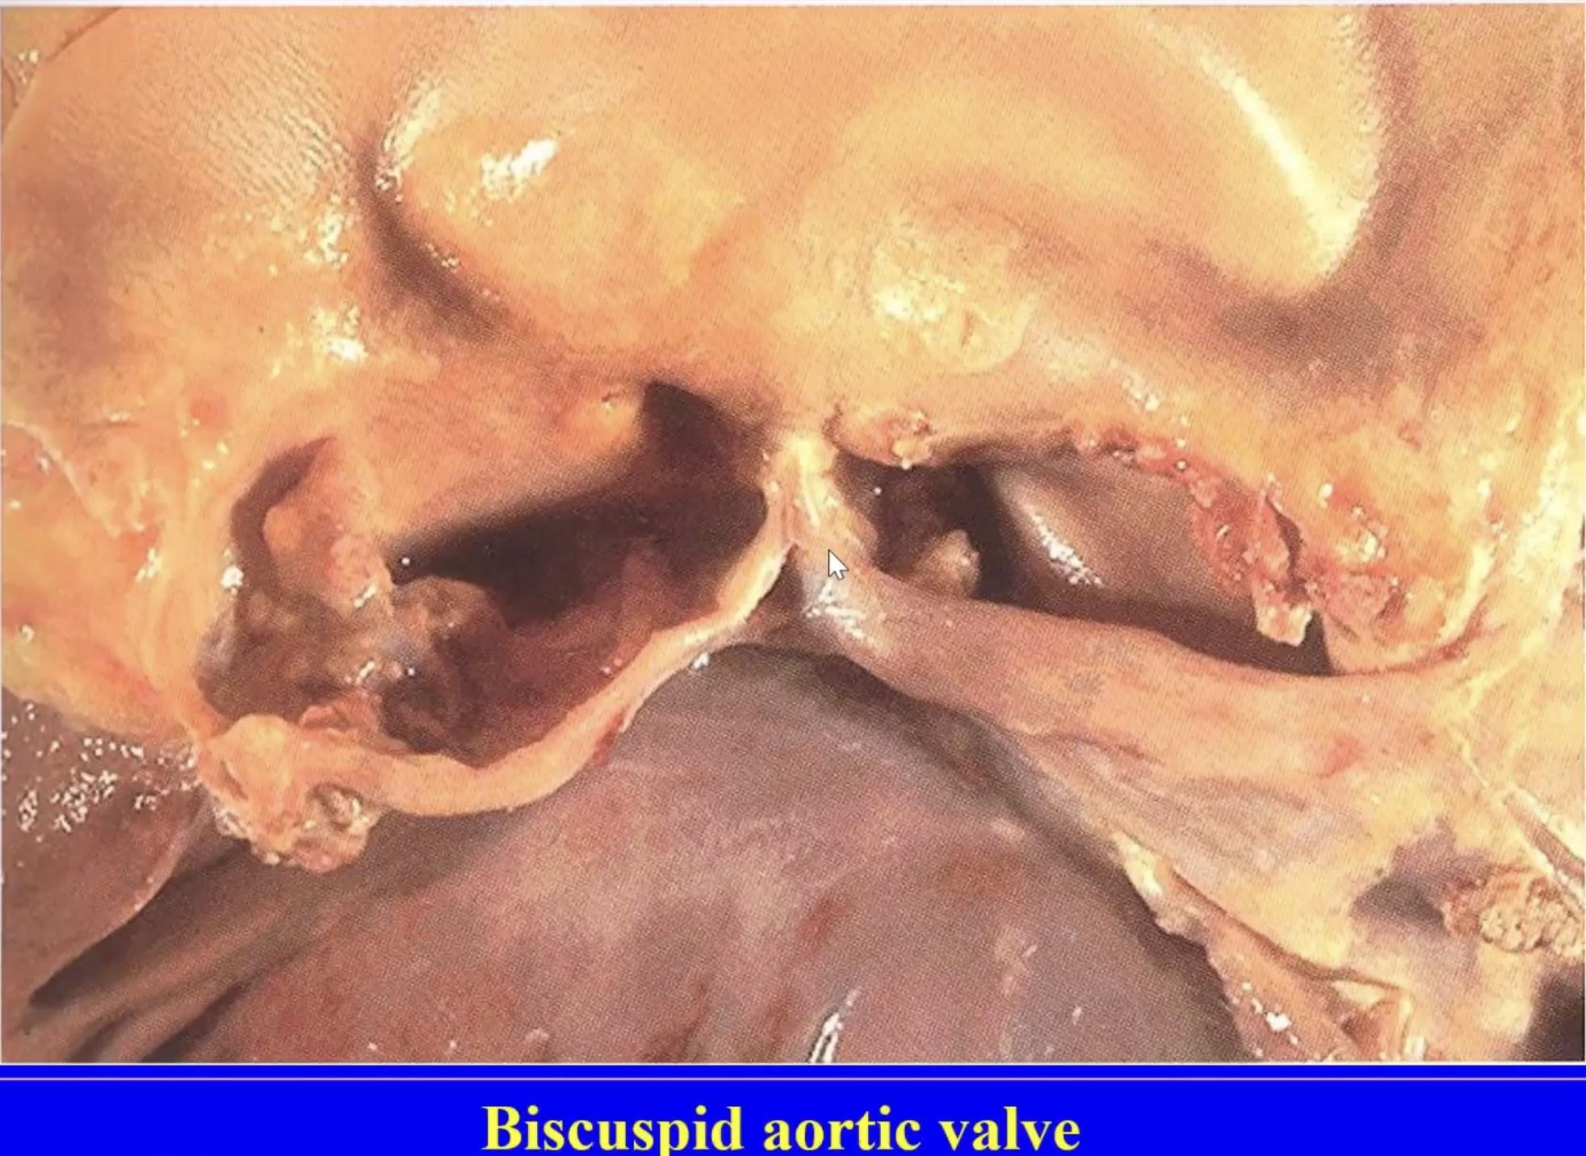
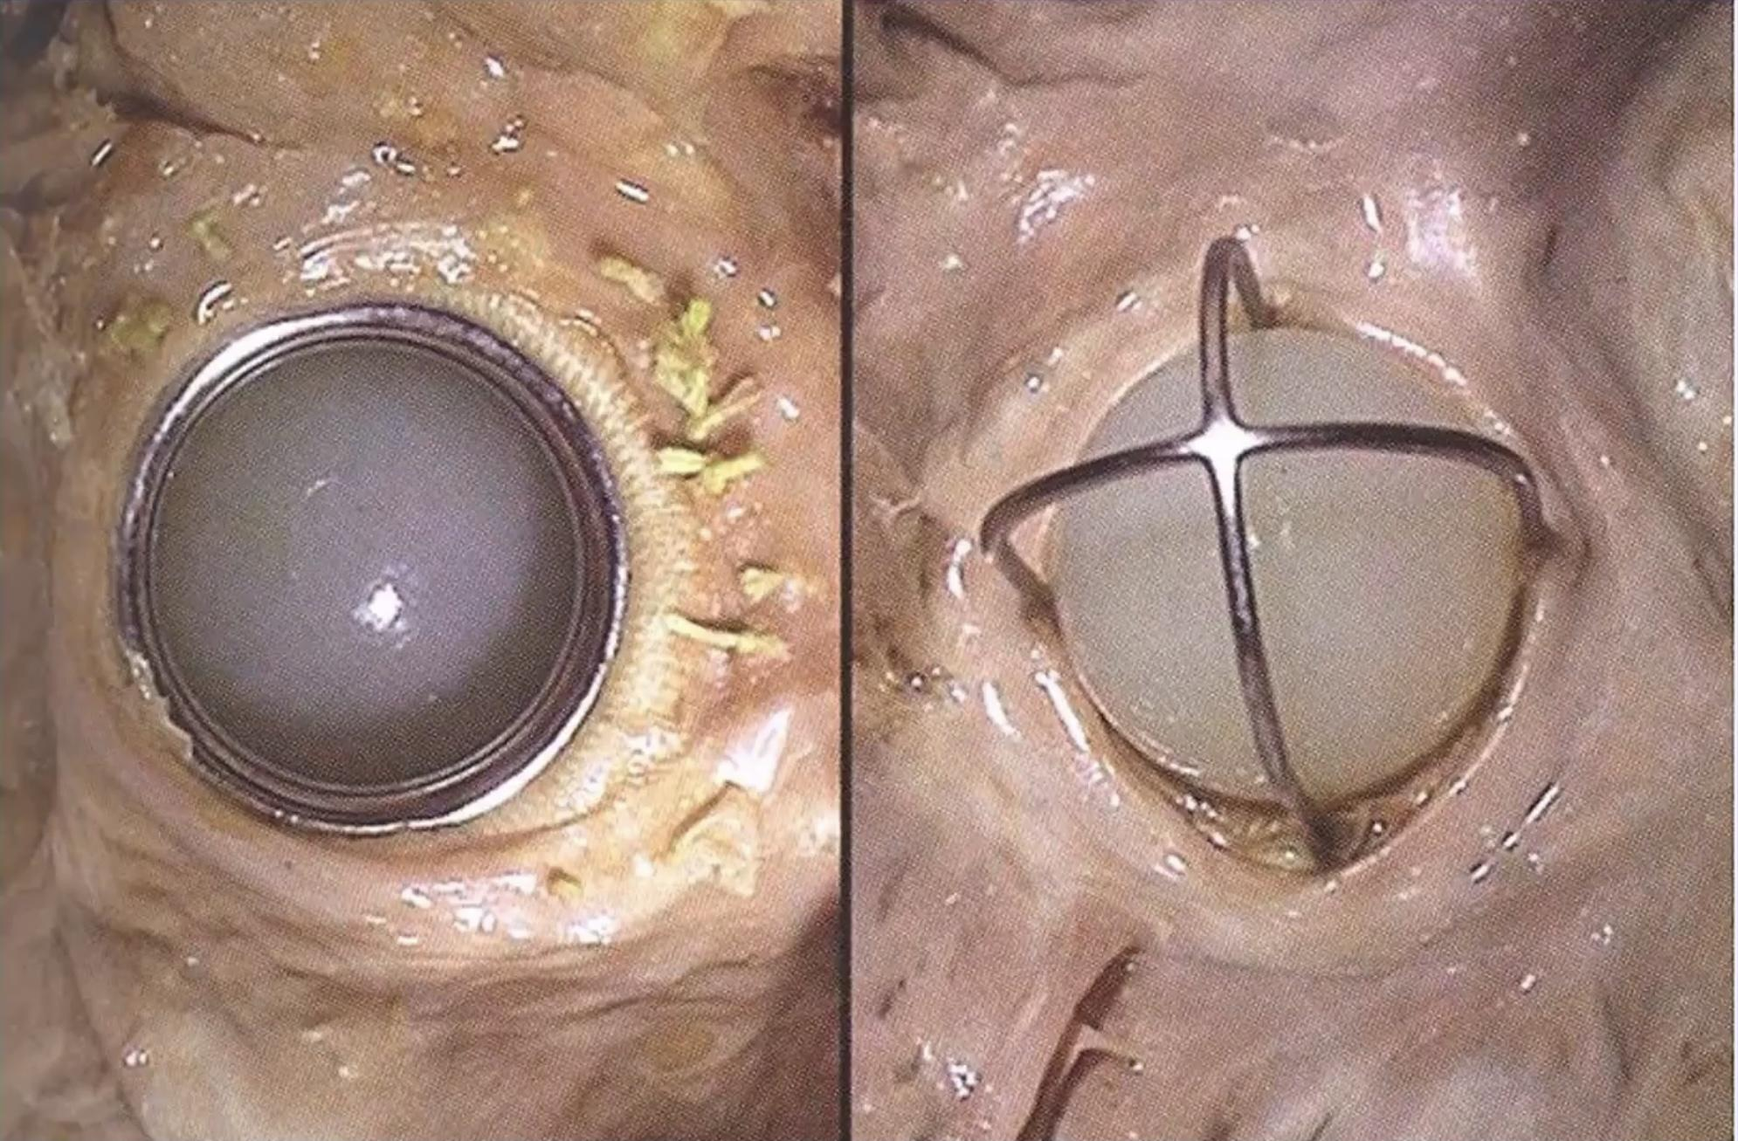
Calcific aortic stenosis
ممكن يكون سببه rheumatic fever and subacute endocarditis depend on conditions.
for example: extraction teeth.
Present fibrosis + stenosis + some calcification
تشوه خلقي بدل لا يصير عنده ٣ صار٢ cusps
Dystrophic calcification
Incompetence mitral valve
May be have (stenosis or incompetence/ stenosis + incompetence “depending on degree of pathology).
Mechanical prosthesis
Used to replace the insufficient valves by artificial valve stitching at the ring of the valve .
Systole—> upward and closure
Diastole —> relaxed and allows the blood flow ( ball downward)

Slide 26
MCQs
Check out 442 Quizlet bank
1-Bacterial endocarditis of the tricuspid valve is mainly caused by?
A- Prosthetic valve disease | B- Rheumatic heart disease | C- Intravenous drug use | D- High pressure shunt in heart
2- Which disease produce a parachute deformity of the cusp?
A- Mitral valve prolapse | B- Mitral stenosis | C- Acute rheumatic fever | D- Aortic stenosis
3-Which one of these is a major criteria of acute rheumatic fever?
A- Fever | B- Arthralgia | C- Subcutaneous nodules | D- EKG changes
4- A multiple tiny granulomatous lesions of the heart?
A- collagen necrosis | B- Anitschkow | C- Aschoff giant cells | D- Aschoff cells
5- What are the types of valves damage in chronic rheumatic heart disease?
A- Stenosis | B- Regurgitation | C- Insufficiency | D- All
1-C 2-A 3-C 4-D 5-D

Slide 27
Team leaders:
Dema
Alkhattabi
Raneem Alwatban
Ibrahim
Alhezam
Sub-leader:
Hassan Alabdullatif
Team members:
Norah
Alrashoud
Maram
Beyari
Omar
Alkadhi
Farah
Alenezi
Manar
Alzahrani
Othman Alabdullah
Hoor
Aloraini
Nawaf
Alrefaei
Rakan
Alromayan
Mayssar Alshobaki
Saad
Alahmari
Osama
alburaih
Nouf
Aldhalaan
Emad
Almutairi
Abdulaziz
Alymni
Special thanks to Sarah Alhamlan

